Slide 1
48.8mW Multi-cell InP HBT Amplifier with on-wafer power combining at 220GHz
Thomas Reed, Mark Rodwell
University of California, Santa Barbara
Zach Griffith, Petra Rowell, Miguel Urteaga, Mark Field, Jon Hacker
Teledyne Scientific & Imaging, LLC
treed@ece.ucsb.edu

Slide 2
220 GHz InP HBT Power Amplifier
mm-Wave Power in Communications and Imaging
250nm Indium Phosphide HBT Technology
MMIC Power Amplifier Cells & Combiners
Multi-cell Power Amplifier Results

Slide 3
mm-Wave Power in Communications and Imaging

Slide 4
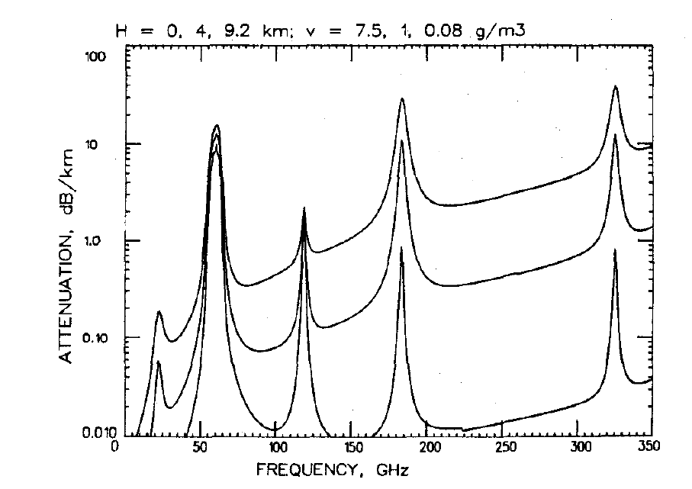
Systems at High Frequency
High Bandwidth Communications
  P_{Rec} decreases as
High Resolution Imaging Systems
  P_{Rec} decreases as
Tx/Rx Challenges:
  Atmospheric Attenuation
    ~2.5 dB/km @ 220 GHz
    +3-30dB/km w/ Fog/Rain
  High Noise Figure
    ~10 dB(InP)
Wiltse, 1997
IEEE APS-Symposium,
220 GHz
sea
level
4 km
9 km
Notes:
Discuss why we need systems at high frequency

Slide 5
mm-Wave Comm. requires large power
Minimum Received Power
Transmission Losses 300m
Minimum Transmitted Power 29.2 dBm = 0.83 W
. . .
PA
LNA
. . .

Slide 6
mm-Wave PA Results

Slide 7
250nm InP HBT Process

Slide 8
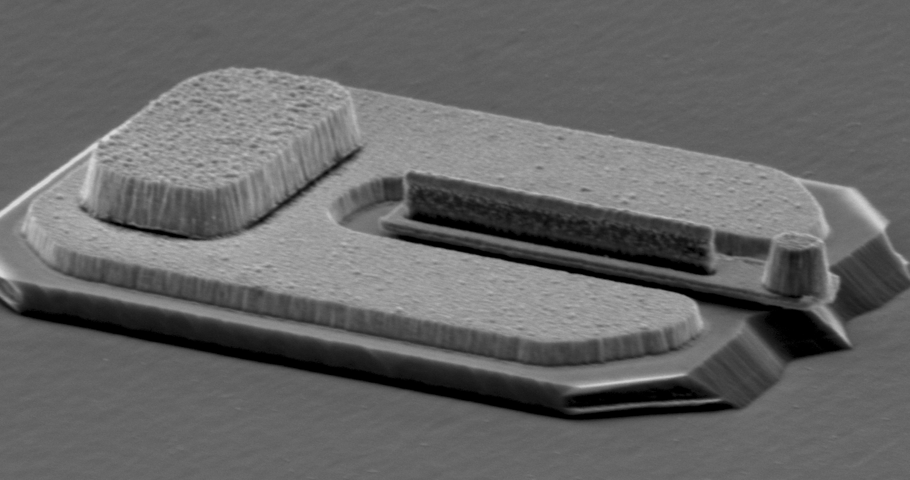
Device High Performance Operating Area
  J_{max} = 12mA/um²
  V_{be,on} = 0.85V
  VB_{cbo} = 4.5V
  P_{max} = 15mW/um²
  V_{ce,hf} = 3V
  high bandwidth
Data courtesy Zach Griffith
Quiescient Bias Point/
Class A load line

Slide 9
ƒ_{t},ƒ_{max} varies with DC Bias
  ft/fmax peak =
  400/700 GHz
  ft/fmax =
  350/590 GHz
  Highly degraded bandwidth above Vce=3V
Notes:
Large signal is affected.

Slide 10
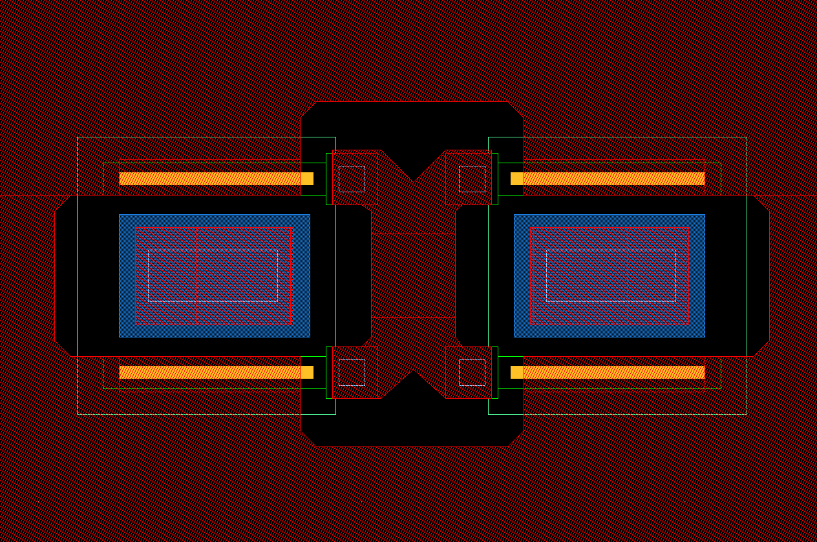
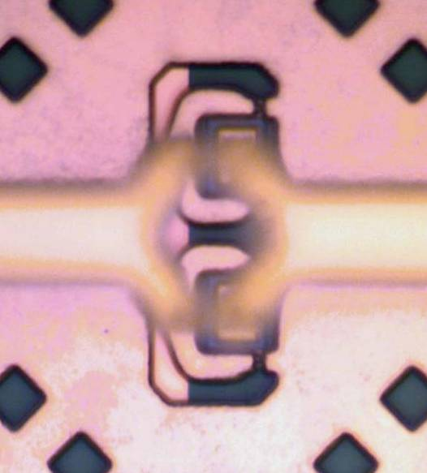
Multi-finger HBT Modeling
Device Modeling
  Hole in Ground Plane
  Multi-finger HBT performance verified
4-finger HBT
  A_{emitter}= 4x 0.25x6μm²
  ft/fmax = 333/530GHz
1-finger HBT
  ft/fmax = 350/590GHz
Base
Emitter
Collector
Ground Plane
Another 4-finger cell

Slide 11
Non-Inverted Microstrip Wiring
  Local GND
  Wider 50Ω than inv. microstrip
  Must Model Holes in GND plane
MIM Capacitors, Thin-Film Resistors
50 Ω
Metal 4
15µm
1µm
  BCB
1µm
Metal 3
5µm
  (ε_{r} = 2.7) BCB
Metal 2
MIM CAP
  BCB
Metal 1
GND

Slide 12
MMIC Power Amplifier Cells
& Combiners

Slide 13
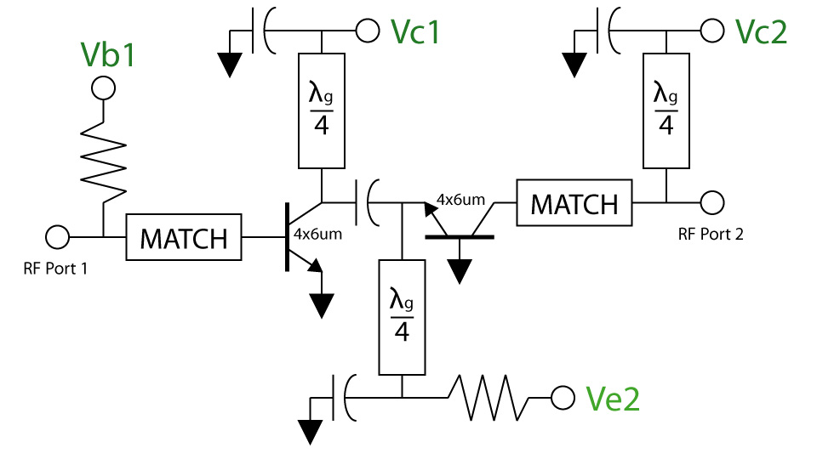
MMIC Power Amplifier Cell Design
Cascode Amplifier Topology
  Gain, Input/Output Isolation,
  Interconnects: ADS Momentum
ΔV
ΔI
High Zo
MIM
Notes:
Consider adding: “Why is there an added blocking capacitor?”

Slide 14
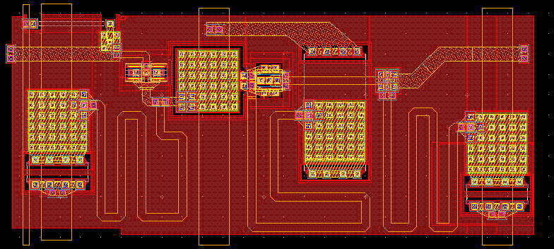
A 4-finger Amplifier Cell

Slide 15
A 4-finger Amplifier Cell
DC Supplies
CE
CB
λ/4 Chokes

Slide 16
A 4-finger Amplifier Cell
Input Matching
Output Tuning
DC Block
Bypass Cap

Slide 17
Combining for High MMIC Power
Combine 4:1 and 2:1 for larger total power
Limits to combiners
  Large IL at L ≥ λ_{g}/4

Slide 18
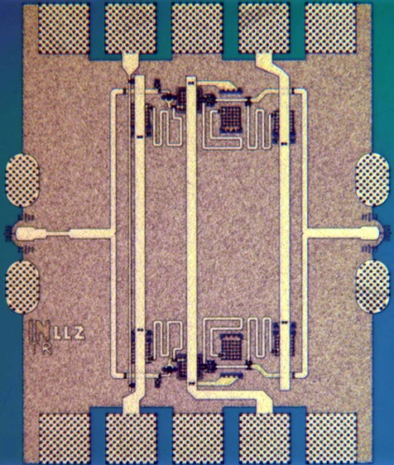
2:1 Power Combiner
√2 * Zo
L = λ/4
Zo
√2 * Zo
Cell
Measured 1.25dB insertion loss for Back-to-back Combiners
Combiner
2-Cell Power Amplifier with 2:1 power combining. The die is 0.7x0.58 mm².
Notes:
Combine 2 slides into 1 for 2:1, 4:1

Slide 19
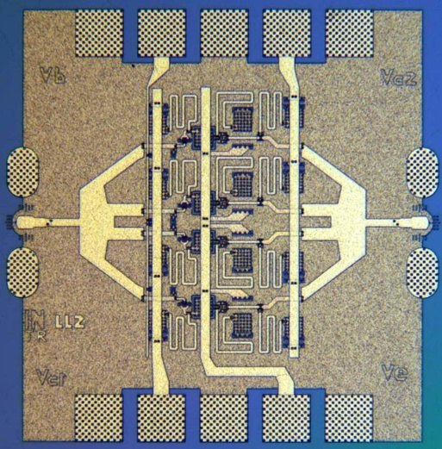
4:1 Power Combiner
Reduced to Lumped L/C for design
Cell
Combiner
Measured 1.3 dB Insertion Loss for Back-to-back 4:1 power Combiners.
4-cell InP HBT amplifier with 4-1 power combiners. The die is 0.7x0.65 mm².

Slide 20
48.8 mW 4-finger Power Amplifiers

Slide 21
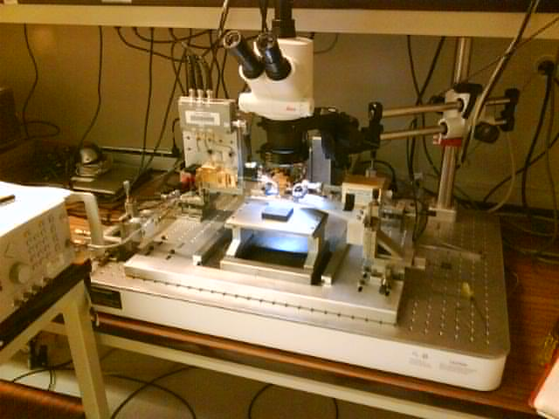
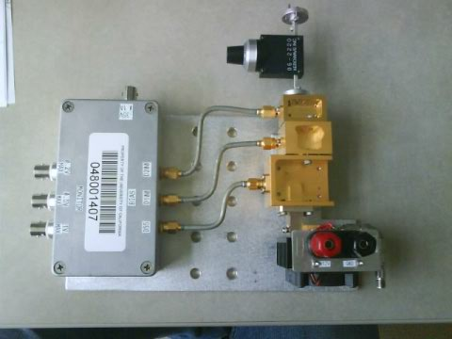
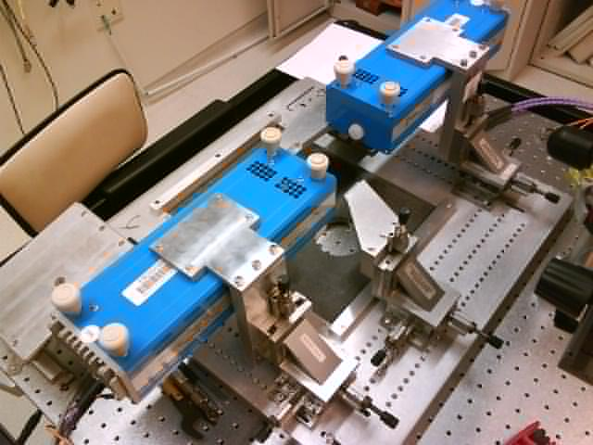
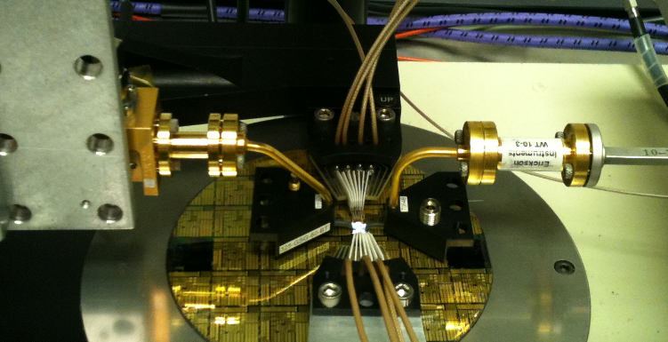
MMIC Measurements and Data
Small Signal Measurement
  VNA with 206-340 GHz frequency extender heads
  SOLT calibration for circuits
Power Sweep Measurement
  200 & 220 GHz frequency multiplier chains and sub-mm wave power meter
  Insertion Loss Calibration
VDI
Source
To
Meter

Slide 22
2-Cell PA Results
S₂₁=10.9 dB @ 220GHz
P_{out,max}=26.3mW @ 208GHz
ΔV = 2, 2.5, 3V

Slide 23
4-Cell PA Results
S₂₁ = 10.1 dB @ 220 GHz
P_{out} ≈ 48mW @ 210-220GHz
Notes:
Combine with power results

Slide 24
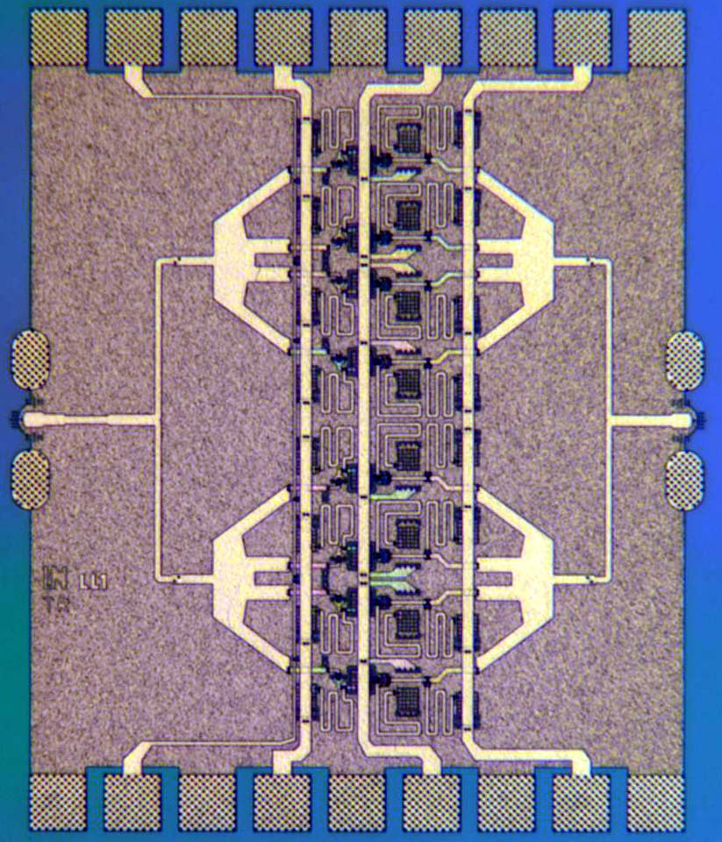
8-Cell Power Amplifiers
.
P_{out} = 66.1mW @ 215 GHz
S_{21,max} = 9.1dB @ 217 GHz
3dB Bandwidth 206-242GHz
Measured P_{out} limited by 220GHz source power

Slide 25
Linear Power Density
InP HBT process is a competitive high power-density technology.

Slide 26
Recapitulation
Modular amplifier cells have been designed to have high gain and high output power.
4-cell amplifiers show 48.8 mW saturated output power at 220 GHz using InP HBTs.
8-cell amplifiers show 58 mW output power at 220 GHz but measurements were limited by source power.

Slide 27
THANK YOU!
CSICS Technical Committee
Zach Griffith, Mark Rodwell, and Mark Field
UCSB Rodwell Group Members
DARPA MTO HiFive Program

Slide 28
Questions?
Notes:
Decrease to 25 slides.

Slide 29
Bonus Slides

Slide 30
mm-Wave Power Amplifiers
Current Power Amplifier Results
Key
Black – GaN
Red – InP HEMT
Green – My InP HBT Results
Yellow – Other InP HBT Results
Fab | Author | Paper | Journal/Conference
Raytheon | Brown, A. | W-band GaN amplifier MMICs | IMS 2011
UCSB | Reed, T. | 66.1 mW InP HBT Power Amplifier | * Not Published Yet
UCSB | Reed, T. | 48.8 mW Multi-cell InP HBT Amplifier with on-wafer power combining at 220 GHz | CSICS 2011
NGST | Radisic, V. | A 50mW 220GHZ Power Amplifier Module | IMS 2010
NGST | Huang, P.P. | A 20mW G-band monolithic driver amplifier using 0.07-um InP HEMT | IEEE MTT-S 2006
UCSB | Paidi | G-band (140-220GHz) and W-band (75-110GHz) InP DHBT medium power amplifiers | IEEE Trans. Microwave Theory Tech Feb 2005
NGST | Deal, W.R. | Development of Sub-Millimeter-Wave Power Amplifiers | IEEE Trans. Microwave Theory Tech Dec 2007
NGST | Chen, Y.C. | A 95-GHz InP HEMT MMIC amplifier with 427-mW power output | IEEE Microwave and Guided Wave Letters Nov 1998
UCSB | Reed, T. | 3.0 mW Common Base Power Amplifier with 3 dB Small Signal Gain at 221 GHz in InP DHBT Technology | Lester Eastman Conference 2010
NGST | Mei, X.B. | Sub-50nm InGaAs/InAlAs/InP HEMT for sub-millimeter wave power amplifier applications | IPRM 2010
NGST | Deal, W.R. | A balanced sub-millimeter wave power amplifier | IMS Digest 2008

Slide 31
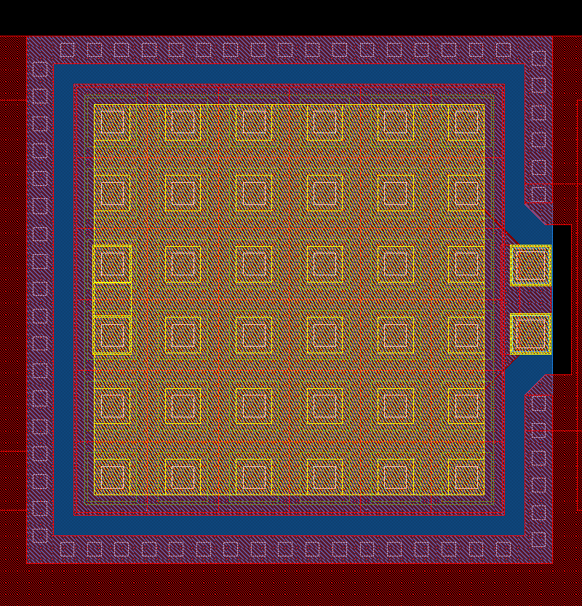
DC Blocking Capacitors
Collector Metal
Ground Extension
Ground
Plane
Ground Plane hole
  Large enough to represent a short at 220GHz.
  Blocking Caps create a hole in the ground plane
    Inductance (Think Slot Antenna)
Port 1
Port 2
DC Block Cap
Port 1
Metal 2
Metal 2
Port 2
MIM CAP
GND
Metal 1
GND
Collector Metal
Notes:
Mention size of capacitor

Slide 32
System Components at High Frequency
High Frequency LNAs
  94 GHz InP mHEMT: 3dB NF
    (Mikko Karkkainen, et al. Coplanar 94 GHz Metamorphic HEMT Low Noise Amplifiers. CSICS 2006.)
  150-215 GHz InP HBT: 5-12dB NF
    (Samoska, L. Towards Terahertz MMIC Amplifiers: Present Status and Trends. MTT-S 2006.)
  300 GHz InP HBT LNA: 11.2dB NF
    (J. Hacker, et al. THz MMICs based on InP HBT Technology. IMS 2010.)
  670 GHz InP HEMT: 13dB NF
    (Deal, W.R., et al. Low Noise Amplification at 0.67 THz Using 30nm InP HEMTs. Microwave and Wireless Components Letters July 2011.)

Slide 33
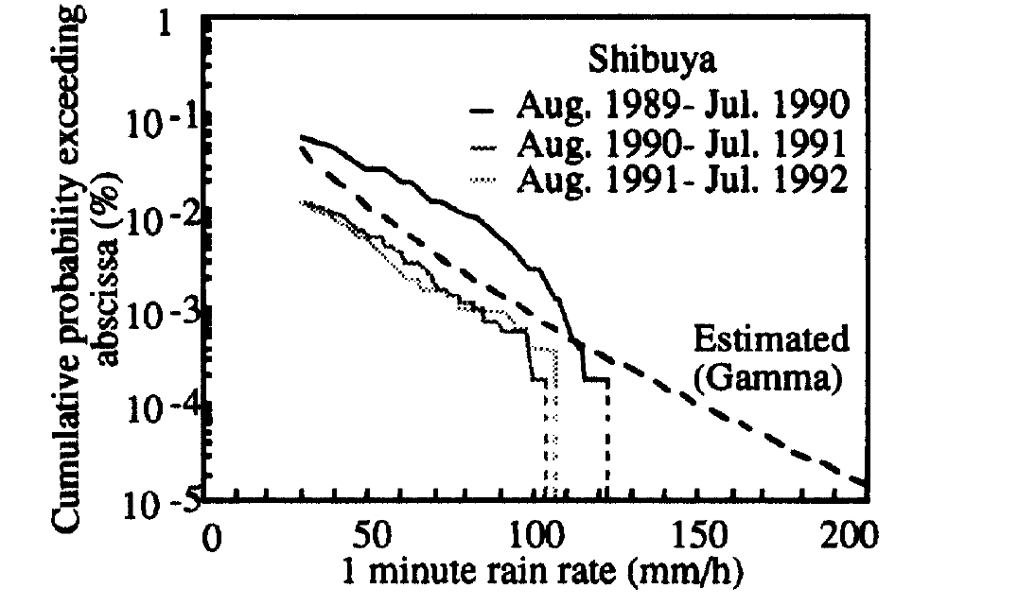
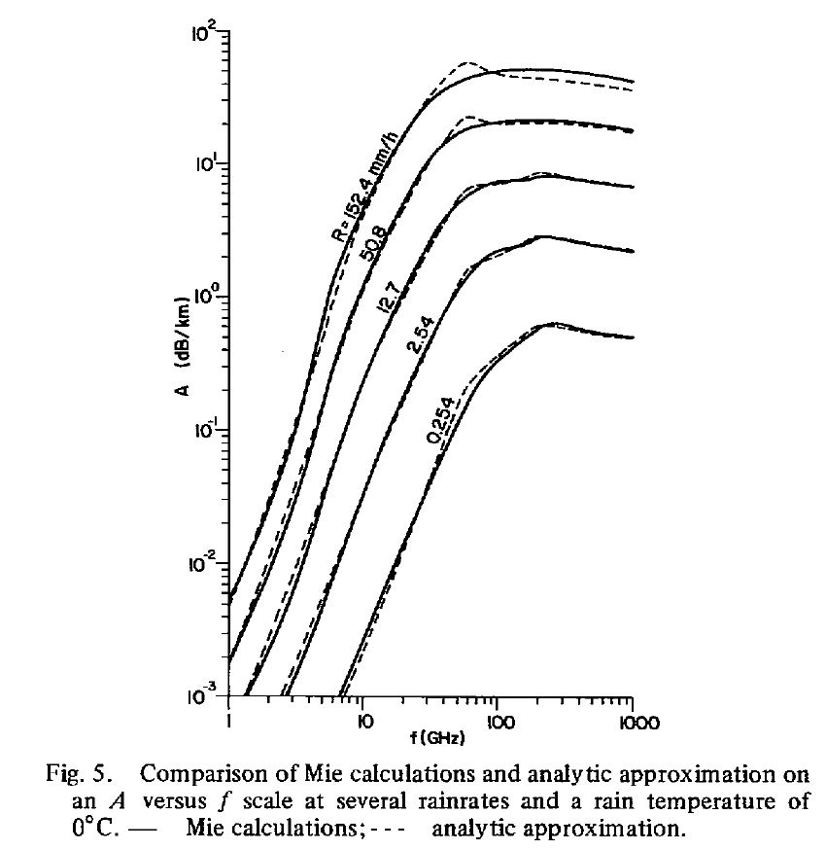
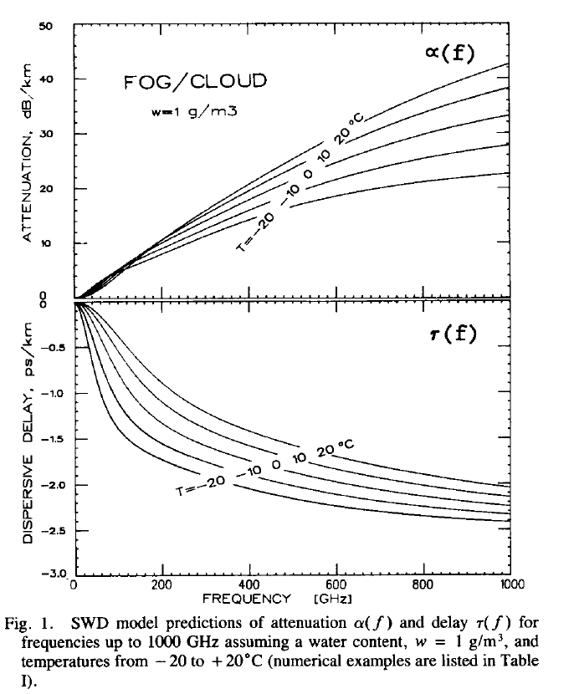
Rain, Fog, & Humidy Reduce Range and Reliability
rain 50 mm/hr: 20 dB/km, 30-1000 GHz
150 mm/hr : 50 dB/km, 30-1000 GHz
Clouds, heavy fog:
~(25 dB/km)x(frequency/500 GHz)
90% Humidity: >30 dB/km above 300 GHz
nondominant below 250 GHz (Rosker 2007 IEEE IMS)
Manabe, Yoshida, .1993 EEE Int. Conf. on Communications,
tropical deluge
heavy rain
very heavy fog
Liebe, Manabe, Hufford,
IEEE Trans Antennas and Propagation, Dec. 1989
rain
Olsen, Rogers, Hodge,
IEEE Trans Antennas & Propagation Mar 1978

Slide 34
MMIC Measurements and Data
“Load Pull” Station
  Power Sweep using VDI 200 GHz and 220GHz Multiplier Chain
  Calorimeter—Erickson sub-mm wave power meter
Calibration
  Insertion Loss calibration with the reference plane at the probe tips
  Waveguide flange to probe tip insertion loss ~1.7dB
VDI
Source
To
Meter
Above Photo Courtesy Zach Griffith
Notes:
Too much information about power sweep

