Slide 1
Prospects for High-Aspect-Ratio FinFETs in Low-Power Logic
3rd Berkeley Symposium on Energy Efficient Electronic Systems, October 28-29, 2013
Mark Rodwell, Doron Elias University of California, Santa Barbara

Slide 2
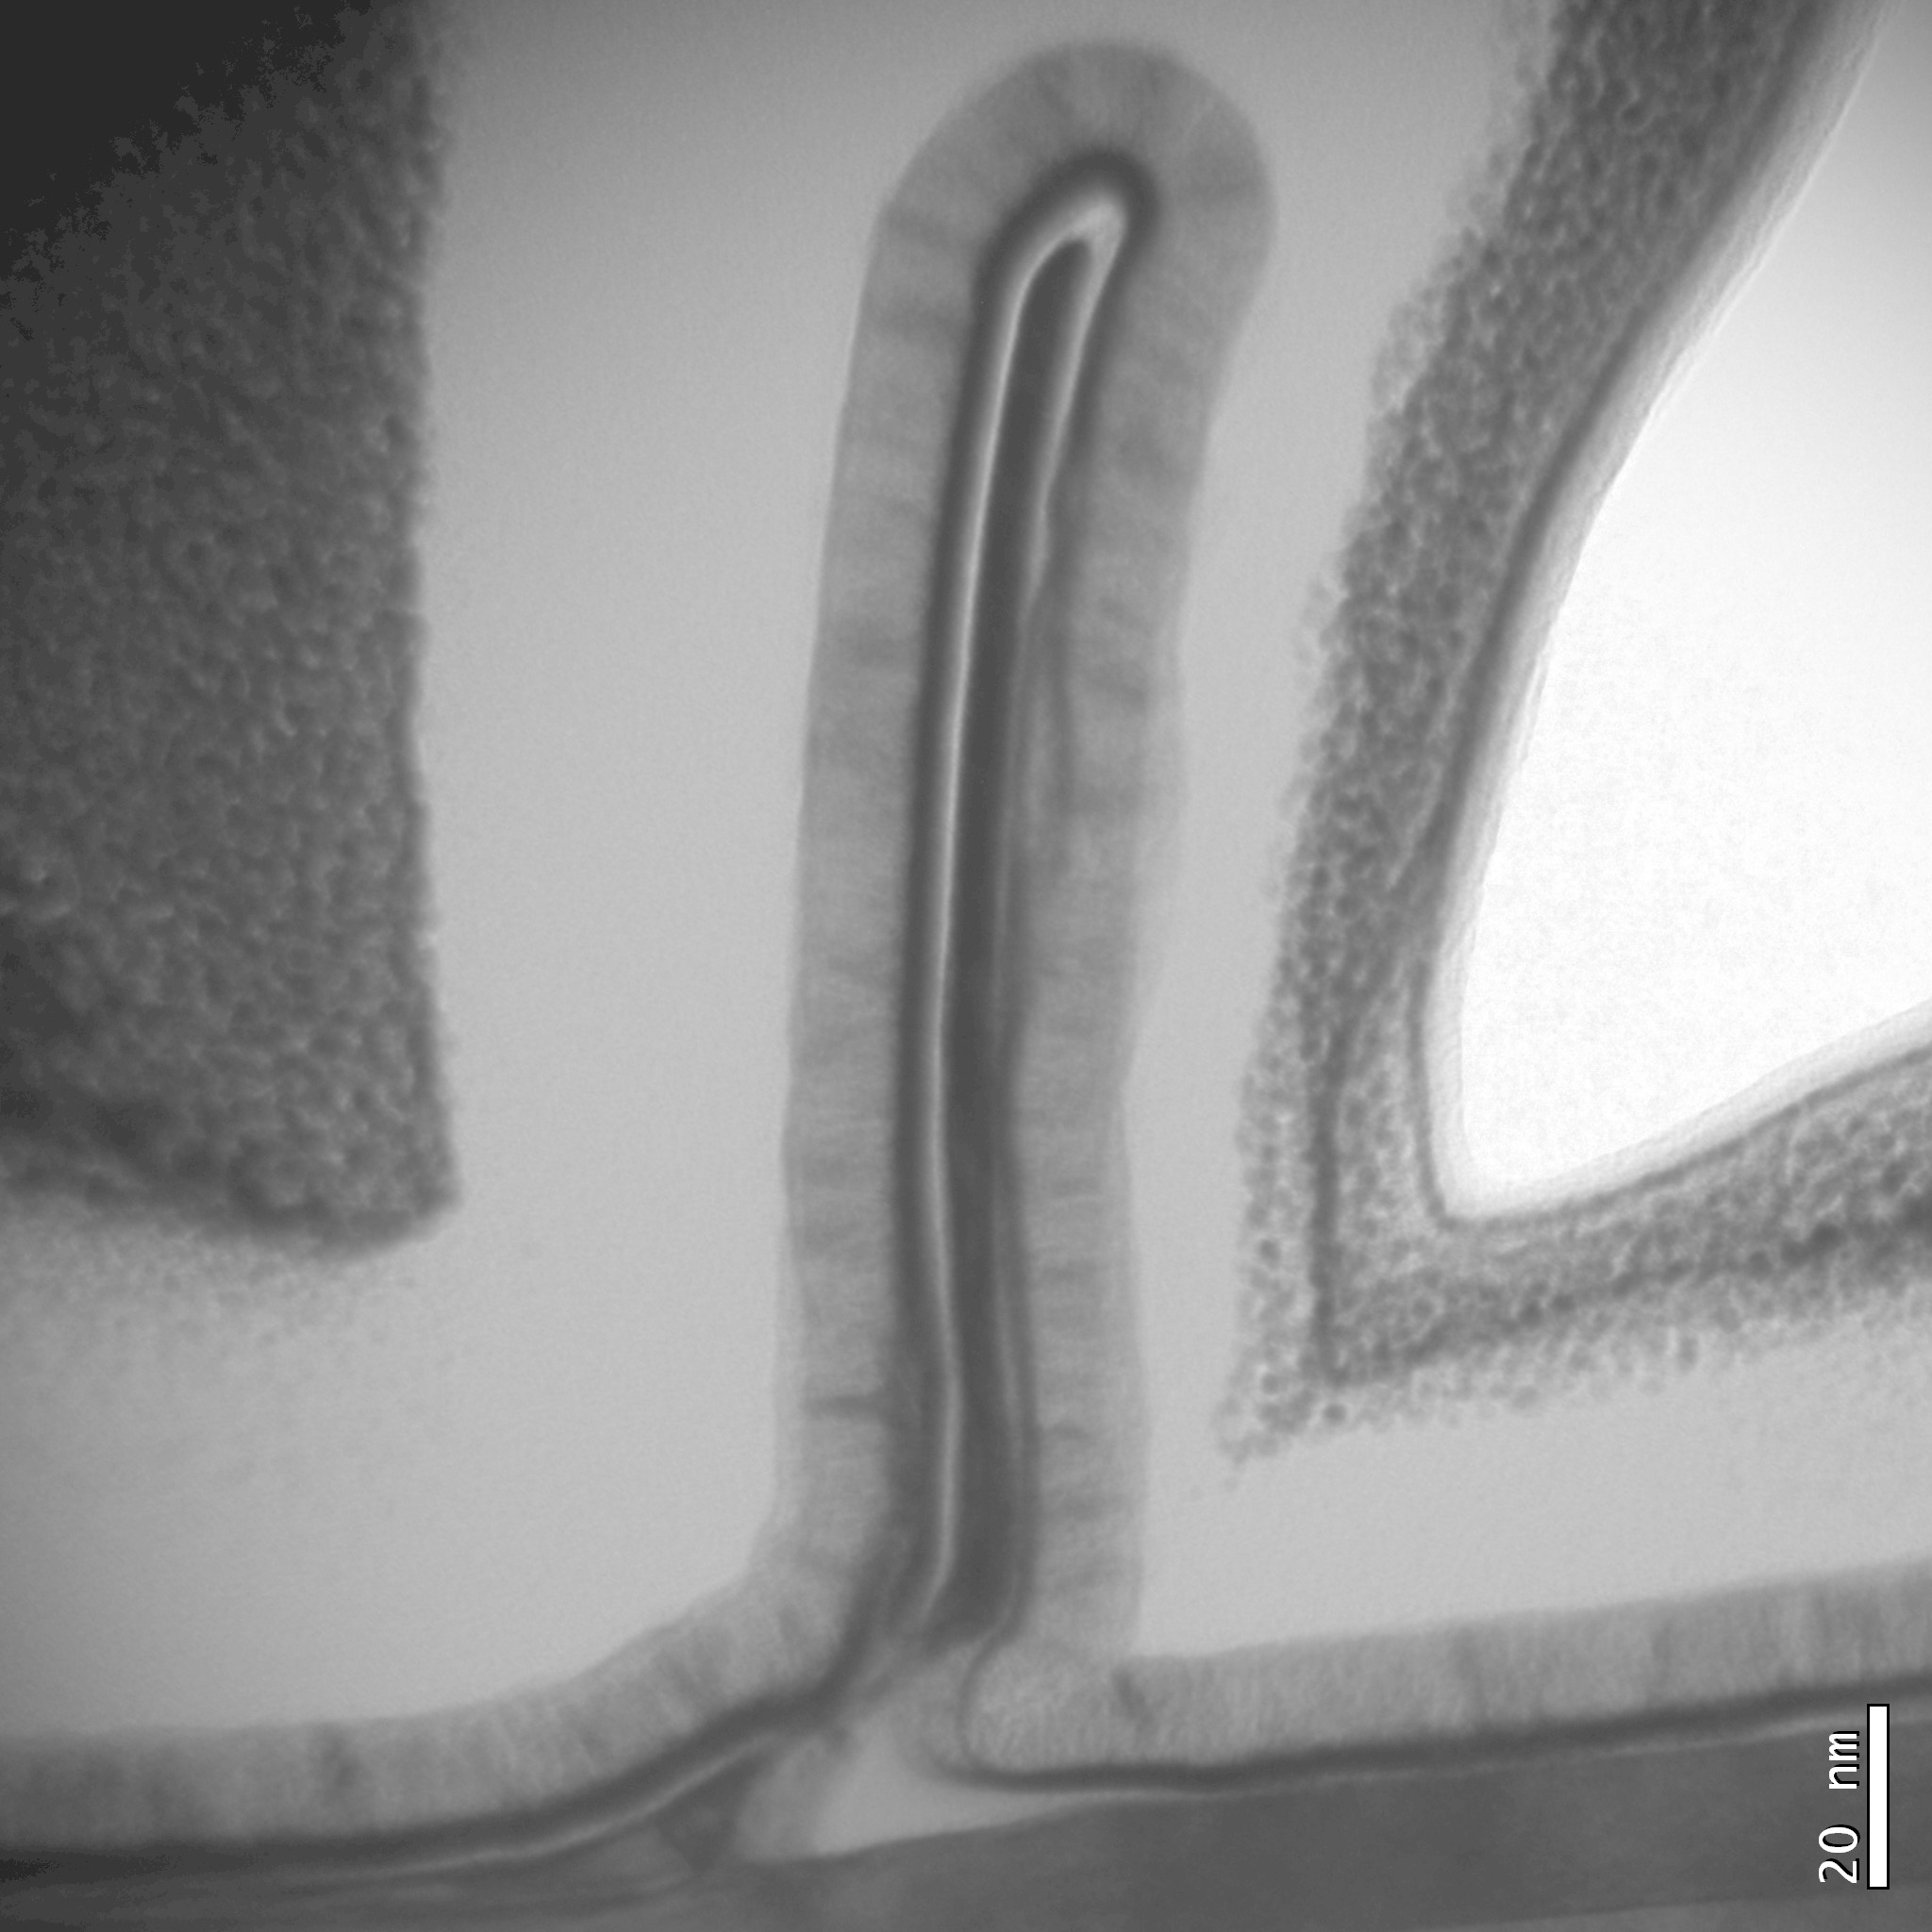
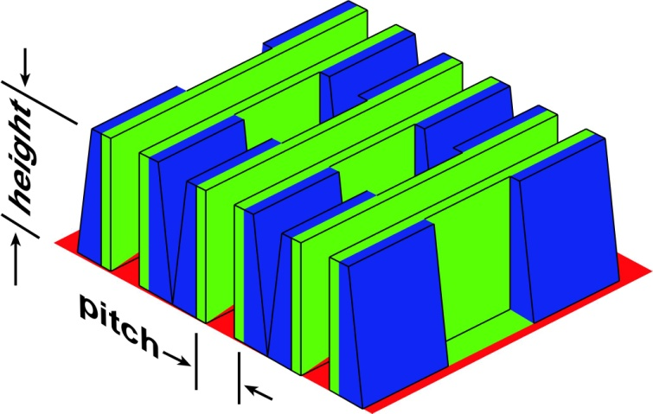
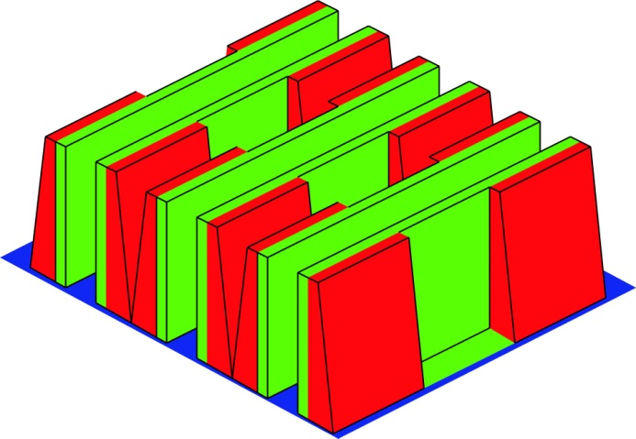
High Aspect Ratio Fins for Low-Power Logic
Fin thickness defined by Atomic layer epitaxy
→ nm thickness control
Fin height defined by sidewall growth
→ 200 nm high fins
InGaAs finFET: 8 nm thick fin 200 nm high
Enables ~4 nm fin bodies→ 8 nm gate length
10:1 more current per unit die area → smaller IC die area complements lithographic scaling Enables high speed, ultra low-power logic, V_{dd}~300 mV
D. Elias, DRC 2013, June, Notre Dame
InGaAs NFET
InGaAs PFET
height>> pitch

Slide 3
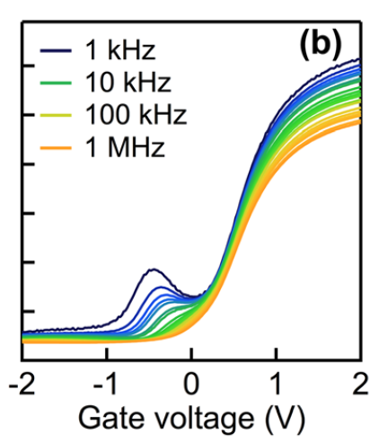
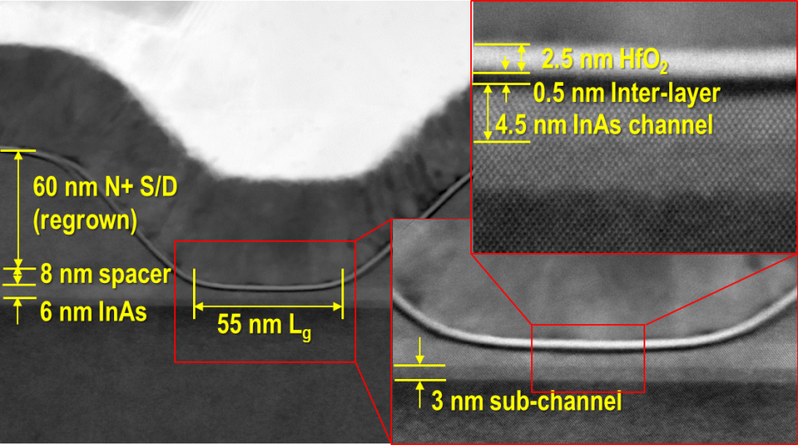
Background: III-V MOS
V. Chobpattana et al (Stemmer group), APPLIED PHYSICS LETTERS 102, 022907 (2013)
L_{g} = 60 nm

Slide 4
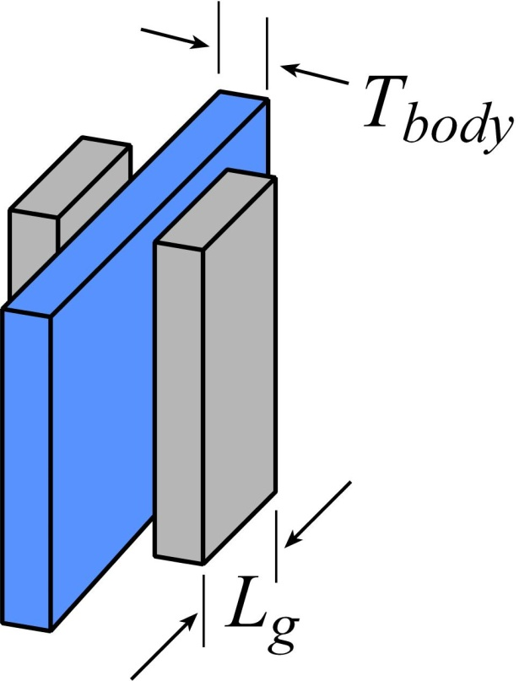
FinFETs by Atomic Layer Epitaxy: Why ?
Electrostatics: body must be thinner than ~L_{g} /2 → less than 4 nm thick body for 8 nm L_{g}
Problem: threshold becomes sensitive to body thickness
Problem: low mobility unless surfaces are very smooth
Implication: At sub-8-nm gate length, need : atomically-smooth interfaces atomically-precise control of channel thickness
side benefit: high drive current→ low-voltage, low-power logic

Slide 5
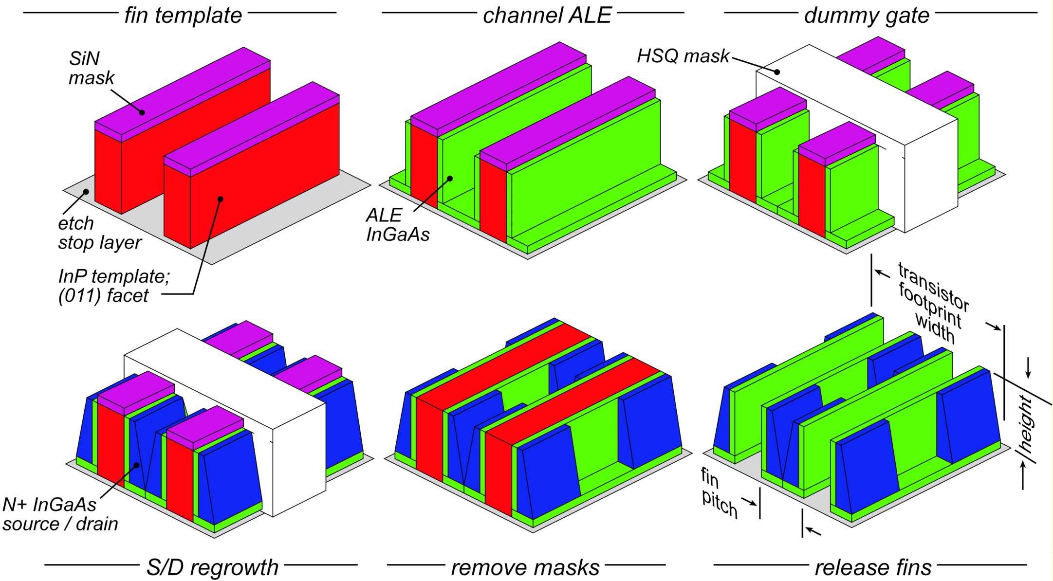
ALE-Defined finFET: Process Flow
Fin template: formed by {110}-facet-selective etch→ atomically smooth
Channel thickness set by ALE growth→ atomically precise
Not shown: gate dielectric, gate metal, S/D metal

Slide 6
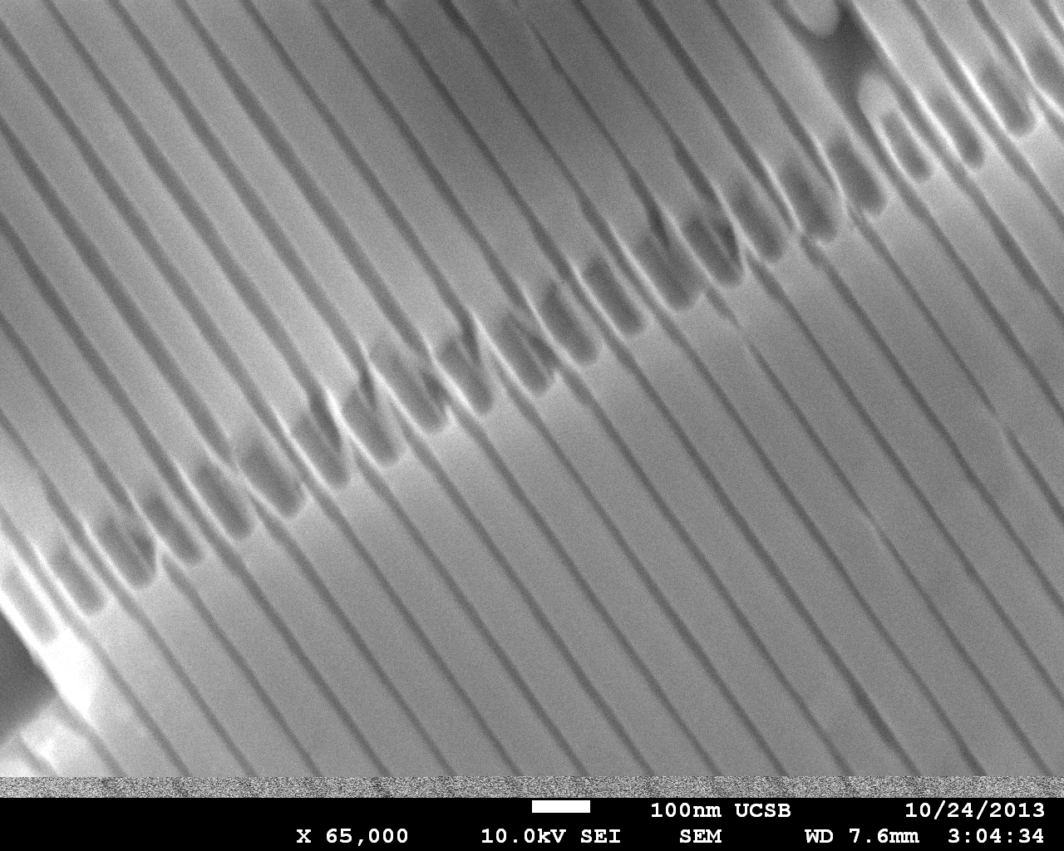
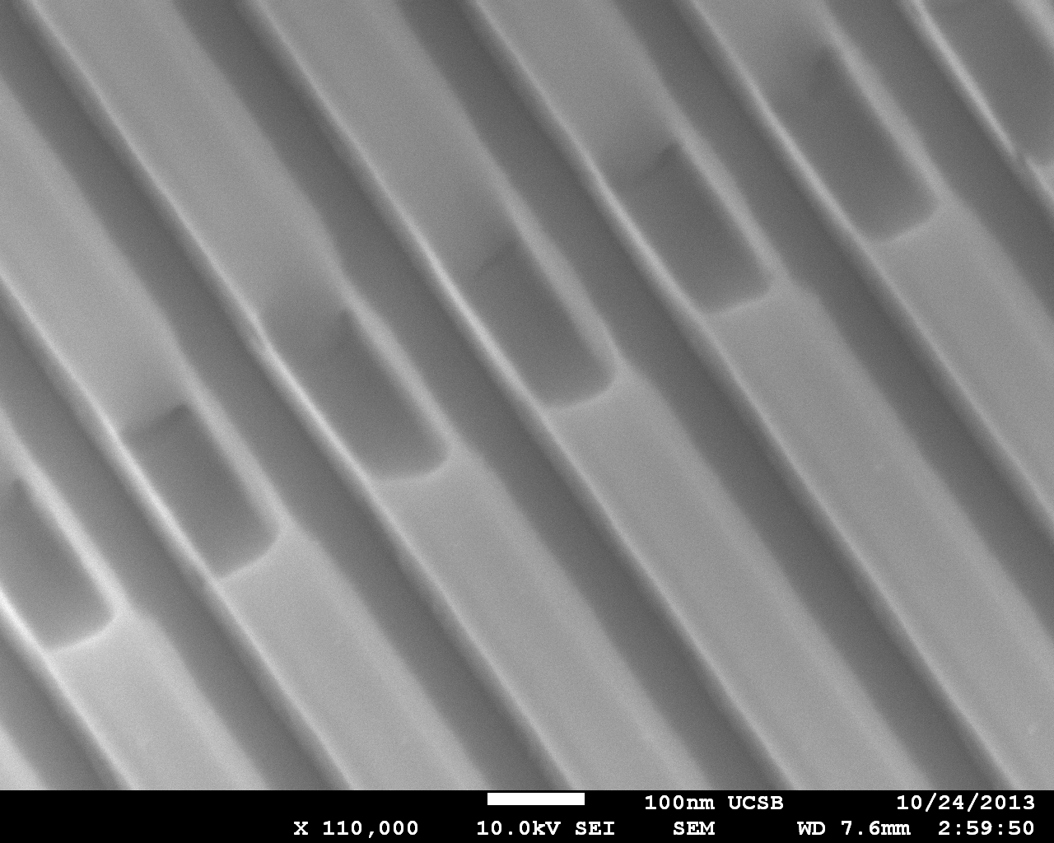
Images
HfO₂
50 nm fin pitch
fin, ~8nm
10 nm thick fins, 100 nm tall
TiN
source
channel
100 nm fin pitch
drain

Slide 7
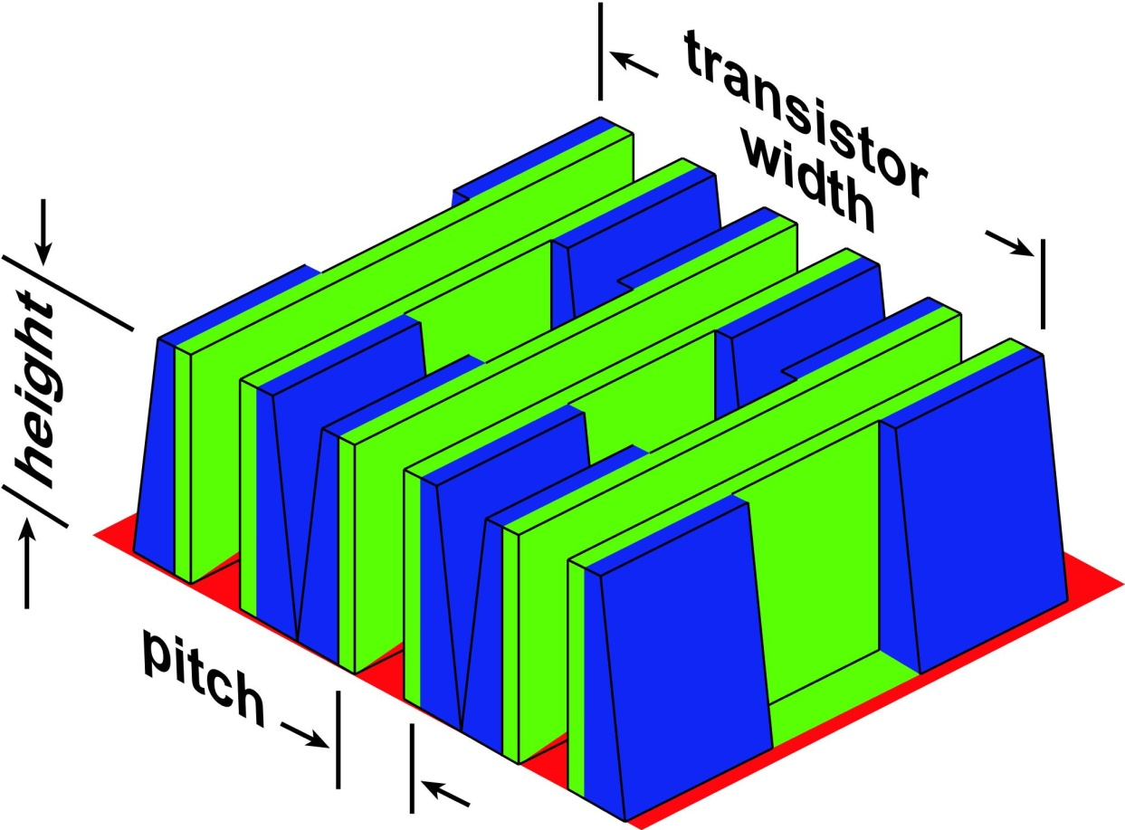
Goal: Tall Fins for High Drive Current
Goal: fin height >> fin pitch (spacing)→ more current per fin → less fins needed → higher integration density
Higher density→ shorter wires→ smaller C_{wire}V_{dd}/I, C_{wire}V_{dd}²/2
7

Slide 8
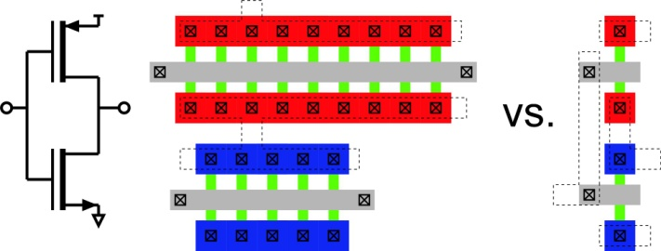
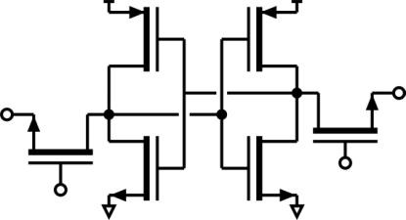
Is the IC Area Reduction Significant ?
Clock/interconnect drivers need large drive currents. Area reduction for these is likely substantial.
FETs in Cache Memory & Registers are drawn at minimum width No area reduction for these.
Most, but not all, Logic Gates will be drawn at minimum width.
Benefit must be evaluated by VLSI architect, not by device physicist.

Slide 9
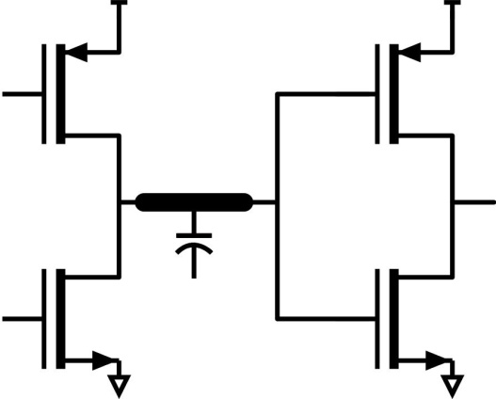
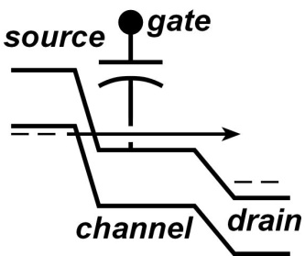
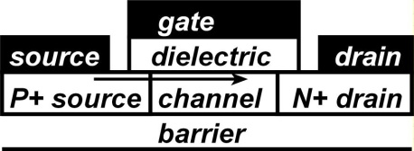
300 mV Logic: Can We Address The CV²/2 Limit ?
The CV²/2 dissipation limit
V_{dd}
With minimum C_{wire}, a minimum switching energy C_{wire}V_{dd}²/2 is set
V_{dd} set for target I_{on}, hence acceptable CV_{dd}/I_{on}.
Threshold set for acceptable off-state dissipation I_{off}V_{dd}.
C_{wire}
Subthreshold logic
Tunnel FETs
V_{dd} is simply reduced. Decreases energy CV_{dd}²/2. Increases delay CV_{dd}/I_{on}.
Bandgap of P+ source truncates thermal distribution.
Potential for low I_{off} at low V_{dd}.
Obtaining high I_{on} /V_{dd} is the challenge.

Slide 10
Goal: Tall Fins for Low-Power, Low-Voltage Logic
Supply reduced from 500mV to 268 mV while maintaining high speed.
3.5:1 power savings ? Must consider FET capacitances.
Assumes (Hodges & Jackson, 2003): (1) Charge-control analysis (2) I_{on,PFET} / W_{g}=0.5*I_{on,NFET} / W_{g} (3) FO=FI=1

Slide 11
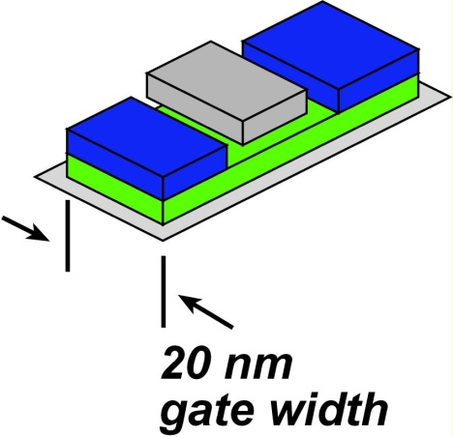
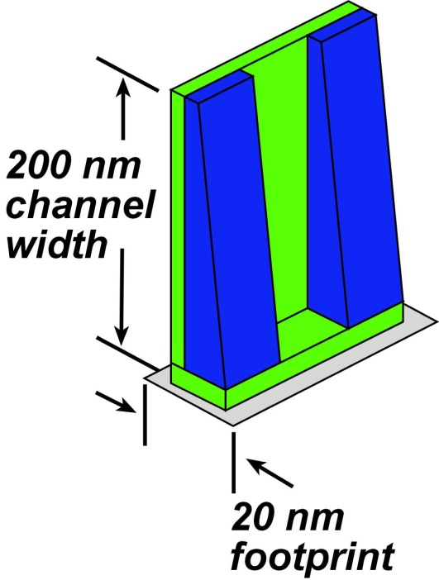
Power and Delay Comparison
Planar FET, V_{dd}=500 mV
I_{on}=20 μA, I_{off}=2nA
C_{g-ch}=I_{on}L_{g} /v_{inj}V_{dd}=1.3 aF
C_{gd-f} = C_{gs-f} = 6 aF
C_{wire}= 2 fF (10 μm length)
C_{total} = 2.1 fF (various multipliers) delay= 52 ps C_{total} V_{DD}²= 0.26 fJ
tall finFET, V_{dd}=268 mV
I_{on}=20 μA, I_{off}=2nA
C_{g-ch}=I_{on}L_{g} /v_{inj}V_{dd}=3.7 aF
C_{gd-f} = C_{gs-f} = 60 aF
C_{wire}= 2 fF (10 μm length)
C_{total} = 2.9 fF (various multipliers) delay= 39 ps C_{total} V_{DD}²= 0.11 fJ
11

Slide 12
Why tall finFETs ? Why Not Just Subthreshold Logic ?
Planar FET, V_{dd}=268 mV
I_{on}=2.0 μA
Low I_{on}→ large CV_{DD}/I_{on} delay, subthreshold logic is slow.
tall finFET, V_{dd}=268 mV
I_{on}=20 μA
12

Slide 13
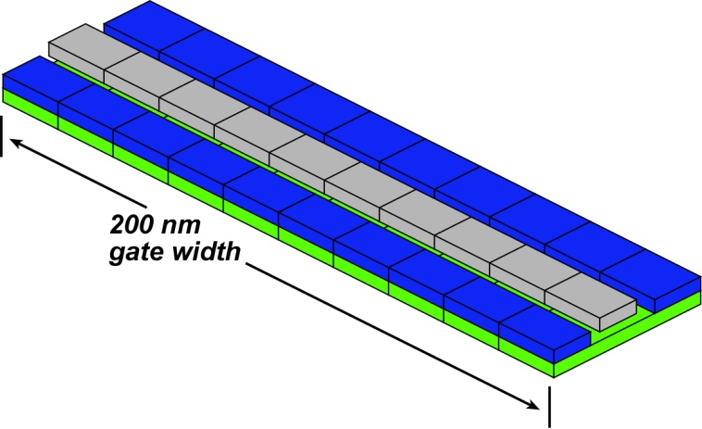
Why tall finFETs ? Why Not Just Subthreshold Logic ?
Planar FET, V_{dd}=268 mV
I_{on}=20 μA
Die size increased 10:1
(also: longer interconnects, etc)
tall finFET, V_{dd}=268 mV
I_{on}=20 μA
13

Slide 14
Tunnel FETs & High-Aspect-Ratio Fins
Quick performance estimate: Assume, for a moment, that P/N tunneling probability is 10%*. Typical of the best reported ohmic contacts .*
Then on-currents for tunnel FETs are ~10:1 smaller than that of normal FETs.
Unless I_{on}/W_{g} is high, tunnel FETs will suffer from either large C_{wire}V/I gate delays or (increasing FET widths) large die areas.
Using high-aspect ratio fin structures, tunnel FET drive currents can be increased. Parasitic fringing capacitance will then also contribute to CV/I & CV².
*Contact to N-InGaAs @ 6E19/cm³ doping: m*=0.1m₀, 0.2 eV, 0.5 nm barrier Baraskar, et al: Journal of Applied Physics, 114, 154516 (2013)

Slide 15
finFETs Defined by Atomic Layer Epitaxy
Fin thickness defined by Atomic layer epitaxy
→ nm thickness control
Fin height defined by sidewall growth
→ 200 nm high fins
InGaAs finFET: 8 nm thick fin 200 nm high
Benefits:
Enables ~4 nm fin bodies→ 8 nm gate length
10:1 more current per unit die area → smaller IC die area Enables high speed, ultra low-power logic, V_{dd}~300 mV
D. Elias, DRC 2013, June, Notre Dame
InGaAs NFET
InGaAs PFET
height>> pitch

Slide 16
(end)

Slide 17
Backups

Slide 18
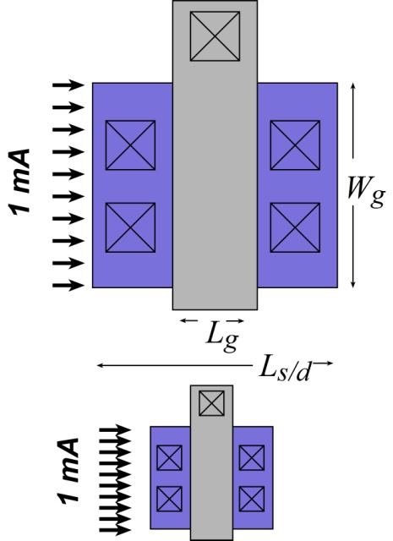
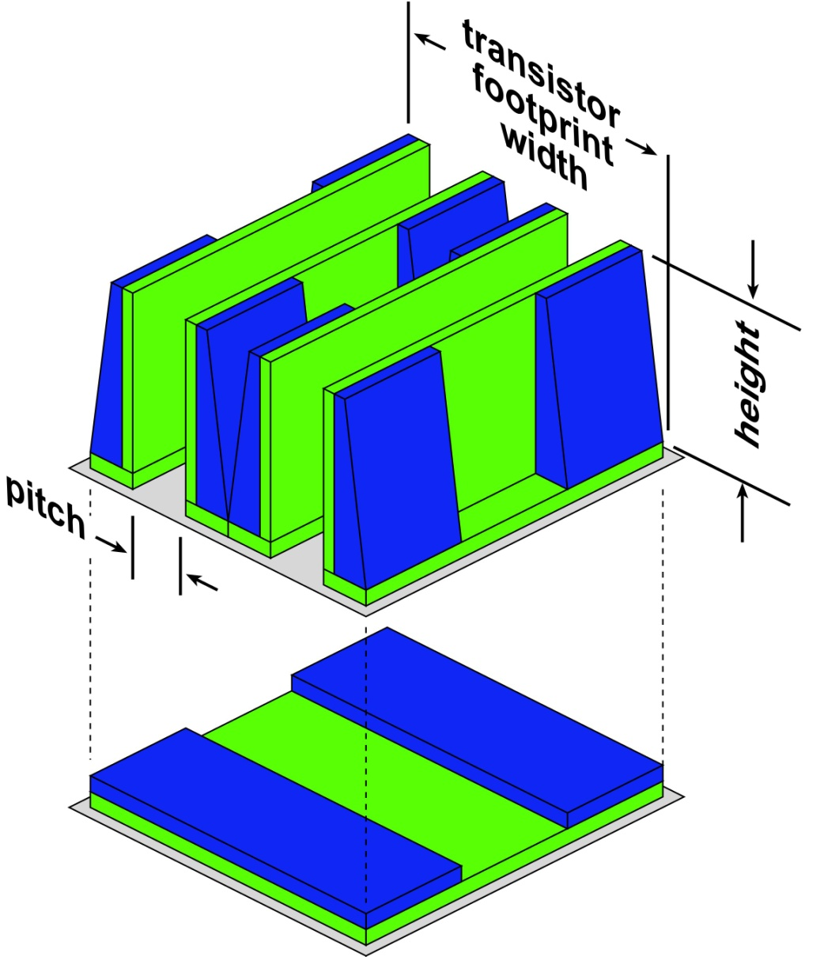
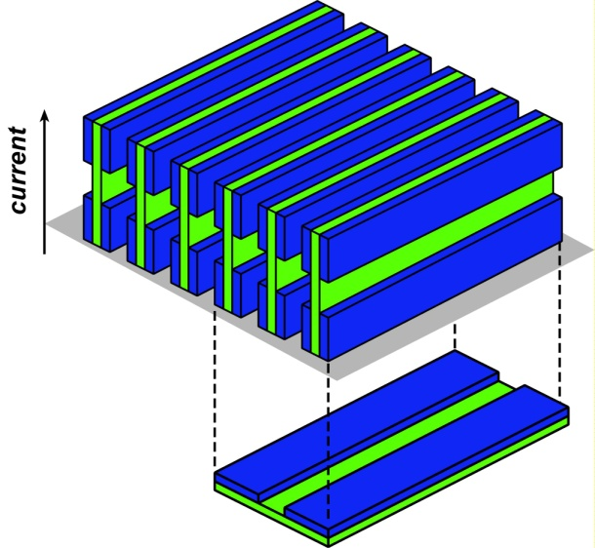
Lithographic Scaling vs. 3-D for High-Density Logic
Past VLSI Scaling: more FETs per IC because of (1) shorter gate & contact lengths (2) increased mA/micron→ less gate width W_{g}.
Today, I_{on} / W_{g} (mA/micron) is not increasing soon, once S/D tunneling dominates, I_{on}/W_{g} will start to decrease
Sub-16nm lithography is also difficult. Further reductions in feature size are expensive.
Can 3-D transistors increase integration density ?
Clear: increased I_{on} for a given FET footprint size.
Clear: can suppress S/D tunneling: tunneling distance >> lithographic distance.
Less clear: decreased size of minimum-geometry FET.
18

Slide 19
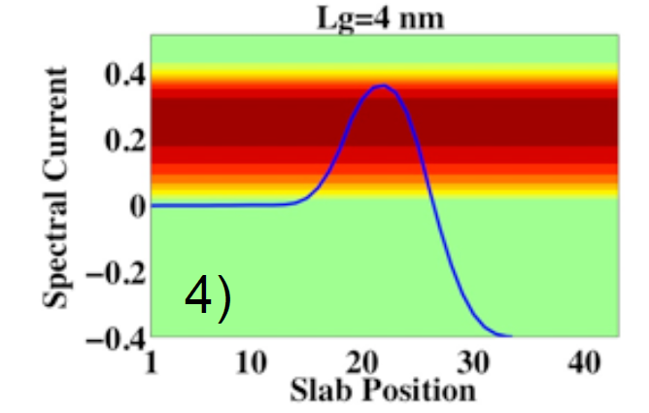
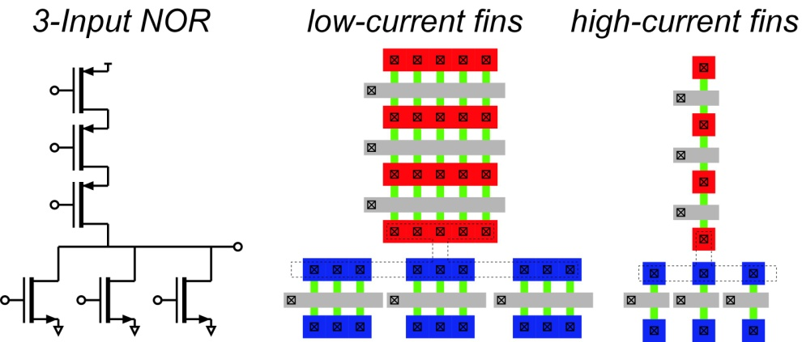
Scaling in the S/D tunneling limit
At 4-8 nm Gate Lengths, high leakage from source/drain tunneling
increases exponentially as gate length is reduced.
Reducing tunneling through increased mass can be counterproductive
increasing m* → less tunneling, but lower FET on-current→ need more die area
Instead: Ultra-tall fins to increase the integration density
example: 3-input NOR gate. other cases: clock & interconnect drivers
19

Slide 20
Minimum gate length: source-drain tunneling (2)
analysis: Rodwell et al, 2010 DRC
increased m* → decreased I_{on} /W_{g} → decreases packing density
20

Slide 21
Geometric Solutions to S/D Tunneling
UID InGaAs vertical spacer
Transport (& tunneling) distance larger than lithographic gate length. Feature used NOW in our current planar FETs. Can be incorporated in high-aspect-ratio finFETs
21

Slide 22
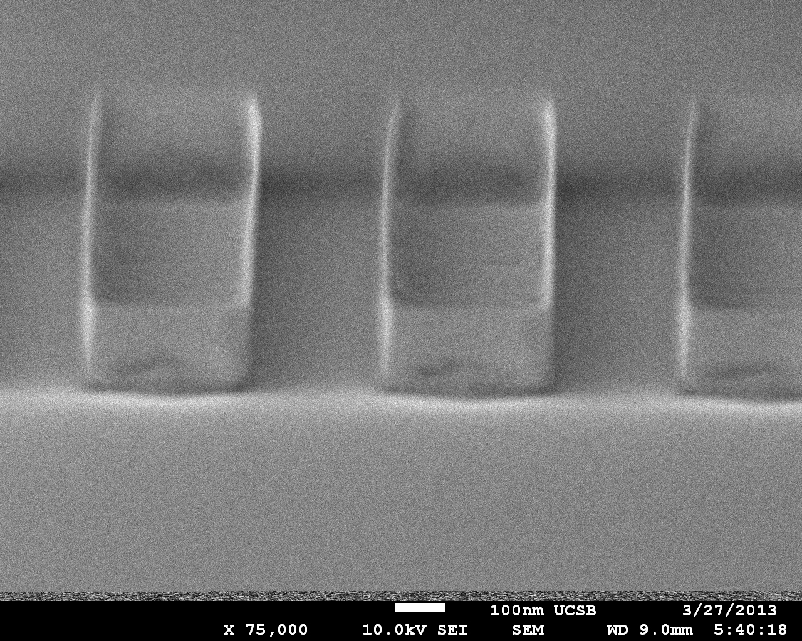
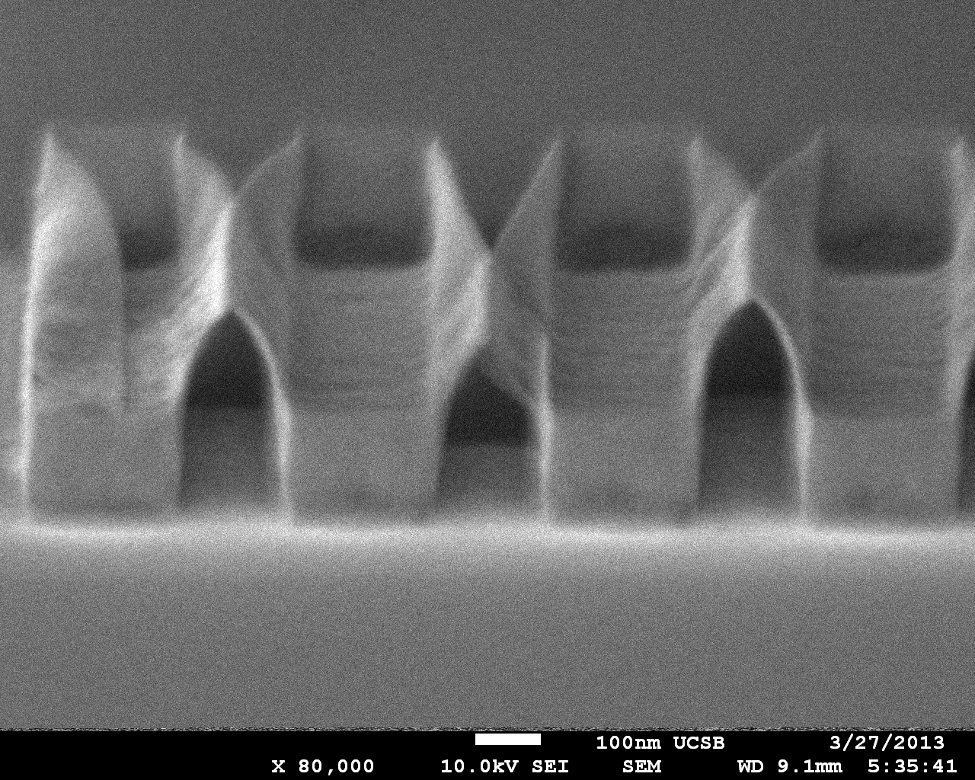
Why Not Release Fins Before S/D Regrowth ?
D. Elias, DRC 2013, June, Notre Dame
Images of released ~10 nm fins:
S/D regrowth provides mechanical support

Slide 23
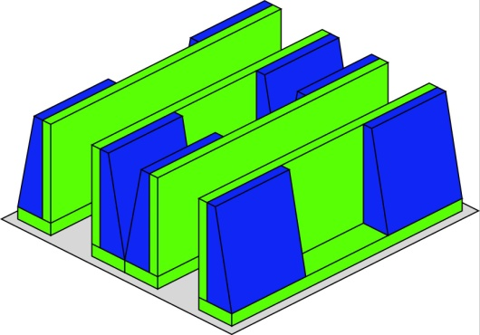
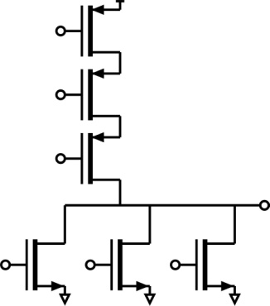
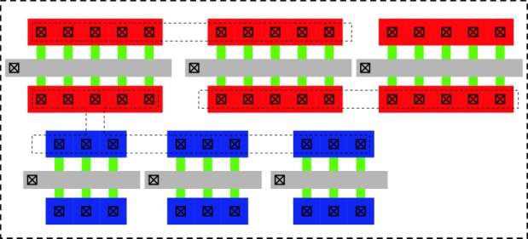
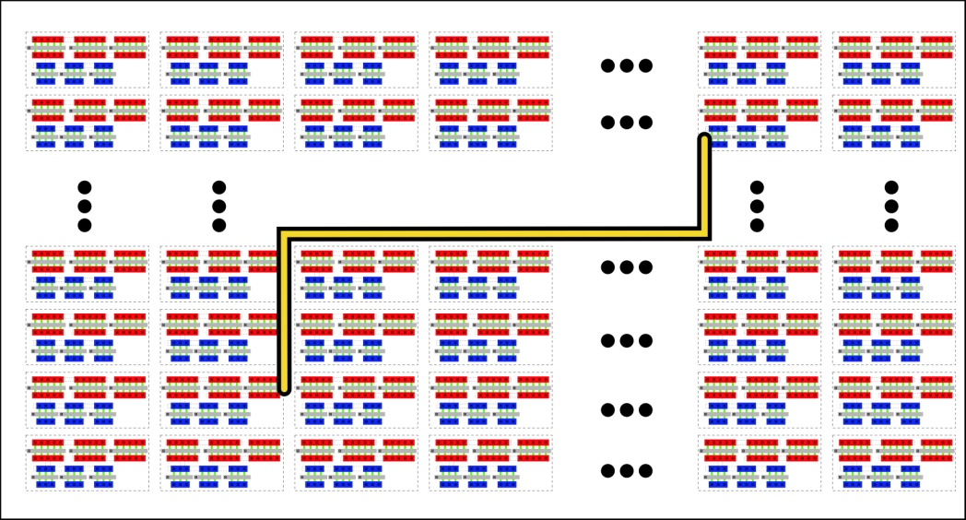
Wire Lengths & Wire Capacitances in VLSI
FET
logic gate
gate die area
Integrated Circuit Layout
interconnect
more current per fin→ less fins needed → higher integration density
more current per fin→ shorter wires→ smaller C_{wire}V_{dd}/I, C_{wire}V_{dd}²/2
23

Slide 24
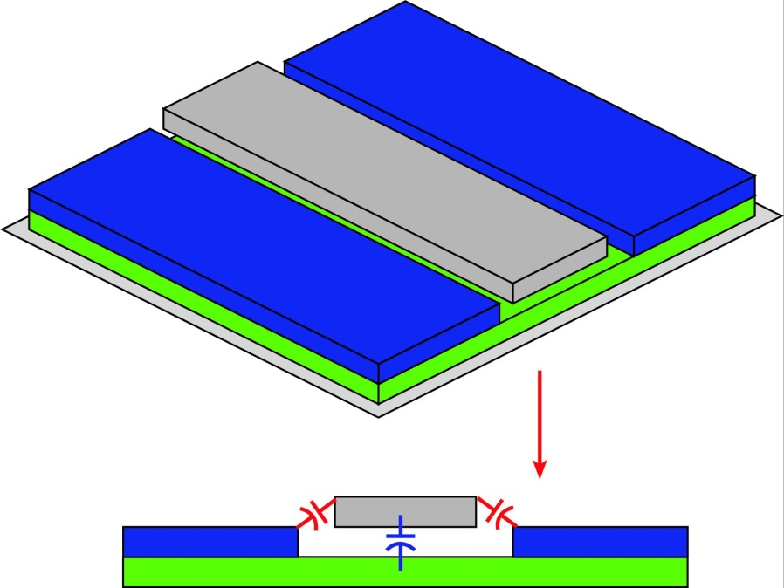
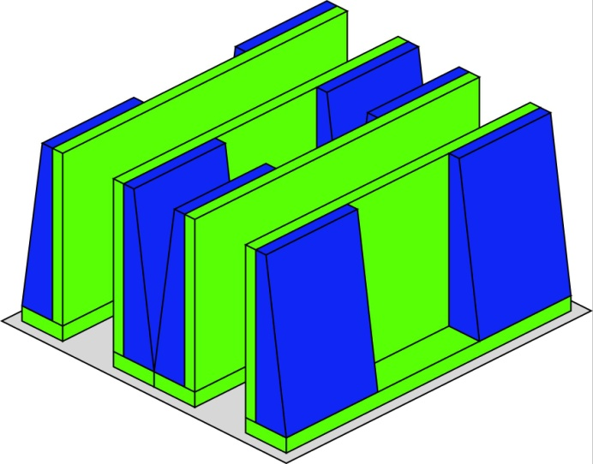
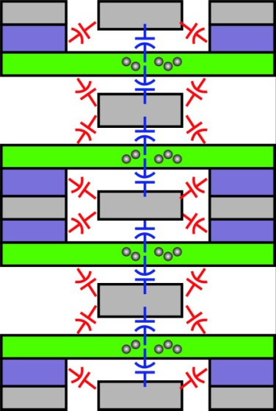
FET Capacitances, Interconnect Capacitances
Similar capacitances
in finFET
24

Slide 25
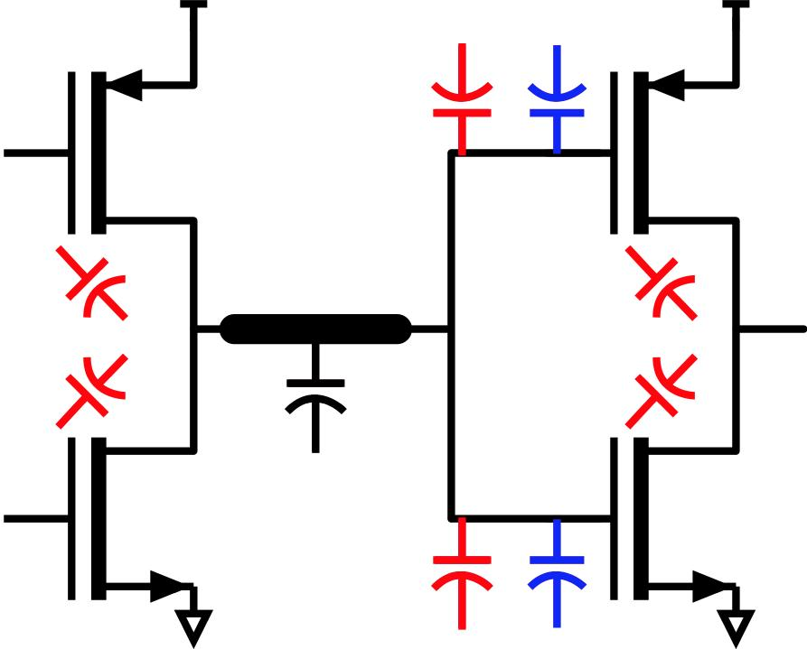
Gate Capacitance, Energy, and Delay
Assumes: (1) Charge-control analysis* (2) I_{on,PFET} / W_{g}=0.5*I_{on,NFET} / W_{g}
(3) FO=FI=1
*Hodges & Jackson, 2003
25

