Slide 1


A DC-100 GHz Bandwidth and 20.5 dB Gain
Limiting Amplifier in 0.25μm InP DHBT Technology
Saeid Daneshgar, Prof. Mark Rodwell (UCSB)
Zach Griffith (Teledyne Scientific Company)

Slide 2
Outline
Application and Motivation of the work
TSC 250nm HBT process overview
Block diagram & schematic of the circuit
Layout & EM modeling
Measurement results and comparison table

Slide 3
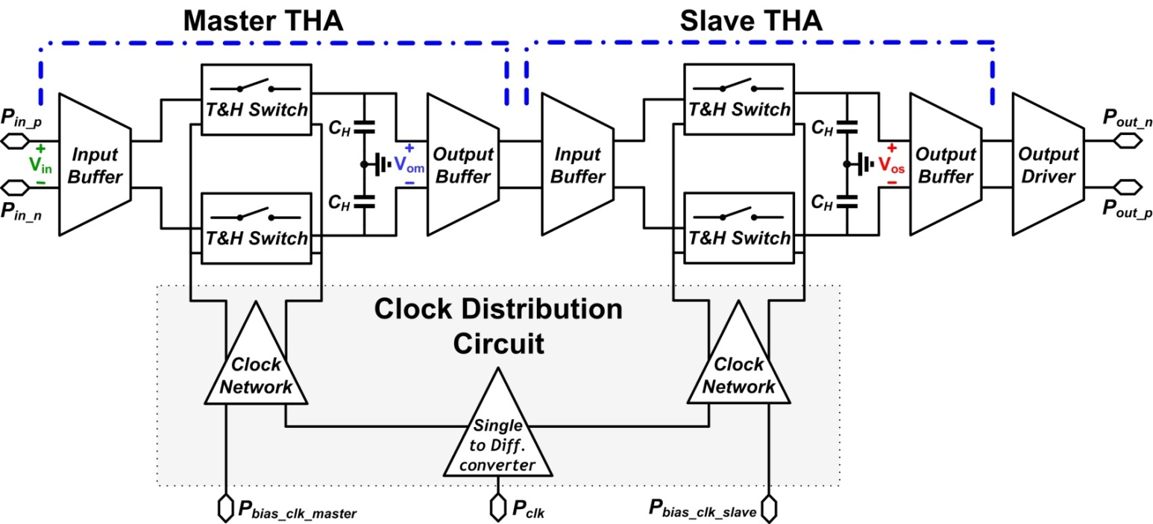
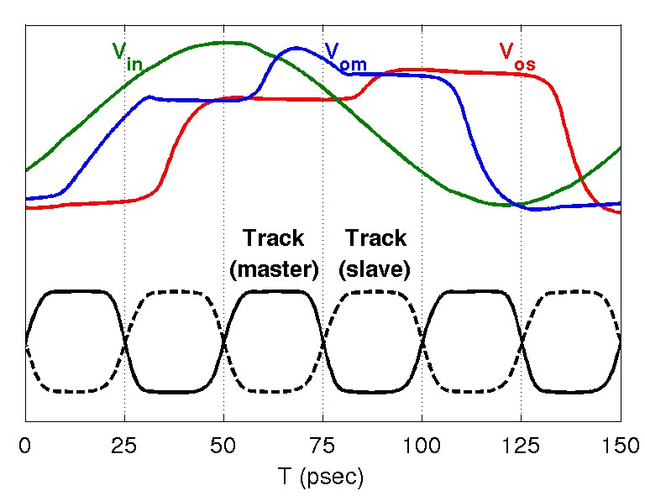
Motivation - I
50 GSample/sec Sample & Hold circuit

Slide 4
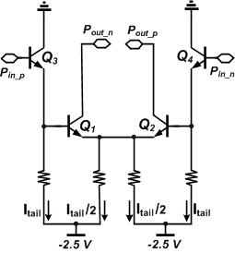
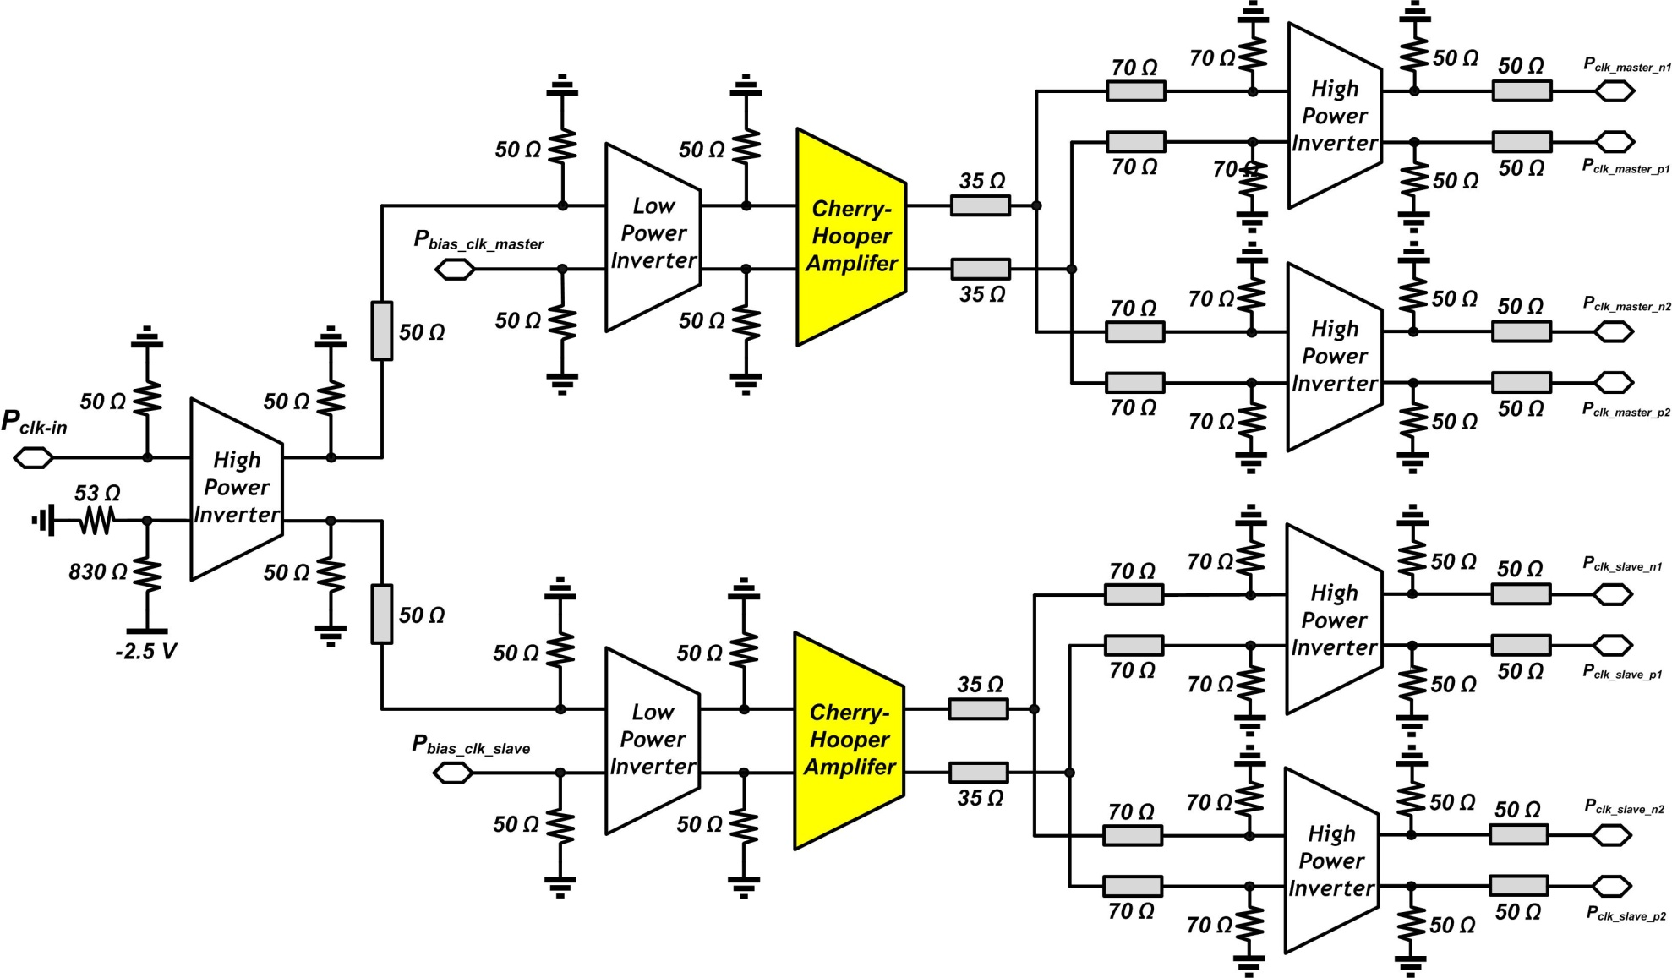
Motivation - II
50 GHz clock circuit

Slide 5
Applications - I
High speed optoelectronic signal conversion requires broadband receivers
Limiting amplifiers are the key components in these receivers in order to:
Provide a low input sensitivity and sufficient gain to achieve saturated output levels from small-signal inputs which enables reliable decision making
Provide a wide bandwidth to achieve short rise and fall times in order to provide an output signal with minimum distortion

Slide 6
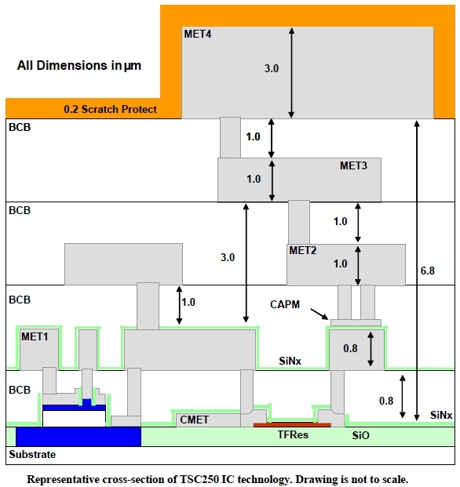
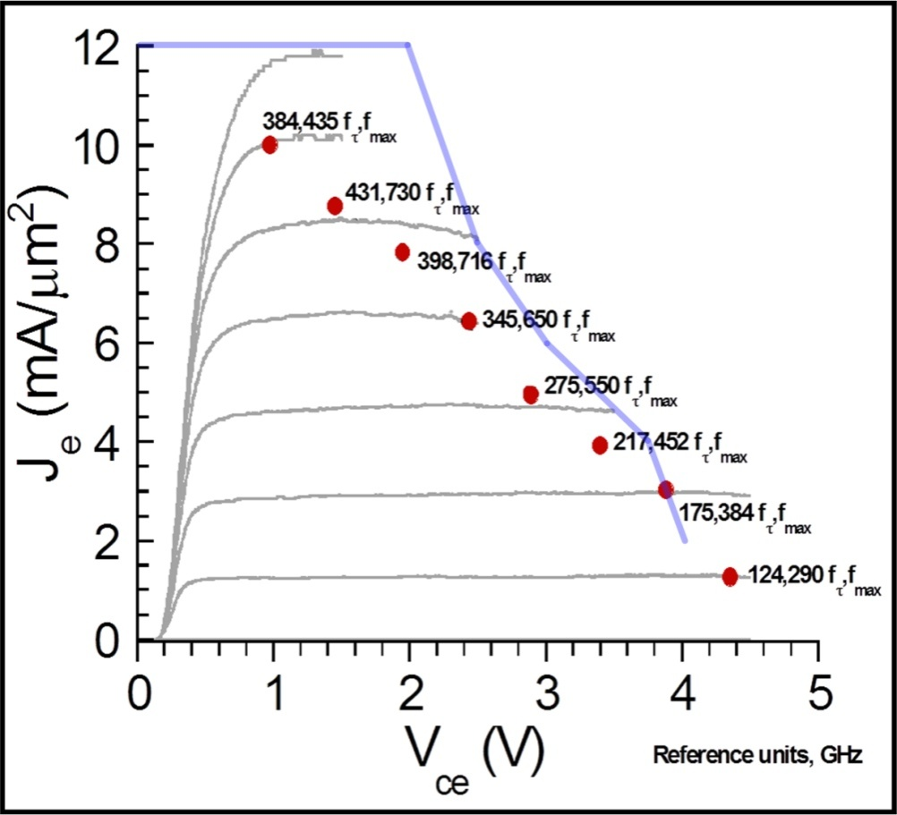
TSC 250nm InP HBT process
Four metal interconnect stack
Peak bandwidth of f_{t}=400 GHz & f_{max} = 700 GHz
MIM caps of 0.3 fF/μm²
Thin-film resistors 50 Ω/square
Plot courtesy Zach Griffith, UCSB 250nm InP HBT, 2007

Slide 7
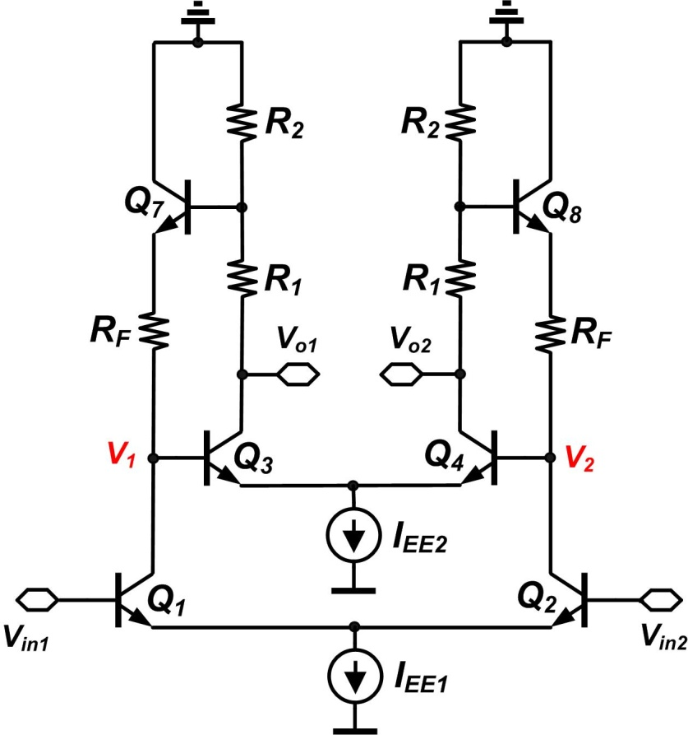

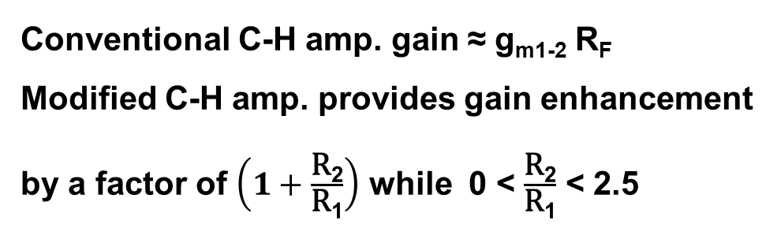
Modified Cherry-Hooper stage [1-3]
Large signal behavior:
Conventional C-H amp. gain ≈ g_{m1-2} R_{F}
Modified C-H amp. provides gain enhancement by a factor of $\left(1+\frac{\text{R}\text{2}}{\text{R}\text{1}}\right)$ while 0 < $\frac{\text{R}\text{2}}{\text{R}\text{1}}$ < 2.5
[1] Y. M. Greshishchev et al., “A 60-dB gain, 55-dB dynamic range, 10-Gb/s broad-band SiGe HBT limiting amplifier,” IEEE JSSC, vol.34, no.12, pp. 1914-1920, Dec. 1999.
[2] K. Ohhata et al., “Design of a 32.7-GHz bandwidth AGC amplifier IC with wide dynamic range implemented in SiGe HBT,” IEEE JSSC, vol.34, no.9, pp. 1290-1297, Sep. 1999
[3] C. D. Holdenried et al., “Analysis and design of HBT Cherry-Hooper amplifiers with emitter-follower feedback for optical communications,” IEEE JSSC, vol.39, no.11, pp. 1959-1967, Nov. 2004.

Slide 8
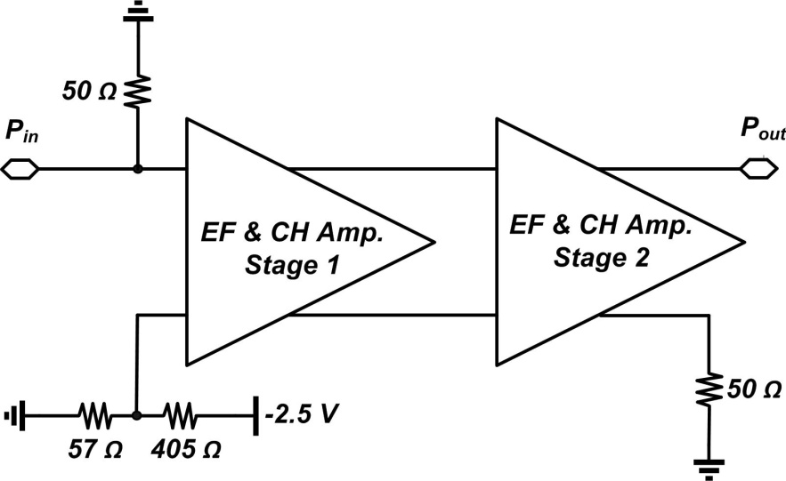
Block Diagram
Single-ended gain and BW measurements have be chosen due to unavailability of 4-port s-param measurement for frequencies > 67 GHz → ~6dB gain has been added to get the differential equivalent

Slide 9
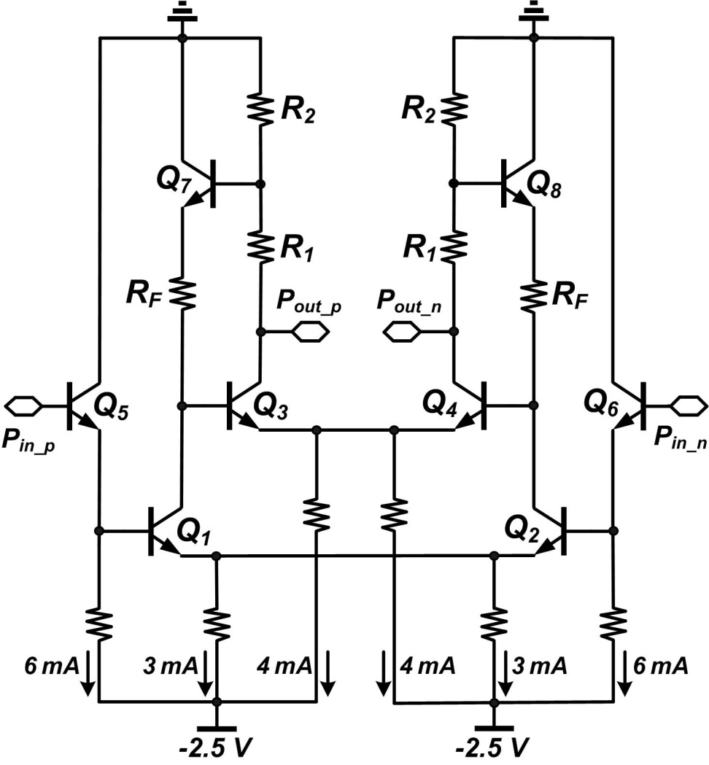
Schematic
R₁ =30 Ω
R₂ =50 Ω
R_{F} =40 Ω
Q₁₋₈ =3x0.25 μm

Slide 10

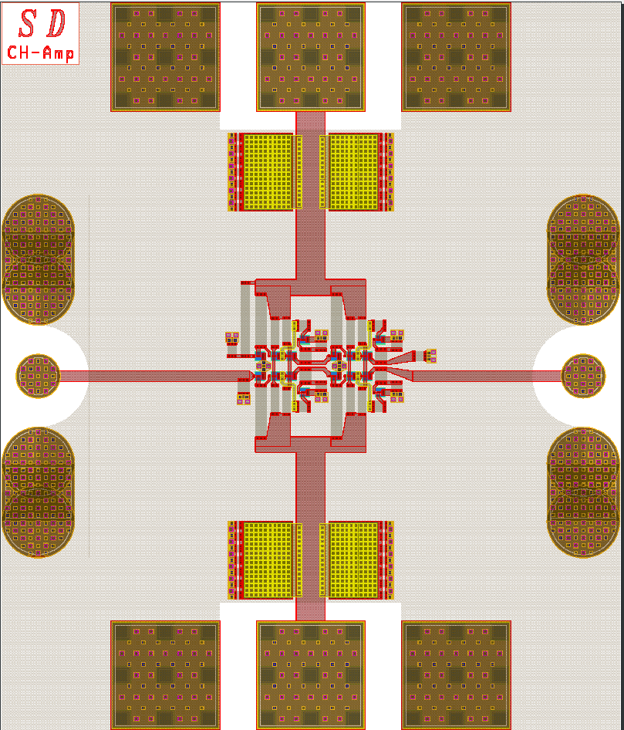
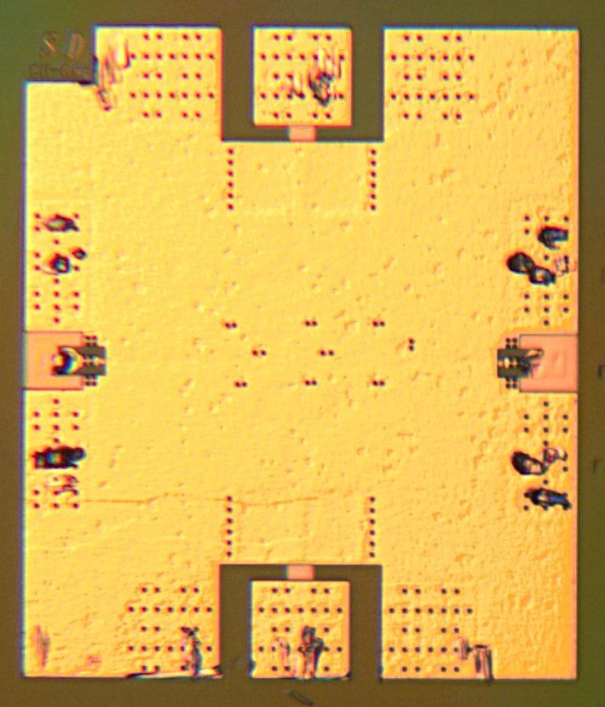
Compact layout
140 µm
100 µm
500 µm
425 µm

Slide 11
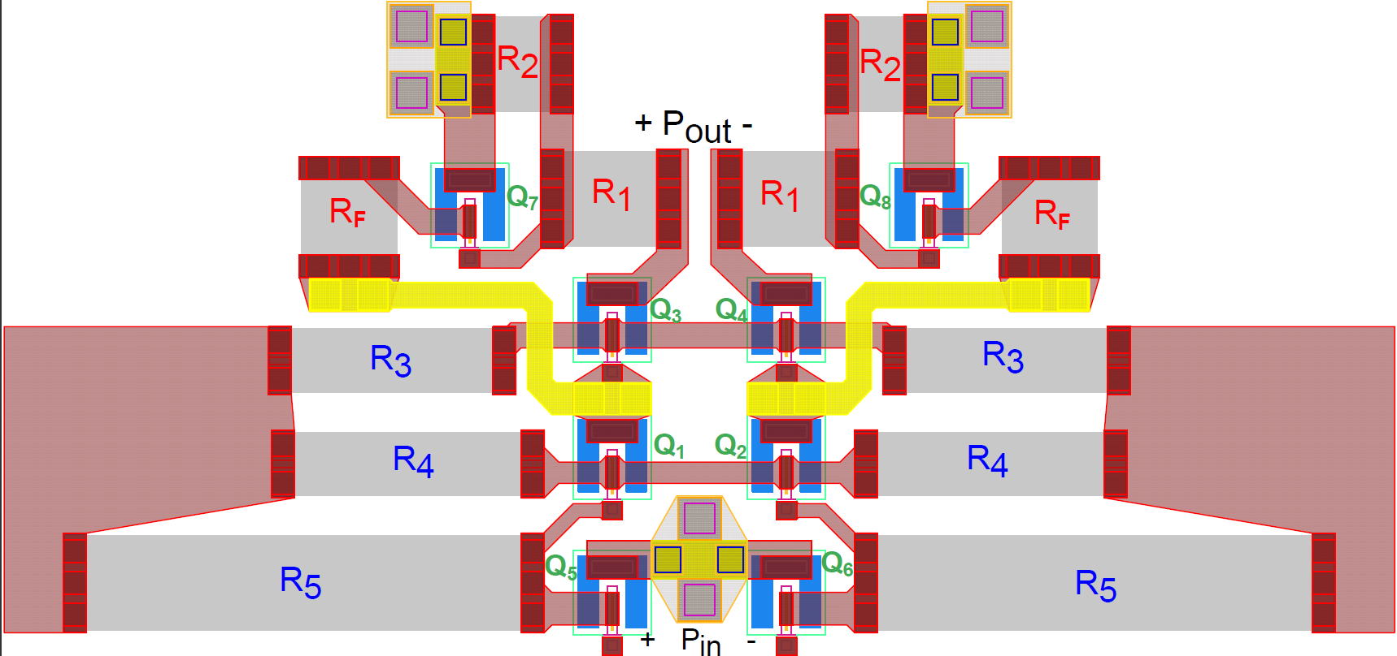
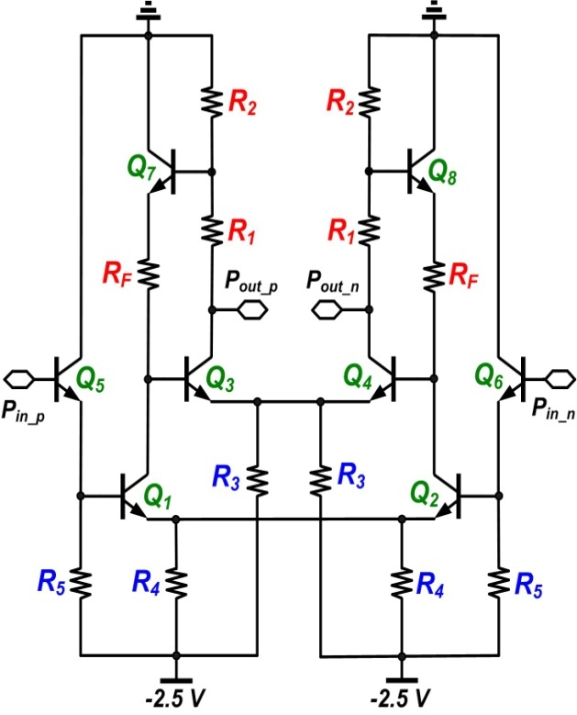
Symmetric layout

Slide 12
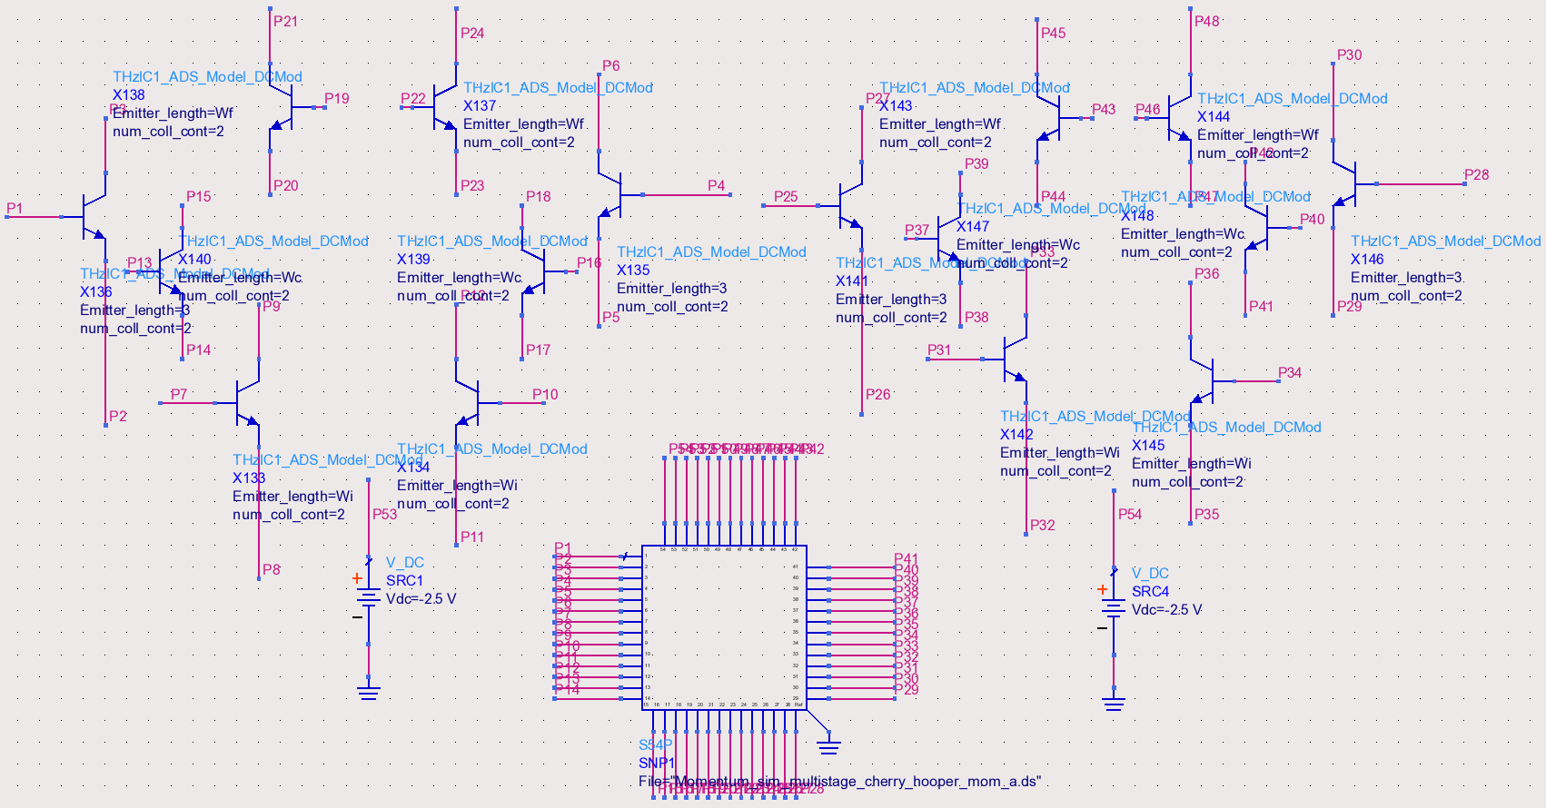
EM Simulation
Whole chip has been modeled using ADS momentum EM simulator
54 port data item

Slide 13
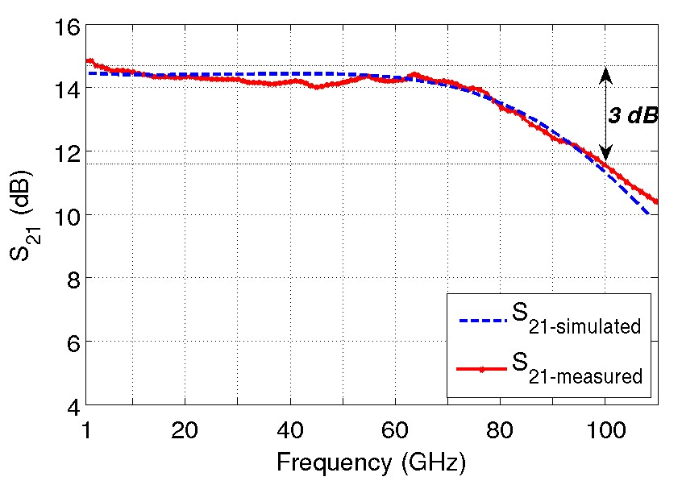
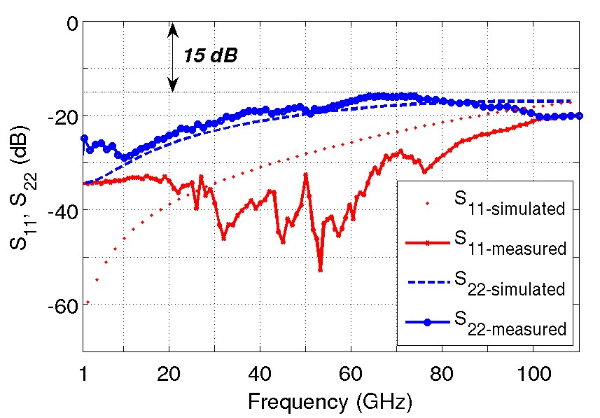
S-parameter measurement results - I
Single-ended input and output return loss
Single-ended insertion loss
S₂₁=14.5 dB , 3dB BW = 100 GHz
S₂₁ gain ripple < ±0.5 dB
S₁₁< -20 dB , S₂₂< -15 dB

Slide 14
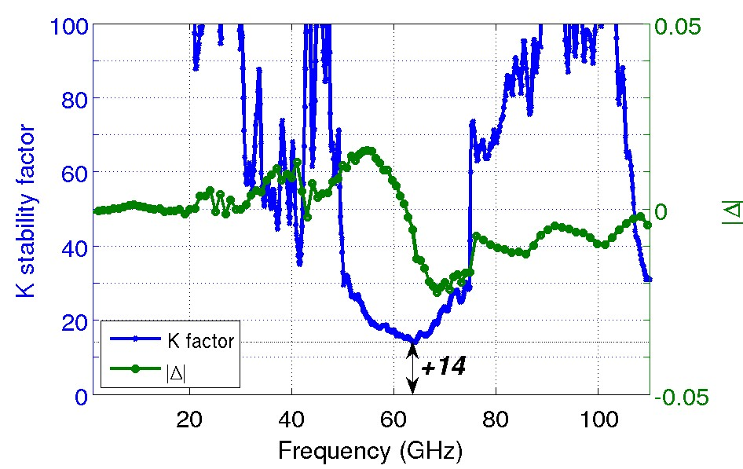
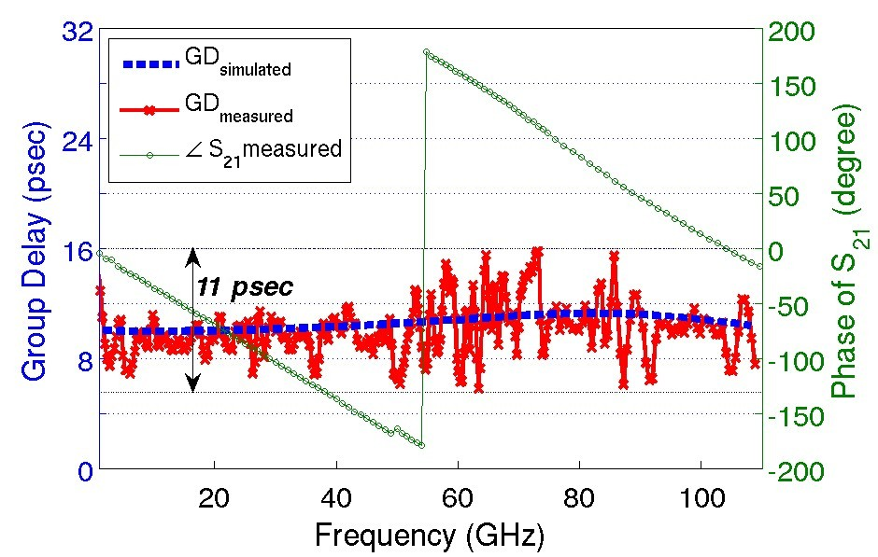


S-parameter measurement results - II
Rollet Stability factor
Group Delay
Group delay ≈ 9 psec
Group delay variation = 11 psec

Slide 15
Eye diagrams @ 30 Gb/s
Small Signal
Large Signal

Slide 16
Eye diagrams @ 40 Gb/s
Small Signal
Large Signal

Slide 17
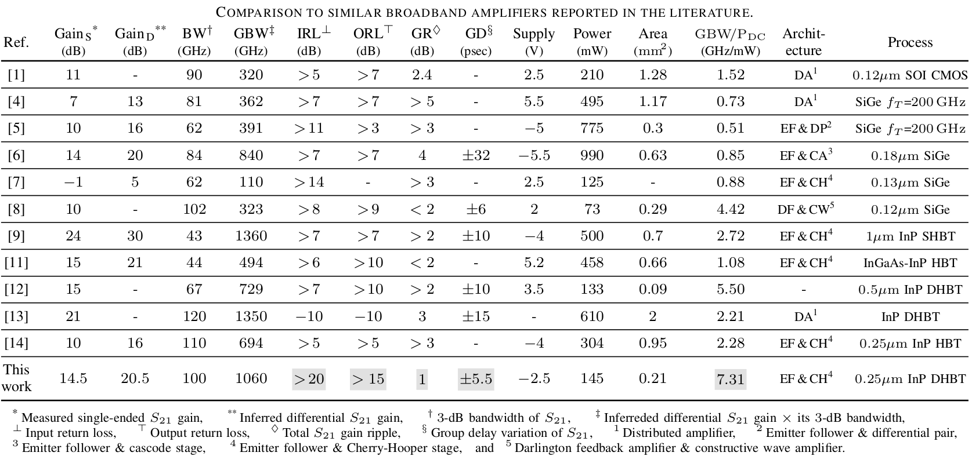
Comparison table

Slide 18
Thank you for your listening

