Slide 1
2013 IEEE Compound Semiconductor IC Symposium, October 13-15, Monterey, C
30% PAE W-band InP Power Amplifiers using Sub-quarter-wavelength Baluns for Series-connected Power-combining
¹H.C. Park, ¹S. Daneshgar, ¹J. C. Rode, ²Z. Griffith, ²M. Urteaga, ³B.S. Kim, ¹M. Rodwell
¹University of California at Santa Barbara
²Teledyne Scientific and Imaging Company
³Sungkyunkwan University
16th October, 2013
hcpark@ece.ucsb.edu
1
Notes:
1

Slide 2
mm-Wave Power Amplifier: Challenges
mm-Wave PAs: applications: High resolution imaging, high speed communication needed: High power / High efficiency / Small die area ( low cost)
Extensive power combining
Compact power-combining
Class E/D/F are poor @ mm-wave insufficient f_{max} , high losses in harmonic terminations efficiency must instead come from combiner
Efficient power-combining
Goal: efficient, compact mm-wave power-combiners
2

Slide 3
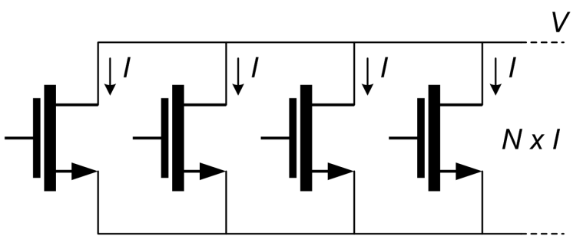
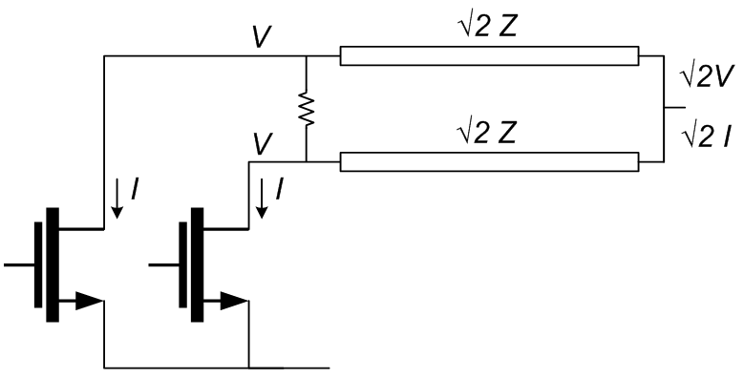
Parallel Power-Combining
Output power: P_{OUT} = N x V x I Parallel connection increases P_{OUT}
Load Impedance: Z_{OPT} = V / (N x I) Parallel connection decreases Z_{opt}
High P_{OUT}→ Low Z_{opt}
Needs impedance transformation: lumped lines, Wilkinson, ...
High insertion loss Small bandwidth Large die area
3

Slide 4
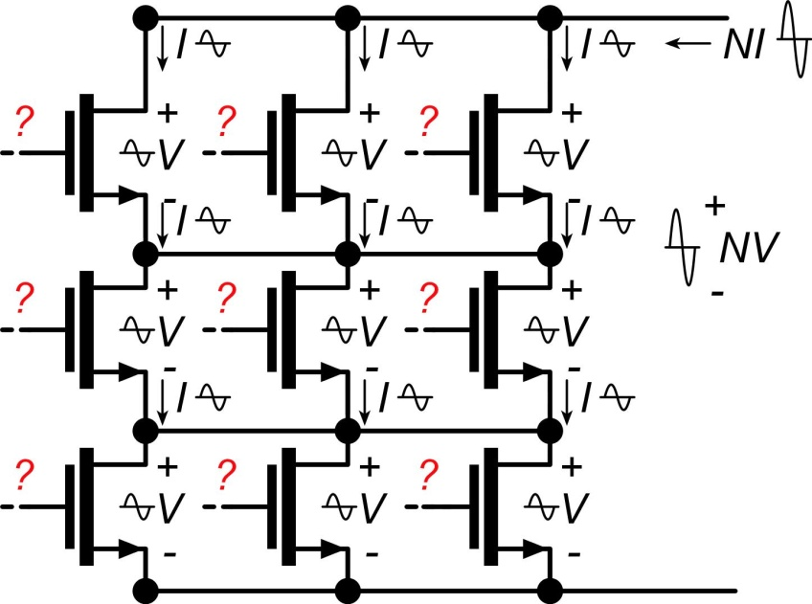
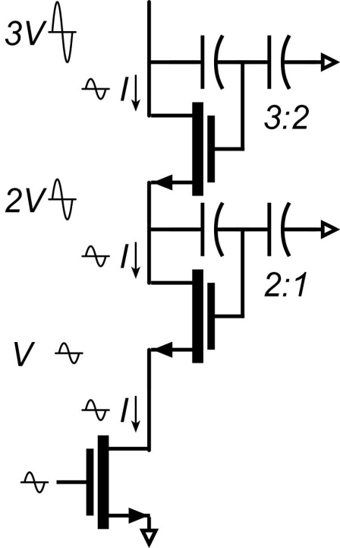
Series Power-Combining & Stacks
Parallel connections: I_{out}=N x I Series connections: V_{out}=N x V
Output power: P_{out}=N² x V x I Load impedance: Z_{opt}=V/I Small or zero power-combining losses Small die area How do we drive the gates ?
Local voltage feedback: drives gates, sets voltage distribution
Design challenge: need uniform RF voltage distribution need ~unity RF current gain per element
...needed for simultaneous compression of all FETs.
4

Slide 5
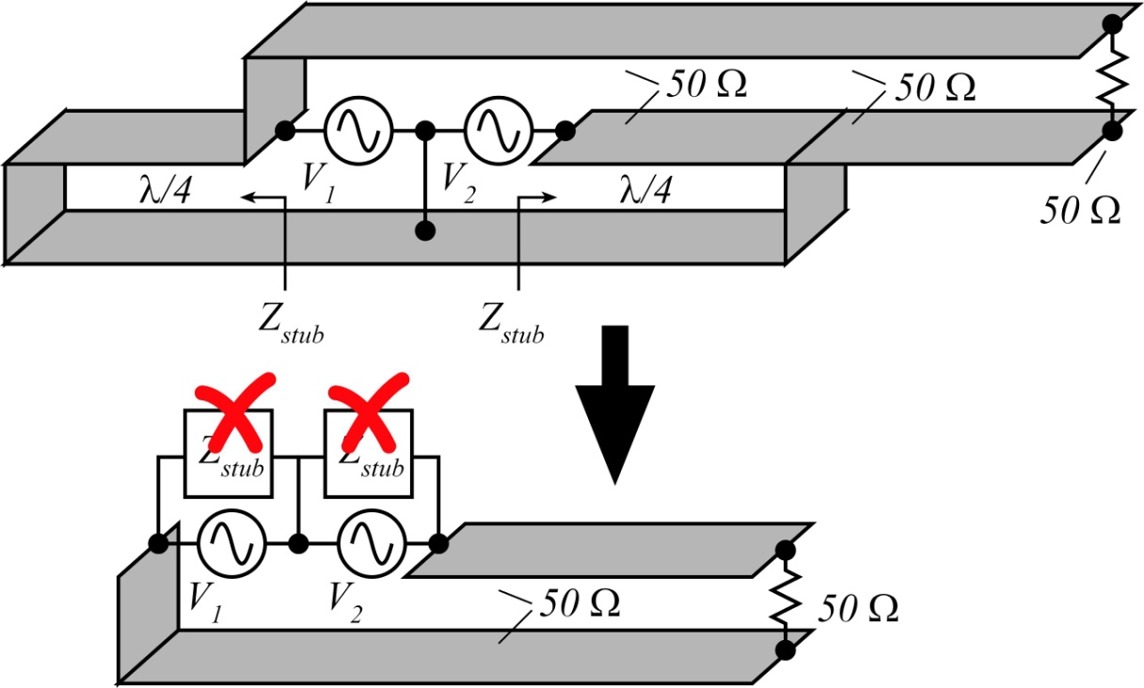
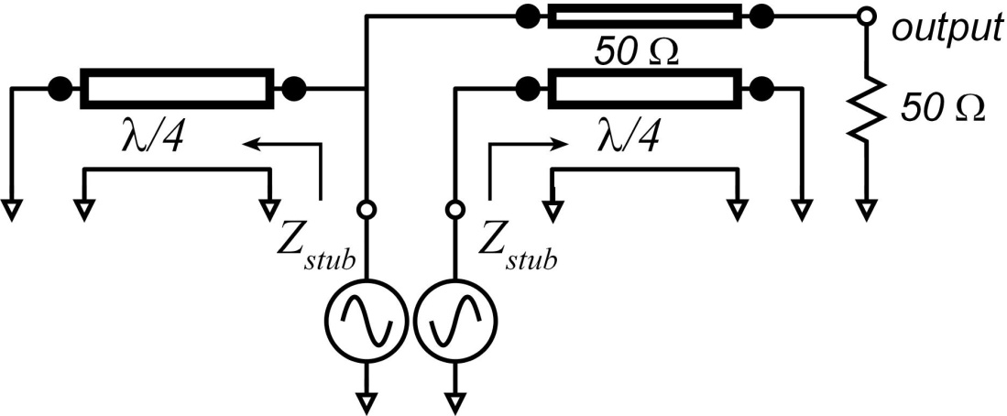
Standard λ/4 Baluns: Series Combining
Balun combiner: voltages add 2:1 series connection each source sees 25 Ω → double I_{max} for each source 4:1 increased P_{out}
Standard λ/4 balun : λ/4 stub→ open circuit long lines→ high losses long lines → large die
5

Slide 6
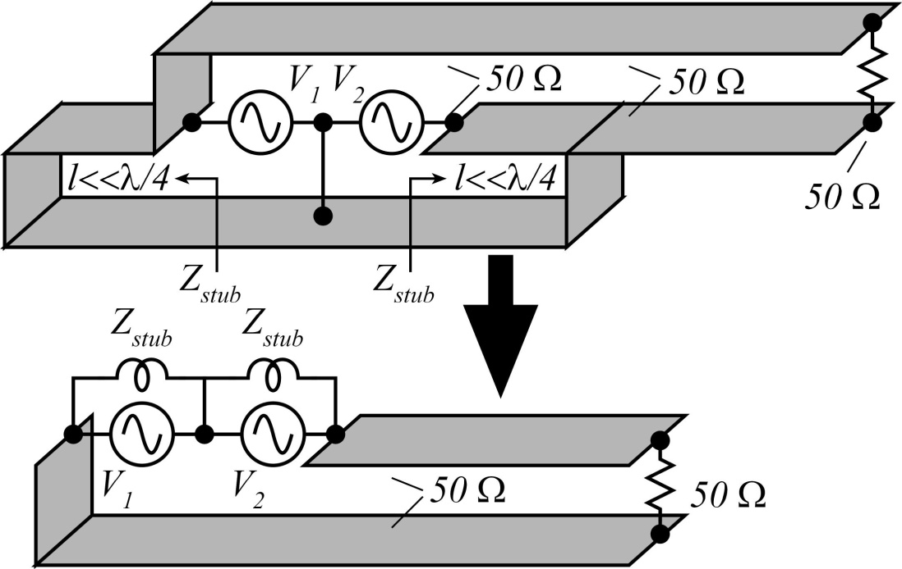
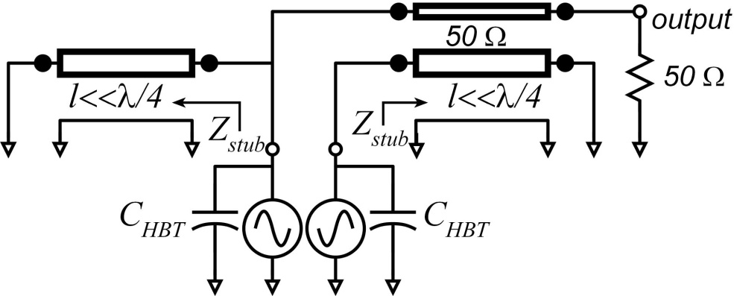
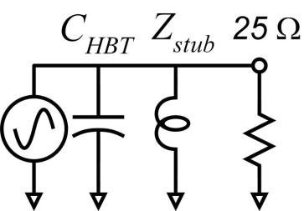
Sub-λ/4 Baluns for Series Combining
What if balun length is <<λ/4 ? Stub becomes inductive !
Sub-λ/4 balun : stub→ inductive tunes transistor C_{out} ! short lines→ low losses short lines → small die
6

Slide 7
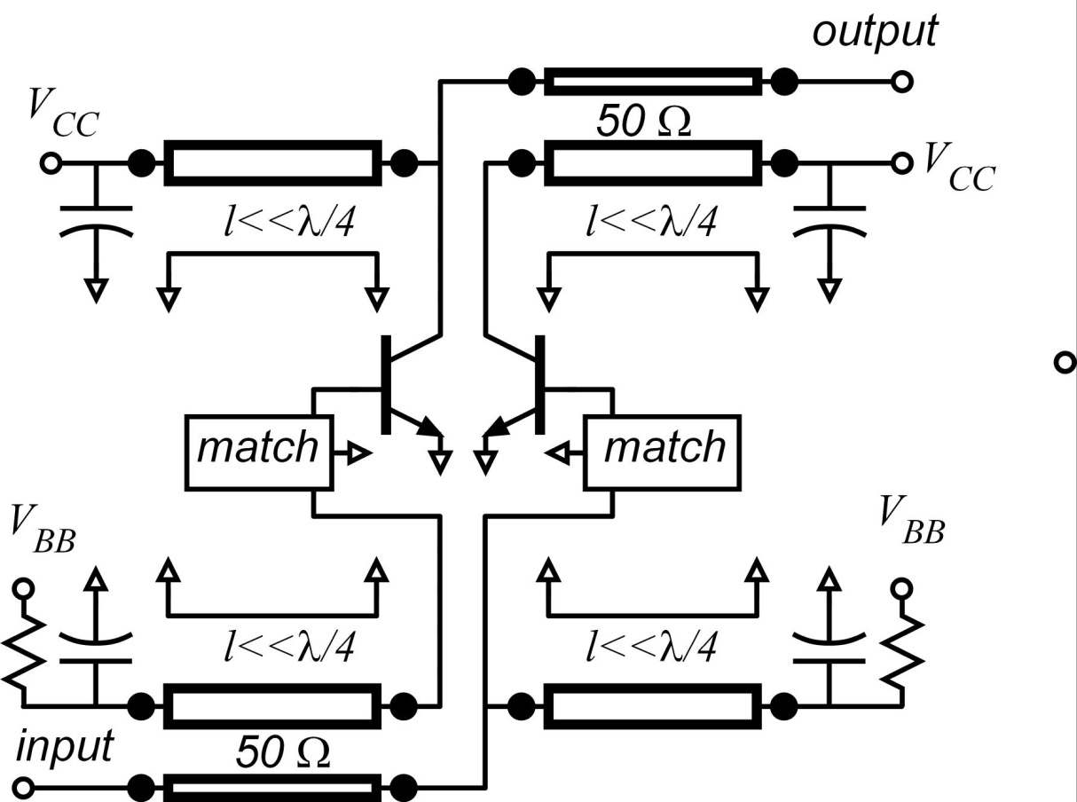
Sub-λ/4 Baluns for Series Combining
2:1 baluns: 2:1 series connection
Each device loaded by 25Ω → HBTs are 2:1 larger than needed for 50Ω load. → 4:1 increased P_{out}.
Sub λ/4 balun: inductive stub balun inductive stub tunes HBT C_{out}.
Similar network on input.
7

Slide 8
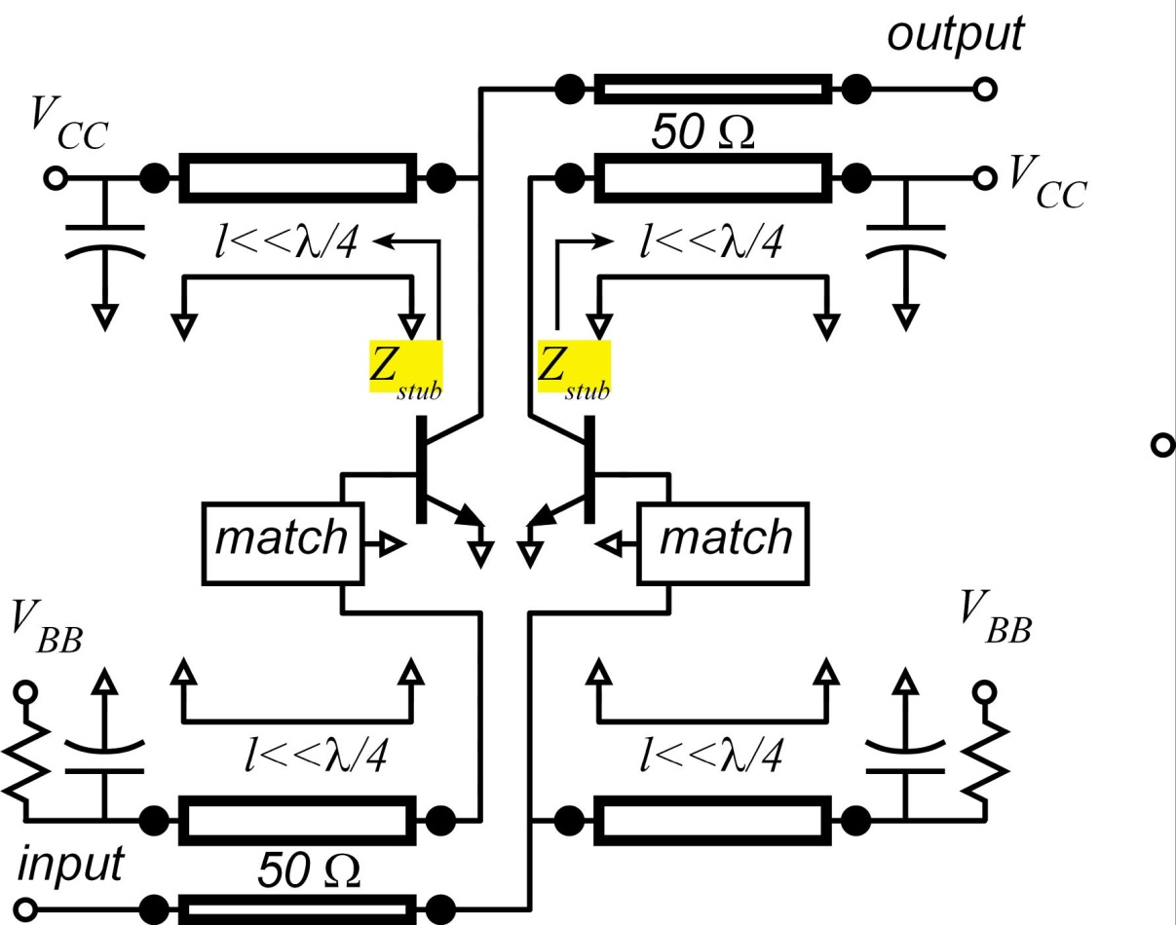
Sub-λ/4 Balun Series-Combiner: Design
Each HBT loaded by 25Ω HBT junction area selected so that I_{max}=V_{max}/25Ω
Each HBT has some C_{out} . Stub length picked so that Z_{stub}=-1/jωC_{out} → tunes HBT
4:1 more power than without combiner.
8

Slide 9
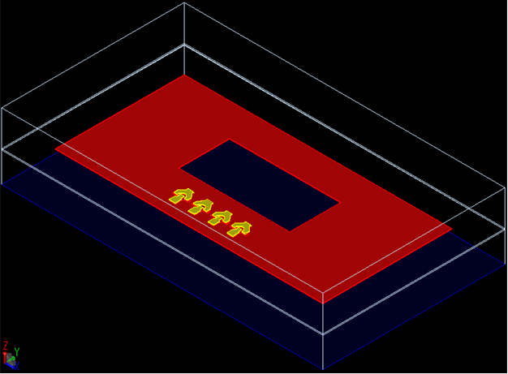
Balun Configurations in PA ICs
Step 1
GND (M₁)
TRs
2 (diff.) x 8 finger TR cells + GND (M₁)
9

Slide 10
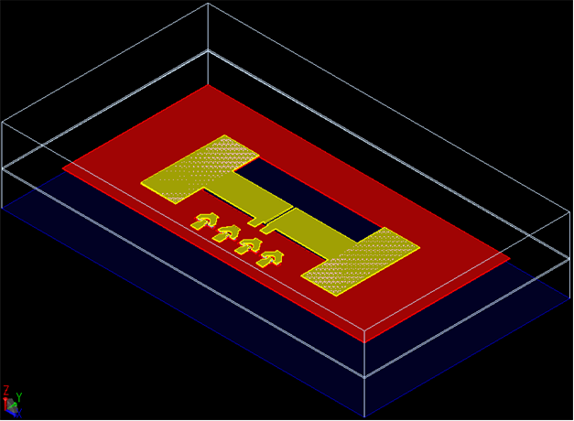
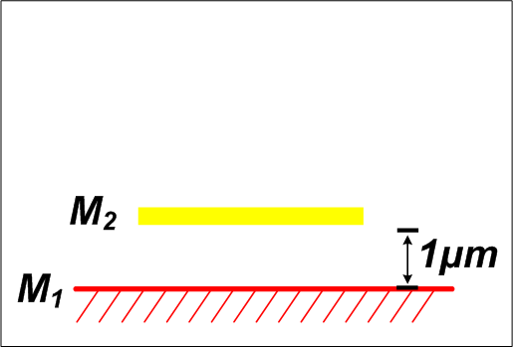
Balun Configurations in PA ICs
Step 2
GND (M₁)
GND (M₁)
CAP
M₂
TRs
TRs
CAP
10

Slide 11
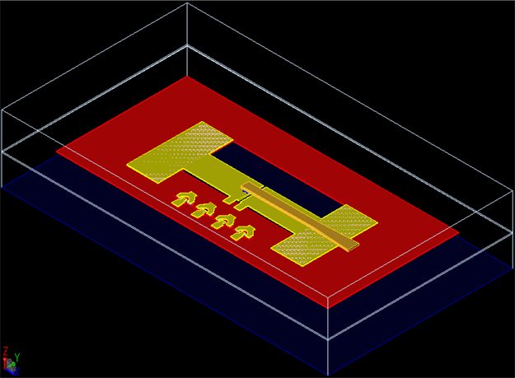
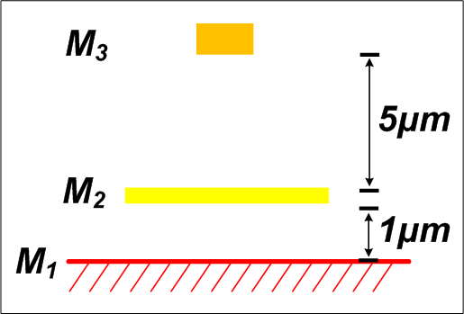
Balun Configurations in PA ICs
Step 3
GND (M₁)
CAP
M₂
CAP
TRs
M₃
M₂–M₃ Microstrip transmission lines
But, E-fields between M₃-M₁ are not negligible !!
11

Slide 12
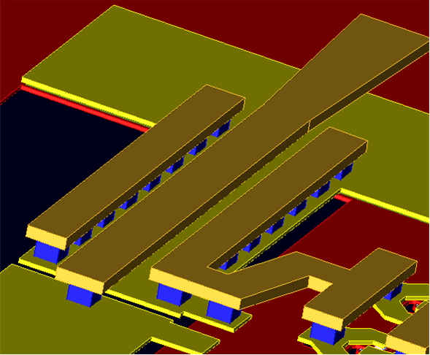
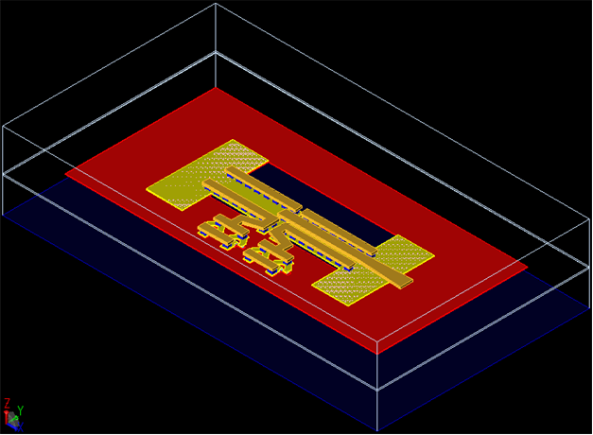
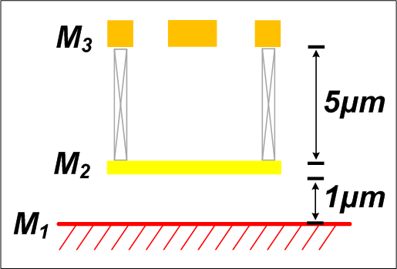
Balun Configurations in PA ICs
Step 4
CAP
M₃
sidewall
sidewall
GND (M₁)
TRs
CAP
M₂
Walls M₂-M₃
CAP
TRs
M₃
M₃–M₁ E-field shield using sidewalls
→ Well-balanced balun with short length (λ/16)
12

Slide 13
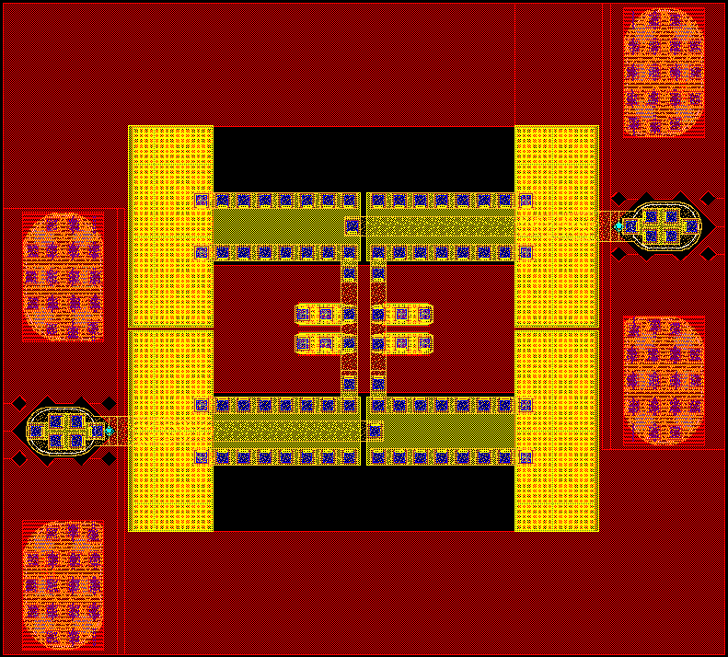
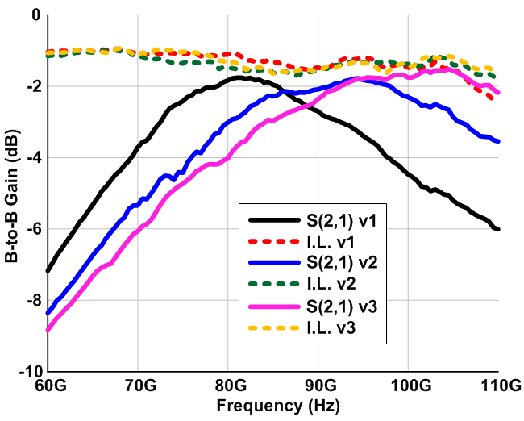
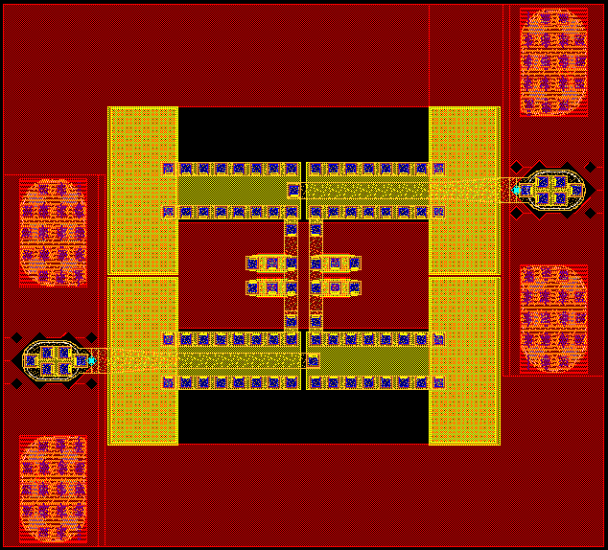
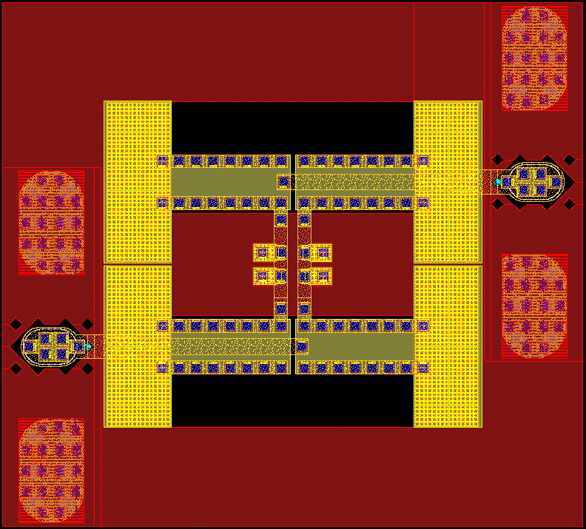
2:1 Balun Test Results
v1
C_{P} = 103fF
F_{C} = 81GHz
I.L. = -1.1dB
S21 = -1.76dB
Back-to-back measured S-parameters
v2
C_{P} = 78fF
F_{C} = 94GHz
I.L. = -1.2dB
S21 = -1.79dB
v3
C_{P} = 65fF
F_{C} = 103GHz
I.L. = -1.2dB
S21 = -1.56dB
*Does not de-embed losses of PADs , capacitors, and interconnection lines
0.6~0.8 dB single-pass insertion loss (used for 4:1 power combining)
13

Slide 14
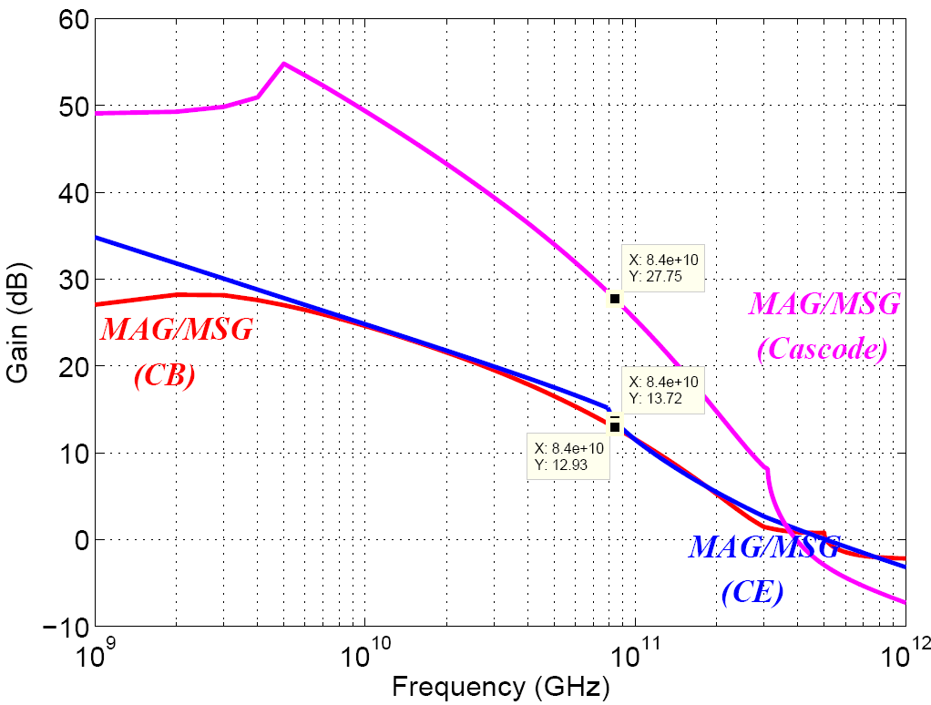
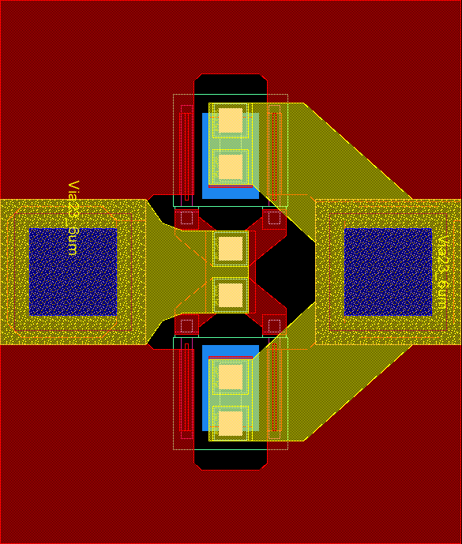
InP HBT (Teledyne 250nm HBT)
cell: 0.25μm x 6μm x 4-fingers
BV_{CEO} = 4.5V , I_{C,max} = 72mA
P_{out} = 15.5dBm
R_{opt} = 56Ω
MAG/MSG including EM-Momentum results
Emitters to GND
Base
Collector
350GHz f_{τ}, 590GHz f_{max}@ J_{E}=6mA/μm²
Courtesy: Teledyne
Science Company
~13dB MAG @ 85 GHz
14

Slide 15
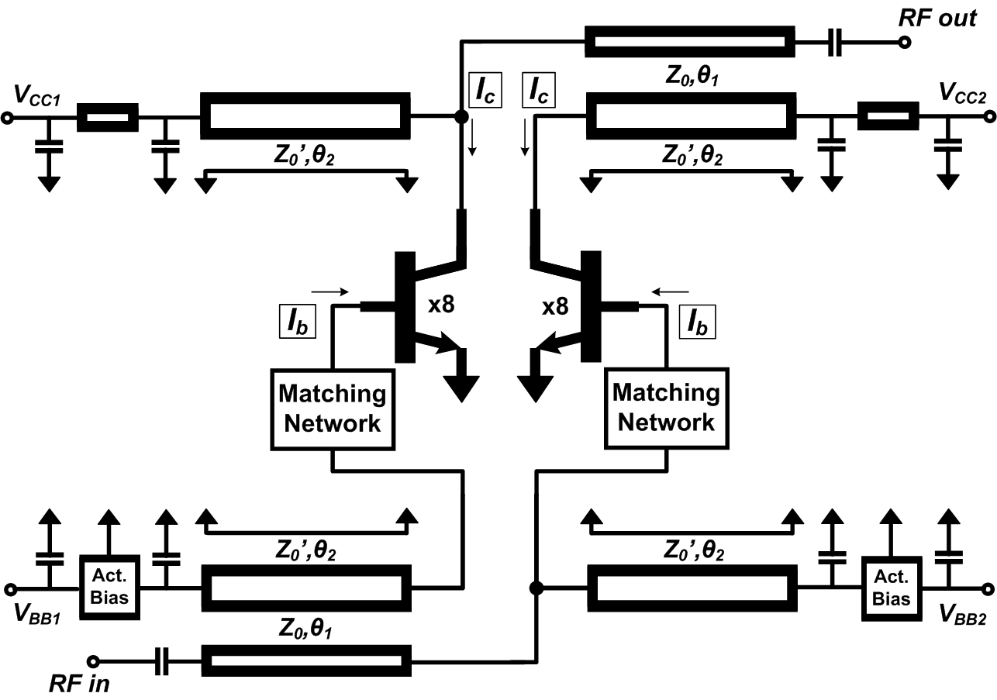
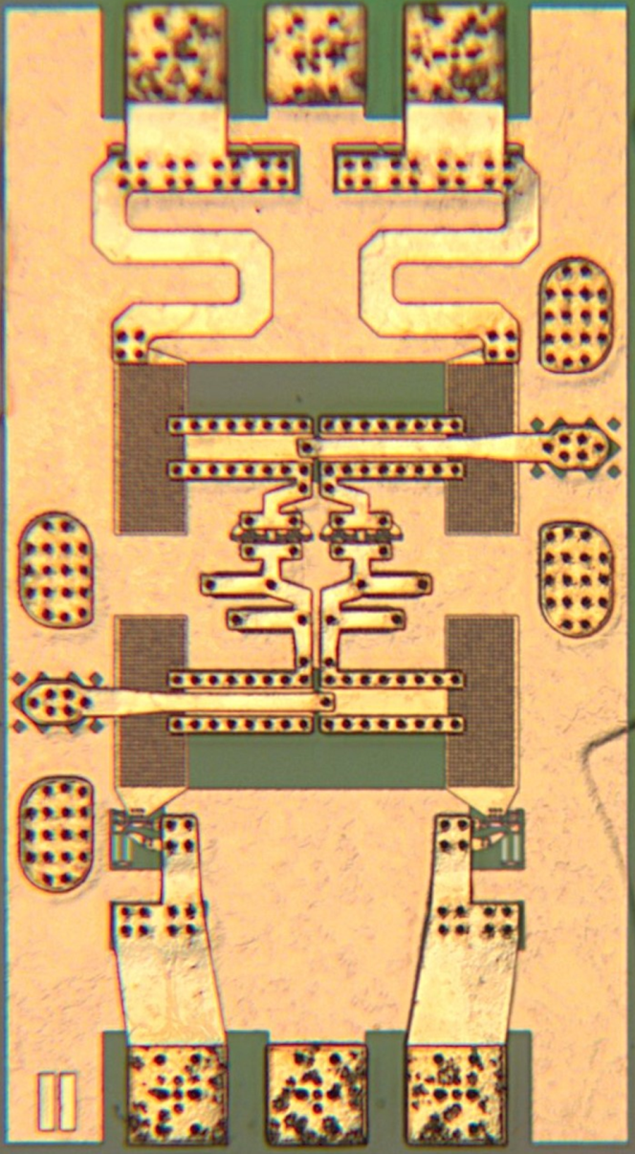
PA Designs Using 2:1 Balun
Identical input / output baluns
2-stage input matching networks
Active bias – thermal / class-AB
15

Slide 16
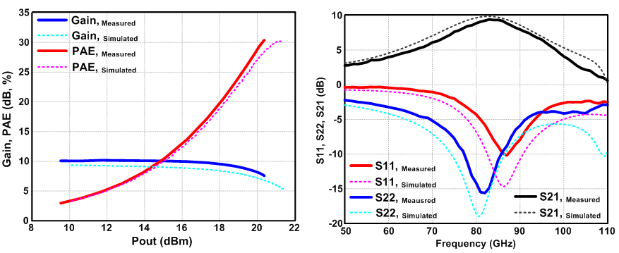
Single-Stage PA IC Test Results (86GHz)
10dB Gain, >100mW P_{SAT}, >30% PAE, 23GHz 3dB-bandwidth
Power per unit IC die area* =294 mW/mm² (if pad area included) =723 mW/mm² (if pad area not included)
16

Slide 17
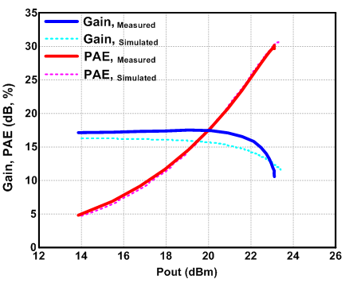
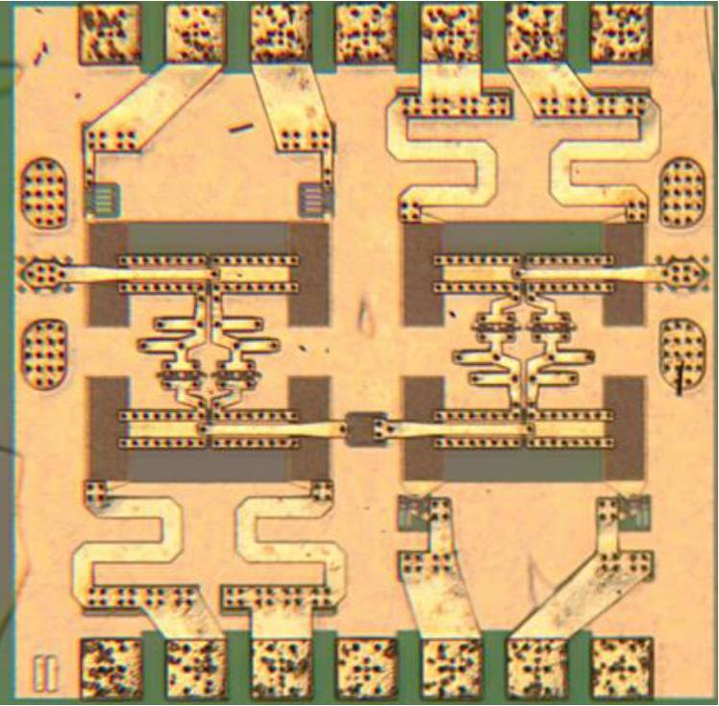
Two-Stage PA IC Test Results (86GHz)
17.5dB Gain, >200mW P_{SAT}, >30% PAE
Power per unit IC die area* =307 mW/mm² (if pad area included) =497 mW/mm² (if pad area not included)
17

Slide 18
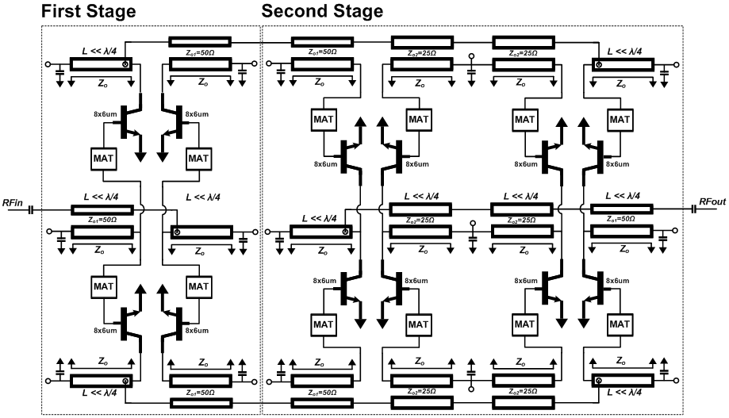
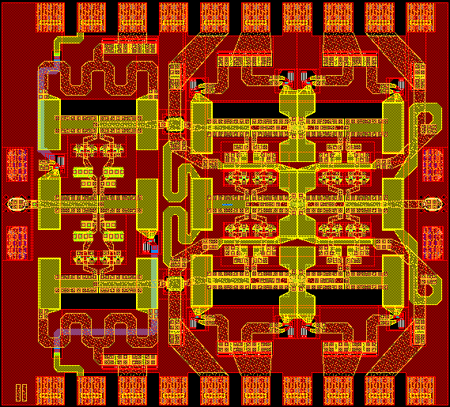
800 mW 1.3mm² Design Using 4:1 Baluns
Baluns for 4:1 series-connected power-combining
4:1 Two-Stage Schematic
4:1 Two-Stage Layout (1.2x1.1mm²)
Small-signal data looks good. Need driver amp for P_{sat} testing.
18

Slide 19
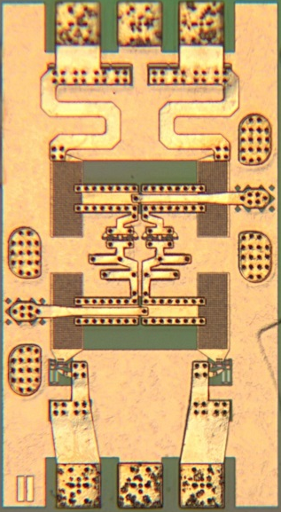
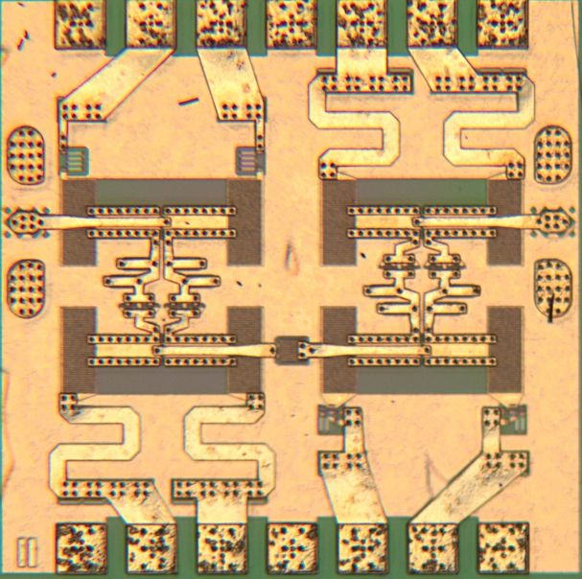
Sub-λ/4 Baluns for Series Combining
Series combining using sub-λ/4 baluns Low-loss (~0.6 dB @85GHz) → high efficiency Compact→ small die area 2:1 baluns→ effective 2:1 series connection 4:1 increase in output power.
W-band power amplifiers using 2:1 baluns Record >30% PAE @ 100mW, 200mW Record 23 GHz 3-dB bandwidth Record 723mW/mm² power density
Completed new designs in test Higher-efficiency ~200 mW, 85 GHz designs 4:1 balun design: goal 800 mW, 85 GHz, 1.3 mm² 220 GHz 4:1 balun design has been taped out
450 x 820 um²
825 x 820 um²
19

Slide 20
Thanks for your attention!
Questions?
hcpark@ece.ucsb.edu

