Slide 1
Performance Impact of Post-Regrowth Channel Etching on InGaAs MOSFETs Having MOCVD Source-Drain Regrowth
Andrew D. Carter¹, S. Lee¹, D.C. Elias¹, C.-Y. Huang¹, J. J. M. Law¹, W. J. Mitchell¹, B. J. Thibeault¹, V. Chobpattana², S. Stemmer², A. C. Gossard¹, and M. J. W. Rodwell¹
¹ECE Department, ²Materials Department,
University of California, Santa Barbara, CA 93106
Device Research Conference 2013
Notre Dame, Indiana
6/24/2013

Slide 2
Overview
Why III-V for VLSI?
Device Physics and Scaling
Process Flows
Measurements
Conclusions

Slide 3
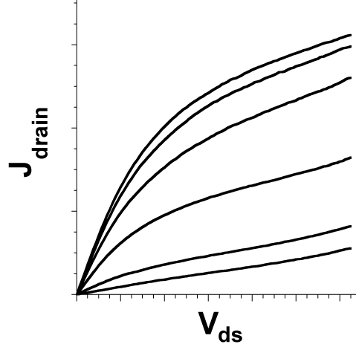
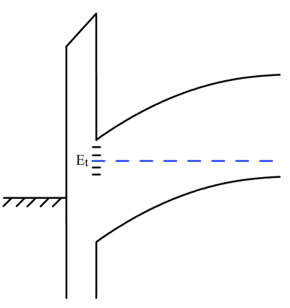
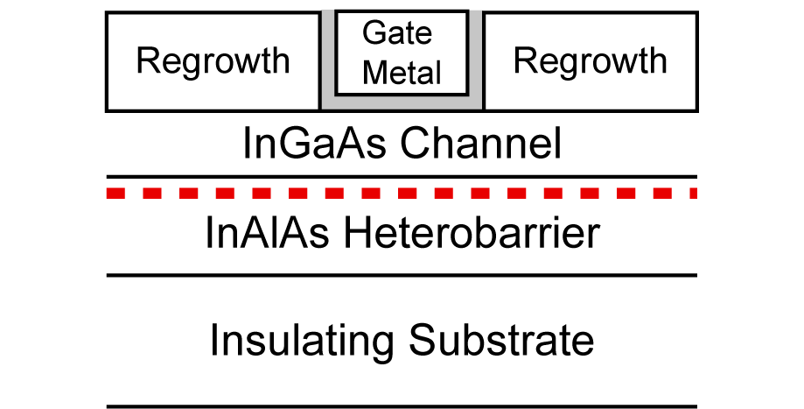
Why III V VLSI?
J_{d,max}
1/R_{on}
Higher electron velocities than Si MOS
  For short L_{g} FETs,
  Transconductance,
  J_{d} and g_{m} are key figures of merit in VLSI
However:
  J_{d} and g_{m} degraded by source large R_{access}
  J_{d} and g_{m} degraded by interface trap density, D_{it}
Therefore, we must develop:
  Low access resistance source/drain contacts
  Thin, high-k, low D_{it} dielectrics on InGaAs
  Fully self-aligned process modules
g_{m}
MOSFETs have been, and always will be, a materials challenge.

Slide 4
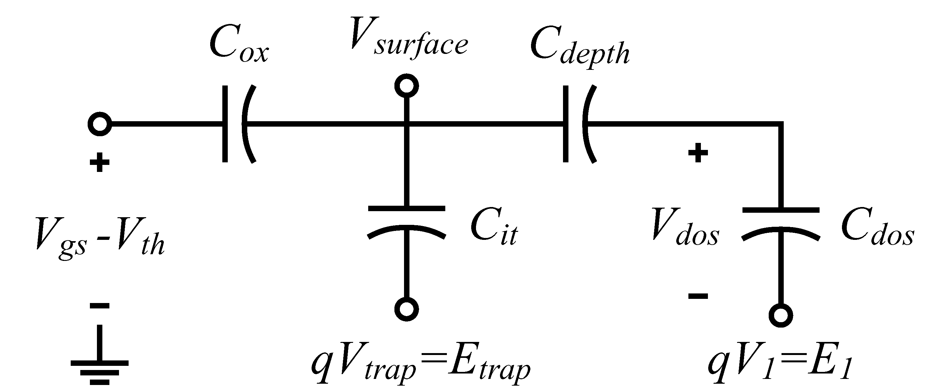
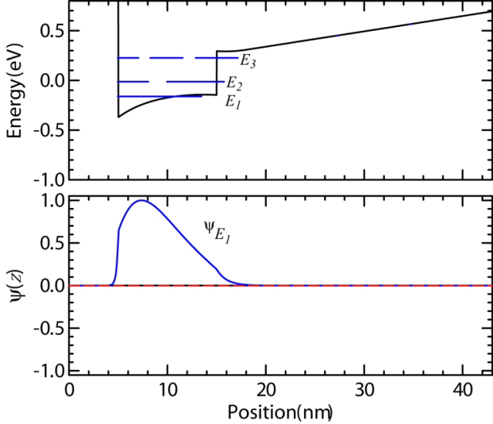
FET Device Physics
D_{it} problem
  ↑C_{it} , ↓ V_{surface}
  V_{surface} supplies C_{dos}
  ↓ V_{surface} =↓ n_{dos} in C_{dos}
Electron band diagram: gate-insulator-channel

Slide 5
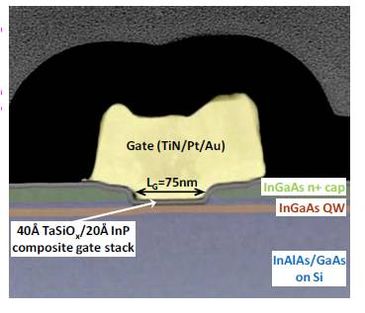
Candidate III-V Planar Geometries
Intel IEDM 2009
“Trench” MOSFET
Leverages HEMT tech.
Gate oxide → Low I_{g} ☺
Small footprint ☺
But
Will the L_{g} scale?
Replacement Gate MOSFET
Easily defined L_{g} ☺
Gate oxide ☺
Small footprint ☺
But
Is RG doping high enough?
DRC 2013

Slide 6
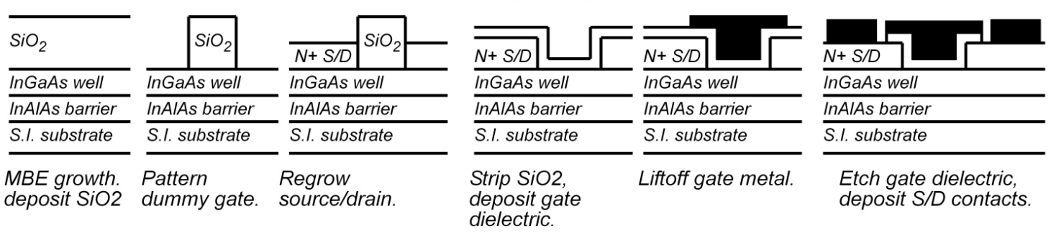
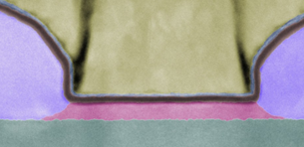
Gate Replacement FET Process Flow
MBE S/D Regrowth
Low-damage process
Thermal gate metal
No/Low-damage plasma
Dielectric post-regrowth
Nickel Gate Metal
InAs
S/D
100 nm L_{g}
10 nm Thick Well
InAlAs Back Barrier
STEM FET cross section, color-coded by chemistry
Figure courtesy Jeremy Law (UCSB)
6
DRC 2013

Slide 7
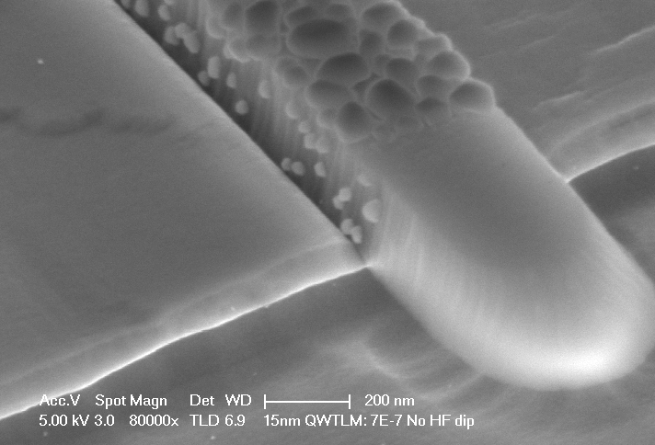
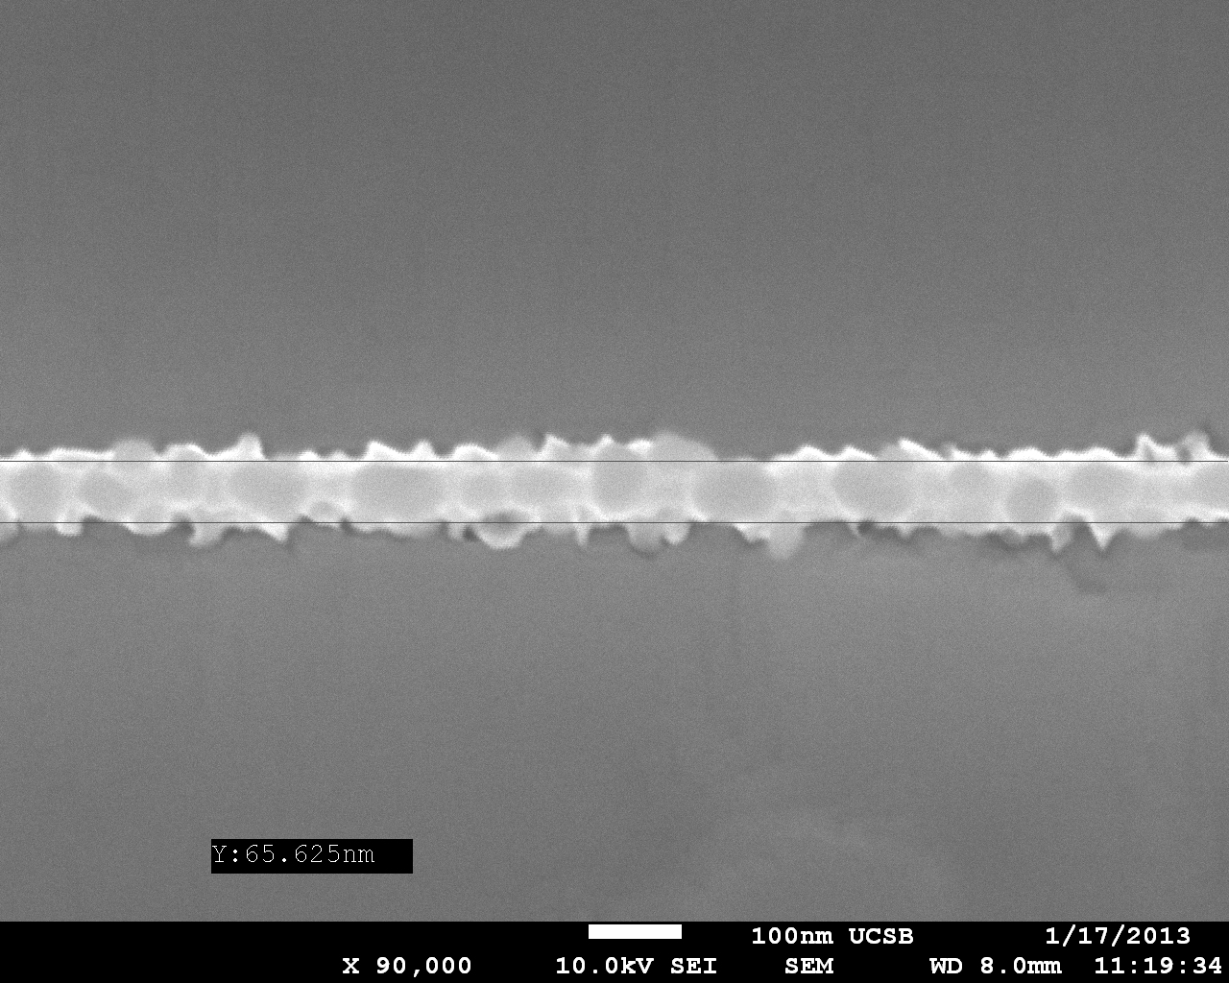
Gate Replacement FET Challenges
SEM of dummy gate
MBE regrowth is non-selective → requires photoresist planarization
DRC 2013

Slide 8
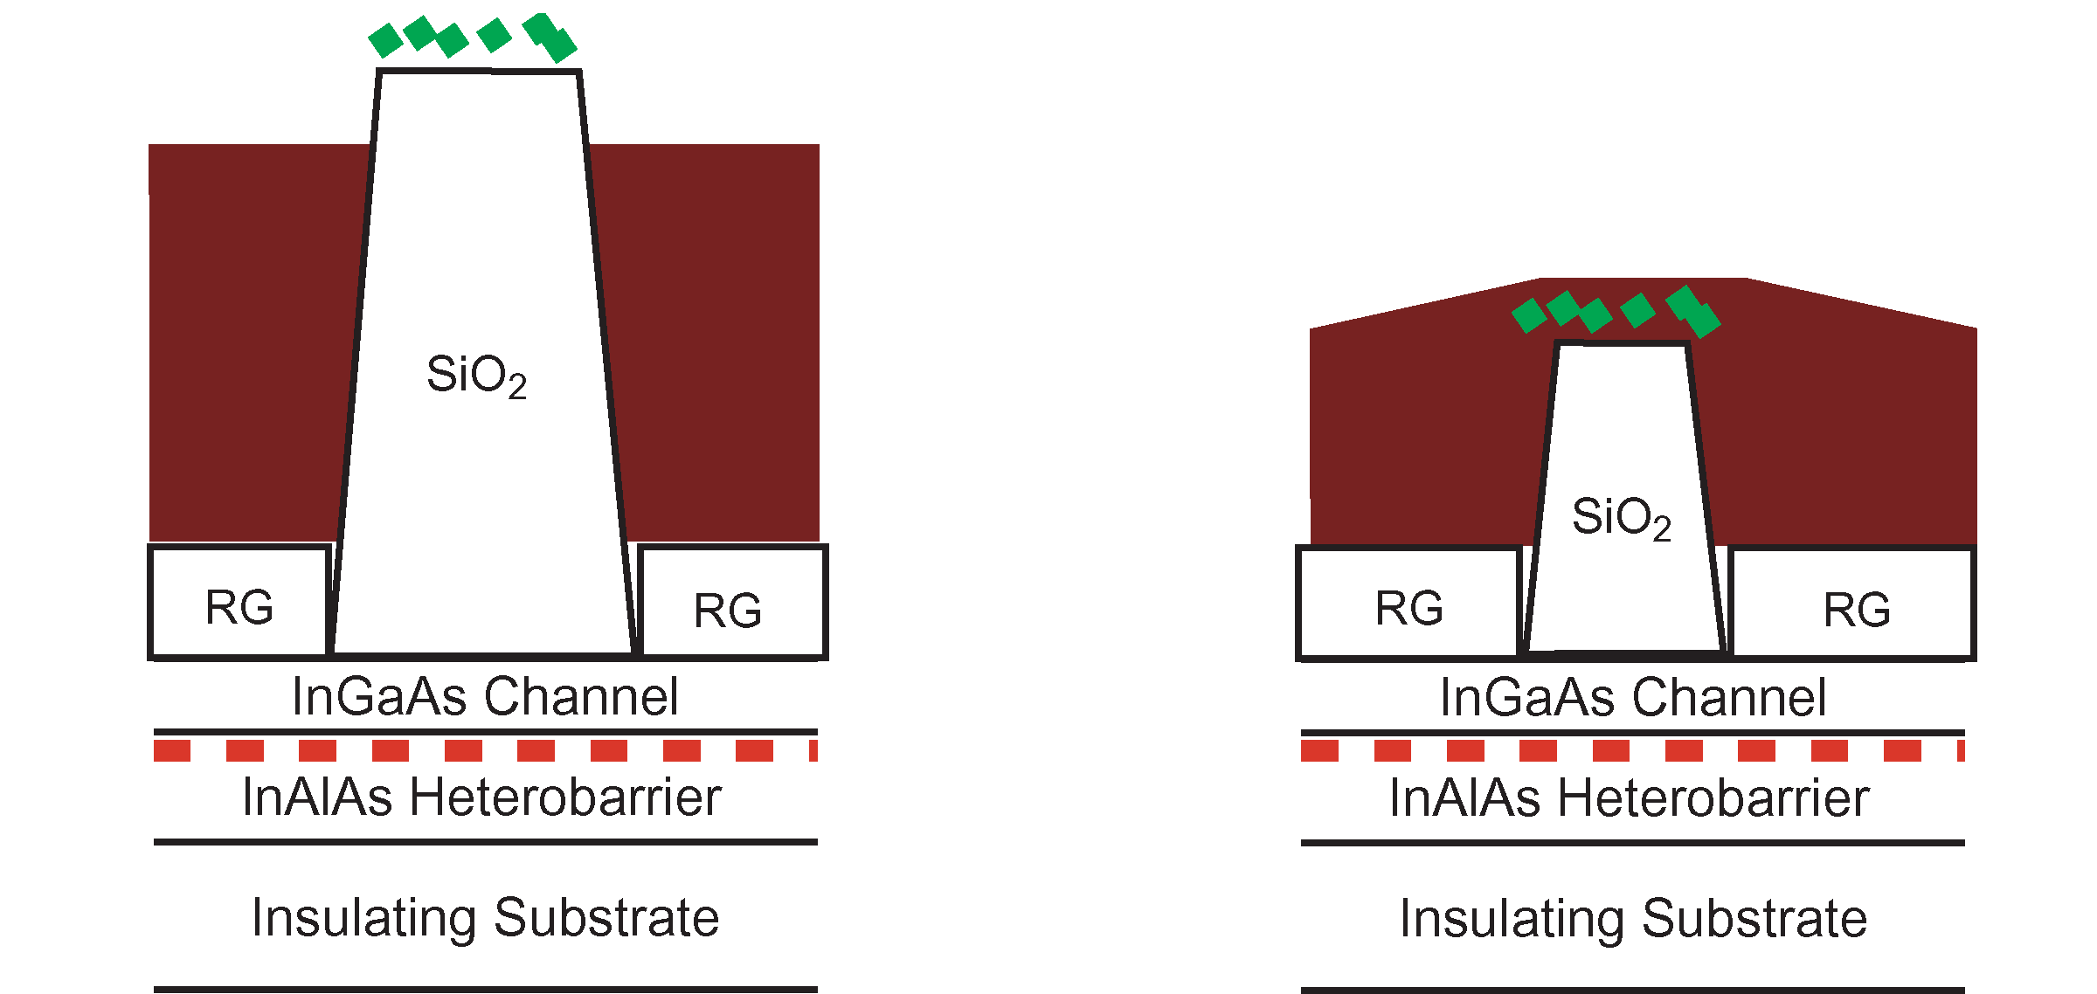
Gate Replacement FET Challenges
Regrowth
Photoresist
Short dummy gates are hard to planarize, aspect-ratio-limited gate length
DRC 2013

Slide 9
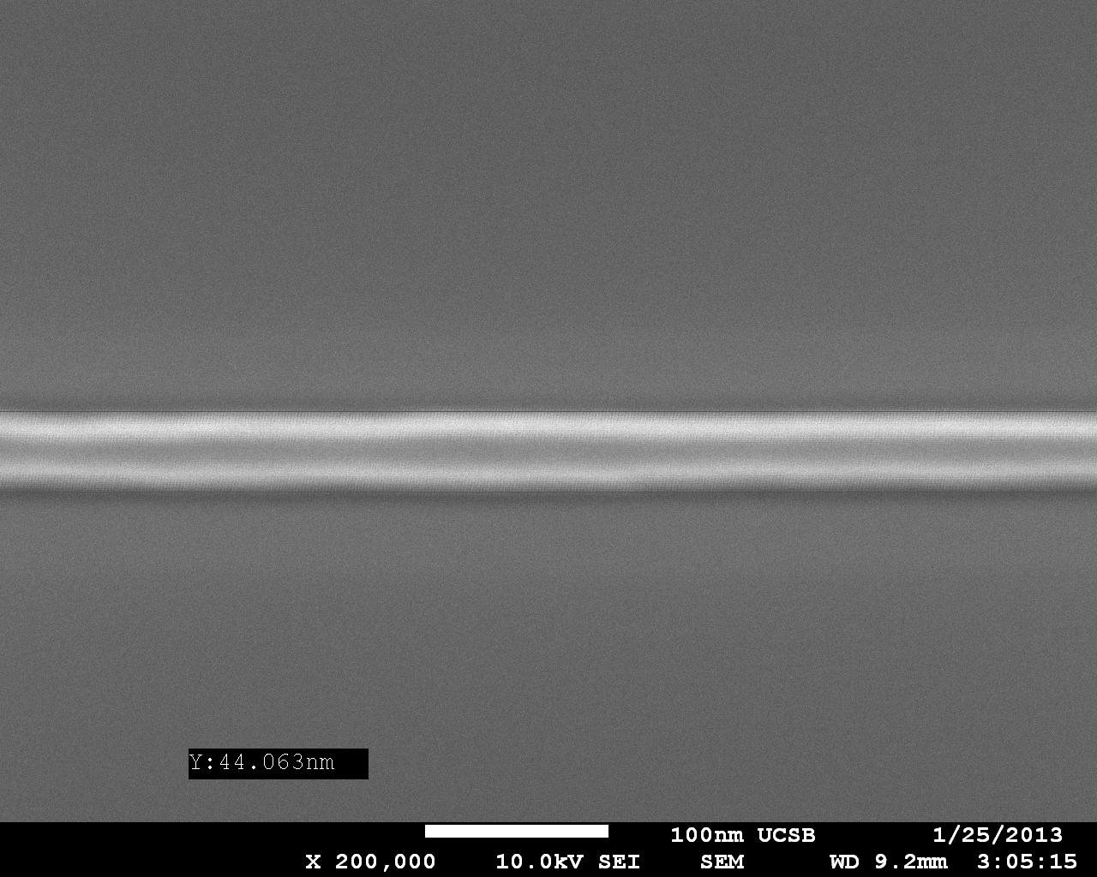
Solution: MOCVD S/D Regrowth *
MBE InAs RG
MOCVD InGaAs RG
MBE is non-selective to the SiO₂ pillar, while MOCVD is selective!
→ PR planarization no longer necessary → short L_{g} that will not fall over
* Terao et al, APEX 2011, and Egard et al, DRC 2011
DRC 2013

Slide 10
MBE Versus MOCVD S/D Regrowth
81 nm L_{g}, (1 nm Al₂O₃/ 4 nm HfO₂), 10 nm channel, MBE InGaAs Regrowth
68 L_{g}, (1 nm Al₂O₃/ 4 nm HfO₂), 10 nm channel, MOCVD InGaAs Regrowth
result
DRC 2013
Similar on-state performance, but large Vth shift, poor SS, DIBL

Slide 11
Poor subthreshold: Channel Degradation
> 300 mV/dec subthreshold swing → D_{it} ? Channel degradation?
Experiment: SiO₂ capping + high temp anneal + strip → MOSCAP 5 nm Al₂O₃
Large dispersion → Large D_{it}
InP channel capping for RG → large subthreshold swing for FETs ☹
DRC 2013

Slide 12
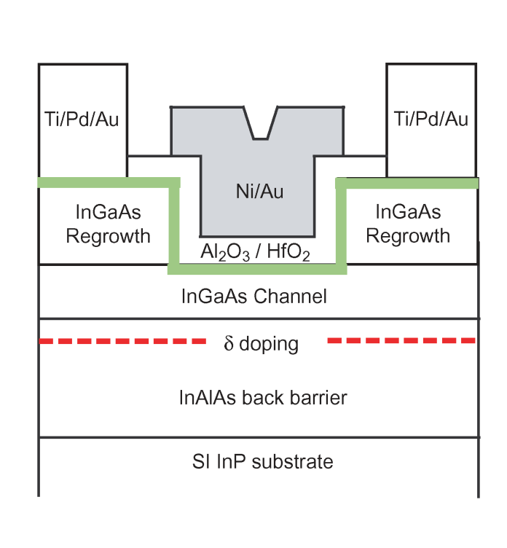
MOCVD: Digital Channel Etching
Digital semiconductor etching*
Before ALD deposition:
Oxidize channel surface (UV O₃)
Etch oxide in HCl:DI
Repeat as needed
Etches ~ 1.2 nm per cycle
Top-down thin channels → Increase C_{depth}
Simultaneous damage removal and body scaling
* S.Lee et al, IPRM 2013
DRC 2013

Slide 13
MOCVD RG with Digital Channel Etching
68 nm actual L_{g}, (1 nm Al₂O₃/ 4 nm HfO₂), No digital etching (~ 10 nm channel)
65 nm actual L_{g}, (1 nm Al₂O₃/ 4 nm HfO₂) 2 cycles of digital etching (~ 6.5 nm channel)
result
All devices improve with channel etch → thinner channel, remove surface damage

Slide 14
MOCVD RG with Digital Channel Etching
Peak transconductance (mS/micron):
50 nm as drawn gate length, 0.5 V V_{gs}
No Etching (10 nm ch.)
2 Cycle Etching (~6.5 nm ch.)
 |  |  | gm map
1 | 1.10 | 0.90
2 | 0.89 | 0.92 | 1.00
3 | 0.93 | 0.90 | 1.10
4 | 1.01 | Blank | 1.09 | 0.91 | 1.16
5 | Open | 1.01 | 1.11 | 1.03 | 0.92 | 1.05
6 | 0.99 | 1.00 | 0.96 | Open | 0.88 | Open
 | A | B | C | D | E | F
 |  |  | gm map
1 | 1.38 | 1.50
2 | 1.50 | 1.45 | 1.51
3 | 1.50 | 1.21 | 1.53 | 1.53
4 | 1.38 | Blank | 1.45 | 1.53 | 1.48
5 | 1.15 | 1.58 | 1.42 | 1.36 | 1.26 | 1.47
6 | 1.09 | 1.38 | 1.42 | 1.47 | 1.39 | 1.50
 | A | B | C | D | E | F
result
All devices improve with channel etch → thinner channel, remove surface damage

Slide 15
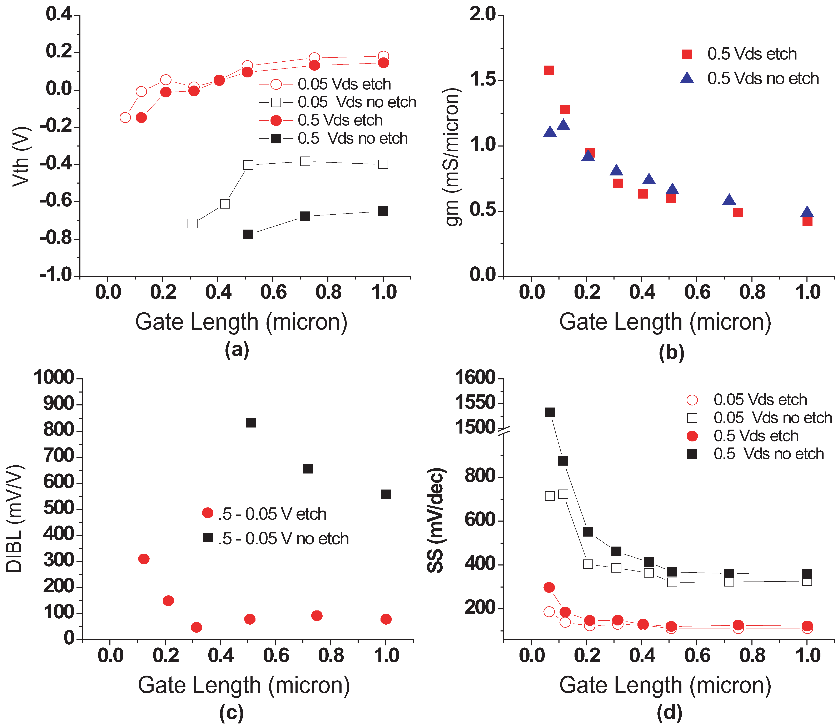
MOCVD RG with Digital Channel Etching
result
All devices improve with channel etch → thinner channel, remove surface damage

Slide 16
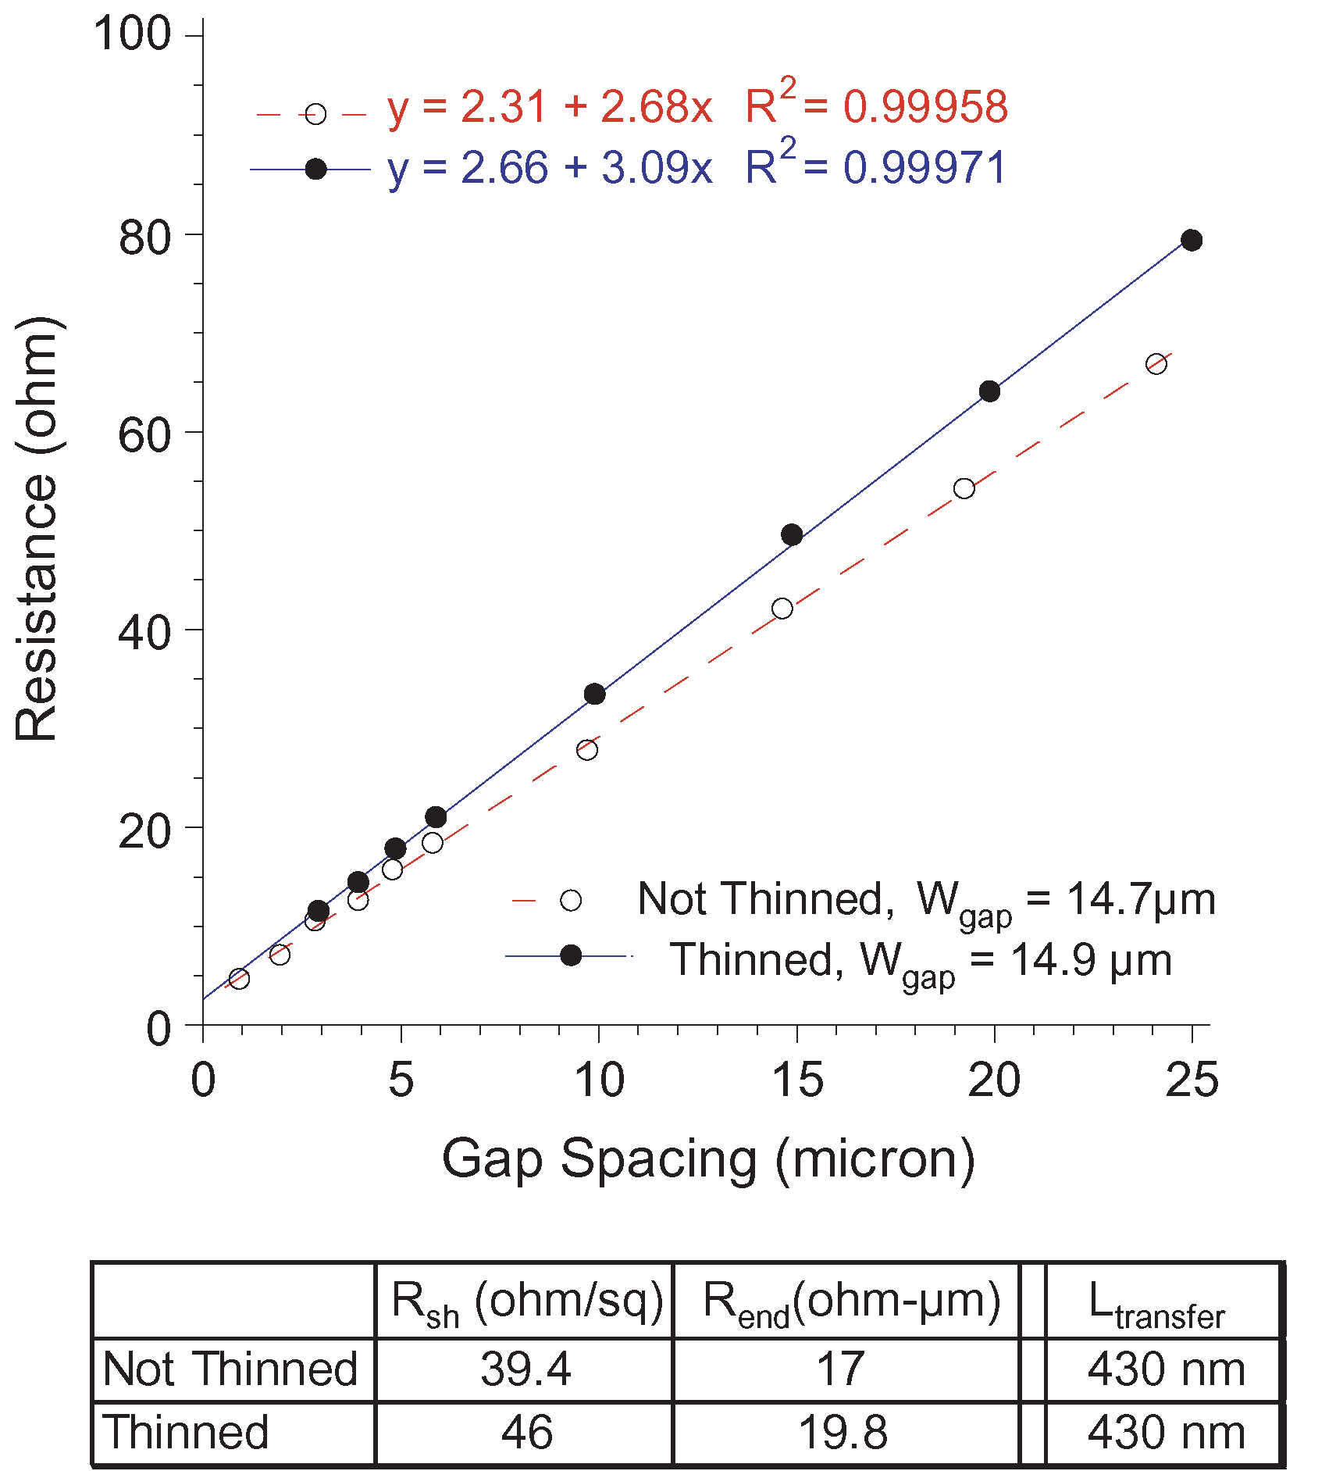
MOCVD RG with Digital Channel Etching
result
DRC 2013
Lower performance for not etched channels not due to metal-RG contact

Slide 17
MOCVD RG: Recent Results
48 nm gate length, ~ 3.8 nm HfO₂, InGaAs with 2 cycle digital etching, p-doped back barrier
40 nm gate length, ~ 3.6 nm HfO₂ , InAs/InGaAs channel, digitally etched *
* S. Lee et al, VLSI 2013
High performance III-V MOS using aggressively scaled ALD dielectrics

Slide 18
Conclusions
65 nm gate last InGaAs MOSFET process flow using MOCVD
J_{drain} = 0.78 mA/μm at 0.5 V V_{gs} – V_{th} , 0.5 V V_{ds}
Peak transconductance: 1.58 mS/micron at 0.5 V V_{ds}
Self-aligned process path for sub-50 nm III-V VLSI
Continued research areas
Thinner gate dielectrics
  Body scaling (thin planar QW and/or FinFETs)
  Improved D_{it} passivation techniques

Slide 19
Thanks for your time!
Questions? contact address: adc [at] ece.ucsb.edu
This research was supported by the SRC Non-classical CMOS Research Center (Task 1437.009).
A portion of this work was done in the UCSB nanofabrication facility, part of NSF funded NNIN network and
MRL Central Facilities supported by the MRSEC Program of the NSF under award No. MR05-20415.

Slide 20
BACK UP SLIDES

Slide 21
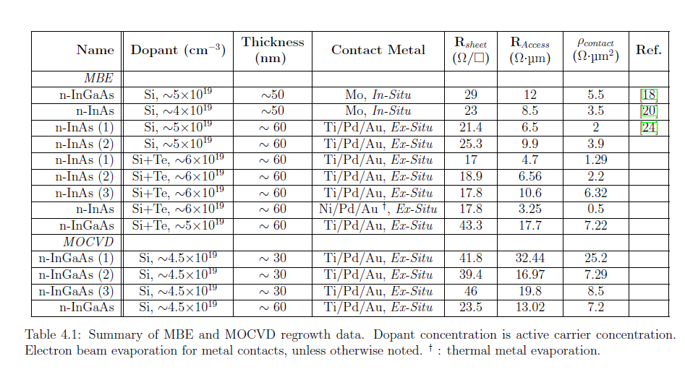
Source-Drain Regrowth Data

Slide 22
MOCVD RG: Recent Results
48 nm gate length, ~ 3.8 nm HfO₂, InGaAs with 2 cycle digital etching, p-doped back barrier
40 nm gate length, ~ 3.6 nm HfO₂ , InAs/InGaAs channel, digitally etched *
* S. Lee et al, VLSI 2013
High performance III-V MOS using aggressively scaled ALD dielectrics

Slide 23
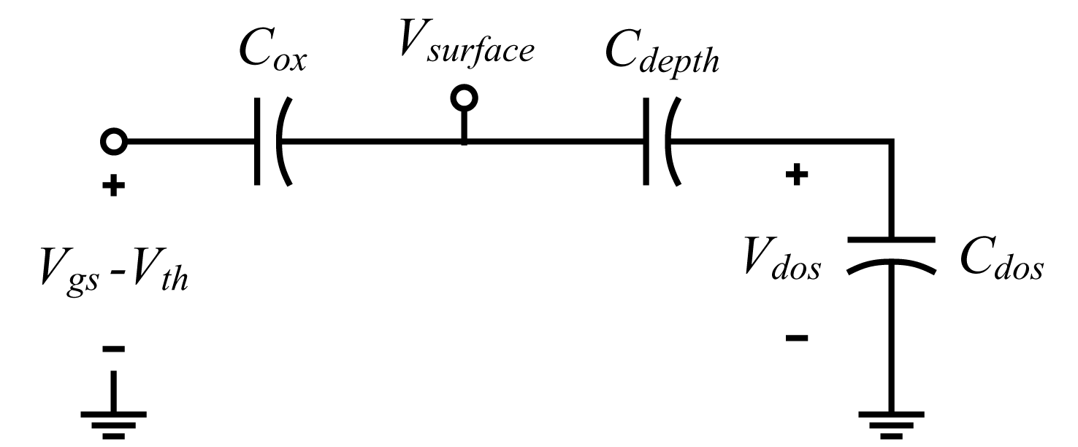
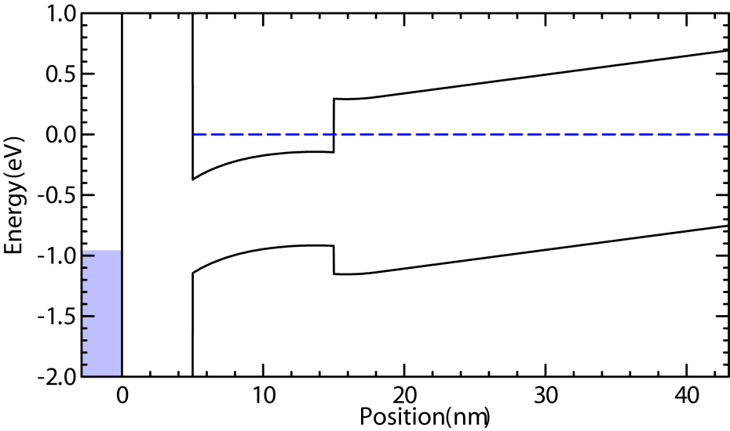

FET Device Physics
*C_{effective} includes C_{ox}, C_{depth}, C_{dos}
Electron band diagram of a quantum well FET

Slide 24
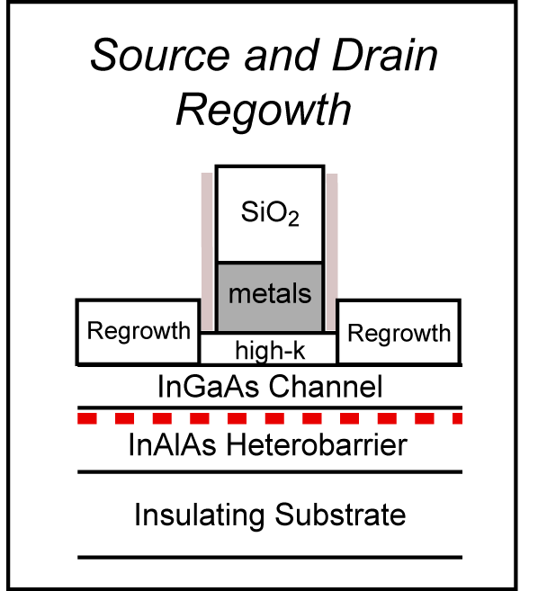
FET Device Scaling
W_{S/D}
L_{g}
Contacted Gate Pitch
L_{S/D}
L_{g}
L_{S/D}
Si CMOS scaling: Contacted gate pitch 4x the gate length¹⁾
4:1 reduction of contact area²⁾ → 4:1 reduction of ρ_{contact}
22 nm node → 33 nm L_{S/D} → For L_{S/D} = L_{T}, requires 5x10⁻⁹ ohm-cm² ρ_{contact}
¹⁾ S. Natarajan, et al, IEDM 2008.
²⁾ M.J.W. Rodwell, et al, IPRM 2010.

Slide 25
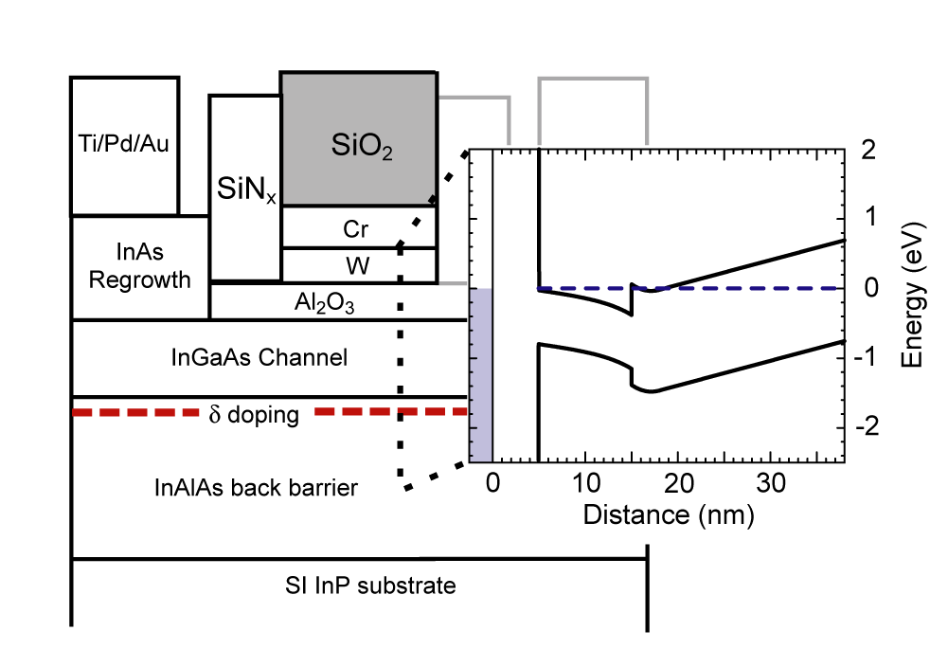
Gate First FET Process Flow
Thick (10 nm) channel
  Process damage mitigation
Heavy ( ~ 9x10¹² cm⁻²) δ doping
  Prevents ungated sidewall current choke
In_{0.52}Al_{0.48}As heterobarrier
  Carrier confinement
Semi-insulating InP
  Device isolation

Slide 26
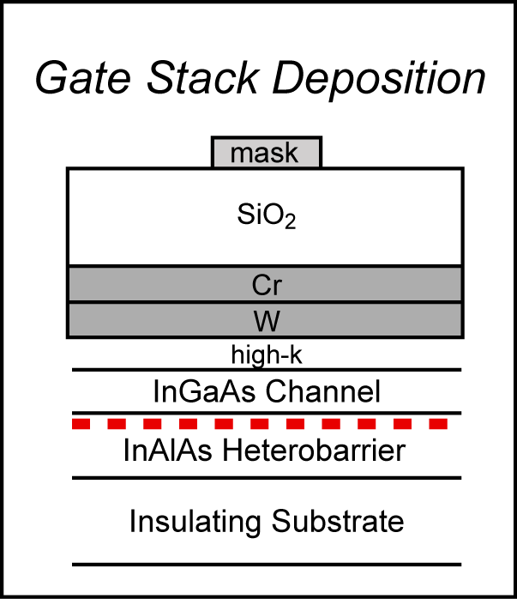
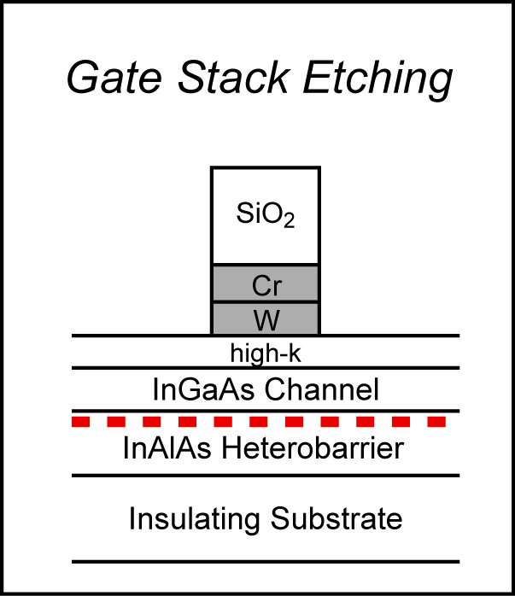
Gate First FET Process Flow
Front End: Gate Stack Definition
  In-situ hydrogen plasma / TMA treatment before Al₂O₃ growth
  Mixed e-beam / optical lithography
  Bi-layer gate (Sputtered W + e-beam evaporated Cr)
    High selectivity, low power dry etch

Slide 27
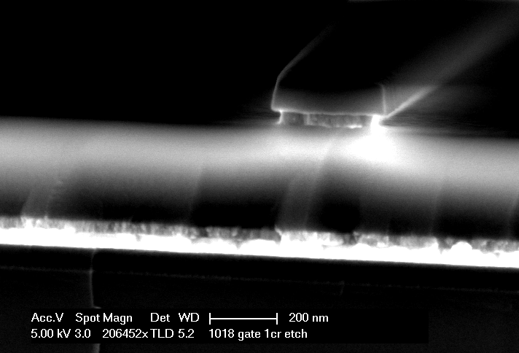
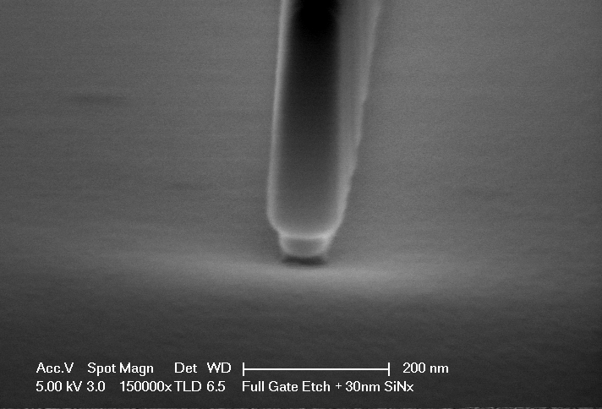
FET Process Development
Use optical lithography to produce >0.5um gates
Use electron beam lithography to produce sub-100nm gates
Need to investigate possible e-beam damage to oxides
HSQ (SiO₂)
SiO₂ + SiN_{x}
Field: SiN_{x}
Cr
Cr + SiN_{x}
SiO₂
Cr
W + SiN_{x}
W
EBL Tests
Finished Gate Etch + Sidewall Deposition

Slide 28
FET Process Development
ICP dry etches calibrated to perform at sub-100nm scale
Increased ICP Power
Higher power dry etch → vertical gate stack
Undercutting leads to fallen gates, ungated access regions → Minimize Cr undercut by reducing thickness

Slide 29
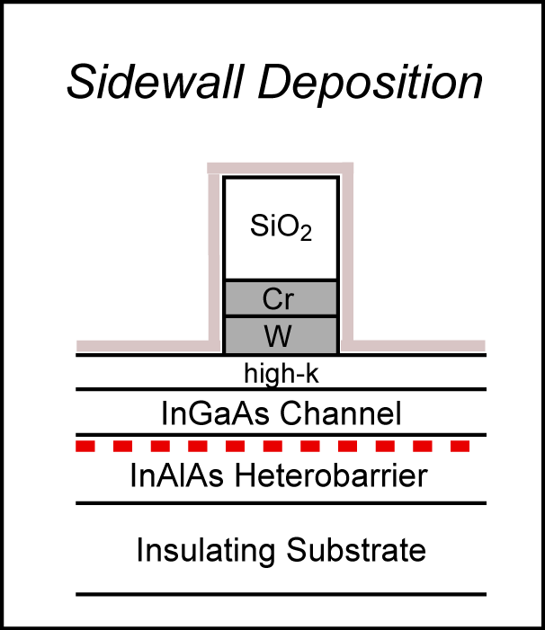
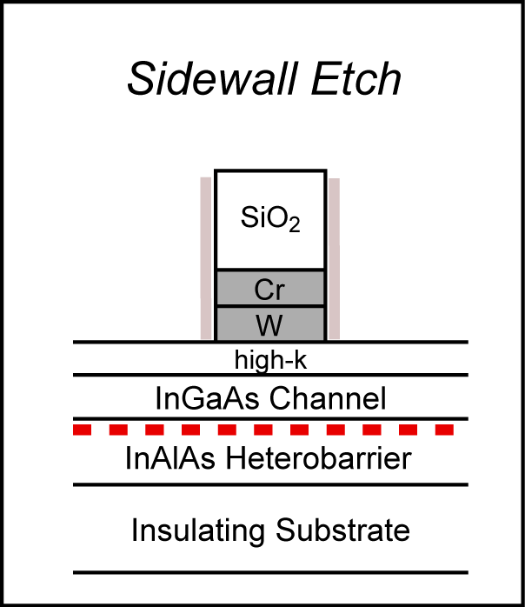
Gate First FET Process Flow
Front End: Gate Stack Definition
  Sidewall Deposition
    Conformal, protects S/D short circuit to gate
  Sidewall etch
    Vertical gate stack → self aligned sidewall

Slide 30
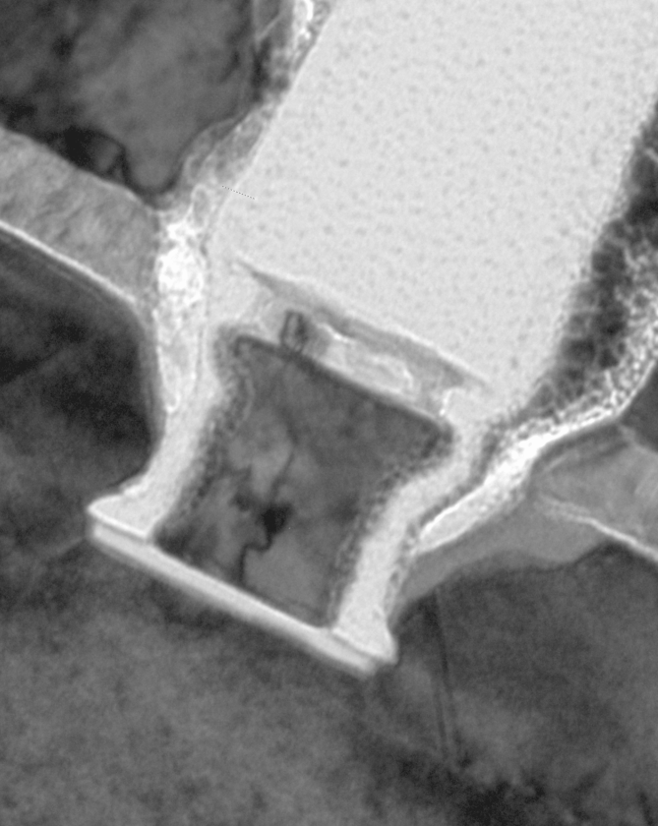
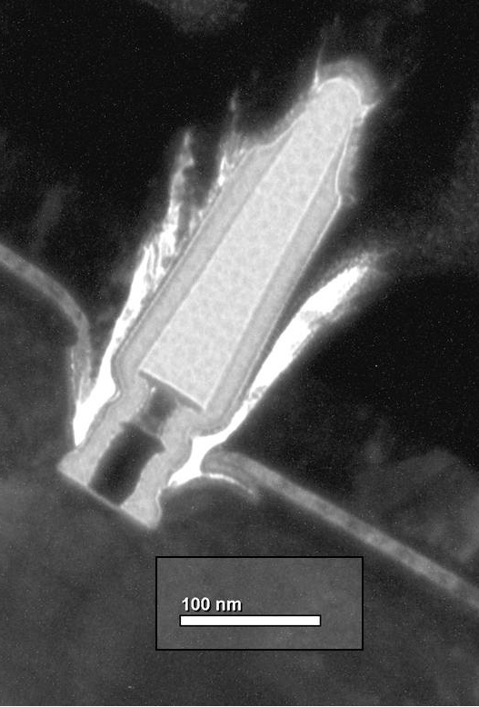
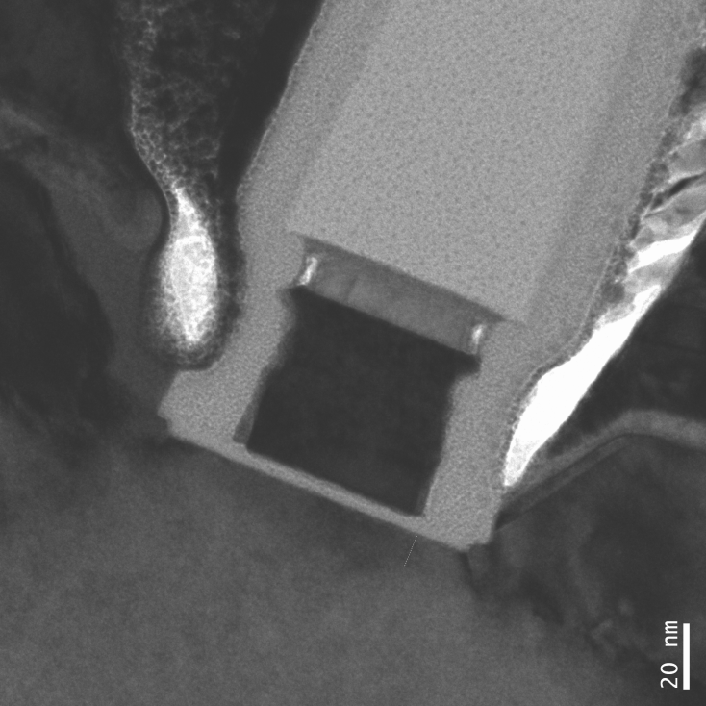
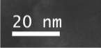
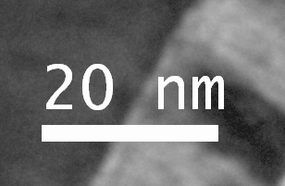
FET Process Development
Low power etch → Isotropic etching + undercut → fallen gates
Large undercuts → ungated regions → high R_{access}
Thick gate stack: Small L_{g} ☺ Large sidewall foot ☹ Unreliable gates ☹
Thin Cr stack: Small L_{g} ☺ Large sidewall foot ☹ Repeatable gate etch?
ALD SiO₂ sidewall: Small L_{g} ☺ Still sidewall foot! ☹ Unrepeatable gate undercut ☹

Slide 31
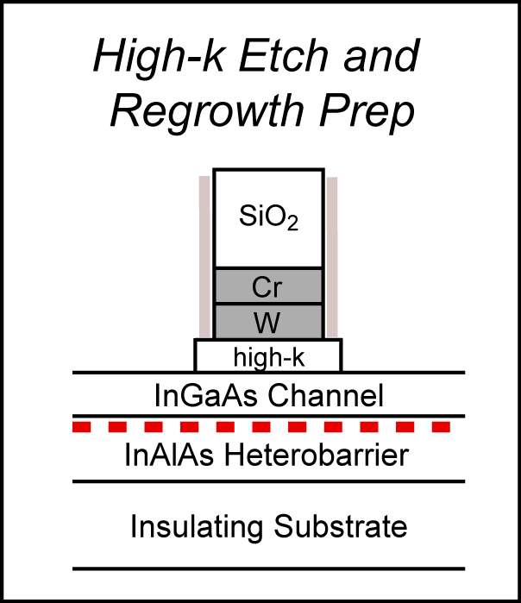
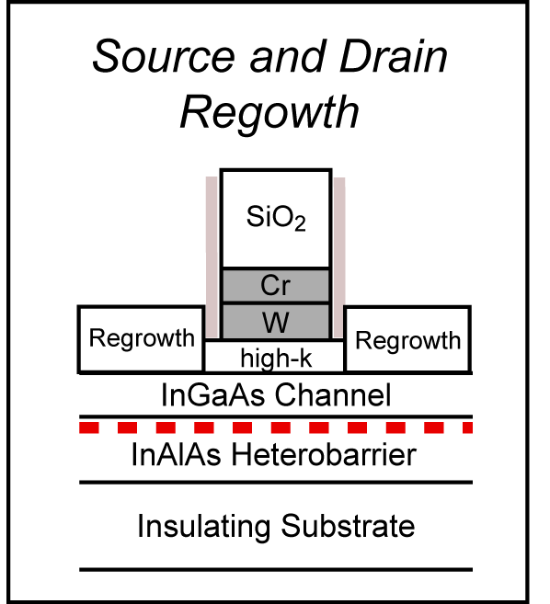
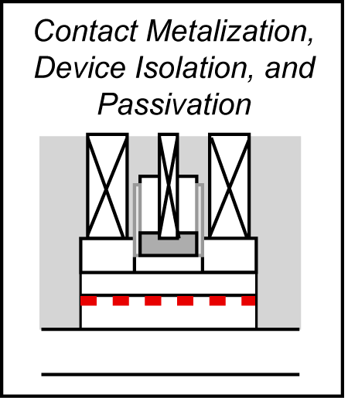
Gate First FET Process Flow
Regrowth and Back End
  Surface preparation
    UV O₃ exposure to clean the source/drain, removed ex-situ before MBE load
  MBE InAs Regrowth
    Low arsenic flux, high temperature → near gate fill in
  Metallization and Mesa Isolation
    In-situ Mo in MBE optional for lower ρ_{c}
    Ti/Pd/Au liftoff
    Wet etch for mesa isolation

Slide 32

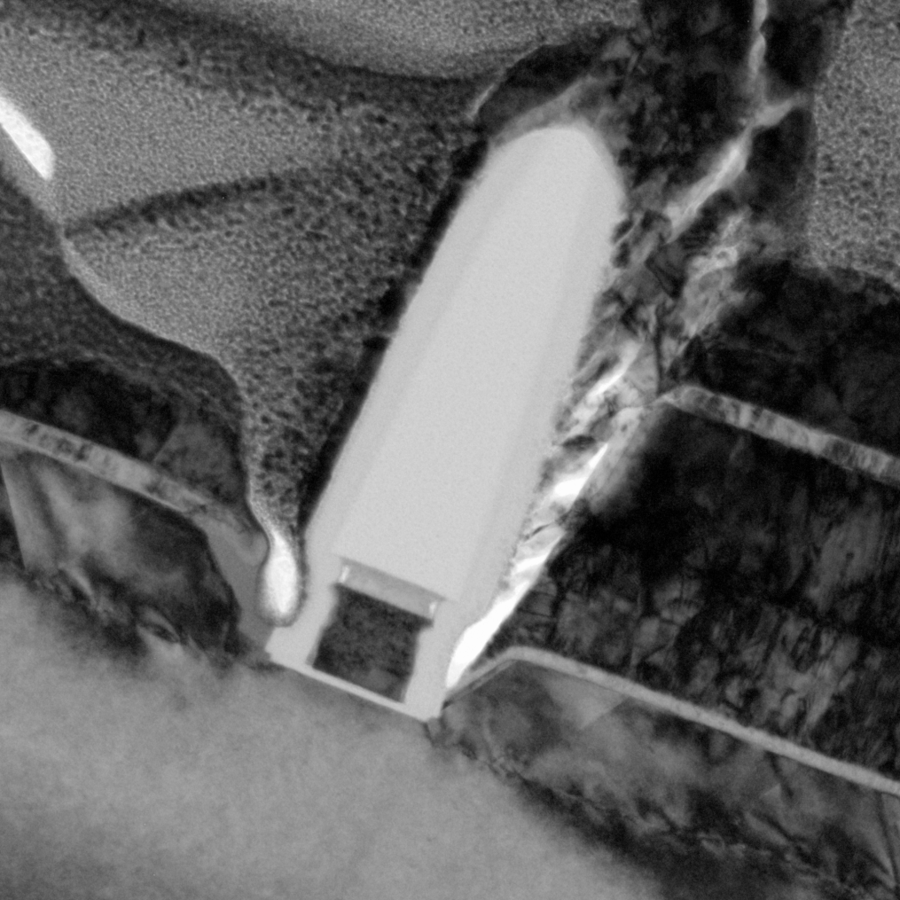

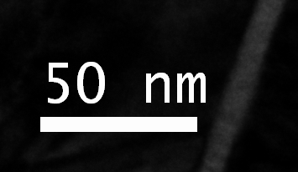
Gate First FET Process Flow
SiO₂
Chrome
Tungsten
Regrowth
Regrowth
SiN_{x} Sidewalls
TEM micrographs of 60 nm L_{g} device

Slide 33
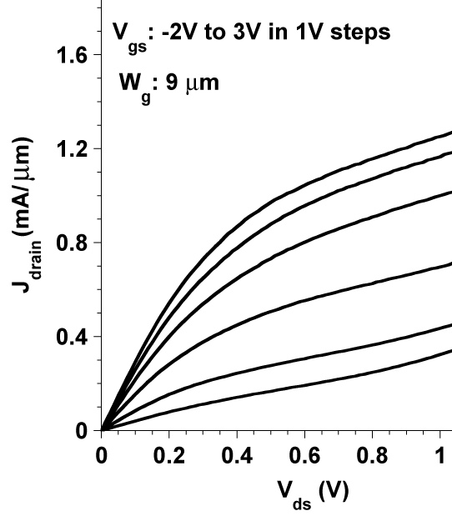
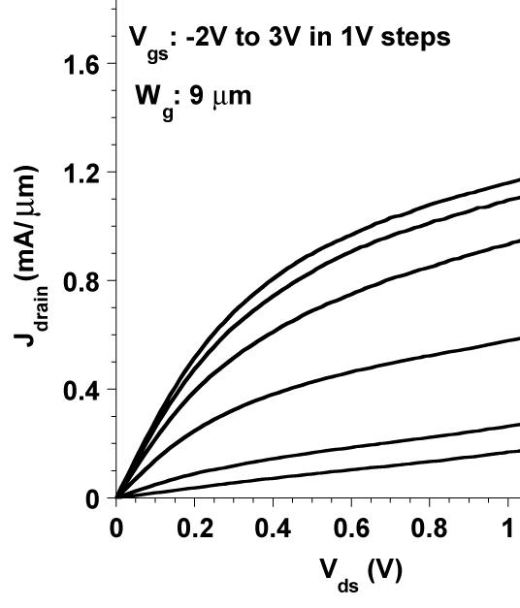
Gate First FET Results
60 nm L_{g}
115 nm L_{g}
Increased leakage current: Heavy δ doping leakage path Drain induced barrier lowering

Slide 34
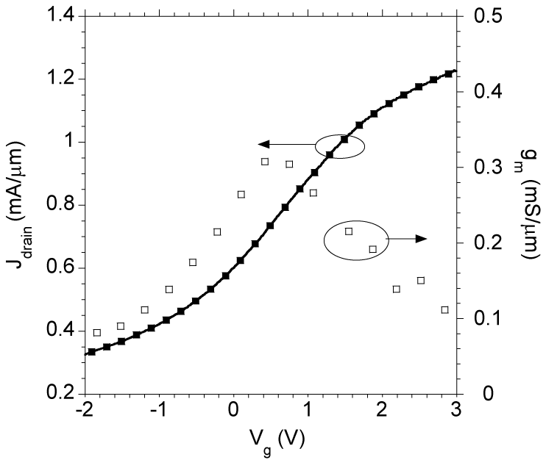
Gate First FET Results
60 nm L_{g}
1/R_{on}
High J_{drain} but depletion mode
Transconductance: Similar to previous results* (~0.3mS/μm)
Low R_{on} (371 ohm-μm) for InGaAs MOSFETs
^{*)} U. Singisetti et al, IEEE EDL Nov. 2009.

Slide 35
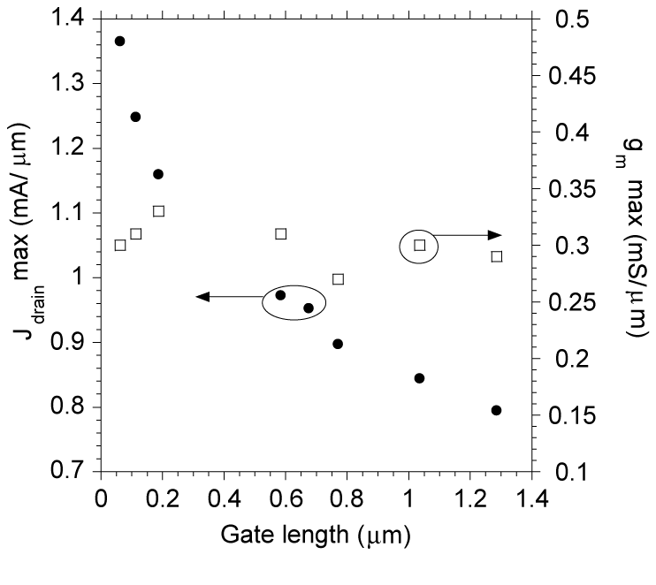
Gate First FET Results
W_{g} = 9 μm
J_{drain} increases rapidly with gate length scaling
Transconductance: Relatively flat with gate length scaling
^{*)} U. Singisetti et al, IEEE EDL Nov. 2009.

Slide 36
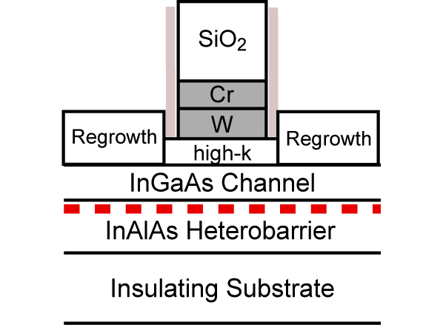
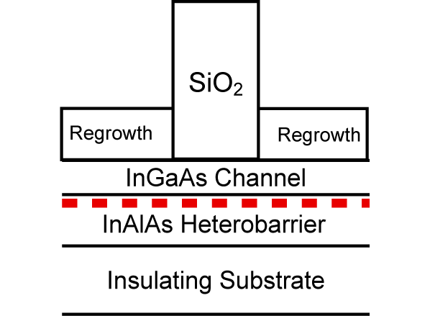
FET: Access Resistance
W_{g}=25 μm T_{chan}=15 nm
W_{g}=9 μm T_{chan}=10 nm
R_{access}: 200 ohm-μm
R_{access}: 100 ohm-μm
MOSFET On Resistance
Gateless Transistor Resistance
Gateless transistor effective diagnostic of regrowth

Slide 37
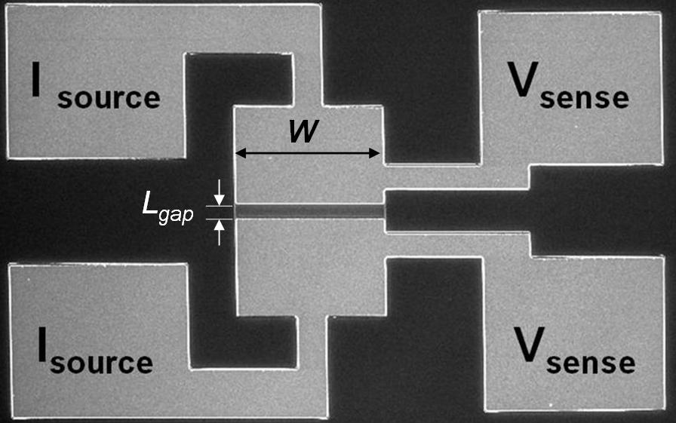
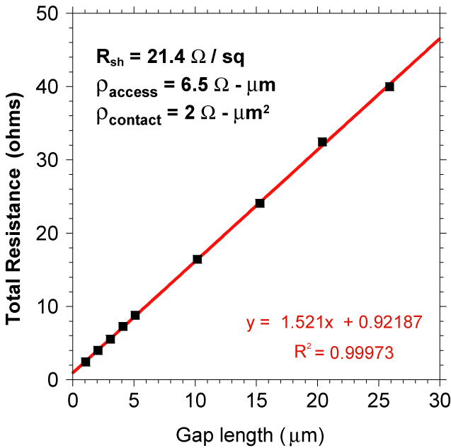
Gate First FET: Metal-Regrowth TLM
W_{g} = 14 μm
Metal-Regrowth access resistance
is not a limiting factor in J_{drain}
Ex-situ Ti/Pd/Au / n-type InAs contacts: ρ_{c} = 2 x 10⁻⁸ ohm-cm²
In-situ Mo / n-type InAs contacts have shown ρ_{c} = 6 x 10⁻⁹ ohm-cm² *
^{*)} M.J.W. Rodwell, et al, IPRM 2010.

Slide 38

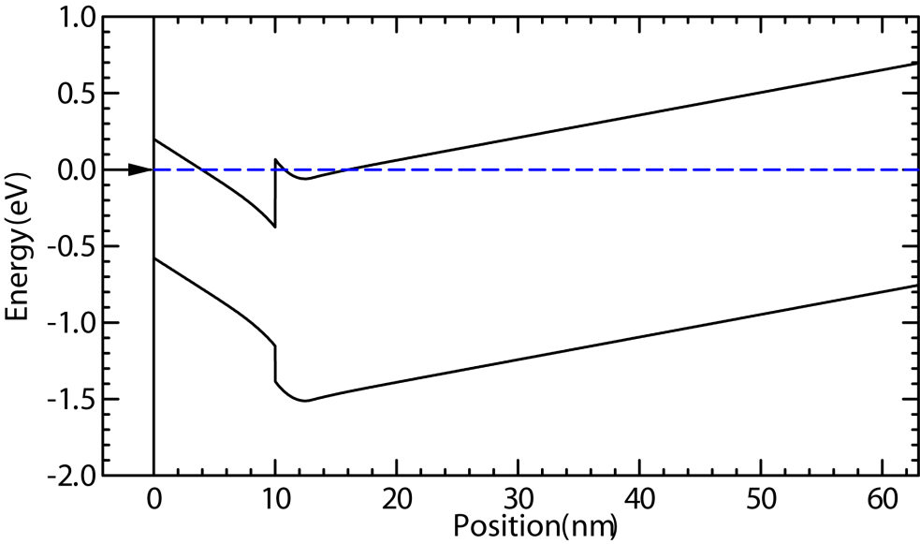
Gate First FET: Issues
Ungated region → potential current choke
  Thinner sidewall can help…
  … but hard to control with gate undercut
Electron band diagram of channel underneath sidewall

Slide 39
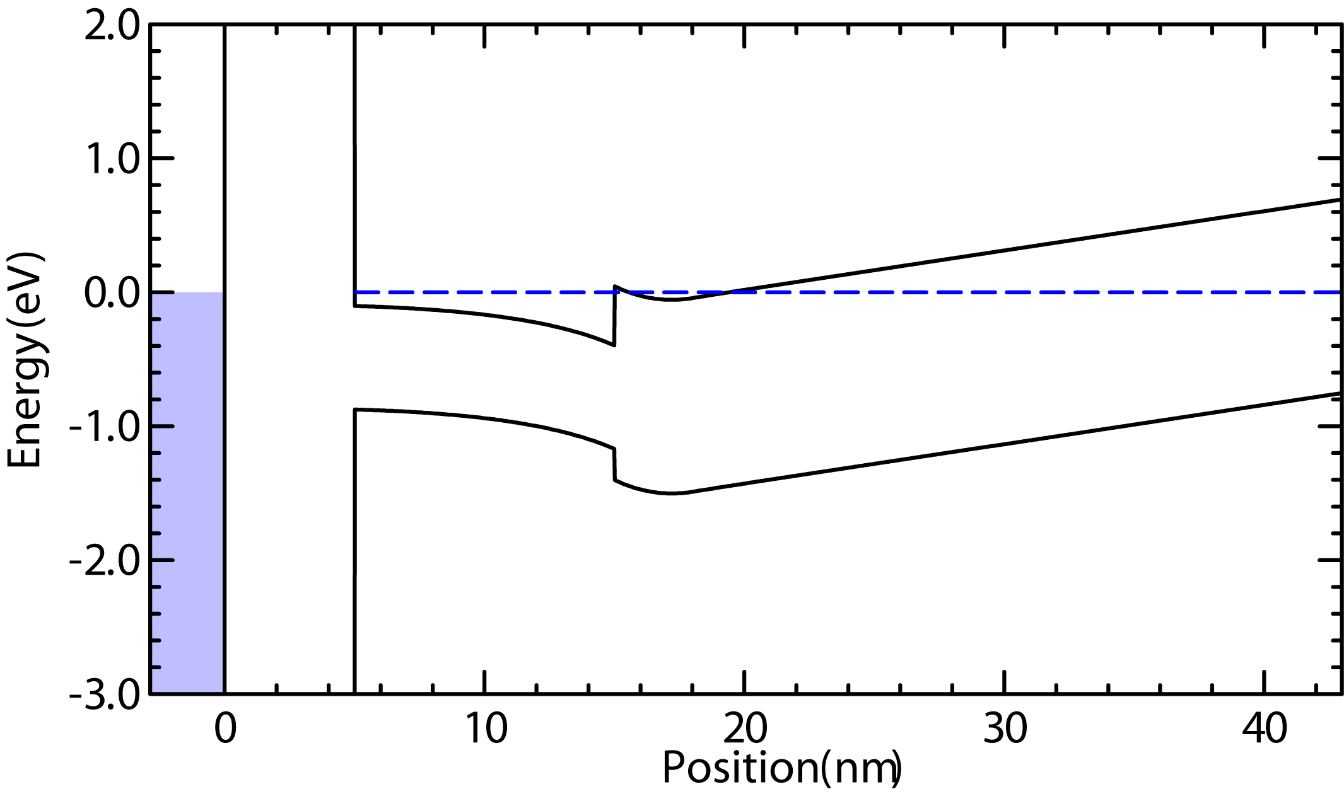
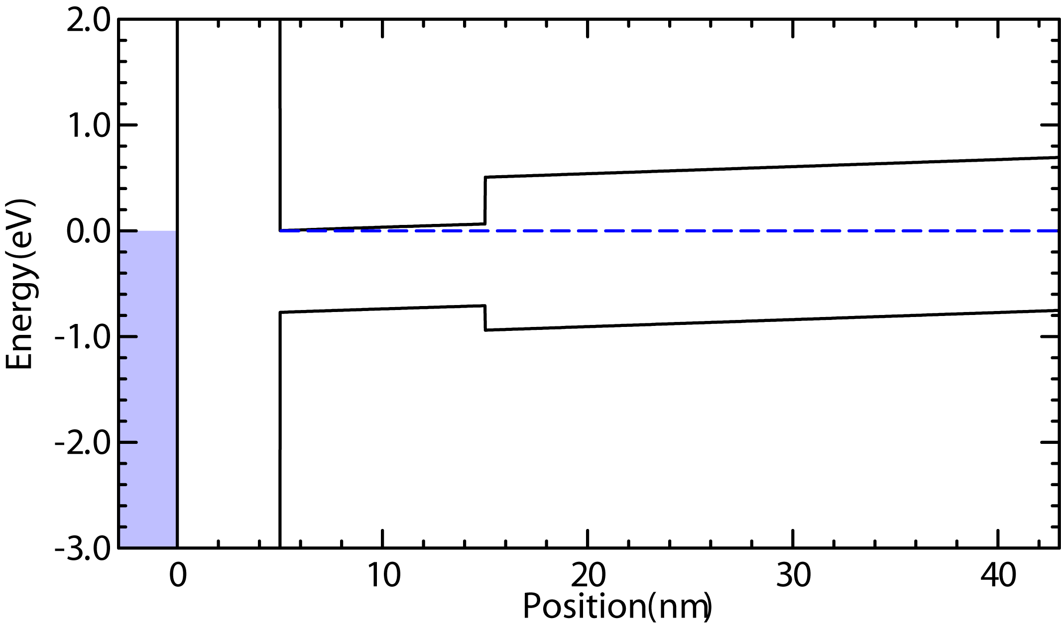
Gate First FET: Issues
Heavy δ doping → parallel conduction, poor g_{m}
  Large leakage current in device
  Decreases C_{depth} → limits g_{m}
Must reduce δ doping while maintaining low R_{access}

Slide 40
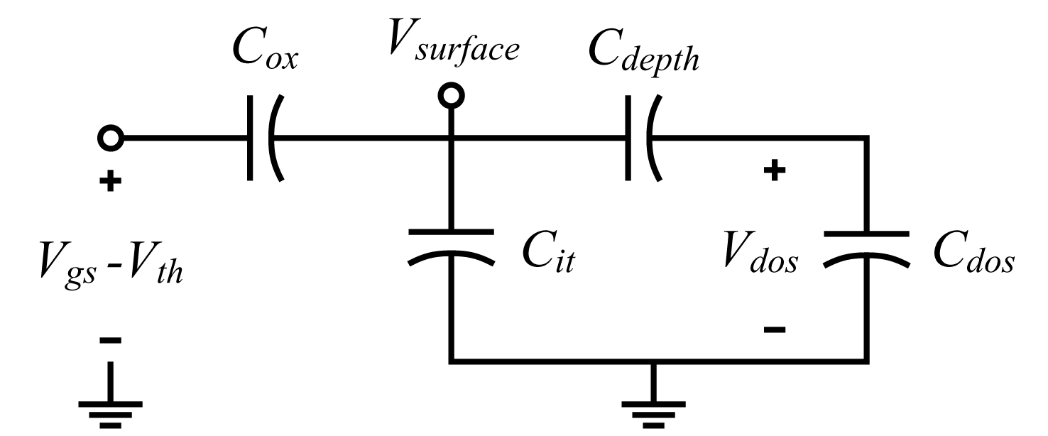
FET Device Physics
Dit problem
  ↑Cit , ↓ Vsurface
  Vsurface also supplies Cdos
  ↓ Vsurface =↓ ndos in Cdos

Slide 41
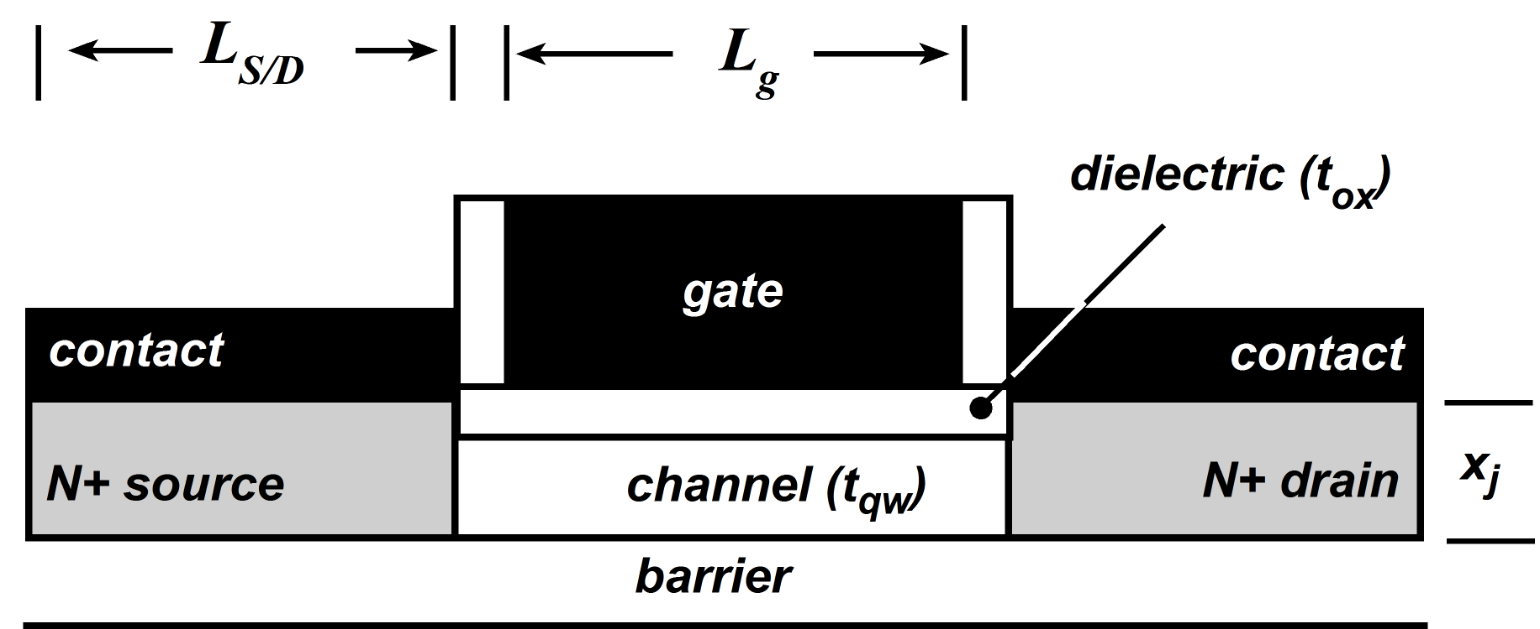
FET Device Scaling
FET parameters | Scaling Rule | How?
Current Density , g_{m} | increase 2:1
Gate Length and Contact Spacing (L_{g},L_{S/D}) | decrease 2:1 | Lithographic Scaling
Channel Electron Density | increase 2:1 | Channel Material and Orientation
Electron Transport Mass (m*_{transverse} ) | constant | Channel Material and Orientation
Gate Capacitance | increase 2:1
Channel Density of States | increase 2:1 | Channel Material and Orientation
Channel Thickness (T_{inv}) | decrease 2:1 | Materials Engineering
Effective Oxide Thickness (T_{ox}) | decrease 2:1 | Materials Engineering
Source/Drain Contact Resistivity | decrease 4:1 | Materials Engineering
Rodwell, IPRM 2010

Slide 42
FET Device Scaling
W_{S/D}
L_{g}
Contacted Gate Pitch
L_{S/D}
5 nm channel, 500 cm²/(V*s) mobility, 5E19 cm⁻³ carriers = 500 ohm/sq
5E-9 ohm cm² contact resistance
L_{transfer} ~ 31 nm
¹⁾ S. Natarajan, et al, IEDM 2008.
²⁾ M.J.W. Rodwell, et al, IPRM 2010.

Slide 43
FET Process Development
1) Poorly controlled dry etch undercut
  Low power etch → Isotropic etching
Thick gate stack: Small L_{g} ☺ Large sidewall foot ☹ unreliable gates ☹
Thin Cr stack: Small L_{g} ☺ Large sidewall foot ☹ Reliable gate etch?
ALD SiO₂ sidewall: Small L_{g} ☺ Still sidewall foot! ☹ Unreliable gate undercut ☹

