Slide 1
Nanometer InP Electron Devices for VLSI and THz Applications
2014 Device Research Conference, June 22-24, Santa Barbara, CA.
M.J.W. Rodwell, UCSB
S. Lee, C.-Y. Huang, D. Elias, V. Chobpattanna, J. Rode,
H.-W. Chiang, P. Choudhary, R. Maurer, , A.C. Gossard,
S. Stemmer: UCSB
M. Urteaga, B. Brar: Teledyne Scientific

Slide 2
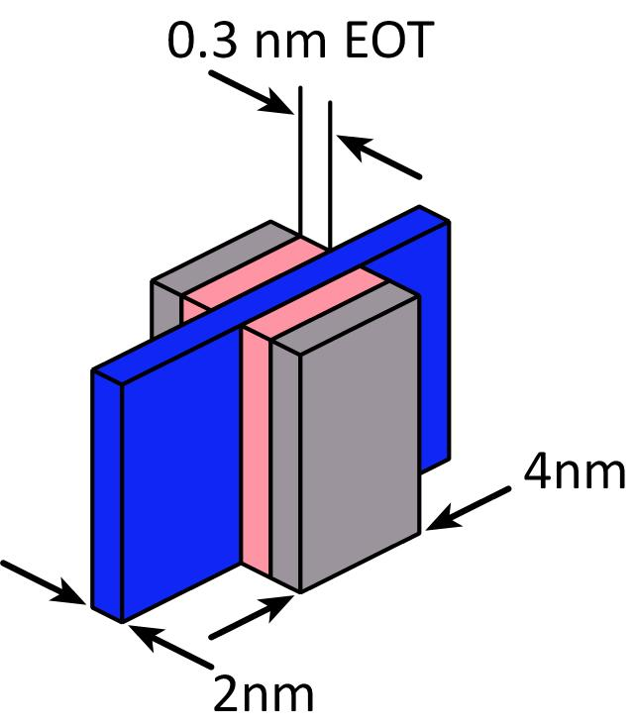
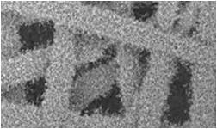
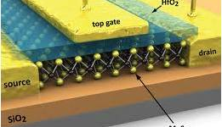
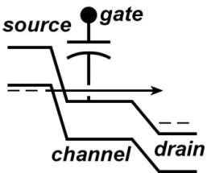
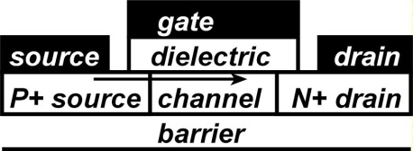
nm FETs & VLSI: how small can we go ?
Will 2-D semiconductors
scale better than bulk ?
4 nm FET:
an engineering
grand challenge
Can we make even good 8nm FETs ?
Can we manage CV² dissipation ?
Are tunnel FETs viable ? Alternatives ?
Perhaps bulk semiconductors
can do very well.

Slide 3
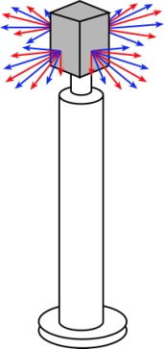


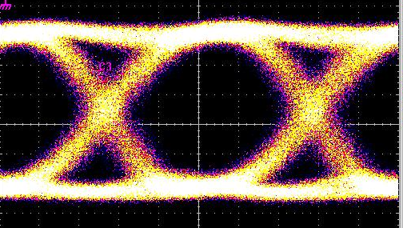
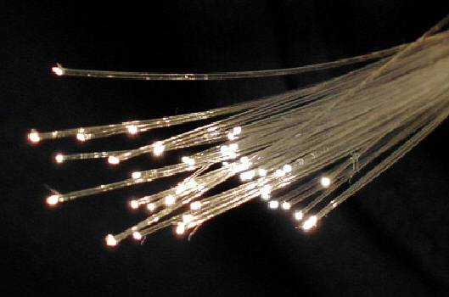

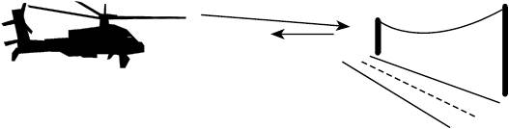
High-frequency electronics: How high can it go ?
820 GHz transistor ICs today
2 THz clearly feasible
*ITU band designations
** IR bands as per ISO 20473
Applications
100+ Gb/s wireless networks
Video-resolution radar
→ fly & drive through fog & rain
near-Terabit
optical fiber links
Transistor Goal: < 3 dB noise, >1 W power, 10% efficiency, 50-500GHz

Slide 4
nm
(III-V) MOSFETs

Slide 5
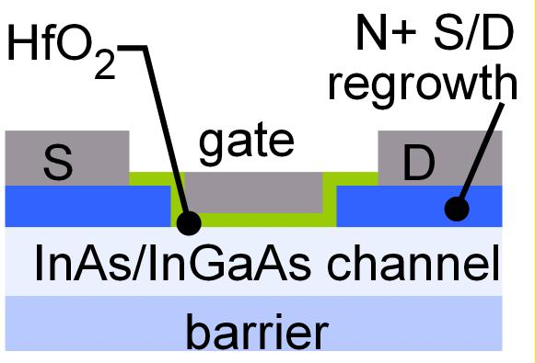
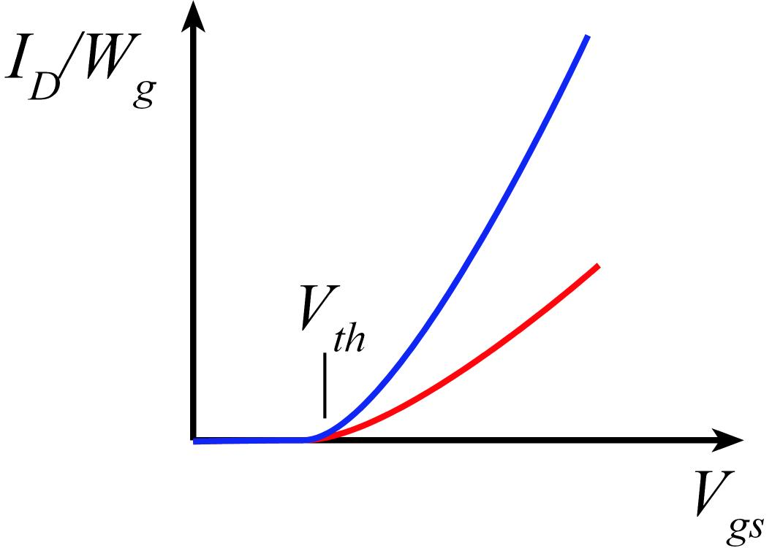
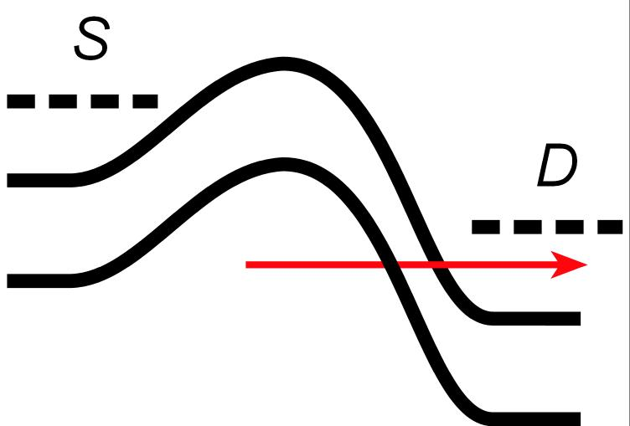
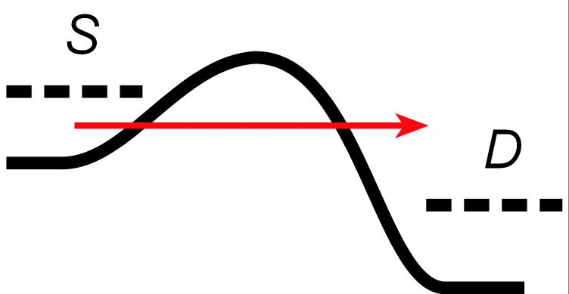
Why III-V MOS ?
III-V vs. Si: Low m*→ higher velocity. Fewer states→ less scattering
→ higher current. Can then trade for lower voltage or smaller FETs.
Problems: Low m*→ less charge. Low m* → more S/D tunneling.
Narrow bandgap→ more band-band tunneling, impact ionization.

Slide 6
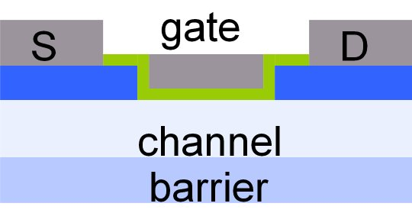
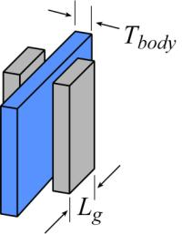
nm/VLSI MOSFET Scaling: Targets
FET parameter | ?? nm Node
gate length | ~10 nm
current density (mA/mm) | 1 mA/μm @0.5V
transport mass
2DEG electron density | 3*10¹²/cm²
gate-channel capacitance density
dielectric equivalent thickness | 0.5 nm (fin: 1.0 nm)
channel thickness | 2.5 nm (fin: 5 nm)
channel state density
contact resistivities | 0.4 Ω-μm²

Slide 7
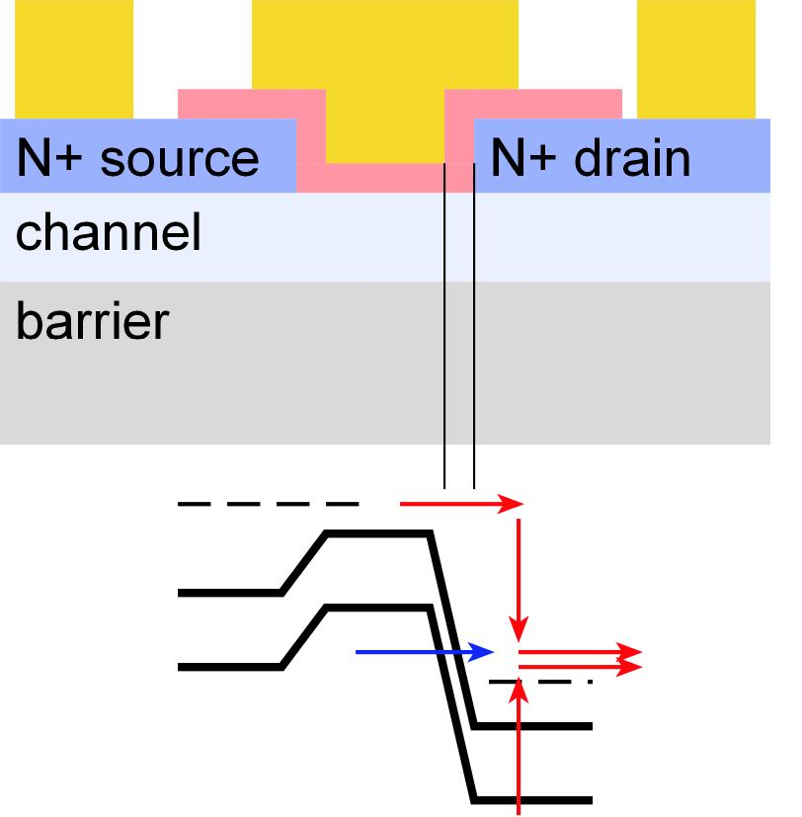
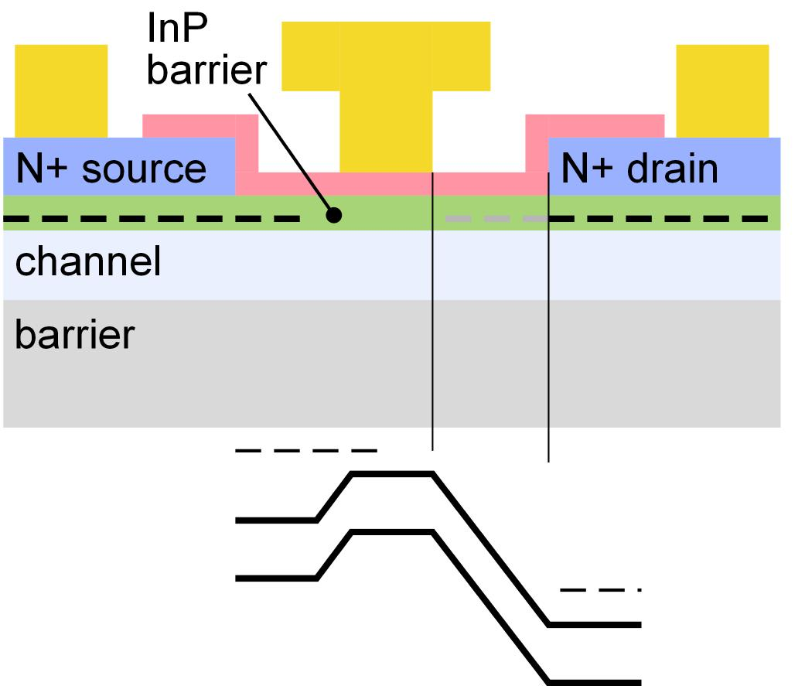
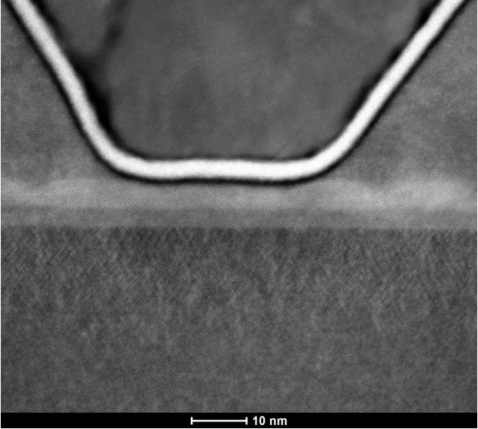
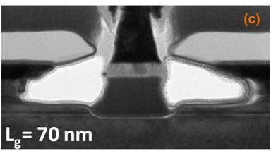
Research III-V MOS: Lateral Spacers & Tunneling
Small S/D contact pitch
MOS-HEMT with large contact pitch
no lateral gate-drain space
~70 nm gate-drain space
Lin, IEDM2013
UCSB

Slide 8
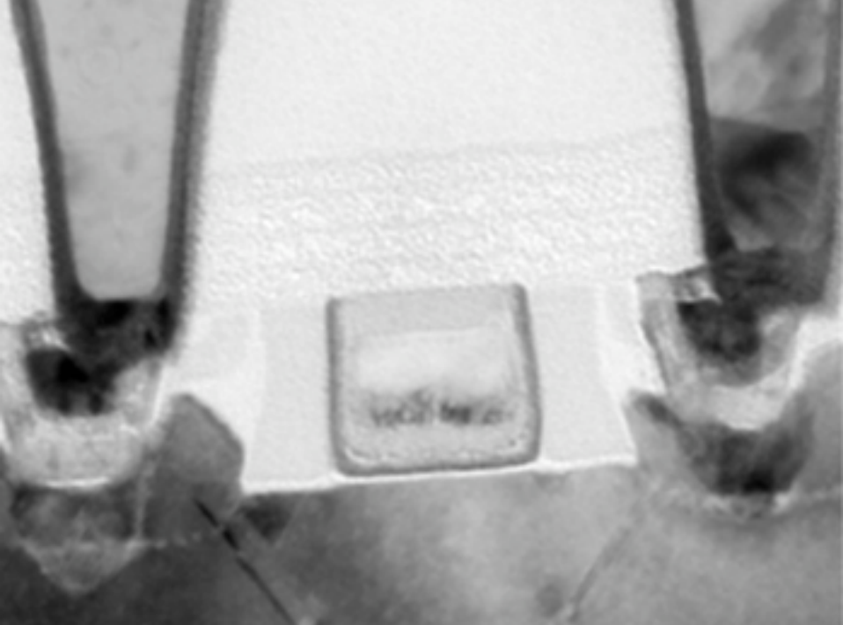
We must build devices with small S/D pitch.
contact pitch ~ 3 times lithographic half-pitch (technology node dimension)
Intel 35nm NMOS
Small S/D pitch hard to realize if we require ~20-50nm lateral gate-drain spacers !

Slide 9
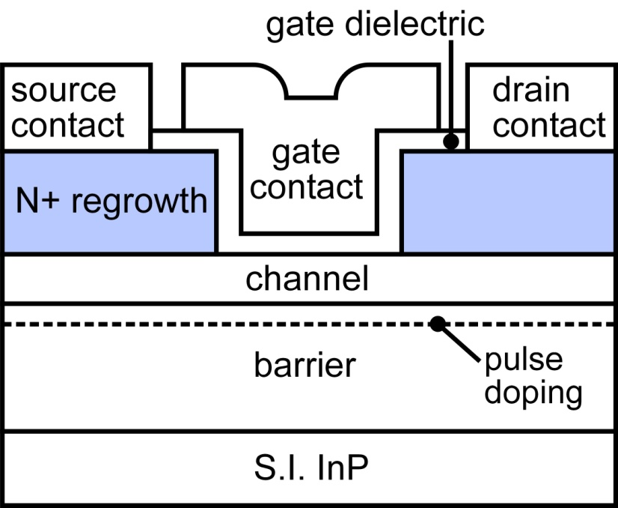
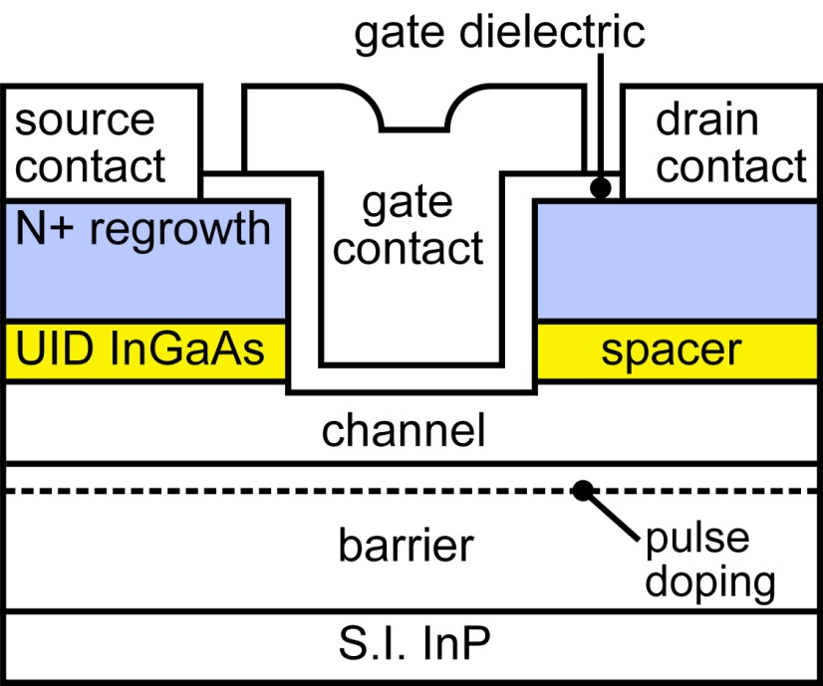
Vertical spacers: less leakage, small S/D pitch
Suppress band-band tunneling, S/D tunneling.
Long gate length, small footprint.

Slide 10
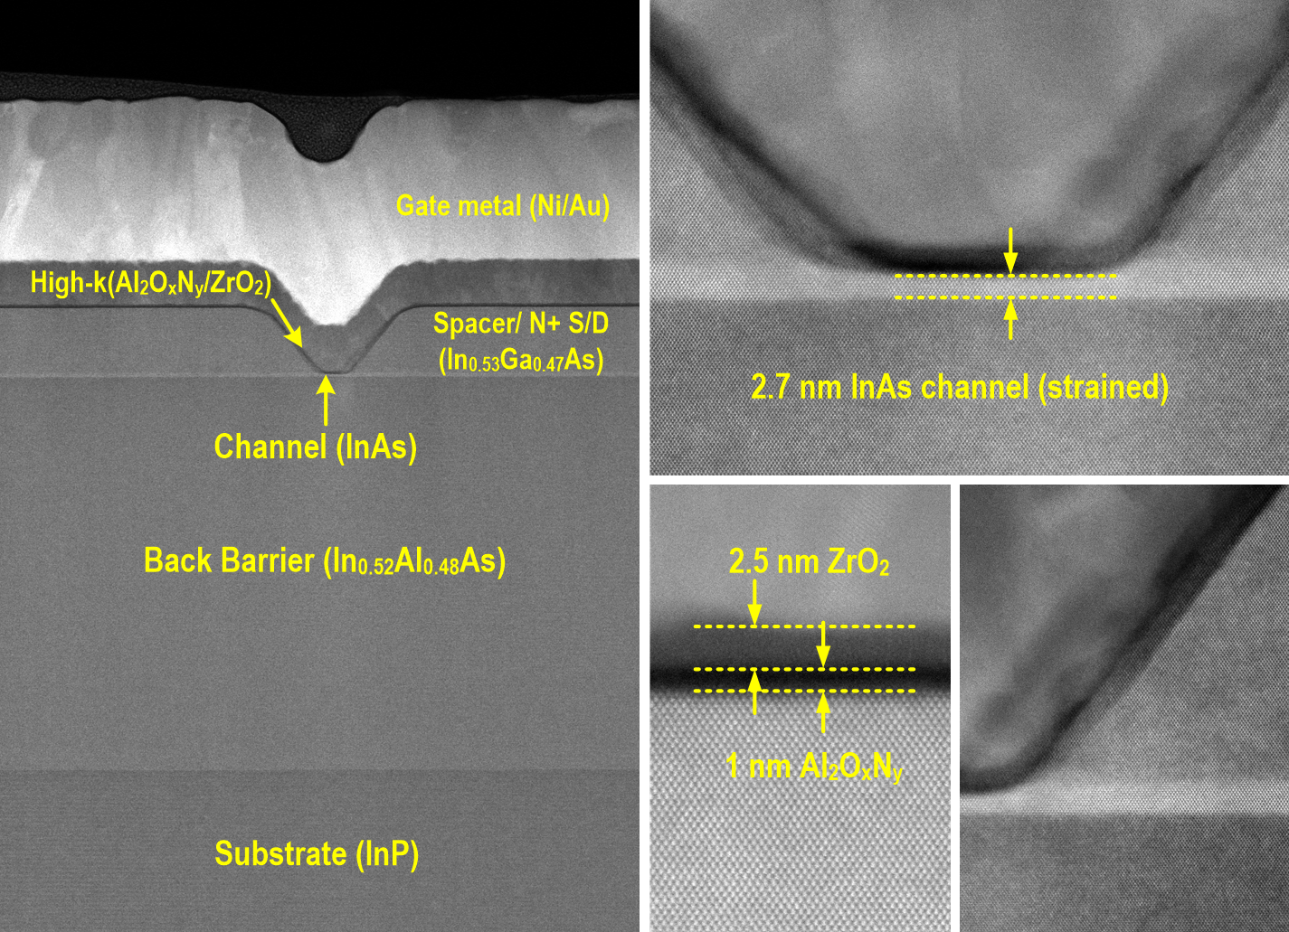
MOSFET: 2.5nm ZrO₂ / 1nm Al₂O₃ / 2.5nm InAs
Courtesy of S. Kraemer (UCSB)
*Heavy elements look brighter
Lee et al., 2014 VSLI Symposium

Slide 11
MOSFET: 2.5nm ZrO₂ / 1nm Al₂O₃ / 2.5nm InAs
Lee et al., 2014 VSLI Symposium

Slide 12
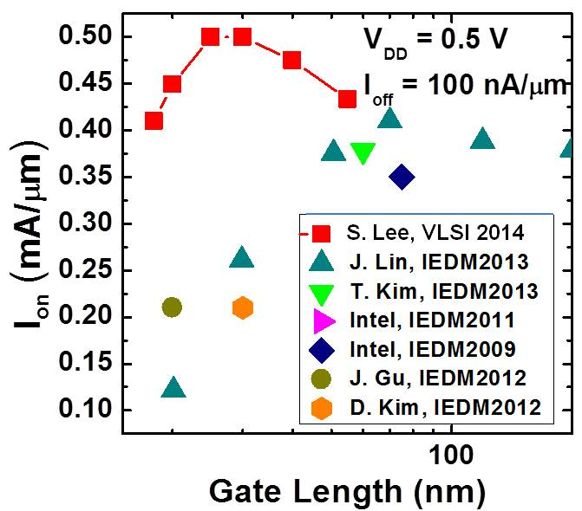
MOSFET: 2.5nm ZrO₂/ 1nm Al₂O₃ / 2.5nm InAs
Performance:
Equals Intel 22nm NMOS finFET (HP), surpasses 14nm FDSOI
Dielectrics: V. Chobpattana, et al., APL 2014
FETs: Lee et al., 2014 VSLI Symposium

Slide 13
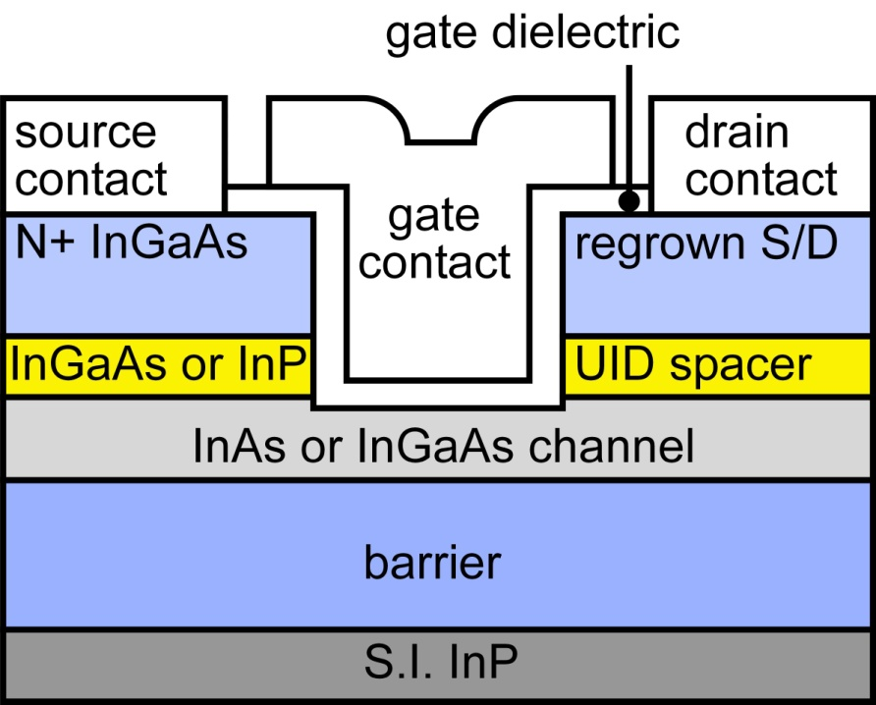
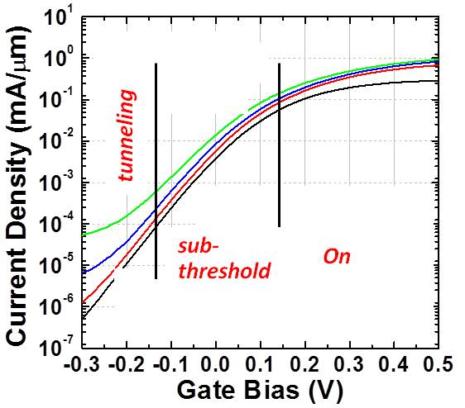
Channel, Dielectric, and Spacer Design
On-current:
Thin dielectrics, thin channels; too thin ?→ scattering .
high indium content (not clear why).
Subthreshold:
dielectrics, thin channels, thick spacers
Tunneling:
thin channels, low indium content, thick spacers

Slide 14
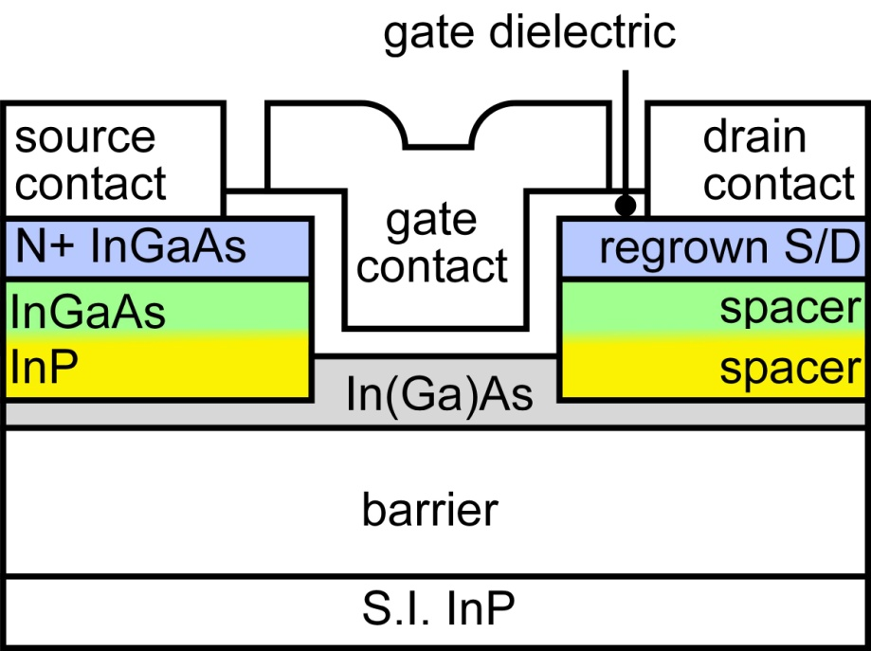
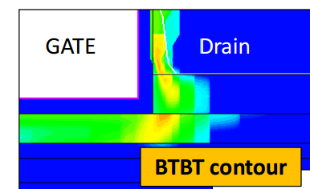
Double Heterojunction MOSFETs: Low Leakage
Huang et al., 2014 DRC,
2014 Les Eastman Conf., 2014 IEDM (submitted)
Byeongkyu Cho: MS report
Meet GP (1nA/μm), LP (30pA/μm), ULP (10 pA/μm) specs ?
InP spacer in highest-field region: BTBT
InGaAs spacer in lower-field regions: less added resistance

Slide 15
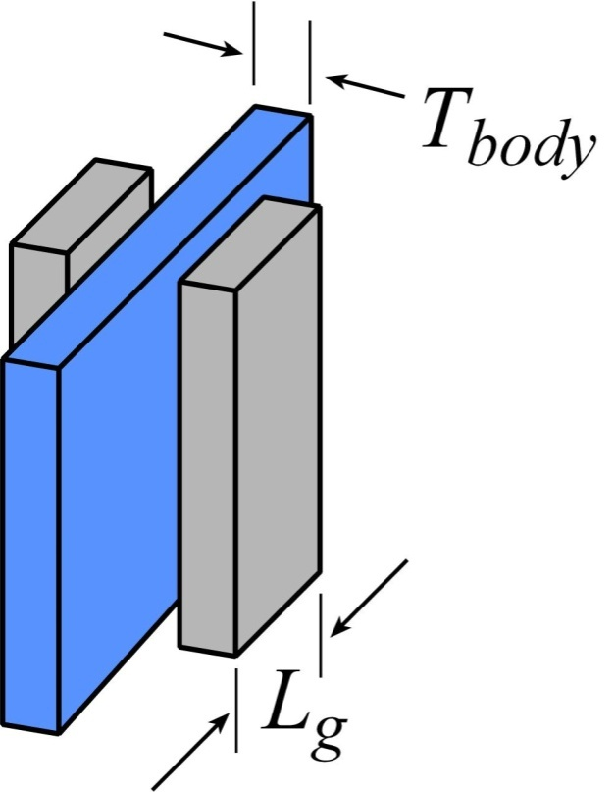
FinFETs by Atomic Layer Epitaxy: Why ?
FinFETs:
body must be < 4 nm thick body for 8 nm L_{g}
Need smooth interfaces, precise fin thickness control
Is fin dry-etching feasible ? Damage ?

Slide 16
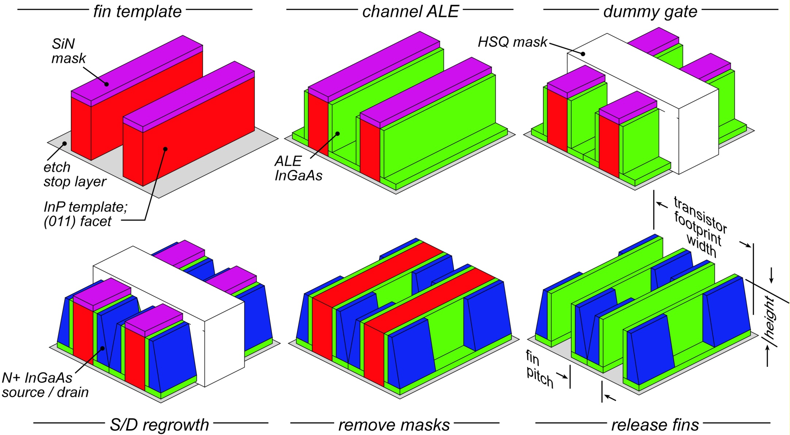
finFET by Sidewall Epitaxial Growth
Cohen-Elias et al., DRC 2013

Slide 17
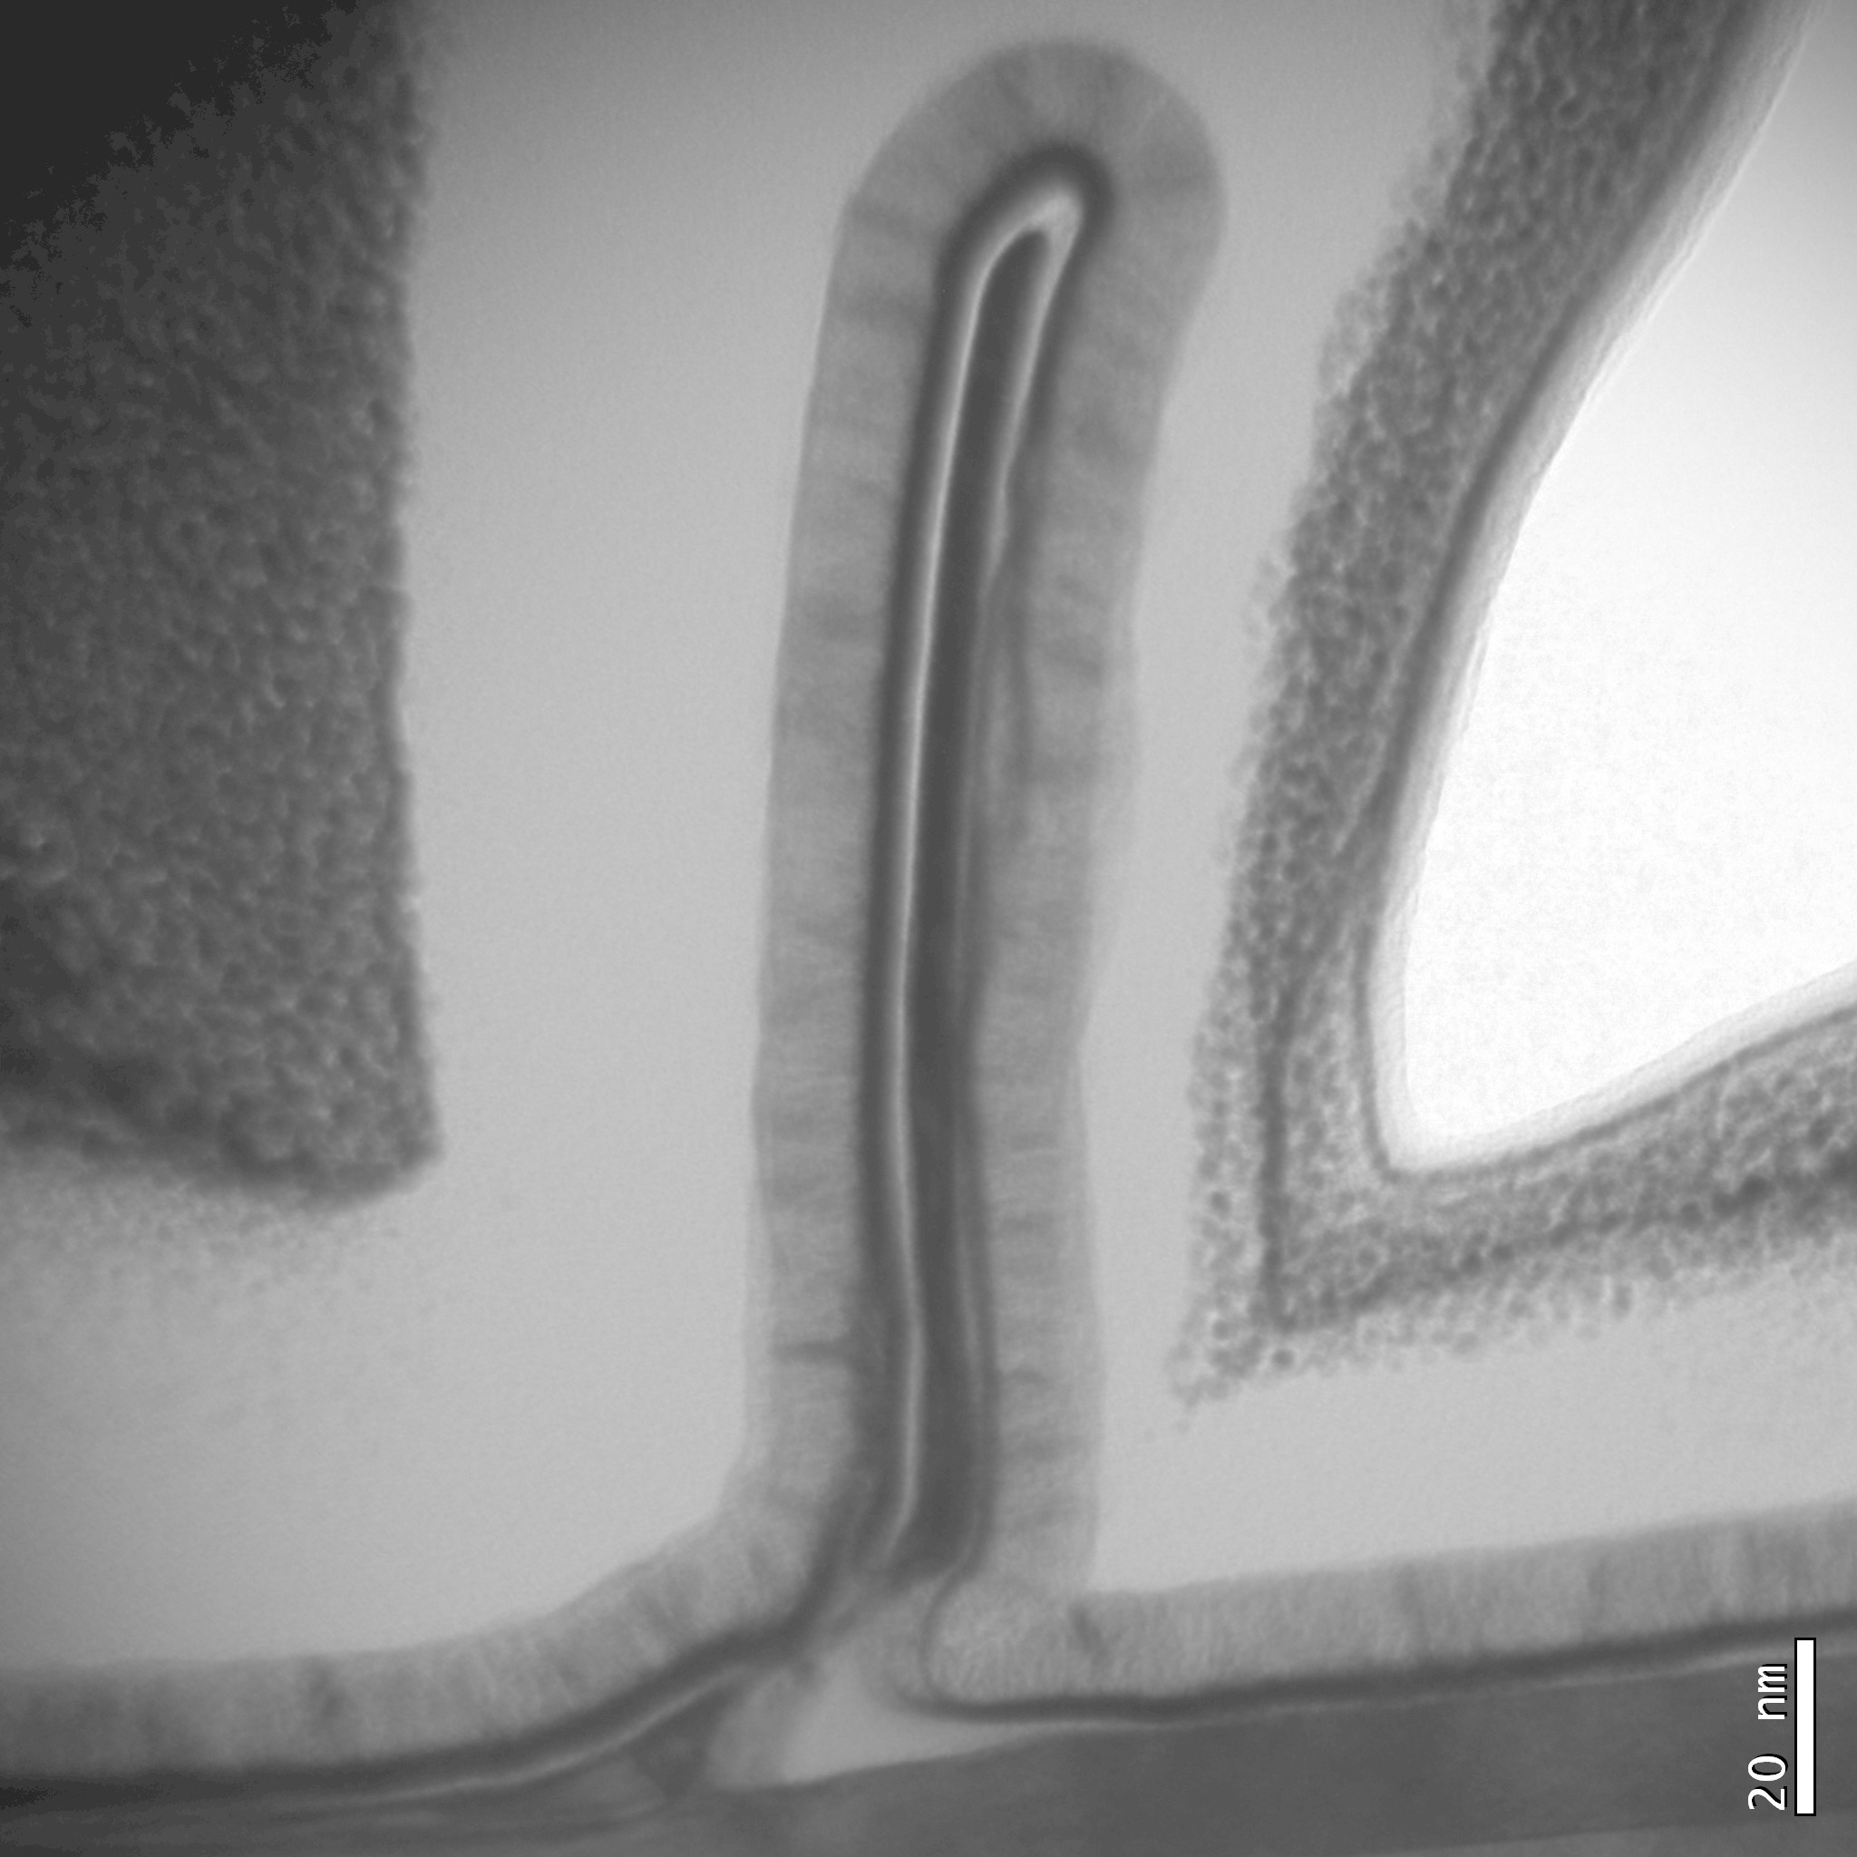
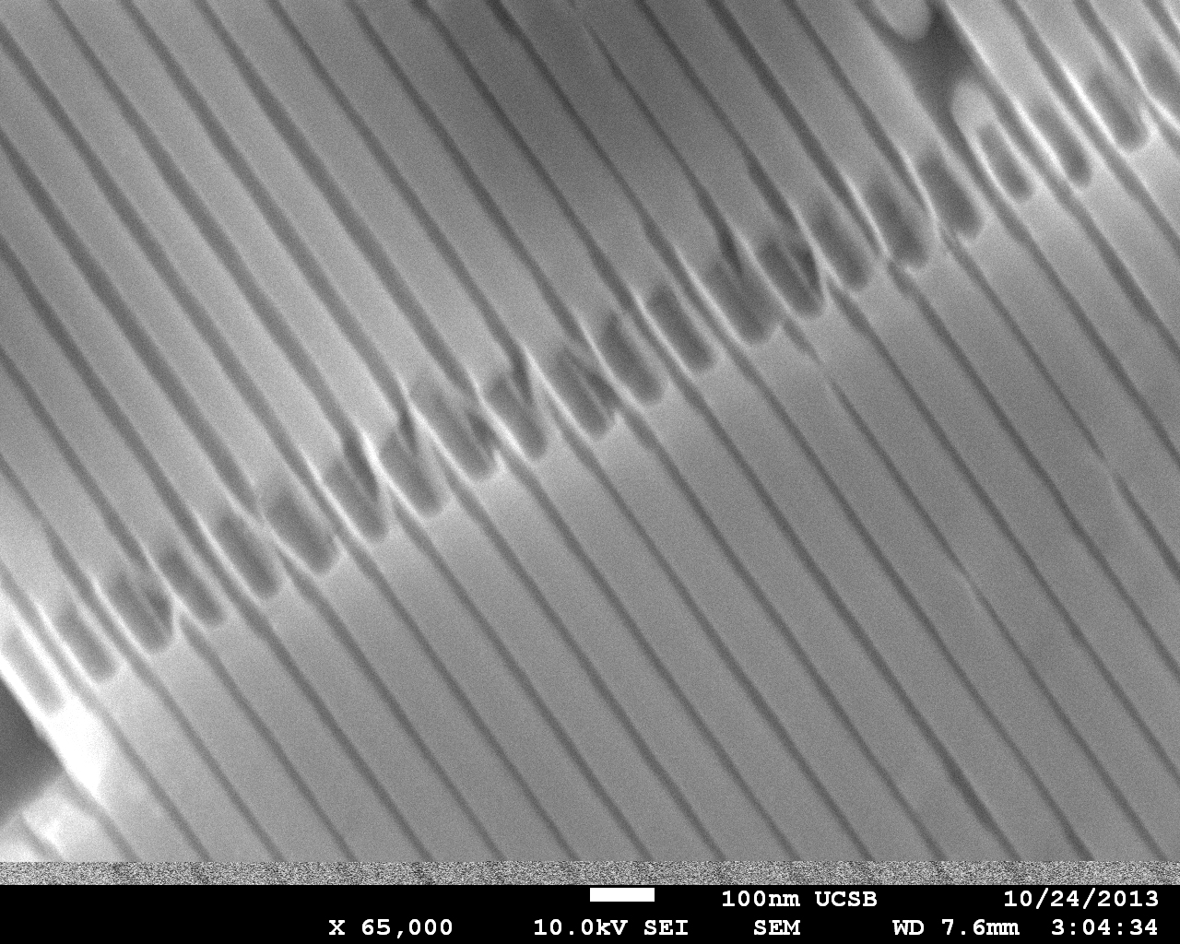
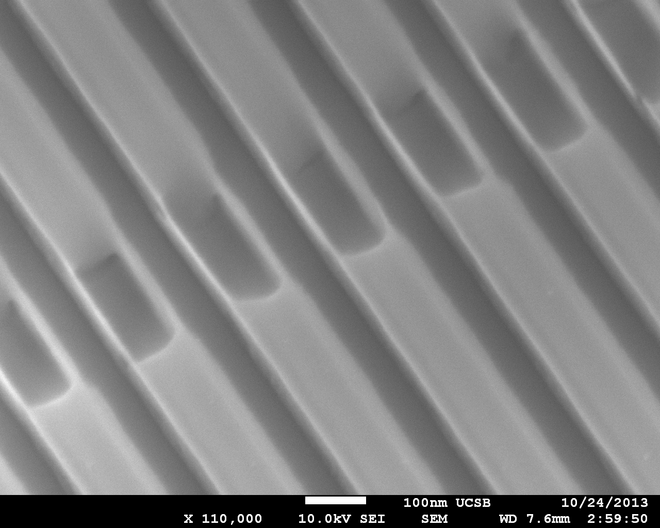

finFET by Sidewall Epitaxial Growth
HfO₂
50 nm fin pitch
fin, ~8nm
10 nm thick fins, 100 nm tall
TiN
source
channel
100 nm fin pitch
drain
BTBT: need <5nm fins
Cohen-Elias et al., DRC 2013

Slide 18
THz Transistors

Slide 19
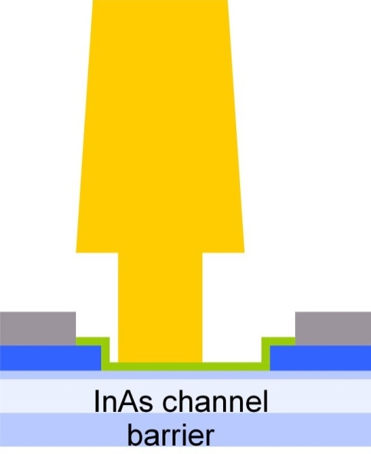

THz Transistor Scaling Laws (to double bandwidth)
FET parameter | change
gate length | decrease 2:1
current density (mA/mm), g_{m} (mS/mm) | increase 2:1
transport mass | constant
2DEG electron density | increase 2:1
gate-channel capacitance density | increase 2:1
dielectric equivalent thickness | decrease 2:1
channel thickness | decrease 2:1
channel state density | increase 2:1
contact resistivities | decrease 4:1
gate
source
drain
emitter
HBT parameter | change
emitter & collector junction widths | decrease 4:1
current density (mA/mm²) | increase 4:1
current density (mA/mm) | constant
collector depletion thickness | decrease 2:1
base thickness | decrease 1.4:1
emitter & base contact resistivities | decrease 4:1
base
collector

Slide 20
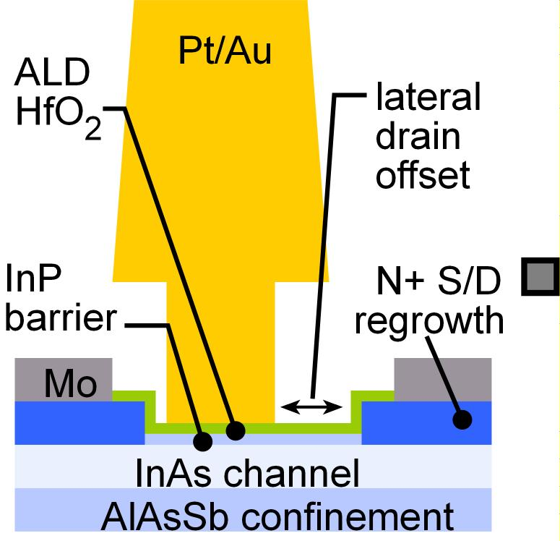
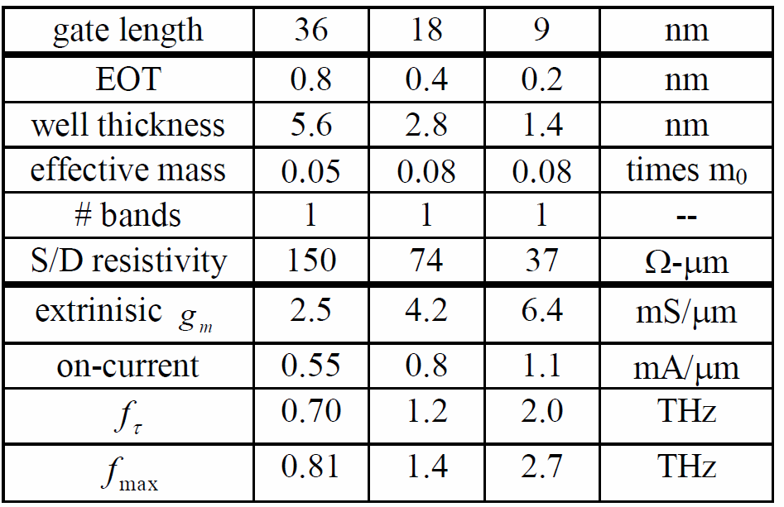
2-3 THz Field-Effect Transistors are Feasible.
3 THz FETs realized by:
Regrown low-resistivity source/drain
Very thin channels, high-K dielectrics
Gates scaled to 9 nm junctions
Impact:
Sensitive, low-noise receivers
from 100-1000 GHz.
3 dB less noise →
need 3 dB less transmit power.

Slide 21
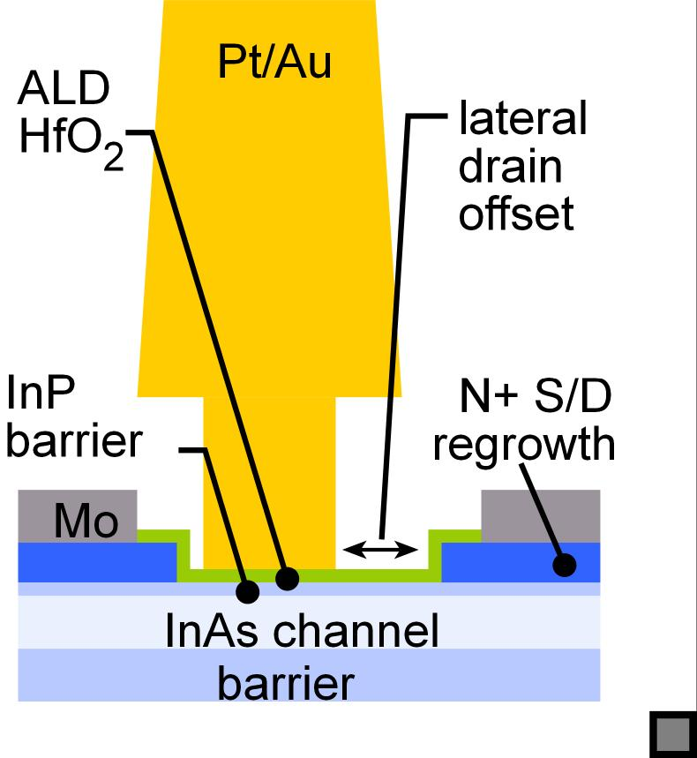
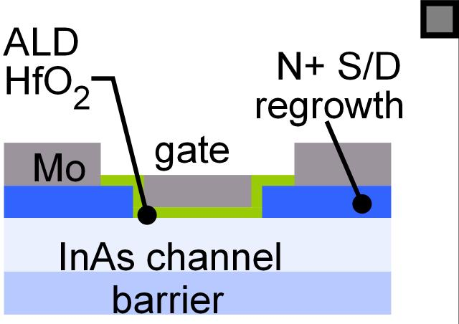
III-V MOS: Benefits THz HEMTs
VLSI III-V MOS
THz III-V MOS
3mS/micron
S. Lee et al., EDL, June 2014

Slide 22
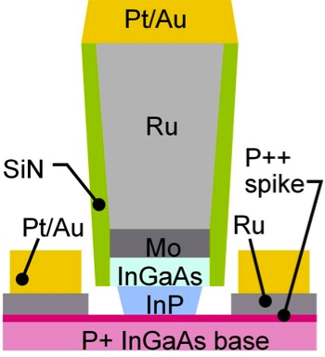
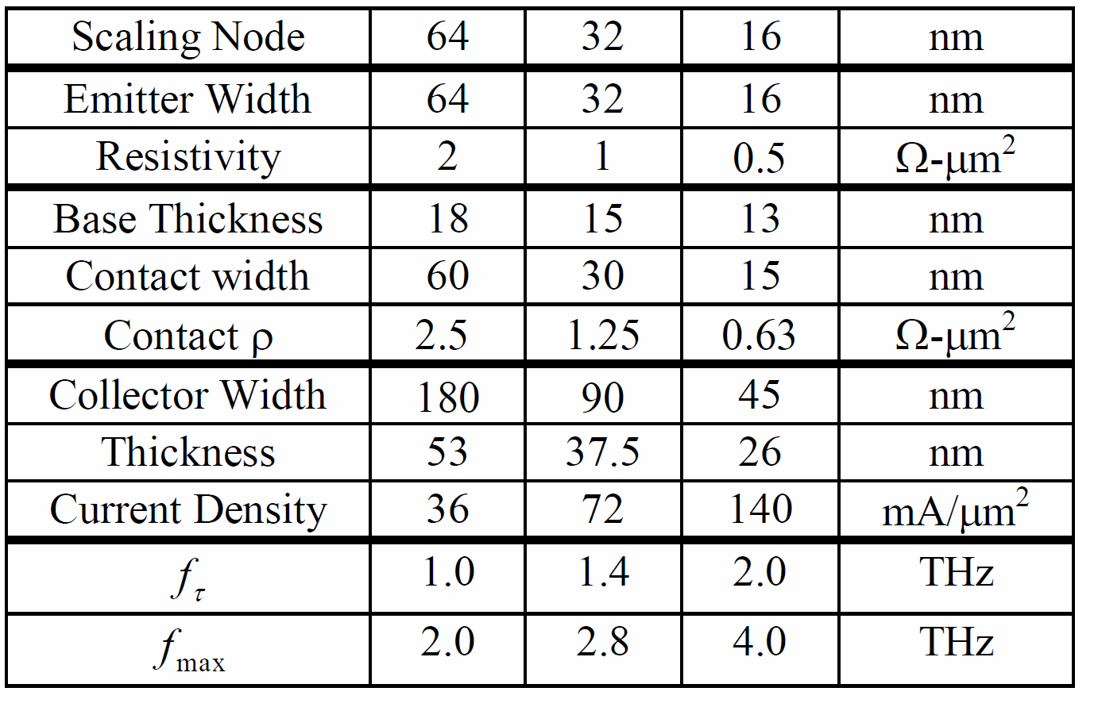
3 THz Bipolar Transistors are Feasible.
Needs
0.5 Ω-μm² resistivity contacts
ultra-shallow→ refractory
~100 mA/μm² current densities
16 nm junctions
Impact:
Efficient power amplifiers,
ADCs
complex mm-wave systems
from 100-1000 GHz.

Slide 23
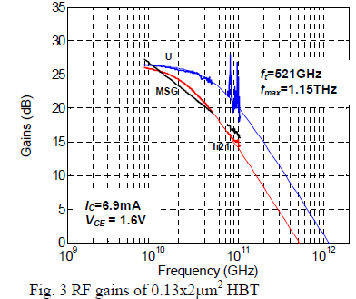
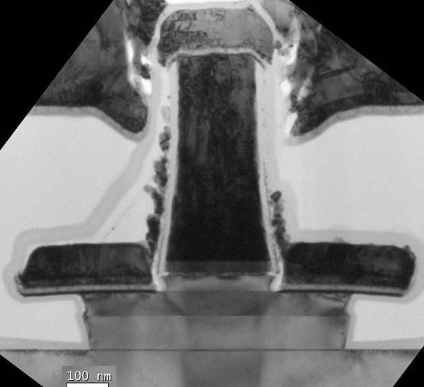
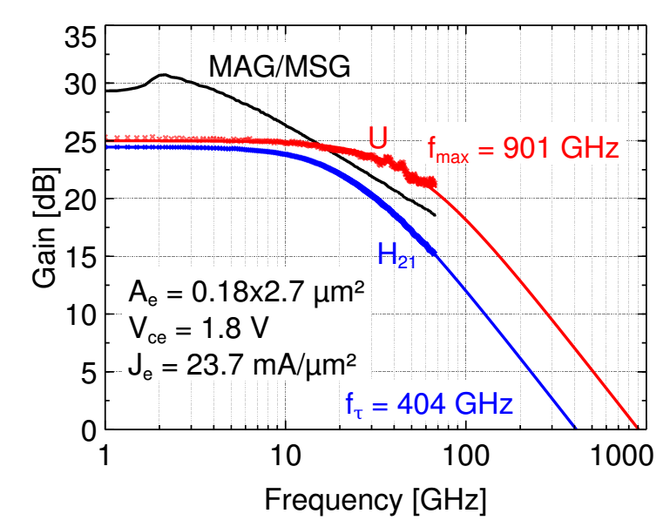
THz InP HBTs: Performance @ 128 nm Node
UCSB: V. Jain et al: 2011 DRC
Teledyne: M. Urteaga et al: 2011 DRC
UCSB: J. Rode et al: unpublished
UCSB: J. Rode et al: unpublished
BVCEO=4.3 V

Slide 24


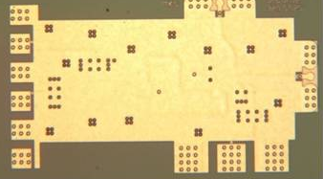
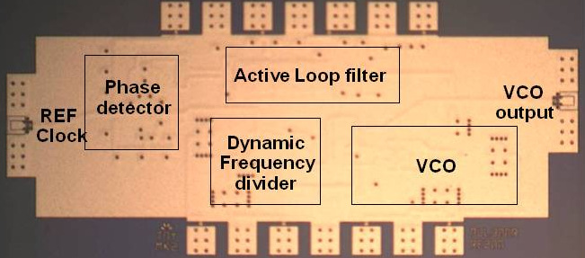
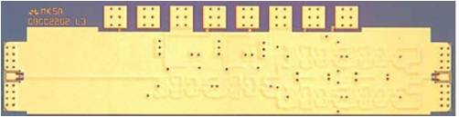

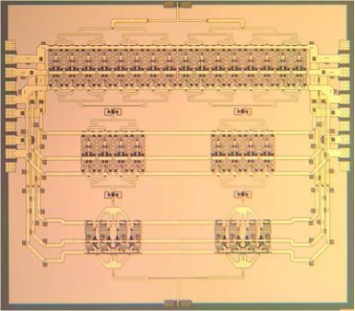
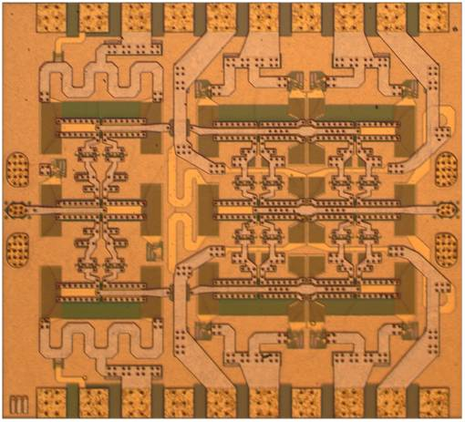
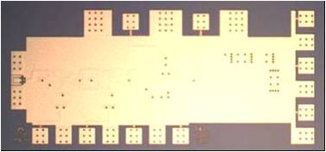
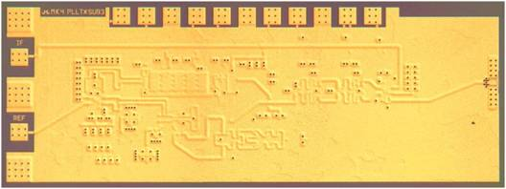
InP HBT Integrated Circuits: 600 GHz & Beyond
614 GHz
fundamental
VCO
340 GHz dynamic frequency divider
M. Seo, TSC / UCSB
M. Seo, UCSB/TSC
IMS 2010
620 GHz, 20 dB gain amplifier
300 GHz fundamental
PLL
M Seo, TSC
IMS 2013
M. Seo, TSC
IMS 2011
Not shown: 670 GHz HBT amplifier
J. Hacker, TSC, IMS 2013
204 GHz static
frequency divider
(ECL master-slave
latch)
220 GHz
180 mW
power amplifier
81 GHz
470 mW
power amplifier
Z. Griffith, TSC
CSIC 2010
T. Reed, UCSB
CSICS 2013
H-C Park UCSB
IMS 2014
Integrated 300/350GHz Receivers:
LNA/Mixer/VCO
600 GHz
Integrated
Transmitter
PLL + Mixer
M. Seo TSC
M. Seo TSC

Slide 25



Extreme Currents: Quadratic I-V Characteristics
Boltzmann
Fermi-Dirac
Highly Degenerate
High currents→ transconductance less than qI/kT → bandwidth decreases
Highly degenerate limit→ Transconductance varies as J^{1/2}(m*)^{1/2} → must increase m*

Slide 26

Ultra Low-Resistivity Refractory Contacts
Baraskar et al, Journal of Applied Physics, 2013
32 nm node
requirements
Refractory: robust under high-current operation.
Low penetration depth: ~ 1 nm.
Performance sufficient for 32 nm /2.8 THz node.

Slide 27

Refractory Emitter Contact and Via
low-resistivity
Mo contact
sputtered,
dry-etched W/TiW via
Refractory metals→ high currents

Slide 28

Needed: Much Better Base Ohmic Contacts
Needed: Much Better Base Ohmic Contacts
Pt/Ti/Pd/Au
(3.5/12/17/70 nm)
emitter
emitter
Au
Au
~5 nm deep
Pt contact
reaction
(into 25 nm base)
Pd
Pd
Ti
Ti
base
base

Slide 29

Two-Step Base Contact Process
1) Blanket deposit 1nm Pt
2) Blanket deposit 10nm Ru
(refractory)
3) Pattern deposit Ti/Au
Surface not exposed to photoresist→ less surface contamination
1 nm Pt layer: 2-3 nm surface penetration
Thick Au: low metal resistance

Slide 30
Two-Step Base Contact Process
32 nm node
requirement
Increased surface doping:
reduced contact resistivity,
increased Auger recombination.
→ Surface doping spike 2-5nm thick.
Need limited-penetration metal

Slide 31

"Near-Refractory" Base Ohmic Contacts

Slide 32



THz InP HBTs
a few more things to fix ...

Slide 33
1-D, 30 THz diodes

Slide 34




1-D (nm) Diodes for 30THz mixing/detection

Slide 35
THz & nm Transistors: What's Needed
What do we want ?
VLSI: lots of on-current, no off-current, low voltage
THz: high frequencies. Low noise, high power, high gain.
How do we get it ?
Extreme current densities
Extremely thin dielectrics (FETs)
Extremely low-resistivity contacts
few-nm critical dimensions
...and sufficient states to carry the current

Slide 36
(end)

Slide 37
Backup slides

Slide 38


InAs/InGaAs MOSET: Process Flow
Development process flow does not provide a small S/D contact pitch,
But: in manufacturing, the vertical spacer can provide a small S/D contact pitch.

Slide 39
set aside slides

Slide 40




Why III-V MOS ? Other good reasons
nm-precise epitaxy, large heterojunctions → thin channels, bandgap engineering
Y-K. Choi et al, VLSI Tech. Symp., 2001
(1nm hard for SOI)
Excellent contacts
Dielectric-channel interface:
Large ΔE_{C}, no SiO₂ at interface
http://nano.boisestate.edu/research-areas/gate-oxide-studies/

Slide 41

The Key question:
Intel 22nm finFETs Jan, IEDM 2012
Compared to Silicon MOS,...
...can we get high I_{on} ,
..and low I_{off} , and low V_{DD} ,
...at a VLSI-relevant (8-10nm) technology node ?
Performance @ e.g. 35nm is not important.
Small S/D pitch is essential.

Slide 42
Transistor Design:
What Matters ?

Slide 43












Scaling: How (V,I,R,C,τ) varies with geometry
Depletion Layers
Fringing Capacitances
Thermal Resistance
Bulk and Contact Resistances
Available states to carry current
→ capacitance,
transconductance
contact resistance

Slide 44





THz & nm Transistors: State Density Limits
2-D: FET
3-D: Bipolar
capacitance
current
conductivity
# available states / energy determines
on-state capacitance,
current & transconductance,
contact/access resistance

