Slide 1




An 81 GHz, 470 mW, 1.1 mm² InP HBT Power Amplifier with 4:1 Series Power Combining using Sub-quarter-wavelength Baluns
Student
Paper
Finalist
TU3B-1
H. Park¹, S. Daneshgar¹, J. C. Rode¹, Z. Griffith², M. Urteaga², B.S. Kim³, M. Rodwell¹
¹University of California, Santa Barbara, CA, US
²Teledyne Scientific and Imaging, Thousand Oaks, CA, US
³Sungkyunkwan University, Suwon, Republic of Korea

Slide 2
Outline
Motivation, Challenge
Power-combining Techniques in mm-Wave
Proposed Baluns (2:1 and 4:1 Series Combiners)
Power Amplifier Designs (2:1 and 4:1)
Measurement Results and Comparisons
Conclusion
TU3B-1
2
IMS2014, Tampa, 1-6 June, 2014

Slide 3
mm-Wave Power Amplifier: Challenges
mm-Wave PAs:
Applications: High speed communications, high resolution images
Needed: High power / High efficiency / Small die area (low cost)
Extensive power combining
Compact power-combining
Class E/D/F are poor @ mm-wave
insufficient gain ~f_{max},
high losses in harmonic terminations
Efficient power-combining
Goal: efficient, compact mm-wave power-combiners
TU3B-1
IMS2014, Tampa, 1-6 June, 2014
3

Slide 4
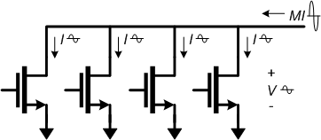
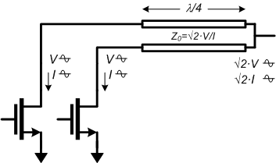
Parallel Power-Combining
Output power: P_{OUT} = V x (M x I)
Parallel connection increases P_{OUT}
Load Impedance: R_{OPT} = V / (M x I)
Parallel connection decreases R_{OPT}
High P_{OUT} using low V_{DD} → Low R_{OPT}
Needs impedance transformation:
Wilkinson or lumped lines …
High insertion loss
Small bandwidth
Large die area
TU3B-1
4
IMS2014, Tampa, 1-6 June, 2014

Slide 5
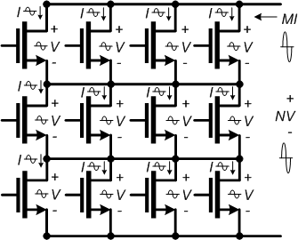
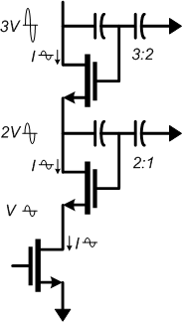
Series Power-Combining & Stacks
Parallel connections: I_{OUT} = M x I
Series connections: V_{OUT} = N x V
Output power: P_{OUT} = (N·M) x V x I
Load impedance: R_{OPT} = (N/M) x V/I
Small or zero power-combining losses
Small die area
BUT, how do we drive the gates ?
Local voltage feedback:
drives gates, sets voltage distribution
Design challenge:
need uniform RF voltage distribution
need ~unity RF current gain per element
...needed for simultaneous compression of all FETs.
TU3B-1
5
IMS2014, Tampa, 1-6 June, 2014

Slide 6
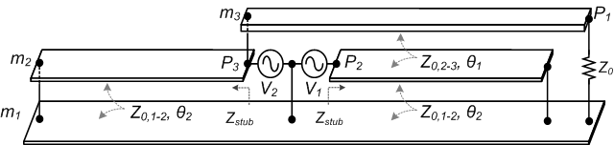
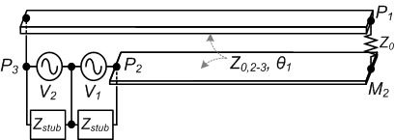
Proposed λ/4 Baluns
Balun structure
Simplified model
Our proposed balun with λ/4 lines
Three-conductor transmission-lines
→ Two separate transmission lines (m₃-m₂, m₂-m₁)
Fields between m₃ and m₁ isolated!
λ/4 line stub → Z_{stub} = open
BUT, still long line → high loss and large die area ☹
TU3B-1
IMS2014, Tampa, 1-6 June, 2014
6

Slide 7
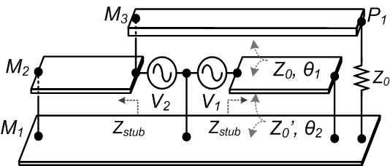
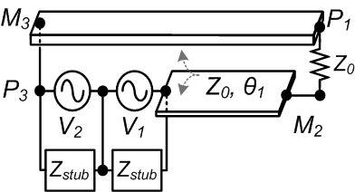
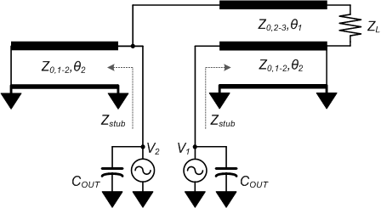
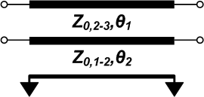
Proposed Sub-λ/4 Baluns
What if balun length is << λ/4 ?
→ Stub line becomes inductive!
Sub-λ/4 balun:
Inductive stub line
Tunes transistor C_{OUT} !!
Short line → Low losses ☺
→ Small die area ☺
*Symbol:
Three-conductor transmission line
TU3B-1
IMS2014, Tampa, 1-6 June, 2014
7

Slide 8
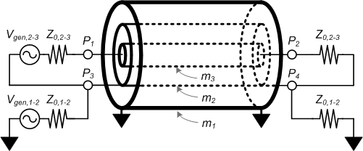
Ideal Tri-axial Line
Two separate transmission lines (m₃-m₂, m₂-m₁)
→ E, H fields between m₃ and m₁ perfectly shielded
TU3B-1
IMS2014, Tampa, 1-6 June, 2014

Slide 9
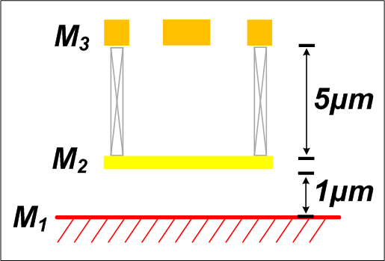
Baluns in Real ICs
1)
2)
3)
4)
  1) M₁ as a GND
  2) Slot-type transmission lines (M₁-M₂), AC short (2 pF MIM)
  3) Microstrip line (M₂-M₃), E-field shielding NOT negligible
  4) Sidewalls between M₃-M₁ (Faraday cages), λ/16 length
TU3B-1
IMS2014, Tampa, 1-6 June, 2014
9

Slide 10
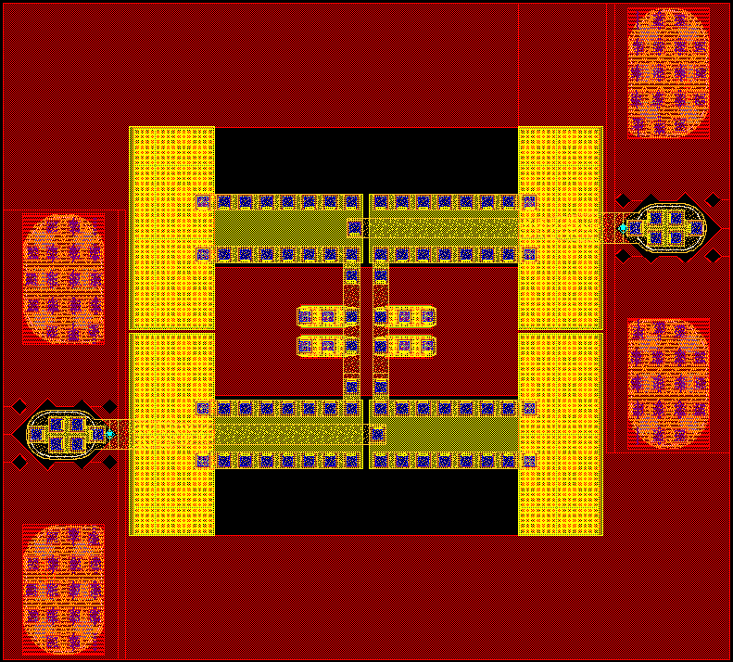
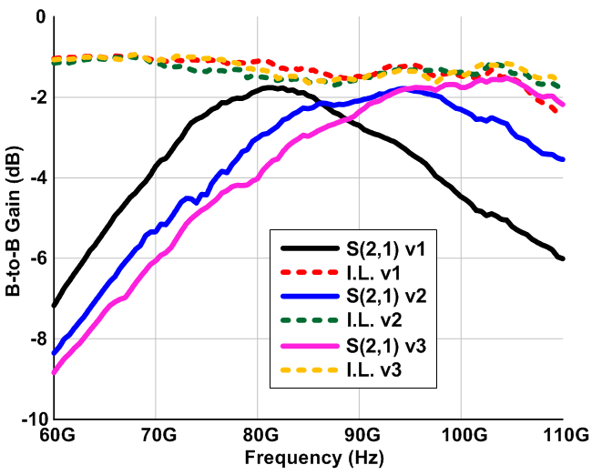
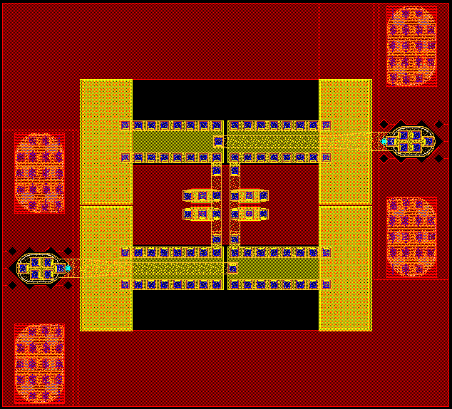
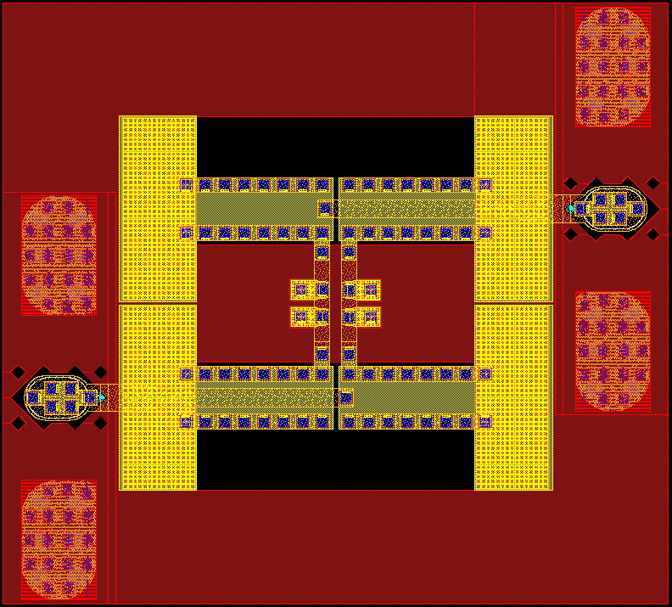
2:1 Balun B-to-B Test Results
v1
C_{P} = 103fF
F_{C} = 81GHz
I.L. = -1.1dB
S21 = -1.76dB
Back-to-back measured S-parameters
v2
C_{P} = 78fF
F_{C} = 94GHz
I.L. = -1.2dB
S21 = -1.79dB
v3
C_{P} = 65fF
F_{C} = 103GHz
I.L. = -1.2dB
S21 = -1.56dB
*Does not de-embed losses of PADs , capacitors, and interconnection lines
< 0.6dB single-pass insertion loss, 0.16 dB/2.7° imbalance
TU3B-1
IMS2014, Tampa, 1-6 June, 2014
10

Slide 11
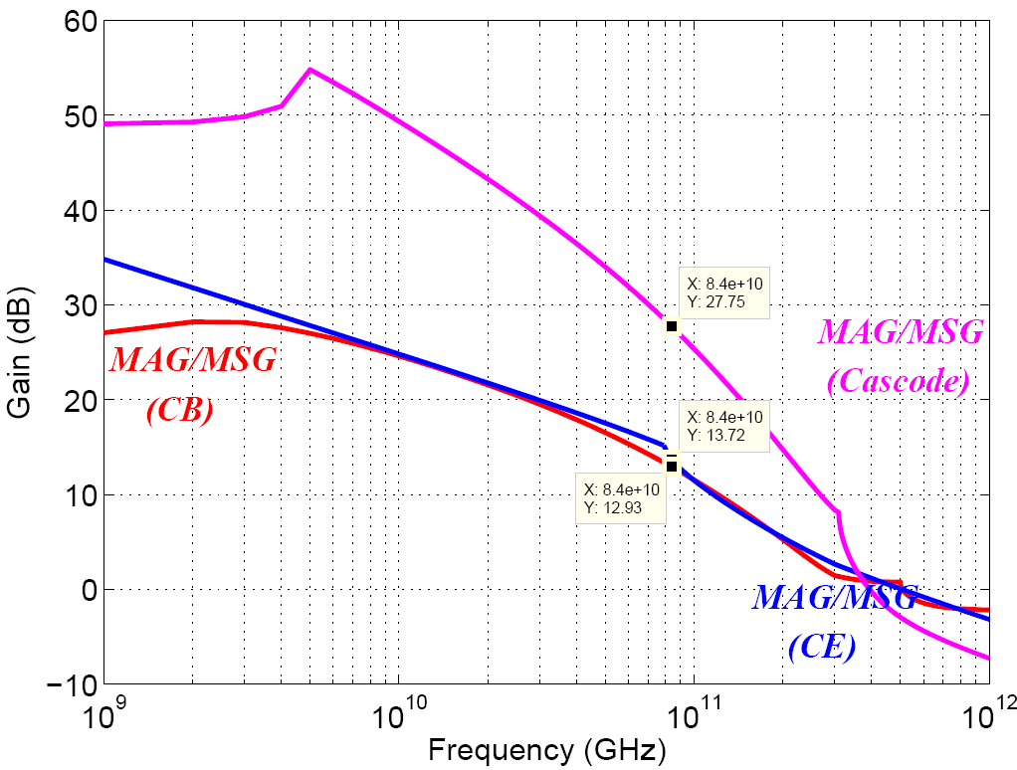
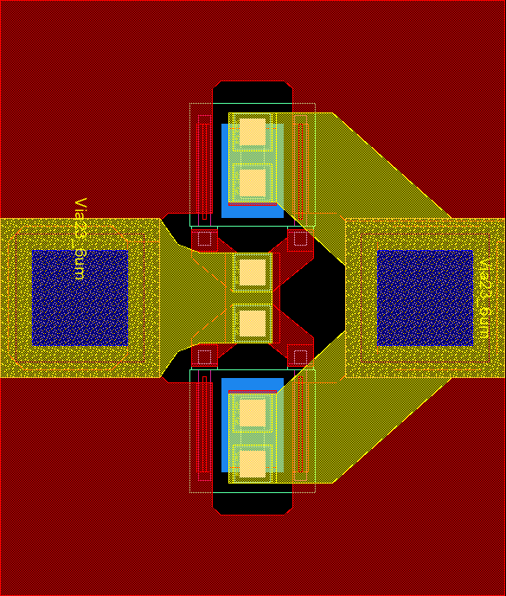
Teledyne 0.25 μm HBTs
Cell: 4-fingers x 0.25 μm x 6 μm
BV_{CEO} = 4.5 V, I_{C,max} = 72 mA
P_{OUT} = 15.5 dBm
R_{OPT} = 56 Ω
MAG/MSG including EM-Sim. results
Emitters to GND
Base
Collector
f_{τ} =285 GHz, f_{max} =525 GHz
@ J_{E} =4.2 mA/μm² and V_{CE} =2.5 V
12~13dB MAG @ 86 GHz
[Z. Griffith et al, IPRM 2012]
Multi-finger 250nm InP HBTs for 220GHz mm-Wave Power Multi-finger 250nm InP HBTs for 220GHz mm-Wave Power
TU3B-1
IMS2014, Tampa, 1-6 June, 2014
11

Slide 12
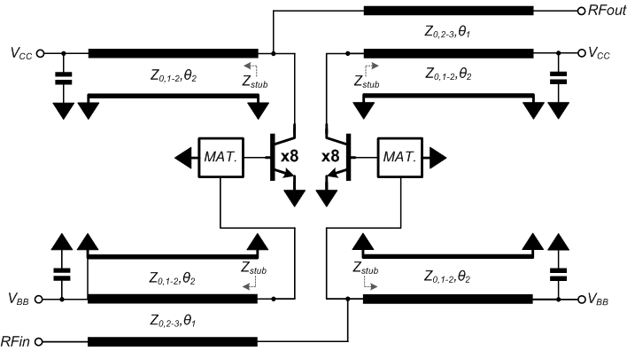
Sub-λ/4 Baluns: PA Design
Each HBT loaded by 25 Ω
HBT junction area selected
so that I_{max}=V_{max}/25 Ω
Each HBT has some C_{OUT}
Stub length picked so that
Z_{stub}=-1/jωC_{OUT} → tunes HBT
4:1 more power
than without the combiner.
TU3B-1
IMS2014, Tampa, 1-6 June, 2014
12

Slide 13
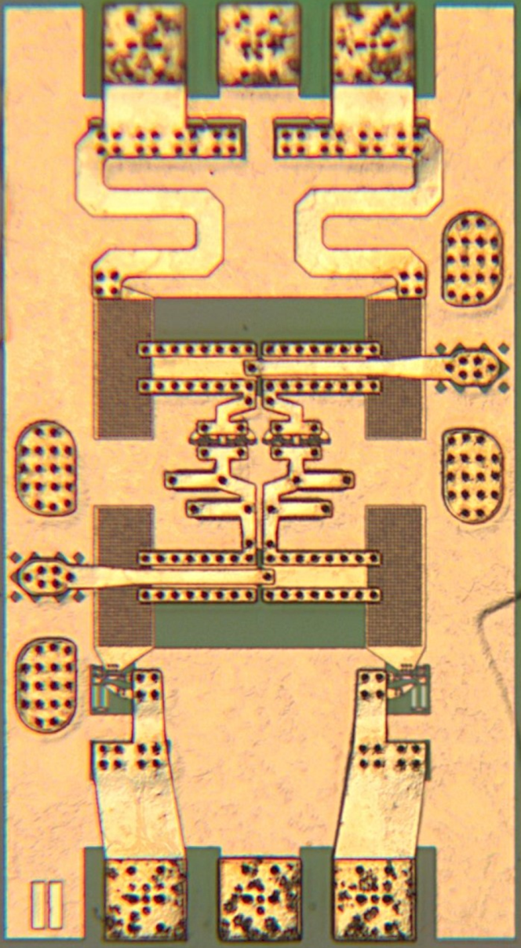
4:1 PA Designs Using 2:1 Balun
Identical input / output baluns
2-section LC input matching network
Active bias: Thermal stability & class-AB
IC size: 450 x 820 um²
[H. Park et al, CSICS 2013]
30% PAE W-Band InP Power Amplifiers Using Sub-Quarter-Wavelength Baluns for Series-Connected Power-Combining
TU3B-1
IMS2014, Tampa, 1-6 June, 2014
13

Slide 14
Single-Stage PA IC Test Results (86GHz)
Small signal measurements
x4 larger output power
than 50 Ohm R_{OPT} device
  Gain: 10 dB
  P_{SAT}: >100 mW @2.5V
  PAE: >30 %
  3-dB BW: 23 GHz
Large signal measurements
  Power density (power/die area)
  = 294 mW/mm² (including RF pads)
  = 1210 mW/mm² (core area)
[H. Park et al, CSICS 2013]
30% PAE W-Band InP Power Amplifiers Using Sub-Quarter-Wavelength Baluns for Series-Connected Power-Combining
TU3B-1
IMS2014, Tampa, 1-6 June, 2014
14

Slide 15
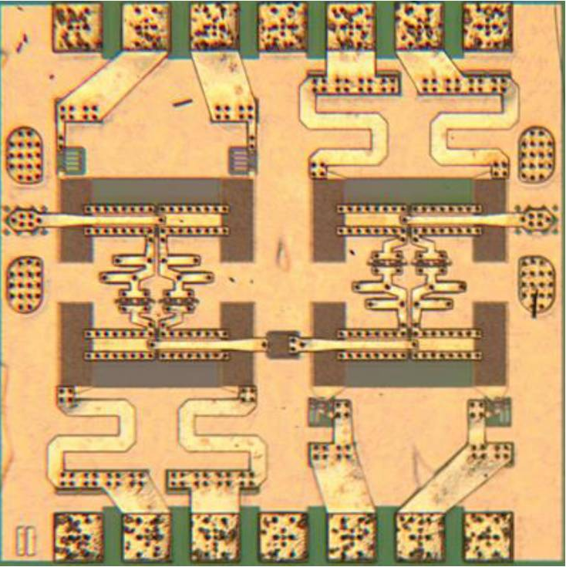
Two-Stage PA IC Test Results (86GHz)
Large signal measurements
  IC size: 825 x 820 um²
  Gain: 17.5 dB
  P_{SAT}: >200 mW @ 3.0 V
  PAE: >30 %
  Power density (power/die area)
  = 307 mW/mm² (including RF pads)
  = 927 mW/mm² (core area)
[H. Park et al, CSICS 2013]
30% PAE W-Band InP Power Amplifiers Using Sub-Quarter-Wavelength Baluns for Series-Connected Power-Combining
TU3B-1
IMS2014, Tampa, 1-6 June, 2014
15

Slide 16
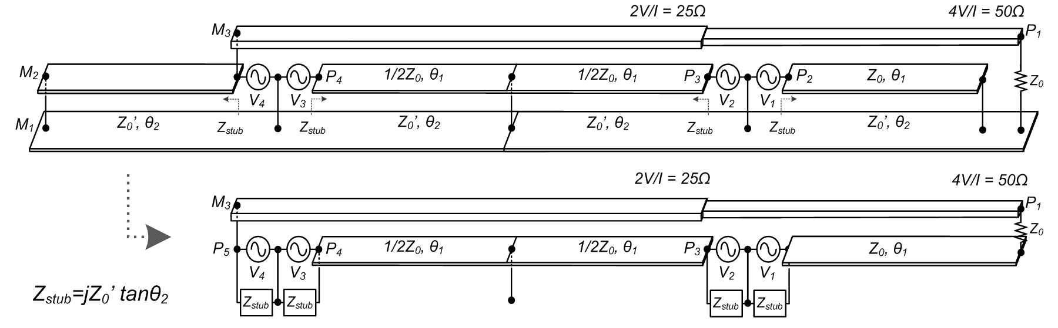
16:1 PA Using 4:1 Baluns
  4:1 series-connected power-combining
Each HBT loaded by 12.5Ω
HBT junction area selected
so that I_{max}=V_{max}/12.5Ω
Each HBT has some C_{OUT}
Stub length picked so that
Z_{stub}=-1/jωC_{out} → tunes HBT
16:1 more power
than without combiner.
TU3B-1
IMS2014, Tampa, 1-6 June, 2014
16

Slide 17
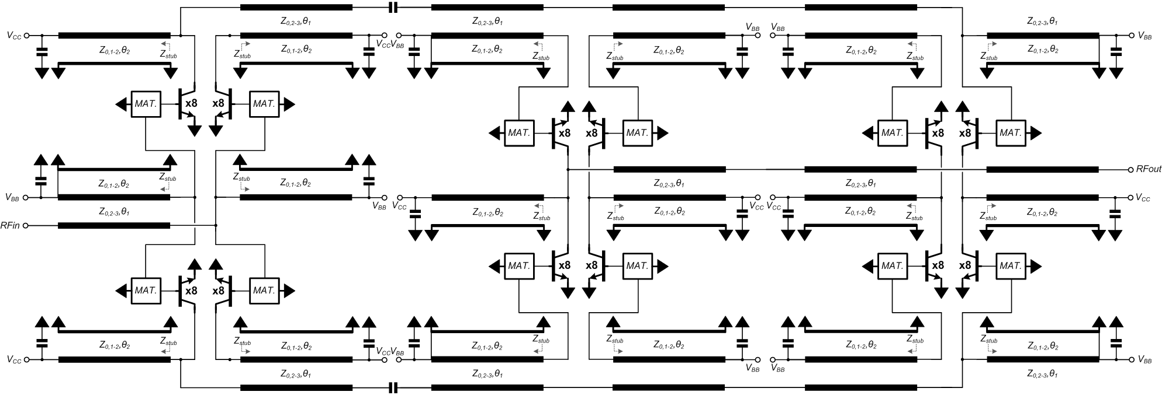
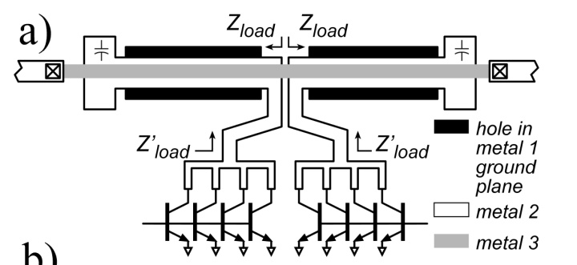
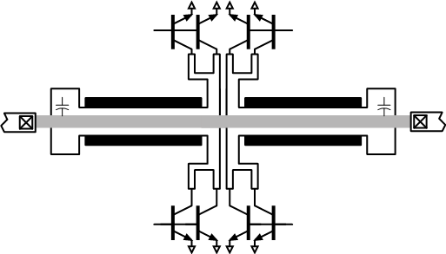
PA IC Schematic (2-stages)
  2-stage PA using 2:1 and 4:1 baluns
1st stage
2nd stage
Long lead lines
Z_{load} ≠ Z’_{load}
TU3B-1
IMS2014, Tampa, 1-6 June, 2014
17

Slide 18
PA IC Die Image (2-stages)
  IC Size: 1.08 x 0.98 mm²
TU3B-1
IMS2014, Tampa, 1-6 June, 2014
18

Slide 19
PA IC Test Results (81 GHz)
Small signal measurements
x16 larger output power
than 50 Ohm R_{OPT} device
  Gain: 17.8dB
  Output Power: 470mW @2.75 V
  PAE: 23.4%
Large signal measurements
  Power density (power/die area)
  = 443 mW/mm² (including pads)
  = 1020 mW/mm² (only core area)
TU3B-1
IMS2014, Tampa, 1-6 June, 2014
19

Slide 20
mm-Wave Power Combiners
Ref. | Tech. | Type | N-way | Freq. (GHz) | IL (dB) | Size (mm²)
This work | 0.25 μm InP HBT | Sub-λ/4 TL | 2:1 | 86 (60-105) | 0.52 (0.68) | 0.03
This work | 0.25 μm InP HBT | Sub-λ/4 TL (ring) | 2:1 | 86 (60-110) | 0.50 (0.63) | 0.04
This work | 0.25 μm InP HBT | Sub-λ/4 TL | 4:1 | 87 (75-103) | 0.91 (1.32) | 0.06
2012 Yi | 0.13 μm BiCMOS | TF | 4:1 | 60 77/79 | 0.73* 1.20* | 0.015
2013 Thian | 0.18 μm BiCMOS | TF | 8:1 | 83.5 (70.5-85) | 1.25 (0.80*) | 0.02#
2010 Chen | 65 nm CMOS | TF | 4:1 | 60 | 0.63* | 0.02#
2010 Law | 90 nm CMOS | Wilkinson | 2:1 | 60 | 0.54 | 0.08
2014 Zhao | 40 nm CMOS | Series/ parallel TF | 4:1 | 75 (65-90) | 0.92* (1.0) | 0.05#
2007 Niknejad | 90 nm CMOS | TL | 4:1 | 60 (55-65) | 1.09* (1.25*) | -
2007 Liu | 0.18 μm CMOS | Marchand | 2:1 | 57 | 3.40 | 0.55
2005 Hamed | InGaP/GaAs | Marchand | 2:1 | (15-45) | (1.50) | 0.40
*Simulation results, #Area estimated by chip image. IL: insertion loss, TF: transformer, and TL: transmission-line. Parentheses in the frequency and insertion loss columns indicate worst-case insertion loss over the indicated bandwidth.
TU3B-1
IMS2014, Tampa, 1-6 June, 2014
20

Slide 21
mm-Wave Power Amplifiers
Ref. | Tech. f_{max} / f_{τ} (GHz) | Freq. (GHz) | BW (GHz) | Max. S₂₁ (dB) | P_{out} (dBm) | Peak PAE (%) | V_{CC} or V_{DD} (V) | Size (mm²) | mW /mm²
This work | 0.25 μm InP HBT 525 / 285 | 86 | 23 | 9.4 | 20.4 | 30.4 | 2.5 | 0.37 0.09* | 294 1210*
This work | 0.25 μm InP HBT 525 / 285 | 86 | 33 | 10.2 | 20.8 | 35.0 | 2.5 | 0.43 0.14* | 285 858*
This Work | 0.25 μm InP HBT 525 / 285 | 81 | >11.5 | 17.5 | 26.7 | 23.4 | 2.75 | 1.06 0.46* | 443 1020*
2011 Brown | 0.14 μm GaN HEMT | 91 | 7⁺ | 16.0 | 30.8 | >20.0 | 17.5 | 2.25 | 530
2012 Micovic | 0.14 μm GaN HEMT 230 / 97 | 95 | 10⁺ | 18.0⁺ | 31.5⁺ | 20.5⁺ | 12.0 | - | -
2012 Yi | 0.13 μm BiCMOS 270 / 240 | 62 84 | >10 >8 | 20.6 27.0 | 20.1 18.0 | 18.0 9.0 | 1.8 2.5 | 0.72 0.68 | 142 93
2013 Agah | 45 nm SOI CMOS | 89 | 10⁺ | 10.3 | 15.8 | 11.0 | 2.8 | 0.37 0.05* | 103 760*
2013 Thian | 0.18 μm BiCMOS 250 / 170 | 78 | 8.9 | 18.3 | 14 | 2.0 | 3.2 | 0.85* | 29*
2010 Chen | 65nm CMOS | 60 | 9 | 20.3 | 18.6 | 15.1 | 1.0 | 0.28* | 256*
2010 Law | 90nm CMOS | 60 | 8 | 20.6 | 19.9 | 14.2 | 1.2 | 1.76 | 55
2014 Zhao | 40nm CMOS | 80 | 15.2 | 18.1 | 20.9 | 22.3 | 0.9 | 0.19* | 647*
*IC core area (excluding DC feed lines and RF pads), ⁺Value estimated from figure, ^{c)}Corporate transmission-line power-combiners, ^{s)}Stacked PA.
TU3B-1
IMS2014, Tampa, 1-6 June, 2014
21

Slide 22
Conclusion
Sub-λ/4 baluns for series-power-combining using a low V_{BV} device
Low-loss <0.6dB @ 2:1 balun, <0.92dB loss @ 4:1 balun
→ High power, high efficiency, compact PA IC designs
W-band power amplifiers using the 2:1 & 4:1 baluns
Record >30 % PAE @ 100 mW, 200 mW, 23.4 % PAE @470 mW
Record 23 GHz 3-dB bandwidth, >10GHz 3-dB BW
Record 1210 mW/mm² power density, 1020 mW/mm²
Future directions
220GHz PA designs using the sub-λ/4 baluns
SiGe PA designs with the optimized balun structures
Phased arrays at K/V/E/W bands
TU3B-1
IMS2014, Tampa, 1-6 June, 2014
22

Slide 23
Thanks for your attention!
hcpark@ece.ucsb.edu
TU3B-1
IMS2014, Tampa, 1-6 June, 2014
23

