Slide 1


Ultrathin InAs-Channel MOSFETs on Si Substrates
Cheng-Ying Huang¹, Xinyu Bao², Zhiyuan Ye², Sanghoon Lee¹, Hanwei Chiang¹, Haoran Li¹, Varistha Chobpattana³, Brian Thibeault¹, William Mitchell¹, Susanne Stemmer³, Arthur Gossard^{1,3}, Errol Sanchez², and Mark Rodwell¹
¹ECE, University of California, Santa Barbara
²Applied Materials, Santa Clara
³Materials Department, University of California, Santa Barbara
VLSI-TSA 2015
HsinChu, Taiwan

Slide 2
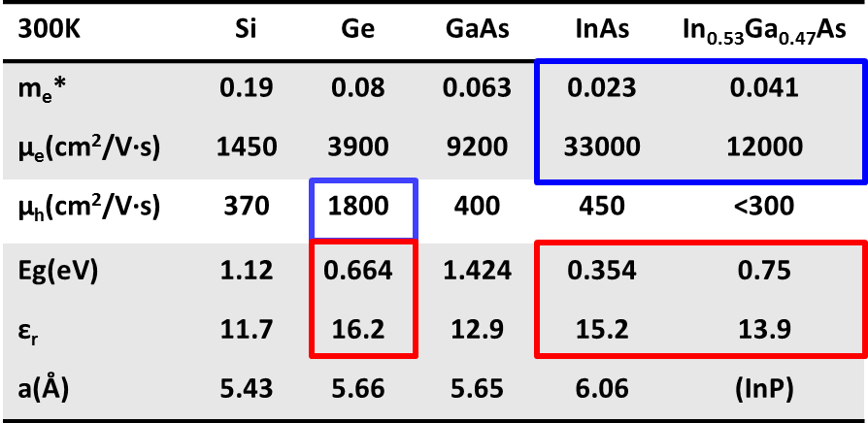
Why InGaAs/InAs FETs?
III-V channel: low electron effective mass, high velocity, high mobility→ higher current at lower V_{DD}
Problems:
Devices: low bandgap → high BTBT leakage
high permittivity → worse electrostatics, large SS and DIBL
- Materials: Integration of III-V on Si, High-K dielectrics on III-V
Goal: Fabricate ultrathin channel III-V FETs on Si
C. Huang et al., DRC 2014
2

Slide 3
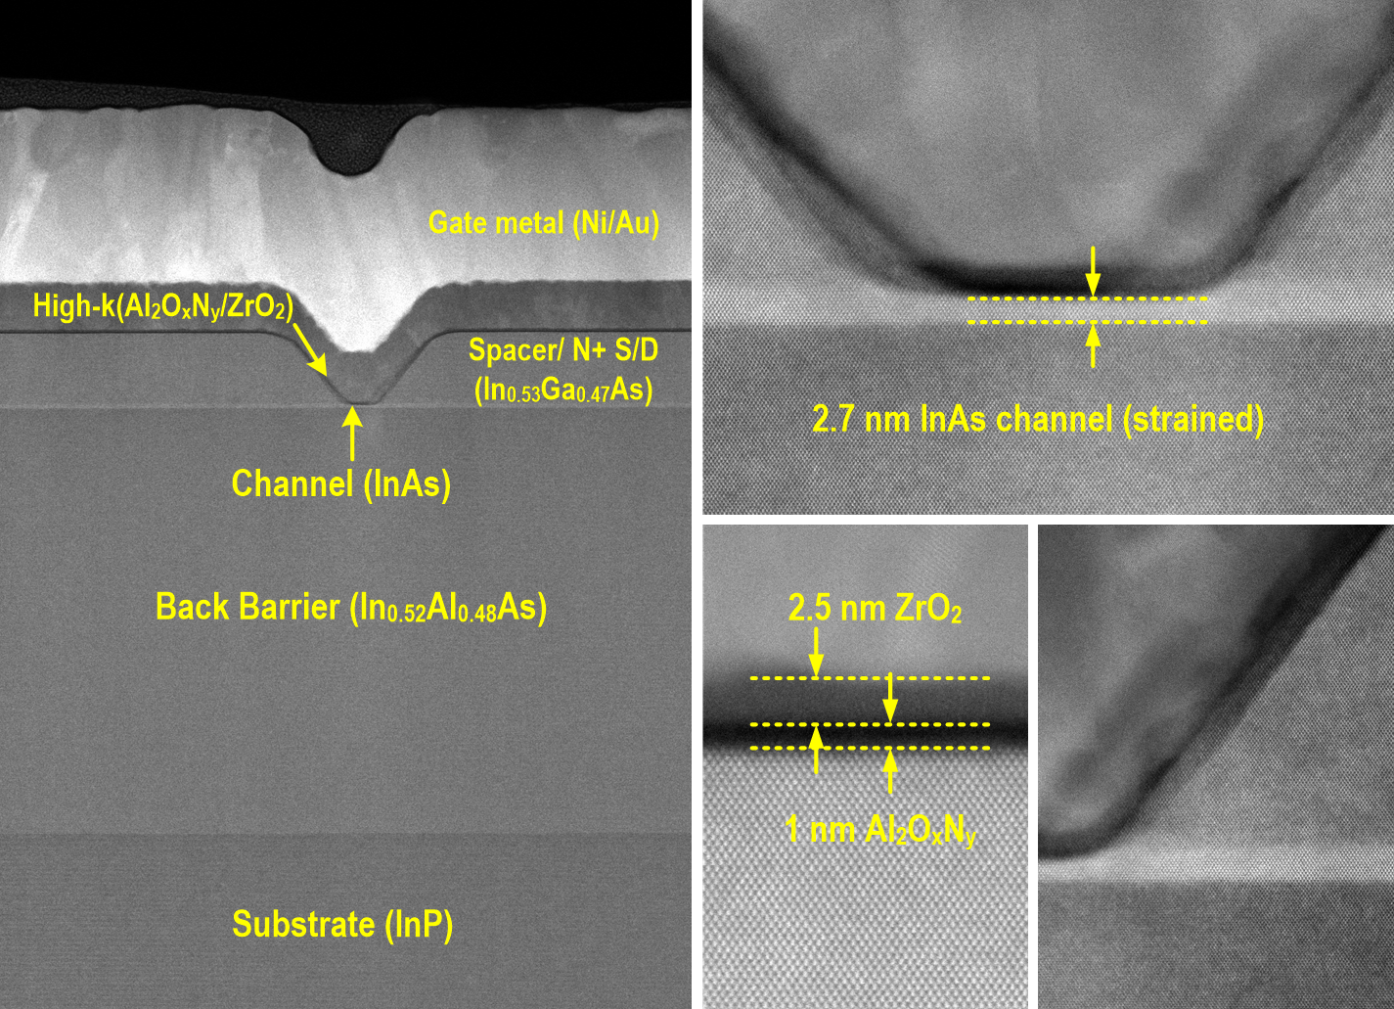
Record III-V FETs on InP substrates
S. Lee et al., VLSI 2014
N+ S/D
Vertical Spacer
3

Slide 4
MOSFET: 2.5nm ZrO₂/ 1nm Al₂O₃ / 2.5nm InAs
61 mV/dec Subthreshold swing at V_{DS}=0.1 V
Negligible hysteresis
4

Slide 5
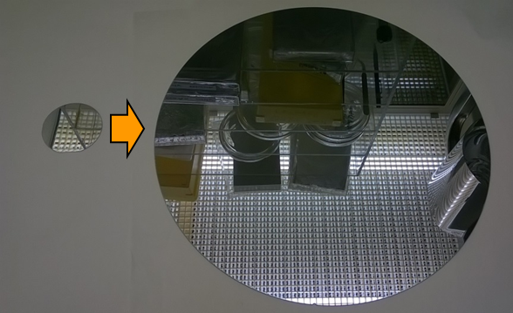
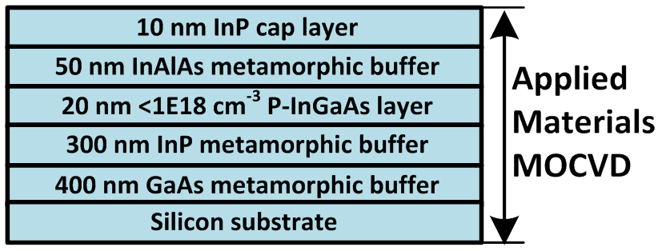
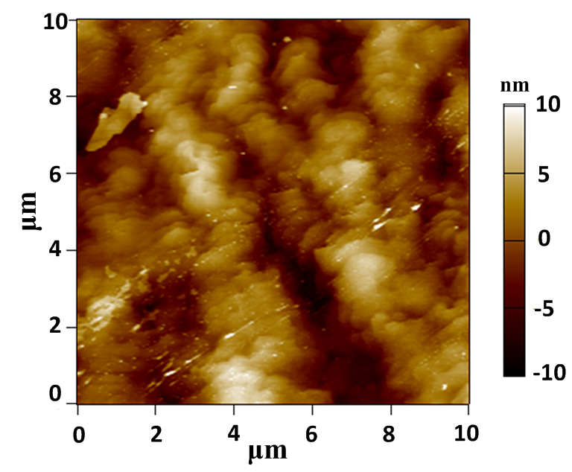
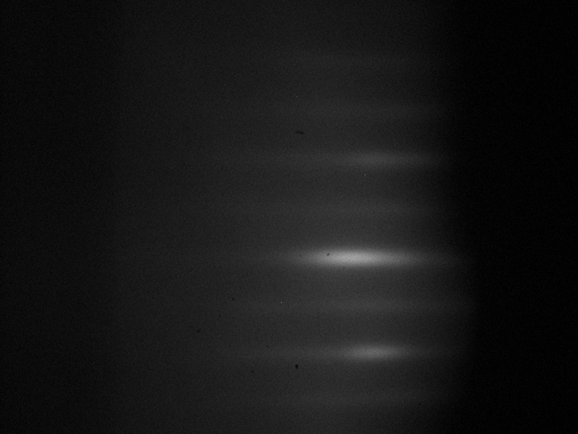
Applied Materials III-V buffer on Si
RHEED in MBE
R_{q}=3.1 nm
5

Slide 6
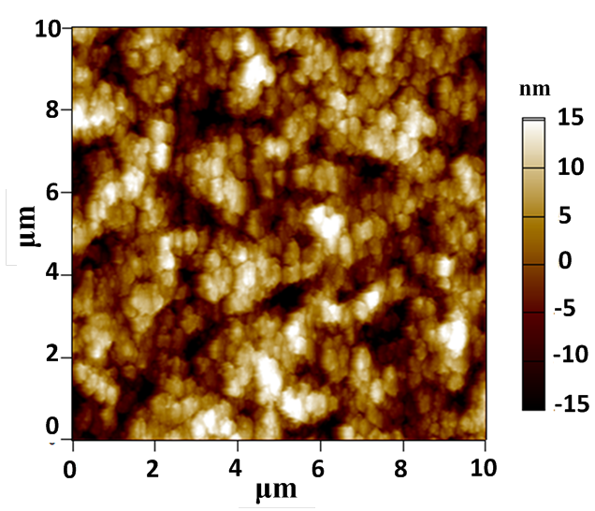
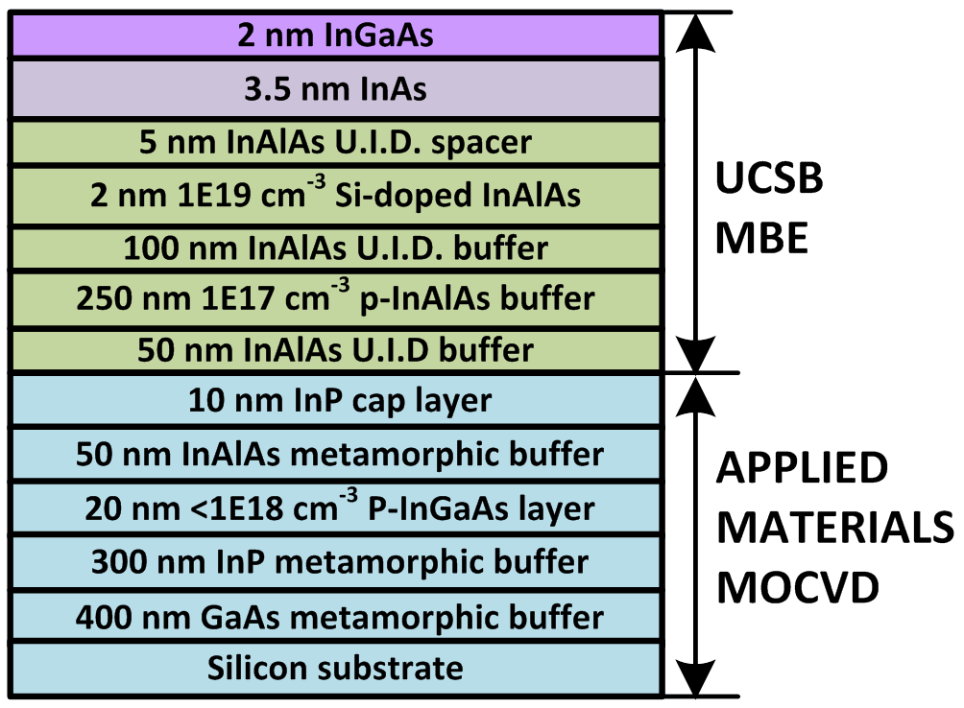
UCSB III-V FET epitaxy
Surface roughness is degraded after FET epitaxy.
R_{q}= 6.9 nm
6

Slide 7
UCSB Gate Last Process Flow
HSQ
HSQ
N+ S/D
Channel
Channel
Channel
III-V Barrier
III-V Barrier
III-V Barrier
Si substrate
Si substrate
Si substrate
MBE/MOCVD grown device epilayer
Pattern dummy gate
MOCVD source/drain regrowth
HfO₂
Ti/Pd/Au
Ni
Ni
N+ S/D
N+ S/D
N+ S/D
Channel
Channel
Channel
III-V Barrier
III-V Barrier
III-V Barrier
Si substrate
Si substrate
Si substrate
Isolation
Strip dummy gate
Digital etch
Deposit dielectric
FGA anneal
Lift-off gate metal
Deposit
S/D contacts
7

Slide 8
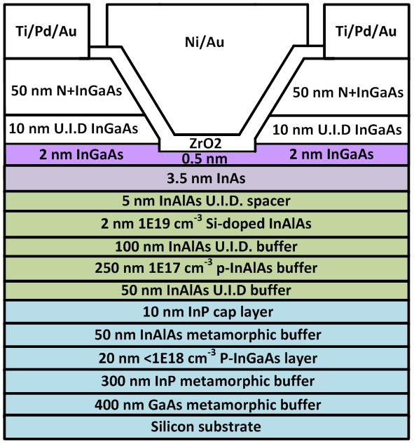
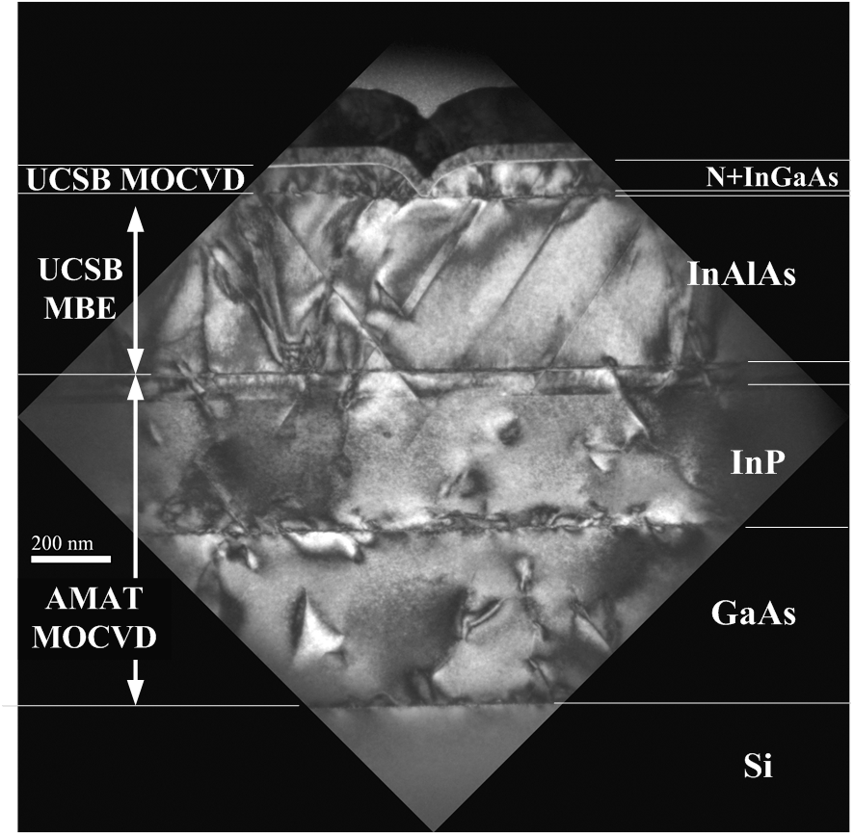
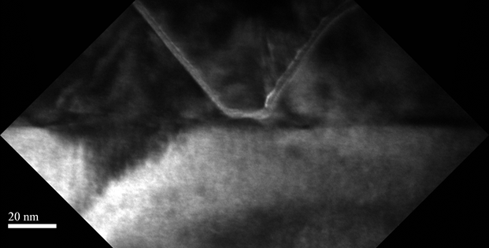
TEM images of III-V FET on Si
Lg~20nm
L_{g}~20nm
8

Slide 9
Short gate length: L_{g}-20 nm
High G_{m}~2.0 mS/μm at V_{D}=0.5 V.
SS~140 mV/dec. at V_{D}=0.5 V and 101 mV/dec. at V_{D}=0.1 V
High I_{on} >1.4 mA/um at V_{GS}=1V.
9

Slide 10
Long gate length: L_{g}-1 μm
SS~74 mV/dec. for L_{g}-1 μm devices.
Off-state leakage dominated by band-to-band tunneling.
Negligible buffer leakage.
10

Slide 11
On-state characteristics
Long L_{g} devices show similar G_{m} to record FETs→ comparable mobility to 2.5 nm InAs on InP.
~25% degradation on S/D sheet resistance and contact resistance.
Thicker channel and degraded R_{S/D} decrease G_{m} at short L_{g}.
11

Slide 12
Subthreshold Characteristics
SS and DIBL are degraded due to thicker channel.
Higher SS at long L_{g}: higher interface trap density.
12

Slide 13
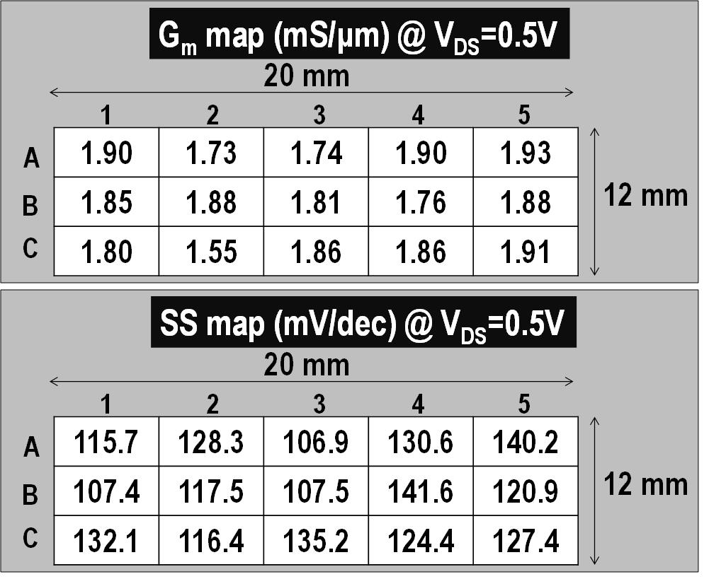
Within-wafer uniformity:L_{g}-45nm devices
G_{m}~1.82 mS/μm
SS~123
mV/dec
13

Slide 14
Benchmark of III-V FETs on Si
I_{on}~235μA/μm
@100nA/μm I_{off}
Further improved material quality reduces R_{on} and increases I_{on}. Further improved surface roughness allows further thinning the
channel, and improves C_{g}, SS and I_{on}.
14

Slide 15
Summary
Demonstrated high performance, and high yield III-V UTB-FETs on Si substrates using the combination of MOCVD and MBE growth, featuring 3.5~4 nm ultrathin channel and L_{g}~20 nm.
Achieved high G_{m} ~ 2.0 mS/μm at V_{D} =0.5V and high I_{on}~1.4 mA/m at V_{GS}=1V and L_{g}~20 nm.
Improving channel surface roughness will allow further channel thickness scaling, and improve SS and I_{on}.
Improving material quality will reduce R_{on} and increase G_{m} and I_{on}.
Thank you! Question?
15

Slide 16
(backup slides follow)

Slide 17
Within-wafer uniformity: V_{th} of Lg-45 nm devices
V_{t, lin} (V) @ 1 μA/μm, V_{DS}=0.1V
20 mm
1
2
3
4
5
A
0.070 | 0.045 | 0.074 | 0.043 | 0.020
0.085 | 0.054 | 0.063 | 0.044 | 0.054
0.041 | 0.102 | 0.047 | 0.056 | 0.055
12 mm
B
C
V_{t,sat} (V) @ 1 μA/μm, V_{DS}=0.5V
20 mm
1
2
3
4
5
A
-0.003 | -0.041 | 0.022 | -0.020 | -0.049
0.036 | -0.006 | 0.008 | -0.042 | -0.006
-0.032 | 0.042 | -0.026 | 0.003 | -0.020
12 mm
B
C

Slide 18
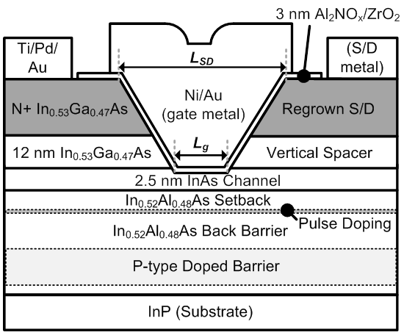
Hero device: VLSI 2014 late news (Sanghoon Lee)
Courtesy of Sanghoon Lee (UCSB)
18

Slide 19
Reducing leakage (3): Ultra-thin channel
S. Lee et al., VLSI 2014
Record III-V MOS
19

Slide 20
MOSFET: 2.5nm ZrO₂/ 1nm Al₂O₃ / 2.5nm InAs
61 mV/dec Subthreshold swing at V_{DS}=0.1 V
Negligible hysteresis
20

Slide 21
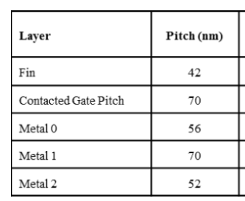
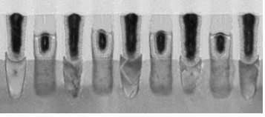
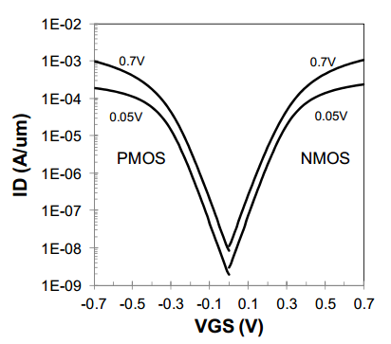
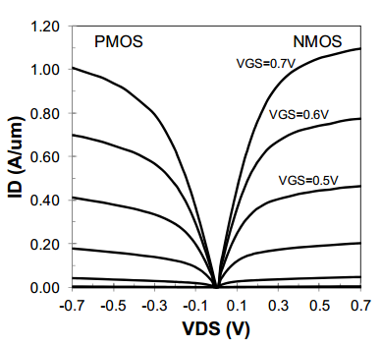
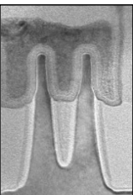
Compared to Intel 14nm finFET
S. Natarajan et al, IEDM 2014, December, San Francisco
I_{off}=10nA/μm, I_{on}=0.45mA/μm @V_{DS}=0.5V per μm of fin footprint
Re-normalizing to fin periphery: ~0.24 mA/μm
21

Slide 22
Reducing leakage (5): Recessed InP S/D spacer
12 nm InGaAs spacer
5 nm Recessed InP spacer
L_{g}-60 nm
C-Y Huang, 2014 Les Eastman Conference
22

Slide 23
Reducing leakage (6): Doping-graded InP spacer
C-Y Huang, 2014 IEDM
L_{g}-30 nm, 30Å ZrO₂
R_{on} at zero L_{g} (Ω∙μm) | 5 nm UID InP | 13 nm UID InP | Doping graded InP
 | ~199 | ~364 | ~270
Doping-graded InP spacer reduces parasitic source/drain resistance and improves G_{m}.
Gate leakage limits I_{off}~300 pA/μm.
23

Slide 24
Reducing leakage (7): Thicker Dielectric
InP graded spacer
InGaAs spacer
38Å ZrO₂
60 pA/μm
Minimum I_{off}~ 60 pA/μm at V_{D}=0.5V for L_{g}-30 nm
100:1 smaller I_{off} compared to InGaAs spacer
C-Y Huang, 2014 IEDM
24

