Slide 1
Record-Performance In(Ga)As MOSFETs
Targeting ITRS High-Performance and Low-Power Logic
227th Electrochemical Society Meeting, Chicago, May 24-28, 2015
M. Rodwell, C. Y. Huang, S. Lee, V. Chobpattana,
B. Thibeault, W. Mitchell, S. Stemmer, A. Gossard
University of California, Santa Barbara

Slide 2
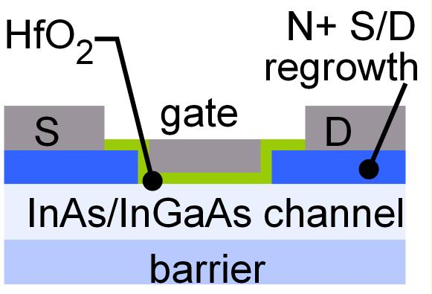
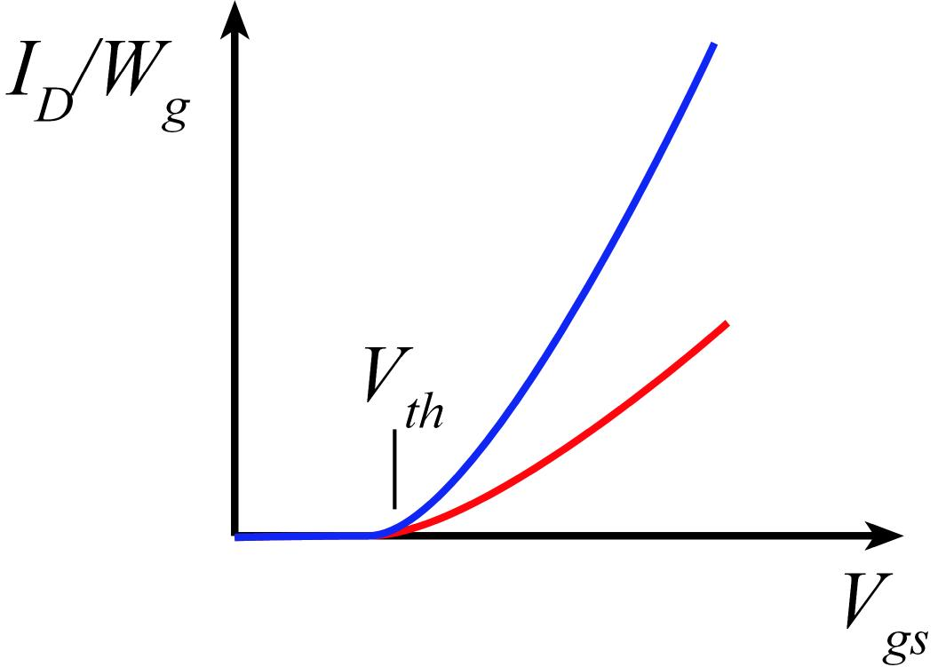
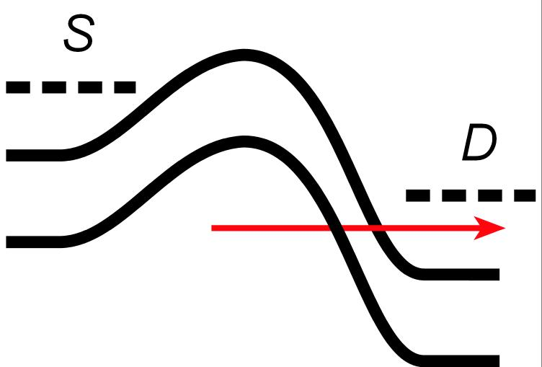
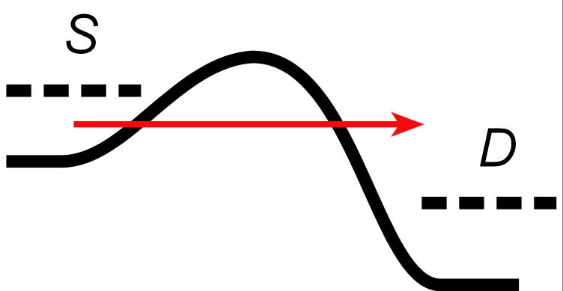
Why III-V MOS ?
III-V vs. Si: Low m*→ higher velocity. Fewer states→ less scattering
→ higher current. Can then trade for lower voltage or smaller FETs.
Problems: Low m*→ less charge. Low m* → more S/D tunneling.
Narrow bandgap→ more band-band tunneling, impact ionization.
2

Slide 3
InGaAs/InAs FETs are leaky!
HP = High Performance: I_{off} =100 nA/μm
GP = General Purpose: I_{off} =1 nA/μm
LP = Low Power: I_{off} =30 pA/μm
ULP = Ultra Low Power: I_{off} =10 pA/μm
3

Slide 4
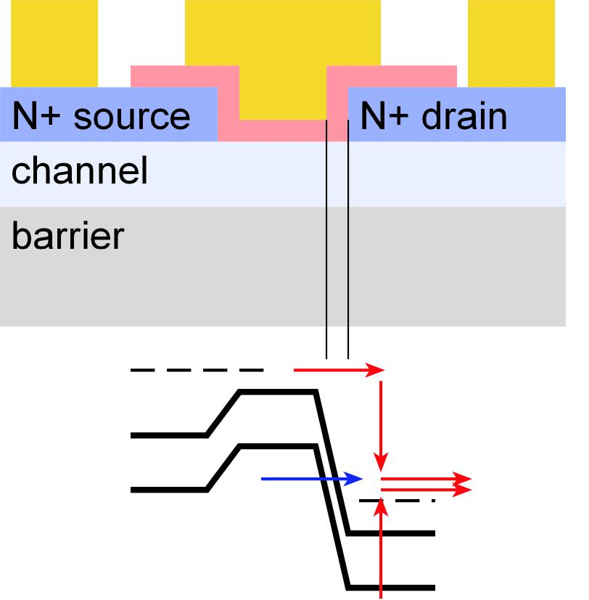
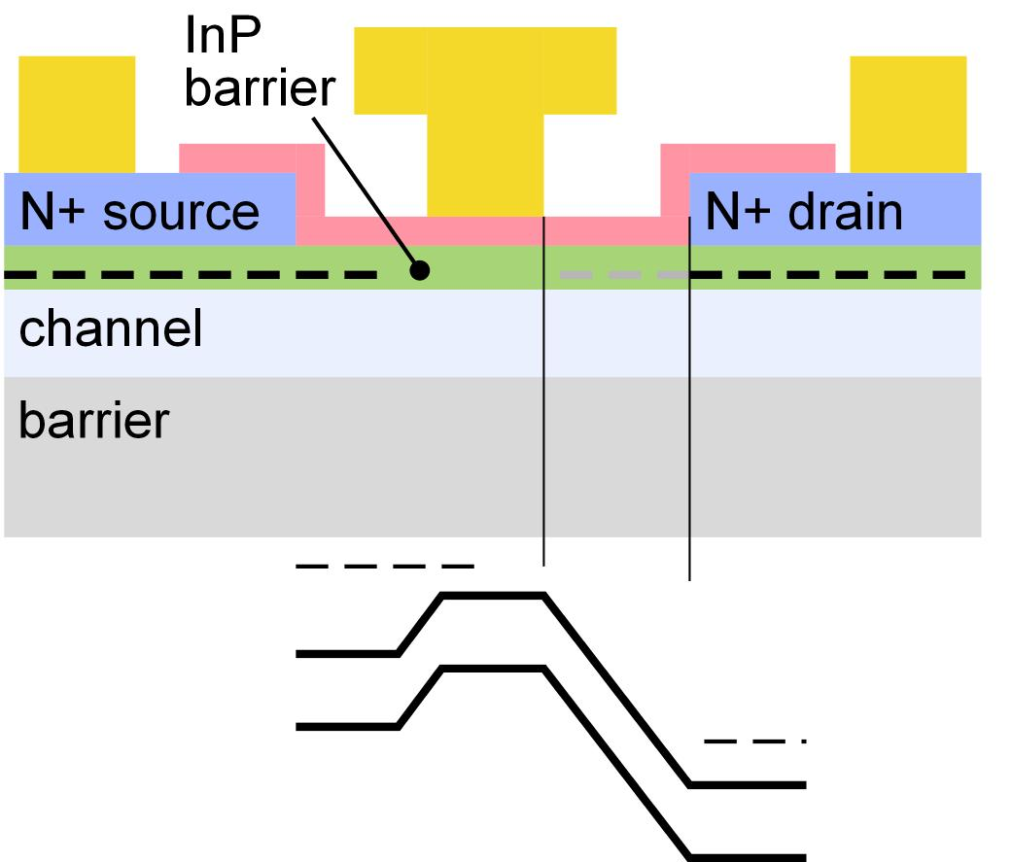
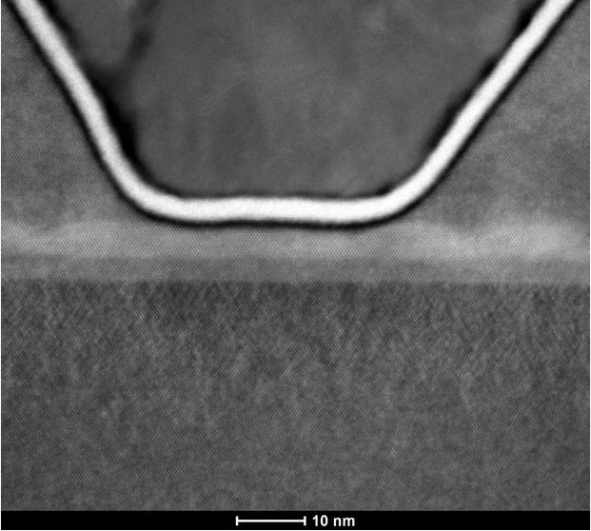
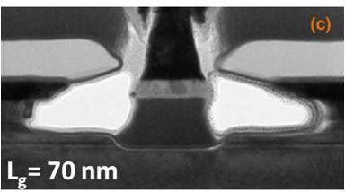
Device Structures: Lateral Spacers & Tunneling
Small S/D contact pitch
MOS-HEMT with large contact pitch
no lateral gate-drain space
~70 nm gate-drain space
Lin, IEDM2013
UCSB
4

Slide 5
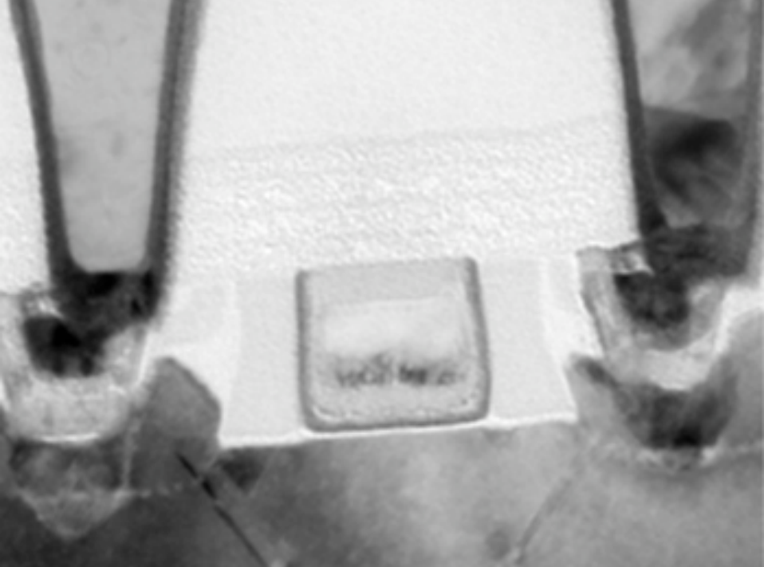
We must build devices with small S/D pitch.
contact pitch ~ 3 times lithographic half-pitch (technology node dimension)
Intel 35nm NMOS
Small S/D pitch hard to realize if we require ~20-50nm lateral gate-drain spacers !
5

Slide 6
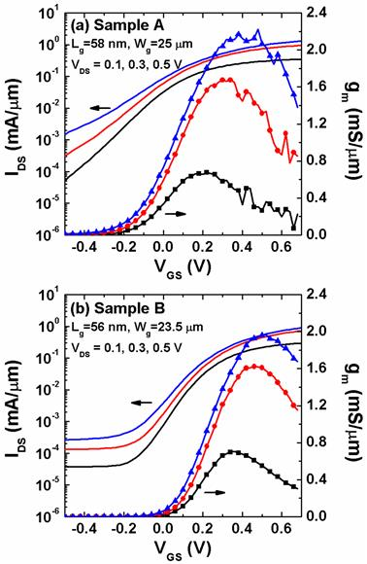
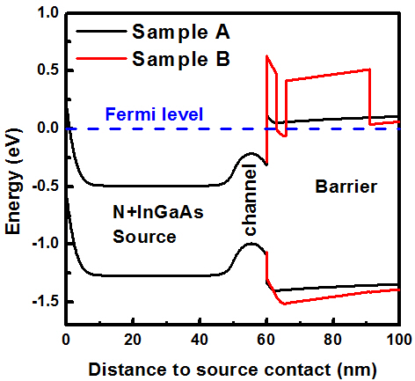
Reducing leakage (1)
Wide band-gap barriers or P-doped back barriers reduces bottom leakage path.
Solution 1: AlAsSb barriers (Sample B) reduces subthreshold leakage.
Solution 2: P-doped InAlAs barriers also work well.
C. Y. Huang et al., APL., 103, 203502 (2013)
6

Slide 7
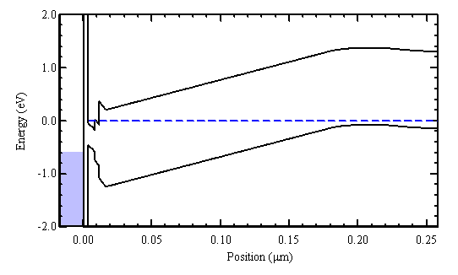
Reducing leakage (1)
Wide band-gap barriers or P-doped back barriers reduces bottom leakage path.
Solution 1: AlAsSb barriers (Sample B) reduces subthreshold leakage.
Solution 2: P-doped InAlAs barriers also work well.
C. Y. Huang et al., APL., 103, 203502 (2013)
7

Slide 8
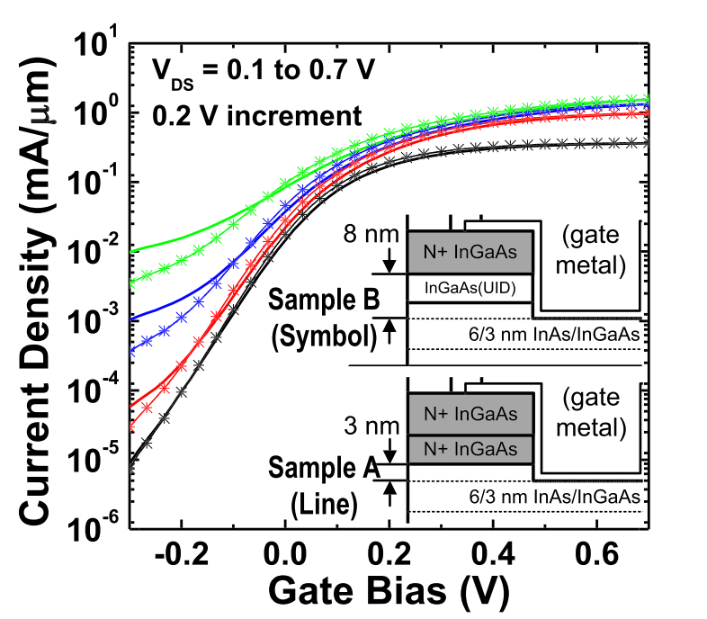
Reducing leakage (2): Source/Drain Vertical Spacer
S. Lee et al., APL 103, 233503 (2013)
C. Y. Huang et al., DRC 2014.
Vertical spacers reduce the peak electric field, improve electrostatics, and reduce BTBT floor.
8

Slide 9
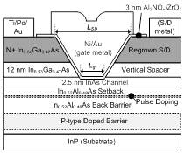
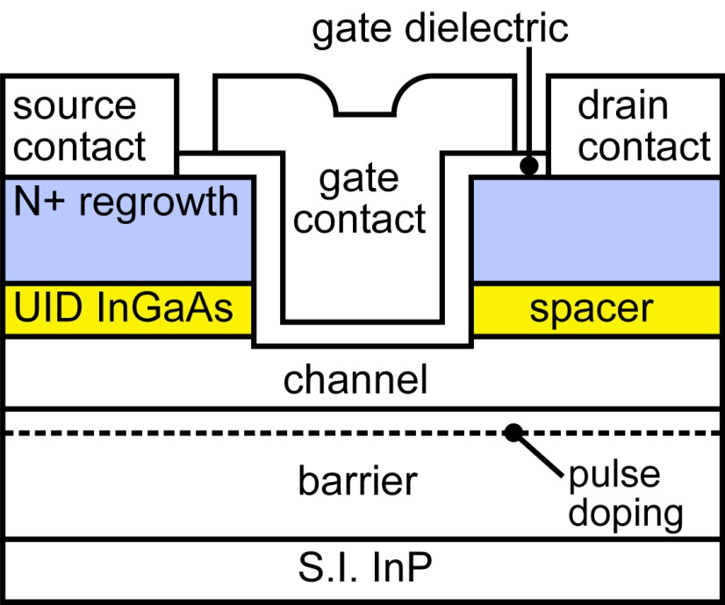
Vertical spacers: some details
Minimum S/D contact pitch:
depends upon regrowth angle
vertical growth reported in literature
our recent results: vertical
Spacer sidewalls are gated through the high-K.
Capacitance to UID sidewalls is small.
added gate length→ adds ~0.3 fF/μm.
Capacitance to N+ contacts layers is large.
easy to eliminate: low-ε_{r} sidewall spacer.
Deliberate band offset between spacer & channel
compensates offset from strong quantization in channel.
9

Slide 10
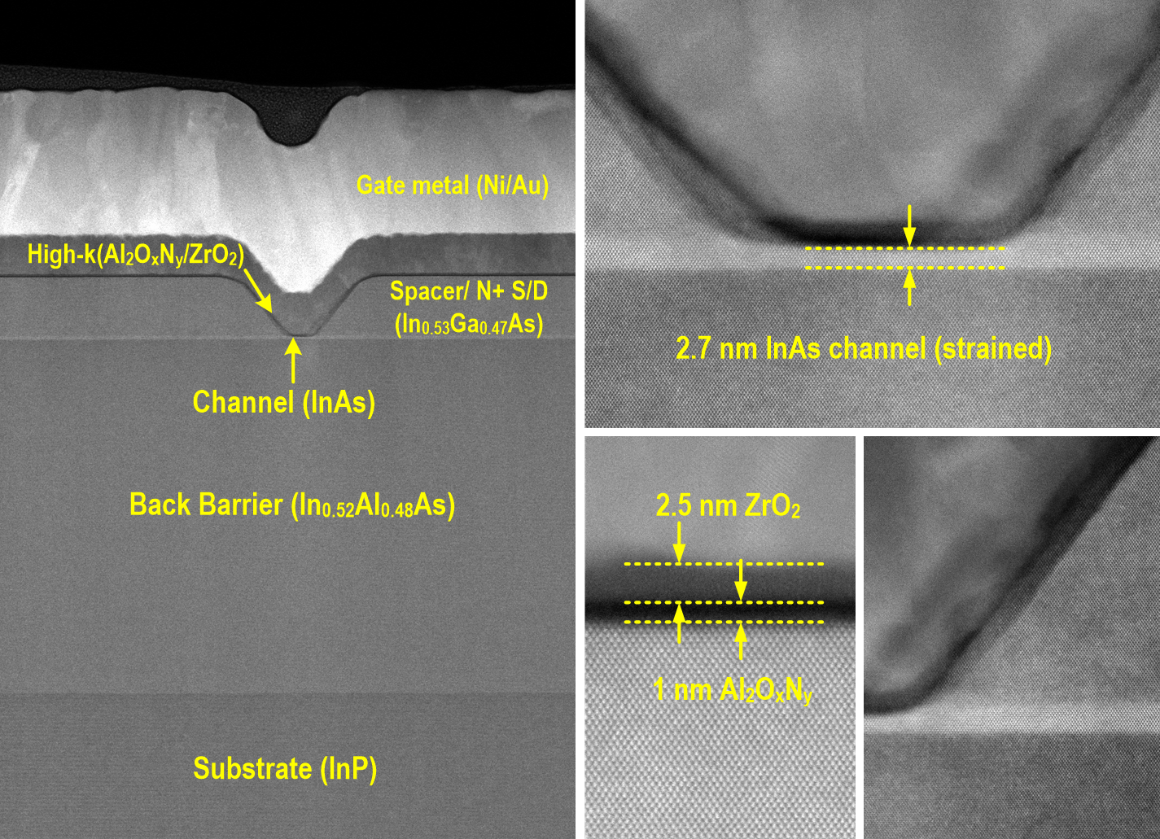
Reducing leakage (3): Ultra-thin channel
Courtesy of S. Kraemer (UCSB)
*Heavy elements look brighter
Lee et al., 2014 VSLI Symposium

Slide 11
Reducing leakage (3): Ultra-thin channel
S. Lee et al., VLSI 2014
[1] Lin IEDM 2013,[2] T.-W. Kim IEDM 2013,[3] Chang IEDM 2013,[4] Kim IEDM 2013
[5] Lee APL 2013 (UCSB), [6] D. H. Kim IEDM 2012,[7] Gu IEDM 2012,[8] Radosavljevic IEDM 2009
11

Slide 12
MOSFET: 2.5nm ZrO₂/ 1nm Al₂O₃ / 2.5nm InAs
61 mV/dec Subthreshold swing at V_{DS}=0.1 V
Negligible hysteresis
12

Slide 13
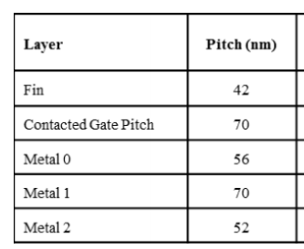
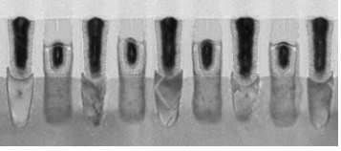
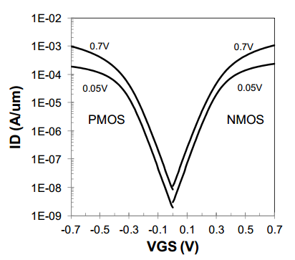
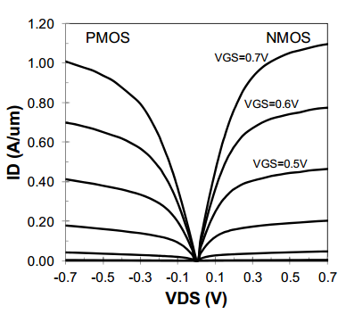
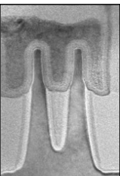
Compared to Intel 14nm finFET
S. Natarajan et al, IEDM 2014, December, San Francisco
I_{off}=10nA/μm, I_{on}=0.45mA/μm @V_{DS}=0.5V per μm of fin footprint
Re-normalizing to fin periphery: ~0.24 mA/μm
13

Slide 14
Off-state comparison: 2.5 nm vs. 5.0 nm-thick InAs channel
2.5 nm InAs
5.0 nm InAs
L_{g} =500 nm
L_{g} =500 nm
Better SS at all gate lengths
⬅ Better electrostatics (aspect ratio) and reduced BTBT (quantized E_{g})
~10:1 reduction in minimum off-state leakage
~5:1 increase in gate leakage ⬅ increased eigenstate
14

Slide 15
On-state comparison: 2.5 nm vs. 5.0 nm-thick InAs channel
1D-Possion Schrodinger solver
(coded by W. Frensley, UT Dallas)
15

Slide 16
ZrO₂ vs. HfO₂: Peak g_{m}, SS, split-CV, and mobility
Comparison: two process runs ZrO₂ , one run HfO₂ , both 2nm (on 1nm Al₂O₃)
(1) ZrO₂ higher capacitance than HfO₂ , (2) ZrO₂ results are reproducible
16

Slide 17
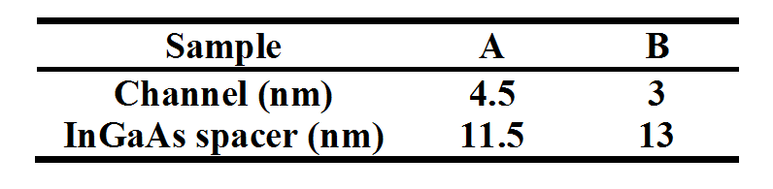
Reducing leakage (4): Thin InGaAs Channel
BTBT limited
Reducing channel thickness improves electrostatics, increases confinement bandgap and reduces BTBT.
17

Slide 18
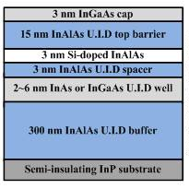
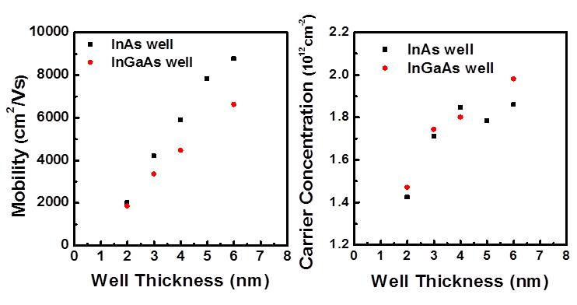
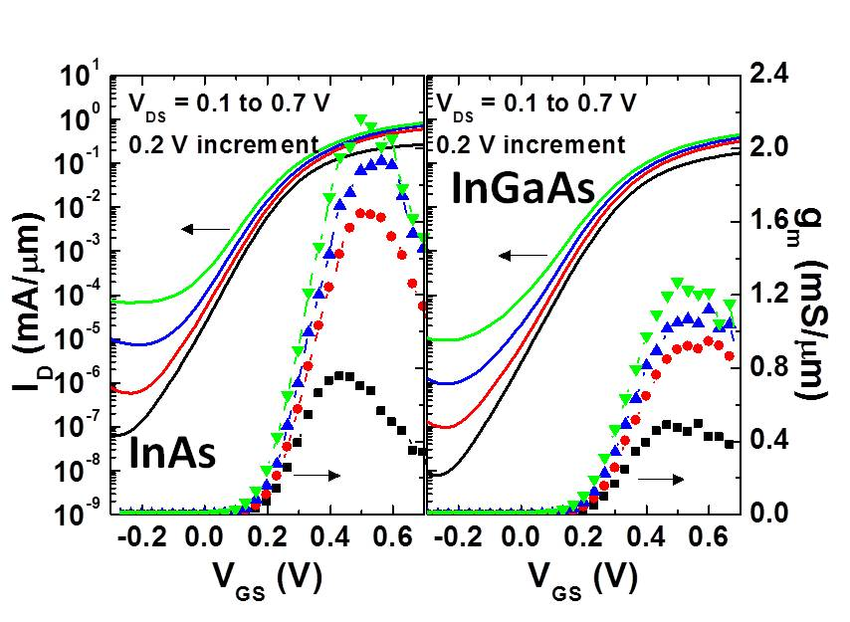
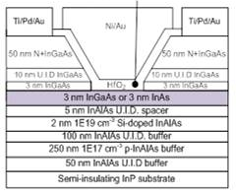
InGaAs vs. InAs Channel
Huang: IPRM 2015
similar mobility in 2-3 nm thick quantum well
InGaAs has lower on-current in FET with 3nm thick channel ?!?
18

Slide 19
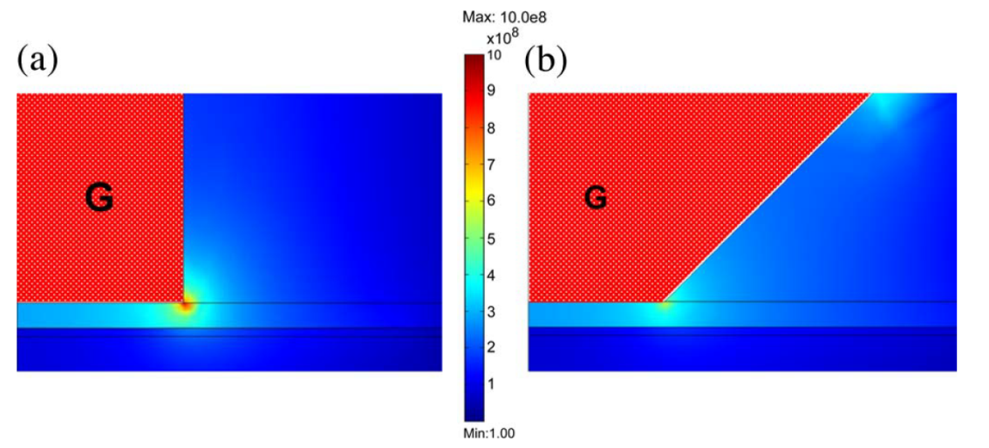
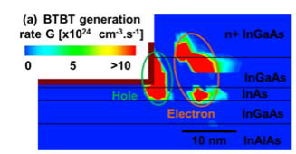
E-field and BTBT contour
R. Chu et al., EDL 29, 974 (2008)
J. Lin et al., EDL 35, 1203 (2014)
Concentrated electric field at the drain end of the channel
Solution:
Replace InGaAs with wide band-gap InP (Eg~1.35 eV)
19

Slide 20
Reducing leakage (5): Doping-graded InP spacer
C-Y Huang, 2014 IEDM
L_{g}-30 nm, 30Å ZrO₂
R_{on} at zero L_{g} (Ω∙μm) | 5 nm UID InP | 13 nm UID InP | Doping graded InP
 | ~199 | ~364 | ~270
Doping-graded InP spacer reduces parasitic source/drain resistance and improves G_{m}.
Gate leakage limits I_{off}~300 pA/μm.
20

Slide 21
Reducing leakage (6): Thicker Dielectric
InP graded spacer
InGaAs spacer
38Å ZrO₂
60 pA/μm
Minimum I_{off}~ 60 pA/μm at V_{D}=0.5V for L_{g}-30 nm
100:1 smaller I_{off} compared to InGaAs spacer
C-Y Huang, 2014 IEDM
21

Slide 22
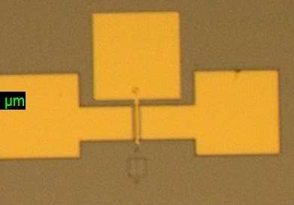
Leakage now dominated by imperfect isolation
Leakage current is independent of gate width
→ leakage now dominated by imperfect device isolation, by edges of device mesa.
22

Slide 23
Refractory Contacts to In(Ga)As
Baraskar et al, Journal of Applied Physics, 2013
Refractory: robust under high-current operation / Low penetration depth: ~ 1 nm / Performance sufficient for 32 nm /2.8 THz node.
State-of-art in III-V contacts: ~5*10⁻⁹ Ω-cm²
Key: high doping, clean surfaces, high indium content for N-type
23

Slide 24
III-V on Si

Slide 25


Ultrathin InAs-Channel MOSFETs on Si Substrates
Cheng-Ying Huang¹, Xinyu Bao², Zhiyuan Ye², Sanghoon Lee¹, Hanwei Chiang¹, Haoran Li¹, Varistha Chobpattana³, Brian Thibeault¹, William Mitchell¹, Susanne Stemmer³, Arthur Gossard^{1,3}, Errol Sanchez², and Mark Rodwell¹
¹ECE, University of California, Santa Barbara
²Applied Materials, Santa Clara
³Materials Department, University of California, Santa Barbara
VLSI-TSA 2015
HsinChu, Taiwan

Slide 26
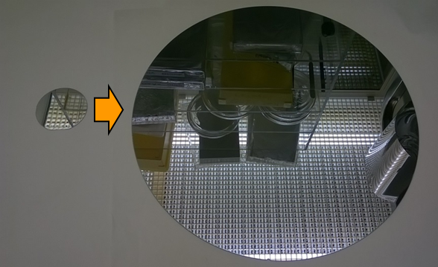
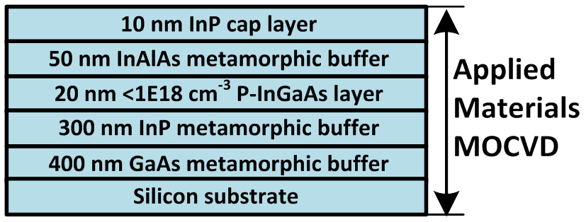
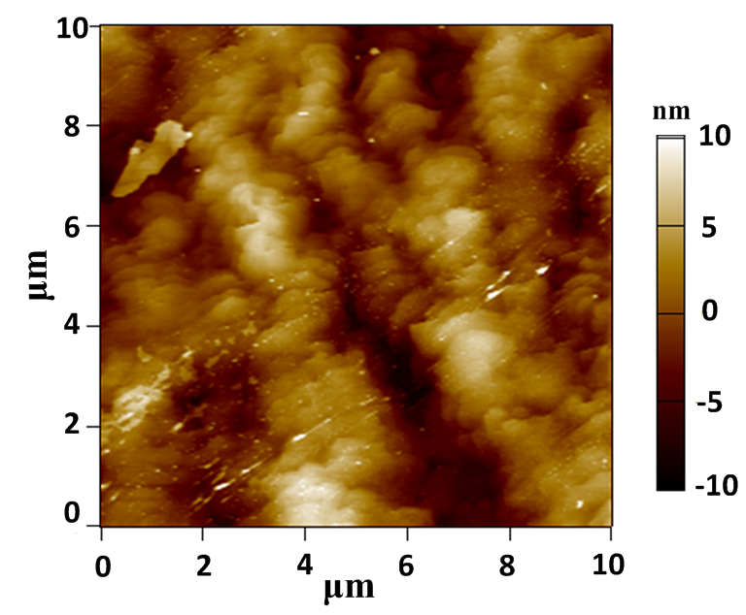
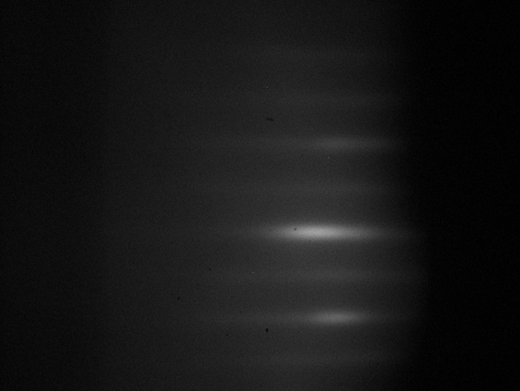
Applied Materials III-V buffer on Si
RHEED in MBE
R_{q}=3.1 nm
26

Slide 27
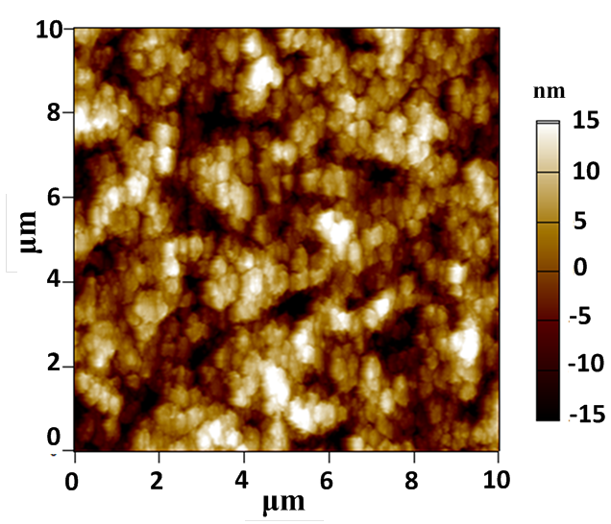
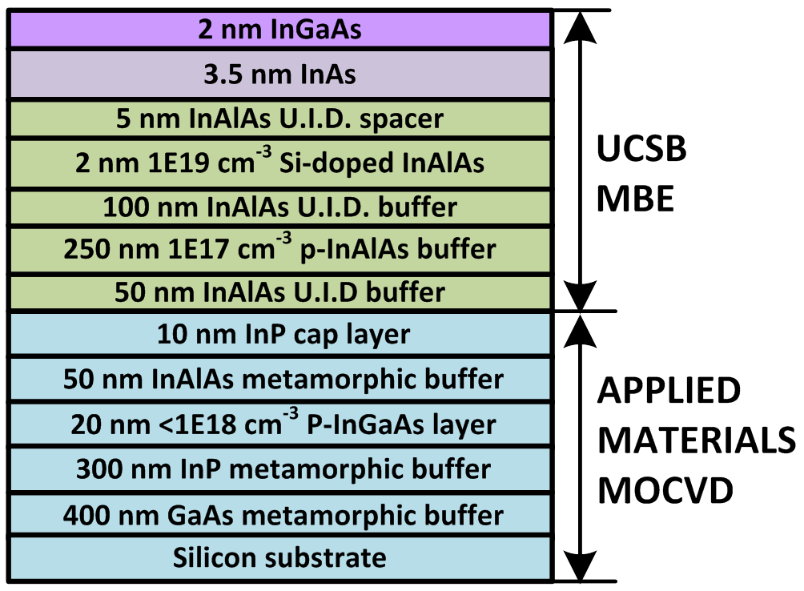
UCSB III-V FET epitaxy
Surface roughness is degraded after FET epitaxy.
R_{q}= 6.9 nm
27

Slide 28
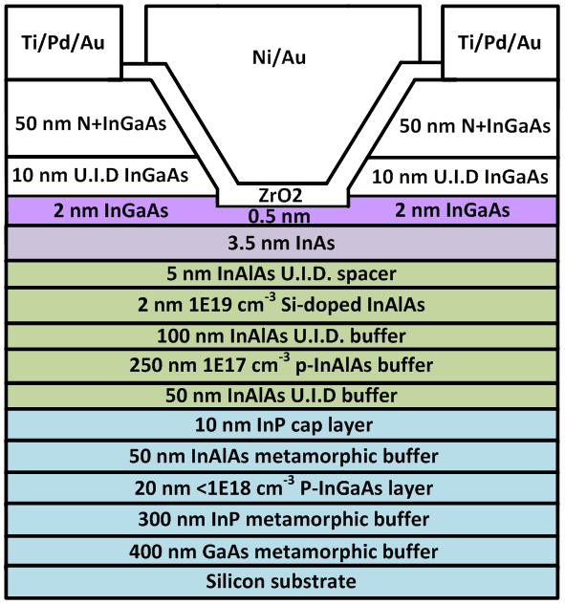
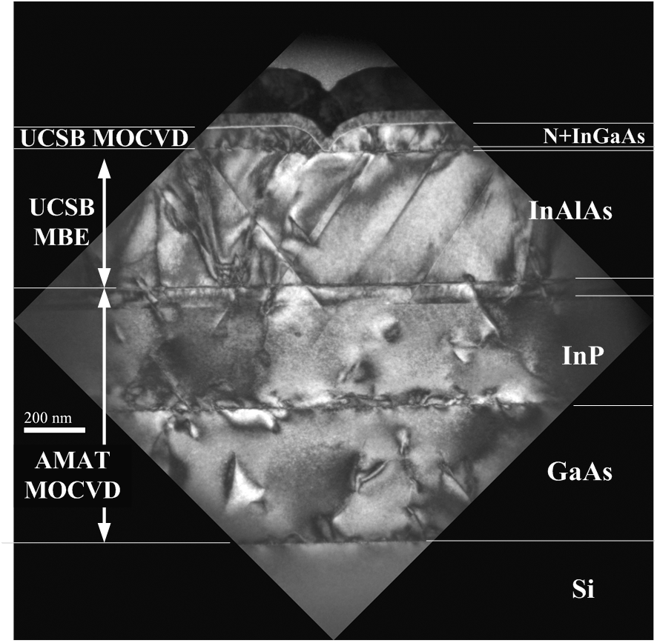
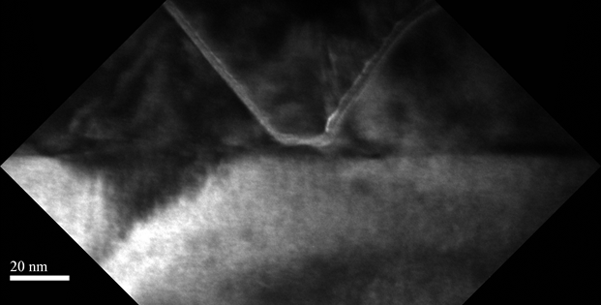
TEM images of III-V FET on Si
Lg~20nm
L_{g}~20nm
28

Slide 29
Short gate length: L_{g}-20 nm
High G_{m}~2.0 mS/μm at V_{D}=0.5 V.
SS~140 mV/dec. at V_{D}=0.5 V and 101 mV/dec. at V_{D}=0.1 V
High I_{on} >1.4 mA/um at V_{GS}=1V.
29

Slide 30
Future Work

Slide 31
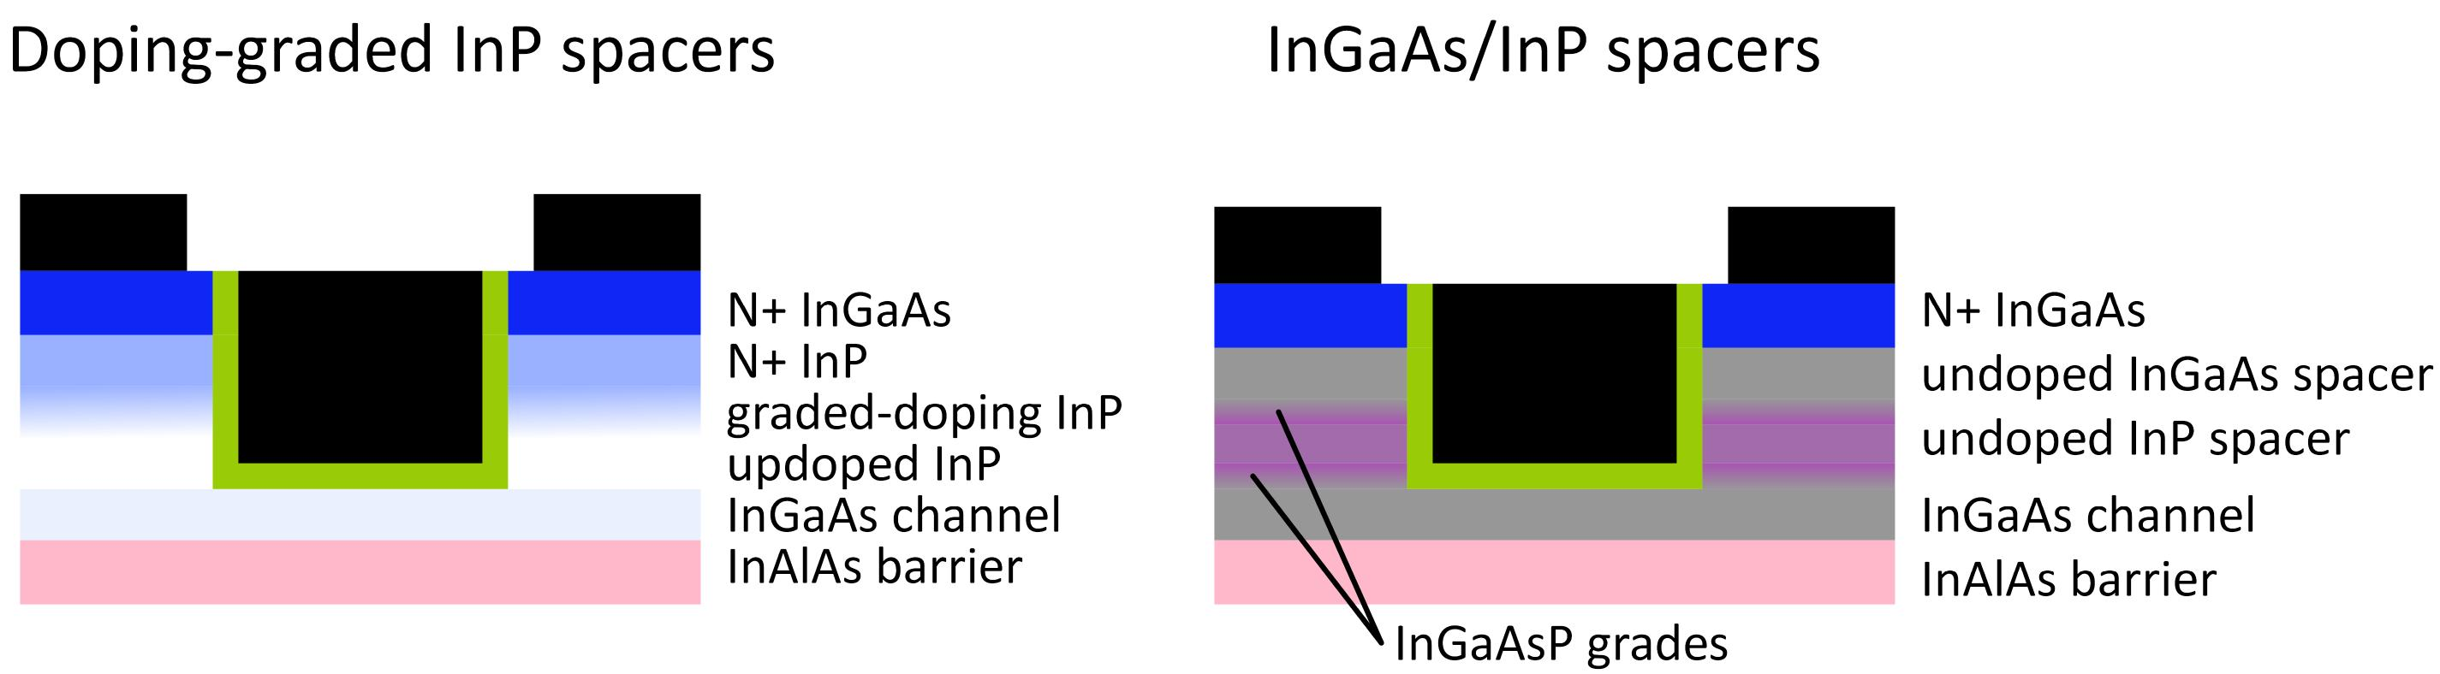
Future Work: High Current & Low Leakage
Wide-gap spacer near channel: reduces BTBT
Upper spacer: improves electrostatics
Thick InP spacers add source resistance, reduce I_{on}.
Solution: composite InP/InGaAs spacer with InGaAsP grades
31

Slide 32
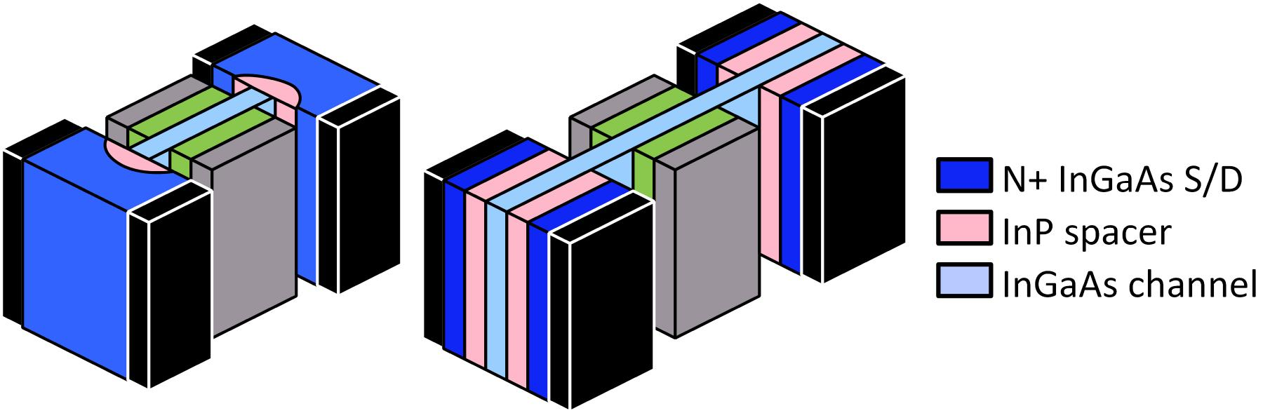
Future Work: High Current & Low Leakage
finFETs: better electostatics→ thick spacers not needed
Need only thin InP spacer to supress BTBT
→ improved on-current
InP spacer formed during S/D regrowth.
32

Slide 33
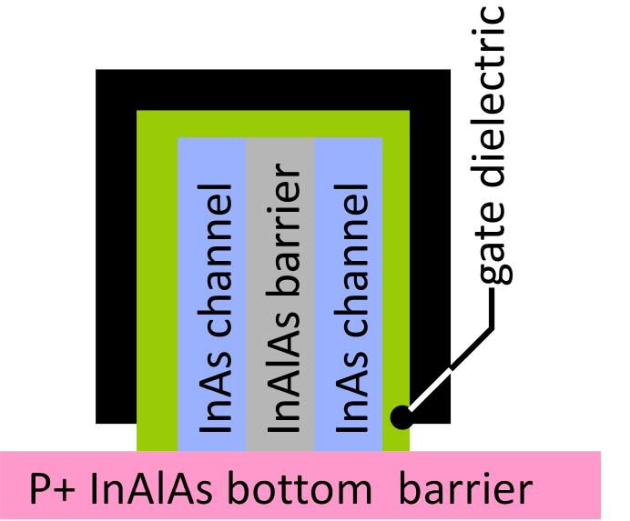
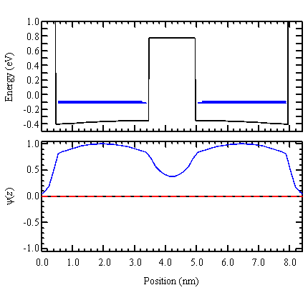
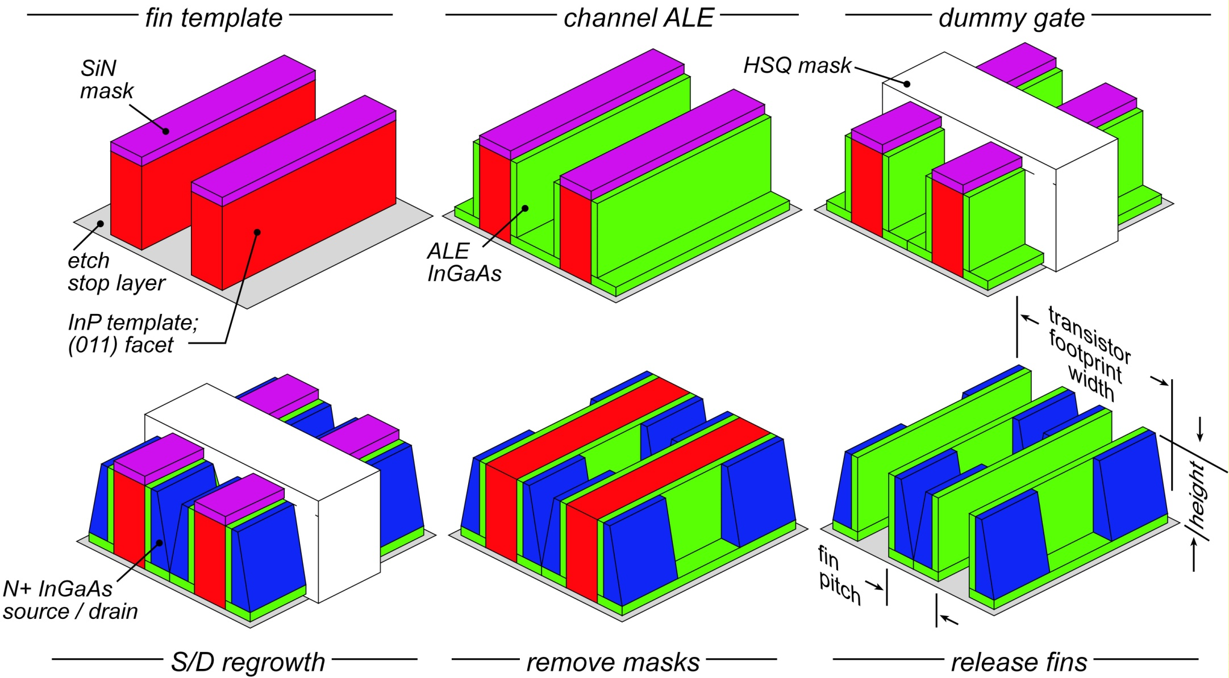
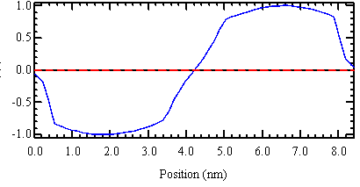
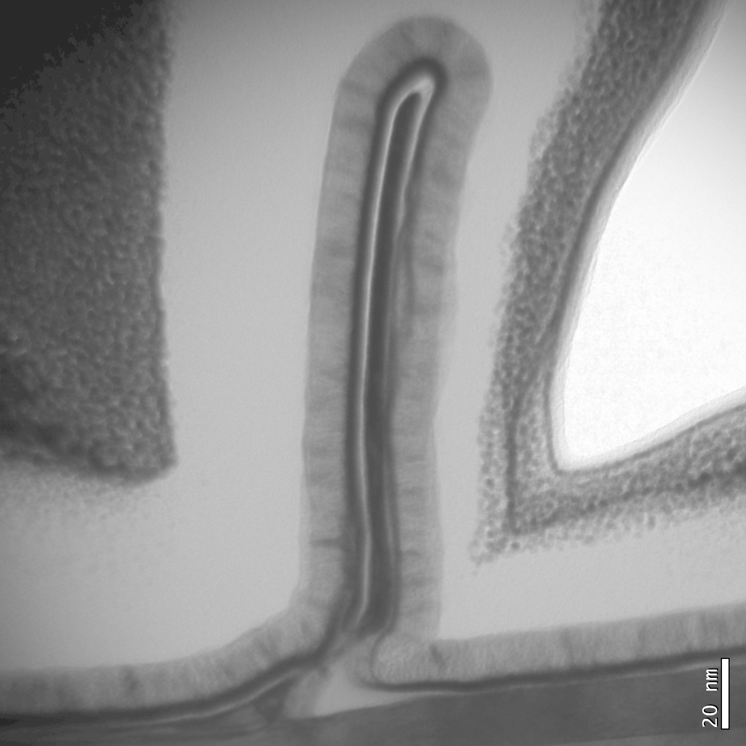
finFET with surface vs. bulk inversion.
3nm InAs well
3nm InAs well
16 meV energy
splitting
1.5nm AlAs
barrier
Cohen-Elias et al., DRC 2013
33
Notes:
Title "MOSFET_with_AlSb_bottom_barrier"
mesh = 0.15 nm ;
Substrate = InP strained;
Temp=350;
Terminals: gate, channel, substrate;
LeftBoundary gate NSchottky = 3.5 eV;
0.5 nm, SiO2 [PosIon = 0.0E12 percm2 * gaussNorm (z - 70 nm, 2 nm)];
< | channel |
3 nm, InGaAs{In 0.99} [Ntype 1.0E11 percm3] (e) channel (h)channel ;
1.5 nm, InAlAs{In 0.01} [Ntype 1.0E11 percm3] (e) channel (h)channel ;
3 nm, InGaAs{In 0.99} [Ntype 1.0E11 percm3] (e) channel (h)channel ;
>
0.5 nm, SiO2 [PosIon = 0.0E12 percm2 * gaussNorm (z - 70 nm, 2 nm)];
RightBoundary substrate NSchottky = 3.5 eV;

Slide 34
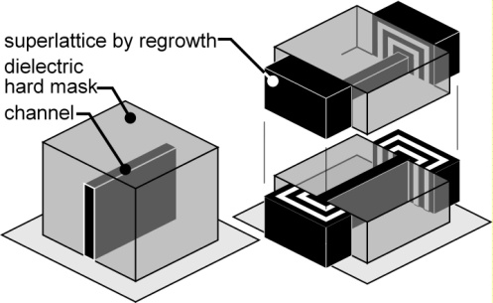
Next: Superlattice Steep FETs
Objective: low-power VLSI
0.1-0.2 V operation
>10:1 less switching energy
Approach: superlattice FET
energy filter in source
MOVCD regrowth
Impact: low-voltage,
high on-current (>> than T-FET)
→ fast, ultra-low-power VLSI logic
We can make it work.
Long et al., (Purdue/UCSB) IEEE EDL, December 2014
34

Slide 35
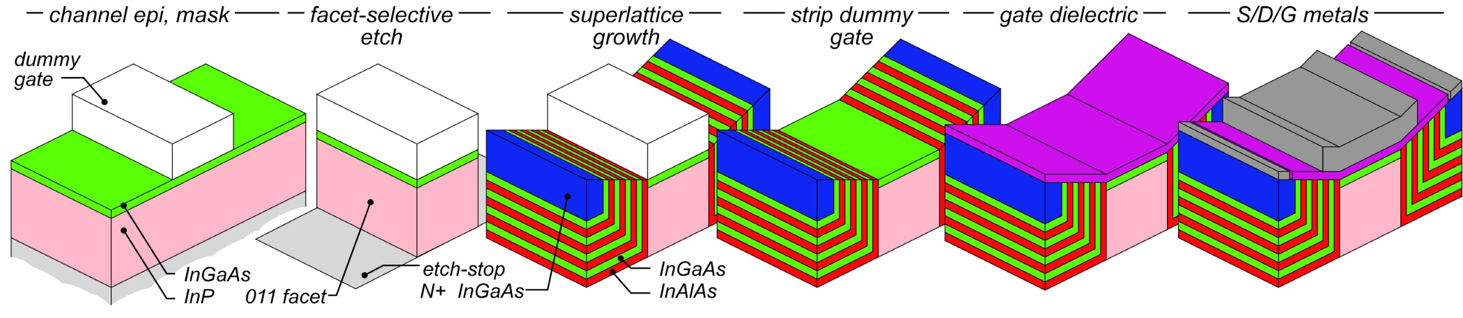
How we might build a superlattice FET
A simple extension of present planar III-V MOS process flow...

Slide 36
III-V MOS
For high-performance applications (I_{off}=100nA/μm)
on-currents substantially better than Si at V_{DD}=0.5V
Lower-power applications (SP/LP/UPL)
target off-currents as small as 10pA/μm
InP spacers can provide such small leakage
Problem: incrased access resistance, reduced I_{on}
Best solution:
Thin (2-5nm) InP spacers in finFETs
fin geometry fixes electrostatics
InP spacers fix BTBT.
36

Slide 37
(end)

