Slide 1


12 nm-Gate-Length Ultrathin-Body InGaAs/InAs MOSFETs with 8.3∙10⁵ I_{ON}/I_{OFF}
Cheng-Ying Huang¹, Prateek Choudhary¹, Sanghoon Lee¹, Stephan Kraemer², Varistha Chobpattana², Brain Thibeault¹, William Mitchell¹, Susanne Stemmer², Arthur Gossard^{1,2}, and Mark Rodwell¹
¹Electrical and Computer Engineering, University of California, Santa Barbara
²Materials Department, University of California, Santa Barbara
Device Research Conference 2015
Late News
Columbus, OH

Slide 2
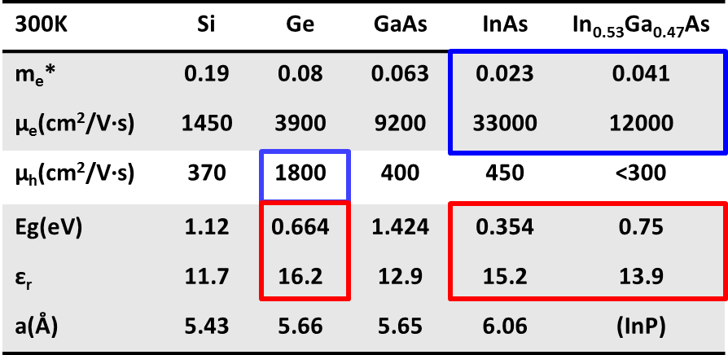
III-V FETs at sub-10-nm nodes?
III-V channels: low electron effective mass, high velocity, high mobility→ higher I_{on} at lower V_{DD}→ reducing switching power
III-V FETs have high leakage current because:
Low bandgap→ larger band-to band tunneling (BTBT) leakage
High permittivity→ worse electrostatics, large subthreshold leakage
I_{off}<100 nA/µm (High performance) and I_{off}<100 pA/µm (Low power)
Question: Can III-V MOSFETs scale to sub-10-nm nodes?
Logic industry node | Physical gate length (nm)
16/14 | 20
10 | 17
7 | 14
5 | 12
Ref: 2013 ITRS Roadmap
2

Slide 3
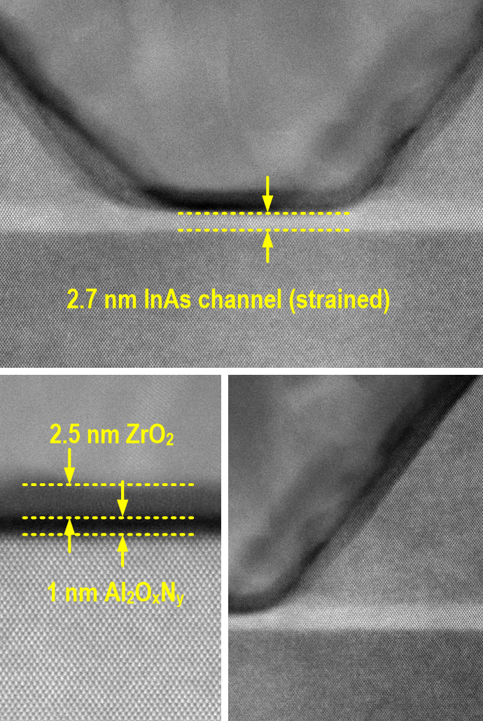
Record high performance III-V FETs
S. Lee et al., VLSI 2014
L_{g}~25 nm
N+ S/D
Vertical Spacer
3

Slide 4
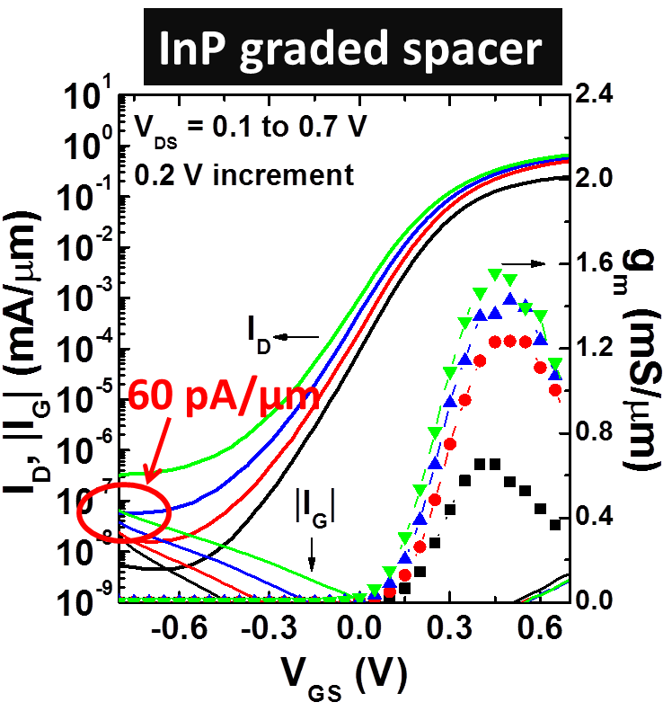
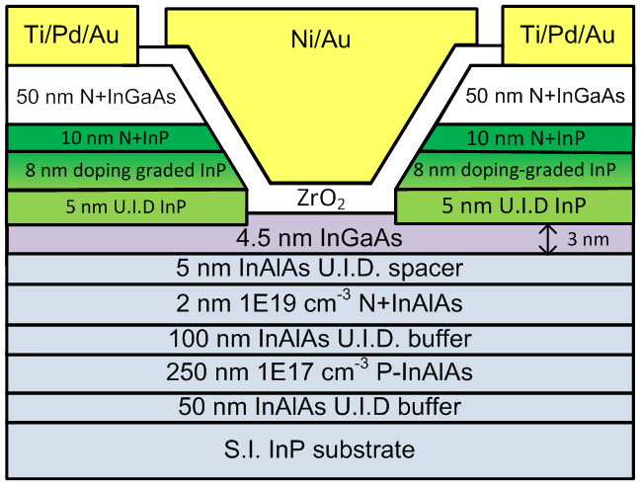
Record low leakage III-V FETs
L_{g}-30nm
L_{g}-30nm
C. Y. Huang et al., IEDM 2014
Minimum I_{off}~ 60 pA/μm at V_{D}=0.5 V for L_{g}-30 nm
Recessed InP shows 100:1 smaller I_{off} compared to InGaAs spacers
BTBT leakage is completely removed→ sidewall leakage dominates I_{off}
4

Slide 5

UCSB Gate Last Process Flow
HSQ
HSQ
N+ S/D
Channel
Ch.
Ch.
Barrier
Barrier
Barrier
Substrate
Substrate
Substrate
MBE grown device epilayer
Pattern dummy gate
Source/drain recess etch
MOCVD source/drain regrowth
ZrO₂
Ti/Pd/Au
Ni
Ni
N+ S/D
N+ S/D
N+ S/D
Ch.
Ch.
Ch.
Barrier
Barrier
Barrier
Substrate
Substrate
Substrate
Isolation
Strip dummy gate
Digital etch
Deposit ALD dielectric
FGA anneal
Lift-off gate metal
Deposit
S/D contacts
5

Slide 6
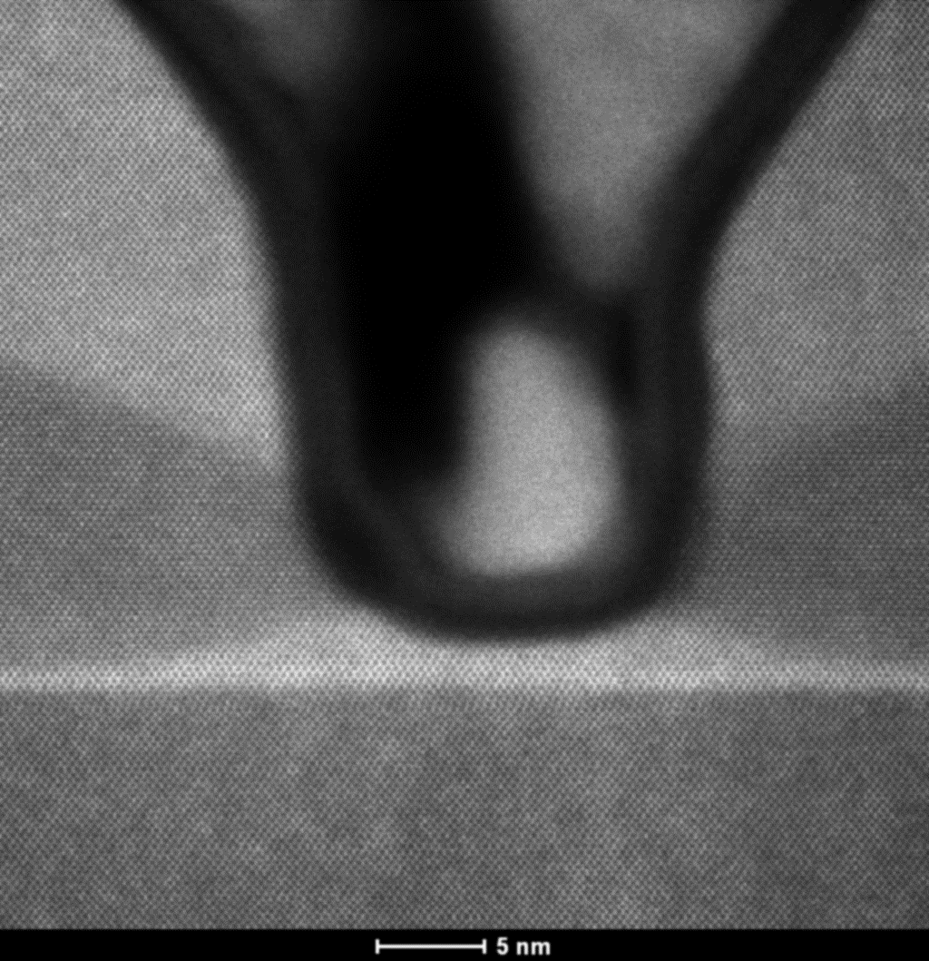
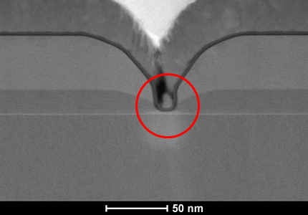
TEM images of L_{g}~12 nm devices
L_{g}~12nm
N+InGaAs
~ 8nm
Cross-setion
N+InP
Ni
InP spacer
Top View
InAlAs
Barrier
t_{ch}~ 2.5 nm
(1.5/1 nm InGaAs/InAs)
6

Slide 7
I_{D}-V_{G} and I_{D}-V_{D} curves of 12nm L_{g} FETs
L_{g}-12nm
I_{off}~1.3 nA/μm
I_{on}~1.1 mA/μm
I_{on}/I_{off} > 8.3∙10⁵
7

Slide 8
On-state performance
Slightly higher G_{m} for a 2.5 nm composite channel than a 4.5 nm InGaAs channel → larger gate capacitance.
A 2.5nm InAs channel with a 12 nm InGaAs spacer shows highest G_{m} → high indium content channel is desirable for UTB III-V FETs.
InP spacers increase parasitic R_{S/D} to ~260 Ω∙μm → InP spacers need further optimization.
8

Slide 9
Subthreshold characteristics
A 2.5nm InAs channel with a 12 nm InGaAs spacer shows the lowest SS and DIBL because of the best electrostatics.
A 5 nm un-doped InP spacer with the atop 8 nm linearly doping-graded InP have shorter effective gate length as compared to 12 nm un-doped InGaAs spacers→ worse electrostatics.
SS~107 mV/dec. and DIBL~260 mV/V for 12 nm devices→ FinFETs will cure this.
9

Slide 10
I_{on} and I_{off} versus L_{g}
High In% content channels are required to improve I_{on}, but I_{off} is relatively large (~10 nA/µm).
InGaAs channels with recessed InP source/drain spacers are required for low leakage FETs.
A clear tradeoff between on-off performance.
10

Slide 11
Mobility extraction at L_{g}-25 µm long channel FETs
This work
InAs channel
Freq: 200 kHz
EOT~ 0.9~1 nm
1.5/1 nm InGaAs/InAs
Mobility~ 250 cm²/V∙s
Mobility~ 280 cm²/V∙s
1.5/1 nm InGaAs/InAs
m*, R_{S/D} more important!
11

Slide 12
Summary
We demonstrated a 12nm-L_{g} ultrathin body III-V MOSFET with well-balanced on-off performance. (I_{on}/I_{off}> 8.3·10⁵)
The 12nm-L_{g} FET shows G_{m}~1.8 mS/µm and SS~107 mS/dec., and minimum I_{off}~ 1.3 nA/µm.
High indium content channel is required to improve on-state current. (High performance logic)
Thin channels, InGaAs channels, and recessed InP source/drain spacers are the key design features for very low leakage III-V MOSFETs. (Low Power Logic)
III-V MOSFETs are scalable to sub-10-nm technology nodes.
12

Slide 13
Acknowledgment
Thanks for your attention!
Questions?
This research was supported by the SRC Non-classical CMOS Research Center (Task 1437.009) and GLOBALFOUNDRIES(Task 2540.001).
A portion of this work was done in the UCSB nanofabrication facility, part of NSF funded NNIN network.
This work was partially supported by the MRSEC Program of the National Science Foundation under Award No. DMR 1121053.
cyhuang@ece.ucsb.edu

Slide 14
(backup slides follow)

Slide 15
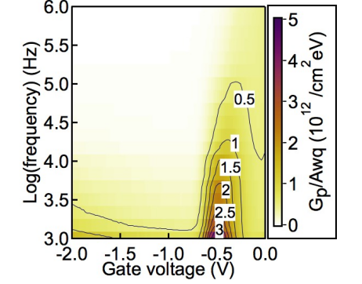
Record low subthreshold swing
S. Lee et al., VLSI 2014
Achieved SS~ 61 mV/dec.
Superior high-k dielectrics on III-V channels.
Dielectrics from Gift Chobpattana, Stemmer group, UCSB.
15

Slide 16
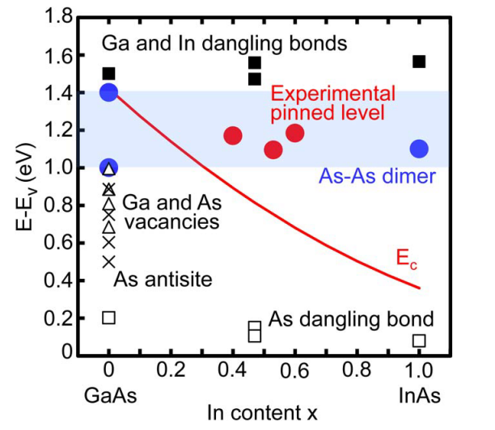
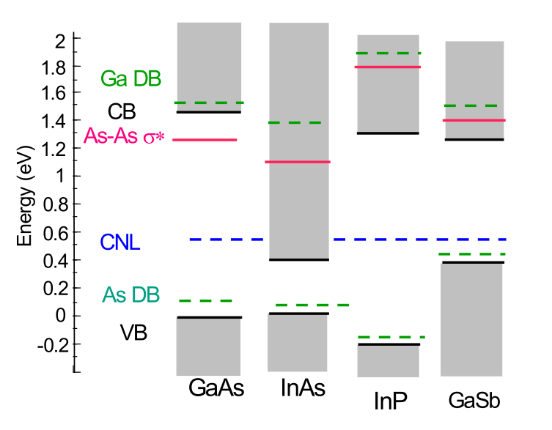
Why InAs channel is better…
Electron scattering with oxide traps inside conduction band
Electrons in high In% content channel have less scattering with oxide traps.
N. Taoka et al., Trans. Electron Devices. 13, 456 (2011)
N. Taoka et al., IEEE IEDM 2011, 610.
J. Robertson et al., J. Appl. Phys. 117, 112806 (2015)
J. Robertson, Appl. Phys. Lett 94, 152104 (2009)

Slide 17
InP spacer thickness: on-state
Thicker InP spacer increases R_{on}, and degrades G_{m}
Thinner spacer is desired at source to reduce R_{S/D}.
17

Slide 18
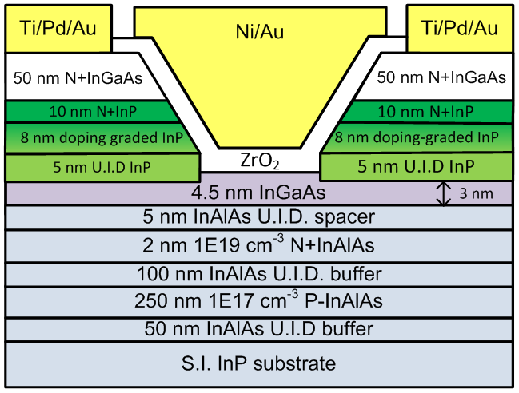
Doping-graded InP spacer
L_{g}-30 nm, 30Å ZrO₂
R_{on} at zero L_{g} (Ω∙μm) | 5 nm UID InP | 13 nm UID InP | Doping graded InP
 | ~199 | ~364 | ~270
Doping-graded InP spacer reduces parasitic source/drain resistance and improves G_{m}.
Gate leakage limits I_{off}~300 pA/μm.
18

Slide 19
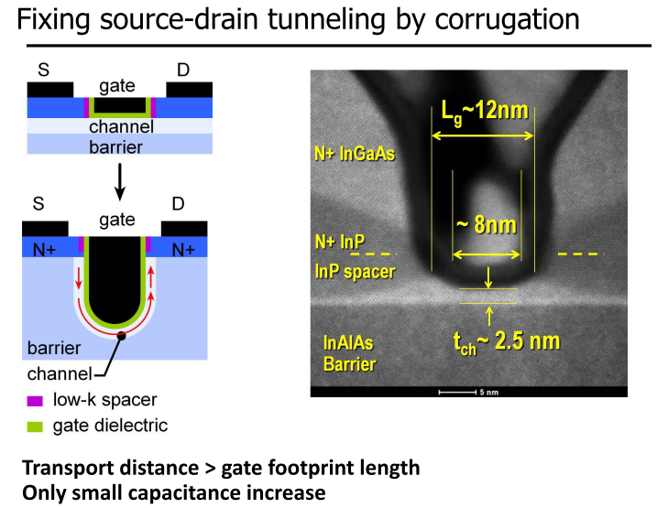

Slide 20
