Slide 1
III-V MOS:
Record-Performance Thermally-Limited Devices,
Prospects for
High-On-Current Steep Subthreshold Swing Devices
IPRM/ISCS Conference, June 30-July , 2015, UCSB
Mark Rodwell, UCSB
III-V MOS
C.-Y. Huang, S. Lee*, A.C. Gossard,
V. Chobpattanna, S. Stemmer, B. Thibeault, W. Mitchell : UCSB
Low-voltage devices
P. Long, E. Wilson, S. Mehrotra, M. Povolotskyi, G. Klimeck: Purdue
Now with: *IBM, **Intel

Slide 2
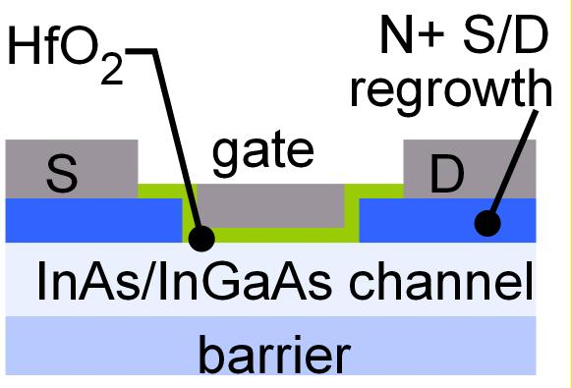
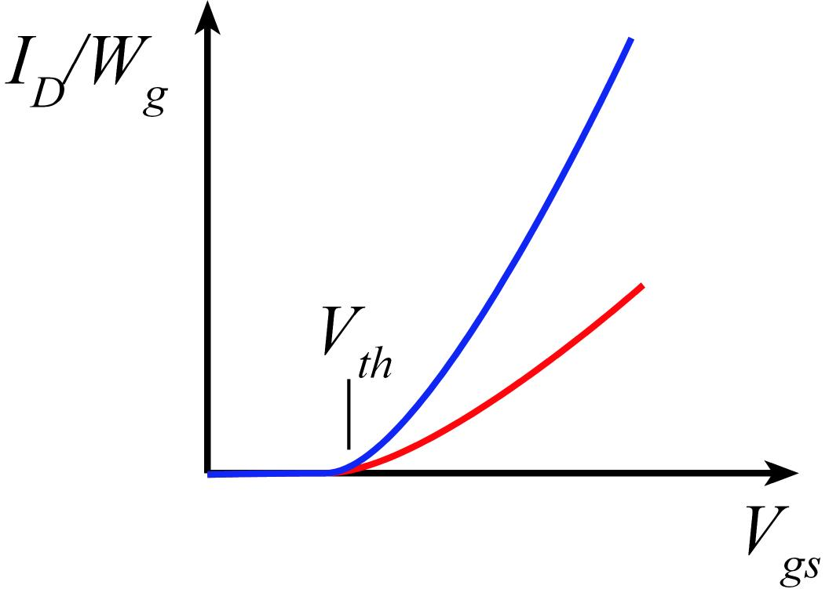
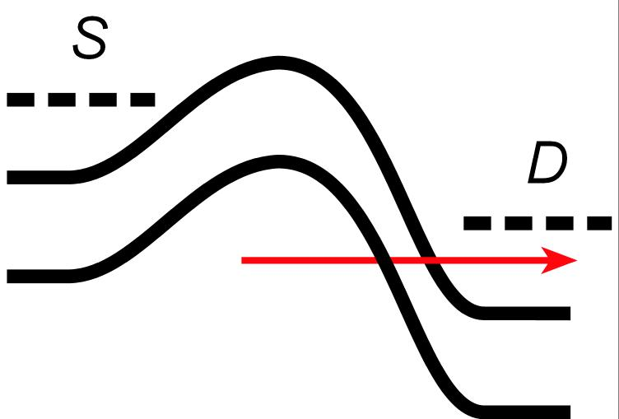
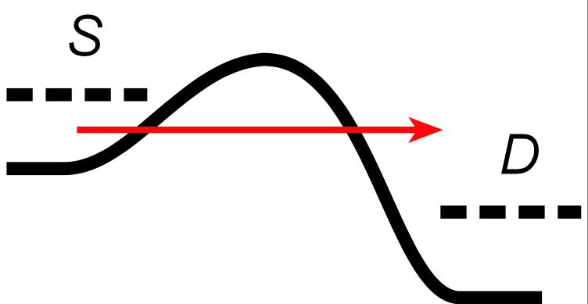
Why III-V MOS ?
III-V vs. Si: Low m*→ higher velocity. Fewer states→ less scattering
→ higher current. Can then trade for lower voltage or smaller FETs.
Problems: Low m*→ less charge. Low m* → more S/D tunneling.
Narrow bandgap→ more band-band tunneling, impact ionization.

Slide 3
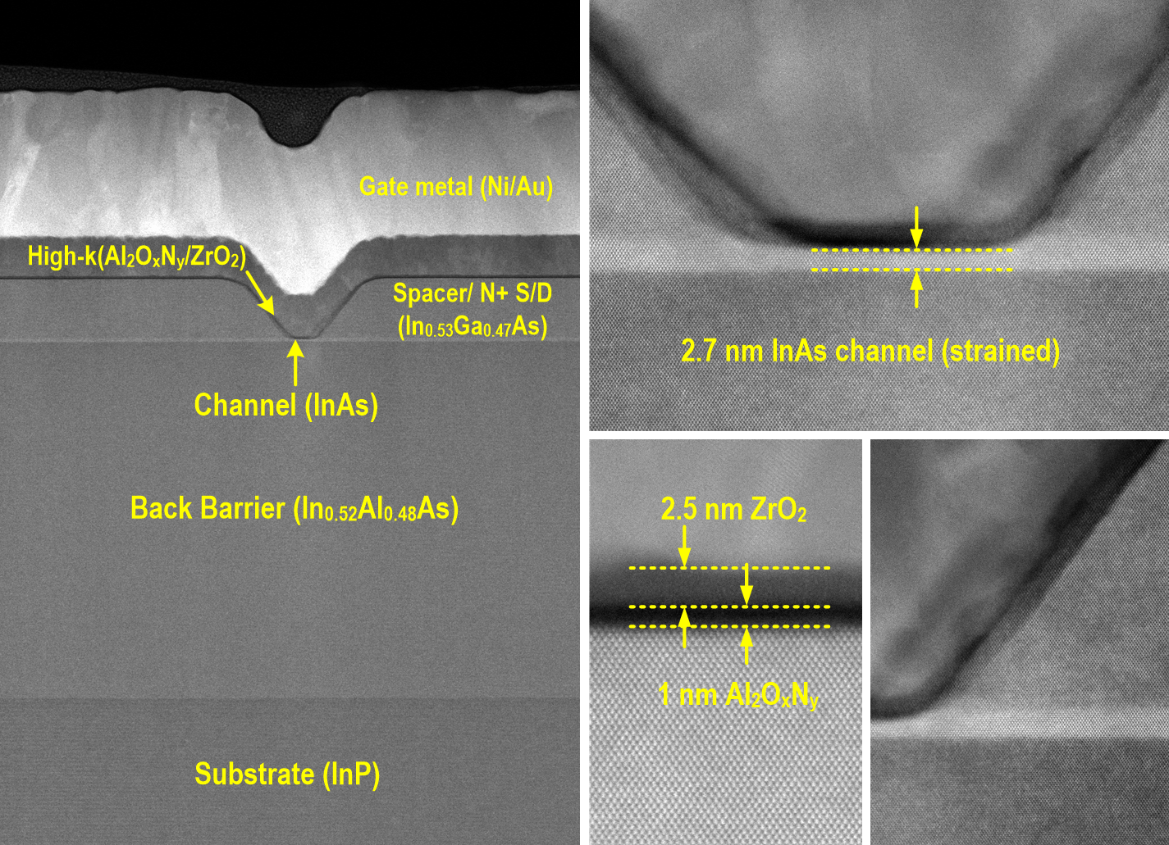
Reducing leakage: Vertical spacer, Ultra-thin channel
N+ S/D
Vertical Spacer
Courtesy of S. Kraemer (UCSB)
*Heavy elements look brighter
Lee et al., 2014 VSLI Symposium

Slide 4
Reducing leakage: Vertical spacer, Ultra-thin channel
S. Lee et al., VLSI 2014
[1] Lin IEDM 2013,[2] T.-W. Kim IEDM 2013,[3] Chang IEDM 2013,[4] Kim IEDM 2013
[5] Lee APL 2013 (UCSB), [6] D. H. Kim IEDM 2012,[7] Gu IEDM 2012,[8] Radosavljevic IEDM 2009

Slide 5
Off-state comparison: 2.5 nm vs. 5.0 nm-thick InAs channel
2.5 nm InAs
5.0 nm InAs
L_{g} =500 nm
L_{g} =500 nm
Better SS at all gate lengths
⬅ Better electrostatics (aspect ratio) and reduced BTBT (quantized E_{g})
~10:1 reduction in minimum off-state leakage
~5:1 increase in gate leakage ⬅ increased eigenstate

Slide 6
On-state comparison: 2.5 nm vs. 5.0 nm-thick InAs channel
1D-Possion Schrodinger solver
(coded by W. Frensley, UT Dallas)

Slide 7
ZrO₂ vs. HfO₂: Peak g_{m}, SS, split-CV, and mobility
Comparison: two process runs ZrO₂ , one run HfO₂ , both 2nm (on 1nm Al₂O₃)
(1) ZrO₂ higher capacitance than HfO₂ , (2) ZrO₂ results, low SS, are reproducible
7

Slide 8
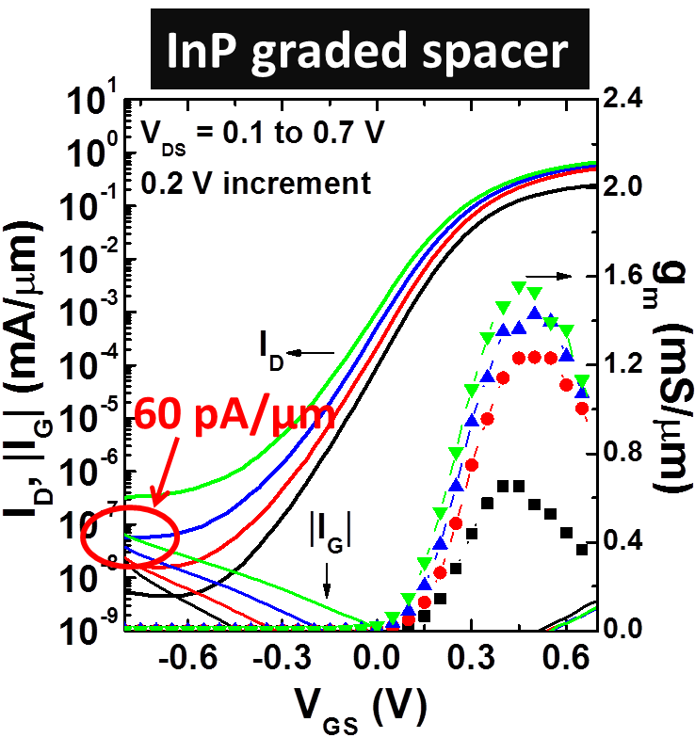
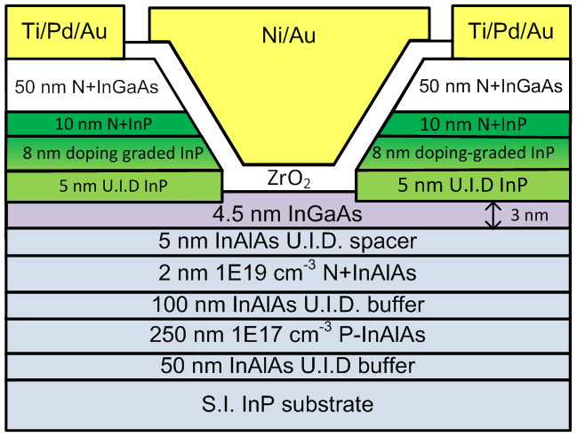
Double-heterojunction MOS: 60 pA/μm leakage
L_{g}-30nm
L_{g}-30nm
C. Y. Huang et al., IEDM 2014
Minimum I_{off}~ 60 pA/μm at V_{D}=0.5V for L_{g}-30 nm
100:1 smaller I_{off} compared to InGaAs spacer
BTBT leakage suppressed→isolation leakage dominates

Slide 9
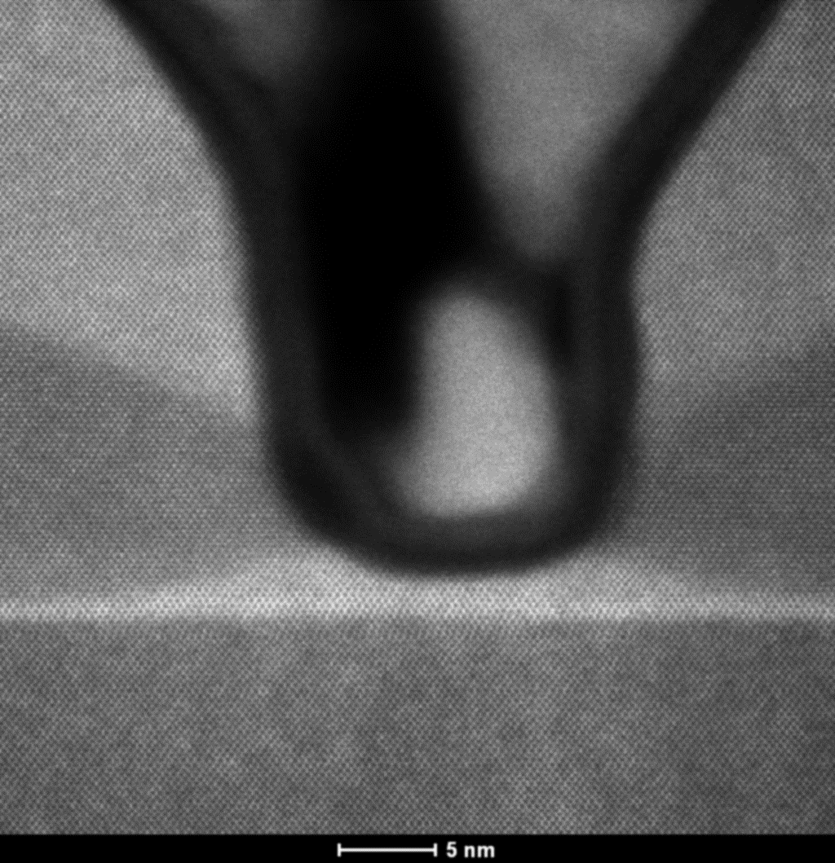
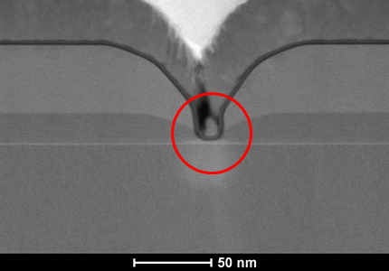
12 nm L_{g} III-V MOS
L_{g}~12nm
N+InGaAs
~ 8nm
Cross-setion
N+InP
Ni
InP spacer
Top View
InAlAs
Barrier
t_{ch}~ 2.5 nm
(1.5/1 nm InGaAs/InAs)

Slide 10
I_{D}-V_{G} and I_{D}-V_{D} curves of 12nm L_{g} FETs
L_{g}-12nm
I_{off}~1.3 nA/μm
I_{on}~1.1 mA/μm
I_{on}/I_{off} > 8.3∙10⁵

Slide 11
Mobility extraction at L_{g}-25 µm long channel FETs
This work
InAs channel
Freq: 200 kHz
EOT~ 0.9~1 nm
1.5/1 nm InGaAs/InAs
Mobility~ 250 cm²/V∙s
Mobility~ 280 cm²/V∙s
1.5/1 nm InGaAs/InAs
m*, R_{S/D} more important!

Slide 12
Steep FETs

Slide 13
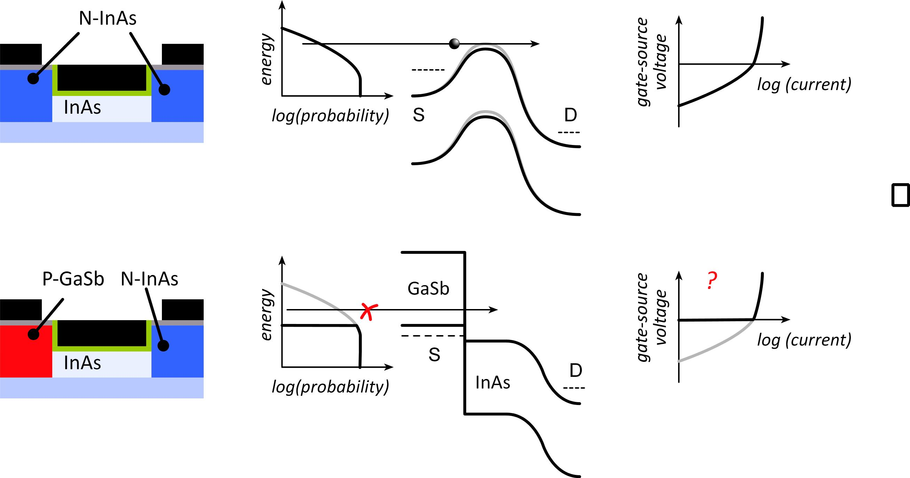
Tunnel FETs: truncating the thermal distribution
Normal
T-FET
J. Appenzeller et al.,
IEEE TED, Dec. 2005
Source bandgap truncates thermal distribution
Must cross bandgap: tunneling
Fix (?): broken-gap heterojunction

Slide 14
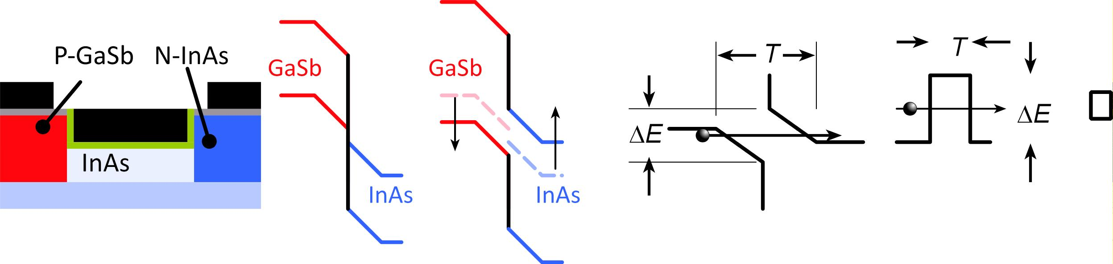
Tunnel FETs: are prospects good ?
Useful devices must be small
Quantization shifts band edges→ tunnel barrier
Band nonparabolicity increases carrier masses
Electrostatics: bands bend in source & channel
What actual on-current might we expect ?

Slide 15
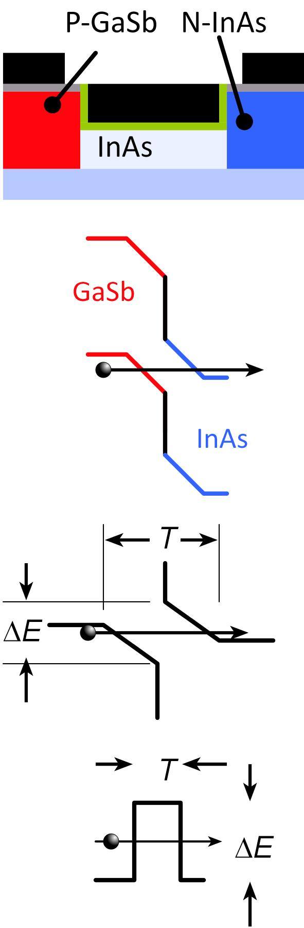
Tunneling Probability
For high I_{on}, tunnel barrier must be *very* thin.
~3-4nm minimum barrier thickness:
P+ doping, body & dielectric thicknesses

Slide 16
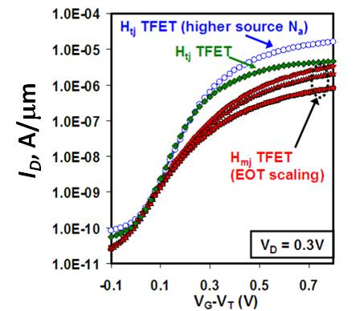
T-FET on-currents are low, T-FET logic is slow
NEMO simulation:
GaSb/InAs tunnel finFET: 2nm thick body, 1nm thick dielectric @ ε_{r}=12, 12nm L_{g}
10 μA/μm
3.0%
Experimental:
InGaAs heterojunction HFET;
Dewey et al,
2011 IEDM,
2012 VLSI Symp.
~15 μA/μm @0.7V
Low current
→ slow logic

Slide 17
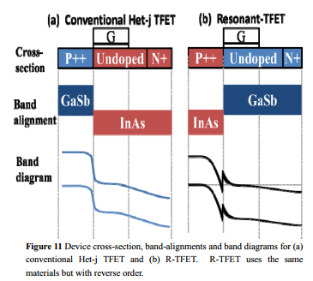
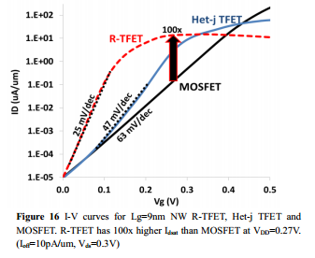
Resonant-enhanced tunnel FET
Avci & Young, (Intel) 2013 IEDM
2nd barrier: bound state
dI/dV peaks as state aligns with source
improved subthreshold swing.
Can we also increase the on-current ?

Slide 18
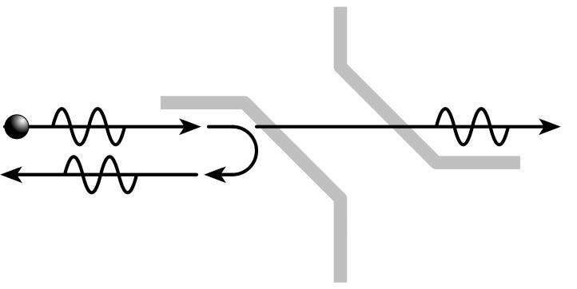
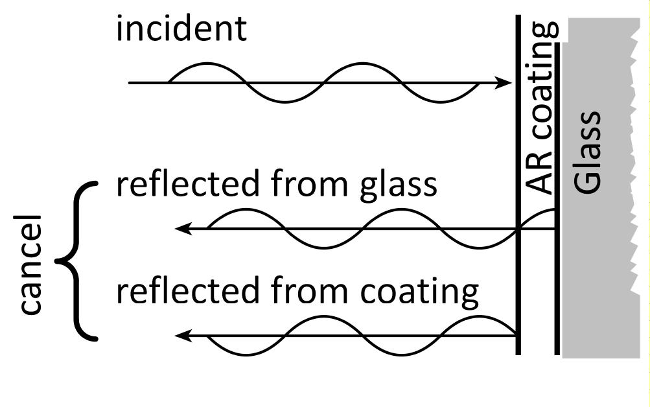
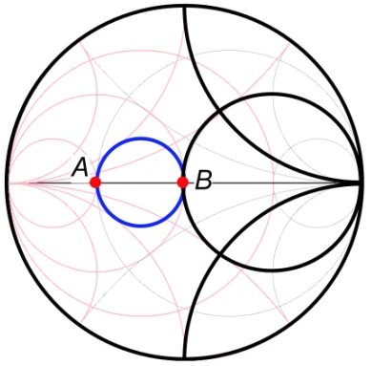
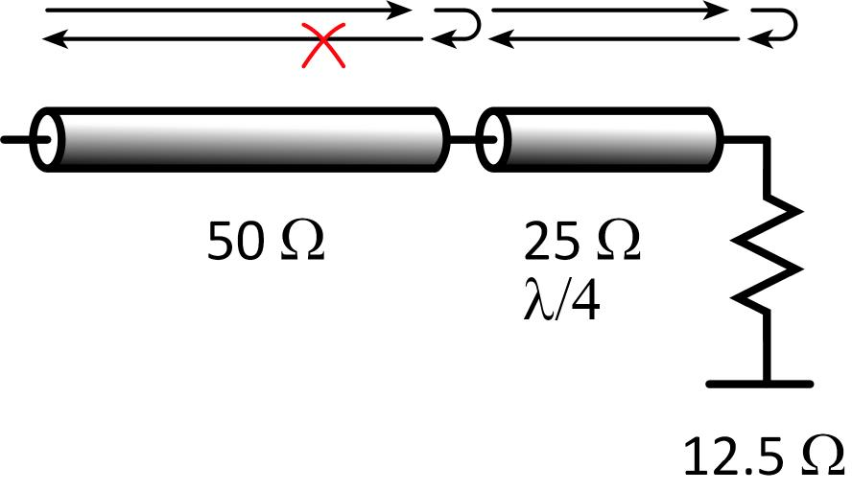
Electron anti-reflection coatings
Tunnel barrier:
transmission coefficient < 100%
reflection coefficient > 0%
want: 100% transmission, zero reflection
familiar problem
Optical coatings
reflection from lens surface
quarter-wave coating, appropriate n
reflections cancel
Microwave impedance-matching
reflection from load
quarter-wave impedance-match
no reflection
Smith chart.

Slide 19
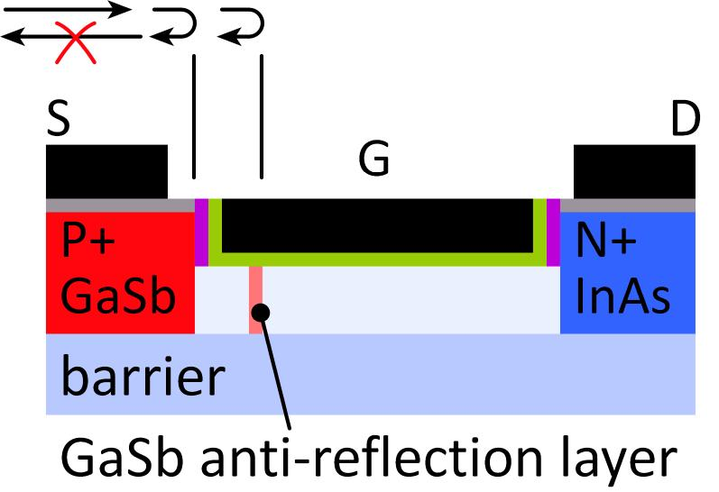
T-FET: single-reflector AR coating
Peak transmission approaches 100%
Narrow transmission peak; limits on-current
Can we do better ?

Slide 20
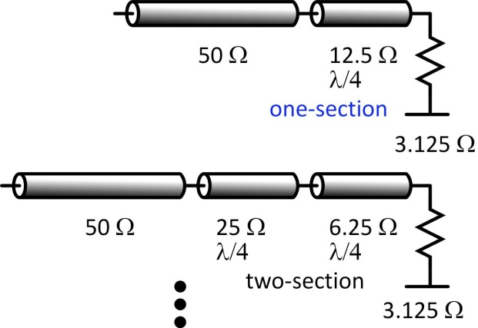
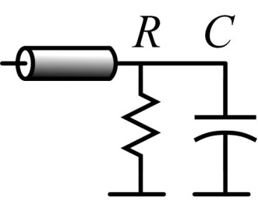
Limits to impedance-matching bandwidth
Microwave matching:
More sections→ more bandwidth
Is there a limit ?
Bode-Fano limits
R. M. Fano, J. Franklin Inst., Jan. 1960
Bound bandwidth for high transmission
example: bound for RC parallel load→
Do electron waves have similar limits ?
Yes ! Schrödinger's equation is isomorphic to E&M plane wave.
Khondker, Khan, Anwar, JAP, May 1988
T-FET design→ microwave impedance-matching problem
Fano: limits energy range of high transmission
Design T-FETs using Smith chart, optimize using filter theory
Working on this: for now design by random search
*

Slide 21
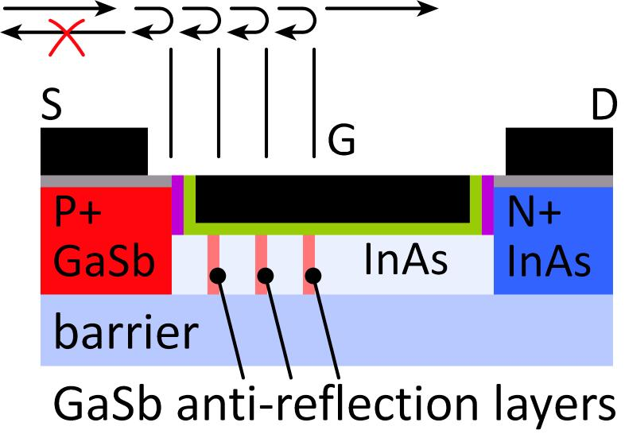
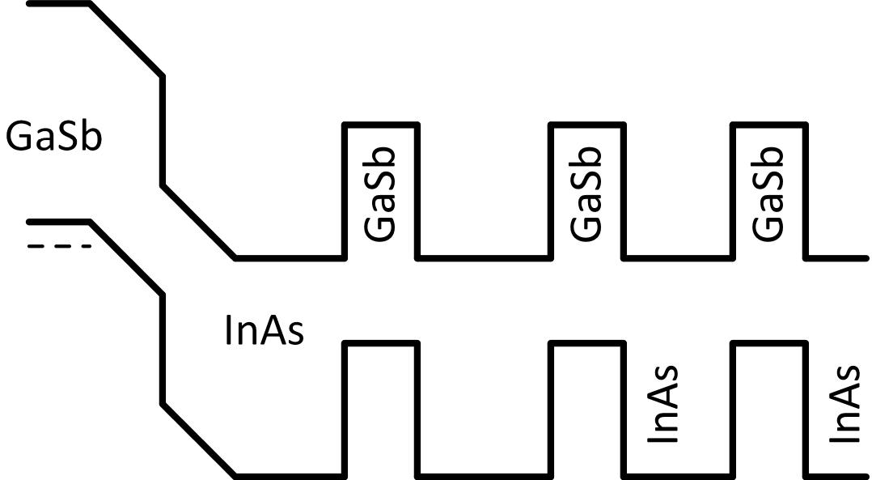
T-FET with 3-layer antireflection coating
Simulation
Interim result; still working on design

Slide 22
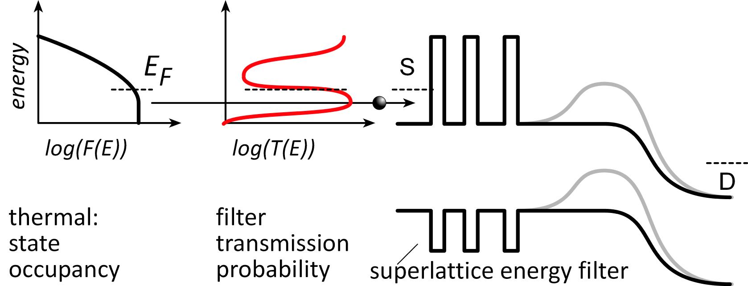
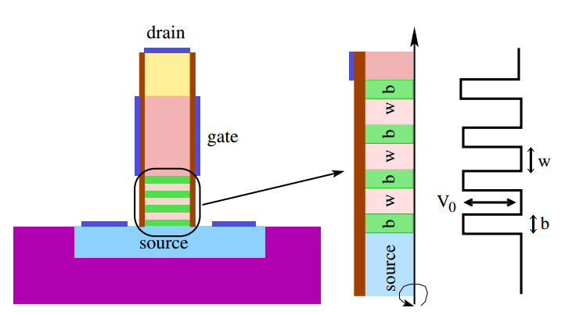
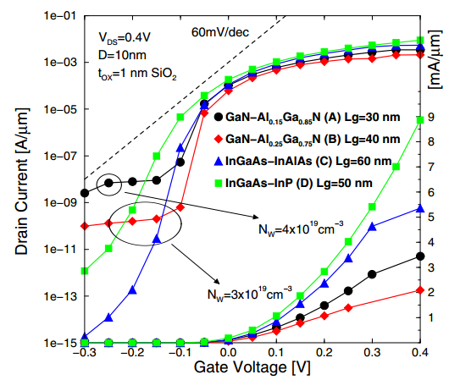
Source superlattice: truncates thermal distribution
Proposed 1D/nanowire device:
M. Bjoerk et al., U.S. Patent 8,129,763, 2012. E. Gnani et al., 2010 ESSDERC
Gnani, 2010 ESSDERC
Gnani, 2010 ESSDERC: simulation

Slide 23
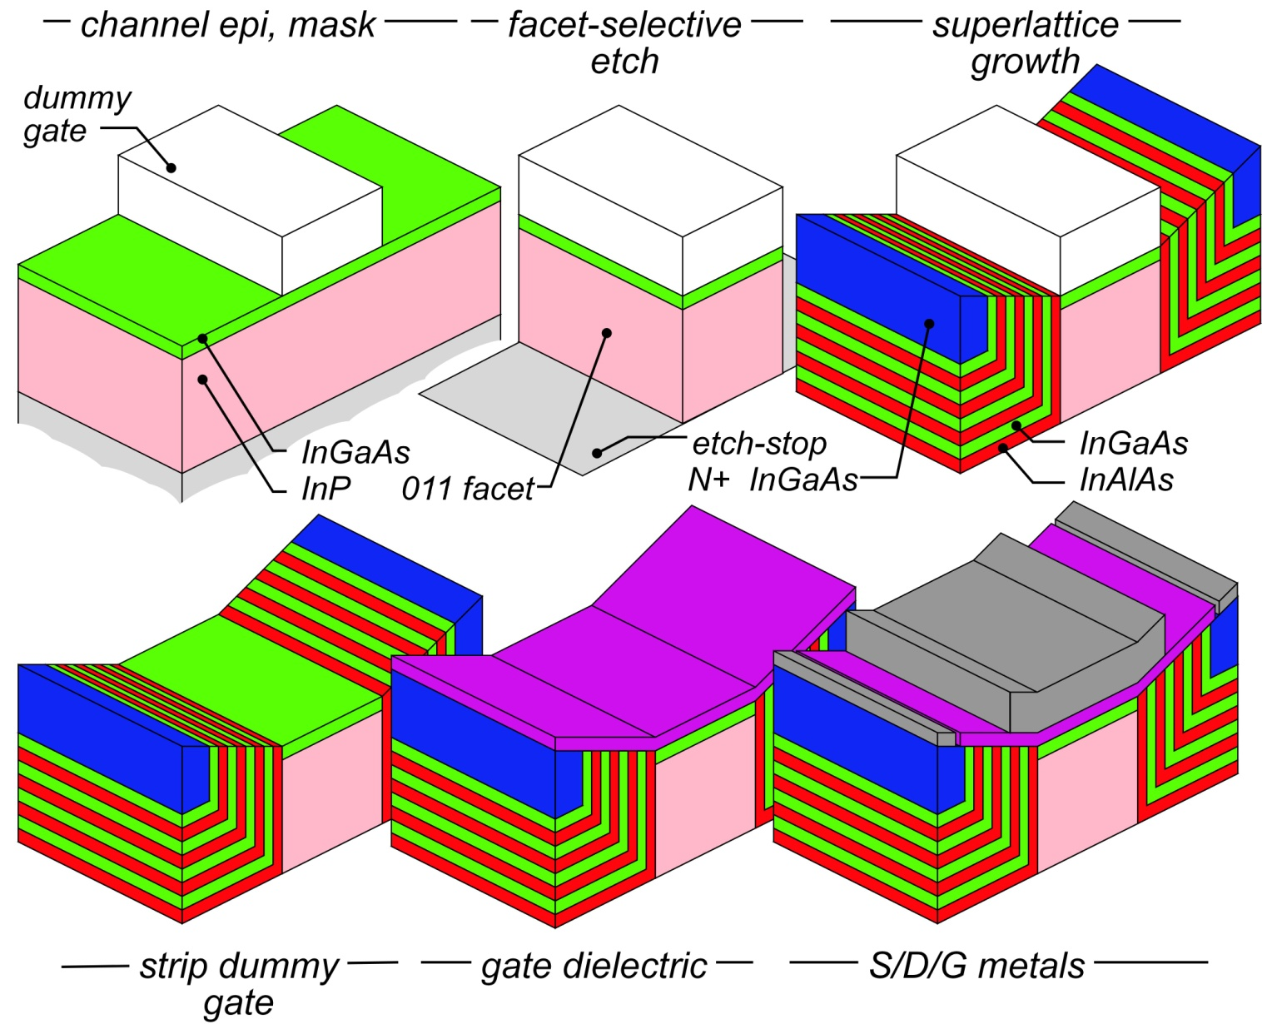
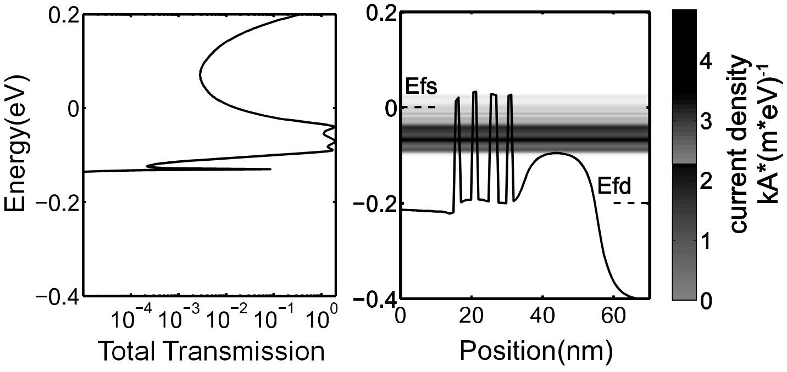
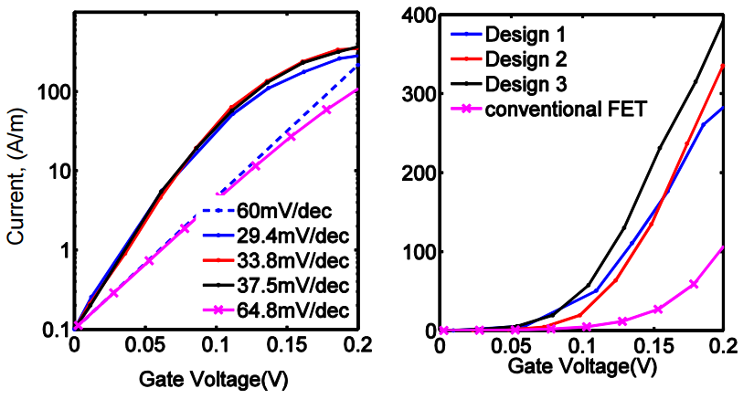
Planar (vs. nanowire) superlattice steep FET
Long et al., EDL, Dec. 2014
Planar superlattice FET
superlattice by ALE regrowth
easier to build than nanowire (?)
Performance (simulations):
~100% transmission in miniband.
0.4 mA/μm I_{on} , 0.1μA/μm I_{off} ,0.2V
Ease of fabrication ?
Tolerances in SL growth ?
Effect of scattering ?
simulation

Slide 24
(backup slides follow)

