Slide 1


Comparison of Ultra-Thin InAs and InGaAs Quantum Wells and
Ultra-Thin-Body Surface-Channel MOSFETs
Cheng-Ying Huang¹, Sanghoon Lee¹, Evan Wilson³, Pengyu Long³, Michael Povolotskyi³, Varistha Chobpattana², Susanne Stemmer², Arthur Gossard^{1,2}, Gerhard Klimeck³, and Mark Rodwell¹
¹ECE, University of California, Santa Barbara
²Materials Department, University of California, Santa Barbara
³Network for Computational Nanotechnology, Purdue University, West Lafayette, IN
CSW/IPRM 2015
Santa Barbara, CA

Slide 2
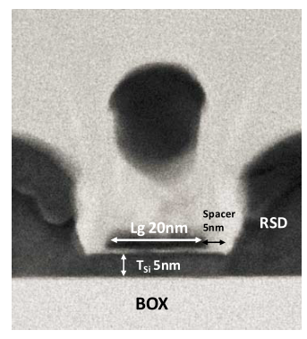
Why III-V FETs? Why Ultra-thin channel?
III-V channel: low electron effective mass→ high velocity, high mobility→ higher current at lower V_{DD}→ reducing switching power
Channel thickness (T_{ch}) must be scaled in proportional to gate length (L_{g}) to maintain electrostatic integrity.
For ultra-thin body (UTB) MOSFETs T_{ch}~1/4 L_{g}, and for FinFETs T_{ch}~1/2 L_{g}.
At 7 or 5 nm nodes, channel thickness should be around 2-4 nm.
Goal: Carefully examine InGaAs and InAs channels. The best design??
300K | Si | InAs | InGaAs
m_{e}* | 0.19 | 0.023 | 0.041
μ_{e}(cm²/V·s) | 1450 | 33000 | 12000
μ_{h}(cm²/V·s) | 370 | 450 | <300
Eg(eV) | 1.12 | 0.354 | 0.75
ε_{r} | 11.7 | 15.2 | 13.9
a(Å) | 5.43 | 6.0583 | (InP)
t_{Si}~5nm
W_{FIN}~8nm
STM-Leti-IBM
14nm UTBSOI
Intel 14nm FinFET
Quantum confinement effects!!
IEDM2014
Makr Bohr, IDF2014
2

Slide 3
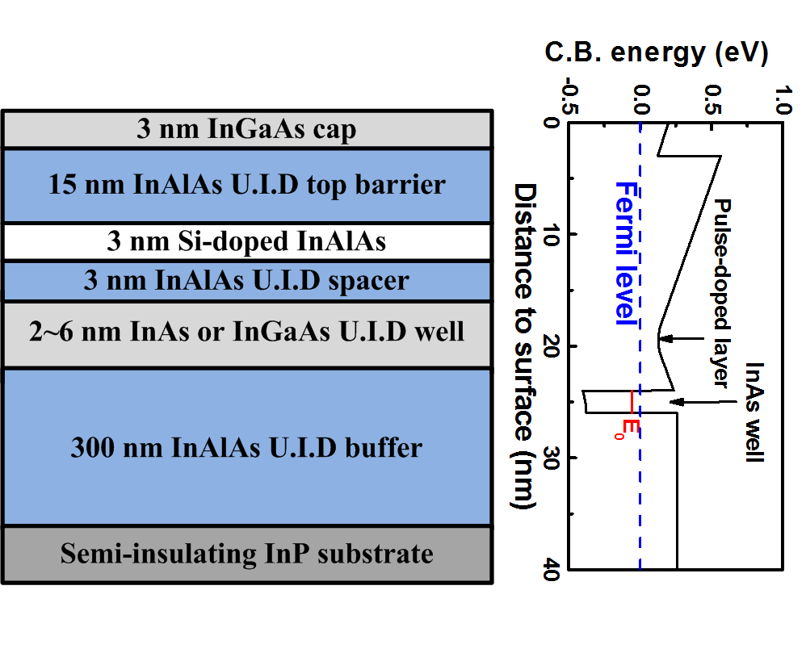
Ultra-thin channel 2DEG: Hall results
Quantum well (QW) 2DEGs were grown by solid source MBE.
For wide wells: μ_{InAs} > μ_{InGaAs}
For narrow wells (~2 nm): μ_{InAs} ≈ μ_{InGaAs}
Carrier concentration decreases due to increased E₀.
3

Slide 4
What happens in thin wells?
Mobility is limited by interface roughness scattering. Strained InAs growth (S-K mode) might induce higher interface roughness.
Electron effective mass are similar for ~2-3 nm InAs and InGaAs wells because of non-parabolic band effects.
µ ~T_{ch}⁻⁶
J. Appl. Phys. 77, 2828 (1995), Phys. Rev. B, 52, 1038 (1996),
Appl. Phys. Lett 64, 2520 (1994), Appl. Phys. Lett 62, 2416 (1993),
G. Mugny et al., EUROSOI-ULSI conference 2015.
C. Y. Huang et al., J. Appl. Phys. 115, 123711 (2013)
4

Slide 5
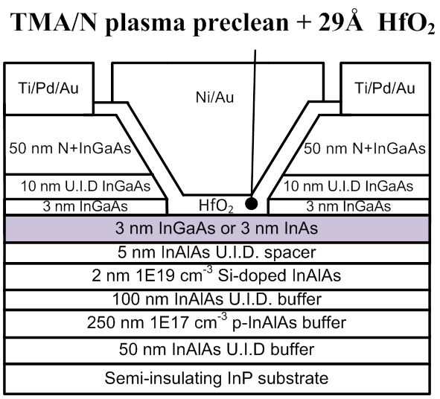
Ultra-thin body III-V FETs: L_{g}~40 nm
InAs
InGaAs
UTB FETs with 3 nm channels were fabricated to compare InAs and InGaAs channels.
1.6:1 I_{on} and transcoaductance for InAs channels.
10:1 lower I_{off} for InGaAs channels.
InAs
InGaAs
5

Slide 6
On-state performance
Higher I_{on} and higher g_{m} for UTB InAs FETs than InGaAs UTB FETs.
InAs FETs achieve g_{m}=2 mS/μm, and I_{on}=400 μA/μm at V_{DS}=0.5V and I_{off}=100 nA/μm.
Similar source/drain resistance (R_{S/D} ) ensures that the performance degradation of InGaAs is not from source/drain, but from channel itself (slope).
6

Slide 7
Subthreshold swing and off-state current
Superior SS~83 mV/dec. and DIBL~110 mV/V because of ultra-thin channels and improved electrostatics.
Minimum I_{off} is 10:1 lower for InGaAs channel at short L_{g}, where leakage current limited by band-to-band tunneling.
InGaAs FETs are limited by gate leakage at long L_{g}.
7

Slide 8
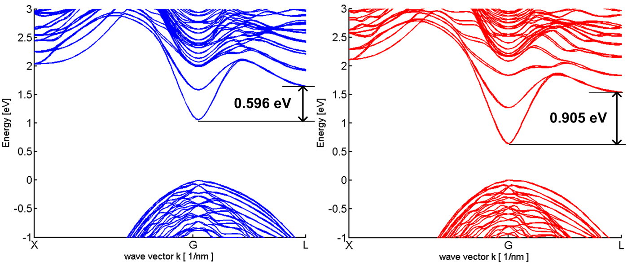

Why QW-2DEGs and UTB-FETs show different results?
1st possible cause: Electron population in L valley due to strong quantum confinement → Unlikely.
2nm InAlAs barrier, 3nm InGaAs channel with H passivation on top
2nm InAlAs barrier, 3nm InAs channel with H passivation on top
Courtesy of Evan Wilson, Pengyu Long, Michael Povolotskyi, and Gerhard Klimeck.
 | In_{0.53}Ga_{0.47}As | InAs
m_{e}* at Γ [m₀] | 0.080 | 0.063
Γ – L separation [eV] | 0.596 | 0.905
E_{g} at Γ [eV] | 1.06 | 0.639
8

Slide 9
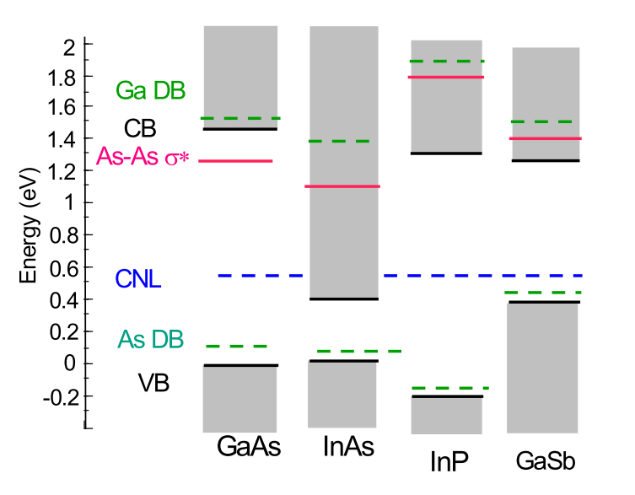
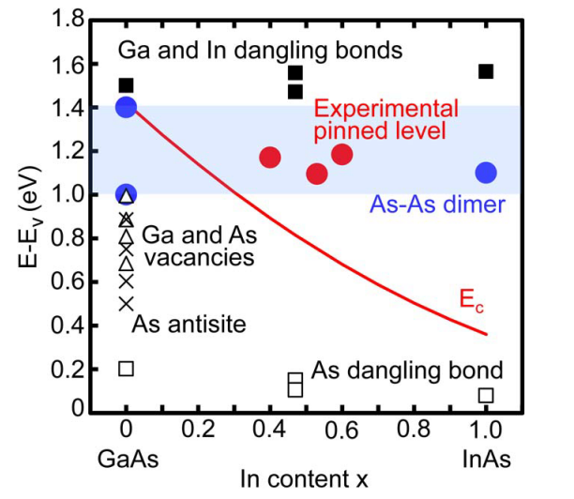
Why QW-2DEGs and UTB-FETs show different results?
2nd possible cause: Electron interaction with oxide traps inside conduction band → Likely.
Electrons in high In% content channels have less scattering and less electron capture by the oxide traps.
J. Robertson et al., J. Appl. Phys. 117, 112806 (2015)
J. Robertson, Appl. Phys. Lett. 94, 152104 (2009)
N. Taoka et al., Trans. Electron Devices. 13, 456 (2011)
N. Taoka et al., IEEE IEDM 2011, 610.
9

Slide 10
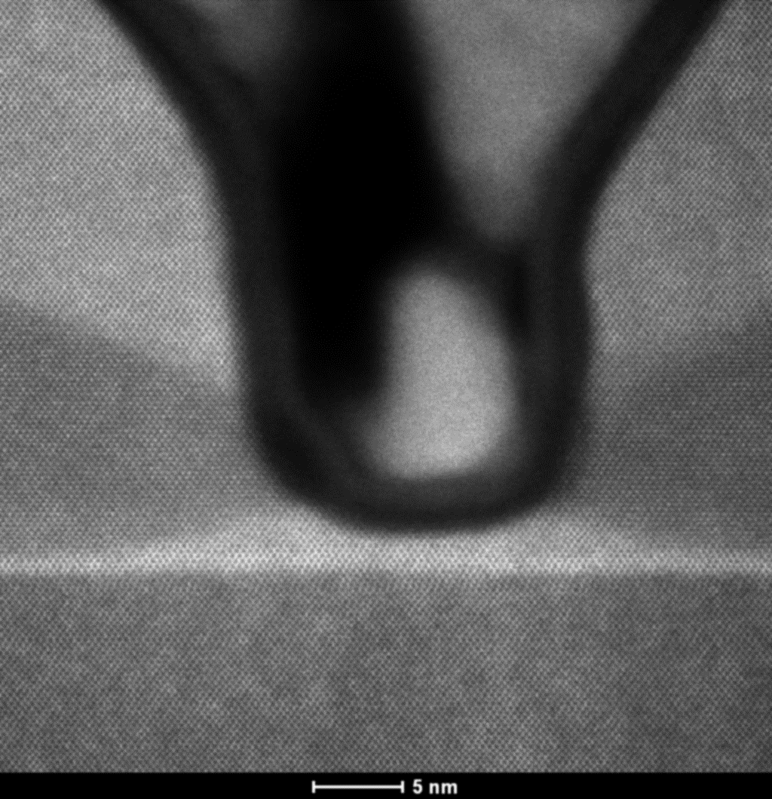
UCSB L_{g}~12 nm III-V MOSFETs (DRC 2015)
L_{g}~12nm
N+InGaAs
~ 8nm
N+InP
Ni
InP spacer
InAlAs
Barrier
t_{ch}~ 2.5 nm
(1.5/1 nm InGaAs/InAs)
I_{on}/I_{off}>8.3·10⁵
10

Slide 11
Summary
Below 10 nm logic nodes, ultrathin channels are required.
In QW 2DEGs, the electron Hall mobility are similar for InGaAs and InAs wells as the wells thinned to 2~3nm.
In UTB MOSFETs, 3 nm InAs channels significantly improve on-state current and transconductance (~1.6:1), and reduce channel resistance as compared to 3 nm InGaAs channel.
Purdue’s tight-binding calculations show large ~0.6 eV Γ–L splitting in 3 nm InGaAs channels, ruling out the possibility of electron population in L-valley.
UCSB C-V measurements show large dispersion in 3 nm InGaAs channels, possibly indicating the significant electron interactions with oxide traps. (As-As anti-bonding may be the culprit)
11

Slide 12
Acknowledgment
Thanks for your attention!
Questions?
This research was supported by the SRC Non-classical CMOS Research Center (Task 1437.009) and GLOBALFOUNDRIES(Task 2540.001).
A portion of this work was done in the UCSB nanofabrication facility, part of NSF funded NNIN network.
This work was partially supported by the MRSEC Program of the National Science Foundation under Award No. DMR 1121053.
cyhuang@ece.ucsb.edu

Slide 13
(backup slides follow)

Slide 14
Mobility in different channel design: 25 µm-L_{g}
m*, C_{g-ch}, R_{S/D} more important for ballistic FETs

Slide 15
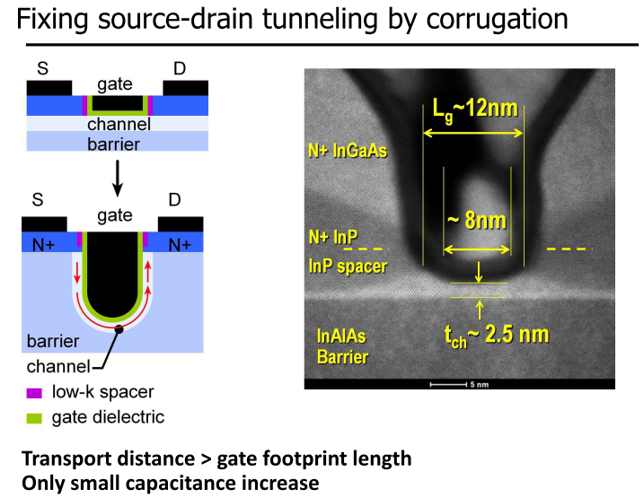

Slide 16
