Slide 1
Materials for nm Transistors: 2D or 3D ?
Conference on Physics of Compound Semiconductors and Interfaces, January 16, 2018, Kona, Hawaii
Mark Rodwell, University of California, Santa Barbara

Slide 2
2D or 3D Semiconductors ?
2D or 3D: which for future electron devices ? VLSI high-frequency wireless power conversion
What are the challenges ? ...and how best to solve them ?
How should materials community best direct its efforts ?
A plea from a transistor & IC design guy: Please focus on atomic-scale techniques in 3D materials

Slide 3
Goals: Transistors for Computers Transistors for Radios

Slide 4
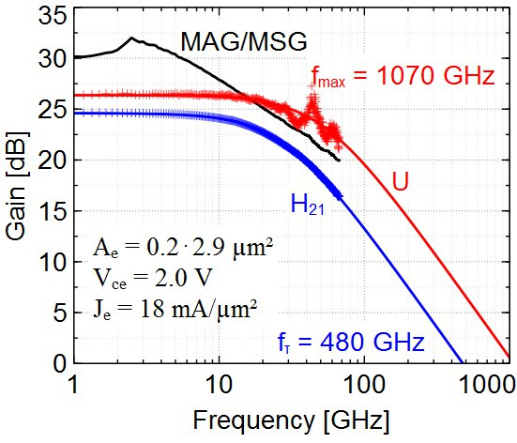
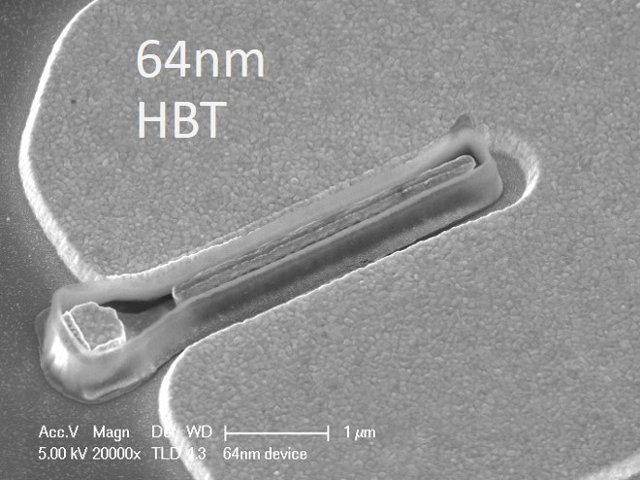
Transistor design: high-frequency wireless
Bipolar transistor cutoff frequencies: transit times, RC charging times, CV/I delays
High-frequency scaling narrow junctions, thin epi layers, high electron velocity high current density, ultra low resistivity contacts Are 2D materials relevant ?
130 nm result Rode (UCSB), IEEE TED, 2015
64 nm in development Yihao Fang, UCSB, unpublished

Slide 5
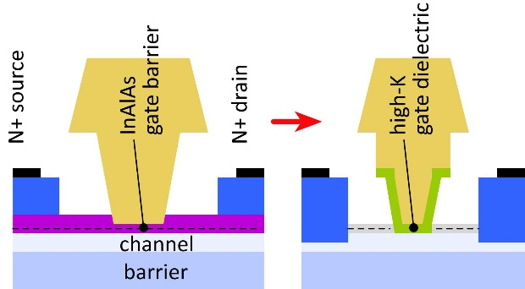
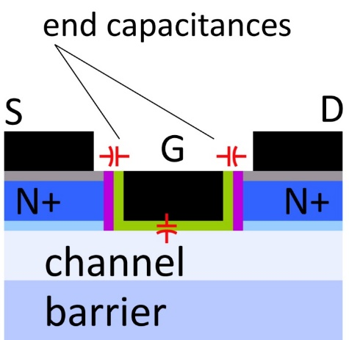
Transistor design: high-frequency wireless
Field-effect transistor cutoff frequencies: Transconductance. Output conductance Gate-channel capacitance. Gate end capacitances. Source and drain access resistance
Need thin channel and thin gate dielectric For low output conductance. For high transconductance → low C_{end}/g_{m} time constant.
Need low access resistivities regrown N+ source / drain interfaces to channel very low resistivity metal-semiconductor contacts
Channel m*, DOS: not too high, not too low

Slide 6
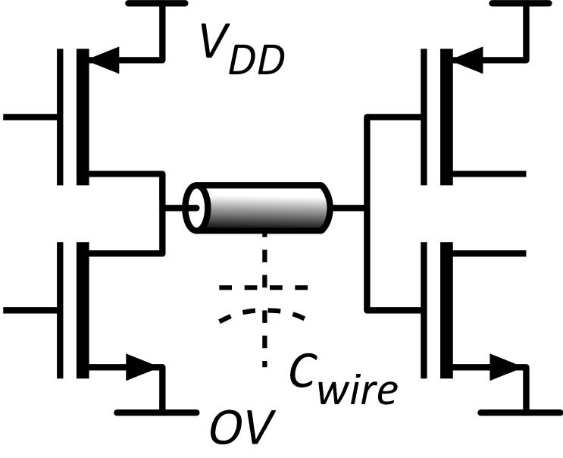
Transistor design goals: VLSI
Small transistors: plentiful, cheap
Small transistors→ short wires small delay CV_{DD} /I low energy CV_{DD}²/2
Small transistor footprint is key
Low leakage current thermal: I_{off} > I_{on}*exp(-qV_{DD}/kT) want low V_{DD} yet low I_{off}.
Want: Large dI/dV above threshold Large on current (mA/micron²) If possible, subthreshold swing steeper than thermal→ low V_{DD}

Slide 7
Transistor design: challenges and solutions

Slide 8
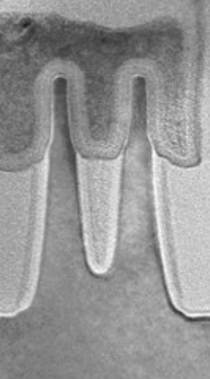
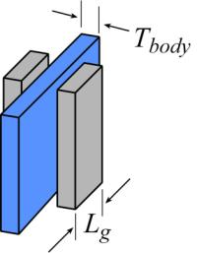
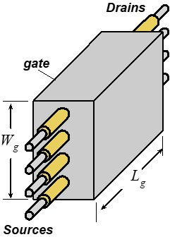
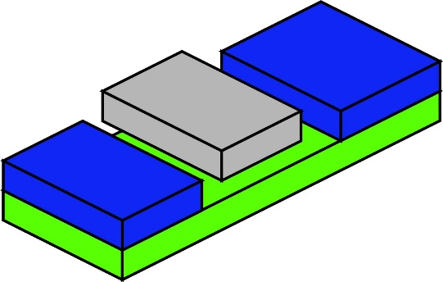
VLSI FETs: Electrostatic scaling limits
Low subthreshold swing: Need large gate-channel capacitance much larger than drain-channel capacitance.
Scaling = shorter gate: need thinner dielectric, thinner channel
Tunneling leakage: minimum dielectric thickness
→ finFETs, gate-all-around FETs.

Slide 9
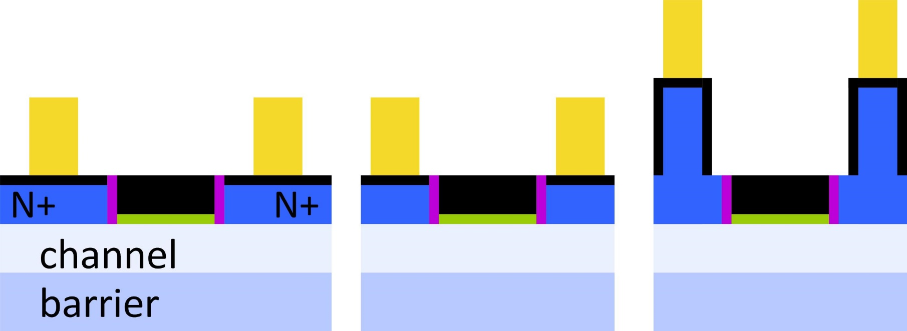
VLSI FETs: S/D access resistivity
7nm node: contacts are substantial fraction of FET footprint
Source/drain access resistance = ρ_{contact}/Area
Need extremely low contact resistivity, ~3× 10⁻⁹ Ω-cm².
or: corrugated or vertical contacts

Slide 10
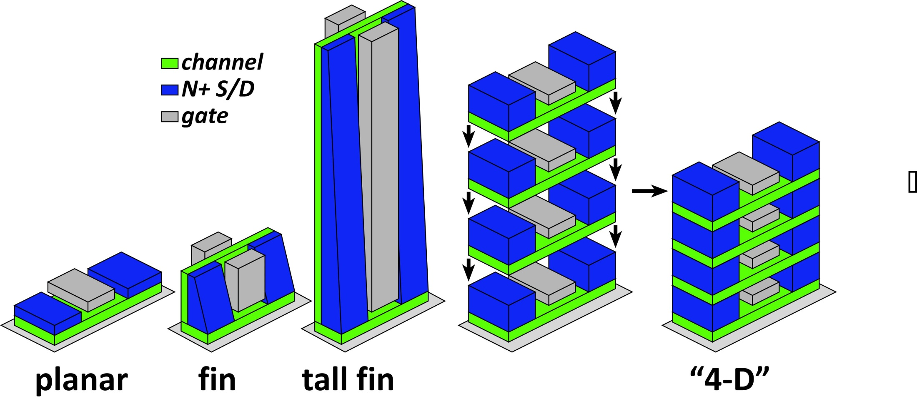
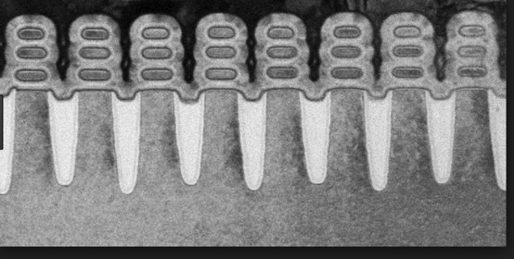
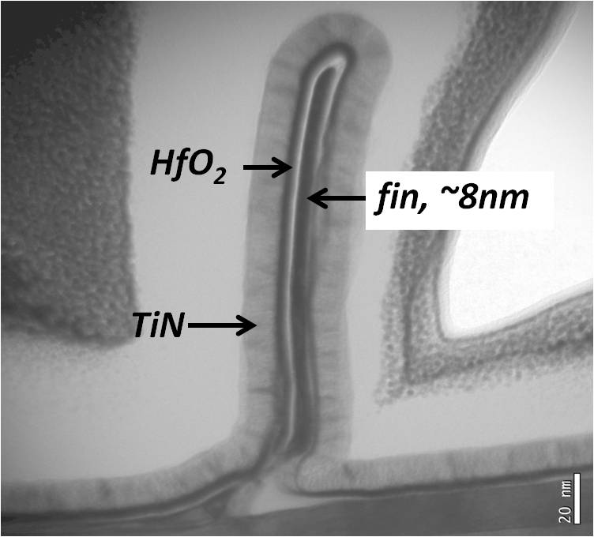
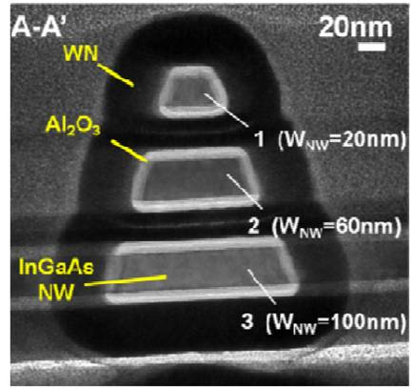
VLSI FETs: increasing drive current density
more current per IC area→ smaller IC area→ shorter wires
→ 3D integration
stacked nanosheet FET
Cohen-Elias et al., UCSB 2013 DRC
J .J. Gu et al., 2012 DRC, Purdue (P. Ye group_ 2012 IEDM
https://www-03.ibm.com/press/us/en/pressrelease/52531.wss

Slide 11
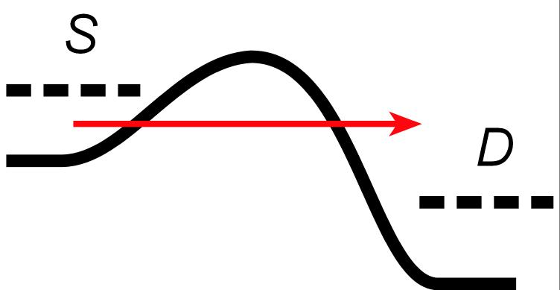
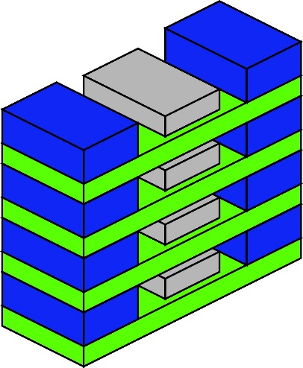
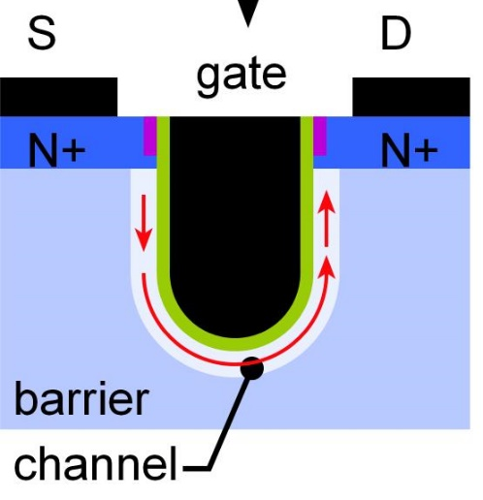
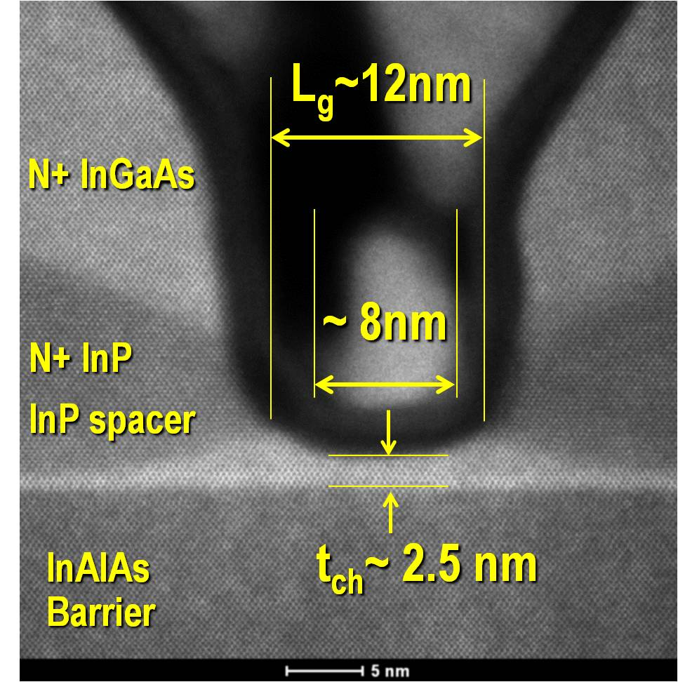
VLSI FETs: S/D tunneling
Source-drain tunneling leakage:
imposes minimum gate length
Solution 1: increased transport mass (Lundstrom) anisotropy, strain Reduces mA/μm with 2DEG FETs. Not so in nanowires Favors stacked stacked nanosheet, stacked nanowire
Solution 2: Corrugation. U-shaped device.

Slide 12
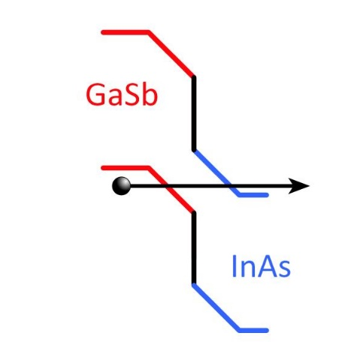
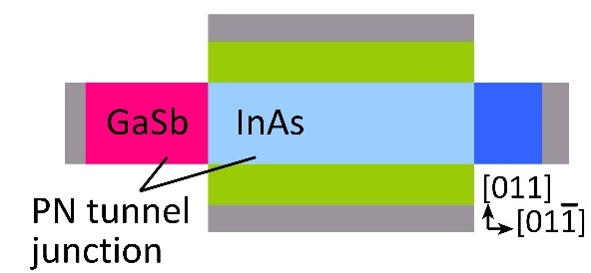
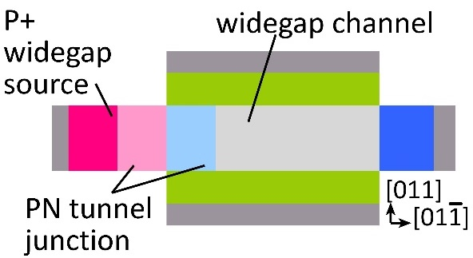
VLSI FETs: power density & supply voltage
TFETs (and FerroFETs): steep subthreshold swing
TFET: truncates source thermal distribution.
TFETs are hard to build ! Requires PN, heterojunction perpendicular to channel needs ultra thin channel for high junction field
UCSB triple-heterojunction TFET designs. simulations: about 30:1 more on-current, 30:1 faster logic even harder to build ! Working on these now.

Slide 13
Template assisted selective epitaxy
L. Czornomaz et al. (IBM Zurich), 2015 & 2016 VLSI Symposia
Can make PN and HJ perpendicular to channel Can control thicknesses to near-atomic precision.
We are trying to use this to make 3HJ TFETs.

Slide 14
Do 2D materials help ?

Slide 15
Do 2D materials aid nm transistor scaling ?
The argument often presented: Thinner channel→ thinner (channel+dielectric)→ shorter L_{g,min}
The counter-argument: It is the sum (channel+dielectric) thickness that matters Dielectric: minimum ~0.5nm EOT Little benefit for channels thinner than 2 nm and...we can make 2nm channels with 3D semiconductors

Slide 16
2D materials: other problems
VLSI: large required areas, low defect density. Exfoliation/transfer→ creases:
Can I make finfets ? or stacked nanosheet FETs ? or stacked nanowires ? Can I introduce corrugation ? increase S/D contact area ? Can I get contact resistivity below 10⁻⁸ Ω-cm² ?

Slide 17
A plea to the materials community

Slide 18
When it gets crowded, build vertically
Los Angeles: sprawl
Manhattan: dense
2-D integration: wire length # gates^{1/2}
3-D integration: wire length #gates^{1/3}
LA is interconnect-limited
1) Chip stacking (skip...different community) 2) 3D transistor integration

Slide 19
What should we do? 3D/2D/3D electronics
Vertically integrated 3-Dimensional transistors using nearly 2-Dimensional channels (1nm or thinner ) made from 3-Dimensional materials
Vertically stacked horizontal nm MOSFETs
Laterally packed vertical nm MOSFETs and TFETs
...with near-atomic control of semiconductor layer thicknesses

Slide 20
What integration density must we beat ?
finFETs permit somewhat shorter gate length than planar FETs But 7nm node uses 15nm gate*; can't get much shorter.
*http://ieeexplore.ieee.org/document/7838334/

Slide 21
What should we do? nm stacked horizontal FETs
Vertical nanosheets: 1 nm channel easier than in finFETs thin the channel to 0.7-1nm precision growth: Atomic Layer Epitaxy . precision surface etching: Atomic Layer ETching
But: only helps electrostatics when body dominates over high-K only helps S/D tunneling given high transport m*.
https://www-03.ibm.com/press/us/en/pressrelease/52531.wss

Slide 22
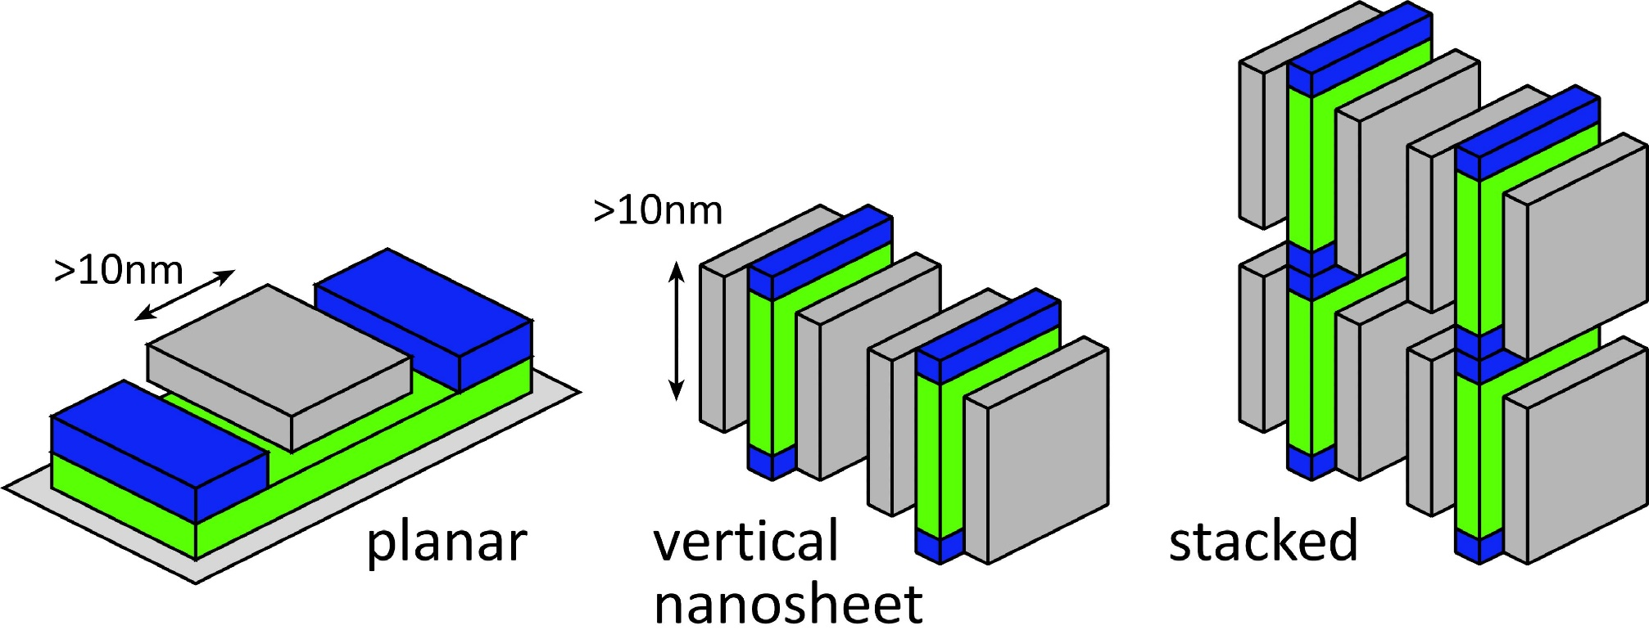
What should we do? nm-channel vertical integration
concept: Paolo A. Gargini Intel/SRC, others ?
Vertical devices: gates can be long (~10nm), yet devices can be packed at <10nm spacing → increased integration density
What integration density can be achieved ?

Slide 23
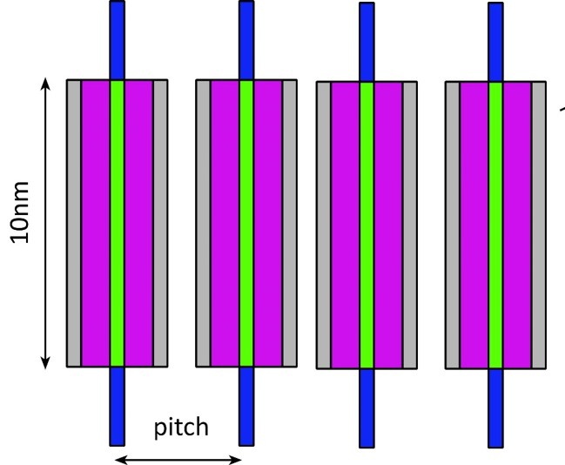
3D: what density can be reached ?
Gate dielectric: 1nm - limited by tunneling FET-FET spacing: 1nm - limited by tunneling Semiconductor channel: 1nm Gate metal: 0.5 nm device pitch (?) 5nm
Physics limits: Integration density can be significantly increased Technology limits: 1nm-thickness fabrication feasible?

Slide 24
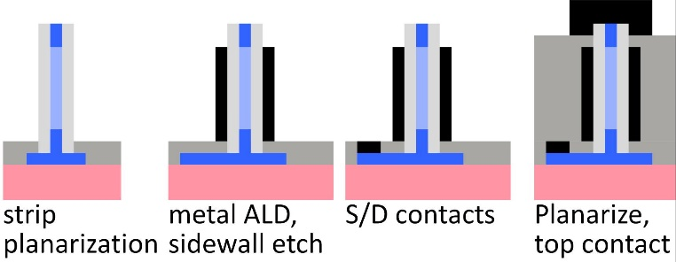
nm-scale fabrication
*V. Djara et al, 2015 VLSI Symposium
nm-scale semiconductor growth: template assisted epitaxy* form ~2-atom-thick Si layer (not 2D semiconductor) technique: selective growth in ALD-defined sacrificial template ALD has single-atom thickness control
nm-scale metallization and contacts ALD metal processes, sidewall etch processes
TFETs can be also fabricated by this technique

