Slide 1
Future Directions in > 100 GHz Devices
2019 IEEE SISC Conference, December 13, San Diego
Mark Rodwell, Yihao Fang, Brian Markman, Hsin-Ying Tseng
University of California, Santa Barbara
rodwell@ece.ucsb.edu
This work was supported in part by the Semiconductor Research Corporation (SRC), DARPA, and the NSF

Slide 2
Future Directions in > 100 GHz Devices
2019 IEEE SISC Conference, December 13, San Diego
Materials Requirements for Future Transistors
Mark Rodwell, Yihao Fang, Brian Markman, Hsin-Ying Tseng
University of California, Santa Barbara
rodwell@ece.ucsb.edu
This work was supported in part by the Semiconductor Research Corporation (SRC), DARPA, and the NSF

Slide 3
Transistor design and materials requirements
Transistors for VLSI
Large I_{on}, small I_{off}, low V_{DD}, small footprint… hard !
MOSFETs, TFETs.
Transistors for wireless
High (f_{τ},f_{max}) , low noise, high power, high efficiency.
InP HBTs, InP MOS-HEMTs, (GaN HEMTs, SiGe HBTs)
Transistors for power switching:
high speed, high voltage, high current,
GaN, SiC, Si LDMOS
…not my field.

Slide 4
nm FETs:
MOS and TFETs

Slide 5
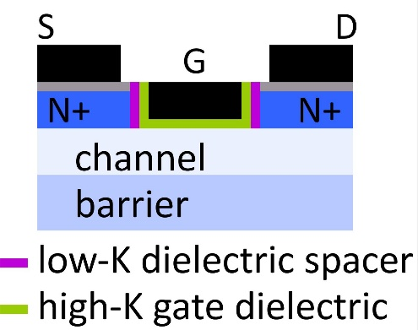
MOSFETs for VLSI
Goals: large I_{on}, small I_{off}, low V_{DD}, small footprint
Minimum L_{g} set by minimum equivalent oxide thickness. Zr_{x}Hf_{1-x}O₂ ?
Minimum contact size set by contact resistivity (<0.3 Ω−μm²)
Ballistic I_{on} set by band structure: EOT, m*, # valleys
I_{off} is degraded by low bandgap
Ideal: m*=0.1m_{e}, 2-3 valleys, E_{g}>1eV, grades to small-E_{g} contact layers

Slide 6
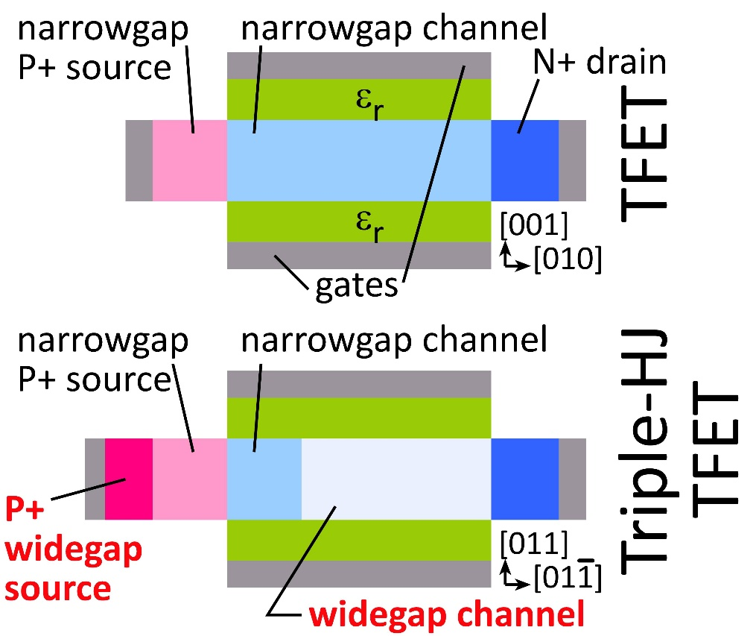
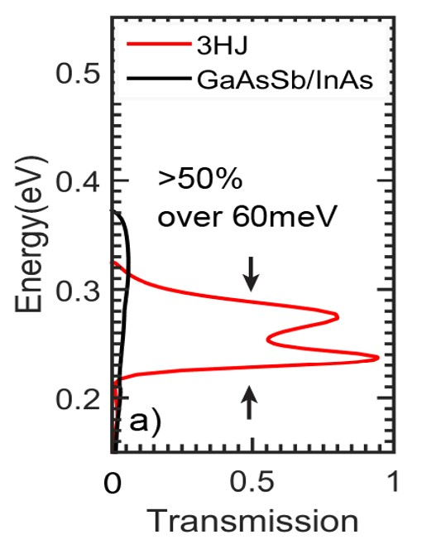
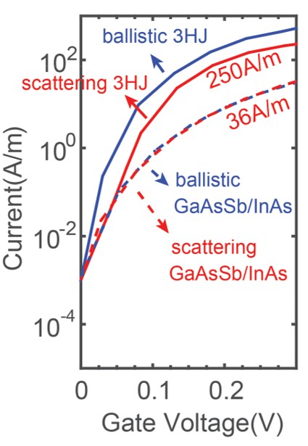
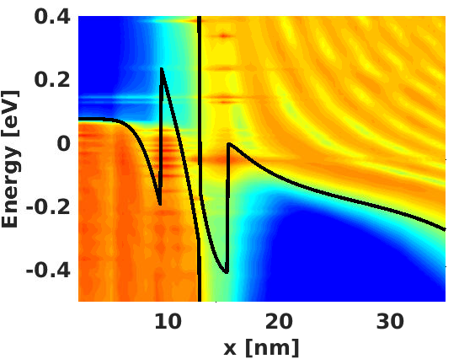
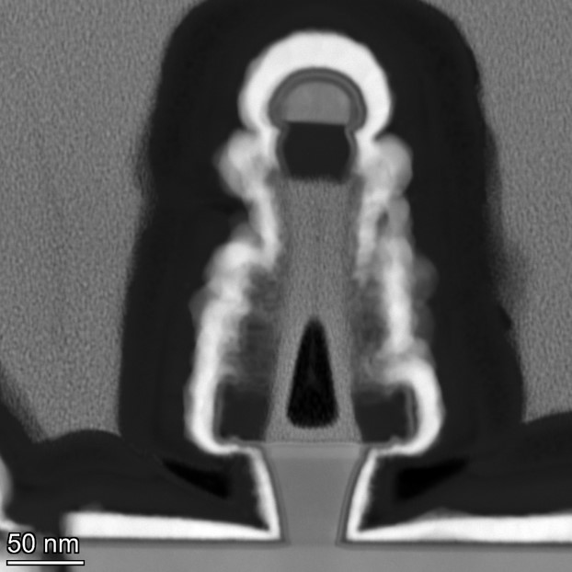
High-current triple-heterojunction TFETs for VLSI
Simulations: M. Povoloski, Purdue
< 2nm
barrier
TFETs: steep SS ✓, low I_{on}; ✘
Triple-HJ TFET: steep SS ✓, high I_{on}; ✓
Materials needs:
Direct bandgap, large band offsets, small tunnel barrier, low m*
Low D_{it} for N & P materials. (N-InAs ✓, N-InP ✓, P-GaAsSb ?, P-InGaAs ?)
small dielectric EOT, low ρ contacts

Slide 7
High-Frequency Transistors

Slide 8

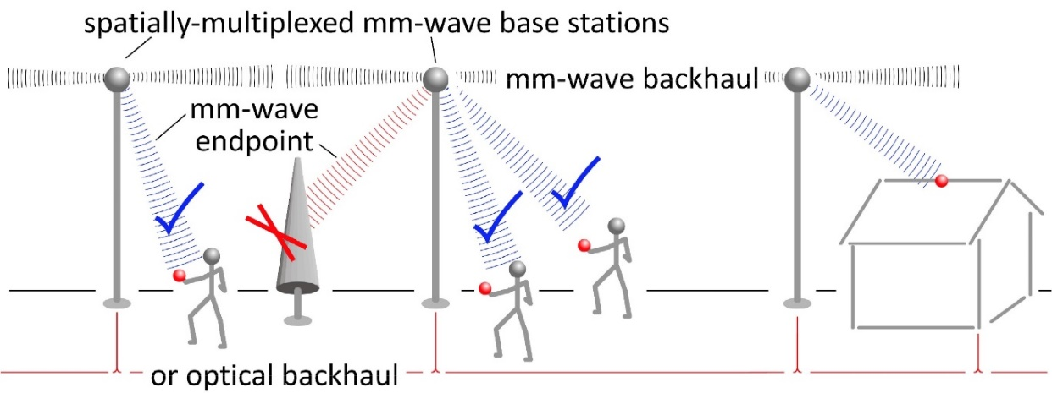
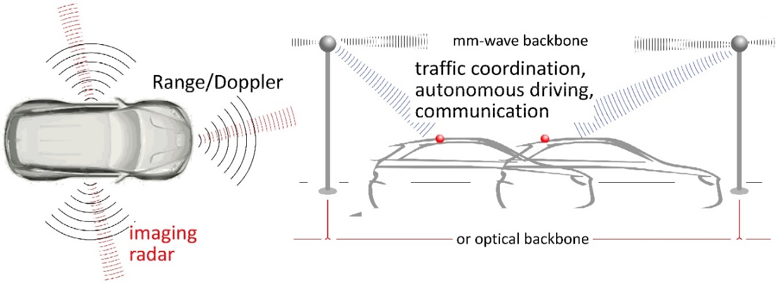
Beyond-5G Wireless: 100-300GHz
10Gb mobile communications:
Unlimited information, anywhere.
Capacity well beyond 5G.
TV-resolution wireless imaging:
See, fly, drive perfectly in any conditions.
Debdeep Jena, Alyosha Molnar, Christoph Studer,
Huili Xing: Cornell University
Dina Katabi: MIT
Sundeep Rangan: New York University
Amin Arbabian, Srabanti Chowdhury: Stanford
Elad Alon, Ali Niknejad, Borivoje Nikolic, Vladimir Stojanovic: University of California, Berkeley
Gabriel Rebeiz: University of California, San Diego
Jim Buckwalter, Upamanyu Madhow, Umesh Mishra, Mark Rodwell: University of California, Santa Barbara
Andreas Molisch, Hossein Hashemi: University of Southern California
Harish Krishnaswamy: Columbia University
Kenneth O: University of Texas, Dallas

Slide 9
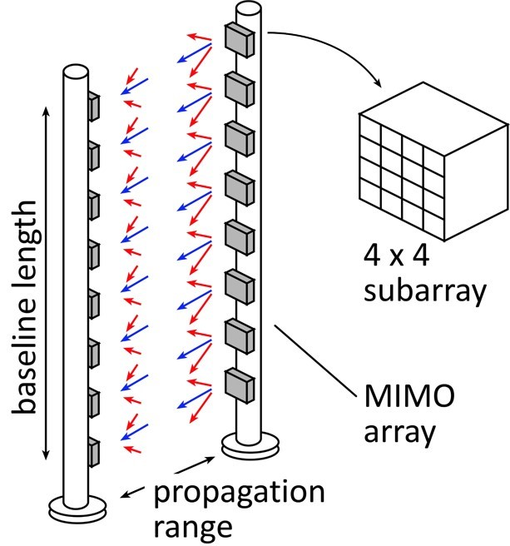
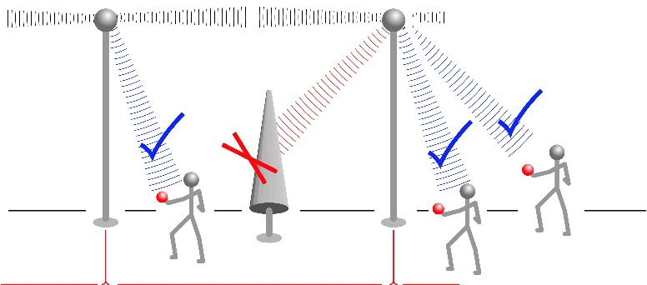
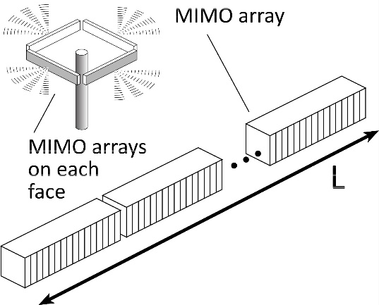
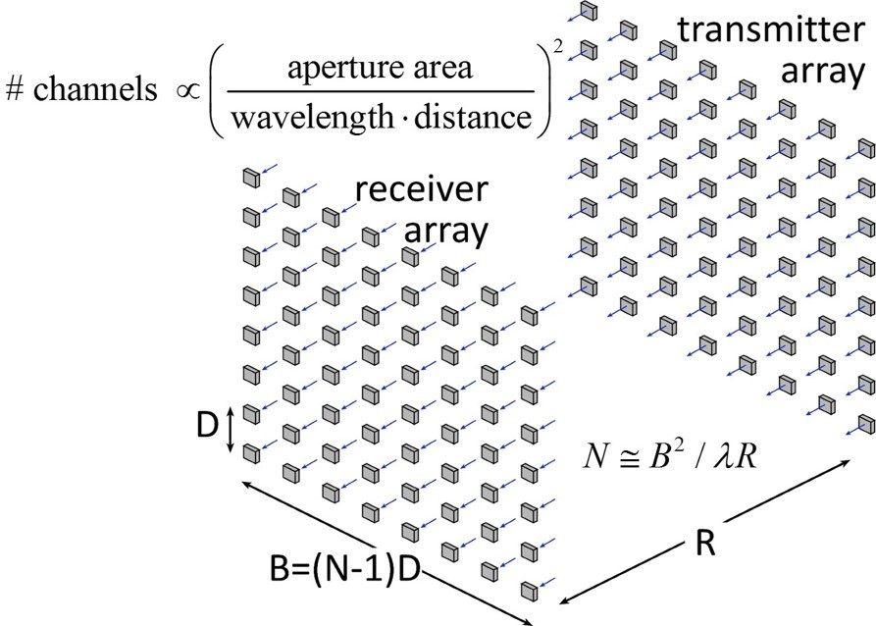
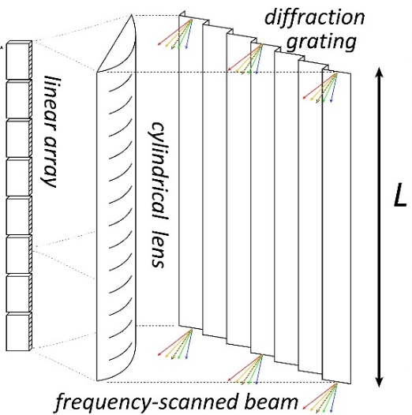

Target applications
MIMO hub:
140GHz, 128 beams/face, 10Gb/s/user, 100m
Point-point MIMO:
240GHz, 340GHz: 640Gb/s, 250-500m
Hardware-efficient imaging:
240GHz, 340 GHz, 300m, 512×64 image, 60Hz, 15dB SNR
5 Tb/s !

Slide 10
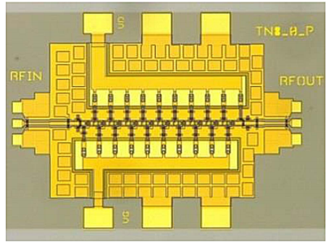
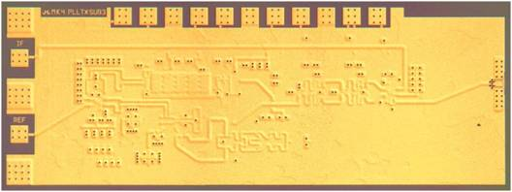
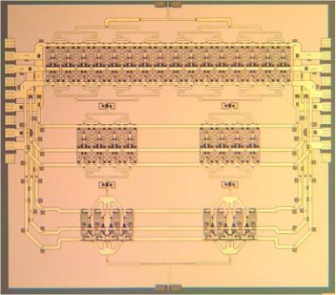

A few high-frequency ICs
570 GHz
fundamental
oscillator;
InP HBT
1.0 THz
Amplifier;
InP HEMT
Mei et al,
Northrop-Grumman
EDL, 2015
M. Seo, TSC / UCSB
JSSC, 2011
600 GHz
Integrated
Transmitter;
InP HBT
PLL + Mixer+Amplifier
M. Seo TSC
2012 IMS
220 GHz
180 mW
power amplifier;
InP HBT
204 GHz static
frequency divider
(ECL master-slave
latch);
InP HBT
T. Reed, UCSB
Z. Griffith, TSC
CSICS 2013
Z. Griffith, TSC / UCSB
CSIC 2010

Slide 11
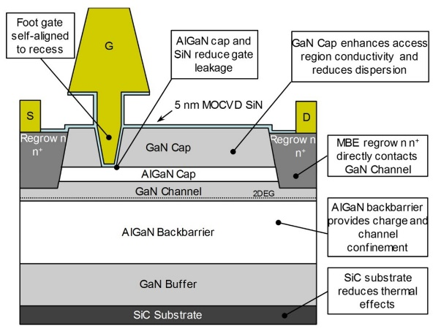
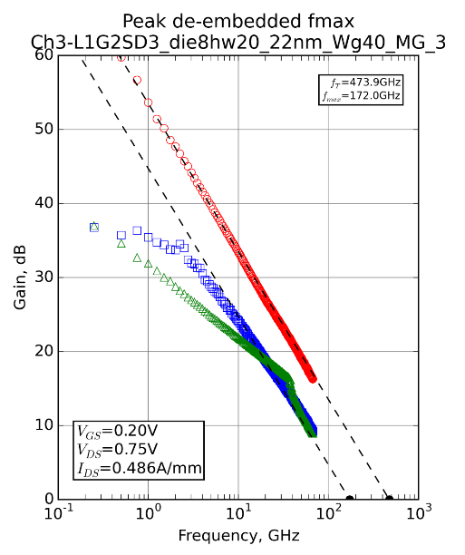
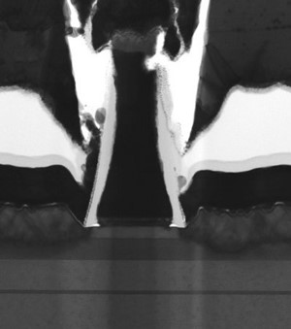
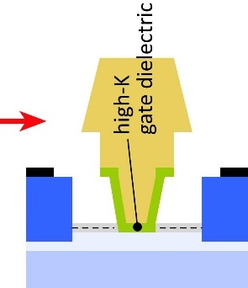
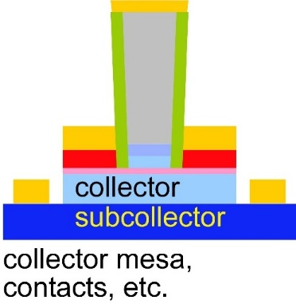
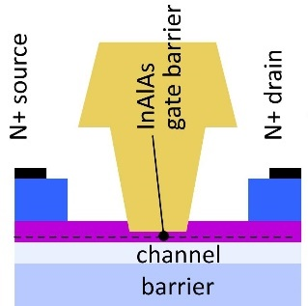
Transistor development for 100-300GHz systems
InGaN and GaN HEMTs:
High power from 100-340GHz
GaN: superior power density at all frequencies
UCSB/Mishra: InGaN for increased mobility
Cornell/Xing: AlN/GaN/AlN
N-polar GaN: Mishra, UCSB
THz InP HBTs:
Efficient 100-650GHz power
more f_{max}: more efficient, higher frequencies
base regrowth: better contacts→ higher f_{max}.
status: working DC devices; moving to THz
THz InP HBTs:
Sensitive 100-650GHz low-noise amplifiers
more f_{τ}: lower noise, higher frequencies
high-K gate dielectric → higher f_{τ}.
status: process modules

Slide 12
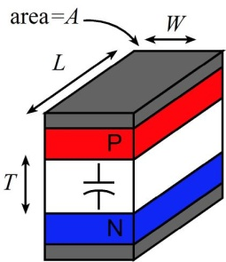
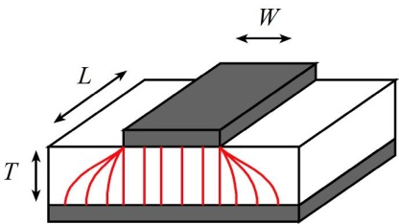
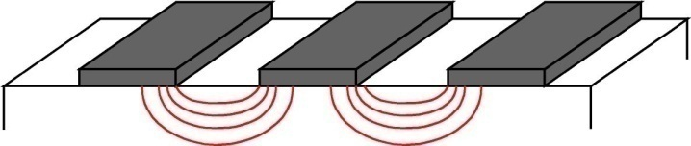
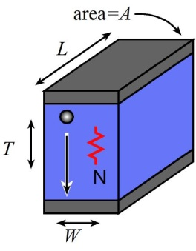
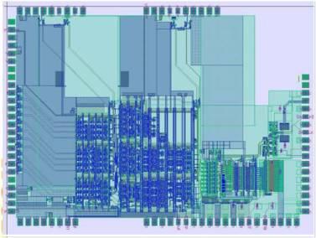
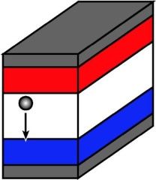
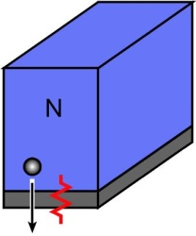
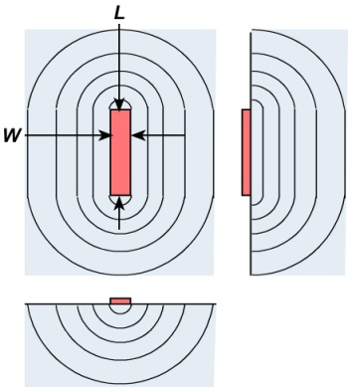
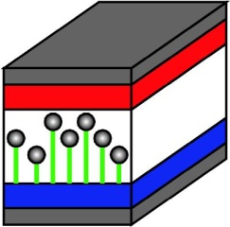
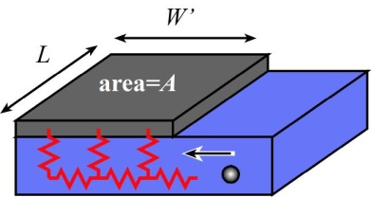
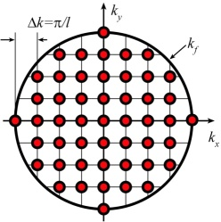
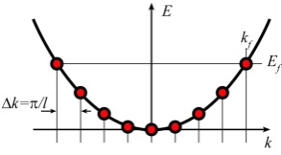
Transistor scaling laws: ( V,I,R,C,τ ) vs. geometry
Depletion Layers
Bulk and
Contact Resistances
Fringing Capacitances
Thermal Resistance
Available quantum states to carry current
→ capacitance,
transconductance
contact resistance

Slide 13
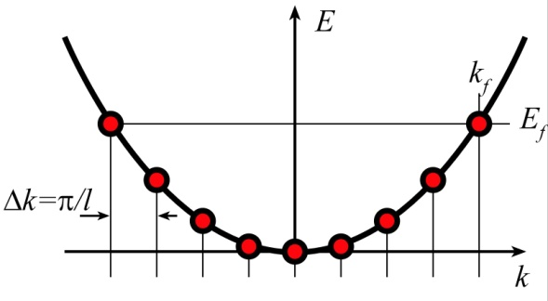
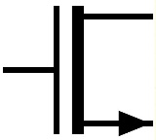
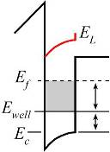
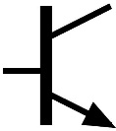
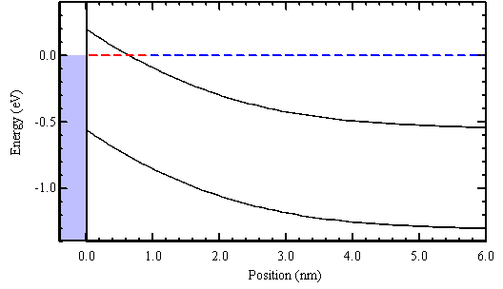
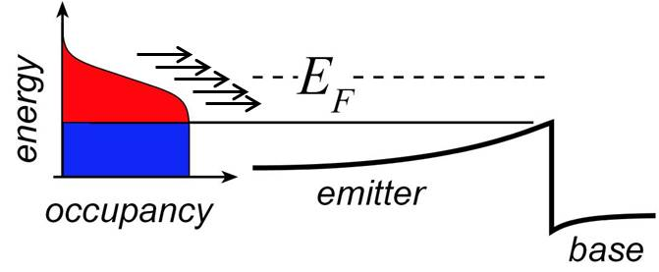
Degenerate State Density (Ballistic) Limits

Slide 14
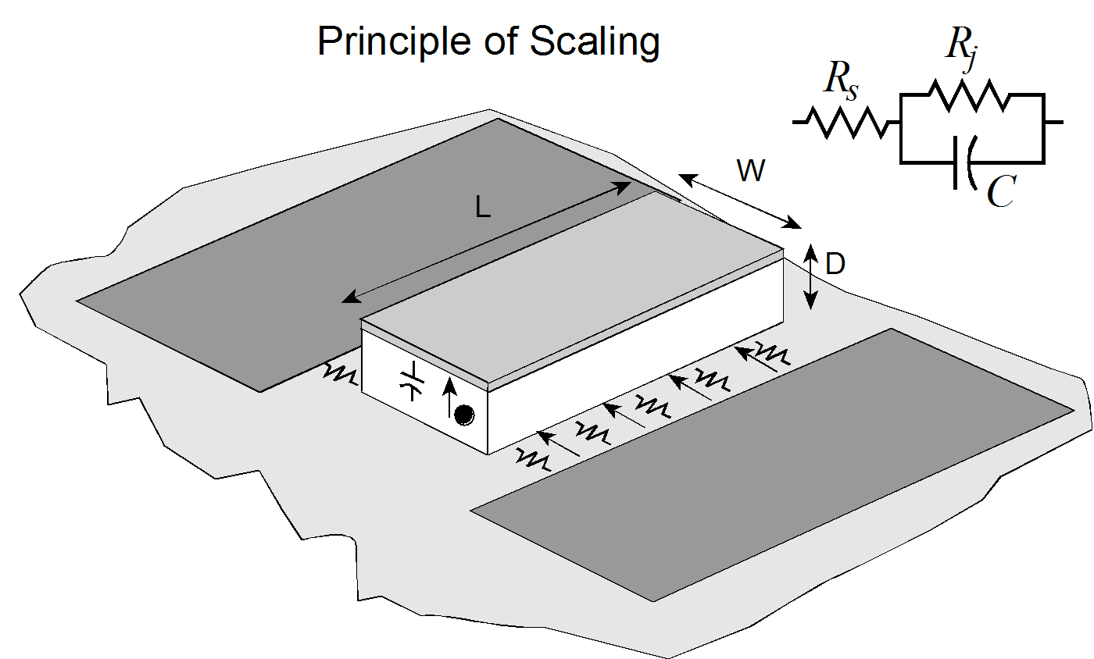
Frequency Limits and Scaling Laws of (most) Electron Devices
PIN photodiode
To double bandwidth:
Reduce thicknesses 2:1
Improve contacts 4:1
Reduce width 4:1,
Keep constant length
Increase current density 4:1

Slide 15
THz Bipolar Transistors

Slide 16
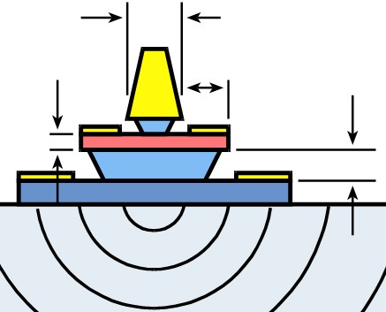
Bipolar Transistor Design: Scaling

Slide 17
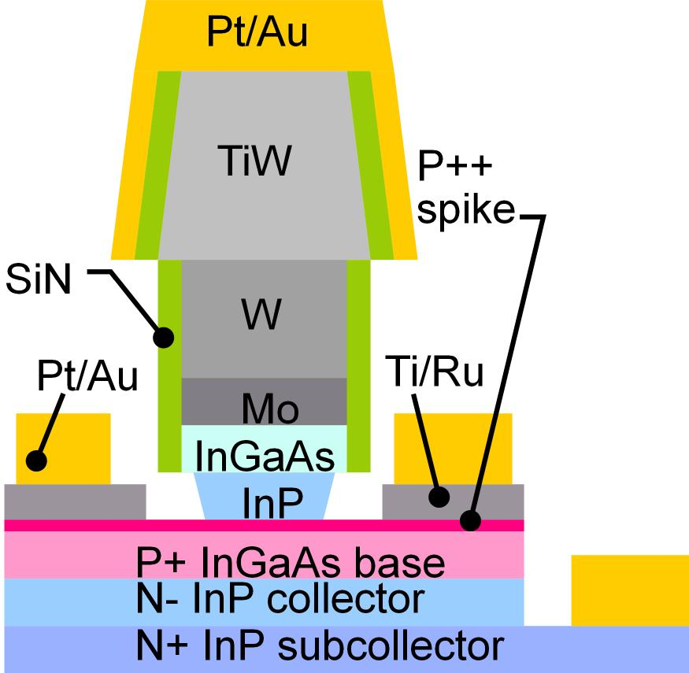
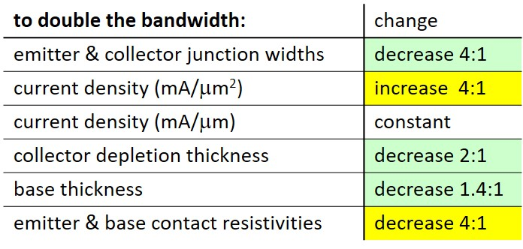
Bipolar Transistor Scaling Laws
Narrow junctions.
Thin layers
High current density
Ultra low resistivity contacts

Slide 18
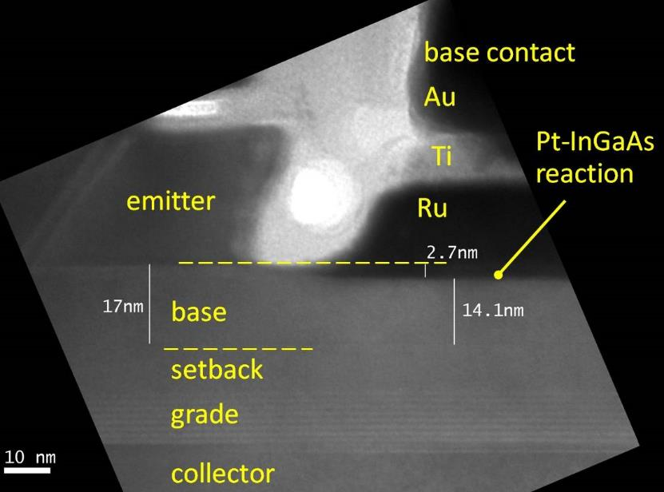
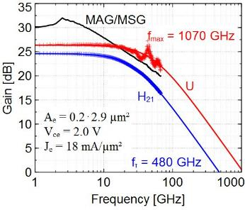
InP HBTs: 1.07 THz @200nm
?
Rode et al., IEEE TED, Aug. 2015

Slide 19
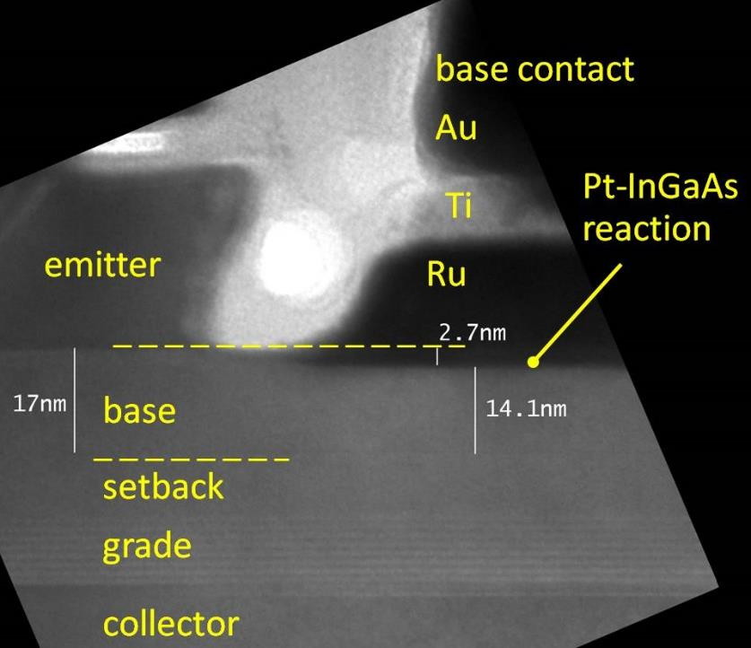
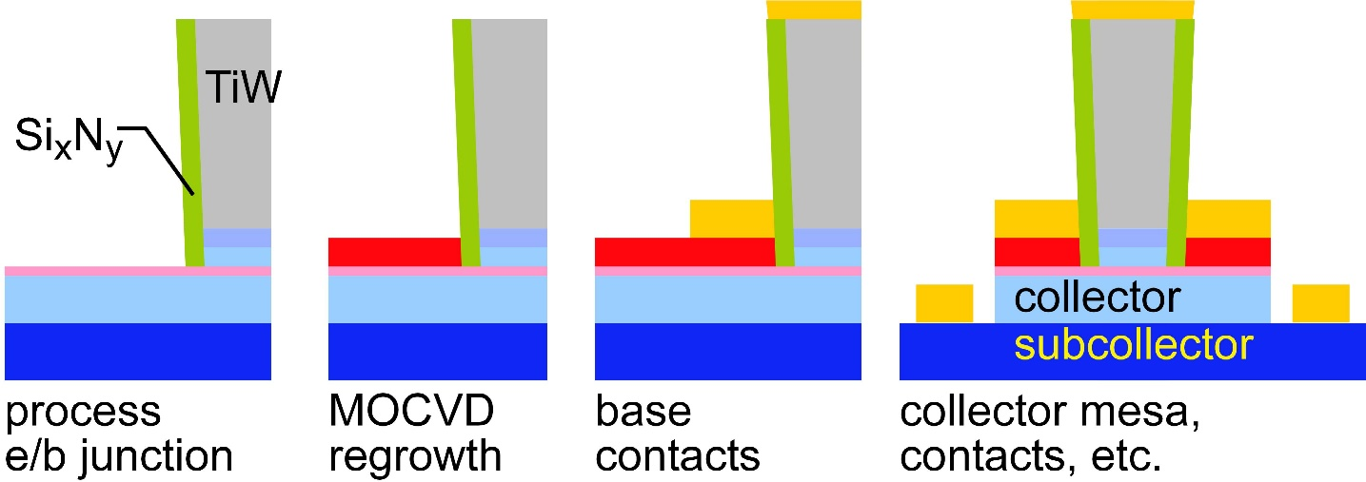
Challenges at the 64nm/2THz & 32nm/3THz Nodes
Need high base contact doping
>10²⁰/cm³ for good contacts
high Auger recombination
very low β.
Need moderate contact penetration
Pd or Pt contacts
react with 3++ nm of base
penetrate surface contaminants
too deep for thin base
Solution: base regrowth:
thin, moderately-doped intrinsic base
InGaAs or GaAsSb @ 10¹⁹-10²⁰/cm³
thick, heavily-doped extrinsic base
P-GaAs, ~10²¹/cm³
Baraskar et al, Journal of Applied Physics, 2013
Rode et al., IEEE TED, Aug. 2015

Slide 20
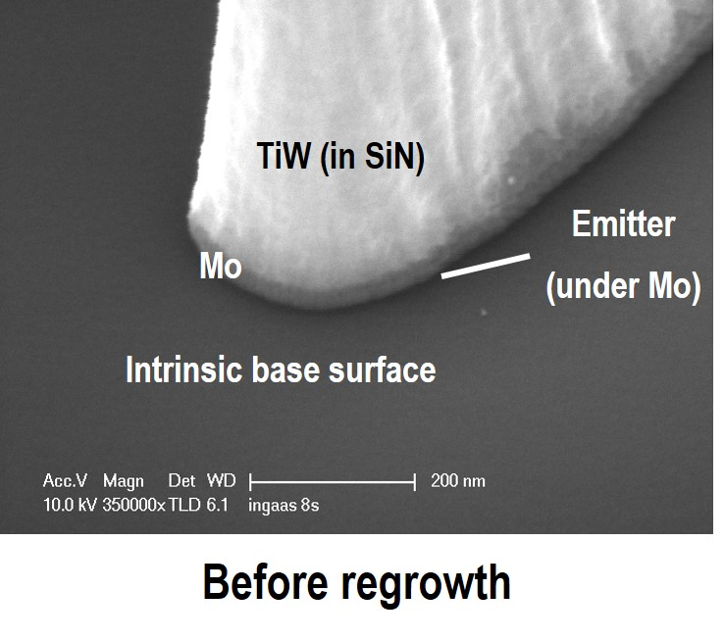
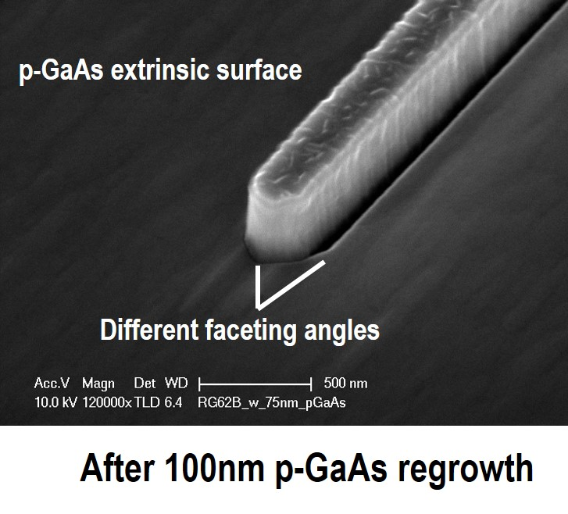



Regrown-Base InP HBTs: Images
Cross-sections
Dry-etched
TiW emitter contact

Slide 21

Regrown-Base InP HBTs: Status
Good DC data: even given regrowth
refractory Mo/W/TiW emitter contact
maintains low ρ_{c}.
Excellent base contacts; but hydrogen base passivation
0.4 Ω−μm² resistivity for GaAs/metal contact✓
290 Ω sheet resistivity for regrown base ✓
0.60Ω−μm² resistivity for InGaAs/GaAs contact✘
1940Ω/ sheet resistivity for intrinsic base ✘
Current process runs: GaAsSb intrinsic base
resistant to hydrogen passivation of carbon base dopant
(current reference sample: GaAsSb base, no regrowth)→→

Slide 22


Materials for Improved THz HBTs
Contacts: existing materials are sufficient.
N-InAs for emitter, regrown ~10²¹ cm⁻³ GaAs for base
Base transit time is no problem: regrowth permits very thin base
Desire: improved voltage at a given bandwidth
1.4eV bandgap→ 30V/μm breakdown
But: increased transit time at high V_{ce}:
Γ-(L,X) scattering, E-k dispersion
Is there a better collector material ?:
Larger bandgap
Larger Γ-(L,X) energy separation
Low optical phonon scattering rates (GaN suffers here).
High thermal conductivity.
Prof. Jasprit Singh; eecs320 notes, Univ Michigan;

Slide 23
THz Field-Effect Transistors

Slide 24
FETs (HEMTs): key for low noise
2:1 to 4:1 increase in f_{τ} :
improved noise
less required transmit power
smaller PAs, less DC power
or higher-frequency systems

Slide 25





High-Frequency FET Scaling
To double f_{τ} , reduce L_{g} 2:1, but this is not enough
Must also reduce C_{gsx}/g_{m} , C_{gd}/g_{m} time constants 2:1
→ g_{m}/W_{g} must be doubled
Must also thin dielectric and channel by 2:1 (g_{m}R_{ds})

Slide 26

FET Current and Transconductance
To increase g_{m}:
thin the oxide & channel
and increase K₁ (mass, # valleys)…hard
or increase (V_{gs}-V_{th})…also hard

Slide 27
FET Scaling Laws (these now broken)
FET parameter | change
gate length | decrease 2:1
current density (mA/mm) | increase 2:1
specific transconductance (mS/mm) | increase 2:1
transport mass | constant
2DEG electron density | increase 2:1
gate-channel capacitance density | increase 2:1
dielectric equivalent thickness | decrease 2:1
channel thickness | decrease 2:1
either (channel state density) | increase 2:1
or (V_{gs}-V_{th}) | increase 4:1
contact resistivities | decrease 4:1
Gate dielectric can't be much further scaled.
Not in CMOS VLSI, not in mm-wave HEMTs
g_{m}/W_{g} (mS/μm) hard to increase→ C_{end} / g_{m} prevents f_{τ} scaling.
Shorter gate lengths degrade electrostatics→ reduced g_{m} /G_{ds} → reduced f_{max} , f_{τ}

Slide 28


1st MOS-HEMT demonstration:
Fraunhofer IAF
Towards faster HEMTs: InAs MOS-HEMTs
Scaling limit: gate insulator thickness
HEMT: InAlAs barrier: tunneling, thermionic leakage
solution: replace InAlAs with high-K dielectric
2nm ZrO₂ (ε_{r}=25): adequately low leakage
Scaling limit: source access resistance
HEMT: InAlAs barrier is under N+ source/drain
solution: regrowth, place N+ layer on InAs channel
Target ~10nm node
~0.3nm EOT, 3nm thick channel
1.2 to 1.5 THz f_{τ}.
8/2019: process working: 470GHz f_{τ}. @ ~28nm L_{g}.
f_{max} very low, f_{τ} high but not high enough.
Now fixing obvious process problems.

Slide 29

Device Images

Slide 30

More Device Images

Slide 31




Increasing FET transconductance
For 1-2 THz f_{τ} , seek g_{mi}= 4-8 mS/μm.
thin the oxide, thin the well
→ increased eigenstate energy
→ loss of confinement at large (V_{gs}-V_{th})
→ constrains maximum transconductance: g_{m}∝(V_{gs}-V_{th})^{1/2}
→ maximum achievable g_{m}.
Need high barrier energies
InAs/InAlAs vs InAs/AlAsSb
InP/AlAsSb ????
Huang, JAP, 2014
B. Markman, to be published

Slide 32

mm-Wave CMOS also won't scale much further
High-frequency Si MOSFET design follows the same principles as high-frequency III-V FET design.
Same physics, so same limits. But, the carrier velocities are lower
Difficult to further thin the gate dielectric (increased gate leakage)→ g_{m} can't increase
Shorter gates don't significantly reduce the capacitance: dominated by ends; ~1fF/μm total
Maximum g_{m}, minimum C→ upper limit on f_{τ}.
about 350-400 GHz. At the *bottom* of the wiring stack
Usable bandwidth is lower than this
high-frequency circuits need controlled-impedance Z_{o}=50Ω interconnects
microstrip lines with signal lines at top of wiring stack.
high-frequency transistors must interface to ~50 Ohm external impedances
~20-30 FET fingers must be tied in parallel to bring device port impedances close to 50Ω.
The necessary wiring further reduces ft, fmax: c.a. 300GHz in leading CMOS technologies.
The best CMOS node for mm-wave is 65nm.
45nm SOI, 22nm SOI are close to this performance
Intel's RF-optimized 22nm finFET is also close to this performance

Slide 33
Materials for THz (MOS) HEMTs
Low resistance in source-gate access region:
moderate to high mobility
High transconductance
sufficient mobility to reach ballistic current.
m*≈ 0.08·m_{o} to 0.16·m_{o} high ballistic v_{inj}
desirable/hard: multiple band minima (large n_{s})
large band offsets for large (E_{f}-E_{c})→ large (V_{gs}-V_{th})
Low S/D access resistances
S/D materials with high doping, low barriers. Grade heterointerfaces
High velocities and high breakdown fields in gate-drain drift region
m* need not be particularly low
low phonon scattering rates
large intervalley energy separation
wide bandgap

Slide 34
Closing

Slide 35
Materials Requirements for Future Transistors
VLSI (MOSFETs, TFETs):
It's mostly about the interfaces: gate dielectrics, S/D contacts
The channel also matters: high ballistic I_{on}, sufficient E_{g} for low I_{off}
MOS-HEMTs for mm-wave ICs, 50-500GHz low-noise amplifiers
Same as VLSI MOSFETs: gate dielectrics, S/D contacts
Large ballistic I_{on}.
How to increase g_{m} ? Large (V_{gs}-V_{th})→ large (E_{barrier}-E_{well})
HBTs for mm-wave ICs, 50-500 GHz power
Contacts are critically important…and achievable
Breakdown vs. transit time: ballistic overshoot matters.
Large intervalley separation, low scattering rates

Slide 36
In case of questions

Slide 37

FET Design: Scaling

