Slide 1

A Dual-Conversion Front-End with a W-Band First Intermediate Frequency for 1-30 GHz Reconfigurable Transceivers
Arda Simsek¹, Seong-Kyun Kim², Ahmed S. H. Ahmed¹, Robert Maurer³, Miguel Urteaga², and Mark. J.W. Rodwell¹
¹University of California at Santa Barbara, CA
²Teledyne Scientific and Imaging, CA
³Marki Microwave Inc., CA

Slide 2
Outline
Motivation
Technology
System Implementation
Summary of the main IC blocks
  High Dynamic Range Diode Mixer
  Frequency Doublers (30-50 GHz, and 60-100 GHz)
  x4 LO Multiplier Chain
System Experiments

Slide 3
Dual-Conversion Receiver
  1-25 GHz RF tuning range
Classical RF architecture: extend to micro/mm-wave frequencies
- Up-convert to 1st IF (100 GHz), down-convert to 2nd IF (or baseband)
- Image response moved out-of-band
- Very wide tuning range, no image response.
Applications:
- Instrumentation
- Wideband surveillance: 1-25 GHz (possibly 1-50 GHz )
- Single IC serving many applications: application-specific LNA + common module

Slide 4
THz HBTs
Teledyne 130 nm InP HBT
1.1 THz f_{max}.
CE: 14.4 dB MSG @100 GHz
CB: 18.5 dB MSG @100 GHz
Process offers:
3 gold metal layers
50 Ohm/sq. thin film resistor
0.3 fF/um² MIM capacitors
Dual conversion at microwave:
100 GHz 1st IF would enable over 1-50 GHz spur-free tuning
High speed IC technologies: 100 GHz IF feasible
THz transistors enable microwave dual-conversion receivers

Slide 5
System Block Diagram – Dual Conversion
1st freq. conversion
(up-conversion)
2nd freq. conversion
(down-conversion)
App. specific LNA / filter
Common module (dual-conversion)
Need high dynamic range & wide tuning range
Spurious free multiplier chain & high dynamic range mixer

Slide 6
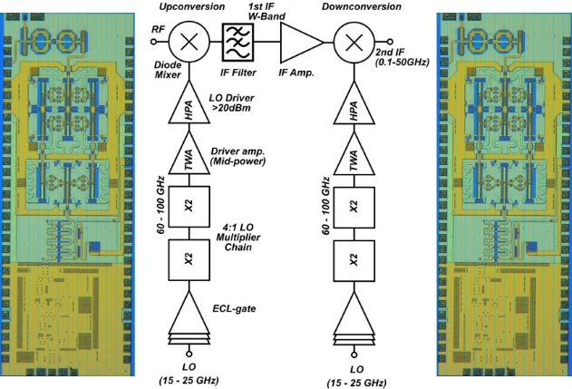
System Implementation – Dual Conversion
Up/down conversion ICs are same
Used back to back to realize the proposed dual conversion receiver
1st IF at W-band 94 GHz or 100 GHz (+/-)

Slide 7
High Dynamic Range Mixer
✓
Transistor mixer:
Low IP3
High noise figure
Poor dynamic range
Design challenges:
High speed diode
Wide bandwidth balun
Wide tuning range + high power LO
Diode mixer:
High IP3
Lower noise figure
Higher dynamic range
InP HBT offers high speed DHBT BC diode
(Schottky-like high-frequency characteristics)
S.K.Kim et al, CSICS 2016
Four series-connected BC diode pairs
RF and LO baluns
Balun loss < 4 dB over W-band

Slide 8
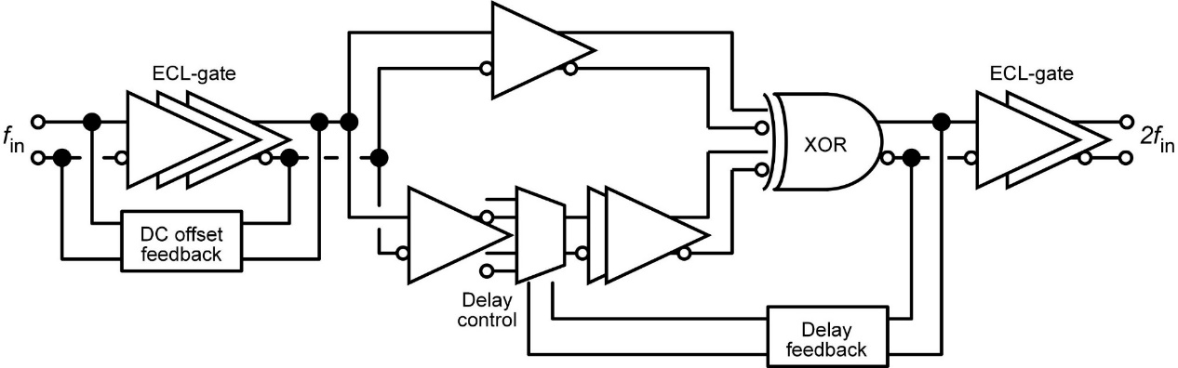
1st Frequency Doubler (30-50 GHz)
Uses digital logic
DC offset feedback
Minimize dc offset of the ECL limiter output
Delay feedback
The phase shifter (delay circuit) to 90 degree delay
→ Suppress spurious harmonics
S.K.Kim et al, EuMW 2018
1st & 3rd harmonics rejection > 30 dBc.
4th harmonic rejection > 18 dBc within the delay tuning range

Slide 9
2nd Frequency Doubler (60-100 GHz)
Uses digital logic
DC offset feedback
Minimize dc offset of the ECL limiter output
Delay feedback
The phase shifter (delay circuit) to 90 degree delay
→ Suppress spurious harmonics
S.K.Kim et al, EuMW 2018
1st & 3rd harmonics rejection > 25 dBc.
4th harmonic rejection: similar behaviour, equipment limitation

Slide 10
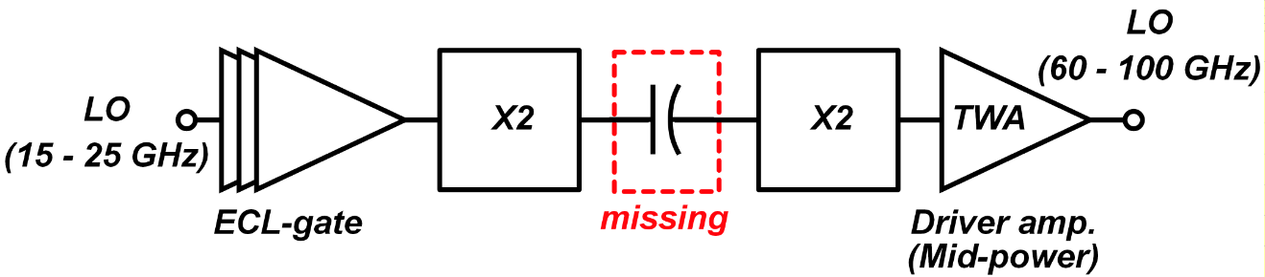
x4 LO Multiplier Chain
x4 multiplier chain from two consecutive doublers
Problem: missing DC blocking cap between doublers
DC offset feedback affected
Travelling wave amplifier as driver with ~ 7-9 dBm Pout
3rd, and 5th harmonic rejection > 20 dBc
system performance degradation due to the multiplier harmonic rejection

Slide 11
Frequency Conversion IC
Integrated frequency conversion IC: Diode mixer, High power LO driver, x4 multiplier chain
Total power consumption: ~ 2.8 W - Multiplier chain and LO driver
Size: 3.3 mm x 1.18mm

Slide 12
Up/Down-Conversion Measurements
Down-conversion
Up-conversion
Down-conversion:
>20 dBm IIP3 and >-6 dB conversion loss
Up-conversion:
>20 dBm IIP3 and >-7 dB conversion loss

Slide 13
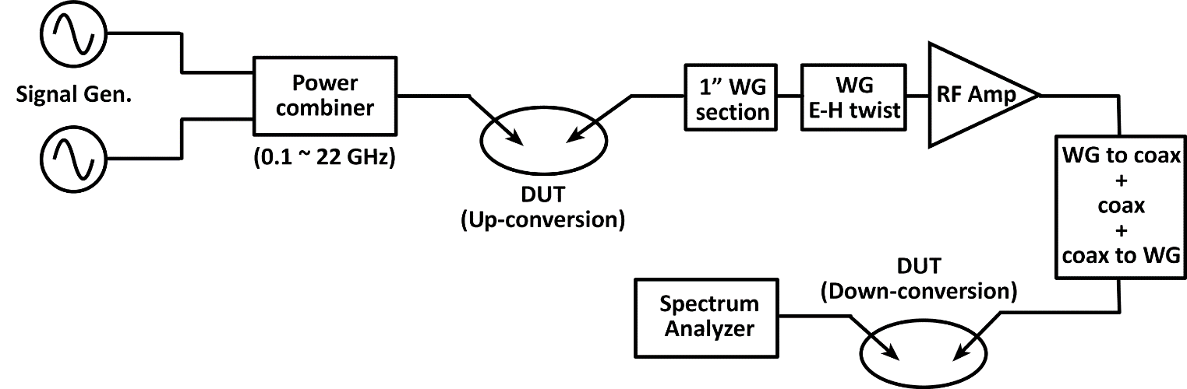
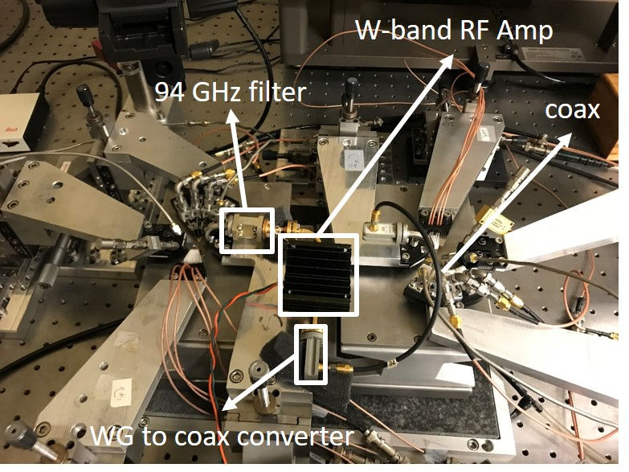
System Measurements - Experiment
2 freq. conversion ICs are connected thru
waveguide components
W-band band-pass filter
W-band amplifier
2 probe stations, 8 probe arms

Slide 14
System Measurements - Procedure
Off-wafer IF section uses
- 94 GHz Band-pass filter and
- commercial W-band amplifier
Available W-band amplifier had relatively high noise figure and low IIP3, total system NF and IIP3 limited by the off wafer IF amplifier and not reported here
Tuning range experiment:
1. Receiver tuned at a particular desired RF frequency and LO held fixed
2. RF is swept over a targeted freq. range DC-40 GHz, while LO is fixed
3. Measurements performed at 2, 5, 10, 20 and 30 GHz RF freq.
4. Relative strength of the receiver spurious response measured as a function of input frequency.
5. Largest spurs come from LO 3rd and 5th harmonics.

Slide 15
System Measurements - Results
32 dB
30 dB
LO 5th
LO 3rd
LO 5th
RF tuned at 2 GHz > 32 dB
RF tuned at 5 GHz > 30 dB
RF tuned at 10 GHz > 25 dB
25 dB
LO 5th
LO 3rd

Slide 16
System Measurements - Results
20 dB
17 dB
LO 5th
LO 6th
LO 5th
LO 6th
LO 3rd
RF tuned at 20 GHz > 20 dB
RF tuned at 30 GHz > 17 dB

Slide 17
1-30 GHz Reconfigurable Transceivers
Dual conversion: classic widely-tunable RF receiver design
Extend to microwave (1-30 GHz) → Need ~100 GHz IF
Dual conversion: feasible with wideband (THz) transistors
100 GHz signal frequency is only 10% of transistor f_{max}
Enable high-dynamic-range mixers & amps.
4:1, 60-100 GHz LO multiplier using digital techniques
Summary of results:
High dynamic range (6-8 dB loss ≈ noise figure, >20 dBm IIP3)
Very wide tuning LO (15-25 GHz ↔ 60-100 GHz)
Spurious free tuning range of 1-30 GHz using dual conversion with IF at 94 GHz
We thank Teledyne Scientific & Imaging for IC fabrication

Slide 18
Thank you

Slide 19
Back-up Slides

Slide 20
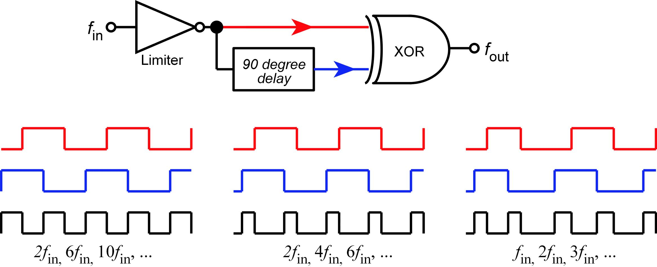
Problems of Conventional Design
Limiter DC offsets
Spurious outputs at DC, 2f_{in}, 4f_{in}, …
→ spurious XOR outputs at f_{in}, 3f_{in}, 5f_{in}, …
Delay ≠ 90 degree
Spurious XOR outputs at DC, 4fin, ...
High-Q filters are required
large die area
poor out-of-band rejection
CMOS digital logic
Cannot operate > 100 GHz

Slide 21
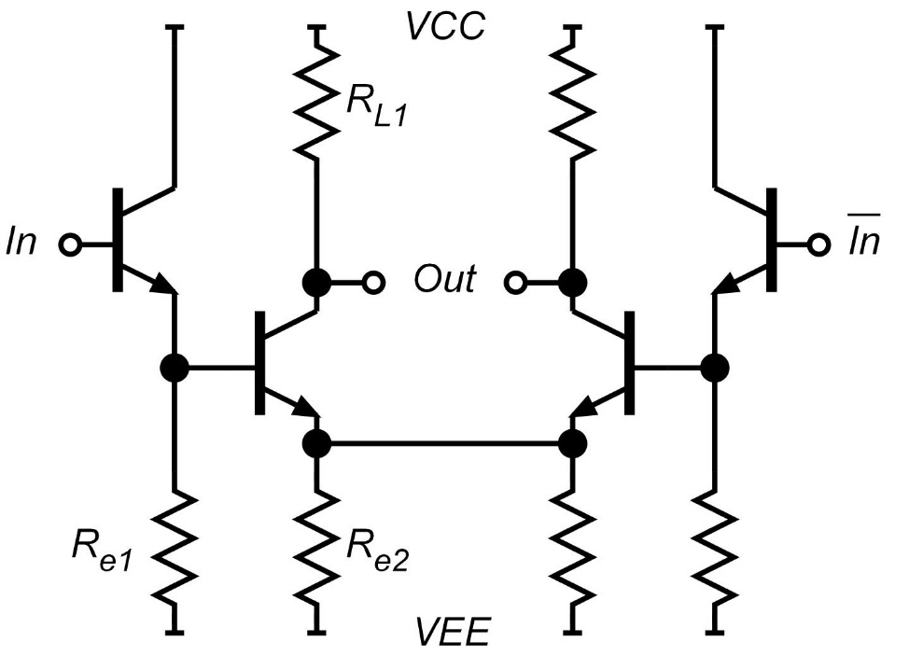
In/Output-stage: ECL-gate
Input
Converts a sinusoidal input into a square-wave
Input can be driven single-endedly
Low input signal (-3 dbm) can drive
Output
Driver 50 Ω output load
ECL-gate can operate at > 100 GHz

Slide 22
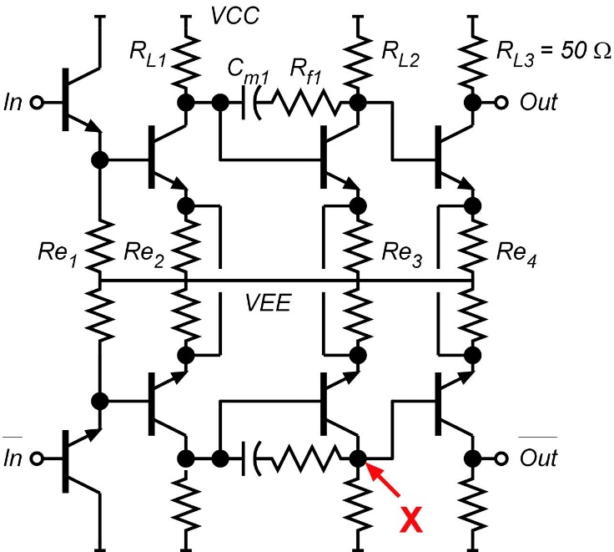
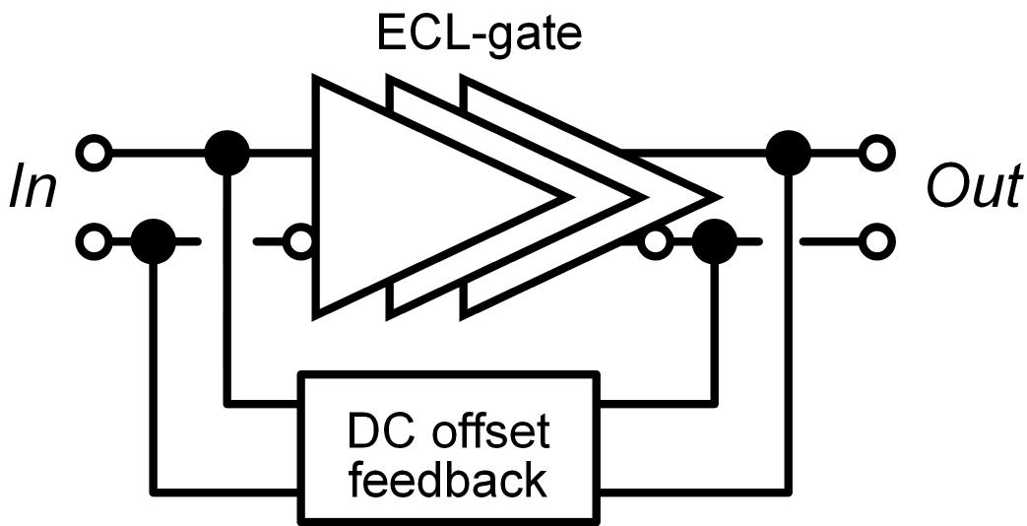
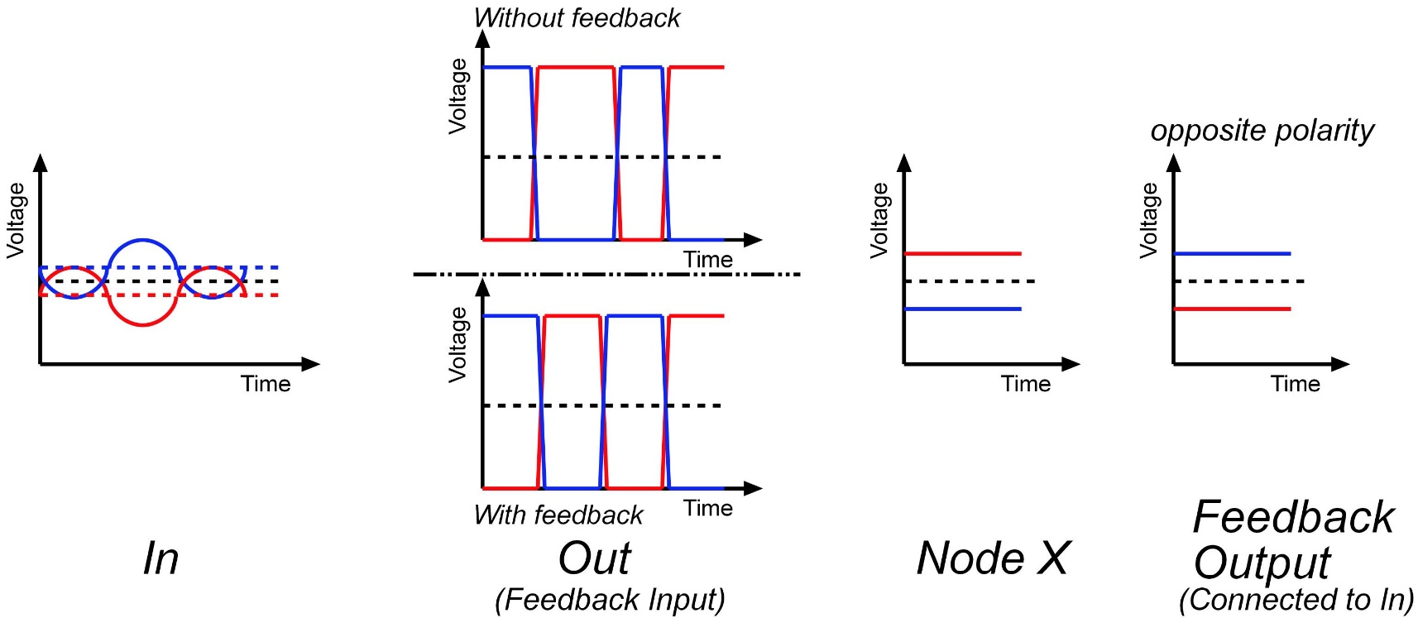
DC-offset Cancellation

Slide 23
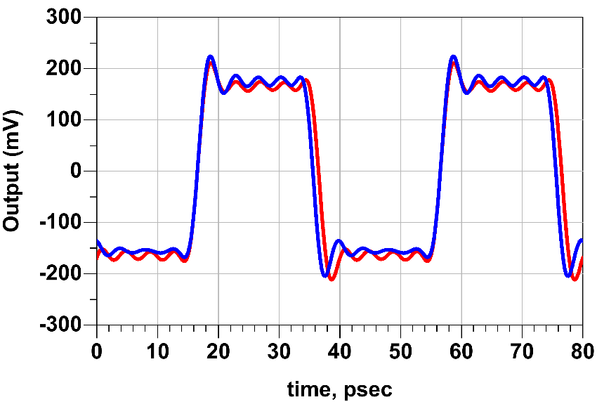
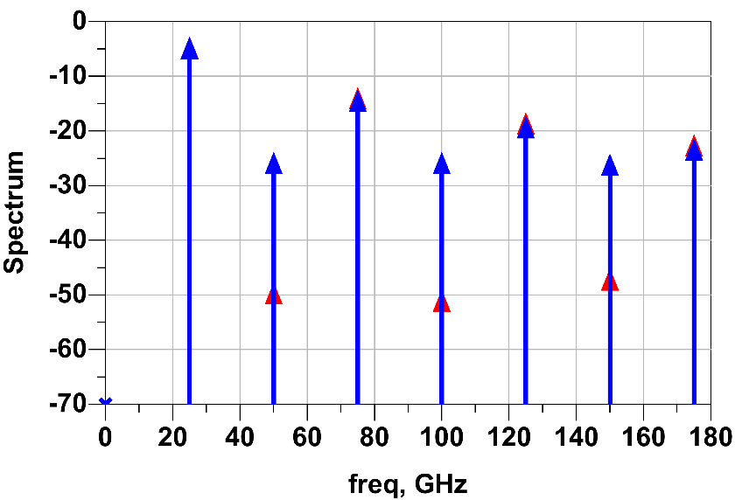
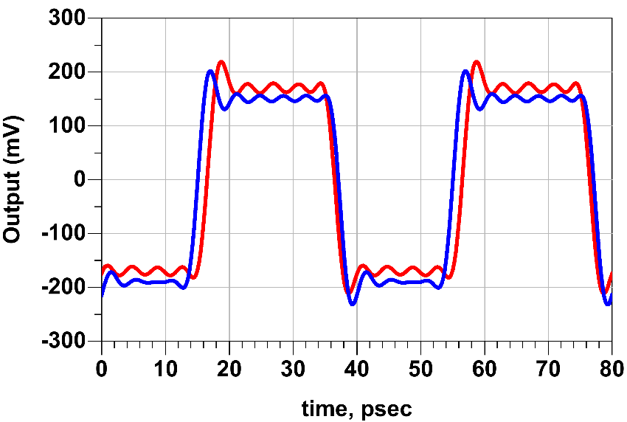
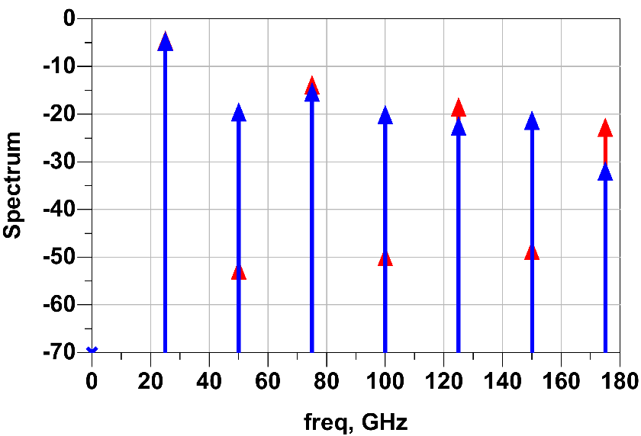
Simulation results: Input 25 GHz
The second ECL-gate has 100 mV offset voltage
w/ feedback
w/o feedback
24 dB
w/ feedback
w/o feedback
Each ECL-gate has 100 mV offset voltage
w/ feedback
w/o feedback
33 dB
w/ feedback
w/o feedback

Slide 24
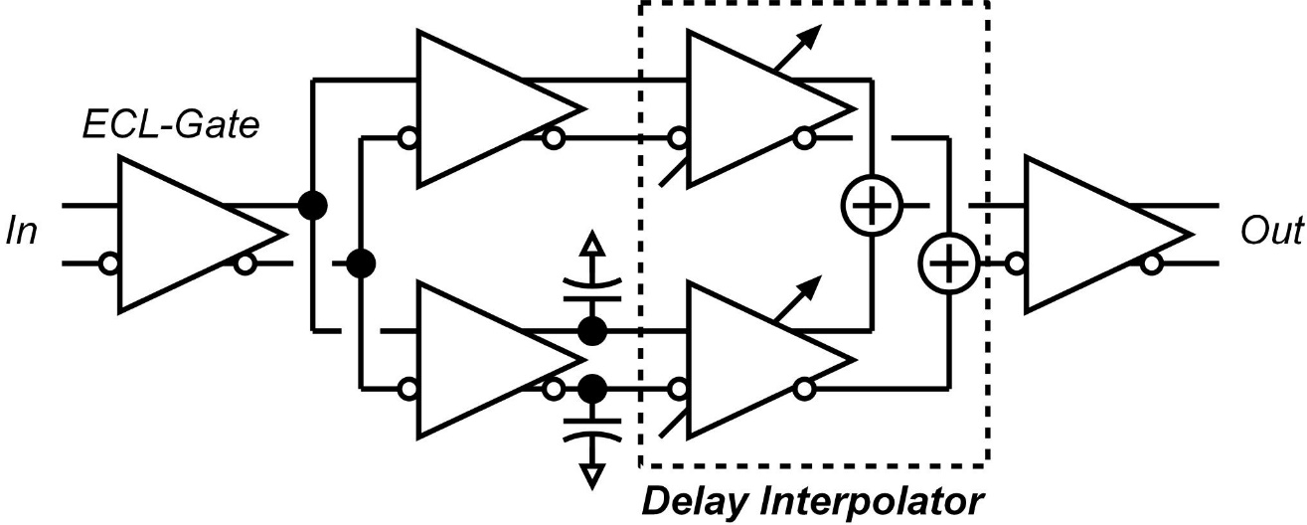
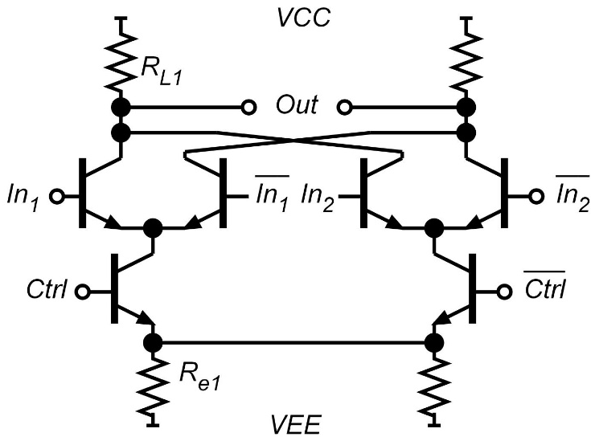
Delay Control
Delay interpolator
Optimum operating range is limited by the tunable delay range
XOR has same topology as the delay interpolator

Slide 25
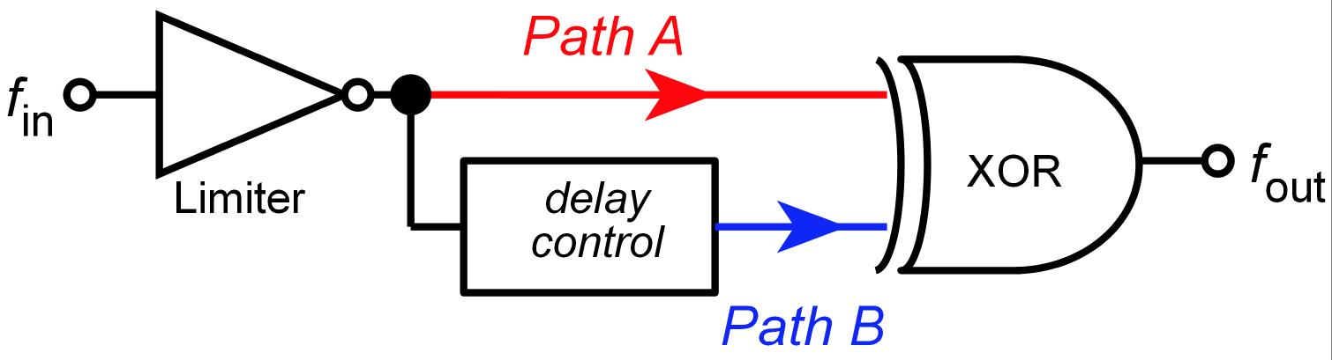
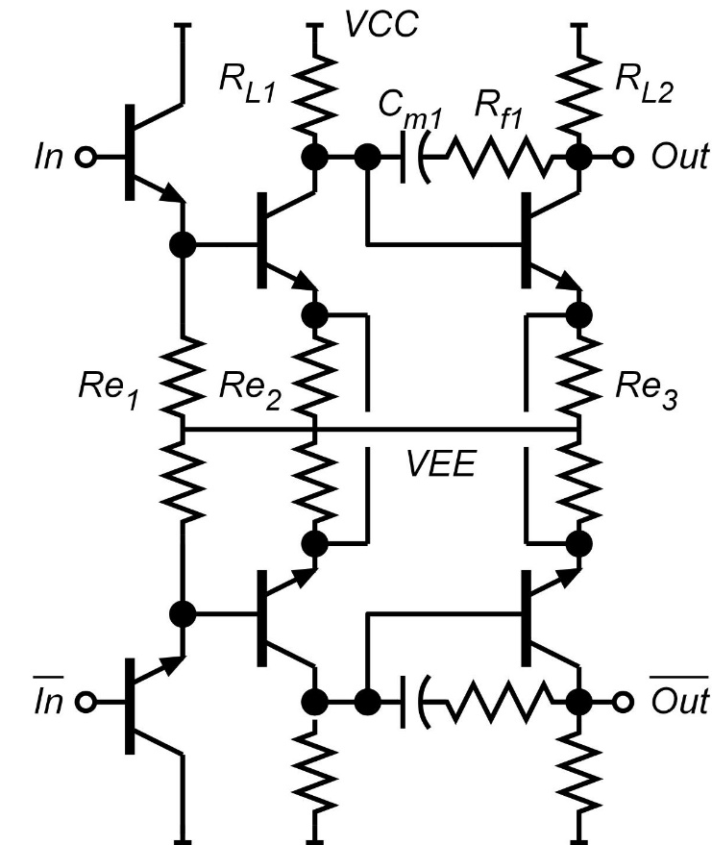
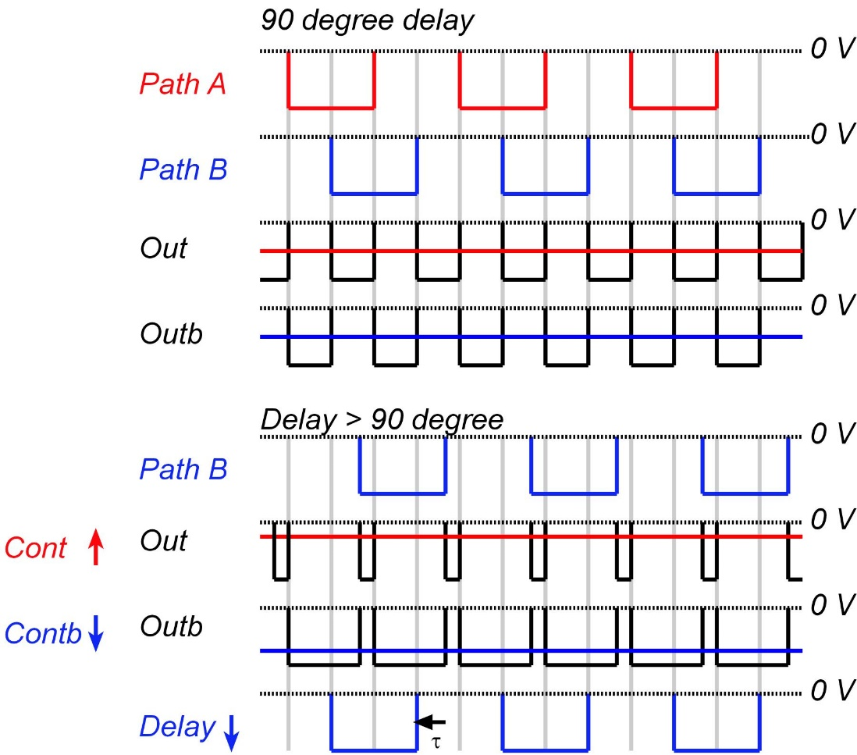
Delay Feedback & Operation
Input is connected to XOR outputs
Outputs are connected to Ctrl
of the delay interpolator

Slide 26
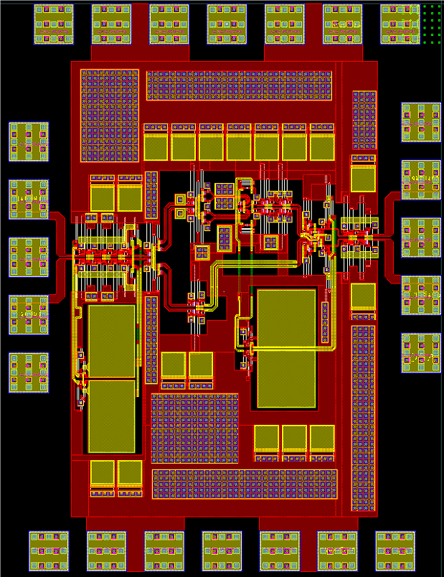
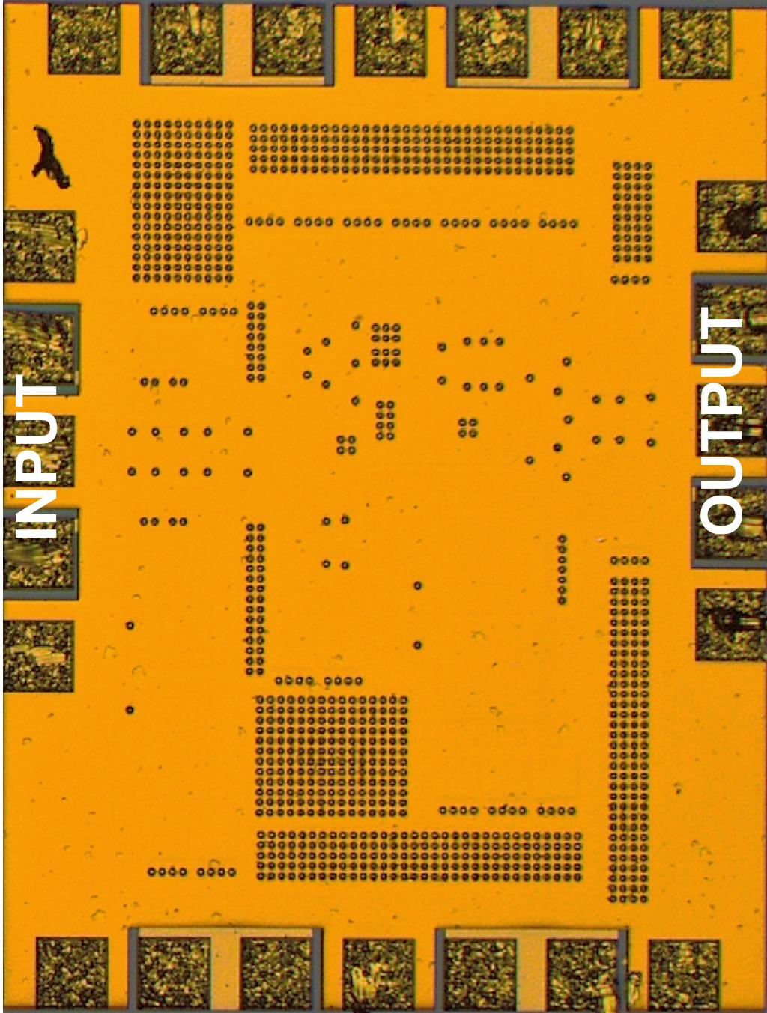
Layout & Chip Photo
Chip size: 750 × 990 um² (area encloses active devices: 540 x 280 um²)
Power consumption: 284 mA (32 – 53 GHz), 324 mA (60-100 GHz) @ 3.3 V

Slide 27
Simulation: Time-domain
Input 15 GHz → Output 30 GHz
Input 25 GHz → Output 50 GHz
* single-ended simulation results
Waveforms have 50 % output duty-cycle
The amplitude correspond to digital logic level in the design

Slide 28
Simulation: Frequency-domain
2nd harmonic output power: -8 ̶ -5 dBm
1st & 3nd harmonic rejection > 40 dBc
4th harmonic rejection > 30 dBc

Slide 29
Phase Noise Measurements
Input: 17.5 GHz, Output 35 GHz
Added phase noise: 6 – 7 dB (*ideal multiplier: 20log(N))

Slide 30
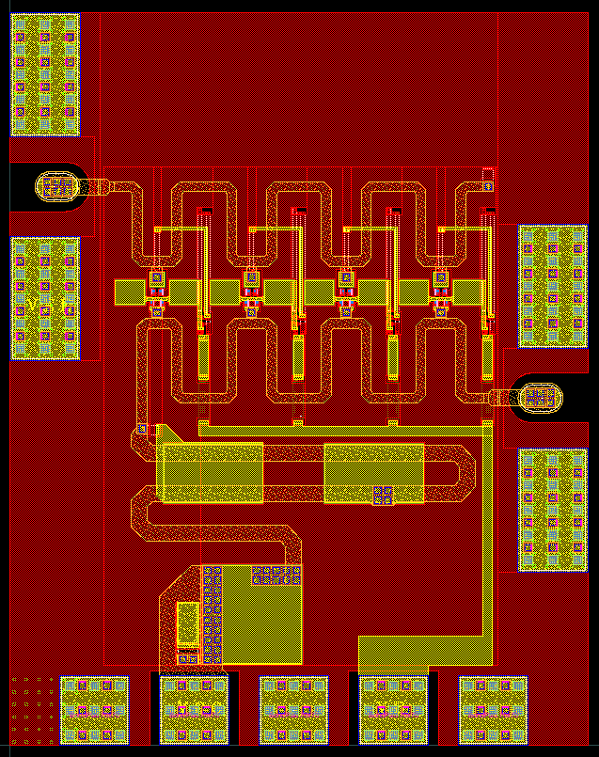
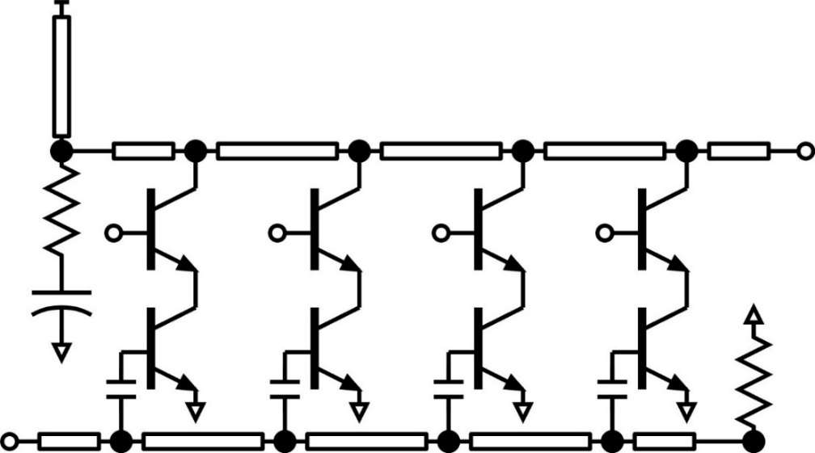
Travelling Wave Amplifier (TWA)
Input
Output
VCC_3P3V_DA
VB_DA
Size: 580 x 740 um²
Bias | Probe
VCC_3P3V_DA: 41.2 mA @ 3.3 V VB_DA: 13.6 mA @ 3.3 V | RF | GSG (W-band, 2)
 | DC | PGP (1)

Slide 31
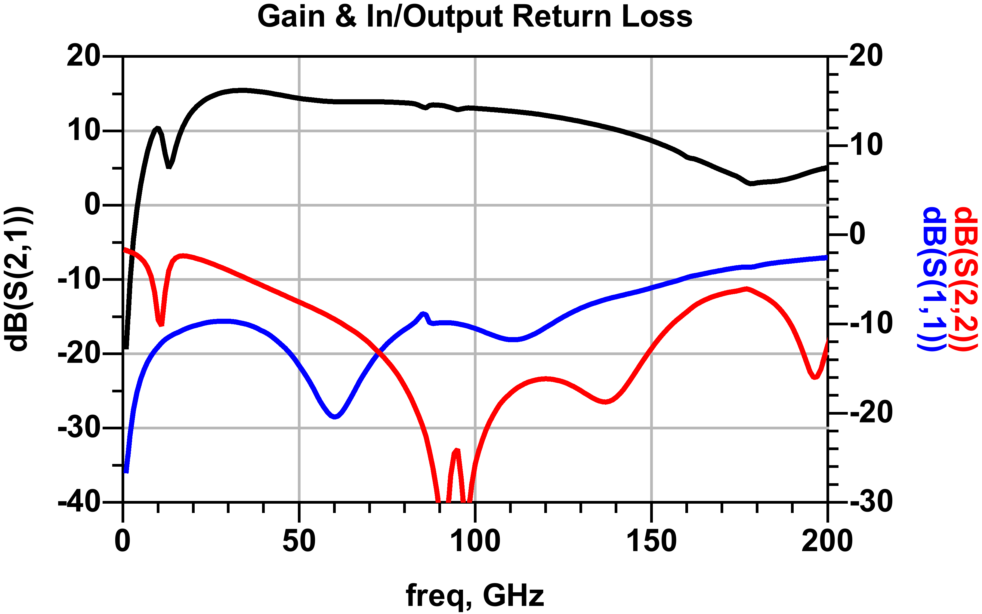
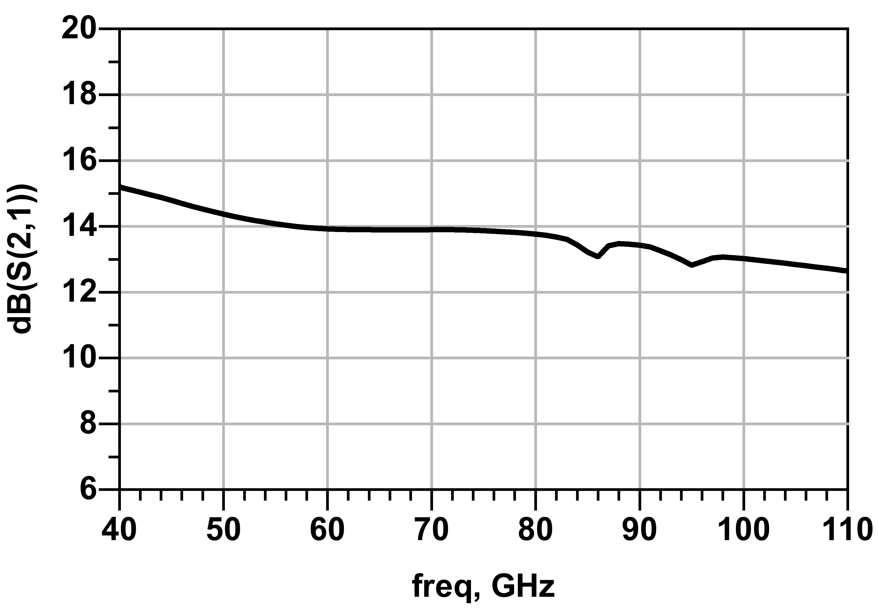
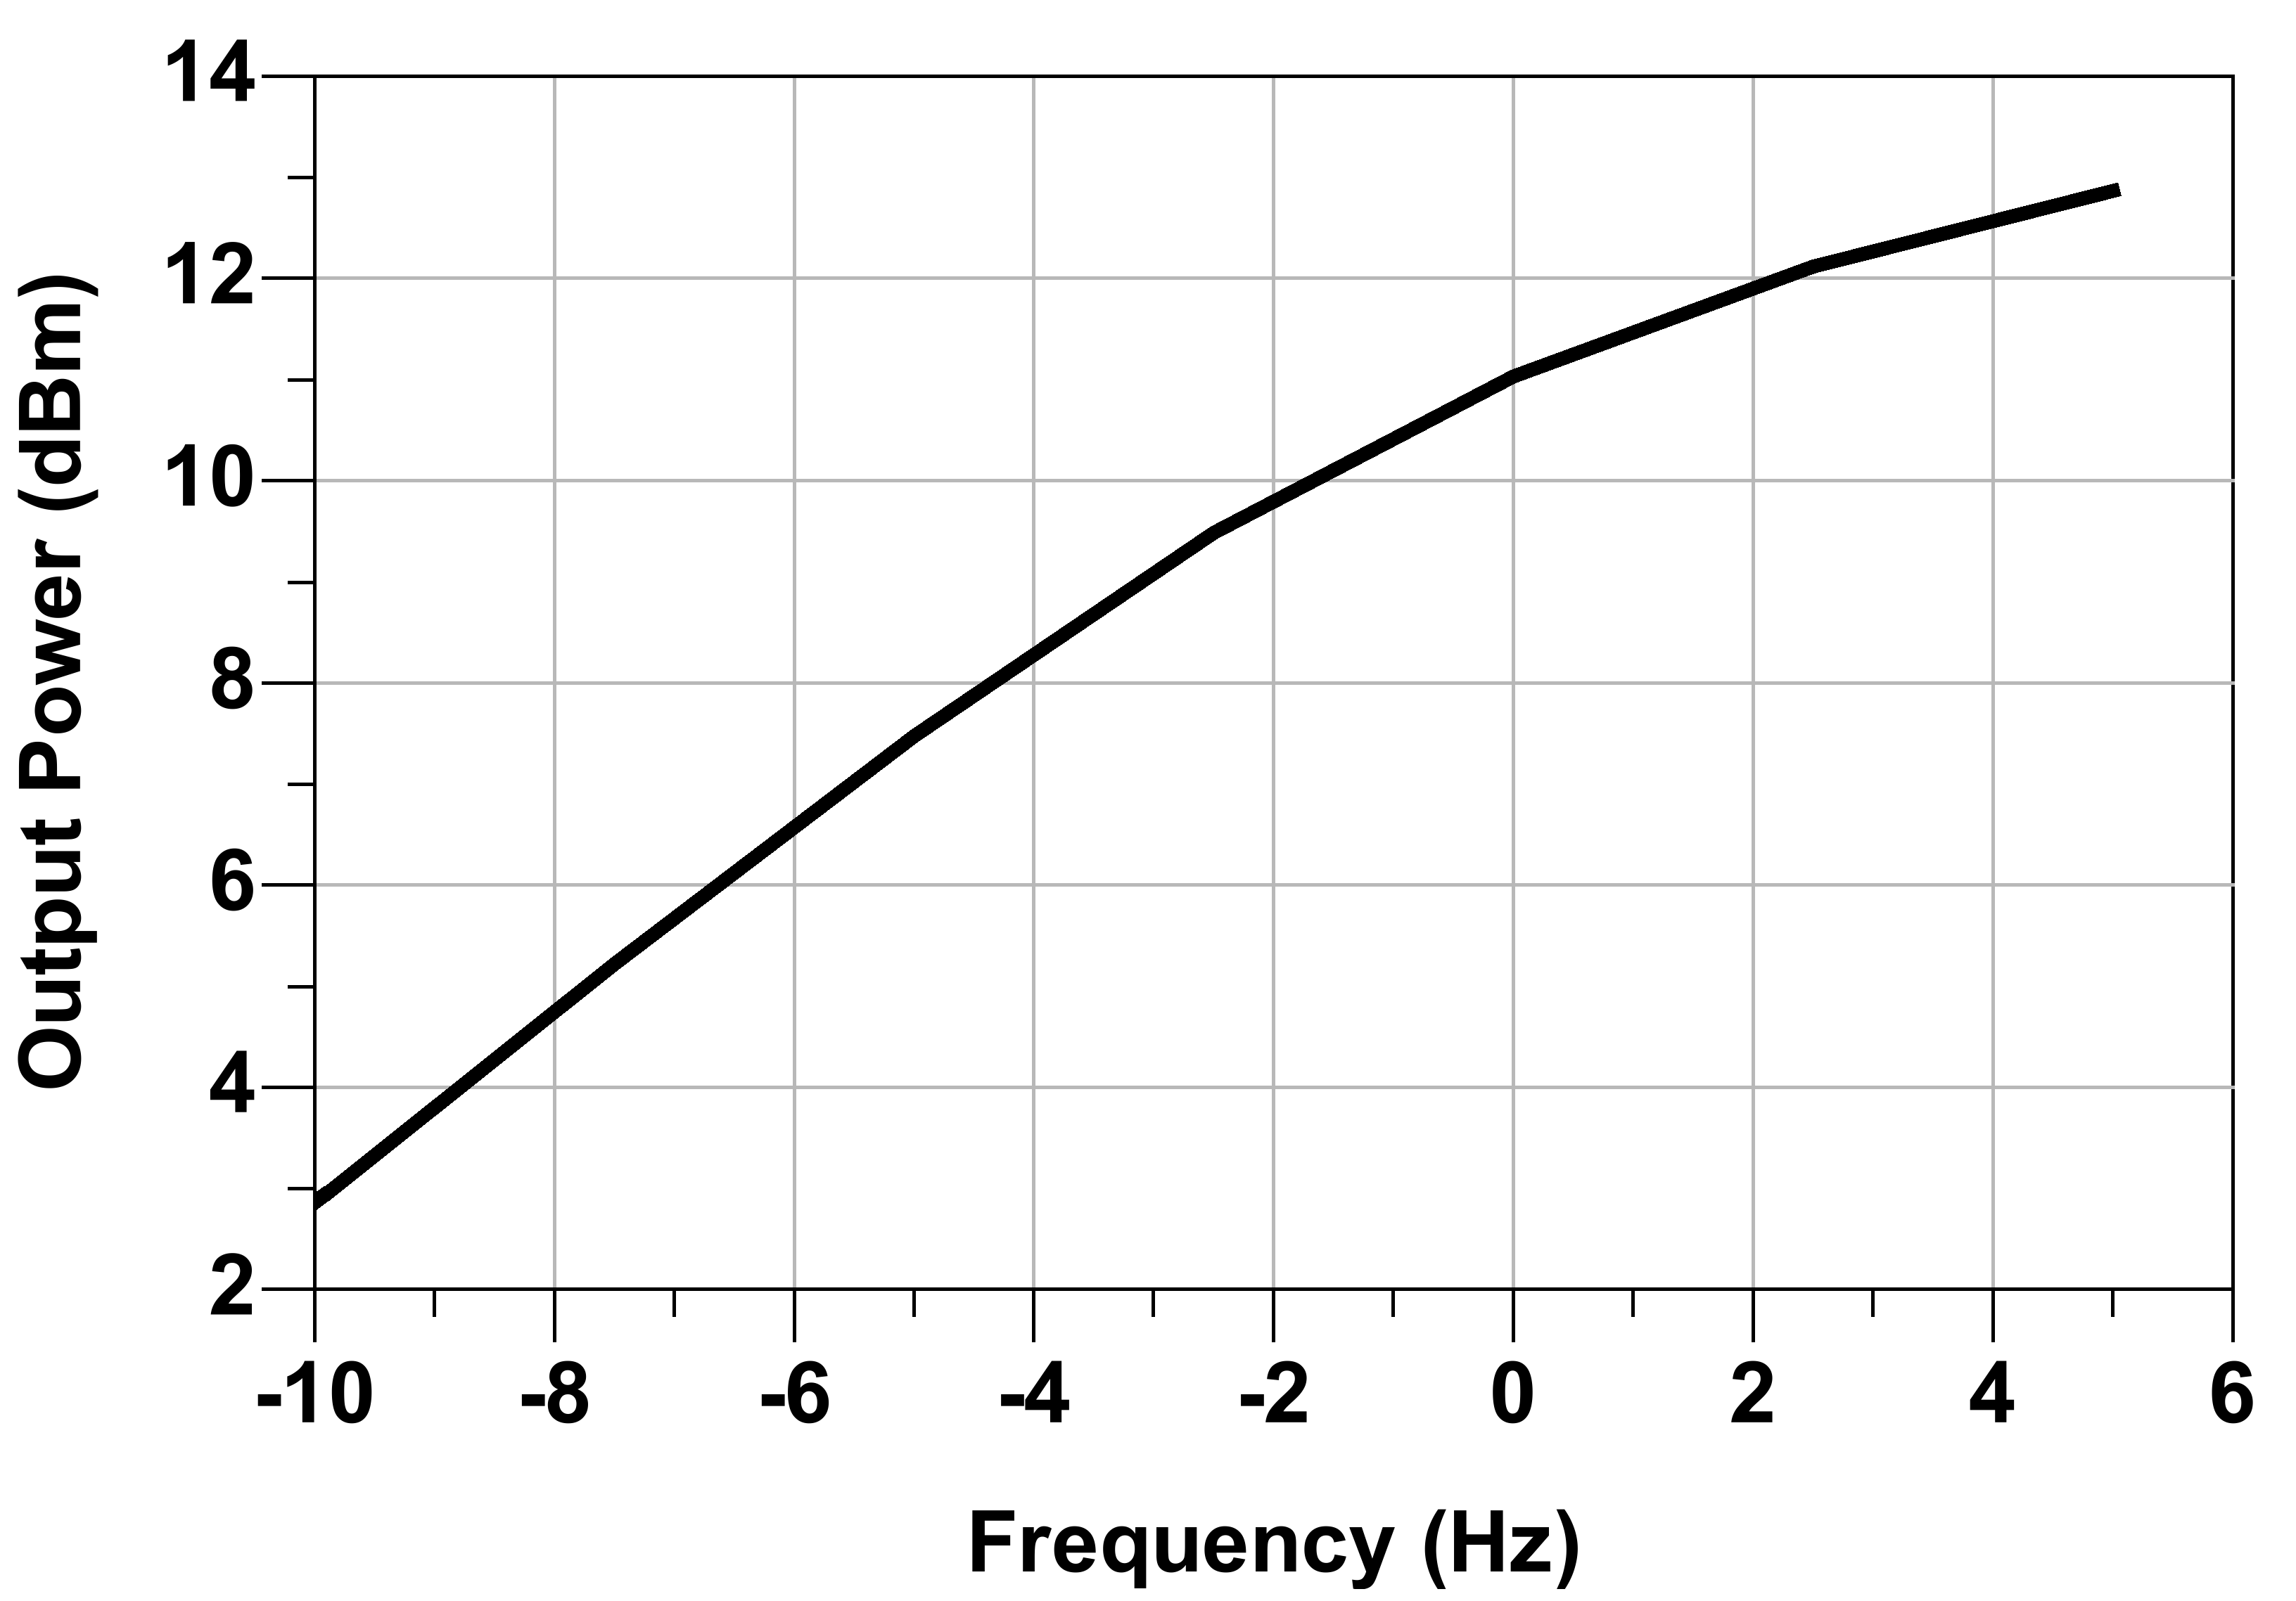
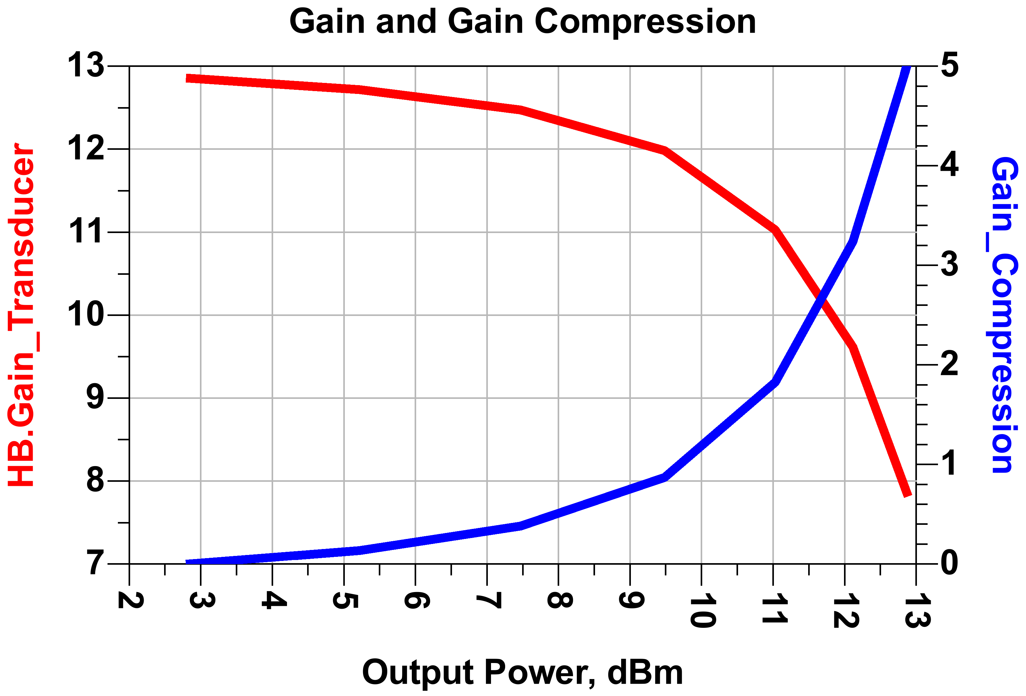
Travelling Wave Amplifier (TWA)

Slide 32
High Speed DHBT BC Diode
DHBT
Band diagram
SHBT band diagram
Double-heterojunction base-collector diode
- Hole minority carrier storage is eliminated by large energy barrier to holes
- Electron minority carrier storage time is small
→ Schottky-like high-frequency characteristics

Slide 33
Balun For Diode Mixer
✘
✓
✓
Common-mode impedance Z_{cm,RF} must be zero
IF port is required
Simple center-tapped transformer has wrong Z_{cm}
- Two transformers in series.
Ferrite loading gives correct Z_{cm}; can't use on IC
Options: two parallel transformers, or balun.
Proposed balun
- Sub-quarter wavelength balun (B1) ^{[3]}
- Section B2 provides the IF port and Z_{cm,RF}=0
Proposed balun
[3] H. Park, et al., IEEE J. Solid-State Circuits (UCSB)

Slide 34
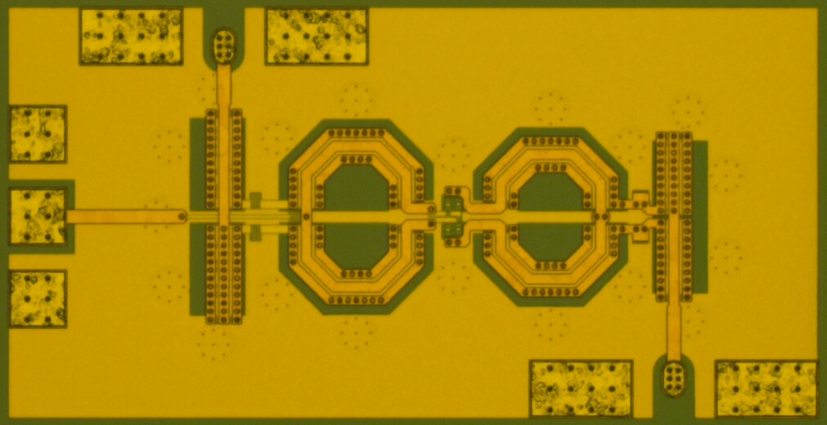
Diode Mixer
Four series-connected BC diode pairs
RF and LO baluns
Balun loss < 4 dB over W-band
RF
IF
LO
Size: 700 um x 300 um (excl. pads)

Slide 35
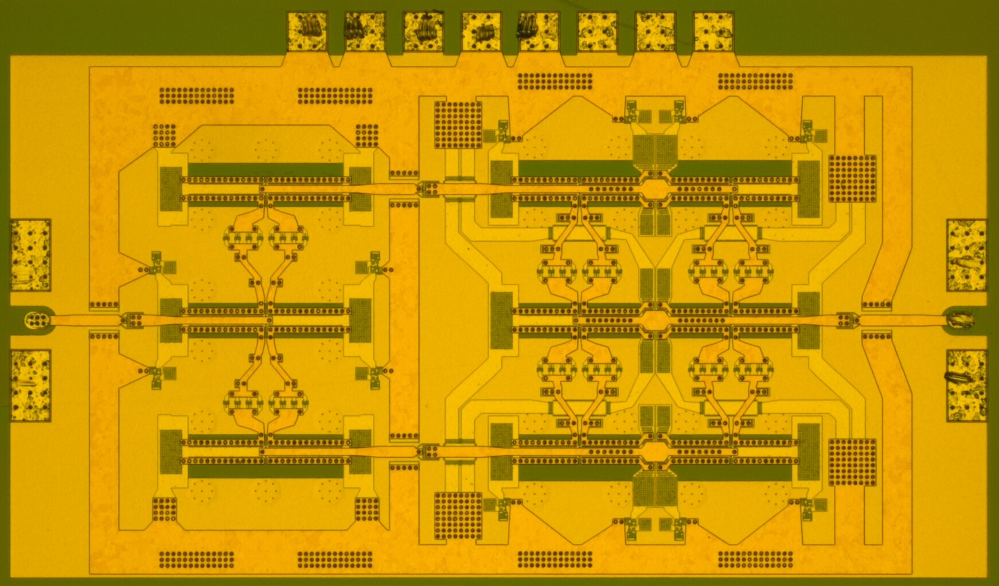
High-Power LO Driver
Wide bandwidth > 60-100 GHz, > 19 dBm output power
R. Maurer, et al., “Ultra-wideband mm-Wave InP Power Amplifiers in 130nm InP HBT Technology,” in 2016 IEEE CSICS

Slide 36
RF Balun Design
*Positive LO cycle
Insertion loss < 3.5 dB, phase error < 4°over W-band

Slide 37
LO Balun Design
*Positive LO cycle
Z_{in} without R_{on,diode}
2-4 dB insertion loss over W-band

Slide 38
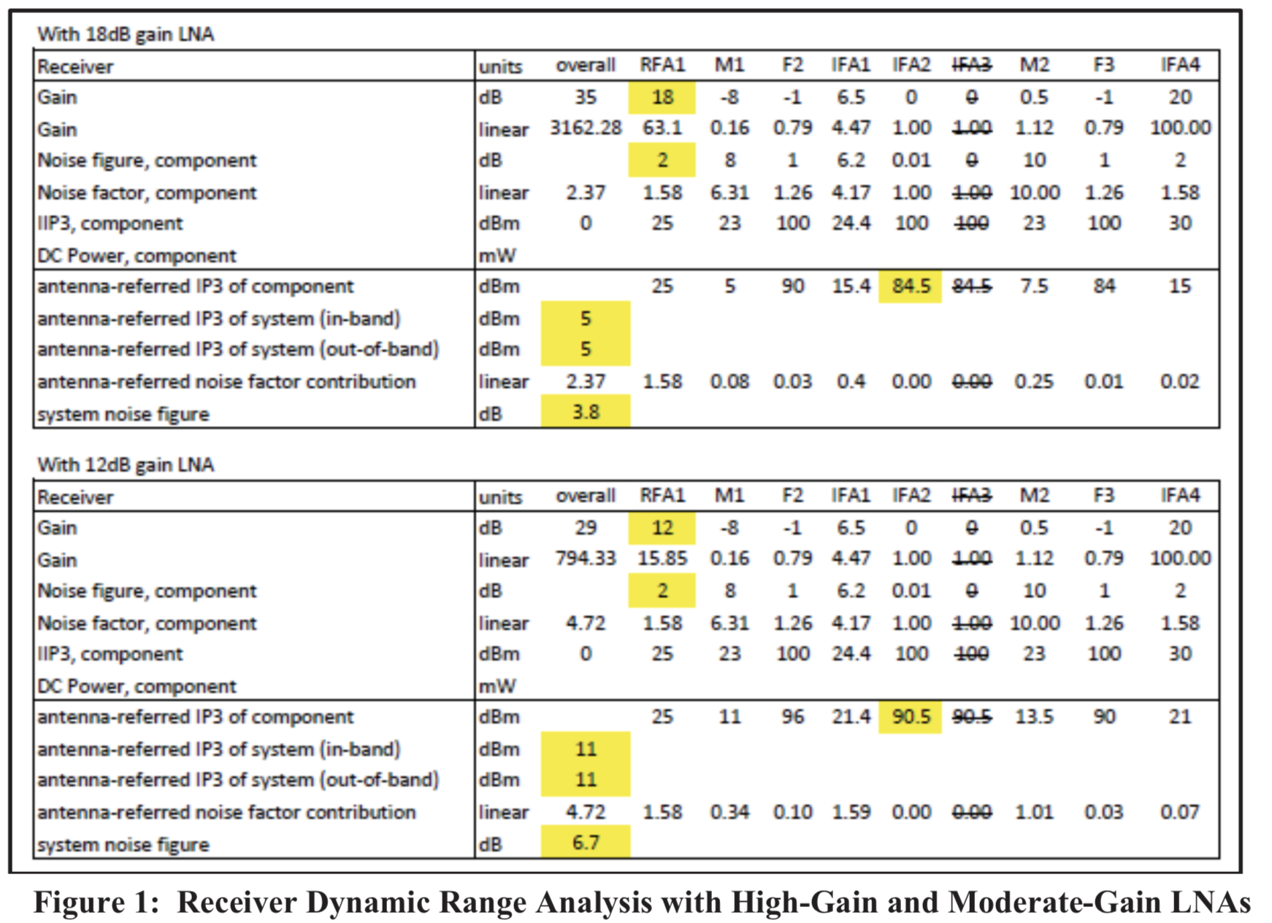
System Performance Assuming some LNAs
LNA with 18 dB and 12 dB gain

Slide 39
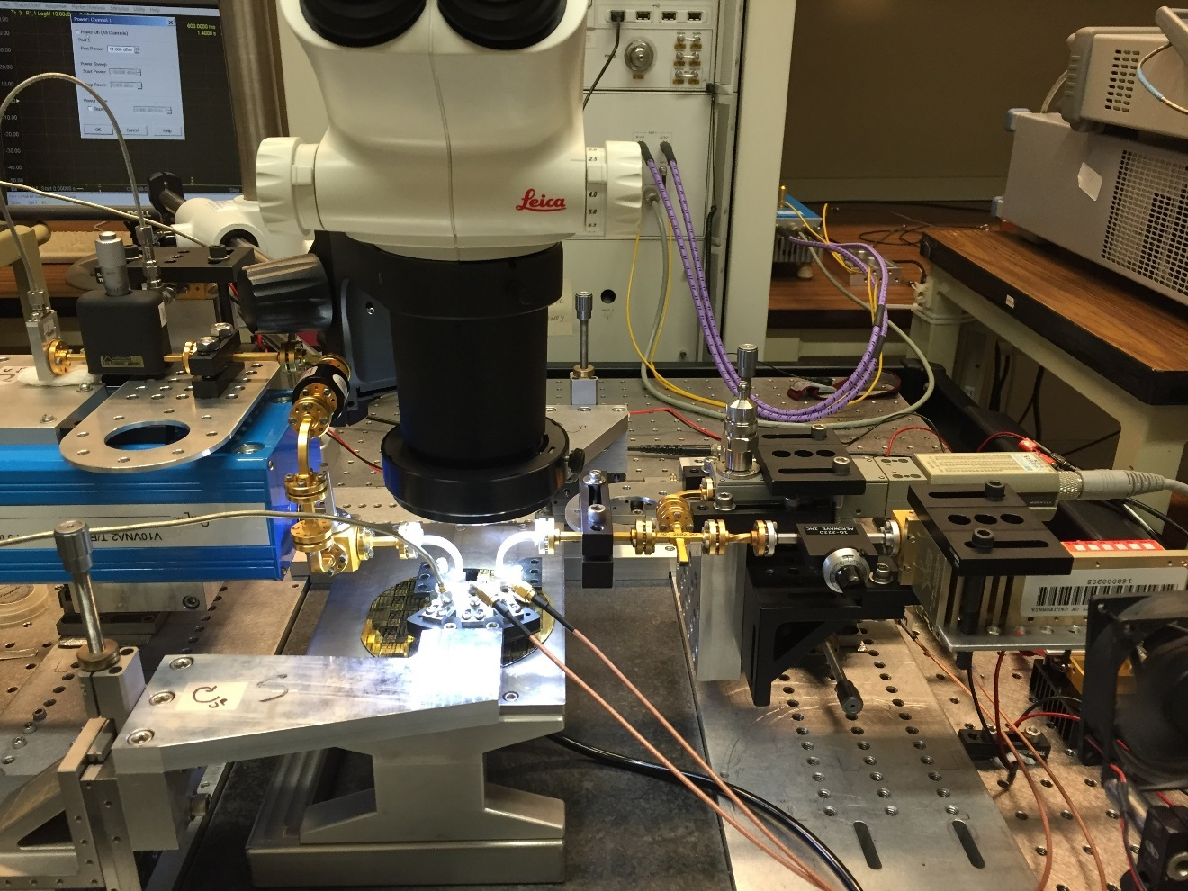
IIP3 Measurement Setup
RF1
Power sensor
(Monitoring LO power)
RF2
Magic-Tee
(Combiner)
LO
IF
Multiplier+amp.
Up-conversion

Slide 40
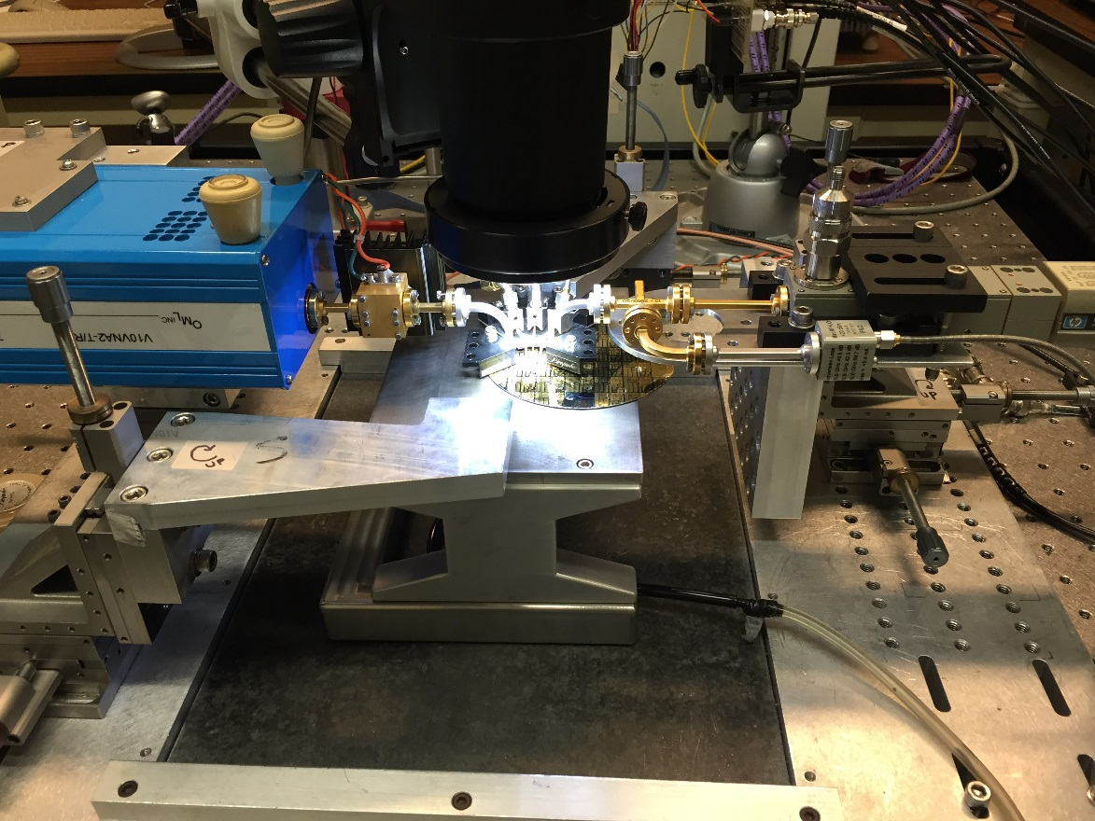
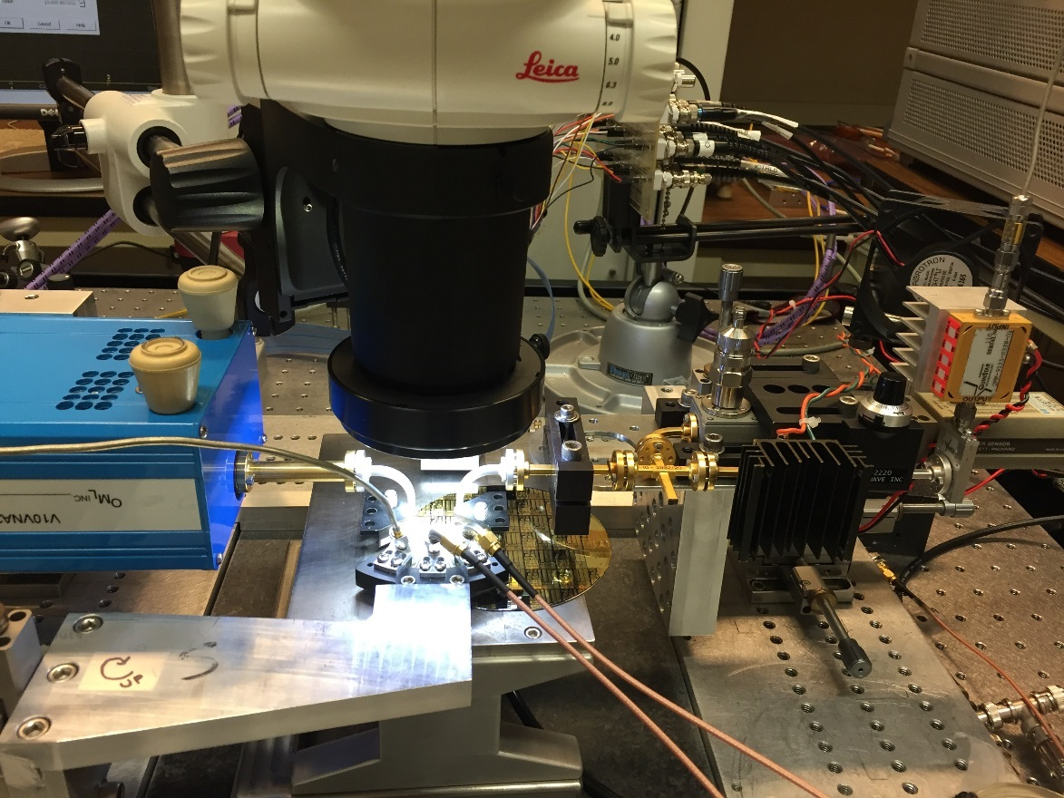
Measurement Setup
Spectrum and gain
IF
Power sensor
(Thru)
LO
LO Input
(9 dBm)
Harmonic mixer
(Coupled)
Down-conversion
Coupler
(20 dB)
RF
Power sensor
(Monitoring LO power)
Up-conversion
RF
LO
Multiplier
IF
W-band amp.

