Slide 1
Beyond 5G:
100-340GHz Transistor, IC, and System Design
Short Course: Device Research Conference, June 23, 2019, University of Michigan
Mark Rodwell,
University of California, Santa Barbara

Slide 2
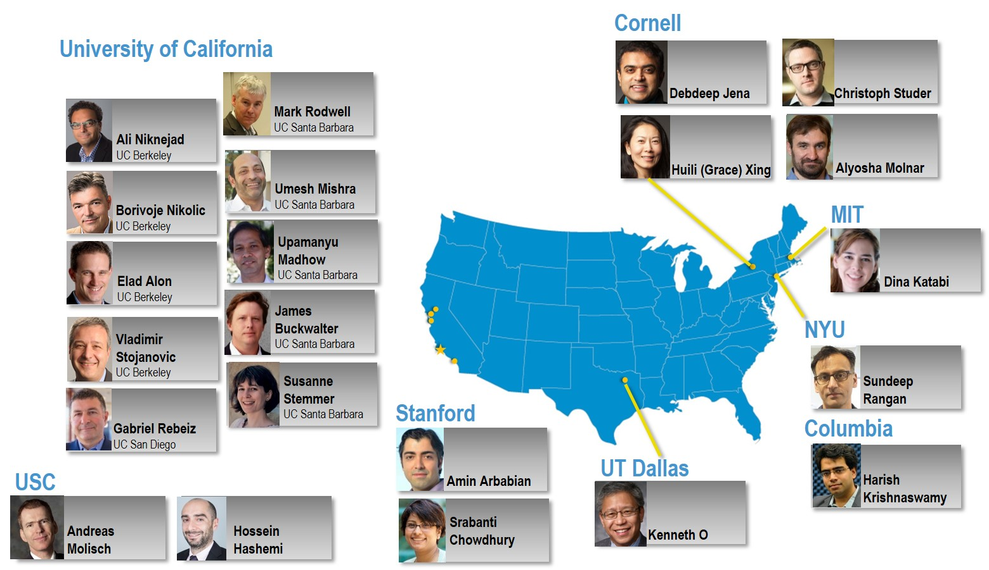
ComSenTer: Wireless Research
Center for Converged Communications & Sensing
at THz.
Duration:
5-years; 1/2018-12/2022.
Funding:
about $36 million total.
Team:
21 Professors,
~65 Ph.D. students
Sponsors:
SRC, DARPA
Focus:
wireless systems,
10-15 years out,
100-340GHz

Slide 3
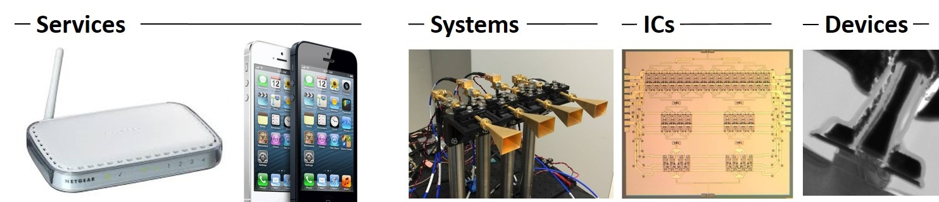
Wireless above 100GHz
Wireless networks: exploding demand.
Immediate industry response: 5G.
28, 38, 57-71(WiGig), 71-86GHz
increased spectrum, extensive beamforming
Next generation (6G ??): above 100GHz..
greatly increased spectrum, massive spectral multiplexing
DOD applications: Imaging/sensing/radar, comms.

Slide 4
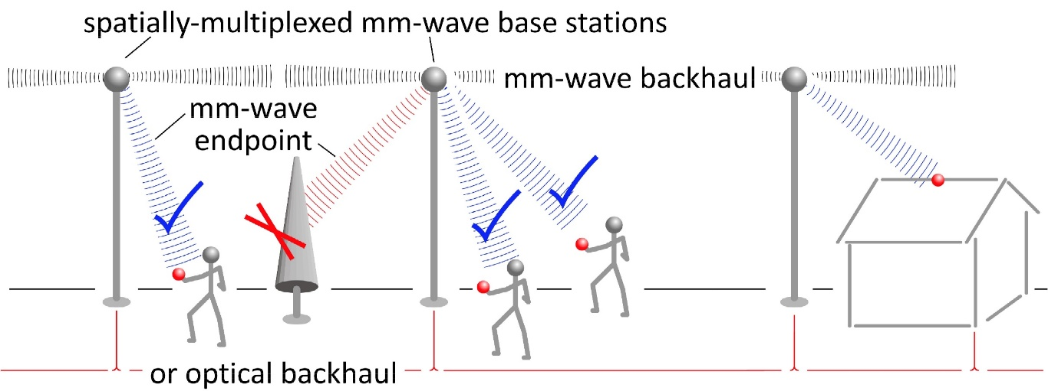

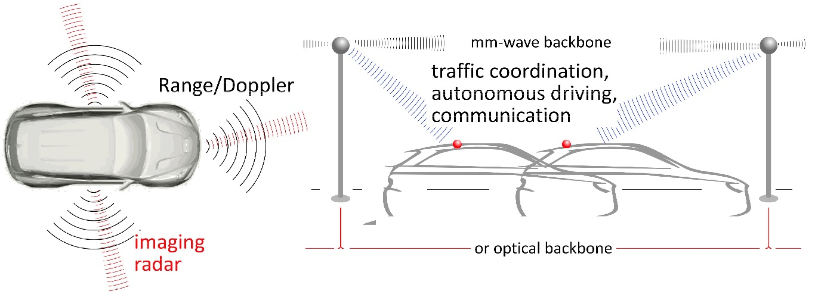
140-340GHz Wireless
10Gb mobile communications:
Unlimited information, anywhere.
Capacity well beyond 5G.
TV-resolution wireless imaging:
See, fly, drive perfectly in any conditions.

Slide 5
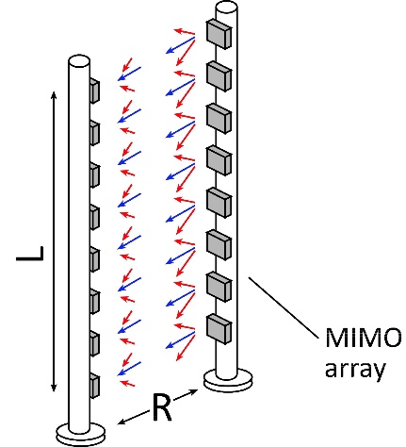
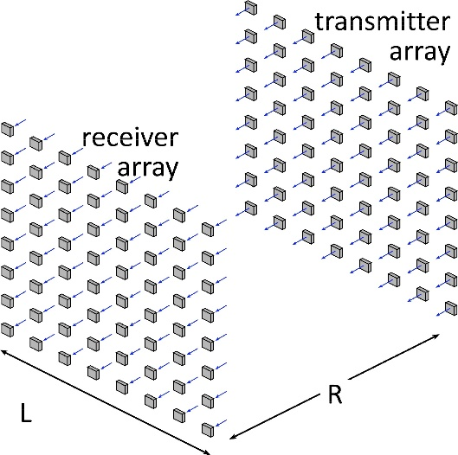
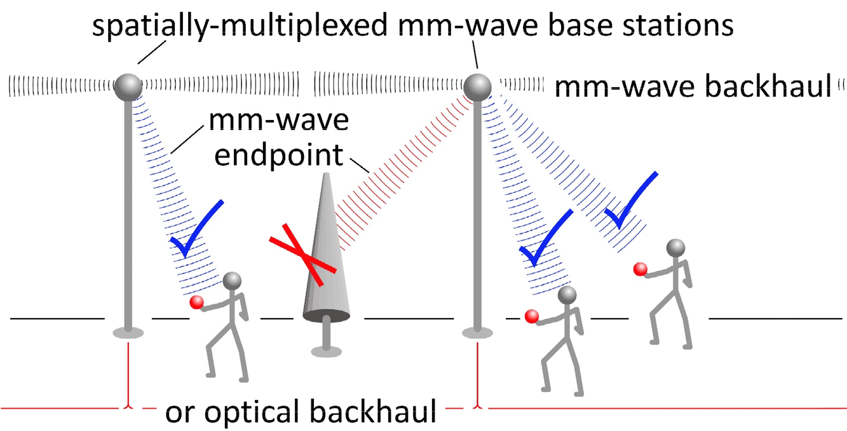
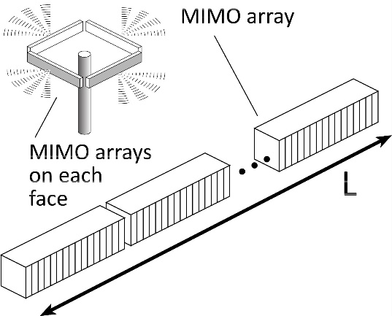
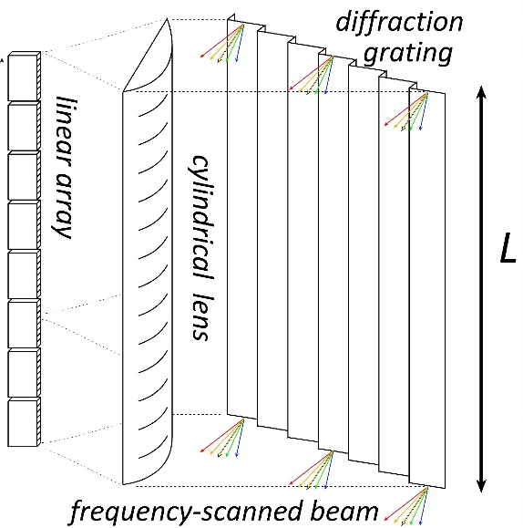
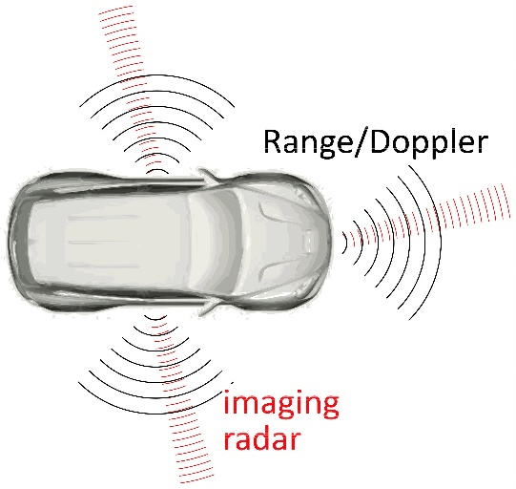
Benefits of Short Wavelengths
Communications: Massive spatial multiplexing, massive # of parallel channels
Imaging: very fine angular resolution
But:
High losses in foul or humid weather.
High λ²/R² path losses.
ICs: poorer PAs & LNAs.
Beams easily blocked.
100-340GHz wireless:
terabit capacity,
short range,
highly intermittent

Slide 6
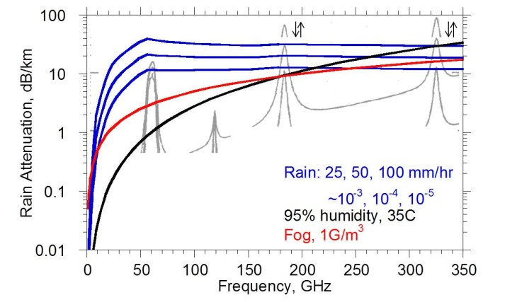
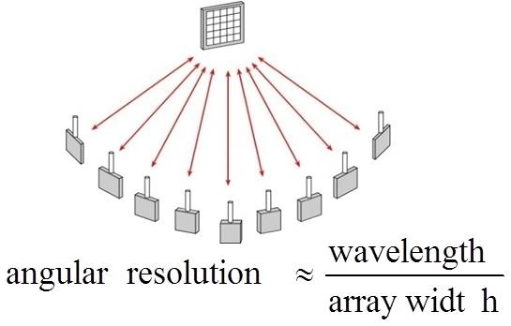
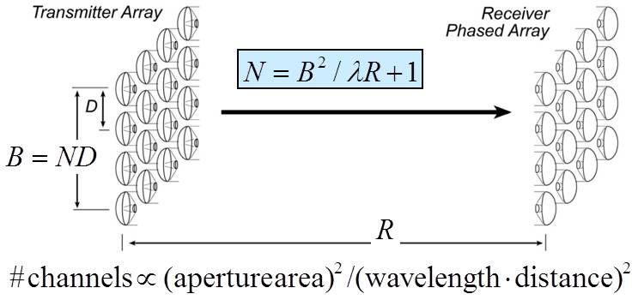
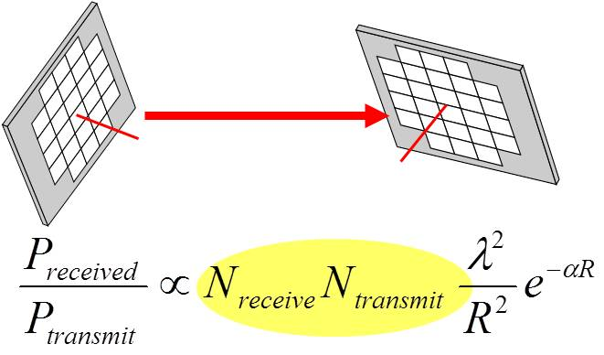
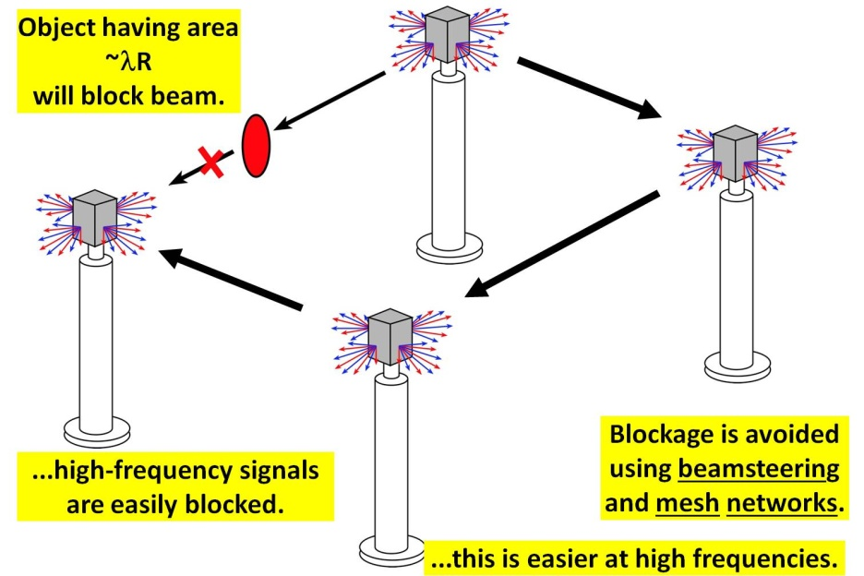
mm-waves: benefits & challenges
Large available spectrum
Massive # parallel channels
spatial
multiplexing
line-of-sight MIMO
(note high attenuation in foul or humid weather)
Torklinson : 2006 Allerton Conference
Sheldon : 2010 IEEE APS-URSI
Torklinson : 2011 IEEE Trans Wireless Comm.
Need phased arrays (overcome high attenuation)
Need mesh networks

Slide 7
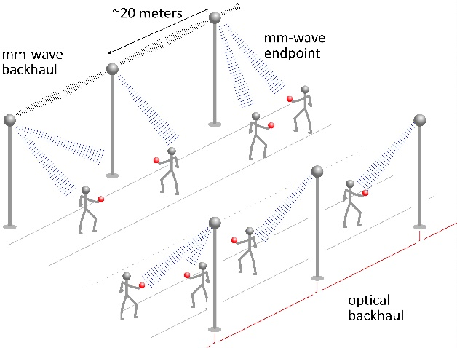
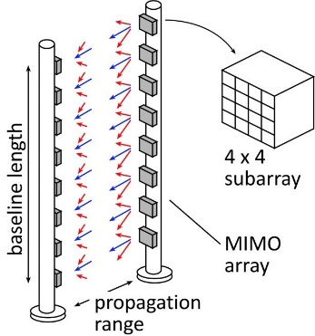
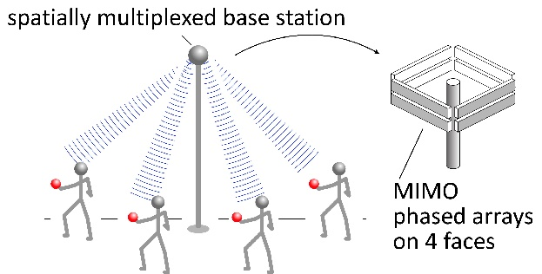
140-340 GHz:
Applications

Slide 8
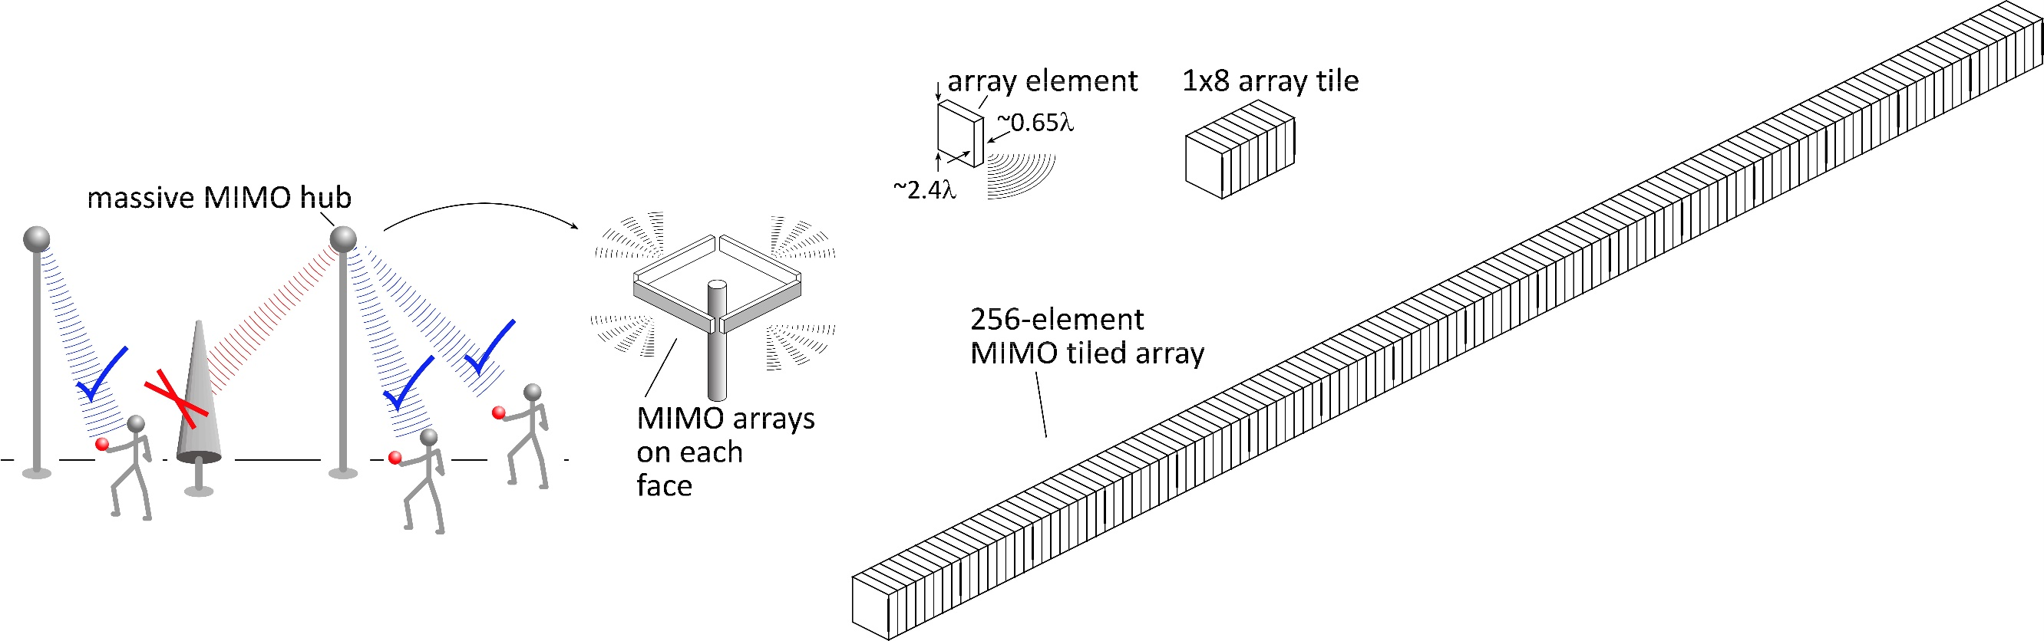
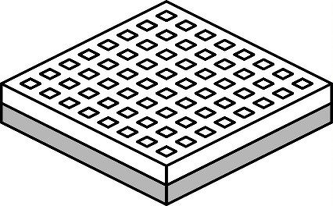
140 GHz spatially multiplexed base station
1 Tb/s spatially-multiplexed base station
256 users/face, 4 faces
1024 total users @ 1 user/beam, 1 Gb/s/beam;
225 m range
Handset:
8 × 8 array
(9×9mm)
Link budget is feasible, but...
Required component dynamic range ?
Required complexity of back-end beamformer ?

Slide 9
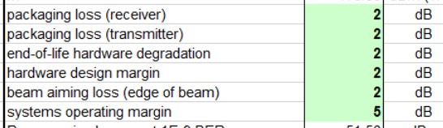
140 GHz spatially multiplexed base station
Each face supports 256 beams @ 1Gb/s/beam.
225 meters range in 50 mm/hr rain
Realistic packaging loss, operating & design margins (20dB total)
PAs: 16 dBm P_{out} (per element)
LNAs: 3 dB noise figure

Slide 10
75 GHz spatially multiplexed base station
If we use instead a 75GHz carrier,
but constrain the handset to a similar size (8mm×8mm)
and the hub to the same number of elements
then the range becomes 210 meters (vs. 225 meters)
Would be similar performance;
except that PAs, LNAs are poorer @ 140GHz
*The hub array is now 9mm×655mm (vs. 5mm×350mm)

Slide 11
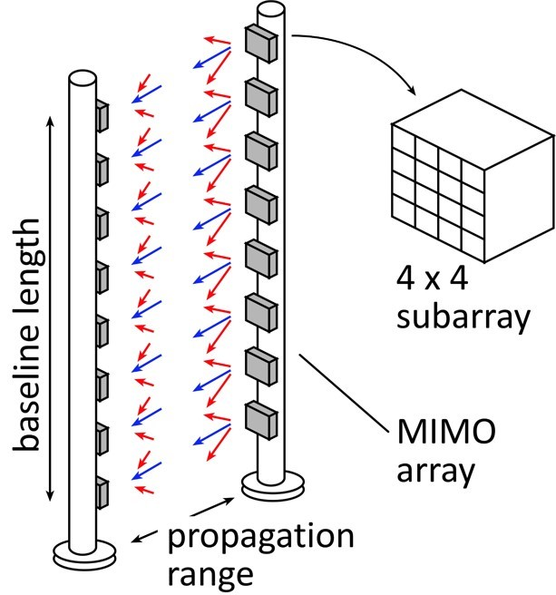
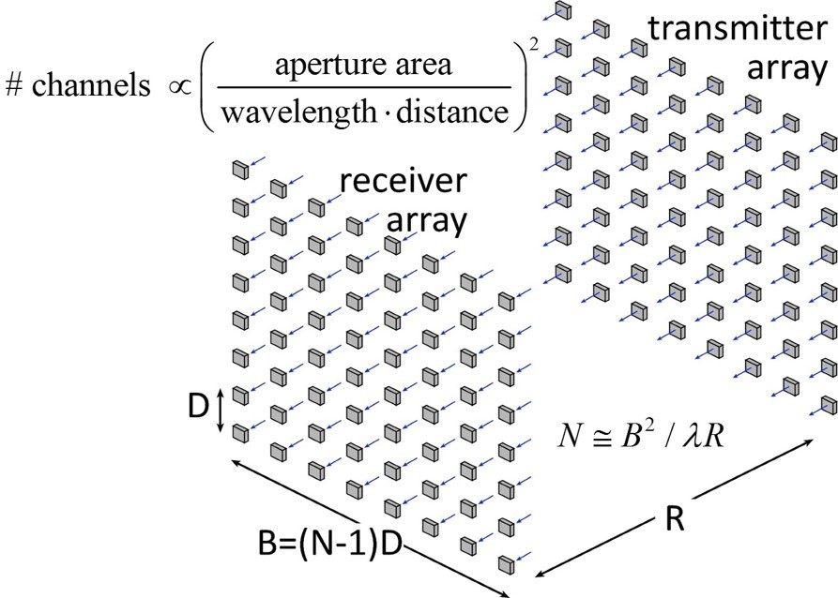
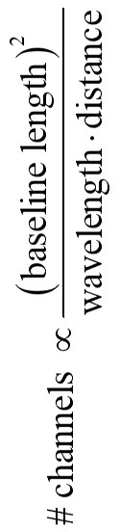
340 GHz (or even 650 GHz) backhaul
linear array
square array
Sub-mm-wave line-of-sight MIMO network backbone
wireless @ optical speed; link network where fiber is too expensive to place.
340 GHz: 640Gb/s @ 500 meters range; 1.6 meter linear array (5Tb/s for 8×8 square array).
650 GHz: 1.28Tb/s @ 500 meter range; 1.6 meter linear array.
Capacity doubles again if we use both polarizations.

Slide 12
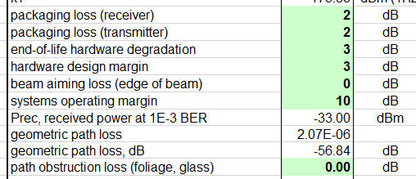
340 GHz 640 Gb/s MIMO backhaul
1.6m MIMO array: 8-elements, each 80 Gb/s QPSK; 640Gb/s total
4 × 4 sub-arrays → 8 degree beamsteering
500 meters range in 50 mm/hr rain; 29 dB/km
Realistic packaging loss, operating & design margins
PAs: 82mW P_{out} (per element)
LNAs: 4 dB noise figure

Slide 13
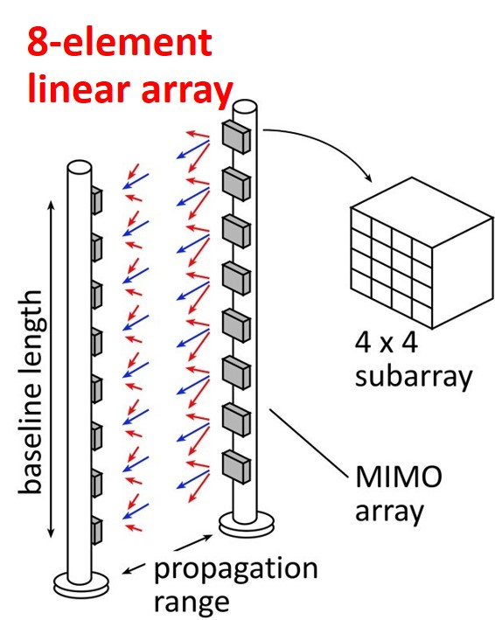
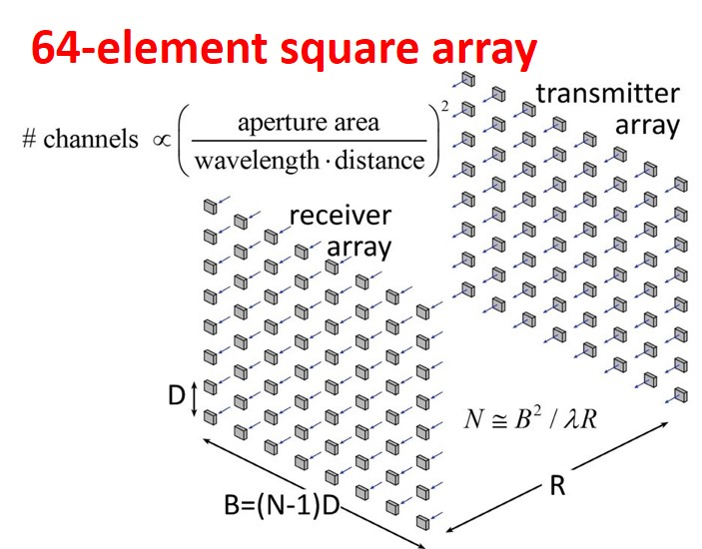
340 GHz 5 Tb/s MIMO backhaul
500m range in 50mm/hr. rain.
8-element 640Gb/s linear array:
requires 80mW power/element
requires 1.6m linear array
8-element 5Tb/s square array:
same link assumptions
requires 10mW power/element
...10W total radiated power
requires 1.6m square array

Slide 14
140 GHz, 640 Gb/s MIMO backhaul
Why not use a lower-frequency carrier, e.g. 140 GHz ?
8-element 640Gb/s linear array:
same link assumptions
requires 2mW (vs. 80mW) power/element
requires 2.6m (vs. 1.6m) linear array
8-element 5Tb/s square array:
same link assumptions
requires 0.25mW (vs. 10mW) power/element
requires 2.6m (vs. 1.6m) square array

Slide 15
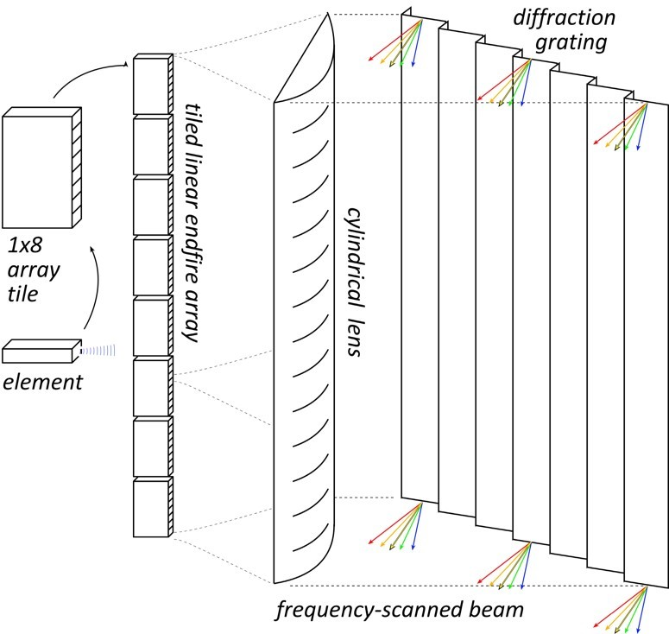
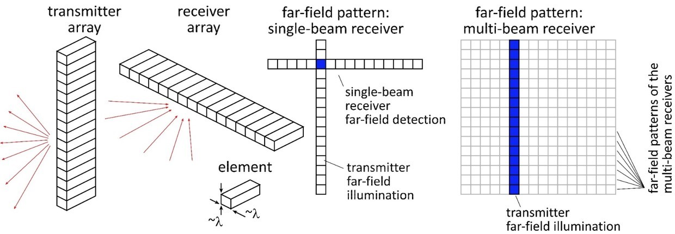


High-resolution imaging radar
Proposed demo: 220GHz frequency-scanned system
64×512 pixels, 60Hz refresh
35cm × 35cm aperture
64-element linear array
Target:
0.3m diameter, 10% reflectivity, 300m range
detect with 5dB SNR in 35dB/km fog.
System:
F=6dB, P_{element}= 10dBm (10% duty cycle)
DOD-relevant: 140GHz close-range system
256×256 pixels, 10ms image acquisition time
27 cm linear arrays, 256 elements
Target (large bullet):
2cm diameter , 10% reflectivity, 100m
detect with 10dB SNR in 20dB/km rain.
System
F=6dB, → Need 0.4W PAs (10% duty cycle)
(reasonable margins)

Slide 16
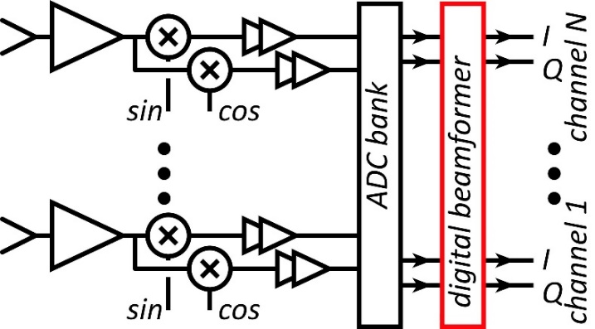
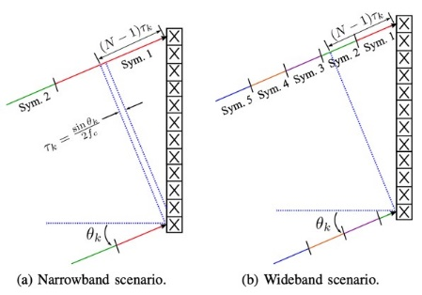
Systems

Slide 17
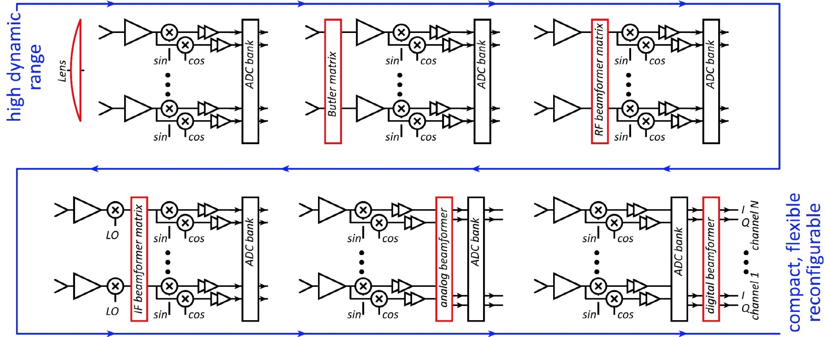
Beamforming for massive spatial multiplexing
Pure digital beamforming:
dynamic range & phase noise requirements: appear to be manageable ✓✓✓
Digital back-end processing requirements (die area, DC power): being investigated ???
Pure RF beamforming: (focal plane, Butler matrixes, RF beamforming)
Established approach in DOD systems (high dynamic range). Issues of array tiling.

Slide 18
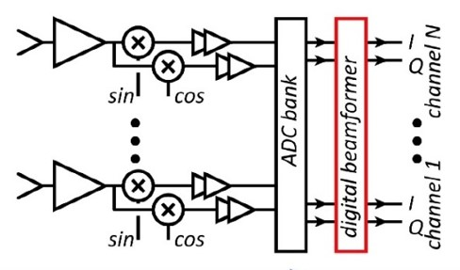
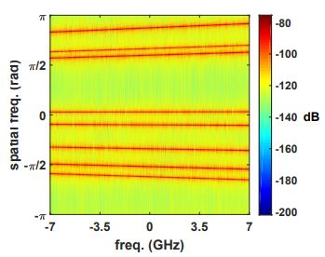
Beamforming for massive spatial multiplexing
Digital beamforming
✓ADCs/DACs: only 3-4 bit ADC/DACs required (Madhow, Studer, Rodwell)
✓Linearity: Amplifier P_{1dB} need be only 3dB above average power (Madhow).
✓Phase noise: Requirements same as for SISO (Alon, Madhow, Niknejad, Rodwell)
Efficient digital beamforming: beamspace algorithm=complexity ~N× log(N) (Madhow)
Efficient digital beamforming: low-resolution matrix (Studer)
Efficient channel estimation : fast beamspace algorithm (Studer)
Efficiently addressing true-time-delay problem: "rainbow" FFT algorithm (Madhow)
✓Array-to-backplane interconnect power: low-power analog baseband 50Ω links (Rodwell)
In progress…
Propagation models and measurements: (Molisch)
Blockage probability, mesh networks, network protocols: (Rangan, Cabric)
MIMO system power analysis: (Rangan, Cabric, Buckwalter)

Slide 19
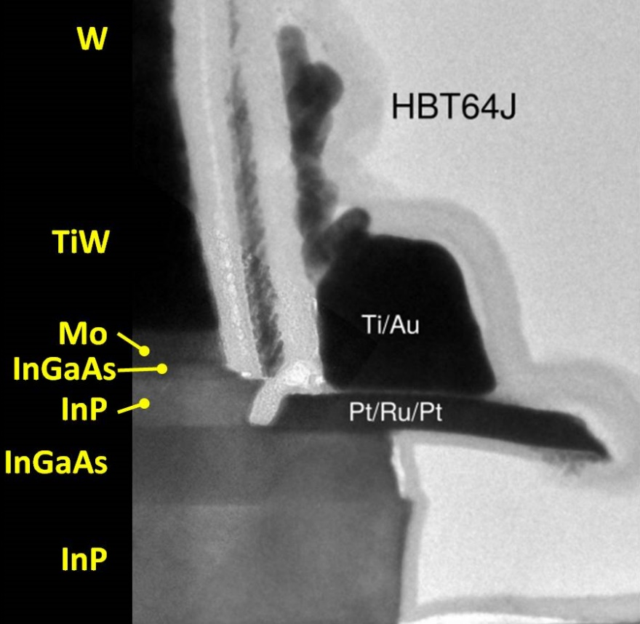
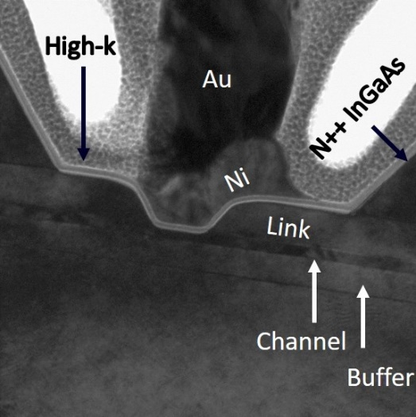
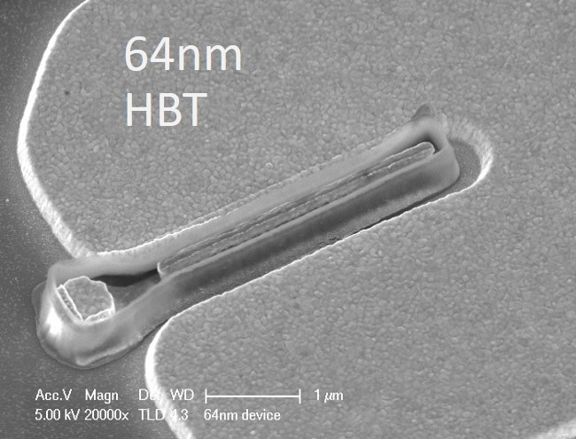
Transistors

Slide 20
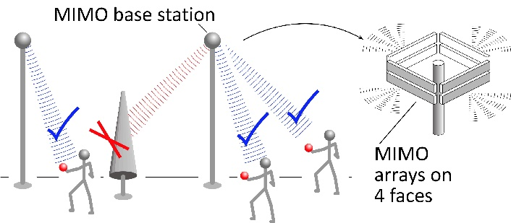
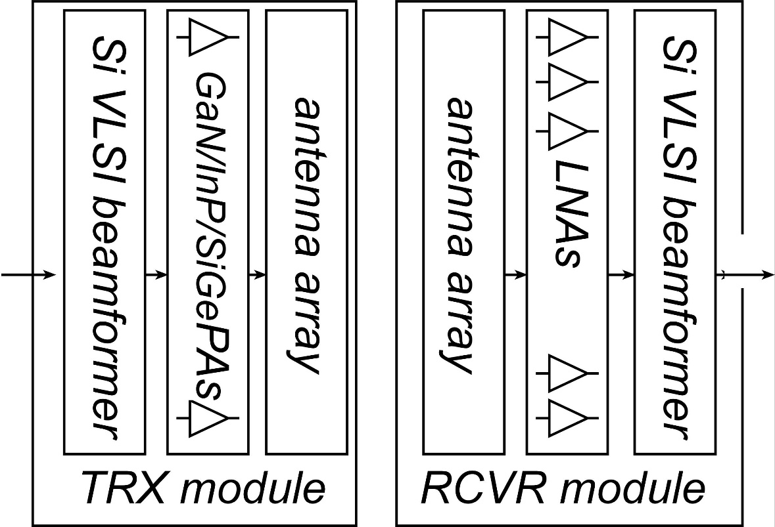
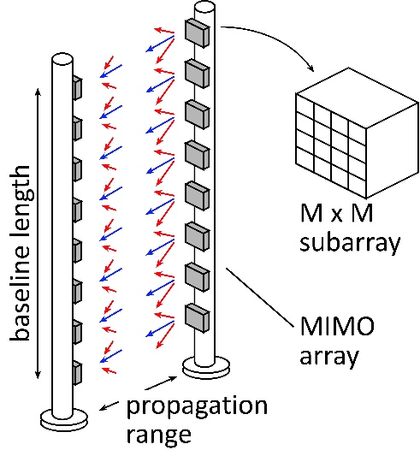
mm-Wave Wireless Transceiver Architecture
custom PAs, LNAs → power, efficiency, noise
Si CMOS beamformer→ integration scale
...similar to today's cell phones.

Slide 21
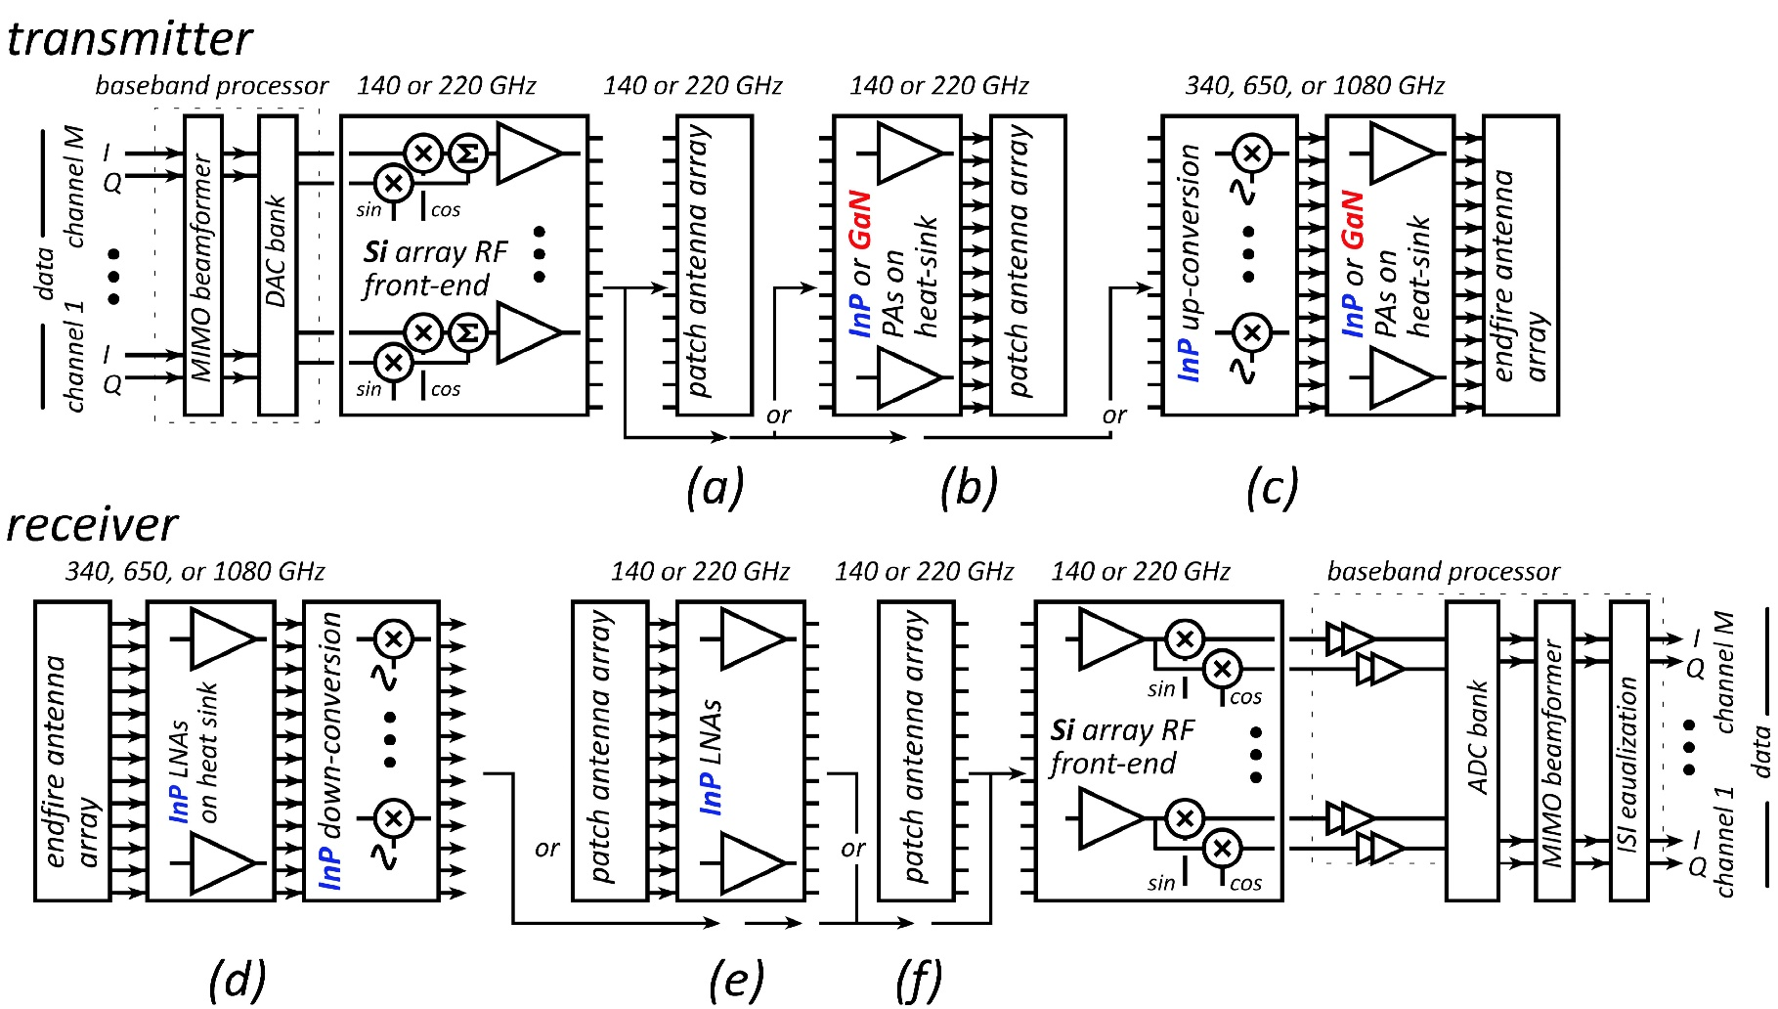

IC Technologies for 100 + GHz systems
Silicon
baseband processing at all frequencies
RF sections @ 140, 200GHz
PAs, LNAs in short-range 140, 220 GHz links
GaN
high-power amplifiers in long-range 140,220GHz links
(possibly 340GHz ?)
InP HEMT
low-noise amplifiers in long-range 140,220GHz links
low-noise amplifiers @ 340, 650GHz
InP HBT
medium-power amplifiers in long-range 140,220GHz links
power amplifiers @340, 650GHz
RF sections @ 340, 650GHz
MIMO hub:
140GHz: F= 4dB, P_{avg}=17.5dBm, P_{sat}≅21.5dBm
220GHz: F= 4dB, P_{avg}=21dBm, P_{sat}≅25dBm
Point-point MIMO:
340GHz: F= 4dB, P_{avg}=9.9dBm, P_{sat}≅13.9dBm
650GHz: F= 4dB, P_{avg}=14.5dBm, P_{sat}≅18.5dBm?

Slide 22
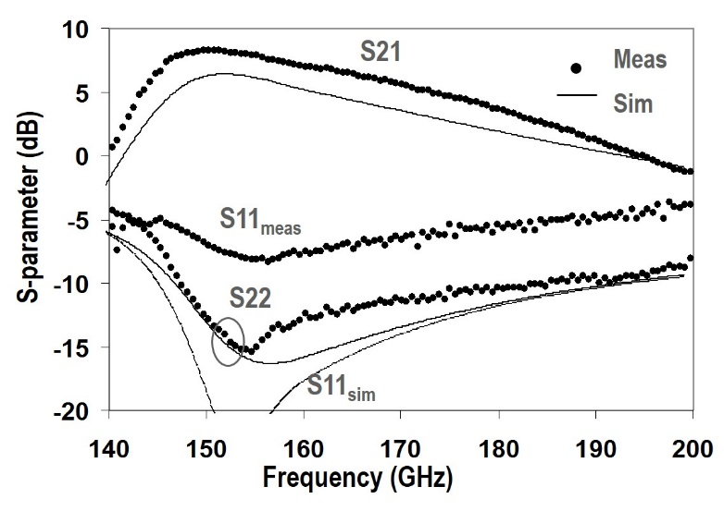
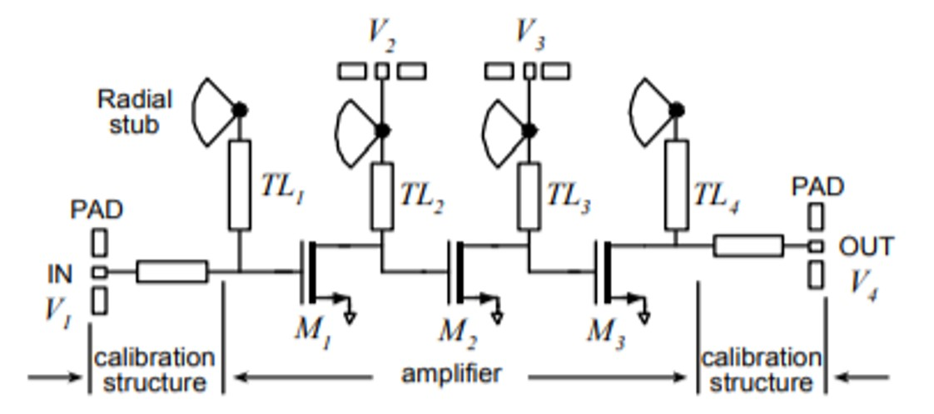
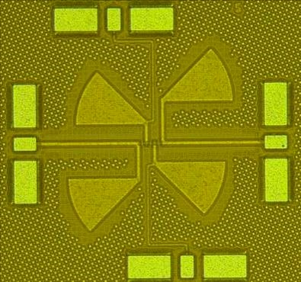
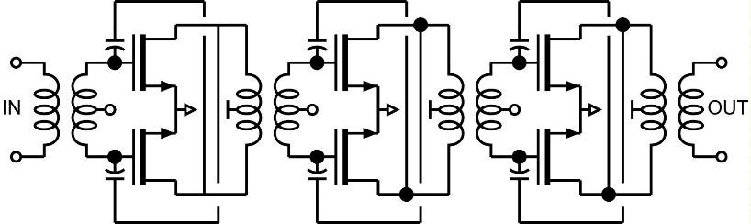
mm-wave CMOS (UCSB examples)
150 GHz amplifier:
IBM 65 nm bulk CMOS, 2.7dB gain per stage Seo et al., JSSC, Dec. 2009
145 GHz amplifier
GF 45 nm SOI CMOS, 6.3 dB gain per stage Kim, Simseck, 2017 BCICTS

Slide 23
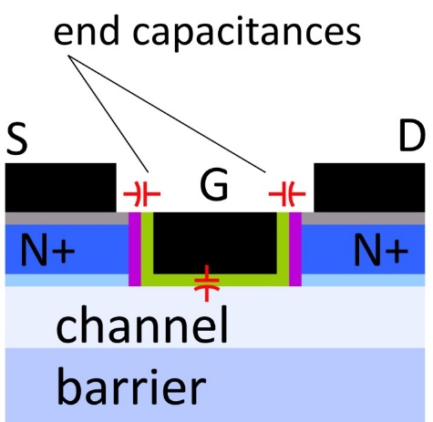
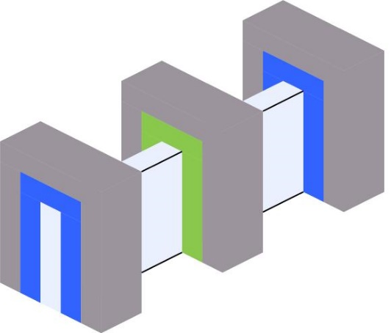
mm-Wave CMOS won't scale much further
Gate dielectric can't be thinned
→ on-current, g_{m} can't increase
Shorter gates give no less capacitance
dominated by ends; ~1fF/μm total
Maximum g_{m}, minimum C→ upper limit on f_{τ}.
about 350-400 GHz.
Tungsten via resistances reduce the gain
Inac et al, CSICS 2011
Present finFETs have yet larger end capacitances

Slide 24
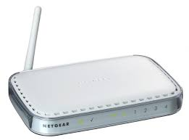
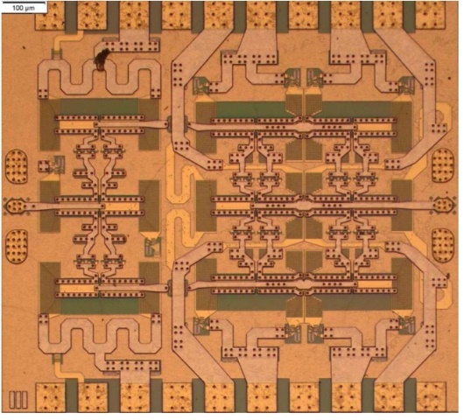

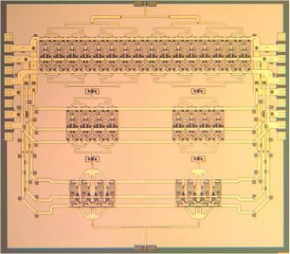

III-V high-power transmitters, low-noise receivers
Cell phones & WiFi: GaAs PAs, LNAs
mm-wave links need:
high transmit power, low receiver noise
0.47 W @86GHz
H Park, UCSB, IMS 2014
0.18 W @220GHz
T Reed, UCSB, CSICS 2013
1.9mW @585GHz
M Seo, TSC, IMS 2013

Slide 25

Gallium Nitride Power Technologies
GaN is the leading high-frequency power technology
N-polar GaN: Mishra

Slide 26



130nm / 1.1THz InP HBT Technology
Teledyne: M. Urteaga et al: 2011 DRC
Rode (UCSB), IEEE TED, 2015
3.5 V breakdown

Slide 27



130nm / 1.1THz InP HBT: IC Examples
220 GHz 0.18W power amplifier
325 GHz, 16mW power amplifier
UCSB/Teledyne: T. Reed et al: 2013 CSICS
UCSB/Teledyne: A. Ahmed, 2018 EuMIC Symp.
Integrated ~600GHz transmitter
Teledyne: M. Urteaga et al: 2017 IEEE Proceedings
but, only ~1 mW output power

Slide 28












Transistor scaling laws: ( V,I,R,C,τ ) vs. geometry
Depletion Layers
Bulk and
Contact Resistances
Fringing Capacitances
Thermal Resistance
Available quantum states to carry current
→ capacitance,
transconductance
contact resistance

Slide 29

Frequency Limits and Scaling Laws of (most) Electron Devices
PIN photodiode
To double bandwidth:
Reduce thicknesses 2:1
Improve contacts 4:1
Reduce width 4:1,
Keep constant length
Increase current density 4:1

Slide 30
Bipolar Transistor Design

Slide 31
Bipolar Transistor Design: Scaling

Slide 32

Making faster bipolar transistors
to double the bandwidth: | change
emitter & collector junction widths | decrease 4:1
current density (mA/μm²) | increase 4:1
current density (mA/μm) | constant
collector depletion thickness | decrease 2:1
base thickness | decrease 1.4:1
emitter & base contact resistivities | decrease 4:1
Teledyne: M. Urteaga et al: 2011 DRC
Narrow junctions.
Thin layers
High current density
Ultra low resistivity contacts

Slide 33


InP HBTs: 1.07 THz @200nm, ?? @ 130nm
?
Rode et al., IEEE TED, Aug. 2015

Slide 34

THz HBTs: The key challenges
Obtaining good base contacts
in HBT vs. in contact test structure
(emitter contacts are fine)
RC parasitics along finger length
metal resistance, excess junction areas
Baraskar et al, Journal of Applied Physics, 2013

Slide 35
Towards a 2 THz SiGe Bipolar Transistor
Similar scaling
InP: 3:1 higher collector velocity
SiGe: good contacts, buried oxides
Key distinction: Breakdown
InP has:
thicker collector at same f_{τ},
wider collector bandgap
Key requirements:
low resistivity Ohmic contacts
note the high current densities
 | InP | SiGe
emitter
junction width | 64 | 18 | nm
access resistivity | 2 | 0.6 | Ω−μm²
base
contact width | 64 | 18 | nm
contact resistivity | 2.5 | 0.7 | Ω−μm²
collector
thickness | 53 | 15 | nm
current density | 36 | 125 | mA/μm²
breakdown | 2.75 | 1.3? | V
f_{τ} | 1000 | 1000 | GHz
f_{max} | 2000 | 2000 | GHz
Assumes collector junction 3:1 wider than emitter.
Assumes SiGe contacts no wider than junctions

Slide 36
FETs (HEMTs): key for low noise
2:1 to 4:1 increase in f_{τ} :
improved noise
less required transmit power
smaller PAs, less DC power
or higher-frequency systems

Slide 37


InP HEMTs: state of the art
First Demonstration of Amplification at 1 THz Using
25-nm InP High Electron Mobility Transistor Process
Xiaobing Mei, et al, IEEE EDL, April 2015 (Northrop-Grumman)

Slide 38


FET Scaling Laws (these now broken)
FET parameter | change
gate length | decrease 2:1
current density (mA/mm) | increase 2:1
specific transconductance (mS/mm) | increase 2:1
transport mass | constant
2DEG electron density | increase 2:1
gate-channel capacitance density | increase 2:1
dielectric equivalent thickness | decrease 2:1
channel thickness | decrease 2:1
channel state density | increase 2:1
contact resistivities | decrease 4:1

Slide 39


FET Scaling Laws (these now broken)
FET parameter | change
gate length | decrease 2:1
current density (mA/mm) | increase 2:1
specific transconductance (mS/mm) | increase 2:1
transport mass | constant
2DEG electron density | increase 2:1
gate-channel capacitance density | increase 2:1
dielectric equivalent thickness | decrease 2:1
channel thickness | decrease 2:1
channel state density | increase 2:1
contact resistivities | decrease 4:1
Gate dielectric can't be much further scaled.
Not in CMOS VLSI, not in mm-wave HEMTs
g_{m}/W_{g} (mS/μm) hard to increase→ C_{end} / g_{m} prevents f_{τ} scaling.
Shorter gate lengths degrade electrostatics→ reduced g_{m} /G_{ds} → reduced f_{max} , f_{τ}

Slide 40




Towards faster HEMTs: MOS-HEMTs
Scaling limit: gate insulator thickness
HEMT: InAlAs barrier: tunneling, thermionic leakage
solution: replace InAlAs with high-K dielectric
2nm ZrO₂ (ε_{r}=25): adequately low leakage
Scaling limit: source access resistance
HEMT: InAlAs barrier is under N+ source/drain
solution: regrowth, place N+ layer on InAs channel
Target ~10nm node
~0.3nm EOT, 3nm thick channel
1.2 to 1.5 THz f_{τ}.
Jun Wu, UCSB, IEEE EDL, 2018

Slide 41

ICs

Slide 42
mm-Wave IC design: the challenges
Transistor gains are low: f_{signal} is significant fraction of f_{max}.
match for optimum gain, noise, or power.
Device dimensions are a significant fraction of a wavelength
Even short lengths of wiring add serious parasitics
Transmission-line losses are high
low Q in VCO resonators and filters
high combining losses in PAs: low power, low efficiency
several dB added noise in LNAs.

Slide 43




Thin-film microstrip: inverted or right-side-up

Slide 44








130nm /1.1 THz InP HBT ICs to 670 GHz
614 GHz
fundamental
VCO
340 GHz dynamic frequency divider
M. Seo, TSC / UCSB
M. Seo, UCSB/TSC
IMS 2010
300 GHz fundamental
PLL
620 GHz, 20 dB gain amplifier
M Seo, TSC
IMS 2013
also: 670GHz amplifier
J. Hacker , TSC
IMS 2013 (not shown)
M. Seo, TSC
IMS 2011
204 GHz static
frequency divider
(ECL master-slave
latch)
220 GHz
180 mW
power amplifier
81 GHz
470 mW
power amplifier
Z. Griffith, TSC / UCSB
CSIC 2010
T. Reed, UCSB
CSICS 2013
H-C Park UCSB
IMS 2014
Integrated 300/350GHz Receivers:
LNA/Mixer/VCO
600 GHz
Integrated
Transmitter
PLL + Mixer
M. Seo TSC
M. Seo TSC

Slide 45




214 GHz, 180mW Power Amplifier (330 mW design)
2.3 mm x 2.5 mm
T. Reed, Z. Griffith, 2014 CSICS http://ieeexplore.ieee.org/xpls/abs_all.jsp?arnumber=6659187&tag=1

Slide 46


205GHz Logic in Thin-Film Inverted Microstrip
205 GHz divider, Griffith et al, IEEE CSICS, Oct. 2010
8:1, 205 GHz static divider in 256 nm InP HBT. Image taken before top metal (ground plane) deposition

Slide 47




140GHz Transceivers: GF 22nm SOI CMOS
0.76 mm
1.9 mm
0.76 mm
A. Farid UCSB, 2019 RFIC symposium
1.9 mm

Slide 48




RX Characterization

Slide 49




TX Characterization

Slide 50


InP Power Amplifier Design
# | Description | Area(mm$×$mm)
1 | 140GHz,P_{out}=19.3dB_{m}, PAE=13%, Gain=23.2dB | 0.63$×$1.08
2 | 140GHz, P_{out}=21.8dB_{m}, PAE=13.5%, Gain=23.4dB | 1.2 $×$1.09
3 | 140GHz,P_{out}=19.8dB_{m}, PAE=6.6%, Gain=24.8dB | 0.95$×$1.07
4 | 140GHz,P_{out}=19.5dB_{m}, PAE=17.9%, Gain=14.5dB | 0.63$×0.86$
5 | 220GHz,P_{out}=20.2dB_{m}, PAE=7.8%, Gain=19.7dB | 1.09$×$0.78
6 | 140GHz,P_{out}=19.3dB_{m}, PAE=17.1%, Gain=14.4dB | 0.6$×$0.79
7 | 220GHz,P_{out}=15.9dB_{m}, PAE=10.2%, Gain=17.9dB | 0.56$×$0.79
8 | 300GHz,P_{out}=13.5dB_{m}, PAE=4.2%, Gain=13.5dB | 0.63$×$0.8
9 | 300GHz,P_{out}=17.8dB_{m}, PAE=3.5%, Gain=15.8dB | 1.1$×$0.94
10 | 140GHz,P_{out}=19.7dB_{m}, PAE=8.1%, Gain=17.7dB | 0.95$×$0.9
11 | 140GHz,P_{out}=21.7dB_{m}, PAE=10.4%, Gain=30.7dB | 1.2$×$1.3
12 | 120GHz, P_{out}=20.4dB_{m}, PAE=9.2%, Gain=20.4dB | 0.95$×$0.98
13 | 140GHz, P_{out}=17.3dB_{m}, PAE=7.5%, Gain=25.3dB | 1.07$×$0.54
14 | 140GHz, P_{out}=15dB_{m}, PAE=28%, Gain=16dB
Class-A mm-Wave Power Amplifiers
120, 140, 220, 300GHz designs
Power: 50-100-200mW
140GHz efficiencies: 17%
Class-B mm-Wave Power Amplifiers
120GHz designs
Power: 30 mW
140GHz efficiencies: 28%
ICs taped out Feb. 2019
Presently in fabrication
Expected test: late summer
James Buckwalter, Mark Rodwell: UCSB

Slide 51

140GHz PA: power and S-parameter simulations
Technology | 250-nm InP HBT
Freq, GHz | 140
VCC, V | 2.5
J_{bias},mA/um | 1.3
S21, dB | 25
P_{out} ,dB_{m}, 2dB | 19.1
PAE % , 2dB | 12.6
P_{sat} ,dB_{m} | 20.9
PAE_{sat} % | 18.3
BW_{3dB}, GHz | 43
P_{DC}, W | 0.65

Slide 52

220GHz PA (CB version)
Power cell:
Smaller base capacitor,
SRF=679GHz
Decrease the shunt inductor
Two stage drivers:
Similar to power cell with higher cap
SRF=512GHz
Technology | 250-nm InP HBT
Freq, GHz | 220
VCC, V | 2.8
J_{bias},mA/um | 1.3
S21, dB | 22.3
P_{out} ,dB_{m}, 2dB | 21
PAE % , 2dB | 8.3
P_{sat} ,dB_{m} | 22
PAE_{sat} % | 10.4
BW_{3dB}, GHz | 48
P_{DC}, W | 1.5
Area=1.09 mm × 0.78mm

Slide 53


300GHz PA (CB version)
power cell and driver:
Decrease base cap and inductor
SRF=714GHz
Three driver stages
Four fingers, LE =6um.
Technology | 250-nm InP HBT
Freq, GHz | 300
VCC, V | 2.5
J_{bias},mA/um | 1.3
S21, dB | 17.6
P_{out} ,dB_{m}, 2dB | 17.8
PAE % , 2dB | 3.5
P_{sat} ,dB_{m} | 19.4
PAE_{sat} % | 5
BW_{3dB}, GHz | 43
P_{DC}, W | 1.65
Area=1.1 mm × 0.94mm

Slide 54


Packages

Slide 55



The mm-wave module design problem
How to make the IC electronics fit ?
100+ GHz arrays: λ₀/2 element spacing is very small.
Antennas on or above IC → IC channel spacing = antenna spacing
→ limited IC area to place circuits
How to avoid catastrophic signal distribution losses ?
long-range, high-gain arrays: array size can be large.
ICs beside array → very long wires between beam former and antenna
→ potential for very high signal distribution losses
How to remove the heat ?
100+ GHz arrays: element spacing is very small.
If antenna spacing = IC channel spacing, then power density is very large

Slide 56


mm-wave/sub-mm-wave packaging
Not all systems steer in two planes...
...some steer in only one.
Not all systems steer over 180 degrees...
...some steer a smaller angular range
Arrays can often be linear (1D), instead of rectangular (2D)
Element spacing can often be greater than λ/2.
→ Array packaging then greatly simplified.

Slide 57


Concept: Tile for linear arrays
Terrestrial system: horizontal steering only→ linear array.
Space at edges of linear array: room for III-V PAs, LNAs.
Alternating-sides feed: 2mm pitch→ room for large GaN PAs.
Mounting directly on metal carrier→ heatsinking.

Slide 58








140GHz array module design
-1.4 dB
-0.53 dB
Simulations good: working with Kyocera. June tapeout ?

Slide 59




140GHz Indoor Gigabit Network Demonstration

Slide 60

Concept: module for small angular scanning
Terrestrial system: horizontal + vertical steering → rectangular array.
Limited angular steering range (installation)→ spacing >> λ/2
Endfire / edge-card geometry: room for III-V PAs, LNAs.
Mounting directly on metal carrier→ heatsinking.
If Vivaldi's are replaced with dipoles, element spacing can be reduced to λ/2.
→ potential for wider angular scanning

Slide 61



λ/2-spaced 2-D Arrays
Tray design
Vertical spacings become very small
difficult to remove heat
Split-block / waveguide design
heatsinking maintained
difficult to manufacture

Slide 62



Wireless above 100GHz

Slide 63
Wireless above 100 GHz
Massive capacities
large available bandwidths
massive spatial multiplexing in base stations and point-point links
Very short range: few 100 meters
short wavelength, high atmospheric losses. Easily-blocked beams.
IC Technology
All-silicon for short ranges below 250 GHz.
III-V LNAs and PAs for longer-range links. Just like cell phones today
III-V frequency extenders for 340GHz and beyond
The challenges
spatial multiplexing: computational complexity
packaging: fitting signal channels in very small areas

Slide 64
In case of questions

Slide 65

140 GHz spatially multiplexed base station

Slide 66

75 GHz spatially multiplexed base station
If we use instead a 75GHz carrier,
the range increases to 325 meters (vs. 250 meters)
but the handset becomes 16mm×16mm (vs. 9mm×9mm),
and the hub array becomes 9mm×655mm (vs. 5mm×350mm)
Or, use a 4×4 (8mm×8mm) handset array,
and the range becomes 210 meters.

Slide 67

340 GHz 640 Gb/s MIMO backhaul

Slide 68

340 GHz 5 Tb/s MIMO backhaul
requires 10mW output per element
...10W total radiated power

