Slide 1

MO3A-5
A Broadband Direct Conversion Transmitter/Receiver at D-band Using CMOS 22nm FDSOI
Ali A. Farid, Arda Simsek, Ahmed Ahmed, Mark J.W. Rodwell
University Of California, Santa Barbara, USA

Slide 2
Outline
Motivation and Goals
Receiver/Transmitter Architecture
Circuit Design
Measurement Results
Performance Summary and Comparison
Conclusion

Slide 3
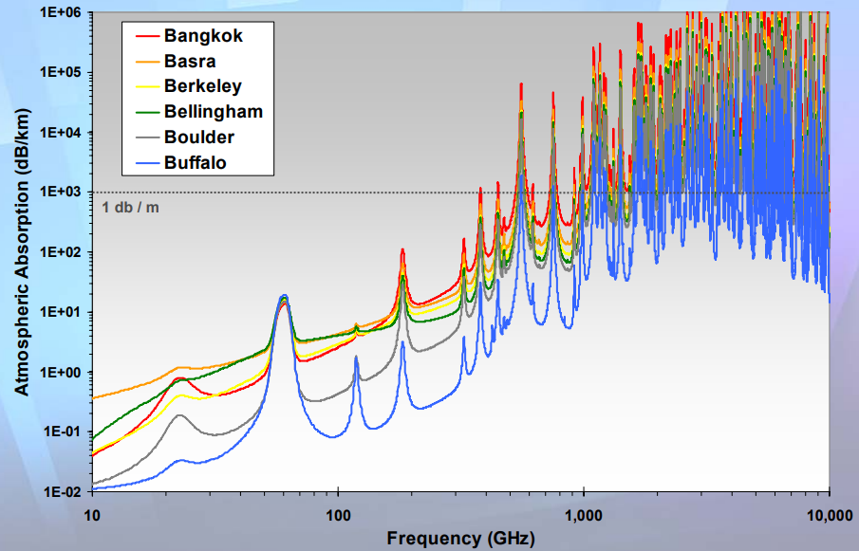
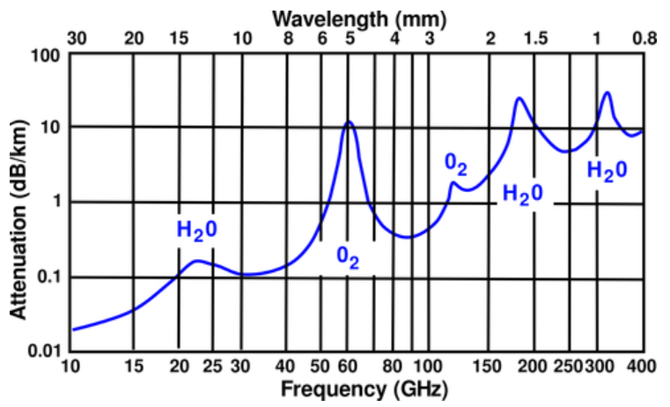
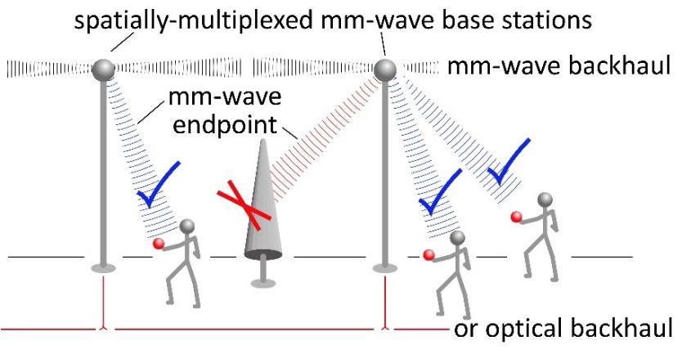
Motivation and Applications
Millimeter waves:
Large available spectrum.
Massive # of parallel channels, multiple independent beams.
Why 135GHz- band?
Less attenuation compared to its neighbor frequency bands.
[M.Rosker, IMS2007]

Slide 4
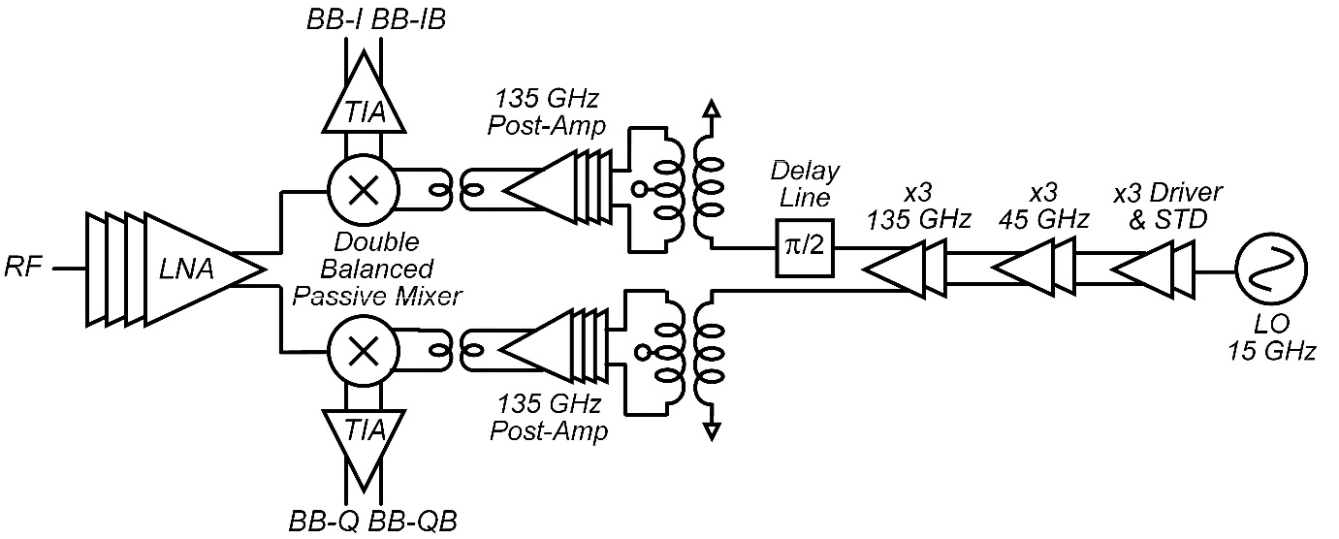
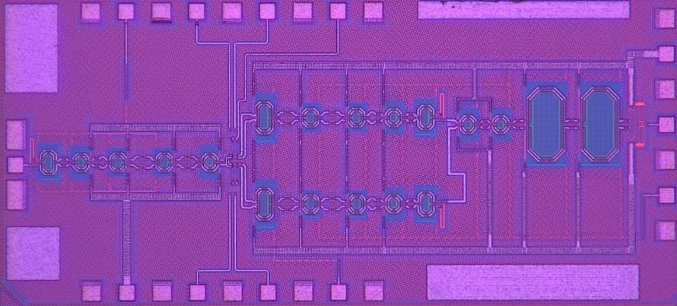
Receiver Architecture
0.76 mm
Direct conversion receiver:
Wideband fully differential LNA.
Double balanced passive mixer.
Broadband pseudo-differential transimpedance amplifier (TIA).
9:1 LO frequency multiplier (15GHz→ 135GHz):
two cascaded limiting amplifiers as triplers.
λ/2 transmission Line to generate LO (I,Q) signals.
1.9 mm

Slide 5
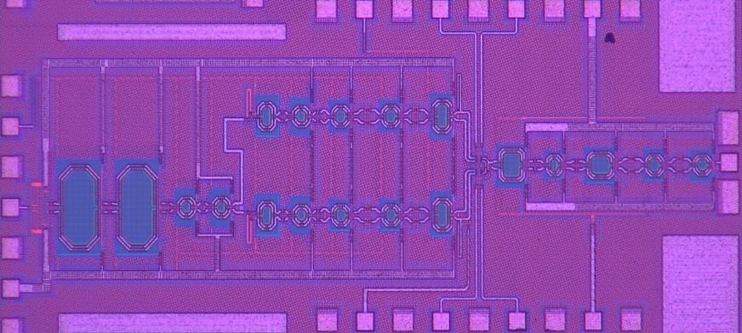
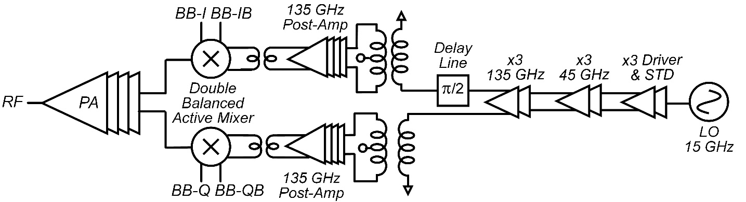
Transmitter Architecture
0.76 mm
Direct conversion Transmitter:
Active double balanced Gilbert cell.
Wideband fully differential driver amplifier.
9:1 LO frequency multiplier (15GHz→ 135GHz):
two cascaded limiting amplifiers as triplers.
λ/2 transmission Line to generate LO (I,Q) signals.
1.9 mm

Slide 6
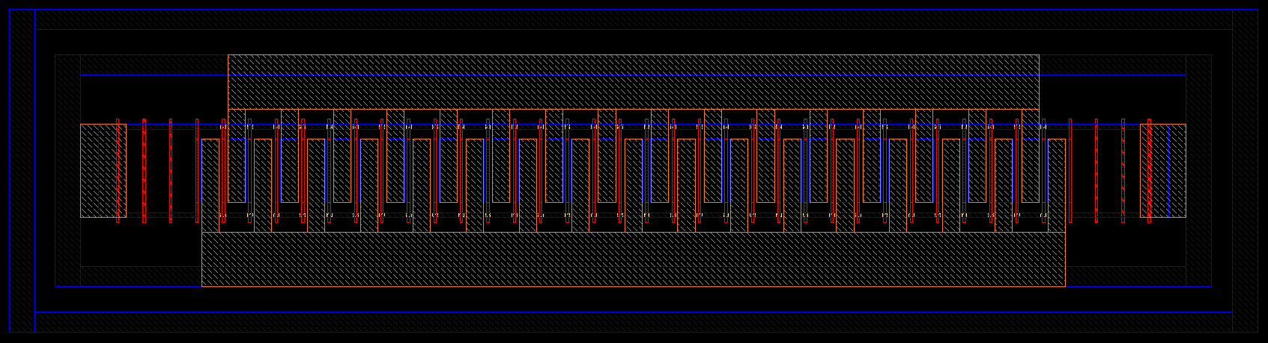
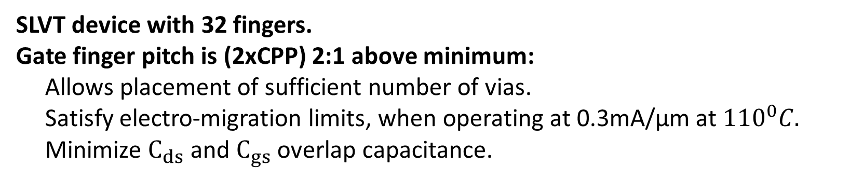
Technology Characterization
BSIM_IMG
Drain (C1)
Gate
Gate
Transistor Core
+
PC,CB,M1-C3
Source (C1)
C3-LB Interconnection parasitic
(Capacitance, resistance, inductance)
SLVT device with 32 fingers.
Gate finger pitch is (2xCPP) 2:1 above minimum:
Allows placement of sufficient number of vias.
Satisfy electro-migration limits, when operating at 0.3mA/μm at ${110}^{0}C.$
Minimize $C_{ds}$ and $C_{gs}$ overlap capacitance.

Slide 7
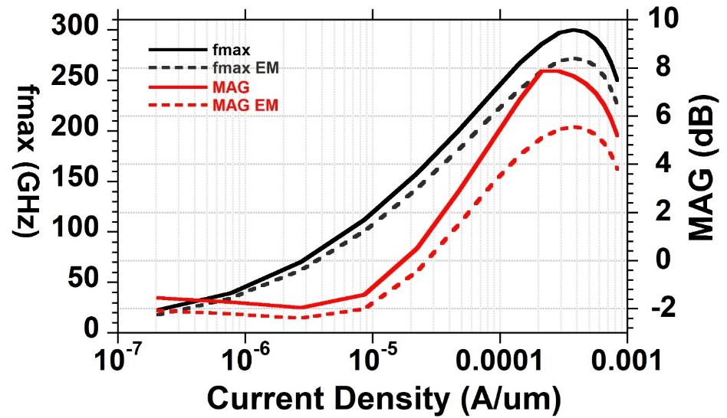
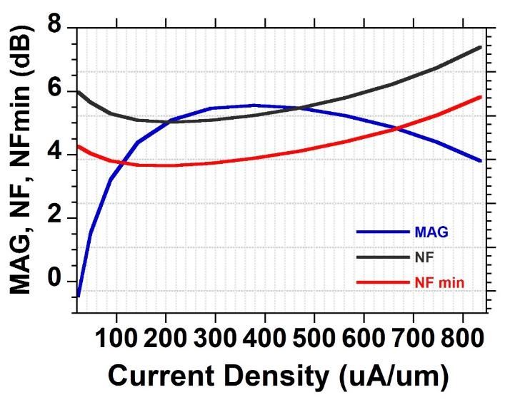

Technology Characterization
At current density of 0.3 mA/μm
f_{max} ~ 300GHz referenced to bottom Metal Layer (M1).
f_{max} ~ 250 GHz referenced to top Metal layer (LB/ Aluminum).
G_{max} = 5.5 dB and NF_{min} = 3.9 dB @ 135 GHz.

Slide 8
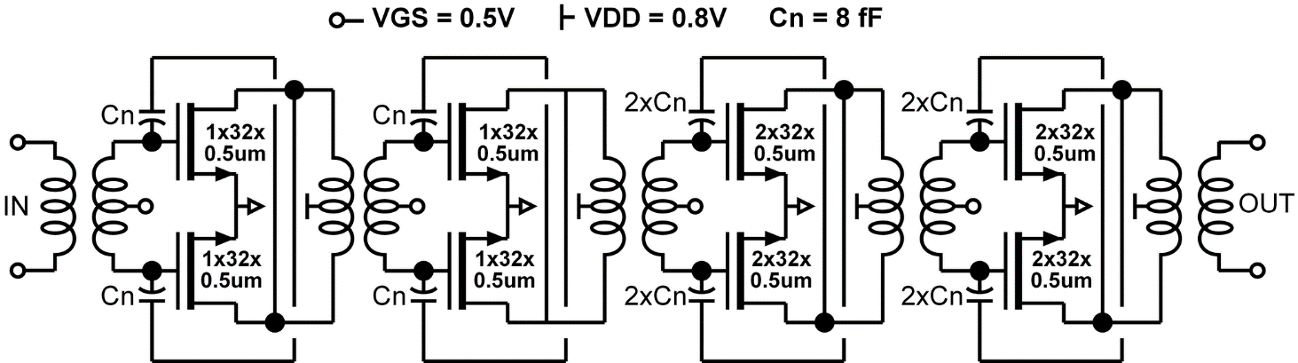
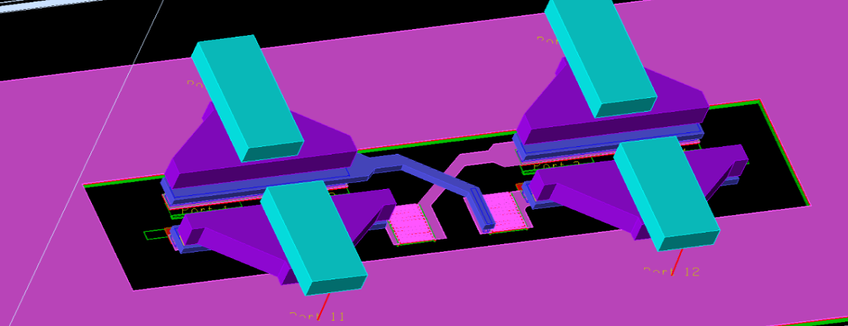
Circuit Design- LNA/PA
4-stage differential CS amplifier
Capacitive neutralization.
First stage optimized for Noise Figure.
Last stage tuning: maximum P_{out}.
Staggered inter-stage tuning
→wider bandwidth.
LB
Drain
LB
Gate
Apmom capacitors

Slide 9
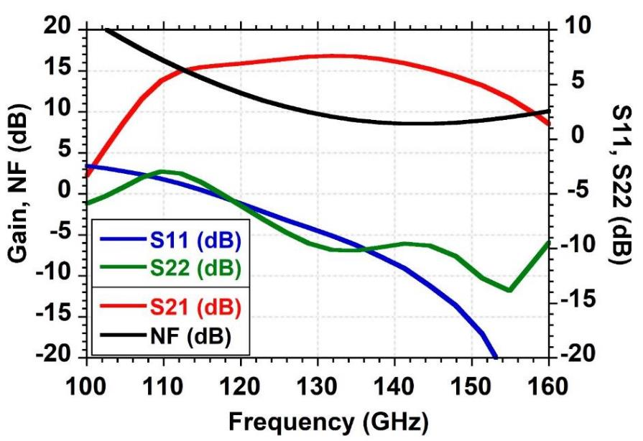
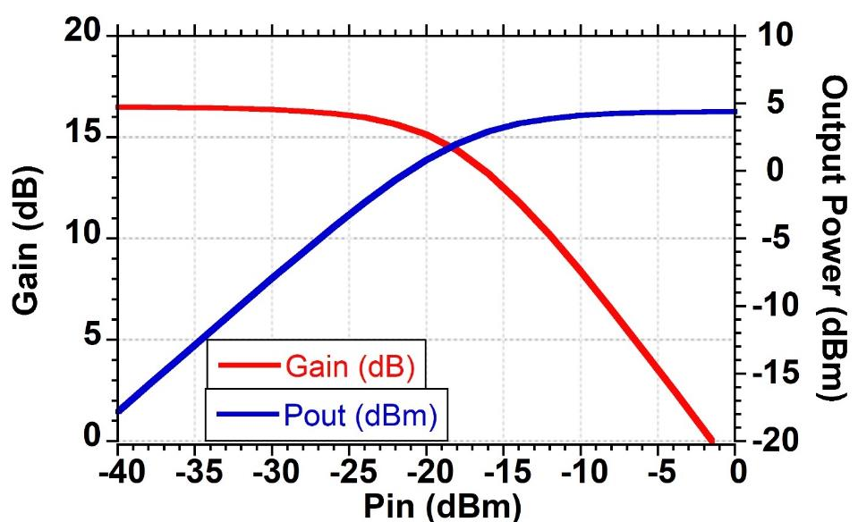
LNA/PA Simulation
Simulated S₂₁ is 16dB with 40GHz 3-dB BW.
P_{sat} is 4.5dBm, while P_{1dB} is 1.8dBm.
Power consumption: 0.8V, 60mA →48mW.

Slide 10
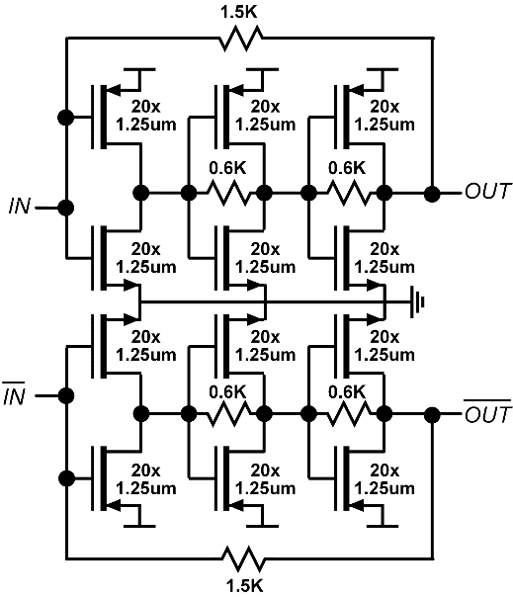
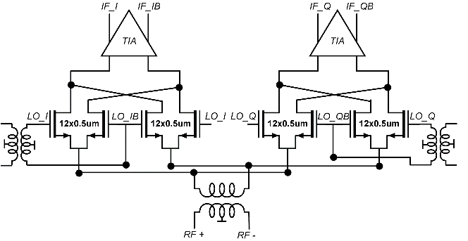
Circuit Design- Down Conversion Mixer
Double balanced passive mixer → high input dynamic range.
LO (I,Q) signals converted to differential form by transformers.
Baseband (I,Q) mixer outputs DC-coupled to TIA.

Slide 11
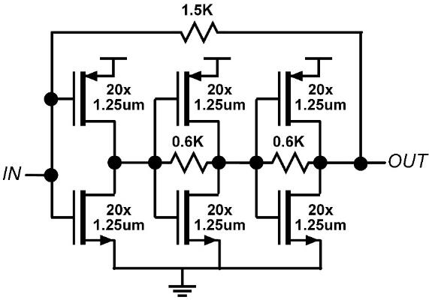
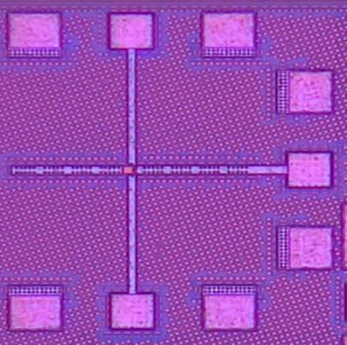
Circuit Design- Transimpedance Amplifier
VDD
Decoupling caps
IN
OUT
24dB gain, measured and simulated.
17GHz bandwidth measured; 22GHz simulated.
Gain notch due to power supply resonance.
No gain notch in fully receiver (differential signal path).

Slide 12
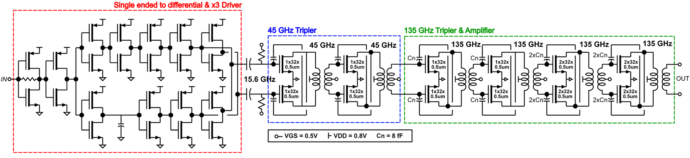
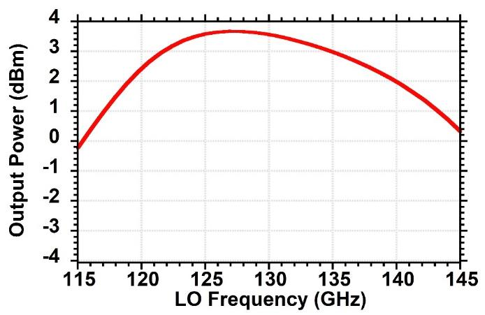
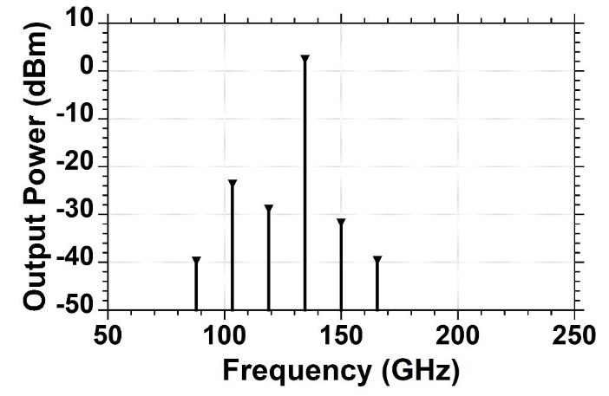
Frequency Multiplier Simulations
HR > 25 dBc
3dB BW = 25GHz

Slide 13
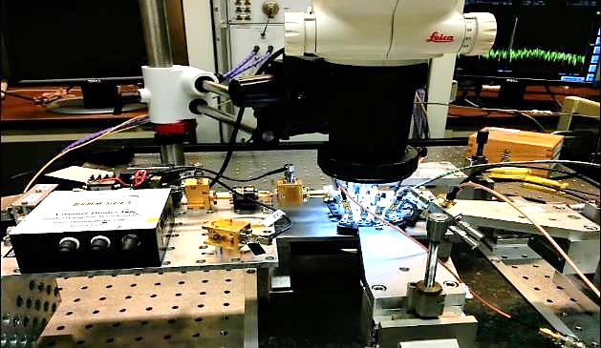
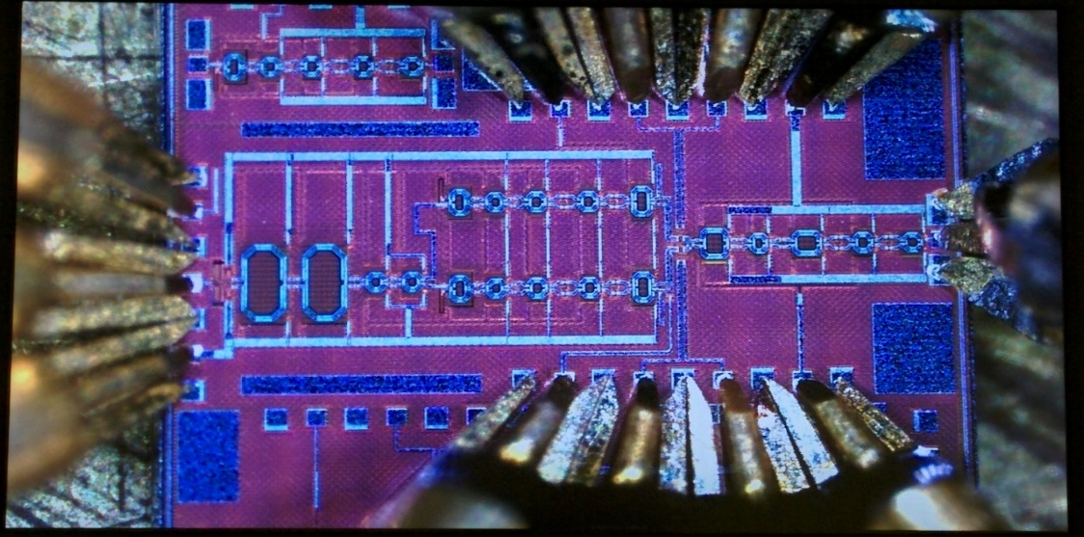
Receiver Measurements
Test Setup:
Input signal source: Virginia Diode AMC333.
TIA outputs terminated by 50Ω.
Characterization:
Conversion gain=27dB.
20GHz Rx modulation BW with Fixed 135GHz LO.

Slide 14
Receiver Measurements
10GHz RX tuning range, limited by LO tuning range.
P_{1dB} =-30dBm (compression due to TIA).

Slide 15
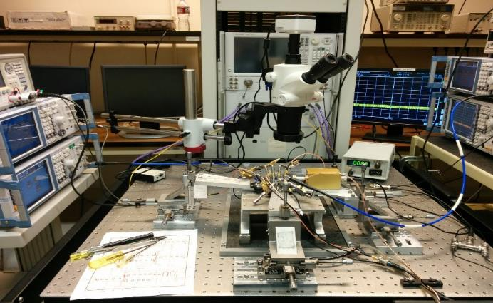
Transmitter Measurements
Test Setup:
Output power measured with PM4 power meter.
Baseband I /Q signal input power =-3dBm
Characterization:
P_{sat}= 2.8dBm.
8GHz Tx tuning range, Limited by LO tuning.
8GHz S.S.B Modulation BW.

Slide 16
Transmitter Measurements
Gain compression characteristics shows 18dB gain.
~ -6dB LO leakage at low input power.
Tx output spectrum with correct DC biasing shows:
LO suppression= 23dB.
2nd harmonic rejection=24dB.

Slide 17
Comparison with state of the art
 | T. Heller, MTT 2016 | A. Simsek, BCICTs 2018 | Y. Yang, RFIC2014 | C. Lee, RFIC 2018 | This Work
Technology | 28nm CMOS | 40nm SOI- CMOS | 45nm CMOS | 40nm CMOS | 22nm SOI- CMOS
Frequency (GHz) | 102-128 | 140 | 155 | 118 | 135
Conversion Gain (dB) | 36-38 | 18 Rx ? Tx | 23 Rx ? Tx | 13 Tx | 27 Rx 18 Tx
Modulation 3dB- Bandwidth (GHz) | 18 Rx | 12 Rx 8 Tx$$ | 9 Rx ? Tx | 14 Tx | 20 Rx 8 Tx$$
NF (dB) | 8.4-10.4 | 5.5* | 20* | - | 8.5*
Pdc (mW) | 51 | 125 Rx 120 Tx | 345 Tx/Rx | 271 | 198 Rx 196 Tx
Tx Psat (dBm) | NA | -2 | -10 | 4.5 | 2.8
Integration | Rx | Tx/Rx | Tx/Rx | Tx | Tx/Rx
*simulated, $$single sideband

Slide 18
Conclusion
D-band broadband transmitter and receiver.
22nm FDSOI CMOS .
Receive channel: 27dB gain, 20GHz 3-dB bandwidth.
Transmit channel: 18dB gain, 2.8dBm saturated output power.
Power consumption (0.8V supply):
transmitter 196mW,
receiver 198mW.
both dominated by the LO multiplier (137mW ).

Slide 19
Questions

