Slide 1
A 140 GHz Two-Channel CMOS Transmitter using Low-Cost Packaging Technologies
Arda Simsek^{1,2}, Ahmed S. H. Ahmed¹, Ali A. Farid¹, Utku Soylu¹ and Mark J. W. Rodwell¹
¹University of California Santa Barbara, Santa Barbara, CA
²Movandi, Irvine, CA

Slide 2
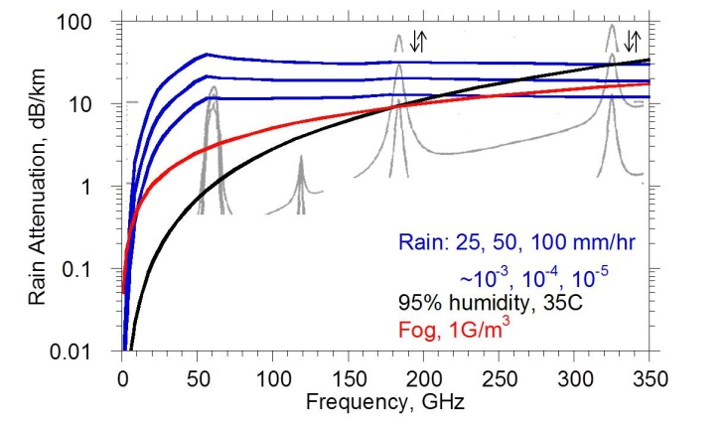
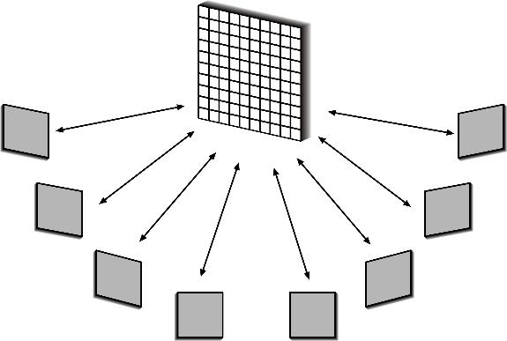
Why 140GHz Wireless ?
Large available spectrum at mm-waves
Shorter wavelength – small IC, antenna arrays
Massive # of parallel channels – multiple independent beams
Low-cost antenna and transition design is critical
IC design above 100 GHz is easier with developments in CMOS and III-V
Packaging and antenna design is the challenge

Slide 3
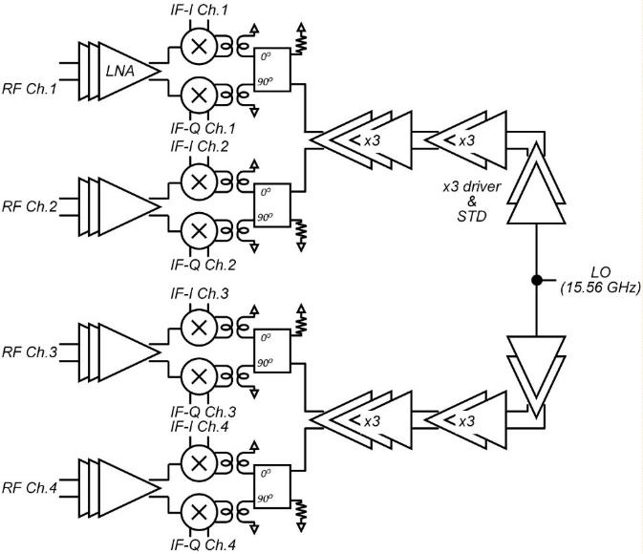
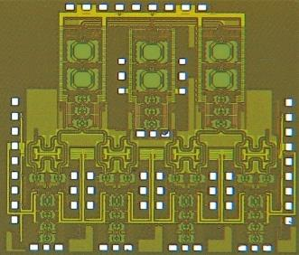
140 GHz 4-Channel Receiver
Direct conversion receiver
140 GHz LNA, double balanced passive mixer
LO distribution through two x9 multipliers from common LO port
18 dB conversion gain
12 GHz 3-dB BW
495 mA @ 1V
1.69 mm x 1.76 mm GlobalFoundries 45nm SOI CMOS
A. Simsek, et al, 2018 IEEE BCICTS,

Slide 4
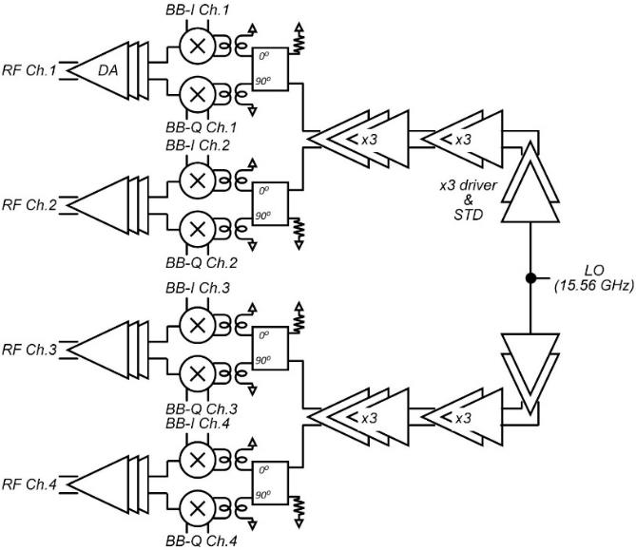
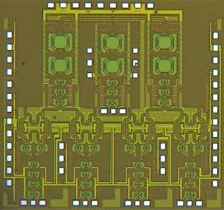
140 GHz 4-Channel Transmitter
Direct conversion transmitter
140 GHz PA (same with LNA), I/Q Gilbert Cell Active Mixer
LO distribution thru two x9 multiplier from common LO port
Pout = -2 dBm @ 145 GHz
463 mA @ 1V
1.69 mm x 1.76 mm GlobalFoundries 45nm SOI CMOS
A. Simsek, et al, 2018 IEEE BCICTS,

Slide 5
Proposed Low-Cost Package
Multi layer PCBs with
high resolution
large number of vias with < 8 mil diamater
cavity
…are expensive
Can we used 2 separate cheaper PCBs and align the height?
Less number of vias in the antenna board with higher resolution
Carrier PCB with large number of vias and less resolution

Slide 6
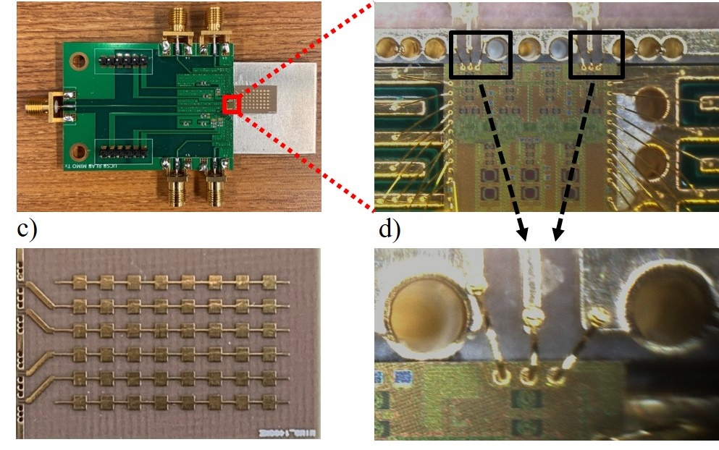
Fully Packaged 2-Channel Transmitter
2-channel of one 4-channel CMOS transmitter and
2-channels of the 4-channel series-fed patch antenna array
2 I/Q baseband inputs and single LO input thru SMA connectors
Separation between the carrier and antenna PCB is < 50 um
Wirebond length is < 250-300 um which gives < 250-300 pH @ 140 GHz

Slide 7
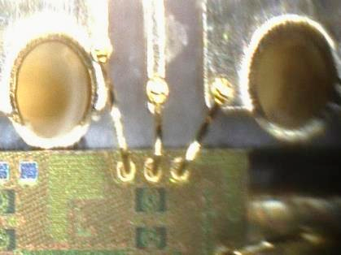
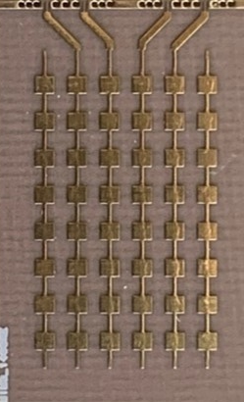
Fully Packaged 4-Channel Receiver
Two 4-channel CMOS receiver ICs used due to wirebond density
2-channel of each IC connected to the 4-channel series-fed patch antenna array
4 I/Q baseband outputs and two LO inputs thru SMA connectors
Separation between the carrier and antenna PCB is < 50 um
Wirebond length is < 250-300 um which gives < 250-300 pH @ 140 GHz

Slide 8
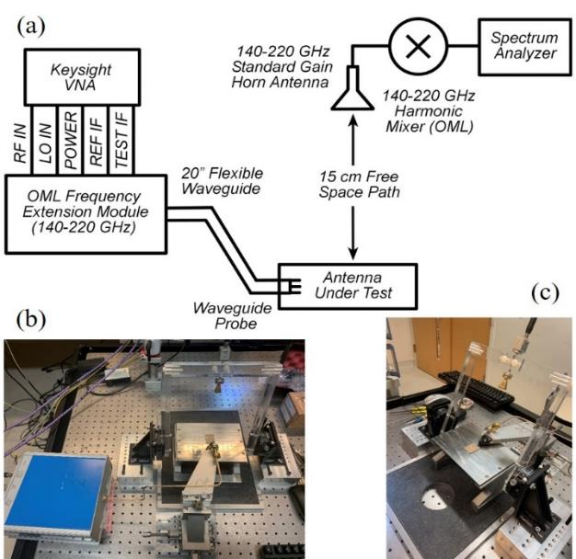
Antenna Design and Measurements
Antennas and transitions designed in Astra MT77 substrate
5 mil substrate thickness, with Dk = 3, and Df = 0.0017
35 mil FR4 under to match the height with CMOS carrier + CMOS chip height
Test structures with GSG 150 um pitch wafer probe interface
(Single patches and 8-element series-fed patch array)
4-5 GHz frequency shift

Slide 9
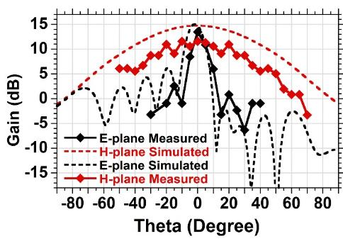
Antenna Design and Measurements
8-element series-fed patch antenna arrays designed in Astra MT77 substrate
5 mil substrate thickness, with Dk = 3, and Df = 0.0017
Test structure created with GSG 150 um pitch wafer probe interface
136, 140 and 144 GHz series-fed antenna arrays are designed
144 GHz antenna array
Frequency shifted ~ 4-5 GHz
Radiation patterns simulated at 144 GHz, measured at 148 GHz

Slide 10
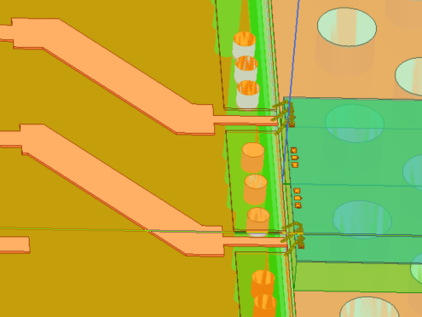
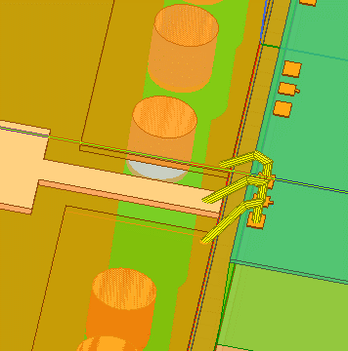
Wirebond Transition Design
CMOS GSG pads (75 um pitch) to 50 Ohm microstrip line transition
90 Ohm GCPW line as a series tuning element
Fringing capacitance between wide microstrip to ground provides shunt tuning
Ground vias with 6 mil diameter/4 mil edge spacing – adds additional inductance
Ref.
plane-2
Ref.
plane-1
Insertion loss without the line = ~ 1.8 dB @148 GHz
Insertion loss with the line = ~ 2.5 dB @ 148 GHz
0.7 mil diameter gold wedge bonding with < 250-300 μm length

Slide 11
System Experiments
2-channel transmitter board measurements:
Data transmission and open eyes up to 14.4 Gb/s QPSK using 1-channel
@25 cm wireless distance
Power combining experiment with 2 Tx channels
Tx-1 EIRP ~ 15 dBm
Tx-2 EIRP ~ 15 dBm
Combined EIRP ~ 20 dBm (ideally 6-dB higher)
Alignment and phases are imperfectly

Slide 12
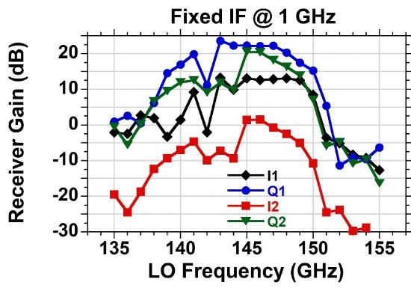
System Experiments
4-channel receiver board measurements:
20-21 dB conversion gain (single ended) with 4-5 GHz 3-dB BW
2 I/Q channels are shown here
I2 channel has a problem in the connector

Slide 13
System Experiments
1-channel transceiver measurements:
25 cm wireless distance
1-channel transmitter and receiver
All losses de-embedded

Slide 14
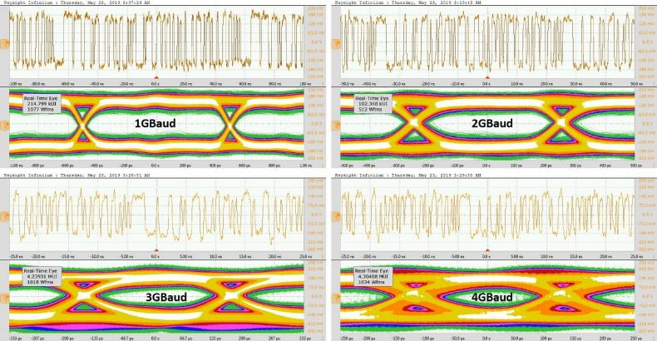
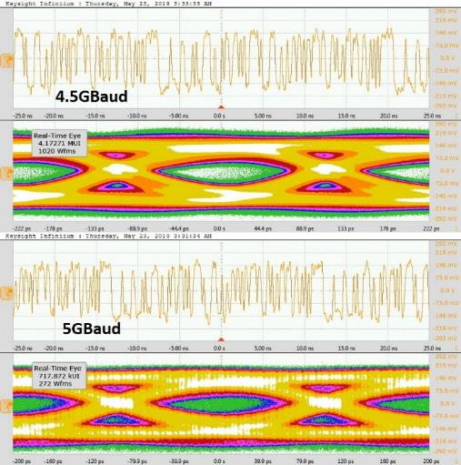
System Experiments
1-channel transceiver measurements:
4096 x 400 symbol length from AWG
BPSK modulation (same data on I/Q)
Saved I/Q output using DSA
Oversampling ratio of 8/10
Offline MMSE channel equalization
10 cm wireless data trans. < 1x10⁻⁵ BER with
22 dB SNR (5 GBaud)
25 cm wireless data trans. < 3x10⁻⁵ BER with
19 dB SNR (5 GBaud)

Slide 15
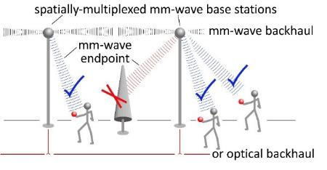
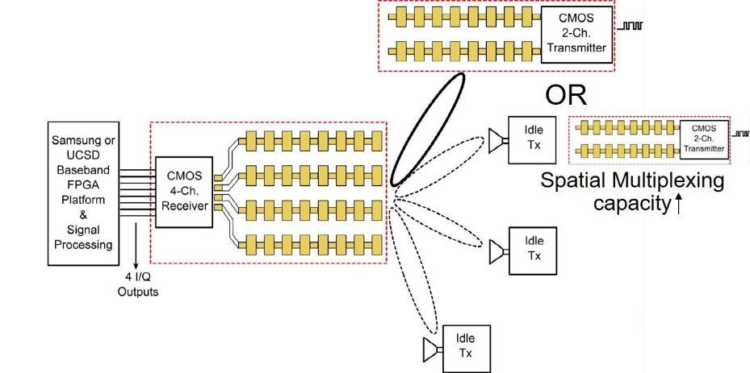
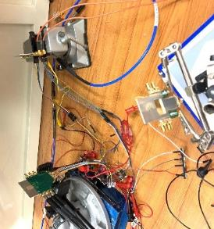
Conclusion and Future Direction
Low-cost antenna design and measurements at D-Band
Wirebond transition design with < 2 dB insertion loss above 140 GHz
Fully packaged, modular 2-channel transmitter and a fully packaged 4-channel receiver
Beamforming gain demonstrated for a simple 2-channel transmitter
1-channel wireless data transmission experiments using these boards:
10 cm wireless data transmission with < 1x10⁻⁵ BER with 22 dB SNR (5 Gbaud BPSK)
25 cm wireless data transmission with < 3x10⁻⁵ BER with 19 dB SNR (5 Gbaud BPSK)
What is next?
Higher order modulation schemes, larger arrays
Multi-beam communications
III-V PA integration for higher power

Slide 16
Acknowledgments
National Science Foundation (NSF) GigaNets program, Contract NO. CNS-1518812
Global Foundries for the 45 nm CMOS SOI chip fabrication
Advotech for the assembly
Navneet Sharma, Hamidreza Memerzadeh, Nikolaus Klammer and Gary Xu at Samsung Research America for valuable suggestions and the measurement equipment.
Prof. James F. Buckwalter for valuable comments.

Slide 17
System Experiments
2-channel transmitter board measurements:
Comparison between state-of-the art designs
 | Farid et al. | Visweswaran et al. | Carpenter et al. | Sawaby et al. | This Work
Technology | 22nm FDSOI CMOS | 28nm CMOS | 250nm InP | 55nm SiGe HBT | 45nm CMOS
Freq. [GHz] | 125-145 | 138-151 | 110-170 | 110-150 | 140-150
Pout (dBm) | 2.8 | 7 | 9 | 2.5 | 2
EIRP (dBm) | - | 11.5 | - | - | 20 (2-Ch)
Data Rate (Gb/s) | - | - | 44 (QPSK) | 36 (QPSK) | 14.4 (QPSK)
Pdc [mW] | 198 (Rx) 196 (Tx) | 500 (3 TRx) | 357 (1 TRx) | 220 (1 Tx) | 500 (4 Tx)
Area [mm²] | 1.44 (Tx) 1.44 (Rx) | 6.5 (3 TRx) | 2.34 (1 TRx) | 90 (package) | 2.94 (4 Tx)
Integration | No Antenna | On-Chip Antenna | Wafer Probing | Off-Chip Antenna | Off-Chip Antenna

Slide 18
Back-up Slides

Slide 19
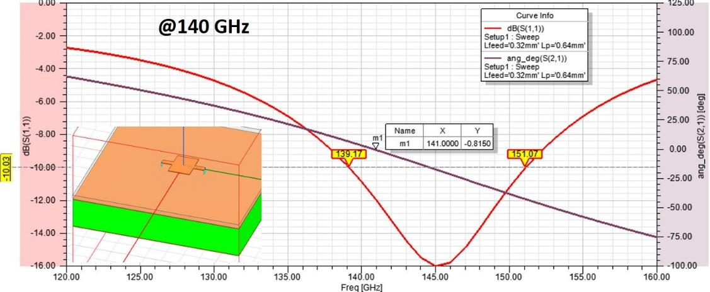
Antenna Design and Measurements
Unit cell design and patch results

Slide 20
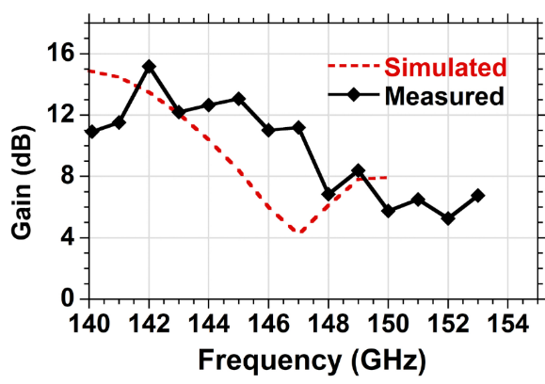
Antenna Design and Measurements
136 GHz (measured @140 GHz, return loss is not available)
140 GHz (measured @144 GHz)

Slide 21
Transmitter Beamforming Gain

Slide 22
Transceiver (Bathtub)

Slide 23
Measurements – Circuit Blocks
LNA
x9 LO Multiplier
41 mA @ 1V
Peak Gain = 19.9 dB @ 145 GHz
3-dB BW = 10GHz
98 mA @ 1V
Peak output power = 1.5 dBm
@ 148 GHz

Slide 24
Measurements – Receiver Channel
18 dB conversion gain
12 GHz 3-dB BW
Narrow-band notch in RF response - limits the data rate
163 mA + 109 mA + 223 mA = 495 mA @ 1V

Slide 25
Measurements – Transmitter Channel
LO-BB
LO+BB
LO
3-dB modulation bandwidth ~ 6 - 8 GHz
Total transmitter output power: -2 dBm with 1 V supply,
3 dBm with 1.2 V supply @ 145 GHz
161 mA + 94 mA + 208 mA = 463 mA @ 1V

Slide 26
Outline
Motivation
140 GHz Transceiver in 45 nm CMOS SOI
Proposed Low-Cost Package
2-Channel Transmitter
4-Channel Receiver
Wirebond Transition Design
140 GHz Antenna Design and Measurements
System Experiments and Results
Conclusion and Future Direction

