Slide 1
A 140GHz power amplifier with 20.5dBm output power and 20.8% PAE in 250-nm InP HBT technology
A. Ahmed¹, M. Seo², A. Farid¹, M. Urteaga³, J. Buckwalter¹, and M. Rodwell¹
¹University of California at Santa Barbara, CA, USA
²Sungkyunkwan University, South Korea
³Teledyne Scientific and Imaging, Thousand Oaks, CA, USA

Slide 2
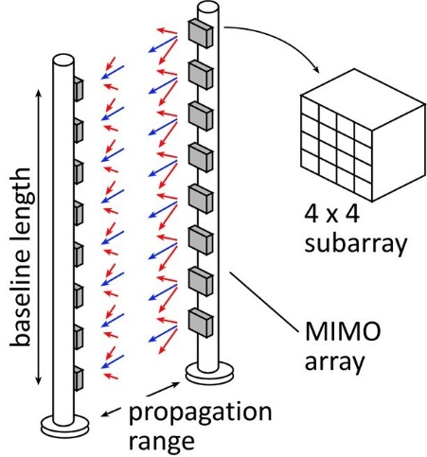
mm-wave Communication (140-1000 GHz)
Objective
Support high data rate communication.
Spatial multiplexing for high capacity.
Cover long distance.
Benefits (140- 1000 GHz)
Large available spectrum, high data rate.
Shorter 𝜆: more channels for the same array size.
Challenge
Atmospheric attenuation is high $P_{R}α\frac{λ^{2}}{R^{2}}e^{−αR}.$

Slide 3
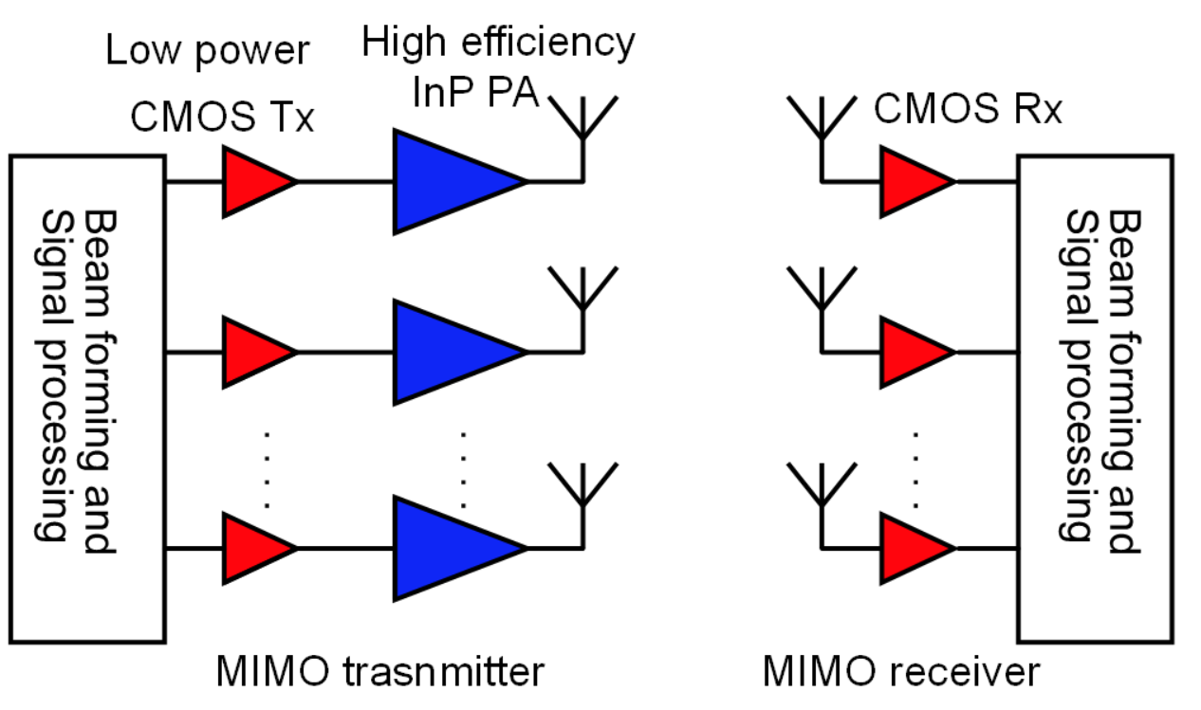
PA Requirments and Link Budget
Tx Antenna Gain | 22.7 dBi
Rx Antenna Gain | 13 dBi
Link range | 50 m
Required output power per element | 20.5dB_{m}
Friss Path Loss | 73 dB
Rx Noise Figure | 8.5 dB
Rx BW | 5 GHz
Bit rate | 10 Gb/s
System Margin | 15 dB
No of elements, Tx ($λ/2$ spacing) | 32
No of elements, Rx ($λ/2$ spacing) | 4
CMOS chips drives high efficiency InP power amplifiers
CMOS’s output power is ~2dBm
20.5dBm output power per element extends the link range to ~50m
Required gain ~20dB
Massive MIMO arrays requires high efficiency PAs to avoid thermal destruction or complex heatsink
calculated data are based on
https://www.ece.ucsb.edu/Faculty/rodwell/Classes/ece218c/ECE218c.htm

Slide 4
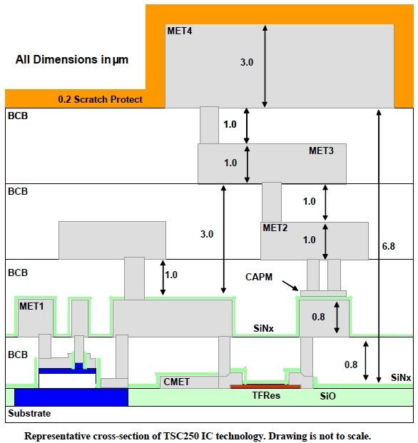
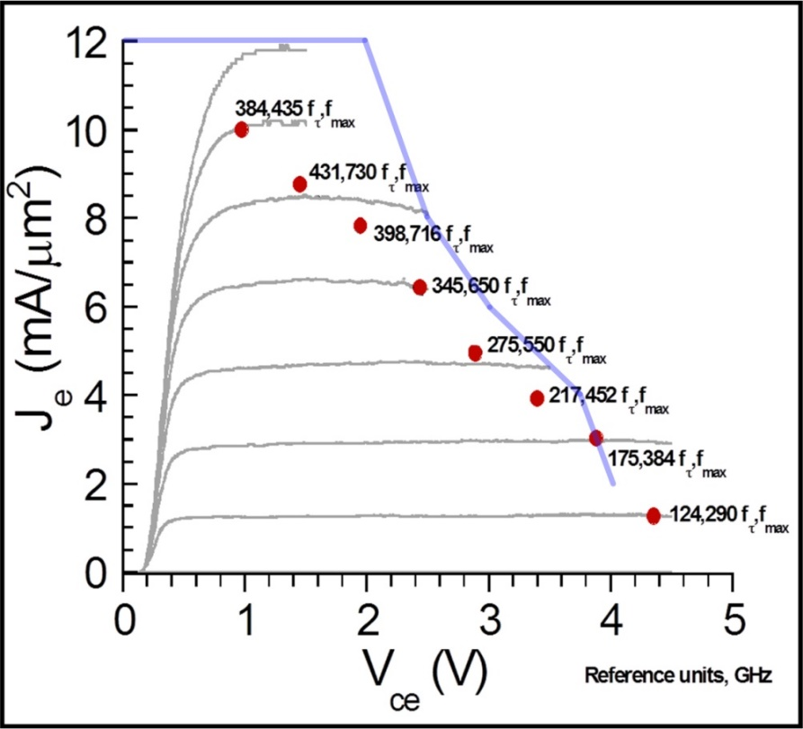
250nm InP HBT Process (Teledyne*)
f_{max}=650GHz.
BV_{CEo}=4.5V.
J_{max}=3mA/µm.
Four Au interconnect.
MIM cap (0.3fF/µm2).
TFR (50Ω/square).
Plot courtesy Zach Griffith, UCSB 250nm InP HBT, 2007
*M. Urteaga, et al, Proc. IEEE, June 2017.

Slide 5
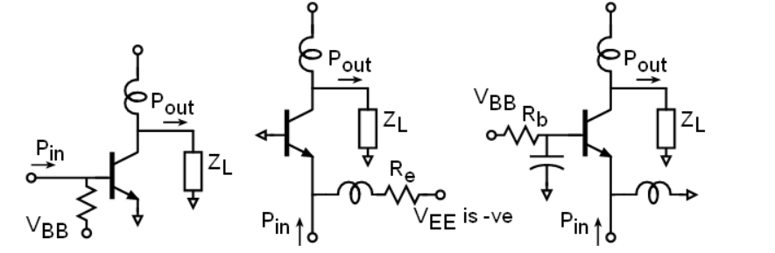
Unit Cell Comparison
Comparison between CE, grounded CB and CB with base capacitor
Simulation is done under same bias condition
Large signal simulation is more relevant in power amplifier
CB with base capacitor shows the highest OP_{1dB} with associated PAE
(a) CE
(b) CB with grounded base
(c) CB with base capacitor
At 140GHz
 | Gain*, dB | PAE**, % | P_{out}**, dB_{m}
CE | 10.7 | 15.4 | 12.0
Grounded CB | 13.1 | 22.4 | 13.5
CB with 600 cap | 9.8 | 29.7 | 15.2
P_{out}, gain, and PAE for CE, grounded CB, and CB with base capacitor.
*under opt load line condition without compression **at 1dB gain compression

Slide 6
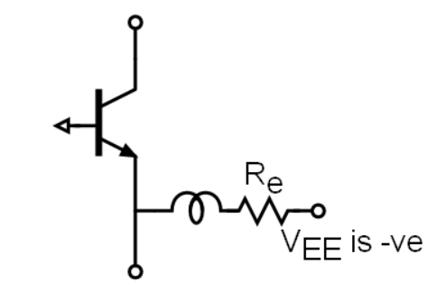
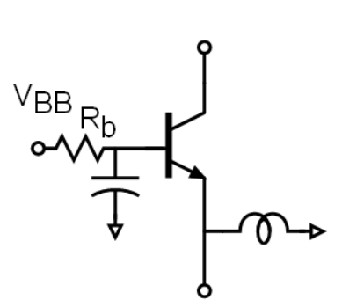
Unit Cell Comparison
 | Gain*, dB | PAE**, % | P_{out}**, dB_{m}
CE | 10.7 | 15.4 | 12.0
Grounded CB | 13.1 | 22.4 | 13.5
CB with 600 cap | 9.8 | 29.7 | 15.2
Common emitter
Lowest OP_{1dB} and Soft compression
Less sensitive to base inductance errors
Common base with grounded base
Higher gain and OP_{1dB}
Requires –ve supply-> huge efficiency drop (large DC current in Re)
Bias is very sensitive without Re due to exponential relation (I_{CE} vs V_{BE})
sensitive to base inductance errors
Common base with base capacitance
Highest PAE and OP_{1dB} due to capacitance feedback linearization
Capacitance help stabilization (not shown)
Stable bias: negligible efficiency due to R_{b} ; base current is very small
Gain drops with smaller capacitance
CB with grounded base
CB with base capacitor

Slide 7
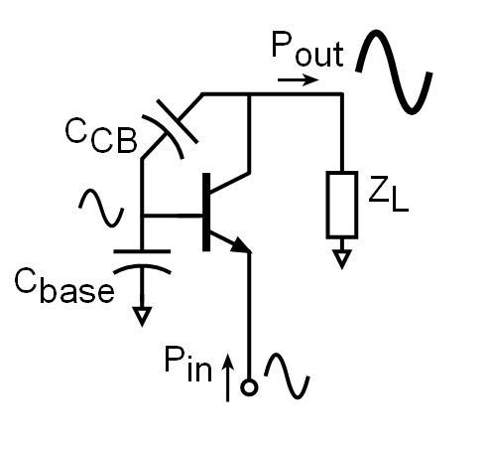
CB viewed as stacked PA cell*
C_{CB} and C_{base} creates negative feedback
This negative feedback
Linearize the amplifier: higher PAE and OP_{1dB}
Allows voltage swing on the base: with proper design, the output swing increases yielding in higher output power
Drops the output impedance: improves S22
PA unit cell/ stack analogy
*A. Ahmed, et al, EUMIC 2018.

Slide 8
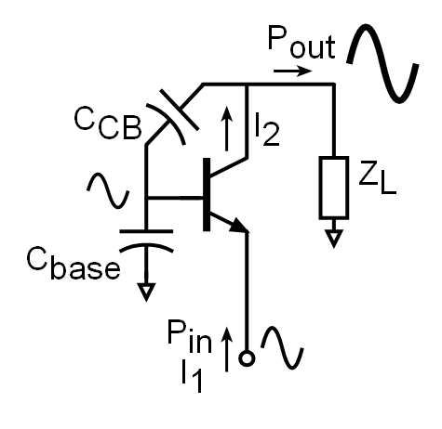
PAE invariance*
Assuming lossless matching network
Internal voltages and currents are constant by proper load and base impedances*
$2\left(n−1\right){ωP}_{add}C_{base}=X_{1}X_{2}\sin\left(Y_{1}−Y_{2}\right)$ (derivation not shown)
The added power per stage is kept constant for the same internal voltages and currents.
$P_{out}=P_{add}+P_{in}$
$X_{1}$ is the magnitude of $I_{1}$
$X_{2}$ is the magnitude of $I_{2}$
$Y_{1}$ is the angle of $I_{1}$ in radians
$Y_{2}$ is the angle of $I_{2}$ in radians
*A. Ahmed, et al, EUMIC 2018.

Slide 9
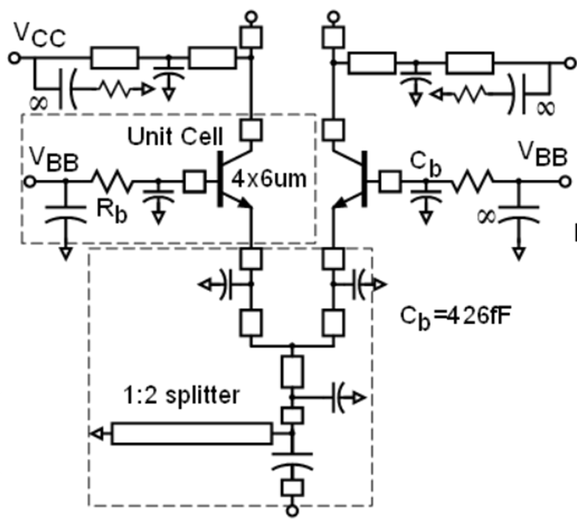
Power Amplifier Cell
Common base with base capacitance
Capacitance dropped slightly
More power and hard compression
lower output impedance (better S22)
Shunt stub tunes the transistor parasitics
Two cells are combined and driven by a single driver-> better PAE
ADS and HFSS are used for the interconnect and matching circuit simulations
Two combined PA cells

Slide 10
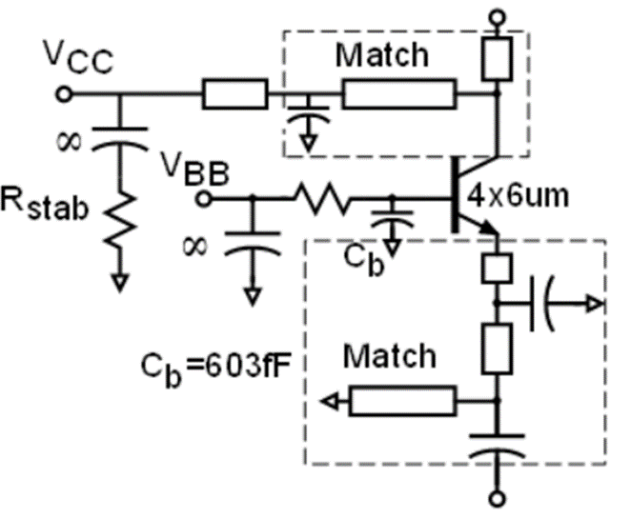
Driver design
Higher base capacitance:
more gain
Input ant output are 50Ω matched
Staggered matching for wider bandwidth
Driver cell

Slide 11
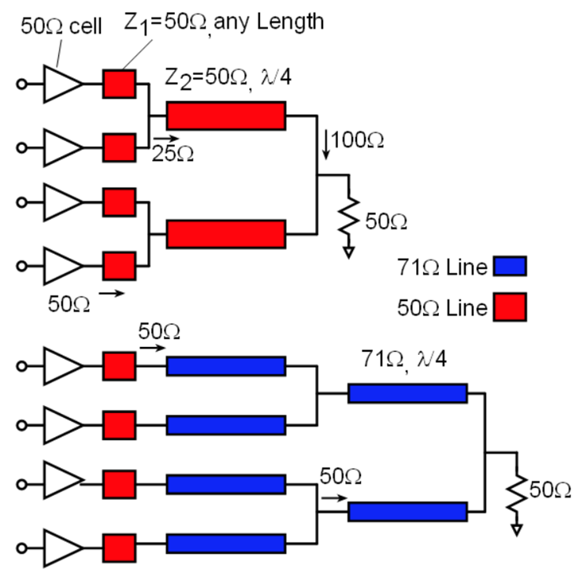
Combiner Design
Transmission line combiner instead of Wilkinson
Proposed combiner
Low loss and very compact
Smaller BW compared to Wilkinson
Wilkinson
Bulky, high loss and skinny line
Higher BW
Proposed combiner
Wilkinson combiner

Slide 12
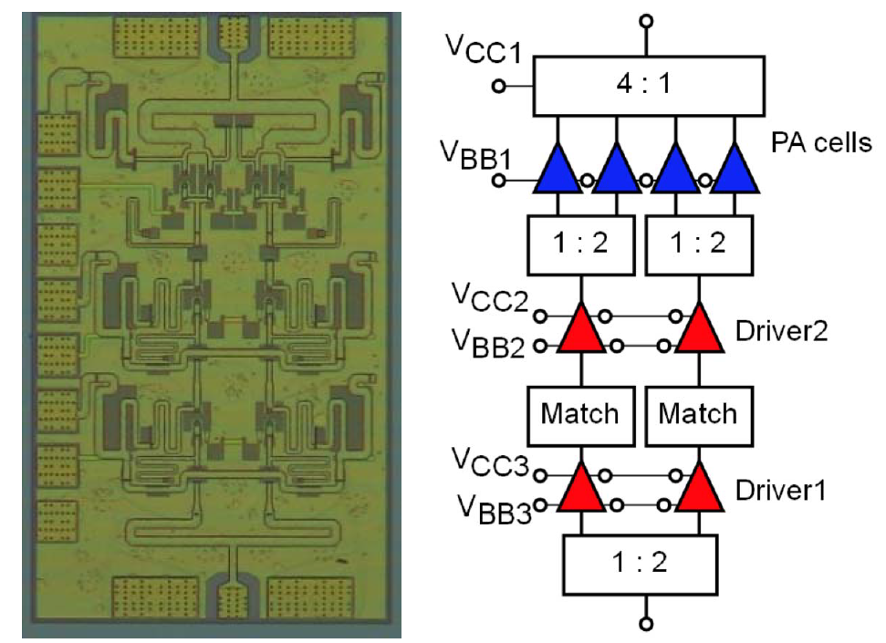
PA block diagram
1.08mmx0.63mm
Three linearized common base stages
Low loss and compact transmission line combiner
First driver scaled to sustain good PAE
Independent bias for each stage to monitor the current and optimize the PAE
Chip micrograph
Block diagram

Slide 13
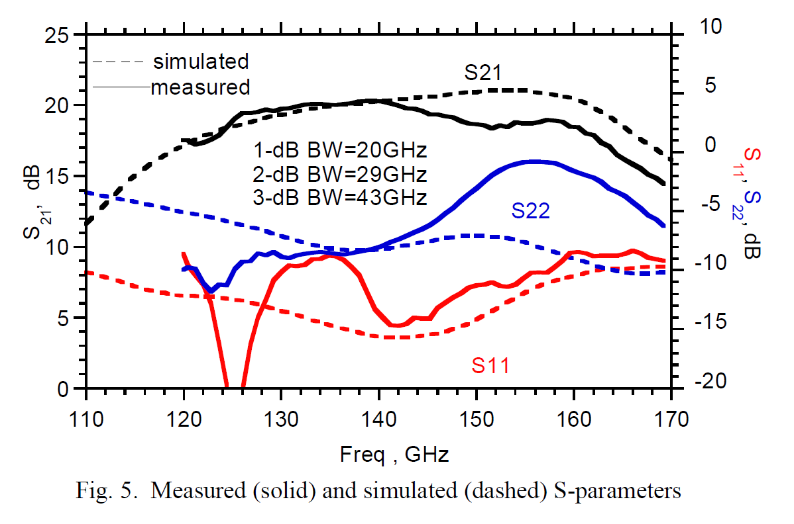
Measurement results
Wide band operation
1dB BW=20GHz
3dB BW=43GHz
V_{CC1} | V_{CC2} | V_{CC3} | V_{BB1} | V_{BB2} | V_{BB3}
2.5V | 2.5V | 1.5V | 1.94V | 1.36V | 1.1V
I_{CC1} | I_{CC2} | I_{CC3} | I_{BB1} | I_{BB2} | I_{BB3}
121mA | 52mA | 31.8mA | 4.1mA | 1.7mA | 0.95mA
Measured (solid) vs simulated (dotted) S-parameters

Slide 14
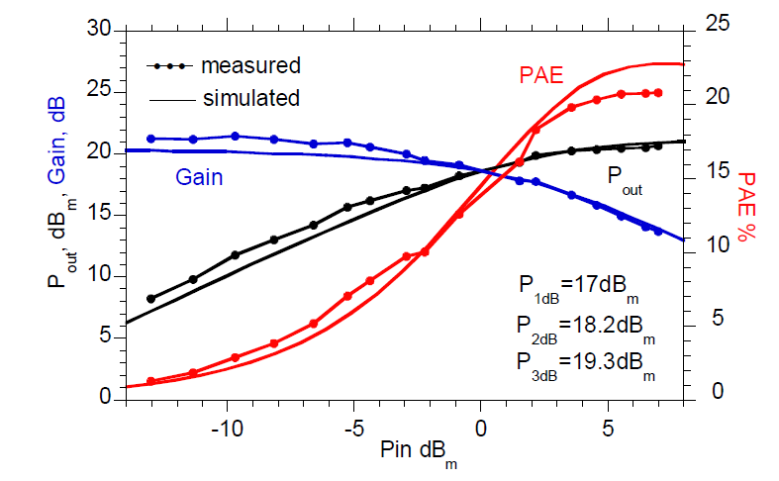
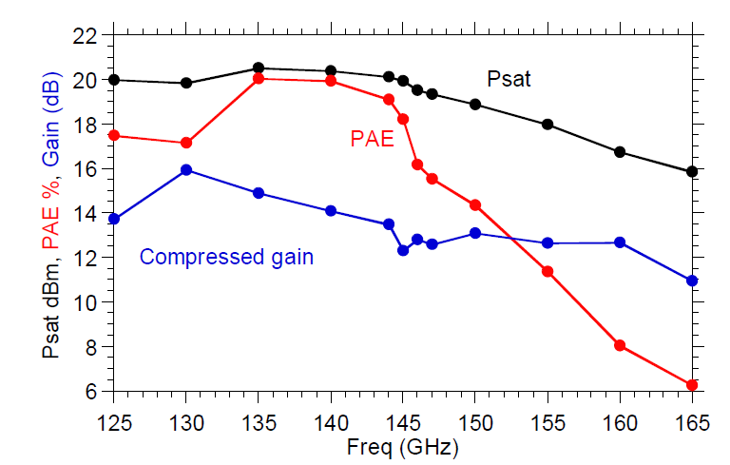
Measurement results
V_{CC1} | V_{CC2} | V_{CC3} | V_{BB1} | V_{BB2} | V_{BB3}
2.5V | 2.5V | 1.5V | 1.95V | 1.4V | 1.1V
I_{CC1} | I_{CC2} | I_{CC3} | I_{BB1} | I_{BB2} | I_{BB3}
130mA | 56mA | 34mA | 5mA | 2mA | 1mA
P_{sat}=20.5dB_{m}, and PAE=20.8%
P_{sat} =18.9-20.5dB_{m} over 125-150GHz
Measured and simulated P_{out}, PAE and gain vs input power at 140GHz
Measured and simulated saturated P_{out}, PAE and gain vs frequency

Slide 15
State-of-the-art results
Highest PAE for comparable P_{sat} and gain
Ref | Technology | Freq (GHz) | P_{sat} (dBm) | BW_{3dB} GHz⁺⁺ | Gain at P_{sat} (dB) | Peak PAE % | Size (mm²) | P_{DC} (W) | P_{sat}/Area mW/mm²
‎[2] | 40 nm CMOS | 140 | 14.8 | 17 | 13** | 8.9 | 0.34 | 0.3 | 88.8
‎[4] | 130-nm SiGe HBT | 155-180 | 18.0 | 25 | 23.5** | 4.0 | 0.85 | 1.57* | 74.2
‎[5] | 130-nm SiGe HBT | 112-142 | 17⁺ | 16 | 29** | 13⁺ | 1.06 | 0.39* | 47.2
‎[6] | 130-nm SiGe HBT | 131-180 | 14 | 49 | 22** | 5.7 | 0.48 | 0.44* | 52.3
‎[7] | 250-nm InP HBT | 110-150 | 23.2-24.0 | 32.7 | 14-16 | 5.8-7.0 | 1.89 | 3.46 | 134
‎[8] | 250-nm InP HBT | 115-150 | 21-21.8 | 34.8 | 15-17.5 | 8.2-10.5 | 0.75 | 1.54 | 205
This work | 250-nm InP HBT | 125-150 | 18.9-20.5 | 43 | 12.3-15.9 | 14.3-20.8 | 0.69 | 0.52 | 162

Slide 16
Summary
Demonstration of record PAE at D-band
Teledyne 250nm InP HBT has high f_{max} and BV_{CEo}
Capacitively linearized common base
Higher OP_{1dB}, and PAE
Easier to bias and stabilize
Compact and low loss transmission line network
Driver scaling and bias optimization

Slide 17
Acknowledgement
This work was supported in part by the Semiconductor Research Corporation and DARPA under the JUMP program.
The authors thank Teledyne Scientific & Imaging for the IC fabrication. The authors would like to thank Zach Griffith for valuable insight and design review.

Slide 18
References
[1] M. J. W. Rodwell et al., "100-340GHz Systems: Transistors and Applications," 2018 IEDM, San Francisco, CA, 2018.
[2] D. Simic and P. Reynaert, "A 14.8 dBm 20.3 dB Power Amplifier for D-band Applications in 40 nm CMOS," RFIC, Philadelphia, PA, 2018, pp. 232-235.
[3] A. A. Farid, A. Simsek, A. S. H. Ahmed and M. J. W. Rodwell, "A Broadband Direct Conversion Transmitter/Receiver at D-band Using CMOS 22nm FDSOI," RFIC, Boston, MA, USA, 2019, pp. 135-138.
[4] M. Kucharski, H. J. Ng and D. Kissinger, "An 18 dBm 155-180 GHz SiGe Power Amplifier Using a 4-Way T-Junction Combining Network," ESSCIRC 2019, Cracow, Poland, 2019, pp. 333-336.
[5] A. Visweswaran et al., "A 112-142GHz Power Amplifier with Regenerative Reactive Feedback achieving 17dBm peak Psat at 13% PAE," ESSCIRC, Cracow, Poland, 2019, pp. 337-340.
[6] Z. Furqan et al., “A 15.5-dBm 160- GHz high-gain power amplifier in SiGe BiCMOS technology,” IEEE Microwave. Wireless Component. Lett., vol. 27, no. 2, pp. 177–179, Feb. 2017.
[7] Z. Griffith, M. Urteaga and P. Rowell, "A 140-GHz 0.25-W PA and a 55-135 GHz 115-135 mW PA, High-Gain, Broadband Power Amplifier
MMICs in 250-nm InP HBT," IMS, Boston, MA, USA, 2019, pp. 1245- 1248.
[8] Z. Griffith, M. Urteaga and P. Rowell, "A Compact 140-GHz, 150-mW High-Gain Power Amplifier MMIC in 250-nm InP HBT," in IEEE Microwave and Wireless Components Letters, vol. 29, no. 4, pp. 282-284, April 2019.
[9] M. Urteaga, Z. Griffith, M. Seo, J. Hacker, M. Rodwell, “InP HBT Technologies for THz Integrated Circuits”, Proceedings of the IEEE, Vol. 105, No. 6, pp 1051-1067 June 2017.
[10] Cripps, S 'RF Power amplifiers for wireless communications', 2nd Edition, Artech House, 2006, ISBNI-S96-93-018-7, sec 3.7 pp. 61-6S.
[11] H. T. Dabag, et al., "Analysis and Design of Stacked-FET Millimeter-Wave Power Amplifiers," IEEE Trans. MTT, vol. 61, no. 4, pp. 1543-1556, April 2013.
[12] A. S. H. Ahmed, A. A. Farid, M. Urteaga and M. J. W. Rodwell, "204GHz Stacked-Power Amplifiers Designed by a Novel Two-Port Technique," 2018 13th European Microwave Integrated Circuits Conference (EuMIC), Madrid, 2018, pp. 29-32.
[13] A. S. H. Ahmed, A. Simsek, M. Urteaga and M. J. W. Rodwell, "8.6-13.6 mW Series-Connected Power Amplifiers Designed at 325 GHz Using 130 nm InP HBT Technology," 2018 IEEE BiCMOS and Compound Semiconductor Integrated Circuits and Technology Symposium (BCICTS), San Diego, CA, 2018, pp. 164-167.
[14] Z. Griffith, M. Urteaga, P. Rowell, R. Pierson and M. Field, "Multi-finger 250nm InP HBTs for 220GHz mm-wave power," 2012 International Conference on Indium Phosphide and Related Materials, Santa Barbara, CA, 2012, pp. 204-207.
[15] T. B. Reed, Z. Griffith, P. Rowell, M. Field and M. Rodwell, "A 180mW InP HBT Power Amplifier MMIC at 214 GHz," (CSICS), Monterey, CA, 2013, pp. 1-4.
[16] Ahmed S. H. Ahmed, Munkyo Seo, Ali A. Farid, Miguel Urteaga, James F. Buckwalter, and Mark J. W. Rodwell, "A 200mW D-band Power Amplifier with 17.8% PAE in 250-nm InP

