Slide 1
100-300GHz Wireless
THz workshop, 2020 IEEE WCNC Conference
Mark Rodwell
University of California, Santa Barbara
Harish Krishnaswami: Columbia University
Debdeep Jena, Alyosha Molnar, Christoph Studer, Huili Xing: Cornell University
Dina Katabi: MIT
Sundeep Rangan: New York University
Amin Arbabian, Srabanti Chowdhury: Stanford
Elad Alon, Ali Niknejad, Borivoje Nikolic, Vladimir Stojanovic: University of California, Berkeley
Danijela Cabric: University of California, Los Angeles
Gabriel Rebeiz: University of California, San Diego
Jim Buckwalter, Upamanyu Madhow, Umesh Mishra, Mark Rodwell, Susanne Stemmer: University of California, Santa Barbara
Andreas Molisch, Hossein Hashemi: University of Southern California
Kenneth O: University of Texas, Dallas
This work was supported in part by the Semiconductor Research Corporation (SRC) and DARPA.

Slide 2
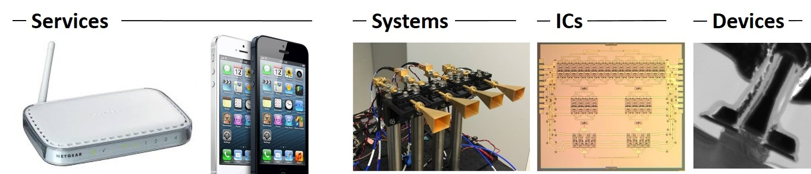
Wireless above 100GHz
Wireless networks: exploding demand.
Immediate industry response: 5G.
28, 38, 57-71(WiGig), 71-86GHz
increased spectrum, extensive beamforming
Next generation (6G ??): above 100GHz..
greatly increased spectrum, massive spatial multiplexing
DOD applications: Imaging/sensing/radar, comms.

Slide 3
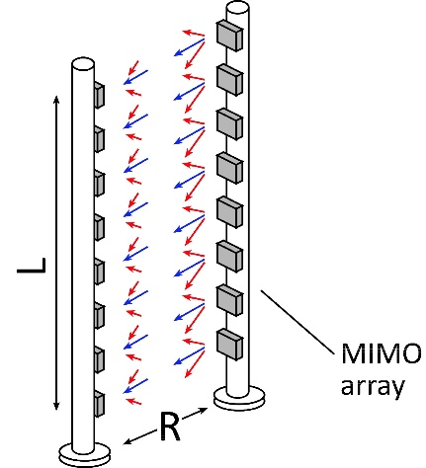
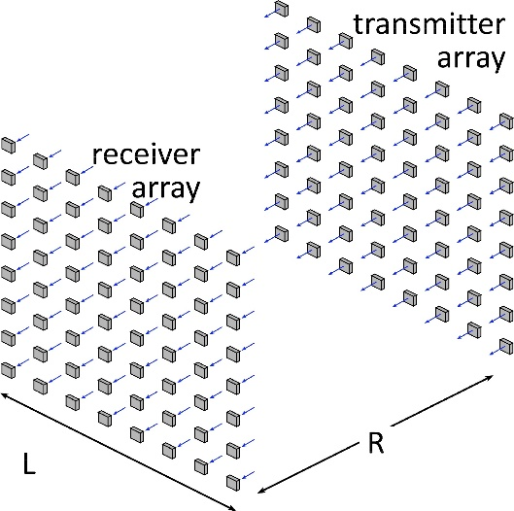
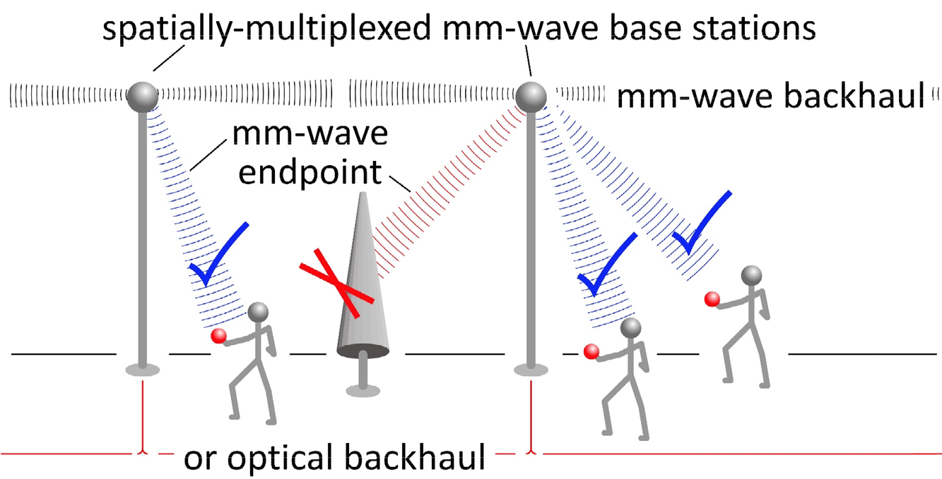
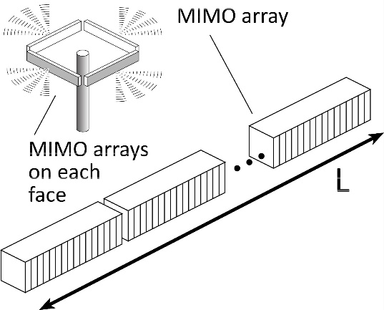
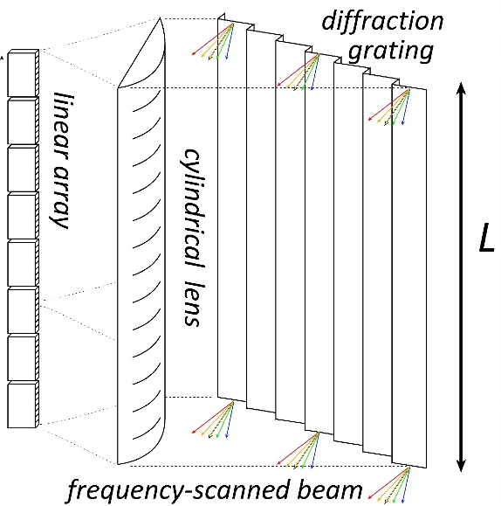
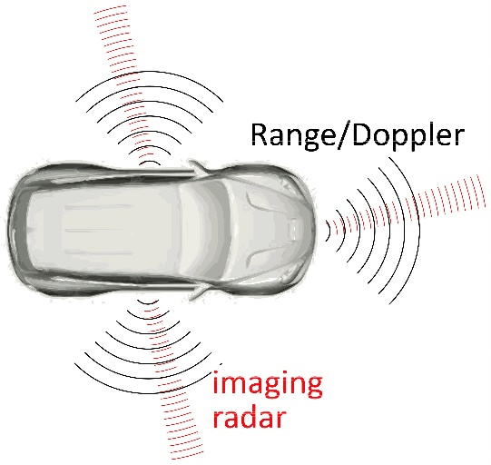

Benefits of Short Wavelengths
Communications: Massive spatial multiplexing, massive # of parallel channels. Also, more spectrum!
Imaging: very fine angular resolution
But:
High losses in foul or humid weather.
High λ²/R² path losses.
ICs: poorer PAs & LNAs.
Beams easily blocked.
100-340GHz wireless:
terabit capacity,
short range,
highly intermittent

Slide 4
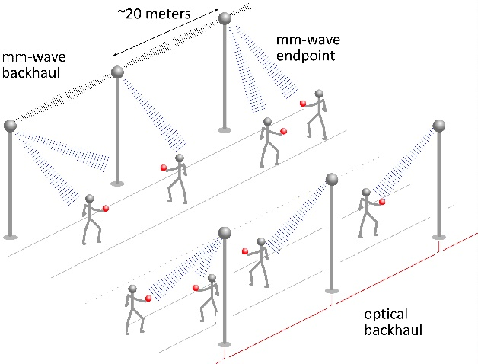
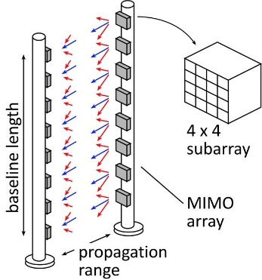
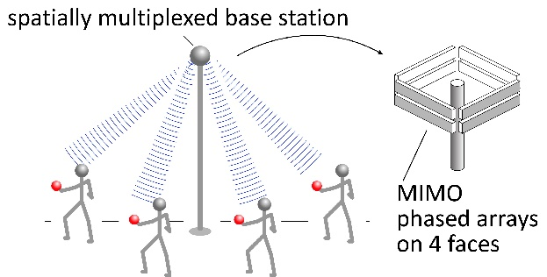
140-340 GHz:
Applications

Slide 5
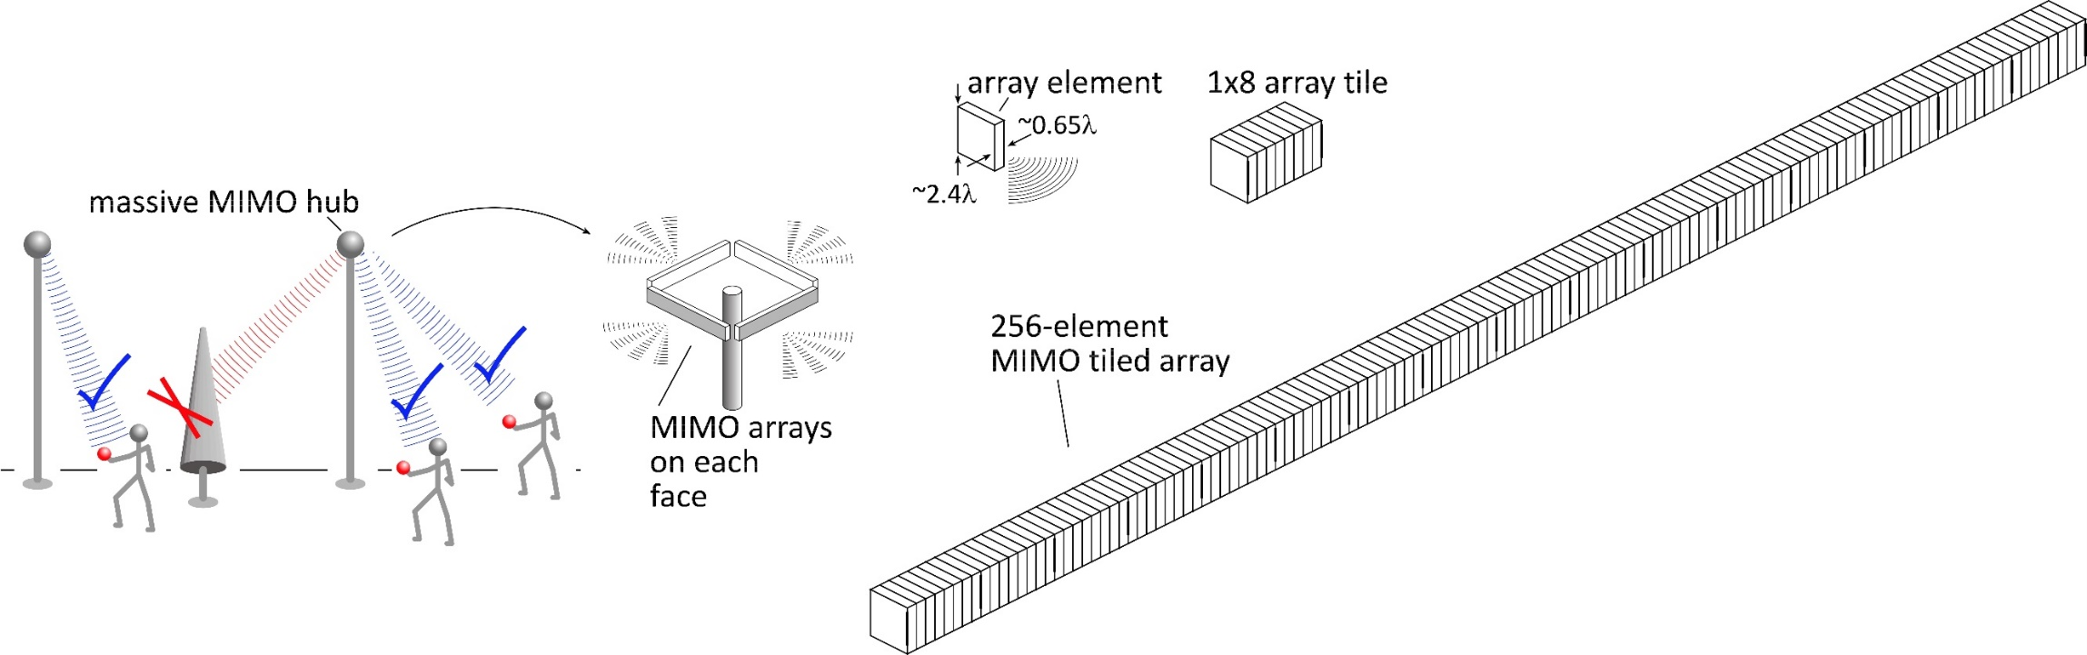
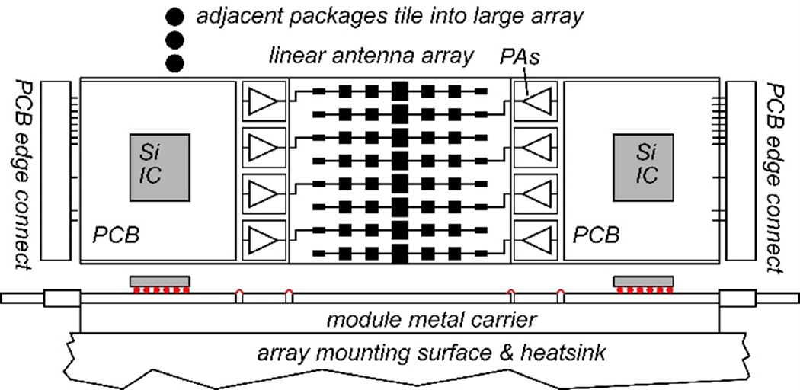
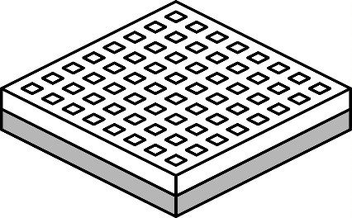
140GHz massive MIMO hub demo
Handset:
8 × 8 array
(9×9mm)
1 Tb/s spatially-multiplexed 140GHz base station
128 users/face, 4 faces. 21 dB_{m} PAs, F=8dB LNAs
1024 total users @ 1 user/beam, 1,10 Gb/s/beam;
225, 100 m range in 50mm/hr rain with 20dB total margins

Slide 6
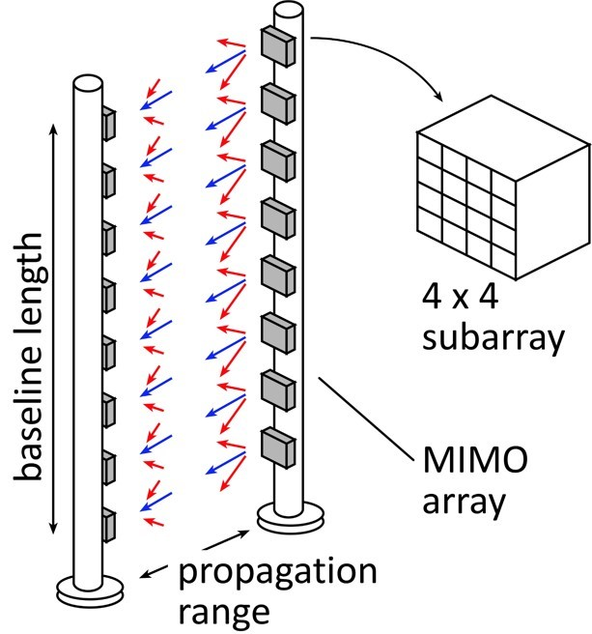
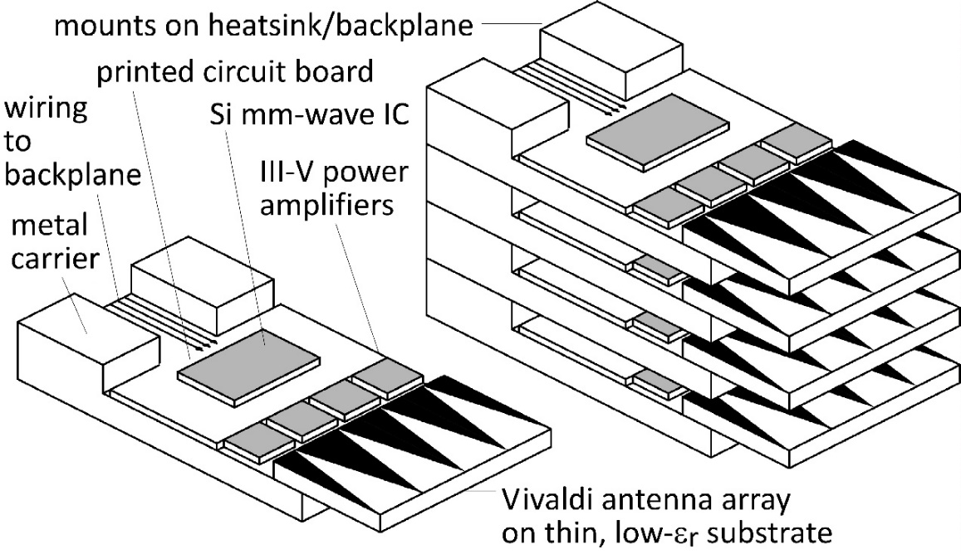
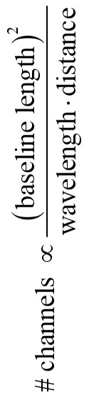
220 GHz, 640 Gb/s MIMO Backhaul
8-element MIMO array
3.1 m baseline.
80Gb/s/subarray→ 640Gb/s total
4 × 4 sub-arrays → 8 degree beamsteering
Key link parameters
500 meters range in 50 mm/hr rain; 23 dB/km
24 dB total margins:
packaging loss, obstruction, operating,
design, aging
PAs: 24mW P_{out} (per élément)
LNAs: 6dB noise figure

Slide 7
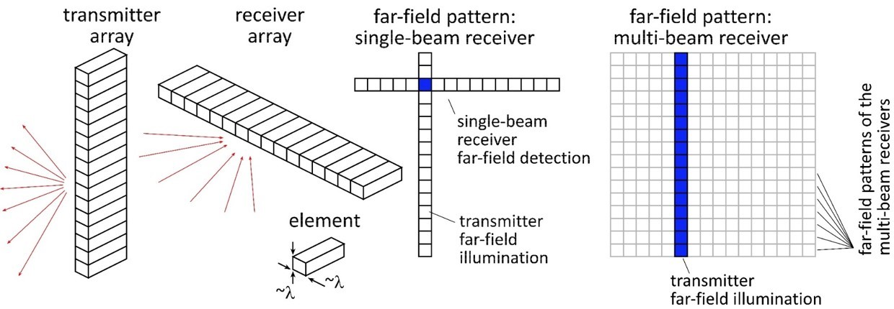


High-resolution imaging radar
Goal: MIMO Imaging Radar
Carrier Frequencies: 140, 210GHz

Slide 8
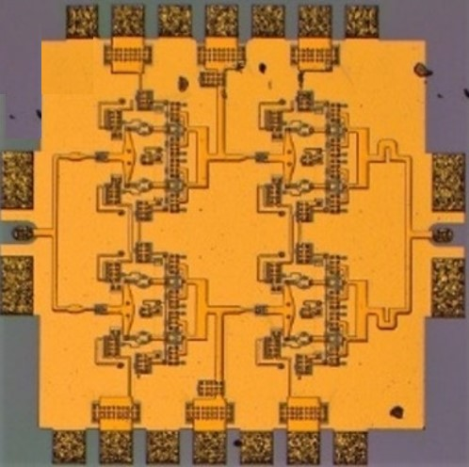
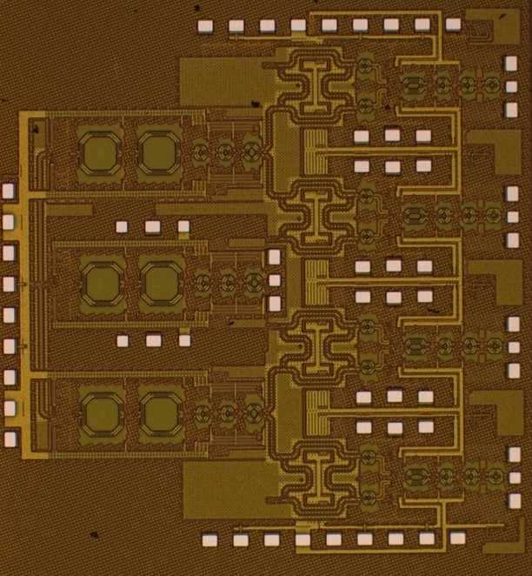
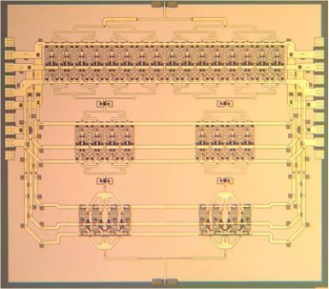
ICs

Slide 9


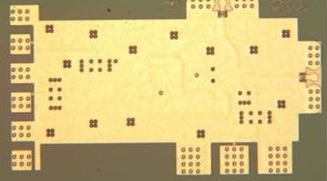
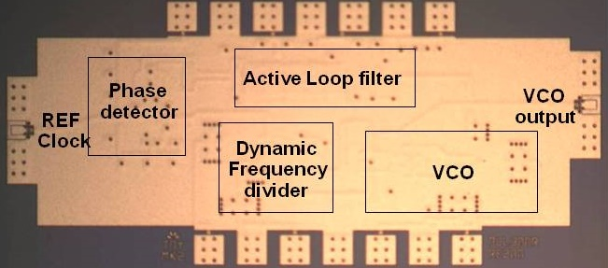
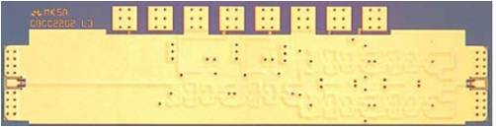

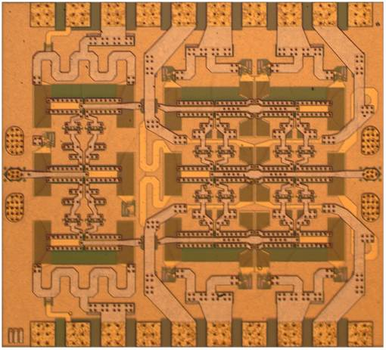
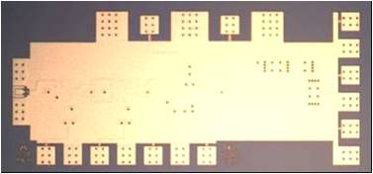
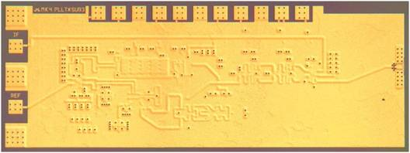
InP HBT to 670 GHz: DARPA TFAST and THz Programs
560 GHz
fundamental
VCO
340 GHz dynamic frequency divider
M. Seo, TSC / UCSB
M. Seo, UCSB/TSC
IMS 2010
300 GHz fundamental
PLL
620 GHz, 20 dB gain amplifier
M Seo, TSC
IMS 2013
also: 670GHz amplifier
J. Hacker , TSC
IMS 2013 (not shown)
M. Seo, TSC
IMS 2011
204 GHz static
frequency divider
(ECL master-slave
latch)
220 GHz
180 mW
power amplifier
81 GHz
470 mW
power amplifier
Z. Griffith, TSC / UCSB
CSIC 2010
T. Reed, UCSB
CSICS 2013
H-C Park UCSB
IMS 2014
Integrated 300/350GHz Receivers:
LNA/Mixer/VCO
600 GHz
Integrated
Transmitter
PLL + Mixer
M. Seo TSC
M. Seo TSC

Slide 10
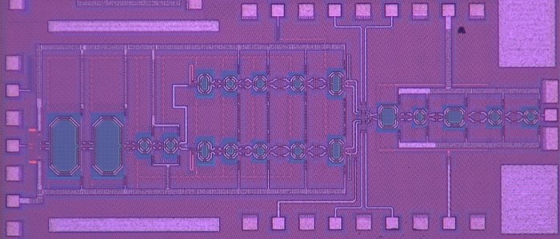
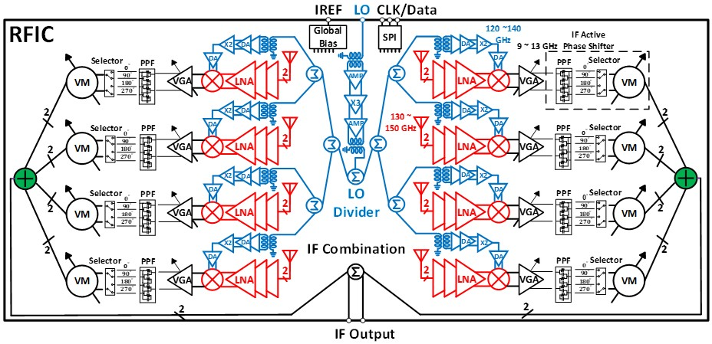
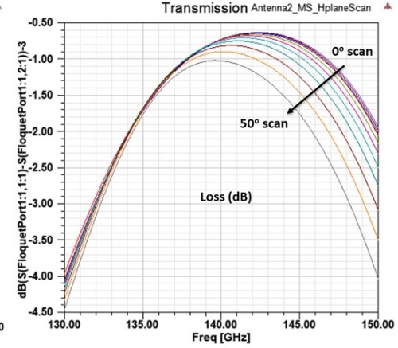
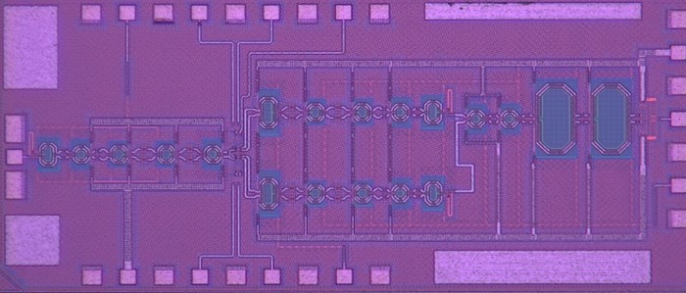
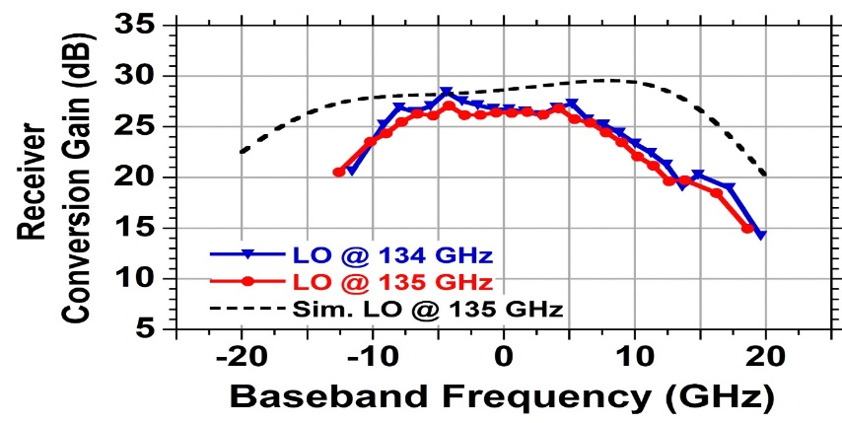
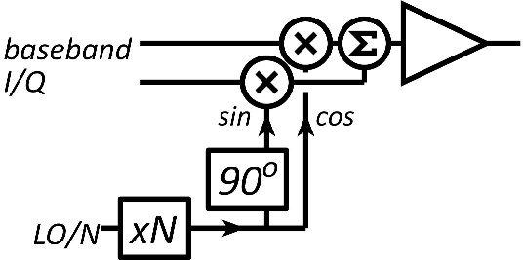
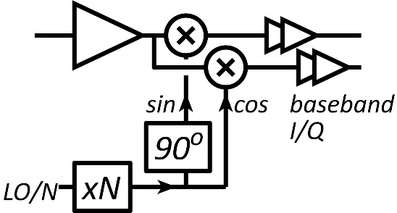
140GHz CMOS ICs
Hub ICs for MIMO Array
Farid (Rodwell) UCSB
8-channel handset array ICs; transmitter and receiver
(Rebeiz group), UCSD

Slide 11
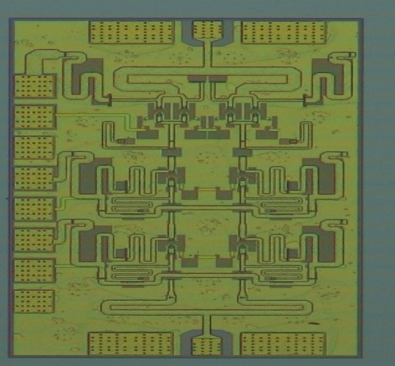
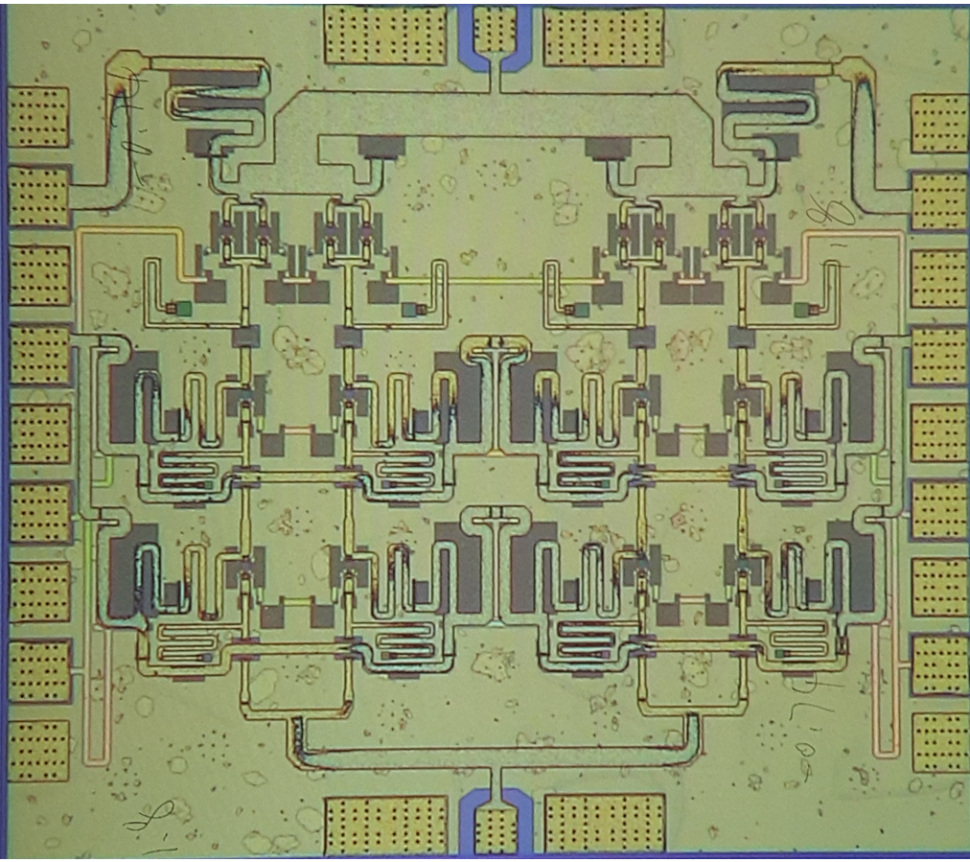
Progress in IC Design: 140GHz InP PAs
110mW power amplifier, 20.8% PAE
A. Ahmed, IMS 2020
190mW power amplifier
A. Ahmed, submitted.
Also: "A 130-GHz Power Amplifier in a 250-nm InP Process with 32% PAE"
Kang Ning (Buckwalter group) 2020 RFIC symposium

Slide 12
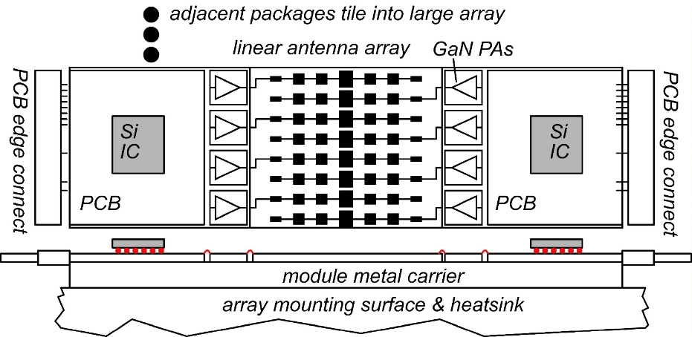

Packages / array modules

Slide 13
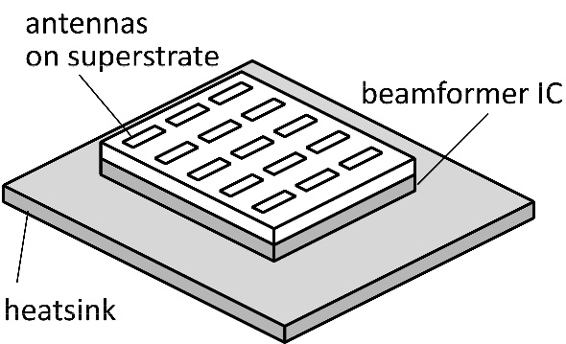
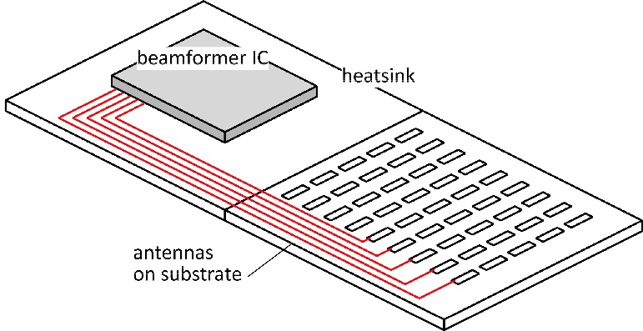
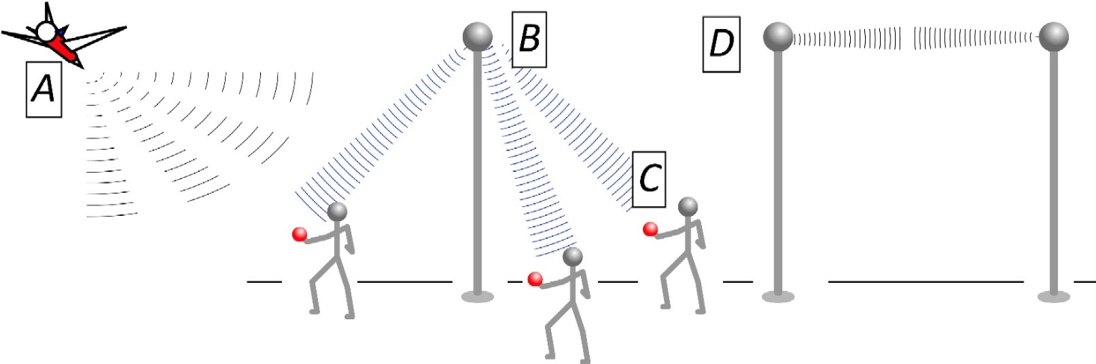

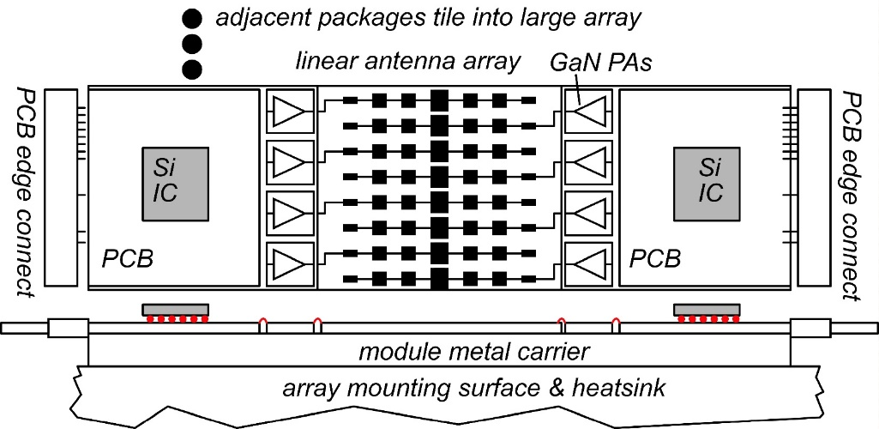
The mm-wave module design problem
How to make the IC electronics fit ?
How to avoid catastrophic signal losses ?
How to remove the heat ?
Not all systems steer in two planes...
...some steer in only one.
Not all systems steer over 180 degrees...
...some steer a smaller angular range

Slide 14
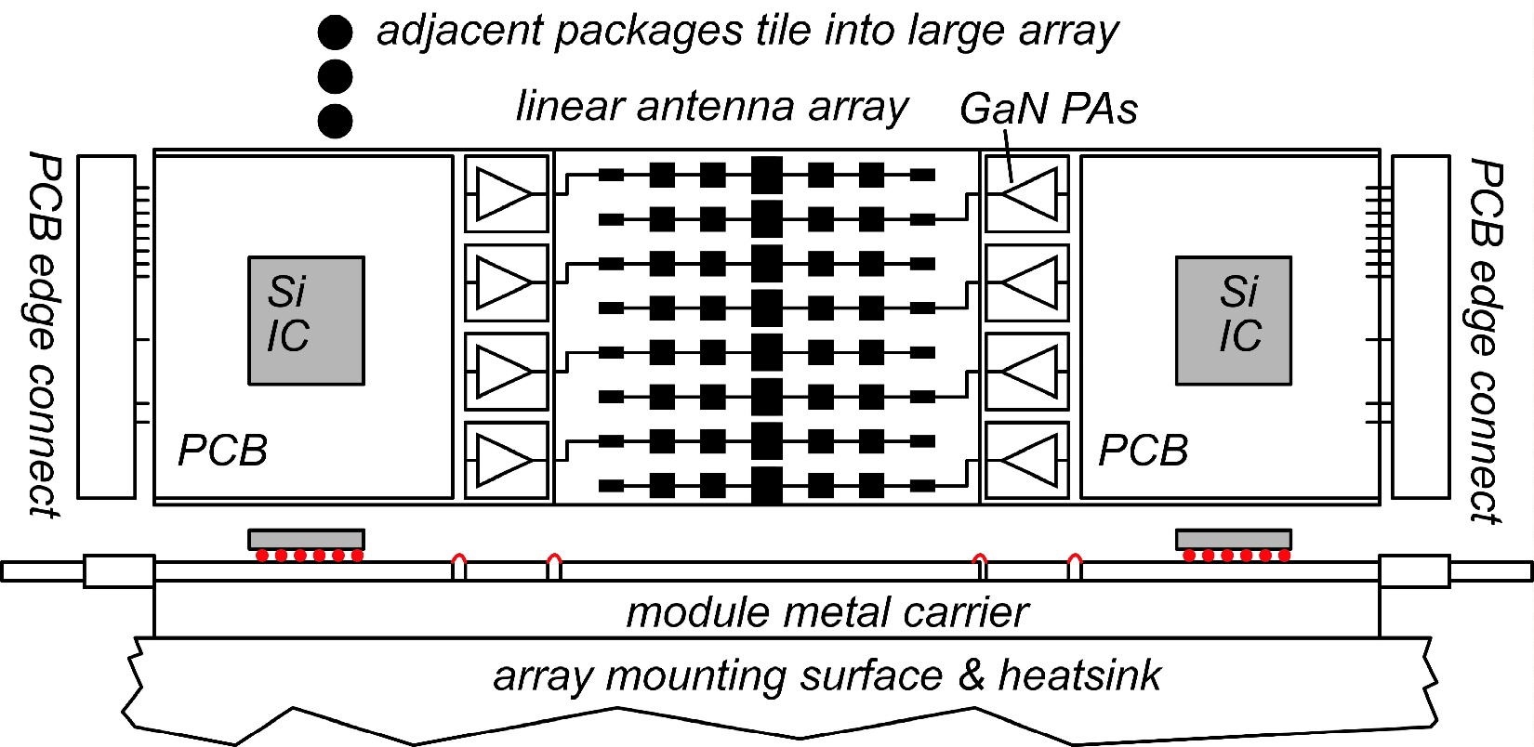
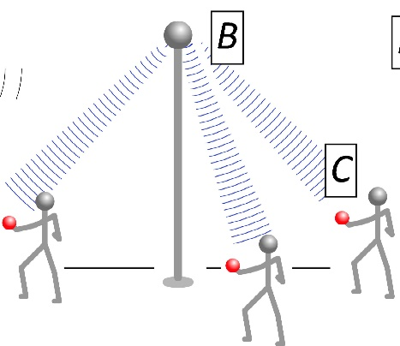
Concept: Tile for linear arrays
Terrestrial system: horizontal steering only→ linear array.
Space at edges of linear array: room for III-V PAs, LNAs.
Alternating-sides feed: 2mm pitch→ room for large GaN PAs.
Mounting directly on metal carrier→ heatsinking.

Slide 15

Concept: module for small angular scanning
Terrestrial system: horizontal + vertical steering → rectangular array.
Limited angular steering range (installation)→ spacing >> λ/2
Endfire / edge-card geometry: room for III-V PAs, LNAs.
Mounting directly on metal carrier→ heatsinking.
If Vivaldi's are replaced with dipoles, element spacing can be reduced to λ/2.
→ potential for wider angular scanning

Slide 16
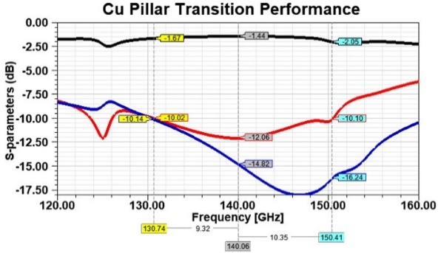
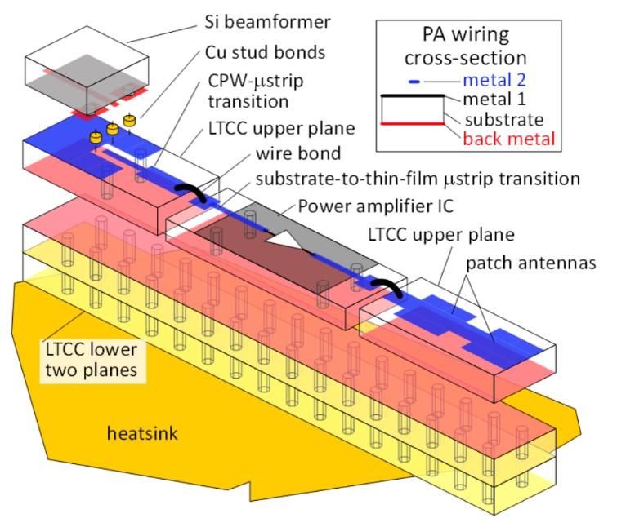
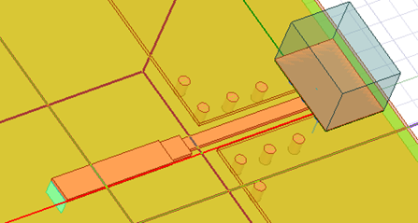
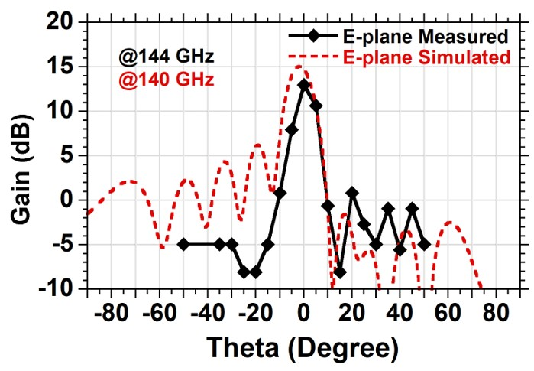
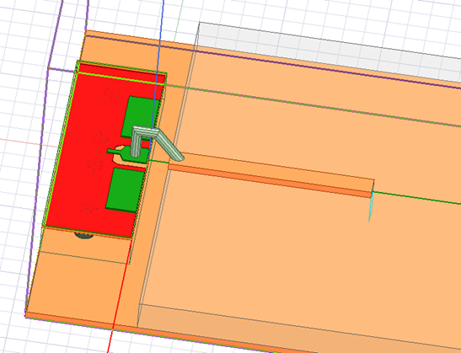
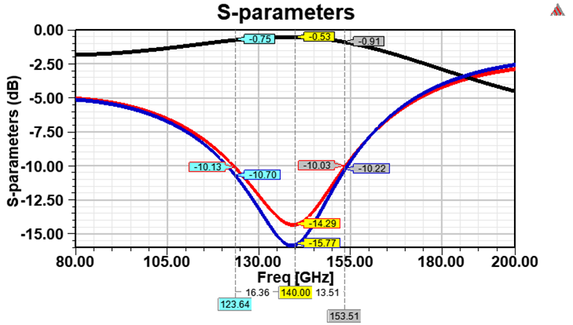
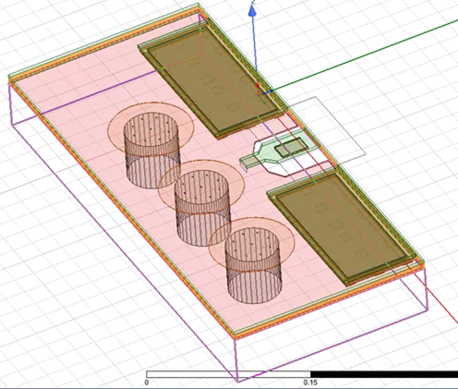
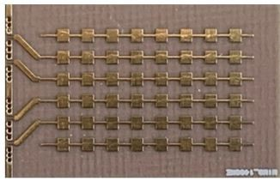
140GHz array module design
-1.4 dB
-0.53 dB
Simulations good: working with Kyocera. June tapeout ?

Slide 17



Systems

Slide 18

Beamforming for massive spatial multiplexing
Pure digital beamforming:
dynamic range & phase noise requirements: appear to be manageable ✓✓✓
Digital back-end processing requirements (die area, DC power): being investigated ?
Analog, hybrid beamforming:
Do not appear to significantly improve dynamic range in massive MIMO.

Slide 19

Progress in System Design
Digital beamforming
✓ADCs/DACs: only 3-4 bit ADC/DACs required (Madhow, Studer, Rodwell)
✓Linearity: Amplifier P_{1dB} need be only 3dB above average power (Madhow).
✓Phase noise: Requirements same as for SISO (Alon, Madhow, Niknejad, Rodwell)
Efficient digital beamforming: beamspace algorithm=complexity ~N× log(N) (Madhow)
Efficient digital beamforming: low-resolution matrix (Studer)
Efficient channel estimation : fast beamspace algorithm (Studer)
Efficiently addressing true-time-delay problem: "rainbow" FFT algorithm (Madhow)
✓Array-to-backplane interconnect power: low-power analog baseband 50Ω links (Rodwell)
In progress…
Propagation models and measurements: (Molisch)
Blockage probability, mesh networks, network protocols: (Rangan, Cabric)
MIMO system power analysis: (Rangan, Cabric, Buckwalter)

Slide 20
Progress: All-Digital Beamformer
mmWave/THz channels are sparse in beamspace domain
Exploiting sparsity can significantly reduce baseband complexity
Challenge: requires fast Fourier transforms (FFTs) at baseband sampling rates
Implementation examples
  1 GHz bandwidth
  10b FFTs generated with Spiral
Specialized FFTs (radix-4, higher streaming width, etc.) will further reduce area and power!
BS antennas | Area | Power
64 | 9mm² | 2W
128 | 32mm² | 7W
256 | 122mm² | 26W
  Synthesis results for 28nm CMOS
Christoph Studer, Cornell

Slide 21



Transistors

Slide 22






Progress in mm-Wave Transistors
InGaN and GaN HEMTs:
High power from 100-340GHz
GaN: superior power density at all frequencies
UCSB/Mishra: InGaN for increased mobility
Cornell/Xing: AlN/GaN/AlN
N-polar GaN: Mishra, UCSB
THz InP HBTs:
SOA today: 130nm node, 1.1 THz f_{max}, 3.5 V breakdown
Efficient 100-650GHz power
more f_{max}: more efficient, higher frequencies
base regrowth: better contacts→ higher f_{max}.
status: working DC devices; moving to THz
THz InP HBTs:
SOA today: 1.5 THz f_{max}, ~1.1 V breakdown
Sensitive 100-650GHz low-noise amplifiers
more f_{τ}: lower noise, higher frequencies
high-K gate dielectric → higher f_{τ}.
status: process modules

Slide 23
Wireless above 100 GHz
Massive capacities
large available bandwidths
massive spatial multiplexing in base stations and point-point links
Very short range: few 100 meters
short wavelength, high atmospheric losses. Easily-blocked beams.
IC Technology
All-silicon for short ranges below 250 GHz.
III-V LNAs and PAs for longer-range links. Just like cell phones today
III-V frequency extenders for 340GHz and beyond
The challenges
spatial multiplexing: computational complexity
packaging: fitting signal channels in very small areas

Slide 24
(backup files follow)

Slide 25


Progress in System Design
ADC resolution:
N ADC bits, M antennas, K signals: SNR=6N+1.76+10.log₁₀(M/K)
3 bits, (M/K)=2→ SNR=23 dB. QPSK needs 9.8 dB.
Jammer tolerance:
Increase ADC resolution by 1 bit→ P_{jammer,max} = K.P_{signal}
Maximum jammer power = sum of all user's power.
Phase noise:
Phase error σ_{φ} : SNR= -20.log₁₀(σ_{φ})+10.log₁₀(M/K), where
MIMO and SISO require similar L(f) .
Beamspace:
lower frequencies, many NLOS paths, complicated channel matrix: O(M³) to beamform
higher frequencies, few NLOS paths, simpler channel matrix: FFT, O(M.logM) to beamform
fewer bits in signal; fewer bits in FFT coefficients.

Slide 26

The mm-wave module design problem
How to make the IC electronics fit ?
100+ GHz arrays: λ₀/2 element spacing is very small.
Antennas on or above IC → IC channel spacing = antenna spacing
→ limited IC area to place circuits
How to avoid catastrophic signal distribution losses ?
long-range, high-gain arrays: array size can be large.
ICs beside array → very long wires between beam former and antenna
→ potential for very high signal distribution losses
How to remove the heat ?
100+ GHz arrays: element spacing is very small.
If antenna spacing = IC channel spacing, then power density is very large

Slide 27

ComSenTer
Center for Converged Communications & Sensing
at THz.
Duration:
5-years; 1/2018-12/2022.
Funding:
about $32 million total.
Team:
21 Professors,
~65 Ph.D. students
Sponsors:
SRC, DARPA
Focus:
wireless systems,
10-15 years out,
100-340GHz

Slide 28



100-340 GHz: challenges & solutions
High attenuation
in foul or humid
weather
Need mesh networks
Need large arrays

