Slide 1


A 190-210GHz Power Amplifier with 17.7-18.5dBm Output Power and 6.9-8.5% PAE
A. Ahmed^{1,2}, U. Soylu², M. Seo³, M. Urteaga⁴,
J. Buckwalter², and M. Rodwell²
¹Marki Microwave Inc., CA
²ECE, University of California, Santa Barbara, USA
³ECE, Sungkyunkwan University, South Korea
⁴Teledyne Scientific Company, Thousand Oaks, CA, USA

Slide 2
Outline
Motivation for mm-wave frequencies and prior work.
Application for the amplifier.
Amplifier design
  Power and driver cells
  Low-loss compact combiner
Measurement results
Summary and conclusion

Slide 3
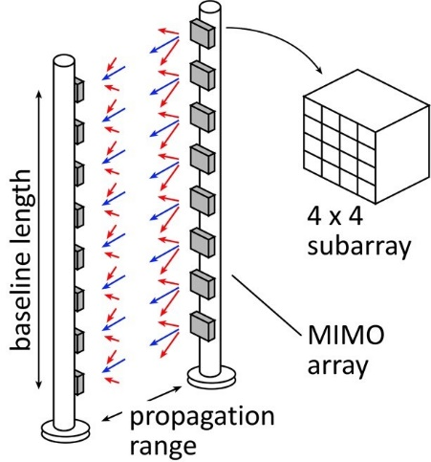
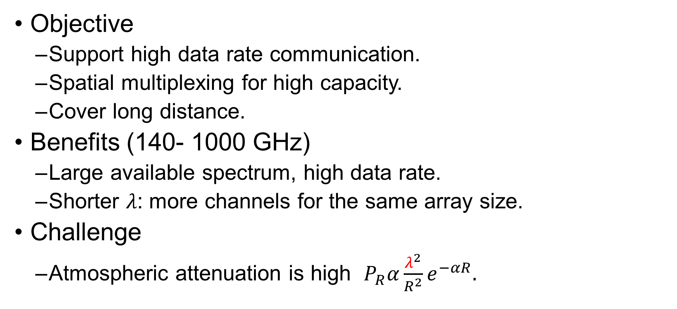
mm-wave Communication (140-1000 GHz)
Objective
  Support high data rate communication.
  Spatial multiplexing for high capacity.
  Cover long distance.
Benefits (140- 1000 GHz)
  Large available spectrum, high data rate.
  Shorter 𝜆: more channels for the same array size.
Challenge
  Atmospheric attenuation is high $P_{R}α\frac{λ^{2}}{R^{2}}e^{−αR}.$

Slide 4
Prior Work at G-band
At 200GHz, CMOS shows 9.4dBm with only 1.03% PAE [2].
SiGe shows 13.5dBm with ~2% drain efficiency [3]
GaN demonstrates higher power with <2.4% peak PAE [4], [5].
InP presented the highest power and efficiency [6]-[18].
Key points
  Designs are not optimized for the highest PAE at OP_{1dB}. PAE at OP_{1dB}<3%
  Power measurement accuracy at the linear region is challenging.

Slide 5
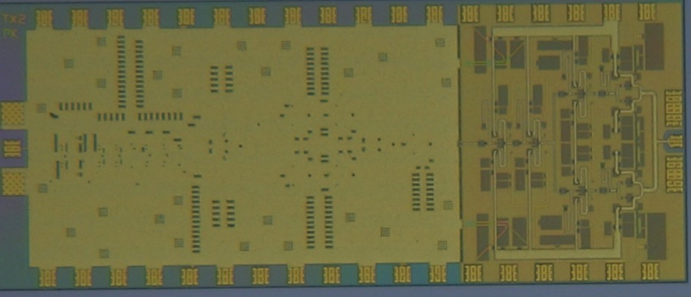
This Work (190-210GHz)
Optimize for the highest efficiency at OP_{1dB}.
OP_{1dB}~17.4dBm, PAE: 6.4% at OP_{1dB}, Gain~23dB.
Accurate power measurement at the linear region.
This amplifier is integrated to a 200GHz transmitter (not published).
2,900 x 1,200 (um²)
PA this work
4 cells
200GHz transmitter, not published

Slide 6
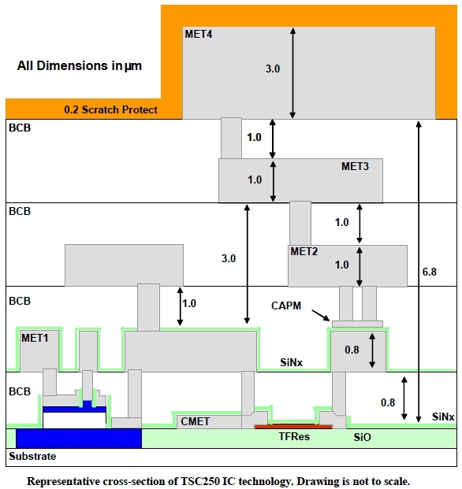
250nm InP HBT Process (Teledyne [6])
Mm-wave amplifier requires fast technologies.
f_{max}=650GHz.
BV_{CEo}=4.5V.
J_{max}=3mA/µm.
Four Au interconnect.
MIM cap (0.3fF/µm2).
TFR (50Ω/square).
Cross section of TSC250 IC

Slide 7
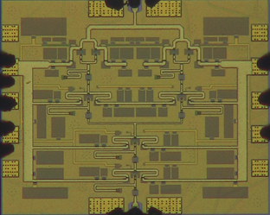
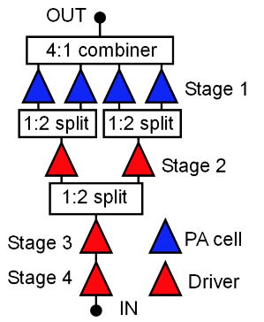
Power Amplifier Design
Four stages amplifier.
Combine four power cells.
Driver scaling sustains good PAE.
Power combining techniques
  Parallel combining: 4:1 transmission line combiner.
  Series combiner: stacked unit cell.
96-μm HBT periphery
48-μm HBT periphery
24-μm HBT periphery
24-μm HBT periphery
Amplifier micrograph
Amplifier block diagram

Slide 8
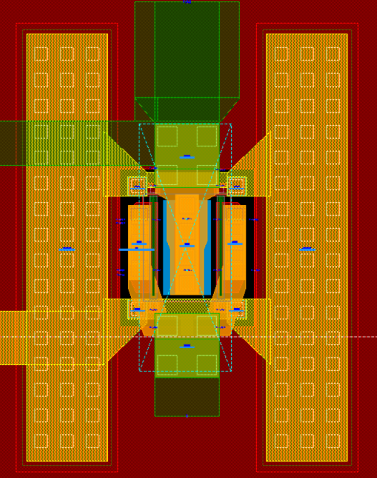
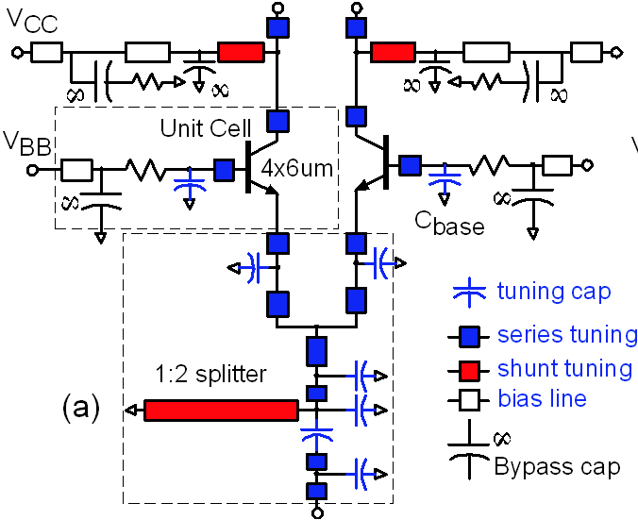
Power Cell Design
CB architecture with finite base impedance.
  Superior PAE at OP_{1dB}, compared to CE or grounded CB,
  due to the feedback linearization [14].
Base capacitances
  Maximum value: limited by the self resonance frequency.
  Minimum value: limited by the acceptable gain.
Shunt transmission lines tunes the transistor parasitics.
Each cell requires ~29Ω load impedance.
Matching considerations
  Staggered tuning for better bandwidth.
  Input impedances are close to the loadline of the driver
  to ensure proper saturation.
Transistor footprint with cap
ZL~29Ω
Power cell schematic

Slide 9
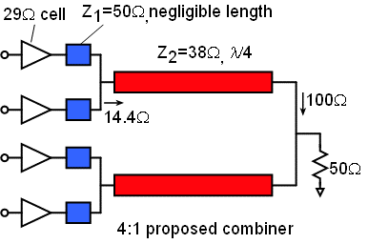
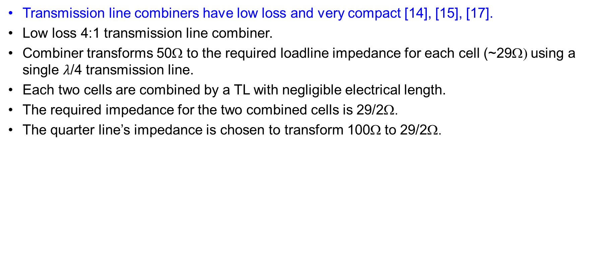
Combiner Design
Transmission line combiners have low loss and very compact [14], [15], [17].
Low loss 4:1 transmission line combiner.
Combiner transforms 50Ω to the required loadline impedance for each cell (~29Ω) using a single $λ$/4 transmission line.
Each two cells are combined by a TL with negligible electrical length.
The required impedance for the two combined cells is 29/2Ω.
The quarter line’s impedance is chosen to transform 100Ω to 29/2Ω.

Slide 10
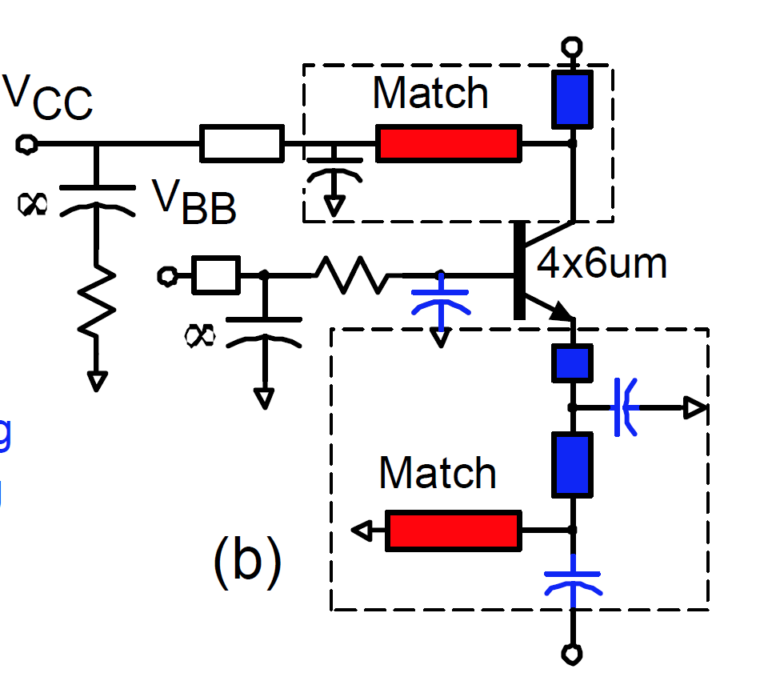
Driver Cell Design
Design is similar to the power cell.
Architecture uses CB with finite base capacitance.
Conservative driver scaling ensures hard compression characteristics at the expense of PAE degradation.
Driver cell
Amplifier block diagram

Slide 11
Measurement Results: s-parameters
Good agreement at low bias
Some deviations are observed at higher bias-> maybe heating effect.
S-parameters at P_{DC}=444mW
S-parameters at P_{DC}=858mW

Slide 12
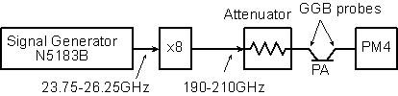
Power Measurement: literature
Conventional measurement: attenuator after a frequency multiplier chain.
Power sweep: change the attenuator settings.
Cons
  The actual input power is unknown-> less accurate results.
  In many cases, the attenuator is manually changed -> lift the probes and turn off the PA, not convenient.
Conventional power setup

Slide 13
Proposed Approach: setup
The VDI’s output power is sampled by a coupler and monitored by the spectrum analyzer.
The spectrum analyzer readings represents the power by adding the appropriate correction factor in the calibration phase.
Sweep input power: control the signal generator.
Proposed power setup

Slide 14
Calibration phase
Record the power difference (dB) between the power meter and spectrum analyzer readings.
This difference is the correction factor that should be added to the spectrum analyzer readings to represents the actual input power.
Calibration

Slide 15
Measurement Phase
Sweep the signal generator power.
Record the spectrum analyzer readings + the appropriate correction factors. This represents the amplifier input power after calibrating the probe losses by through measurements.
Report the power meter reading.
The power meter readings represent the amplifier output power after calibrating probe loss.
Measurement

Slide 16
Pros of this measurement approach
Accurate gain measurement even at very low input power.
Power is swept by the signal generator
-> Extremely convenient since all the measurements are done without lifting the probes or turn off the PA bias.

Slide 17
Power Measurement Results
Many points are recorded at different frequencies.
Discrepancy between simulations and measurement maybe due to the probe conditions.
Freq, GHz | OP_{1dB}, dBm | PAE, % at OP_{1dB} | P_{sat}, dBm | PAE, % at P_{sat}
194 | 17.4 | 6.4 | 18.5 | 8.5
202 | 16.6 | 5.3 | 18.3 | 7.9
Pout, Gain, and PAE vs Pin at 194GHz
Pout, Gain, and PAE vs Pin at 202GHz

Slide 18
Power Measurement Results
More points are taken at different frequencies.
P_{sat}=17.7-18.5dB_{m}, with PAE=6.9-8.5% over 190-210GHz
OP_{1dB} =16-17.4dB_{m} with PAE=4.7-6.4% over 125-150GHz
Measured P_{out} with the associated PAE and gain vs. frequency reported at the peak PAE.

Slide 19
State-of-the-art results
Ref | [7] | [8] | [9] | [10] | This work
Freq, GHz | 204 | 190 | 180-260 | 190.8-244 | 190-210
P_{sat}, dBm | 18.0 | 11 | 17.5-21.5 | 16.2-18.9ª | 17.7-18.5
Gain at P_{sat} (dB) | 16.5 | 19.2 | 13-17.5 | 19-22ª | 13.4-16.8
PAE at P_{sat}% | 4.8 | 9.6 | 5.1 | 3.3-6.1 | 6.9-8.5%
OP_{1dB}, dBm | 15.5ª | 3 | 17.5 | 16.1-17.16ª | 16-17.4
PAE at OP_{1dB}% | 3.2ª | 2 | 2.1ª | 2.3-3.0ª | 4.7-6.4
Gain at OP_{1dB} | 15.5ª | 27ª | 23.5ª | 23.8-35.0ª | 17.9-23.1
BW_{3dB}, GHz | >25 | 26 | 18ª | 53 | >20.5
Size (mm²) | 0.91 | 0.45 | 1.8 | 1.54 | 1.14
P_{DC} (mW) | 1180 | 970 | 2620 | 1270 | 814
P_{sat}/Area mW/mm² | 69.2 | 28.2 | 77.9 | 50.6 | 62.1
OP_{1dB} /Area mW/mm² | 39 | 28 | 31.2 | 33.8 | 48.2
Technology | 130nm InP | 250-nm InP HBT
This work shows a record PAE at OP_{1dB}

Slide 20
Summary
Demonstration of record PAE at G-band
Communication transmitter requires careful attention to the performance at OP_{1dB}
Key features for highest efficiency at OP_{1dB}
  Proper cell topology: Capacitively linearized common base
  Higher OP_{1dB}, and PAE
  Driver scaling sustains good PAE
Compact and low loss transmission line network

Slide 21
Acknowledgement
This work was supported in part by the Semiconductor Research Corporation and DARPA under the JUMP program.
The authors thank Teledyne Scientific & Imaging for the IC fabrication.

Slide 22
Thank You

Slide 23
References
[1] M. J. W. Rodwell et al., “100-340GHz Systems: Transistors and Applications,” in Proc. IEEE IEDM, 2018, pp. 14.3.1-14.3.4.
[2] H. Bameri and O. Momeni, "An Embedded 200 GHz Power Amplifier with 9.4 dBm Saturated Power and 19.5 dB Gain in 65 nm CMOS," in Proc. RFIC2020, 2020, pp. 191-194
[3] M. H. Eissa and D. Kissinger, "4.5 A 13.5dBm Fully Integrated 200-to-255GHz Power Amplifier with a 4-Way Power Combiner in SiGe:C BiCMOS," 2019 IEEE International Solid- State Circuits Conference - (ISSCC), San Francisco, CA, USA, 2019, pp. 82-84.
[4] M. Ćwikliński et al., "D-Band and G-Band High-Performance GaN Power Amplifier MMICs," in IEEE Trans. Microw. Theory Techn., vol. 67, no. 12, pp. 5080-5089, Dec. 2019.
[5] M. Ćwikliński et al., "First Demonstration of G-Band Broadband GaN Power Amplifier MMICs Operating Beyond 200 GHz," 2020 IEEE/MTT-S International Microwave Symposium (IMS), Los Angeles, CA, USA, 2020, pp. 1117-1120.
[6] M. Urteaga, Z. Griffith, M. Seo, J. Hacker, M. Rodwell, “InP HBT Technologies for THz Integrated Circuits”, Proc. of the IEEE, vol. 105, no. 6, pp 1051-1067, June 2017.
[7] A. S. H. Ahmed, A. A. Farid, M. Urteaga and M. J. W. Rodwell, "204GHz Stacked-Power Amplifiers Designed by a Novel Two-Port Technique," 2018 13th European Microwave Integrated Circuits Conference (EuMIC), Madrid, 2018, pp. 29-32.
[8] Z. Griffith, M. Urteaga and P. Rowell, "A 190-GHz High-Gain, 3-dBm OP1dB Low DC-Power Amplifier in 250-nm InP HBT," in IEEE MWCL, vol. 27, pp. 1128-1130, Dec. 2017.
[9] Z. Griffith, M. Urteaga and P. Rowell, "180–265 GHz, 17–24 dBm output power broadband, high-gain power amplifiers in InP HBT," 2017 IEEE MTT-S International Microwave Symposium (IMS), Honololu, HI, 2017, pp. 973-976.
[10] Z. Griffith, M. Urteaga, P. Rowell, and R. Pierson, “A 50–80mW SSPA from 190.8– 244GHz at 0.5mW pin,” in Proc. IMS2014, 2014, pp. 1–4.
[11] V. Radisic, D. W. Scott, A. Cavus, and C. Monier, “220-GHz high-efficiency InP HBT power amplifiers,” IEEE Trans. Microw. Theory Techn., vol. 62, no. 12, pp. 3001–3005, Dec. 2014.
[12] T.B. Reed, Z. Griffith, P. Rowell, M. Field, and M. Rodwell, "A 180mW InP HBT power amplifier MMIC at 214 GHz," in 2013 IEEE Compound Semiconductor Integrated Circuit Symposium,
Monterey, CA, Oct. 2013, pp.I-4.
[13] M. Bao, V. Vassilev, D. Gustafsson and H. Zirath, "G-band Power Amplifiers in 130 nm InP Technology," 2020 15th European Microwave Integrated Circuits Conference (EuMIC), Utrecht, Netherlands, 2021, pp. 5-8.
[14] A. S. H. Ahmed, M. Seo, A. A. Farid, M. Urteaga, J. F. Buckwalter and M. J. W. Rodwell, "A 140GHz power amplifier with 20.5dBm output power and 20.8% PAE in 250-nm InP HBT technology," 2020 IEEE/MTT-S International Microwave Symposium (IMS), Los Angeles, CA, USA, 2020, pp. 492-495.
[15] A. S. H. Ahmed, M. Seo, A. A. Farid, M. Urteaga, J. F. Buckwalter and M. J. W. Rodwell, "A 200mW D-band Power Amplifier with 17.8% PAE in 250-nm InP HBT Technology," 2020 15th European Microwave Integrated Circuits Conference (EuMIC), Utrecht, Netherlands, 2021, pp. 1-4.
[16] M. Seo, A. S. H. Ahmed, U. Soylu, A. A. Farid, Y. Na, and M. J. W. Rodwell, "A 200 GHz InP HBT Direct-Conversion LO-Phase-Shifted Transmitter/Receiver with 15 dBm Output Power," submitted to 2021 IEEE Radio Frequency Integrated Circuits Symposium (RFIC), Atlanta, GA.
[17] A. S. H. Ahmed, U. Soylu, M. Seo, Miguel Urteaga and M. J. W. Rodwell, " A compact H-band Power Amplifier with High Output Power," submitted to 2021 IEEE/MTT-S International Microwave Symposium (IMS), Atlanta, GA.
[18] A. S. H. Ahmed, A. Simsek, M. Urteaga and M. J. W. Rodwell, "8.6-13.6 mW Series-Connected Power Amplifiers Designed at 325 GHz Using 130 nm InP HBT Technology," 2018 IEEE BiCMOS and Compound Semiconductor Integrated Circuits and Technology Symposium (BCICTS), San Diego, CA, USA, 2018, pp. 164-167.

Slide 24
DC Bias Lines and Power Supply Oscillations
Only two independent DC supplies -> reduce the bias complexity.
one supply biases all stages’ collectors and the second biases the stages’ bases.
There are many feedback loops-> potential stability problems.
We noticed a potential oscillation problem at low
frequencies (~GHz and lower) in earlier designs.
The low frequency oscillations are not adequately
modeled and does not show up in simulations.
In this design, we added many bypass capacitors
with series resistors to avoid out of band oscillations.
There is no indication for oscillations.

Slide 25
Measurement accuracy
The dynamic range of the power sweep is defined as follows:
  The minimum input power: limited by the spectrum analyzer noise level.
  Spectrum analyzer with reasonable noise levels shows smooth gain curves at low input power-> get accurate results to accurately report OP_{1dB}.
  The maximum power: limited by the harmonic mixer saturation limit.
Calibration
Measurement

Slide 26
Measurement accuracy
Probe losses are calibrated by through measurement.
Old probes show non-50Ω impedance which degrades the output power.
So, the probes may contribute to higher losses than the one measured in the through measurement.
We did the measurement with an old probe pair, and we believe that the results could be improved by a newer one.

