Slide 1
Transistors for 100-300GHz Wireless
Plenary, ESSCIRC ESSDERC 2021 European Solid-state Circuits and Devices Conference, Grenoble and online. September 15, 2021.
Mark Rodwell, Brian Markman, Yihao Fang, Logan Whitaker, Hsin-Ying Tseng, A. S. H. Ahmed University of California, Santa Barbara rodwell@ece.ucsb.edu
This work was supported in part by the Semiconductor Research Corporation (SRC) and DARPA

Slide 2
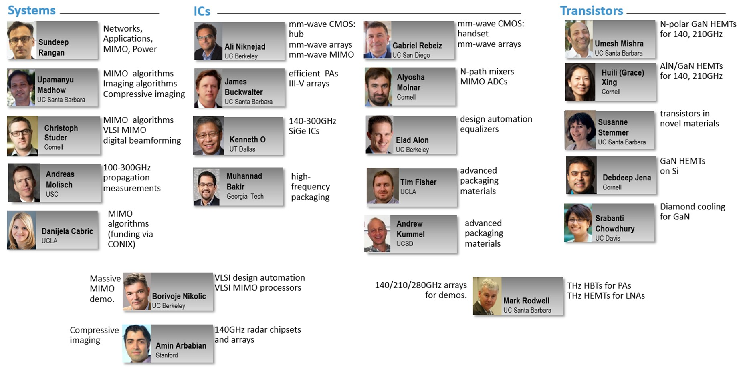
Acknowledgements
Also: Kyocera: D. Kim, H. Horikawa, M. Imayoshi. Samsung: G. Xu, N. Sharma, S. Abu-Surra, W. Choi Pi-Radio: A. Dhananjay,

Slide 3
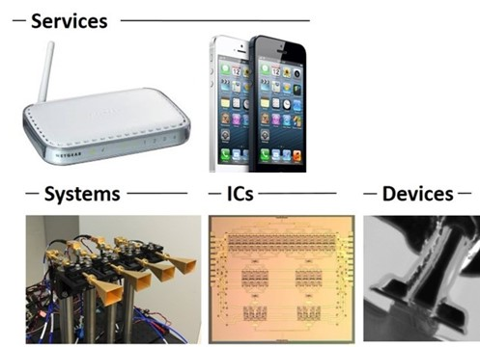
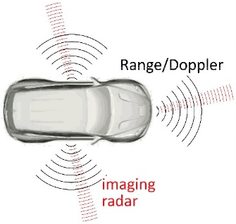
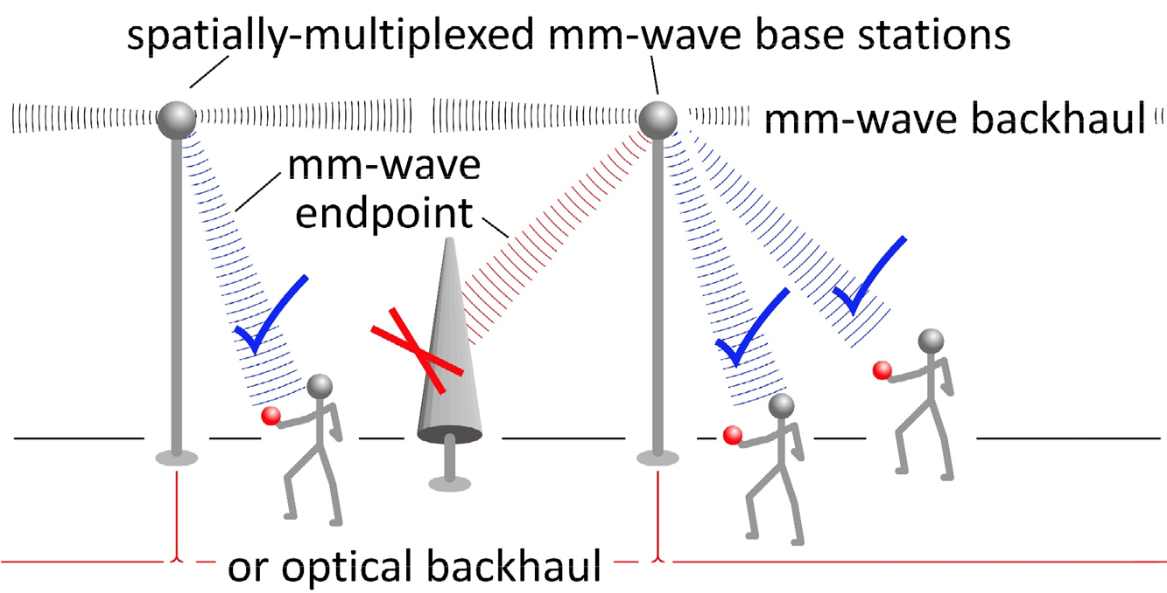
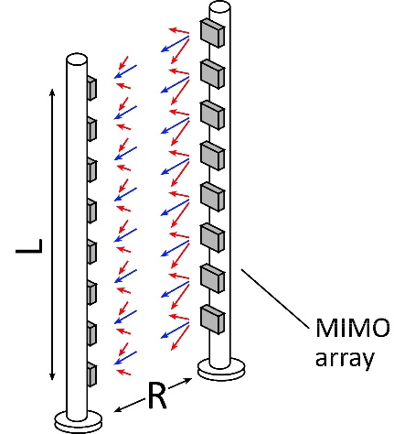
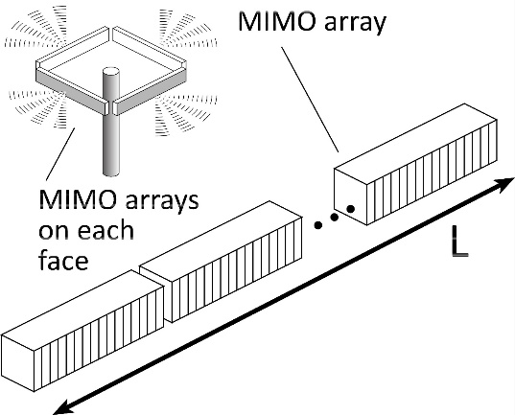
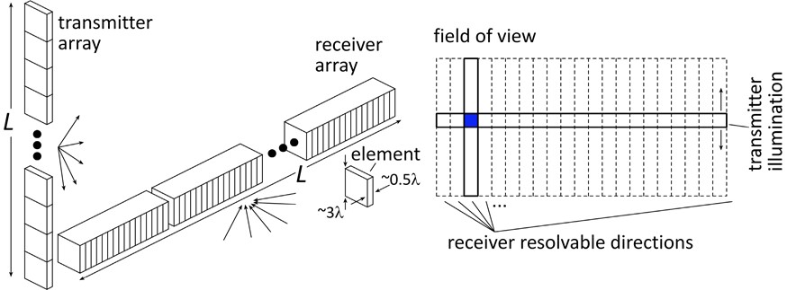
Transistors for 100-300GHz wireless
Wireless networks: exploding demand.
Immediate industry response: 5G. ~6~100GHz increased spectrum, extensive beamforming
Next generation: 100-300GHz (???) greatly increased spectrum, massive spatial multiplexing
100-300GHz carriers, massive spatial multiplexing → Terabit hubs and backhaul links, high-resolution imaging radar
What transistors do we need ?

Slide 4
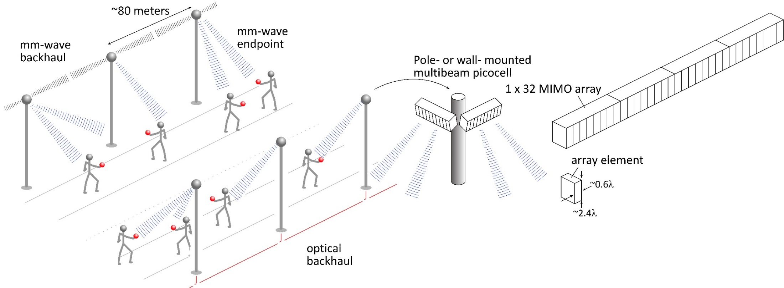
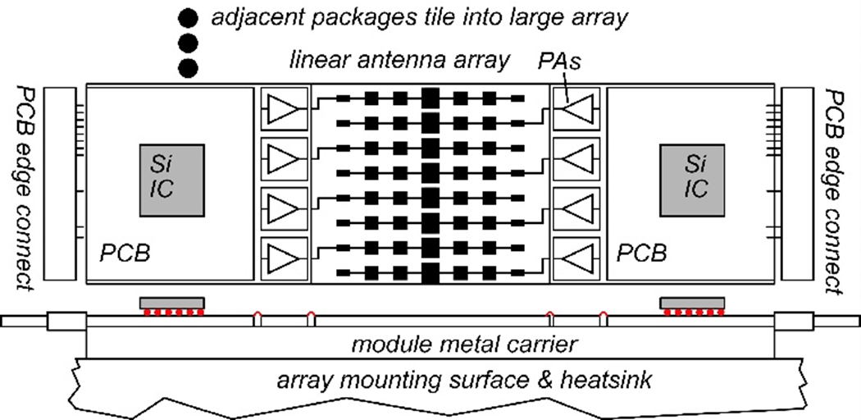
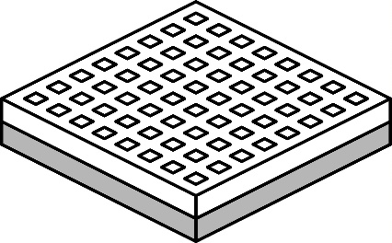
140GHz, 160 Gb/s MIMO network hub
Hub with 32-element array (four 1×8 modules): 16 users/array. F=8dB LNAs, P_{1dB}=21 dBm PAs 10 Gb/s/beam→ 160 Gb/s total capacity 40 m range in 50mm/hr rain with 17dB total margins
Handset: 8 × 8 array (9×9mm)

Slide 5
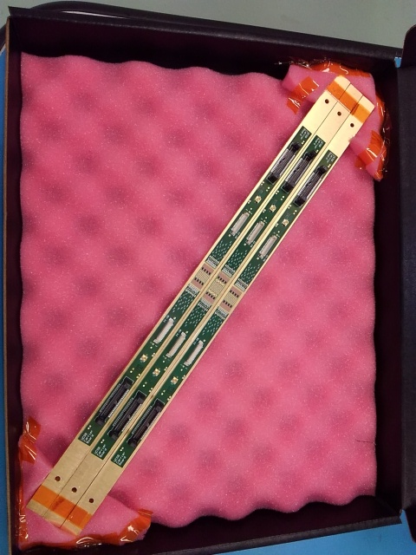
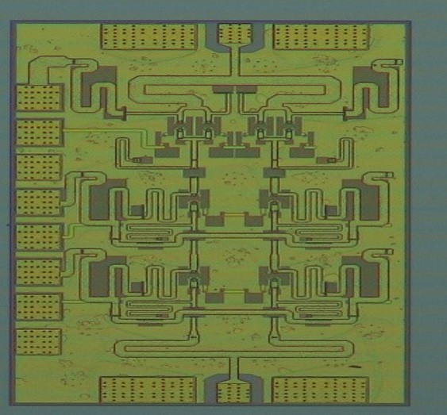
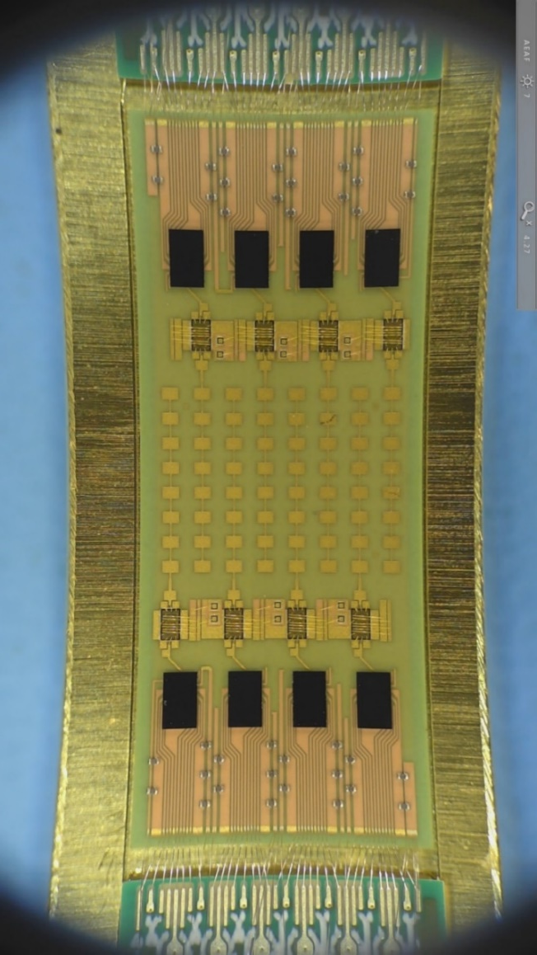
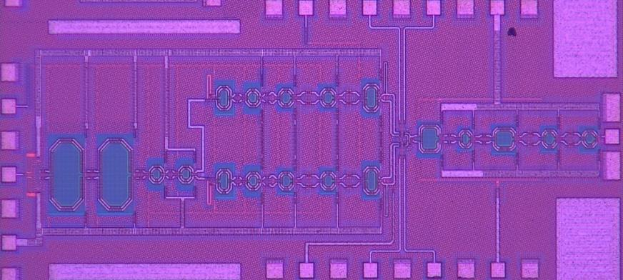
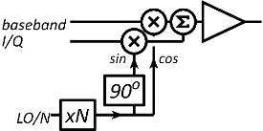
8-channel 140GHz MIMO hub modules
A. Farid et. al, in review
110mW power amplifier Teledyne 250nm InP HBT 20.8% PAE
Transmitter IC GlobalFoundries 22nm SOI CMOS
Kyocera LTCC carrier

Slide 6
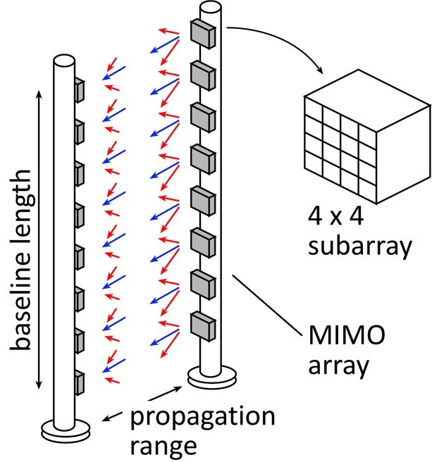
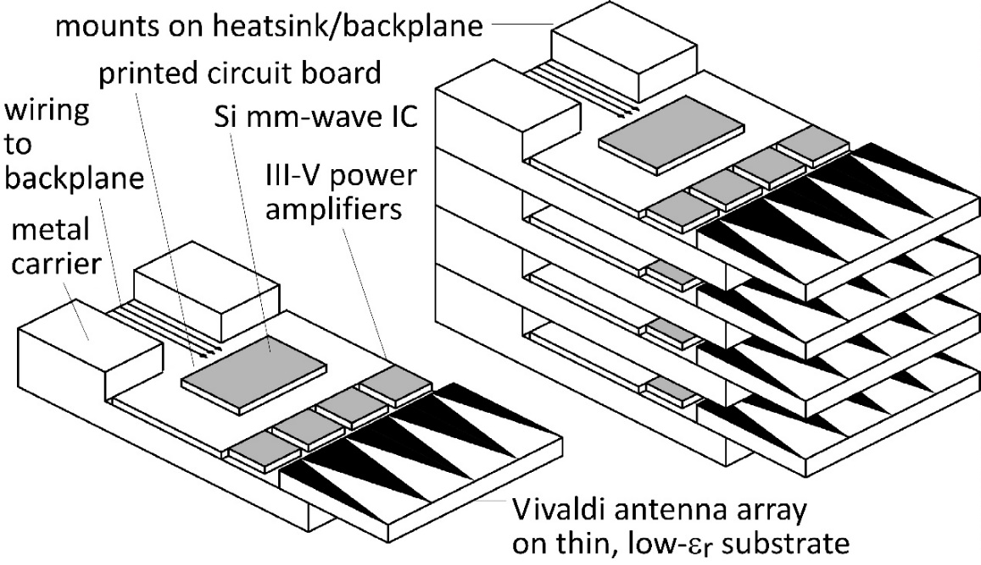
210 GHz, 640 Gb/s MIMO backhaul
8-element MIMO array 3.1 m baseline for 500 meters range. 80Gb/s/subarray→ 640Gb/s total 4 × 4 sub-arrays → 8 degree beamsteering
Key link parameters 500 meters range in 50 mm/hr rain; 23 dB/km 20 dB total margins: packaging loss, obstruction, operating, design, aging LNAs: 6dB noise figure PAs: 18dBm =P_{1dB} (per element)

Slide 7
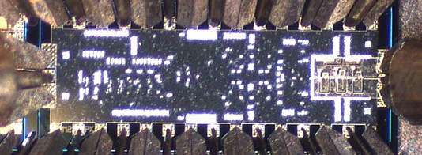
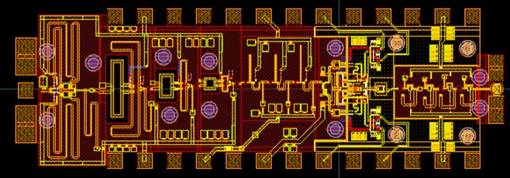
210 GHz transmitter and receiver ICs
210GHz transmitter: 20GHz bandwidth, 15.5-16.5dBm power
210GHz receiver: 20GHz bandwidth, 7.7-9.5dB noise figure
M. Seo et al, 2021 IMS; Teledyne 250nm InP HBT
Size: 2.9 x 0.75 mm²
Size: 2.3 x 0.85 mm²
280GHz transmitter: 17dBm power (simulated)
280GHz receiver: 11dB noise figure, 40GHz bandwidth (sim.)
Solyu, Alz, Ahmed, Seo; UCSB/Sungkyunkwan; Teledyne 250nm InP HBT

Slide 8
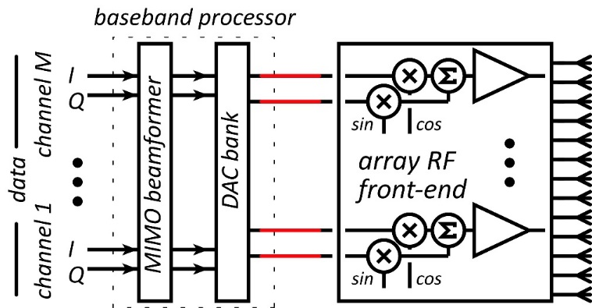
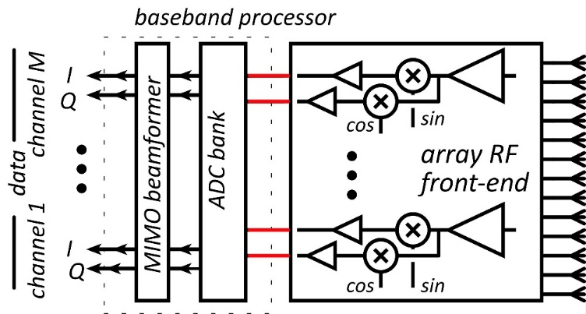
100-300GHz wireless: transistor requirements
Transmitters need: high power-added efficiency $PAE=(P_{out}−P_{in})/P_{DC}$ high added power density (P_{out}-P_{in})/(gate width, emitter length) Receivers need: low cascaded noise $F_{casc}=F+{(F−1)}/G+{(F−1)}/{G^{2}+…}$
Need reasonable gain/stage. die area, power, accumulated gain compression
(gain in PAs, LNAs is less than MAG/MSG, U, ... )

Slide 9
Transistors for 100-300GHz
CMOS: good power & noise up to ~150GHz. Not much beyond. 65-32nm nodes are best.
InP HBT: record 100-300GHz PAs
SiGe HBT: outperforms CMOS above 200GHz
GaN HEMT: record power below 100GHz. Bandwidth improving
InGaAs-channel HEMT: world's best low-noise amplifiers
*results with low PAE at high Psat or low Psat with high PAE are not shown
Results compiled 8/1/2021

Slide 10
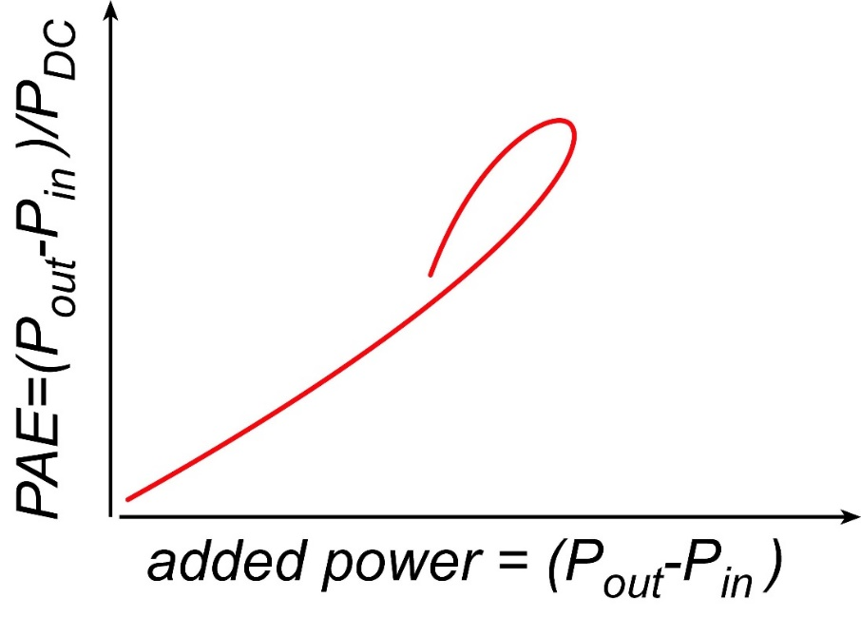
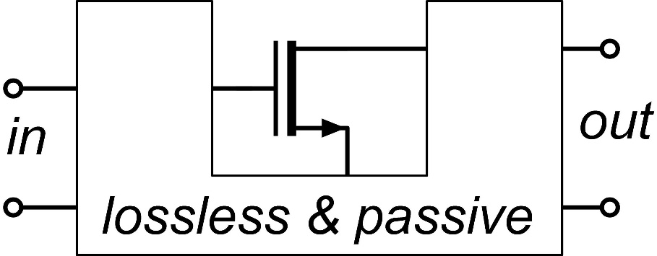
Where the IC designer can't help us.
mm-wave transistor gain is low: gain-boosting is common Common-source vs. common-gate. Capacitive neutralization. Controlled positive feedback (Singhakowinta, Int. J. Electronics, 1966) Such circuits don't improve the parameters that matter the most. The circuit* doesn't change the transistor minimum cascaded noise figure. (Haus, Adler, Proc. IRE, 1958) The circuit* doesn't change the transistor maximum efficiency vs. added power curve.
$$F_{casc}=F+{(F−1)}/G+{(F−1)}/{G^{2}+…}$$
*If lossless, and given the correct source and load impedances.

Slide 11
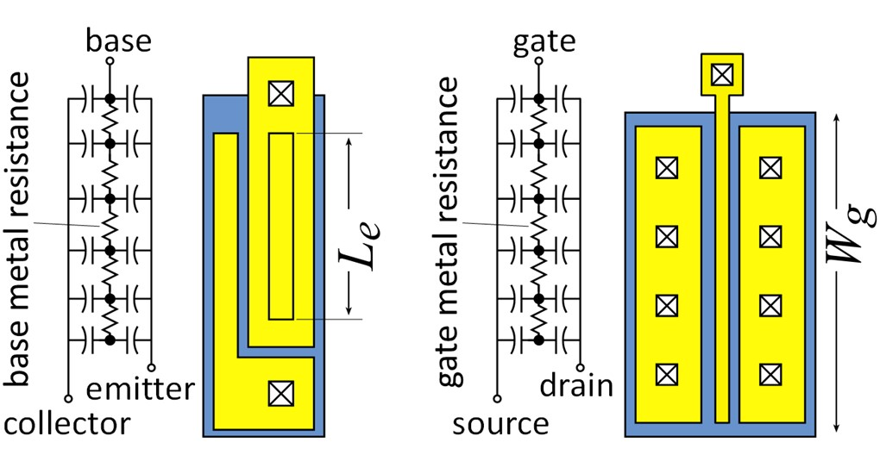
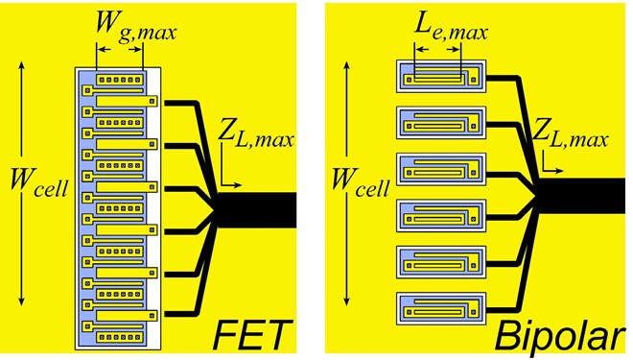
Current density, finger pitch limit cell output power

Slide 12
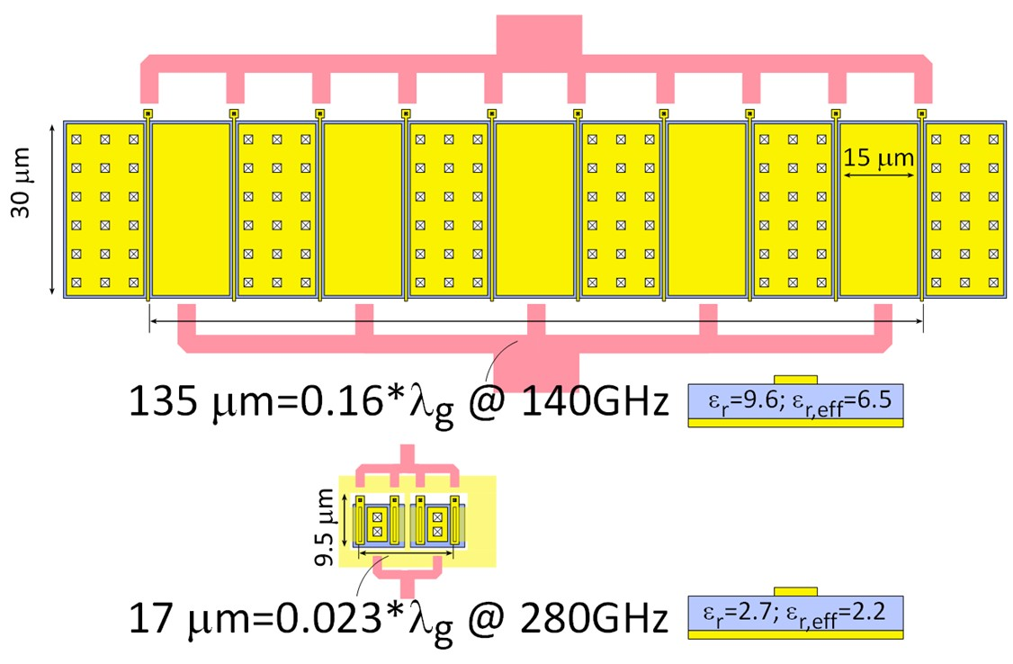
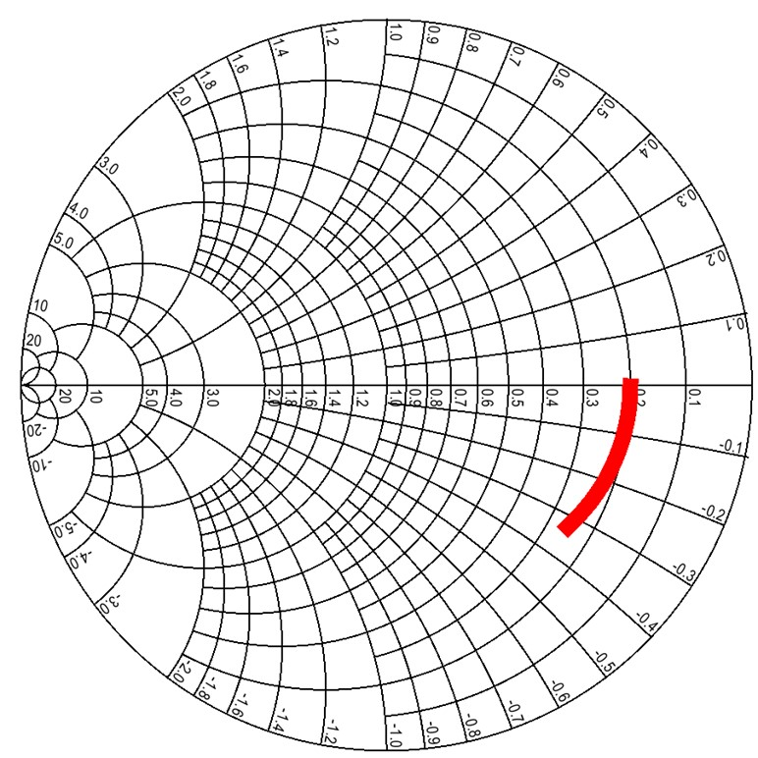
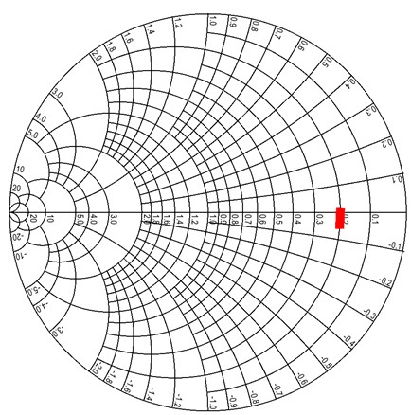
Current density, finger pitch limit cell output power
K. Shinohara, Teledyne: GaN HEMT thermal analysis
50Ω GaN PA cell @ 140GHz (1.6W) 25V swing, 1.67mA/μm, gates: 30 μm width, 15 μm pitch
50Ω InP HBT PA cell @ 280GHz (40mW) 4V swing, 3.3mA/μm, emitters: 6 μm length, 6 μm pitch
High V_{br}, low I_{max} ? Device sized to drive 50Ω might approach λ_{g}/4 width. Small finger pitch is critical; limited by thermal design

Slide 13
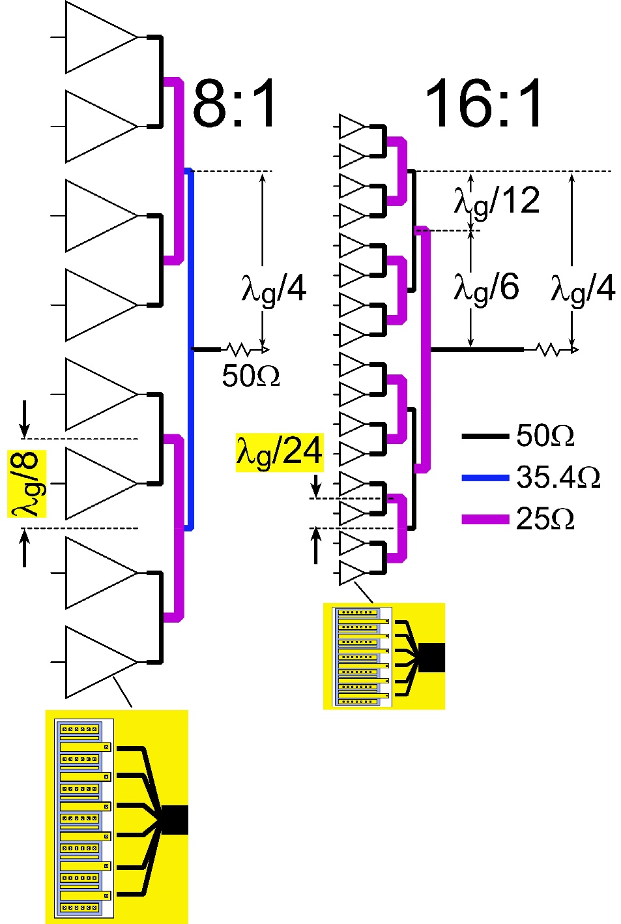
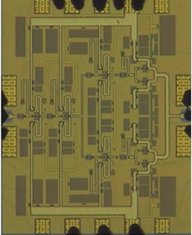
Current density, finger pitch limit power combining
More cells: more output power
Number of cells limited by combining losses.
Losses mostly limited by size.
Can 50Ω cell fit in λ_{g}/8 (120 μm) pitch ? →8:1 combining with 0.4dB loss @200GHz
Can 50Ω cell fit in λ_{g}/24 (40 μm) pitch ? →16:1 combining with 0.5dB loss @200GHz
200GHz InP HBT PA: 80 μm cell pitch

Slide 14
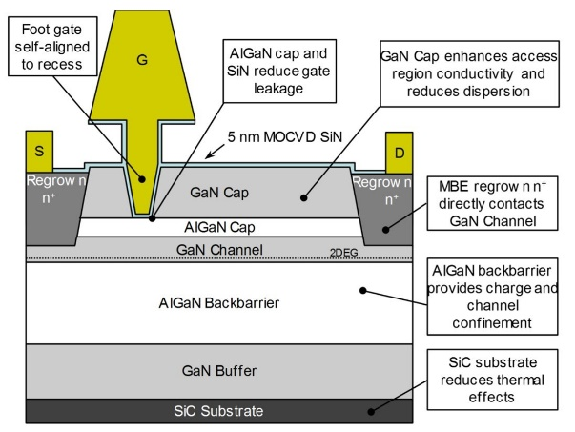
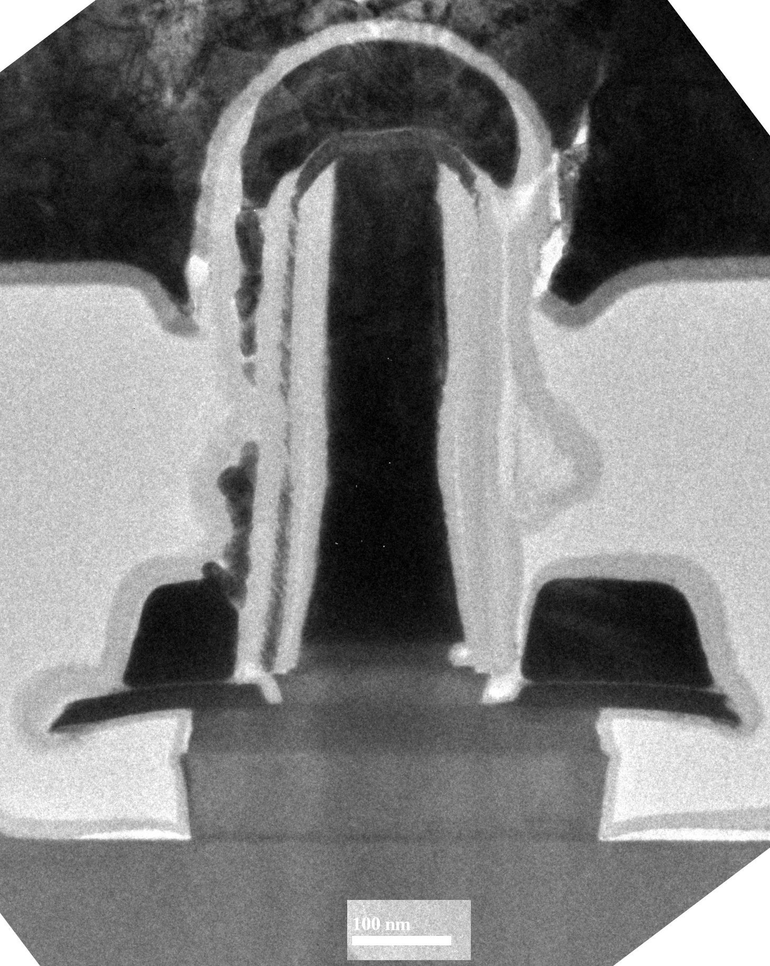
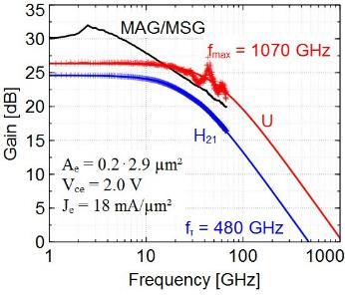
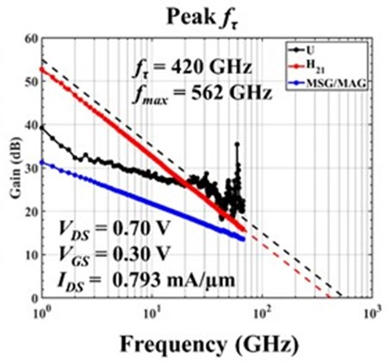
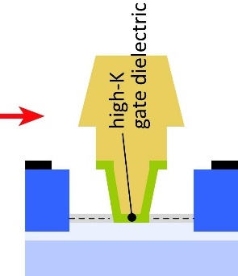
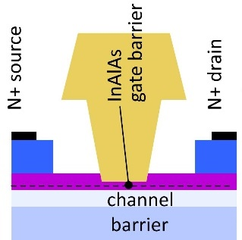
mm-Wave Transistor Development
InGaN and GaN HEMTs: Leading power technology to ~110GHz Efforts to extend this to 140, 220GHz.
N-polar GaN: Mishra, UCSB
THz InP HBTs: State-of-art: 1.1THz f_{max} @ 130nm node (Teledyne: Urteaga, DRC 2011) Efficient 100-650GHz power
THz InP HEMTs: State-of-art: 1.5THz f_{max} @ 32nm node (NGST: X. Mei, EDL 2015) Sensitive 100-650GHz low-noise amplifiers high-K gate dielectric *might* permit further scaling.
Rode , IEEE TED 2015

Slide 15
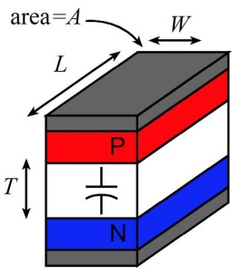
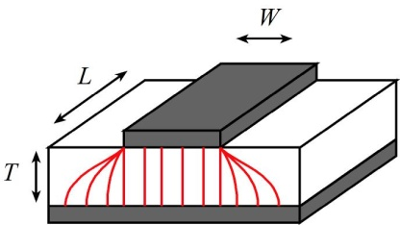
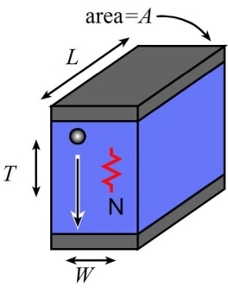
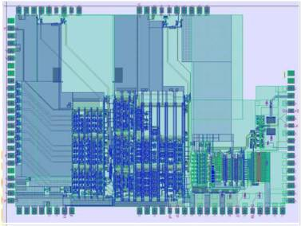
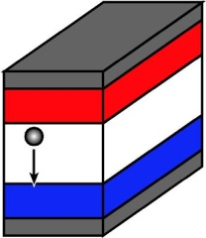
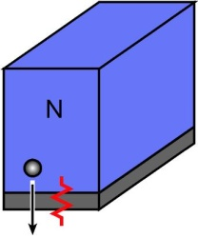
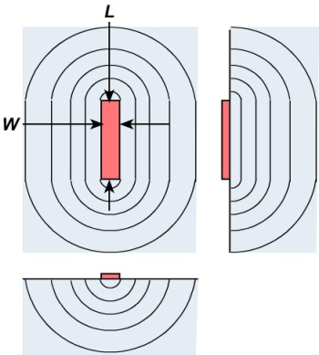
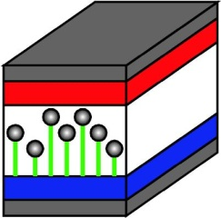
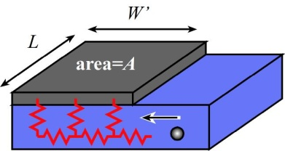
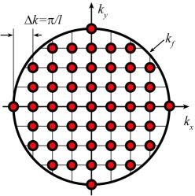
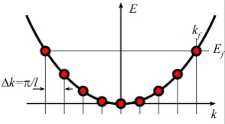
Transistor scaling laws: ( V,I,R,C,τ ) vs. geometry
Depletion Layers
Bulk and Contact Resistances
Fringing Capacitances
Thermal Resistance
Available quantum states to carry current
→ capacitance, transconductance contact resistance

Slide 16
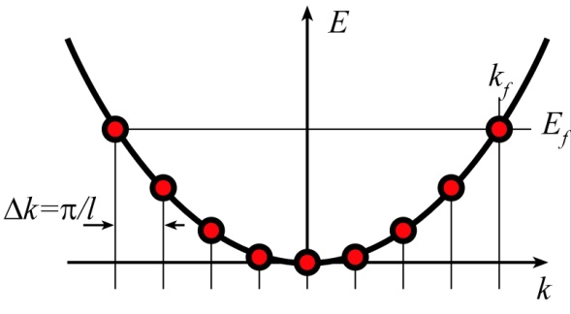
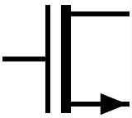
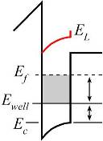
Degenerate State Density (Ballistic) Limits

Slide 17
Bipolar Transistor Design: Scaling

Slide 18
Bipolar Transistor Scaling Laws
Narrow junctions. Thin layers High current density Ultra low resistivity contacts

Slide 19
Refractory Ohmic Contacts to In(Ga)As
Baraskar et al, Journal of Applied Physics, 2013
32 nm (2.8THz) node requirements
Refractory: robust under high-current operation / Low penetration depth: ~ 1 nm
Why no ~2THz HBTs today? Problem: reproducing these base contacts in full HBT process flow

Slide 20
InP HBTs: 1.07 THz @200nm, ?? @ 130nm
Rode , IEEE TED, Aug. 2015
?
Rode et al., IEEE TED, Aug. 2015

Slide 21
THz Transistor Measurements
Simple pads: Substrate coupling: need small pads, narrow CPW Ambiguity in pad stripping order. UCSB 130nm HBTs: order not important. Add through & load to remove ambiguity
Rodwell, IEDM 2017
On-wafer through-reflect-line: No ambiguity from pad stripping. Calibration to line Zo Still must avoid substrate mode coupling CPW particularly vulnerable. better: thin-film microstrip or ~25 μm substrate with TSV's
Urteaga, DRC 2011
D. F. Williams, A. Young, M. Urteaga, "A Prescription for Sub-Millimeter-Wave Transistor Characterization," IEEE Transactions on Terahertz Science and Technology, July 2013

Slide 22
Challenges @ 64nm/2THz, 32nm/3THz Nodes
Need high base contact doping >10²⁰/cm³ for good contacts high Auger recombination very low β.
Seem to need 1-3nm contact penetration Pd or Pt contacts react with 3++ nm of base penetrate surface contaminants too deep for thin base
Base regrowth as possible solution thin, moderately-doped intrinsic base InGaAs or GaAsSb @ 10¹⁹-10²⁰/cm³ thick, heavily-doped extrinsic base P-GaAs, ~10²¹/cm³
Baraskar et al, Journal of Applied Physics, 2013
Rode et al., IEEE TED, Aug. 2015

Slide 23
Regrown-Base InP HBTs: Images
Cross-sections
Dry-etched TiW emitter contact

Slide 24
Regrown-Base InP HBTs: Status
Good DC data: even given regrowth refractory Mo/W/TiW emitter contact maintains low ρ_{c}.
Excellent base contacts; but hydrogen base passivation 0.4 Ω−μm² resistivity for GaAs/metal contact✓ 290 Ω sheet resistivity for regrown base ✓ 0.60Ω−μm² resistivity for InGaAs/GaAs contact✘ 1940Ω/ sheet resistivity for intrinsic base ✘
Recent efforts: in-situ MOCVD hydrogen anneal Preliminary results: marginal ~300GHz f_{max} (still excessive hydrogen)

Slide 25
FETs (HEMTs): key for low noise
2:1 to 4:1 increase in f_{τ} : improved noise less required transmit power smaller PAs, less DC power
or higher-frequency systems

Slide 26
High-Frequency FET Scaling
To double f_{τ} , reduce L_{g} 2:1, but this is not enough
Must also reduce C_{gsx}/g_{m} , C_{gd}/g_{m} time constants 2:1
→ g_{m}/W_{g} must be doubled
Must also thin dielectric and channel by 2:1 (g_{m}R_{ds})

Slide 27
FET Current and Transconductance
To increase g_{m}: thin the oxide & channel and increase K₁ (mass, # valleys)…hard or increase (V_{gs}-V_{th})…also hard

Slide 28
Towards faster HEMTs: InAs MOS-HEMTs
Simple ballistic theory: thin dielectric→ increased g_{m}. HEMT: InAlAs barrier: tunneling, thermionic leakage
Thinner gate insulator HEMT: ~6nm InAlAs (ε_{r}=12), limited by tunneling MOS-HEMT: 2nm ZrO₂ (ε_{r}=25)
Less source resistance HEMT: InAlAs barrier under N+ source/drain MOS-HEMT: N+ layer on InAs channel
Limitations to theory: Assumes parabolic E-k dispersion: unrealistic Ignores effect of maximum gate overdrive (V_{gs}-V_{th})
1st MOS-HEMT demonstration: Fraunhofer IAF / IBM Zurich

Slide 29
MOS-HEMT: fabrication flow

Slide 30
MOS-HEMT: device structure
t_{ch} | Channel Material | ZrO₂ Cycles
7.0 nm | InAs / InGaAs | 30
B. Markman et. al, 2021 DRC

Slide 31
DC characteristics @ 40 nm L_{g} , 2 × 10µm W_{g}
Peak g_{m} | R_{A} | I_{on} | I_{off} | I_{g} | Long L_{g} SS_{min}
2.4 mS/µm | 49 – 55 Ω•µm | > 1.45 mA/µm | < 10 nA/µm | < 10 nA/µm | 76 mV/dec
B. Markman et. al, 2021 DRC

Slide 32
RF characteristics @ 40 nm L_{g} , 2 × 10µm W_{g}
f_{ꚍ} = 420 GHz f_{max} = 562 GHz
V_{DS} = 0.70 V V_{GS} = 0.30 V I_{DS} = 0.79 mA/µm
Peak f_{ꚍ} = 420 GHz on L_{g} = 40 nm $\left(0\overline{1}1\right)$ conduction device, peak f_{max} at L_{g} = 50 nm
f_{max} extrapolation difficult because of peaks in U; calibration artifacts or negative resistance

Slide 33
Need for higher energy barriers
To increase transconductance: thin the oxide, thin the well → increased eigenstate energy → loss of confinement at large (V_{gs}-V_{th}) → constrains maximum transconductance: I_{D}∝(V_{gs}-V_{th})^{3/2} → g_{m}∝(V_{gs}-V_{th})^{1/2} → maximum achievable g_{m}.
Need high barrier energies InAs/InAlAs vs InAs/AlAsSb InP/AlAsSb ????
Huang, JAP, 2014
B. Markman

Slide 34
Transistors for 100-300GHz wireless
Systems Multi-beam (MIMO) endpoint and backhaul links. Imaging radar
Transistor parameters LNAs: cascaded noise figure PAs: high PAE, high power density (W/mm) high f_{τ} × V_{br} PAs need high A/mm & closely-spaced fingers
Today's available IC technologies CMOS: good to ~150GHz. 65-32nm nodes are best. SiGe: surpasses CMOS above 200GHz. InP HBT: record 100-300GHz PAs GaN HEMT: record power below 100GHz. Improving InGaAs FETs: record LNAs
Improved InP HBTs goal: improved PAE in 100-300GHz PAs. challenge: base contact resistivity scaling. Process complexity.
Improved InGaAs FETs High-K gate dielectric may permit further scaling. High-K / InP / AlAsSb ?

Slide 35
In case of questions

Slide 36
210 GHz FMCW crossed-array imaging car radar
Array: 36×1 transmit, 1×216 receive 36 (v) × 216 (h) image length: 15cm (6 inches), beamwidth: 0.27º, view: 10º (v) ×90º (h). scan: 40Hz
Electronics transmit power/element: 50mW receiver noise: 6dB packaging losses: 2dB TX, 2dB RX
Sees: 22cm diameter target (a soccer ball) @ -10dB reflectivity 200m range, with 10dB SNR in heavy fog/rain @ 22dB/km with 4dB operating margins.

Slide 37
FET Scaling Laws (these now broken)
FET parameter | change
gate length | decrease 2:1
current density (mA/mm) | increase 2:1
specific transconductance (mS/mm) | increase 2:1
transport mass | constant
2DEG electron density | increase 2:1
gate-channel capacitance density | increase 2:1
dielectric equivalent thickness | decrease 2:1
channel thickness | decrease 2:1
either (channel state density) | increase 2:1
or (V_{gs}-V_{th}) | increase 4:1
contact resistivities | decrease 4:1
Gate dielectric can't be much further scaled. Not in CMOS VLSI, not in mm-wave HEMTs
g_{m}/W_{g} (mS/μm) hard to increase→ C_{end} / g_{m} prevents f_{τ} scaling.
Shorter gate lengths degrade electrostatics→ reduced g_{m} /G_{ds} → reduced f_{max} , f_{τ}

