Slide 1
(Paper x.x)
135GHz CMOS / LTCC MIMO Receiver Array Tile Modules
Ali A. Farid^{1,2}, Ahmed S. H. Ahmed^{1,3}, Aditya Dhnanjay⁴,
Mark J. W. Rodwell¹
¹University of California, Santa Barbara, USA
²Intel Corporation, USA
³Marki Microwave, USA
⁴Tandon school of Engineering, NYU, USA
Notes:
The slide guide is meant to be used with PowerPoint.

Slide 2
Outline
Motivation
IC-Package Interconnect technology
Interposer Stack build up
Integrated Receiver module
Module Wireless Link Experiment
Conclusion

Slide 3
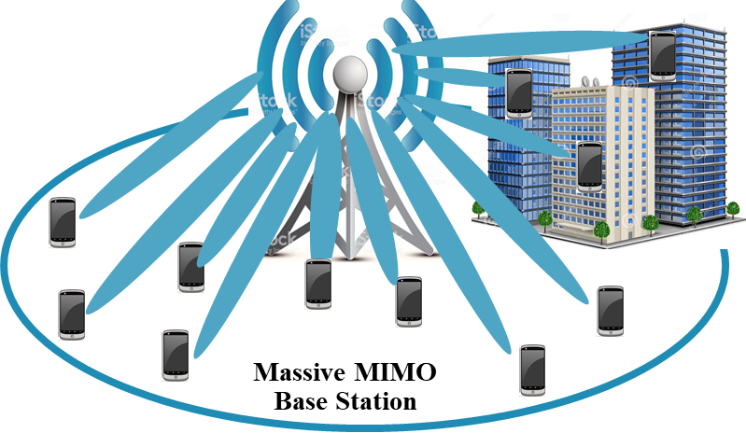
Opportunities and challenges at mmwave
A. Farid at al, RWS2021
Large available spectrum ()
Massive # of parallel channels, Multiple independent beams
Low-cost high-performance packaging (?)

Slide 4
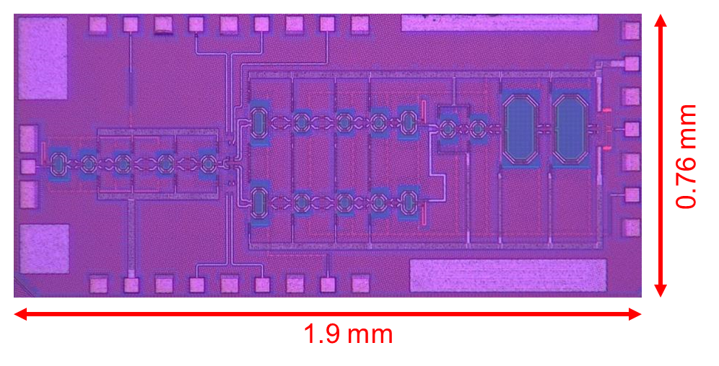
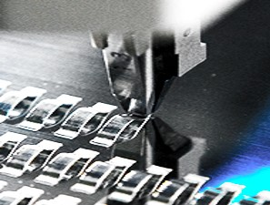
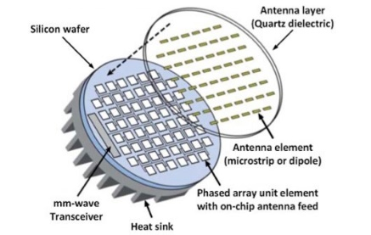
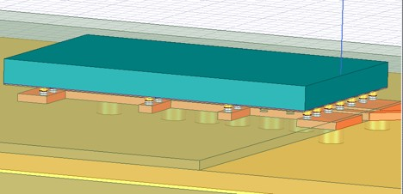
IC and Package Interconnect
Type | Transition Loss/ Frequency | Technology | Cost | Heatsinking
(ball) wirebonds | 100 GHz ✘ | Industry standard | low | good
ribbon, mesh bond | 200 GHz | Handcrafted | high ✘ | good
patch antennas on superstrate | 1000 GHz | Straightforward | low | good
Cu stud flip-chip | >200 GHz | Industry standard | low | OK
A. Farid at al, RFIC2019
Direct Conversion RX in GF-22FDSOI
20GHz 3-dB BW
27dB Conversion gain
Mark Rodwell, "100-300GHz Wireless: Transistors, ICs, packages, systems.“6G Workshop, IEEE RF/Wireless Week (RWW2021), 17 - 20 January San Diego, California, USA

Slide 5
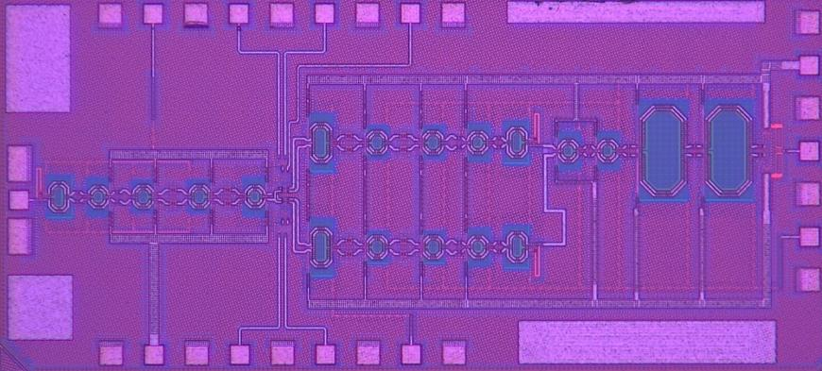
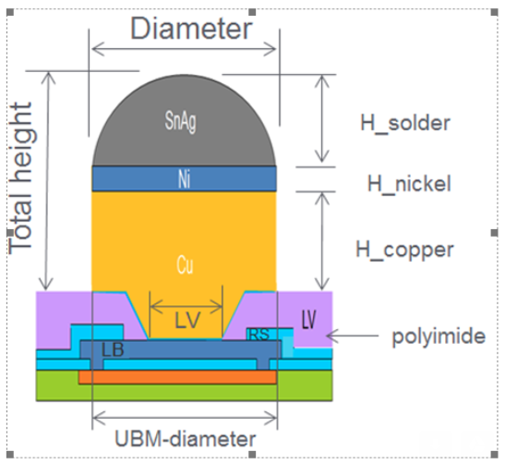
IC and Package Interconnect
A. Farid at al, RFIC2019
A. Farid at al, BCICST2021
Chip bonded to LTCC carrier using 50μm diameter copper pillar
Pillars equally spaced at 125μm
IC-package transition loss of 1dB

Slide 6
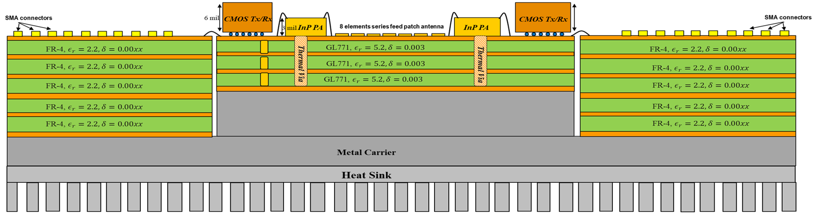
MIMO 1-D Array Tile
Ceramic Interposer
Lower Cost PCB!
High Lithographic resolution (40μm)
0.6λ antenna spacing
Dense wirebond routing from Interposer to carrier board
Higher Cost and slower turnaround time
Coarse Lithographic resolution (80μm)
λ antenna spacing
No need for wire bonding (all solution on one board)
Lower Cost?

Slide 7
Challenges with the PCB approach
Issues | Lessons learned
Difficulty in bonding copper studs to PCB Over etched boards/poor quality Wider solder mask opening Thick solder mask layers | PCB unsuitable for copper pillars High resolution PCB is expensive

Slide 8
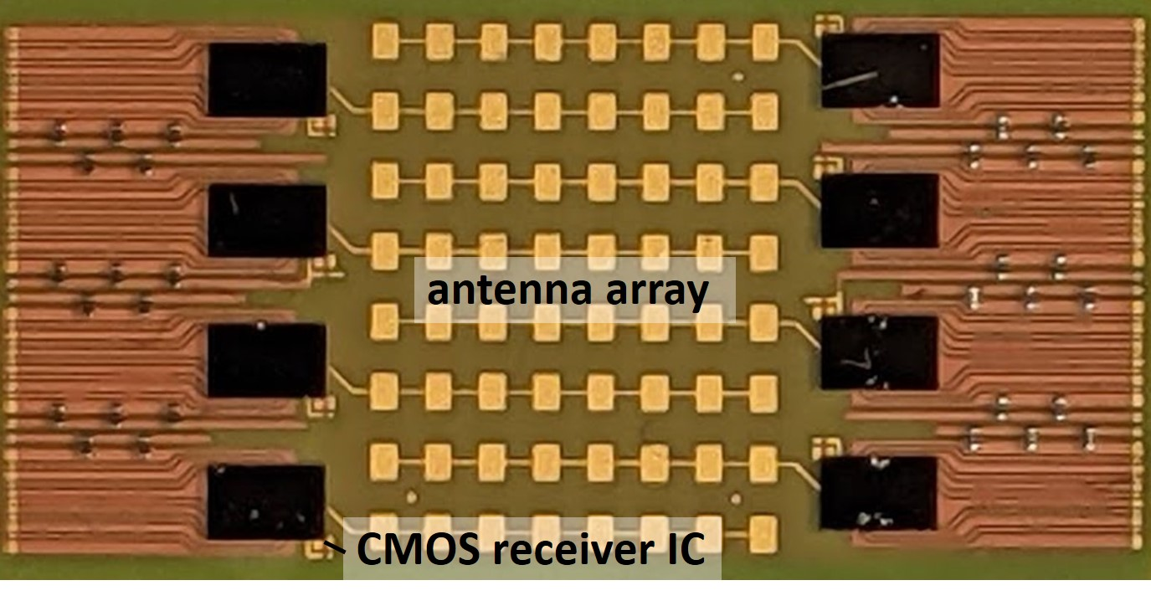
Integrated Receiver Module on LTCC
4 channels/side
8-elements series fed-patch antenna/channel
0.65λ antenna spacing
I/Q , LO, DC signals routed from LTCC to PCB using AL wirebonds (1.25mil)

Slide 9
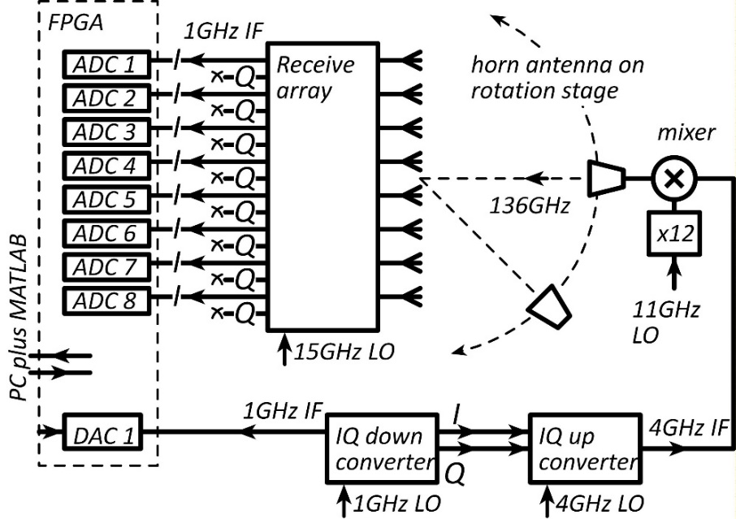
Module Calibration and Testing Setup
Rx module connected to ZCU-111 for array calibration and beamforming.
Test transmitter mounted at 15cm distance on a rotating arm.
Wideband 1-GHz OFDM signal used for array calibration (explain briefly)
https://github.com/pi-radio/Pi-Radio-v1-NRT
https://dl.acm.org/doi/abs/10.1145/3411276.3412195

Slide 10
Module Conversion Gain & Radiation Pattern
8-working channel
floating ground!
4-working channel
1.3 λ antenna spacing (Limited F.O.V)

Slide 11
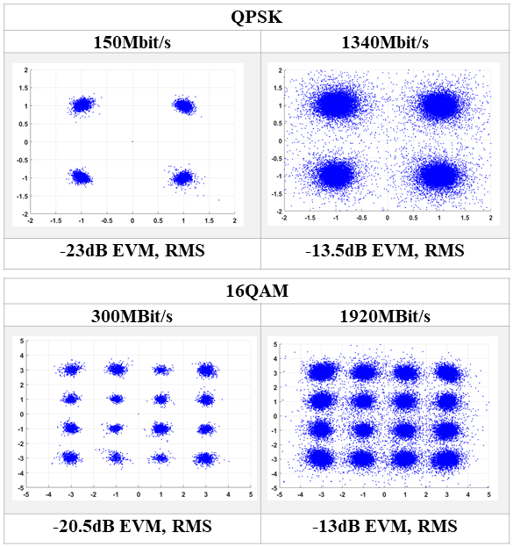
Receiver Module Wireless Link
In single-beam operation: there is –
13.5dB RMS EVM in 1.34Gb/s QPSK
13dB EVM, RMS in 1.92Gb/s 16QAM
What is limiting Module datarate?

Slide 12
Comparison with state of the art
 | Townley CICC2020 | Singh RFIC2020 | S. Li IMS2021 | Abu-Surra ICC2021 | Sawaby RFIC2020 | This Work
Freq (GHz) | 113 | 115-155 135-170 | 140 | 140 | 135 | 135
IC Technology | 28nm CMOS | 0.13μm SiGe | 45nm SOI | 45nm SOI | 0.13μm SiGe | 22FD-SOI
Package Technology | PCB | Radio on Glass | Quartz Superstrate | PCB | PCB + Lens | LTCC Interposer
Type | 1 Channel | 1 Channel | Single beam | MIMO$ | 2x2 LOS MIMO | MIMO
# of channels | 2 | 1 | 8 | 4,8, and 16 | 2 | 8
Antenna | Yes | No | Yes | Yes | Yes | Yes
Data rate | 80Gb/s | 36Gb/s 8Gb/s | 16Gb/s 18Gb/s | 6Gb/s | 2x16Gb/s | 3Gb/s
Format | 16QAM | 64QAM /256QAM | QPSK 64QAM | 16QAM | QPSK | 16QAM
EVM | -- | -23dB -30dB | 6.25% 5.5% | NA | -- | -13.5dB -13dB
Link | Air | WR-6 | Air | Air | Air | Air
Distance | 10cm | -- | -- | 15m | 6cm | 15cm

Slide 13
Conclusion
Packaging approach for massive MIMO arrays in Tile
Assembly challenges with advanced copper pillars
Why PCB approach is not the right candidate
Tile of 8-elements with 3Gb/s per beam

Slide 14
Acknowledgment
Authors would like to thanks
Kyocera Japan for ceramic interposer fabrication
Kyocera San Diego for module assembly
GlobalFoundries for CMOS chip fabrication and free access to advanced copper pillars
This work was supported in part by the Semiconductor Research Corporation and DARPA under the JUMP program.

Slide 15
Questions?

