Slide 1



A 200 GHz InP HBT Direct-Conversion
LO-Phase-Shifted Transmitter/Receiver
with 15 dBm Output Power
Munkyo Seo¹, Ahmed S. H. Ahmed^{2,3}, Utku Soylu³, Ali Farid³,
Yunsik Na¹, and Mark Rodwell³
¹Dept of ECE, Sungkyunkwan University, South Korea
²Marki Microwave Inc., USA
³Dept of ECE, University of California, Santa Barbara, USA

Slide 2
Outline
Motivation
Overview
Transceiver circuit design
Measured results
Summary

Slide 3
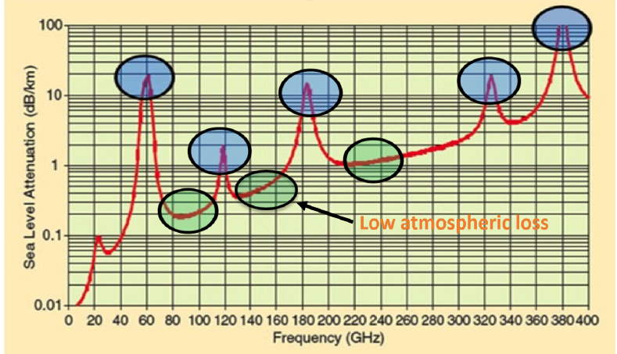


Wireless Communication @ 200 GHz
Motivation
  Large available BW → High data rate (6G)
  Low atmospheric loss @ 200 GHz band
Challenges
  Short wavelength → High path loss
  Low transistor gain → Low efficiency → Low battery life
Proposed 200 GHz transceiver
  InP-HBT → High P_{out} & high efficiency
  Mixed use of normal & inverted microstrip
  Integrated LO phase shifter → Phased-array
Normal microstrip
1.1 dB/mm @200GHz
Ground holes
PA & LNA
Inverted microstrip
2.5 dB/mm @200GHz
Continuous GND
High-density blocks

Slide 4
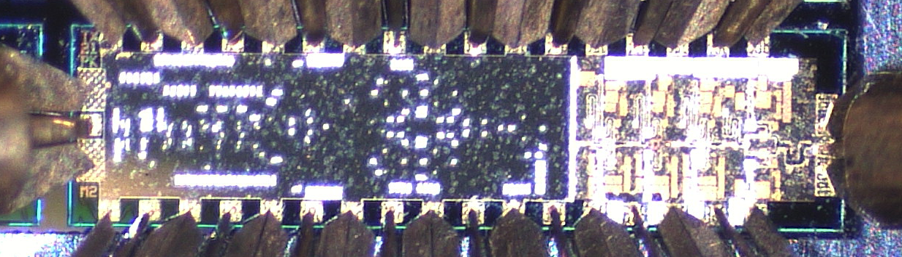
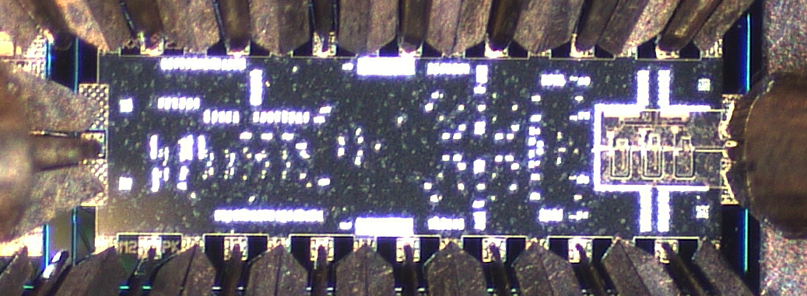
Proposed 200 GHz Transmitter / Receiver
200 GHz direct-conversion TX
200 GHz direct-conversion RX
Size: 2.9 x 0.75 mm²
Size: 2.3 x 0.85 mm²
LO multiplier
chain
TX I-Q mixer
LO multiplier
chain
RX I-Q mixer
PA
0 º
90 º
LNA
25 GHz
0 º
90 º
25 GHz
Phase
Shifter
Phase
Shifter
RF
x2
x2
x2
RF
x2
x2
x2
Inverted microstrip
I
Q
Normal microstrip
Inverted microstrip
I
Q
Normal microstrip
PA & LNA: Normal microstrip for best PAE and lowest NF
Mixer, LO multiplier, phase shifter: Inverted microstrip for low-inductance ground
Integrated LO phase shifter enables phased-array operation of multiple ICs

Slide 5
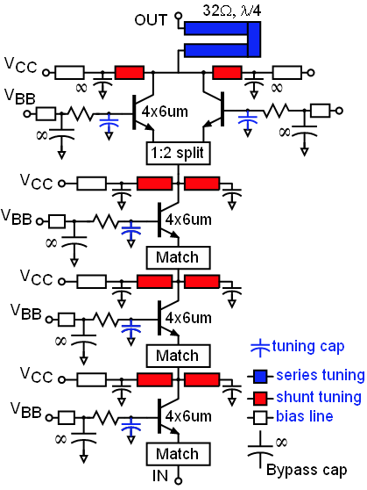
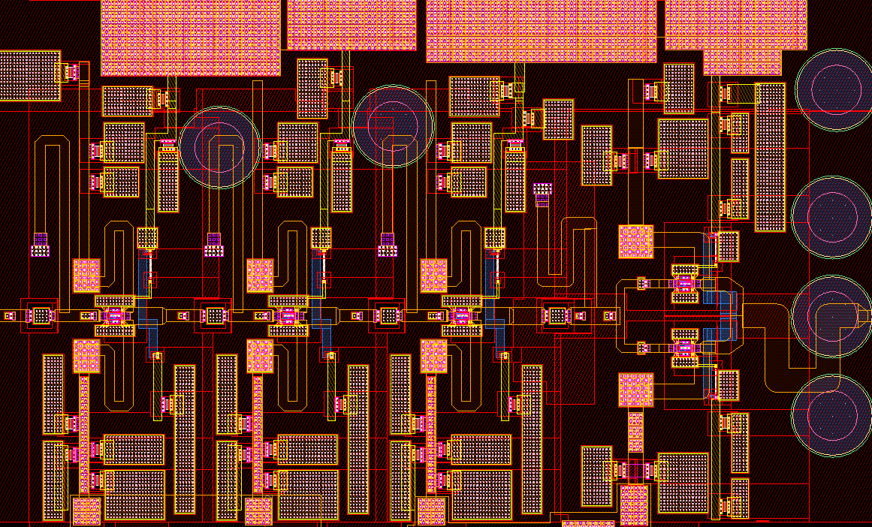
200 GHz PA Design
PA schematic
PA layout
Size: 850 x 550 μm²
4-stage common-base w/ C_{base}
  Higher efficiency @OP1dB than common-emitter
  Higher efficiency @OP1dB than common-base with no C_{base}
Low-loss 2:1 combiner w/ a single λ/4 line & shunt L
Sim: P_{sat} = 17dBm@200GHz, S₂₁ > 20dB, P_{DC} = 450mW

Slide 6
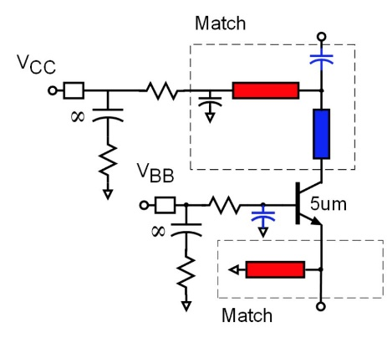
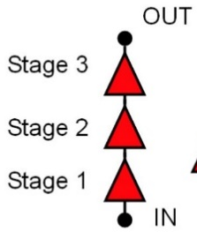
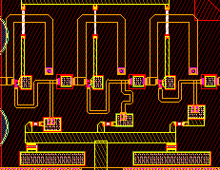
200 GHz LNA Design
3-stage LNA
1-stage
3-stage LNA layout
Size: 350 x 250 μm²
3-stage common-base (CB)
Base cap. adjusted for simultaneous noise & S₁₁ matching
Emitter length scaled for minimum input matching loss
Simulation: S₂₁ = 15dB, 3-dB BW = 35GHz, P_{DC} = 14mW

Slide 7
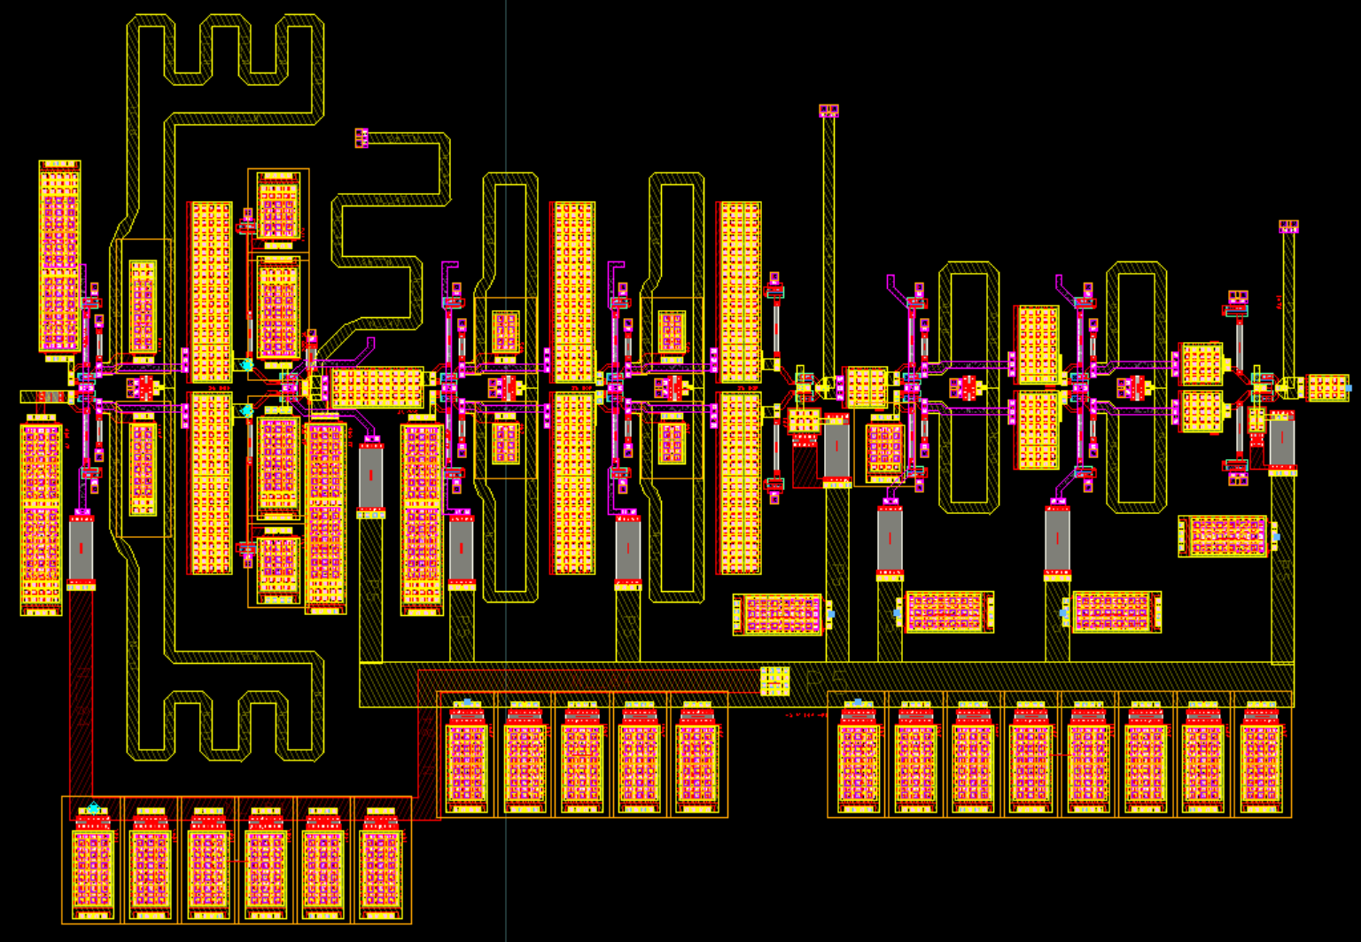
LO Frequency Multiplier Design
x8 LO multiplier schematic
25 GHz
50 GHz
100 GHz
200 GHz
Multiplier layout
x2
x2
x2
Size: 580 x 400 μm²
Cascade of three push-push doublers → x8 LO multiplier
Capacitive emitter degeneration → Operates with wider ranges of P_{in}
Simulation: P_{out} > 0dBm for 180-230GHz (BW = 50GHz), P_{DC} = 250mW

Slide 8
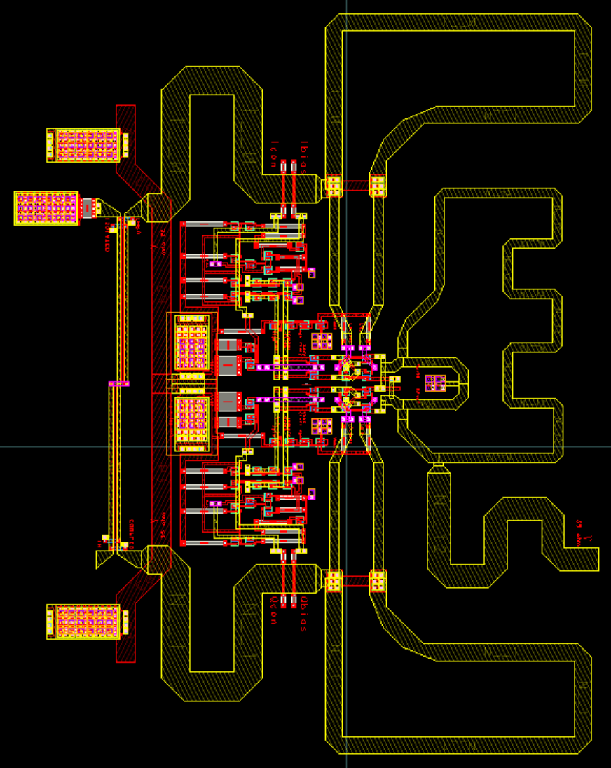
200 GHz LO Phase Shifter
Phase shifter schematic
Phase shifter layout
Lange
coupler
I-Q
Vector
Mod.
0 °
Balun
Input
Balun
Output
90 °
Balun
Sign
control
(I & Q)
Bias
control
(I & Q)
Size: 300 x 400 μm²
Vector-modulator-based phase shifter
Wideband operation by using Lange coupler
Sim: I/Q phase error < 2deg, mag. error < 0.3dB for 170-250GHz, P_{DC} = 100mW

Slide 9
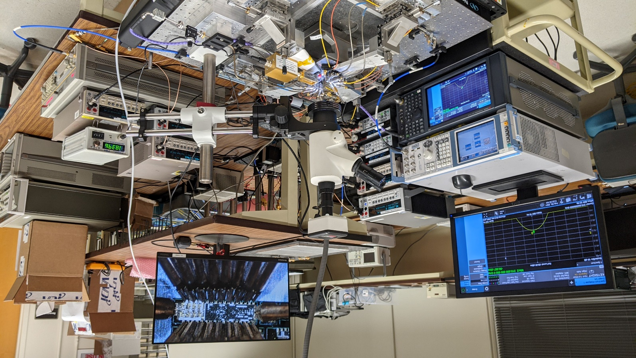
Transmitter Testing Setup
20 dB coupler
0 – 20 GHz (BB)
BB in
RF out
Power meter (PM4)
LO in
25.6 GHz (LO)
Spectrum analyzer
200 GHz
TX IC
Harmonic mixer
140-220 GHz (WR5) on-wafer testing
Simultaneous freq. & power testing
TX used as a calibration reference

Slide 10
Measured TX Conversion Gain
Conversion Gain @ fixed f_{LO}
Conversion Gain @ fixed f_{BB}
Peak conversion gain = 34 dB
3-dB bandwidth > 20 GHz
LO multiplier tuning bandwidth > 30 GHz

Slide 11
Measured TX Output Power
P_{out} vs P_{in} @ f_{LO}=207 GHz (f_{BB}=1 GHz)
P_{sat} vs f_{RF}
P_{sat} = 16.5 dBm @ f_{RF} = 195 GHz, 15.3 dBm @ f_{RF} = 200 GHz
P_{DC} = 1,250 mW

Slide 12
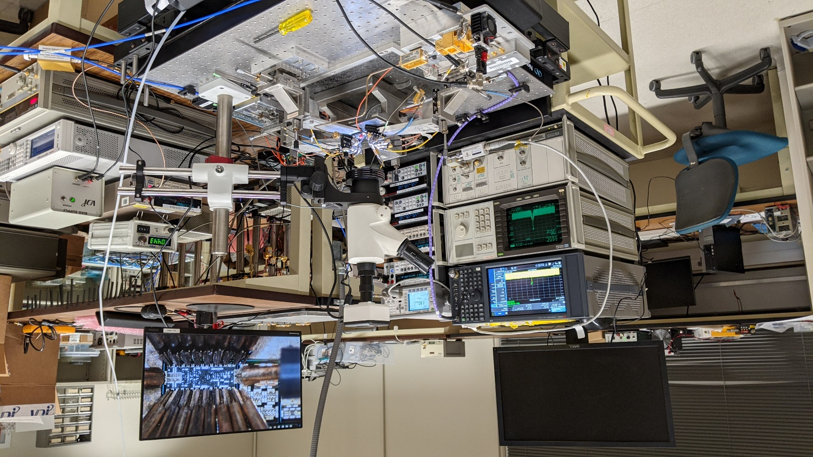
Receiver Testing Setup
Freq. Multiplier
20 dB coupler
Var. attenuator
20 dB coupler
RF in
BB out
×8
Power meter
LO in
Spectrum analyzer
200 GHz
RX IC
Spectrum analyzer
LO
Harmonic mixer
140-220 GHz (WR5) on-wafer testing
Simultaneous freq. & power testing
RX driven by multiplier & variable attenuator

Slide 13
Measured RX Conversion Gain
Conversion Gain @ fixed f_{LO}
Conversion Gain @ fixed f_{BB}
Peak conversion gain = 25 dB
LO multiplier tuning bandwidth > 25 GHz

Slide 14
Measured RX Power & Noise Figure
P_{out} vs P_{in} @ f_{LO}=206 GHz (f_{BB}=1 GHz)
VDI-WR5.1-NS
Hot/Cold noise source
RX-IC
BB LNA
SA
Noise Figure
Input P_{1dB} = -24 dBm
P_{sat} = +1 dBm
P_{DC} = 825 mW
NF = 7.7 – 9.3 dB (200-212 GHz)

Slide 15
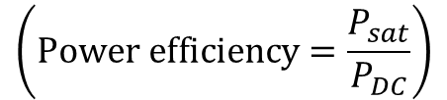
Performance Comparison of Transmitter
This work
This work
$$\left(\text{Power} \text{efficiency}=\frac{P_{sat}}{P_{DC}}\right)$$

Slide 16
Summary
200 GHz direct-conversion transmitter / receiver in InP HBT
Highest P_{out} and efficiency, among all integrated TX beyond 200 GHz
Modulated testing is under way

Slide 17
Acknowledgement
This work was supported by ComSenTer, a JUMP program sponsored by the Semiconductor Research Corporation, by a gift from Samsung corporation and by the Samsung Electronics, under the Grant SRFC-TB1803-06.
The authors thank Teledyne Scientific & Imaging for the IC fabrication.

Slide 18
Thank you very much!

Slide 19
References
[1] M. J. W. Rodwell et al., “100-340GHz Systems: Transistors and Applications,” in Proc. IEEE IEDM, 2018, pp. 14.3.1-14.3.4
[2] M. Abbasi et al., “Single-chip 220-GHz active heterodyne receive and transmitter MMICs with on-chip integrated antenna,” IEEE Trans. Microwave Theory and Techniques, vol. 59, no. 2, Feb. 2011.
[3] D. Lopez-Diaz et al., "A subharmonic chipset for gigabit communication around 240 GHz," 2012 IEEE/MTT-S International Microwave Symposium Digest, Montreal, QC, Canada, 2012, pp. 1-3.
[4] Z. Wang, P. Chiang, P. Nazari, C. Wang, Z. Chen and P. Heydari, "A CMOS 210-GHz Fundamental Transceiver with OOK Modulation," in IEEE Journal of Solid-State Circuits, vol. 49, no. 3, pp. 564-580, March 2014.
[5] S. Kang, S. V. Thyagarajan and A. M. Niknejad, "A 240 GHz Fully Integrated Wideband QPSK Transmitter in 65 nm CMOS," in IEEE Journal of Solid-State Circuits, vol. 50, no. 10, pp. 2256-2267, Oct. 2015.
[6] S. Kim et al., "300 GHz Integrated Heterodyne Receiver and Transmitter with On-Chip Fundamental Local Oscillator and Mixers," in IEEE Transactions on Terahertz Science and Technology, vol. 5, no. 1, pp. 92-101, Jan. 2015.
[7] N. Sarmah et al., "A Fully Integrated 240-GHz Direct-Conversion Quadrature Transmitter and Receiver Chipset in SiGe Technology," in IEEE Transactions on Microwave Theory and Techniques, vol. 64, no. 2, pp. 562-574, Feb. 2016.
[8] D. Fritsche, P. Stärke, C. Carta and F. Ellinger, "A Low-Power SiGe BiCMOS 190-GHz Transceiver Chipset with Demonstrated Data Rates up to 50 Gbit/s Using On-Chip Antennas," in IEEE Transactions on Microwave Theory and Techniques, vol. 65, no. 9, pp. 3312-3323, Sept. 2017.
[9] S. Lee et al., "An 80-Gb/s 300-GHz-Band Single-Chip CMOS Transceiver," in IEEE Journal of Solid-State Circuits, vol. 54, no. 12, pp. 3577-3588, Dec. 2019.
[10] P. Rodríguez-Vázquez, J. Grzyb, B. Heinemann and U. R. Pfeiffer, "A 16-QAM 100-Gb/s 1-M Wireless Link with an EVM of 17% at 230 GHz in an SiGe Technology," in IEEE Microwave and Wireless Components Letters, vol. 29, no. 4, pp. 297-299, April 2019.
[11] P. Rodriguez-Vazquez, J. Grzyb, B. Heinemann and U. R. Pfeiffer, "A QPSK 110-Gb/s Polarization-Diversity MIMO Wireless Link With a 220–255 GHz Tunable LO in a SiGe HBT Technology," in IEEE Transactions on Microwave Theory and Techniques, vol. 68, no. 9, pp. 3834-3851, Sept. 2020.
[12] M. H. Eissa, N. Maletic, E. Grass, R. Kraemer, D. Kissinger and A. Malignaggi, "100 Gbps 0.8-m Wireless Link based on Fully Integrated 240 GHz IQ Transmitter and Receiver," 2020 IEEE/MTT-S International Microwave Symposium (IMS), Los Angeles, CA, USA, 2020, pp. 627-630.
[13] H. Hamada et al., "300-GHz-Band 120-Gb/s Wireless Front-End Based on InP-HEMT PAs and Mixers," in IEEE Journal of Solid-State Circuits, vol. 55, no. 9, pp. 2316-2335, Sept. 2020.
[14] A. S. H. Ahmed, M. Seo, A. A. Farid, M. Urteaga, J. F. Buckwalter and M. J. W. Rodwell, "A 140GHz power amplifier with 20.5dBm output power and 20.8% PAE in 250-nm InP HBT technology," 2020 IEEE/MTT-S International Microwave Symposium (IMS), Los Angeles, CA, USA, 2020, pp. 492-495.
[15] A. S. H. Ahmed, U. Soylu, M. Seo, M. Urteaga, J. F. Buckwalter and M. J. W. Rodwell., " A 190-210GHz Power Amplifier with 17.7-18.5dBm Output Power and 6.9-8.5% PAE.," in press, Proc. IMS2021.
[16] A. S. H. Ahmed, M. Seo, A. A. Farid, M. Urteaga, J. F. Buckwalter and M. J. W. Rodwell, "A 200mW D-band Power Amplifier with 17.8% PAE in 250-nm InP HBT Technology," 2020 15th European Microwave Integrated Circuits Conference (EuMIC), Utrecht, Netherlands, 2021, pp. 1-4.
[17] Y. Xing et al., “Propagation measurement system and approach at 140 GHz – Moving to 6G and above 100 GHz,” 2018 IEEE Global Communications Conference.

Slide 20
Performance Comparison
Ref. | Technology | Integrated TX circuit blocks | Freq. (GHz) | P_{sat} (dBm) | P_{DC} (mW) | Efficiency (%)
[2] | 0.1μm GaAs mHEMT | IF-mixer, LO multiplier (×2), PA, antenna | 220 | -6 | 110 | 0.23
[3] | 50nm GaAs mHEMT | IF-mixer, PA | 240 | 1 | N/A | N/A
[4] | 32nm SOI CMOS | LO VCO, OOK mod, PA, antenna | 210 | 4.6 | 240 | 1.20
[5] | 65nm CMOS | IQ-mixer, tripler | 240 | -0.5 | 220 | 0.41
[6] | 250nm InP-HBT | IF-mixer, LO driver, LO oscillator | 298.1 | -2.3 | 452 | 0.13
[7] | 130nm SiGe | IQ-mixer, LO multiplier (×16), PA | 240 | -4.4 | 1,033 | 0.04
[8] | 130nm SiGe | Mixer, LO driver, antenna | 190 | -6 | 32¹ | 0.78
[9] | 40nm CMOS | IQ-mixer, LO multiplier (×3) | 265.68 | -1.6 | 890 | 0.08
[10] | 130nm SiGe | IQ-mixer, LO multiplier (×16), PA | 220-255 | 5 | 960 | 0.33
[11] | 130nm SiGe | IQ-mixer, LO multiplier (×16), PA | 225-255 | 7.5 | 960² | 0.59
[12] | 130nm SiGe | IQ-mixer, LO multiplier (×8), PA | 240 | 12⁴ | 1,237 | 1.28
[13] | 80nm InP-HEMT | IF-mixer, LO driver, PA³ | 290 | 12 | 6,600 | 0.24
This work | 250nm InP-HBT | IQ-mixer, LO multiplier (×8), phase shifter, PA | 195 | 16.5 | 1,250 | 3.57
 |  |  | 200 | 15.3 | 1,250 | 2.71
¹P_{DC} not including LO generator at 190 GHz ²P_{DC} for 1-channel I-Q TX+LO ³Individually packaged, not integrated ⁴Measured from PA breakout

