Slide 1
L_{g} = 40nm Composite Channel MOS-HEMT Exhibiting f_{τ} = 420 GHz, f_{max} = 562 GHz
Brian Markman, Simoné Tommaso Šuran Brunelli, Matt Guidry, Logan Whitaker, and Mark Rodwell
UCSB Department of Electrical and Computer Engineering
Funding: SRC & DARPA

Slide 2
High f_{τ} , f_{max} HEMT Motivation
MOS-HEMT Advantage
Device 1 – Link Wet Etched
Fabrication
DC Characteristics
RF Characteristics
Device 2 – Link “Recessed”
Fabrication
DC Characteristics
RF Characteristics

Slide 3
High f_{τ} , f_{max} HEMT Motivation
Current electromagnetic bands are crowded
Need to move into currently unallocated bands at higher frequencies
Higher frequency = higher data rate = faster upload/download speeds
For circuits to be efficient (high PAE) need f_{op} ≈ 0.1-0.2 • f_{max}
Atmospheric attenuation means many base stations and spatial multiplexing

Slide 4
HEMT Motivation – Reduce Noise Figure
2:1 to 4:1 increase in f_{τ} :
Improved noise
Less required transmit power
Smaller PAs, less DC power
Or higher-frequency systems
Reprinted with permission of Mark Rodwell

Slide 5
Noise Figure / Measure Considerations
PA = Power Amplifier
LNA = Low Noise Amplifier
Signal in
Signal out
LNA
PA 1
PA 2
PA 3
$$F_{∞}=F_{1}+\frac{F_{2}−1}{G_{1}}+\frac{F_{3}−1}{G_{1}G_{2}}+\frac{F_{4}−1}{G_{1}G_{2}G_{3}}…$$
$$M=F_{∞}−1$$
Noise of cascaded amplifiers is more important than noise of one
F∞ can be big even if F₁ is small → cannot forget G₁
Cannot forget about f_{max} → Need balanced f_{ꚍ} , f_{max}

Slide 6
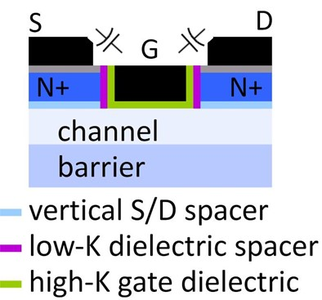
Reduce Noise Figure – What Device?
MOSFETs
Gate dielectric and L_{g} can't be much further scaled (CMOS and mm-wave)
g_{m}/W_{g} (mS/μm) hard to increase → C_{end} / g_{m} prevents f_{τ} scaling
Move source-drain further away → HEMTs

Slide 7
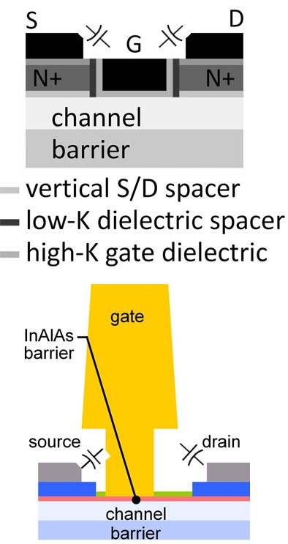
Reduce Noise Figure – What Device?
MOSFETs
Gate dielectric and L_{g} can't be much further scaled (CMOS and mm-wave)
g_{m}/W_{g} (mS/μm) hard to increase → C_{end} / g_{m} prevents f_{τ} scaling
Move source-drain further away → HEMTs
HEMTs
Gate leakage current density → small CBO of InAlAs to InGaAs
R_{S} associated with getting electrons through widegap modulation doped link

Slide 8
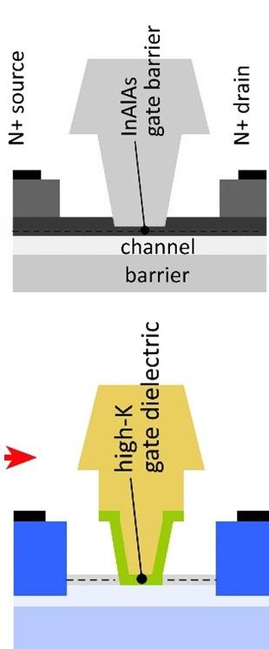
Reduce Noise Figure – What Device?
MOSFETs
Gate dielectric and L_{g} can't be much further scaled (CMOS and mm-wave)
g_{m}/W_{g} (mS/μm) hard to increase → C_{end} / g_{m} prevents f_{τ} scaling
Move source-drain further away → HEMTs
HEMTs
Gate leakage current density → small CBO of InAlAs to InGaAs
R_{S} associated with getting electrons through widegap modulation doped link
MOS-HEMTs
Replace InAlAs gate dielectric with high-k
Reduces gate leakage, increases C_{g-ch}, increases g_{m}, increases f_{τ}
Better electrostatics, increases g_{m} / G_{DS}, increases f_{max}
Regrowth process rather than recess etch process
Place N+ source-drain directly on channel, reduces R_{S}, increase g_{m}

Slide 9
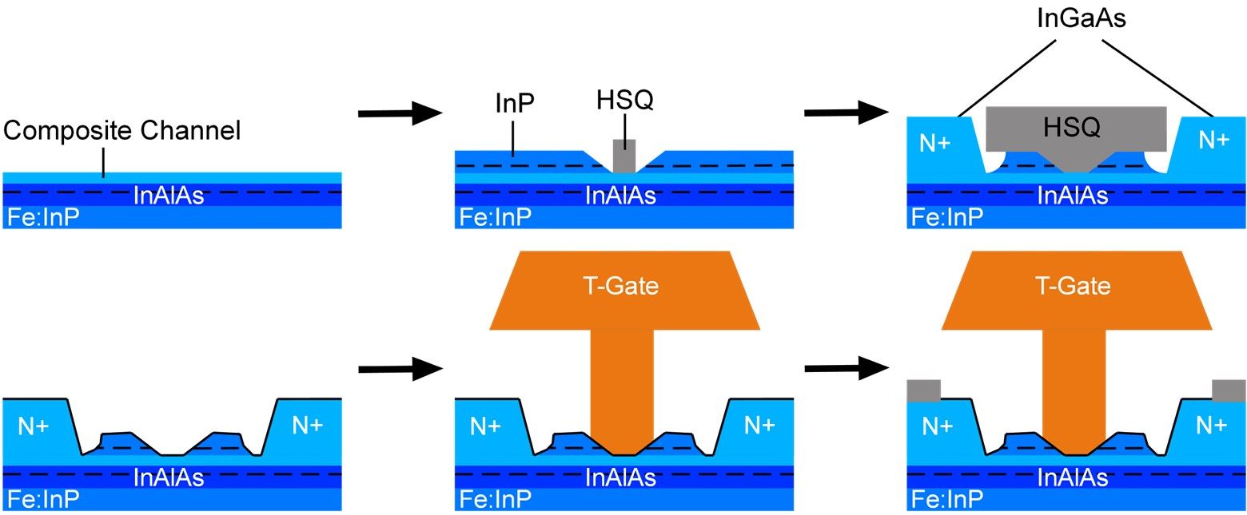
Device 1 – Link Wet Etched

Slide 10
Device 1 – Device Structure
Au
Au
High-k
Ni
Al_{x}O_{y}N_{z}
Ni
Undercutting
Au
Ni
N+ InGaAs
Ni
InP
InAlAs
~17.5nm
InP etch stop
Channel
InAlAs
InAlAs
Composite link
InAlAs
t_{ch} | Channel Material | ZrO₂ Cycles
2.5 nm | InGaAs | 30

Slide 11
Device 1 – DC Characteristics
Same as [1] → likely large R_{end} due to isotropic undercut, R_{vert} likely lower
Peak g_{m} | R_{A} | I_{on} | I_{off} | I_{g} | Long L_{g} SS_{min}
1.6 mS/µm | 69 Ω•µm | > 0.75 mA/µm | > 1.0 µA/µm | < 10 nA/µm | N/A

Slide 12
Device 1 – Peak Performance
Peak f_{ꚍ} = 356 GHz and f_{max} = 403 GHz on the same device (L_{g} = 12 nm $\left(0\overline{1}1\right)$ conduction)
Shift to larger V_{GS} due to thin channel and higher V_{DS}
Why aren’t g_{m} and f_{t} larger? Channel is thin, have high-k, both should be high!

Slide 13
Thin Channels are not the Whole Picture
Thin channel gives large C_{QW} and C_{DOS}
C_{QW}: Wave-function moves towards oxide
C_{DOS}: in-plane effective mass increases
Wave function has “thickness”
Fermi Level moves to populate low DOS
Oxide
Channel
Back Barrier
Oxide
Channel
Back Barrier
$$E_{F}$$
$$E_{1}$$
$$E_{1}$$
$C=\frac{g_{v}m^{∗}q^{2}}{2πħ^{2}}$
$$C=\frac{ε_{ch}}{t_{ch}/2}$$
$$g_{m}≡\frac{∂I_{D}}{∂V_{GS}}∝\sqrt{\left(C_{GS}\left[V_{G}−V_{T}\right]\right)}$$

Slide 14
Thin Channels are not the Whole Picture
Thin channel gives large C_{QW} and C_{DOS}
C_{QW}: Wave-function moves towards oxide
C_{DOS}: in-plane effective mass increases
Wave function has “thickness”
Fermi Level moves to populate low DOS
Oxide
Channel
Back Barrier
Oxide
Channel
Back Barrier
$$E_{F}$$
$$E_{1}$$
$$E_{1}$$
$C=\frac{g_{v}m^{∗}q^{2}}{2πħ^{2}}$
$$C=\frac{ε_{ch}}{t_{ch}/2}$$
$$g_{m}≡\frac{∂I_{D}}{∂V_{GS}}∝\sqrt{\left(C_{GS}\left[V_{G}−V_{T}\right]\right)}$$

Slide 15
Ultra-thin Body Quantum Wells
Maximum $\left(V_{gs}−V_{th}\right)∝\left(E_{F}−E_{1}\right)$, depends on band offset of channel | back barrier
Thin Channel Take-Aways:
Larger $E_{1}∝\frac{1}{m^{∗}t^{2}}$ → less available $\left(E_{F}−E_{1}\right)$, small m* channels → E₁ move faster
Channel needs to be thick enough for small E₁ = high g_{m,i}, I_{DS}
Channel needs to be thin enough for high C_{gs,i} and high aspect ratio (g_{m} / G_{DS})
Sweet spot ~6-10nm, unsurprisingly consistent with SOA MOSFETs and HEMTs

Slide 16
Device 1 – Take Away
Wet etching gives unpredictable link region profile
R_{S} moderately reduced but isotropic profile not worth reduction
Results in larger R_{L} due to resistive ends
Thin channels limit maximum g_{m}
Low I_{g} → room to thin high-k
Optimize channel thickness → thicker NOT thinner

Slide 17
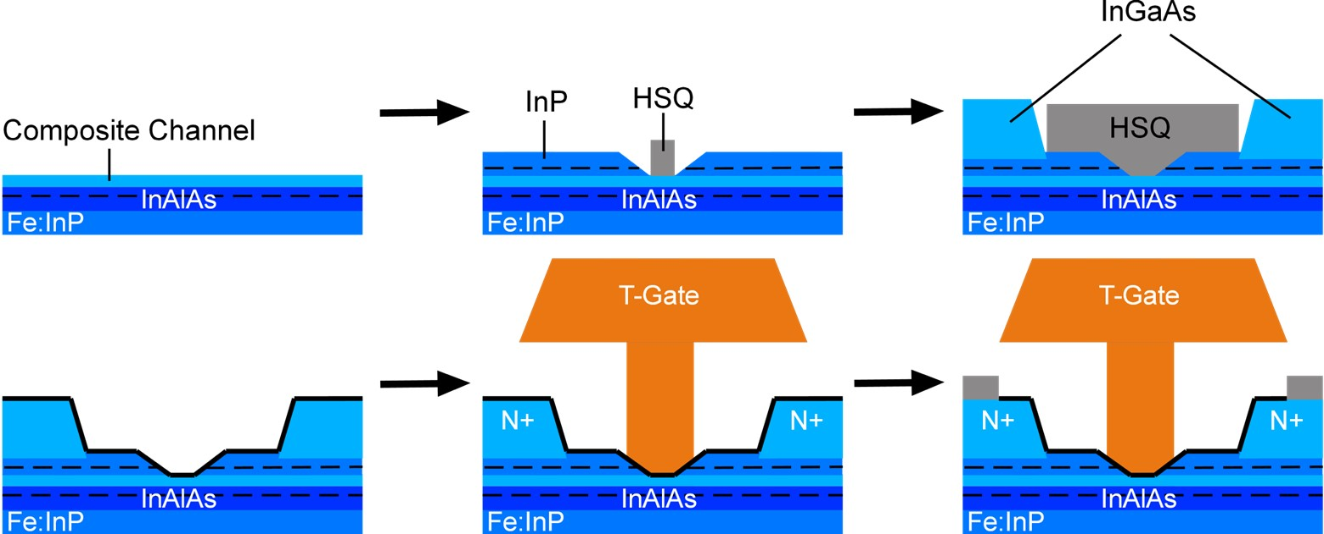
Device 2 - Fabrication

Slide 18
Device 2 – Device Structure
t_{ch} | Channel Material | ZrO₂ Cycles
7.0 nm | InAs / InGaAs | 30

Slide 19
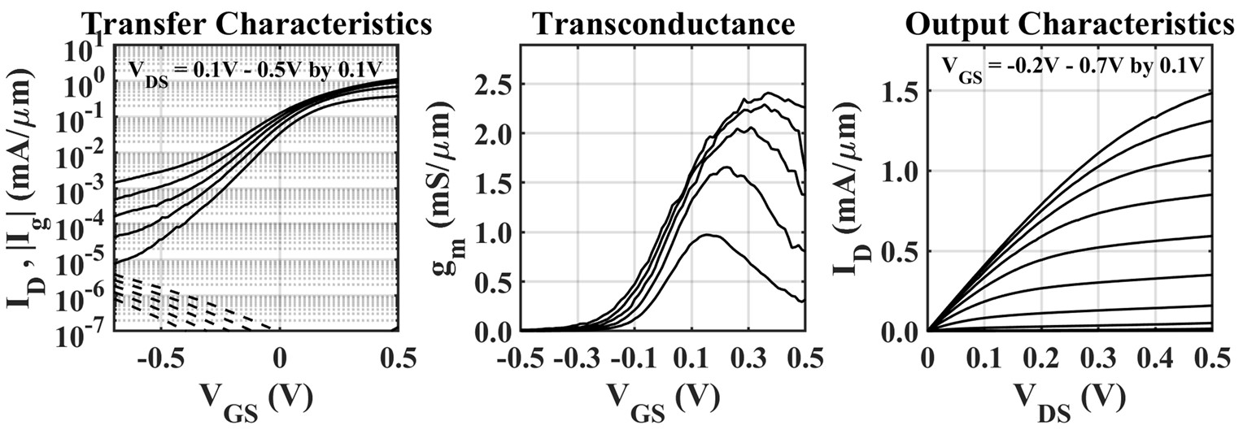
Device 2 – DC Characteristics
Peak g_{m} | R_{A} | I_{on} | I_{off} | I_{g} | Long L_{g} SS_{min}
2.4 mS/µm | 49 – 55 Ω•µm | > 1.45 mA/µm | < 10 nA/µm | < 10 nA/µm | 76 mV/dec

Slide 20
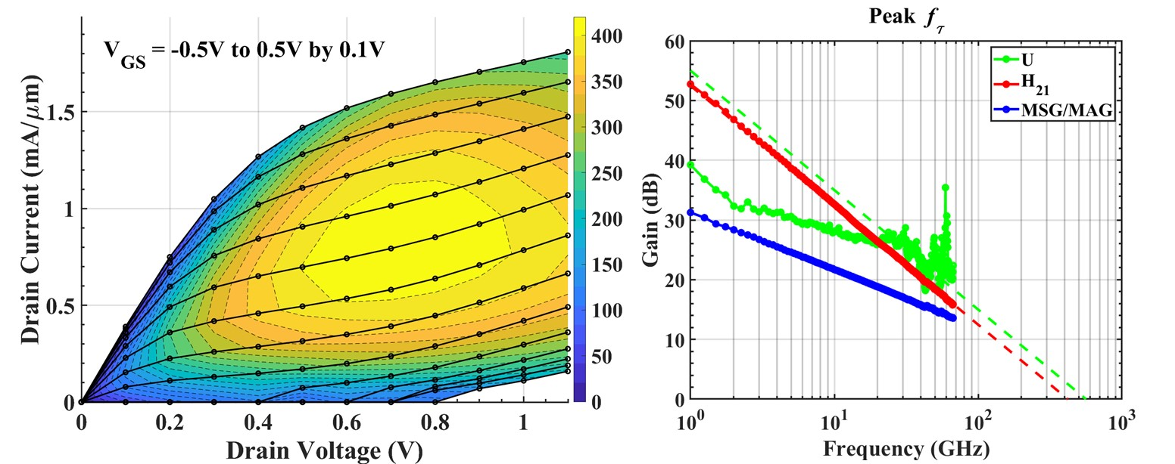
Device 2 – Peak Performance – L_{g} = 40 nm, W_{mesa} = 10µm
f_{ꚍ} = 420 GHz
f_{max} = 562 GHz
V_{DS} = 0.70 V
V_{GS} = 0.30 V
I_{DS} = 0.793 mA/µm
Peak f_{ꚍ} = 420 GHz on L_{g} = 40 nm $\left(0\overline{1}1\right)$ conduction device, peak f_{max} at L_{g} = 50 nm
Extrapolation of f_{max} difficult because of noisy U → occasionally see “spiking”

Slide 21
Deice 2 – Take Away
Link thinning gives excellent R_{S} and predictable profile
Peak g_{m} likely limited source-starvation → need more n_{Link}
Low I_{g} → room to thin high-k
Need to improve T-Gate process to reduce C_{GS,p} and C_{GD,p}

Slide 22
HEMT / MOS-HEMT State-of-the-Art
HEMTs
MOS-HEMTs
NGC 2015
NTT 2018 – 2019
Teledyne 2011
Fraunhofer 2019
UCSB 2018 – 2021
Tokyo 2013

Slide 23
Conclusions
Extremely high g_{m} = 2.9 mS/µm → competitive with SOA HEMTs
Extremely low R_{S} < 100 Ω•µm → will increase with InAlAs link
Extremely low g_{ds} = 0.2 mS/µm → significantly better than SOA HEMTs
Improving high frequency FOMs → f_{ꚍ} , f_{max} > 400 GHz
Need to improve T-Gate process to reduce parasitics!

Slide 24
MOS-HEMT Future Work
Problems:
Peak f_{ꚍ} severely limited by large C_{GS,p} → need a self-aligned process
Peak f_{max} limited by large R_{G} (poor yield & reproducibility) → improve T-Gate process
Low breakdown voltage and therefore low power-handling → wide E_{g} channel
Solutions:
Self-Aligned “Regrowth Reversal” Process → reduces C_{GS,p} and improves T-Gate process
Wide-bandgap back-barriers (AlAsSb) for improved G_{DS}
InP channel / AlAsSb back-barrier MOS-HEMT for high-power

Slide 25
Acknowledgements
Funding: DARPA ComSenTer

Slide 26
QUESTIONS

Slide 27
FET Scaling Laws (Now Broken)
Wave function has “thickness”
FET parameter | change
gate length | decrease 2:1
current density (mA/mm) | increase 2:1
specific transconductance (mS/mm) | increase 2:1
transport mass | constant
2DEG electron density | increase 2:1
gate-channel capacitance density | increase 2:1
dielectric equivalent thickness | decrease 2:1
channel thickness | decrease 2:1
channel state density | increase 2:1
contact resistivities | decrease 4:1
Oxide
Channel
Back Barrier
$$E_{1}$$
$$C=\frac{ε_{ch}}{t_{ch}/2}$$
Fermi Level moves to populate low DOS
Oxide
Channel
Back Barrier
$$E_{F}$$
$$E_{1}$$
$C=\frac{g_{v}m^{∗}q^{2}}{2πħ^{2}}$

Slide 28
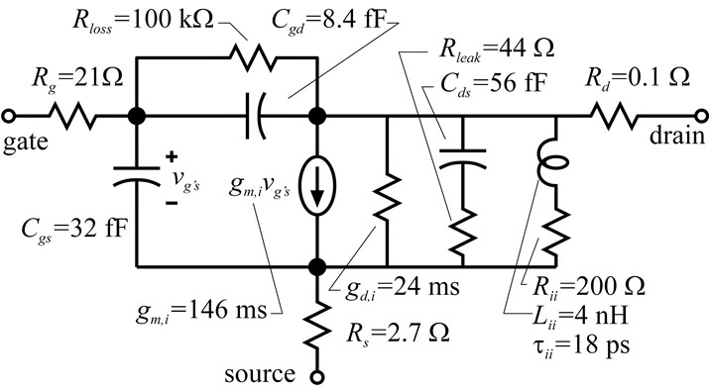
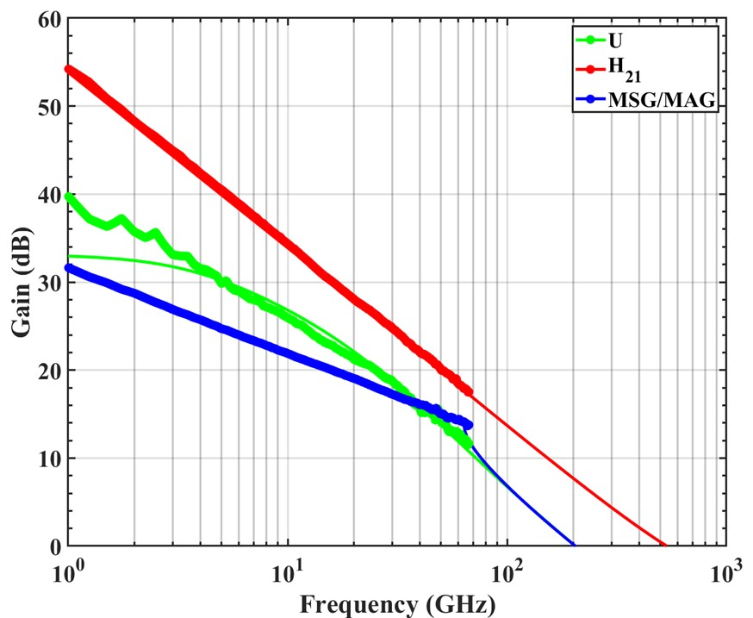
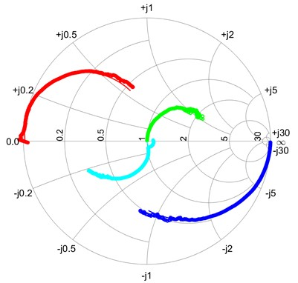
[1] Device 0 SSEC: L_{g} = 8 nm
$f_{τ}=533 GHz$
$f_{max}=204 GHz$
S₂₁/5
5•S₁₂
$V_{DS}=0.70 V$
$V_{GS}=0.30 V$
$I_{DS}=0.852 mA/μm$
S₂₂
S₁₁

Slide 29
Device 1 SSEC: L_{g} = 12 nm
f_{ꚍ} = 375 GHz
f_{max} = 326 GHz
V_{DS} = 1.00 V
V_{GS} = 0.50 V
I_{DS} = 0.664 mA/µm
S₂₁/5
5•S₁₂
S₂₂
SSEC very difficult to fit… do not trust this model
S₁₁

Slide 30
Device 2 SSEC: L_{g} = 40 nm
Significantly improved fit, trustable
$f_{τ}=454 GHz$
$f_{max}=567 GHz$
$V_{DS}=0.70 V$
$V_{GS}=0.30 V$
$I_{DS}=0.852 mA/μm$

Slide 31
Model vs. Extrapolation
Device | Extraction | L_{g} (nm) | f_{ꚍ} (GHz) | f_{max} (GHz)
0 | Extrapolation | 8 | 511 | 256
0 | Modeled | 8 | 533 | 204
1 | Extrapolation | 12 | 356 | 398
1 | Modeled | 12 | 375 | 326
2 | Extrapolation | 40 | 402 | 560
2 | Modeled | 40 | 454 | 567

Slide 32
[1] Device 0 - Fabrication

Slide 33
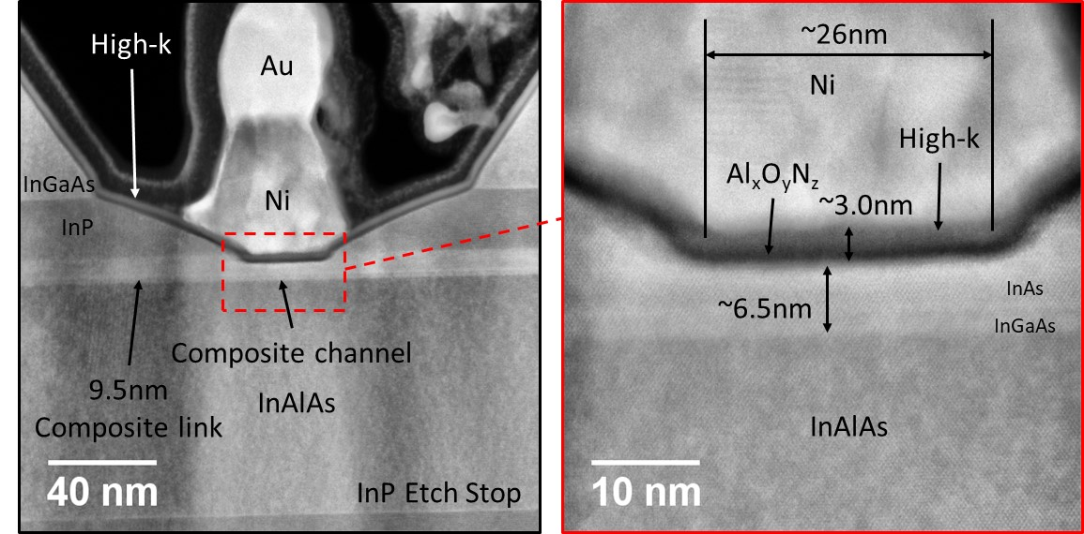
[1] Device 0 – Device Structure
t_{ch} | Channel Material | ZrO₂ Cycles
6.5 nm | InAs / InGaAs | 40

Slide 34
[1] Device 0 – DC Characteristics
Peak g_{m} | R_{A} | I_{on} | I_{off} | I_{g} | Long L_{g} SS_{min}
2.2 mS/µm | 68 – 85 Ω•µm | > 0.90 mA/µm | > 1.0 µA/µm | < 10 pA/µm | N/A

Slide 35
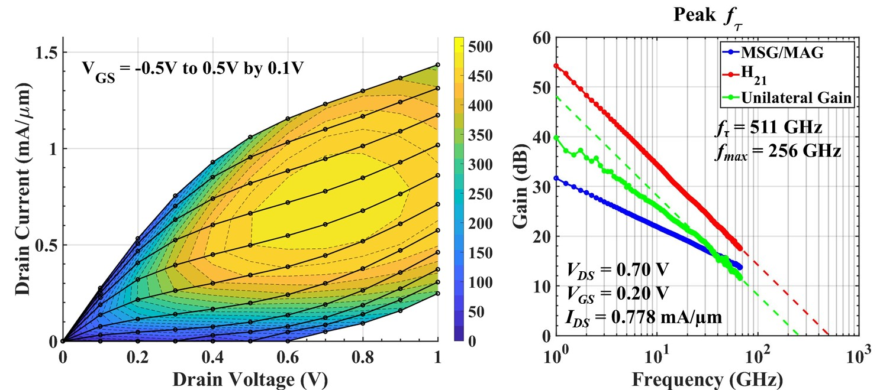
[1] Device 0 – Peak Performance

Slide 36
Device 1 – RF Characteristics
Balanced f_{ꚍ} , f_{max}
Extremely high C_{GS} ≈ 0.9 fF/µm
Rapid drop in FOMs due to thin channel
High C_{GD} ≈ 0.3 fF/µm
Low peak g_{m,e} ≈ 2.0 mS/µm
Improved R_{G} ≤ 10 Ω
Excellent g_{ds,e} ≈ 0.3 mS/µm

Slide 37
Device 2 – RF Characteristics
Balanced f_{ꚍ} , f_{max}
Extremely high C_{GS} ≈ 0.9 fF/µm
High C_{GD} ≈ 0.4 fF/µm
Gradually decreasing f_{ꚍ}
Constant / increasing f_{max}
High peak g_{m,e} ≈ 2.9 mS/µm
Maintained R_{G} ≤ 10 Ω
Excellent g_{ds,e} ≈ 0.2 mS/µm

Slide 38
HEMT / MOS-HEMT State-of-the-Art
Institution | Device | Year | g_{m} (mS/µm) | f_{t} (GHz) | f_{max} (GHz) | √(f_{t}•f_{max})
Teledyne | HEMT | 2011 | 2.75 | 688 | 800 | 742
Tokyo Tech | HEMT | 2013 | 2.1 | 710 | 478 | 583
NGC | HEMT | 2015 | 3.1 | 610 | 1500 | 957
NTT | HEMT | 2019 | 2.8 | 703 | 820 | 759
Fraunhaufer | MOS-HEMT | 2019 | 2.4 | 275 | 640 | 420
UCSB Gen. 0 | MOS-HEMT | 2018 | 1.5 | 357 | 410 | 383
UCSB Gen. 1 | MOS-HEMT | 2019 | 2.3 | 511 | 256 | 361
UCSB Gen. 2 | MOS-HEMT | 2019 | 1.6 | 356 | 403 | 379
UCSB Gen. 3 | MOS-HEMT | 2020 | 2.9 | 406 | 562 | 477

Slide 39
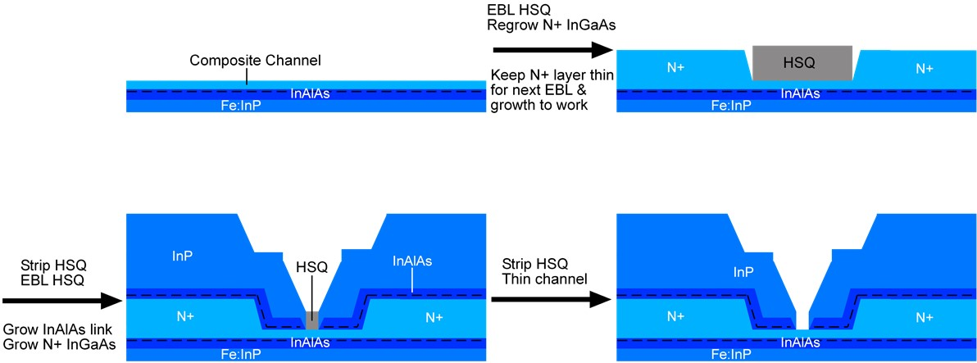
MOS-HEMT Future Work
Peak f_{ꚍ} severely limited by large C_{GS,p} → need a self-aligned process
Peak f_{max} limited by large R_{G} (poor yield & reproducibility) → improve T-Gate process
Develop > 1 x 10¹⁹ cm⁻³ In_{0.52}Al_{0.48}As for link region top barrier
Elegantly *hopefully* solved in one simple process

Slide 40
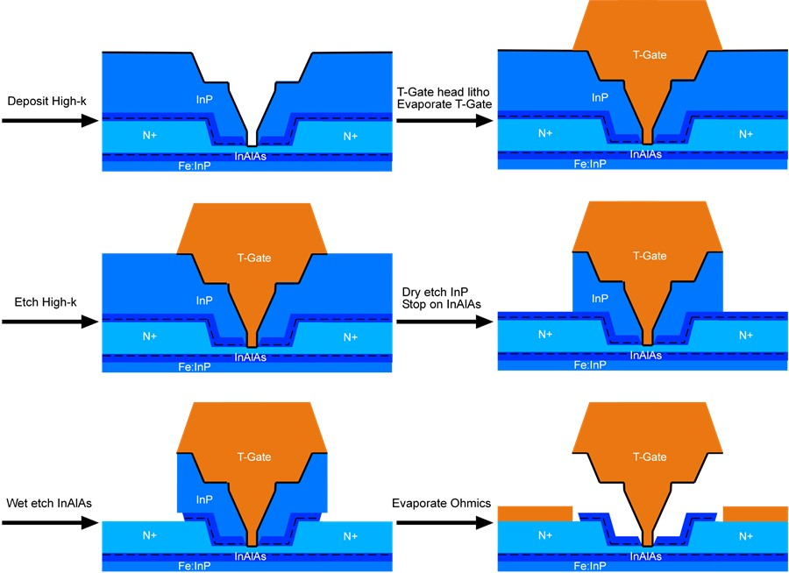
MOS-HEMT Future Work

Slide 41
MOS-HEMT Future Work
Advantages
Larger T-Gate aperture
Improved RG
Self-aligned Gate-Recess and T-Gate foot
Self-aligned ohmics possible
Disadvantages
Etching (dry & wet) in critical regions
Topography on wafer before critical dimension definition
Regrowth dynamics

