Slide 1
D-band CMOS+InP and CMOS-only MIMO communication transceiver technologies
Mark Rodwell University of California, Santa Barbara Rodwell@ece.ucsb.edu

Slide 2
Acknowledgments
Collaborators (ComSenTer): Debdeep Jena, Alyosha Molnar, Christoph Studer, Huili Xing: Cornell University Muhannad Bakir: Georgia Tech Sundeep Rangan: New York University Amin Arbabian, Srabanti Chowdhury: Stanford Elad Alon, Ali Niknejad, Borivoje Nikolic : University of California, Berkeley Danijela Cabric, Tim Fisher: University of California, Los Angeles Andrew Kummel, Gabriel Rebeiz: University of California, San Diego Jim Buckwalter, Upamanyu Madhow, Umesh Mishra, Mark Rodwell, Susanne Stemmer: University of California, Santa Barbara Andreas Molisch: University of Southern California Kenneth O: University of Texas, Dallas
Collaborators: (Samsung) Gary Xu, Navneet Sharma, Will Choi, Eunyoung Seok. (PiRadio) Aditya Dhananjay
Co-Authors: At UCSB: Ali Farid, Ahmed A.S. Ahmed, Utku Solyu, Amirreza Alizadeh, Navid Hosseinzadeh, Seungchan Lee Beyond UCSB: Prof. Munkyo Seo, Sungkyunkwan Univ.
Sponsors: Semiconductor Research Corporation JUMP Program (Tim Green, Todd Younkin). Analog Devices, ARM, DARPA, EMD Performance Materials, IBM, Intel, Lockheed-Martin, Micron, NIST, Northrop-Grumman, NSF, Raytheon, Samsung, SK hynix, TSMC.
This work was supported in part by the Semiconductor Research Corporation (SRC) and DARPA.

Slide 3
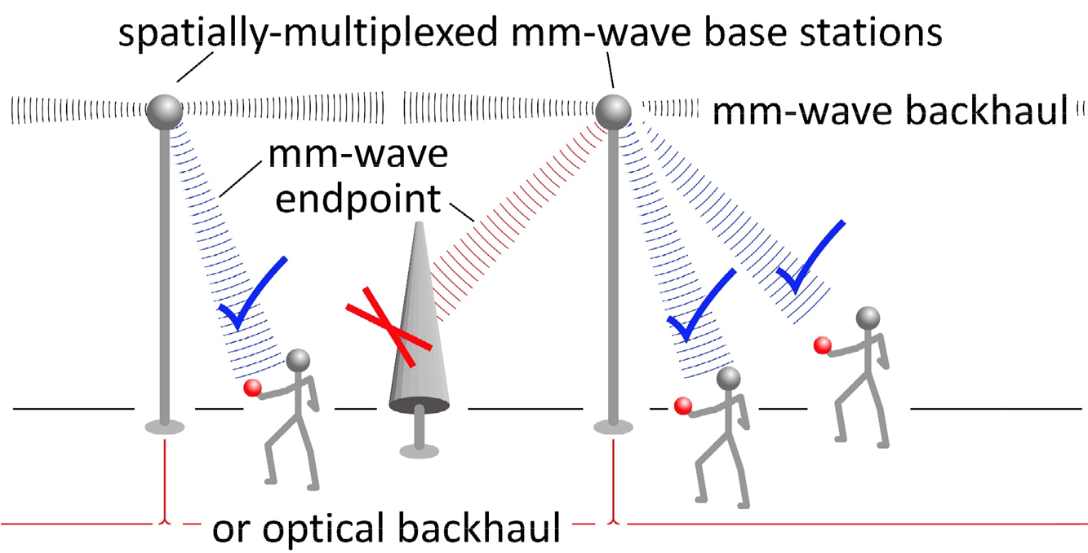
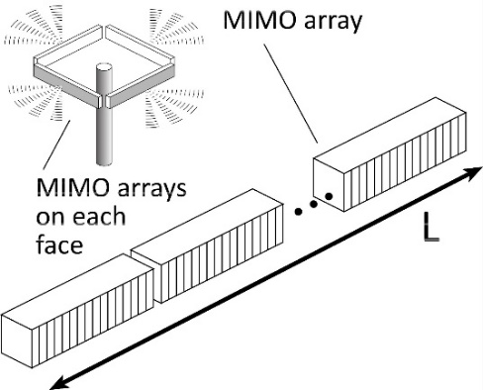
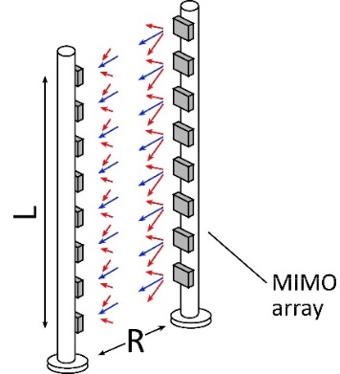
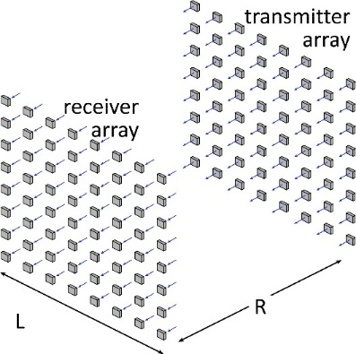
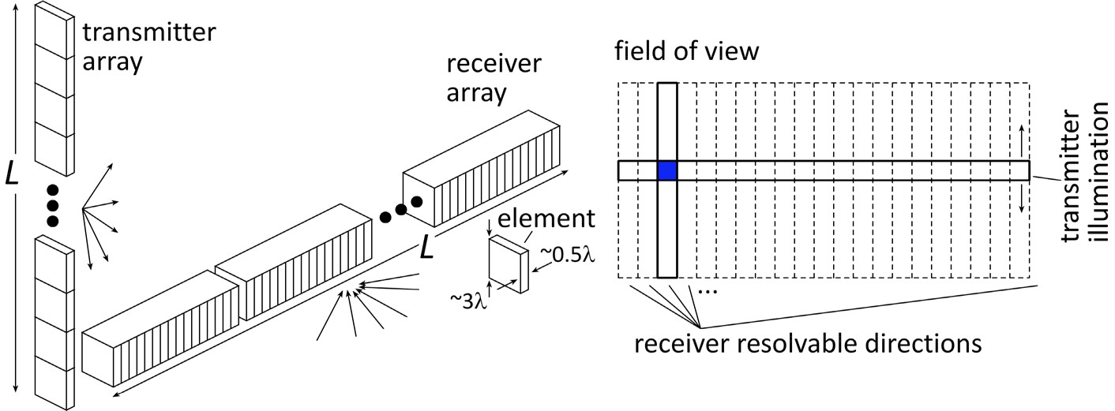
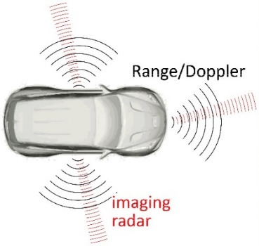
Benefits of Short Wavelengths
Communications: Massive spatial multiplexing, massive # of parallel channels. Also, more spectrum.
Imaging: very fine angular resolution
But: High losses in foul or humid weather. High λ²/R² path losses. ICs: poorer PAs & LNAs. Beams easily blocked.
100-300GHz wireless: terabit capacity, short range, highly intermittent

Slide 4
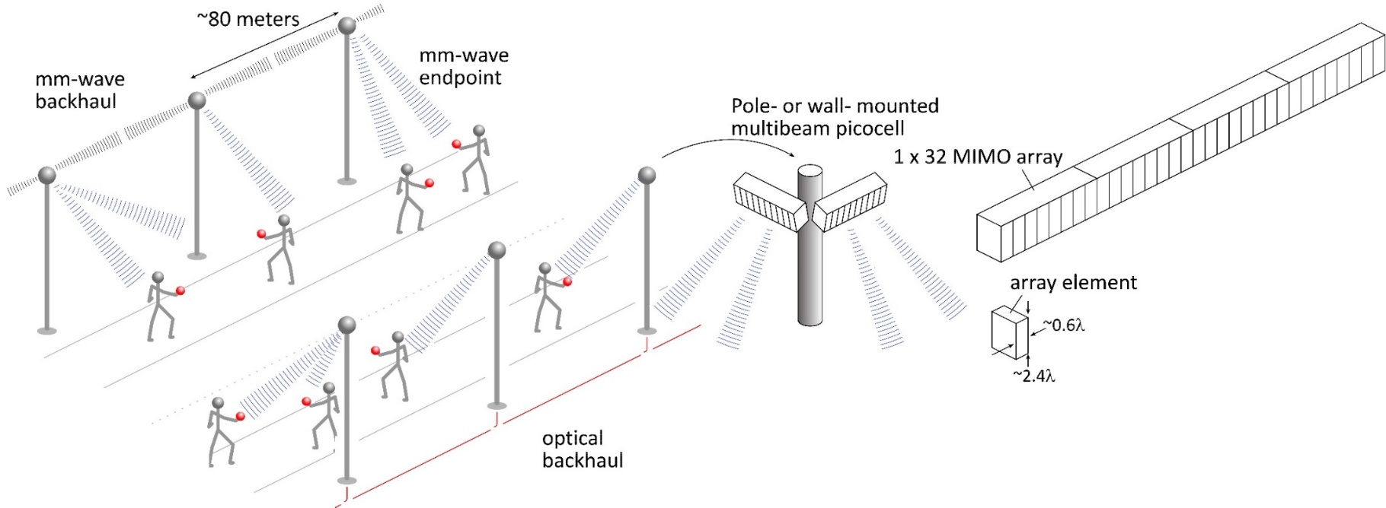
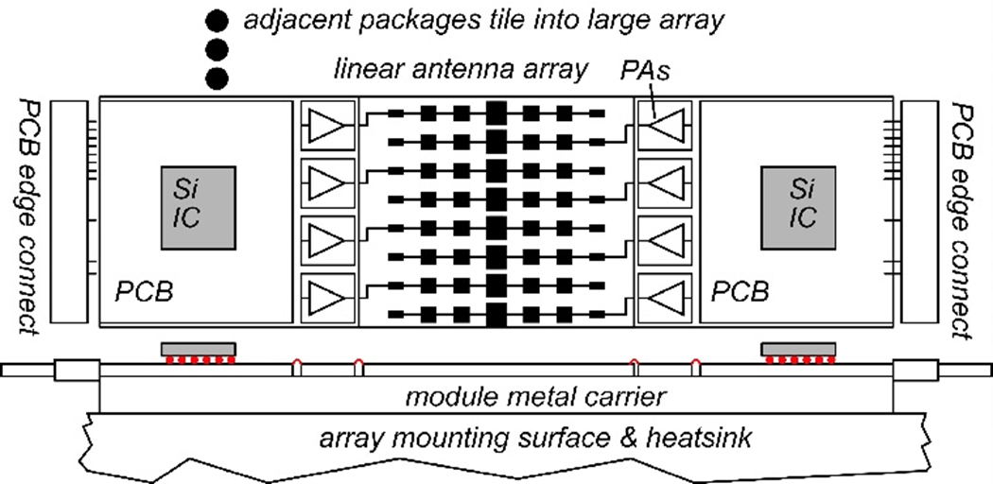
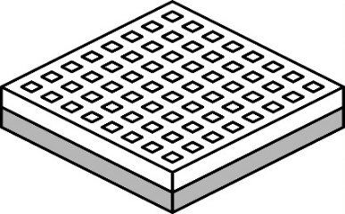
140GHz moderate-MIMO hub
Handset: 8 × 8 array (9×9mm)
If hub uses 32-element array (four 1×8 modules): 16 users/array. P_{1dB}=21 dB_{m} PAs, F=8dB LNAs 1,10 Gb/s/beam→ 16, 160 Gb/s total capacity 70, 40 m range in 50mm/hr rain with 17dB total margins

Slide 5
70 GHz spatially multiplexed base station
If we use instead a 70GHz carrier, the range increases to 70 meters (vs. 40 meters) but the handset becomes 16mm×16mm (vs. 8mm×8mm), and the hub array becomes 19mm×612mm (vs. 10mm×328mm)
Or, use a 4×4 (8mm×8mm) handset array, and the range becomes ..about 40 meters.
Same handset area (more handset elements)→ same link budget Easier to obtain license for 140±2.5GHz than 70±2.5GHz

Slide 6
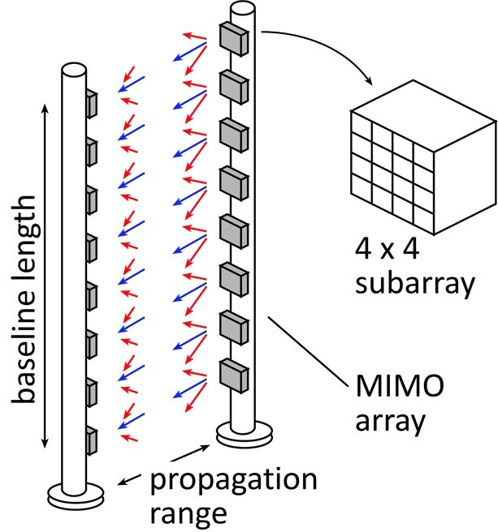
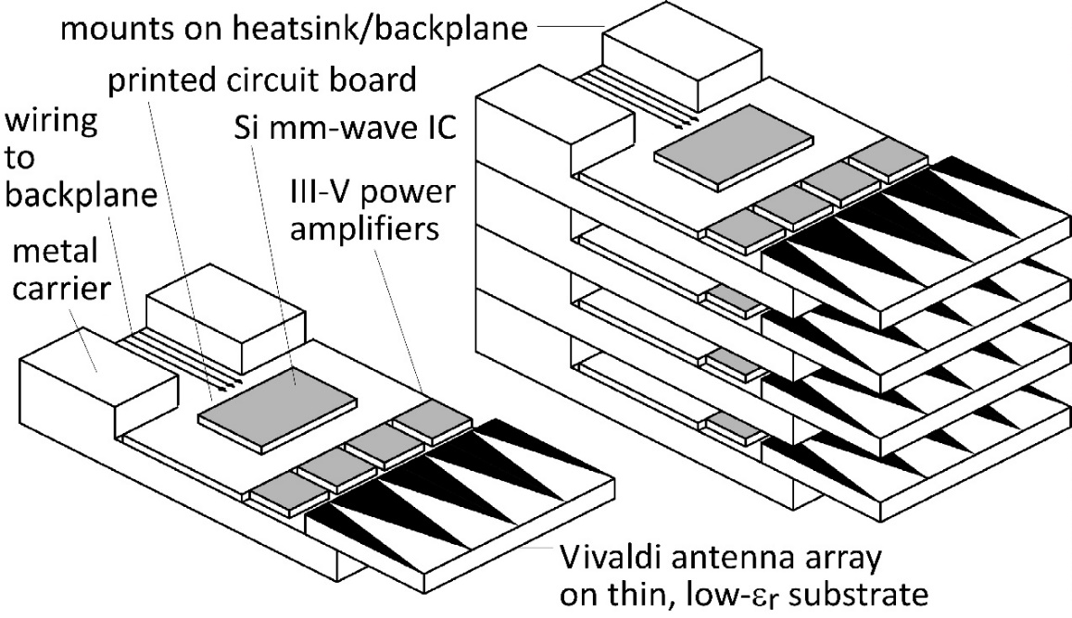
210 GHz, 640 Gb/s MIMO Backhaul
Key link parameters 500 meters range in 50 mm/hr rain; 23 dB/km 20 dB total margins: packaging loss, obstruction, operating, design, aging PAs: 18dBm =P_{1dB} (per element) LNAs: 6dB noise figure
8-element MIMO array 2.1 m baseline. 80Gb/s/subarray→ 640Gb/s total 4 × 4 sub-arrays → 8 degree beamsteering

Slide 7
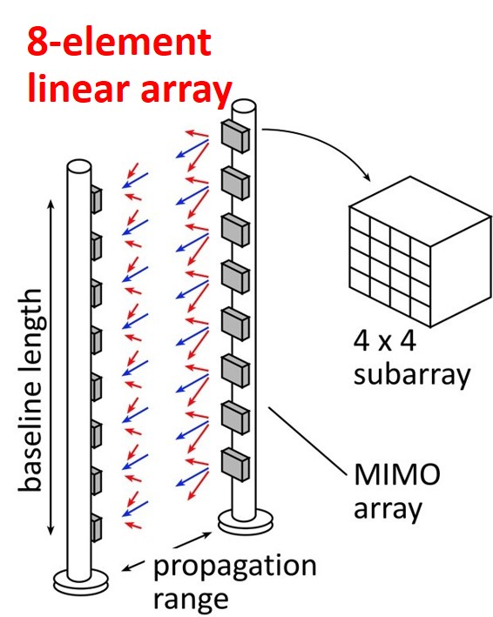
75 GHz, 640 Gb/s MIMO backhaul (16QAM)
Why not use a lower-frequency carrier, e.g. 75 GHz ? Must use at least 16QAM, given 80Gb/s/channel…
8-element 640Gb/s linear array:
requires 16dB_{m} transmit power/element (P_{out})
requires 3.5m linear array
Similar RF power output, physically larger

Slide 8
Systems Design

Slide 9
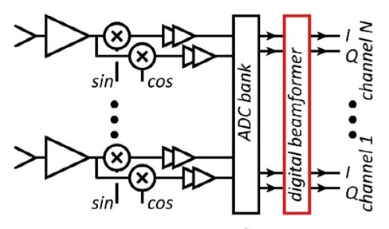
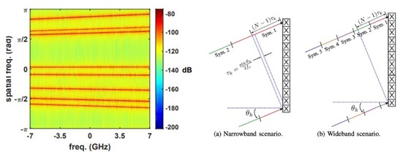
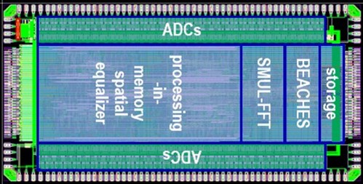
MIMO System Design
ADCs/DACs¹: QPSK needs only 3-4 bit ADC/DACs N ADC bits, M antennas, K signals: SNR=6N+1.76+10.log₁₀(M/K) 3 bits, (M/K)=2→ SNR=23 dB. QPSK needs 9.8 dB.
Linearity¹: Amplifier P_{1dB} need be only 4 dB above average power
Phase noise^{2,3}: Requirements same as for SISO
Efficient digital beamforming^{4,5}: beamspace algorithm=complexity ~N× log(N)
Efficient VLSI digital beamformer implementation⁶: low-resolution matrix
Efficient beamforming in broadband arrays⁷: combined spatial & temporal FFTs.
1) M. Abdelghany et al, IEEE Trans. Wireless Comm, Sept. 2021 2) M. E. Rasekh et al, IEEE Trans. Wireless Comm, Oct. 2021 3) A. Puglielli et al, 2016 IEEE ICC 4) M. Abdelghany, et. al, , 2019 IEEE SPAWC 5) S. H. Mirfarshbafan et al, IEEE Trans CAS 1, 2020 6) O Castañeda Fernández et. al, 2021 ESSCIRC 7) M. Abdelghany et al 2019 IEEE GLOBECOM

Slide 10
100-300 GHz IC design: Transistors

Slide 11
Transistors for 100-300GHz
CMOS: good power & noise up to ~150GHz. Not much beyond. 65-32nm nodes are best.
InP HBT: record 100-300GHz PAs
SiGe HBT: out-performs CMOS above 200GHz
GaN HEMT: record power below 100GHz. Bandwidth improving
InGaAs-channel HEMT: world's best low-noise amplifiers
Results with low power but high PAE, or low PAE but high power, are not shown
Results compiled 9/9/2021

Slide 12
100-300 GHz IC design: Low-noise amplifiers

Slide 13
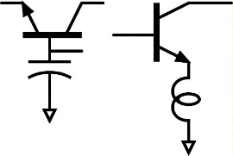
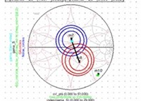
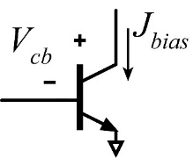
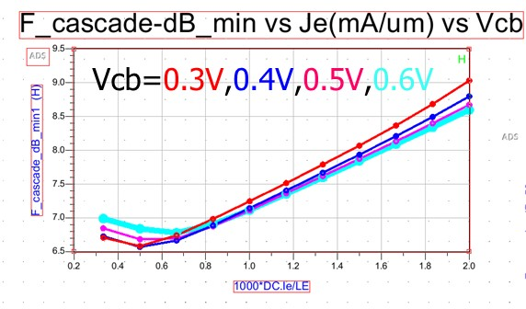
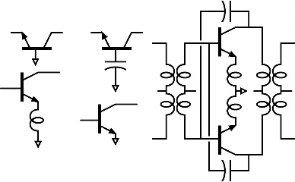
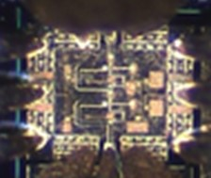
LNA design: noise close to transistor limits
1) Goal: low noise measure, not noise figure
4) Capacitance in common-base; just like inductance in common-emitter, allows simultaneous tuning for zero reflection coefficient and minimum M.
5) Write ADS Python code to display source impedance for minimum M.
2) Find bias current density for lowest noise measure
6) Scale transistor size to eliminate series tuning element. Less input tuning→ less noise from passive element loss.
@210GHz, F_{cascade,min}= 6.57 dB given: J_{e}=0.5 mA/um, V_{cb}=0.3V
U. Solyu et. al, to be presented, 2021 EuMIC Conference
3) Minimum M is independent of circuit configuration*; pick for high bandwidth or high gain/stage (= low P_{DC})
Result: 7.2-7.4dB LNA noise given 6.6dB transistor F_{cascade}.
<-- all give the same minimum M…
…but common-base gives highest gain (InP HBT @210GHz).
*HA Haus, RB Adler, Proceedings of the IRE, 1958

Slide 14
100-300 GHz IC design: Power amplifiers

Slide 15
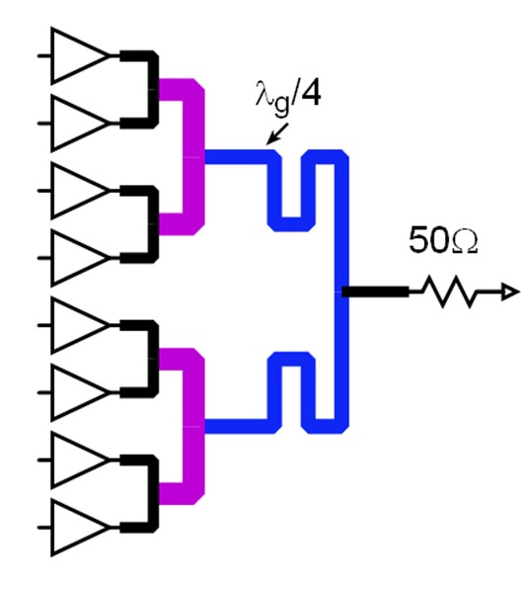
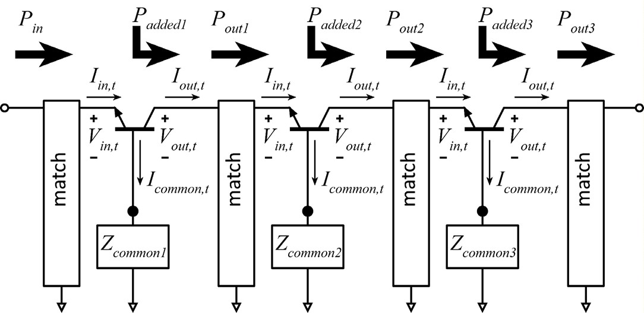
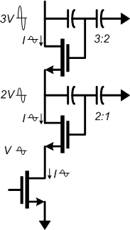
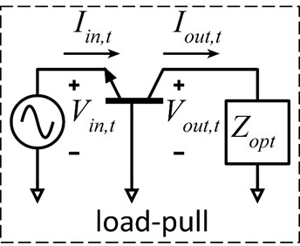
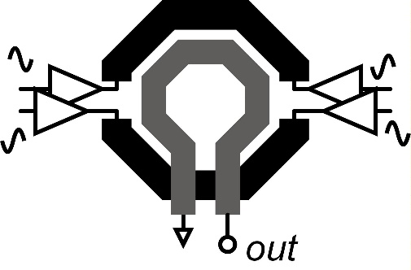
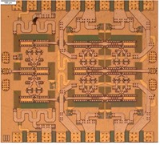
100-300GHz Power combining: what is best ?
Corporate T-line
Direct series-connected M. Shifrin: 1992 IEEE μWave/mmWave Monolithic Circuits Symp. (Raytheon)
Cascaded combining A. Ahmed 2018 EuMIC, 2021 RFIC (UCSB)
Distributed Active Transformer I. Aoki, IEEE Trans MTT, Jan. 2002 (CalTech)
Balun series-connected λ/4 baluns: Y. Yoshihara, 2008 IEEE Asian Solid-State Circuits Conference (Toshiba) sub-λ/4 baluns: H. Park, et al, IEEE JSSC, Oct. 2014 (UCSB)
470mW, 81GHz, 23.4% PAE

Slide 16
Transistor stacking. Why ? Why not ?
 | Lower frequencies | Higher frequencies
Corporate combining | length $∝1/f$→ large die area ✘ dB loss $∝1/\sqrt{f}$→ high loss ✘ | length $∝1/f$→ small die area ✓ dB loss $∝1/\sqrt{f}$→ low loss ✓
Series-connected | more transistor fingers per cell → ok ✓ | more transistor fingers per cell→ parasitics ✘

Slide 17
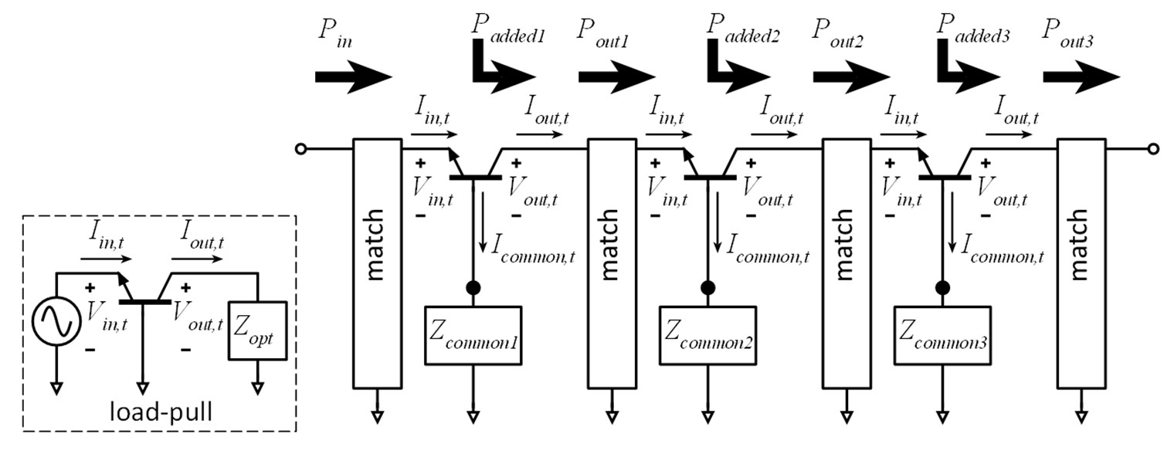
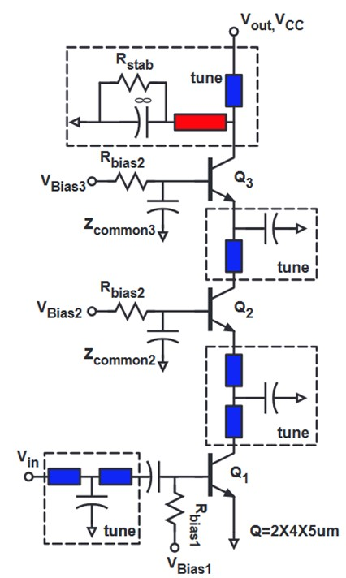
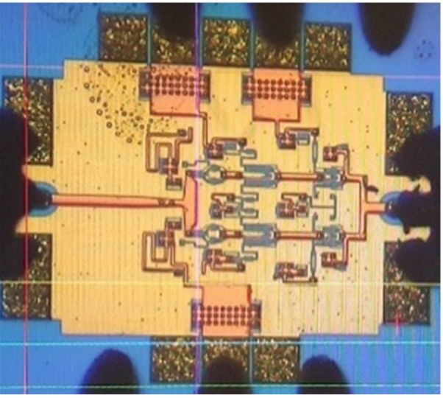
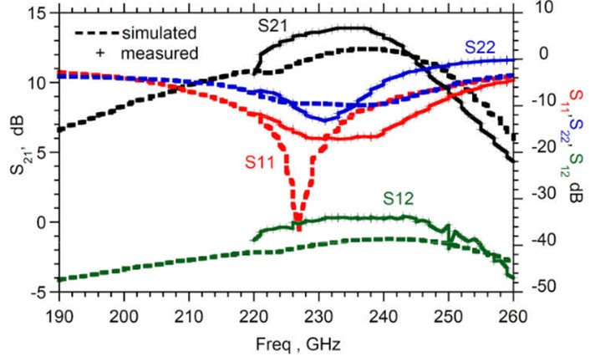
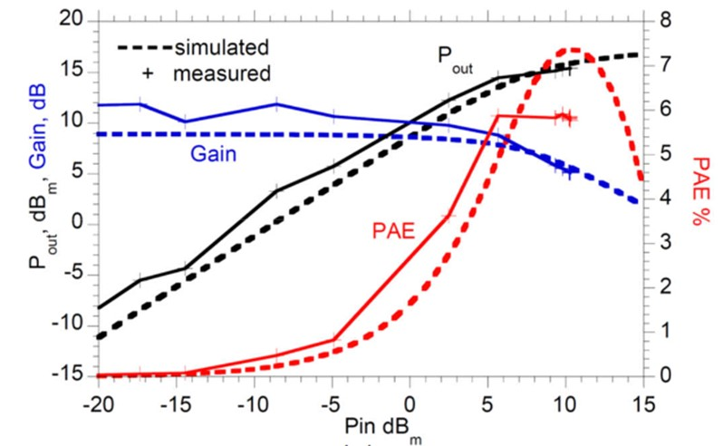
Cascade combining as stacking plus matching
A. S. H. Ahmed et al, 2018 EuMIC (UCSB)

Slide 18
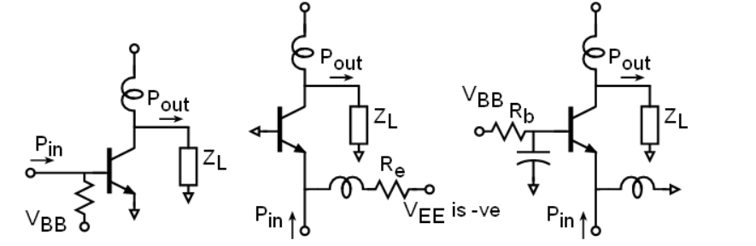
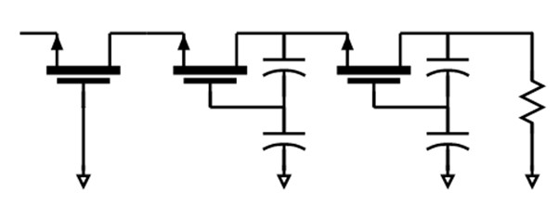
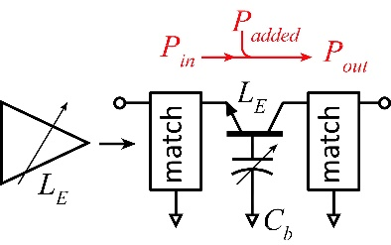
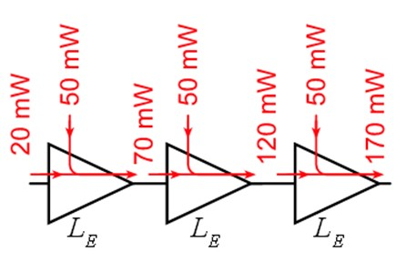
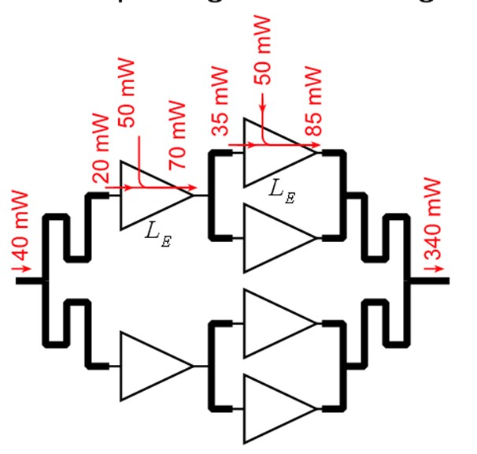
Capacitively degenerated common-base
Lower gain, same peak PAE, higher PAE at P_{1dB}.
How does this differ from stacking ?
(a) CE
(b) CB with grounded base
(c) CB with base capacitor
At 140GHz

Slide 19
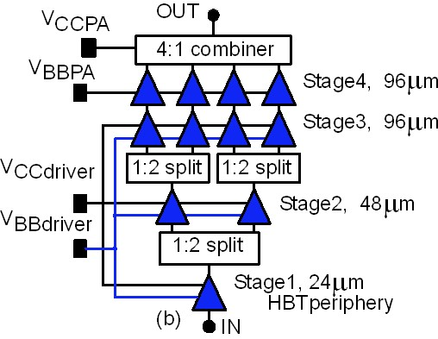
Generalized cascade combining
A. S. H. Ahmed et al, 2018 EuMIC (UCSB) A. S. H. Ahmed, et al, 2021 RFIC Symposium
266GHz, 16.8dBm, 4.0% PAE

Slide 20
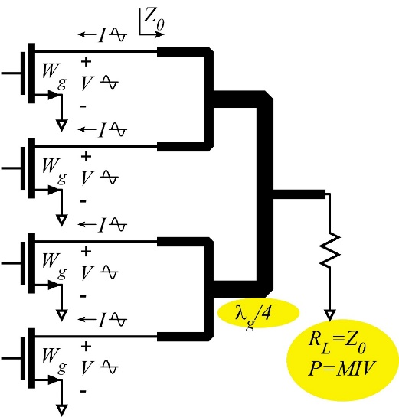
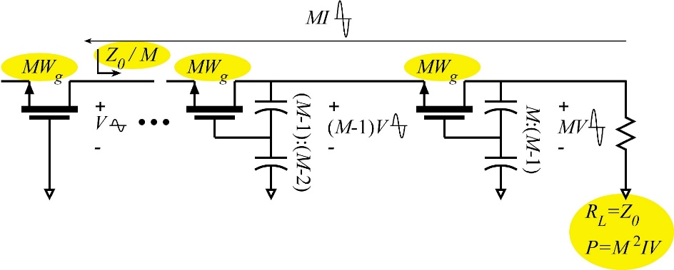
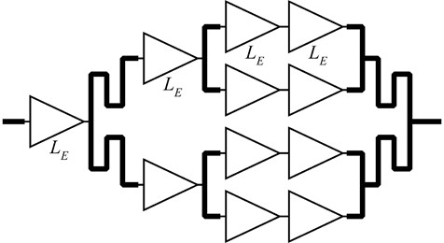
Cascade Combining: Why ? Why not ?
 | Lower frequencies | Higher frequencies
Corporate combining | length $∝1/f$→ large die area ✘ dB loss $∝1/\sqrt{f}$→ high loss ✘ | length $∝1/f$→ small die area ✓ dB loss $∝1/\sqrt{f}$→ low loss ✓
Series-connected | more transistor fingers per cell → ok ✓ | more transistor fingers per cell→ parasitics ✘
Cascade combining | large interstage matching networks✘ | small interstage matching networks ✓ small # transistor fingers per cell → ok ✓ cascade cell pass-though losses ✘

Slide 21
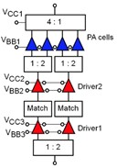
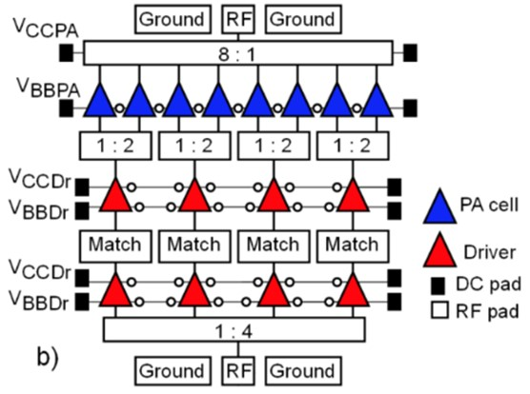
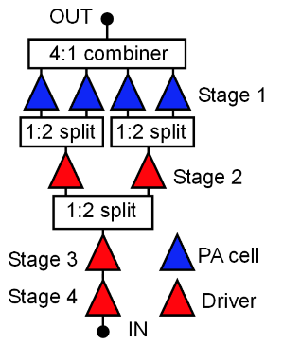
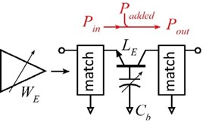
Recent high-efficiency 100-300GHz PAs
Teledyne 250nm InP HBT technology
Ahmed et al, 2020 IMS, 2020 EuMIC, 2021 IMS, 2021 RFIC
140GHz, 20.5dBm, 20.8% PAE
130GHz, 200mW, 17.8% PAE
194GHz, 17.4dBm, 8.5% PAE
266GHz, 16.8dBm, 4.0% PAE

Slide 22
ICs and Modules: 140 GHz

Slide 23
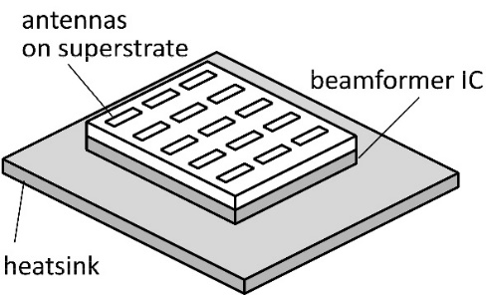
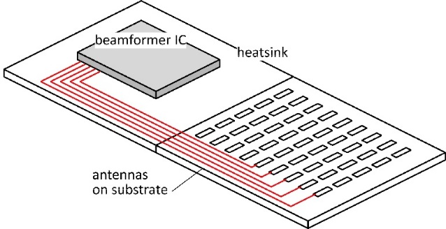
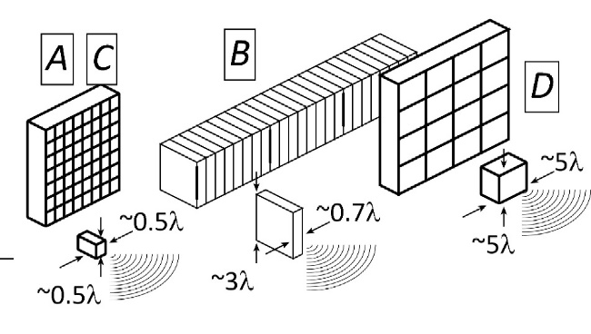
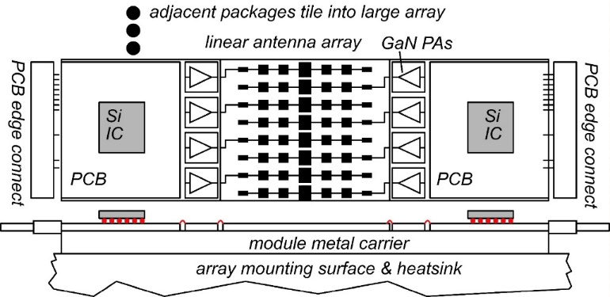
The mm-wave module design problem
How to make the IC electronics fit ? How to avoid catastrophic signal losses ? How to remove the heat ?
Not all systems steer in two planes... ...some steer in only one.
Not all systems steer over 180 degrees... ...some steer a smaller angular range

Slide 24
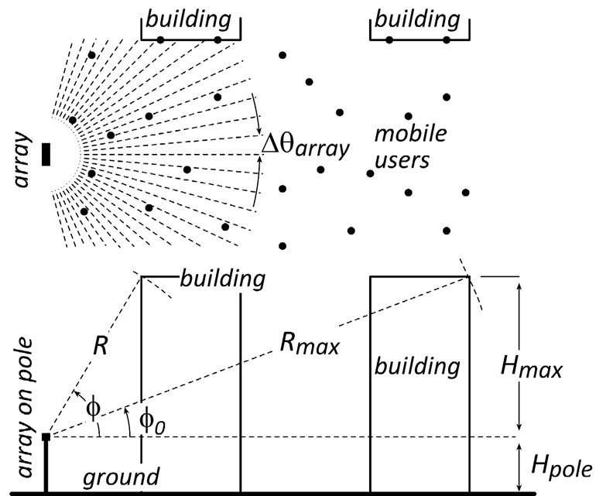
Do we need 2D arrays ? 1D might be fine.
1/sin²φ sidelobes provide strong signals to tall buildings.
Providing sidelobes reduces broadside gain by less than 3dB.
→ Don't need 2D arrays to serve tall buildings

Slide 25
2D vs. 1D: user spatial distribution
uniform horizontal & vertical user distributions
uniform horizontal, nonuniform vertical
design 1: 2D array
✘
✓
design 2: 1D array
✓
✓
Spatial distribution of users, and of scattering objects, guides choice of array geometry.

Slide 26
140GHz hub: packaging challenges
IC-package interconnects Difficult at > 100 GHz
Removing heat Thermal vias are marginal
Interconnect density Dense wiring for DC, LO, IF, control. Hard to fit these all in.
Economies of scale Advanced packaging standards require sophisticated tools High-volume orders only Hard for small-volume orders (research, universities) Packaging industry is moving offshore

Slide 27
100-300GHz IC-package connections

Slide 28
135GHz 8-channel MIMO hub array tile modules
Receiver: A. Farid et. al, 2021 IEEE BCICTS; Transmitter in review

Slide 29
140GHz hub: ICs & Antennas

Slide 30
135 GHz Cu stud CMOS / LTCC transition
50 μm diameter Cu studs
1.15 dB simulated loss
Includes Cu pillar, 220 μm CPW section
~0.85 dB measured loss.
Low assembly yield with LTCC; too small

Slide 31
Series-fed patch antenna on LTCC

Slide 32
CMOS/InP PA transition design
Au wirebonds: poor but easily obtained 150 μm long, 25 μm diameter Ground return: through IC TSV's 2.6dB simulated insertion loss
Ribbon bonds, flip-chip bonds: harder to get. both much better at 140 GHz InP flip-chip bonds: ~$80k per MPW run investigating firms for ribbon-bonding

Slide 33
InP PA/antenna transition design
8-element series-fed patch antenna
Antenna-PA match: stepped-impedance line
Simulations: 12dB antenna gain, 6GHz 3-dB bandwidth

Slide 34
8-element 135 GHz MIMO receiver array
4 channels/side
8-elements series fed-patch antenna/channel
0.65 λ antenna spacing
PCB provides I/Q , LO reference, DC connections

Slide 35
Receive module testing
Rx module connected to ZCU-111 for array calibration and beamforming.
Test transmitter mounted at 15cm distance on a rotating arm.
Wideband 1-GHz OFDM signal used for array calibration
https://github.com/pi-radio/Pi-Radio-v1-NRT
https://dl.acm.org/doi/abs/10.1145/3411276.3412195

Slide 36
Conversion gain, radiation pattern
8 working channels: good patterns
Poor ground: limits data rate
4 working channels: patterns with sidelobes
good ground: data transmission experiments

Slide 37
135GHz 8-channel MIMO hub array tile modules
140GHz MIMO hub receiver array modules, 4-element, 8-element MIMO beamforming Data transmission up to 1.9Gb/s
140GHz MIMO hub transmitter array modules, 8-element 38.5dBm EIRP Data transmission up to 1.9Gb/s Performance limited by assembly yield. Data rate limited by connector.
Link demonstration to be reported
Receiver: A. Farid, 2021 BCICTS; Transmitter: in review
110mW InP PA 20.8% PAE
CMOS TX, RX ICs GlobalFoundries 22nm SOI CMOS.
Teledyne 250nm InP HBT

Slide 38
Gen-II 140GHz MIMO hub modules
Gen I 140 GHz CMOS+InP modules low assembly yield: 50 μm Cu stud too small for LTCC used in Samsung link demo; to be announced.
Gen II 140 GHz CMOS+InP modules change to C4 solder bonds: more easily assembled on LTCC ICs re-fabricated with C4 bonds LTCC carriers re-designed for C4 bonds PCB has higher-bandwidth baseband IQ connectors: 10Gb/s. Assembly planned in Winter 2022.

Slide 39
140 GHz C4-LTCC Transition Design
Simulated 1.3 dB insertion loss at 140 GHz.
C4 has better assembly yield with LTCC than 50 μm Cu studs

Slide 40
140 GHz IF Beamforming Phased-Array Transmitter
Siwei Li, 2021 IEEE IMS: Rebeiz Group, UCSD

Slide 41
Beamspace digital beamformer IC
All-digital receive beamformer ASIC in 65nm CMOS
Beamspace algorithm
Supports 32 antennas and 1 to 16 users
20GB/s throughput given 16 simultaneously transmitting users under conditions requiring 3-bit ADC resolution
Record 9.98GB/s throughput given 16 simultaneously transmitting users under conditions requiring 6-bit ADC resolution
Castaneda Fernandez 2021 ESSCIRC. Studer Group, Cornell/ETHZ Molnar Group, Cornell

Slide 42
ICs and Modules: 210 GHz & 280 GHz

Slide 43
210 GHz Transmitter and Receiver ICs
M. Seo et al, 2021 IMS; Teledyne 250nm InP HBT
Size: 2.9 x 0.75 mm²
Size: 2.3 x 0.85 mm²

Slide 44
LO multiplier: 25 GHz to 200 GHz
M. Seo et al, 2021 IMS; Teledyne 250nm InP HBT
multiplier design by M. Seo
P_{out} > -5 dBm over 165 - 240 GHz Spurious < -40 dBc over 180-230 GHz P_{DC} = 282 mW 0.58 mm x 0.4 mm

Slide 45
280GHz transmitter, receiver IC designs
Solyu, Alz, Ahmed, Seo; UCSB/Sungkyunkwan
Teledyne 250nm InP HBT technology
Receiver
Transmitter
simulations: 11dB noise figure, 40GHz bandwidth
simulations: 17dB saturated output power.
Application: point-point MIMO backhaul links

Slide 46
210, 280 GHz MIMO backhaul modules
Single-channel modules (simplicity) 210 GHz InP TX, RX ICs 2x2 patch antenna feed on fused silica substrate Primary antenna: 200 mm Teflon lens Assembly: 200 GHz ribbon bonds, low-frequency ball-bonds 280 GHz modules will be similar

Slide 47
100-300GHz Wireless

Slide 48
100-300GHz Wireless
Massive capacities large available bandwidths massive spatial multiplexing in base stations and point-point links
Very short range: few 100 meters short wavelength, high atmospheric losses. Easily-blocked beams.
IC Technology All-CMOS for short ranges below 200 GHz. SiGe or III-V LNAs and PAs for longer-range links. Just like cell phones today SiGe or III-V frequency extenders for 200GHz and beyond
The challenges digital beamformer computational complexity packaging: fitting signal channels in very small areas mesh networking to accommodate beam blockage driving the technologies to low cost

Slide 49
Backup slides

Slide 50
1D or 2D subarray for backhaul ?
Should we use 4x4 array, 1x16, or 16x1 array ? All provide same system link budget, same # RF channels, same angular scanning range.

Slide 51
Normal & inverted microstrip
Normal: PAs, LNAs smaller skin-effect losses ✓ ground-plane holes at transistors✘
266GHz, 16.8dBm PA: A. Ahmed et. al, 2021 IMS
Inverted: high-density blocks (mixers, phase shifters,…) higher skin-effect losses✘ no ground-plane breaks: better ground integrity✓
529GHz dynamic divider: M. Seo et al, IEICE Electronics Express, Feb. 2015

Slide 52
100-300GHz wireless: transistor requirements
Transmitters need: high power-added efficiency $PAE=(P_{out}−P_{in})/P_{DC}$ high added power density (P_{out}-P_{in})/(gate width, emitter length) Receivers need: low cascaded noise $F_{casc}=F+{(F−1)}/G+{(F−1)}/{G^{2}+…}$
Need reasonable gain/stage. die area, power, accumulated gain compression
(gain in PAs, LNAs is less than MAG/MSG, U, ... )

Slide 53
Where the IC designer can't help
mm-wave transistor gain is low: gain-boosting is common Common-source vs. common-gate. Capacitive neutralization. Unconditionally stable positive feedback (Singhakowinta, Int. J. Electronics, 1966) Such circuits don't improve the parameters that matter the most.
The circuit* doesn't change the transistor minimum cascaded noise figure. (Haus, Adler, Proc. IRE, 1958) The circuit* doesn't change the transistor maximum efficiency vs. added power curve.
$$F_{casc}=1+M=F+{(F−1)}/G+{(F−1)}/{G^{2}+…}$$
*If lossless, and given the correct source and load impedances.

Slide 54
Low-Loss 100-300GHz Corporate Combining
Wilkinson trees are lossy: Signal passes through *many* 70.7Ω, λ/4 lines. λ/4 lines are long. 70.7Ω lines are narrow…and lossy→ High loss.
Single-(λ/4) combiners are much less lossy Each design uses a single effective λ/4 section. Shorter lines, low-Z_{o} lines → lower loss But, low loss only if transistor cells fit.

Slide 55
Denser Integration: higher PAE at high Power
Compact multi-finger transistor layouts → Shorter combiner lines → Less loss → Higher PAE.

Slide 56
Series combining using sub-λ/4 baluns
λ/4 baluns: Y. Yoshihara, 2008 IEEE Asian Solid-State Circuits Conference (Toshiba) sub-λ/4 baluns: H. Park, et al, IEEE JSSC, Oct. 2014 (UCSB)
81GHz, 17 dB Gain 470 mW P_{sat} , 23% PAE Teledyne 250 nm InP HBT 2 stages, 1.0 mm²(incl pads)

Slide 57
Sub-λ/4 Balun Combiners. Why ? Why not ?
 | Lower frequencies | Higher frequencies
Corporate combining | length $∝1/f$→ large die area ✘ dB loss $∝1/\sqrt{f}$→ high loss ✘ | length $∝1/f$→ small die area ✓ dB loss $∝1/\sqrt{f}$→ low loss ✓
Sub-λ/4 Balun | more transistor fingers per cell → ok ✓ | more transistor fingers per cell→ parasitics ✘ impedance shift of transistor-balun interconnect ✘

Slide 58
On-Wafer Interconnect Losses

Slide 59
Current density, finger pitch limit cell output power

Slide 60
Current density, finger pitch limit cell output power
50Ω GaN PA cell @ 140GHz (1.6W) 25V swing, 1.67mA/μm, gates: 30 μm width, 15 μm pitch
K. Shinohara, Teledyne: GaN HEMT thermal analysis
50Ω InP HBT PA cell @ 280GHz (40mW) 4V swing, 3.3mA/μm, emitters: 6 μm length, 6 μm pitch
High V_{br}, low I_{max} ? Device sized to drive 50Ω might approach λ_{g}/4 width. Small finger pitch is critical; limited by thermal design

Slide 61
Summary: InP transistors & ICs
InP HEMTs: 1.5THz f_{max}, 1.0THz amplifiers
W. Deal et al, 2016 IEDM (Northrop-Grumman)
130nm InP HBTs: 1.1THz f_{max}, 3.5V. 670 GHz amplifiers
M. Urteaga, et al, IEEE Proceedings June 2017 (Teledyne)
250nm InP HBTs: 650GHz f_{max}, 4.5V.
Z. Griffith et al, 2007 IPRM conference (UCSB)
M. Urteaga, et al, IEEE Proceedings June 2017 (Teledyne)
204 GHz static frequency divider Z. Griffith et al, 2010 IEEE CSICS

