Slide 1
IC, Module, and Sytems Design for 100-300GHz MIMO Communications
2022 International Symposium on Future Trends of Terahertz Semiconductor Technologies, March 5, Kyoto University
Mark Rodwell¹, Ali A. Farid¹, A. S. H. Ahmed¹, M. Seo², U. Soylu¹, A. Alizadeh¹, N. Hosseinzadeh¹, S. Lee¹
¹University of California, Santa Barbara ²Sungkyunkwan University rodwell@ece.ucsb.edu
Acknowledgement: This work was supported in part by the Semiconductor Research Corporation (SRC) and DARPA.

Slide 2
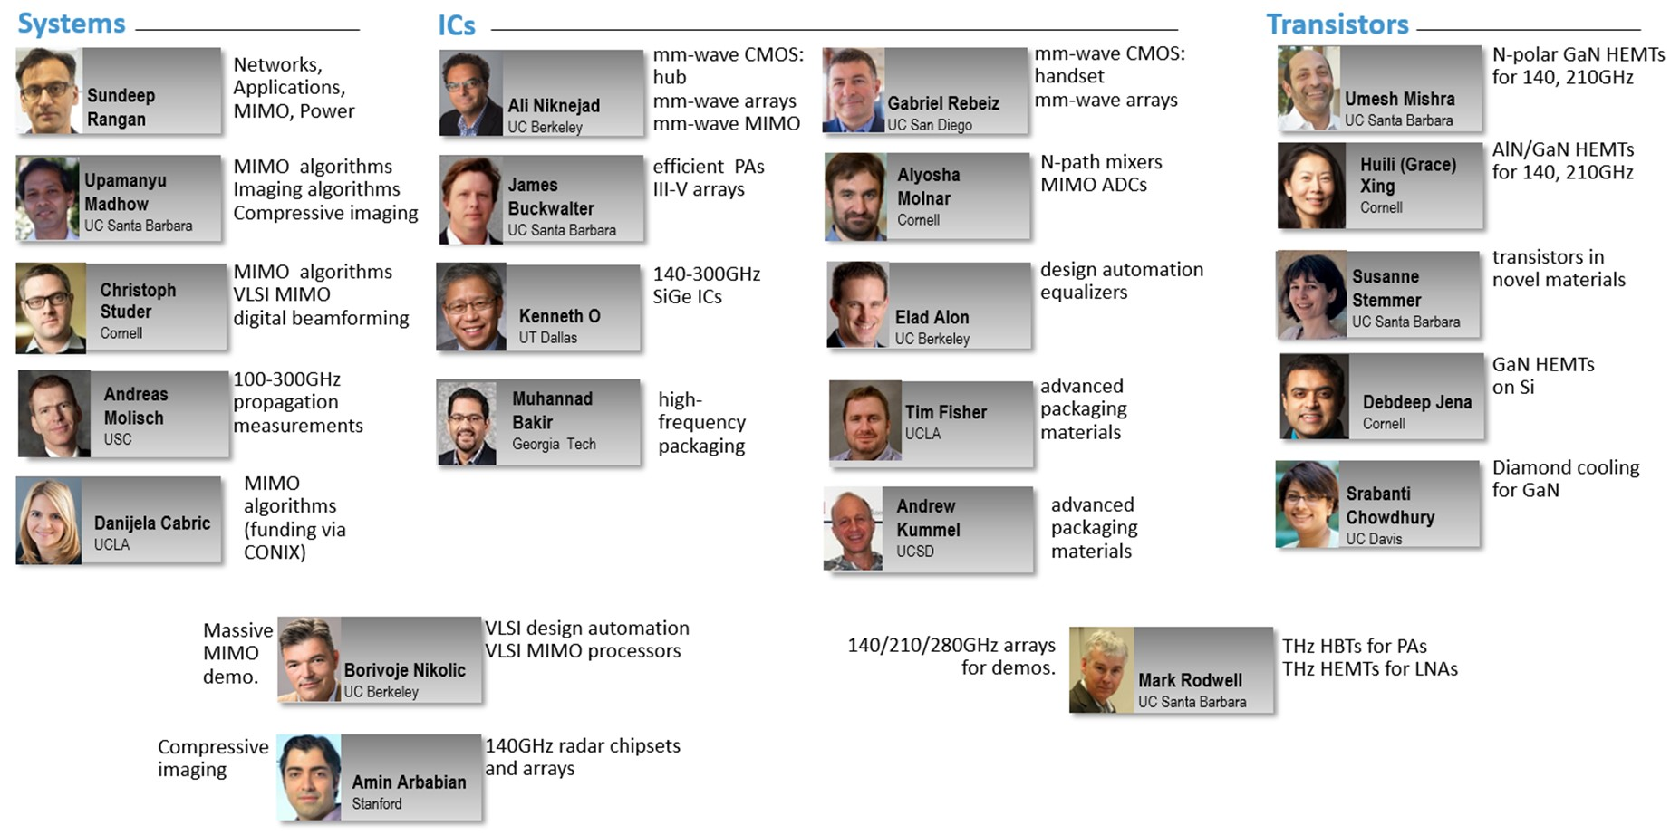
Acknowledgements
Also: Kyocera: D. Kim, H. Horikawa, M. Imayoshi. Samsung: G. Xu, N. Sharma, S. Abu-Surra, W. Choi Pi-Radio: A. Dhananjay,

Slide 3
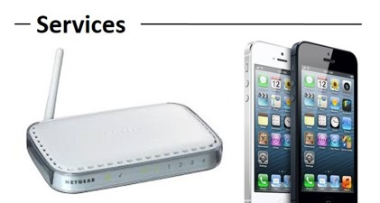
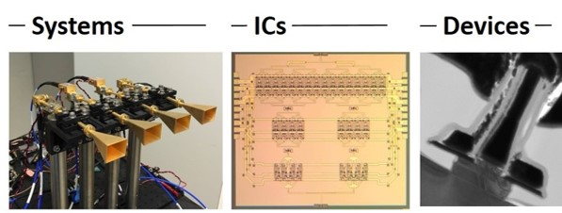
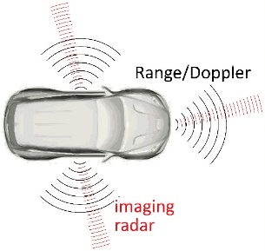
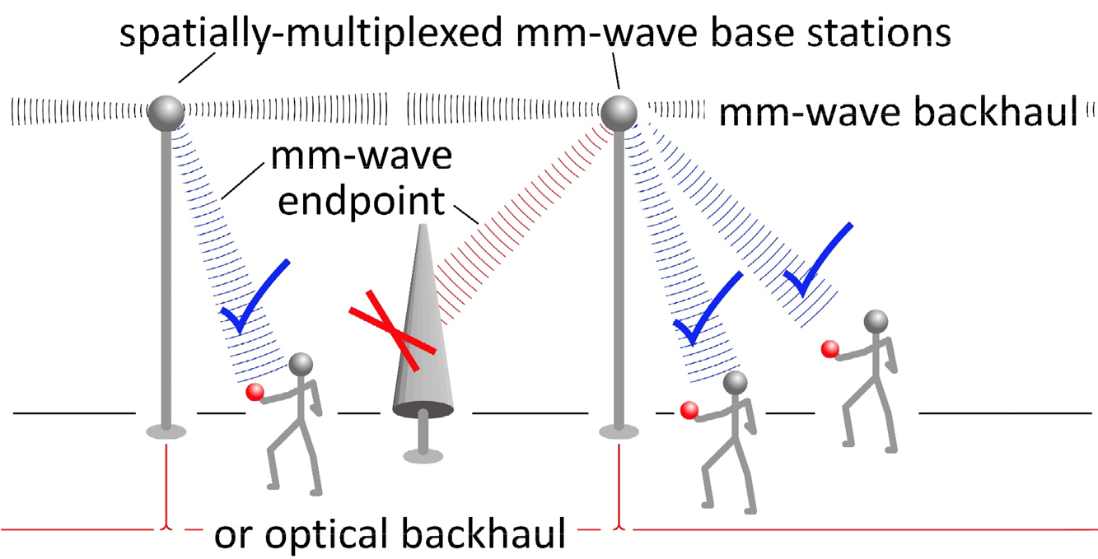
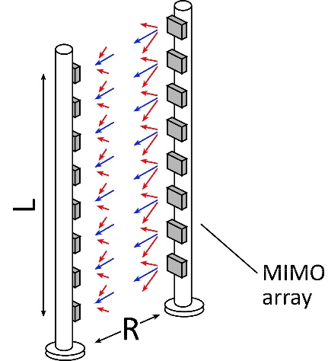
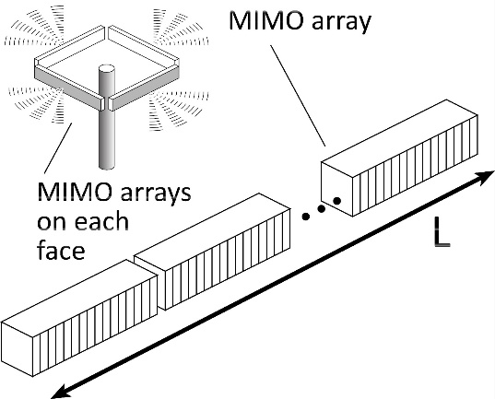
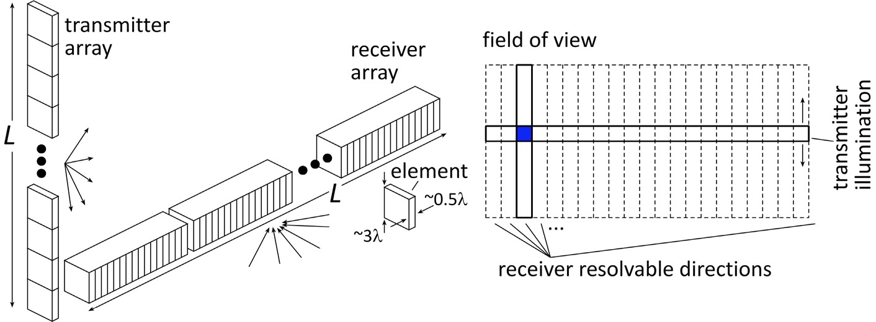
100-300GHz Wireless
Wireless networks: exploding demand.
Immediate industry response: 5G. ~1~40 GHz ("5G?") ~40~100GHz ("5.5G ?") increased spectrum, extensive beamforming
Next generation might be above 100GHz.. (?) greatly increased spectrum, massive spatial multiplexing
100-300GHz carriers, massive spatial multiplexing → Terabit hubs and backhaul links, high-resolution imaging radar

Slide 4
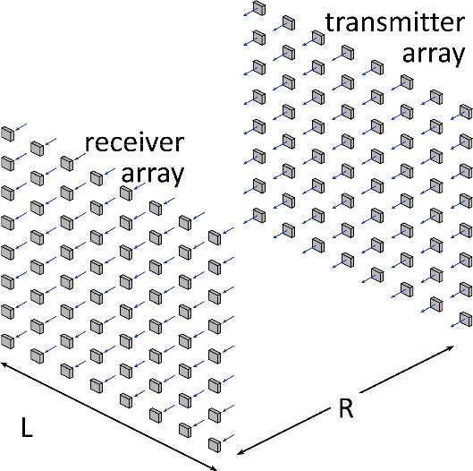
Benefits of Short Wavelengths
Communications: Massive spatial multiplexing, massive # of parallel channels. Also, more spectrum!
Imaging: very fine angular resolution
But: High losses in foul or humid weather. High λ²/R² path losses. ICs: poorer PAs & LNAs. Beams easily blocked.
100-340GHz wireless: terabit capacity, short range, highly intermittent

Slide 5
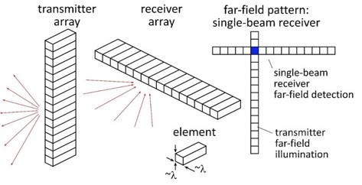
Applications

Slide 6
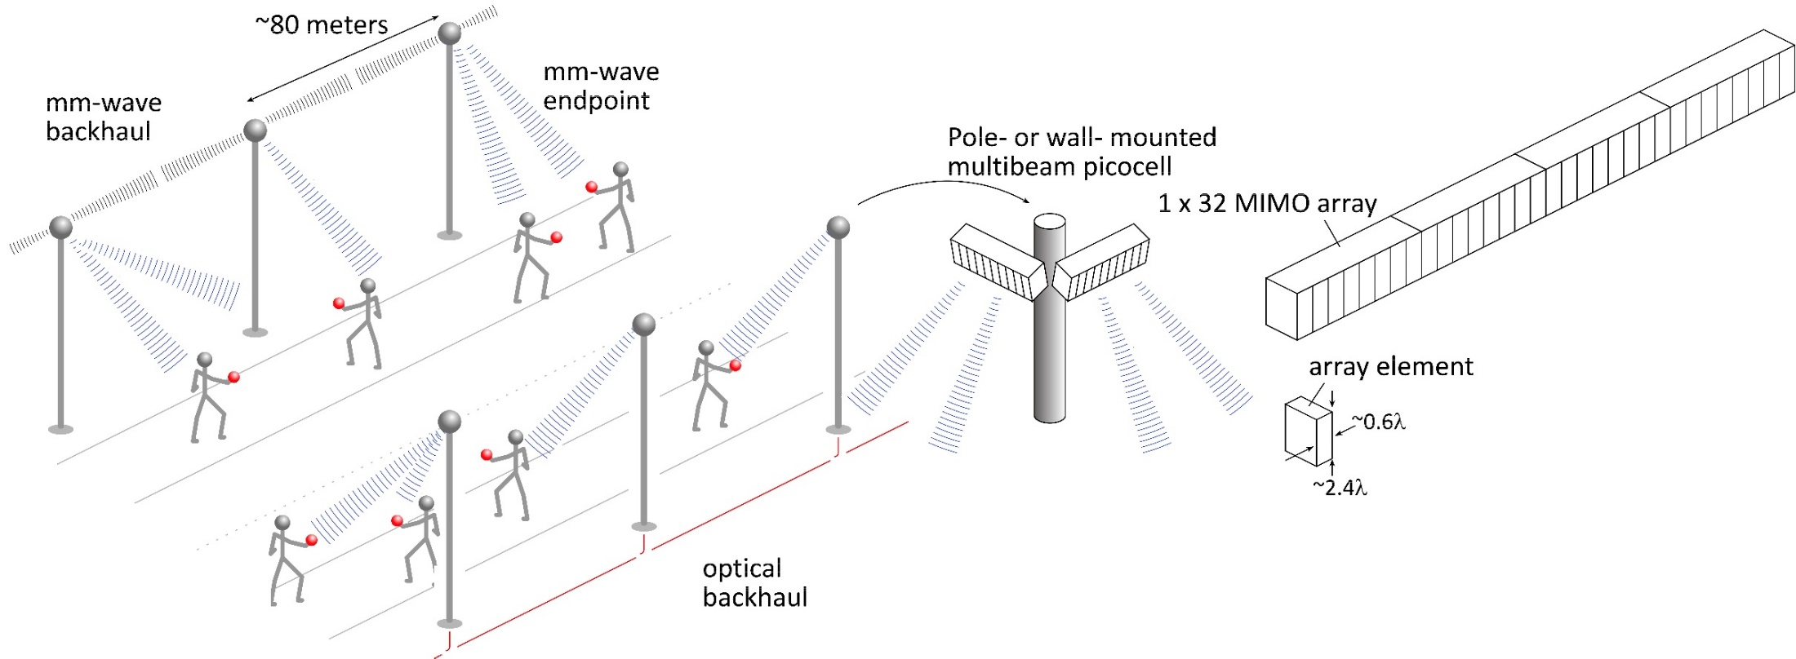
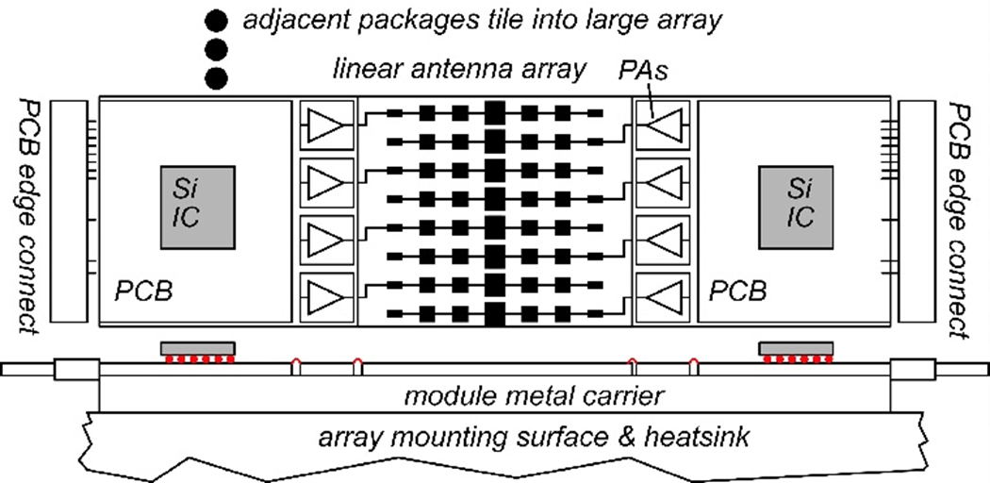
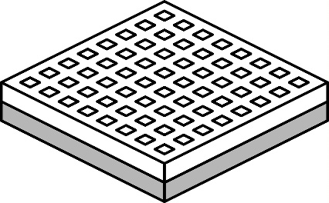
140GHz moderate-MIMO hub
Handset: 8 × 8 array (9×9mm)
If demo uses 32-element array (four 1×8 modules): 16 users/array. P_{1dB}=21 dB_{m} PAs, F=8dB LNAs 1,10 Gb/s/beam→ 16, 160 Gb/s total capacity 70, 40 m range in 50mm/hr rain with 17dB total margins

Slide 7
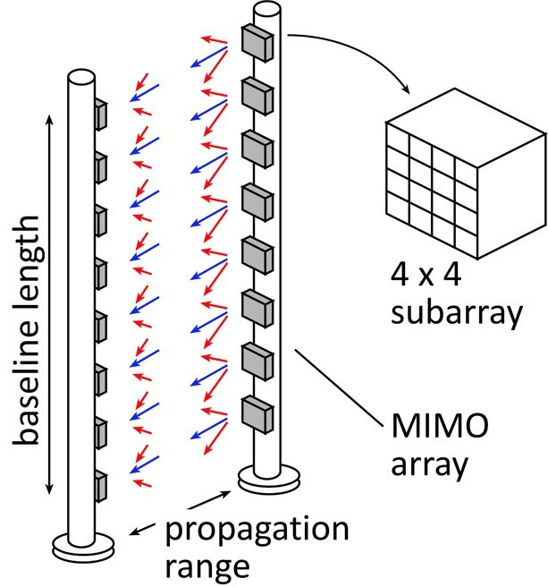
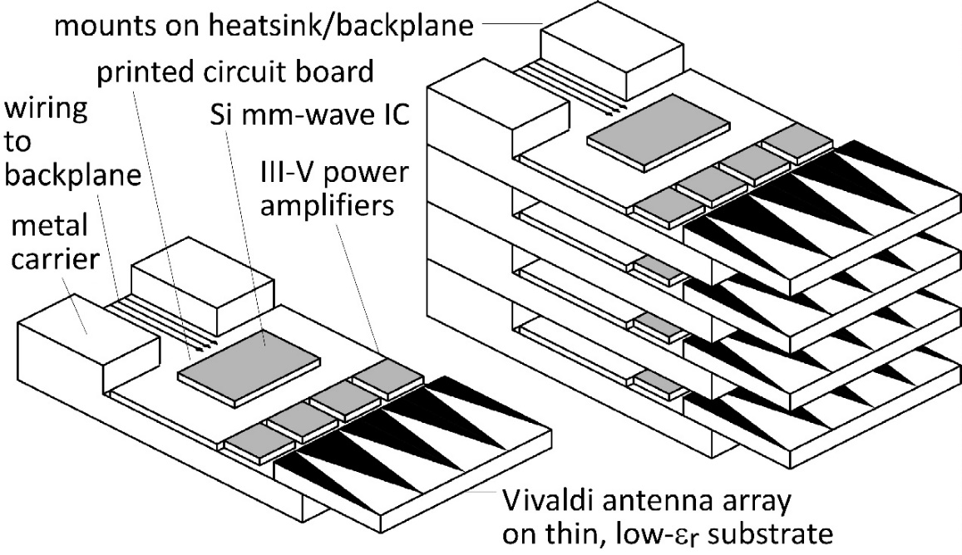
210 GHz, 640 Gb/s MIMO Backhaul
8-element MIMO array 2.1 m baseline. 80Gb/s/subarray→ 640Gb/s total 4 × 4 sub-arrays → 8 degree beamsteering
Key link parameters 500 meters range in 50 mm/hr rain; 23 dB/km 20 dB total margins: packaging loss, obstruction, operating, design, aging PAs: 18dBm =P_{1dB} (per element) LNAs: 6dB noise figure

Slide 8
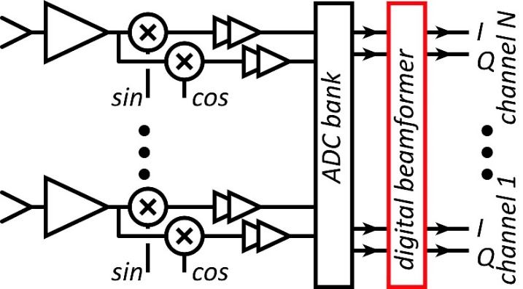
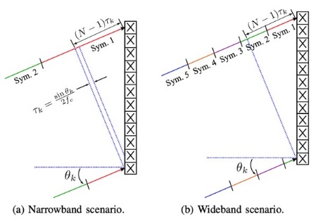
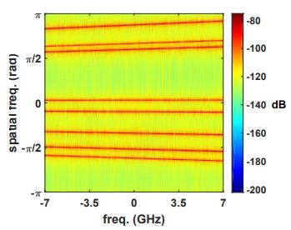
Systems

Slide 9
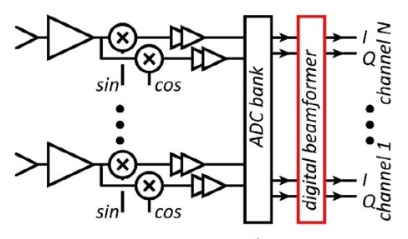
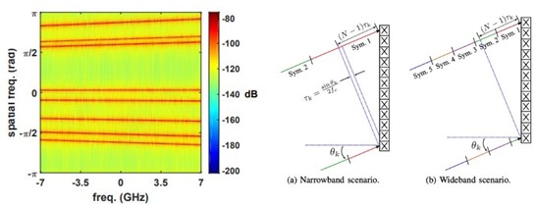
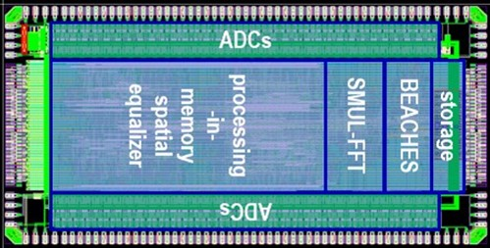
System Design
ADCs/DACs¹: QPSK needs only 3-4 bit ADC/DACs N ADC bits, M antennas, K signals: SNR=6N+1.76+10.log₁₀(M/K) 3 bits, (M/K)=2→ SNR=23 dB. QPSK needs 9.8 dB.
Linearity¹: Amplifier P_{1dB} need be only 4 dB above average power
Phase noise^{2,3}: Requirements same as for SISO
Efficient digital beamforming^{4,5}: beamspace algorithm=complexity ~N× log(N)
Efficient VLSI digital beamformer implementation⁶: low-resolution matrix
Efficiently beamforming in broadband arrays⁷: combined spatial & temporal FFTs.
1) M. Abdelghany et al, IEEE Trans. Wireless Comm, Sept. 2021, doi: 10.1109/TWC.2021.3069378. 2) M. E. Rasekh et al, IEEE Trans. Wireless Comm, Oct. 2021, doi: 10.1109/TWC.2021.3074911. 3) A. Puglielli et al, 2016 IEEE ICC, doi: 10.1109/ICC.2016.7511631. 4) M. Abdelghany, et. al, , 2019 IEEE SPAWC: doi: 10.1109/SPAWC.2019.8815585 5) S. H. Mirfarshbafan et al, IEEE Trans CAS 1, 2020, doi: 10.1109/TCSI.2020.3023023 6) O Castañeda Fernández et. al, 2021 ESSCIRC 7) M. Abdelghany et al 2019 IEEE GLOBECOM doi: 10.1109/GLOBECOM38437.2019.9013233.

Slide 10
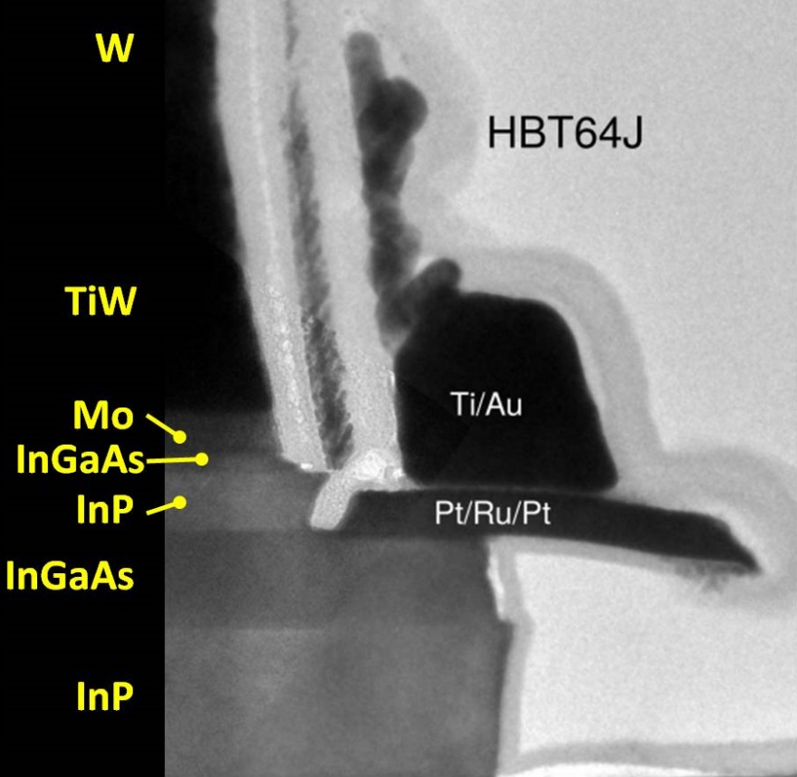
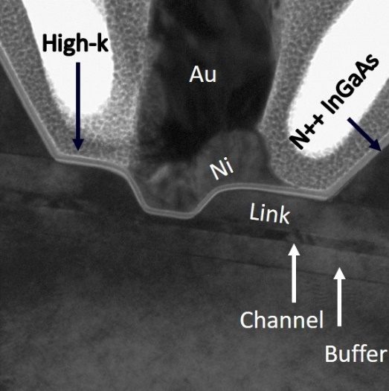
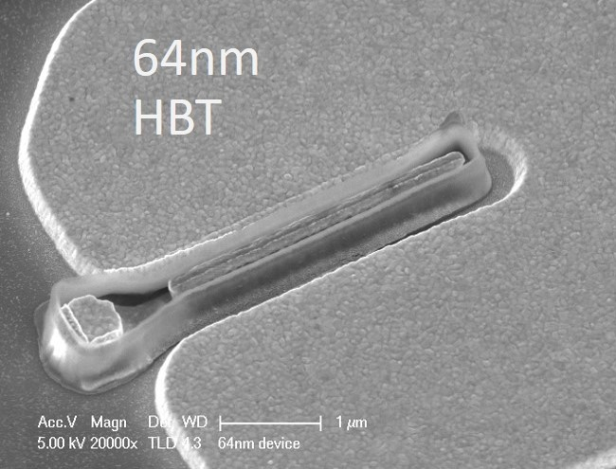
Transistors

Slide 11
Transistors for 100-300GHz
CMOS: good power & noise up to ~150GHz. Not much beyond. 65-22nm nodes are best.
InP HBT: record 100-300GHz PAs
SiGe HBT: power better than CMOS, worse than InP HBT
GaN HEMT: record power below 100GHz. Bandwidth improving
InGaAs-channel HEMT: world's best low-noise amplifiers
*results with low PAE at high Psat or low Psat with high PAE are not shown
Results compiled 9/9/2021

Slide 12
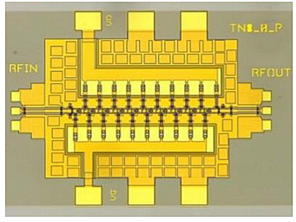
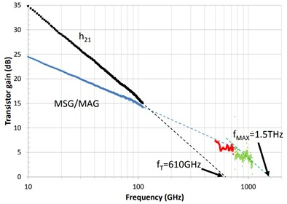
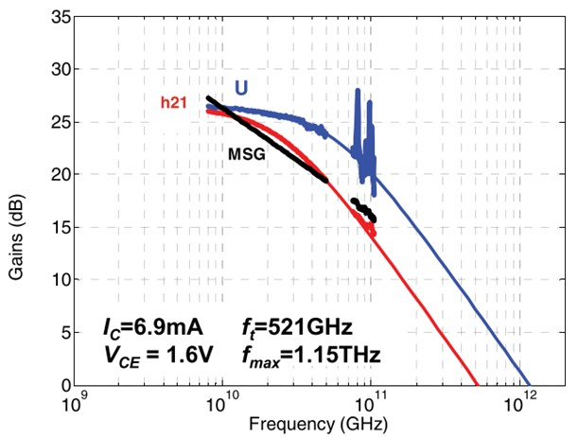
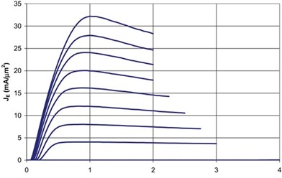
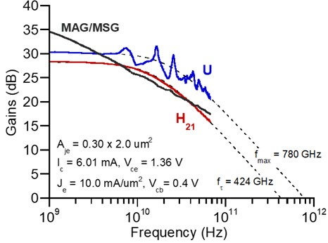
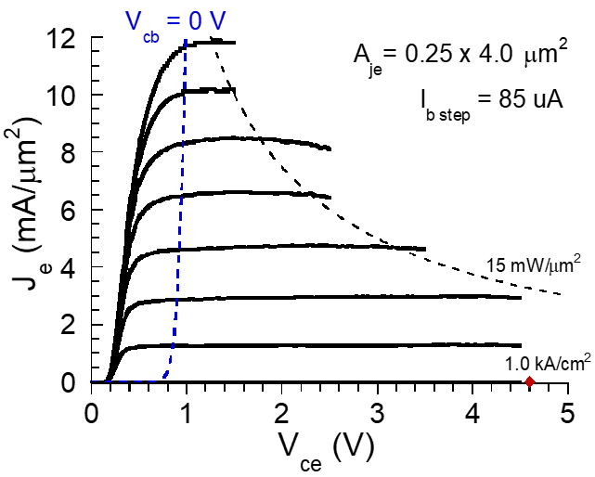
InP Transistors and ICs
InP HEMTs: 1.5THz f_{max}, 1.0THz amplifiers
W. Deal et al, 2016 IEDM (Northrop-Grumman)
130nm InP HBTs: 1.1THz f_{max}, 3.5V. 670 GHz amplifiers
M. Urteaga, et al, IEEE Proceedings June 2017 (Teledyne)
250nm InP HBTs: 650GHz f_{max}, 4.5V.
Z. Griffith et al, 2007 IPRM conference (UCSB)
M. Urteaga, et al, IEEE Proceedings June 2017 (Teledyne)

Slide 13
Power Amplifiers

Slide 14
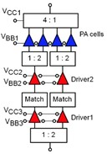
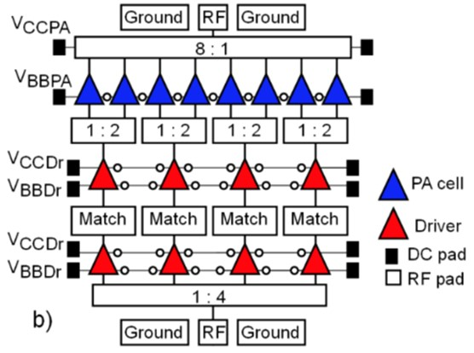
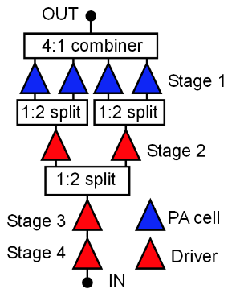
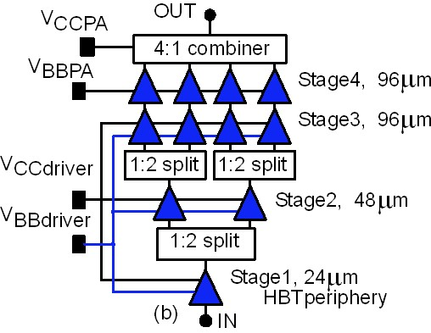
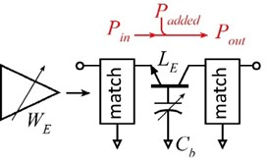
Recent high-efficiency 100-300GHz PAs
Teledyne 250nm InP HBT technology
Ahmed et al, 2020 IMS, 2020 EuMIC, 2021 IMS, 2021 RFIC
140GHz, 20.5dBm, 20.8% PAE
130GHz, 200mW, 17.8% PAE
194GHz, 17.4dBm, 8.5% PAE
266GHz, 16.8dBm, 4.0% PAE
Mixture of corporate and cascade power-combining.

Slide 15
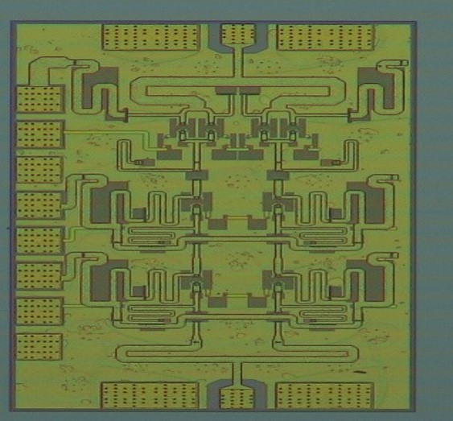
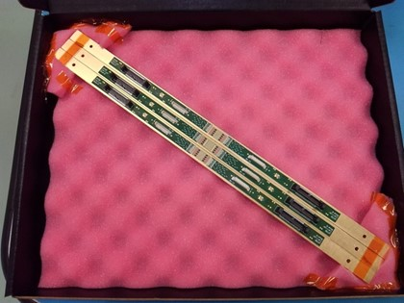
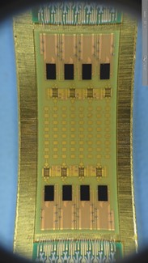
140 GHz Array Modules

Slide 16
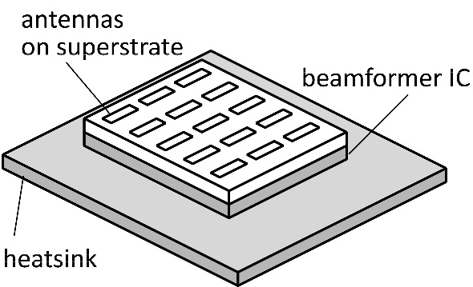
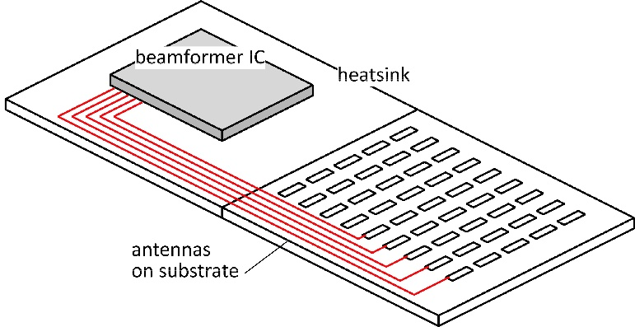
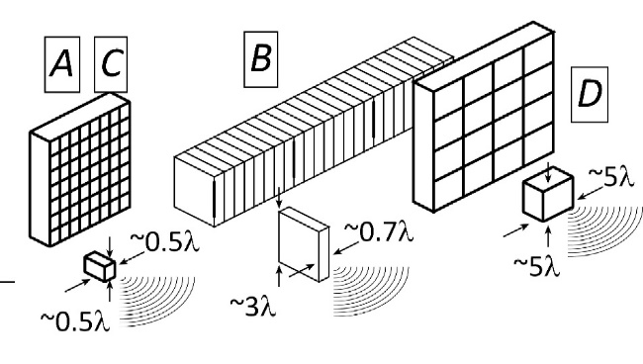
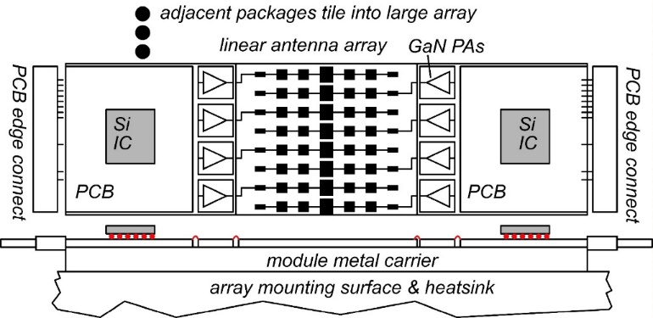
The mm-wave module design problem
How to make the IC electronics fit ? How to avoid catastrophic signal losses ? How to remove the heat ?
Not all systems steer in two planes... ...some steer in only one.
Not all systems steer over 180 degrees... ...some steer a smaller angular range

Slide 17
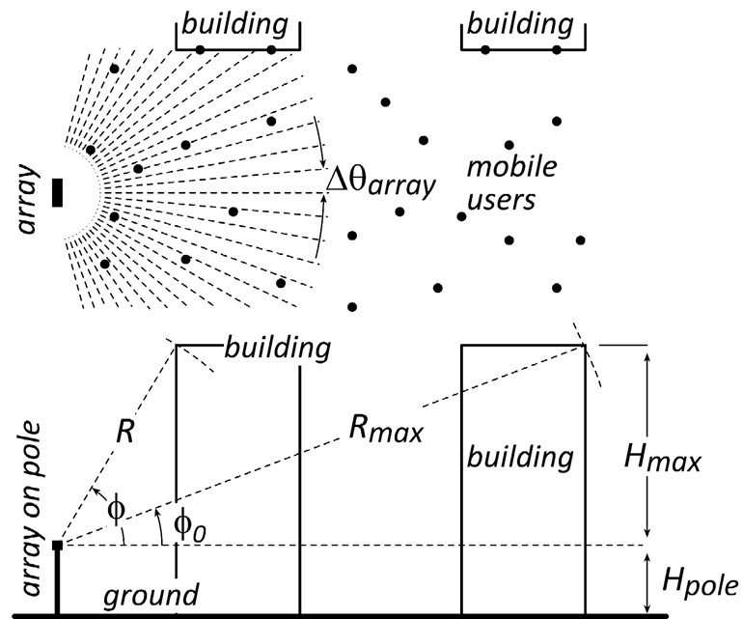
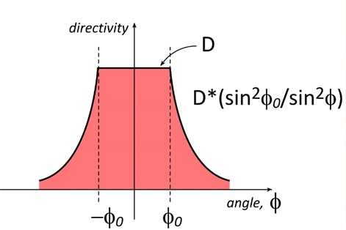
Do we need 2D arrays ? 1D steering might be fine.
1/sin²φ sidelobes provide strong signals to tall buildings.
Providing sidelobes reduces broadside gain by less than 3dB.
→ Don't need 2D arrays to serve tall buildings

Slide 18
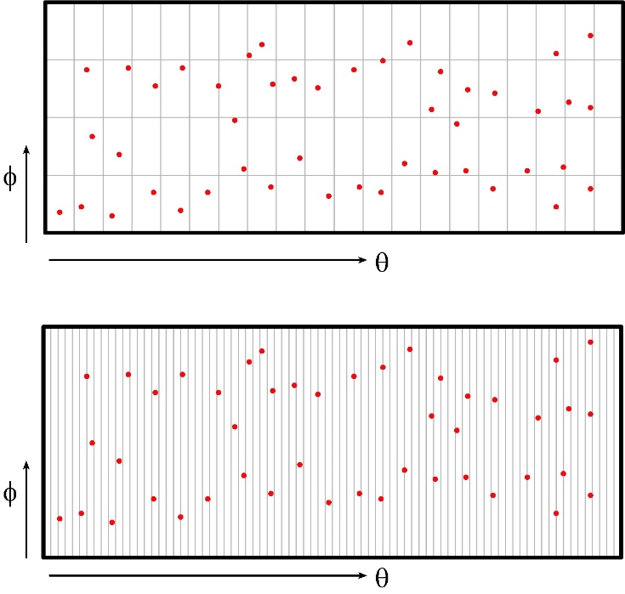
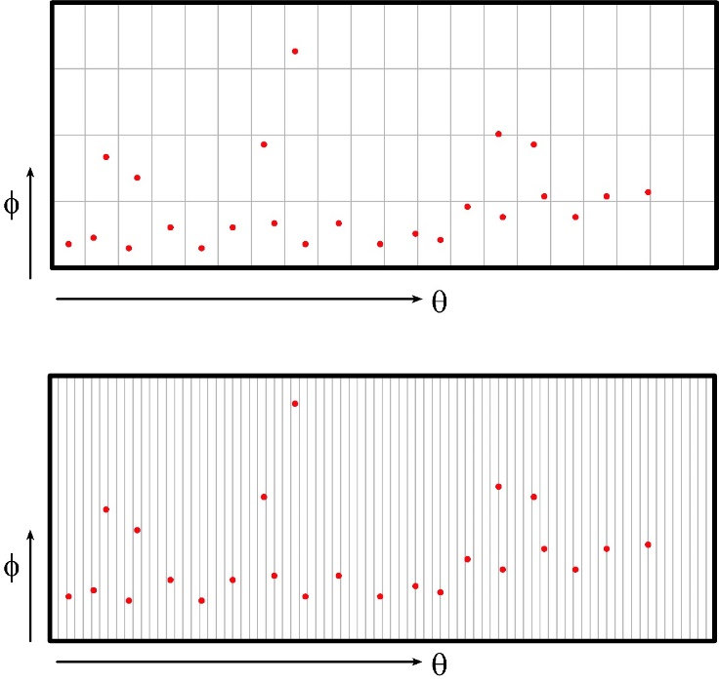
2D vs. 1D: user spatial distribution
uniform horizontal & vertical user distributions
uniform horizontal, nonuniform vertical
design 1: 2D array
✘
✓
design 2: 1D array
✓
✓
Spatial distribution of users, and of scattering objects, guides choice of array geometry.

Slide 19
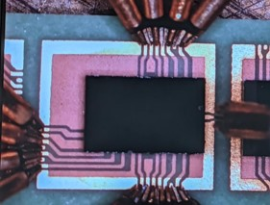
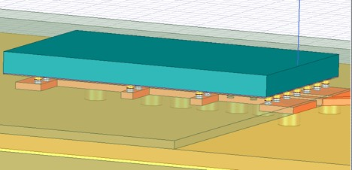
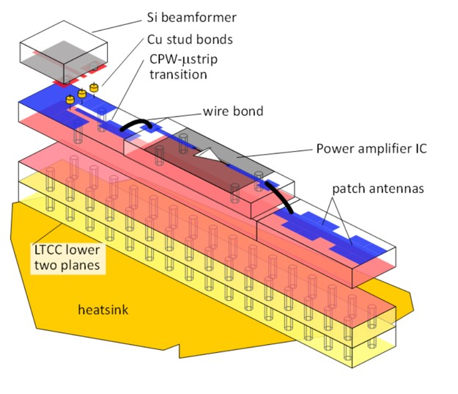
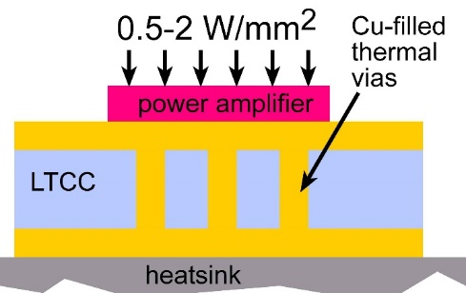
140GHz hub: packaging challenges
IC-package interconnects Difficult at > 100 GHz
Removing heat Thermal vias are marginal
Interconnect density Dense wiring for DC, LO, IF, control. Hard to fit these all in.
Economies of scale Advanced packaging standards require sophisticated tools High-volume orders only Hard for small-volume orders (research, universities) Packaging industry is moving offshore

Slide 20
100-300GHz IC-package connections
type | Frequency | technology | cost | heatsinking
micromachined waveguide interface | 1000 GHz | Research. Cheap one day ? | high ✘ | good
ribbon, mesh bond | 200 GHz | Handcrafted. | high ✘ | good
patch antennas on superstrate | 1000 GHz | Straightforward | low | good
Cu stud flip-chip | >200 GHz | Industry standard | low | ok, marginal for PA ✘
hot vias | 200 GHz | Development | low ? | good
(ball) wirebonds | 100 GHz ✘ | Industry standard | low | good
Deal, IEEE Trans THz, Sept 2011
G. Rebeiz

Slide 21
135GHz 8-channel MIMO hub array tile modules
140GHz MIMO hub receiver array modules, 4-element, 8-element MIMO beamforming Data transmission up to 1.9Gb/s
140GHz MIMO hub transmitter array modules, 8-element results in review
Receiver: A. Farid, 2021 BCICTS; Transmitter: in review
110mW InP PA 20.8% PAE
CMOS TX, RX ICs GlobalFoundries 22nm SOI CMOS.
Teledyne 250nm InP HBT

Slide 22
210 GHz and 280 GHz Array Modules

Slide 23
210 GHz MIMO backhaul demo
Key link parameters 500 meters range in 50 mm/hr rain; 23 dB/km 20 dB total margins: packaging loss, obstruction, operating, design, aging PAs: 63mW =P_{1dB} (per element) LNAs: 6dB noise figure
8-element MIMO array 3.1 m baseline for 500m link. 80Gb/s/subarray→ 640Gb/s total 4 × 4 sub-arrays → 8 degree beamsteering

Slide 24
210 GHz Transmitter and Receiver ICs
M. Seo et al, 2021 IMS; Teledyne 250nm InP HBT
200 GHz direct-conversion TX
200 GHz direct-conversion RX
Size: 2.9 x 0.75 mm²
Size: 2.3 x 0.85 mm²

Slide 25
210 GHz MIMO transceiver modules: in development

Slide 26
280GHz transmitter and receiver IC designs
Solyu, Alz, Ahmed, Seo; UCSB/Sungkyunkwan
Teledyne 250nm InP HBT technology
Receiver
Transmitter
simulations: 11dB noise figure, 40GHz bandwidth
simulations: 17dB saturated output power.
Application: point-point MIMO backhaul links

Slide 27
100-300GHz Wireless

Slide 28
Wireless above 100 GHz
Massive capacities large available bandwidths massive spatial multiplexing in base stations and point-point links
Very short range: few 100 meters short wavelength, high atmospheric losses. Easily-blocked beams.
IC Technology All-silicon for short ranges below 200 GHz. SiGe or III-V LNAs and PAs for longer-range links. Just like cell phones today III-V frequency extenders for 340GHz and beyond
The challenges computational complexity packaging: fitting signal channels in very small areas mesh networking to accommodate beam blockage driving the technologies to low cost

Slide 29
(backup files follow)

Slide 30
70 GHz spatially multiplexed base station
If we use instead a 70GHz carrier, the range increases to 70 meters (vs. 40 meters) but the handset becomes 16mm×16mm (vs. 8mm×8mm), and the hub array becomes 19mm×612mm (vs. 10mm×328mm)
Or, use a 4×4 (8mm×8mm) handset array, and the range becomes ..about 40 meters.
Same handset area (more handset elements)→ same link budget Easier to obtain license for 140±2.5GHz than 70±2.5GHz

Slide 31
75 GHz, 640 Gb/s MIMO backhaul (16QAM)
Why not use a lower-frequency carrier, e.g. 75 GHz ? Must use at least 16QAM, given 80Gb/s/channel…
8-element 640Gb/s linear array:
requires 16dB_{m} transmit power/element (P_{out})
requires 3.5m linear array
Similar RF power output, physically larger

