Slide 1
Quasi-vdW epitaxy of GaAs on Si
Darshana Wickramaratne¹, Y. Alaskar^{2,3}, S. Arafin², A. G. Norman⁴, Jin Zou⁵, Z. Zhang⁵, K.L Wang², R. K. Lake¹
1 Dept. of Electrical and Computer Engineering, UC Riverside, CA 92521, USA
2 Department of Electrical Engineering, UCLA, CA 90095, USA
3 King Abdulaziz City for Science and Technology, Riyadh 11442, Saudi Arabia
4 National Renewable Energy Laboratory, Denver, CO 80401, USA
5 Materials Engineering, The University of Queensland, St. Lucia, QLD 4072, Australia
Lawrence Epitaxy Workshop, Tempe, AZ 2015

Slide 2
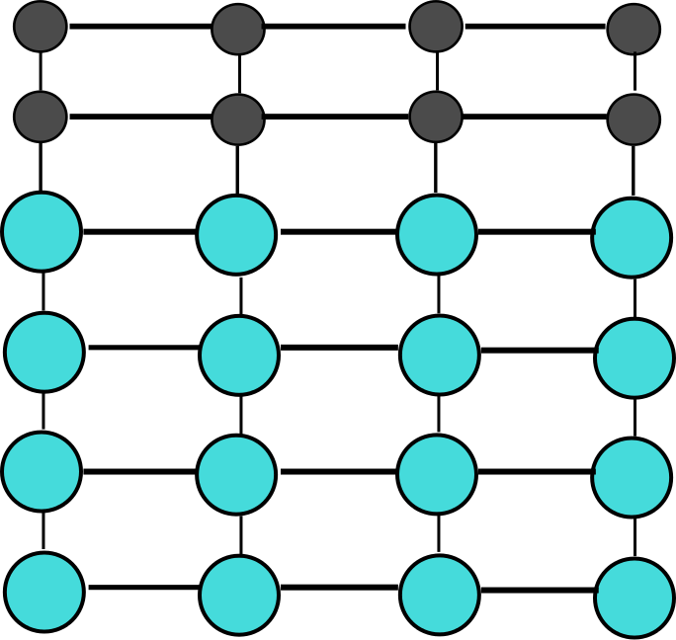
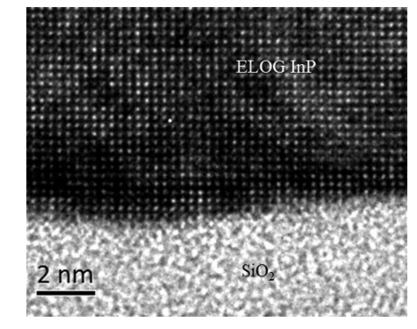
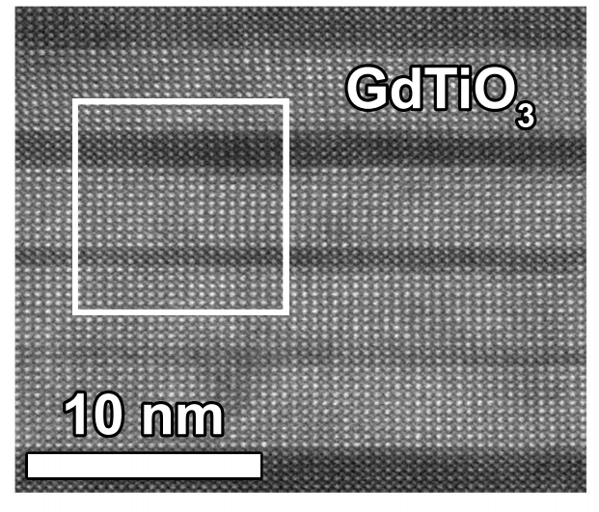
Heteroepitaxy
Challenges:
Surface dangling bonds/Surface states
Lattice mismatch
Polar on non-polar effects
Thermal expansion mismatch
...
InP on amorphous SiO₂
J Crystal Growth
GdTiO₃/SrTiO₃ superlattice
Phys. Rev. B 89, 075140, 2014

Slide 3
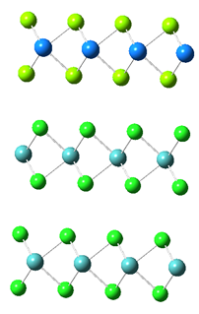
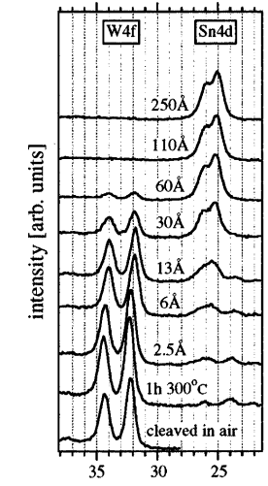
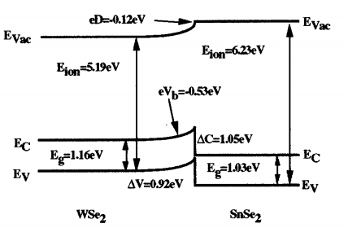
van-der-Waal epitaxy
Proposed by Koma in 1984 for growth of NbSe₂ on MoSe₂. (Surface Science, 174(1), 556-560) Successfully adapted to other 2D materials
Low growth axis bond energies mitigates strain due to lattice mismatch
Challenges
Low surface energy of substrate
Low adsorption and migration energies
vdW gap
vdW gap
Journ of Appl Phys vol 5, 5, 1999

Slide 4
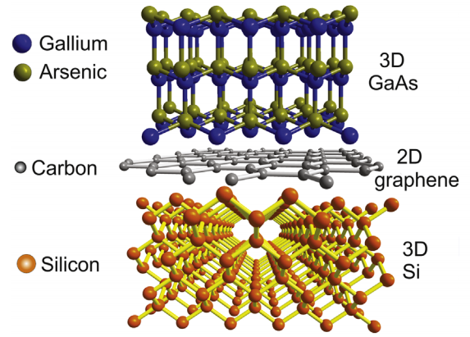
Quasi van-der-Waal epitaxy
Y Alaskar, et. al J Crystal Growth 2015

Slide 5
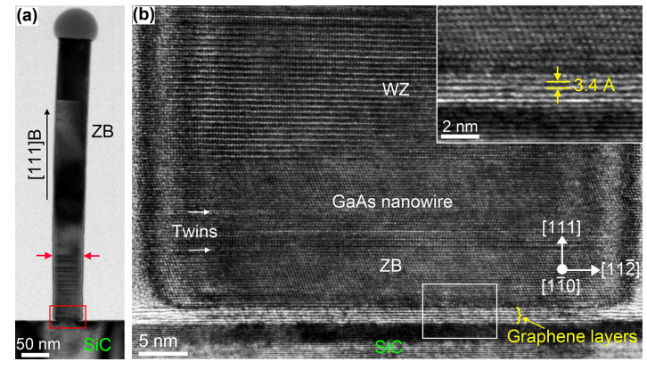
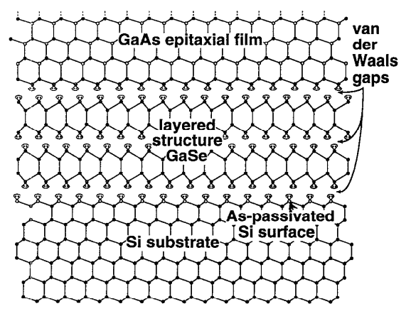
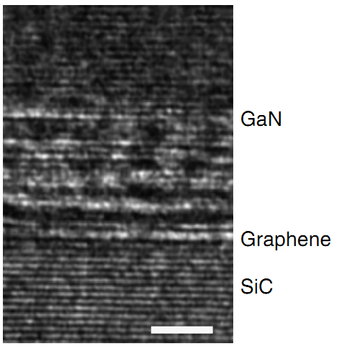
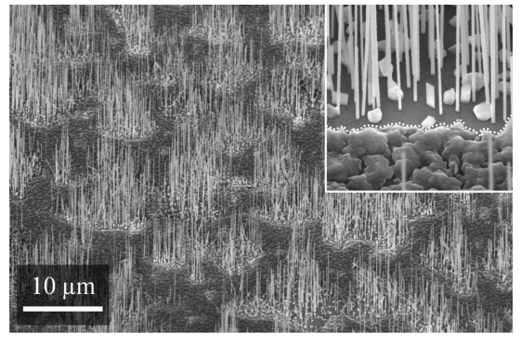
Overview: Epitaxy on vdW Materials
Nano Lett. 2012, 12, 4570−457
Mixed phase growth of ZB and WZ
GaAs nanowires on graphene
J Appl. Phys. 74 (12), 1993
Growth of GaSe/GaAs on Si
Nano Lett. 2012, 12, 4570−457
InGaAs nanowire growth on graphene and
MoS₂
Nature Comm. 5, 2014
Direct growth of WZ-GaN on graphene/SiC substrate

Slide 6
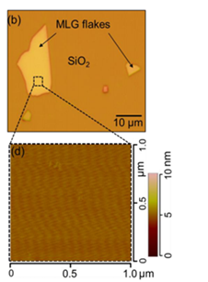
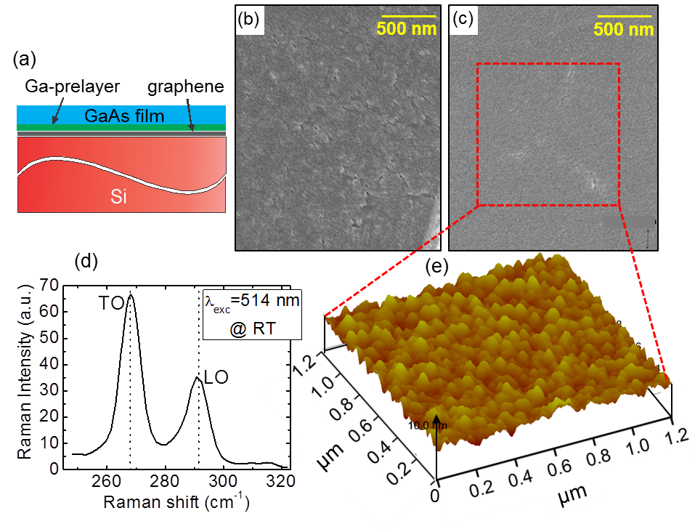
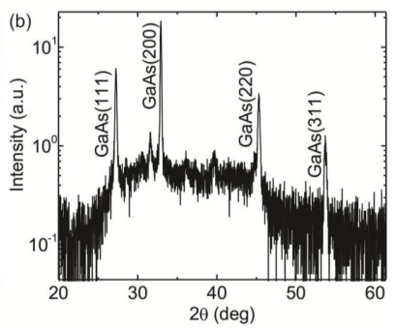
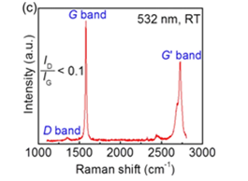
Experimental Results
UCLA, NREL, Univ. Of Queensland, Y Alaskar, et. al, Adv Func Materials, 2014
Exfoliated Graphene

Slide 7
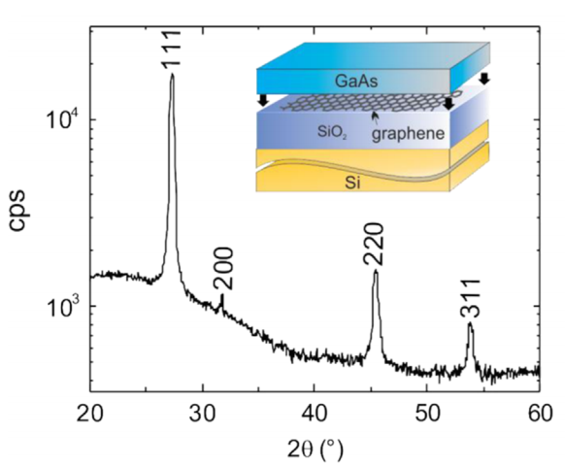
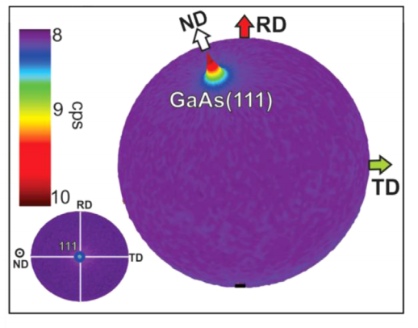
Experimental Results cont’d...
CVD Graphene
Y Alaskar, et. al J Crystal Growth 2015

Slide 8
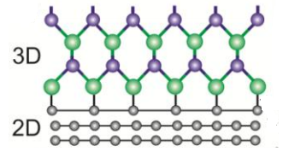
Formalism
Density functional theory, slab supercell geometries
GaAs Band gap (eV)
Experiment | LDA | HSE
1.424 | 0.79 | 1.419
LDA bandgaps corrected for using hybrid HSE functional
vdW interactions accounted for using semi-empirical correction

Slide 9
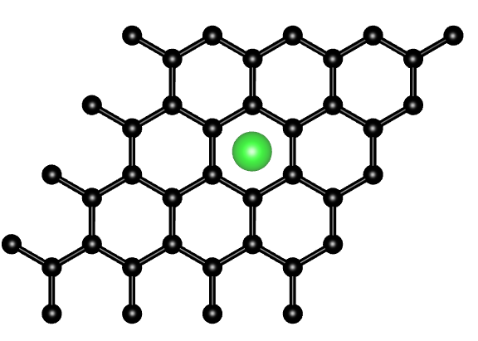
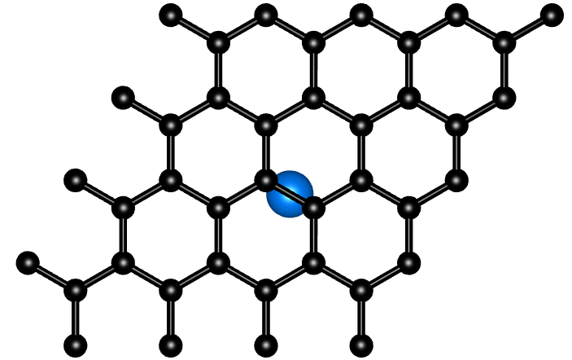
Graphene: Adsorption Energy and Migration Energy
 | Adsorption Site | Adsorption Energy - 2L (eV) | Adsorption Energy – 4L (eV) | Migration Energy – 2L(eV)
Ga | H | 1.5 | 1.53 | 0.05
Al | H | 1.7 | 1.72 | 0.03
In | H | 1.3 | 1.43 | 0.06
As | B | 1.3 | 1.28 | 0.21
N | B | 3.8 | 3.85 | 0.98
H-site
B-site

Slide 10
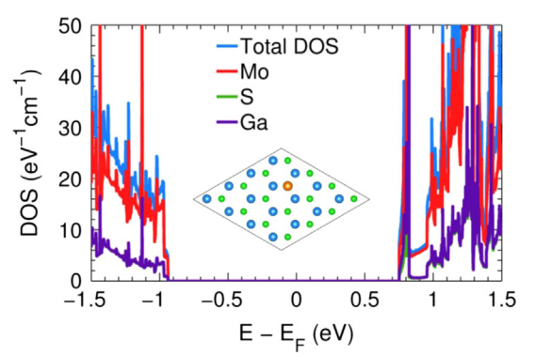
MoS₂ & h-BN: Adsorption and Migration Energy
 | Adsorption Energy
 | 1L h-BN (meV/atom) | 6L h-BN (meV/atom) | 1L-MoS₂ (meV/atom) | 6L-MoS₂ (meV/atom)
Ga | 131.6 (T) | 134.3 (T) | 234.6 (T) | 239.2 (T)
Al | 135.1 (T) | 101.1 (T) | 237.4 (T) | 241.6 (T)
In | 66.9 (B) | 85.1 (T) | 573.1 (T) | 582.1 (T)
As | 296.9 (B) | 341.5 (T) | 527.8 (T) | 537.8 (T)
Adsorption energies on monolayer and bilayer MoS₂ and h-BN are an order
of magnitude lower compared to the adsorption energies on graphene
Weak hybridization of the III/V elements with the MoS2 and h-BN layers leads to low
adsorption energies

Slide 11
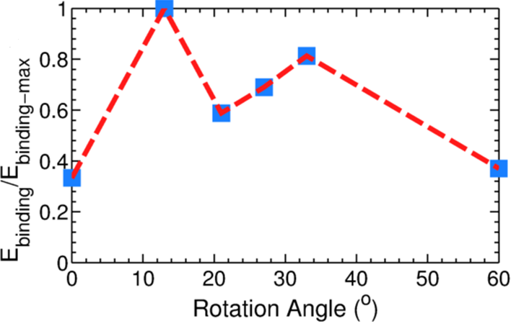
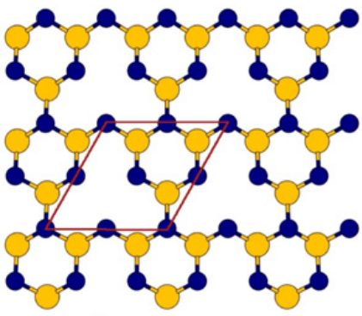
Preferred phase and misorientation
Surface | Binding energy/C-atom (meV)
2x2 Reconstructed ZB GaAs(111) | -65.88
√19x√19 Reconstructed ZB GaAs(111) | -64.21
Wurtzite GaAs (0001) | -30.11
Ga
As

Slide 12
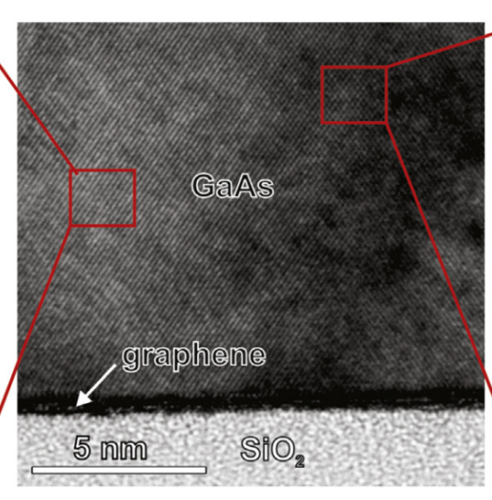
Summary and Conclusions
Experimental demonstration of 25 nm thick GaAs(111) Si/SiO₂/Graphene substrate using quasi van der Waal epitaxy
XRD indicates strong 111 orientation of GaAs on CVD grown graphene
DFT calculations indicate graphene is a superior vdW buffer layer compared to MoS₂ and h-BN
Reconstructed GaAs(111) interface with graphene is preferred over WZ GaAs(0001)

