Slide 1
40Gbit/s Coherent Optical Receiver Using a Costas Loop
H. Park, M. Lu, E. Bloch, T. Reed, Z. Griffith, L. Johansson, L. Coldren, and M. Rodwell
University of California at Santa Barbara

Slide 2
Introductions
Motivations
Higher Spectral Efficiency – QPSK / multi-level QAMs
Higher Data Rates – 40Gbit/s, 100Gbit/s, and even higher
Higher Receiving Sensitivity
Recent Coherent Optical Communication
Coherent detection based on DSP
Local oscillator (LO) laser
Polarization diversity 90° optical hybrid
Balanced detectors
High speed analog to digital convertor (ADC)
High speed digital signal processing (DSP)

Slide 3
Coherent Optical Communications
Coherent Optical Receiver – I
Advantages:
Multi-level constellations
High data rate
Phase managements
Polarization managements
Dis-advantages:
Electrical circuit complexity
Speed limitations
Cost issues
Power consumptions

Slide 4
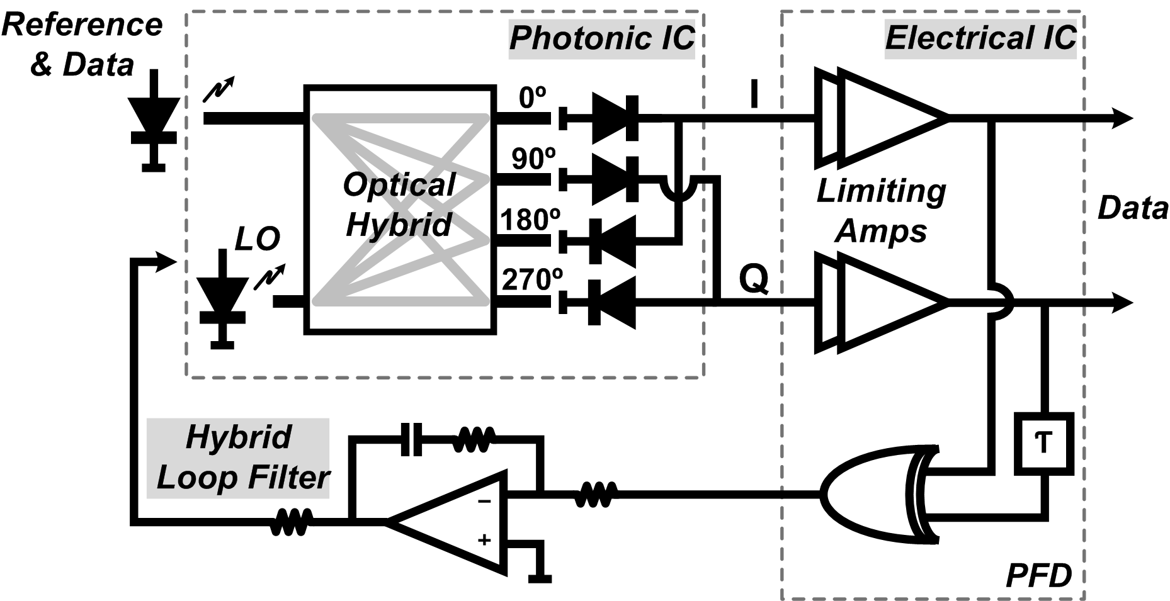
Coherent Optical Communications
Coherent Optical Receiver – II
Homodyne OPLL based coherent receiver – Costas Loop
Optical carrier recovering technique
Requiring Stable OPLL

Slide 5
Coherent Optical Communications
Coherent Optical Receiver – II
Challenges:
Long loop delays (*1ns)
Narrow loop bandwidth (*100MHz)
Transmitting and LO lasers’ linewidth
Sensitive by external variations
Solutions:
Integrated circuits (photonic IC, electrical IC)
Feed-forward loop filter topology
Minimizing Interconnection delays
Digitally operating feedback system

Slide 6
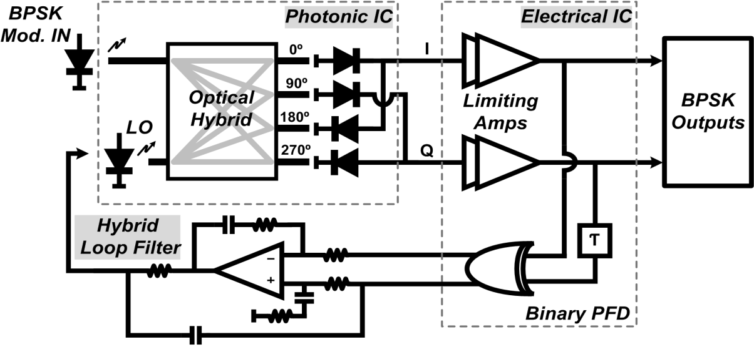
Phase Locked Coherent BPSK Receiver
Homodyne OPLL + Costas Loop
Three blocks: photonic IC, electrical IC, and hybrid loop filter
High speed BPSK data demodulations

Slide 7
Phase Locked Coherent BPSK Receiver
Photonic IC
SG-DBR laser – 40nm tunable ranges
90° optical hybrid
4 un-balance photodiodes – 30GHz bandwidth

Slide 8
Phase Locked Coherent BPSK Receiver

Slide 9
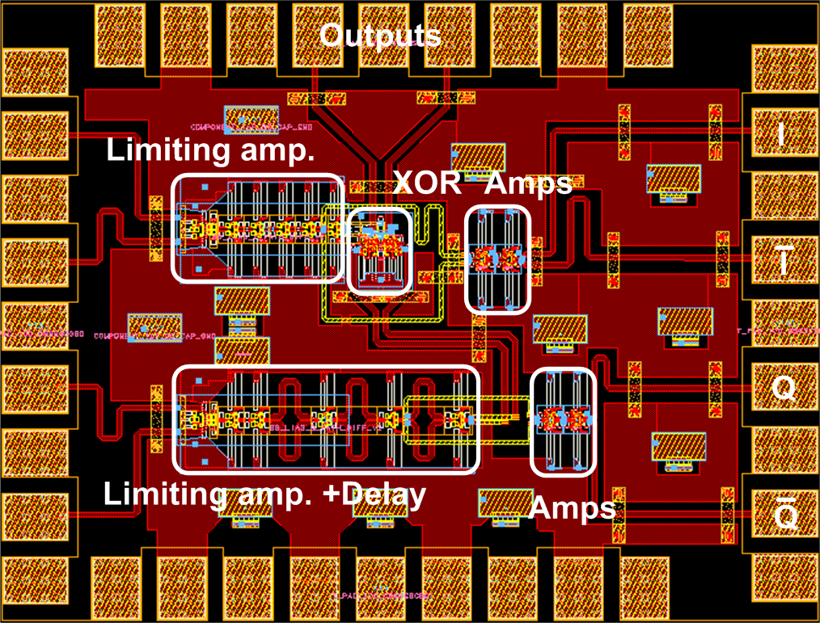
Phase Locked Coherent BPSK Receiver
Electrical IC
Teledyne’s
500nm InP HBT
300GHz ft / fmax
Limiting amplifiers
Phase / frequency detector (PFD) – XOR + delay line

Slide 10
Phase Locked Coherent BPSK Receiver

Slide 11
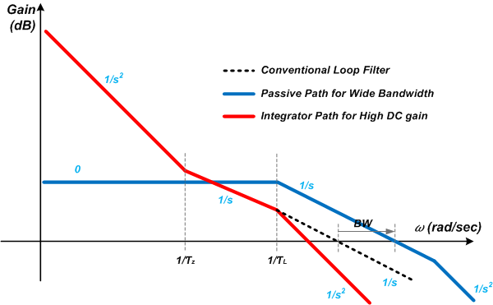
Phase Locked Coherent BPSK Receiver
Loop Filter
Open Loop Responses
* Challenges:
1. OP amp has lots of delays
2. OP amps bandwidth is limited (100MHz)
Main Path
Feed-Forward Path
Main path by integrator – high gain at DC and low frequencies
Feed-forward path – passive capacitor component

Slide 12
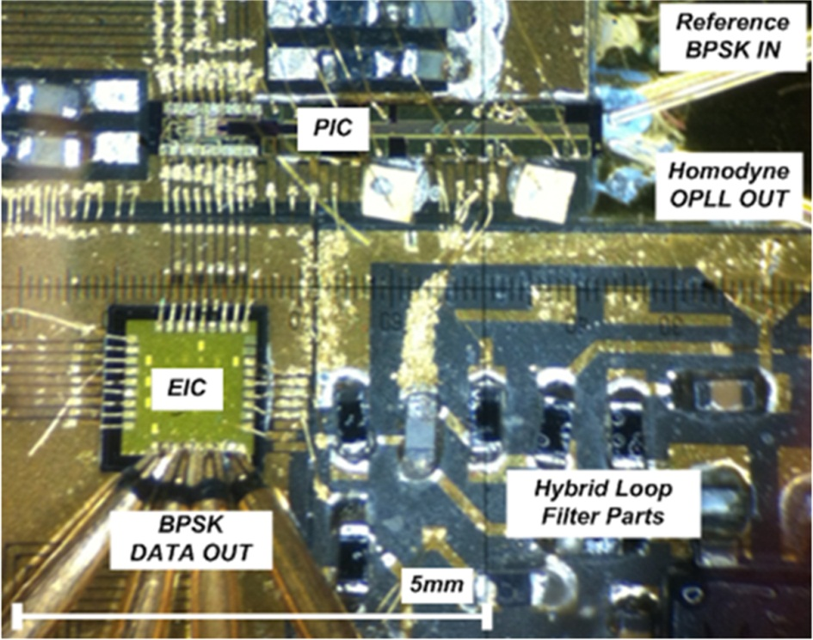
Phase Locked Coherent BPSK Receiver
Integration on a Single Carrier board
Fabricated in UCSB (Mingzhi Lu)
Designed by Eli Bloch using
Teledyne 500nm HBT Process
Loop filter and system
designed by Hyun-chul Park
Compact chip size of 10 x 10mm²
Total delay (120ps)=PIC (40ps)+EIC (50ps)+Interconnection (30ps)
1GHz Loop Bandwidth is feasible

Slide 13
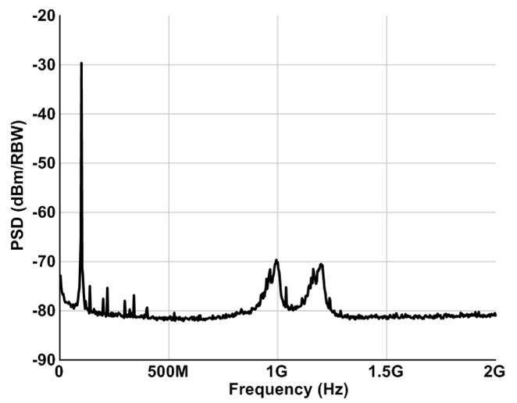
Test Results – Homodyne OPLL
Beating spectrum: locked SG-DBR + Ref. with 100MHz mod.
1.1GHz closed loop bandwidth
Beating laser tones at 100MHz
1.1GHz LBW
Left peak
Right peak

Slide 14
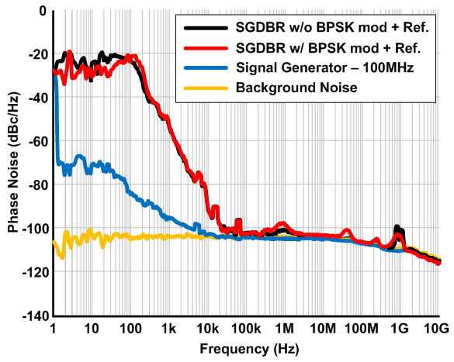
Test Results – Homodyne OPLL
Cross correlation between SG-DBR and reference lasers
-100dBc/Hz @ above 50kHz
-100dBc/Hz @ above 50kHz

Slide 15
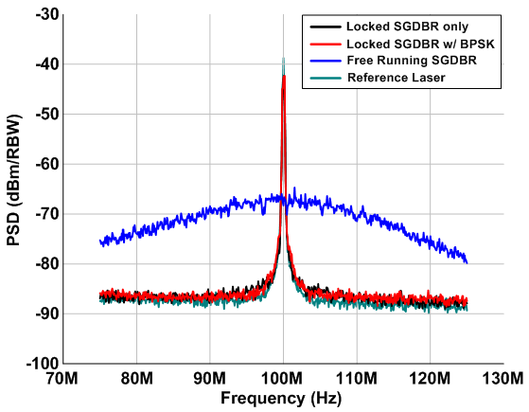
Test Results – Homodyne OPLL
Linewidth using self-heterodyne with 25km optical fiber
10MHz linewidth for free-running SG-DBR
50MHz Span
50kHz RBW
10MHz

Slide 16
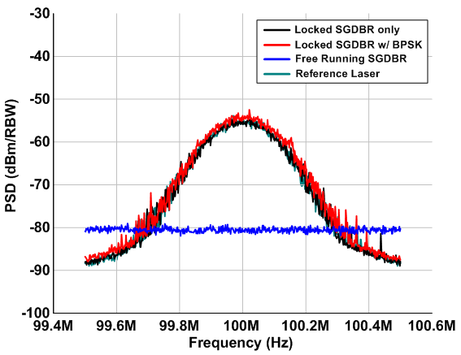
Test Results – Homodyne OPLL
Reference laser (Koshin) linewidth 100kHz
100kHz linewidth for locked SG-DBR laser
1MHz Span
3kHz RBW
100kHz

Slide 17
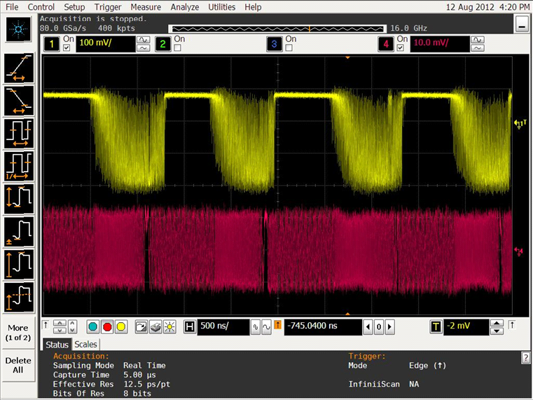
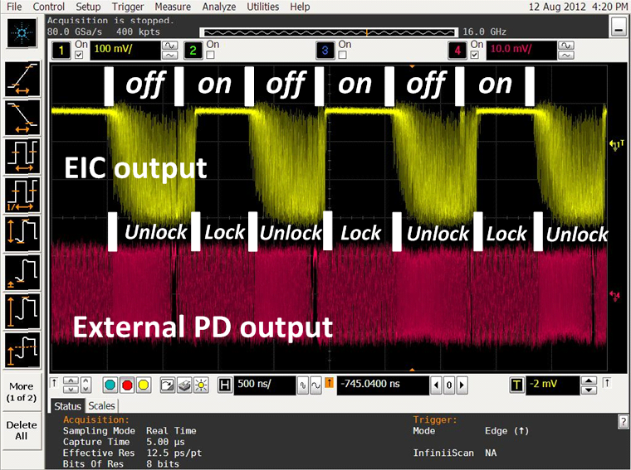
Test Results – Homodyne OPLL
400MHz/512bits ON-OFF laser
Locking conditions: EIC output – DC, External PD output – 100MHz

Slide 18
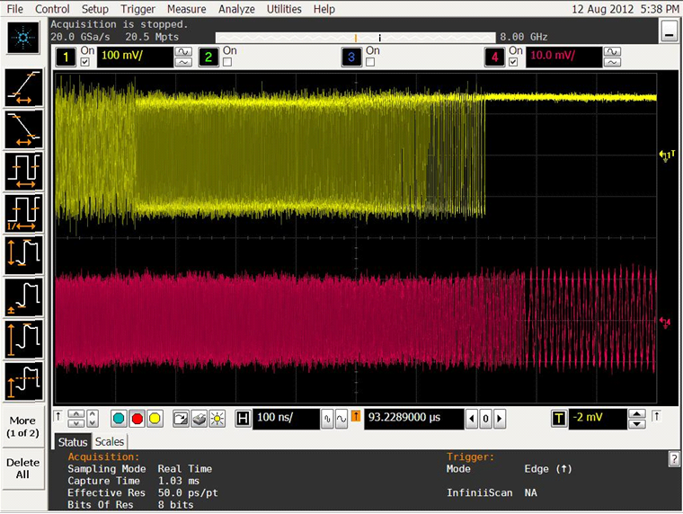
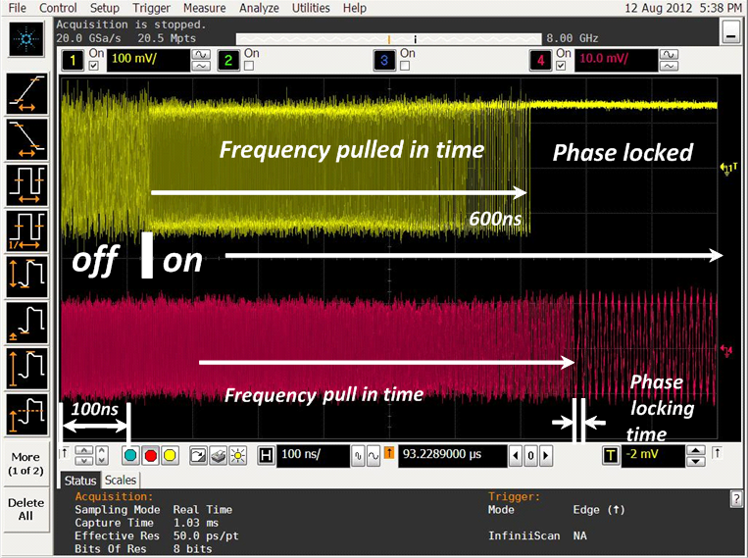
Test Results – Homodyne OPLL
Frequency pull-in time ~600ns
Phase lock time <10ns
* Worst conditions

Slide 19
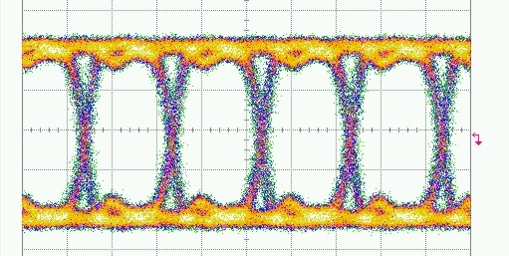
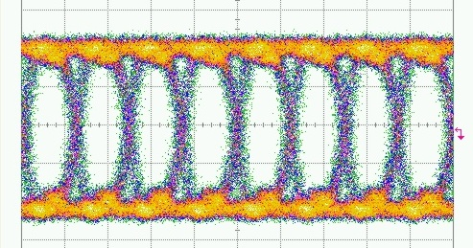
Test Results – BPSK Receiver
PRBS 2³¹-1 signals – up to 40Gb/s BPSK data
Open eye diagrams for 25Gb/s and 40Gb/s
25Gb/s
40Gb/s

Slide 20
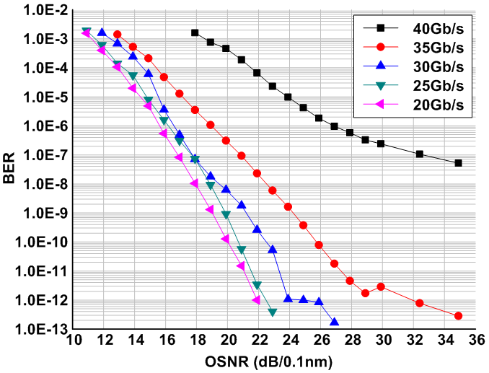
Test Results – BPSK Receiver
BER vs. OSNR (20Gb/s to 40Gb/s)
Error-free up to 35Gb/s , < 1.0E-7 @ 40Gb/s

Slide 21
Conclusions
The first demonstration highly integrated optical Costas loop receiver
Integrated PIC, integrated EIC, and feed-forward loop filter
The receiver is Integrated within 10x10mm²
A stable homodyne OPLL by 120ps delay and 1.1GHz loop bandwidth
40Gbit/s BPSK coherent optical receiver (BER < 1.0e-7)
Error-free (BER < 1.0e-12) up to 35Gbit/s
Future works: QPSK receivers / long haul tests / dispersion compensations / polarization managements
Thank you for your attention !

