Slide 1
Sub-mm-Wave Technologies:
Systems, ICs, THz Transistors
2013 Asia-Pacific Microwave Conference, November 8th, Seoul
Mark Rodwell
University of California, Santa Barbara
Coauthors:
J. Rode, H.W. Chiang, T. Reed, S. Daneshgar, V. Jain, E. Lobisser,
A. Baraskar, B. J. Thibeault, B. Mitchell, A. C. Gossard, UCSB
Munkyo Seo, Jonathan Hacker, Adam Young, Zach Griffith, Richard Pierson, Miguel Urteaga, Teledyne Scientific Company
rodwell@ece.ucsb.edu 805-893-3244

Slide 2
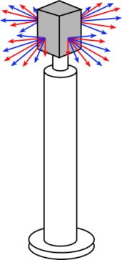


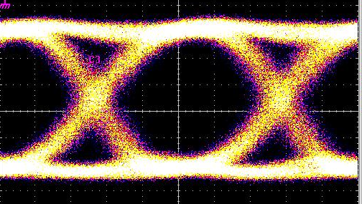
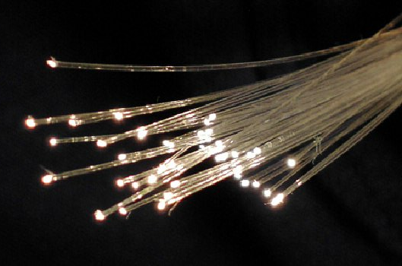

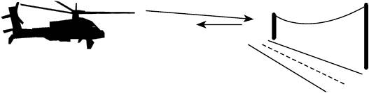
50-500 GHz Electronics: What Is It For ?
820 GHz transistor ICs today
2 THz clearly feasible
*ITU band designations
** IR bands as per ISO 20473
Applications
100+ Gb/s wireless networks
Video-resolution radar
→ fly & drive through fog & rain
near-Terabit
optical fiber links

Slide 3
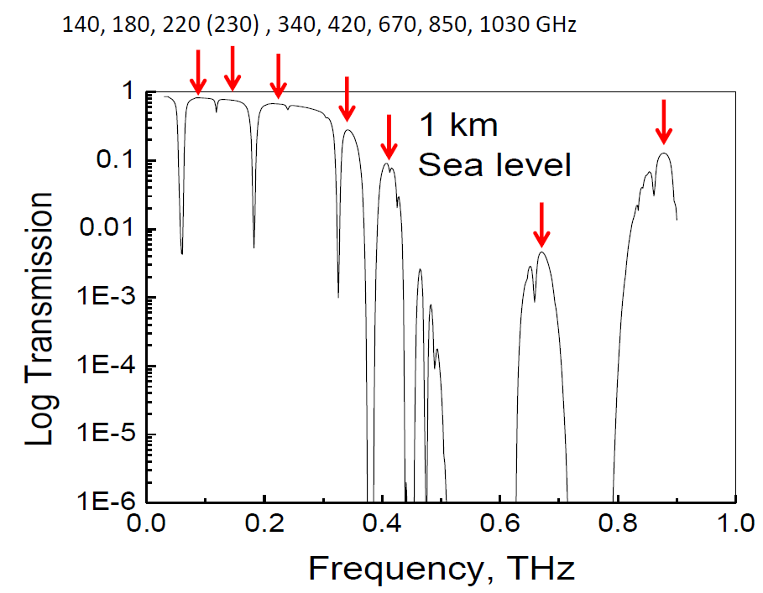
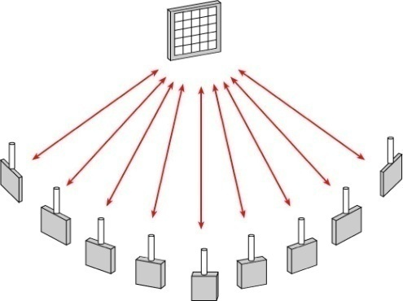
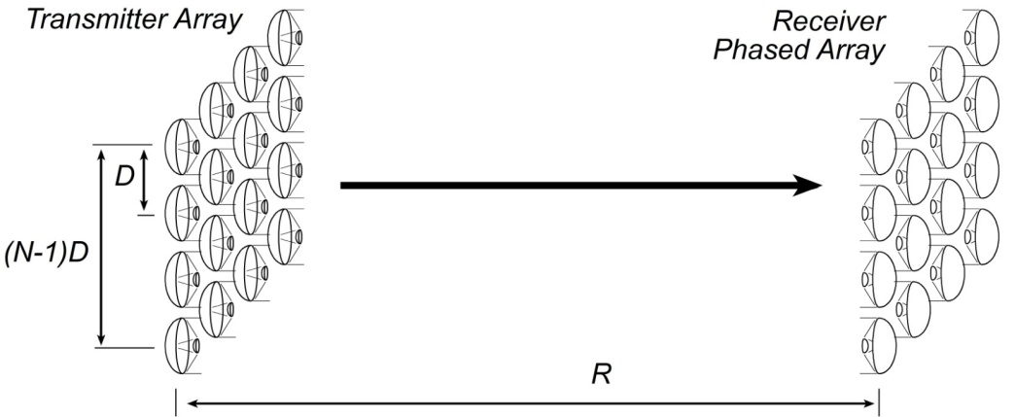
50-500 GHz Wireless Has High Capacity
very large bandwidths available
short wavelengths→ many parallel channels
Sheldon IMS 2009
Torkildson : IEEE Trans Wireless Comms. Dec. 2011.
3

Slide 4

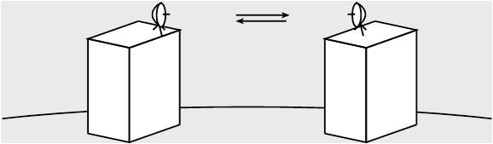
50-500 GHz Wireless Needs Phased Arrays
isotropic antenna → weak signal →short range
highly directional antenna → strong signal, but must be aimed
no good for mobile
must be precisely aimed →too expensive for telecom operators
beam steering arrays → strong signal, steerable
32-element array → 30 (45?) dB increased SNR

Slide 5
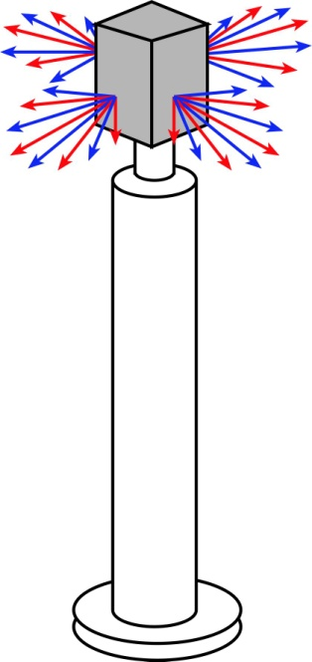
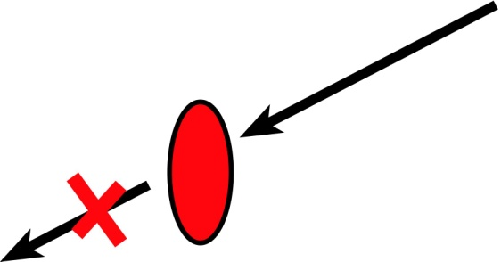

50-500 GHz Wireless Needs Mesh Networks
Object having area
~λR
will block beam.
Blockage is avoided
using beamsteering
and mesh networks.
...high-frequency signals
are easily blocked.
...this is easier at high frequencies.

Slide 6
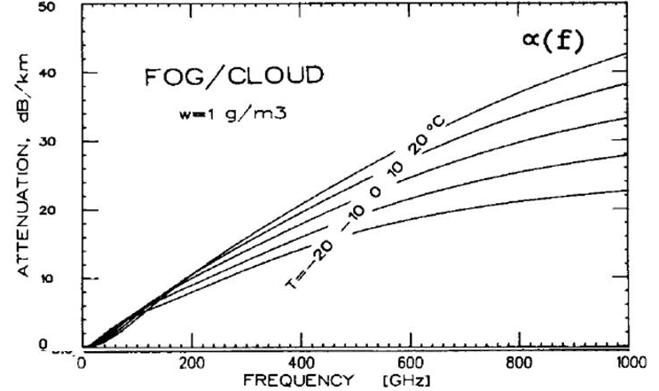
50-500 GHz Wireless Has High Attenuation
High Rain Attenuation
High Fog Attenuation
very heavy fog
five-9's rain @ 50-1000 GHz:
→ 30 dB/km
~(25 dB/km)x(frequency/500 GHz)
50-500 GHz links must tolerate ~30 dB/km attenuation
Olsen, Rogers, Hodge, IEEE Trans Antennas & Propagation Mar 1978
Liebe, Manabe, Hufford, IEEE Trans Antennas and Propagation, Dec. 1989

Slide 7
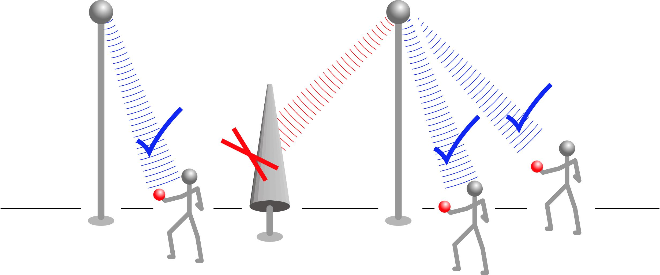
mm-Waves for Terabit Mobile Communications
Goal: 1Gb/s per mobile user
spatially-multiplexed mm-wave base stations

Slide 8
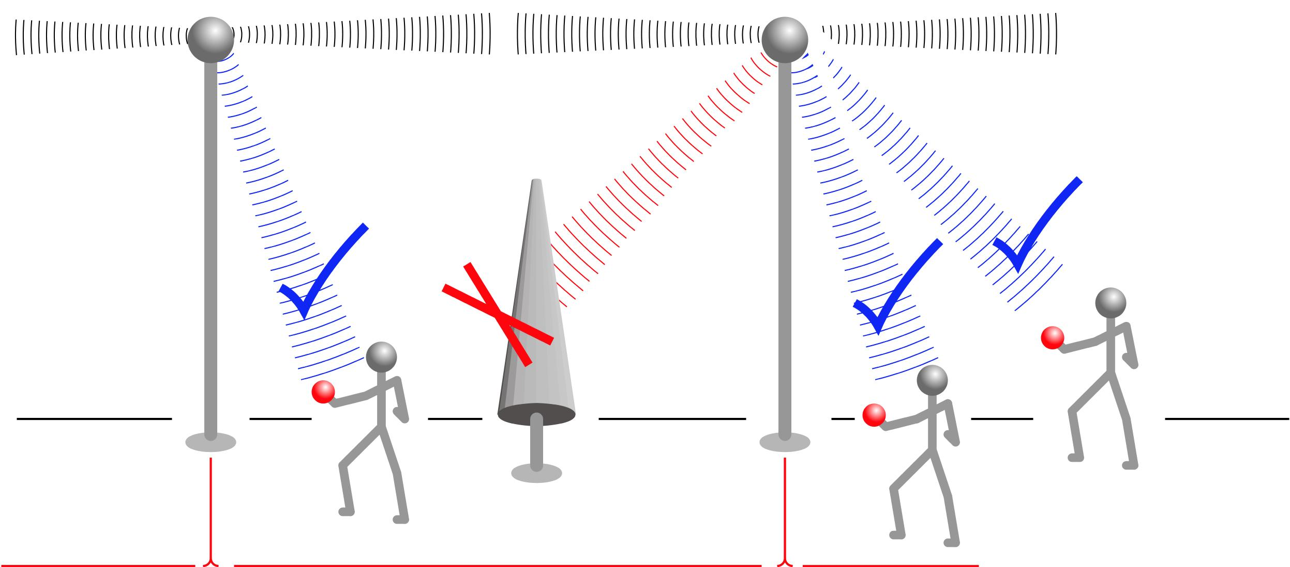
mm-Waves for Terabit Mobile Communications
Goal: 1Gb/s per mobile user
spatially-multiplexed mm-wave base stations
mm-wave backhaul
or optical backhaul

Slide 9
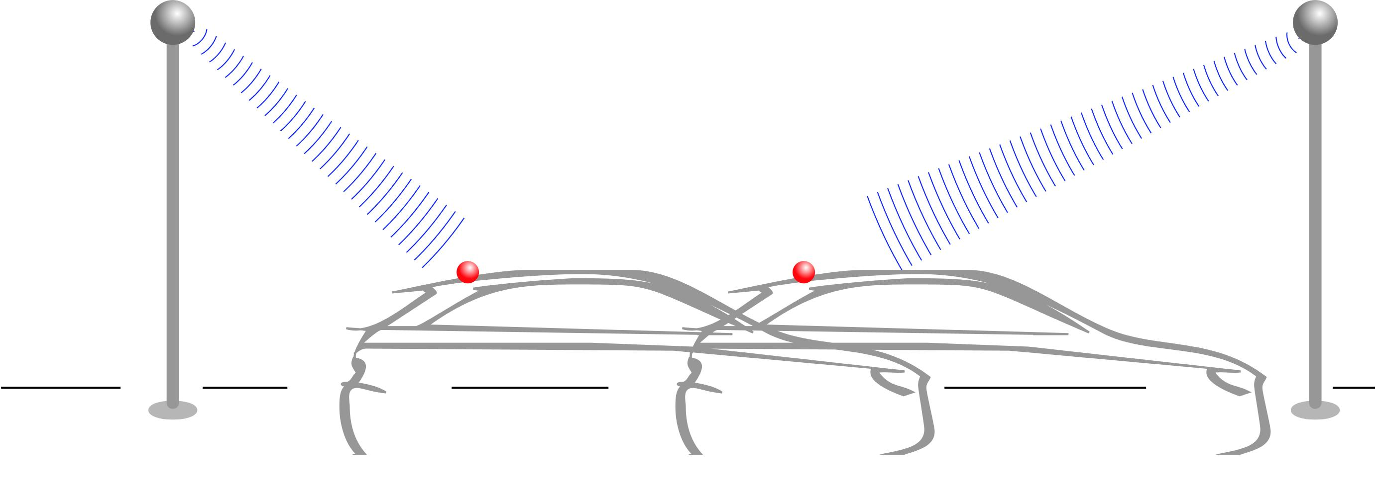
mm-Waves for Terabit Mobile Communications
Goal: 1Gb/s per mobile user
spatially-multiplexed mm-wave base stations

Slide 10
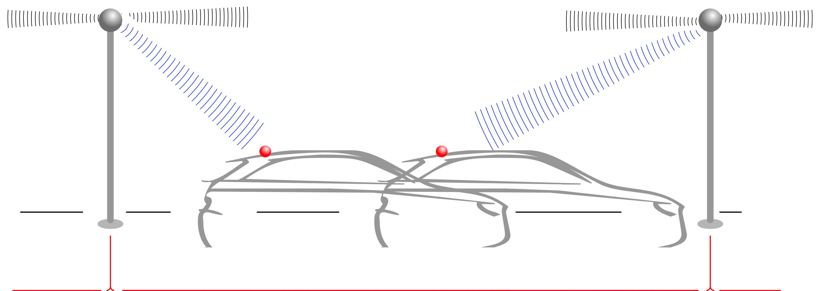
mm-Waves for Terabit Mobile Communications
Goal: 1Gb/s per mobile user
spatially-multiplexed mm-wave base stations
mm-wave backhaul
or optical backhaul

Slide 11
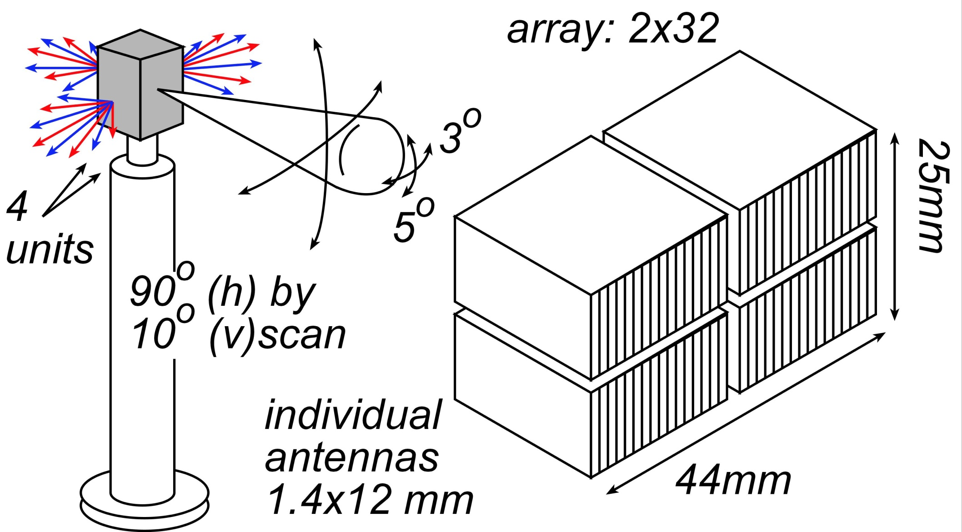
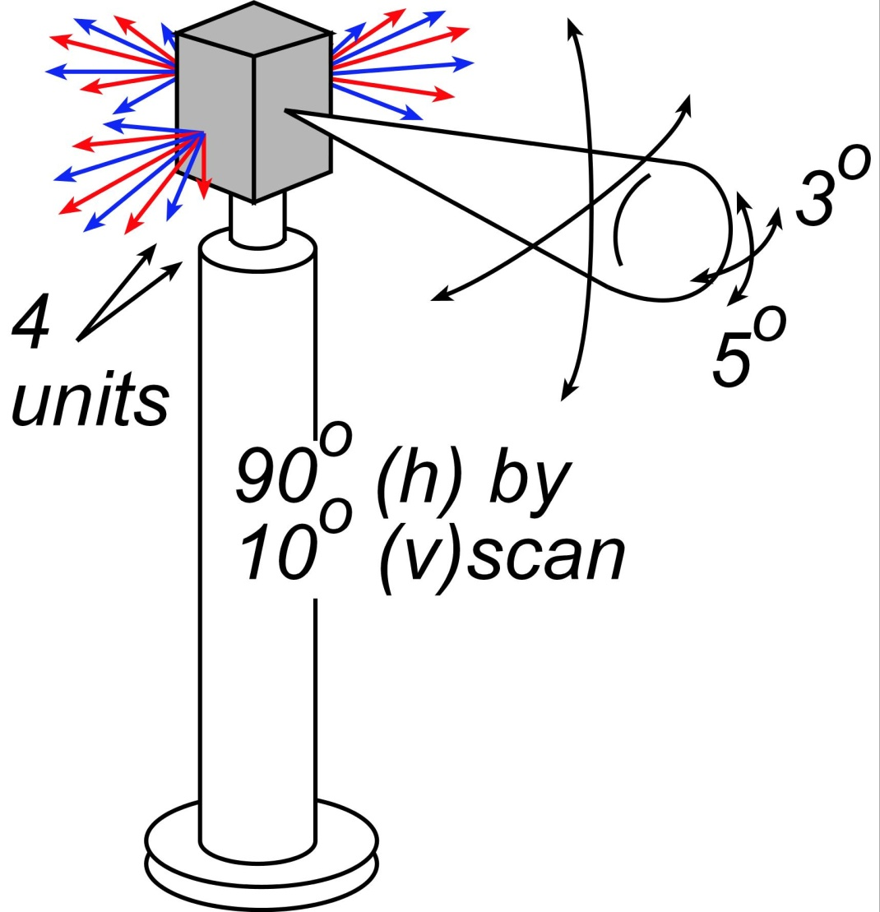
140 GHz, 10 Gb/s Adaptive Picocell Backhaul

Slide 12

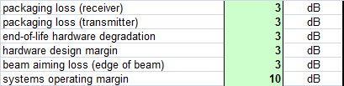
140 GHz, 10 Gb/s Adaptive Picocell Backhaul
350 meters range in five-9's rain
Realistic packaging loss, operating & design margins
PAs: 24 dBm P_{sat} (per element)→ GaN or InP
LNAs: 4 dB noise figure → InP HEMT

Slide 13
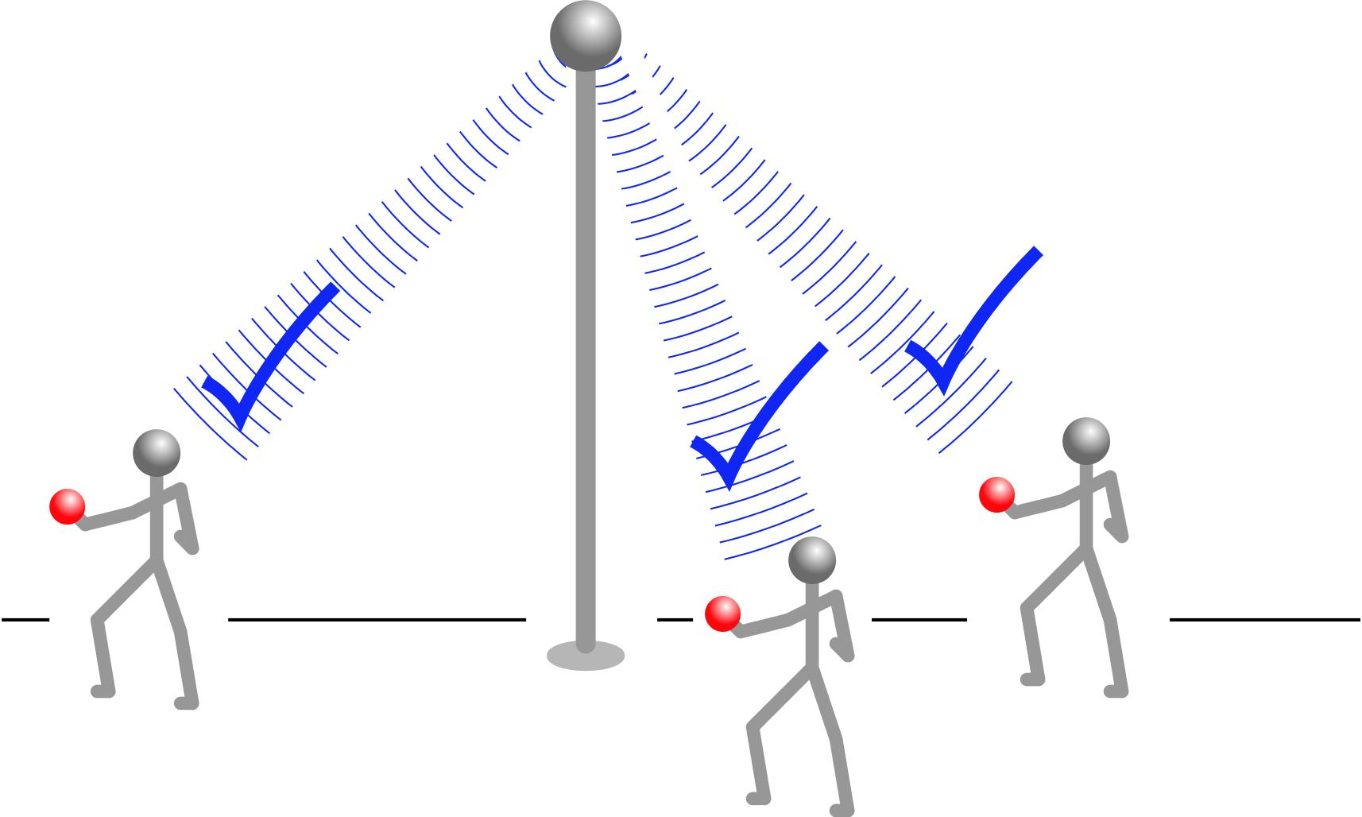
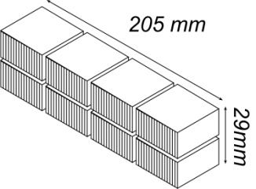
60 GHz, 1 Tb/s Spatially-Multiplexed Base Station
2x64 array on each of four faces.
Each face supports 128 users, 128 beams: 512 total users.
Each beam: 2Gb/s.
200 meters range in 50 mm/hr rain
Realistic packaging loss, operating & design margins
PAs: 20 dBm P_{out} , 26 dBm P_{sat} (per element)
LNAs: 3 dB noise figure

Slide 14

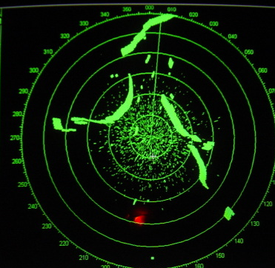
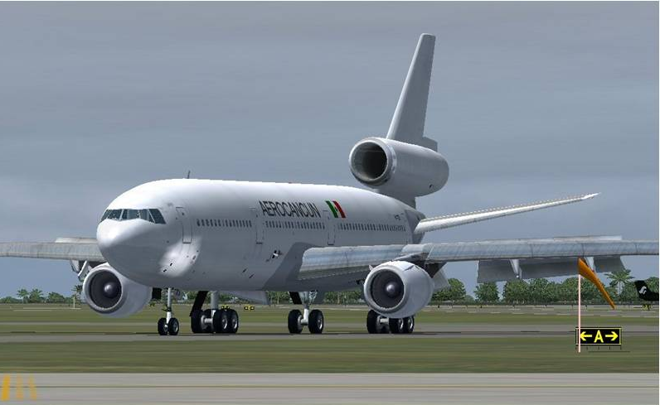
400 GHz frequency-scanned imaging radar
What your eyes see-- in fog
What you see with X-band radar
What you would like to see

Slide 15
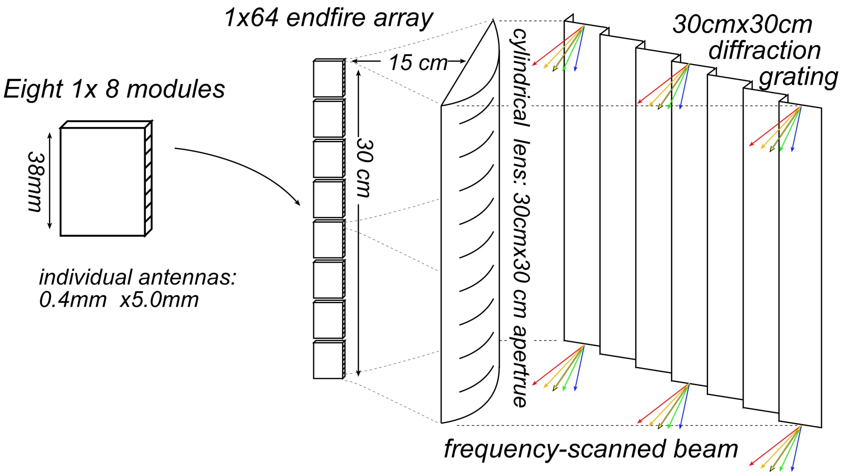
400 GHz frequency-scanned imaging car radar

Slide 16
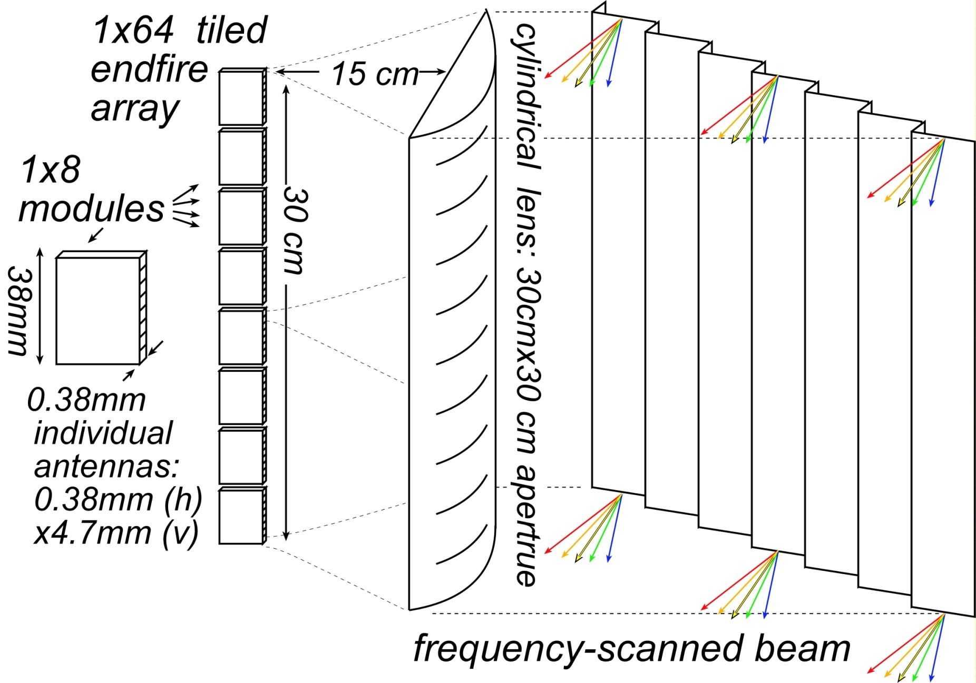
400 GHz frequency-scanned imaging car radar
Range: see a basketball at 300 meters (10 seconds warning) in heavy fog
(10 dB SNR, 25 dB/km, 30cm diameter target, 10% reflectivity, 100 km/Hr)
Image refresh rate: 60 Hz
Resolution 64×512 pixels
Angular resolution: 0.14 degrees
Angular field of view: 9 by 73 degrees
Aperture: 35 cm by 35 cm
Component requirements:
50 mW peak power/element,
3% pulse duty factor
6.5 dB noise figure,
5 dB package losses
5 dB manufacturing/aging margin

Slide 17
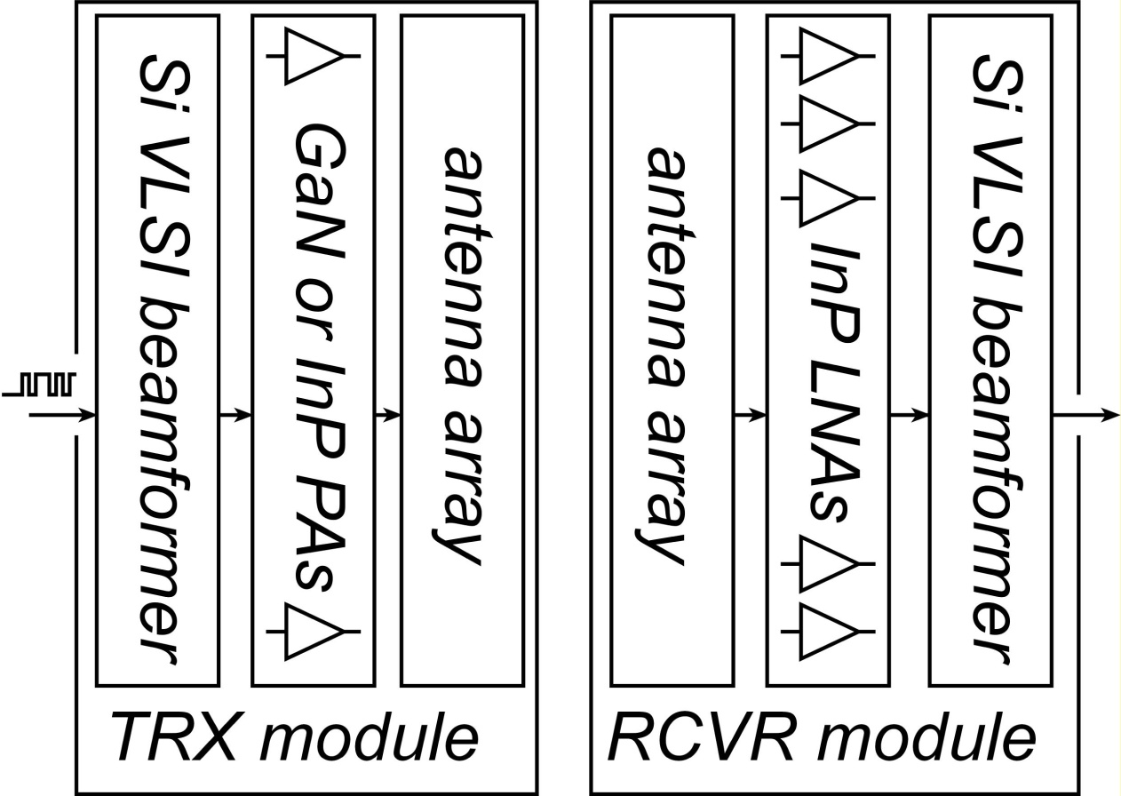
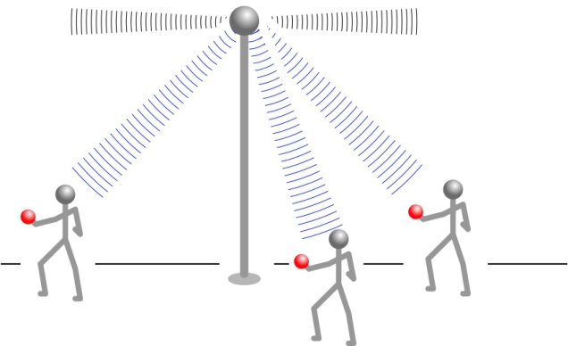
50-500 GHz Wireless Transceiver Architecture
backhaul
endpoint
III-V LNAs, III-V PAs → power, efficiency, noise
Si CMOS beamformer→ integration scale
...similar to today's cell phones.
High antenna array gain → large array area
→ far to large for monolithic integration

Slide 18
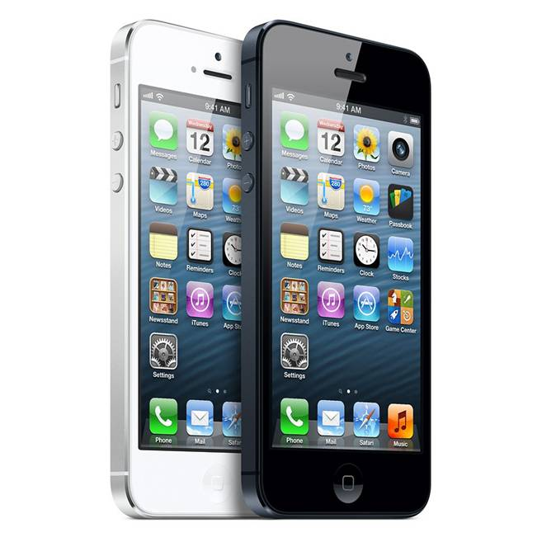
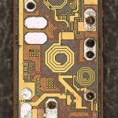
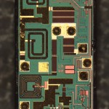
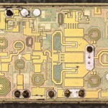
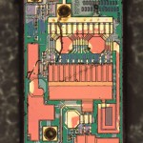
III-V PAs and LNAs in today's wireless systems...
http://www.chipworks.com/blog/recentteardowns/2012/10/02/apple-iphone-5-the-rf/

Slide 19
Transistors
for
50-500 GHz
systems
19

Slide 20
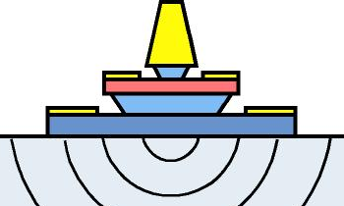
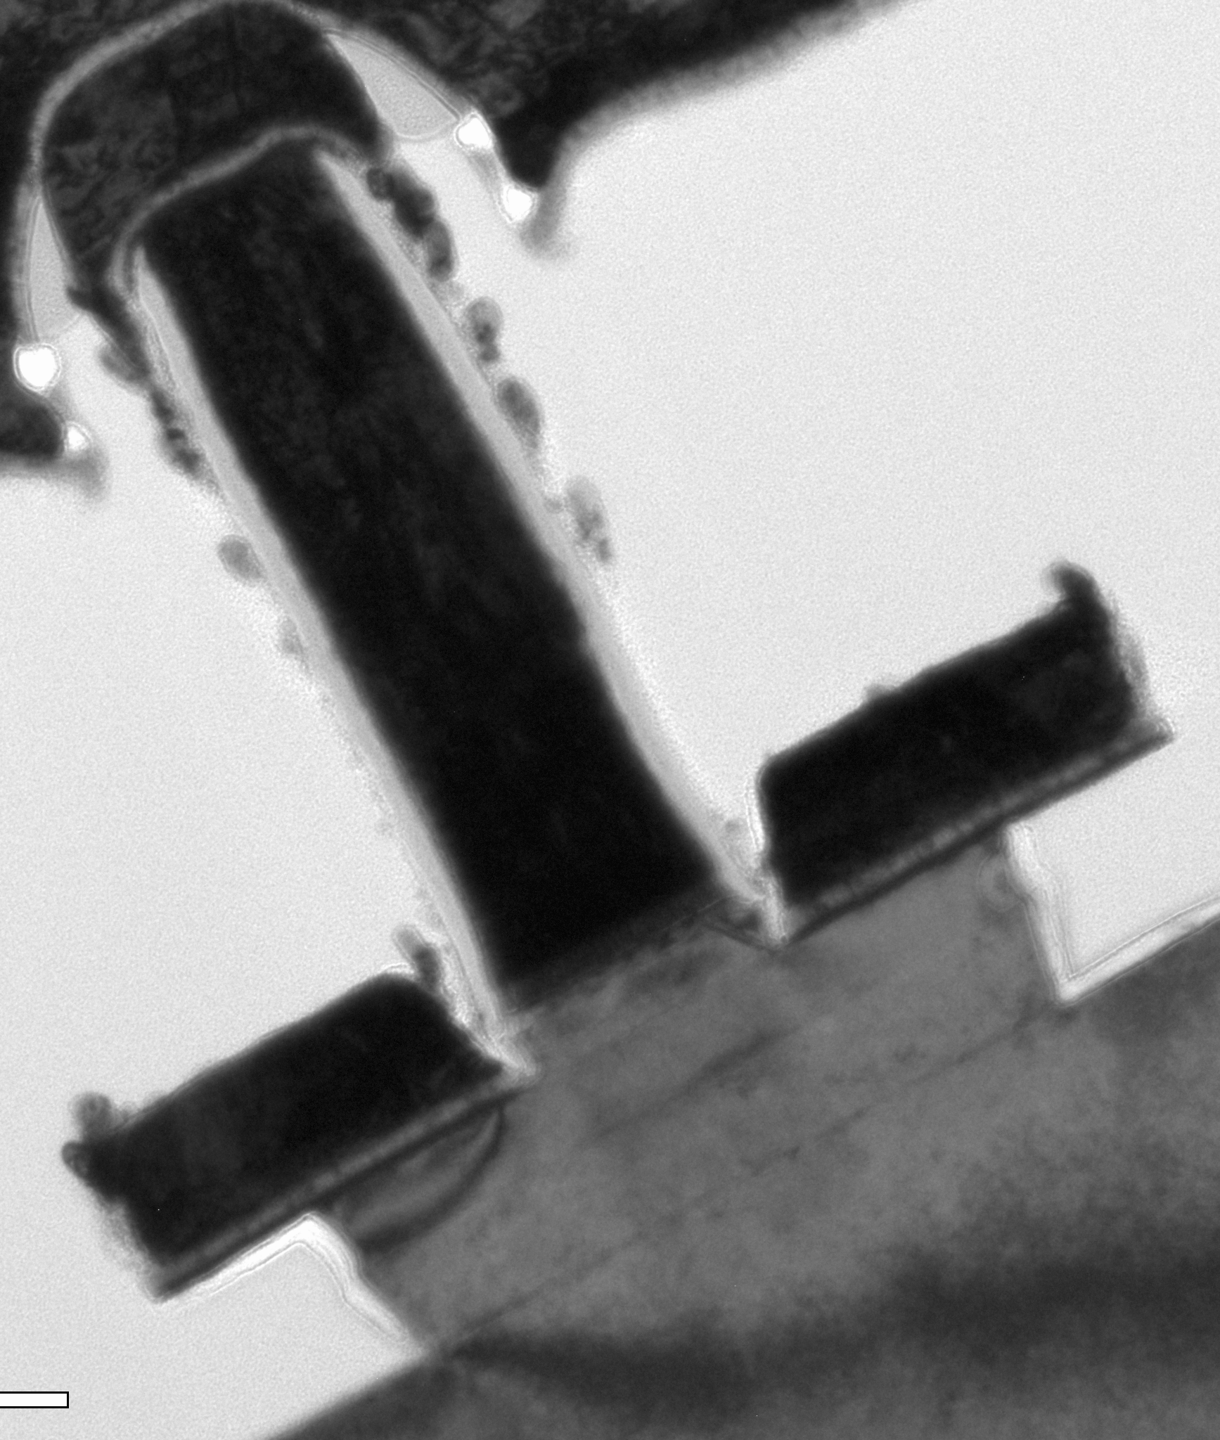
THz InP Heterojunction Bipolar Transistors
HBT parameter | change
emitter & collector junction widths | decrease 4:1
current density (mA/μm²) | increase 4:1
current density (mA/μm) | constant
collector depletion thickness | decrease 2:1
base thickness | decrease 1.4:1
emitter & base contact resistivities | decrease 4:1
Challenges:
Narrow junctions
low-resistivity contacts.
high current densities

Slide 21
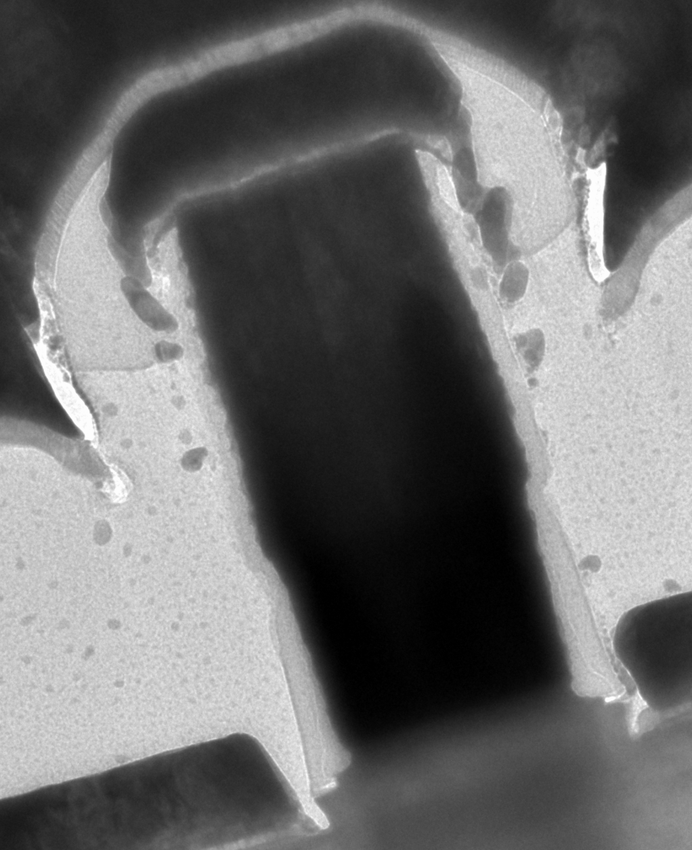
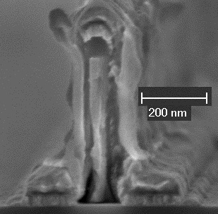
Sub-200-nm Emitter Contact & Post
Refractory contact, refractory post→ high-current operation
Fabrication: blanket sputter, dry-etch
TiW
SiN_{x}
100 nm
W
Mo
21
HBT: V. Jain. Process: Jain & Lobisser

Slide 22
Ultra Low-Resistivity Refractory Contacts
Barasakar et al
IEEE IPRM 2012
Mo
Mo
32 nm/ 3THz node requirements
Refractory: robust under high-current operation
Low penetration depth, ~ 1 nm
Contact performance sufficient for 32 nm /2.8 THz node.
22

Slide 23
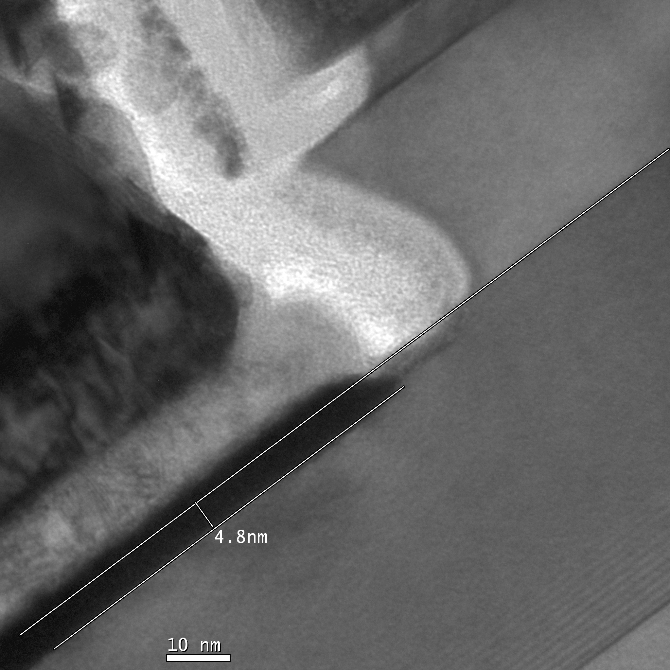
Needed: Greatly Improved Ohmic Contacts
Needed: Greatly Improved Ohmic Contacts
emitter
Pt/Ti/Pd/Au
emitter
Au
Au
~5 nm
Pt contact
penetration
(into 25 nm base)
Pd
Pd
Ti
Ti
base
base
23

Slide 24
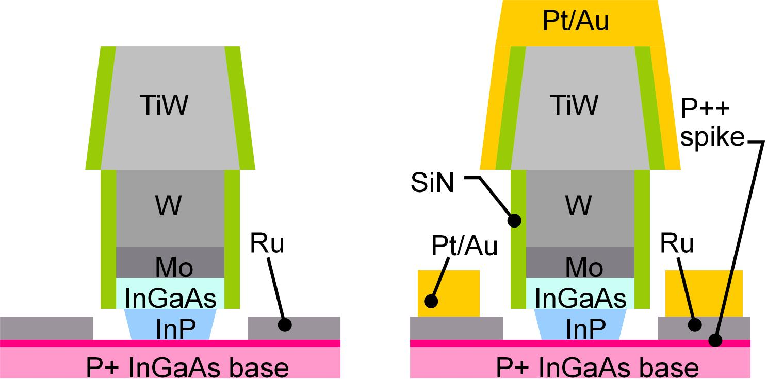
Refractory Base Process (1)
Blanket liftoff; refractory base metal
Patterned liftoff; Thick Ti/Au
low contact resistivity
low penetration depth
low bulk access resistivity
base surface not exposed to photoresist chemistry: no contamination
low contact resistivity, shallow contacts
low penetration depth allows thin base, pulsed-doped base contacts
24

Slide 25
Refractory Base Process (2)
32 nm node
requirement
Increased surface doping:
reduced contact resistivity,
but increased Auger recombination.
→ Surface doping spike at most 2-5 thick.
Refractory contacts do not penetrate; compatible with pulse doping.
25

Slide 26
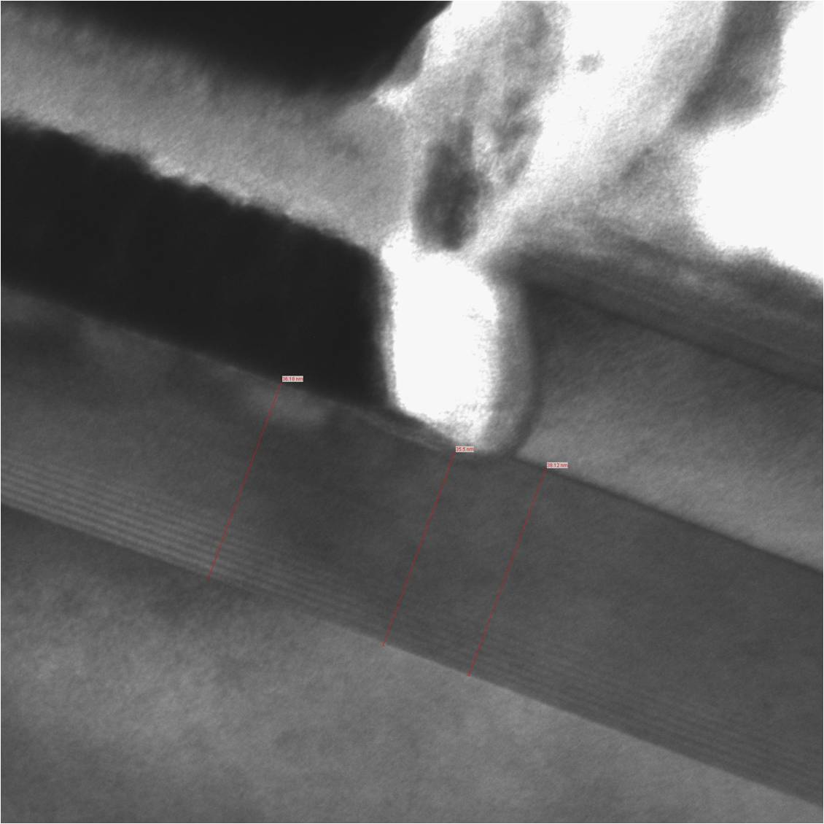
Refractory Base Ohmic Contacts
Refractory Base Ohmic Contacts
Ti
Ru / Ti / Au
Ti
Ru
Ru
2.0 nm
<2 nm
Ru contact
penetration
(surface removal
during cleaning)
2.6 nm
2.6 nm
base
base
emitter
emitter
36.2 nm
35.5 nm
38.1 nm
26

Slide 27
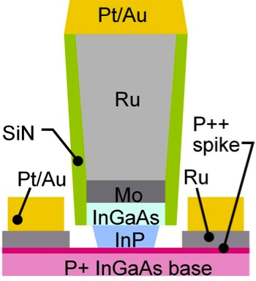
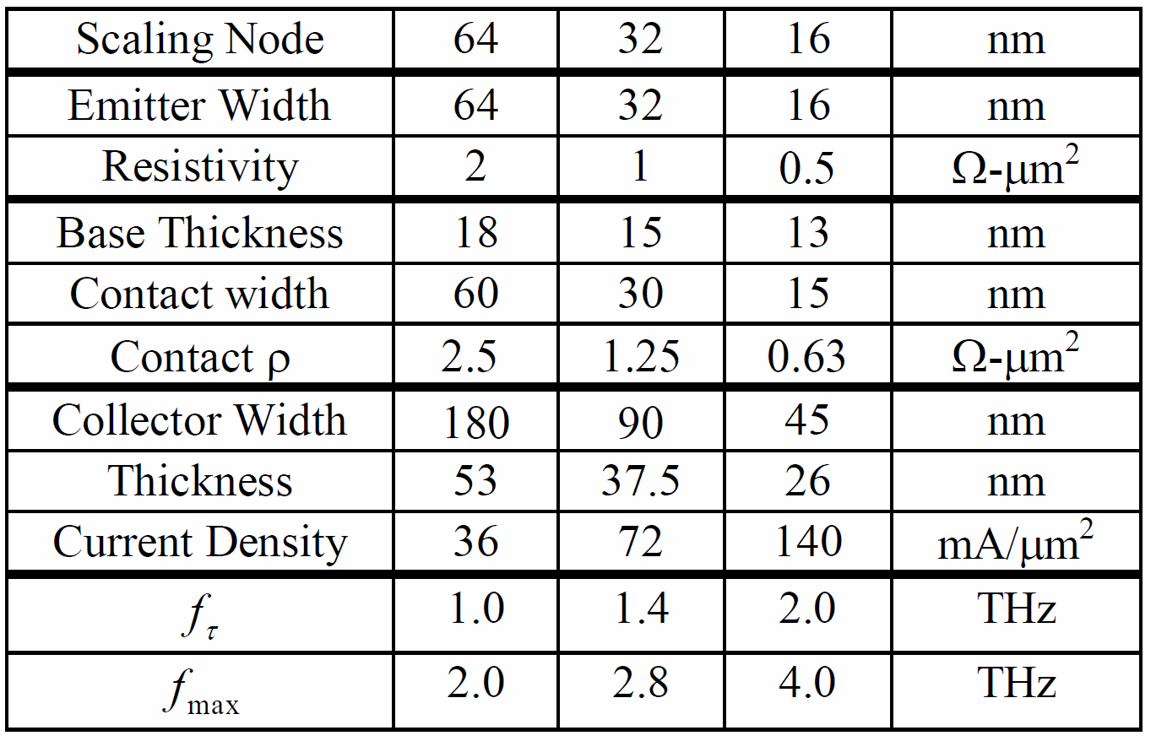
3-4 THz Bipolar Transistors are Feasible.
4 THz HBTs realized by:
Extremely low resistivity contacts
Extreme current densities
Processes scaled to 16 nm junctions
Impact:
efficient power amplifiers
and complex signal processing
from 100-1000 GHz.
27

Slide 28
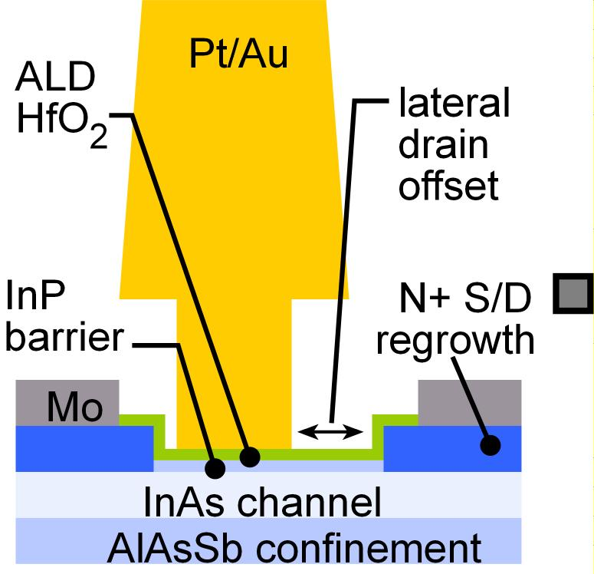
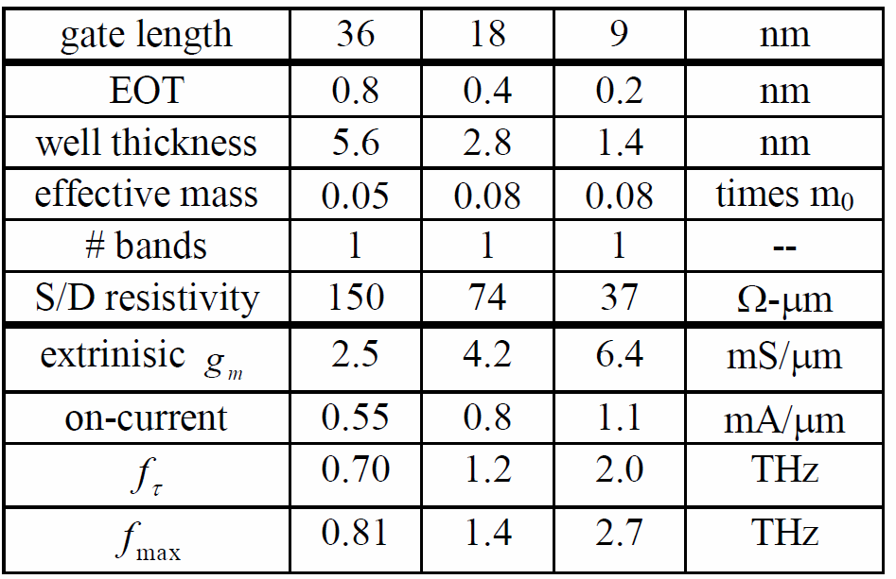
2-3 THz Field-Effect Transistors are Feasible.
3 THz FETs realized by:
Regrown low-resistivity source/drain
Very thin channels, high-K dielectrics
Gates scaled to 9 nm junctions
Impact:
Sensitive, low-noise receivers
from 100-1000 GHz.
3 dB less noise →
need 3 dB less transmit power.
28

Slide 29


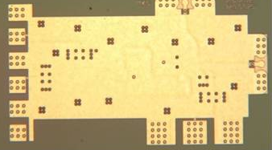
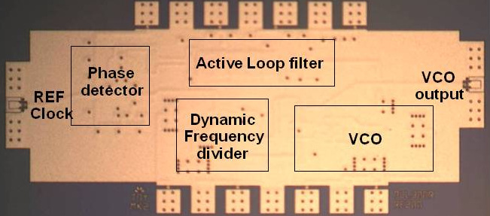
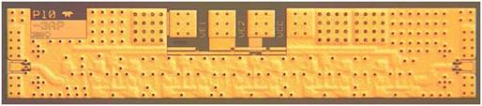

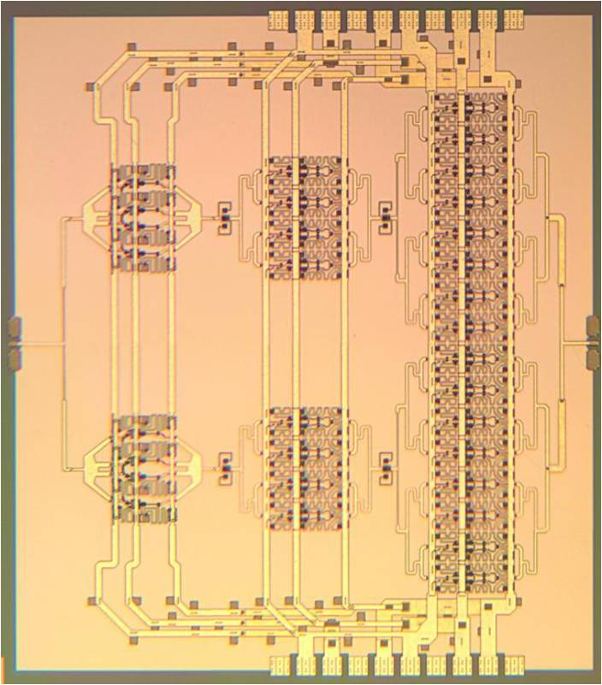
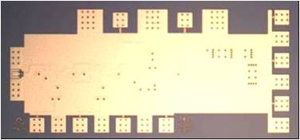
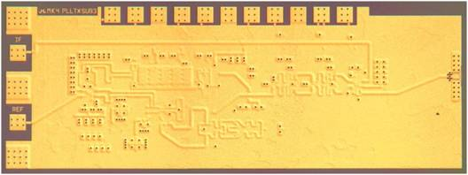
InP HBT Integrated Circuits: 600 GHz & Beyond
614 GHz
fundamental
VCO
340 GHz dynamic frequency divider
M. Seo, TSC / UCSB
M. Seo, UCSB/TSC
IMS 2010
585-600 GHz amplifier, > 34 dB gain, 2.8 dBm output
300 GHz fundamental
PLL
M. Seo, TSC
IMS 2013
M. Seo, TSC
IMS 2011
204 GHz static
frequency divider
(ECL master-slave
latch)
220 GHz
180 mW
power amplifier
Z. Griffith, TSC
CSIC 2010
T. Reed, UCSB
Z. Griffith, Teledyne
CSICS 2013
Integrated 300/350GHz Receivers:
LNA/Mixer/VCO
600 GHz
Integrated
Transmitter
PLL + Mixer
M. Seo TSC
M. Seo TSC

Slide 30
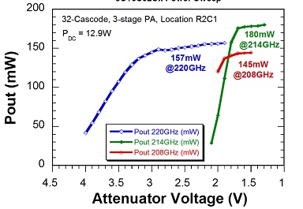
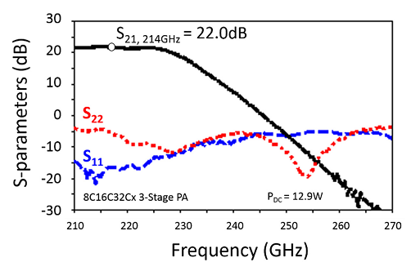
220 GHz 180mW Power Amplifier (330 mW design)
2.3 mm x 2.5 mm
T. Reed, UCSB
Z. Griffith, Teledyne
Teledyne 250 nm InP HBT
30

Slide 31



PAs using Sub-λ/4 Baluns for Series-Combining
  80-90 GHz Power Amplifier
  17.5dB Gain, >200mW P_{SAT}, >30% PAE
  Power per unit IC die area*
  =307 mW/mm² (pad area included)
  =497 mW/mm² (if pad area not included)
31

Slide 32



800 mW 1.3mm² Design Using 4:1 Baluns
  Baluns for 4:1 series-connected power-combining
  4:1 Two-Stage Schematic
  4:1 Two-Stage Layout (1.2x1.1mm²)
Small-signal data looks good. Need driver amp for P_{sat} testing.
32

Slide 33
50-500 GHz Wireless Electronics
Mobile communication @ 2Gb/s per user, 1 Tb/s per base station
Requires: large arrays, complex signal processing, high P_{out} , low F_{min}
VLSI beamformers
VLSI equalizers
III-V LNAs & PAs
III-V Transistors will perform well enough for 1.5-2 THz systems.

Slide 34
(backup slides follow)
34

Slide 35

50-500 GHz Wireless Has Low Attenuation ?
Wiltse, 1997 IEEE Int. APS Symposium, July
2-5 dB/km
200-300 GHz
125-165 GHz
75-110 GHz
Low attenuation on a sunny day

Slide 36
mm/sub-mm-waves: Not my usual presentation
My typical THz electronics presentation:
THz transistor design & fabrication, mm/sub-mm-wave IC design
Today a different emphasis:
50+ GHz systems: potential high-volume applications
Link analysis→ what performance do we need ?
What will the hardware look like ?
What components, packages, devices should we develop ?
(wrap up with a quick summary of THz transistor & IC results)

Slide 37

Effects of array size, Transmitter PAE, Receiver F_{min}
200 mW phase shifters in TRX & RCVR, 0.1 W LNAs
Large arrays:
more directivity, more complex ICs
Small arrays:
less directivity, less complex ICs
→ Proper array size minimizes DC power
Low transmitter PAE
& high receiver noise
are partially offset using arrays,
but DC power, system complexity still suffer

