Slide 1
Formation of Sub-10 nm width InGaAs finFETs of 200 nm Height by Atomic Layer Epitaxy
IEEE Device Research Conference, June 24-27 2013, Notre Dame
*D. Cohen-Elias¹, J.J.M. Law¹, H.W. Chiang¹, A. Sivananthan¹,
C. Zhang¹, B. J. Thibeault¹, W.J. Mitchell¹, S. Lee¹, A.D. Carter¹,
C.-Y. Huang¹, V. Chobpattana², S. Stemmer², S. Keller¹, M. J.W. Rodwell¹
¹ECE and ²Materials Departments
University of California, Santa Barbara, CA

Slide 2
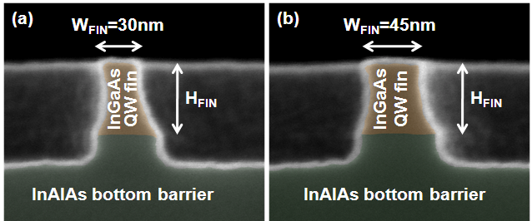
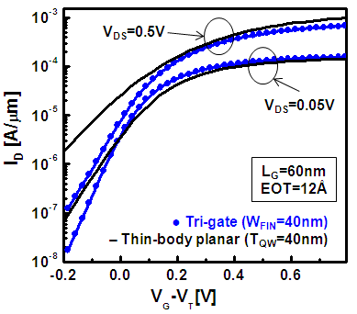
Goal: FinFET with 2-4 nm Body Thickness
Intel L_{g}=60nm III-V FinFET (IEDM 2011)
30 nm fin:
too thick at 60 nm gate length
For good electrostatics,
need fin thickness ~ (gate length/2)
S. H. Park et al., NNIN Symposium Feb 2012.
8nm gate length → need <4 nm thick fin

Slide 3
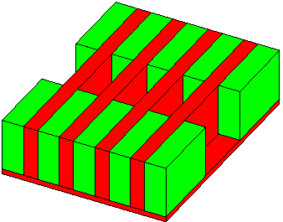
Goal: Tall Fins for High Drive Current
Goal:
large on-current
from small transistor footprint.
Transistor Width
J_{surf}
Height
J_{surf}
J_{surf}
D
J_{surf}
S
Pitch
Goal: fin height >> fin pitch (spacing)

Slide 4
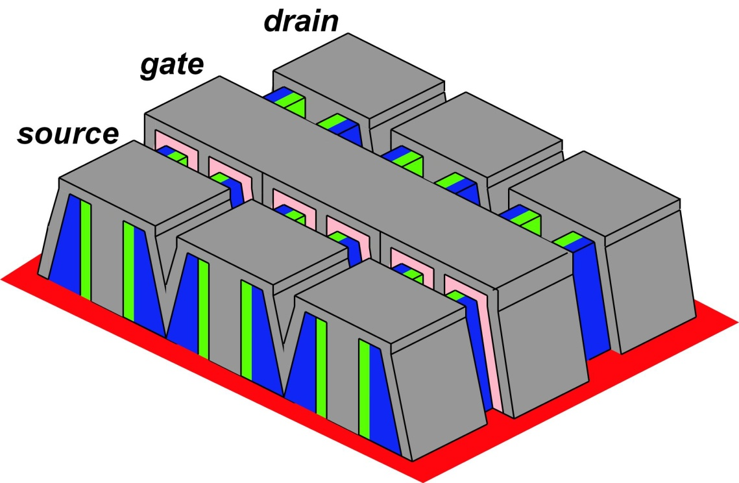
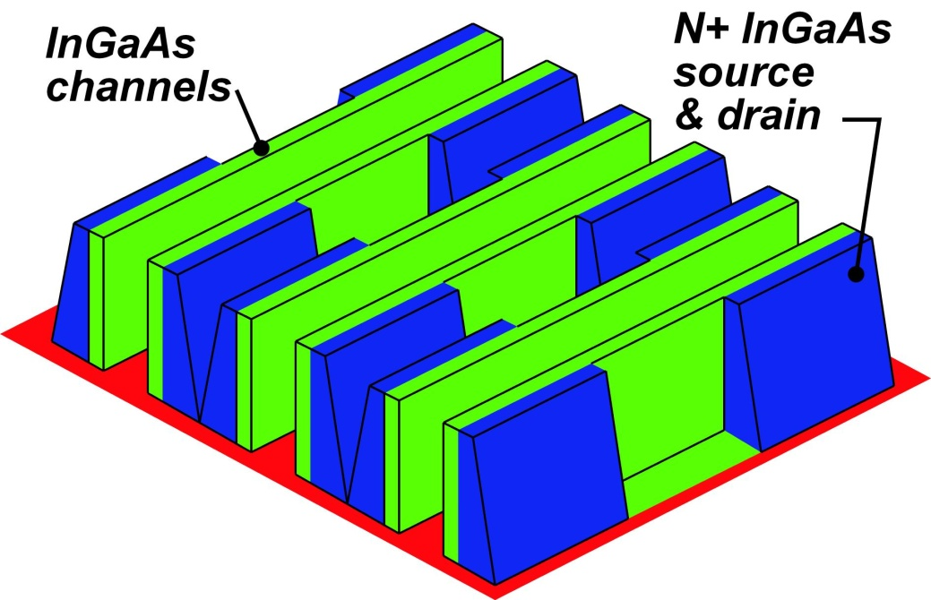
Goal: Fins with Integrated N+ Source/Drain
regrowth→ small S/D pitch → High Integration Density

Slide 5
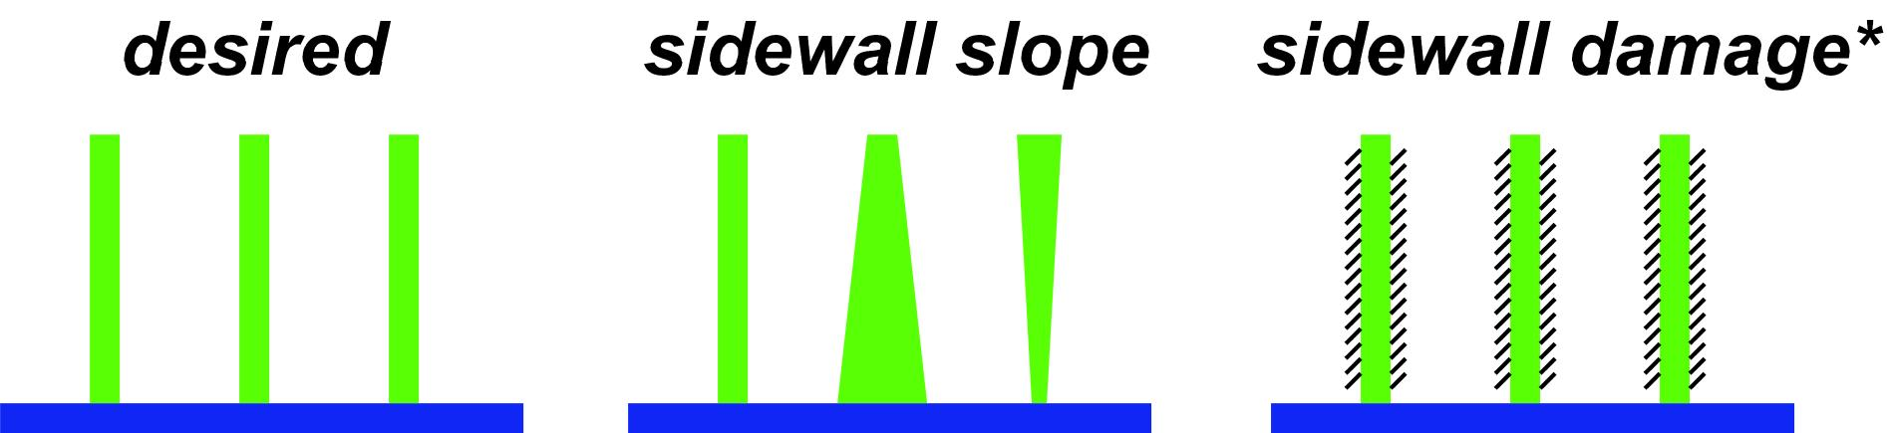
Why Not Dry-Etch a 2nm Fin ?
Goal: 2-4 nm thickness, 100+ nm height
*metallization-induced damage increases D_{it}:
Burek et al, JVST B. 29,4, Jul/Aug 2011;
Dry-etching may well do similar surface damage
serious process challenges

Slide 6
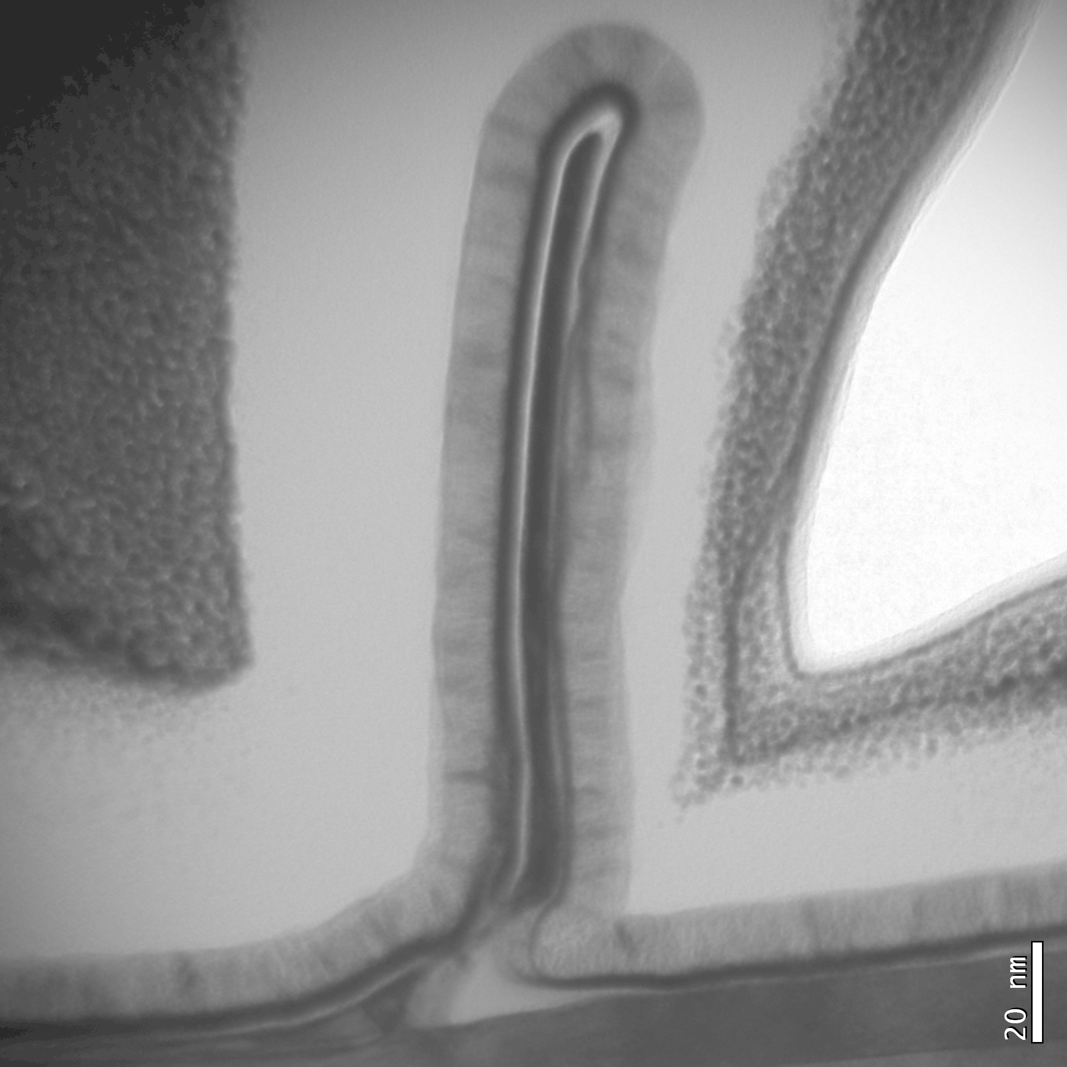
FinFETs by Atomic Layer Epitaxy
Fin thickness defined by
Atomic layer epitaxy (ALE)
→ nm thickness control
HfO₂
Fin
~8nm
Fin height defined by
sidewall growth
TiN
→ 200 nm high fins
thin, tall fins → few-nm L_{g} , high currents

Slide 7
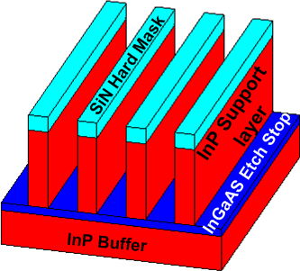
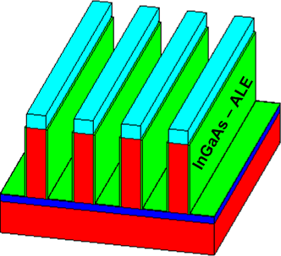
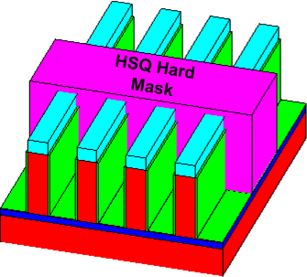
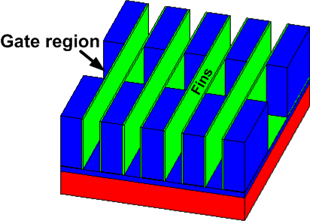
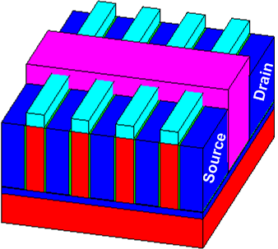
ALE-Defined finFET: Process Flow
Fin Template
Channel ALE
Dummy Gate
Gate Dielectric
Gate Metal
S/D Metal
Release Fins
S/D Regrowth

Slide 8
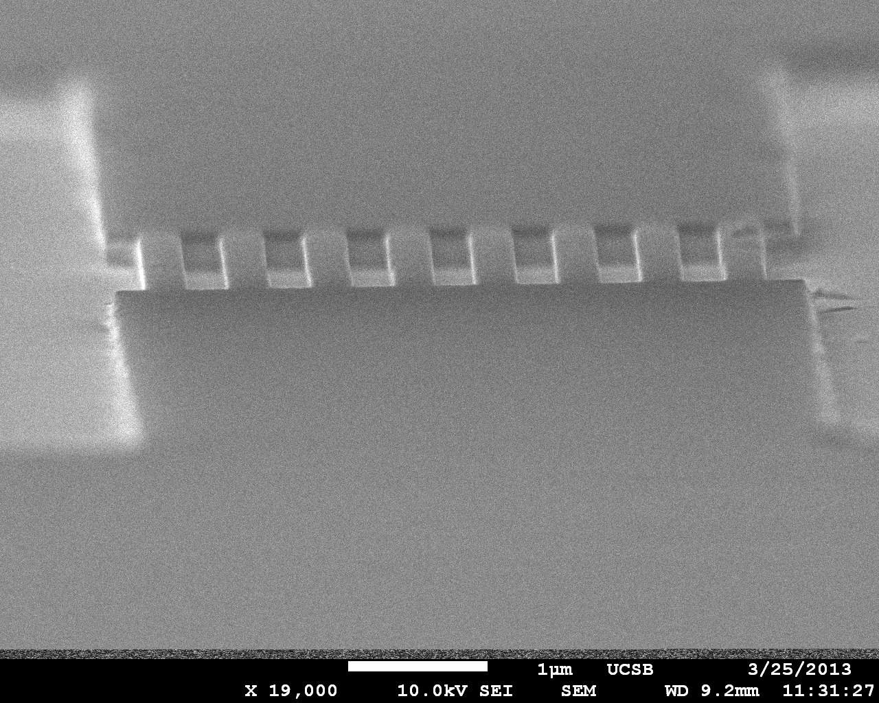
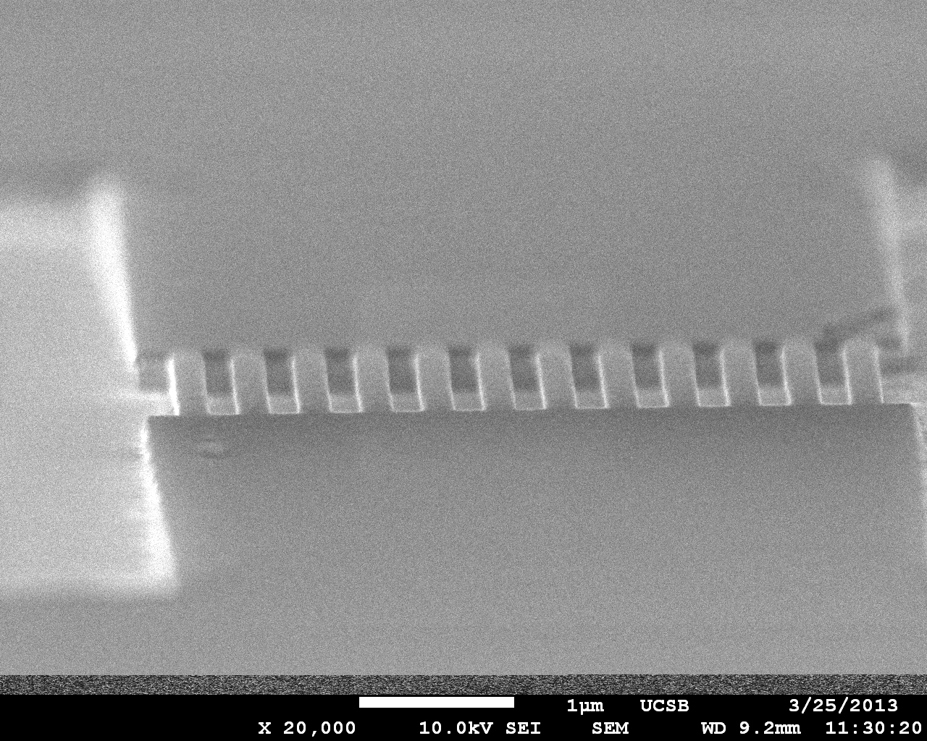
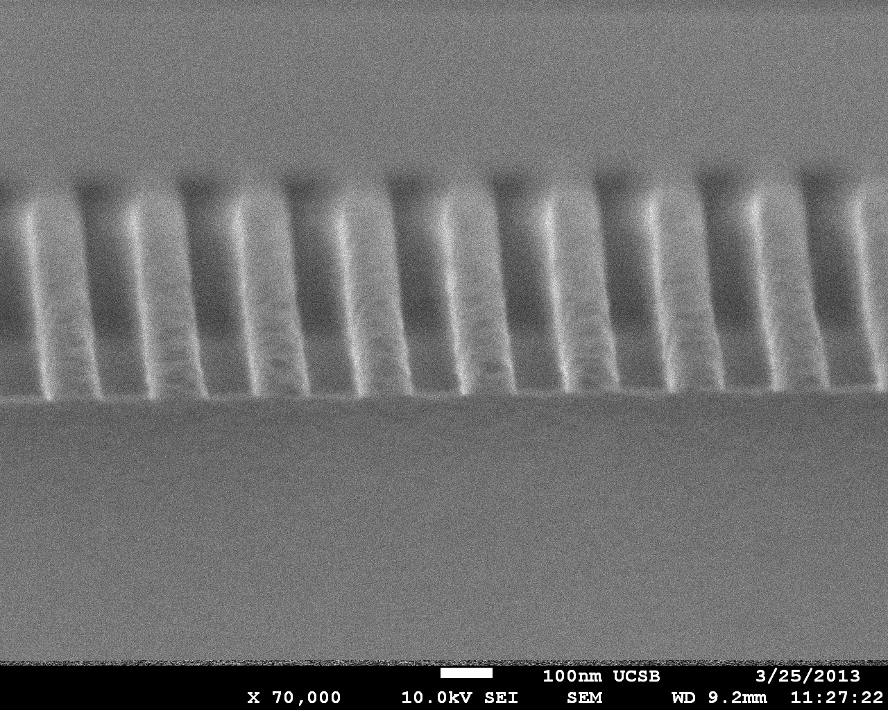
Fin Template
(011)
SiN hard mask:
Ridges oriented along [011]
H₃PO₄ : HCL etch:
facet-selective, material-selective
forms vertical (011) sidewalls
stops on InGaAs etch-stop
InGaAs etch-stop:
defines template height→ defines fin height

Slide 9
Channel Growth by Atomic Layer Epitaxy
1 monolayer growth per cycle.
InGaAs monolayer ~ 2.9A
→
S.P. DenBaars, P.D. Dapkus
Journal of Crystal Growth, 98 (1989)
TBA flow
→
H₂ flow
→
TMI+ TMGa flow
H₂ flow
→
Using UCSB MOCVD :
1.7 Monolayer of InGaAs / Cycle
(Not true ALE mode)

Slide 10
Channel Growth by Atomic Layer Epitaxy
Growth:
lattice-matched InGaAs
20 ALE cycles → <10 nm channel
Masked growth:
no InGaAs growth on top of template
Details:
one ALE cycle = 10 sec TMGa/TMI, 10 sec H₂ , 10 sec TBAs, 10 sec H₂
450 C growth

Slide 11
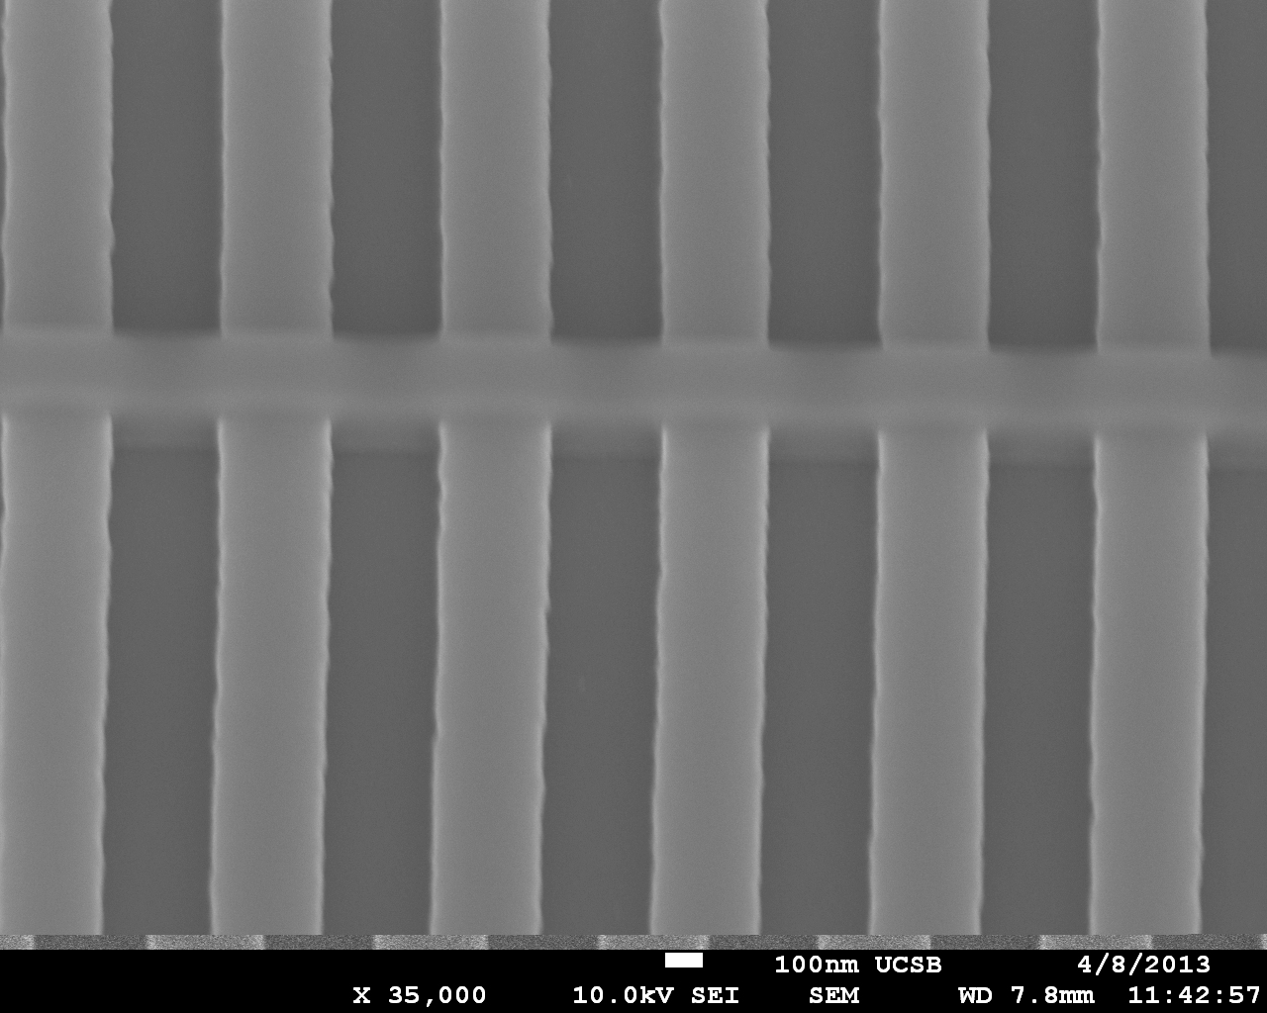
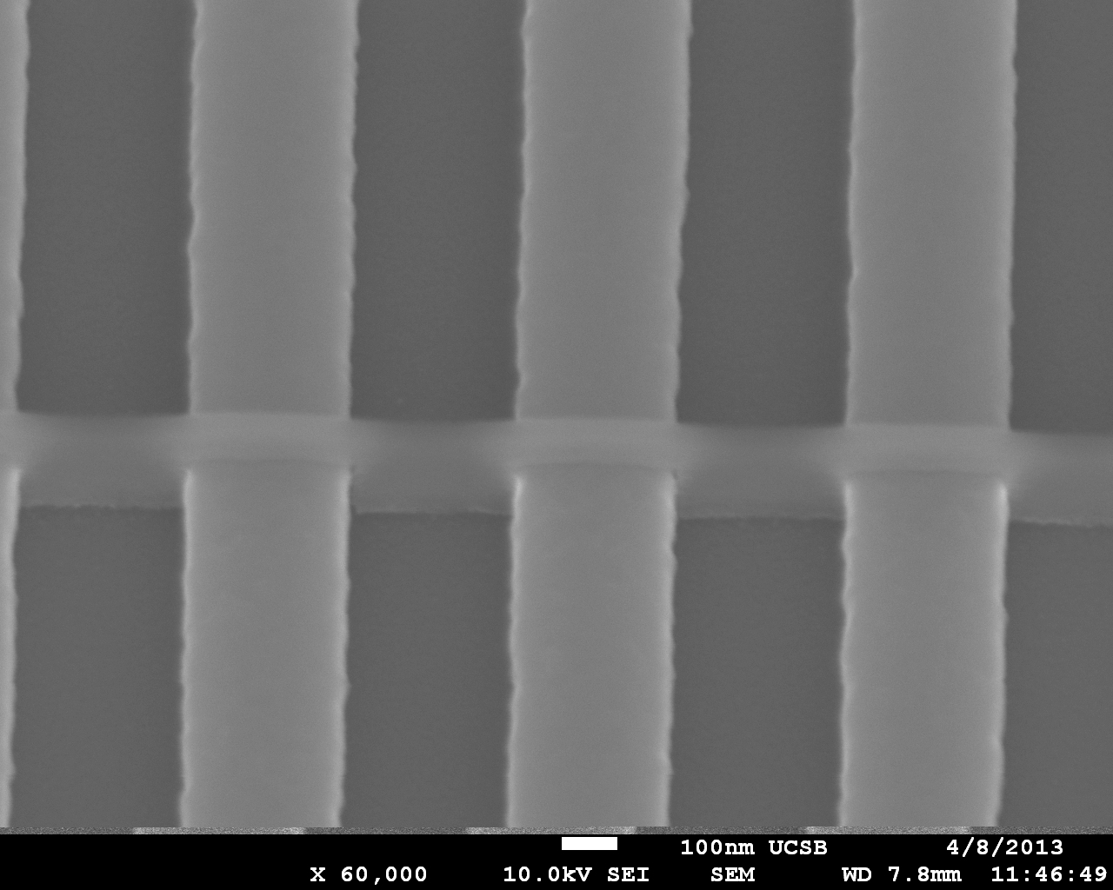
Dummy Gate: Patterns Source and Drain
HSQ
Mask
HSQ* : E-beam definable SiO₂
ALD Al₂O₃ mask sub-layer: adhesion
*HSQ: Hydrogen silsesquioxane

Slide 12
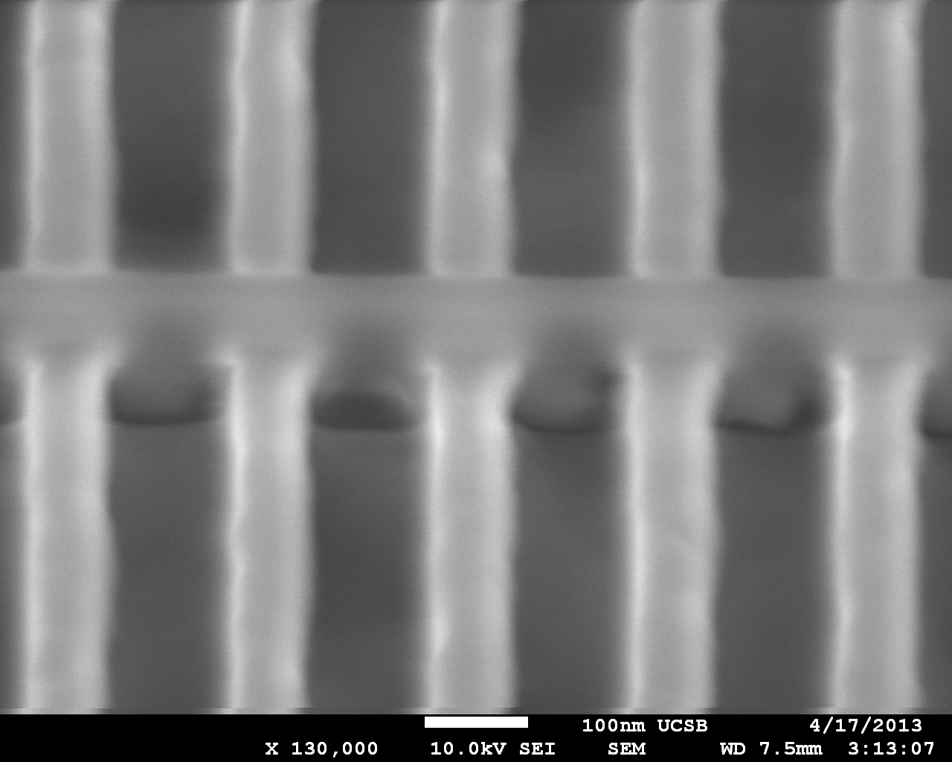
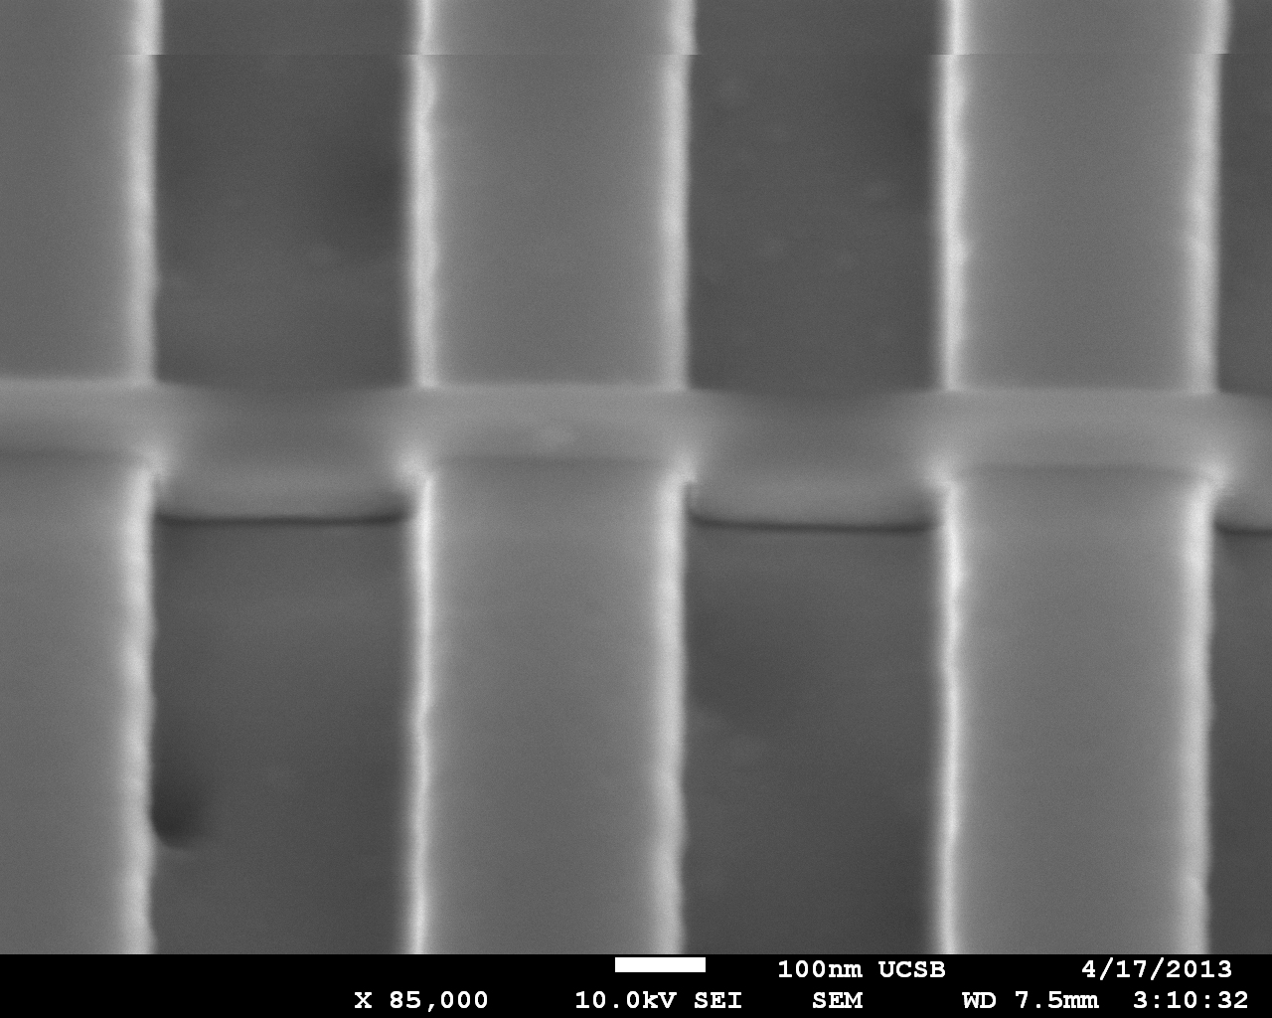
Source Drain Regrowth
Drain
HSQ
Source
MOCVD Regrowth
600C
lattice-matched N+ InGaAs,
5*10¹⁹/cm³ doping

Slide 13
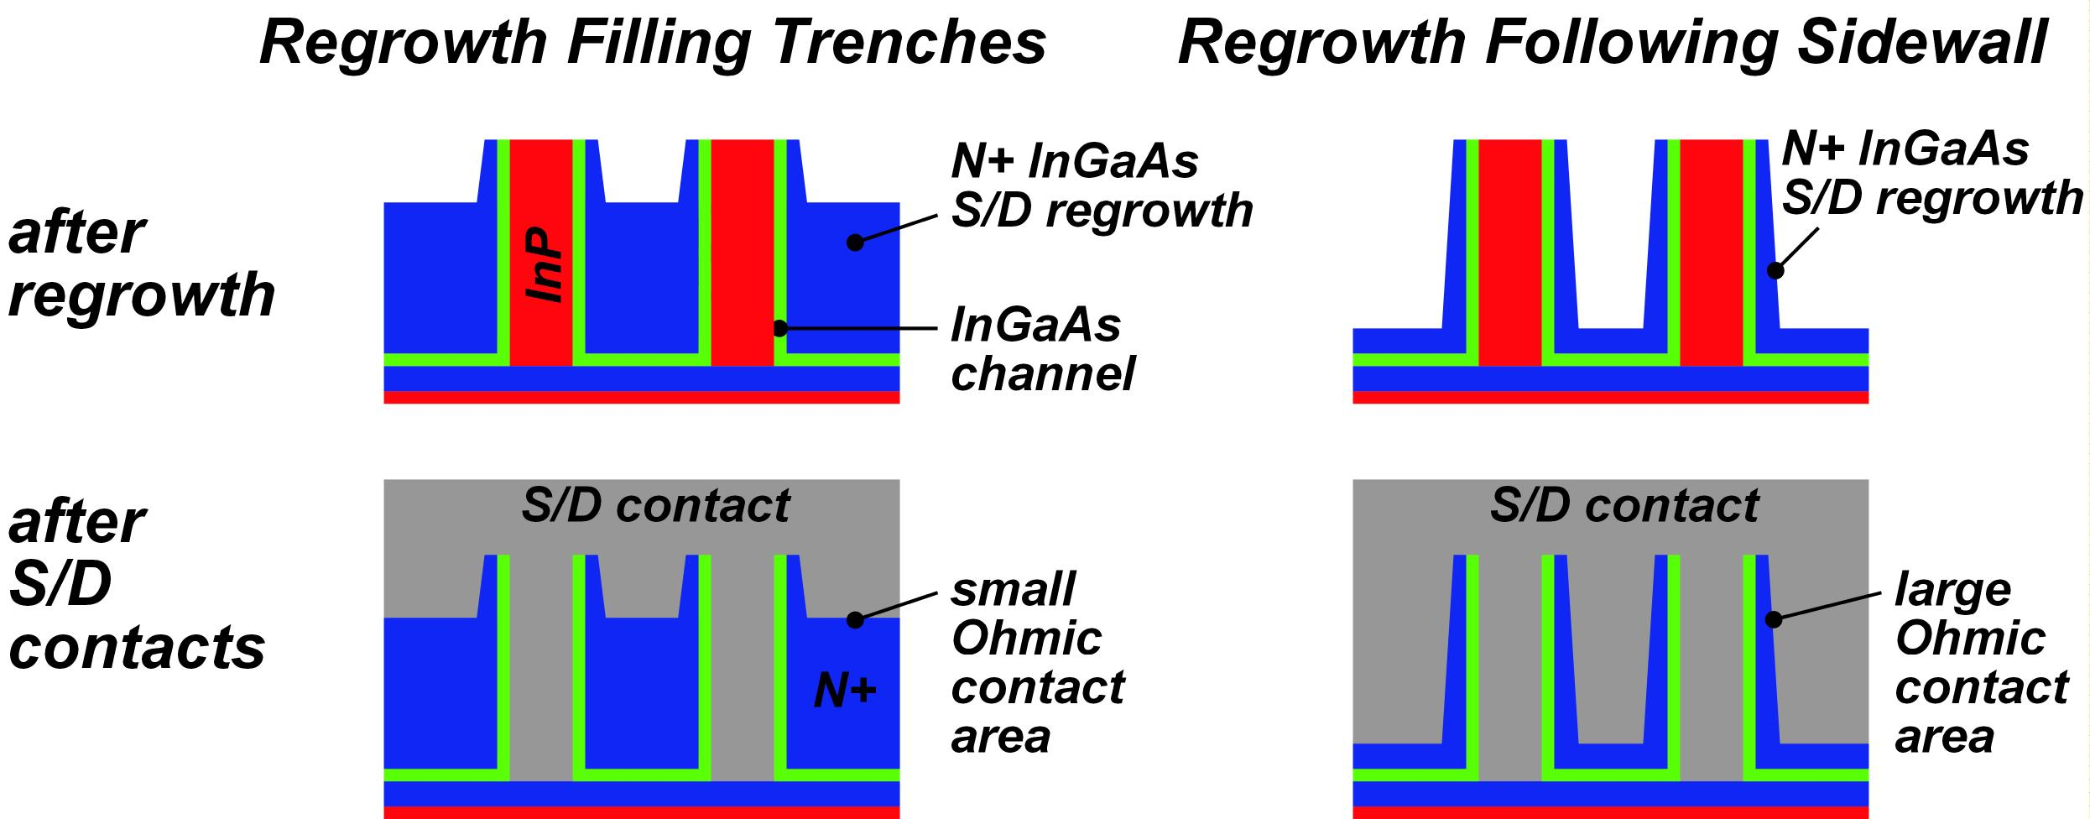
S/D Regrowth: Filling vs. Sidewall Regrowth
Present process:
S/D regrowth partly fills spaces between fins
Target process:
S/D sidewall regrowth by ALE
→ large contact area → low access resistance

Slide 14
Source Drain Regrowth
Drain
HSQ
Source

Slide 15
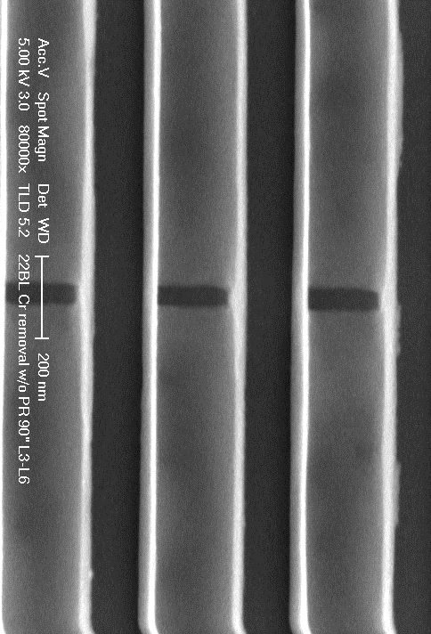
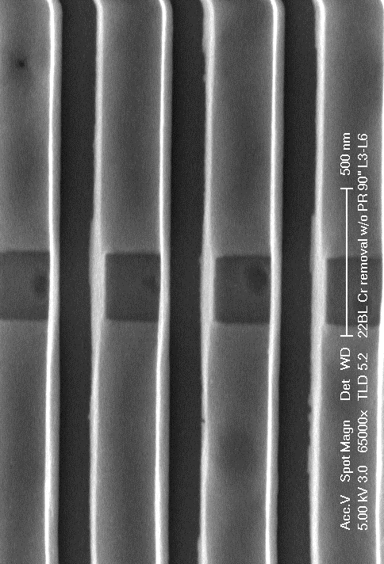
Fin Release
fin release:
H₃PO₄:HCl selective wet-etch
etches InP
stops on InGaAs

Slide 16
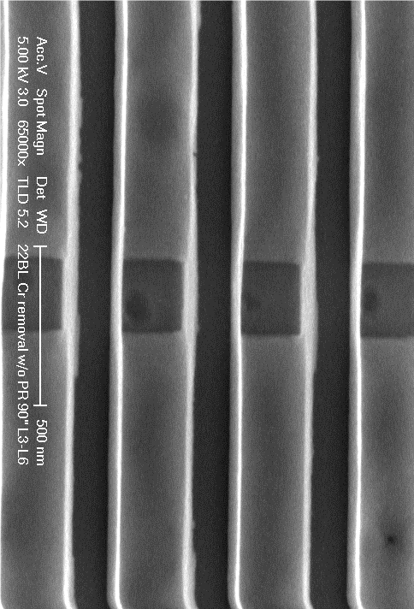
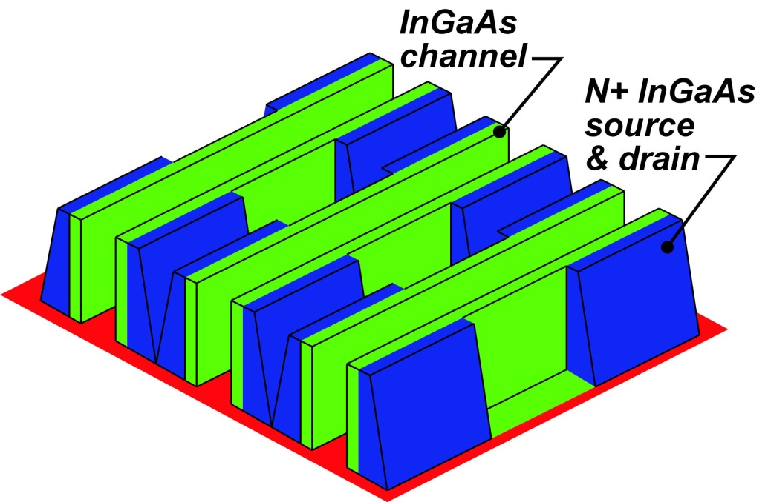
Fin Release
N+
fin without N+ regrowth
fin with N+ regrowth
N+

Slide 17
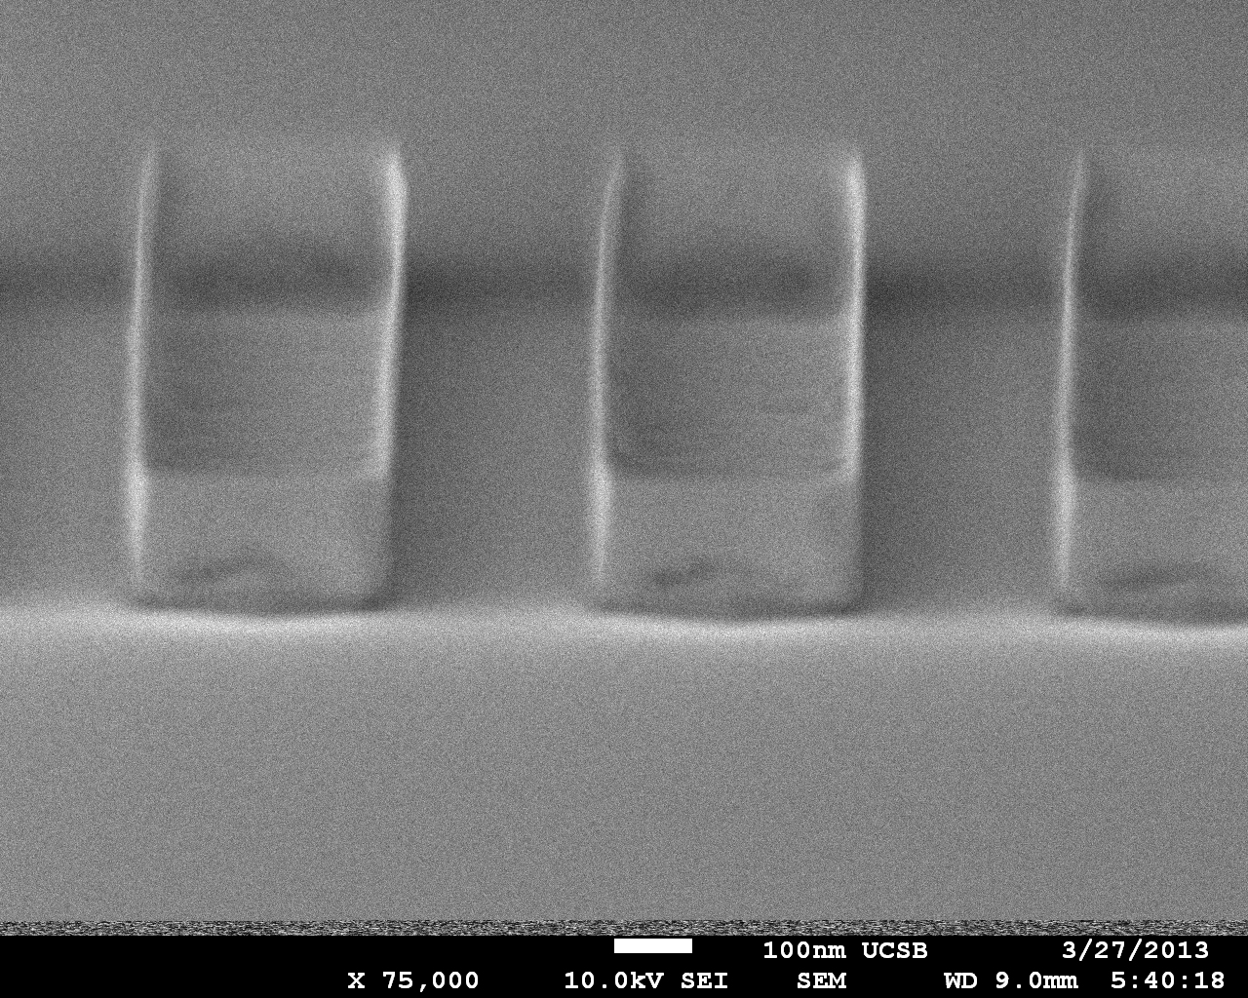
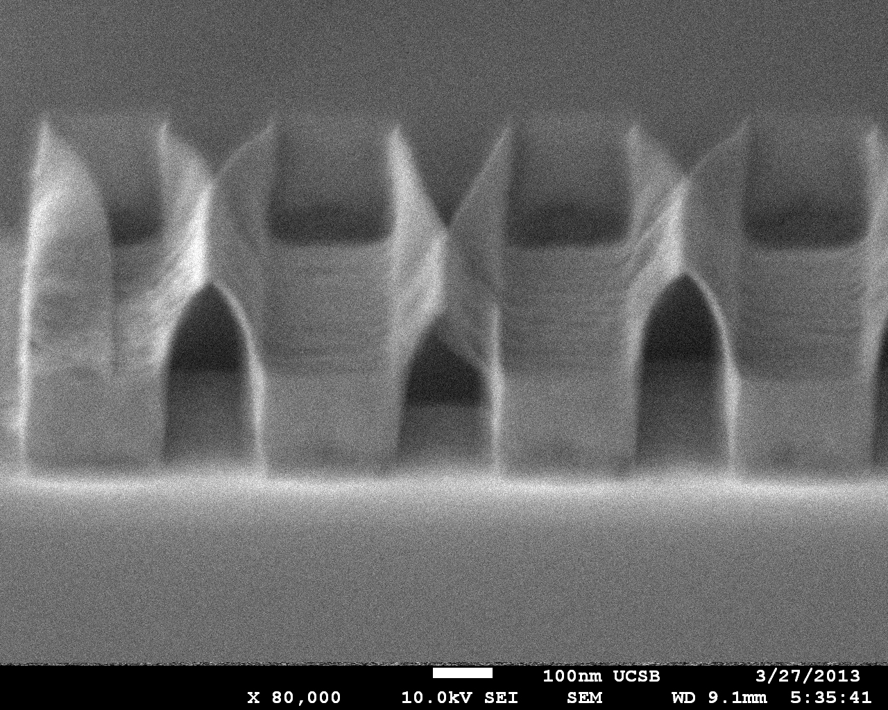
Why Not Release Fins Before S/D Regrowth ?
Images of released ~10 nm fins:
S/D regrowth provides mechanical support

Slide 18
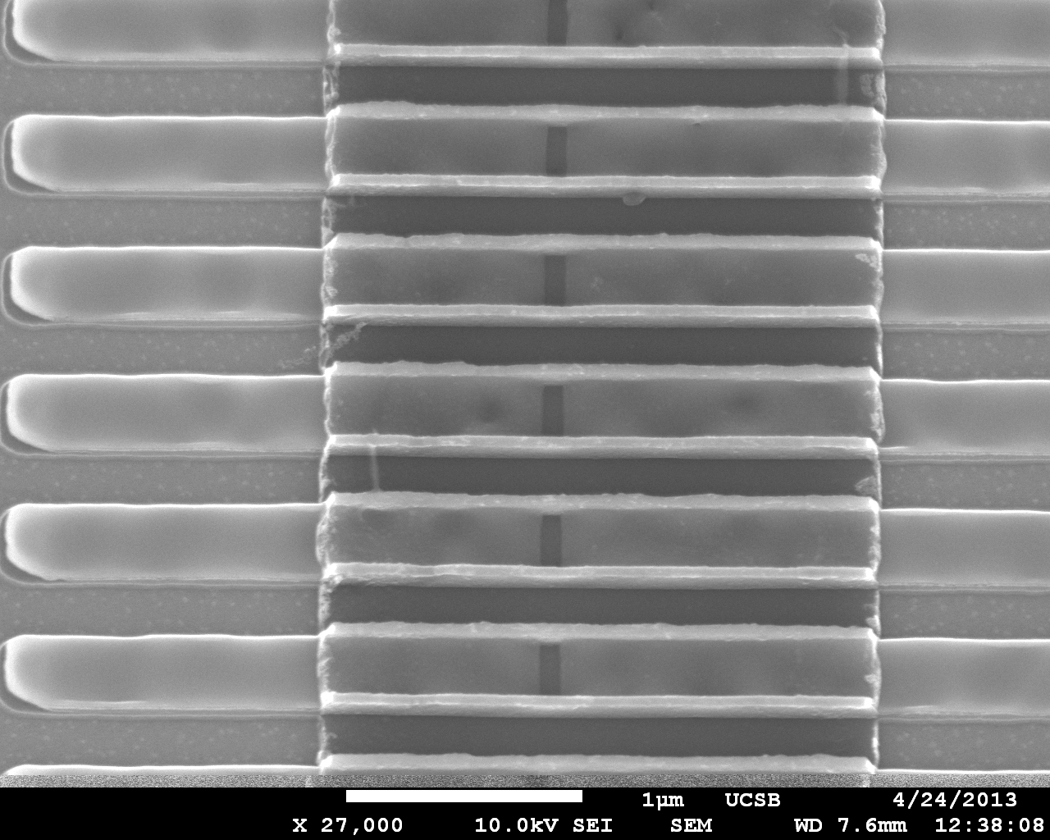
ALD Gate Dielectric, ALD Gate Metal
HfO₂ and TiN ALD gate Stack
Source
Drain

Slide 19
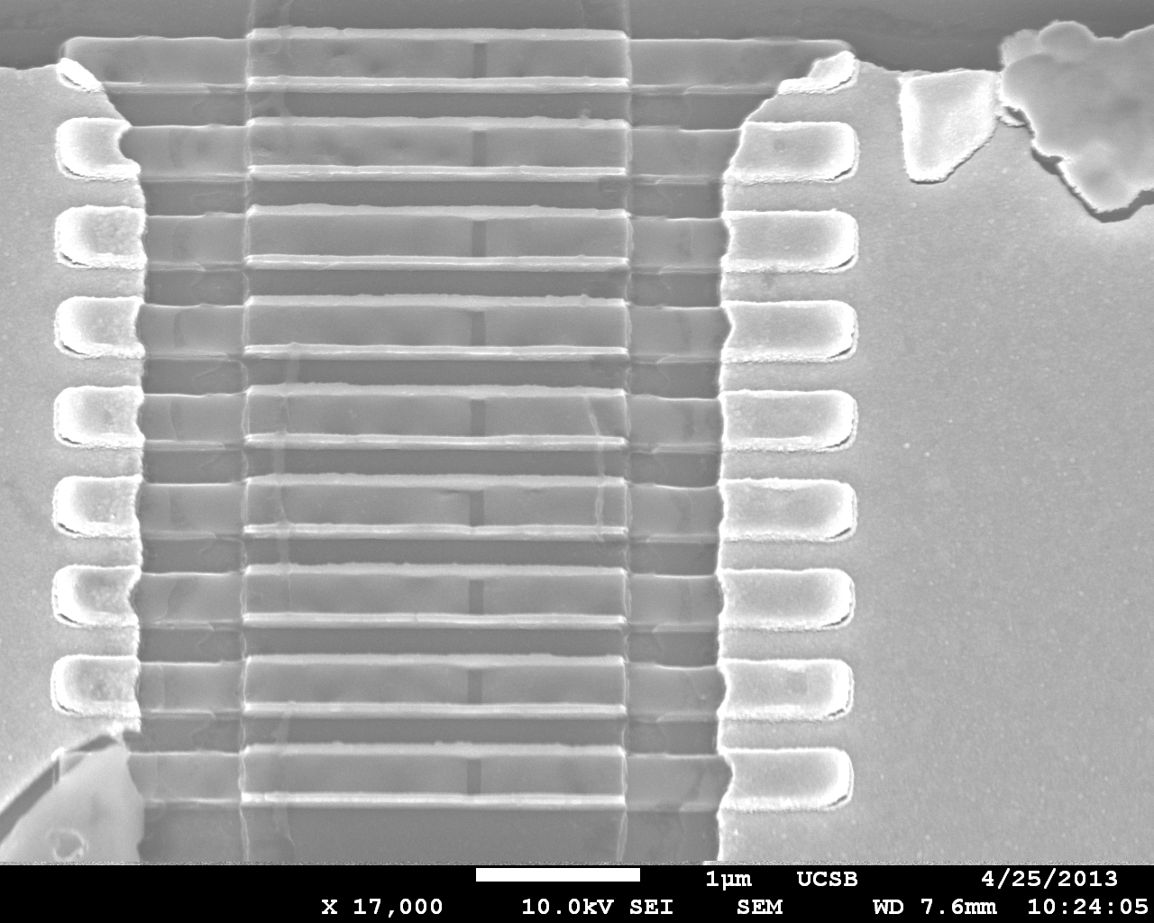
Source and Drain Metal
Gate
Source Metal
Drain Metal

Slide 20

TEM Images
HfO₂
Fin
~8nm
TiN

Slide 21
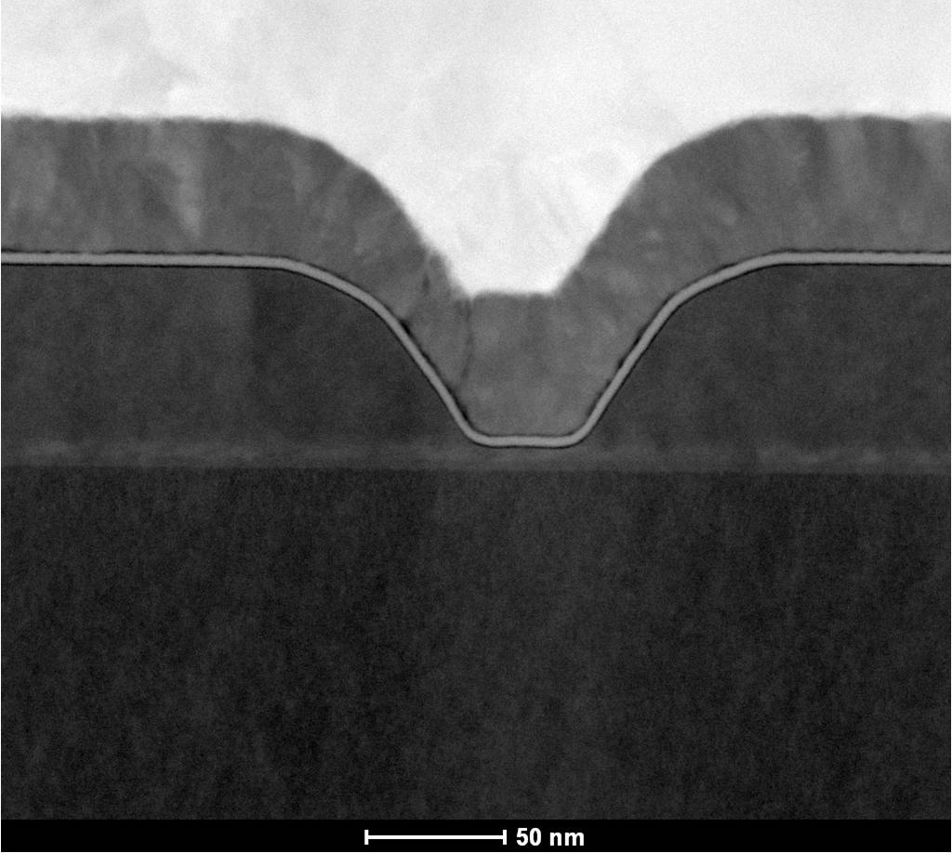
Where is the DC Data ?
Present finFETs: very high leakage
Planar FET: thermal Ni gate
finFET: ALD TiN gate
interface damage ?
Planar FET: 100 interface
finFET: 011 interfaces
ALD surface preparation ?
Planar InAs/InGaAs MOSFET
Lee et al, 2013 VLSI symposium

Slide 22
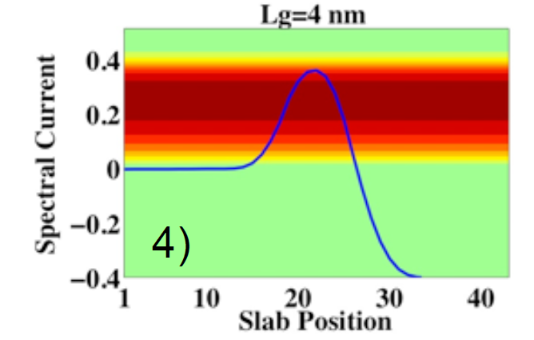

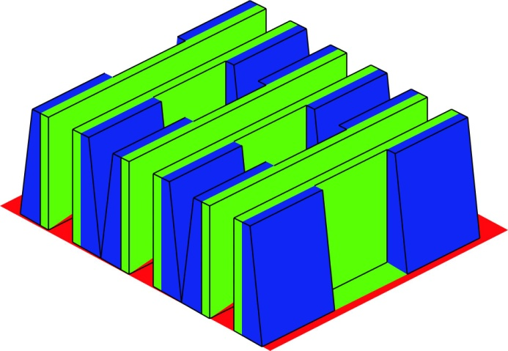
3-D Transistors to Extend Moore's Law
Lundstrom: high S/D tunneling @ 4-7 nm L_{g}
→ increase m* as L_{g} decreases
Implication: FETs won’t improve with scaling
increased m* → decreased v_{inj}
→ decreased I_{on} , increased CV/I
If we scale only to increase the IC packing density, why reduce L_{g} ?
Alternative: 3-D integration
...or other
geometries...
height>> pitch

Slide 23
FinFETs by Atomic Layer Epitaxy
ALE-defined fin
→ few-nm thick channels
→ scaling to 8nm gate length
HfO₂
Fin
~8nm
200 nm fin height
→enhance drive current
TiN
J_{surf}
J_{surf}
J_{surf}
D
J_{surf}
S

Slide 24
Thank You

Slide 25
