Slide 1
50-500GHz Wireless Technologies: Transistors, ICs, and Systems
Plenary, Asia-Pacific Microwave Conference, December 6, 2015, Nanjing, China
Mark Rodwell, UCSB
J. Rode*, P. Choudhary, B. Thibeault, W. Mitchell,
J. Buckwalter, U. Madhow, A.C. Gossard : UCSB
M. Urteaga, J. Hacker, Z. Griffith, B. Brar: Teledyne Scientific and Imaging
M. Seo: Sungkyunkwan University
* Now with Intel

Slide 2

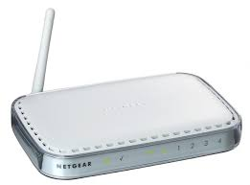
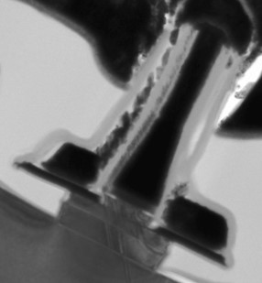
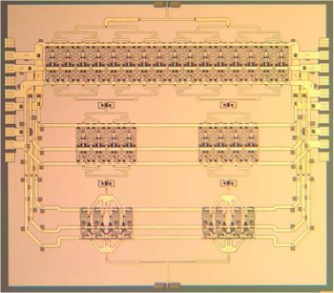
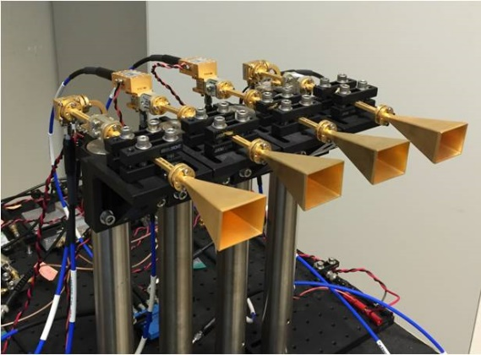
Why mm-wave wireless ?

Slide 3
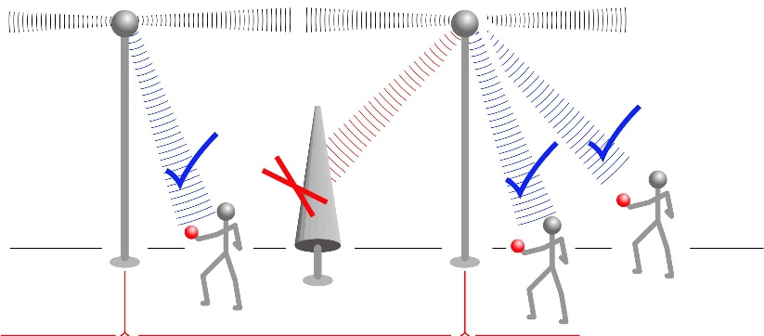
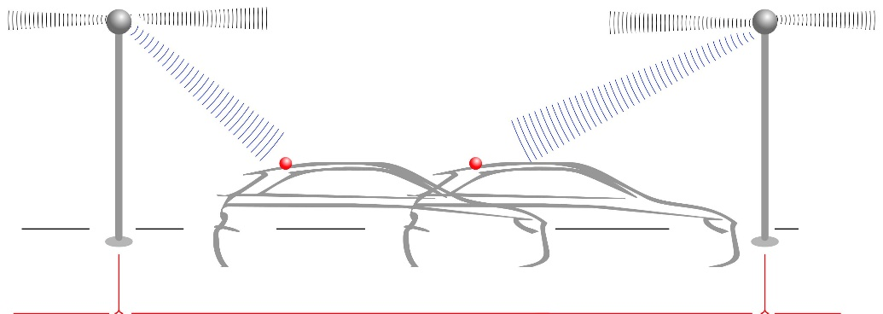
Links

Slide 4
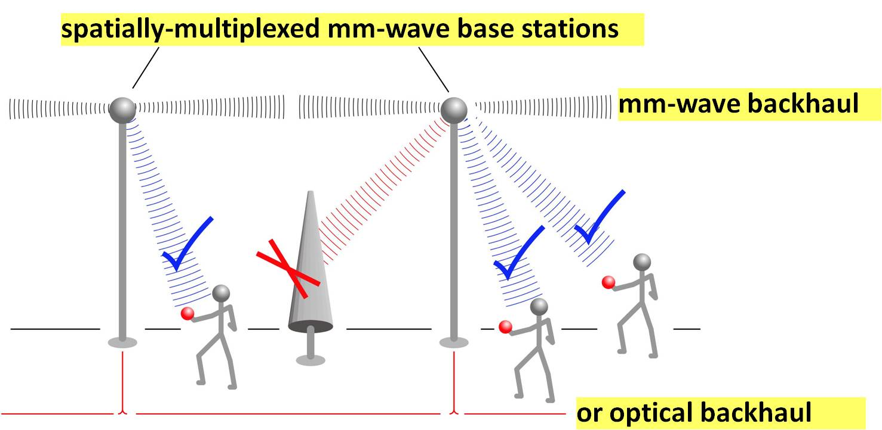
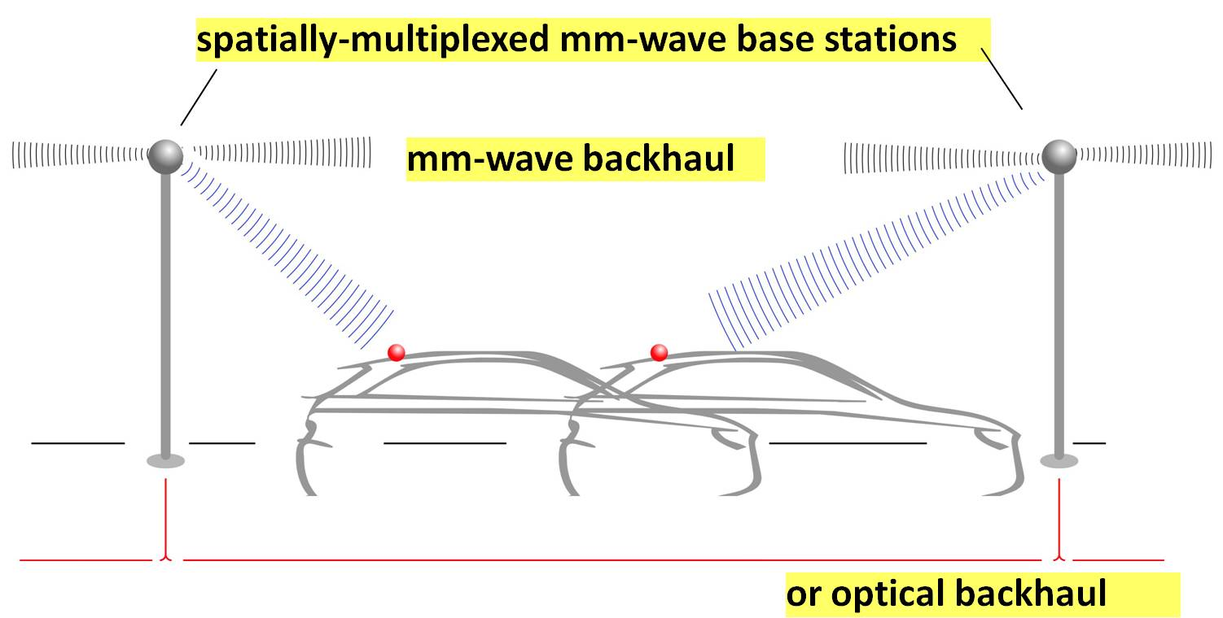
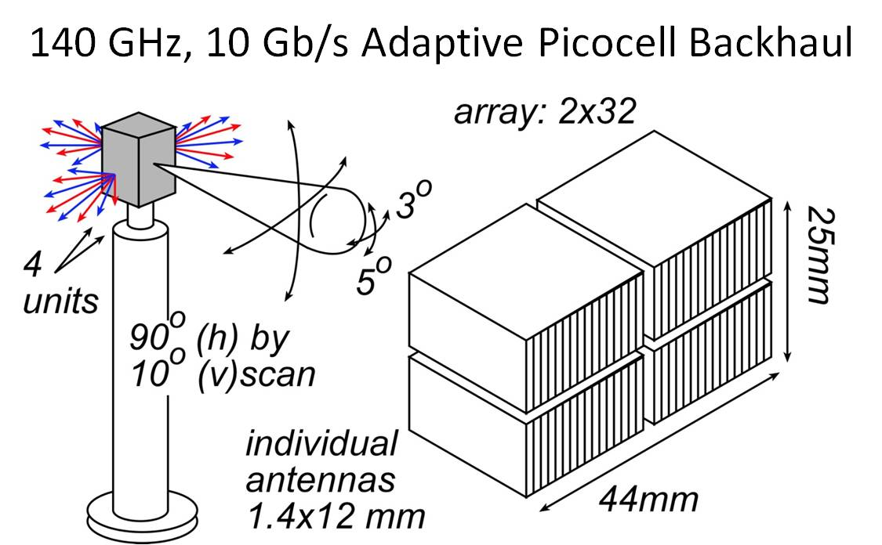
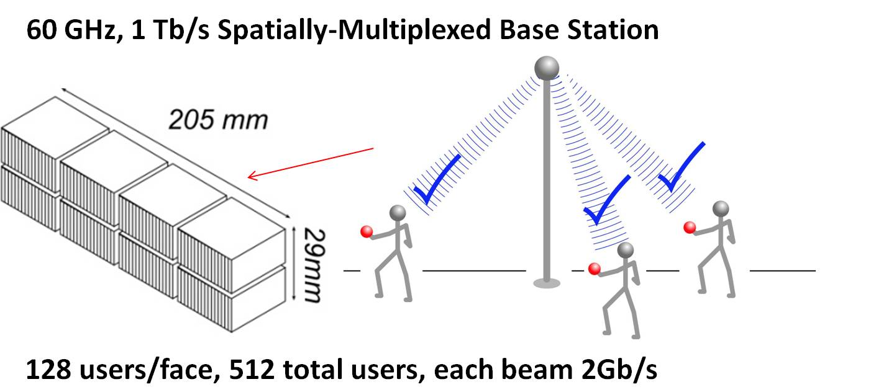
mm-Waves: high-capacity mobile communications
Needs→ research:
RF front end: phased array ICs, high-power transmitters, low-noise receivers
IF/baseband: ICs for multi-beam beamforming, for ISI/multipath suppression, ...

Slide 5
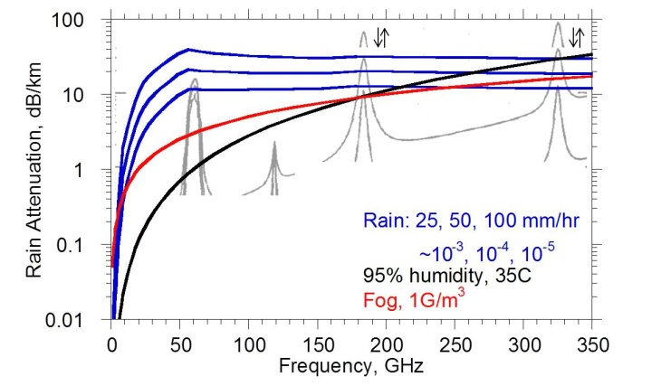
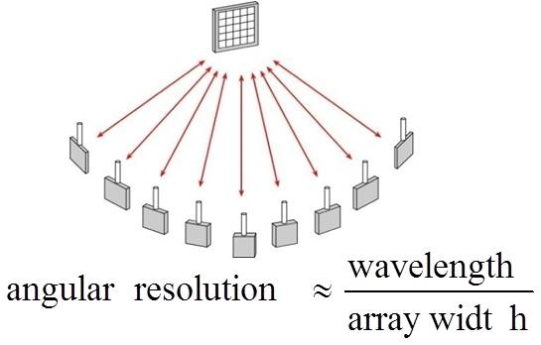
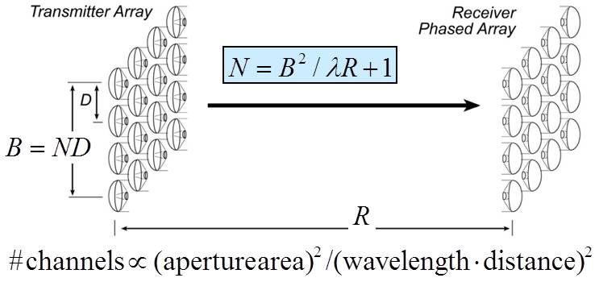
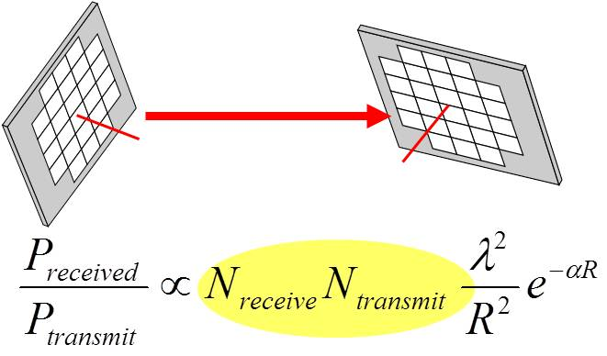
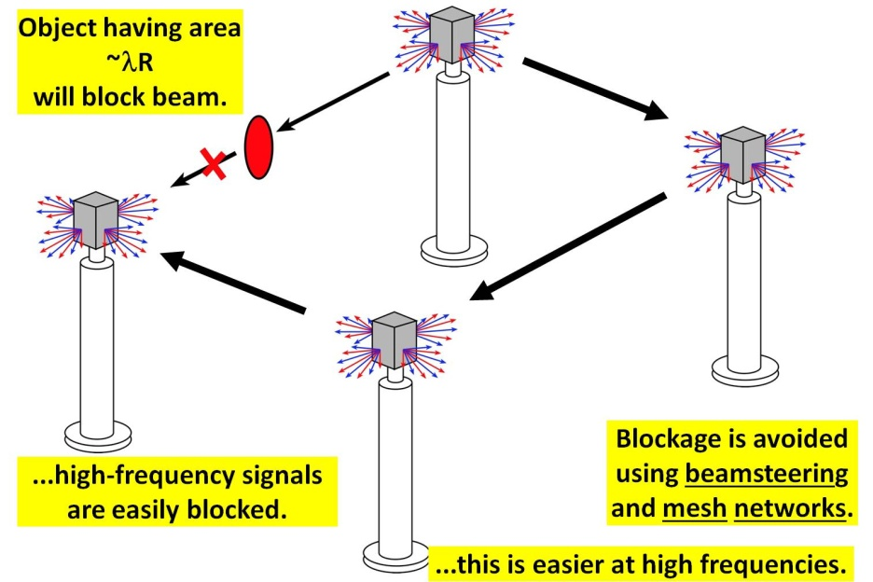
mm-Waves: benefits & challenges
Large available spectrum
Massive # parallel channels
spatial
multiplexing
line-of-sight MIMO
(note high attenuation in foul weather)
Need phased arrays (overcome high attenuation)
Need mesh networks
5

Slide 6
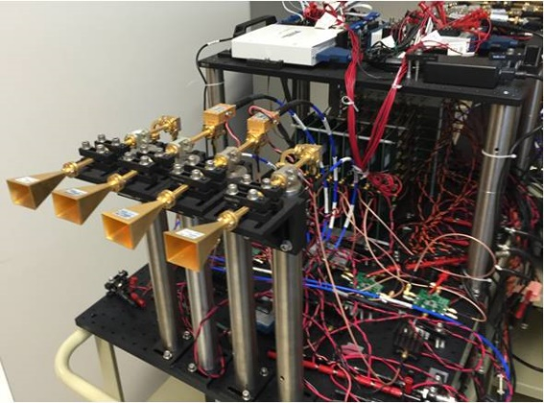
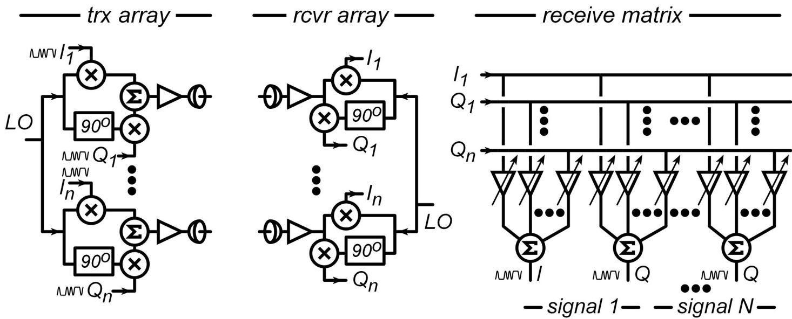
mm-Wave LOS MIMO: multi-channel for high capacity
Torklinson : 2006 Allerton Conference
Sheldon : 2010 IEEE APS-URSI
Torklinson : 2011 IEEE Trans Wireless Comm.

Slide 7
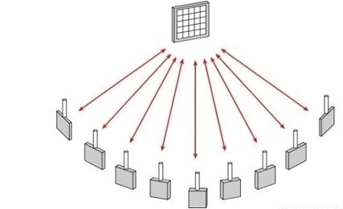
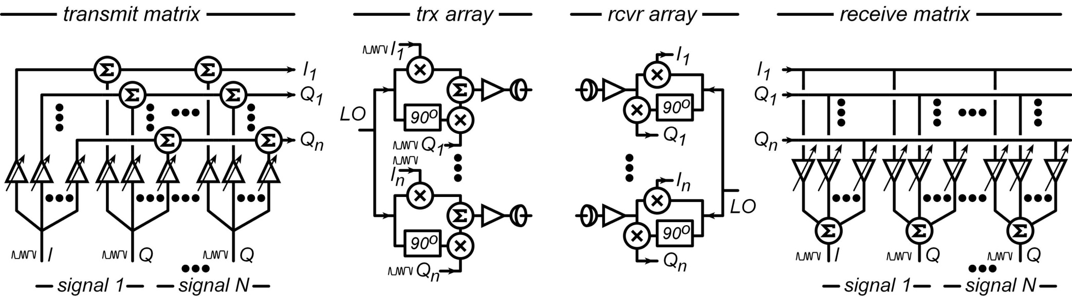
Spatial Multiplexing: massive capacity RF networks
multiple independent beams
each carrying different data
each independently aimed
# beams = # array elements
Hardware: multi-beam phased array ICs

Slide 8
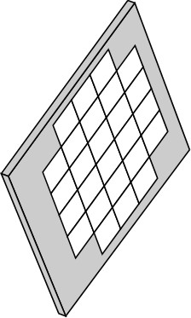
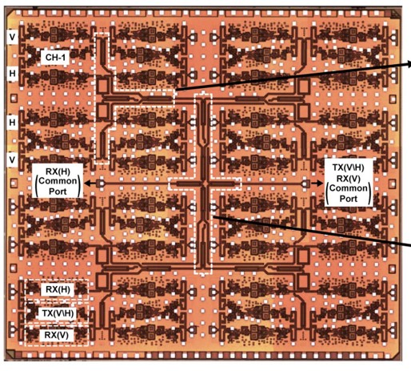
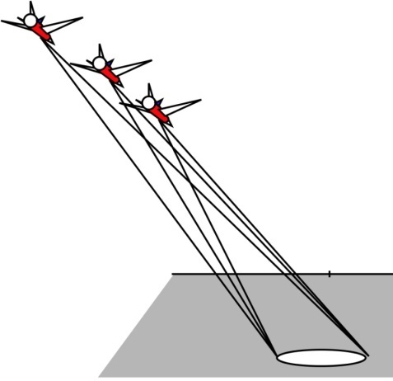
Millimeter-wave imaging
10,000-pixel, 94GHz imaging array→ 10,000 elements
Demonstrated:
SiGe, 1.3 kW (UCSD/Rebeiz)
Lower-power designs:
InP, CMOS, SiGe
(UCSB, UCSD, Virginia Poly.)
Golcuk: Trans MTT, Aug 2014
235 GHz video-rate synthetic aperture radar
1 transmitter, 1 receiver
100,000 pixels
20 Hz refresh rate
5 cm resolution @ 1km
50 Watt transmitter
(tube, solid-state driver)

Slide 9
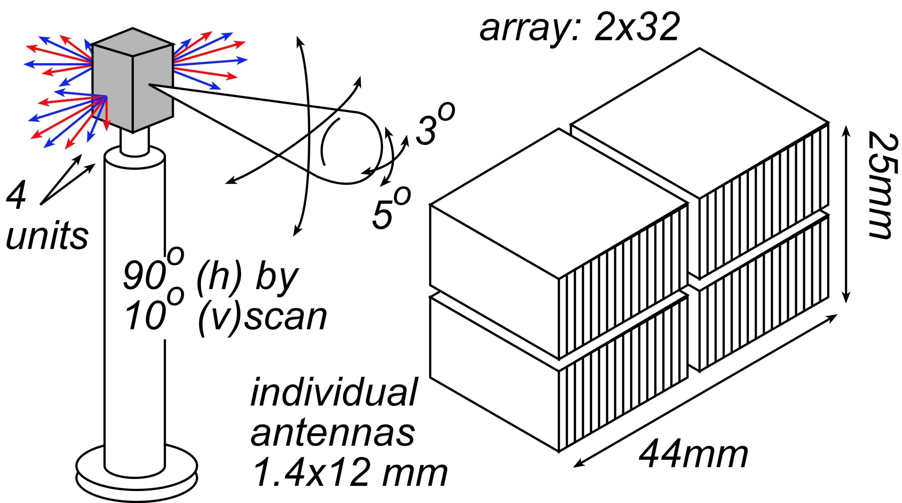
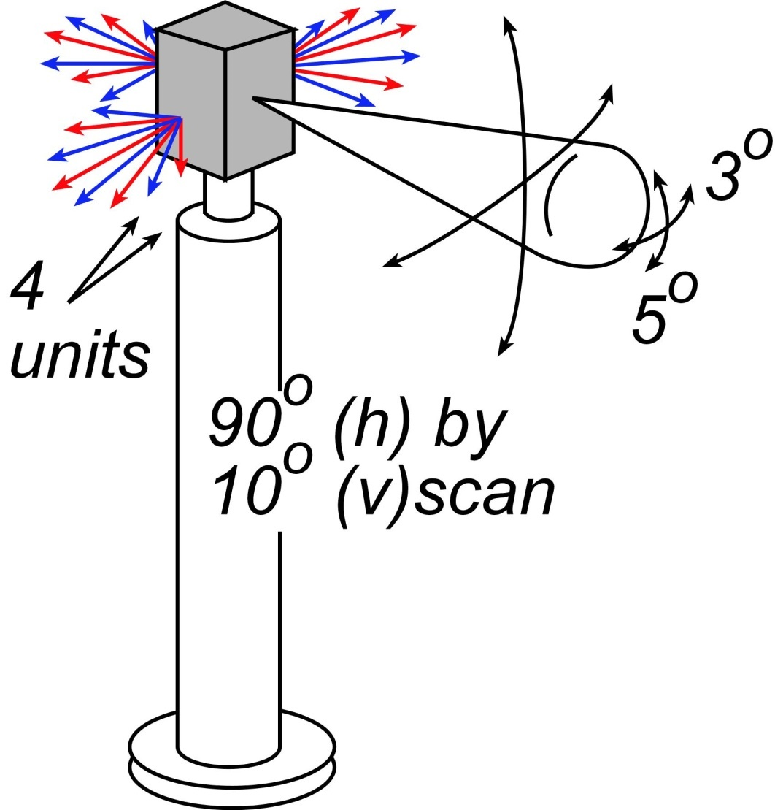
140 GHz, 10 Gb/s Adaptive Picocell Backhaul

Slide 10

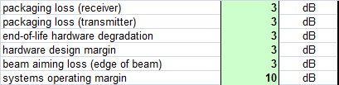
140 GHz, 10 Gb/s Adaptive Picocell Backhaul
350 meters range in 50mm/hr rain
Realistic packaging loss, operating & design margins
PAs: 24 dBm P_{sat} (per element)→ GaN or InP
LNAs: 4 dB noise figure → InP HEMT

Slide 11
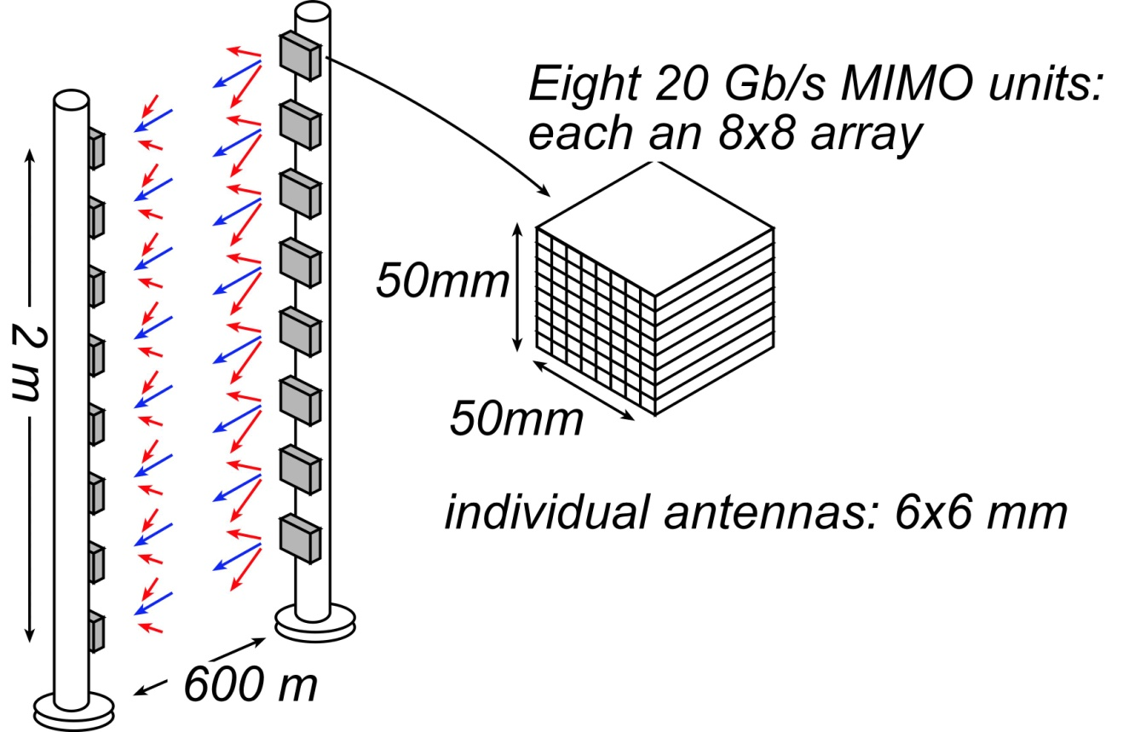
340GHz, 160Gb/s spatially multiplexed backhaul
1º beamwidth; 8º beamsteering
600 meters range in 50 mm/hr rain
Realistic packaging loss, operating & design margins
PAs: 14 dBm P_{sat} (per element)→ InP
LNAs: 7 dB noise figure → InP HEMT

Slide 12
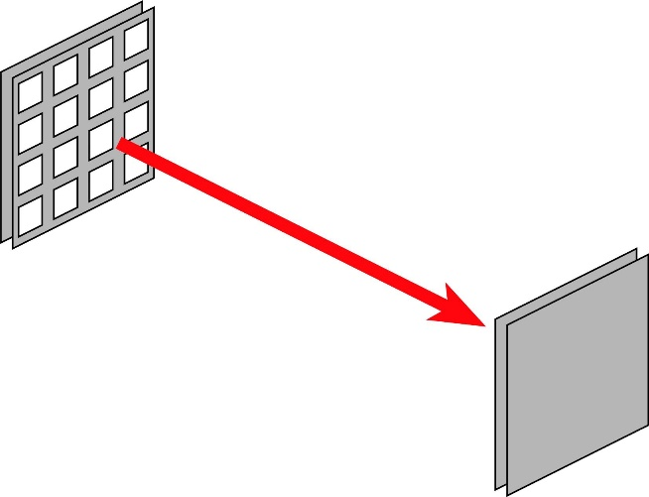
Optimum array size for low system power
At optimum-size array,
target PA output power
is typically 10-200 mW

Slide 13
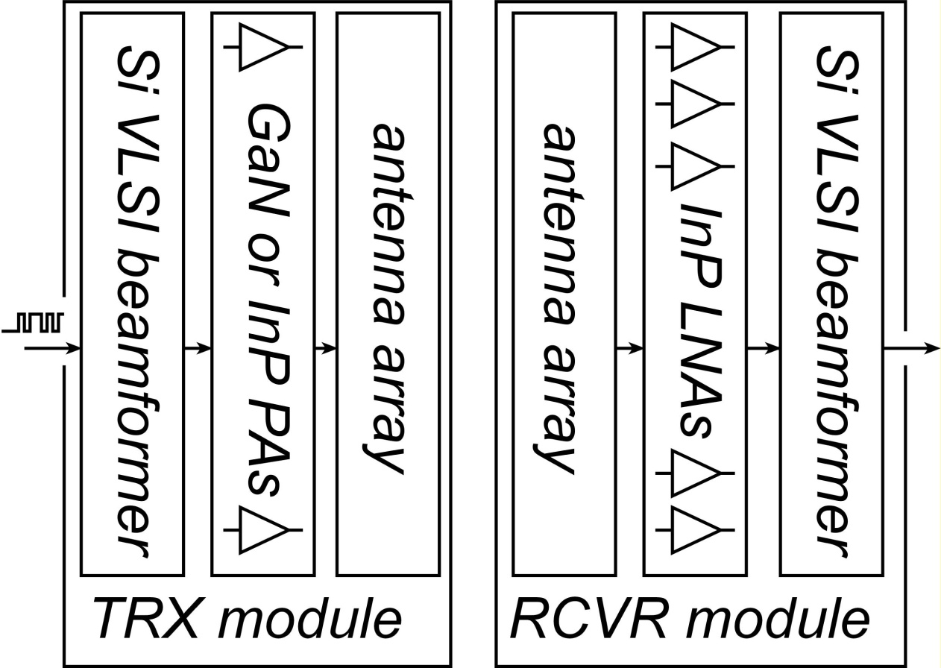
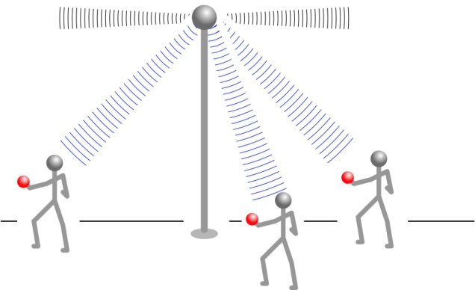


50-500 GHz Wireless Transceiver Architecture
backhaul
endpoint
III-V LNAs, III-V PAs → power, efficiency, noise
Si CMOS beamformer→ integration scale
...similar to today's cell phones.
High-gain antenna → large area
→ much too big for monolithic integration

Slide 14
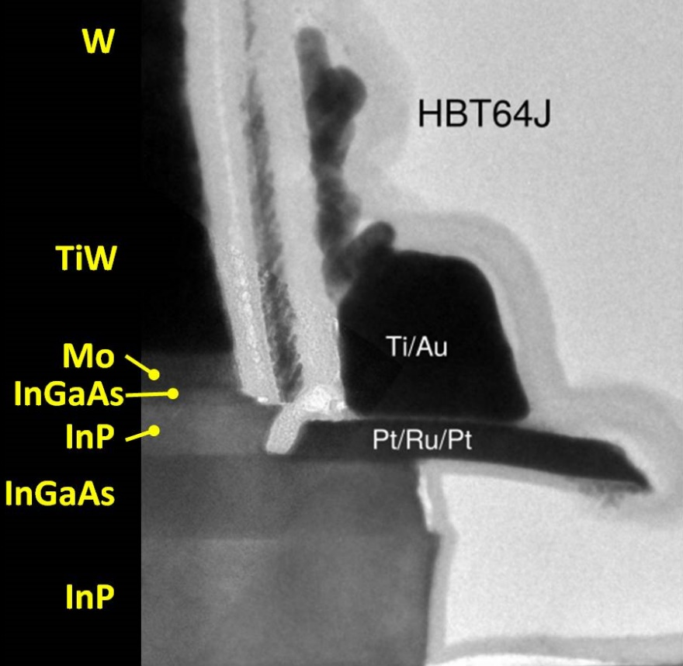
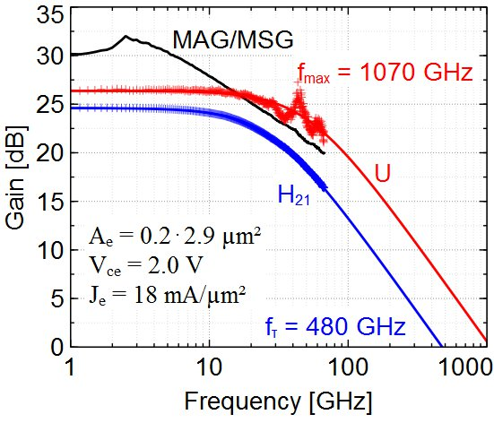
Transistors

Slide 15
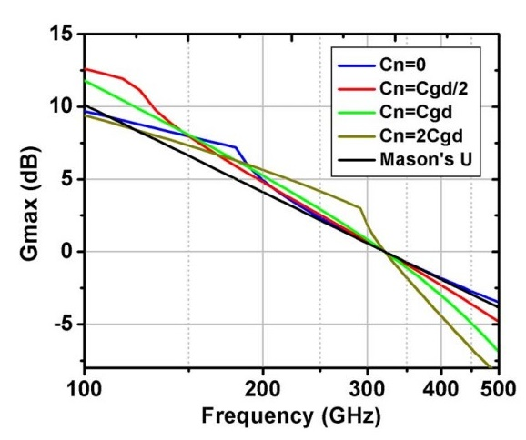
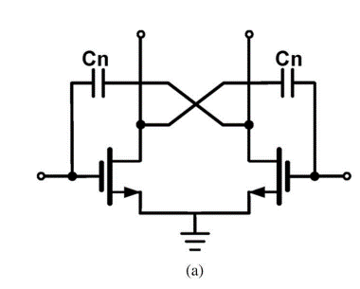
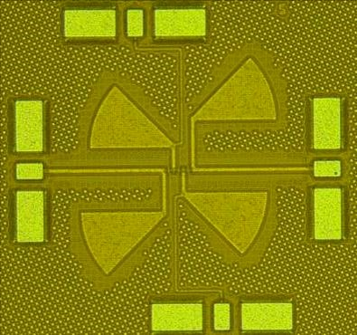
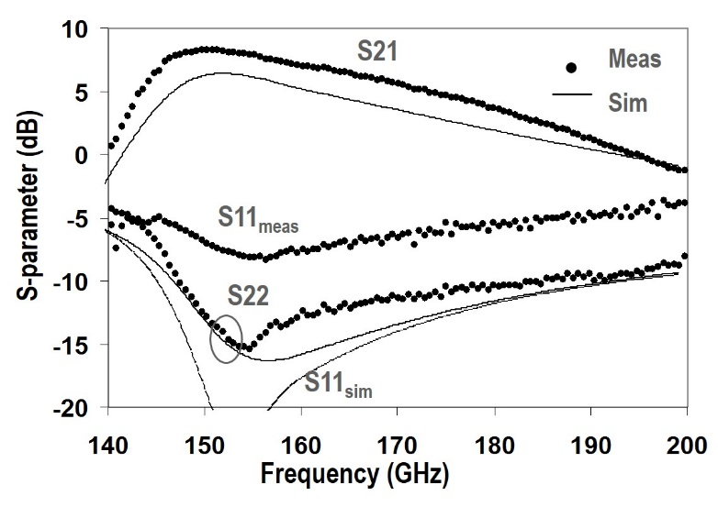
mm-wave CMOS (examples)
210 GHz amplifier: 32 nm SOI, positive feedback, 15 dB, 3 stages
Wang et al. (Heydari), JSSC, March 2014
300 GHz f_{max}
150 GHz amplifier: 65 nm bulk CMOS, 8.2 dB, 3 stages (250GHz f_{max})
Seo et al. (UCSB), JSSC, December 2009

Slide 16
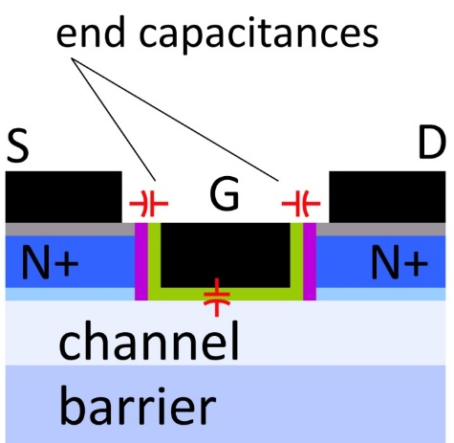
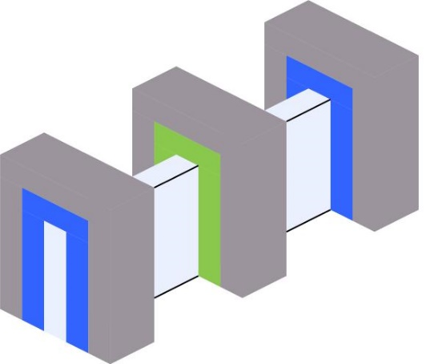
mm-Wave CMOS won't scale much further
Gate dielectric can't be thinned
→ on-current, g_{m} can't increase
Shorter gates give no less capacitance
dominated by ends; ~1fF/μm total
Maximum g_{m}, minimum C→ upper limit on f_{τ}.
about 350-400 GHz.
Tungsten via resistances reduce the gain
Inac et al, CSICS 2011
Present finFETs have yet larger end capacitances

Slide 17
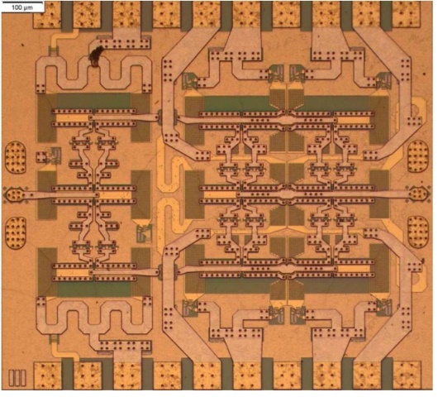
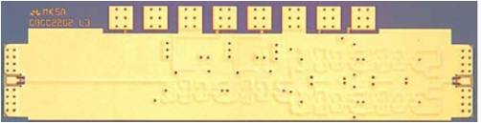
III-V high-power transmitters, low-noise receivers
Cell phones & WiFi:
GaAs PAs, LNAs
mm-wave links need
high transmit power,
low receiver noise
0.47 W @86GHz
H Park, UCSB, IMS 2014
0.18 W @220GHz
T Reed, UCSB, CSICS 2013
1.9mW @585GHz
M Seo, TSC, IMS 2013

Slide 18
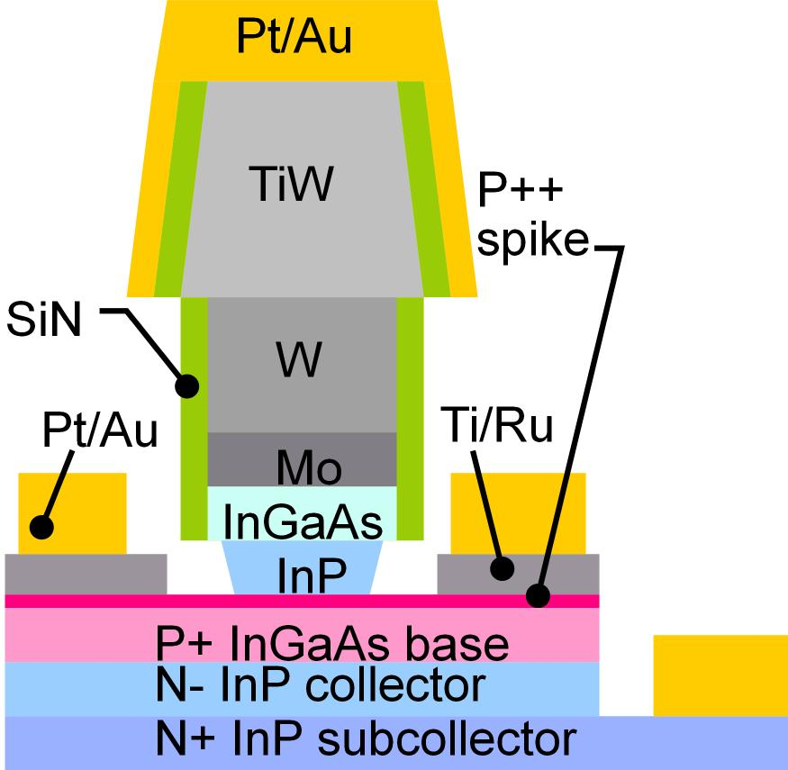
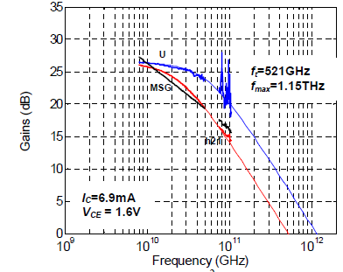
Making faster bipolar transistors
to double the bandwidth: | change
emitter & collector junction widths | decrease 4:1
current density (mA/μm²) | increase 4:1
current density (mA/μm) | constant
collector depletion thickness | decrease 2:1
base thickness | decrease 1.4:1
emitter & base contact resistivities | decrease 4:1
Teledyne: M. Urteaga et al: 2011 DRC
Narrow junctions.
Thin layers
High current density
Ultra low resistivity contacts

Slide 19
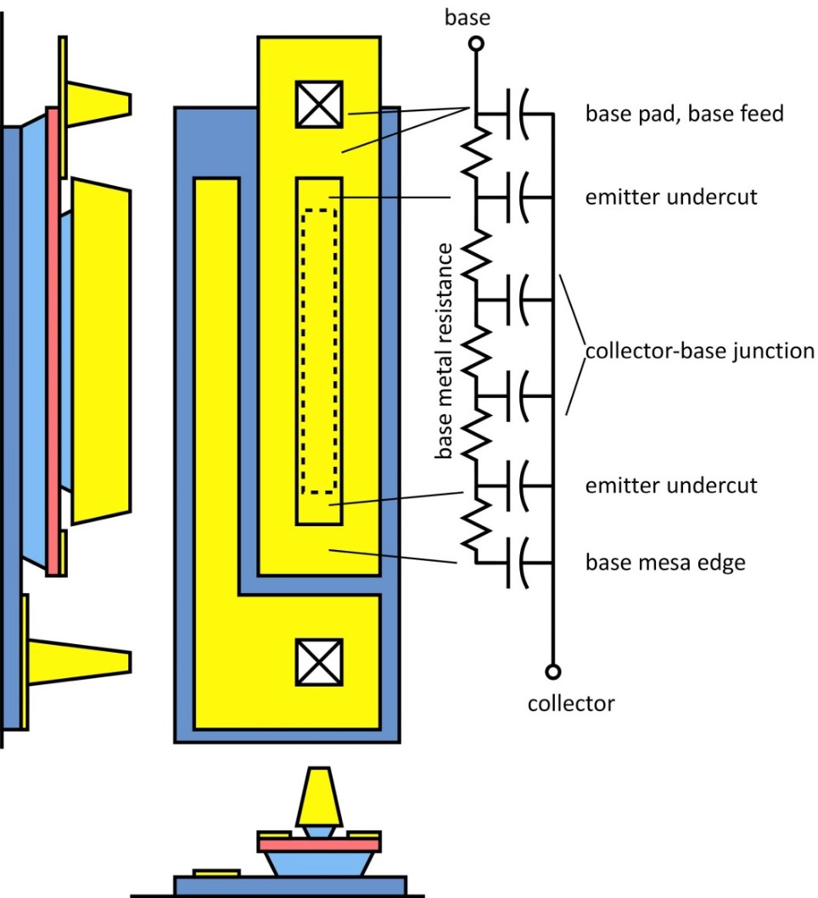
THz HBTs: The key challenges
Obtaining good base contacts
in HBT vs. in contact test structure
(emitter contacts are fine)
RC parasitics along finger length
metal resistance, excess junction areas
Baraskar et al, Journal of Applied Physics, 2013

Slide 20
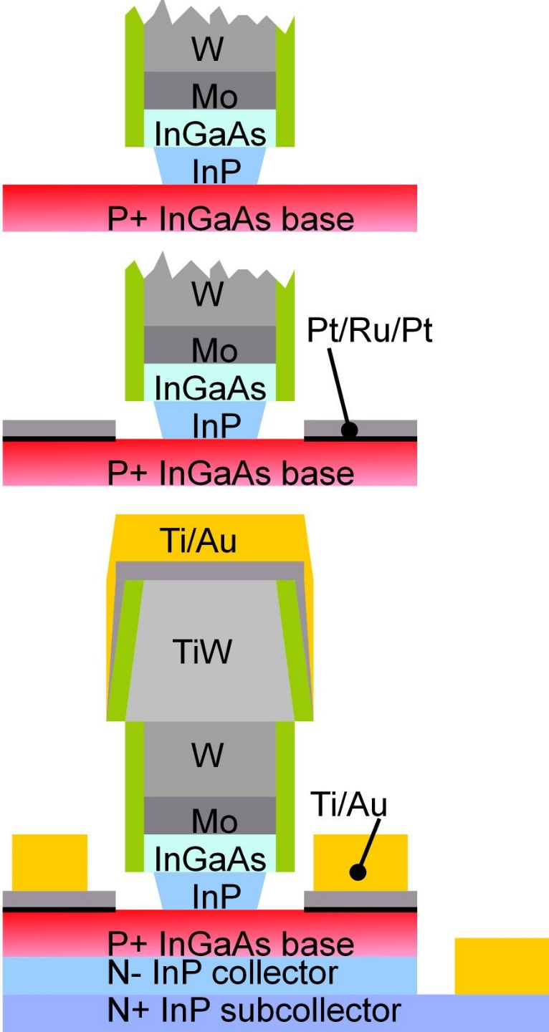
THz HBTs: double base metal process
Blanket surface clean (UV O₃ / HCl)
strips organics, process residues, surface oxides
Blanket base metal
no photoresist; no organic residues
Ru refractory diffusion barrier
2 nm Pt : penetrates residual oxides
Rode et al., IEEE TED, Aug. 2015
Thick Ti/Au base pad metal liftoff
thick metal→ low resistivity

Slide 21
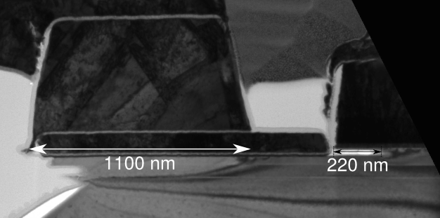
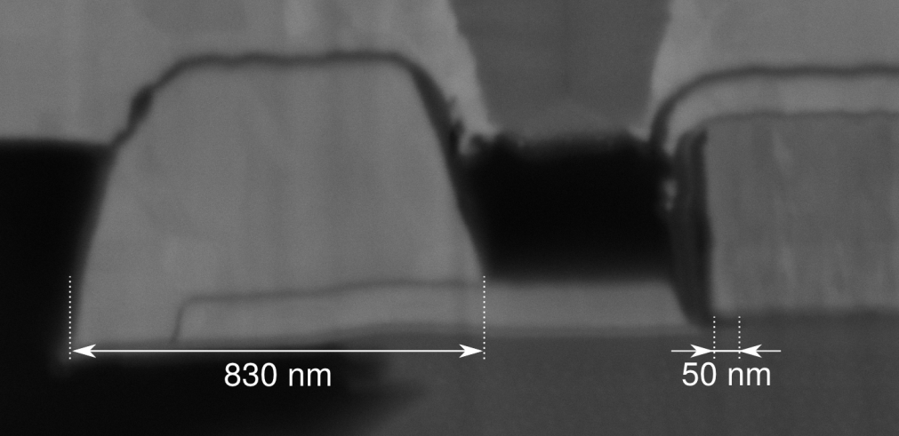
Reducing Emitter Length Effects
large base post
large emitter
end undercut
before
Rode et al., IEEE TED, Aug. 2015
small base post undercut
small emitter
end undercut
after
small base post
large base post undercut
21

Slide 22
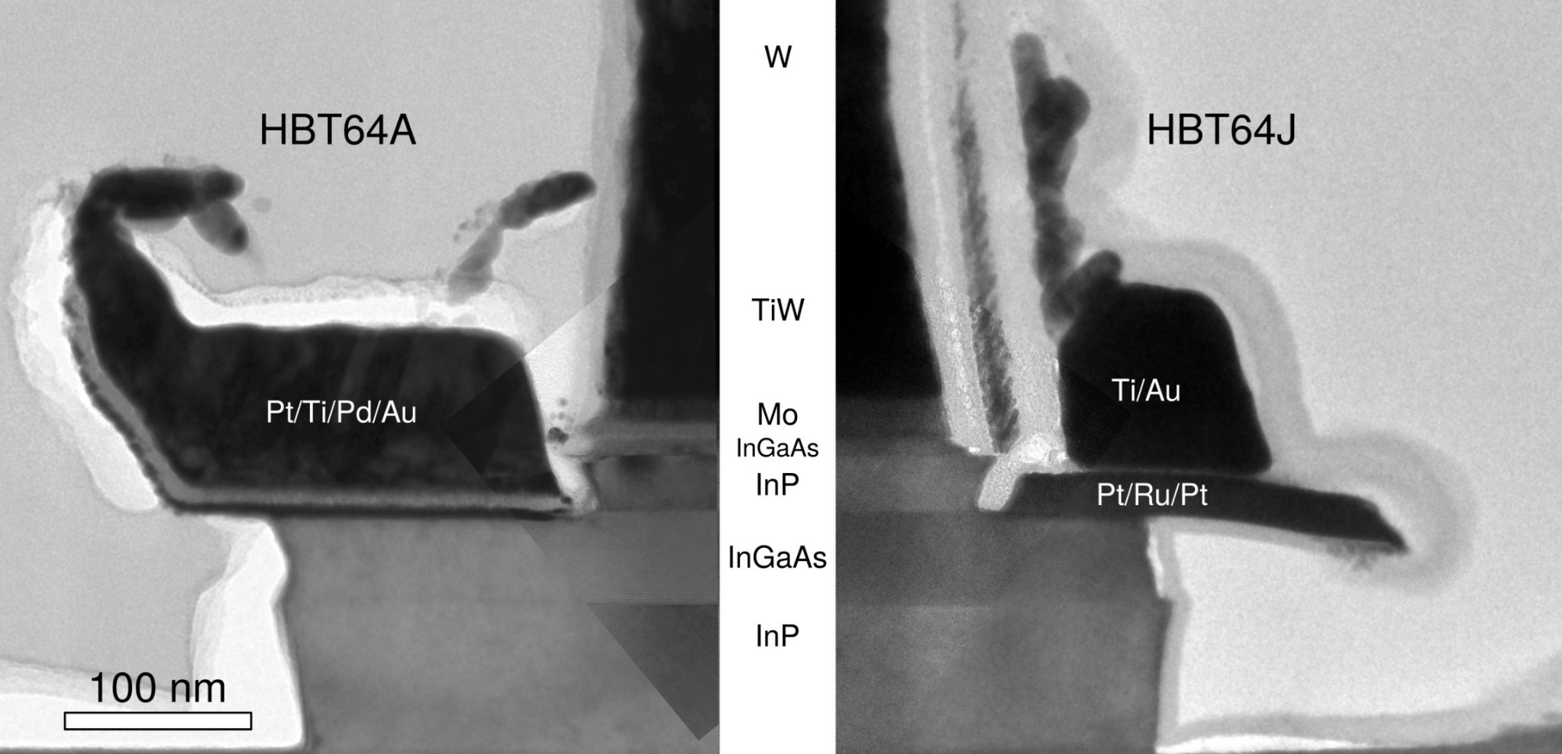
Reducing Emitter Length Effects
before
after
thicker Au
base metal
narrower
collector
junction
Rode et al., IEEE TED, Aug. 2015
22

Slide 23
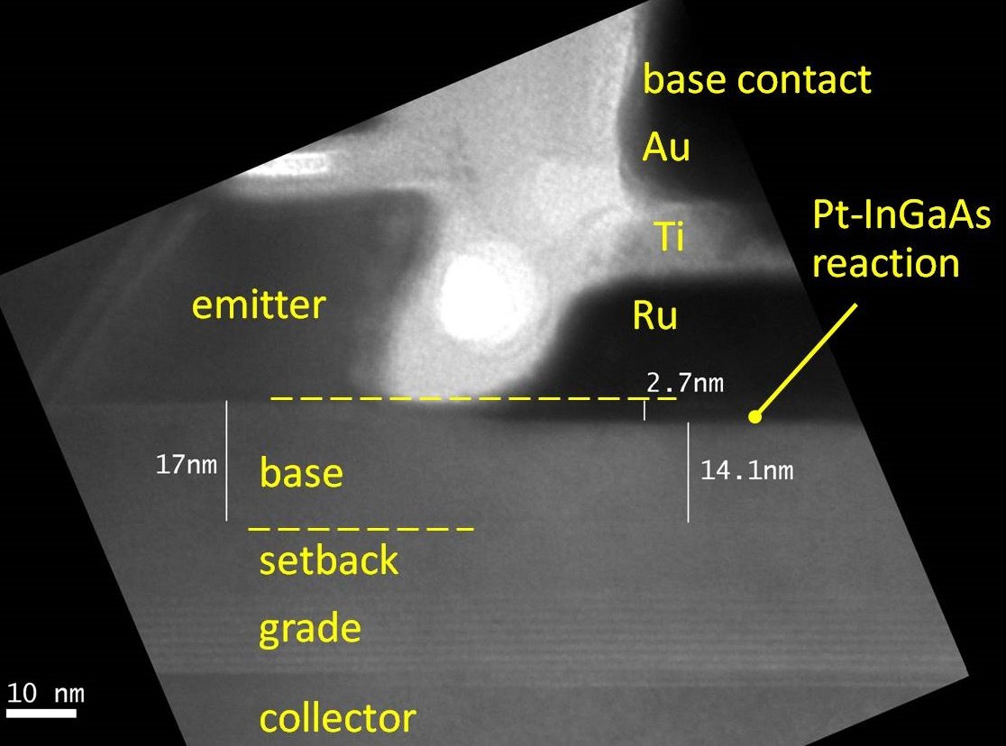
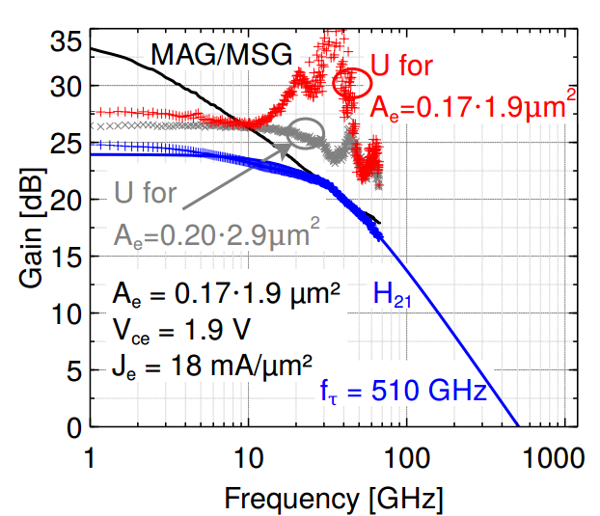
InP HBTs: 1.07 THz @200nm, ?? @ 130nm
?
Rode et al., IEEE TED, Aug. 2015

Slide 24


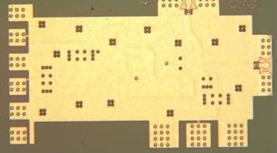
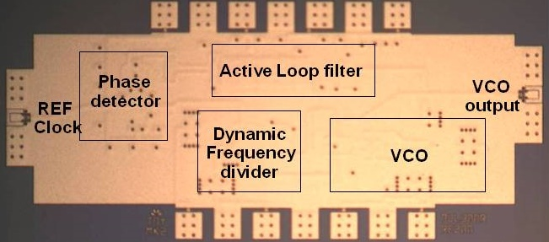




130nm /1.1 THz InP HBT: ICs to 670 GHz
614 GHz
fundamental
VCO
340 GHz dynamic frequency divider
M. Seo, TSC / UCSB
M. Seo, UCSB/TSC
IMS 2010
300 GHz fundamental
PLL
620 GHz, 20 dB gain amplifier
M Seo, TSC
IMS 2013
also: 670GHz amplifier
J. Hacker , TSC
IMS 2013 (not shown)
M. Seo, TSC
IMS 2011
204 GHz static
frequency divider
(ECL master-slave
latch)
220 GHz
180 mW
power amplifier
81 GHz
470 mW
power amplifier
Z. Griffith, TSC
CSIC 2010
T. Reed, UCSB
CSICS 2013
H-C Park UCSB
IMS 2014
Integrated 300/350GHz Receivers:
LNA/Mixer/VCO
600 GHz
Integrated
Transmitter
PLL + Mixer
M. Seo TSC
M. Seo TSC

Slide 25

Towards a 3 THz InP Bipolar Transistor
Extreme base doping→ low-resistivity contacts→ high f_{max}
Extreme base doping→ fast Auger (NP²) recombination→ low β.
Solution: very strong base compositional grading→ high β

Slide 26



1/2-THz SiGe HBTs
500 GHz f_{max} SiGe HBTs Heinemann et al. (IHP), 2010 IEDM
16-element multiplier array @ 500GHz (1 mW total output)
U. Pfeiffer et. al. (Wuppertal / IHP) , 2014 ISSCC

Slide 27
Towards a 2 THz SiGe Bipolar Transistor
 | InP | SiGe
emitter
junction width | 64 | 18 | nm
access resistivity | 2 | 0.6 | Ω−μm²
base
contact width | 64 | 18 | nm
contact resistivity | 2.5 | 0.7 | Ω−μm²
collector
thickness | 53 | 15 | nm
current density | 36 | 125 | mA/μm²
breakdown | 2.75 | 1.3? | V
f_{τ} | 1000 | 1000 | GHz
f_{max} | 2000 | 2000 | GHz
Similar scaling
InP: 3:1 higher collector velocity
SiGe: good contacts, buried oxides
Key distinction: Breakdown
InP has:
thicker collector at same f_{τ},
wider collector bandgap
Key requirements:
low resistivity Ohmic contacts
note the high current densities
Assumes collector junction 3:1 wider than emitter.
Assumes SiGe contacts no wider than junctions

Slide 28


Towards at 2.5 THz HEMT
First Demonstration of Amplification at 1 THz Using
25-nm InP High Electron Mobility Transistor Process
Xiaobing Mei, et al, IEEE EDL, April 2015 (Northrop-Grumman)
FET scaling laws; 2:1 higher bandwidth | change
gate length | decrease 2:1
current density (mA/mm), g_{m} (mS/mm) | increase 2:1
transport mass | constant
gate-channel capacitance density | increase 2:1
contact resistivities | decrease 4:1
Need thinner dielectrics, better contacts

Slide 29



Towards at 2.5 THz HEMT
VLSI III-V MOS
C. Y. Huang et al., DRC 2015
THz III-V MOS

Slide 30
Power Amplifiers

Slide 31



220 GHz power amplifiers; 256nm InP HBT
90 mW
180 mW (330 mW design; thermally limited)
164 mW, 0.43 W/mm, 2.4% PAE
T. Reed (UCSB), Z. Griffith (TSC), IEEE CSIC 2012 & 2013; Teledyne 256nm InP HBT

Slide 32
mm-Wave Power Amplifier: Challenges
needed: High power / High efficiency / Small die area ( low cost)
Extensive power combining
Compact power-combining
Class E/D/F are poor @ mm-wave
insufficient f_{max} ,
high losses in harmonic terminations
Efficient power-combining
Goal: efficient, compact mm-wave power-combiners

Slide 33




Parallel Power-Combining
Output power: P_{OUT} = N x V x I
Parallel connection increases P_{OUT}
Load Impedance: Z_{OPT} = V / (N x I)
Parallel connection decreases Z_{opt}
High P_{OUT}→ Low Z_{opt}
Needs impedance transformation:
lumped lines, Wilkinson, ...
High insertion loss
Small bandwidth
Large die area

Slide 34



Series Power-Combining & Stacks
Parallel connections: I_{out}=N x I
Series connections: V_{out}=N x V
Output power: P_{out}=N² x V x I
Load impedance: Z_{opt}=V/I
Small or zero power-combining losses
Small die area
How do we drive the gates ?
Local voltage feedback:
drives gates, sets voltage distribution
Design challenge:
need uniform RF voltage distribution
need ~unity RF current gain per element
...needed for simultaneous compression of all FETs.
Shifrin et al., 1992 IEEE-IMS; Rodwell et al., U.S. Patent 5,945,879, 1999; Pornpromlikit et al., 2011 CSICS

Slide 35

Sub-λ/4 Baluns for Series Combining
Balun combiner:
2:1 series connection
each source sees 25 Ω
→ 4:1 increased P_{out}
Standard λ/4 balun :
long lines
→ high losses
→ large die
Sub-λ/4 balun :
stub→ inductive
tunes transistor C_{out} !
short lines→ low losses
short lines → small die
Park et al., 2013 CSICS, 2014 IEEE-IMS

Slide 36


2:1 series-connected 86GHz power amplifier
20 dB Gain
188mW P_{sat}
1.96 W/mm
32.8% PAE
Teledyne 250 nm InP HBT
2 stages, 1.0 mm²
Daneshgar et al., 2014 IEEE-IMS

Slide 37


4:1 series-connected 81GHz power amplifier
17 dB Gain
470 mW P_{sat}
23% PAE
Teledyne 250 nm InP HBT
2 stages, 1.0 mm²(incl pads)
Park et al., 2014 IEEE-IMS

Slide 38



Teledyne: 1.9 mW, 585 GHz Power Amplifier
M. Seo et al., Teledyne Scientific: IMS2013
S-parameters
Output Power
12-Stage Common-base
2.8 dBm P_{sat}
>20 dB gain up to 620 GHz
What limits output power in sub-mm-wave amplifiers ?

Slide 39


Sub-mm-wave PAs: need more current !
3 μm max emitter length (> 1 THz f_{max})
2 mA/μm max current density
I_{max}= 6 mA
Maximum 3 Volt p-p output
Load: 3V/6mA= 500 Ω
Combiner cannot provide 500 Ω loading
common-base HBT
HBTs with microstrip combiner
collector
base
ground
plane
emitter

Slide 40



Multi-finger HBTs: more current, lower f_{max}
More current
→ lower cell load resistance
one-finger common-base HBT
collector
base
ground
plane
Reduced f_{max}, reduced RF gain:
common-lead inductance→ Z₁₂
feedback capacitance→ Y₁₂
phase imbalance between fingers.
emitter
two-finger power cell
collector
base
Worse at higher frequencies:
less tolerant of cell parasitics
less current per cell
higher required load resistance
Can optimum load be reached ?
emitter
four-finger power cell: parasitics
collector
base
emitter-collector capacitance
unequal emitter inductances
emitter

Slide 41

Sub-mm-wave transistors: need more current
InP HBTs:
thinner collector→ more current
hotter→ improve heat-sinking
or: longer emitters→ thicker base metal
GaN HEMTs:
much higher voltage
100+ GHz: large multi-finger FETs not feasible
Need high current to exploit high voltage.
Example:
2mA/μm, 100 μm max gate width, 50 Volts
200mA maximum current
50 Volts/200mA= 250 Ω load→ unrealizable.
Need more mA/μm or longer fingers

Slide 42


50-500GHz Wireless

Slide 43







50-500 GHz Wireless Electronics
Mobile communication @ 2Gb/s per user, 1 Tb/s per base station
Requires: large arrays, complex signal processing, high P_{out} , low F_{min}
VLSI beamformers
VLSI equalizers
III-V LNAs & PAs
III-V Transistors may perform well enough even for 1 THz systems.

Slide 44
(backup slides follow)

Slide 45
asdfsadfasdfadsf
asdfasdfdfasdf

Slide 46
Talk is 40 min
plus 10 min for questions…
35-40 slides

Slide 47

Sub-mm-wave PAs: need more current !
<3 μm emitter length for > 1 THz f_{max}
2 mA/μm max current density
I_{max}= 6 mA
Maximum 3 Volt p-p output
Load: 3V/6mA= 500 Ω
base
collector
emitter
Combiner cannot provide 500 Ω loading
ground
plane

