Slide 1
Device, Circuit, and Systems Considerations for Highly Integrated
30-300GHz Wireless Systems
Short Course, IEEE BCICTS Conference, San Diego, October 14, 2018
Mark Rodwell,
University of California, Santa Barbara

Slide 2
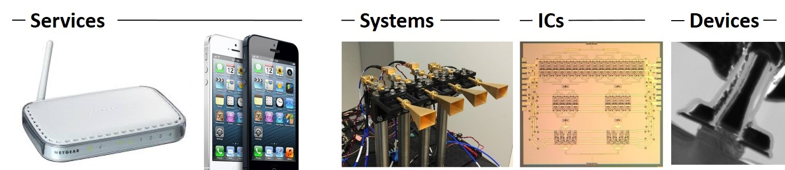
Why mm-wave wireless ?
Wireless networks: exploding demand.
Immediate industry response: 5G.
28, 38, 57-71(WiGig), 71-86GHz
increased spectrum, extensive beamforming
Next generation (6G ??): above 100GHz..
greatly increased spectrum, massive spectral multiplexing
DOD applications: Imaging/sensing/radar, comms.

Slide 3
A very incomplete history of THz electronics
1950-1990: THz GaAs Schottky diodes in waveguide
Multipliers and mixers. Radio astronomy. Instruments. Spectroscopy.
1980's: THz spectroscopy using fs/ps pulsed lasers
ps/fs pulsed lasers, optical/electrical conversion, time-domain techniques
"optics is fast; electronics is slow"
1985-95: ps pulses using GaAs NLTLs + diode sampling ICs
100GHz commercial sampling scopes, fast network analyzers.
1995-2010: THz transistors, THz ICs
Can we make transistors work at 1THz ?
Abandon classical electrostatic barriers for quantum transitions ?
Can circuit concepts work at 1THz ? (of course, just need D<<λ !)
Dead end: Detecting poison gas

Slide 4
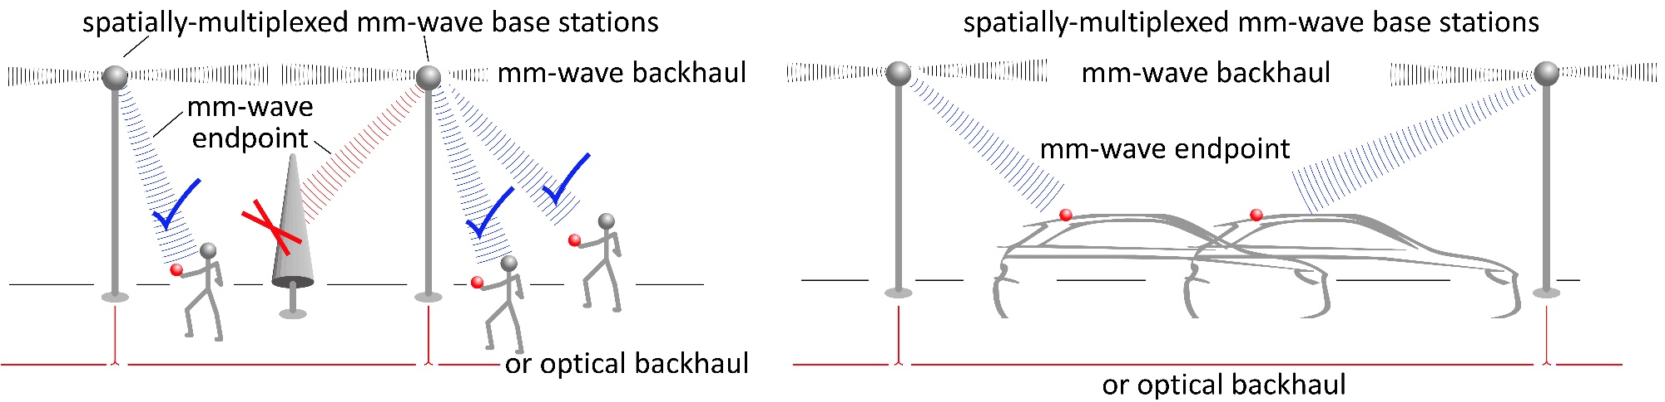
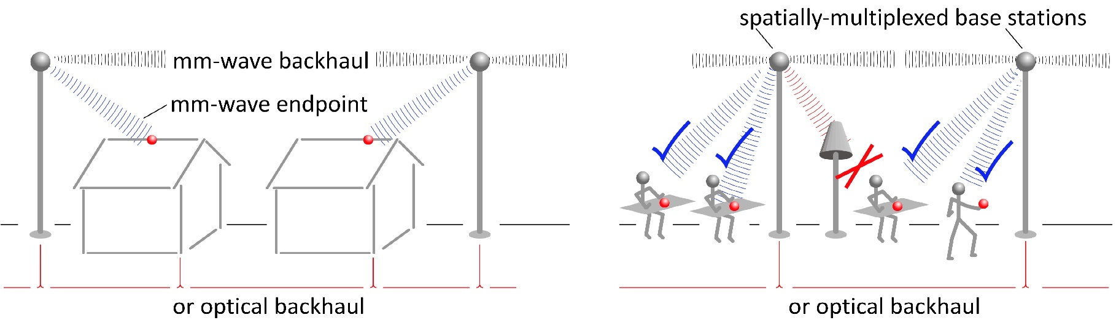
mm-waves: high-capacity mobile communications
Gigabit mobile communication: Information anywhere, any time, without limits
Residential/office communication: Cellular/internet convergence: competition, low cost, broader deployment

Slide 5
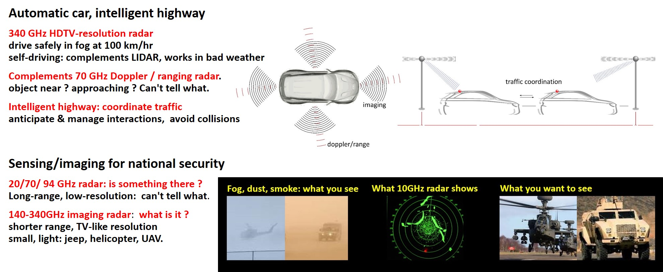
mm-wave imaging: fog/clouds/smoke/dust

Slide 6
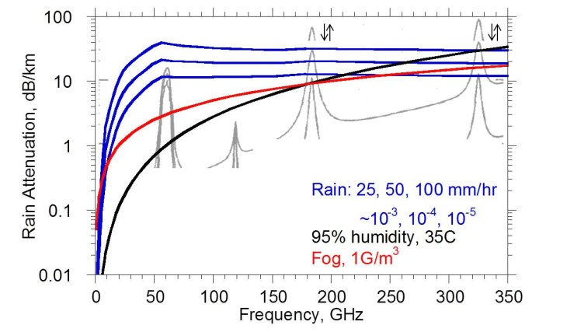
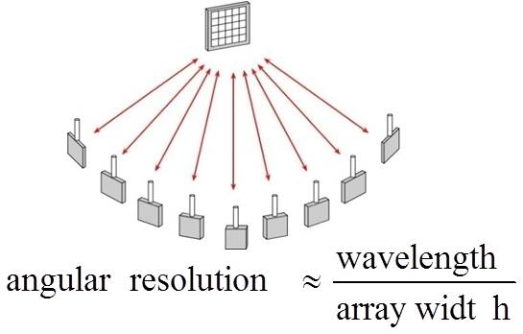
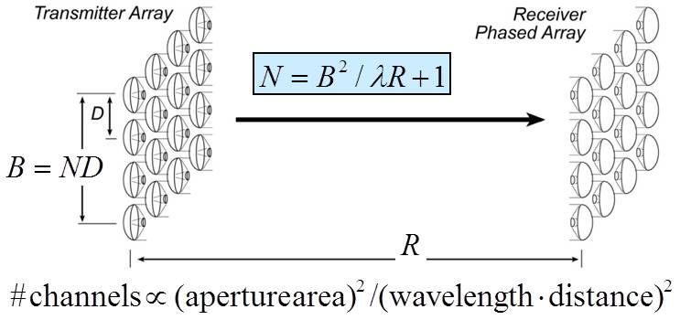
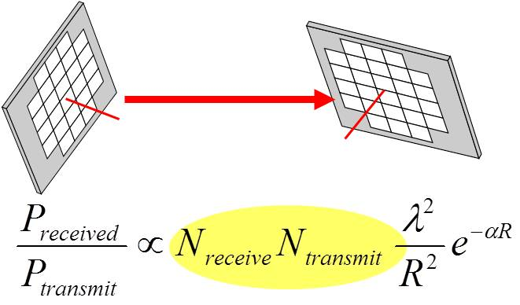
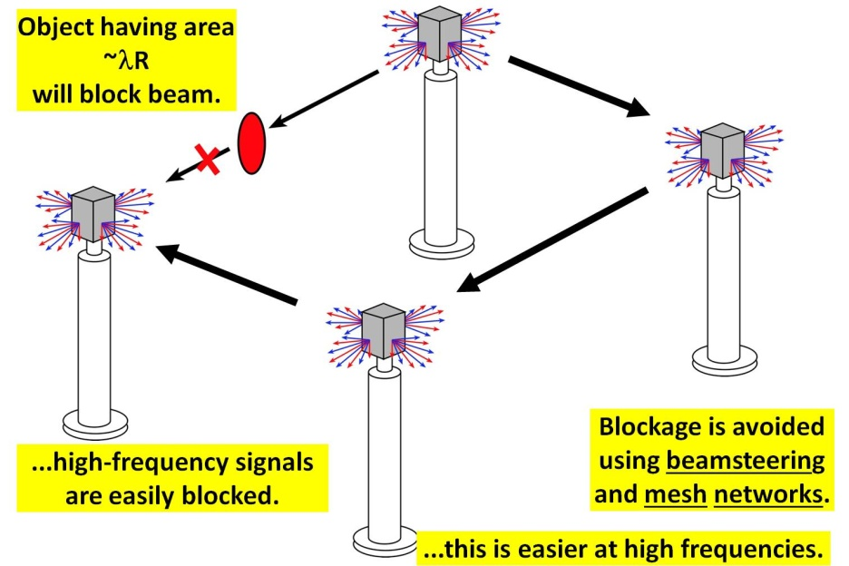
mm-waves: benefits & challenges
Large available spectrum
Massive # parallel channels
spatial
multiplexing
line-of-sight MIMO
(note high attenuation in foul or humid weather)
Need phased arrays (overcome high attenuation)
Need mesh networks

Slide 7
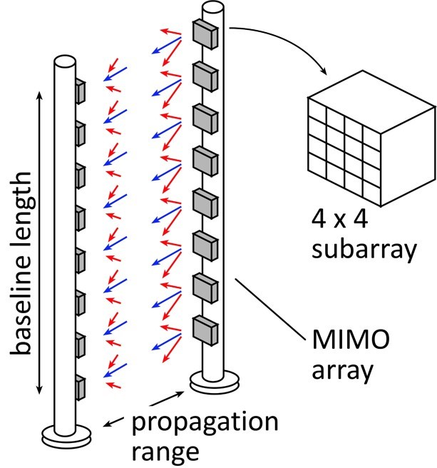
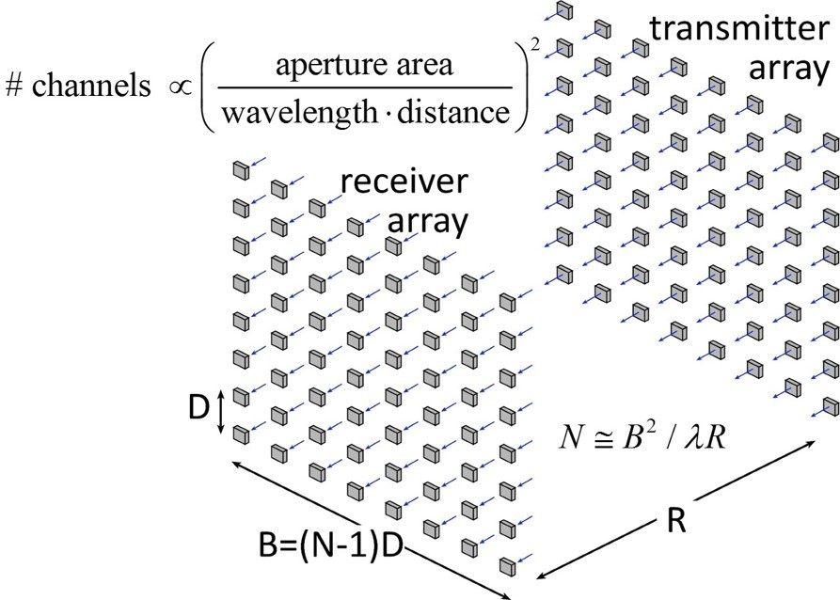
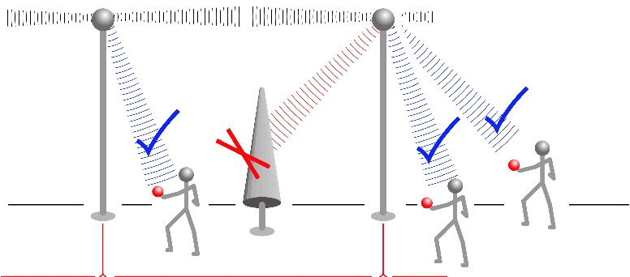
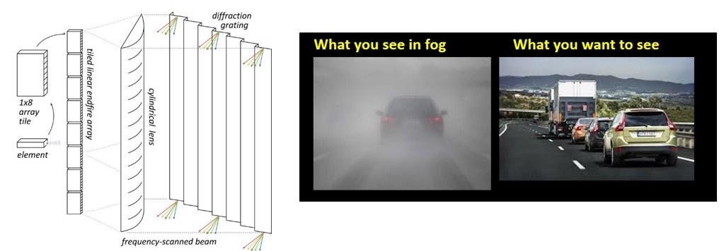
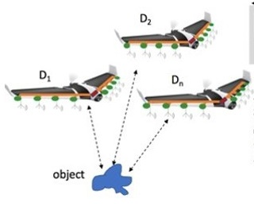
mm-waves: potential applications
High-capacity hubs
massive spatial multiplexing
High-capacity backhaul
massive spatial multiplexing
High-resolution imaging
drive through fog/rain/snow
Compact imaging: drones
image through fog/smoke/rain

Slide 8
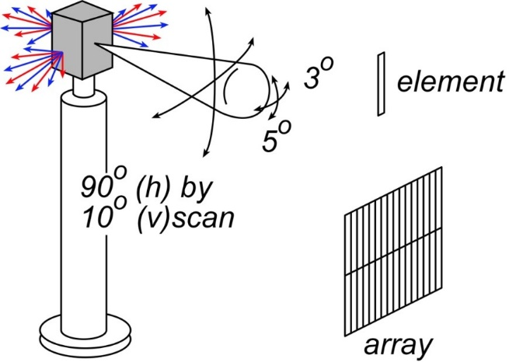
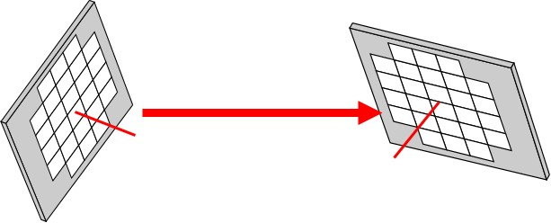
mm-wave fundamentals

Slide 9

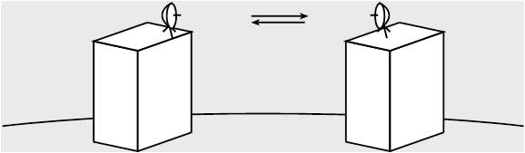
mm-Wave Wireless Needs Phased Arrays
isotropic antenna
→ weak signal
→short range
highly directional antenna
→ strong signal,
must be aimed
no good for mobile
must be precisely aimed →too expensive for telecom operators
beam steering arrays
→ strong signal,
steerable
32-element array → 30 (45?) dB increased SNR

Slide 10
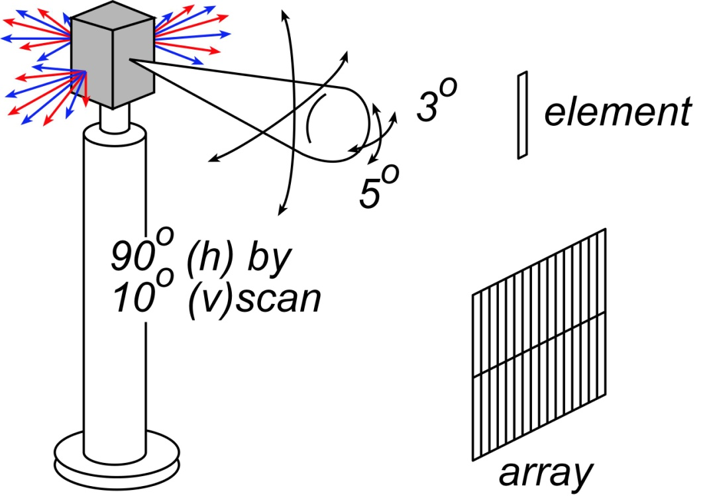
Antenna & array basics

Slide 11
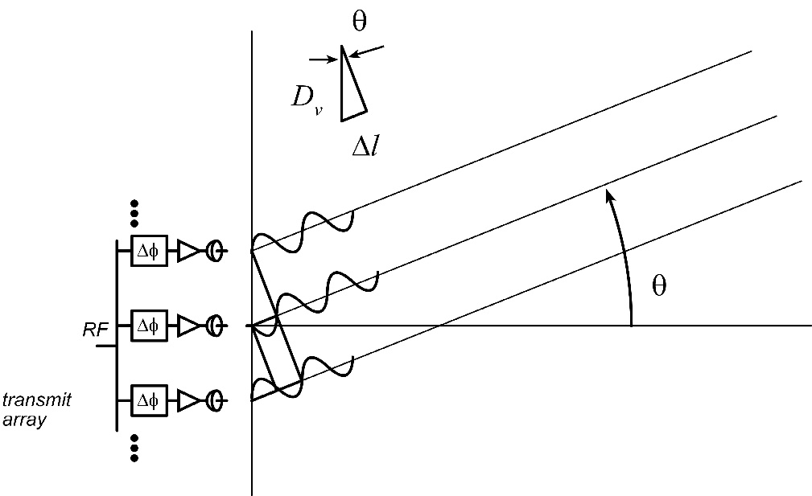
Electronic beamsteering, a.k.a. phased array

Slide 12
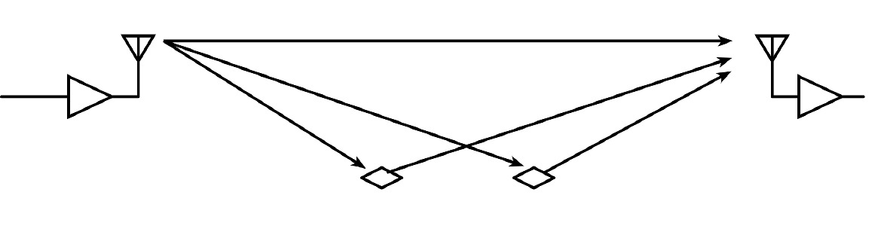
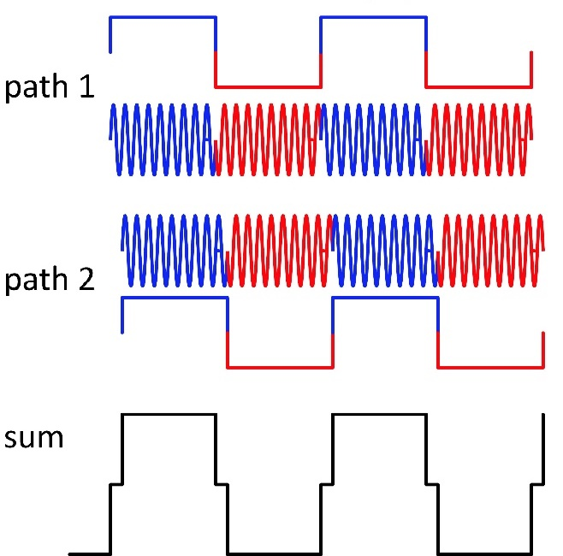
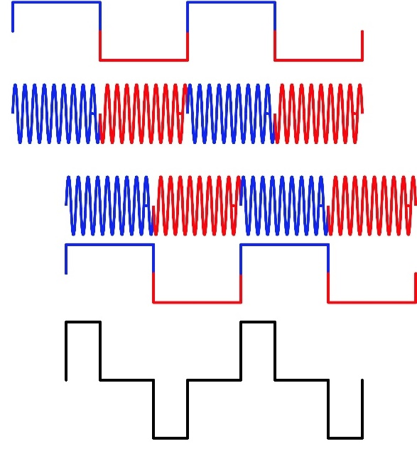
Multipath propagation: fading & ISI
(Delay spread<< symbol period ): fading
LOS, NLOS arrive with aligned symbol periods.
LOS, NLOS possibly out-of-phase: weak signal.
(Delay spread ≥ symbol period ): ISI
One bit period interferes with another.
Need adaptive equalization or OFDM.

Slide 13
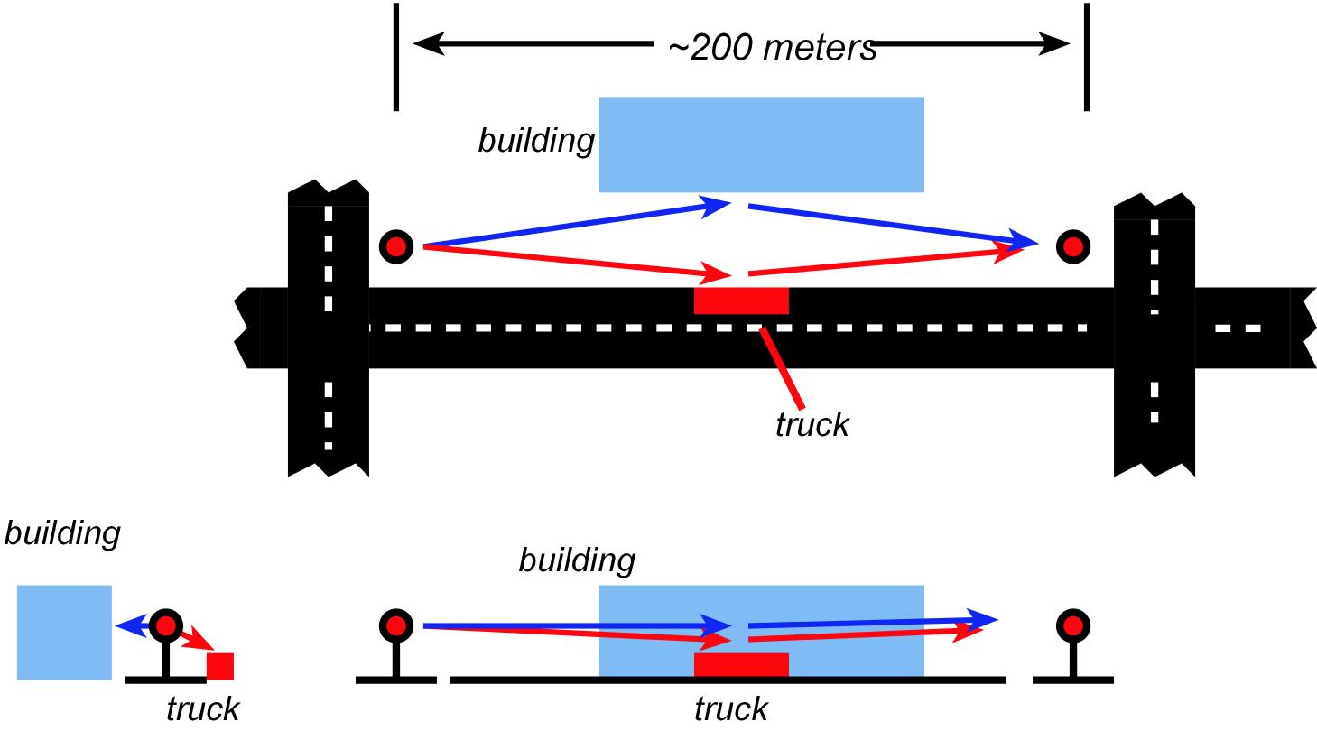

Beamforming can suppress ISI
1 Gbaud with 10º array beamwidth :
multipath mostly causes fading
not much ISI
10 Gbaud with 10º array beamwidth :
significant fading and significant ISI
Solution 1: adaptive equalization or ODFM
cost, complexity @ high rates ?
Solution 2: larger arrays
narrower beamwidth

Slide 14
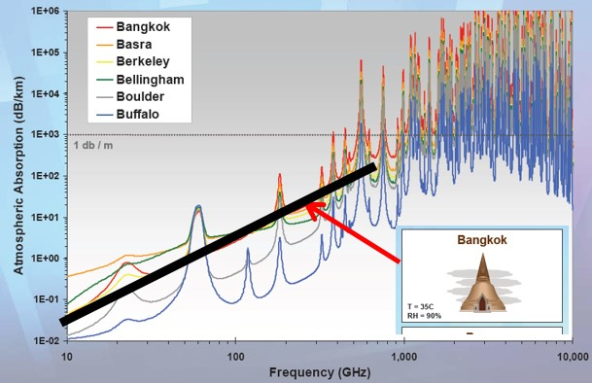
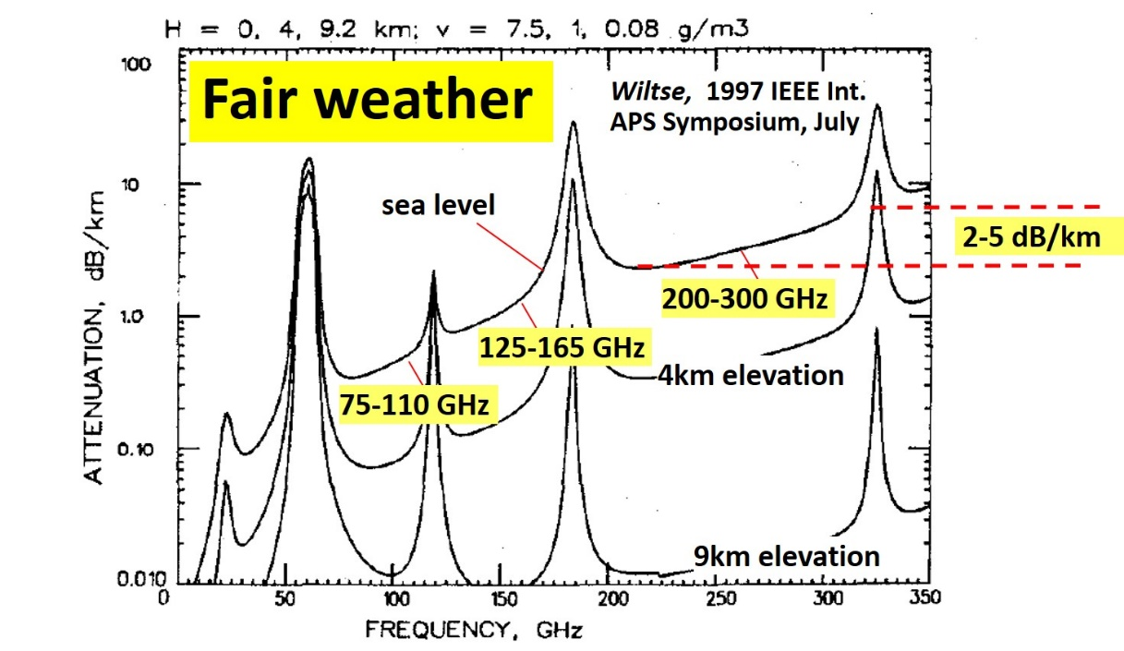
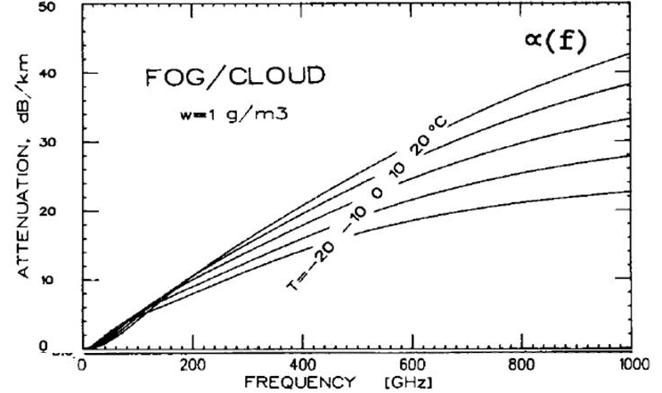
Propagation, rain or shine
35ºC, 95% Humidity
loss (dB/km)~(frequency/60GHz)²
11 dB/km@200 GHz, 5.5dB/km@140GHz
Extreme Fog (1g/m³)
~(25 dB/km)x(frequency/500 GHz)
Rain:
10⁻³: 25mm/hr, 11dB/km
10⁻⁴: 50-85mm/hr, 19dB/km
10⁻⁵: 100+mm/hr: 30dB/km
Rosker, Wallace, 2007 IEEE International microwave symposium
Olsen, Rogers, Hodge, IEEE Trans Antennas & Propagation Mar 1978
Liebe, Manabe, Hufford, IEEE Trans Antennas and Propagation, Dec. 1989
Liebe, IEEE Trans Ant and Pro, Vol 31, No. 1, Jan 1983
Karasawa, Maekawa, IEEE Proc, Vol 85 , #6 , June 1997

Slide 15
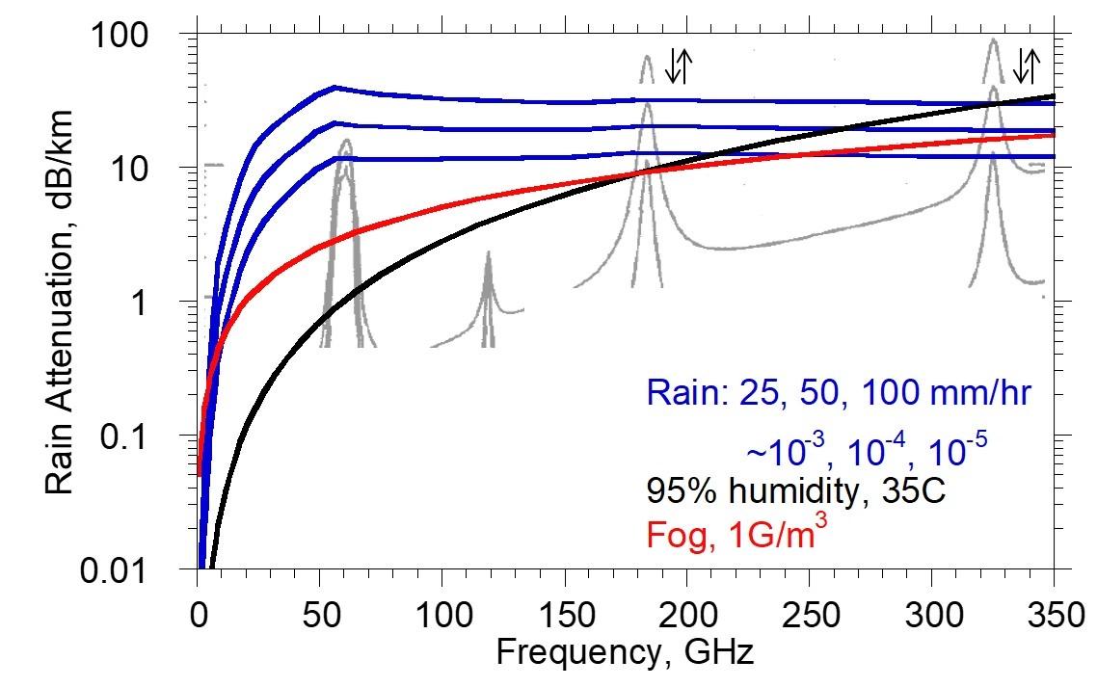
Atmospheric Attenuation: Implications
Worst-case attenuation: ~constant over 50-250 GHz.
10⁻⁵ outage rate: equal losses over 50-300 GHz
10⁻³ outage rate: equal losses over 50-200 GHz
Hardware favors lower frequencies
Propagation environment is similar for 50-250GHz links
...but don't forget λ²/R² term !
Exclusive use of VLSI Si processes would force use of ~ < 180GHz

Slide 16
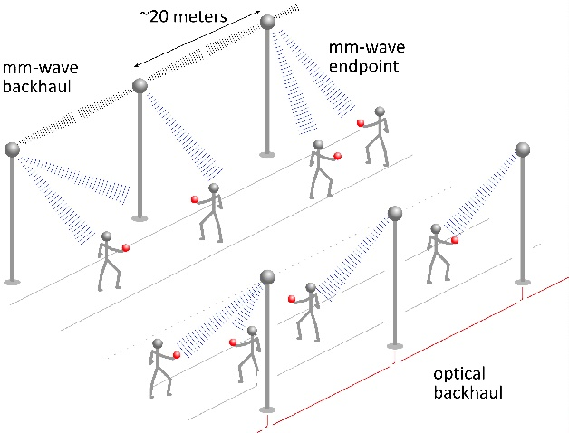
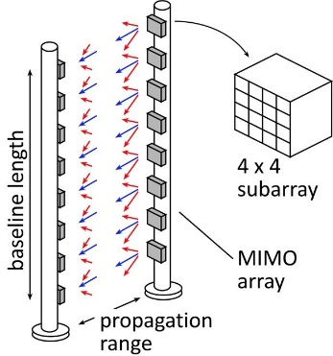
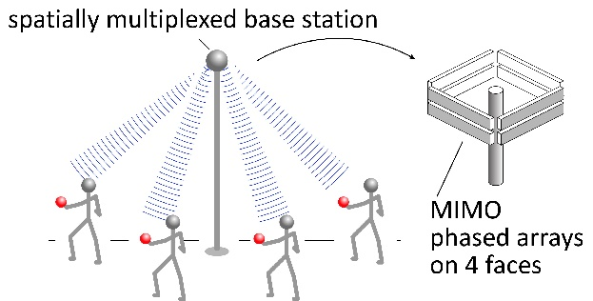
140-340 GHz:
Possible Systems

Slide 17
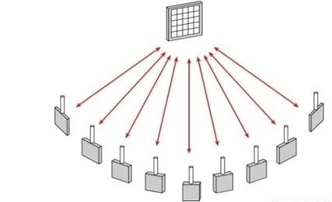
Spatial Multiplexing: massive capacity RF networks
multiple independent beams
each carrying different data
each independently aimed
# beams approaches # array elements
small: 1000 elements @220 GHz=3 square inches
Hardware: multi-beam phased array ICs

Slide 18
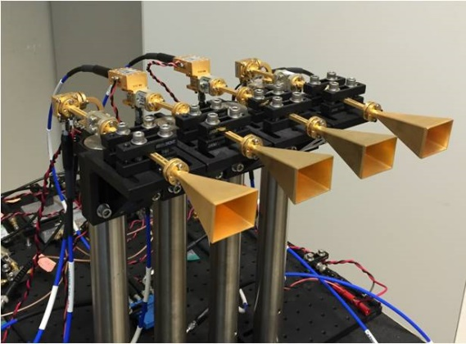
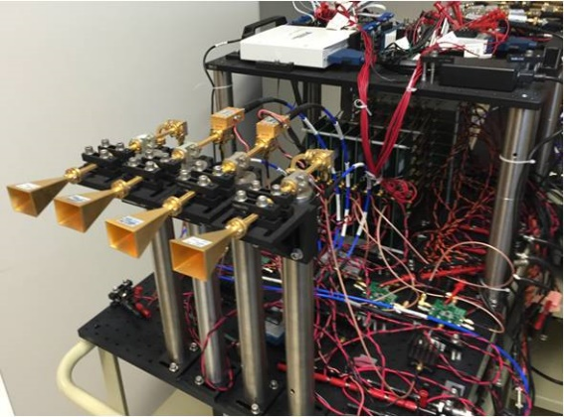
mm-Wave LOS MIMO: multi-channel for high capacity
Massive capacity wireless; physically small
Torklinson : 2006 Allerton Conference
Sheldon : 2010 IEEE APS-URSI
Torklinson : 2011 IEEE Trans Wireless Comm.

Slide 19

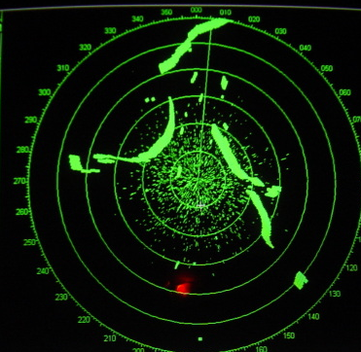

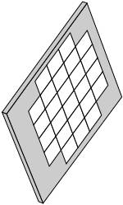
mm-wave imaging: TV-like resolution, small array
mm-waves → high resolution from small antenna apertures
What you see in fog
What 10GHz radar shows
What you want to see
goal: ~0.2º resolution, 10³-10⁶ pixels
NxN phased array
D
angular resolution = λ /D (radians)
340 GHz, 35 cm/14 inch aperture → 0.14 degree resolution
HDTV-like resolution, fits on car, plane, UAV
D

Slide 20
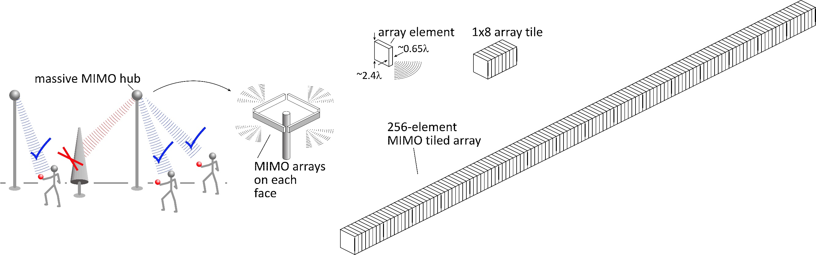
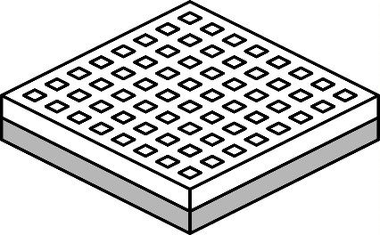
140 GHz spatially multiplexed base station
1 Tb/s spatially-multiplexed base station
256 users/face, 4 faces
1024 total users @ 1 user/beam, 1 Gb/s/beam;
225 m range
Handset:
8 × 8 array
(9×9mm)
Link budget is feasible, but...
Required component dynamic range ?
Required complexity of back-end beamformer ?

Slide 21
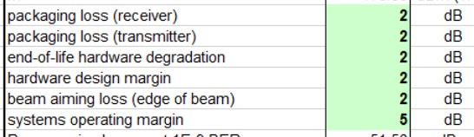
140 GHz spatially multiplexed base station
Each face supports 256 beams @ 1Gb/s/beam.
225 meters range in 50 mm/hr rain
Realistic packaging loss, operating & design margins (20dB total)
PAs: 16 dBm P_{out} (per element)
LNAs: 3 dB noise figure

Slide 22
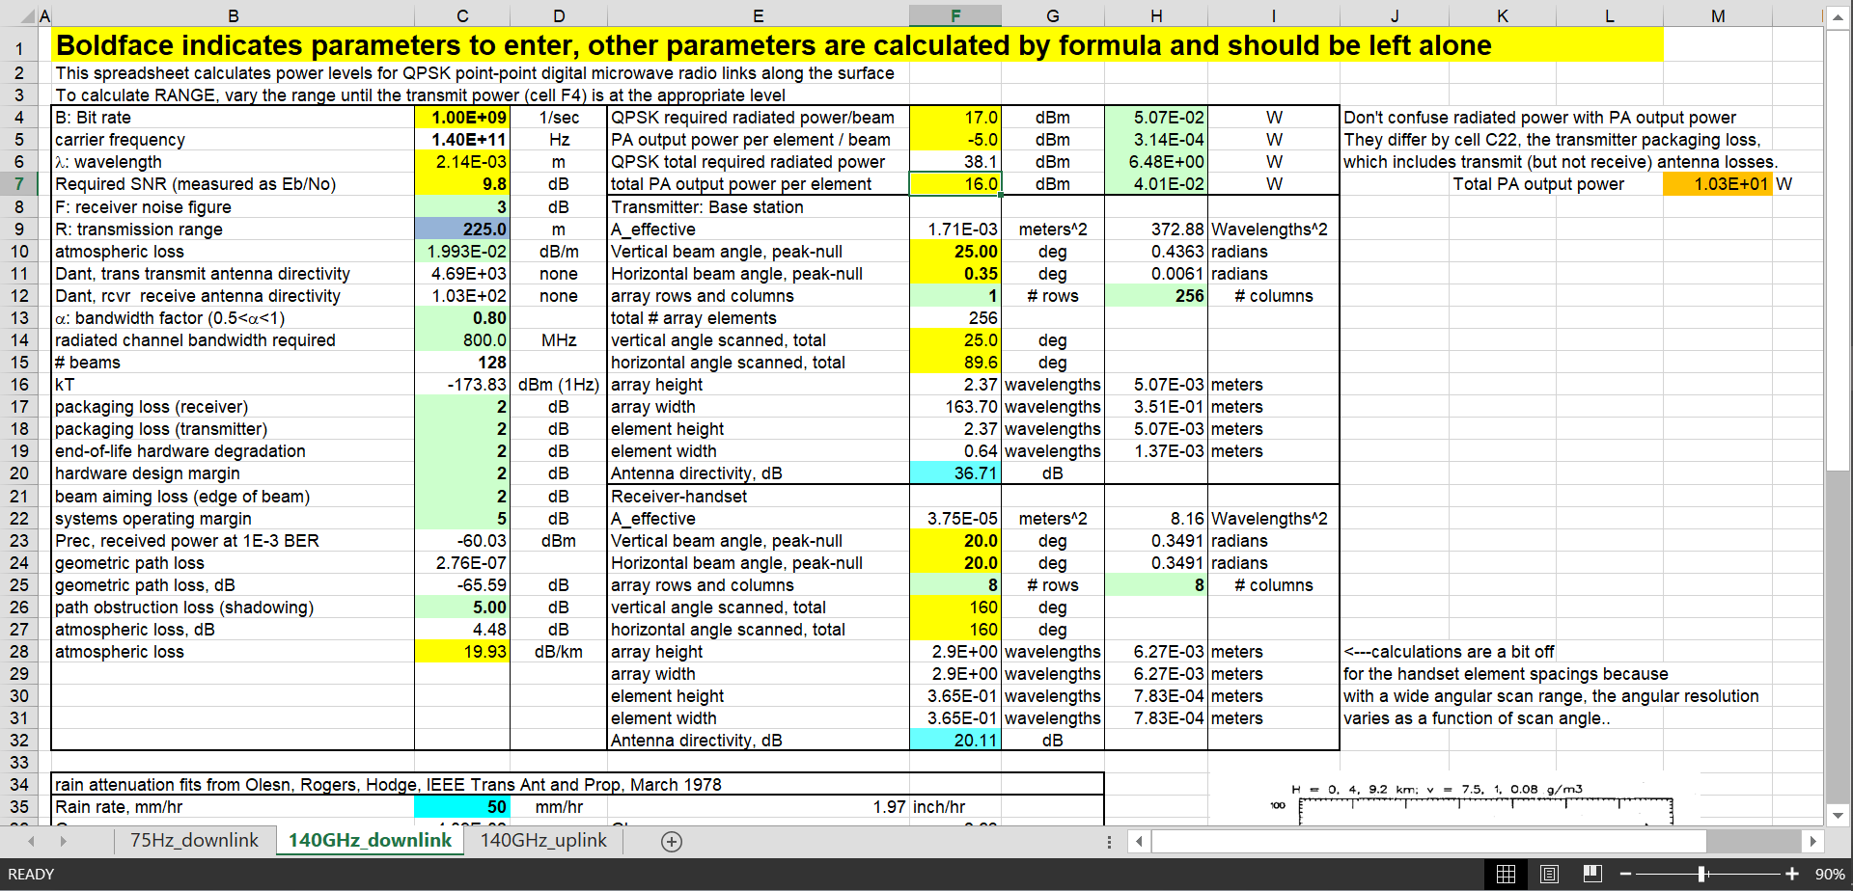
140 GHz spatially multiplexed base station

Slide 23
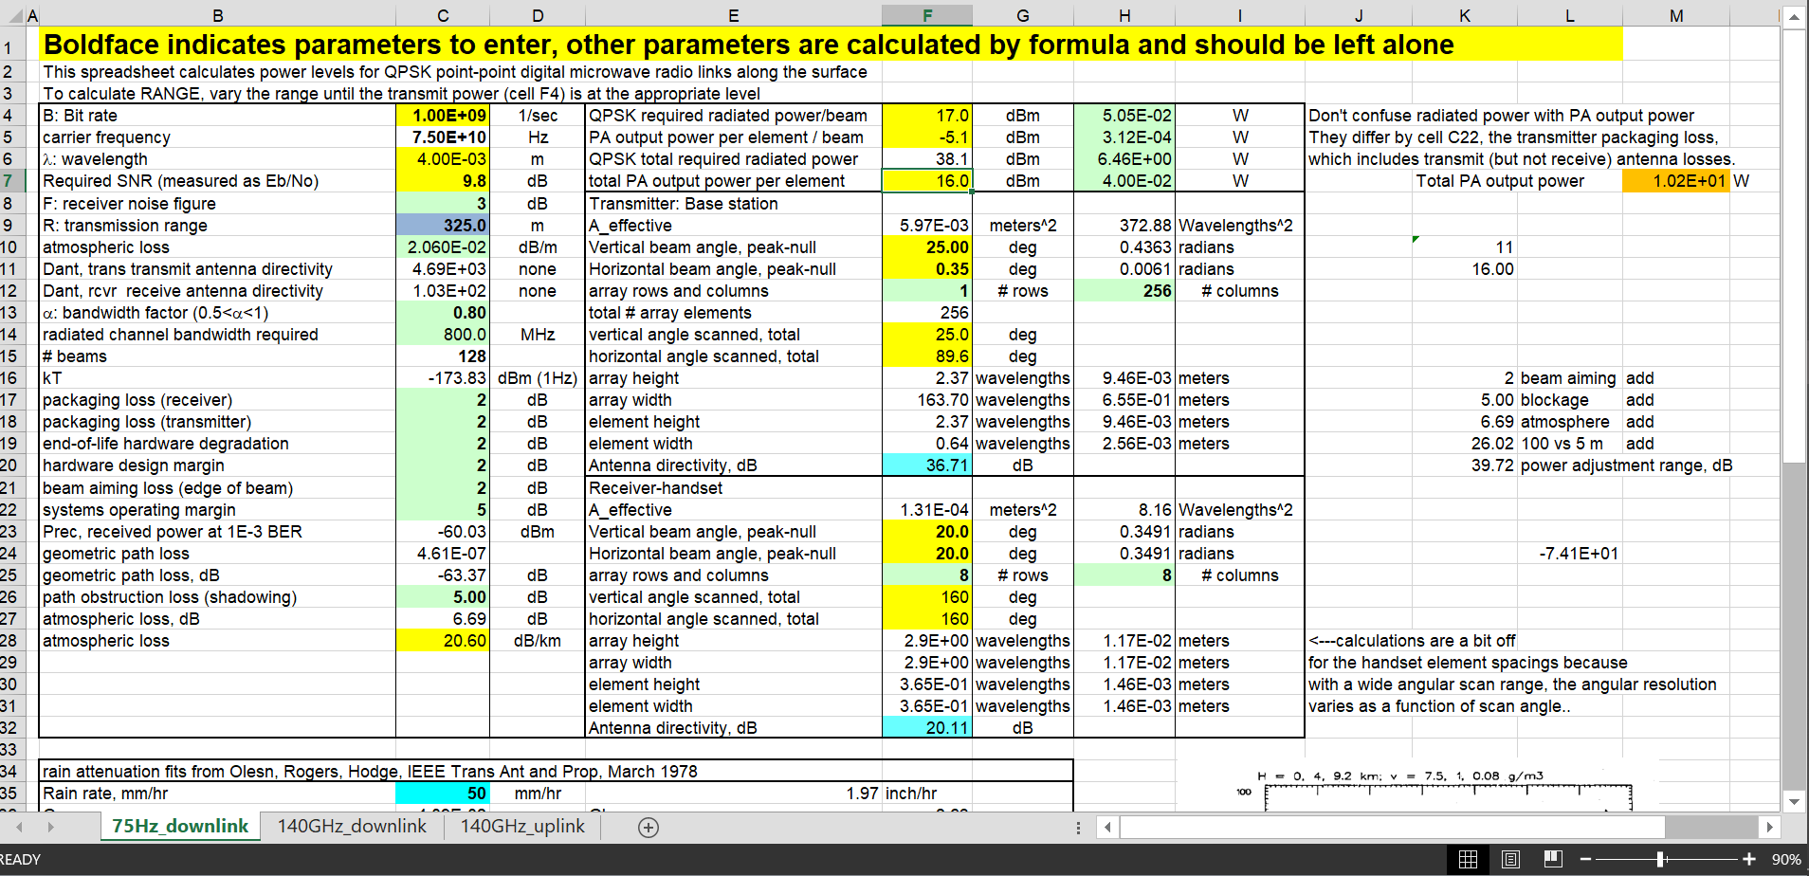
75 GHz spatially multiplexed base station
If we use instead a 75GHz carrier,
the range increases to 325 meters (vs. 250 meters)
but the handset becomes 16mm×16mm (vs. 9mm×9mm),
and the hub array becomes 9mm×655mm (vs. 5mm×350mm)
Or, use a 4×4 (8mm×8mm) handset array,
and the range becomes 210 meters.

Slide 24
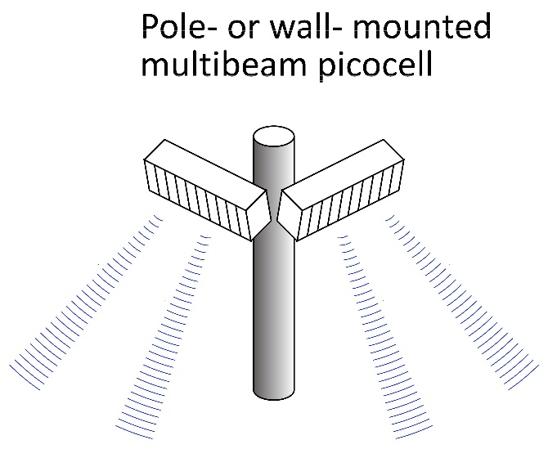
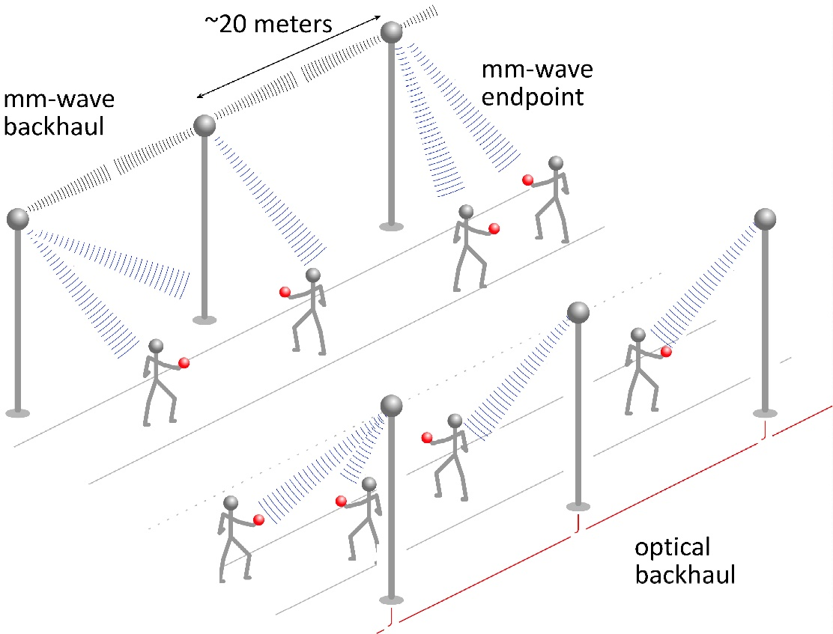
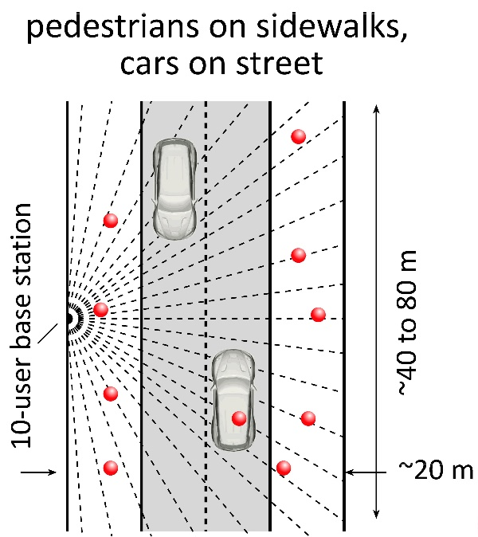
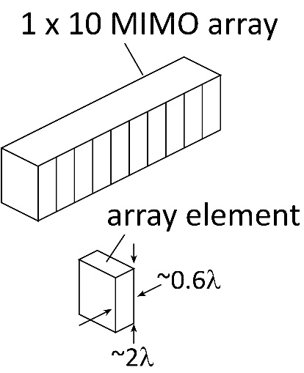
75GHz or 140GHz spatially multiplexed femtocells

Slide 25
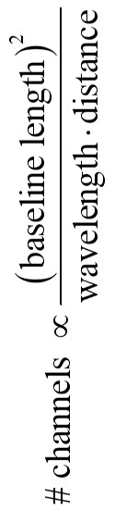
340 GHz (or even 650 GHz) backhaul
linear array
square array
Sub-mm-wave line-of-sight MIMO network backbone
wireless @ optical speed; link network where fiber is too expensive to place.
340 GHz: 640Gb/s @ 500 meters range; 1.6 meter linear array (5Tb/s for 8×8 square array).
650 GHz: 1.28Tb/s @ 500 meter range; 1.6 meter linear array.
Capacity doubles again if we use both polarizations.

Slide 26
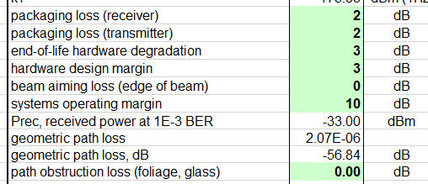
340 GHz 640 Gb/s MIMO backhaul
1.6m MIMO array: 8-elements, each 80 Gb/s QPSK; 640Gb/s total
4 × 4 sub-arrays → 8 degree beamsteering
500 meters range in 50 mm/hr rain; 29 dB/km
Realistic packaging loss, operating & design margins
PAs: 82mW P_{out} (per element)
LNAs: 4 dB noise figure

Slide 27
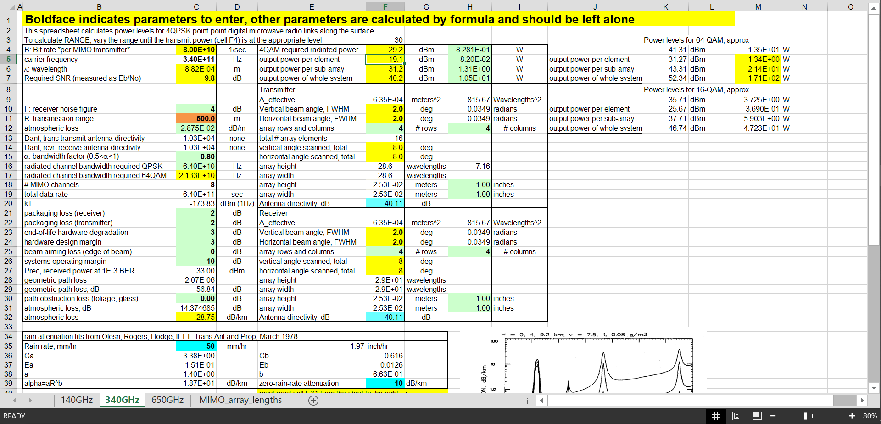
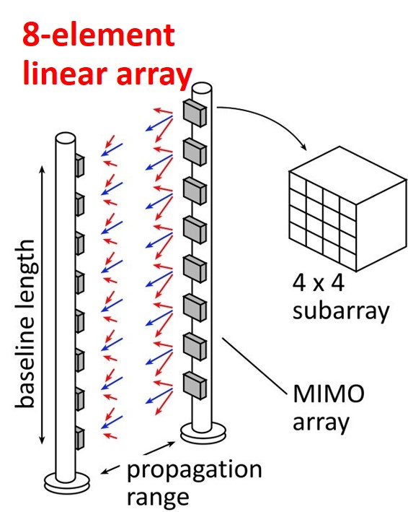
340 GHz 640 Gb/s MIMO backhaul

Slide 28
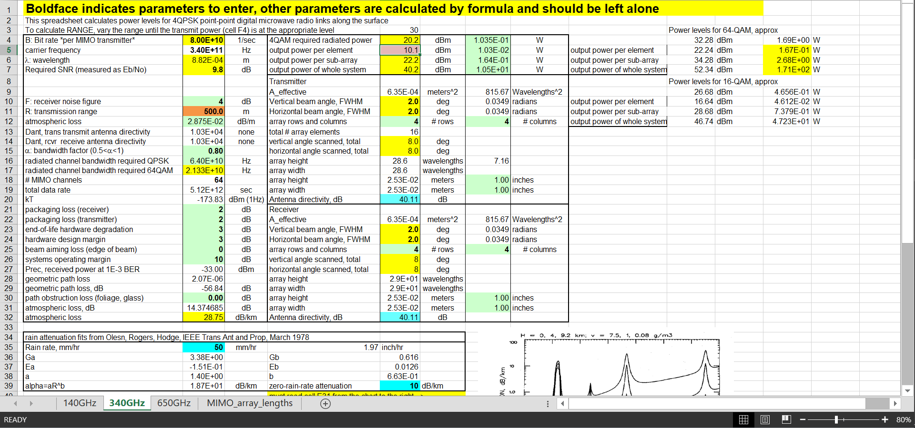
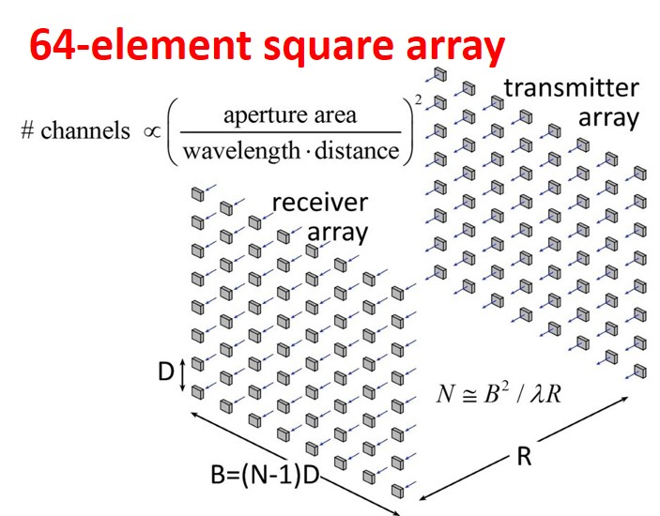
340 GHz 5 Tb/s MIMO backhaul
requires 10mW output per element
...10W total radiated power

Slide 29
140 GHz, 640 Gb/s MIMO backhaul
Why not use a lower-frequency carrier, e.g. 140 GHz ?
8-element 640Gb/s linear array:
same link assumptions
requires 2mW (vs. 80mW) power/element
requires 2.6m (vs. 1.6m) linear array
8-element 5Tb/s square array:
same link assumptions
requires 0.25mW (vs. 10mW) power/element
requires 2.6m (vs. 1.6m) square array

Slide 30



340 GHz frequency-scanned imaging car radar
Imaging for cars, aircraft
drive safely @ 65MPH in heavy fog
fly in heavy dust/fog/smoke
Short wavelengths:
HDTV-resolution imaging,
small: helicopter, drone, car
The challenge: complexity
standard array: # pixels = # RF channels
HDTV image: ~2×10⁶ pixels.
Need 2×10⁶ RF channels !
Hardware-efficient imaging
# RF channels << # pixels
several techniques

Slide 31
340 GHz frequency-scanned imaging car radar
See a soccer ball at 300 meters in heavy fog
(10 seconds warning @ 100 km/hr.)
(5 dB SNR, 35 dB/km, 30cm diameter target, 10% reflectivity)
Image refresh rate: 60 Hz
Resolution 64×512 pixels
Angular resolution: 0.14 degrees
Angular field of view: 9 by 73 degrees
Aperture: 35 cm by 35 cm
Component requirements:
44 mW peak power/element,
3% pulse duty factor
6 dB noise figure,
3 dB package losses (each: trx, rcvr)
5 dB manufacturing/aging margin

Slide 32

340 GHz frequency-scanned imaging car radar

Slide 33

mm-wave imaging with crossed linear arrays
Established approach.
Transmitter illuminates vertical stripe. Receiver detects horizontal stripe.
Requires 1×N arrays to form N×N image.
N²:1 SNR degradation with single-beam receiver
Only 1/N of transmitter power is detected
Receiver directivity is N:1 smaller than if focused on one image pixel
N¹:1 SNR degradation with multi-beam receiver
Receiver detects all transmitter power
Receiver directivity is N:1 smaller than if focused on one image pixel

Slide 34



Transistors

Slide 35



mm-Wave Wireless Transceiver Architecture
custom PAs, LNAs → power, efficiency, noise
Si CMOS beamformer→ integration scale
...similar to today's cell phones.

Slide 36


IC Technologies for 100 + GHz systems
Silicon
baseband processing at all frequencies
RF sections @ 140, 200GHz
PAs, LNAs in short-range 140, 220 GHz links
GaN
high-power amplifiers in long-range 140,220GHz links
(possibly 340GHz ?)
InP HEMT
low-noise amplifiers in long-range 140,220GHz links
low-noise amplifiers @ 340, 650GHz
InP HBT
medium-power amplifiers in long-range 140,220GHz links
power amplifiers @340, 650GHz
RF sections @ 340, 650GHz
MIMO hub:
140GHz: F= 4dB, P_{avg}=17.5dBm, P_{sat}≅21.5dBm
220GHz: F= 4dB, P_{avg}=21dBm, P_{sat}≅25dBm
Point-point MIMO:
340GHz: F= 4dB, P_{avg}=9.9dBm, P_{sat}≅13.9dBm
650GHz: F= 4dB, P_{avg}=14.5dBm, P_{sat}≅18.5dBm?

Slide 37




mm-wave CMOS (UCSB examples)
150 GHz amplifier:
IBM 65 nm bulk CMOS, 2.7dB gain per stage Seo et al., JSSC, Dec. 2009
145 GHz amplifier
GF 45 nm SOI CMOS, 6.3 dB gain per stage Kim, Simseck, 2017 BCICTS

Slide 38



140GHz MIMO transceiver front-end ICs
S. Lee, A. Simseck, UCSB, 2018 BCICTS, to be presented

Slide 39


mm-Wave CMOS won't scale much further
Gate dielectric can't be thinned
→ on-current, g_{m} can't increase
Shorter gates give no less capacitance
dominated by ends; ~1fF/μm total
Maximum g_{m}, minimum C→ upper limit on f_{τ}.
about 350-400 GHz.
Tungsten via resistances reduce the gain
Inac et al, CSICS 2011
Present finFETs have yet larger end capacitances

Slide 40





III-V high-power transmitters, low-noise receivers
Cell phones & WiFi: GaAs PAs, LNAs
mm-wave links need:
high transmit power, low receiver noise
0.47 W @86GHz
H Park, UCSB, IMS 2014
0.18 W @220GHz
T Reed, UCSB, CSICS 2013
1.9mW @585GHz
M Seo, TSC, IMS 2013

Slide 41

Gallium Nitride Power Technologies
GaN is the leading high-frequency power technology
N-polar GaN: Mishra

Slide 42



130nm / 1.1THz InP HBT Technology
Teledyne: M. Urteaga et al: 2011 DRC
Rode (UCSB), IEEE TED, 2015
3.5 V breakdown

Slide 43



130nm / 1.1THz InP HBT: IC Examples
220 GHz 0.18W power amplifier
325 GHz, 16mW power amplifier
UCSB/Teledyne: T. Reed et al: 2013 CSICS
UCSB/Teledyne: A. Ahmed, 2018 EuMIC Symp.
Integrated ~600GHz transmitter
Teledyne: M. Urteaga et al: 2017 IEEE Proceedings
but, only ~1 mW output power

Slide 44












Transistor scaling laws: ( V,I,R,C,τ ) vs. geometry
Depletion Layers
Bulk and
Contact Resistances
Fringing Capacitances
Thermal Resistance
Available quantum states to carry current
→ capacitance,
transconductance
contact resistance

Slide 45

Frequency Limits and Scaling Laws of (most) Electron Devices
PIN photodiode
To double bandwidth:
Reduce thicknesses 2:1
Improve contacts 4:1
Reduce width 4:1,
Keep constant length
Increase current density 4:1

Slide 46
Bipolar Transistor Design

Slide 47
Bipolar Transistor Design: Scaling

Slide 48

Why InP Bipolar Transistors ?
InP: better electron transport than Si
higher electron velocity: 3.5 vs 1.0 × 10⁷ cm/s
plus wider bandgap→ higher breakdown field
InGaAs base, base-emitter heterojunction:
very low base sheet resistance
Implications:
Higher (f_{τ}, f_{max}) at a given scaling node
Higher breakdown* at a given (f_{τ}, f_{max})
*Breakdown is too complicated to summarize with BVCEO.
BVCBO vs. BVCEO vs. safe operating area ?
Bottom line: look at V_{ce} used in published IC data for a given IC technology.

Slide 49

Making faster bipolar transistors
to double the bandwidth: | change
emitter & collector junction widths | decrease 4:1
current density (mA/μm²) | increase 4:1
current density (mA/μm) | constant
collector depletion thickness | decrease 2:1
base thickness | decrease 1.4:1
emitter & base contact resistivities | decrease 4:1
Teledyne: M. Urteaga et al: 2011 DRC
Narrow junctions.
Thin layers
High current density
Ultra low resistivity contacts

Slide 50
Refractory Ohmic Contacts to In(Ga)As
Baraskar et al, Journal of Applied Physics, 2013
32 nm (2.8THz) node
requirements
Refractory: robust under high-current operation / Low penetration depth: ~ 1 nm
Why no ~2THz HBTs today? Problem: reproducing these base contacts in full HBT process flow

Slide 51

THz HBTs: The key challenges
Obtaining good base contacts
in HBT vs. in contact test structure
(emitter contacts are fine)
RC parasitics along finger length
metal resistance, excess junction areas
Baraskar et al, Journal of Applied Physics, 2013

Slide 52


InP HBTs: 1.07 THz @200nm, ?? @ 130nm
?
Rode et al., IEEE TED, Aug. 2015

Slide 53








130nm /1.1 THz InP HBT ICs to 670 GHz
614 GHz
fundamental
VCO
340 GHz dynamic frequency divider
M. Seo, TSC / UCSB
M. Seo, UCSB/TSC
IMS 2010
300 GHz fundamental
PLL
620 GHz, 20 dB gain amplifier
M Seo, TSC
IMS 2013
also: 670GHz amplifier
J. Hacker , TSC
IMS 2013 (not shown)
M. Seo, TSC
IMS 2011
204 GHz static
frequency divider
(ECL master-slave
latch)
220 GHz
180 mW
power amplifier
81 GHz
470 mW
power amplifier
Z. Griffith, TSC / UCSB
CSIC 2010
T. Reed, UCSB
CSICS 2013
H-C Park UCSB
IMS 2014
Integrated 300/350GHz Receivers:
LNA/Mixer/VCO
600 GHz
Integrated
Transmitter
PLL + Mixer
M. Seo TSC
M. Seo TSC

Slide 54
Towards a 2 THz SiGe Bipolar Transistor
Similar scaling
InP: 3:1 higher collector velocity
SiGe: good contacts, buried oxides
Key distinction: Breakdown
InP has:
thicker collector at same f_{τ},
wider collector bandgap
Key requirements:
low resistivity Ohmic contacts
note the high current densities
 | InP | SiGe
emitter
junction width | 64 | 18 | nm
access resistivity | 2 | 0.6 | Ω−μm²
base
contact width | 64 | 18 | nm
contact resistivity | 2.5 | 0.7 | Ω−μm²
collector
thickness | 53 | 15 | nm
current density | 36 | 125 | mA/μm²
breakdown | 2.75 | 1.3? | V
f_{τ} | 1000 | 1000 | GHz
f_{max} | 2000 | 2000 | GHz
Assumes collector junction 3:1 wider than emitter.
Assumes SiGe contacts no wider than junctions

Slide 55




Towards the 2 THz / 64nm Node: 1st step = scaling
Narrow junctions.
Thin semiconductor layers
High current density
Ultra low resistivity contacts
Initial DC data with 90nm devices
Yihao Fang, UCSB, submitted to DRC 2018

Slide 56
FETs (HEMTs): key for low noise
2:1 to 4:1 increase in f_{τ} :
improved noise
less required transmit power
smaller PAs, less DC power
or higher-frequency systems

Slide 57


InP HEMTs: state of the art
First Demonstration of Amplification at 1 THz Using
25-nm InP High Electron Mobility Transistor Process
Xiaobing Mei, et al, IEEE EDL, April 2015 (Northrop-Grumman)

Slide 58


FET Scaling Laws (these now broken)
FET parameter | change
gate length | decrease 2:1
current density (mA/mm) | increase 2:1
specific transconductance (mS/mm) | increase 2:1
transport mass | constant
2DEG electron density | increase 2:1
gate-channel capacitance density | increase 2:1
dielectric equivalent thickness | decrease 2:1
channel thickness | decrease 2:1
channel state density | increase 2:1
contact resistivities | decrease 4:1

Slide 59


FET Scaling Laws (these now broken)
FET parameter | change
gate length | decrease 2:1
current density (mA/mm) | increase 2:1
specific transconductance (mS/mm) | increase 2:1
transport mass | constant
2DEG electron density | increase 2:1
gate-channel capacitance density | increase 2:1
dielectric equivalent thickness | decrease 2:1
channel thickness | decrease 2:1
channel state density | increase 2:1
contact resistivities | decrease 4:1
Gate dielectric can't be much further scaled.
Not in CMOS VLSI, not in mm-wave HEMTs
g_{m}/W_{g} (mS/μm) hard to increase→ C_{end} / g_{m} prevents f_{τ} scaling.
Shorter gate lengths degrade electrostatics→ reduced g_{m} /G_{ds} → reduced f_{max} , f_{τ}

Slide 60

Towards faster HEMTs
Scaling limit: gate insulator thickness
HEMT: InAlAs barrier: tunneling, thermionic leakage
solution: replace InAlAs with high-K dielectric
2nm ZrO₂ (ε_{r}=25): adequately low leakage
Scaling limit: source access resistance
HEMT: InAlAs barrier is under N+ source/drain
solution: regrowth, place N+ layer on InAs channel
Target ~10nm node
~0.3nm EOT, 3nm thick channel
1.2 to 1.5 THz f_{τ}.

Slide 61



Towards faster HEMTs: 1st results
Jun Wu, UCSB, IEEE EDL, 2018
Double regrowth
modulation-doped access regions
N+ contacts
High-K gate dielectric
3 nm ZrO2.
Highly scaled
5nm InAs channel
10-30nm gate lengths
Things to fix
S/D contacts too far from gate
widegap barrier under N+ S/D
gate too wide: landed partly on access regions

Slide 62


Towards faster HEMTs: next step
Jun Wu, UCSB, Unpublished
Revised process: no N- material between channel and contacts
reduced source/drain access resistance
Revised process: sacrificial layer
reduces parasitic gate-channel overlap: less gate-source capacitance
Thinner gate dielectric (2nm ZrO₂), thinner channel (3nm InAs)
higher g_{m} , lower g_{ds}

Slide 63

ICs

Slide 64
mm-Wave IC design: the challenges
Transistor gains are low: f_{signal} is significant fraction of f_{max}.
usually must match for optimum gain, noise, or power.
(Transistor, resistor, capacitor) dimensions are a significant fraction of a wavelength
Even short lengths of random wiring add serious inductance and/or capacitance
Transmission-line losses are high
low Q in VCO resonators and filters
high combining losses in PAs: low power, low efficiency
several dB added noise in LNAs.
First consider the IC wiring stack
(the next 5-6 slides are very old, predate modern mm-wave CMOS)

Slide 65
III-V MIMIC Interconnects: Classic Substrate Microstrip
W
Zero ground
inductance
in package
Thick Substrate
→ low skin loss
No ground plane
breaks in IC
H
k_{z}
High via inductance
TM substrate
mode coupling
12 pH for 100 μm substrate -- 7.5 Ω @ 100 GHz
Strong coupling when substrate approaches ~λ_{d} / 4 thickness
lines must be
widely spaced
ground vias must be
widely spaced
Line spacings must be
~3*(substrate thickness)
all factors require very thin substrates for >100 GHz ICs
→ lapping to ~50 μm substrate thickness typical for 100+ GHz

Slide 66




Coplanar Waveguide
No ground vias
No need (???) to thin substrate
Hard to ground IC
to package
+V
+V
+V
0V
Parasitic microstrip mode
ground plane breaks → loss of ground integrity
substrate mode coupling
or substrate losses
III-V:
semi-insulating substrate→ substrate mode coupling
Silicon
conducting substrate
→ substrate conductivity losses
k_{z}
-V
0V
+V
0V
Parasitic slot mode
Repairing ground plane with ground straps is effective only in simple ICs
In more complex CPW ICs, ground plane rapidly vanishes
→ common-lead inductance → strong circuit-circuit coupling
poor ground integrity
loss of impedance control
ground bounce
coupling, EMI, oscillation
40 Gb/s differential TWA modulator driver
note CPW lines, fragmented ground plane
35 GHz master-slave latch in CPW
note fragmented ground plane
175 GHz tuned amplifier in CPW
note fragmented ground plane

Slide 67
If It Has Breaks, It Is Not A Ground Plane !
signal line
signal line
ground plane
coupling / EMI due to poor ground system integrity is common in high-frequency systems
whether on PC boards
...or on ICs.

Slide 68


No clean ground return ? → interconnects hard to model
35 GHz static divider
interconnects have no clear local ground return
interconnect inductance is non-local
interconnect inductance has no compact model
8 GHz clock-rate delta-sigma ADC
thin-film microstrip wiring
every interconnect can be modeled as microstrip
some interconnects are terminated in their Zo
some interconnects are not terminated
...but ALL are precisely modeled
InP 8 GHz clock rate delta-sigma ADC

Slide 69


III-V MIMIC Interconnects: Thin-Film Microstrip
narrow line spacing → IC density
no substrate radiation, no substrate losses
fewer breaks in ground plane than CPW
... but ground breaks at device placements
still have problem with package grounding
InP 34 GHz PA
(Jon Hacker , Teledyne)
...need to flip-chip bond
W
thin dielectrics → narrow lines
→ high line losses
→ low current capability
→ no high-Z_{o} lines
H

Slide 70



III-V MIMIC Interconnects: Inverted Thin-Film Microstrip
narrow line spacing → IC density
Some substrate radiation / substrate losses
No breaks in ground plane
... no ground breaks at device placements
still have problem with package grounding
InP 150 GHz master-slave latch
...need to flip-chip bond
thin dielectrics → narrow lines
→ high line losses
→ low current capability
→ no high-Z_{o} lines
InP 8 GHz clock rate delta-sigma ADC

Slide 71

VLSI mm-wave interconnects with ground integrity
narrow line spacing → IC density
no substrate radiation, no substrate losses
negligible breaks in ground plane
negligible ground breaks @ device placements
Also:
Ground plane at *intermediate level* permits
critical signal paths to cross supply lines, or other
interconnects without coupling.
(critical signal line is placed above ground,
other lines and supplies are placed below ground)
still have problem with package grounding
...need to flip-chip bond
thin dielectrics → narrow lines
→ high line losses
→ low current capability
→ no high-Z_{o} lines

Slide 72


ICs in Thin-Film (Not Inverted) Microstrip
Note breaks in ground plane at transistors, resistors, capacitors
Interconnects within these breaks will be more difficult to model.

Slide 73

ICs in Thin-Film Inverted Microstrip
100 GHz differential TASTIS Amp. 512nm InP HBT

Slide 74


ICs in Thin-Film Inverted Microstrip
205 GHz divider, Griffith et al, IEEE CSIC, Oct. 2010
8:1, 205 GHz static divider in 256 nm InP HBT. Image taken before top metal (ground plane) deposition

Slide 75



High Speed ECL Design: transmission-lines
Followers associated with inputs, not outputs
Emitters never drive long wires.
(instability with capacitive load)
Double termination for least ringing,
send or receive termination for moderate-length lines,
high-Z loading saves power but kills speed.

Slide 76


Power supply problems
local resonances between bypass cap and supply interconnects
global LC standing-wave resonances on supply bus
Detuning of individual stages
Coupling, feedback via supply→ oscillation, loss of path isolation

Slide 77

Power supply problems
The supply impedance will
detune individual stages.

Slide 78

Power supply problems
Model the supply in all simulations.
"If it is on the {IC, PCB, probe station}, put it in the simulation."
Here, the supply is terminated by 50 Ohms through a bias T.
This avoids resonances.
More generally, we must simulate system
for wide range of external supply impedance.

Slide 79


Differential mm-wave stages
Common-emitter
Common-base
M. Seo, Teledyne
M. Seo, 2013 IMS
Virtual ground→ avoids ground via inductance ✓
Avoids power-supply coupling ✓
Potential problems with common mode ✘

Slide 80



Pseudo-Differential Stages

Slide 81

RF-IC Design: Simple & Well-Known Procedures
1: (over)stabilize at the design frequency
guided by stability circles
2: Tune input for F_{min} (LNAs) or output for P_{sat} (PAs)
3: Tune remaining port for maximum gain
4: Add out-of-band stabilization.
This seems simple: so where are the challenges ?

Slide 82
mm-Wave IC design: the challenges
Transistor gains are low: f_{signal} is significant fraction of f_{max}.
usually must match for optimum gain, noise, or power.
(Transistor, resistor, capacitor) dimensions are a significant fraction of a wavelength
Even short lengths of random wiring add serious inductance and/or capacitance
Transmission-line losses are high
low Q in VCO resonators and filters
high combining losses in PAs: low power, low efficiency
several dB added noise in LNAs.

Slide 83




Multi-finger transistor cell layout

Slide 84


Sub-mm-wave PAs: need more current
3 μm max emitter length (> 1 THz f_{max})
2 mA/μm max current density: I_{max}= 6 mA
Maximum 3 Volt p-p output
Load: 3V/6mA= 500 Ω
Combiner cannot provide 500 Ω loading

Slide 85

mm-wave PAs: need more current
InP HBTs:
thinner collector→ more current
hotter→ improve heat-sinking
or: longer emitters→ thicker base metal
GaN HEMTs:
much higher voltage
100+ GHz: large multi-finger FETs not feasible
Need high current to exploit high voltage.
Example:
2mA/μm, 100 μm max gate width, 50 Volts
200mA maximum current
50 Volts/200mA= 250 Ω load→ unrealizable.
Need more mA/μm or longer fingers

Slide 86


4:1 series-connected 81GHz power amplifier
Park et al., 2014 IEEE-IMS
17 dB Gain, 470 mW P_{sat} , 23% PAE
Teledyne 250 nm InP HBT, 2 stages, 1.0 mm²(incl pads)

Slide 87


90 mW, 220 GHz Power Amplifier
active area, 1.02 x 0.85 mm
die: 2.42 x 1.22 mm
Reed (UCSB) and Griffith (Teledyne): CSIC 2012. Teledyne 250 nm InP HBT

Slide 88




214 GHz, 180mW Power Amplifier (330 mW design)
2.3 mm x 2.5 mm
T. Reed, Z. Griffith, 2014 CSICS http://ieeexplore.ieee.org/xpls/abs_all.jsp?arnumber=6659187&tag=1

Slide 89




220GHz PA Design; in development
Technology: 250nm InP HBT
Combining techniques investigated:
  - Series, Balun, Wilkinson
  - Branched λ/4 network ✓
Unit cells investigated
  - CE, Cascode
  - CB with grounded base
  - CB with optimized base impedance
8 to 1 combiner
ONLY 0.7dB loss
Technology | 250-nm InP HBT
Freq, GHz | 205
#cells | 8
VCC, V | 2.25
J_{bias},mA/um | 1.33
S21, dB | 15.9
P_{out} ,dB_{m} | 17.8*, 20.7**
PAE % | 6.8*,12.9**
BW_{3dB}, GHz | 35
area, µm$×$µm | 750×717
*at 1dB compression, **at 2dB
S21
Max P_{sat}
Gain
Linearity
P_{out}
Gain
S22
Unit cell
PAE
S11

Slide 90




370 GHz dynamic divider

Slide 91






570 GHz oscillator

Slide 92




326 GHz series-connected PA
16mW Psat; 1.3% PAE, 16.6dB gain
A. Ahmed, 2018 BCICTS

Slide 93


Systems & Packages

Slide 94

Beamforming for massive spatial multiplexing
Pure digital beamforming:
dynamic range & phase noise requirements: both appear to be manageable ✓✓✓
Digital back-end processing requirements (die area, DC power): being investigated ???
Pure RF beamforming: (focal plane, Butler matrixes, RF beamforming)
Established approach in DOD systems (high dynamic range). Issues of array tiling.

Slide 95

Large arrays formed from small tile models
Point-point MIMO, MIMO hub, imaging
all require relative large arrays
Modular assembly
large array formed from many small tiles

Slide 96



The mm-wave module design problem
How to make the IC electronics fit ?
100+ GHz arrays: λ₀/2 element spacing is very small.
Antennas on or above IC → IC channel spacing = antenna spacing
→ limited IC area to place circuits
How to avoid catastrophic signal distribution losses ?
long-range, high-gain arrays: array size can be large.
ICs beside array → very long wires between beam former and antenna
→ potential for very high signal distribution losses
How to remove the heat ?
100+ GHz arrays: element spacing is very small.
If antenna spacing = IC channel spacing, then power density is very large

Slide 97


mm-wave/sub-mm-wave packaging
Not all systems steer in two planes...
...some steer in only one.
Not all systems steer over 180 degrees...
...some steer a smaller angular range
Arrays can often be linear (1D), instead of rectangular (2D)
Element spacing can often be greater than λ/2.
→ Array packaging then greatly simplified.

Slide 98

Background: split-block waveguides
Waveguides are manufactured (milled or die cast) from a set of pieces
Precision pins aid alignment

Slide 99


Concept: Tile for mm-wave arrays
Split-block assembly. Modules tile into larger array
IC area can be much larger than antenna area→ electronics can fit
Low-loss waveguide feeds, efficient waveguide horn antennas
Efficient heat-sinking: permits W-level GaN, InP, SiGe PAs for long range

Slide 100


Concept: Tile for linear arrays
Terrestrial system: horizontal steering only→ linear array.
Space at edges of linear array: room for III-V PAs, LNAs.
Alternating-sides feed: 2mm pitch→ room for large GaN PAs.
Mounting directly on metal carrier→ heatsinking.

Slide 101

Concept: module for small angular scanning
Terrestrial system: horizontal + vertical steering → rectangular array.
Limited angular steering range (installation)→ spacing >> λ/2
Endfire / edge-card geometry: room for III-V PAs, LNAs.
Mounting directly on metal carrier→ heatsinking.
If Vivaldi's are replaced with dipoles, element spacing can be reduced to λ/2.
→ potential for wider angular scanning

Slide 102

Concept: module for handset
Handset transceiver performance: less challenging.
No external III-V PAs, LNAs
Handset transceiver is simpler: single-beam, not spatially multiplexed
Smaller die area→ array pixel fits in λ/2 × λ/2
Vertical integration of antenna on low-ε_{r} superstrate.
fused Silica (Rebeiz)
possibly also: spin-cast BCB or polyimide, post-process.

Slide 103


Wireless above 100GHz

Slide 104
Wireless above 100 GHz
Massive capacities
large available bandwidths
massive spatial multiplexing in base stations and point-point links
Very short range: few 100 meters
short wavelength, high atmospheric losses. Easily-blocked beams.
IC Technology
All-silicon for short ranges below 250 GHz.
III-V LNAs and PAs for longer-range links. Just like cell phones today
III-V frequency extenders for 340GHz and beyond
The challenges
spatial multiplexing: computational complexity, dynamic range
packaging: fitting signal channels in very small areas

