Slide 1
Transistors: mm-Wave and Low-Power VLSI
Plenary, Compound Semiconductor Week, May 29th, 2018 - June 1st, 2018, MIT
Mark Rodwell, UCSB
Low-voltage devices
B. Markman, H.-Y. Tseng, S. Brunelli, S. Choi, A. Goswani, C. Palmstrøm, J. Klamkin: UCSB
P. Long, J. Huang, E. Wilson, S. Mehrotra, C.Y.-Chen, M. Povolotskyi, G. Klimeck: Purdue
InP HBT:
Y. Fang, J. Rode*: UCSB
InP MOS-HEMT
J. Wu: UCSB
Millimeter-wave systems design, mm-wave ICs.
M. Abdelghany, A. Farid, A. Ahmed, U. Madhow : UCSB
A. Niknejad: UC Berkeley
Now with *Intel

Slide 2
VLSI Transistors
2

Slide 3
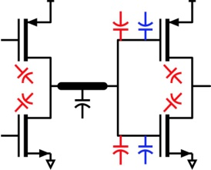
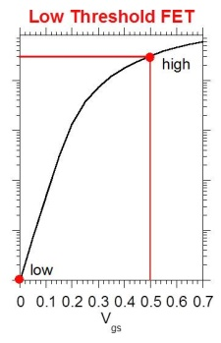
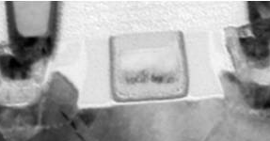
Why is Moore's law scaling nearly over ?
Power density: becoming excessive
C_{wire}V_{DD}² switching energy:
→ want low V_{DD}
Static leakage I_{off} > I_{on}exp(-qV_{DD} /kT)
→ want high V_{DD}
Cannot make FET gates much shorter
Oxide tunneling: minimum oxide thickness
→ minimum gate length given electrostatics
Source-drain tunneling: minimum gate length
Reducing gate length reduces power:
integration density ↑, wiring capacitance ↓, switching energy ↓.
Reduce power by reducing voltage or increasing density

Slide 4
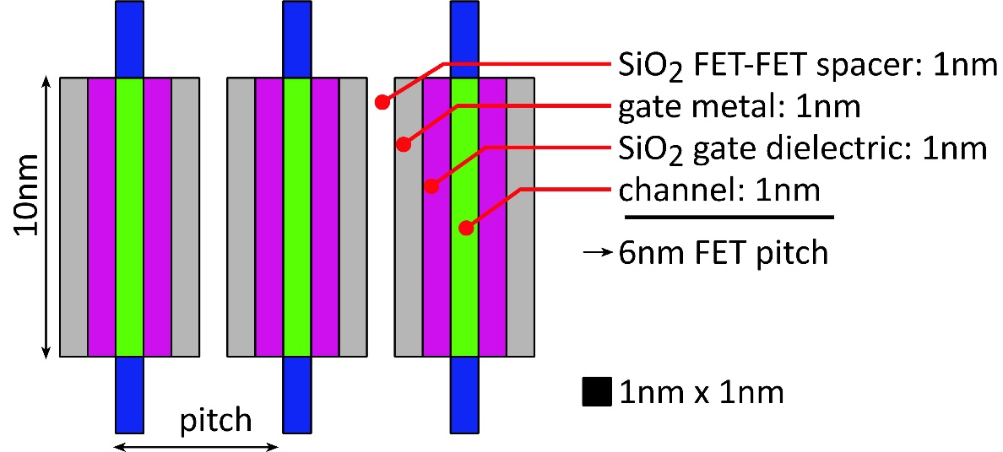
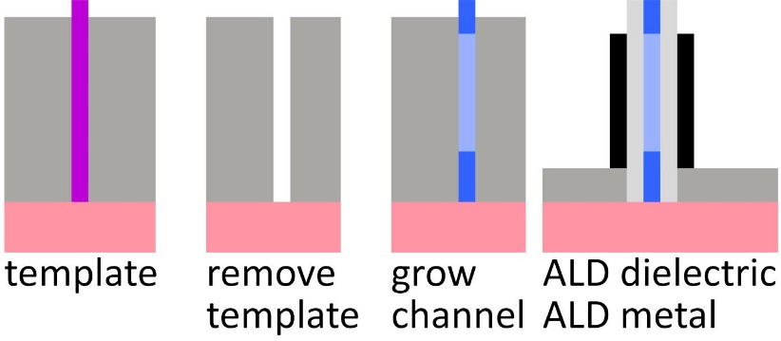
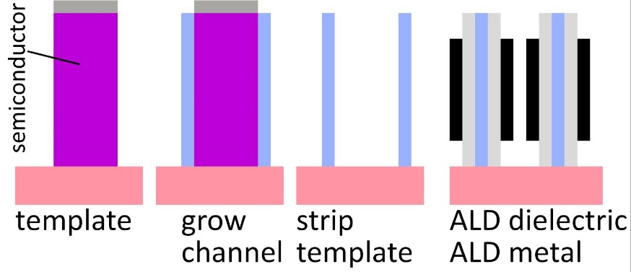
3D: increasing integration density
Planar FETs: 7nm node uses 15nm gate; can't get much shorter
> 15nm minimum transistor pitch.
R. Xie et al., 2016 IEDM
If oriented vertically, minimum transistor pitch is ~6nm
physical limit; fabrication might be difficult/impossible
Perhaps it can be done ?

Slide 5
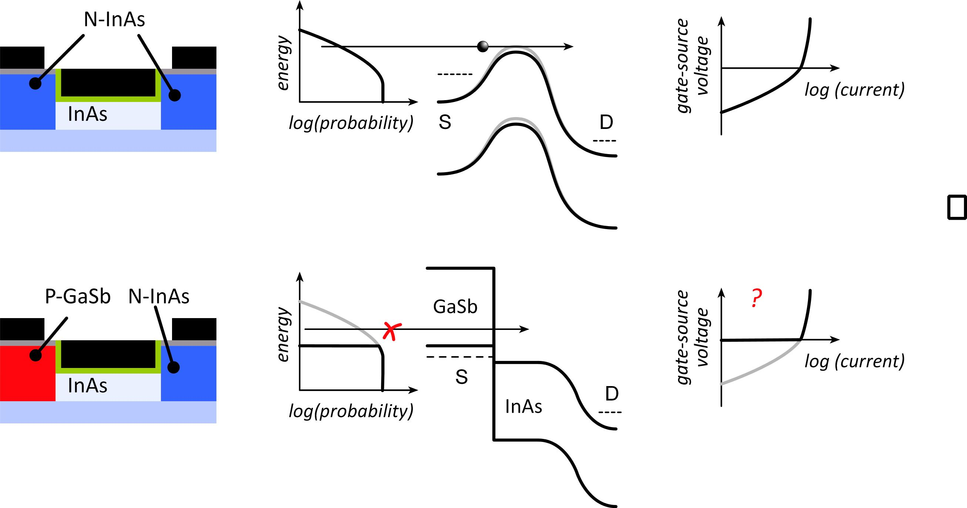
Tunnel FETs: truncating the thermal distribution
Normal
T-FET
J. Appenzeller et al.,
IEEE TED, Dec. 2005
Source bandgap truncates thermal distribution✓
Must cross bandgap: tunneling ✘
Fix (?): GaSb/InAs broken-gap heterojunction

Slide 6
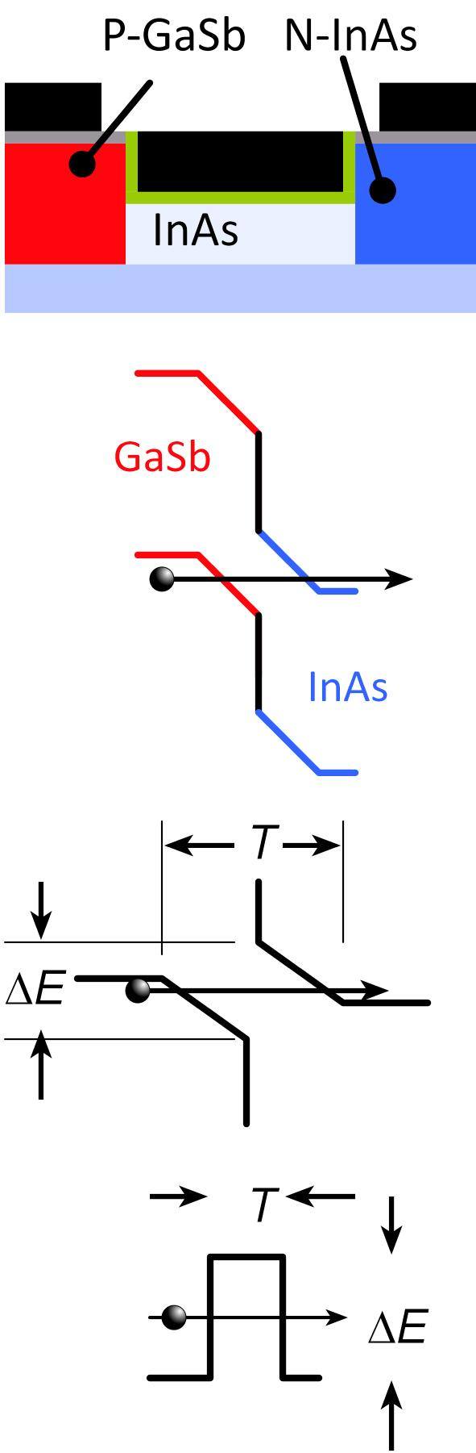
Tunnel FETs: are prospects good ?
Real TFET
nonzero barrier energy: quantization
nonzero barrier thickness: electrostatics
For high I_{on}, tunnel barrier must be *very* thin.

Slide 7
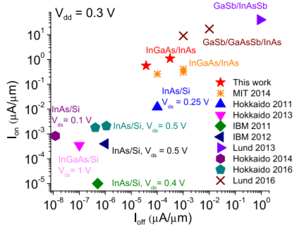

TFET on-currents are low, TFET logic is slow
NEMO simulation:
GaSb/InAs tunnel finFET: 2nm thick body, 1nm thick dielectric @ ε_{r}=12, 12nm L_{g}
10 μA/μm
3.0%
Experimental:
Tabulation from Zhao et al.,
MIT, IEEE EDL, 7/2017
Low current
→ slow logic

Slide 8
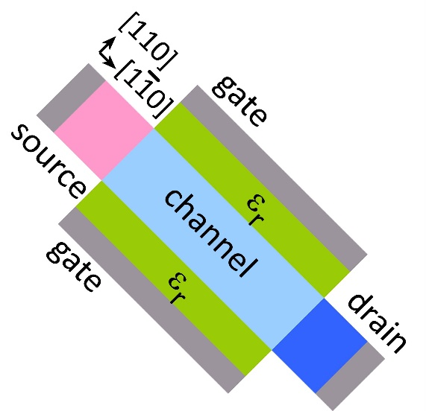
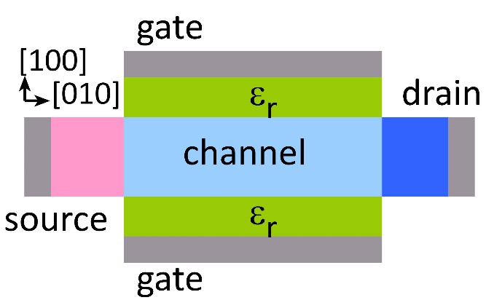
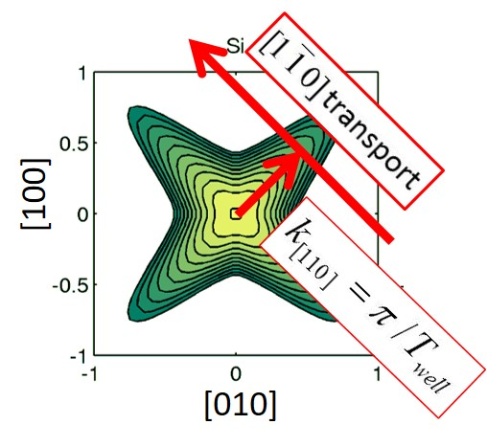
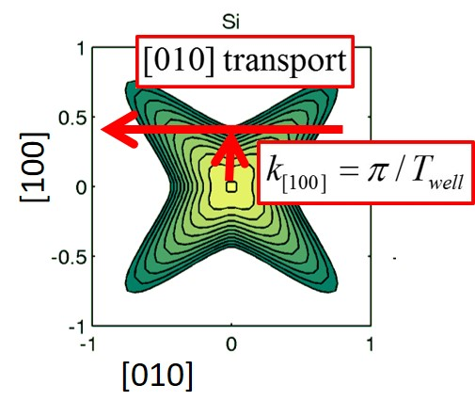
[110] gives more on-current than [100]
P. Long et al., EDL 3/2016
high confinement mass
low transport mass
low confinement mass
high transport mass

Slide 9
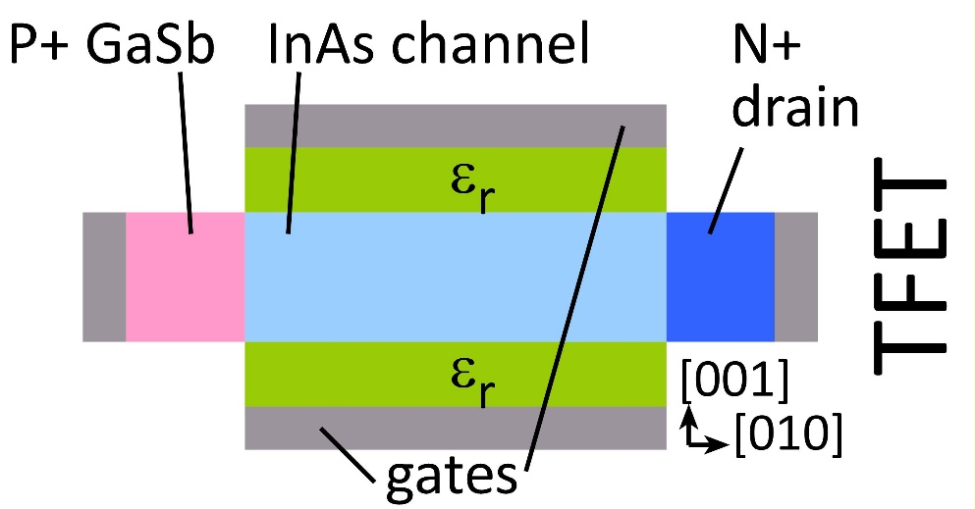
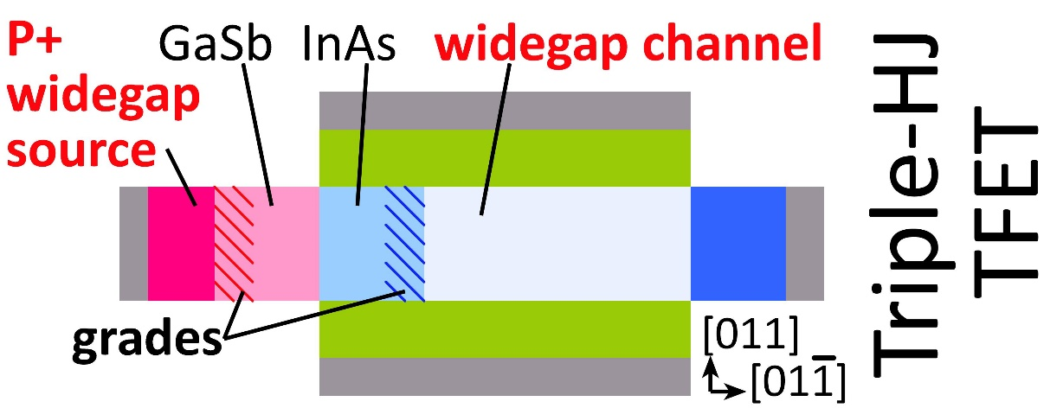
Heterojunctions increase the junction field.
Source HJ: S. Brocard, et al., EDL, 2/2014; Channel HJ: P. Long et al., EDL 3/2016
Added heterojunctions→ greater built-in potential→greater field→ thinner barrier
Key facts: 2nm thick channel, design for V_{DD}=70mV.

Slide 10
Heterojunctions increase the tunneling probability
Source HJ: S. Brocard, et al., EDL, 2/2014; Channel HJ: P. Long et al., EDL 3/2016
Added heterojunctions→ greater built-in potential→greater field→ thinner barrier
Key facts: 2nm thick channel, design for V_{DD}=70mV.

Slide 11
Heterojunctions increase the on-current
Source HJ: S. Brocard, et al., EDL, 2/2014; Channel HJ: P. Long et al., EDL 3/2016
Added heterojunctions→ greater built-in potential→greater field→ thinner barrier
Key facts: 2nm thick channel, design for V_{DD}=70mV.

Slide 12
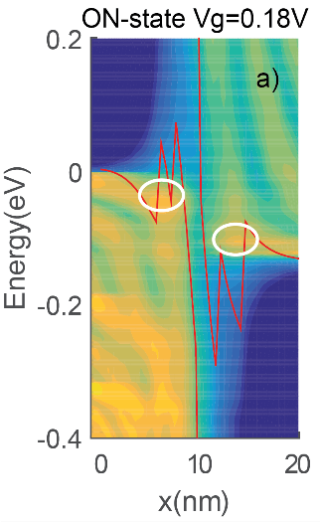
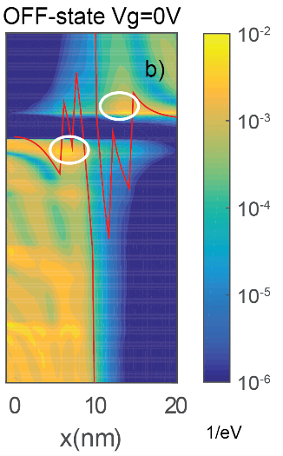
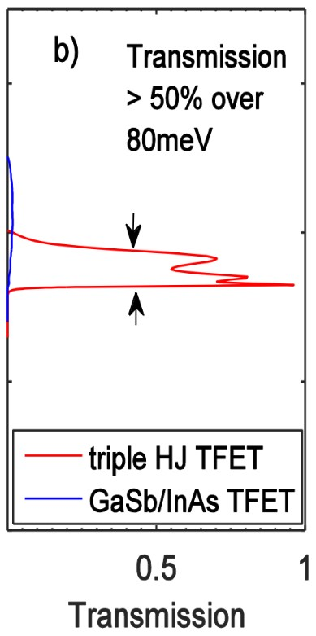
Role of the resonant bound states
P. Long et al., 2016 IEDM: Resonances in TFETs: Avci & Young (Intel) 2013 IEDM
local density of states, 1/eV
On-state: bound states increase transmission
Off-sate: evanescent tails of bound states increases leakage
→ Keep the bound state energies near the well edge energies

Slide 13
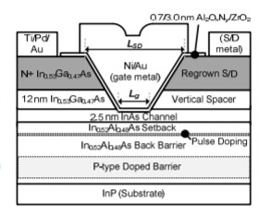
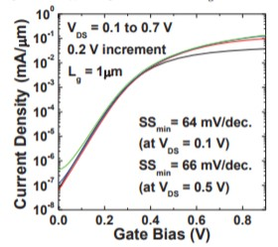
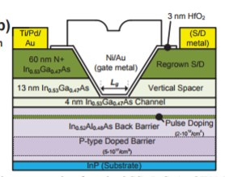
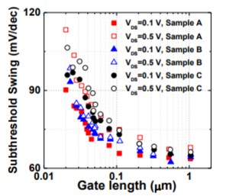
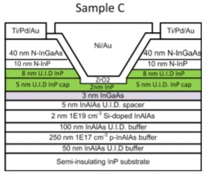
Preferred semiconductors under gate dielectric
InAs: 61mV/dec.
Lee et al., 2014 VLSI Symposium
InGaAs: 64mV/dec.
Lee et al., 2014 DRC
InP: 67*mV/dec.
*Note InP/InGaAs band offset
Huang et al., 2014 Lester Eastman Conference
Gate dielectrics: Chobpattana et al. (Stemmer), APL 5/2014, APL 10/2014, Carter et al. (Rodwell) Applied Physics Express 8/2011

Slide 14
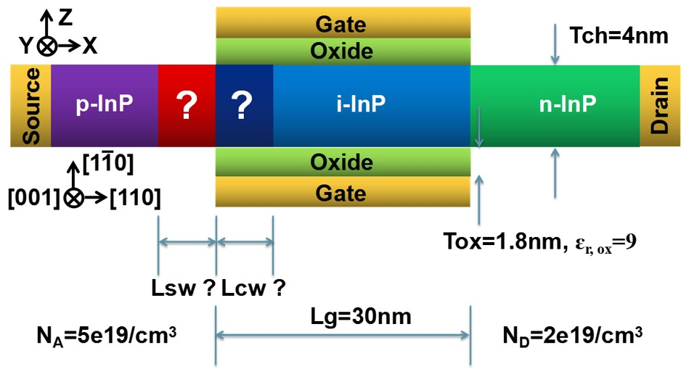
Target 3HJ tunnel transistor design
Long et al., 2017 DRC
N_{A}=5×10¹⁹/cm³
Design Source well (N_{A}=5×10¹⁹/cm³) Channel well
1) 4.0nm p-Ga_{0.47}In_{0.53}As 4.5nm i-Ga_{0.47}In_{0.53}As
2) 4.0nm p-Ga_{0.74}In_{0.26}As, 1.9% tensile strain 4.0nm i-Ga_{0.23}In_{0.77}As, 1.6% compressive strain
3) 4.0nm p-GaAs, 3.8% tensile strain 3.5nm i-InAs, 3.1% compressive strain
Design 3: highest current, no semiconductor alloys.
Need design revision: P-InP → P-InAlAs in source

Slide 15
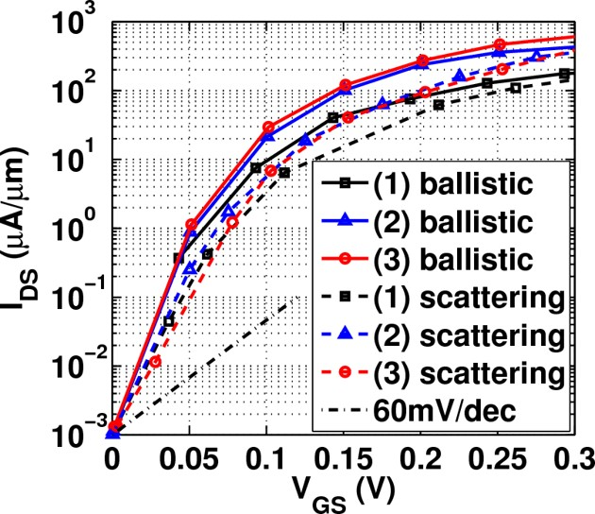
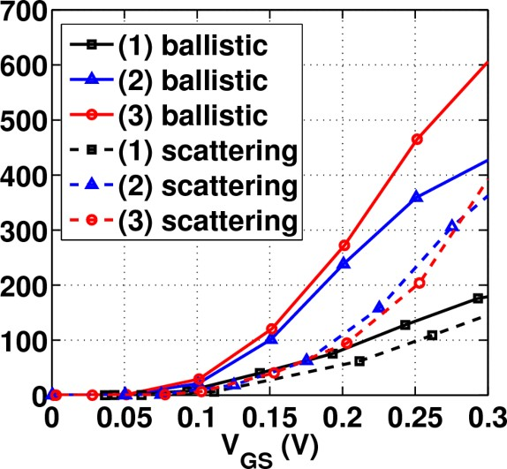
Target 3HJ tunnel transistor design: simulations
Long et al., 2017 DRC
Design Ballistic (SS, I_{on} @ I_{off}=1nA/μm, V_{DD}=0.3V) With phonon-assisted tunneling
1) 15mV/dec., 0.18mA/μm 20mV/dec., 0.14mA/μm
2) 14mV/dec., 0.43mA/μm 26mV/dec., 0.36mA/μm
3) 14mV/dec., 0.61mA/μm 34mV/dec., 0.39mA/μm
Design 3: highest current, no semiconductor alloys.

Slide 16
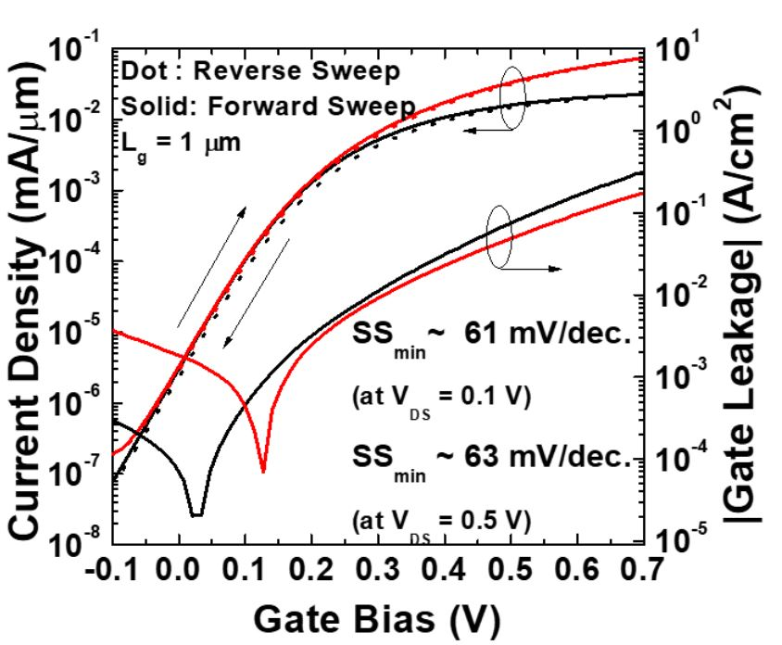
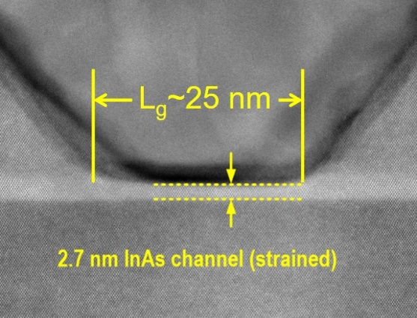
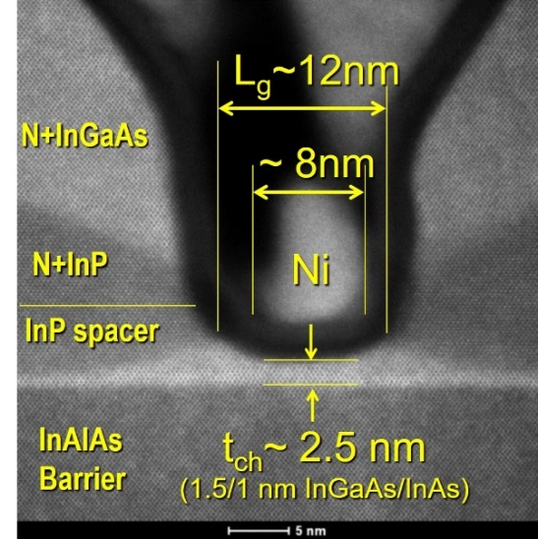
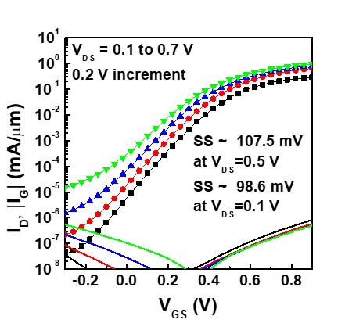
Base III-V MOS Technology at UCSB
Gate dielectrics with very low trap density
22nm L_{g}: 0.5 mA/μm I_{ON} @ 100nA/μm I_{OFF} & 0.5V V_{DD}
V. Chobpattanna, S. Stemmer
FET data: S Lee, 2014 VLSI Symp.
S. Lee et al., VLSI 2014
Good DC MOSFET with 12nm L_{g}, 2.5 nm thick channel
C. Y. Huang et al., DRC 2015

Slide 17
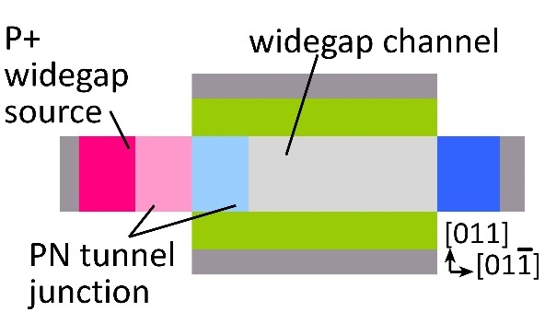
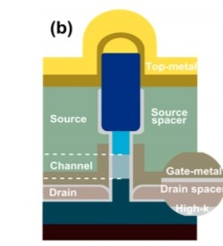
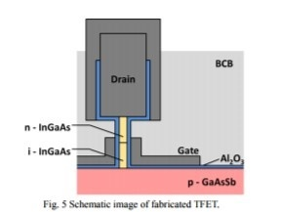
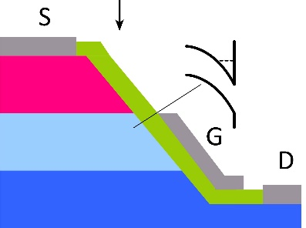
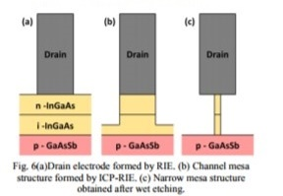
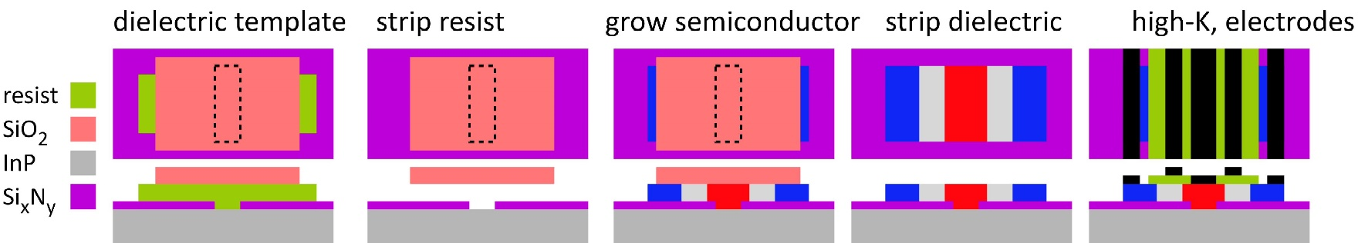
How to build the device? No easy approach.
All TFETs:
need junction perpendicular to gate dielectric.
how ?
Example processes:
gated mesa edge
nanowire
vertical etched ridge
Memišević, et al
2016 IEEE Silicon Nanoelectronics Workshop
Fujimatsu, Saito, Miyamoto, 2012 IEEE IPRM
Target growth & process flow: Template Assisted Selective Epitaxy (TASE)
L. Czornomaz et al. (IBM Zurich ), 2015 & 2016 VLSI Symposia

Slide 18
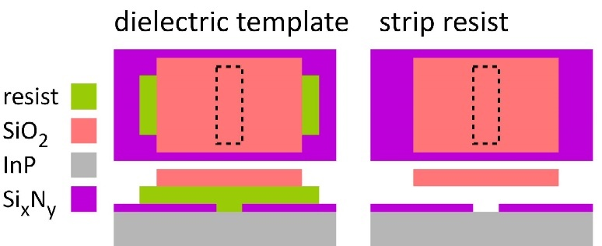
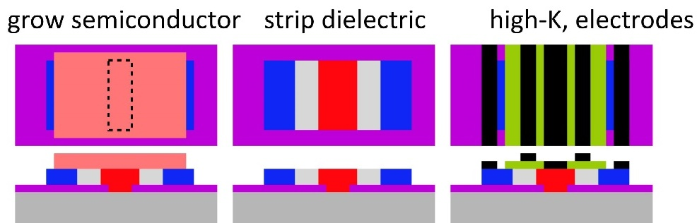
TFETs by template-assisted epitaxy
TASE: L. Czornomaz et al. (IBM Zurich ), 2015 & 2016 VLSI Symposia
This conference: see paper Fr2B7, Nanostructures session, S. Brunelli et al., Towards Horizontal Heterojunctions ...

Slide 19
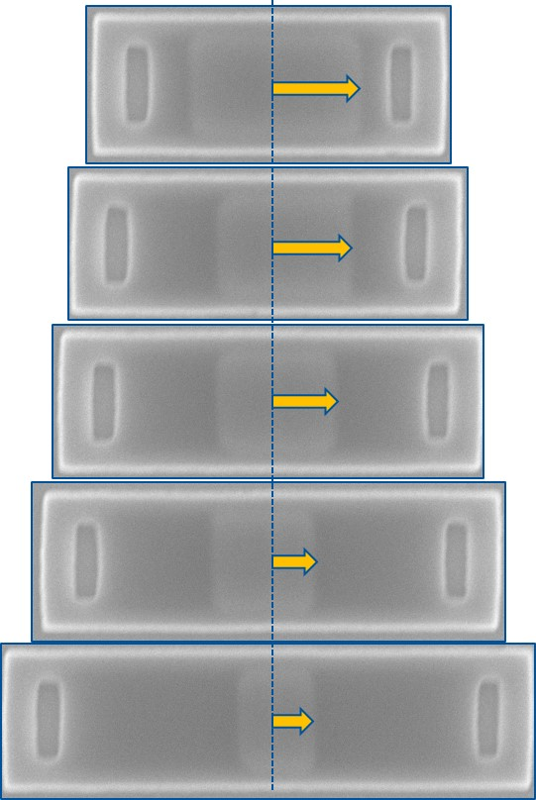
MOCVD TASE
Growth in the template cavity appears to be limited by diffusion mechanisms
Template length influences growth rate with inverse proportionality
Summary of four growth runs of different time
This conference: see paper Fr2B7, Nanostructures session, S. Brunelli et al., Towards Horizontal Heterojunctions ...

Slide 20
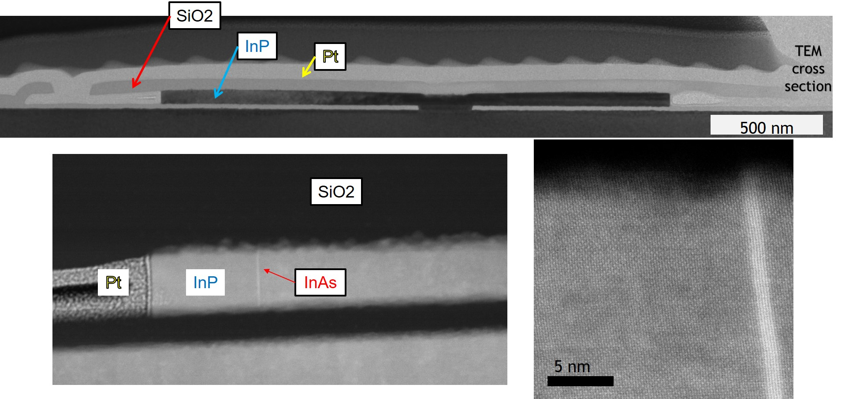

TFETs: horizontal heterojunctions by TASE
Heterojunctions by pseudo-ALE
InP with ~1.25nm strained InAs layers
110 wafer, clean $1\overline{1}0$ growth facets
This conference: see paper Fr2B7, Nanostructures session, S. Brunelli et al., Towards Horizontal Heterojunctions ...

Slide 21
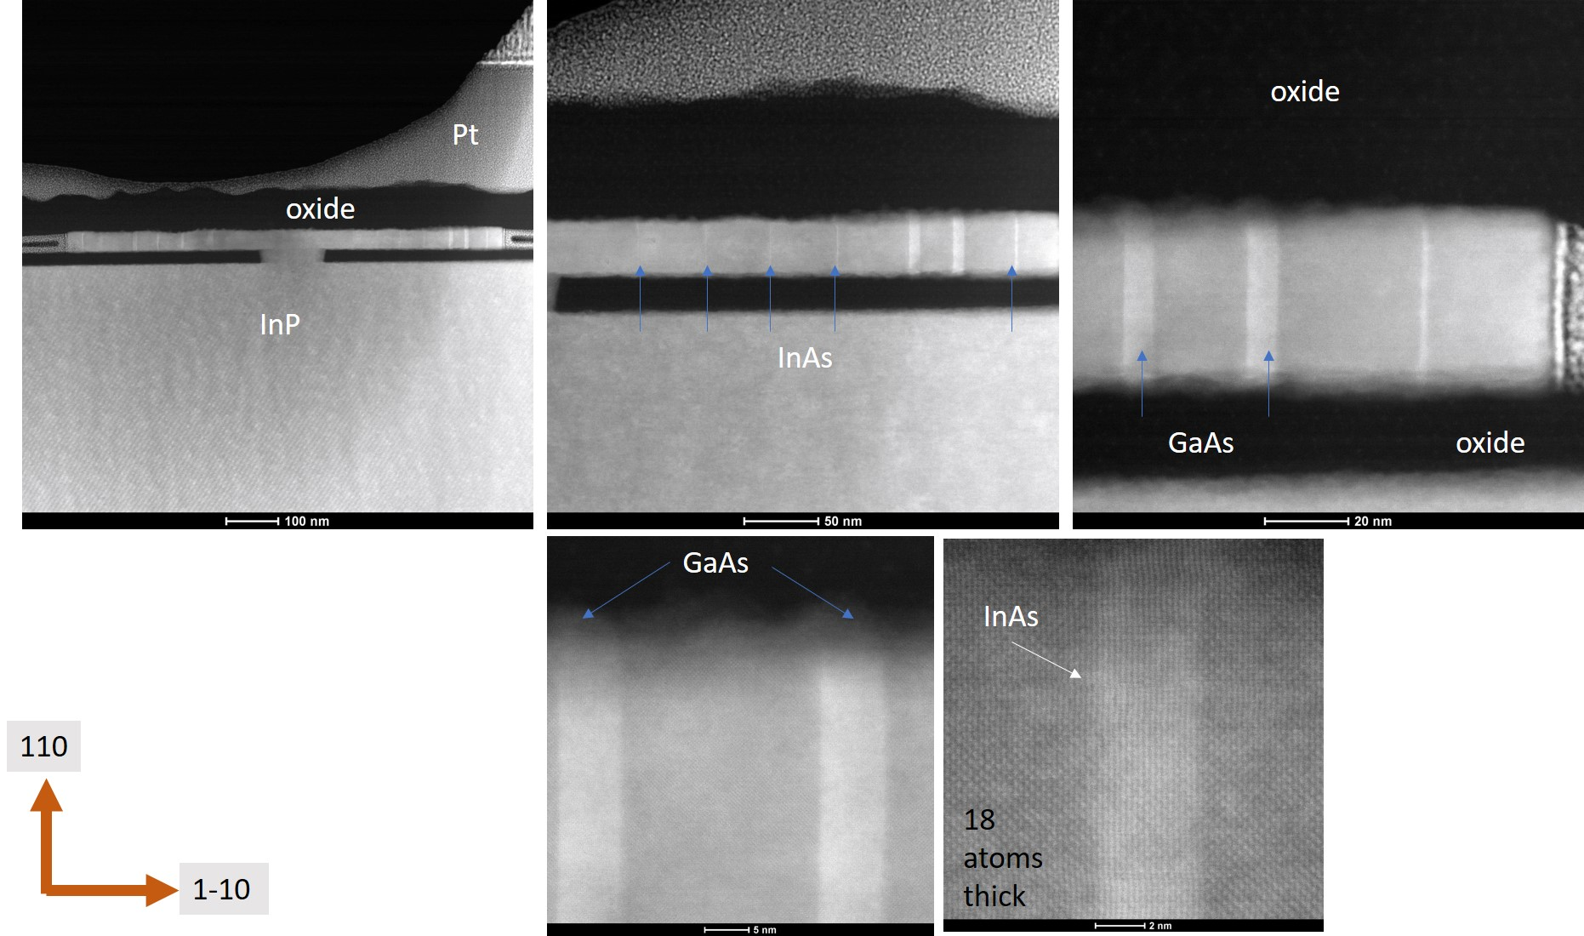
Horizontal InAs & GaAs heterojunctions in InP
Working now on better control of the layer thicknesses...

Slide 22

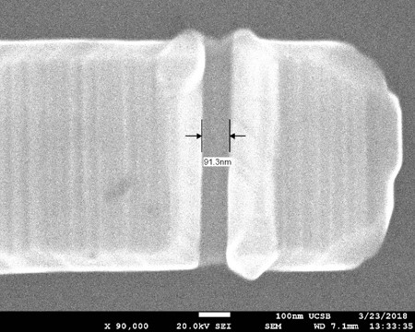
Towards a TASE-fabricated TFET
First step: simple MOSFET with regrowth S/D contacts
ALE-deposited gate dielectric and metals
Remaining steps for 3HJ-TFET
horizontal GaAs/InAs/InP HJ
P+ InGaAs doping
...growth & fabrication

Slide 23
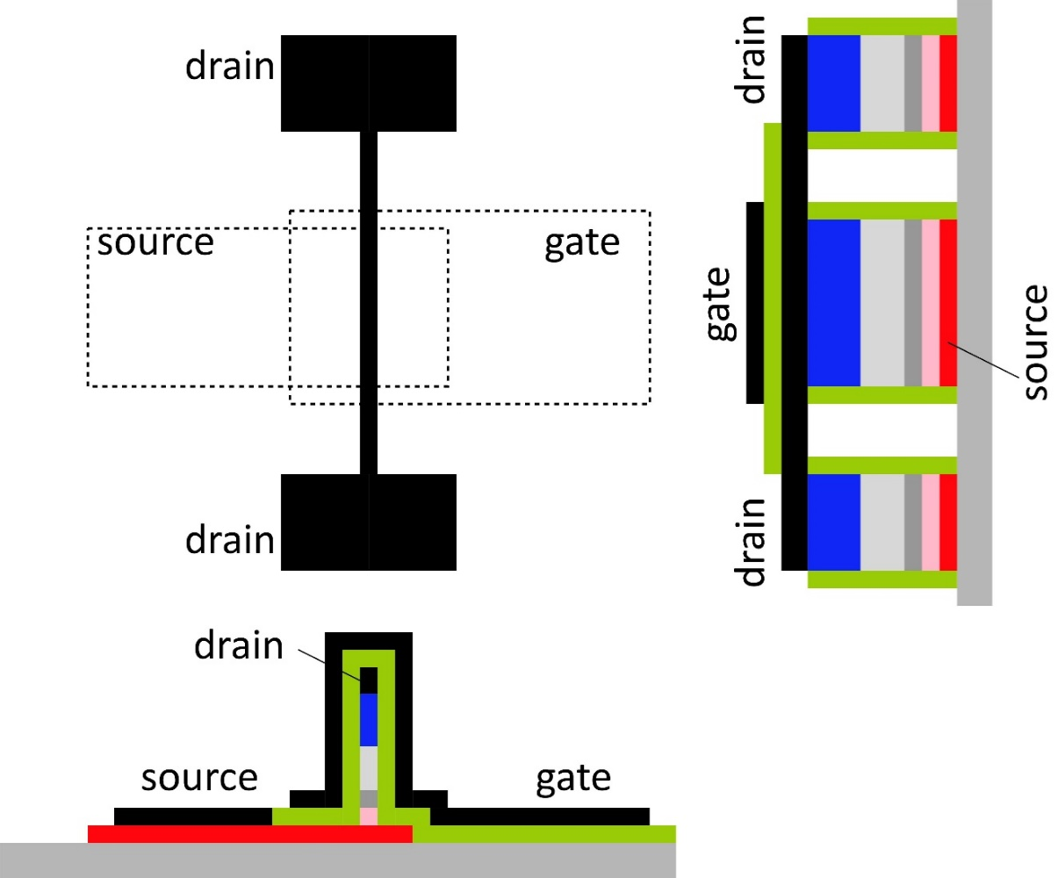
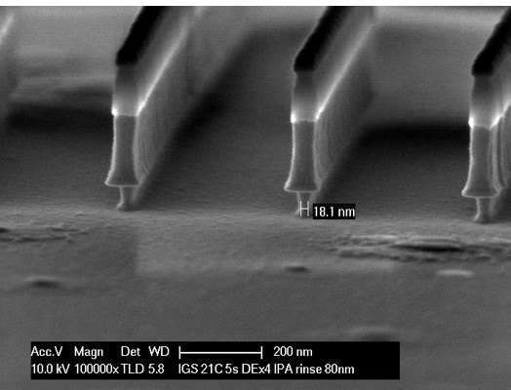
Alterative process: vertical ridge
Drain pads
support narrow vertical ridge
→ target 5-10 nm ridge
Wrap-around gate
wraps over drain
no need for planarization
18nm fins

Slide 24
THz transistors
24

Slide 25
Transistors for mm-wave, sub-mm-wave wireless
Massive growth in use of radio communication
sub-5GHz spectrum almost used up
Next generation 5G, coming soon.
28, 38, 57-71(WiGig), and 71-86GHz.
Some degree of spatial multiplexing (multiple beams)
Research now explores the next generation (6G?).
100+ GHz carriers: 140, 220, 340GHz
maybe 650GHz
massive spatial multiplexing
This will drive transistor development:
PAs for transmitters, GaN, InP HBT, SiGe HBT
LNAs for receivers: InP HEMT, InP MOS-HEMT

Slide 26
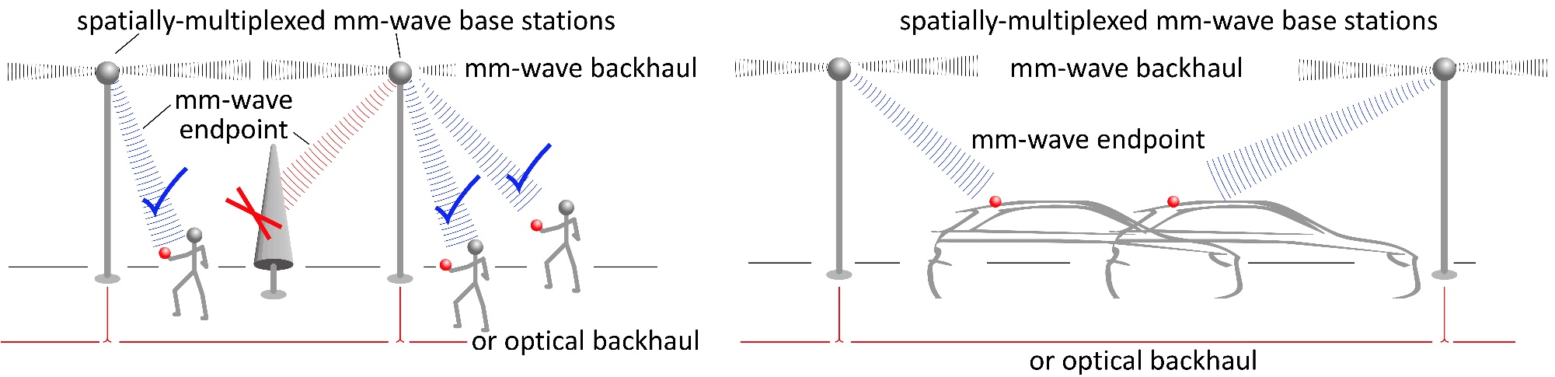
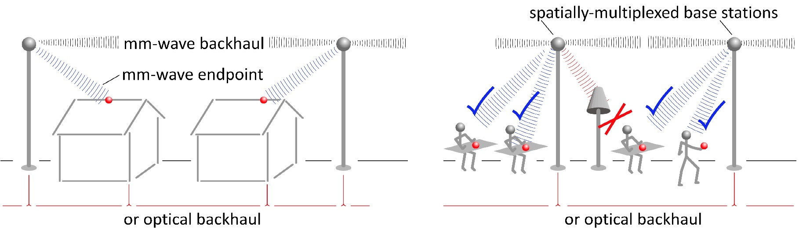
100-340GHz wireless communications
Gigabit mobile communication.
Information anywhere, any time, without limits
Gigabit residential/office communication.
Cellular/internet convergence: competition, low cost, broader deployment

Slide 27
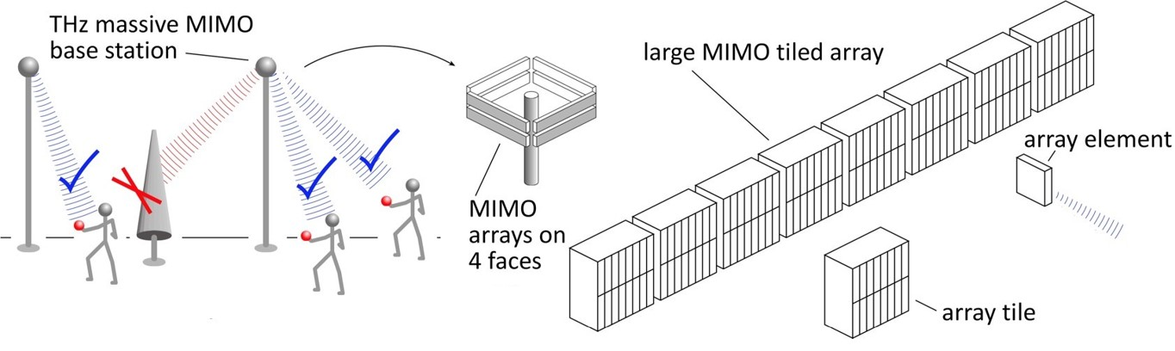
140/220 GHz spatially multiplexed base station
10 Tb/s spatially-multiplexed base station
Each face supports 256 beams @ 10Gb/s/beam.
100 meters range in 50 mm/hr rain
Realistic packaging loss, operating & design margins
Key device specifications:
140 GHz: PAs: P_{sat}=21.5 dBm: LNAs: F=4 dB
220 GHz: PAs: P_{sat}=25 dBm: LNAs: F=4 dB

Slide 28
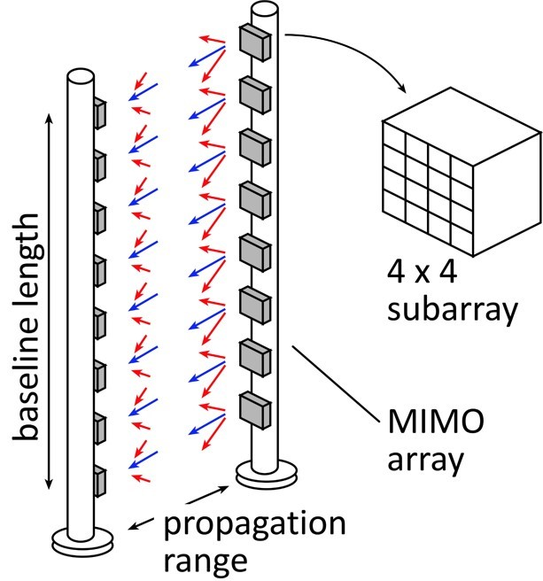
340 GHz, 650 GHz spatially-multiplexed backhaul
340 GHz:
640Gb/s @ 240 meters;
1.2 meter, 8-element array
F= 4dB, P_{sat}≅14dBm
650 GHz:
1.28Tb/s @ 240 meters;
1.2 meter, 16-element array
F= 4dB, P_{avg}=14.5dBm, P_{sat}≅18.5dBm

Slide 29
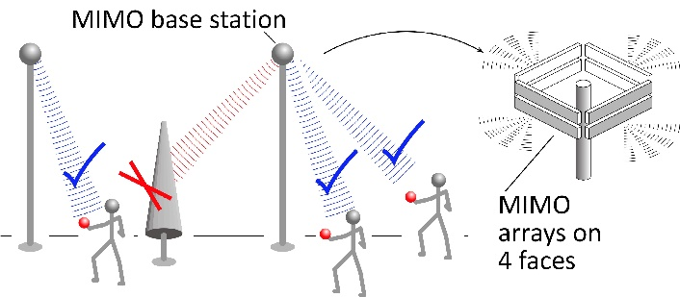
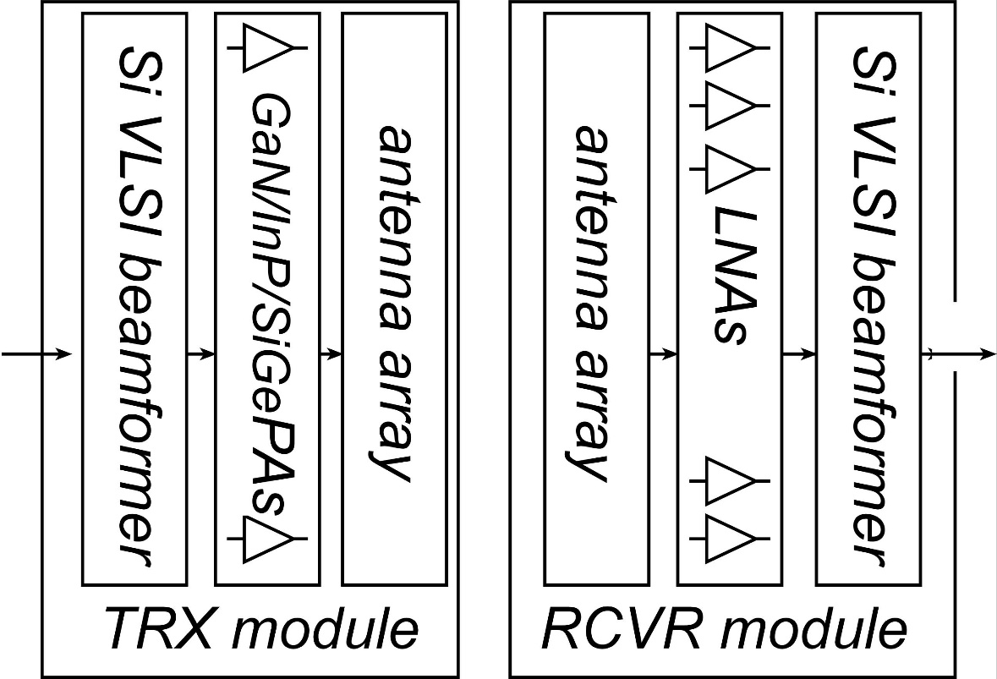

mm-Wave Wireless Transceiver Architecture
custom PAs, LNAs → power, efficiency, noise
Si CMOS beamformer→ integration scale
...similar to today's cell phones.

Slide 30




mm-wave CMOS (examples)
260 GHz amplifier, Feedback-enhanced-gain:
65nm bulk CMOS, 2.3 dB gain per stage (350GHz f_{max})
Momeni ISSCC, March 2013
350 GHz f_{max}
145 GHz amplifier, conventional neutralized design:
45 nm SOI CMOS, 6.3 dB gain per stage, ~1.5mW P_{sat}
Kim et al. (UCSB), submitted

Slide 31


mm-Wave CMOS won't scale much further
Gate dielectric can't be thinned
→ on-current, g_{m} can't increase
Shorter gates give no less capacitance
dominated by ends; ~1fF/μm total
Maximum g_{m}, minimum C→ upper limit on f_{τ}.
about 350-400 GHz.
Tungsten via resistances reduce the gain
Inac et al, CSICS 2011
Present finFETs have yet larger end capacitances

Slide 32


Gallium nitride mm-wave power
GaN is the leading high-frequency power technology
N-polar GaN: Mishra
nm AlN/GaN: Xing/Jena

Slide 33



130nm / 1.1THz InP HBT Technology
Teledyne: M. Urteaga et al: 2011 DRC
Rode (UCSB), IEEE TED, 2015
3.5 V breakdown

Slide 34



THz transistor measurements
Problems with simple pads:
Substrate resonances @ >35 GHz → make pads small, grounds close(!)
Ambiguity in series-first or shunt-first pad stripping.
Our present HBTs, stripping order makes only a minor difference.
220 μm
(publication used parallel elements outside)
On-wafer LRL is much better
No pad-stripping.
Still must avoid substrate resonances
thinned substrate with TSV's
or thin-film microstrip wiring

Slide 35




130nm / 1.1THz InP HBT: IC Examples
220 GHz 0.18W power amplifier
325 GHz, 16mW power amplifier
UCSB/Teledyne: T. Reed et al: 2013 CSICS
UCSB/Teledyne: (A. Ahmed, submitted)
Integrated ~600GHz transmitter
Teledyne: M. Urteaga et al: 2017 IEEE Proceedings
but, only ~1 mW output power

Slide 36


InP HBT: Towards the 2 THz / 64nm Node
Thin semiconductor layers (transit time)
High current density (CV/I)
Narrow junctions (heat)
Ultra low resistivity contacts (RC)
Low base metal resistance (RC)
5nm P+ spike: low-ρ_{c} contacts, good β.
90 nm HBT
45 nm emitter
Yihao Fang, UCSB, to be submitted

Slide 37



InP HBT: Towards the 2 THz / 64nm Node
Good β, even at 90nm.
Yihao Fang, UCSB, to be submitted
...because of doping pulse, grade

Slide 38

Challenges at 65nm: base contacts, base metal
Obtaining good base contacts
in HBT vs. in contact test structure
(emitter contacts are fine)
RC parasitics along finger length
metal resistance, excess junction areas
Rode et al., IEEE TED, Aug. 2015
Baraskar et al, Journal of Applied Physics, 2013

Slide 39

Challenges at 65nm: Base contact penetration
TLM test samples:
ultra-clean surfaces
non-penetrating contacts
refractories: Ru, Mo, Ir, W
→ ~6×10⁻⁹ Ω-cm² resistivity
HBT emitter:
first process step
ultra-clean surfaces
refractory Mo contacts
~1-2×10⁻⁸ Ω-cm² resistivity
HBT base:
late process step
UV-O₃/HCl cleaning not enough
controlled-penetration contacts: 1nm Pt→ 3nm reaction depth
→ incompatible with thin & pulse-doped base designs
Rode et al., IEEE TED, Aug. 2015

Slide 40






Next: regrowth instead of scaling
Goal: regrown-base HBT
increased β, f_{max}
Intrinsic/extrinsic base junction
metamorphic p-GaAs/p-InGaAs
electron barrier→ high β
low intrinsic doping→ low Auger→ high β
Goal: pedestal-collector HBT
increased f_{max}
1st step :
collector growth in dielectric window
Next step:
base lateral overgrowth,
or base confined lateral overgrowth

Slide 41


mm-wave PAs: need higher current density
3 μm max emitter length (> 1 THz f_{max})
2 mA/μm max current density
I_{max}= 6 mA
Maximum 3 Volt p-p output
Load: 3V/6mA= 500 Ω
1) Transmission-line combiner: cannot provide 500 Ω loading
2) Lumped multi-finger layouts: parasitics, reduced gain, f_{max}

Slide 42
HEMTs: key for low noise
Hand-derived modified Fukui Expression, fits CAD simulation extremely well.
2:1 to 4:1 increase in f_{τ} → improved noise
→ less required transmit power→ easier PAs, less DC power
or enable higher-frequency systems

Slide 43


Towards faster HEMTs
Scaling limit: gate insulator thickness
HEMT: InAlAs barrier: tunneling, thermionic leakage
solution: replace InAlAs with high-K dielectric
2nm ZrO₂ (ε_{r}=25): adequately low leakage
Scaling limit: source access resistance
HEMT: InAlAs barrier is under N+ source/drain
solution: regrowth, placing N+ layer on InAs channel
Jun Wu, UCSB, IEEE EDL

Slide 44



Jun Wu, UCSB, IEEE EDL, 2018
Towards faster HEMTs
Double regrowth
modulation-doped access regions
N+ contacts
High-K gate dielectric: 3 nm ZrO2.
Highly scaled
5nm InAs channel
10-30nm gate lengths

Slide 45


Jun Wu, UCSB, Unpublished
Towards faster HEMTs: next step
Revised process: no N- material between channel and contacts
reduced source/drain access resistance
Revised process: sacrificial layer
reduces parasitic gate-channel overlap: less gate-source capacitance
Thinner gate dielectric (2nm ZrO₂), thinner channel (3nm InAs)
higher g_{m} , lower g_{ds}

Slide 46
Transistors:
mm-Wave
Low-Power VLSI
46

Slide 47
Electron devices for VLSI
Low-voltage transistors
low voltage → low CV² → low switching power.
NC FETs.
high-current TFETs.
3D integration
more transistors/cm²→smaller IC→ shorter wires→ less power
process-intensive: can universities contribute ?
nm-scale memory
easier than nm logic: don't need good I_{on}, I_{off} at low V_{DD}.
just need to change a physical state, then measure it.

Slide 48
nm and THz Transistors
The transistor was demonstrated 70 years ago.
most easy things have been done.
nm technologies need advanced tools: hard for universities.
what should we do next ?
VLSI
low voltage logic: NCFETs, high-current TFETs
3D integration.
atomic-scale memory.
High-frequency transistors: 100-340GHz
power transistors: GaN HEMT, InP HBT
low-noise transistors: InP HEMT
Beyond-220GHz transistors: InP HBT & HEMT
Power conversion and control.

Slide 49
(backup slides follow)

Slide 50





100-340 GHz: benefits & challenges
Large available spectrum
Massive # parallel channels
spatial
multiplexing
(note high attenuation in foul or humid weather)
line-of-sight MIMO
Need phased arrays (overcome high attenuation)
Need mesh networks

Slide 51



100-340GHz: radar and imaging
340 GHz TV-resolution radar: see through fog and rain.
drive safely in fog at 100 km/hr
self-driving: complements LIDAR, but works in bad weather
60 GHz Doppler / ranging radar.
long-range but low-resolution: detects objects, but can't recognize them .
Imaging for drones, small aircraft
small, light aperture, high resolution.

Slide 52
Effect of order of pad stripping

Slide 53
Effect of order of pad stripping

Slide 54


InP HBTs: 1.07 THz @200nm, ?? @ 130nm
?
Rode et al., IEEE TED, Aug. 2015

