Slide 1
100-340GHz wireless communications and imaging
Microelectronics Reliability and Qualification Workshop, The Aerospace Corporation, El Segundo, CA, Feb. 5-7, 2019
M. Rodwell, UC Santa Barbara ; A. Niknejad, UC Berkeley;
J. Buckwalter, U. Madhow, U. Mishra, S. Stemmer, UC Santa Barbara;
E. Alon, B. Nikolic, V. Stojanovic, UC Berkeley;
D. Jena, A. Molnar, C. Studer, H. Xing, Cornell;
A. Molisch, H. Hashemi, USC;
H. Krishnaswamy, Columbia; G. Rebeiz, UC San Diego; D. Katabi, MIT; S. Rangan, NYU; A. Arbabian, Stanford; S. Chowdhury, UC Davis; K. O, UT Dallas
This work was supported in part by the Semiconductor Research Corporation (SRC) and DARPA.

Slide 2
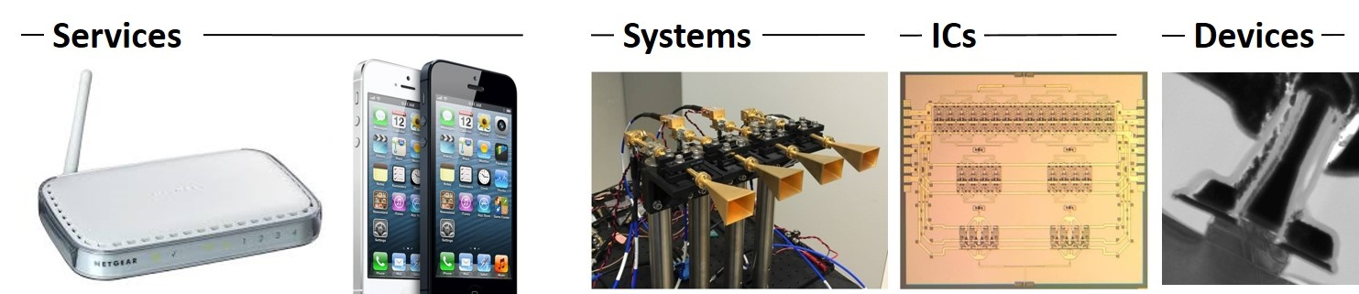
Why 100-340GHz wireless ?
Wireless networks: exploding demand.
Immediate industry response: 5G.
28, 38, 57-71(WiGig), 71-86GHz
increased spectrum, extensive beamforming
Next generation (6G ??): above 100GHz.
greatly increased spectrum, massive spectral multiplexing
Also TV-like imaging/sensing/radar: cars, airplanes, drones

Slide 3
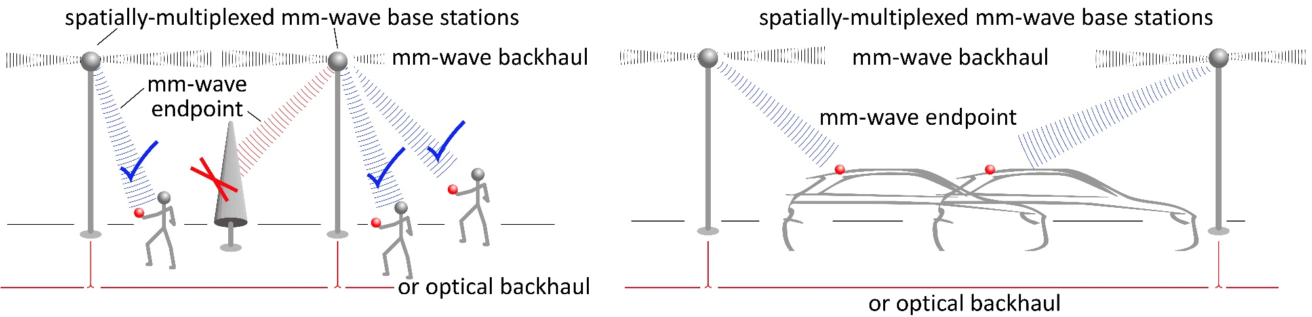
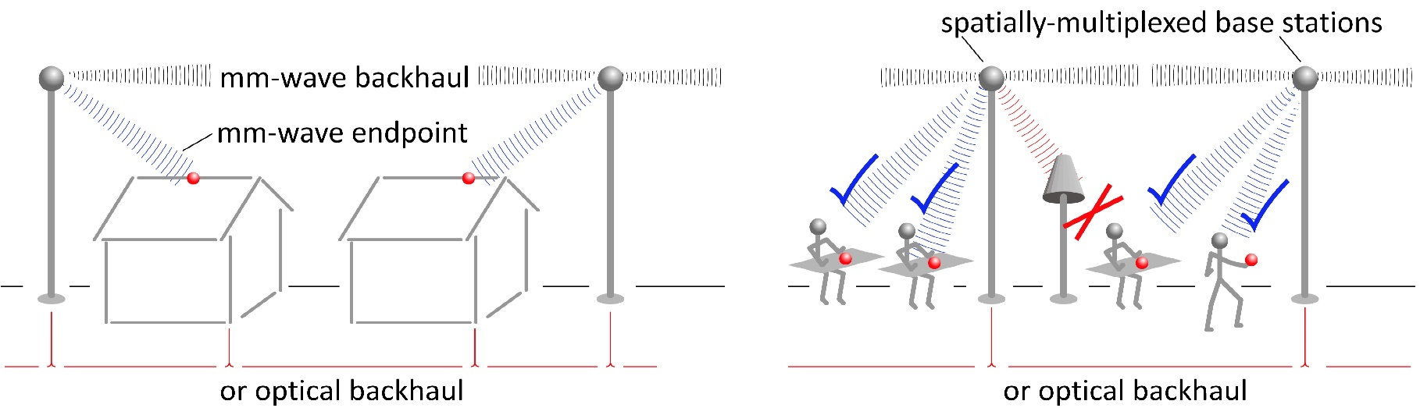
100-340GHz: high-capacity communications
Gigabit mobile communication: Information anywhere, any time, without limits
Residential/office communication: Cellular/internet convergence: competition, low cost, broader deployment

Slide 4
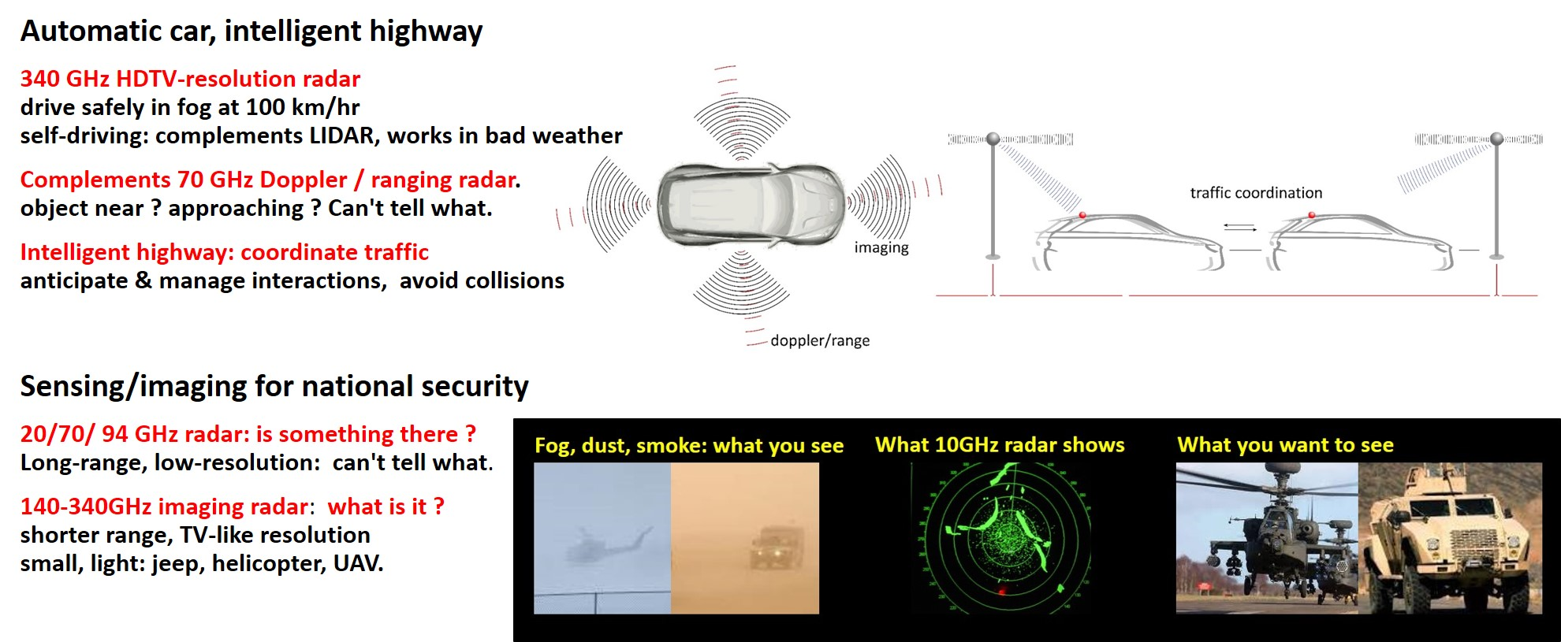
100-340GHz imaging: fog/clouds/smoke/dust

Slide 5
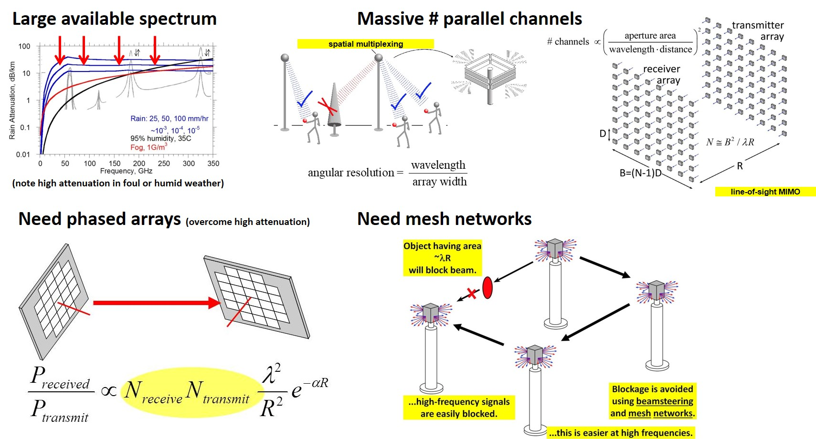
100-340GHz: benefits & challenges

Slide 6
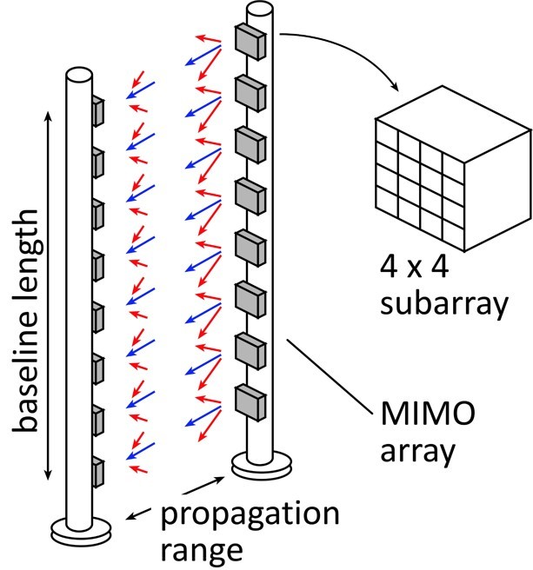
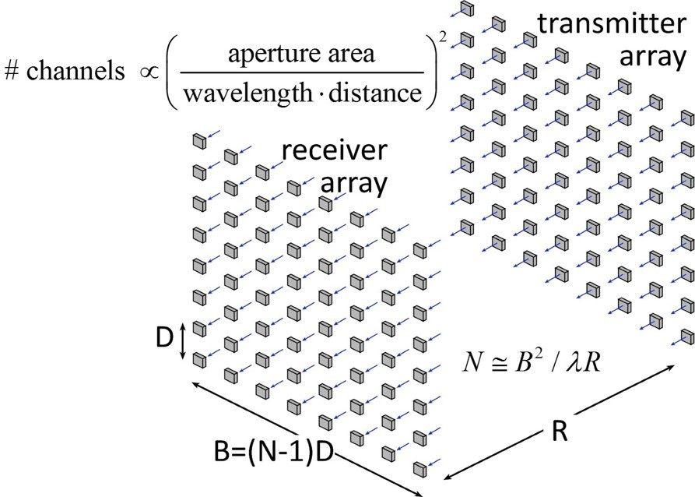
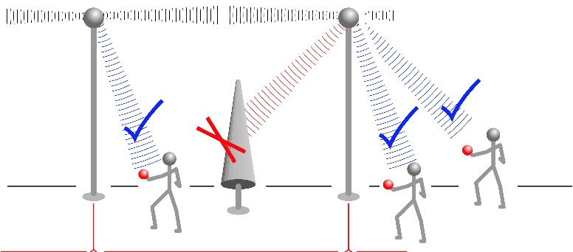
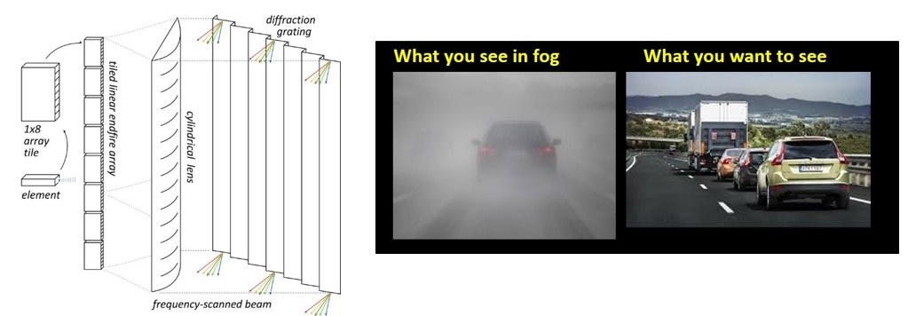
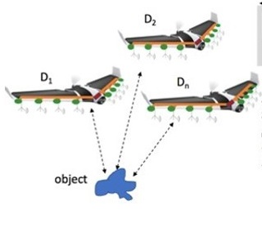


140-340GHz: ComSenTer target applications
MIMO hub: 128 beams/face, 1/10Gb/s/user
140 GHz
Point-point MIMO: 340GHz: Tb/s links
massive spatial multiplexing
220, 340GHz imaging: drive/fly in fog/rain/snow
300m, 512×64 image, 60Hz, 15dB SNR
Ultra-compact imaging: drones
unlike visible: image through fog/smoke/rain

Slide 7
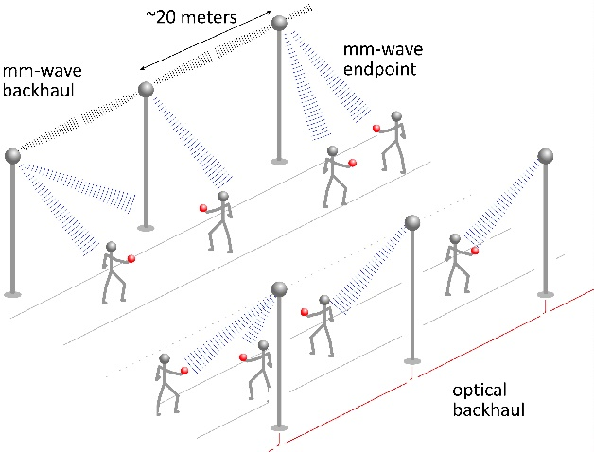
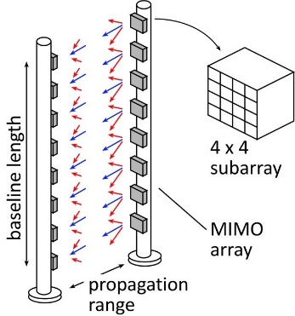
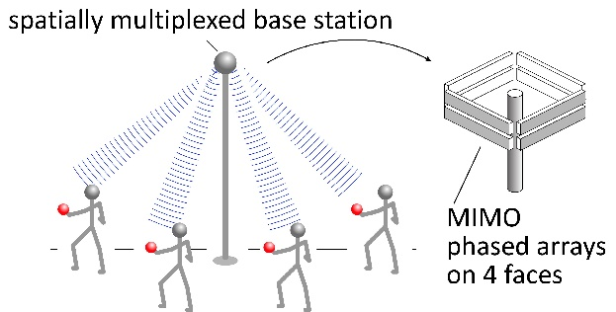
140-340 GHz:
Applications

Slide 8
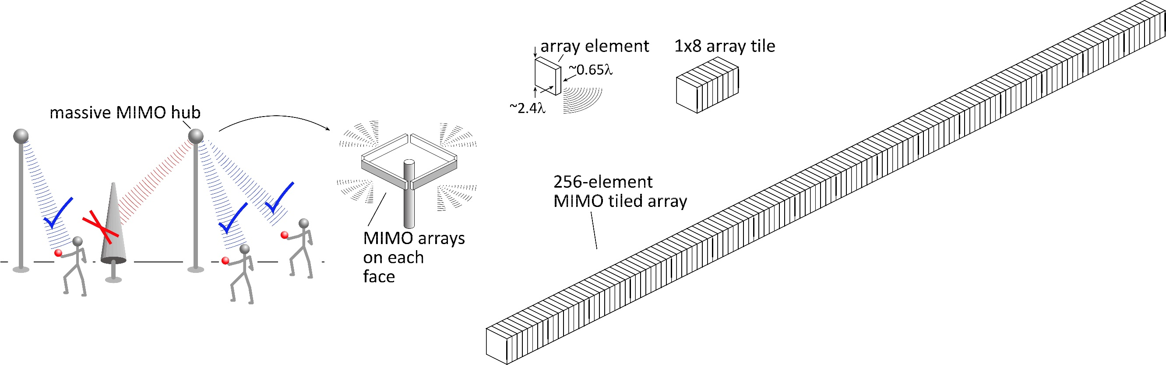
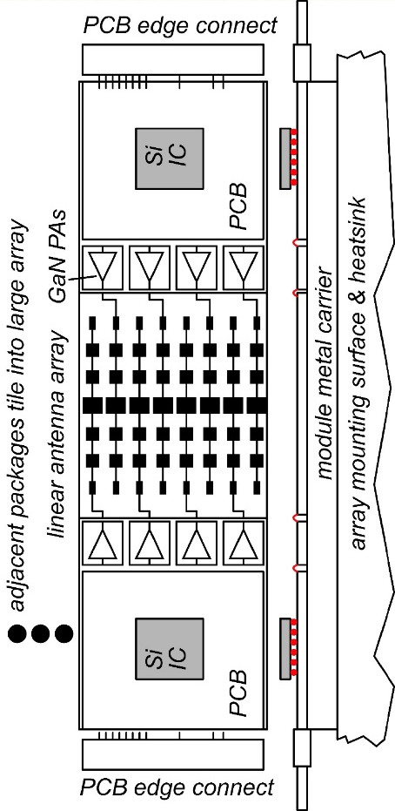
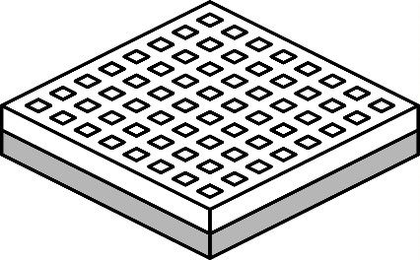
140 GHz spatially multiplexed base station
1 Tb/s spatially-multiplexed base station
256 users/face, 4 faces
1024 total users @ 1 user/beam, 1 Gb/s/beam;
225 m range
Handset:
8 × 8 array
(9×9mm)
Link budget is feasible, but...
Required component dynamic range ?
Required complexity of back-end beamformer ?

Slide 9
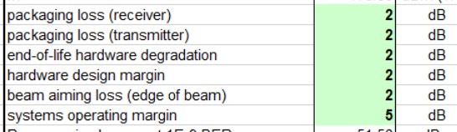
140 GHz spatially multiplexed base station
Each face supports 256 beams @ 1Gb/s/beam.
225 meters range in 50 mm/hr rain
Realistic packaging loss, operating & design margins (20dB total)
PAs: 16 dBm P_{out} (per element)
LNAs: 3 dB noise figure

Slide 10
75 GHz spatially multiplexed base station
Suppose we instead use a 75GHz carrier:
keep the handset the same size: 8mm×8mm (4×4)
keep the same # base station array elements
→ same Friss transmission losses
Also: same 4-9's foul-weather losses
Then:
almost the same range (210 meters vs. 225 meters)
larger array dimensions 9mm×655mm (vs. 5mm×350mm)
but, today 75GHz ICs are easier than 140GHz ICs…

Slide 11
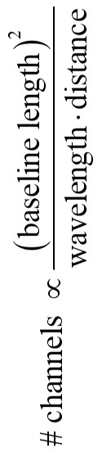
340 GHz (or even 650 GHz) backhaul
linear array
square array
Sub-mm-wave line-of-sight MIMO network backbone
wireless @ optical speed; link network where fiber is too expensive to place.
340 GHz: 640Gb/s @ 500 meters range; 1.6 meter linear array (5Tb/s for 8×8 square array).
650 GHz: 1.28Tb/s @ 500 meter range; 1.6 meter linear array.
Capacity doubles again if we use both polarizations.

Slide 12
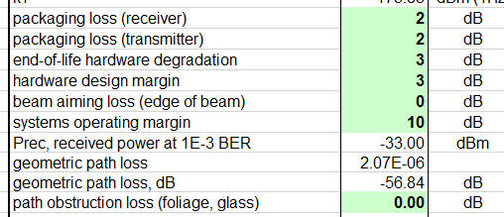
340 GHz 640 Gb/s MIMO backhaul
1.6m MIMO array: 8-elements, each 80 Gb/s QPSK; 640Gb/s total
4 × 4 sub-arrays → 8 degree beamsteering
500 meters range in 50 mm/hr rain; 29 dB/km
Realistic packaging loss, operating & design margins
PAs: 82mW P_{out} (per element)
LNAs: 4 dB noise figure

Slide 13
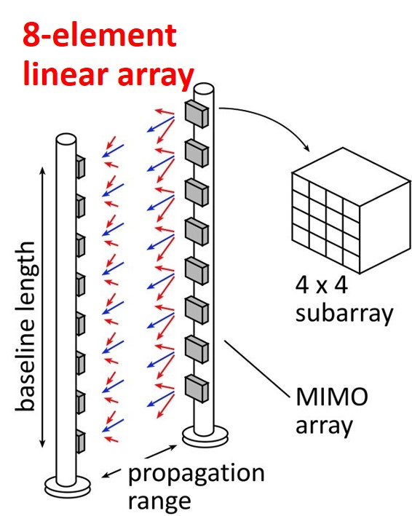
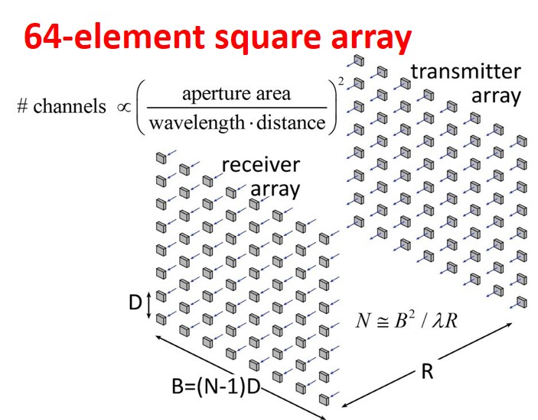
340 GHz 5 Tb/s MIMO backhaul
500m range in 50mm/hr. rain.
8-element 640Gb/s linear array:
requires 80mW power/element
requires 1.6m linear array
8-element 5Tb/s square array:
same link assumptions
requires 10mW power/element
...10W total radiated power
requires 1.6m square array

Slide 14
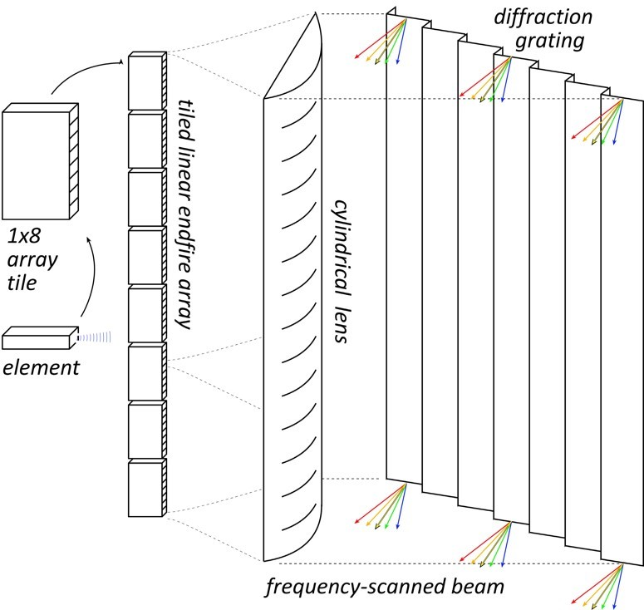


340 GHz frequency-scanned imaging car radar
Imaging for cars, aircraft
drive safely @ 65MPH in heavy fog
fly in heavy dust/fog/smoke
Short wavelengths:
HDTV-resolution imaging,
small: helicopter, drone, car
The challenge: complexity
standard array: # pixels = # RF channels
HDTV image: ~2×10⁶ pixels.
Need 2×10⁶ RF channels !
Hardware-efficient imaging
# RF channels << # pixels
several techniques

Slide 15
340 GHz frequency-scanned imaging car radar
See a soccer ball at 300 meters in heavy fog
(10 seconds warning @ 100 km/hr.)
(5 dB SNR, 35 dB/km, 30cm diameter target, 10% reflectivity)
Image refresh rate: 60 Hz
Resolution 64×512 pixels
Angular resolution: 0.14 degrees
Angular field of view: 9 by 73 degrees
Aperture: 35 cm by 35 cm
Component requirements:
44 mW peak power/element,
3% pulse duty factor
6 dB noise figure,
3 dB package losses (each: trx, rcvr)
5 dB manufacturing/aging margin

Slide 16
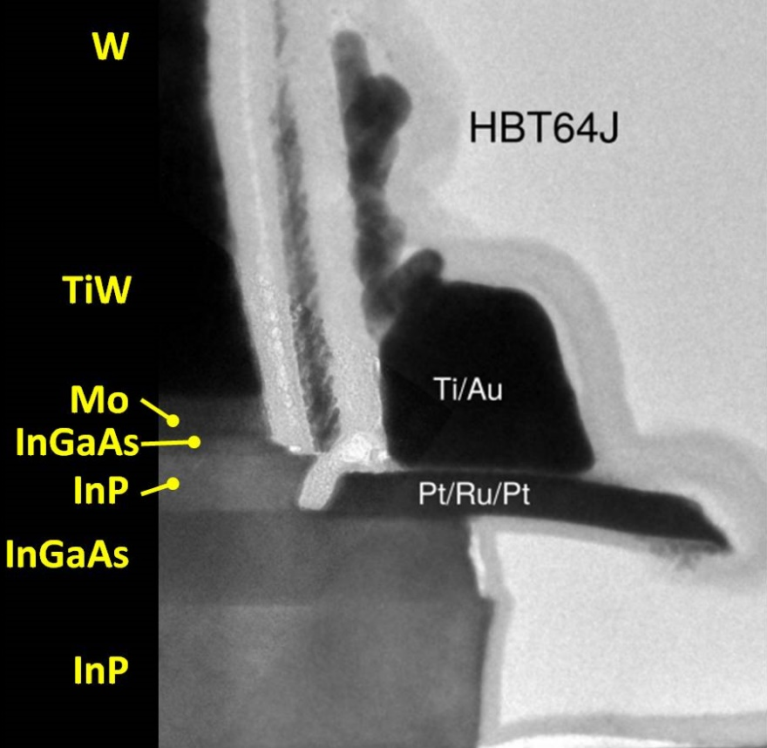
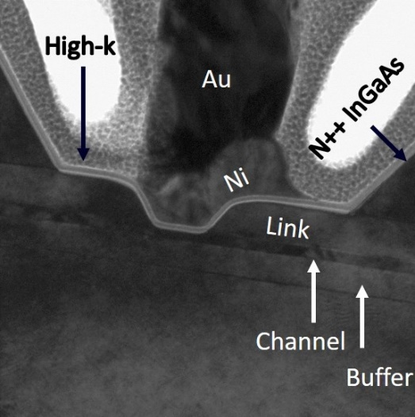
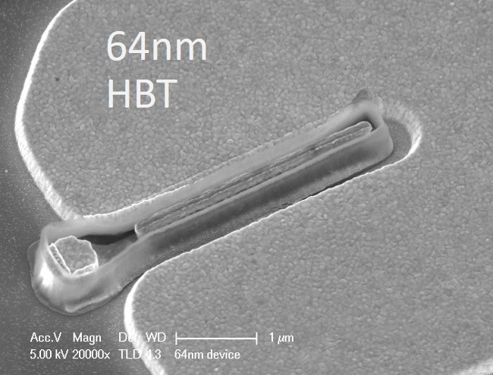
Transistors

Slide 17
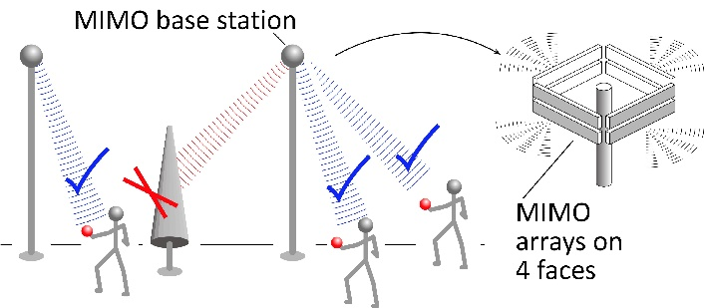
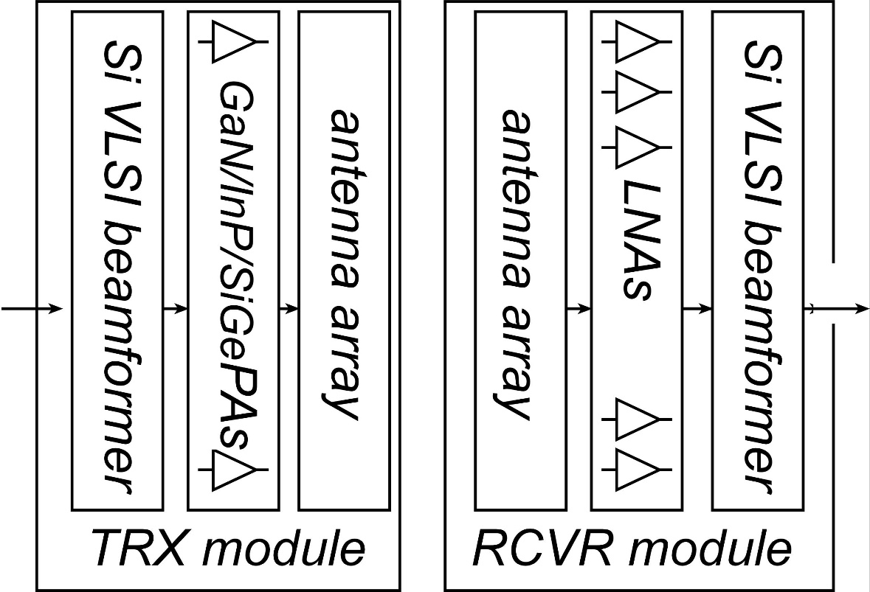
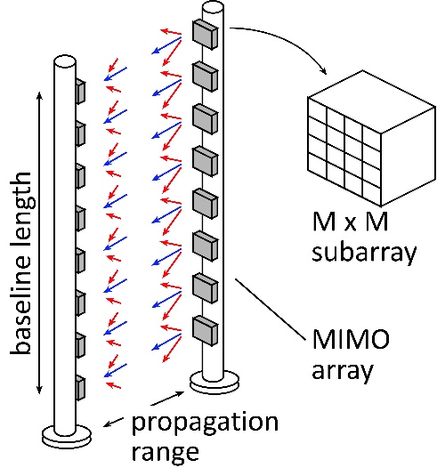
mm-Wave Wireless Transceiver Architecture
custom PAs, LNAs → power, efficiency, noise
Si CMOS beamformer→ integration scale
...similar to today's cell phones.

Slide 18
100-1000 GHz transistors and ICs
 | f_{max} GHz | Good ICs to (GHz) | complexity | LNAs | PAS | increased bandwidth ?
CMOS | 350 | 150/200 | multichannel transceivers | ok | poor: 1-5 mW | not looking good
Production SiGe | 300 | 200/250 | multichannel transceivers | good | OK: 20-100 mW | depends on $$
R&D SiGe | 700 | 300/500 | multichannel transceivers | good | OK: 20-100 mW | 2-3THz
R&D InP HBT | 1150 | 400/650 | PA, frequency converters | poor | good: 100-200 mW | 2-3THz
R&D InP HEMT | 1500 | 500/1000 | LNA | great | weak: 20-50 mW | 2-3THz
R&D GaN | 400 | 120/140 | PAs | good | excellent: 0.1-1W | 600GHz
CNT, 2D, plasmonics etc. : no evidence or theory suggesting that these are useful or superior for 100-2000GHz ICs with useful performance, hero experiments
THz transistors exist today; further R&D will further extend their bandwidth
The challenge: driving the (reduced cost→ larger market→ reduced cost) cycle

Slide 19
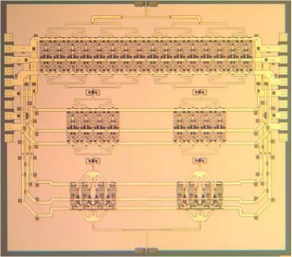
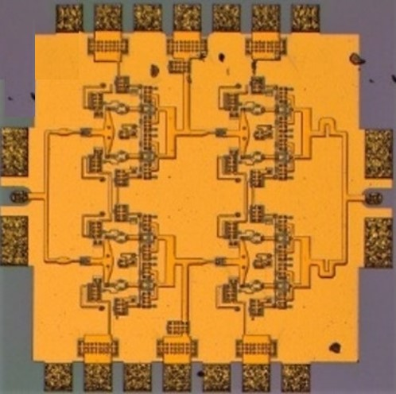
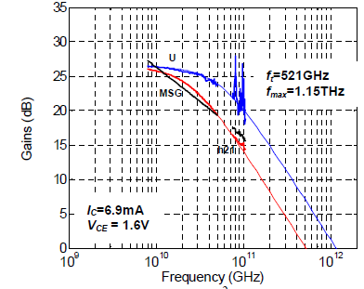
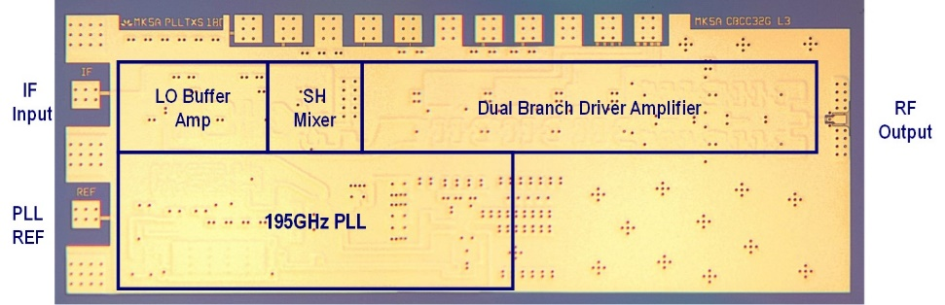
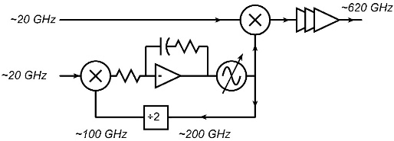
130nm / 1.1THz InP HBT Technology
1.1THz f_{max} HBT,
3.5 V breakdown
220 GHz, 0.18W
power amplifier
325 GHz, 16mW
power amplifier
Teledyne/UCSB: M. Urteaga et al: 2011 DRC
UCSB/Teledyne: T. Reed et al: 2013 CSICS
UCSB/Teledyne:
A. Ahmed, 2018 EuMIC Symp.
Integrated ~600GHz transmitter
Teledyne: M. Urteaga et al: 2017 IEEE Proceedings

Slide 20
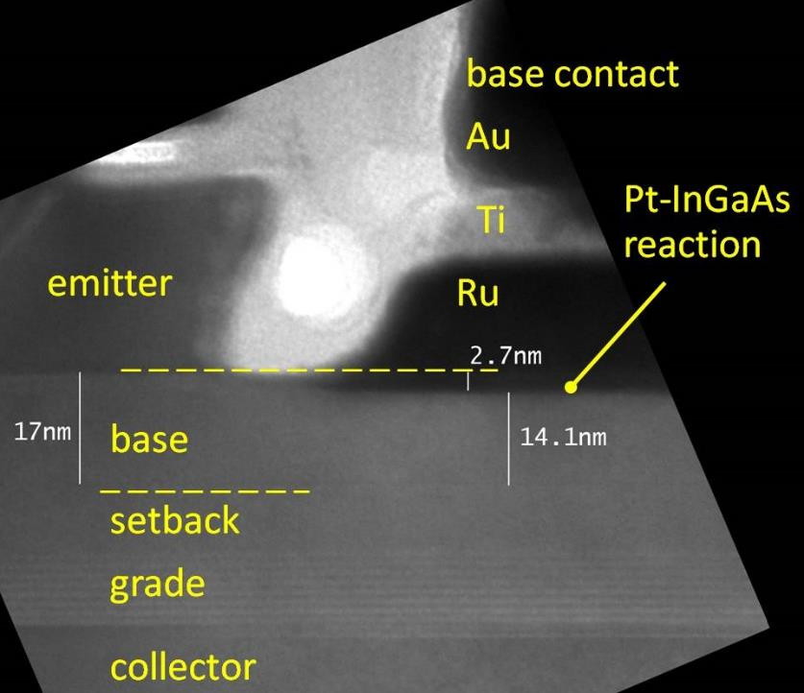
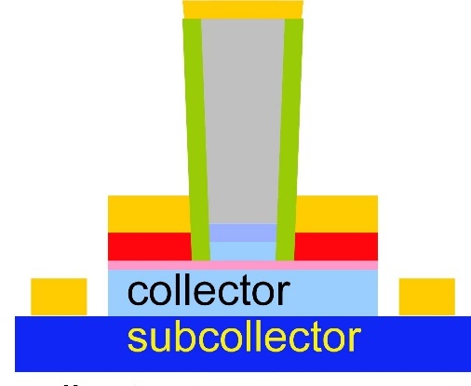
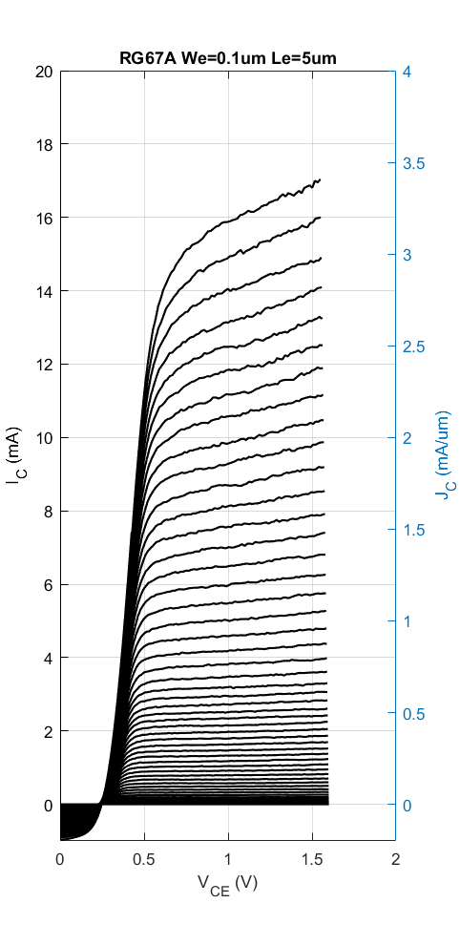
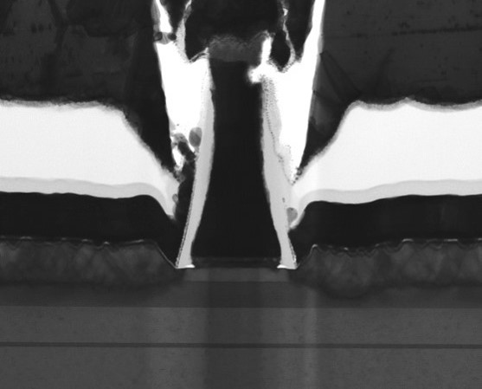
Challenges at the 64nm/2THz & 32nm/3THz Nodes
Need high base contact doping
>10²⁰/cm³ for good contacts
high Auger recombination
very low β.
Need moderate contact penetration
Pd or Pt contacts
react with 3++ nm of base
penetrate surface contaminants
too deep for thin base
Solution: base regrowth:
thin, moderately-doped intrinsic base
thick, heavily-doped extrinsic base
Baraskar et al, Journal of Applied Physics, 2013
Rode et al., IEEE TED, Aug. 2015

Slide 21
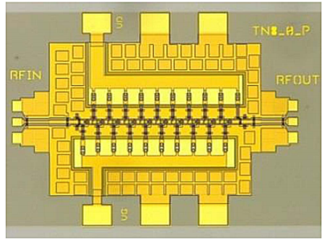
FETs (HEMTs): key for low noise
2:1 to 4:1 increase in f_{τ} :
improved noise
less required transmit power
smaller PAs, less DC power
or higher-frequency systems
First Demonstration of Amplification at 1 THz Using
25-nm InP High Electron Mobility Transistor Process
Xiaobing Mei, et al, IEEE EDL, April 2015 (Northrop-Grumman)

Slide 22
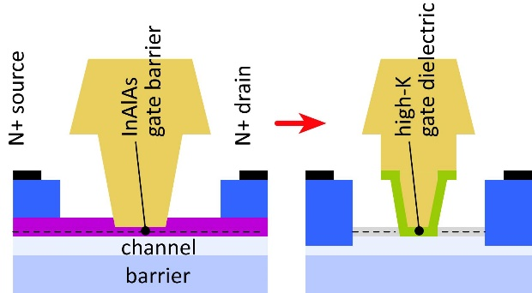
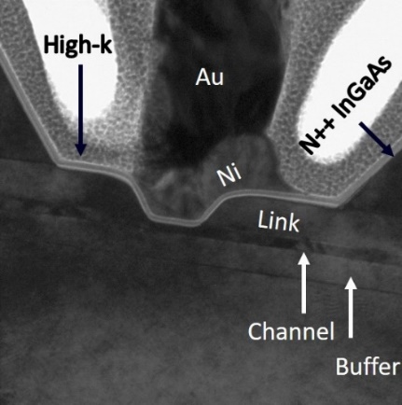
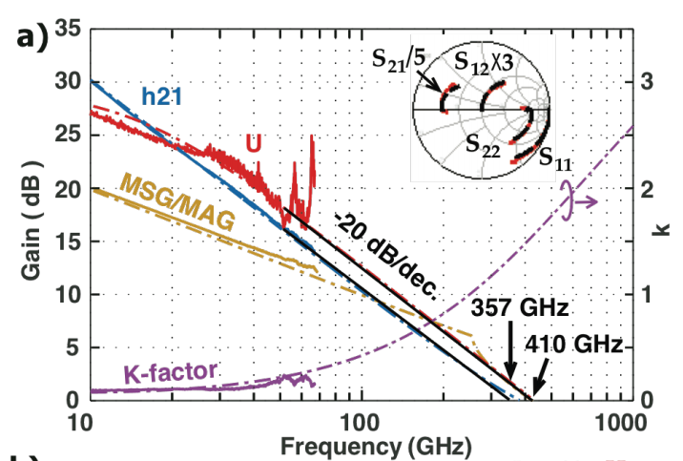
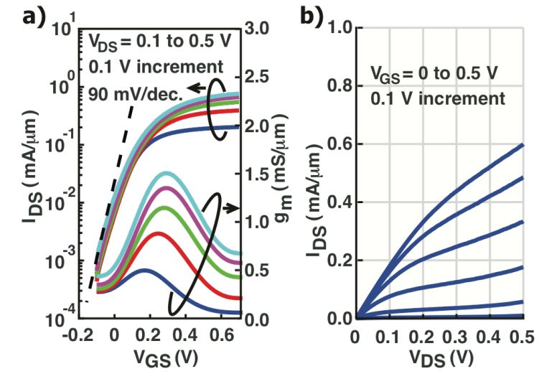
Towards faster HEMTs: MOS-HEMTs
1st demonstration: Fraunhofer IAF
Scaling limit: gate insulator thickness
HEMT: InAlAs barrier: tunneling, thermionic leakage
solution: replace InAlAs with high-K dielectric
2nm ZrO₂ (ε_{r}=25): adequately low leakage
Scaling limit: source access resistance
HEMT: InAlAs barrier is under N+ source/drain
solution: regrowth, place N+ layer on InAs channel
Target ~10nm node
~0.3nm EOT, 3nm thick channel
1.2 to 1.5 THz f_{τ}.
Jun Wu, UCSB, IEEE EDL, 2018

Slide 23
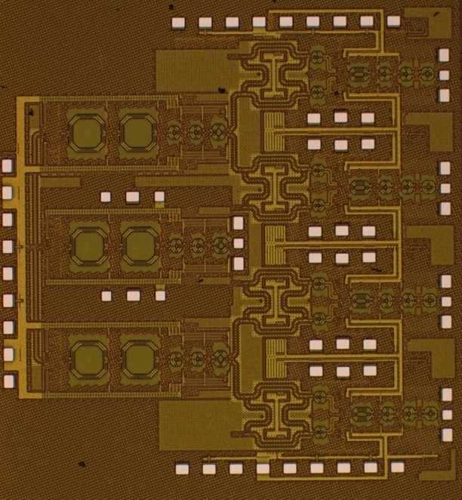
ICs

Slide 24


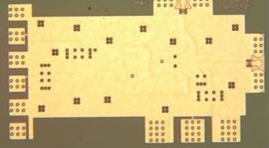

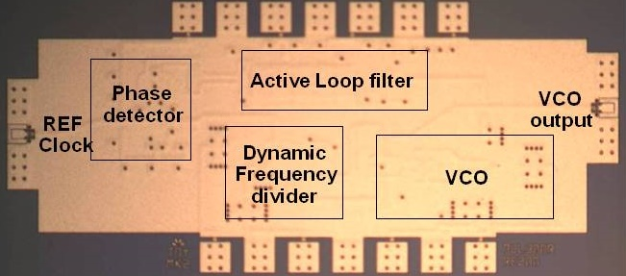
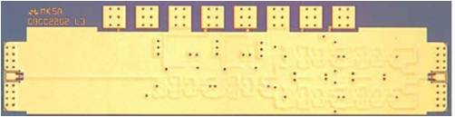
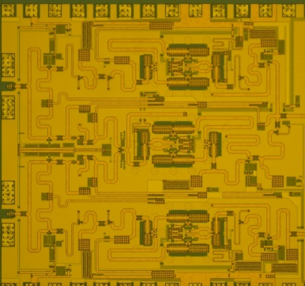

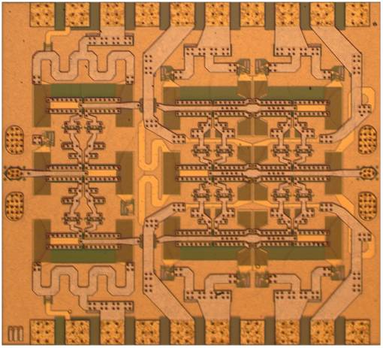
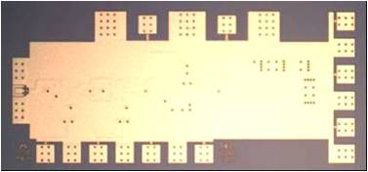
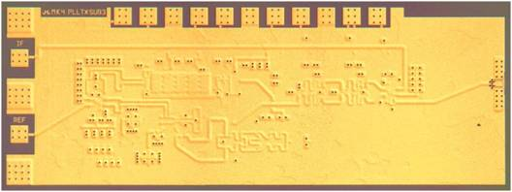
130nm /1.1 THz InP HBT ICs to 670 GHz
530 GHz dynamic frequency divider
614 GHz
fundamental
VCO
340 GHz dynamic frequency divider
M. Seo, TSC
IEICE letter 2015
M. Seo, TSC / UCSB
M. Seo, UCSB/TSC
IMS 2010
300 GHz fundamental
PLL
94 GHz ultra low power phased-array pixel
620 GHz, 20 dB gain amplifier
M Seo, TSC
IMS 2013
also: 670GHz amplifier
J. Hacker , TSC
IMS 2013 (not shown)
S-K. Kim, UCSB
IEEE JSSC 2017
M. Seo, TSC
IMS 2011
204 GHz static
frequency divider
(ECL master-slave
latch)
220 GHz
180 mW
power amplifier
81 GHz
470 mW
power amplifier
Z. Griffith, TSC / UCSB
CSIC 2010
T. Reed, UCSB
CSICS 2013
H-C Park UCSB
IMS 2014
Integrated 300/350GHz Receivers:
LNA/Mixer/VCO
600 GHz
Integrated
Transmitter
PLL + Mixer
M. Seo TSC
M. Seo TSC

Slide 25



140GHz MIMO transceiver front-end ICs
S. Lee, A. Simseck, UCSB, 2018 BCICTS, to be presented

Slide 26


Systems & Packages

Slide 27

Beamforming for massive spatial multiplexing
Pure digital beamforming:
dynamic range & phase noise requirements: both appear to be manageable ✓✓✓
Digital back-end processing requirements (die area, DC power): being investigated ???
Pure RF beamforming: (focal plane, Butler matrixes, RF beamforming)
Established approach in DOD systems (high dynamic range). Issues of array tiling.

Slide 28


The mm-wave module design problem
How to make the IC electronics fit ?
λ₀/2 spacing= 1mm @ 150GHz
How to fit large power amplifier die ?
Catastrophic losses ?
Wire bonds, flip-chip bonds
If large apertures, losses on any long interconnects
How to remove the heat ?
High power densities

Slide 29


mm-wave/sub-mm-wave packaging
Not all systems steer in two planes...
...some steer in only one.
Not all systems steer over 180 degrees...
...some steer a smaller angular range
Arrays can often be linear (1D), instead of rectangular (2D)
Element spacing can often be greater than λ/2.
→ Array packaging then greatly simplified.

Slide 30


Wireless above 100GHz

Slide 31
Wireless above 100 GHz
Massive capacities
large available bandwidths
massive spatial multiplexing in base stations and point-point links
Very short range: few 100 meters
short wavelength, high atmospheric losses. Easily-blocked beams.
IC Technology
All-silicon for short ranges below 250 GHz.
III-V LNAs and PAs for longer-range links. Just like cell phones today
III-V frequency extenders for 340GHz and beyond
The challenges
spatial multiplexing: computational complexity, dynamic range
packaging: fitting signal channels in very small areas

Slide 32
In case of questions

Slide 33


Concept: Tile for linear arrays
Terrestrial system: horizontal steering only→ linear array.
Space at edges of linear array: room for III-V PAs, LNAs.
Alternating-sides feed: 2mm pitch→ room for large GaN PAs.
Mounting directly on metal carrier→ heatsinking.

Slide 34
140 GHz, 640 Gb/s MIMO backhaul
Why not use a lower-frequency carrier, e.g. 140 GHz ?
8-element 640Gb/s linear array:
same link assumptions
requires 2mW (vs. 80mW) power/element
requires 2.6m (vs. 1.6m) linear array
8-element 5Tb/s square array:
same link assumptions
requires 0.25mW (vs. 10mW) power/element
requires 2.6m (vs. 1.6m) square array

Slide 35

140 GHz spatially multiplexed base station

Slide 36

75 GHz spatially multiplexed base station
If we use instead a 75GHz carrier,
the range increases to 325 meters (vs. 250 meters)
but the handset becomes 16mm×16mm (vs. 9mm×9mm),
and the hub array becomes 9mm×655mm (vs. 5mm×350mm)
Or, use a 4×4 (8mm×8mm) handset array,
and the range becomes 210 meters.

Slide 37

340 GHz 640 Gb/s MIMO backhaul

Slide 38

340 GHz 5 Tb/s MIMO backhaul
requires 10mW output per element
...10W total radiated power

Slide 39

Background: split-block waveguides
Waveguides are manufactured (milled or die cast) from a set of pieces
Precision pins aid alignment

Slide 40


Concept: Tile for mm-wave arrays
Split-block assembly. Modules tile into larger array
IC area can be much larger than antenna area→ electronics can fit
Low-loss waveguide feeds, efficient waveguide horn antennas
Efficient heat-sinking: permits W-level GaN, InP, SiGe PAs for long range

Slide 41
Concept: Tile for linear arrays
Terrestrial system: horizontal steering only→ linear array.
Space at edges of linear array: room for III-V PAs, LNAs.
Alternating-sides feed: 2mm pitch→ room for large GaN PAs.
Mounting directly on metal carrier→ heatsinking.

Slide 42

Concept: module for small angular scanning
Terrestrial system: horizontal + vertical steering → rectangular array.
Limited angular steering range (installation)→ spacing >> λ/2
Endfire / edge-card geometry: room for III-V PAs, LNAs.
Mounting directly on metal carrier→ heatsinking.
If Vivaldi's are replaced with dipoles, element spacing can be reduced to λ/2.
→ potential for wider angular scanning

Slide 43

Concept: module for handset
Handset transceiver performance: less challenging.
No external III-V PAs, LNAs
Handset transceiver is simpler: single-beam, not spatially multiplexed
Smaller die area→ array pixel fits in λ/2 × λ/2
Vertical integration of antenna on low-ε_{r} superstrate.
fused Silica (Rebeiz)
possibly also: spin-cast BCB or polyimide, post-process.

Slide 44

Gallium Nitride Power Technologies
GaN is the leading high-frequency power technology
N-polar GaN: Mishra

