Slide 1
100-300GHz Wireless Communications: Systems, Arrays, ICs, and Transistors
2021 Joint EuCNC & 6G Summit, June 8-11, 2021 (online meeting)
Mark Rodwell,University of California, Santa Barbara, rodwell@ece.ucsb.edu Ali Niknejad, University of California, Berkeley
Debdeep Jena, Alyosha Molnar, Christoph Studer, Huili Xing: Cornell University Muhannad Bakir: Georgia Tech Sundeep Rangan: New York University Amin Arbabian, Srabanti Chowdhury: Stanford Elad Alon, Ali Niknejad, Borivoje Nikolic : University of California, Berkeley Danijela Cabric, Tim Fisher: University of California, Los Angeles Andrew Kummel, Gabriel Rebeiz: University of California, San Diego Jim Buckwalter, Upamanyu Madhow, Umesh Mishra, Mark Rodwell, Susanne Stemmer: University of California, Santa Barbara Andreas Molisch: University of Southern California Kenneth O: University of Texas, Dallas
This work was supported in part by the Semiconductor Research Corporation (SRC) and DARPA.

Slide 2
Collaborators (ComSenTer Wireless Team)
Systems
ICs
Transistors
mm-wave CMOS: hub mm-wave arrays mm-wave MIMO
mm-wave CMOS: handset mm-wave arrays
N-polar GaN HEMTs for 140, 210GHz
Networks, Applications, MIMO, Power
Sundeep
Rangan
Ali Niknejad
UC Berkeley
Gabriel Rebeiz
UC San Diego
Umesh Mishra
UC Santa Barbara
AlN/GaN HEMTs for 140, 210GHz
Upamanyu
Madhow
UC Santa Barbara
MIMO algorithms Imaging algorithms Compressive imaging
efficient PAs III-V arrays
Alyosha Molnar
Cornell
N-path mixers MIMO ADCs
Huili (Grace) Xing
Cornell
James Buckwalter
UC Santa Barbara
transistors in novel materials
MIMO algorithms VLSI MIMO digital beamforming
140-300GHz SiGe ICs
design automation equalizers
Susanne Stemmer
UC Santa Barbara
Christoph Studer
Cornell
Kenneth O
UT Dallas
Elad Alon
UC Berkeley
100-300GHz propagation measurements
GaN HEMTs on Si
Andreas Molisch
USC
Muhannad Bakir Georgia Tech
high- frequency packaging
advanced packaging materials
Debdeep Jena
Cornell
Tim Fisher
UCLA
Diamond cooling for GaN
MIMO algorithms (funding via CONIX)
Srabanti Chowdhury
UC Davis
Andrew Kummel
UCSD
advanced packaging materials
Danijela Cabric
UCLA
Massive MIMO demo.
VLSI design automation VLSI MIMO processors
140/210/280GHz arrays for demos.
THz HBTs for PAs THz HEMTs for LNAs
Borivoje Nikolic
UC Berkeley
Mark Rodwell
UC Santa Barbara
Compressive imaging
140GHz radar chipsets and arrays
Amin Arbabian
Stanford

Slide 3
Sponsors

Slide 4
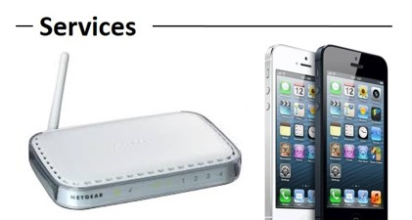
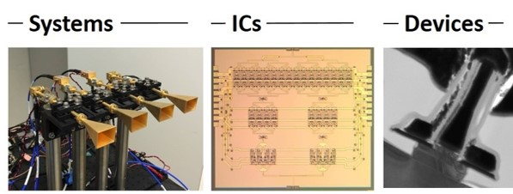
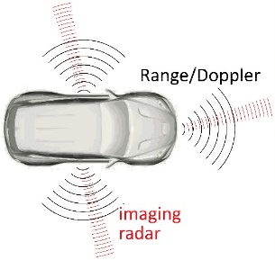
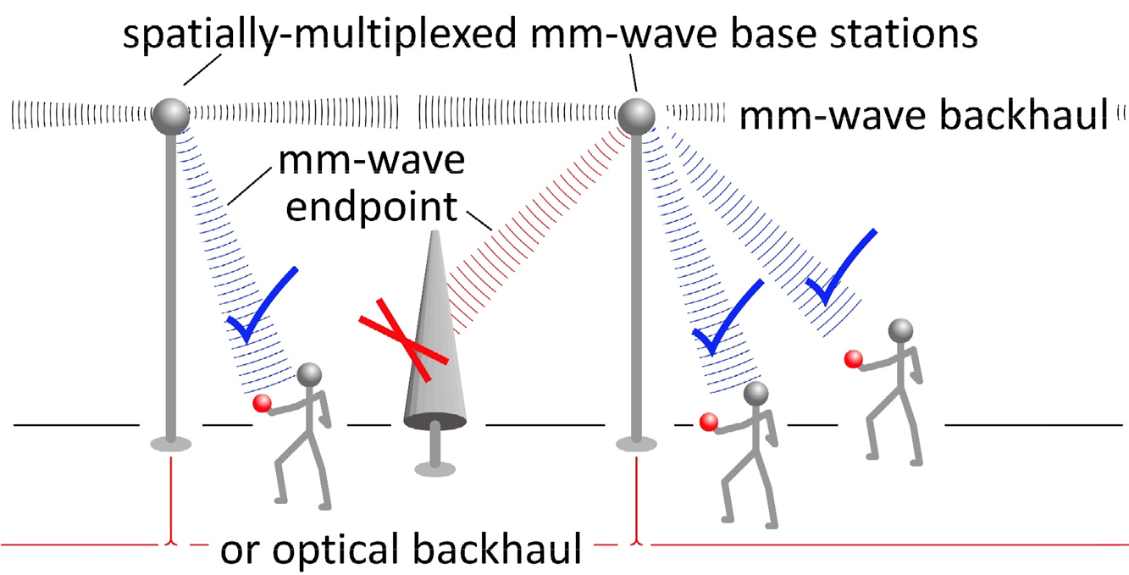
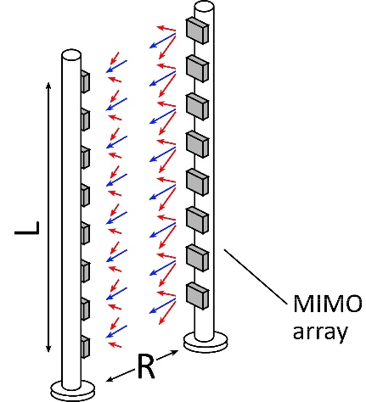
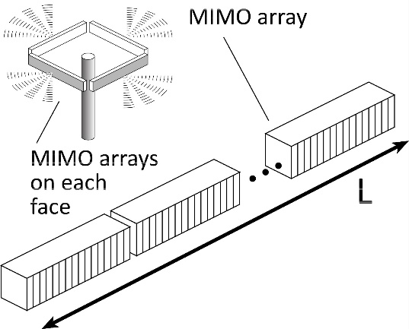
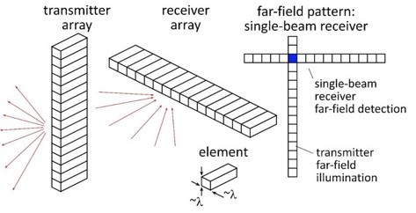
Beyond-5G Wireless
Wireless networks: exploding demand.
Immediate industry response: 5G. ~10-100GHz carriers. increased spectrum, extensive beamforming
Next generation (6G ??): above 100GHz.. greatly increased spectrum, massive spatial multiplexing
JUMP Centers: research commercialized in 15 years
ComSenTer: 100-300GHz carriers, massive spatial multiplexing → Terabit hubs and backhaul links, high-resolution imaging radar

Slide 5
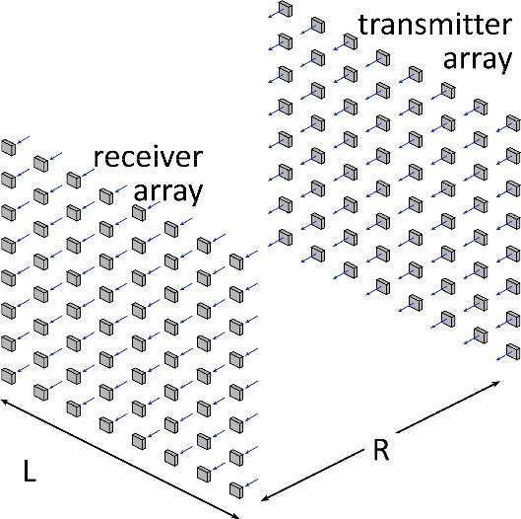
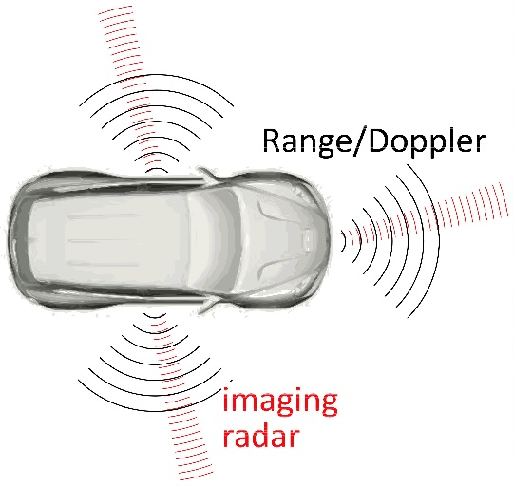
Benefits of Short Wavelengths
Communications: Massive spatial multiplexing, massive # of parallel channels. Also, more spectrum!
Imaging: very fine angular resolution
But: High losses in foul or humid weather. High λ²/R² path losses. ICs: poorer PAs & LNAs. Beams easily blocked.
100-340GHz wireless: terabit capacity, short range, highly intermittent

Slide 6
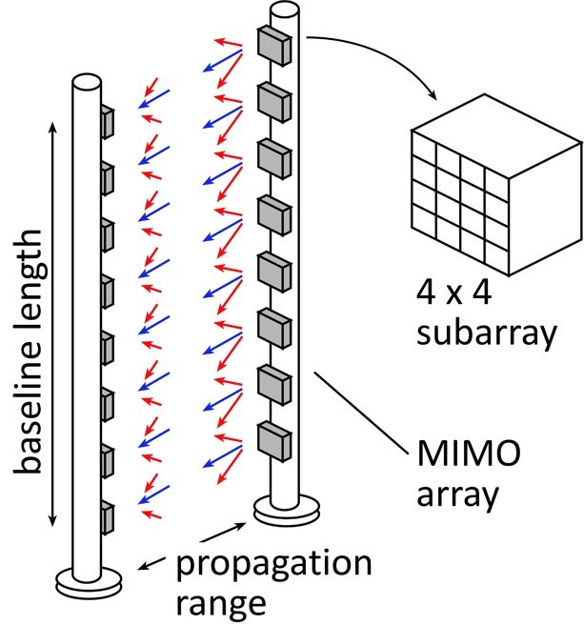
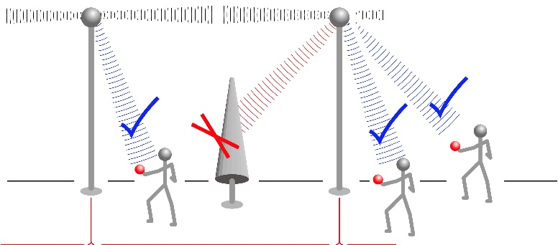
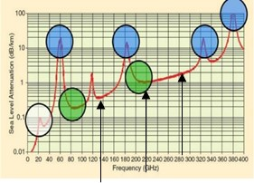
Potential 100-300GHz Systems
140GHz MIMO Hub
210 or 280GHz MIMO Backhaul
140 or 210GHz Imaging Radar

Slide 7
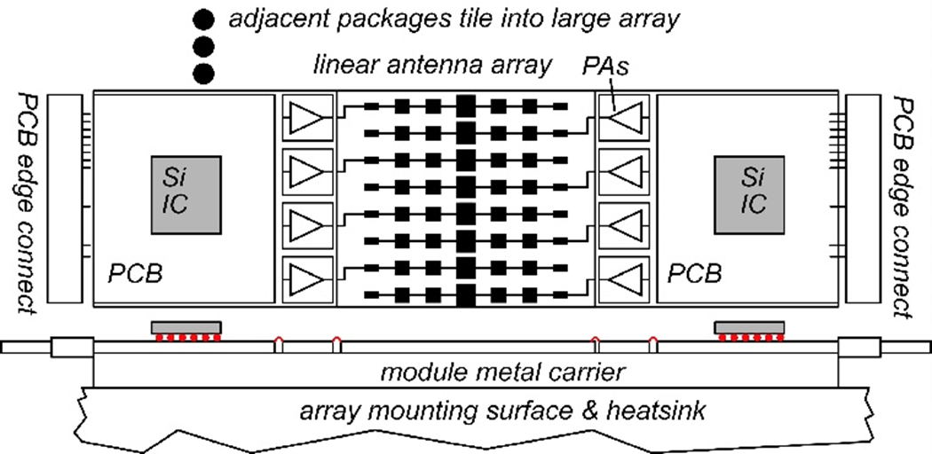
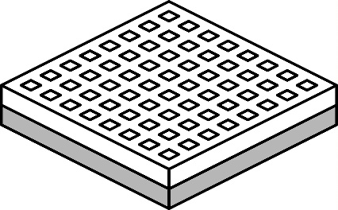
140GHz massive MIMO hub
Handset: 8 × 8 array (9×9mm)
0.5-5 Tb/s spatially-multiplexed 140GHz base station 128 users/face, 4 faces. P_{1dB}=21 dB_{m} PAs, F=8dB LNAs 512 total users @ 1 user/beam, 1,10 Gb/s/beam; 230, 100 m range in 50mm/hr rain with 17dB total margins

Slide 8
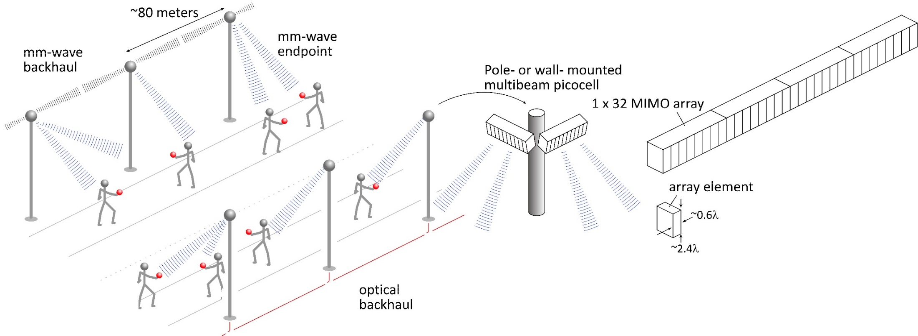
140GHz moderate-MIMO hub
If demo uses 32-element array (four 1×8 modules): 16 users/array. P_{1dB}=21 dB_{m} PAs, F=8dB LNAs 1,10 Gb/s/beam→ 16, 160 Gb/s total capacity 40, 70 m range in 50mm/hr rain with 17dB total margins
Range varies as (# hub elements)^{0.5} → (Service area/element) is constant
Handset: 8 × 8 array (9×9mm)

Slide 9
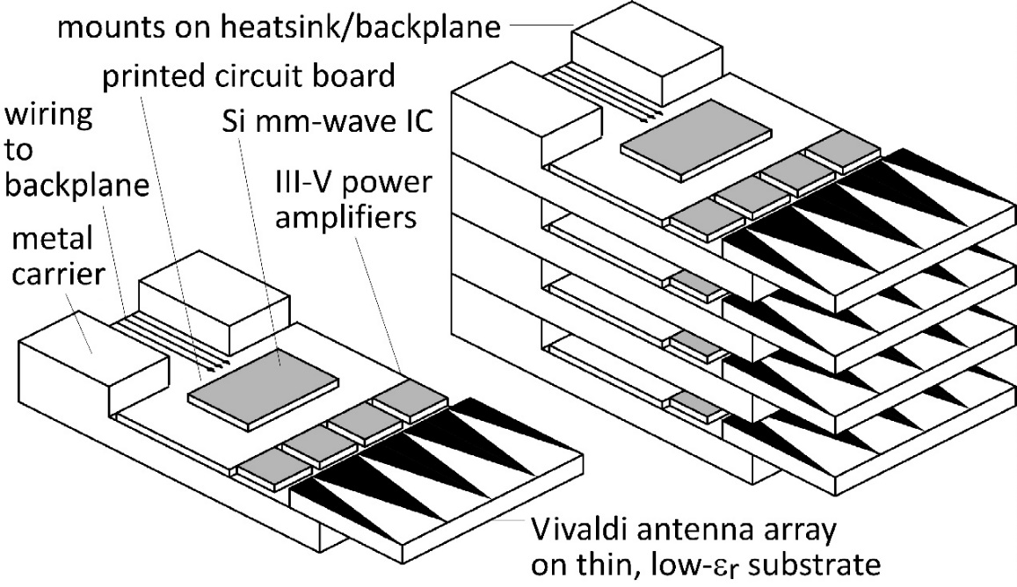
210 GHz, 640 Gb/s MIMO Backhaul
8-element MIMO array 3.1 m baseline. 80Gb/s/subarray→ 640Gb/s total 4 × 4 sub-arrays → 8 degree beamsteering
Key link parameters 500 meters range in 50 mm/hr rain; 23 dB/km 20 dB total margins: packaging loss, obstruction, operating, design, aging PAs: 18dBm =P_{1dB} (per element) LNAs: 6dB noise figure

Slide 10
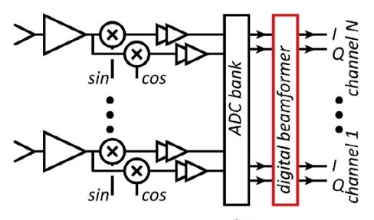
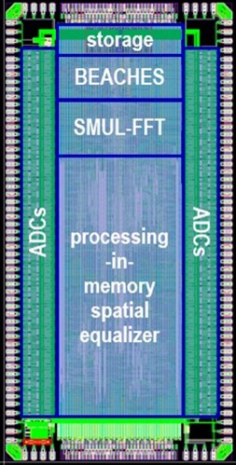
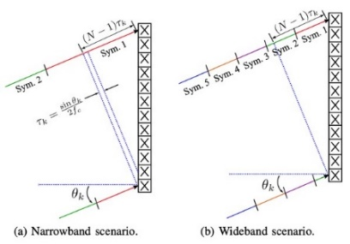
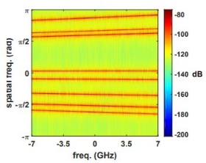
System Design
ADCs/DACs: only 3-4 bit ADC/DACs required (Madhow, Studer, Rodwell)
Linearity: Amplifier P_{1dB} need be only 3dB above average power (Madhow)
Phase noise: Requirements same as for SISO (Alon, Madhow, Niknejad, Rodwell)
Efficient digital beamforming: beamspace algorithm=complexity ~N× log(N) (Madhow, Studer)
Efficient digital beamforming: low-resolution matrix (Studer)
Efficient channel estimation : fast beamspace algorithm (Studer)
Efficiently addressing true-time-delay problem: "rainbow" FFT algorithm (Madhow, Cabric, Studer)

Slide 11
100-1000 GHz Transistors and ICs
 | f_{max} GHz | Good ICs to (GHz) | complexity | LNAs | PAS | increased bandwidth ?
CMOS | 350 | 150/200 | transceivers | good | weak: 10-30 mW | not easy
Production SiGe | 300 | 200/250 | transceivers | ok | OK: 20-100 mW | depends on $$
R&D SiGe | 700 | 300/500 | transceivers | good | OK: 20-100 mW | 2-3THz
R&D InP HBT | 1150 | 400/650 | PA, converters | ok* | good: 100-200 mW | 2-3THz
R&D InP HEMT | 1500 | 500/1000 | LNA | great | weak: 20-50 mW | 2-3THz
R&D GaN | 400 | 120/140 | PAs | good | excellent: 0.1-1W | 600GHz
ICs with useful performance, hero experiments *can be addressed
There are THz transistors today; their bandwidth will increase
Challenge: reducing costs, increasing market size

Slide 12
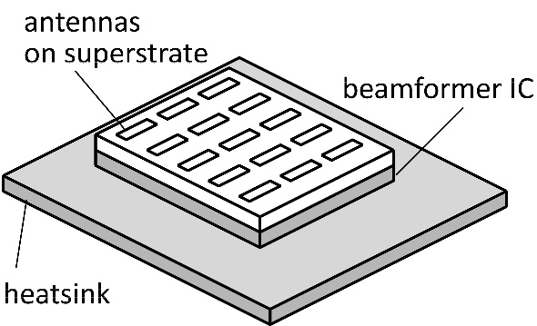
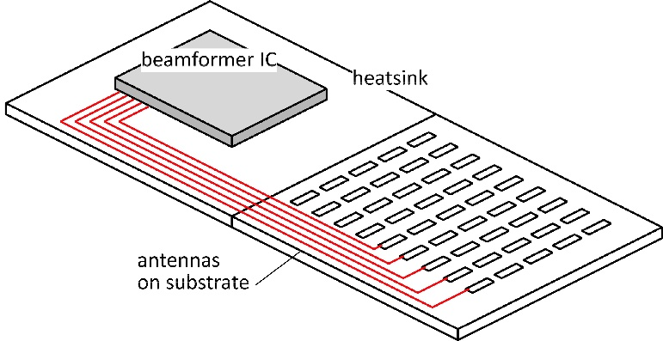
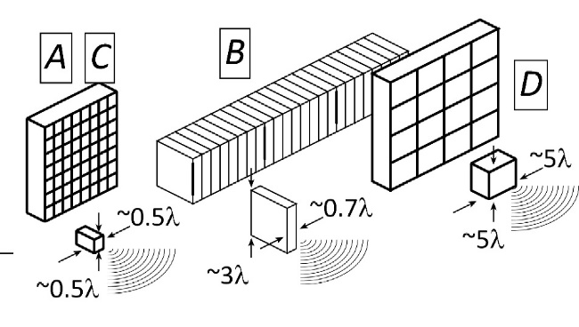
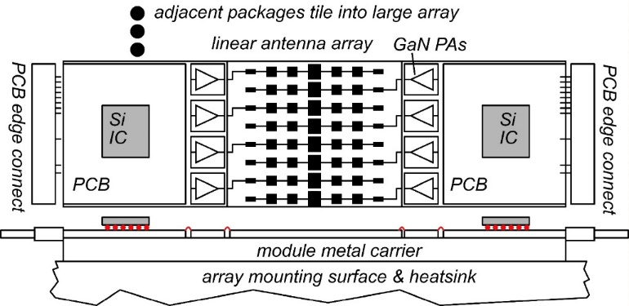
The mm-wave module design problem
How to make the IC electronics fit ? How to avoid catastrophic signal losses ? How to remove the heat ?
Not all systems steer in two planes... ...some steer in only one.
Not all systems steer over 180 degrees... ...some steer a smaller angular range

Slide 13
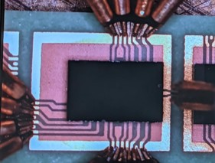
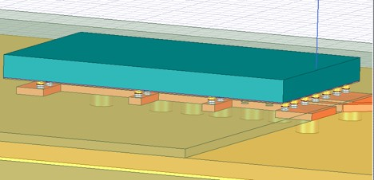
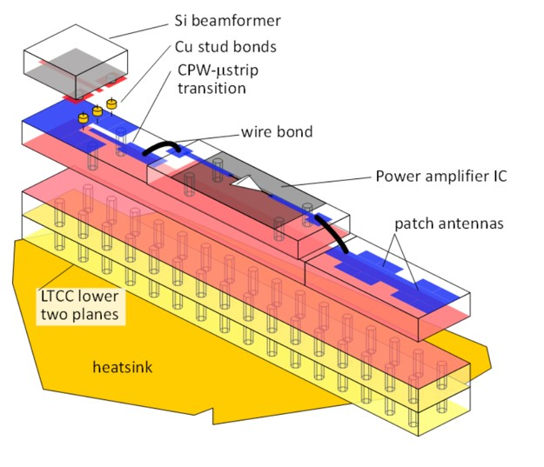
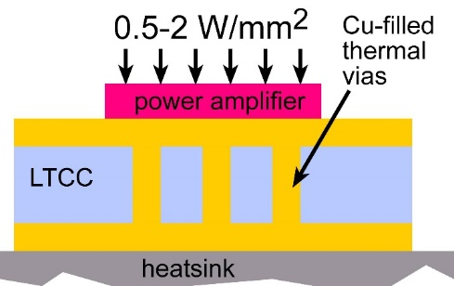
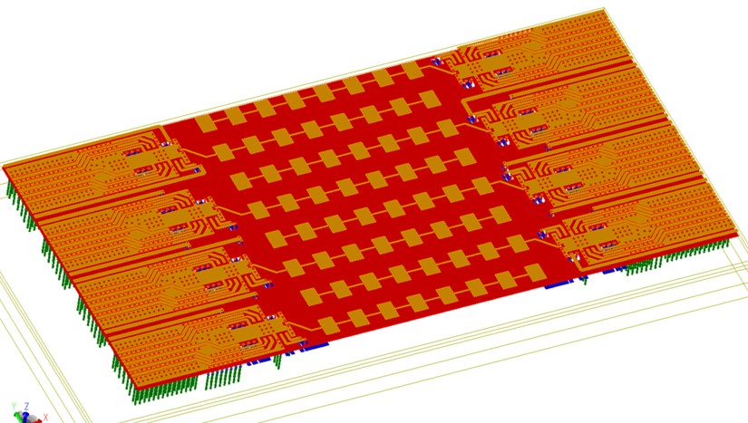
140GHz hub: packaging challenges
IC-package interconnects Difficult at > 100 GHz
Removing heat Thermal vias are marginal
Interconnect density Dense wiring for DC, LO, IF, control. Hard to fit these all in.
Economies of scale Advanced packaging standards require sophisticated tools High-volume orders only Hard for small-volume orders (research, universities) Packaging industry is moving offshore

Slide 14
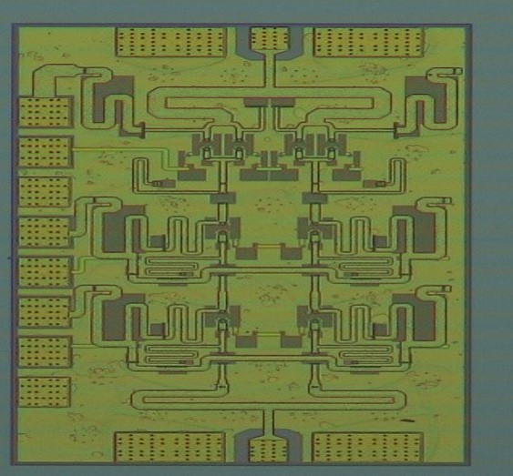
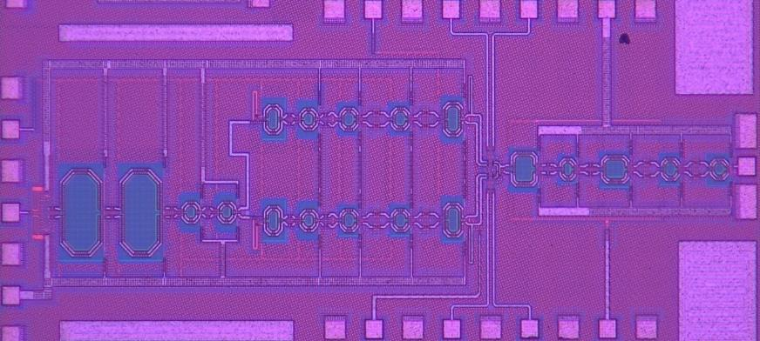
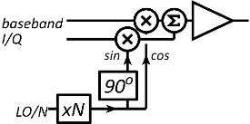
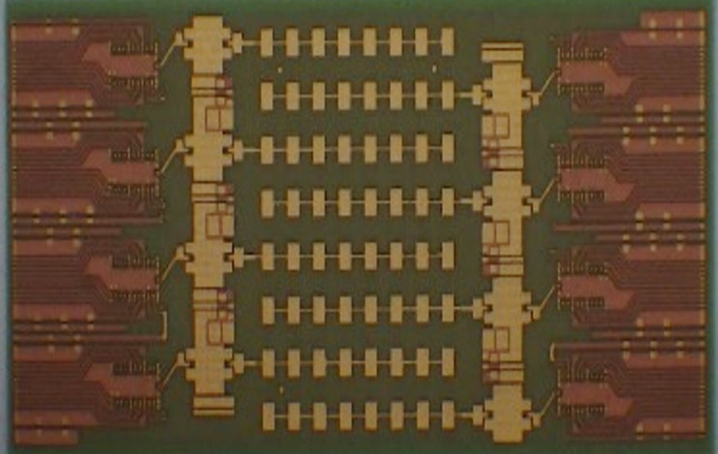
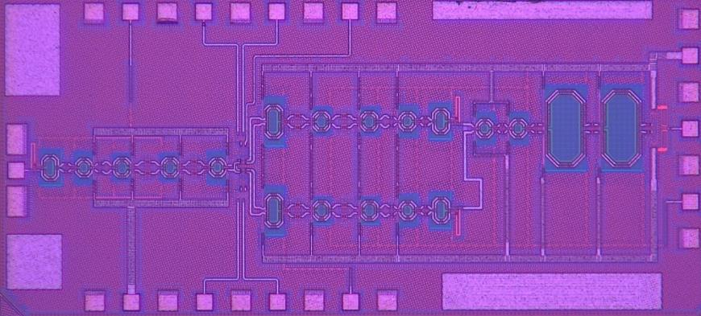
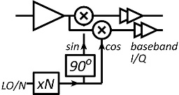
140GHz hub: ICs & Antennas
110mW InP Power Amplifier 20.8% PAE
LTCC Array module
CMOS Transmitter IC 22nm SOI CMOS.
190mW InP Power Amplifier 16.7% PAE
Receiver IC 22nm SOI CMOS.
GlobalFoundries 22nm SOI CMOS
1 cm
Teledyne InP HBT
Kyocera

Slide 15
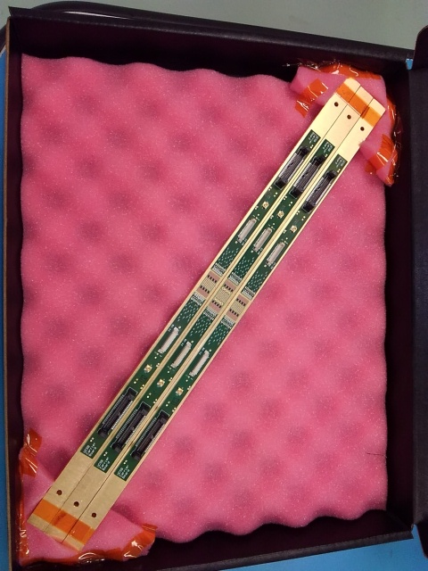
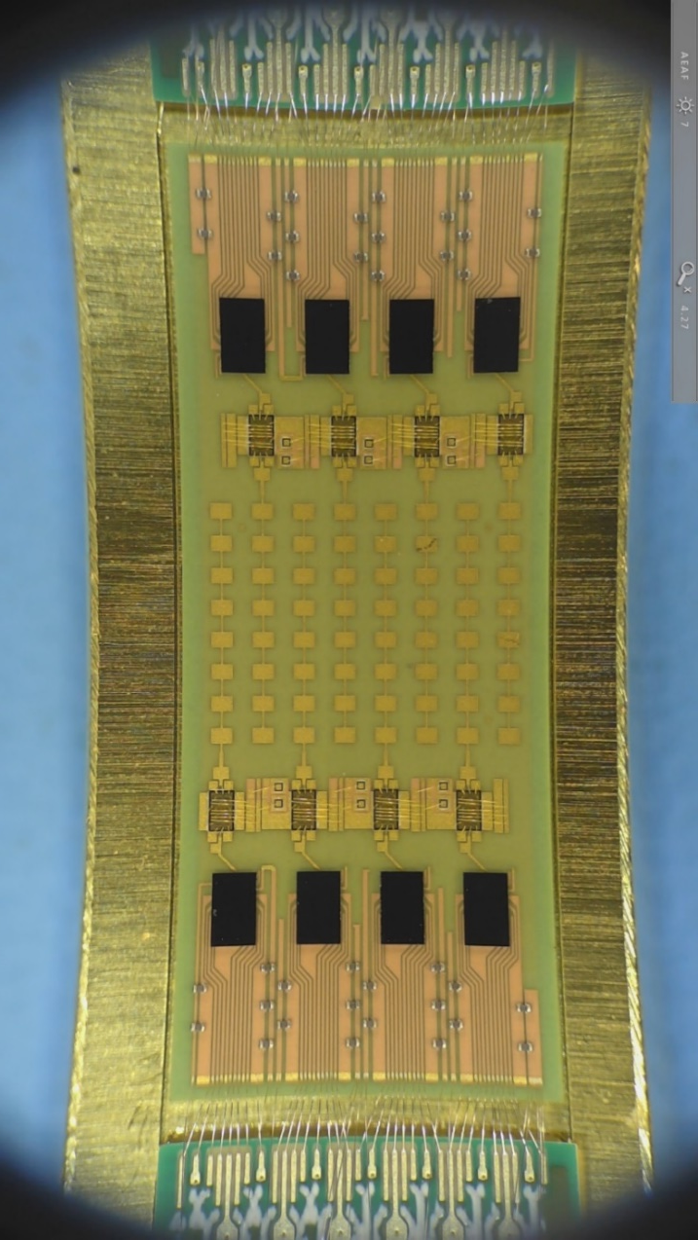
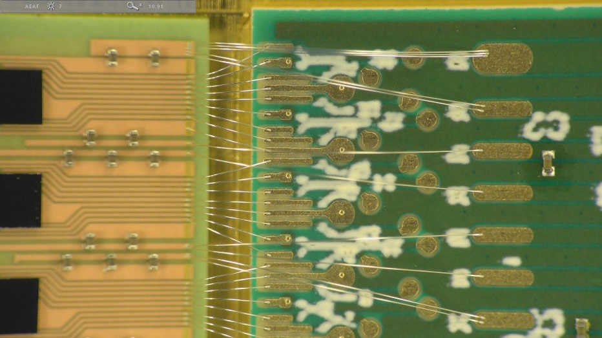
8-Channel 140GHz MIMO hub modules being tested.

Slide 16
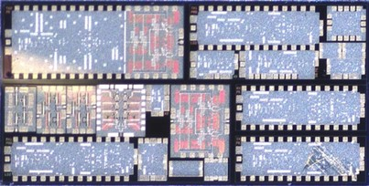
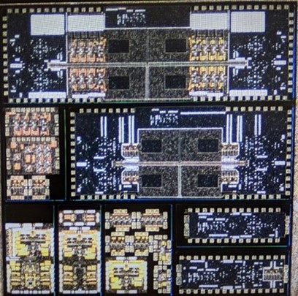
ICs for 210GHz and 280GHz MIMO links
210GHz and 280GHz transceivers in development.
210GHz transmitter, receiver: M. Seo et al, 2021 IMS
200GHz high-efficiency power amplifier: A. Ahmed et al, 2021 IMS
270GHz high-efficiency power amplifier: A. Ahmed et al, 2021 RFIC
4-channel 210GHz tranmistter and receiver arrays: to be tested
280GHz transmitter and receiver ICs: being designed.

Slide 17
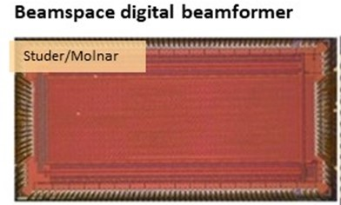
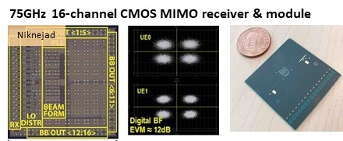
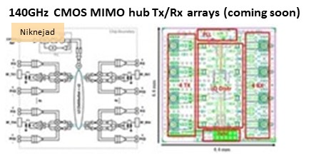
A few key IC results
IMS2021, RFIC201, JSSC submission
ISSCC2021
IMS2021, RFIC2021, IMS2020, EuMIC2020, RFIC2019, EuMIC2021 submission

Slide 18
Wireless above 100 GHz
Massive capacities large available bandwidths massive spatial multiplexing in base stations and point-point links
Very short range: few 100 meters short wavelength, high atmospheric losses. Easily-blocked beams.
IC Technology All-CMOS for short ranges below 200 GHz. SiGe, GaN, or III-V LNAs and PAs for longer-range links. Just like cell phones today SiGe or III-V frequency extenders for 220GHz and beyond
The challenges digital beamformer computational complexity packaging: fitting signal channels in very small areas mesh networking to accommodate beam blockage driving the technologies to low cost

Slide 19
(backup files follow)

Slide 20
100-300GHz Wireless Communications: Systems, Arrays, ICs, and Transistors
2021 Joint EuCNC & 6G Summit, June 8-11, 2021 (online meeting)
Mark Rodwell, University of California, Santa Barbara, rodwell@ece.ucsb.edu
Debdeep Jena, Alyosha Molnar, Christoph Studer, Huili Xing: Cornell University Muhannad Bakir: Georgia Tech Sundeep Rangan: New York University Amin Arbabian, Srabanti Chowdhury: Stanford Elad Alon, Ali Niknejad, Borivoje Nikolic : University of California, Berkeley Danijela Cabric, Tim Fisher: University of California, Los Angeles Andrew Kummel, Gabriel Rebeiz: University of California, San Diego Jim Buckwalter, Upamanyu Madhow, Umesh Mishra, Mark Rodwell, Susanne Stemmer: University of California, Santa Barbara Andreas Molisch: University of Southern California Kenneth O: University of Texas, Dallas
This work was supported in part by the Semiconductor Research Corporation (SRC) and DARPA.

Slide 21
Collaborators (ComSenTer Wireless Team)
Systems
ICs
Transistors
mm-wave CMOS: hub mm-wave arrays mm-wave MIMO
mm-wave CMOS: handset mm-wave arrays
N-polar GaN HEMTs for 140, 210GHz
Networks, Applications, MIMO, Power
Sundeep
Rangan
Ali Niknejad
UC Berkeley
Gabriel Rebeiz
UC San Diego
Umesh Mishra
UC Santa Barbara
AlN/GaN HEMTs for 140, 210GHz
Upamanyu
Madhow
UC Santa Barbara
MIMO algorithms Imaging algorithms Compressive imaging
efficient PAs III-V arrays
Alyosha Molnar
Cornell
N-path mixers MIMO ADCs
Huili (Grace) Xing
Cornell
James Buckwalter
UC Santa Barbara
transistors in novel materials
MIMO algorithms VLSI MIMO digital beamforming
140-300GHz SiGe ICs
design automation equalizers
Susanne Stemmer
UC Santa Barbara
Christoph Studer
Cornell
Kenneth O
UT Dallas
Elad Alon
UC Berkeley
100-300GHz propagation measurements
GaN HEMTs on Si
Andreas Molisch
USC
Muhannad Bakir Georgia Tech
high- frequency packaging
advanced packaging materials
Debdeep Jena
Cornell
Tim Fisher
UCLA
Diamond cooling for GaN
MIMO algorithms (funding via CONIX)
Srabanti Chowdhury
UC Davis
Andrew Kummel
UCSD
advanced packaging materials
Danijela Cabric
UCLA
Massive MIMO demo.
VLSI design automation VLSI MIMO processors
140/210/280GHz arrays for demos.
THz HBTs for PAs THz HEMTs for LNAs
Borivoje Nikolic
UC Berkeley
Mark Rodwell
UC Santa Barbara
Compressive imaging
140GHz radar chipsets and arrays
Amin Arbabian
Stanford

Slide 22
Sponsors

Slide 23
Beyond-5G Wireless
Wireless networks: exploding demand.
Immediate industry response: 5G. ~10-100GHz carriers. increased spectrum, extensive beamforming
Next generation (6G ??): above 100GHz.. greatly increased spectrum, massive spatial multiplexing
JUMP Centers: research commercialized in 15 years
ComSenTer: 100-300GHz carriers, massive spatial multiplexing → Terabit hubs and backhaul links, high-resolution imaging radar

Slide 24
Benefits of Short Wavelengths
Communications: Massive spatial multiplexing, massive # of parallel channels. Also, more spectrum!
Imaging: very fine angular resolution
But: High losses in foul or humid weather. High λ²/R² path losses. ICs: poorer PAs & LNAs. Beams easily blocked.
100-340GHz wireless: terabit capacity, short range, highly intermittent

Slide 25
Potential 100-300GHz Systems
140GHz MIMO Hub
210 or 280GHz MIMO Backhaul
140 or 210GHz Imaging Radar

Slide 26
140GHz massive MIMO hub
Handset: 8 × 8 array (9×9mm)
0.5-5 Tb/s spatially-multiplexed 140GHz base station 128 users/face, 4 faces. P_{1dB}=21 dB_{m} PAs, F=8dB LNAs 512 total users @ 1 user/beam, 1,10 Gb/s/beam; 230, 100 m range in 50mm/hr rain with 17dB total margins

Slide 27
140GHz moderate-MIMO hub
If demo uses 32-element array (four 1×8 modules): 16 users/array. P_{1dB}=21 dB_{m} PAs, F=8dB LNAs 1,10 Gb/s/beam→ 16, 160 Gb/s total capacity 40, 70 m range in 50mm/hr rain with 17dB total margins
Range varies as (# hub elements)^{0.5} → (Service area/element) is constant
Handset: 8 × 8 array (9×9mm)

Slide 28
210 GHz, 640 Gb/s MIMO Backhaul
8-element MIMO array 3.1 m baseline. 80Gb/s/subarray→ 640Gb/s total 4 × 4 sub-arrays → 8 degree beamsteering
Key link parameters 500 meters range in 50 mm/hr rain; 23 dB/km 20 dB total margins: packaging loss, obstruction, operating, design, aging PAs: 18dBm =P_{1dB} (per element) LNAs: 6dB noise figure

Slide 29
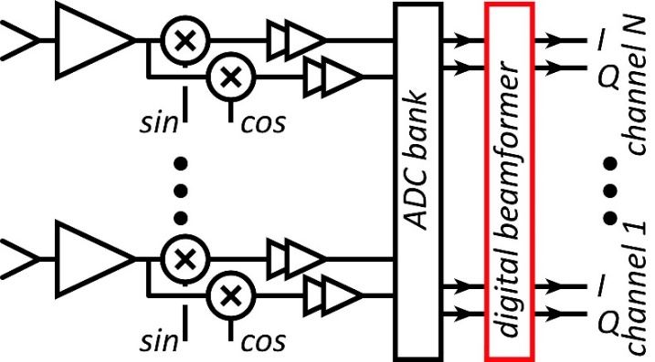
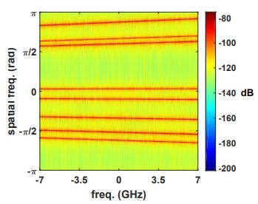
Systems

Slide 30
System Design
ADCs/DACs: only 3-4 bit ADC/DACs required (Madhow, Studer, Rodwell)
Linearity: Amplifier P_{1dB} need be only 3dB above average power (Madhow)
Phase noise: Requirements same as for SISO (Alon, Madhow, Niknejad, Rodwell)
Efficient digital beamforming: beamspace algorithm=complexity ~N× log(N) (Madhow, Studer)
Efficient digital beamforming: low-resolution matrix (Studer)
Efficient channel estimation : fast beamspace algorithm (Studer)
Efficiently addressing true-time-delay problem: "rainbow" FFT algorithm (Madhow, Cabric, Studer)

Slide 31
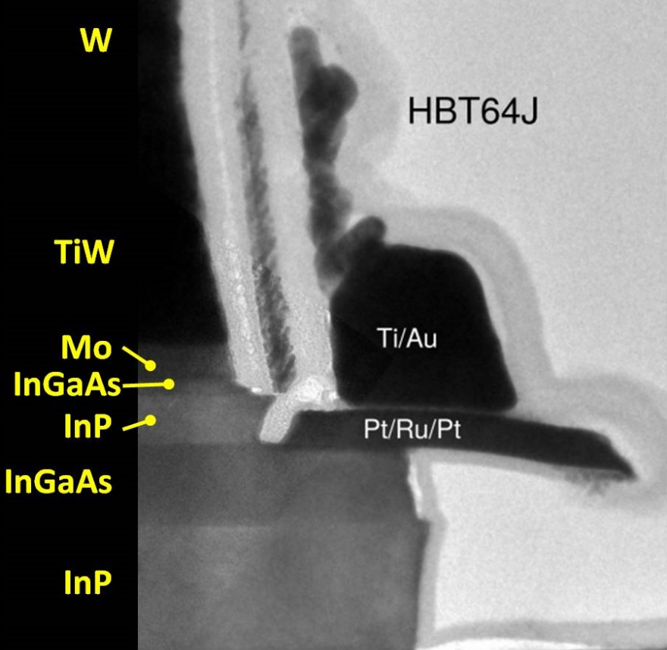
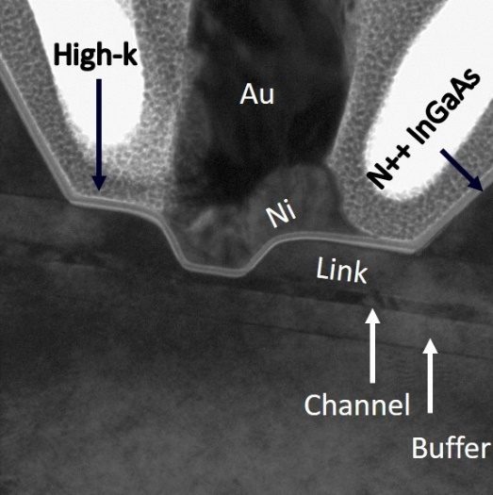
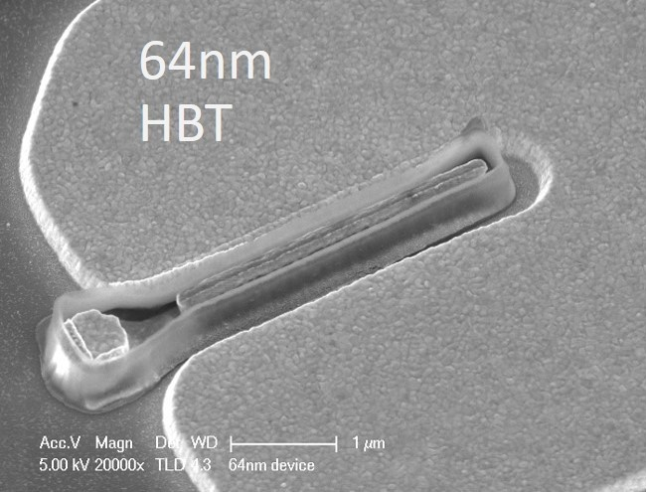
Transistors

Slide 32
100-1000 GHz Transistors and ICs
 | f_{max} GHz | Good ICs to (GHz) | complexity | LNAs | PAS | increased bandwidth ?
CMOS | 350 | 150/200 | transceivers | good | weak: 10-30 mW | not easy
Production SiGe | 300 | 200/250 | transceivers | ok | OK: 20-100 mW | depends on $$
R&D SiGe | 700 | 300/500 | transceivers | good | OK: 20-100 mW | 2-3THz
R&D InP HBT | 1150 | 400/650 | PA, converters | ok* | good: 100-200 mW | 2-3THz
R&D InP HEMT | 1500 | 500/1000 | LNA | great | weak: 20-50 mW | 2-3THz
R&D GaN | 400 | 120/140 | PAs | good | excellent: 0.1-1W | 600GHz
ICs with useful performance, hero experiments *can be addressed
There are THz transistors today; their bandwidth will increase
Challenge: reducing costs, increasing market size

Slide 33
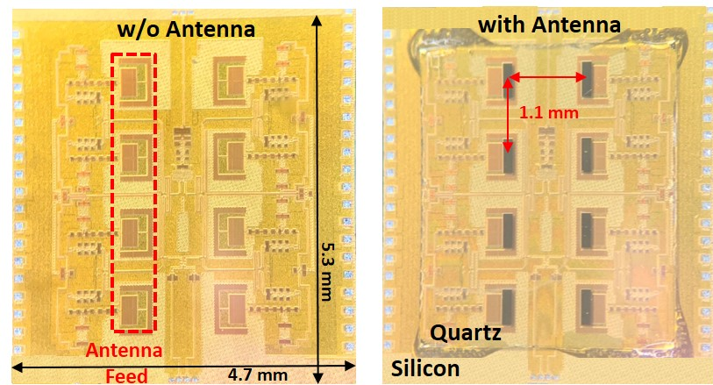
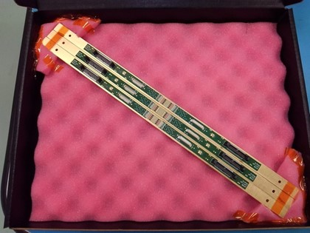
ICs and Packages

Slide 34
The mm-wave module design problem
How to make the IC electronics fit ? How to avoid catastrophic signal losses ? How to remove the heat ?
Not all systems steer in two planes... ...some steer in only one.
Not all systems steer over 180 degrees... ...some steer a smaller angular range

Slide 35
140GHz hub: packaging challenges
IC-package interconnects Difficult at > 100 GHz
Removing heat Thermal vias are marginal
Interconnect density Dense wiring for DC, LO, IF, control. Hard to fit these all in.
Economies of scale Advanced packaging standards require sophisticated tools High-volume orders only Hard for small-volume orders (research, universities) Packaging industry is moving offshore

Slide 36
140GHz hub: ICs & Antennas
110mW InP Power Amplifier 20.8% PAE
LTCC Array module
CMOS Transmitter IC 22nm SOI CMOS.
190mW InP Power Amplifier 16.7% PAE
Receiver IC 22nm SOI CMOS.
GlobalFoundries 22nm SOI CMOS
1 cm
Teledyne InP HBT
Kyocera

Slide 37
8-Channel 140GHz MIMO hub modules being tested.

Slide 38
ICs for 210GHz and 280GHz MIMO links
210GHz and 280GHz transceivers in development.
210GHz transmitter, receiver: M. Seo et al, 2021 IMS
200GHz high-efficiency power amplifier: A. Ahmed et al, 2021 IMS
270GHz high-efficiency power amplifier: A. Ahmed et al, 2021 RFIC
4-channel 210GHz tranmistter and receiver arrays: to be tested
280GHz transmitter and receiver ICs: being designed.

Slide 39
A few key IC results

Slide 40
100-300GHz Wireless

Slide 41
Wireless above 100 GHz
Massive capacities large available bandwidths massive spatial multiplexing in base stations and point-point links
Very short range: few 100 meters short wavelength, high atmospheric losses. Easily-blocked beams.
IC Technology All-CMOS for short ranges below 200 GHz. SiGe, GaN, or III-V LNAs and PAs for longer-range links. Just like cell phones today SiGe or III-V frequency extenders for 220GHz and beyond
The challenges digital beamformer computational complexity packaging: fitting signal channels in very small areas mesh networking to accommodate beam blockage driving the technologies to low cost

