Slide 1
100-300GHz Wireless: Transistors, ICs, packages, systems.
6G Workshop, IEEE RF/Wireless Week, January 2021, online.
Mark Rodwell, UCSB
Harish Krishnaswami: Columbia University Debdeep Jena, Alyosha Molnar, Christoph Studer, Huili Xing: Cornell University Dina Katabi: MIT Sundeep Rangan: New York University Amin Arbabian, Srabanti Chowdhury: Stanford Elad Alon, Ali Niknejad, Borivoje Nikolic, Vladimir Stojanovic: University of California, Berkeley Danijela Cabric: University of California, Los Angeles Gabriel Rebeiz: University of California, San Diego Jim Buckwalter, Upamanyu Madhow, Umesh Mishra, Mark Rodwell, Susanne Stemmer: University of California, Santa Barbara Andreas Molisch, Hossein Hashemi: University of Southern California Kenneth O: University of Texas, Dallas

Slide 2
Team and their roles
Systems
ICs
Transistors
Networks, Applications, MIMO, Power
mm-wave CMOS: hub mm-wave arrays mm-wave MIMO
mm-wave CMOS: handset mm-wave arrays
N-polar GaN HEMTs for 140, 210GHz
Sundeep
Rangan
Ali Niknejad
UC Berkeley
Gabriel Rebeiz
UC San Diego
Umesh Mishra
UC Santa Barbara
Upamanyu
Madhow
UC Santa Barbara
MIMO algorithms Imaging algorithms Compressive imaging
efficient PAs III-V arrays
Alyosha Molnar
Cornell
N-path mixers MIMO ADCs
Huili (Grace) Xing
Cornell
AlN/GaN HEMTs for 140, 210GHz
James Buckwalter
UC Santa Barbara
MIMO algorithms VLSI MIMO processors
200-300GHz passive CMOS
design automation equalizers
GaN HEMTs on Si
Christoph Studer
Cornell
Kenneth O
UT Dallas
Elad Alon
UC Berkeley
Debdeep Jena
Cornell
Andreas Molisch
USC
100-300GHz propagation measurements
Harish Krishnaswamy
Columbia
STAR Novel MIMO
photonic links
Diamond cooling for GaN
Vladimir
Stojanovic
UC Berkeley
Srabanti Chowdhury
UC Davis
Applications: VR, cars, …
acoustic filters
Susanne Stemmer
UC Santa Barbara
transistors in novel materials
Dina Katabi
MIT
Hossein Hashemi
USC
Massive MIMO demo.
VLSI design automation VLSI MIMO processors
Danijela Cabric
UCLA
Borivoje Nikolic
UC Berkeley
140/210/290GHz arrays for demos.
THz HBTs for PAs THz HEMTs for LNAs
MIMO algorithms
Mark Rodwell
UC Santa Barbara
Compressive imaging
140GHz radar chipsets and arrays
Amin Arbabian
Stanford

Slide 3
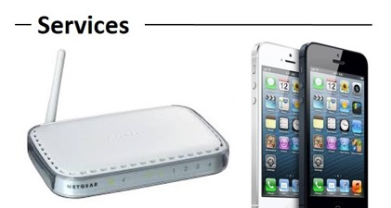
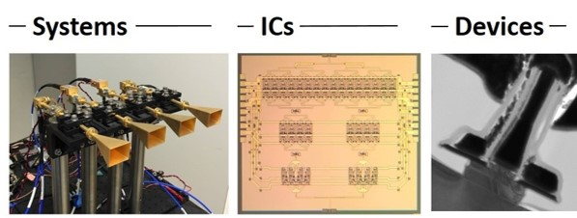
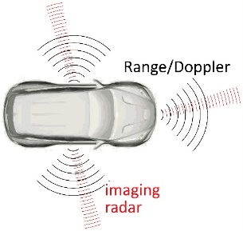
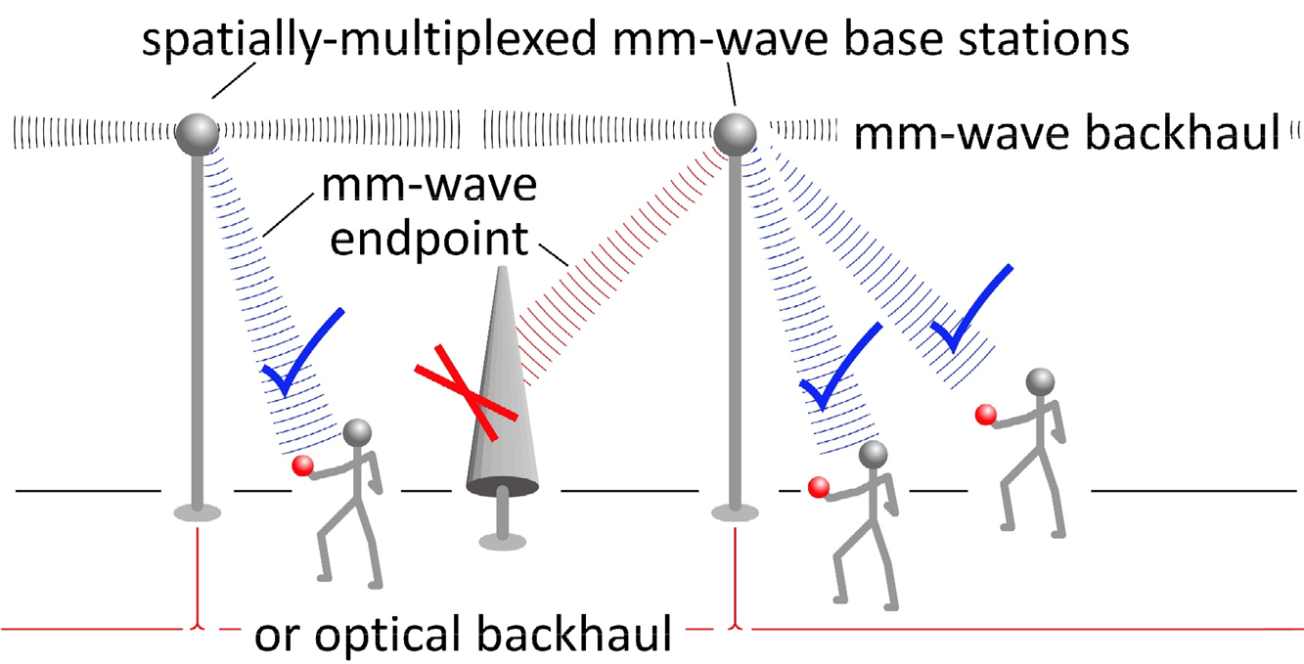
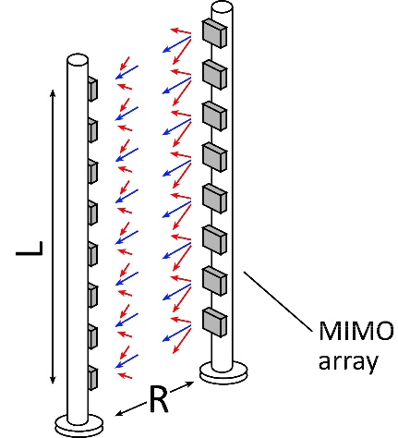
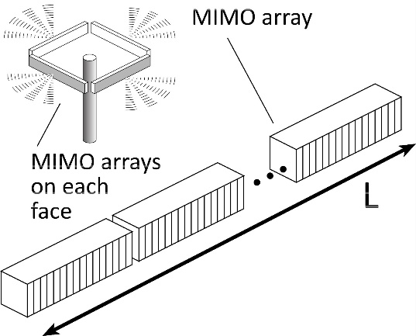
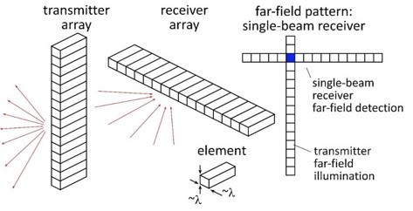
Beyond-5G Wireless
Wireless networks: exploding demand.
Immediate industry response: 5G. ~10-100GHz carriers. increased spectrum, extensive beamforming
Next generation (6G ??): above 100GHz.. greatly increased spectrum, massive spatial multiplexing
JUMP Centers: research commercialized in 15 years
ComSenTer: 100-300GHz carriers, massive spatial multiplexing → Terabit hubs and backhaul links, high-resolution imaging radar

Slide 4
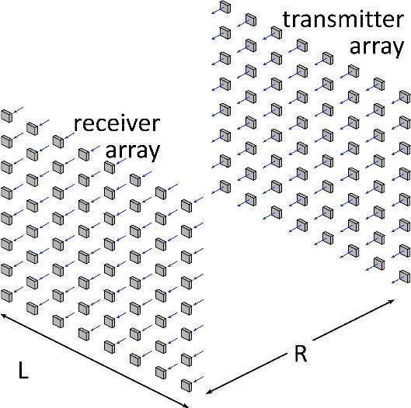
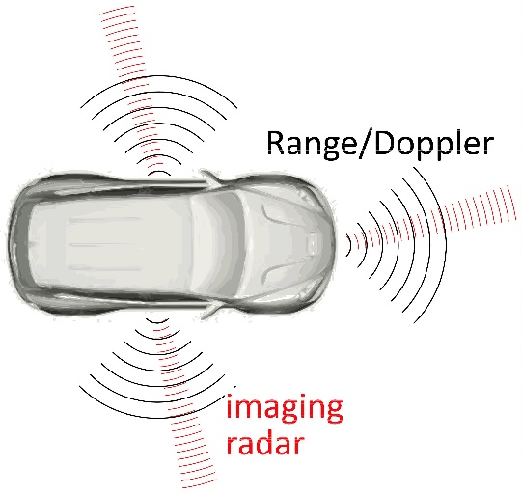
Benefits of Short Wavelengths
Communications: Massive spatial multiplexing, massive # of parallel channels. Also, more spectrum!
Imaging: very fine angular resolution
But: High losses in foul or humid weather. High λ²/R² path losses. ICs: poorer PAs & LNAs. Beams easily blocked.
100-340GHz wireless: terabit capacity, short range, highly intermittent

Slide 5
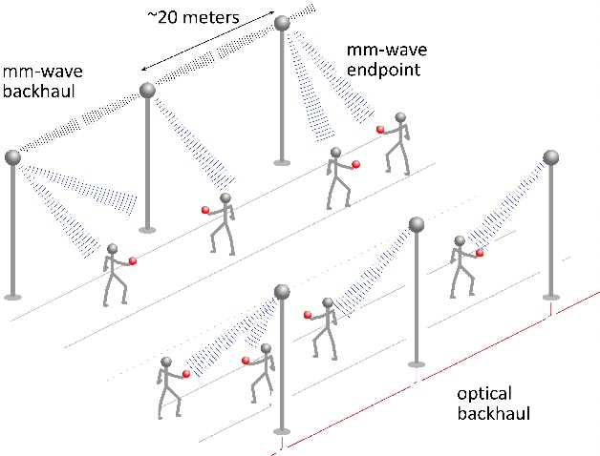
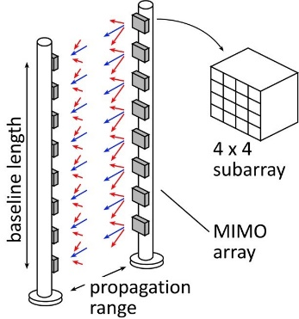
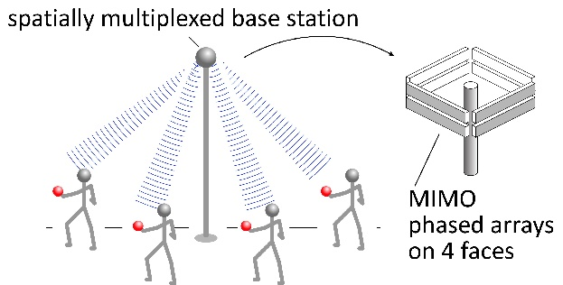
100-300 GHz: Applications

Slide 6
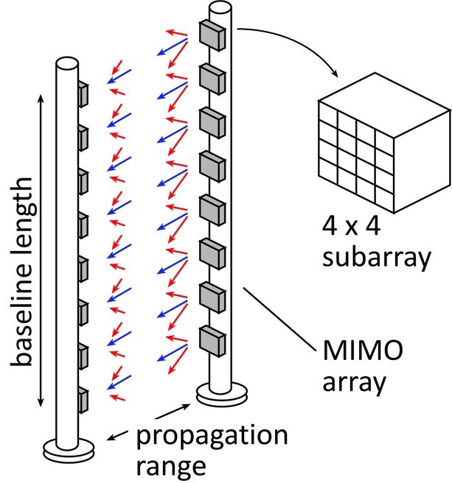
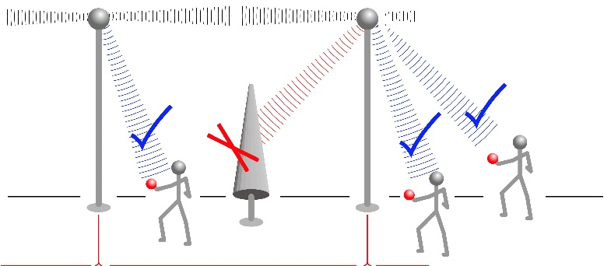
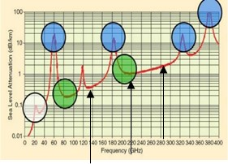
100-300GHz: Demonstration Systems
MIMO hub: 140GHz
Point-point MIMO: 210, 280GHz
Cross-linear-array imaging: 210, 280GHz
UCSB FCC permit: 137 +/- 15 GHz, 210 +/- 15 GHz, 280 +/- 15 GHz

Slide 7
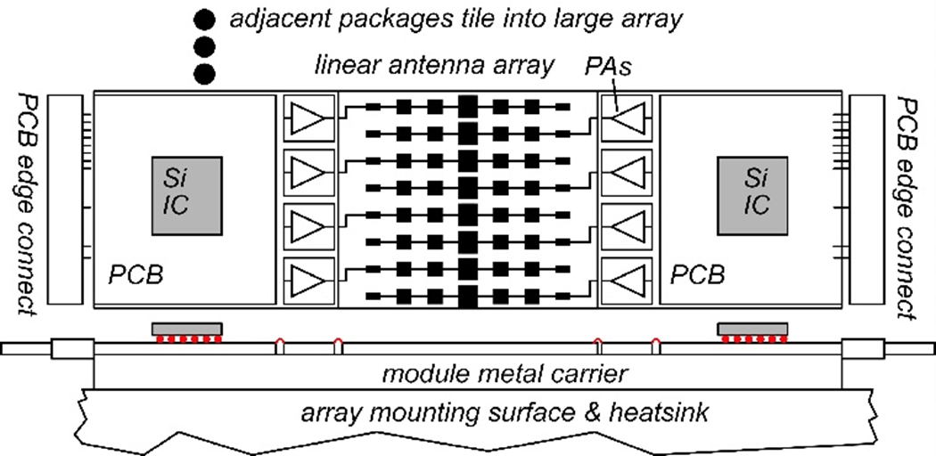
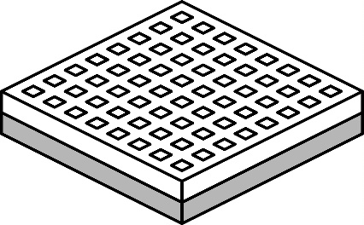
140GHz massive MIMO hub
Handset: 8 × 8 array (9×9mm)
0.5-5 Tb/s spatially-multiplexed 140GHz base station 128 users/face, 4 faces. P_{1dB}=21 dB_{m} PAs, F=8dB LNAs 512 total users @ 1 user/beam, 1,10 Gb/s/beam; 230, 100 m range in 50mm/hr rain with 17dB total margins

Slide 8
70 GHz spatially multiplexed base station
If we use instead a 70GHz carrier, the range increases to 168 meters (vs. 100 meters) but the handset becomes 16mm×16mm (vs. 8mm×8mm), and the hub array becomes 20mm×524mm (vs. 10mm×262mm)
Or, use a 4×4 (8mm×8mm) handset array, and the range becomes ..100 meters.
Same handset area (more handset elements)→ same link budget Easier to obtain license for 140±2.5GHz than 75±2.5GHz

Slide 9
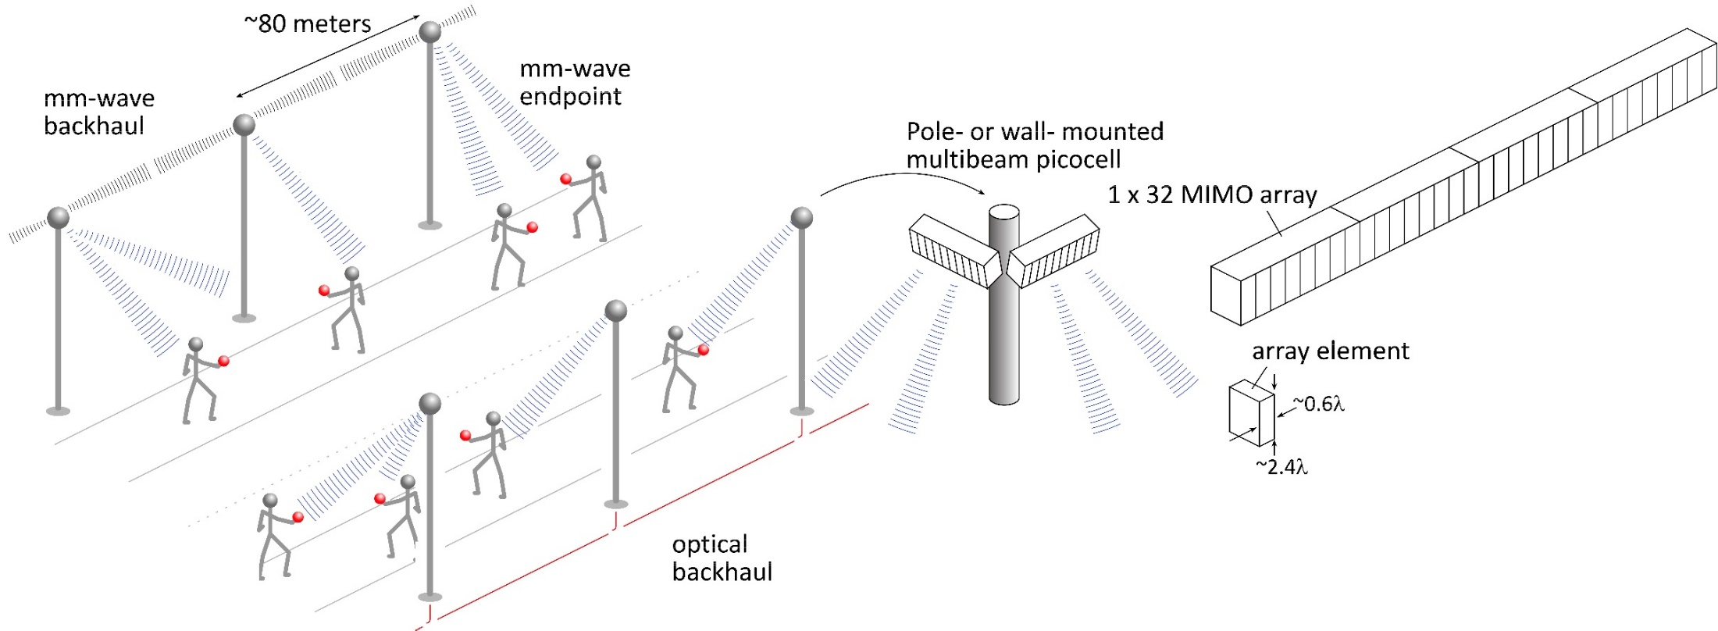
140GHz moderate-MIMO hub
If demo uses 32-element array (four 1×8 modules): 16 users/array. P_{1dB}=21 dB_{m} PAs, F=8dB LNAs 1,10 Gb/s/beam→ 16, 160 Gb/s total capacity 40, 70 m range in 50mm/hr rain with 17dB total margins
Range varies as (# hub elements)^{0.5} → (Service area/element) is constant
Handset: 8 × 8 array (9×9mm)

Slide 10
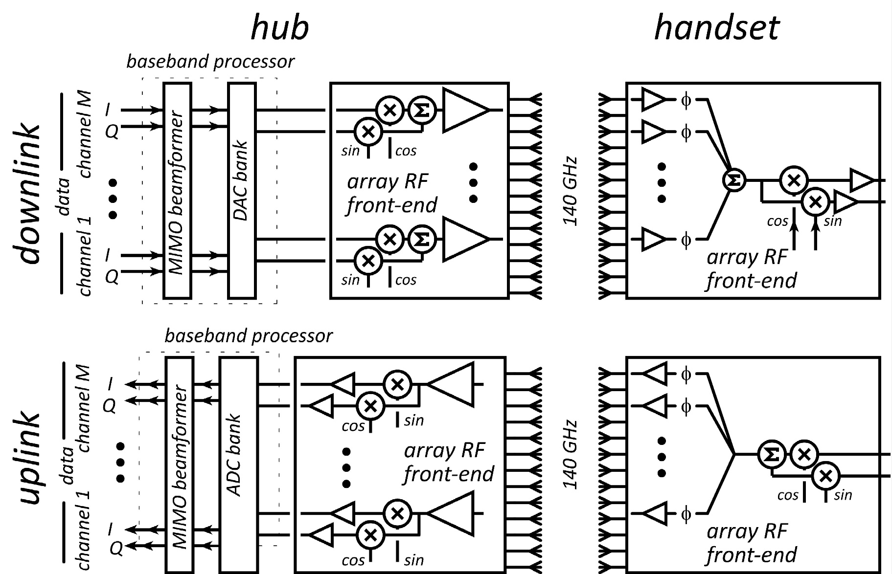
140GHz Architecture (Sketch)
75GHz RF front-ends BWRC
140 GHz hub RF front-ends UCSB
140GHz handset RF front-ends UCSD Beamforming by:
FPGA: demos, algorithms
BWRC Hydra: flexible, general
Custom Si VLSI beamformer ICs in development (BWRC, Cornell)

Slide 11
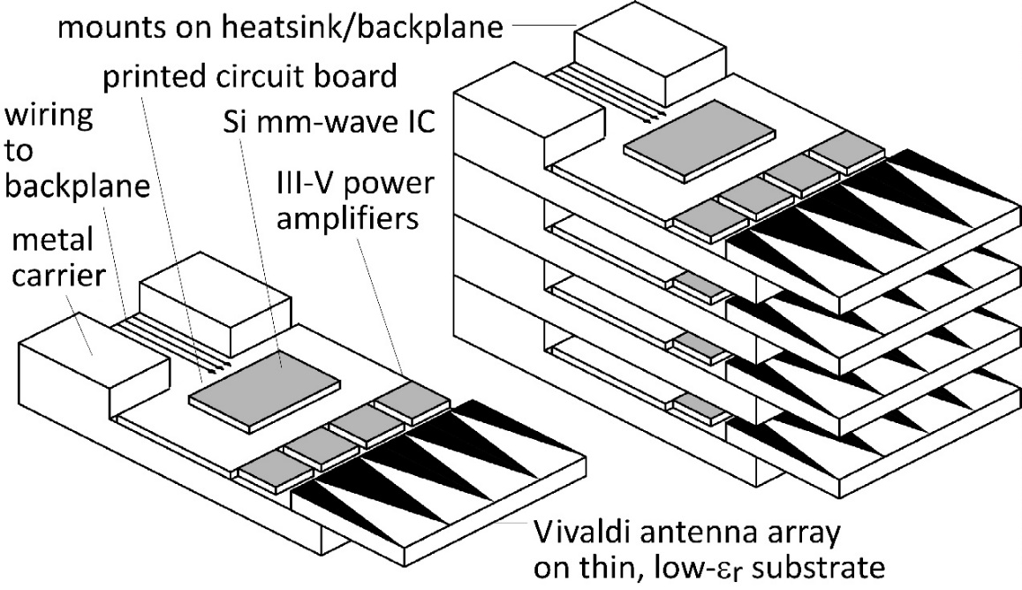
210 GHz, 640 Gb/s MIMO Backhaul
8-element MIMO array 3.1 m baseline. 80Gb/s/subarray→ 640Gb/s total 4 × 4 sub-arrays → 8 degree beamsteering
Key link parameters 500 meters range in 50 mm/hr rain; 23 dB/km 20 dB total margins: packaging loss, obstruction, operating, design, aging PAs: 18dBm =P_{1dB} (per element) LNAs: 6dB noise figure

Slide 12
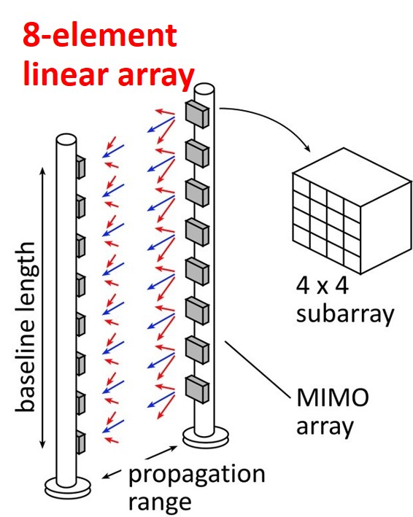
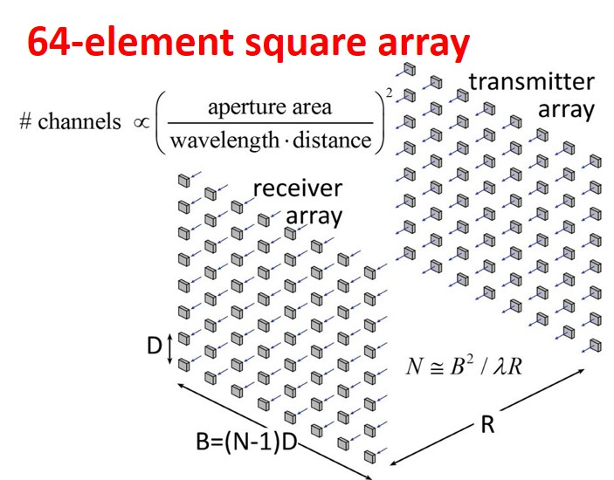
210 GHz, 5.1 Tb/s MIMO backhaul
500m range in 50mm/hr. rain.
8-element 640Gb/s linear array: requires 14dB_{m} transmit power/element (P_{out}) ….3.2W total output power requires 2.1m linear array
64-element 5Tb/s square array: same link assumptions requires 5dB_{m} transmit power/element (P_{out}) ….3.2W total output power requires 2.1m square array
Complex system: can we make it cheaply ?

Slide 13
70 GHz, 640 Gb/s MIMO backhaul (16QAM)
Why not use a lower-frequency carrier, e.g. 70 GHz ?
8-element 640Gb/s linear array: requires 11dB_{m} transmit power/element (P_{out}) ….1.7W total output power requires 5.5m linear array
64-element 5Tb/s square array: same link assumptions requires 2dB_{m} transmit power/element (P_{out}) ….1.7W total output power requires 5.5m square array
Similar RF power output, physically larger

Slide 14
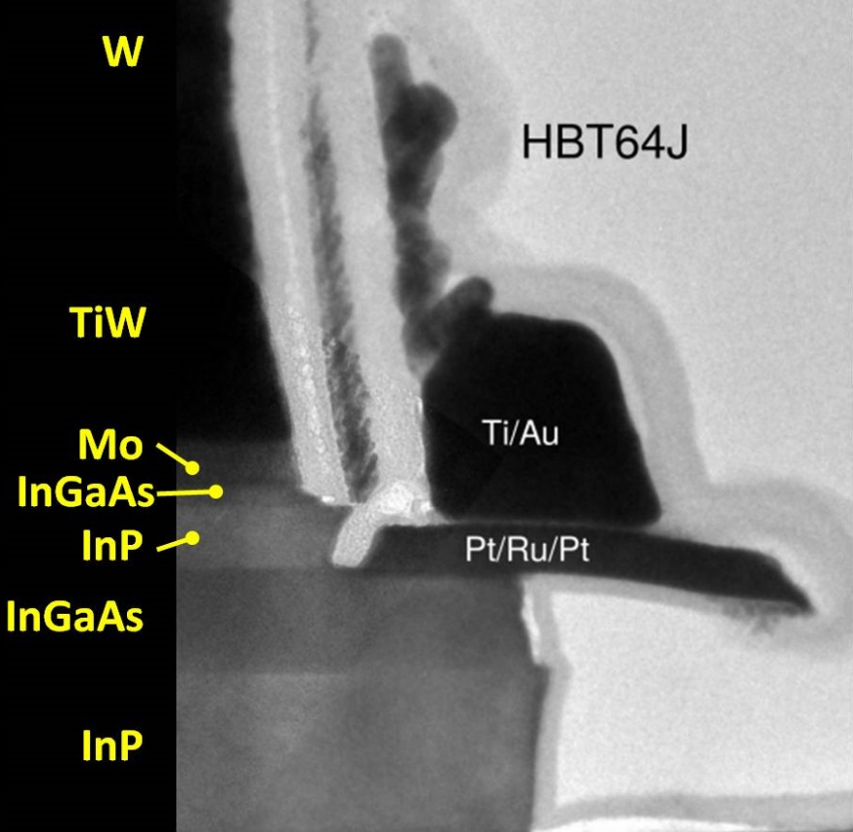
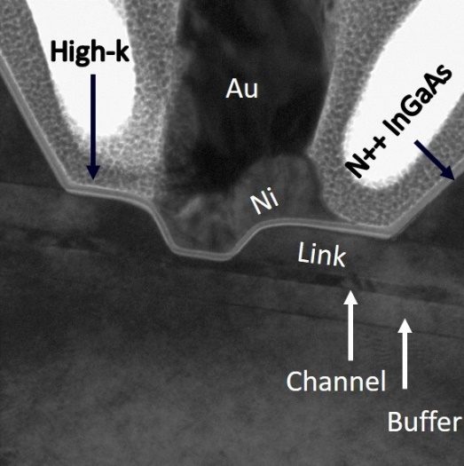
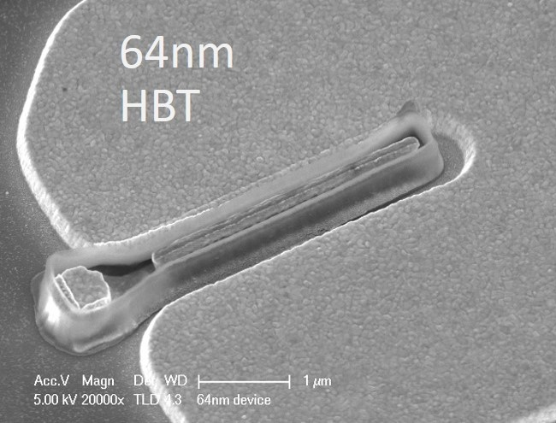
Transistors

Slide 15
100-1000 GHz Transistors and ICs
 | f_{max} GHz | Good ICs to (GHz) | complexity | LNAs | PAS | increased bandwidth ?
CMOS | 350 | 150/200 | transceivers | good | weak: 10-30 mW | not easy
Production SiGe | 300 | 200/250 | transceivers | ok | OK: 20-100 mW | depends on $$
R&D SiGe | 700 | 300/500 | transceivers | good | OK: 20-100 mW | 2-3THz
R&D InP HBT | 1150 | 400/650 | PA, converters | ok* | good: 100-200 mW | 2-3THz
R&D InP HEMT | 1500 | 500/1000 | LNA | great | weak: 20-50 mW | 2-3THz
R&D GaN | 400 | 120/140 | PAs | good | excellent: 0.1-1W | 600GHz
ICs with useful performance, hero experiments *can be addressed
There are THz transistors today; their bandwidth will increase
Challenge: reducing costs, increasing market size

Slide 16
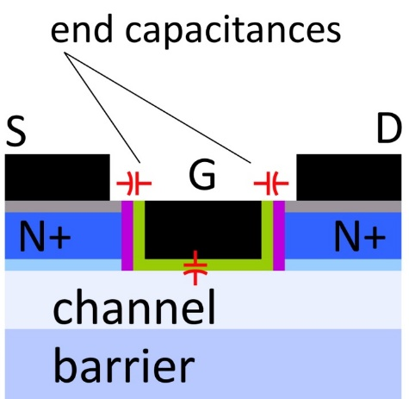
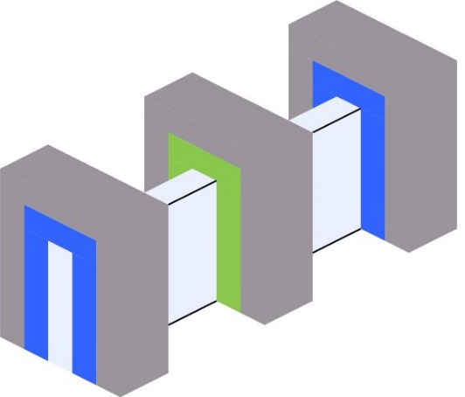
mm-Wave CMOS won't scale much further
Gate dielectric can't be thinned → on-current, g_{m} can't increase
Shorter gates give no less capacitance dominated by ends; ~1fF/μm total
Maximum g_{m}, minimum C→ upper limit on f_{τ}. about 350-400 GHz.
Tungsten via resistances reduce the gain
Inac et al, CSICS 2011
Present finFETs have yet larger end capacitances

Slide 17
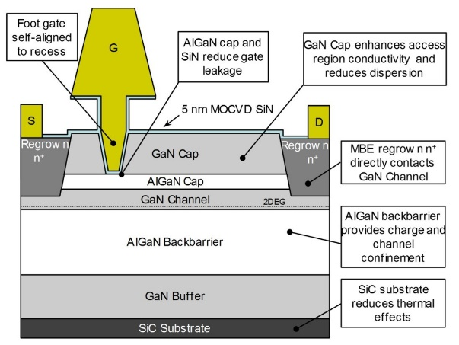
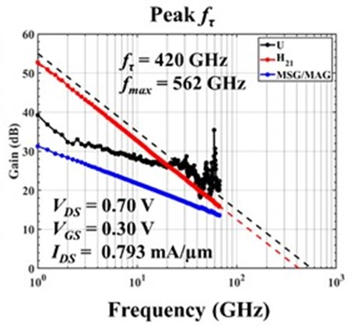
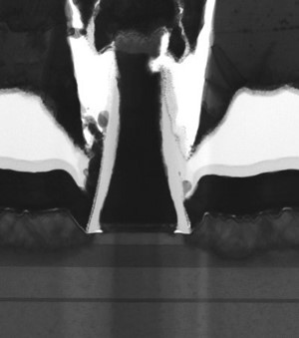
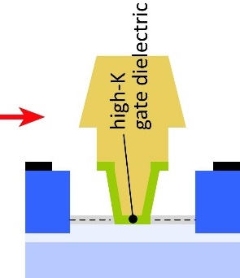
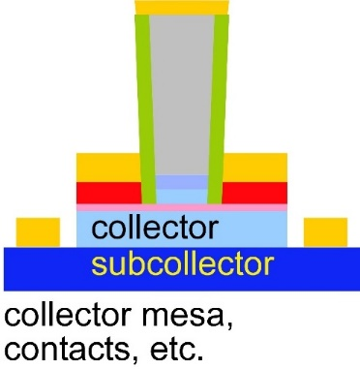
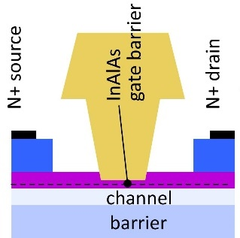
mm-Wave Transistor Development
InGaN and GaN HEMTs: High power from 100-340GHz GaN: superior power density at all frequencies UCSB/Mishra: InGaN for increased mobility Cornell/Xing: AlN/GaN/AlN
N-polar GaN: Mishra, UCSB
THz InP HBTs: State-of-art: 1.1THz f_{max} @ 130nm node Efficient 100-650GHz power more f_{max}: more efficient, higher frequencies base regrowth: better contacts→ higher f_{max}. status: working DC devices; moving to THz
THz InP HEMTs: State-of-art: 1.5THz f_{max} @ 32nm node Sensitive 100-650GHz low-noise amplifiers more f_{τ}: lower noise, higher frequencies high-K gate dielectric → higher f_{τ}, f_{max}

Slide 18
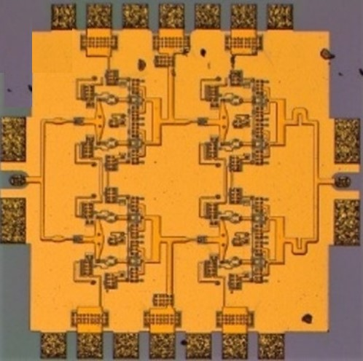
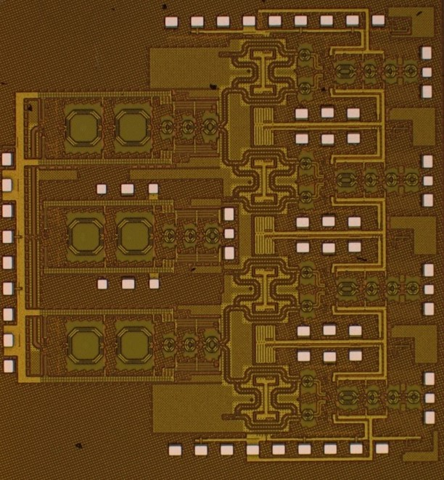
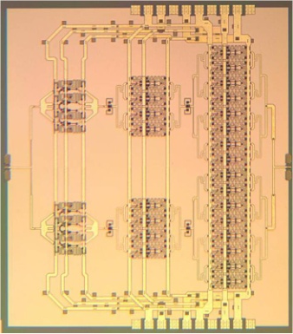
ICs

Slide 19
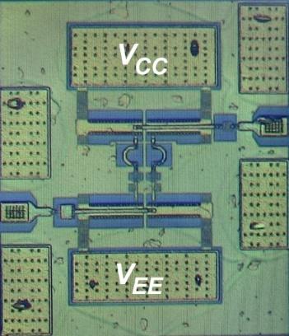
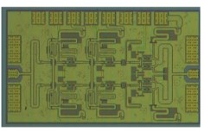
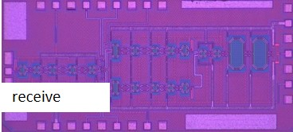
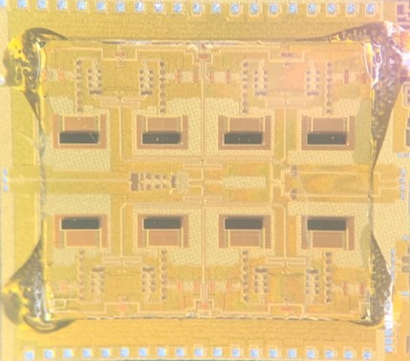
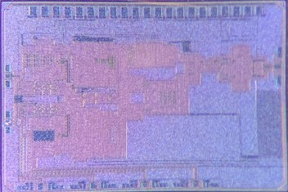
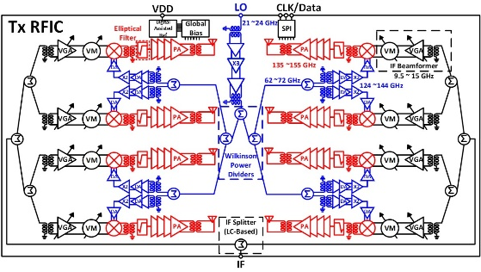
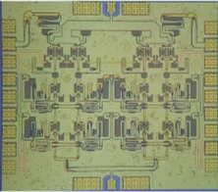
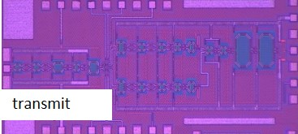
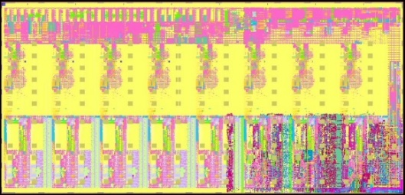
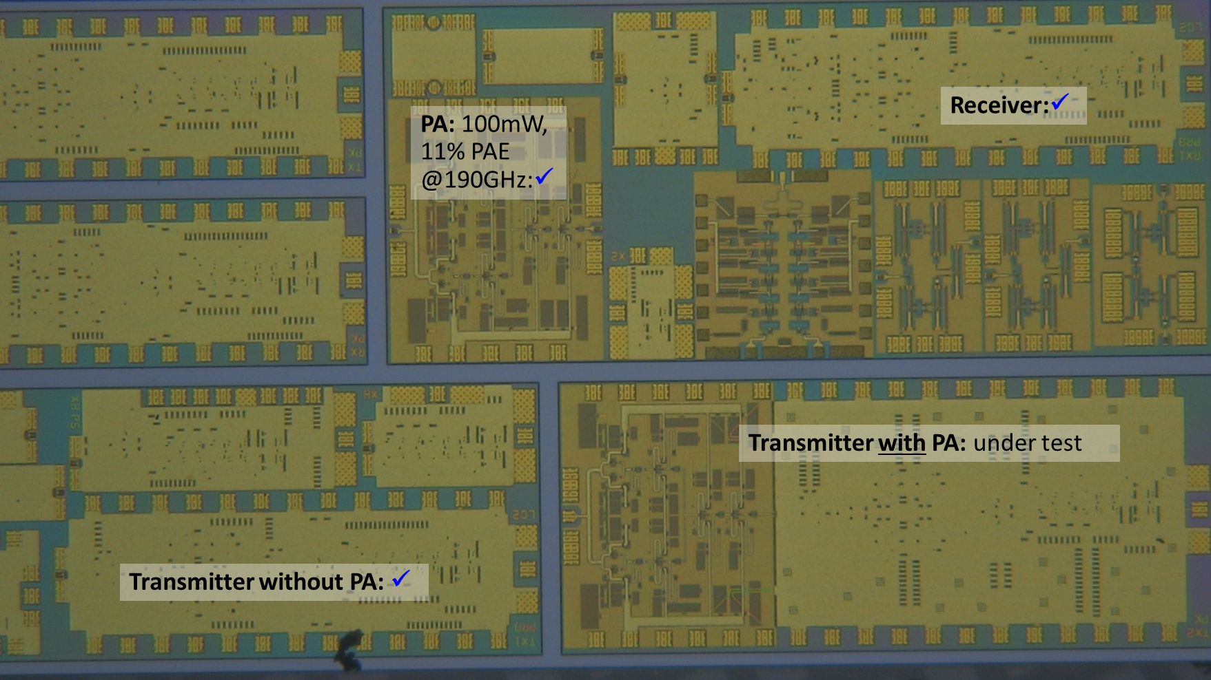
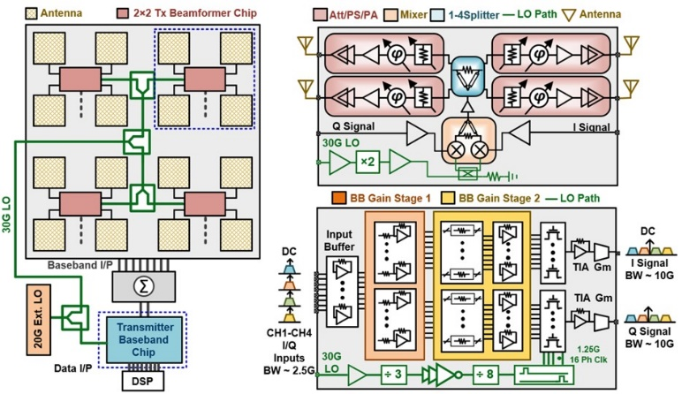
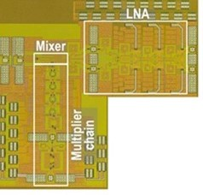
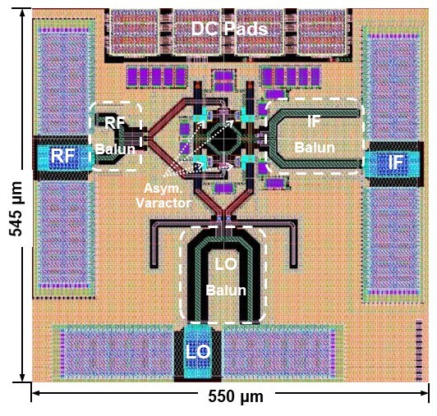
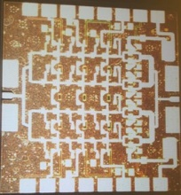
ComSenTer Research: ICs
Record-PAE Class B 140GHz PAs Buckwalter
Record-PAE Class A 100-200mW 140GHz PAs Rodwell
140GHz CMOS handset ICs Rodwell
140GHz 8-element handset TRX, RCVR arrays and PAs Rebeiz
210GHz InP transceivers and arrays, 210, 280GHz PAs Seo/Rodwell
Hydra digital processor (beamformer) Nikolic
60GHz CMOS channel aggregation transceiver Krishnaswamy
280GHz CMOS upconvert mixers 420 GHz CMOS receiver O
Beamspace digital beamformer Studer/Molnar
75GHz MIMO front-ends Niknejad, Alon, Nikolic
Not shown: 140GHz, 210GHz outphasing transmitters Buckwalter mm-wave N-path mixers Molnar GaN active circulators Krishnaswamy 140GHz GaN PAs Buckwalter

Slide 20
ComSenTer 140GHz CMOS ICs for hub & handset
1st-generation hub ICs: UCSB
Handset array ICs: UCSD
Farid et al, RFIC 2019
Rebeiz group
2nd-generation hub ICs: UC Berkeley

Slide 21
ComSenTer 140GHz InP ICs for hub
110mW power amplifier, 20.8% PAE A. Ahmed, IMS 2020
190mW power amplifier, 16.7% PAE A. Ahmed, EuMIC 2020.
Also: "A 130-GHz Power Amplifier in a 250-nm InP Process with 32% PAE" Kang Ning (Buckwalter group) 2020 RFIC symposium

Slide 22
210 GHz MIMO backhaul: ICs
M. Seo Sungkyunkwan/UCSB A. Ahmed, U. Solyu, M. Rodwell UCSB
LNA
Receiver:✓
PA ✓
Teledyne 250nm (650GHz) InP HBT.
Transmitter with PA: ✘
Transmitter without PA: ✓

Slide 23
Packages / array modules

Slide 24
The mm-wave module design problem
How to make the IC electronics fit ? How to avoid catastrophic signal losses ? How to remove the heat ?
Not all systems steer in two planes... ...some steer in only one.
Not all systems steer over 180 degrees... ...some steer a smaller angular range

Slide 25
140GHz hub: packaging challenges
IC-package interconnects Difficult at > 100 GHz
Removing heat Thermal vias are marginal
Interconnect density Dense wiring for DC, LO, IF, control. Hard to fit these all in.
Economies of scale Advanced packaging standards require sophisticated tools High-volume orders only Hard for small-volume orders (research, universities) Packaging industry is moving offshore

Slide 26
100-300GHz IC-package connections
type | Frequency | technology | cost | heatsinking
micromachined waveguide interface | 1000 GHz | Research. Cheap one day ? | high ✘ | good
ribbon, mesh bond | 200 GHz | Handcrafted. | high ✘ | good
patch antennas on superstrate | 1000 GHz | Straightforward | low | good
Cu stud flip-chip | >200 GHz | Industry standard | low | ok, marginal for PA ✘
hot vias | 200 GHz | Development | low ? | good
(ball) wirebonds | 100 GHz ✘ | Industry standard | low | good
Deal, IEEE Trans THz, Sept 2011
G. Rebeiz

Slide 27
140GHz massive MIMO hub modules
140GHz InP PAs
140GHz CMOS ICs
transmit
P_{sat} ~100mW
receive
8 CMOS ICs, 8 InP PAs
LTCC-based array tile
…
…
connector interface board
Kyocera LTCC carrier
connector interface board
Farid, Ahmed, Rodwell, UCSB; Flynn, Dunn, Niknejad, Nikolic, BWRC; Rebeiz, UCSD

Slide 28
140GHz hub: ICs & Antennas
110mW InP Power Amplifier 20.8% PAE
LTCC Array module
CMOS Transmitter IC 22nm SOI CMOS.
190mW InP Power Amplifier 16.7% PAE
Receiver IC 22nm SOI CMOS.
GlobalFoundries 22nm SOI CMOS
1 cm
Teledyne InP HBT
Kyocera
Farid, Ahmed, Rodwell, UCSB; Flynn, Dunn, Niknejad, Nikolic, BWRC; Rebeiz, UCSD

Slide 29
140GHz Single-Channel CMOS+InP Transmitter
A. Farid, A. S. Ahmed, UCSB, modules being tested
Farid, Ahmed, Rodwell, UCSB; Flynn, Dunn, Niknejad, Nikolic, BWRC; Rebeiz, UCSD

Slide 30
Concept: module for small angular scanning
Terrestrial system: horizontal + vertical steering → rectangular array. Limited angular steering range (installation)→ spacing >> λ/2 Endfire / edge-card geometry: room for III-V PAs, LNAs. Mounting directly on metal carrier→ heatsinking.

Slide 31
2D arrays

Slide 32
The mm-wave module design problem
How to make the IC electronics fit ? How to avoid catastrophic signal losses ? How to remove the heat ?
Not all systems steer in two planes... ...some steer in only one.
Not all systems steer over 180 degrees... ...some steer a smaller angular range

Slide 33
100-300GHz: 2D arrays
Single-beam array: 1 PA, one phase-shifter in ~0.36λ²
Multi-beam array: 1 PA, one mixer in ~0.36λ²
f | 100 | 150 | 200 | 250 | 300 | GHz
λ | 3 | 2 | 1.5 | 1.2 | 1 | mm
λ/2 | 1.5 | 1 | 0.75 | 0.6 | 0.5 | mm
0.6λ | 1.8 | 1.2 | 0.9 | 0.72 | 0.6 | mm

Slide 34
100-300GHz, 2D arrays: ICs can fit
200GHz array cell 0.9 mm x 0.9 mm
200GHz 40mW PA 0.56 mm x 0.78 mm
LO frequency multiplier 0.58 mm x 0.4 mm
Phase shifter 0.3 mm x 0.4 mm
TX I/Q mixer 0.16mm x 0.08 mm
RX mixer (I or Q) 0.16 mm x 0.11 mm
LO buffer amp. 0.34 mm x 0.18 mm
(layouts are roughly in proportion; may not be in exact scale)
0.6λ x 0.6λ
200GHz 2D arrays: ~feasible with present IC blocks.
300GHz 2D arrays: layout compaction: better IC design smaller power amplifiers better wiring

Slide 35
How should we scale array design at high frequencies ?
(Worst-case atmospheric loss: ~constant over 50-300GHz)
Proposed scaling law | change
carrier frequency | increase 2:1
aperture area | keep constant
total transmit power | keep constant
Implication | change
capacity (# beams·bit rate per beam) | increases 4:1
number elements | increases 4:1
RF power per cm² aperture area | stays constant
RF power per element | decreases 4:1
IC area/element (tiled array) | decreases 4:1
IC area/element (trayed array) | decreases 2:1
IC power/area (tiled array) | stays constant
IC power/area (trayed array) | decreases 2:1

Slide 36
Systems

Slide 37
Beamforming for massive spatial multiplexing
Pure digital beamforming: dynamic range & phase noise requirements: appear to be manageable ✓✓✓ Digital back-end processing requirements (die area, DC power): being investigated ?
Analog, hybrid beamforming: Do not appear to significantly improve dynamic range in massive MIMO.

Slide 38
Progress in System Design
Digital beamforming:
ADCs/DACs: only 3-4 bit ADC/DACs required (Madhow, Studer)
Linearity: Amplifier P_{1dB} need be only 3dB above average power (Madhow).
Phase noise: Requirements same as for SISO (Alon, Madhow, Niknejad, Rodwell)
Efficient digital beamforming: beamspace algorithm (spatial FFT, sparsity) (Madhow, Studer)
Efficient digital beamforming: low-resolution matrix (Studer, Molnar)
Efficient channel estimation : fast beamspace algorithm (Studer)
Efficiently addressing true-time-delay problem: "rainbow" FFT algorithm (Madhow, Cabric)
Other issues:
Propagation models and measurements
Blockage probability, mesh networks, network protocols

Slide 39
Progress in System Design
ADC resolution: N ADC bits, M antennas, K signals: SNR=6N+1.76+10.log₁₀(M/K) 3 bits, (M/K)=2→ SNR=23 dB. QPSK needs 9.8 dB.
Jammer tolerance: Increase ADC resolution by 1 bit→ P_{jammer,max} = K.P_{signal} Maximum jammer power = sum of all user's power.
Phase noise: Phase error σ_{φ} : SNR= -20.log₁₀(σ_{φ})+10.log₁₀(M/K), where MIMO and SISO require similar L(f) .
Beamspace: lower frequencies, many NLOS paths, complicated channel matrix: O(M³) to beamform higher frequencies, few NLOS paths, simpler channel matrix: FFT, O(M.logM) to beamform fewer bits in signal; fewer bits in FFT coefficients.

Slide 40
Array-beamformer interconnects
(I,Q) links
IF links
(I,Q) links needs 4 (differential IQ) lines/antenna physically large modules. OK DC power/line (few mW)
IF links as in emerging 5G systems needs one IF line/antenna physically much smaller modules small required DC power/line
Required IF signal interface power is very small; low required DC power for line driver.

Slide 41
100-300GHz Wireless

Slide 42
Wireless above 100 GHz
Massive capacities large available bandwidths massive spatial multiplexing in base stations and point-point links
Very short range: few 100 meters short wavelength, high atmospheric losses. Easily-blocked beams.
IC Technology All-CMOS for short ranges below 200 GHz. SiGe, GaN, or III-V LNAs and PAs for longer-range links. Just like cell phones today SiGe or III-V frequency extenders for 220GHz and beyond
The challenges digital beamformer computational complexity packaging: fitting signal channels in very small areas mesh networking to accommodate beam blockage driving the technologies to low cost

Slide 43
(backup files follow)

Slide 44
100-300 GHz: challenges & solutions
High attenuation in foul or humid weather
Need mesh networks
Need large arrays

Slide 45
Towards faster HEMTs: InAs MOS-HEMTs
Goal: Higher f_{τ} for lower noise, sensitive receivers 1200 vs. 600GHz f_{τ} : 1.5dB better F_{min} @ 300GHz. Increased bandwidth by scaling. Scaling limit: gate insulator thickness InAlAs barrier with high-K dielectric
Scaling limit: source access resistance by regrowth, place N+ layer on InAs channel Also: thinner channel, higher barriers, larger electron supply
Present devices: 420GHz f_{τ}, 560GHz f_{max} @ ~20nm L_{g} Bandwidth limited by gate misalignment Next step: self-aligned process

Slide 46
Base Regrowth for THz HBTs
Why regrowth ? good contacts: need high base doping under contacts good DC gain : need lower base doping under emitter solution: heavily-doped regrown extrinsic base
Initial ComSenTer HBT work: nm scaling. HBTs with 90nm emitter width.
First regrown-base results: InGaAs base InGaAs intrinsic base. Regrown GaAs extrinsic base Excellent DC characteristics. ✓ But: hydrogen passivation of InGaAs base during regrowth ✘
Second regrown-base results: GaAsSb base GaAsSb: resistance to hydrogen passivation DC results in winter: good DC characteristics Next step: scaled THz device run.

Slide 47
100-300GHz tile array
How to make everything fit ? radiated signal: up intense thermal flux: down DC/control/LO/IF lines: laterally
Need dense I/O and heat removal directly under IC → Crystalline SiC or AlN carrier ($$$) → Ceramic SiC or AlN carrier ($$) → LTCC with diamond/silver-filled thermal vias ($)
If RF power density is independent of wavelength, then so will be the temperature rise across the package

Slide 48
InP ICs for 210GHz Point-Point MIMO
Transceivers & Arrays for 210GHz MIMO links
Planned packaging approaches
2/2020 tapeout: 210 GHz TX front-end w/ +20 dBm Psat 210 GHz TX front-end w/ +2 dBm Psat 210 GHz RX front-end 280GHz PAs and LNAs
InP IC bonding to patch antenna arrays on quartz. plan: ribbon bonds using wedge bonder
5/2020 tapeout: Improved 210, 280GHz LNAs and PAs 210 GHz transmitters, receivers using these 2x2 transmitter array with superstrate antenna 2x2 receiver array with superstrate antenna
2x2 array with UCSD SiO₂ antenna superstrate simple, expensive in die area limits array size to 2x2 (or 2x4).
Seo, UCSB & Sungkyunkwan Univ.; Ahmed, Solyu, Rodwell, UCSB; Li, Zhang, Rebeiz, UCSD

