Slide 1
100-300GHz Wireless Communications: IC and System Design
2021 IEEE International Symposium on Personal, Indoor and Mobile Radio Communications (PIMRC), 9/15/2021
Mark Rodwell University of California, Santa Barbara rodwell@ece.ucsb.edu
Acknowledgement: This work was supported in part by the Semiconductor Research Corporation (SRC) and DARPA.

Slide 2
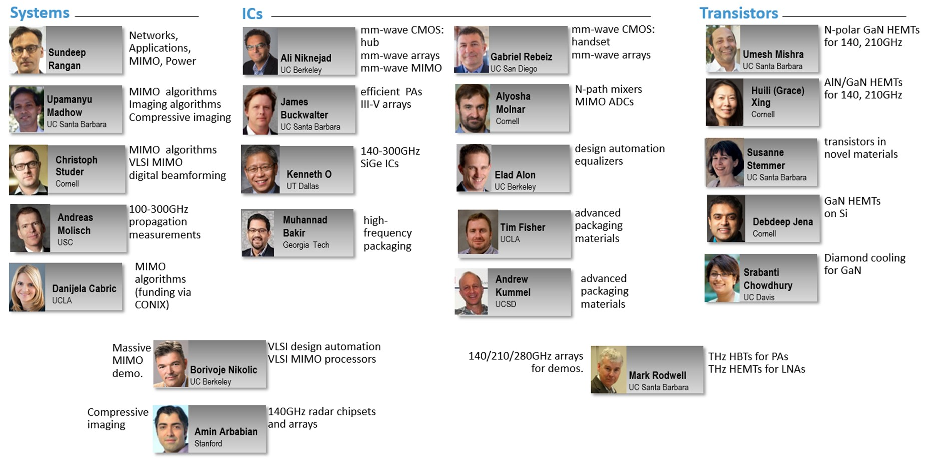
Acknowledgements

Slide 3
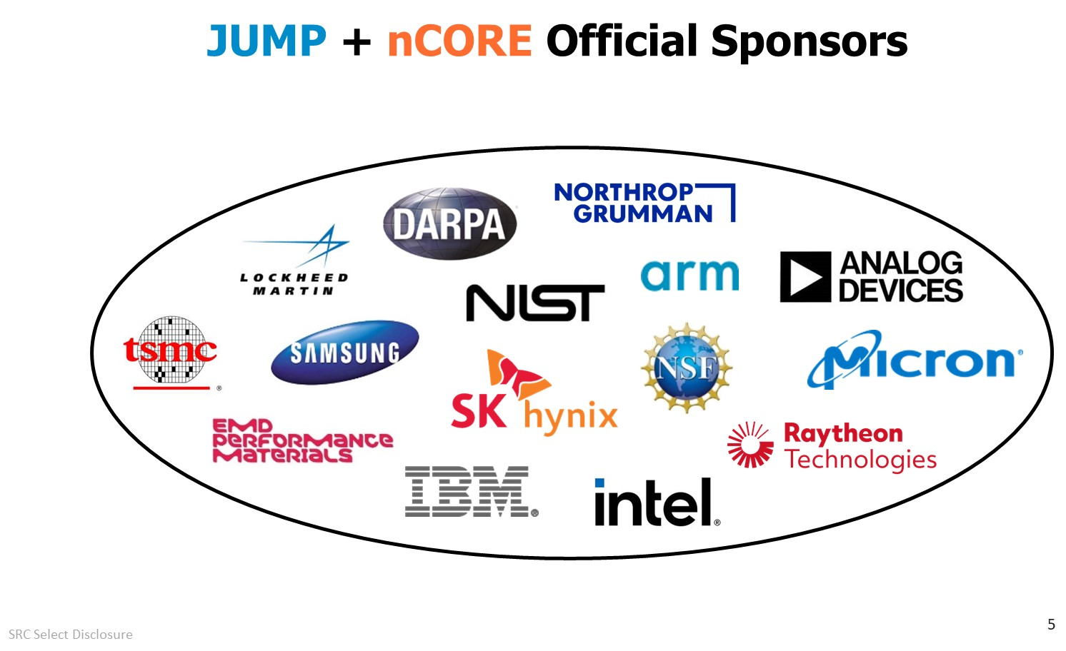

Slide 4
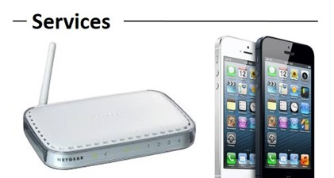
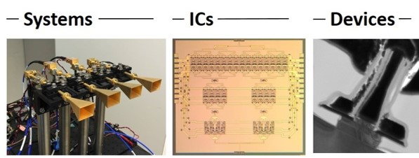
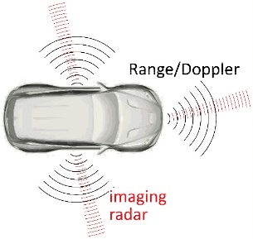
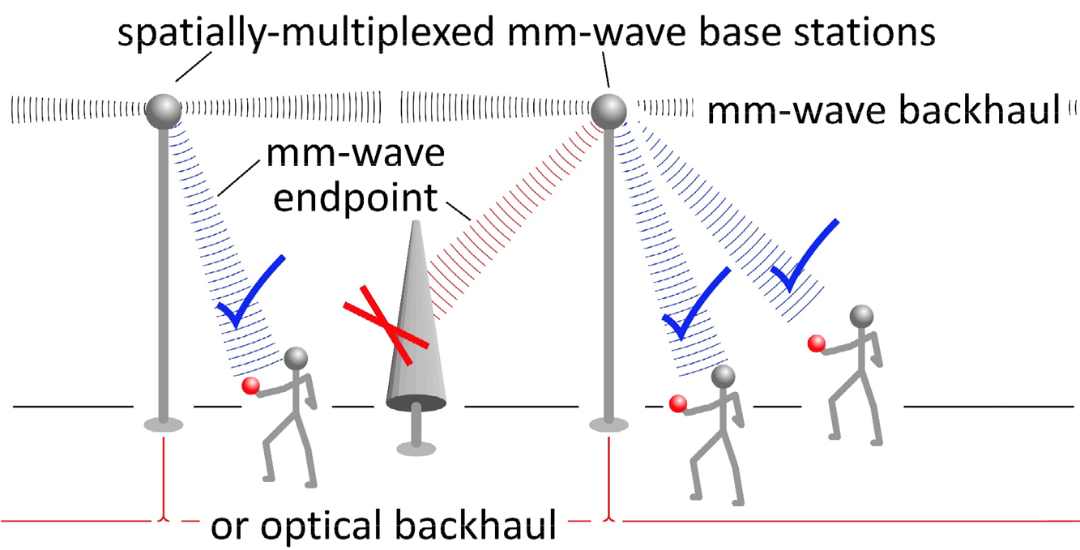
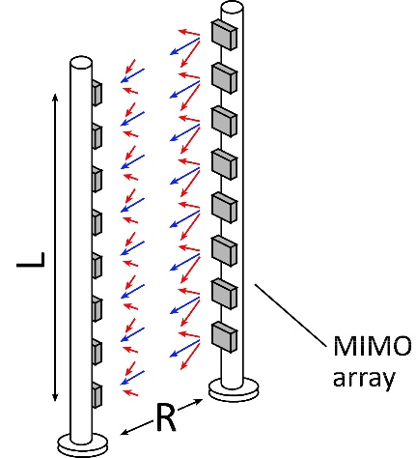
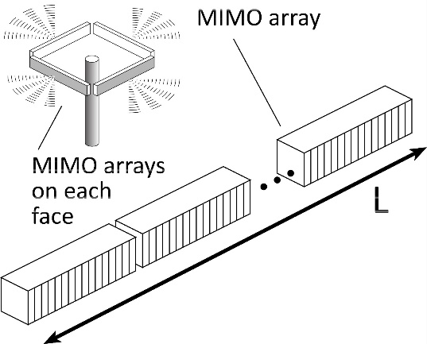
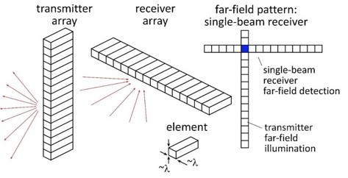
100-300GHz Wireless
Wireless networks: exploding demand.
Immediate industry response: 5G. ~10~40 GHz ("5G") ~40~100GHz ("5.5G ?") increased spectrum, extensive beamforming
Next generation (6G ??): above 100GHz.. (?) greatly increased spectrum, massive spatial multiplexing
100-300GHz carriers, massive spatial multiplexing → Terabit hubs and backhaul links, high-resolution imaging radar

Slide 5
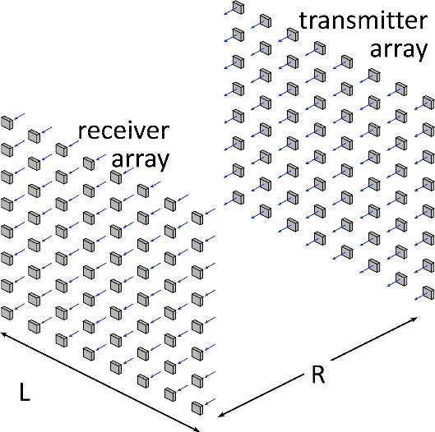
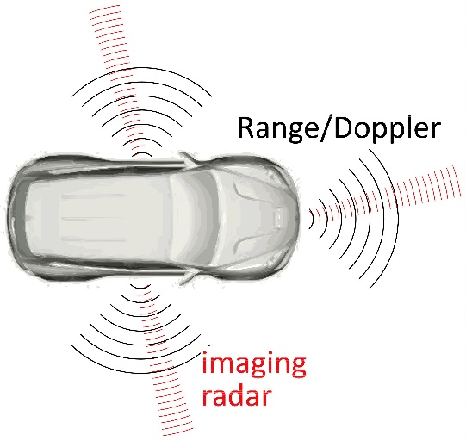
Benefits of Short Wavelengths
Communications: Massive spatial multiplexing, massive # of parallel channels. Also, more spectrum!
Imaging: very fine angular resolution
But: High losses in foul or humid weather. High λ²/R² path losses. ICs: poorer PAs & LNAs. Beams easily blocked.
100-340GHz wireless: terabit capacity, short range, highly intermittent

Slide 6
Applications

Slide 7
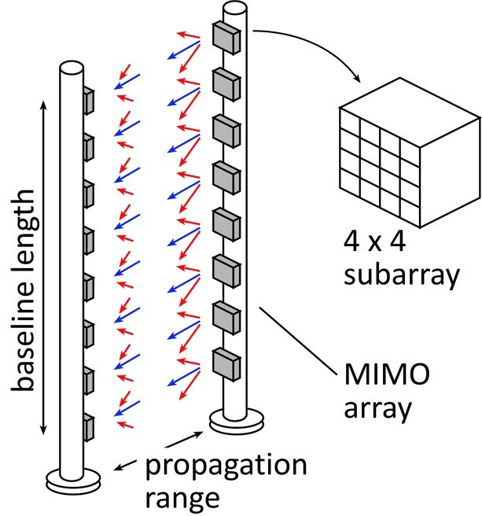
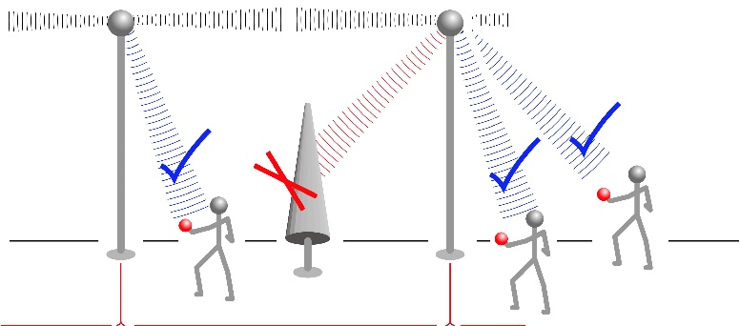
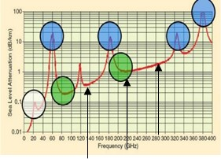
Potential 100-300GHz Systems
140GHz MIMO Hub
210 or 280GHz MIMO Backhaul
140 or 210GHz Imaging Radar

Slide 8
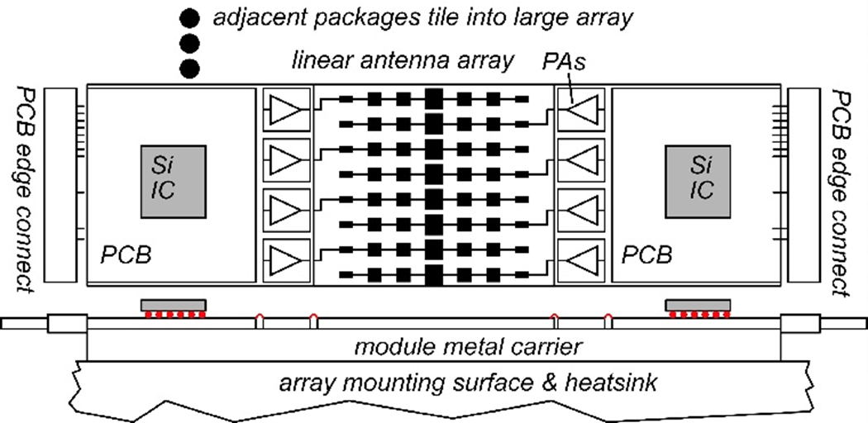
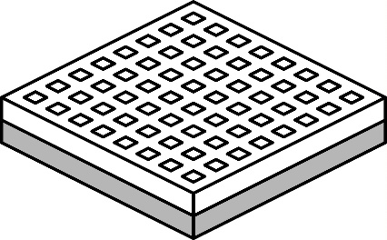
140GHz massive MIMO hub
Handset: 8 × 8 array (9×9mm)
0.5-5 Tb/s spatially-multiplexed 140GHz base station 128 users/face, 4 faces. P_{1dB}=21 dB_{m} PAs, F=8dB LNAs 512 total users @ 1 user/beam, 1,10 Gb/s/beam; 230, 100 m range in 50mm/hr rain with 17dB total margins

Slide 9
70 GHz spatially multiplexed base station
If we use instead a 70GHz carrier, the range increases to 168 meters (vs. 100 meters) but the handset becomes 16mm×16mm (vs. 8mm×8mm), and the hub array becomes 20mm×524mm (vs. 10mm×262mm)
Or, use a 4×4 (8mm×8mm) handset array, and the range becomes ..100 meters.
Same handset area (more handset elements)→ same link budget Easier to obtain license for 140±2.5GHz than 75±2.5GHz

Slide 10
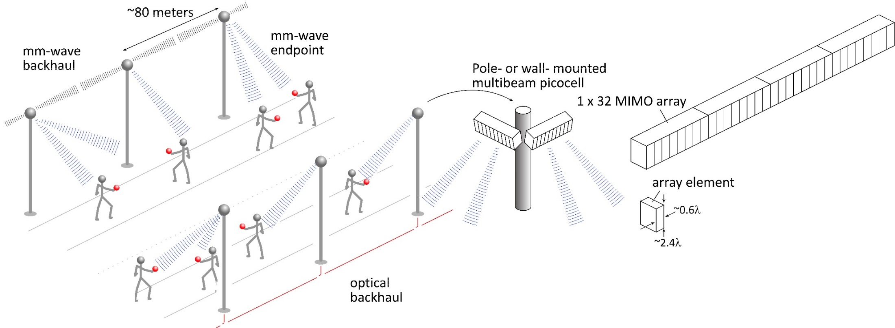
140GHz moderate-MIMO hub
If demo uses 32-element array (four 1×8 modules): 16 users/array. P_{1dB}=21 dB_{m} PAs, F=8dB LNAs 1,10 Gb/s/beam→ 16, 160 Gb/s total capacity 70, 40 m range in 50mm/hr rain with 17dB total margins
Range varies as (# hub elements)^{0.5} → (Service area/element) is constant
Handset: 8 × 8 array (9×9mm)

Slide 11
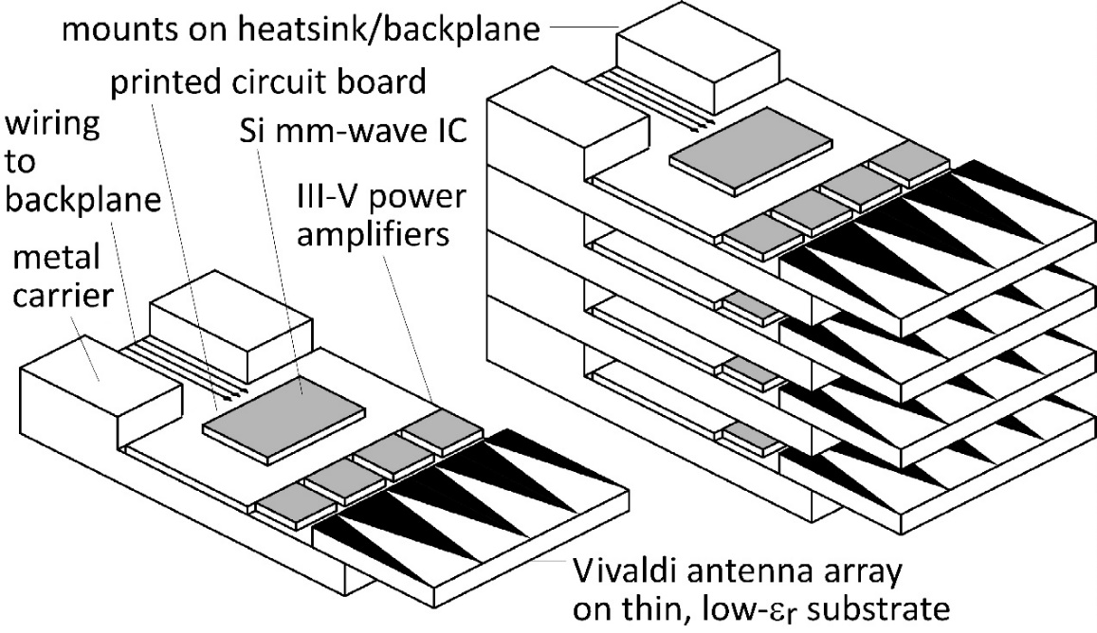
210 GHz, 640 Gb/s MIMO Backhaul
8-element MIMO array 3.1 m baseline. 80Gb/s/subarray→ 640Gb/s total 4 × 4 sub-arrays → 8 degree beamsteering
Key link parameters 500 meters range in 50 mm/hr rain; 23 dB/km 20 dB total margins: packaging loss, obstruction, operating, design, aging PAs: 18dBm =P_{1dB} (per element) LNAs: 6dB noise figure

Slide 12
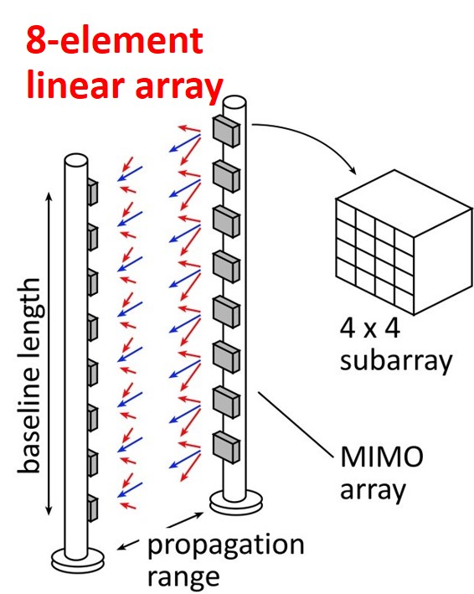
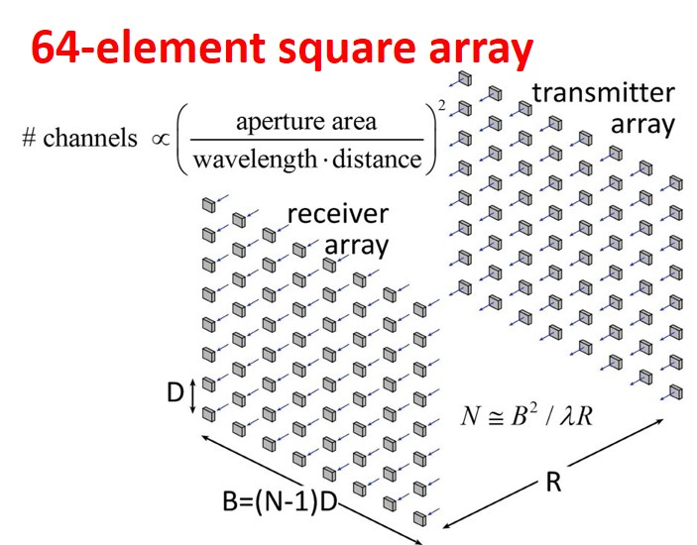
210 GHz, 5.1 Tb/s MIMO backhaul
500m range in 50mm/hr. rain.
8-element 640Gb/s linear array: requires 14dB_{m} transmit power/element (P_{out}) ….3.2W total output power requires 2.1m linear array
64-element 5Tb/s square array: same link assumptions requires 5dB_{m} transmit power/element (P_{out}) ….3.2W total output power requires 2.1m square array
Complex system: can we make it cheaply ?

Slide 13
70 GHz, 640 Gb/s MIMO backhaul (16QAM)
Why not use a lower-frequency carrier, e.g. 70 GHz ?
8-element 640Gb/s linear array: requires 11dB_{m} transmit power/element (P_{out}) ….1.7W total output power requires 5.5m linear array
64-element 5Tb/s square array: same link assumptions requires 2dB_{m} transmit power/element (P_{out}) ….1.7W total output power requires 5.5m square array
Similar RF power output, physically larger

Slide 14
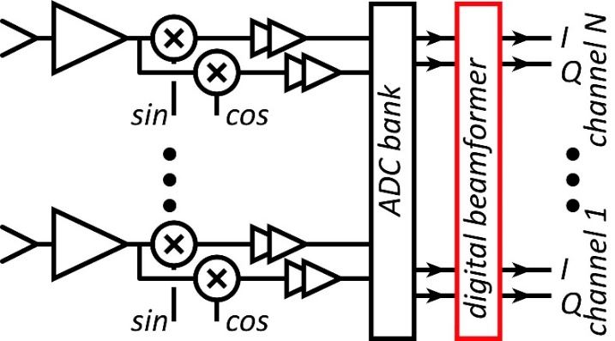
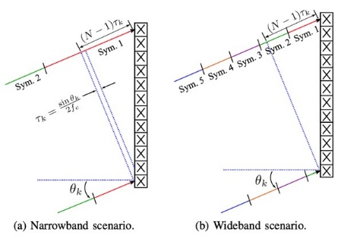
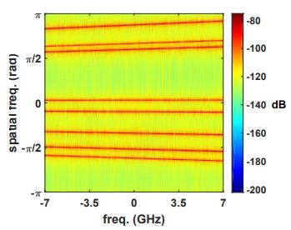
Systems

Slide 15
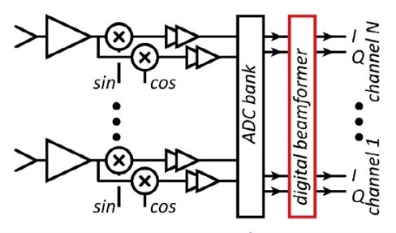
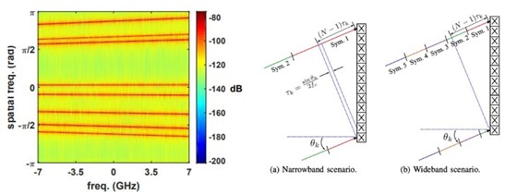
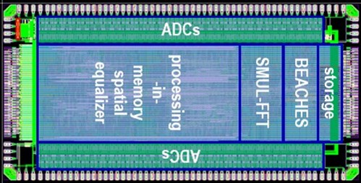
System Design
ADCs/DACs: QPSK needs only 3-4 bit ADC/DACs (Madhow, Studer, Rodwell) N ADC bits, M antennas, K signals: SNR=6N+1.76+10.log₁₀(M/K) 3 bits, (M/K)=2→ SNR=23 dB. QPSK needs 9.8 dB.
Linearity: Amplifier P_{1dB} need be only 3-4 dB above average power (Madhow).
Phase noise: Requirements same as for SISO (Alon, Madhow, Niknejad, Rodwell)
Efficient digital beamforming: beamspace algorithm=complexity ~N× log(N) (Madhow, Studer)
Efficient digital beamforming: low-resolution matrix (Studer: 2021 ESSCIRC, this week)
Efficiently addressing true-time-delay problem: "rainbow" FFT algorithm (Madhow, Cabric, Studer)

Slide 16
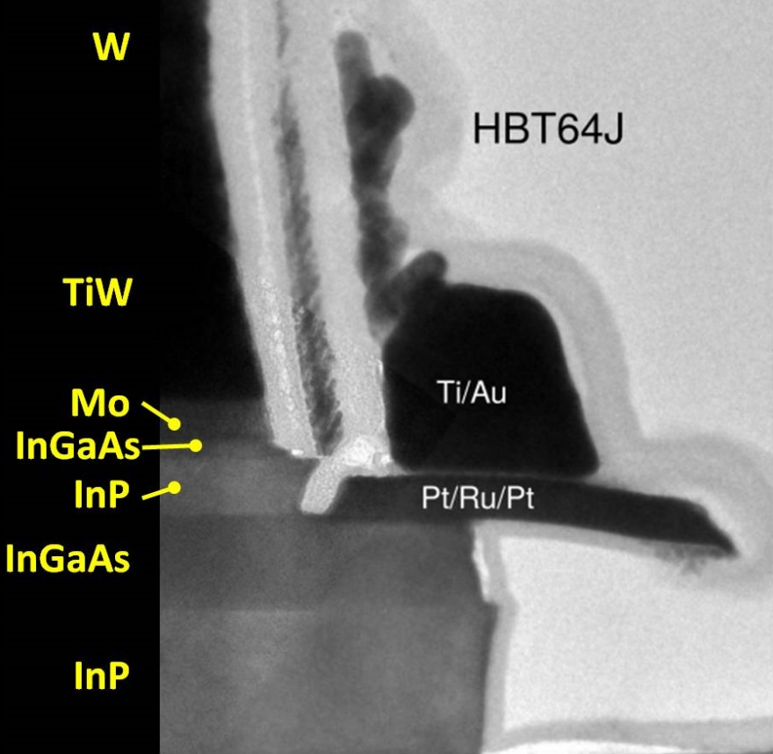
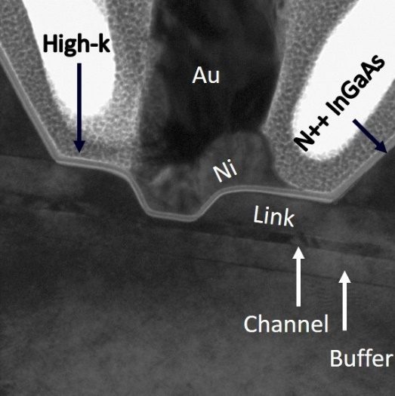
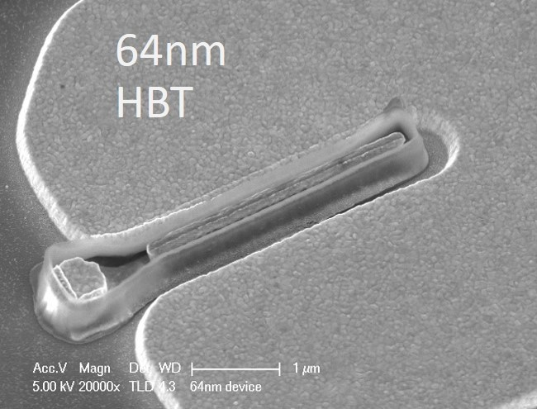
Transistors

Slide 17
100-300GHz ICs
CMOS: good power & noise up to ~150GHz. Not much beyond. 65-32nm nodes are best.
InP HBT: record 100-300GHz PAs
SiGe HBT: out-performs CMOS above 200GHz
GaN HEMT: record power below 100GHz. Bandwidth improving
InGaAs-channel HEMT: world's best low-noise amplifiers
*results with low PAE at high Psat or low Psat with high PAE are not shown

Slide 18
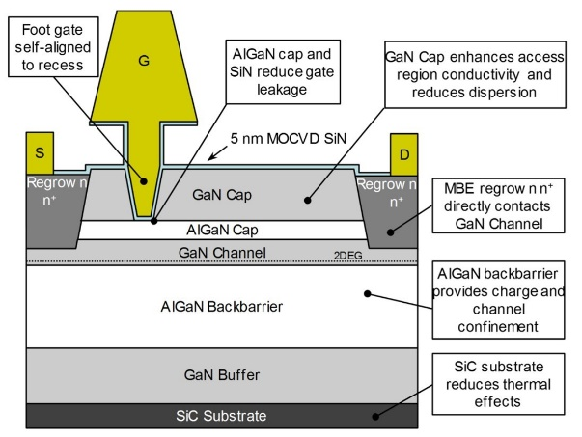
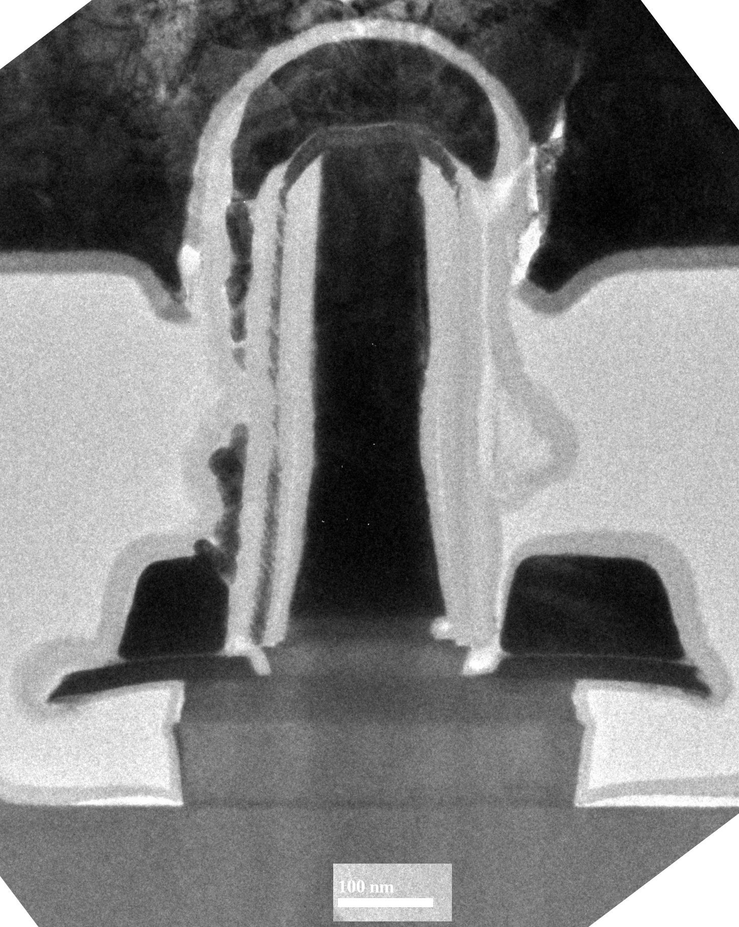
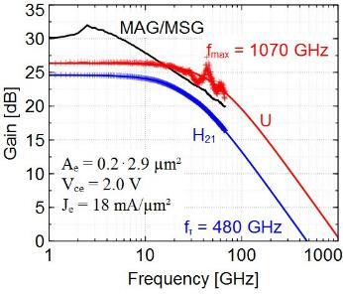
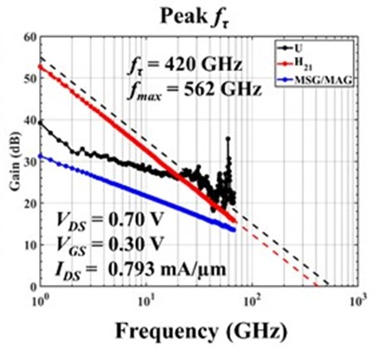
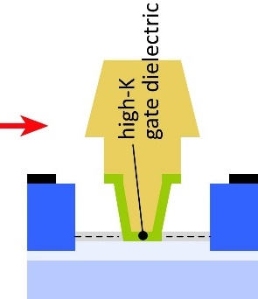
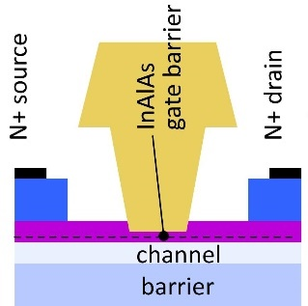
mm-Wave Transistor Development
InGaN and GaN HEMTs: Leading power techology to ~110GHz Efforts to extend this to 140, 220GHz.
N-polar GaN: Mishra, UCSB
THz InP HBTs: State-of-art: 1.1THz f_{max} @ 130nm node Efficient 100-650GHz power
THz InP HEMTs: State-of-art: 1.5THz f_{max} @ 32nm node Sensitive 100-650GHz low-noise amplifiers high-K gate dielectric *might* permit further scaling.

Slide 19
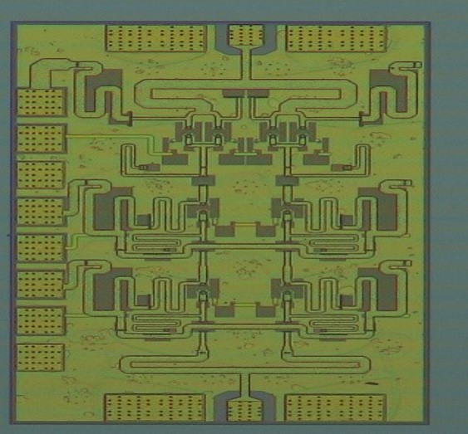
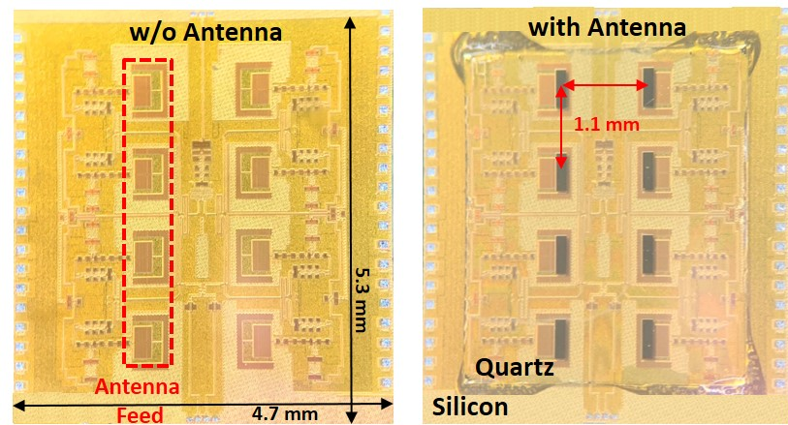
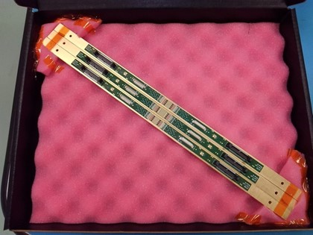
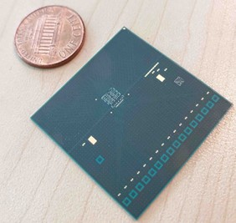
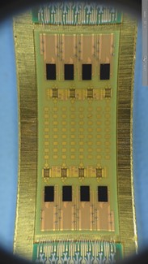
ICs and Packages: 140 GHz

Slide 20
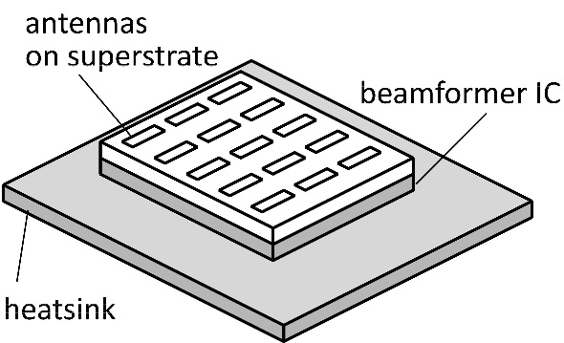
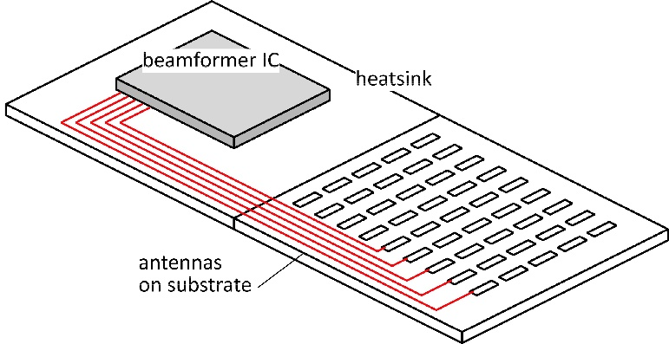
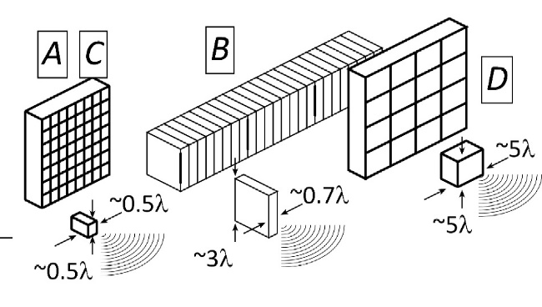
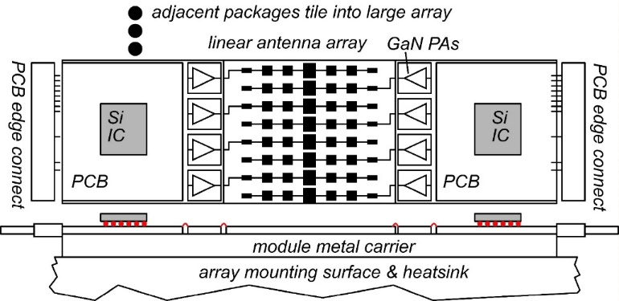
The mm-wave module design problem
How to make the IC electronics fit ? How to avoid catastrophic signal losses ? How to remove the heat ?
Not all systems steer in two planes... ...some steer in only one.
Not all systems steer over 180 degrees... ...some steer a smaller angular range

Slide 21
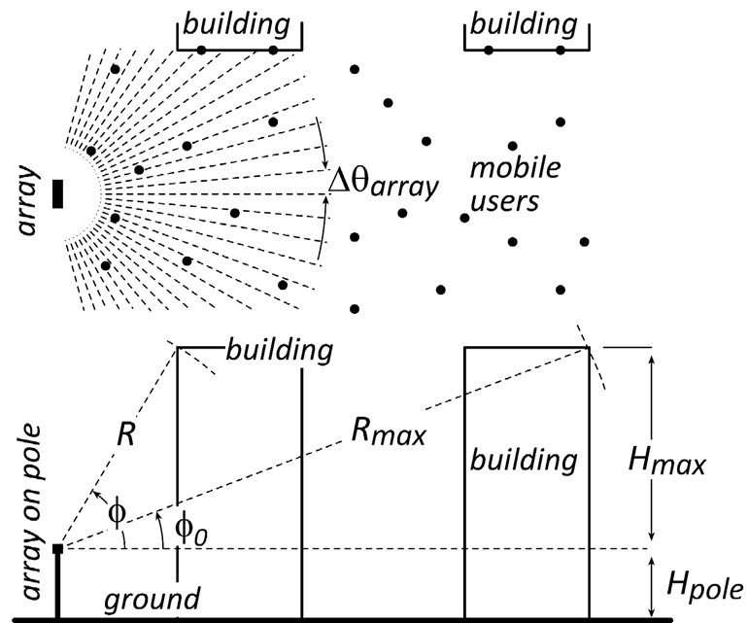
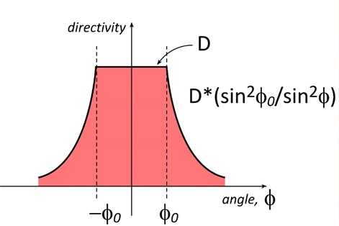
Do we need 2D arrays ? 1D steering might be fine.
1/sin²φ sidelobes provide strong signals to tall buildlings.
Providing sidelobes reduces broadside gain by less than 3dB.
→ Don't need 2D arrays to serve tall buildings

Slide 22
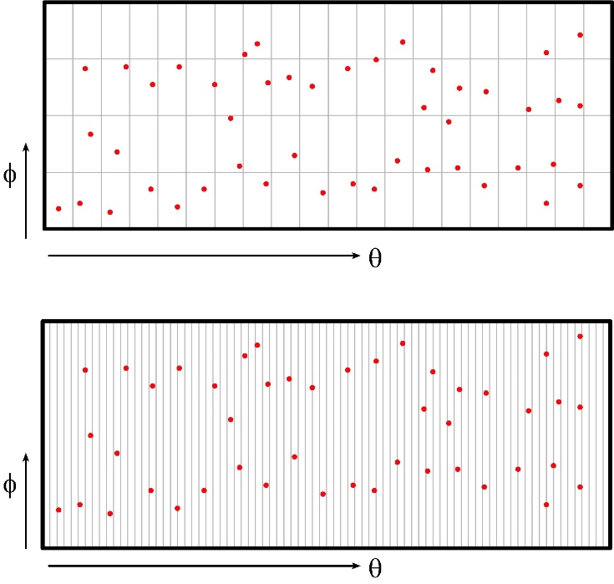
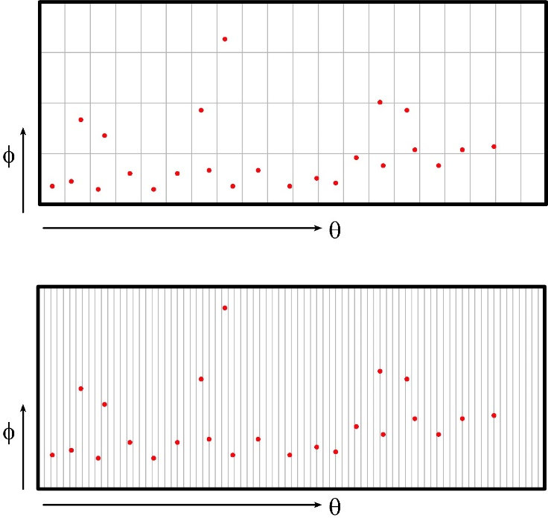
2D vs. 1D: user spatial distribution
uniform horizontal & vertical user distributions
uniform horizontal, nonuniform vertical
design 1: 2D array
✘
✓
design 2: 1D array
✓
✓
Spatial distribution of users, and of scattering objects, guides choice of array geometry.

Slide 23
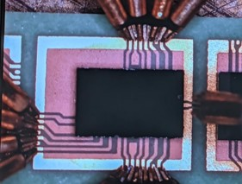
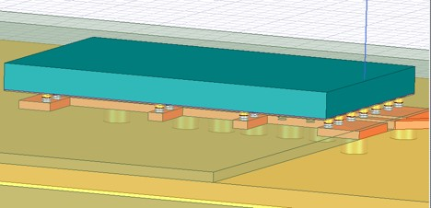
140GHz hub: packaging challenges
IC-package interconnects Difficult at > 100 GHz
Removing heat Thermal vias are marginal
Interconnect density Dense wiring for DC, LO, IF, control. Hard to fit these all in.
Economies of scale Advanced packaging standards require sophisticated tools High-volume orders only Hard for small-volume orders (research, universities) Packaging industry is moving offshore

Slide 24
100-300GHz IC-package connections
type | Frequency | technology | cost | heatsinking
micromachined waveguide interface | 1000 GHz | Research. Cheap one day ? | high ✘ | good
ribbon, mesh bond | 200 GHz | Handcrafted. | high ✘ | good
patch antennas on superstrate | 1000 GHz | Straightforward | low | good
Cu stud flip-chip | >200 GHz | Industry standard | low | ok, marginal for PA ✘
hot vias | 200 GHz | Development | low ? | good
(ball) wirebonds | 100 GHz ✘ | Industry standard | low | good
Deal, IEEE Trans THz, Sept 2011
G. Rebeiz

Slide 25
140GHz hub: ICs & Antennas
110mW InP Power Amplifier 20.8% PAE
LTCC Array module
CMOS Transmitter IC 22nm SOI CMOS.
190mW InP Power Amplifier 16.7% PAE
Receiver IC 22nm SOI CMOS.
GlobalFoundries 22nm SOI CMOS
1 cm
Teledyne InP HBT
Kyocera
Farid, Ahmed, Rodwell, UCSB; Flynn, Dunn, Niknejad, Nikolic, BWRC; Rebeiz, UCSD

Slide 26
140GHz transmitter channel
Farid, 2021 IMS, RFIC
CMOS-only TX channel
CMOS+InP TX channel

Slide 27
8-Channel 140GHz MIMO hub modules

Slide 28
135GHz 8-channel MIMO hub array tile modules
A. Farid et. al, submitted to the 2021 IEEE BCICTS Symposium
Receiver
Transmitter

Slide 29
ICs and Packages: 210 & 280 GHz

Slide 30
210 GHz MIMO backhaul demo
Key link parameters 500 meters range in 50 mm/hr rain; 23 dB/km 20 dB total margins: packaging loss, obstruction, operating, design, aging PAs: 63mW =P_{1dB} (per element) LNAs: 6dB noise figure
8-element MIMO array 3.1 m baseline for 500m link. 80Gb/s/subarray→ 640Gb/s total 4 × 4 sub-arrays → 8 degree beamsteering

Slide 31
210 GHz Transmitter and Receiver ICs
M. Seo et al, 2021 IMS; Teledyne 250nm InP HBT
200 GHz direct-conversion TX
200 GHz direct-conversion RX
Size: 2.9 x 0.75 mm²
Size: 2.3 x 0.85 mm²

Slide 32
Power Amplifiers in 250nm InP HBT
Ahmed et al, 2020 IMS, 2020 EuMIC, 2021 IMS, 2021 RFIC
Teledyne 250nm InP HBT technology
140GHz, 20.5dBm, 20.8% PAE
130GHz, 200mW, 17.8% PAE
194GHz, 17.4dBm, 8.5% PAE
266GHz, 16.8dBm, 4.0% PAE
Record-setting efficiency for 100-300GHz power amplifiers.

Slide 33
280GHz transmitter and receiver IC designs
Solyu, Alz, Ahmed, Seo; UCSB/Sungkyunkwan
Teledyne 250nm InP HBT technology
Receiver
Transmitter
simulations: 11dB noise figure, 40GHz bandwidth
simulations: 17dB saturated output power.
Application: point-point MIMO backhaul links

Slide 34
2D arrays

Slide 35
The 100-300GHz 2D Array Challenge
System architecture: Single-beam: simpler RF front-end, simpler baseband MIMO: complex digital baseband, flexible, many beams
Arrays can be made from either tiles or trays
Arrays must be vast: 100-1,000-10,000 elements
Arrays must be dense: packaging challenges Many DC/IF/LO lines, plus antenna interface. Fitting IC functions into available area. Removing the heat.
f | 100 | 150 | 200 | 250 | 300 | GHz
λ | 3 | 2 | 1.5 | 1.2 | 1 | mm
λ/2 | 1.5 | 1 | 0.75 | 0.6 | 0.5 | mm
0.6λ | 1.8 | 1.2 | 0.9 | 0.72 | 0.6 | mm

Slide 36
100-300GHz array frequency scaling
(Worst-case atmospheric loss: ~constant over 50-300GHz)
Proposed scaling law | change
carrier frequency | increase 2:1
aperture area | keep constant
total transmit power | keep constant
Implication | change
capacity (# beams·bit rate per beam) | increases 4:1
number elements | increases 4:1
RF power per cm² aperture area | stays constant
RF power per element | decreases 4:1
IC area/element (tiled array) | decreases 4:1
IC area/element (trayed array) | decreases 2:1
IC power/area (tiled array) | stays constant
IC power/area (trayed array) | decreases 2:1

Slide 37
100-300GHz Wireless

Slide 38
Wireless above 100 GHz
Massive capacities large available bandwidths massive spatial multiplexing in base stations and point-point links
Very short range: few 100 meters short wavelength, high atmospheric losses. Easily-blocked beams.
IC Technology All-silicon for short ranges below 200 GHz. SiGe or III-V LNAs and PAs for longer-range links. Just like cell phones today III-V frequency extenders for 340GHz and beyond
The challenges computational complexity packaging: fitting signal channels in very small areas mesh networking to accommodate beam blockage driving the technologies to low cost

Slide 39
(backup files follow)

Slide 40
Updated tech comparsion slide

Slide 41
Transistors for 100-300GHz
CMOS: good power & noise up to ~150GHz. Not much beyond. 65-32nm nodes are best.
InP HBT: record 100-300GHz PAs
SiGe HBT: power better than CMOS, worse than InP HBT
GaN HEMT: record power below 100GHz. Bandwidth improving
InGaAs-channel HEMT: world's best low-noise amplifiers
*results with low PAE at high Psat or low Psat with high PAE are not shown
Results compiled 9/9/2021

