Slide 1
ICs and Transceiver Module Design for 100-300GHz Wireless
Mark Rodwell
Doluca Family Chair, University of California, Santa Barbara rodwell@ece.ucsb.edu

Slide 2
Acknowledgments
Collaborators (ComSenTer):
Debdeep Jena, Alyosha Molnar, Christoph Studer, Huili Xing: Cornell University
Muhannad Bakir: Georgia Tech
Sundeep Rangan: New York University
Amin Arbabian, Srabanti Chowdhury: Stanford
Elad Alon, Ali Niknejad, Borivoje Nikolic : University of California, Berkeley
Danijela Cabric, Tim Fisher: University of California, Los Angeles
Andrew Kummel, Gabriel Rebeiz: University of California, San Diego
Jim Buckwalter, Upamanyu Madhow, Umesh Mishra, Mark Rodwell, Susanne Stemmer: University of California, Santa Barbara
Andreas Molisch: University of Southern California
Kenneth O: University of Texas, Dallas
Collaborators: (Samsung) Gary Xu, Navneet Sharma, Will Choi, Eunyoung Seok. (PiRadio) Aditya Dhananjay
Co-Authors:
At UCSB: Ali Farid, Ahmed A.S. Ahmed, Utku Solyu, Amirreza Alizadeh, Navid Hosseinzadeh, Seungchan Lee
Beyond UCSB: Prof. Munkyo Seo, Sungkyunkwan Univ.
Sponsors: Semiconductor Research Corporation JUMP Program (Tim Green, Todd Younkin).
Analog Devices, ARM, DARPA, EMD Performance Materials, IBM, Intel, Lockheed-Martin, Micron, NIST, Northrop-Grumman, NSF, Raytheon, Samsung, SK hynix, TSMC.
This work was supported in part by the Semiconductor Research Corporation (SRC) and DARPA.

Slide 3
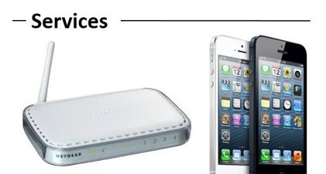
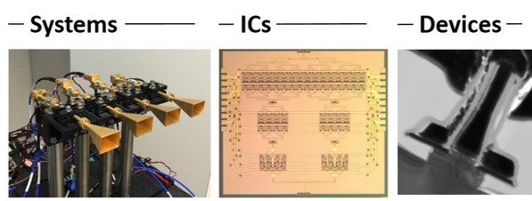
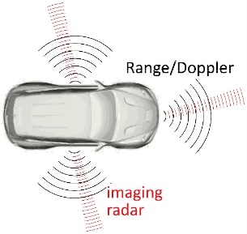
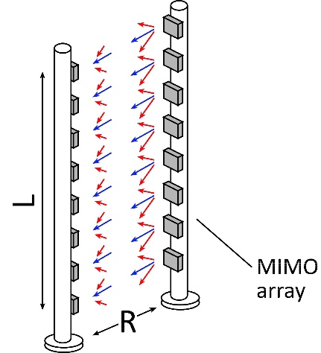
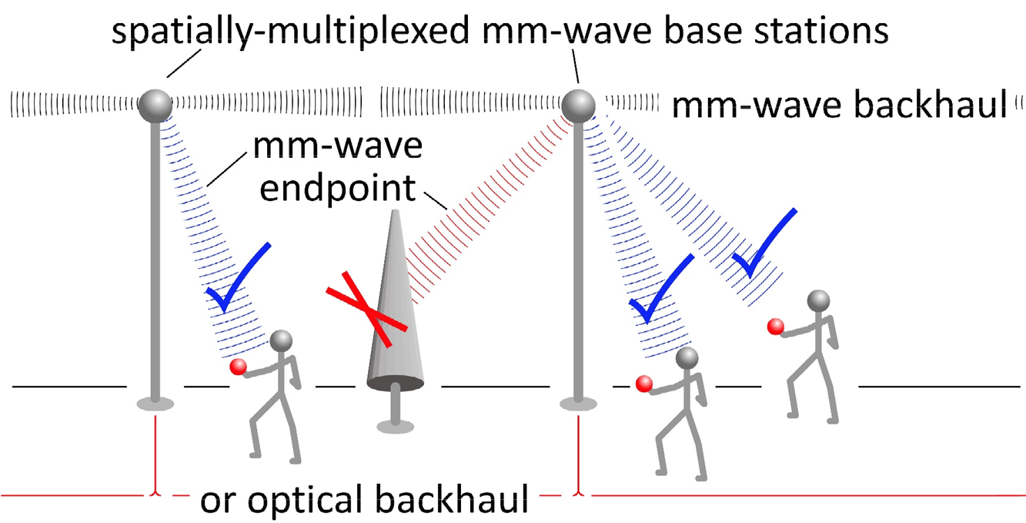
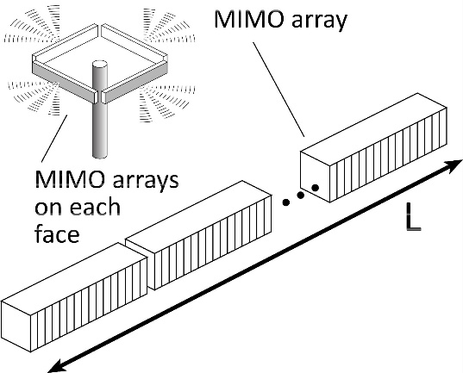
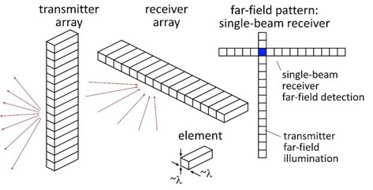
100-300GHz Wireless
Wireless networks: exploding demand.
Immediate industry response: 5G.
~3~100 GHz
increased spectrum, extensive beamforming
Next generation (6G ??): above 100GHz.. (???)
greatly increased spectrum, massive spatial multiplexing
100-300GHz carriers, massive spatial multiplexing
→ Terabit hubs and backhaul links, high-resolution imaging radar

Slide 4

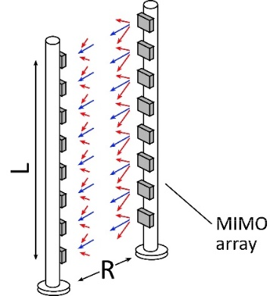
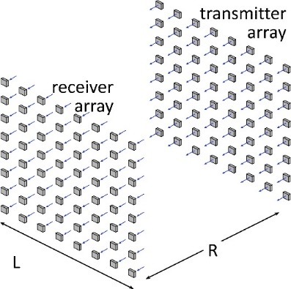
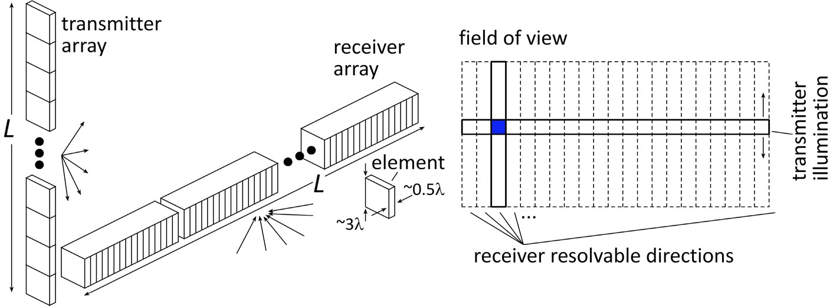


Benefits of Short Wavelengths
Communications: Massive spatial multiplexing, massive # of parallel channels. Also, more spectrum.
Imaging: very fine angular resolution
But:
High losses in foul or humid weather.
High λ²/R² path losses.
ICs: poorer PAs & LNAs.
Beams easily blocked.
100-300GHz wireless:
terabit capacity,
short range,
highly intermittent

Slide 5
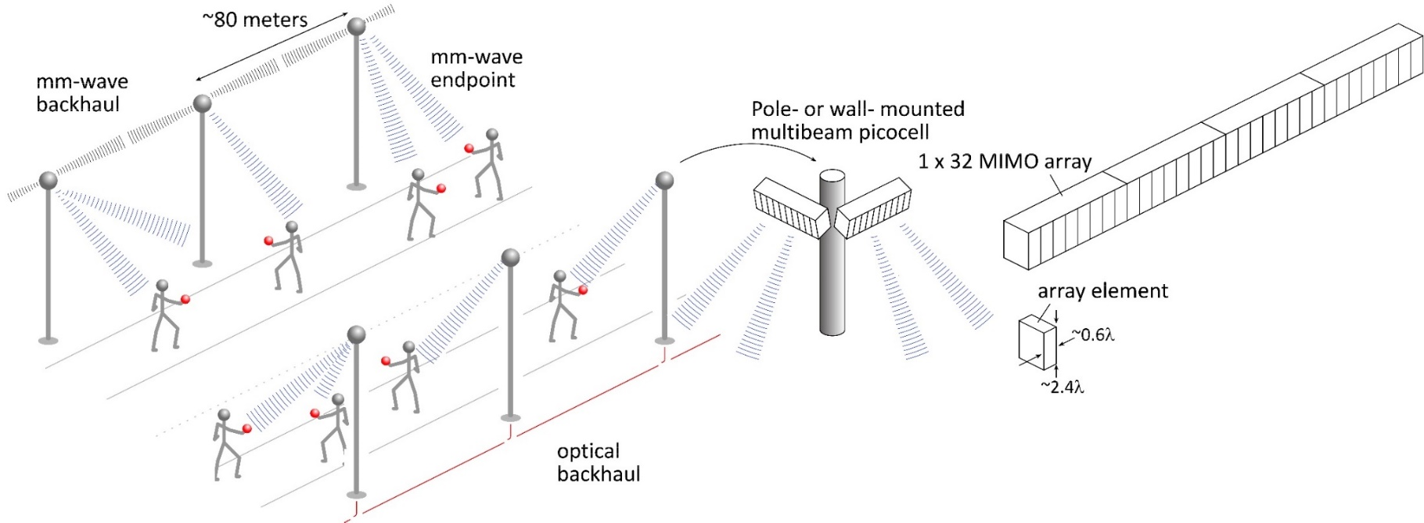
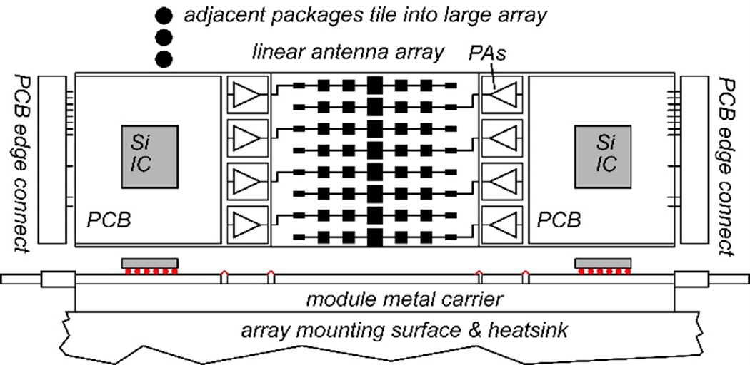
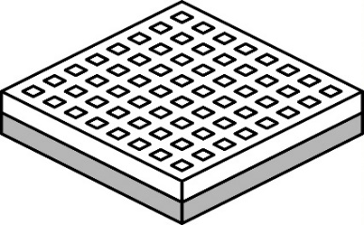
140GHz moderate-MIMO hub
Handset:
8 × 8 array
(9×9mm)
If hub uses 32-element array (four 1×8 modules):
16 users/array. P_{1dB}=21 dB_{m} PAs, F=8dB LNAs
1,10 Gb/s/beam→ 16, 160 Gb/s total capacity
70, 40 m range in 50mm/hr rain with 17dB total margins

Slide 6
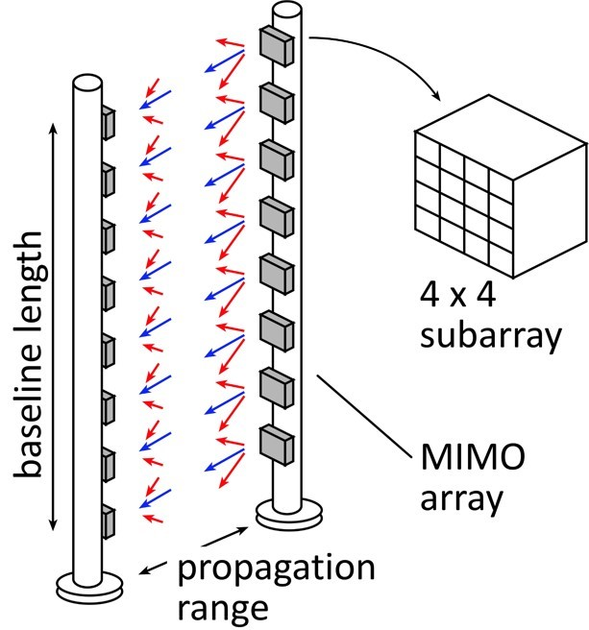
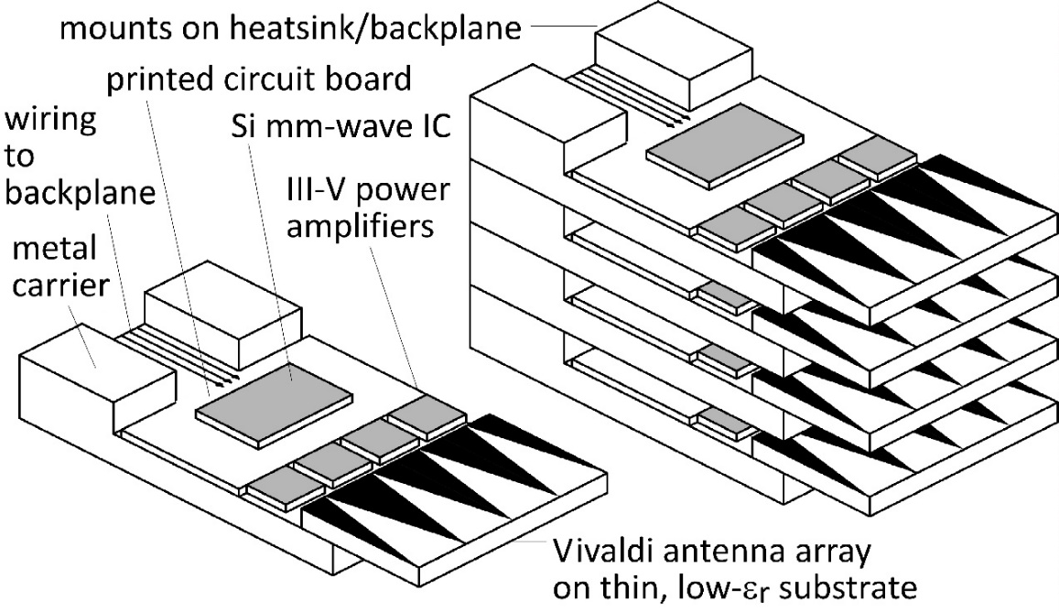
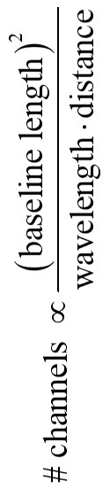
210 GHz, 640 Gb/s MIMO Backhaul
Key link parameters
500 meters range in 50 mm/hr rain; 23 dB/km
20 dB total margins:
packaging loss, obstruction, operating, design, aging
PAs: 18dBm =P_{1dB} (per element)
LNAs: 6dB noise figure
8-element MIMO array
2.1 m baseline.
80Gb/s/subarray→ 640Gb/s total
4 × 4 sub-arrays → 8 degree beamsteering

Slide 7
Systems Design

Slide 8
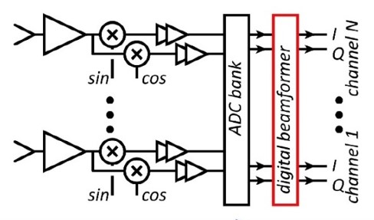
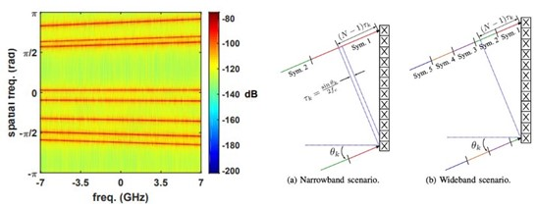
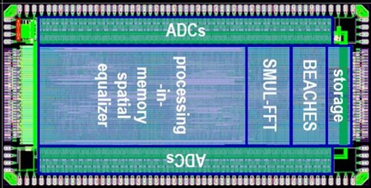
MIMO System Design
ADCs/DACs¹: QPSK needs only 3-4 bit ADC/DACs
N ADC bits, M antennas, K signals: SNR=6N+1.76+10.log₁₀(M/K)
3 bits, (M/K)=2→ SNR=23 dB. QPSK needs 9.8 dB.
Linearity¹: Amplifier P_{1dB} need be only 4 dB above average power
Phase noise^{2,3}: Requirements same as for SISO
Efficient digital beamforming^{4,5}: beamspace algorithm
Efficient VLSI digital beamformer implementation⁶: low-resolution matrix
Efficient beamforming in broadband arrays⁷: combined spatial & temporal FFTs.
1) M. Abdelghany et al, IEEE Trans. Wireless Comm, Sept. 2021
2) M. E. Rasekh et al, IEEE Trans. Wireless Comm, Oct. 2021
3) A. Puglielli et al, 2016 IEEE ICC
4) M. Abdelghany, et. al, , 2019 IEEE SPAWC
5) S. H. Mirfarshbafan et al, IEEE Trans CAS 1, 2020
6) O Castañeda Fernández et. al, 2021 ESSCIRC
7) M. Abdelghany et al 2019 IEEE GLOBECOM

Slide 9
100-300 GHz IC design: Transistors

Slide 10
Transistors for 100-300GHz
CMOS: good power & noise up to ~150GHz. Not much beyond.
65-22nm nodes are best.
InP HBT: record 100-300GHz PAs
SiGe HBT: out-performs CMOS above 200GHz
GaN HEMT: record power below 100GHz. Bandwidth improving
InGaAs-channel HEMT: world's best low-noise amplifiers
Results with low power but high PAE, or low PAE but high power, are not shown
Results compiled 9/9/2021

Slide 11
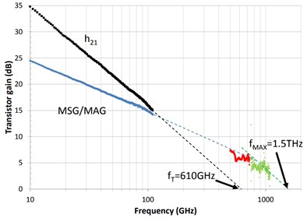
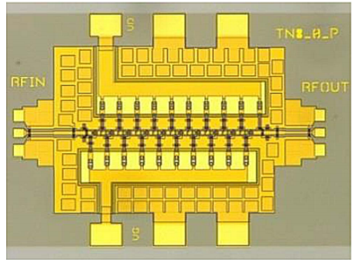
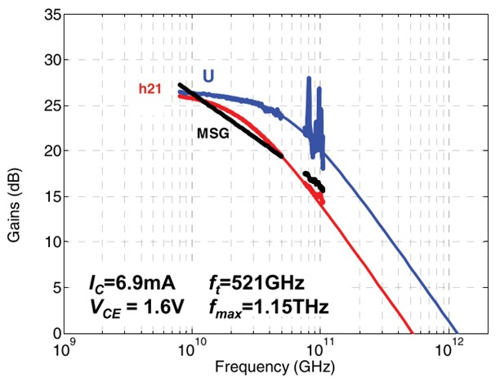
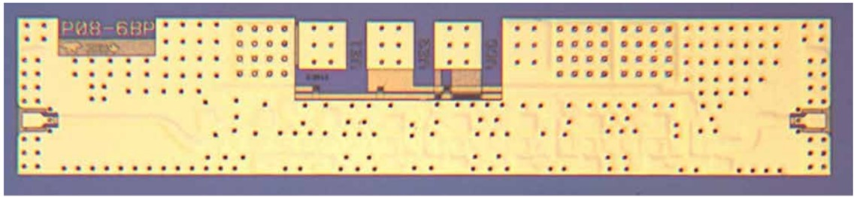
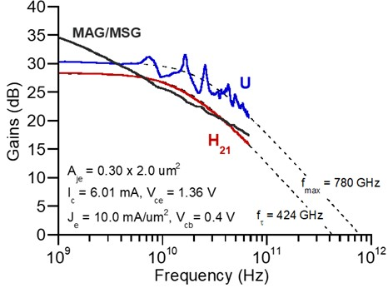

Summary: InP transistors & ICs
InP HEMTs: 1.5THz f_{max}, 1.0THz amplifiers
W. Deal et al, 2016 IEDM (Northrop-Grumman)
130nm InP HBTs: 1.1THz f_{max}, 3.5V. 670 GHz amplifiers
M. Urteaga, et al, IEEE Proceedings June 2017 (Teledyne)
250nm InP HBTs: 650GHz f_{max}, 4.5V.
Z. Griffith et al, 2007 IPRM conference (UCSB)
M. Urteaga, et al, IEEE Proceedings June 2017 (Teledyne)
204 GHz static frequency divider
Z. Griffith et al, 2010 IEEE CSICS

Slide 12
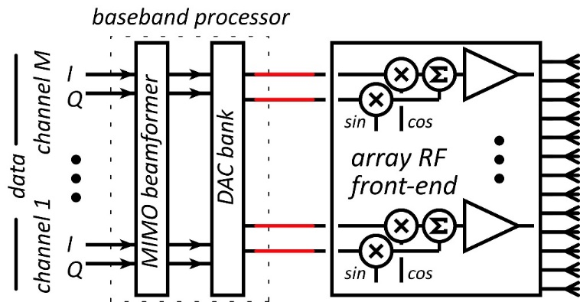
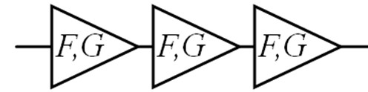
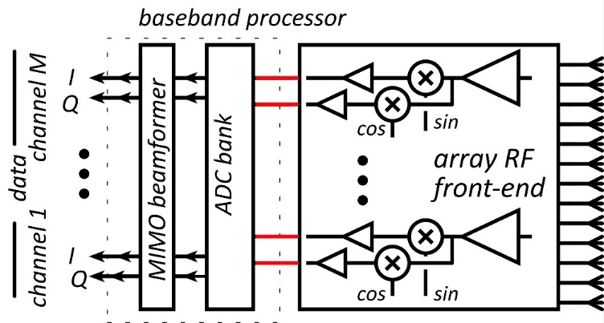
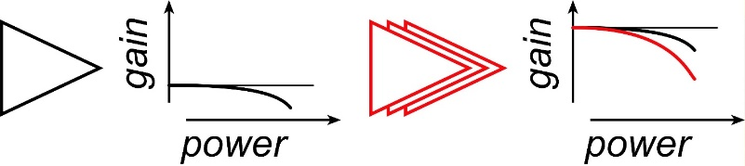
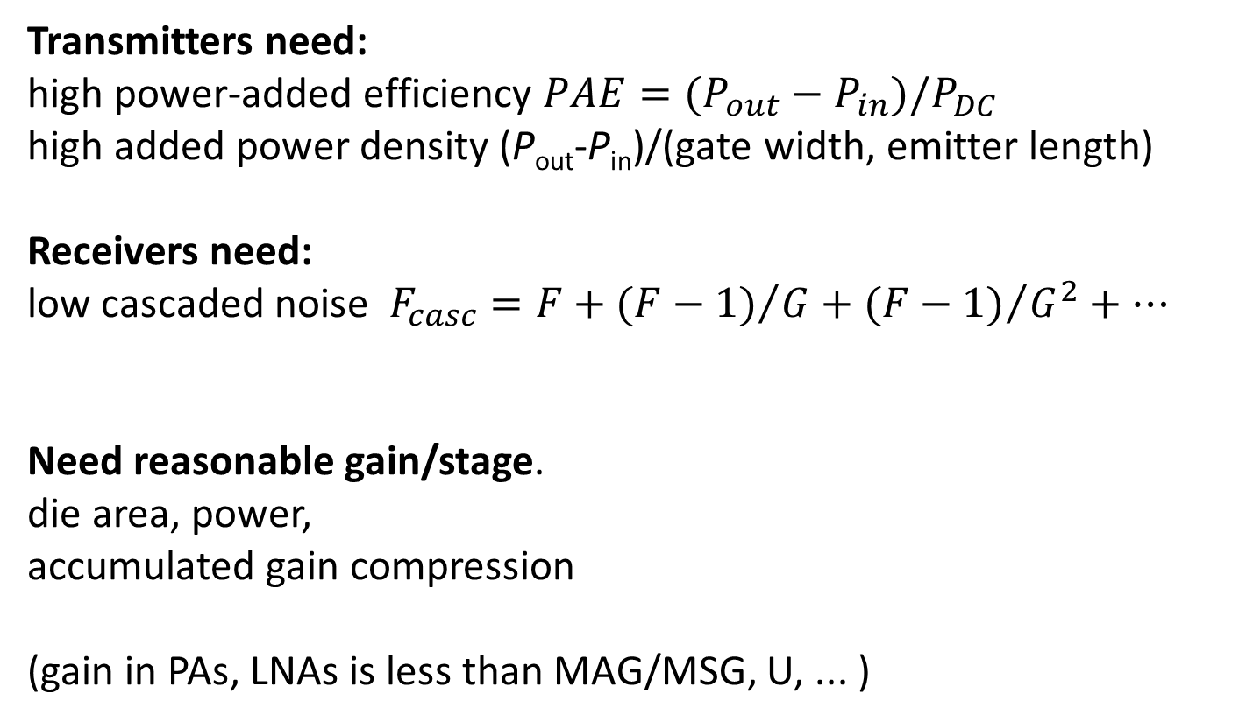
100-300GHz wireless: transistor requirements
Transmitters need:
high power-added efficiency $PAE=(P_{out}−P_{in})/P_{DC}$
high added power density (P_{out}-P_{in})/(gate width, emitter length)
Receivers need:
low cascaded noise $F_{casc}=F+{(F−1)}/G+{(F−1)}/{G^{2}+…}$
Need reasonable gain/stage.
die area, power,
accumulated gain compression
(gain in PAs, LNAs is less than MAG/MSG, U, ... )

Slide 13
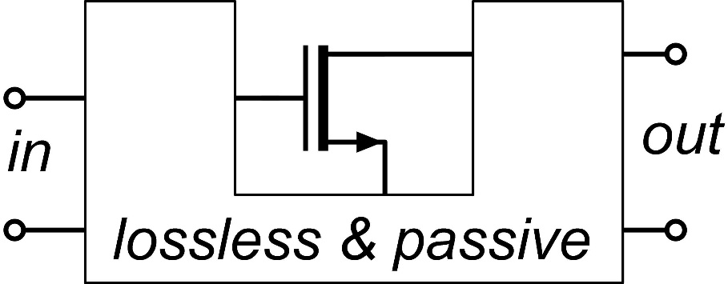
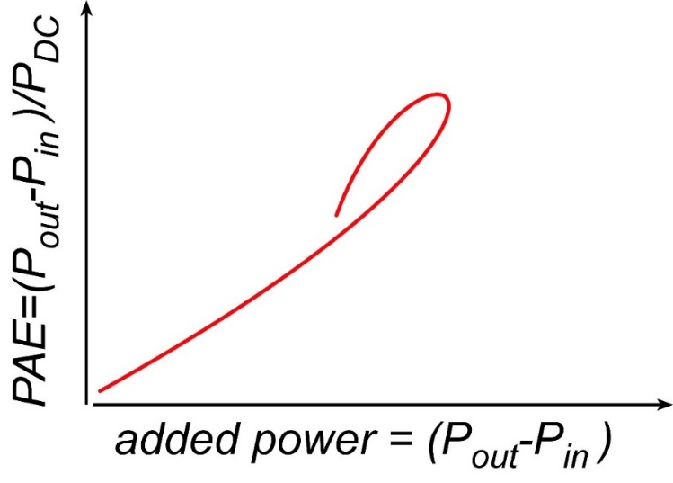
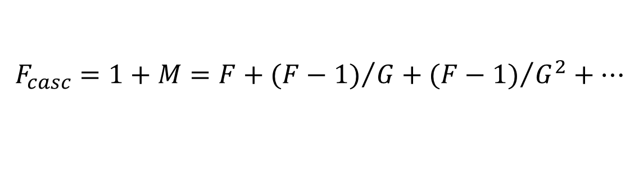
Where the IC designer can't help
mm-wave transistor gain is low: gain-boosting is common
Common-source vs. common-gate.
Capacitive neutralization. Unconditionally stable positive feedback (Singhakowinta, Int. J. Electronics, 1966)
Such circuits don't improve the parameters that matter the most.
The circuit* doesn't change the transistor minimum cascaded noise figure. (Haus, Adler, Proc. IRE, 1958)
The circuit* doesn't change the transistor maximum efficiency vs. added power curve.
$$F_{casc}=1+M=F+{(F−1)}/G+{(F−1)}/{G^{2}+…}$$
*If lossless, and given the correct source and load impedances.

Slide 14
100-300 GHz IC design: Interconnects

Slide 15
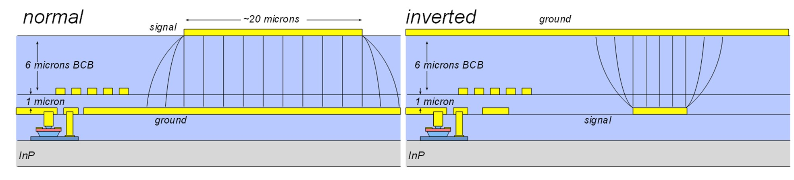
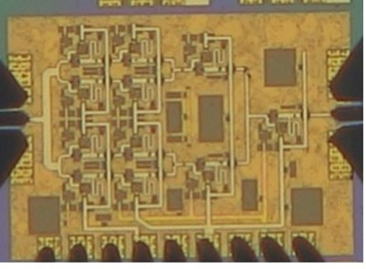
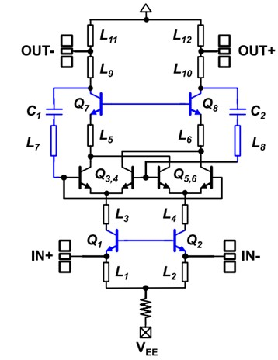
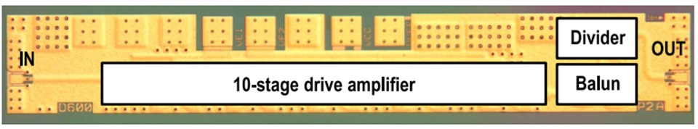
Normal & inverted microstrip
Normal: PAs, LNAs
smaller skin-effect losses ✓
ground-plane holes at transistors✘
Inverted: high-density blocks (mixers, phase shifters,…)
higher skin-effect losses✘
no ground-plane breaks: better ground integrity✓
266GHz, 16.8dBm PA: A. Ahmed et. al, 2021 IMS
529GHz dynamic divider: M. Seo et al, IEICE Electronics Express, Feb. 2015

Slide 16
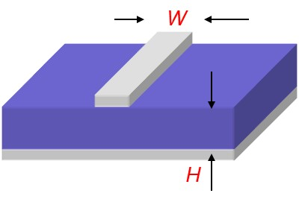
On-Wafer Interconnect Losses

Slide 17
100-300 GHz IC design:
Low-noise amplifiers

Slide 18
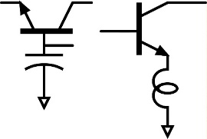

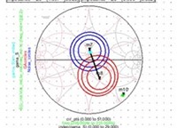
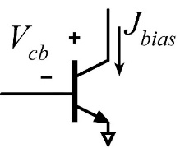
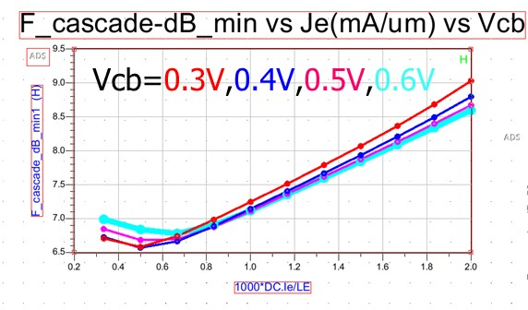
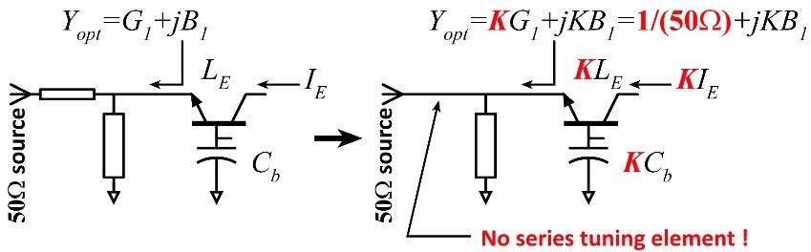
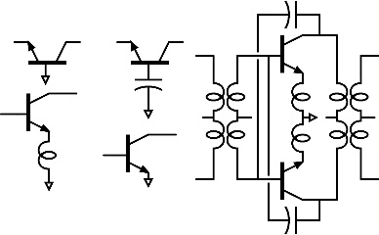
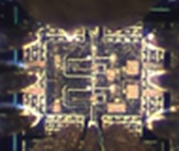
LNA design: noise close to transistor limits
1) Goal: low noise measure, not noise figure
4) Capacitance in common-base; just like
inductance in common-emitter, allows simultaneous
tuning for zero reflection coefficient and minimum M.
5) Write ADS Python code to display
source impedance for minimum M.
2) Find bias current density for lowest noise measure
6) Scale transistor size to eliminate series tuning element.
Less input tuning→ less noise from passive element loss.
@210GHz,
F_{cascade,min}= 6.57 dB
given:
J_{e}=0.5 mA/um,
V_{cb}=0.3V
U. Solyu et. al, to be presented, 2021 EuMIC Conference
3) Minimum M is independent of circuit configuration*;
pick for high bandwidth or high gain/stage (= low P_{DC})
Result: 7.2-7.4dB LNA noise given 6.6dB transistor F_{cascade}.
<-- all give the same minimum M…
…but common-base gives highest gain (InP HBT @210GHz).
*HA Haus, RB Adler, Proceedings of the IRE, 1958

Slide 19
100-300 GHz IC design:
Power amplifiers

Slide 20
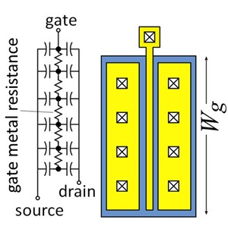
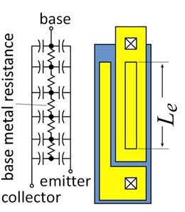
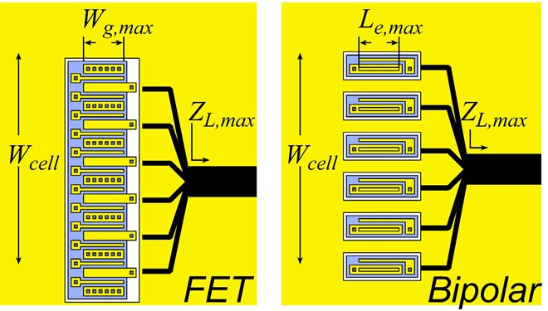
Current density, finger pitch limit cell output power

Slide 21
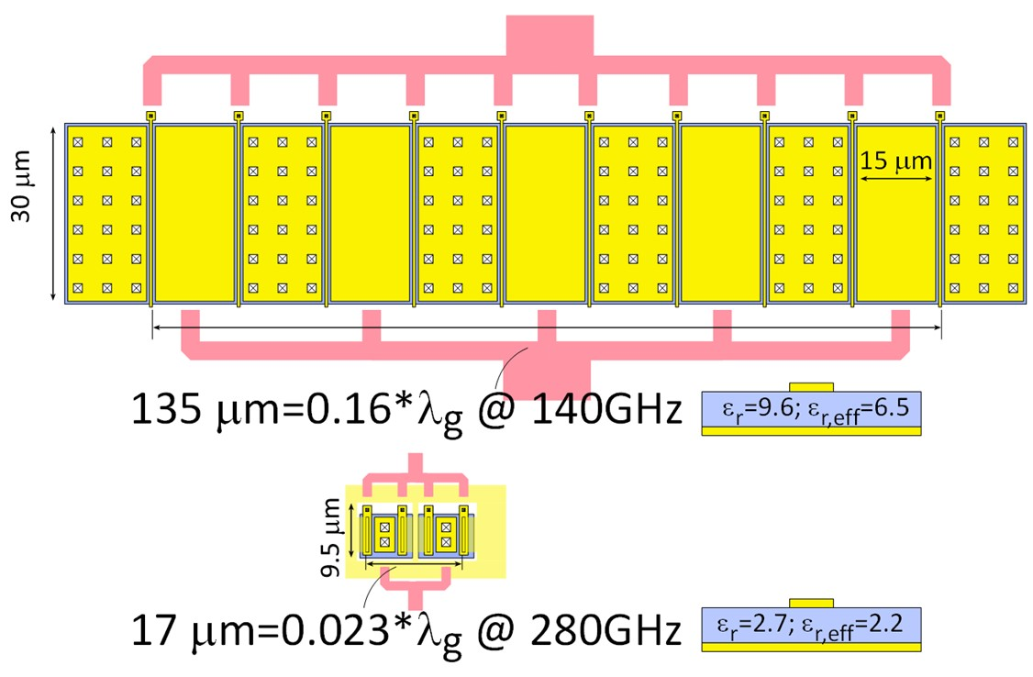
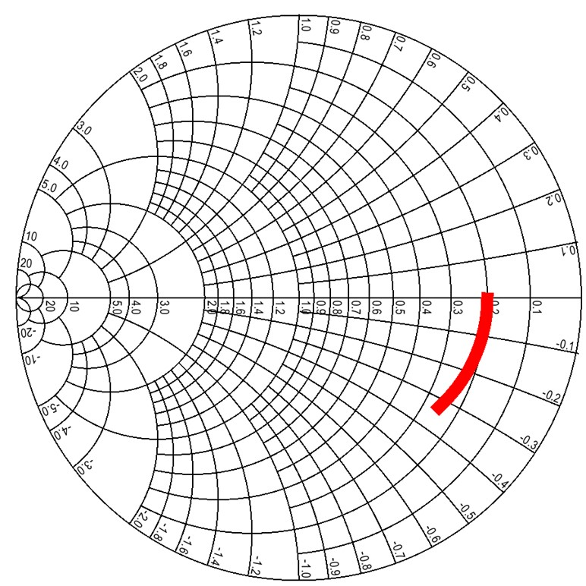
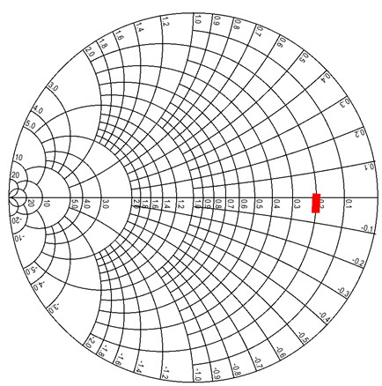
Current density, finger pitch limit cell output power
50Ω GaN PA cell @ 140GHz (1.6W)
25V swing, 1.67mA/μm,
gates: 30 μm width, 15 μm pitch
K. Shinohara, Teledyne: GaN HEMT thermal analysis
50Ω InP HBT PA cell @ 280GHz (40mW)
4V swing, 3.3mA/μm,
emitters: 6 μm length, 6 μm pitch
High V_{br}, low I_{max} ? Device sized to drive 50Ω might approach λ_{g}/4 width.
Small finger pitch is critical; limited by thermal design

Slide 22



Low-Loss 100-300GHz Corporate Combining
Wilkinson trees are lossy:
Signal passes through *many* 70.7Ω, λ/4 lines.
λ/4 lines are long.
70.7Ω lines are narrow…and lossy→ High loss.
Single-(λ/4) combiners are much less lossy
Each design uses a single effective λ/4 section.
Shorter lines, low-Z_{o} lines → lower loss
But, low loss only if transistor cells fit.

Slide 23






100-300GHz Power combining: what is best ?
Corporate T-line
Direct series-connected
M. Shifrin: 1992 IEEE μWave/mmWave Monolithic Circuits Symp. (Raytheon)
Cascaded combining
A. Ahmed 2018 EuMIC, 2021 RFIC (UCSB)
Distributed Active Transformer
I. Aoki, IEEE Trans MTT, Jan. 2002 (CalTech)
Balun series-connected
λ/4 baluns: Y. Yoshihara, 2008 IEEE Asian Solid-State Circuits Conference (Toshiba)
sub-λ/4 baluns: H. Park, et al, IEEE JSSC, Oct. 2014 (UCSB)

Slide 24


Transistor stacking. Why ? Why not ?
 | Lower frequencies | Higher frequencies
Corporate combining | length $∝1/f$→ large die area ✘ dB loss $∝1/\sqrt{f}$→ high loss ✘ | length $∝1/f$→ small die area ✓ dB loss $∝1/\sqrt{f}$→ low loss ✓
Series-connected | more transistor fingers per cell → ok ✓ | more transistor fingers per cell→ parasitics ✘

Slide 25



Series combining using sub-λ/4 baluns
λ/4 baluns: Y. Yoshihara, 2008 IEEE Asian Solid-State Circuits Conference (Toshiba)
sub-λ/4 baluns: H. Park, et al, IEEE JSSC, Oct. 2014 (UCSB)
81GHz, 17 dB Gain
470 mW P_{sat} , 23% PAE
Teledyne 250 nm InP HBT
2 stages, 1.0 mm²(incl pads)

Slide 26


Sub-λ/4 Balun Combiners. Why ? Why not ?
 | Lower frequencies | Higher frequencies
Corporate combining | length $∝1/f$→ large die area ✘ dB loss $∝1/\sqrt{f}$→ high loss ✘ | length $∝1/f$→ small die area ✓ dB loss $∝1/\sqrt{f}$→ low loss ✓
Sub-λ/4 Balun | more transistor fingers per cell → ok ✓ | more transistor fingers per cell→ parasitics ✘ impedance shift of transistor-balun interconnect ✘

Slide 27





Cascade combining as stacking plus matching
A. S. H. Ahmed et al, 2018 EuMIC (UCSB)

Slide 28



Generalized cascade combining
A. S. H. Ahmed et al, 2018 EuMIC (UCSB)
A. S. H. Ahmed, et al, 2021 RFIC Symposium
266GHz, 16.8dBm, 4.0% PAE

Slide 29





Cascade Combining: Why ? Why not ?
 | Lower frequencies | Higher frequencies
Corporate combining | length $∝1/f$→ large die area ✘ dB loss $∝1/\sqrt{f}$→ high loss ✘ | length $∝1/f$→ small die area ✓ dB loss $∝1/\sqrt{f}$→ low loss ✓
Series-connected | more transistor fingers per cell → ok ✓ | more transistor fingers per cell→ parasitics ✘
Cascade combining | large interstage matching networks✘ | small interstage matching networks ✓ small # transistor fingers per cell → ok ✓ cascade cell pass-though losses ✘

Slide 30




Recent high-efficiency 100-300GHz PAs
Teledyne 250nm InP HBT technology
Ahmed et al, 2020 IMS, 2020 EuMIC, 2021 IMS, 2021 RFIC
140GHz, 20.5dBm, 20.8% PAE
130GHz, 200mW, 17.8% PAE
194GHz, 17.4dBm, 8.5% PAE
266GHz, 16.8dBm, 4.0% PAE

Slide 31
ICs and Packages: 140 GHz

Slide 32





The mm-wave module design problem
How to make the IC electronics fit ?
How to avoid catastrophic signal losses ?
How to remove the heat ?
Not all systems steer in two planes...
...some steer in only one.
Not all systems steer over 180 degrees...
...some steer a smaller angular range

Slide 33

100-300GHz IC-package connections

Slide 34





140GHz hub: packaging challenges
IC-package interconnects
Difficult at > 100 GHz
Removing heat
Thermal vias are marginal
Interconnect density
Dense wiring for DC, LO, IF, control.
Hard to fit these all in.
Economies of scale
Advanced packaging standards require sophisticated tools
High-volume orders only
Hard for small-volume orders (research, universities)
Packaging industry is moving offshore

Slide 35


135GHz 8-channel MIMO hub array tile modules
Receiver: A. Farid et. al, to be presented, 2021 IEEE BCICTS; Transmitter to be submitted

Slide 36









135GHz 8-channel MIMO hub array tile modules
140GHz MIMO hub receiver array modules,
4-element, 8-element
MIMO beamforming
Data transmission up to 1.9Gb/s
140GHz MIMO hub transmitter array modules,
8-element
38.5dBm EIRP
Data transmission up to 1.9Gb/s
Performance limited by assembly yield.
Data rate limited by connector.
Receiver: A. Farid, 2021 BCICTS; Transmitter: to be submitted
110mW InP PA
20.8% PAE
CMOS TX, RX ICs
GlobalFoundries
22nm SOI CMOS.
Teledyne 250nm InP HBT

Slide 37


140 GHz IF Beamforming Phased-Array Receiver
S. Li, et al , IEEE JSSC 2021, Rebeiz Group, UCSD
Wirebond
LO, IF, VDD, SPI
Antenna
Quartz Superstrate Layer
LO
Silicon
1.1 mm
1.1 mm
LO
x3
Antenna
Feed
5.3 mm
Channel
8-element
IF
8-element Receiver Chip Area is 5.3 mm x 4.7 mm
1.1 mm channel to channel spacing is dependent on the $\frac{λ}{2}$ length at 140 GHz in the air
4.7 mm

Slide 38





140 GHz IF Beamforming Phased-Array Transmitter
Siwei Li, 2021 IEEE IMS: Rebeiz Group, UCSD

Slide 39

High-power 140GHz CMOS Amplifier
Power Amplifier for 140GHz ICs
45 nm SOI CMOS (GlobalFoundries)
17.5dBm saturated output power
13.4% peak power-added efficiency
Record performance
S. Li , 2021 IEEE RFIC Symposium
Rebeiz Group, UCSD

Slide 40




Fully Connected E-band 16x16 Uplink
16 x 16 subarrays
Low power: 7 mW/user/element
7-76 GHz, 81-86 GHz
4 simultaneous users demonstrated
Can support 16 users, 2 Gb/s/user
E. Naviasky, 2021 ISSCC
(Niknejad group, UC Berkeley)

Slide 41
Beamspace digital beamformer IC
All-digital receive beamformer ASIC in 65nm CMOS
Beamspace algorithm
Supports 32 antennas and 1 to 16 users
20GB/s throughput given
16 simultaneously transmitting users
under conditions requiring 3-bit ADC resolution
Record 9.98GB/s throughput given
16 simultaneously transmitting users
under conditions requiring 6-bit ADC resolution
Castaneda Fernandez 2021 ESSCIRC.
Studer Group, Cornell/ETHZ
Molnar Group, Cornell

Slide 42
ICs and Packages: 210 GHz & 280 GHz

Slide 43




210 GHz Transmitter and Receiver ICs
M. Seo et al, 2021 IMS; Teledyne 250nm InP HBT
Size: 2.9 x 0.75 mm²
Size: 2.3 x 0.85 mm²

Slide 44


280GHz transmitter and receiver IC designs
Solyu, Alz, Ahmed, Seo; UCSB/Sungkyunkwan
Teledyne 250nm InP HBT technology
Receiver
Transmitter
simulations: 11dB noise figure, 40GHz bandwidth
simulations: 17dB saturated output power.
Application: point-point MIMO backhaul links

Slide 45
100-300GHz Wireless
Massive capacities
large available bandwidths
massive spatial multiplexing in base stations and point-point links
Very short range: few 100 meters
short wavelength, high atmospheric losses. Easily-blocked beams.
IC Technology
All-CMOS for short ranges below 200 GHz.
SiGe or III-V LNAs and PAs for longer-range links. Just like cell phones today
SiGe or III-V frequency extenders for 200GHz and beyond
The challenges
digital beamformer computational complexity
packaging: fitting signal channels in very small areas
mesh networking to accommodate beam blockage
driving the technologies to low cost

Slide 46
References
Systems Design
100-300GHz Link examples: M. J. W. Rodwell, "100-340GHz Spatially Multiplexed Communications: IC, Transceiver, and Link Design," 2019 IEEE 20th International Workshop on Signal Processing Advances in Wireless Communications (SPAWC), 2019, pp. 1-5, doi: 10.1109/SPAWC.2019.8815433.
Required ADC/DAC resolution and amplifier IP3, P1dB in massive MIMO: M. Abdelghany, A. A. Farid, M. E. Rasekh, U. Madhow and M. J. W. Rodwell, "A Design Framework for All-Digital mmWave Massive MIMO With per-Antenna Nonlinearities," in IEEE Transactions on Wireless Communications, vol. 20, no. 9, pp. 5689-5701, Sept. 2021, doi: 10.1109/TWC.2021.3069378.
Phase noise in massive MIMO: M. E. Rasekh, M. Abdelghany, U. Madhow and M. Rodwell, "Phase Noise in Modular Millimeter Wave Massive MIMO," in IEEE Transactions on Wireless Communications, vol. 20, no. 10, pp. 6522-6535, Oct. 2021, doi: 10.1109/TWC.2021.3074911.
Phase noise in massive MIMO: A. Puglielli, G. LaCaille, A. M. Niknejad, G. Wright, B. Nikolić and E. Alon, "Phase noise scaling and tracking in OFDM multi-user beamforming arrays," 2016 IEEE International Conference on Communications (ICC), 2016, pp. 1-6, doi: 10.1109/ICC.2016.7511631.
Beamspace algorithm for MIMO hub digital beamforming: M. Abdelghany, U. Madhow and A. Tölli, "Beamspace Local LMMSE: An Efficient Digital Backend for mmWave Massive MIMO," 2019 IEEE 20th International Workshop on Signal Processing Advances in Wireless Communications (SPAWC), 2019, pp. 1-5, doi: 10.1109/SPAWC.2019.8815585.
Beamspace algorithm and VLSI design for MIMO hub digital beamforming: S. H. Mirfarshbafan, A. Gallyas-Sanhueza, R. Ghods and C. Studer, "Beamspace Channel Estimation for Massive MIMO mmWave Systems: Algorithm and VLSI Design," in IEEE Transactions on Circuits and Systems I: Regular Papers, vol. 67, no. 12, pp. 5482-5495, Dec. 2020, doi: 10.1109/TCSI.2020.3023023.
Digital beamformer IC: Oscar F. Castaneda Fernandez , Zachariah Boynton , Seyed Hadi Mirfarshbafan , Shimin Huang , Jamie Ye , Alyosha Molnar , Christoph Studer, "A Resolution-Adaptive 8mm2 9.98Gb/s 39.7pJ/b 32-Antenna All-Digital Spatial Equalizer for mmWave Massive MU-MIMO in 65nm CMOS", 2021 European Solid-State Circuits Conference.
Algorithms for MIMO digital beamforming with broaband waveforms: M. Abdelghany, U. Madhow and M. Rodwell, "An Efficient Digital Backend for Wideband Single-Carrier mmWave Massive MIMO," 2019 IEEE Global Communications Conference (GLOBECOM), 2019, pp. 1-6, doi: 10.1109/GLOBECOM38437.2019.9013233.

Slide 47
References
Transistors
InP HEMT:W. R. Deal, K. Leong, W. Yoshida, A. Zamora and X. B. Mei, "InP HEMT integrated circuits operating above 1,000 GHz," 2016 IEEE International Electron Devices Meeting (IEDM), 2016, pp. 29.1.1-29.1.4, doi: 10.1109/IEDM.2016.7838502
InP HBT: M. Urteaga, Z. Griffith, M. Seo, J. Hacker and M. J. W. Rodwell, "InP HBT Technologies for THz Integrated Circuits," Proceedings of the IEEE, vol. 105, no. 6, pp. 1051-1067, June 2017, doi: 10.1109/JPROC.2017.2692178.
InP HBT: M. J. W. Rodwell, M. Le and B. Brar, "InP Bipolar ICs: Scaling Roadmaps, Frequency Limits, Manufacturable Technologies," in Proceedings of the IEEE, vol. 96, no. 2, pp. 271-286, Feb. 2008, doi: 10.1109/JPROC.2007.911058.
finFET: H. Lee, S. Callender, S. Rami, W. Shin, Q. Yu and J. M. Marulanda, "Intel 22nm Low-Power FinFET (22FFL) Process Technology for 5G and Beyond," 2020 IEEE Custom Integrated Circuits Conference (CICC), 2020, pp. 1-7, doi: 10.1109/CICC48029.2020.9075914.
22nm SOI CMOS: C. Li et al., "5G mm-Wave front-end-module design with advanced SOI process," 2017 IEEE 12th International Conference on ASIC (ASICON), 2017, pp. 1017-1020, doi: 10.1109/ASICON.2017.8252651.
SiGe HBT: B. Heinemann et al., "SiGe HBT with ft/fmax of 505 GHz/720 GHz," 2016 IEDM, San Francisco, CA, 2016, pp. 3.1.1-3.1.4.
GaN HEMT: S. Wienecke et al., "N-Polar GaN Cap MISHEMT With Record Power Density Exceeding 6.5 W/mm at 94 GHz," IEEE Electron Device Letters, vol. 38, no. 3, pp. 359-362, March 2017
GaN HEMT: A. Fung et al., "Gallium nitride amplifiers beyond W-band," 2018 IEEE Radio and Wireless Symposium (RWS), 2018, pp. 150-153, doi: 10.1109/RWS.2018.8304971.

Slide 48
References
Power Amplifiers
Stacking: M. Shifrin, Y. Ayasli, and P. Katzin, “A new power amplifier topology with series biasing and power combining of transistors,” in 1992 IEEE Microwave and Millimeter-Wave Monolithic Circuits Symp. Dig. Papers, Jun. 1992, pp. 39–41.
Stacking: S. Pornpromlikit, H.-T. Dabag, B. Hanafi, J. Kim, L. Larson, J. Buckwalter, and P. Asbeck, “A Q-band amplifier implemented with stacked 45-nm CMOS FETs,” in Proc. 2011 IEEE Compound Semiconductor Integrated Circuit Symp. (CSICS), Oct. 2011, pp. 1–4.
Distributed active transformers: I. Aoki, S. Kee, D. Rutledge, and A. Hajimiri, “Distributed active transformer: A new power-combining and impedance-transformation technique,” IEEE Trans. Microw. Theory Tech., vol. 50, no. 1, pp. 316–331, Jan. 2002S
Series combining with baluns: Y. Yoshihara, R. Fujimoto, N. Ono, T. Mitomo, H. Hoshino and M. Hamada, "A 60-GHz CMOS power amplifier with Marchand balun-based parallel power combiner," 2008 IEEE Asian Solid-State Circuits Conference, 2008, pp. 121-124, doi: 10.1109/ASSCC.2008.4708744.
Series combining with sub-quarter-wave baluns: H. Park, S. Daneshgar, Z. Griffith, M. Urteaga, B. Kim and M. Rodwell, "Millimeter-Wave Series Power Combining Using Sub-Quarter-Wavelength Baluns," IEEE JSSC, vol. 49, no. 10, pp. 2089-2102, Oct. 2014
Cascade combining: A. S. H. Ahmed, A. A. Farid, M. Urteaga and M. J. W. Rodwell, "204GHz Stacked-Power Amplifiers Designed by a Novel Two-Port Technique," 2018 13th European Microwave Integrated Circuits Conference (EuMIC), 2018, pp. 29-32, doi: 10.23919/EuMIC.2018.8539884.
270GHz InP HBT PA: A. S. H. Ahmed, U. Soylu, M. Seo, M. Urteaga and M. J. W. Rodwell, "A compact H-band Power Amplifier with High Output Power," 2021 IEEE Radio Frequency Integrated Circuits Symposium (RFIC), 2021, pp. 123-126, doi: 10.1109/RFIC51843.2021.9490426.
140GHz CMOS PA: S. Li and G. M. Rebeiz, "A 130-151 GHz 8-Way Power Amplifier with 16.8-17.5 dBm Psat and 11.7-13.4% PAE Using CMOS 45nm RFSOI," 2021 IEEE Radio Frequency Integrated Circuits Symposium (RFIC), 2021, pp. 115-118, doi: 10.1109/RFIC51843.2021.9490507.

Slide 49
References
Power Amplifiers (more)
270GHz power amplifier: A. S. H. Ahmed, U. Soylu, M. Seo, M. Urteaga and M. J. W. Rodwell, "A compact H-band Power Amplifier with High Output Power," 2021 IEEE Radio Frequency Integrated Circuits Symposium (RFIC), 2021, pp. 123-126, doi: 10.1109/RFIC51843.2021.9490426.
200GHz power amplifier: A. S. H. Ahmed, U. Soylu, M. Seo, M. Urteaga, M. J. W. Rodwell, "A 190-210GHz Power Amplifier with 17.7-18.5dBm Output Power and 6.9-8.5% PAE." IEEE International Microwave Symposium (IMS). 6-11 June, Atlanta and virtual
130GHz power amplifier: A. S. H. Ahmed, M. Seo, A. A. Farid, M. Urteaga, J. F. Buckwalter and M. J. W. Rodwell, "A 200mW D-band Power Amplifier with 17.8% PAE in 250-nm InP HBT Technology," 2020 15th European Microwave Integrated Circuits Conference (EuMIC), 2021, pp. 1-4, doi: 10.1109/EuMIC48047.2021.00012.
140GHz power amplifier: A. S. H. Ahmed, M. Seo, A. A. Farid, M. Urteaga, J. F. Buckwalter and M. J. W. Rodwell, "A 140GHz power amplifier with 20.5dBm output power and 20.8% PAE in 250-nm InP HBT technology," 2020 IEEE/MTT-S International Microwave Symposium (IMS), 2020, pp. 492-495, doi: 10.1109/IMS30576.2020.9224012.
LNAs
200GHz InP HBT LNAs: Utku Soylu, Ahmed S. H. Ahmed, Munkyo Seo, Ali Farid, Mark Rodwell, "200 GHz Low Noise Amplifiers in 250nm InP HBT Technology", 2021 EuMIC (delayed by COVID to Jan 2022 )
InGaAs-channel HEMT LNAs: G. Moschetti et al., "A 183 GHz Metamorphic HEMT Low-Noise Amplifier With 3.5 dB Noise Figure," in IEEE Microwave and Wireless Components Letters, vol. 25, no. 9, pp. 618-620, Sept. 2015, doi: 10.1109/LMWC.2015.2451355.
Circuit theory
Maximum acheivable unconditionally stable gain: A. Slnghakowinta & A. R. Boothroyd (1966) Gain Capability of Two-port Amplifiers , International Journal of Electronics, 21:6, 549-560, DOI: 10.1080/00207216608937931
Noise theory: H. A. Haus and R. B. Adler, "Optimum Noise Performance of Linear Amplifiers," in Proceedings of the IRE, vol. 46, no. 8, pp. 1517-1533, Aug. 1958. doi: 10.1109/JRPROC.1958.286973

Slide 50
References
Frequency Dividers
Static Dividers: Z. Griffith, M. Urteaga, R. Pierson, P. Rowell, M. Rodwell and B. Brar, "A 204.8GHz Static Divide-by-8 Frequency Divider in 250nm InP HBT," 2010 IEEE Compound Semiconductor Integrated Circuit Symposium (CSICS), 2010, pp. 1-4, doi: 10.1109/CSICS.2010.5619684.
Dynamic Dividers: Munkyo Seo, John Hacker, Miguel Urteaga, Anders Skalare, Mark Rodwell, " A 529 GHz Dynamic Frequency Divider in 130 nm InP HBT Process", IEICE Electronics Express, Vol. 12 (2015) No. 3 pp. 20141118. February 10, 2015, https://doi.org/10.1587/elex.12.20141118
Phased arrays and MIMO Transeiver modules
CMOS phased array: S. Li, Z. Zhang, B. Rupakula and G. M. Rebeiz, "An Eight-Element 140-GHz Wafer-Scale IF Beamforming Phased-Array Receiver With 64-QAM Operation in CMOS RFSOI," in IEEE Journal of Solid-State Circuits, doi: 10.1109/JSSC.2021.3102876.
CMOS phased array: Siwei Li, Zhe Zhang , Bhaskara R. Rupakula, Gabriel M. Rebeiz, "An Eight-Element 140 GHz Wafer-Scale Phased-Array Transmitter with 32 dBm Peak EIRP and > 16 Gbps 16QAM and 64QAM Operation", 2021 IEEE MTT-S International Microwave Symposium
140GHz CMOS MIMO receiver hub modules: A. A. Farid, A. S. H. Ahmed, A Dhananjay, P. Skrimponis, S. Rangan, M. J. W. Rodwell, "135GHz CMOS / LTCC MIMO Receiver Array Tile Modules", 2021 IEEE BiCMOS and Compound Semiconductor Integrated Circuits and Technology Symposium (BCICTS),
140GHz CMOS MIMO receiver and transmitter hub modules: Ali A. Farid, Ahmed S. H. Ahmed, Aditya Dhananjay, Mark J. W. Rodwell, "135GHz Transmitter and Receiver Multiuser MIMO Array Tiles for Wireless Communications", submitted to IEEE JSSC.
M. Seo, A. S. H. Ahmed, U. Soylu, A. Farid, Y. Na and M. Rodwell, "A 200 GHz InP HBT Direct-Conversion LO-Phase-Shifted Transmitter/Receiver with 15 dBm Output Power," 2021 IEEE MTT-S International Microwave Symposium (IMS), 2021, pp. 378-381, doi: 10.1109/IMS19712.2021.9575035.

Slide 51
Backup slides
(for questions, for reference)

Slide 52
210 GHz FMCW crossed-array imaging car radar
Array:
36×1 transmit, 1×216 receive
36 (v) × 216 (h) image
length: 15cm (6 inches),
beamwidth: 0.27º,
view: 10º (v) ×90º (h).
scan: 40Hz
Electronics
transmit power/element: 50mW
receiver noise: 6dB
packaging losses: 2dB TX, 2dB RX
Sees:
22cm diameter target (a soccer ball) @ -10dB reflectivity
200m range,
with 10dB SNR
in heavy fog/rain @ 22dB/km
with 4dB operating margins.

Slide 53
70 GHz spatially multiplexed base station
If we use instead a 70GHz carrier,
the range increases to 70 meters (vs. 40 meters)
but the handset becomes 16mm×16mm (vs. 8mm×8mm),
and the hub array becomes 19mm×612mm (vs. 10mm×328mm)
Or, use a 4×4 (8mm×8mm) handset array,
and the range becomes ..about 40 meters.
Same handset area (more handset elements)→ same link budget
Easier to obtain license for 140±2.5GHz than 70±2.5GHz

Slide 54

75 GHz, 640 Gb/s MIMO backhaul (16QAM)
Why not use a lower-frequency carrier, e.g. 75 GHz ?
Must use at least 16QAM, given 80Gb/s/channel…
8-element 640Gb/s linear array:
requires 16dB_{m} transmit power/element (P_{out})
requires 3.5m linear array
Similar RF power output, physically larger

Slide 55


Do we need 2D arrays ? 1D might be fine.
1/sin²φ sidelobes provide strong signals to tall buildings.
Providing sidelobes reduces broadside gain by less than 3dB.
→ Don't need 2D arrays to serve tall buildings

Slide 56




2D vs. 1D: user spatial distribution
uniform horizontal & vertical user distributions
uniform horizontal, nonuniform vertical
design 1: 2D array
✘
✓
design 2: 1D array
✓
✓
Spatial distribution of users, and of scattering objects, guides choice of array geometry.

Slide 57

1D or 2D subarray for backhaul ?
Should we use 4x4 array, 1x16, or 16x1 array ?
All provide same system link budget, same # RF channels, same angular scanning range.

Slide 58



Denser Integration: higher PAE at high Power
Compact multi-finger transistor layouts
→ Shorter combiner lines
→ Less loss
→ Higher PAE.

Slide 59






Capacitively degenerated common-base
Lower gain, same peak PAE, higher PAE at P_{1dB}.
How does this differ from stacking ?
(a) CE
(b) CB with
grounded base
(c) CB with
base capacitor
At 140GHz

