Slide 1

Neurophysiological Discoveries of the 2014 Nobel Prize Winners in Medicine from a Computer Arithmetic Perspective
Behrooz Parhami
Dept. Electrical & Computer Engr.
Univ. of California, Santa Barbara, USA
parhami@ece.ucsb.edu
Presented at the 20th Int’l Symp. Computer Architecture and Digital Systems
Guilan University, Iran, August 2020

Slide 2
About This Presentation
A preliminary version of this slide show was developed for a talk at Asilomar Conference on Signals, Systems, and Computers, held November 1-4, 2009. Subsequently, the slide show was updated and expanded to incorporate results of new research.
All rights reserved for the author. ©2009-2020 Behrooz Parhami
Edition | Released | Revised | Revised | Revised
First | Nov. 2009 | June 2019 | Aug. 2020

Slide 3
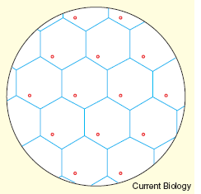
Outline
Introduction / Background
  What were the discoveries?
  Mixed digital/analog arithmetic
  Residue number system (RNS)
RNS with Continuous Digits (CD-RNS)
  Distinct from conventional RNS
  Motivations for this study
Dynamic Range and Precision
Choosing the CD-RNS Moduli
Conclusions / Future Work
Figure from

Slide 4
Abstract
The discovery that mammals use a multi-modular method akin to residue number system (RNS), but with continuous residues or digits, to encode position information led to the award of the 2014 Nobel Prize in Medicine. After a brief review of the evidence in support of this hypothesis, and how it relates to RNS, I discuss the properties of continuous-digit RNS, and present results on the dynamic range, representational accuracy, and factors affecting the choice of the moduli, which are themselves real numbers. I conclude with suggestions for further research on important open problems concerning the process of selection, or evolutionary refinement, of the set of moduli in such a representation.

Slide 5

Speaker’s Brief Technical Bio
Behrooz Parhami (PhD, UCLA 1973) is Professor of Electrical and Computer Engineering, and former Associate Dean for Academic Personnel, College of Engineering, at University of California, Santa Barbara, where he teaches and does research in the field of computer architecture: more specifically, in computer arithmetic, parallel processing, and dependable computing.
A Life Fellow of IEEE, a Fellow of IET and British Computer Society, and recipient of several other awards (including a most-cited paper award from J. Parallel & Distributed Computing), he has written six textbooks and more than 300 peer-reviewed technical papers. Professionally, he serves on journal editorial boards (including for 3 different IEEE Transactions) and conference program committees, and he is also active in technical consulting.

Slide 6
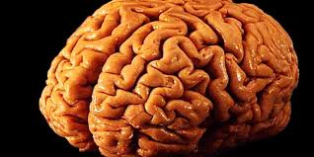

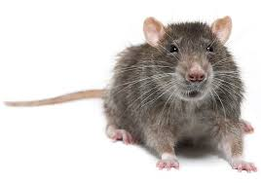
How Looking at Nature Helps my Research
Parallel processing
Parallelism used extensively in human brain
and other natural systems
Dependable (fault-tolerant) computing
The self-healing amphibian axolotl
can regenerate a near-perfect replica
of almost any body part it loses
Computer arithmetic
My subject area today: Use of residue
representation in rat’s navigational system

Slide 7

Nobel Prize in Physiology or Medicine: 2014
One half went to John O'Keefe (University College, London), the other half to May-Britt Moser (Center for Neural Computation, Norway) and Edvard I. Moser (Kavli Institute for Systems Neuroscience, Norway) "for their discoveries of cells that constitute a positioning system in the brain."

Slide 8

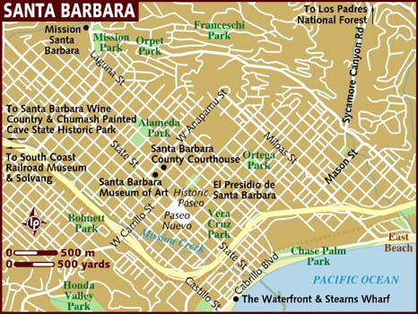
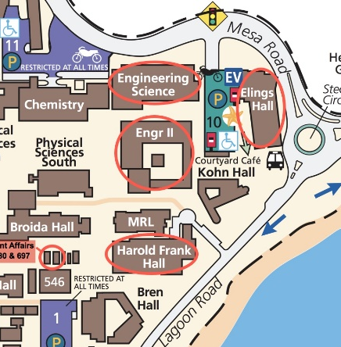
Sense of Place in Humans and Animals
The sense of place and the ability to navigate are some of the most fundamental brain functions.
German philosopher Immanuel Kant (1724-1804) argued that some mental abilities exist independent of experience.
He considered perception of place as one of these innate abilities through which the external world had to be organized/perceived.

Slide 9
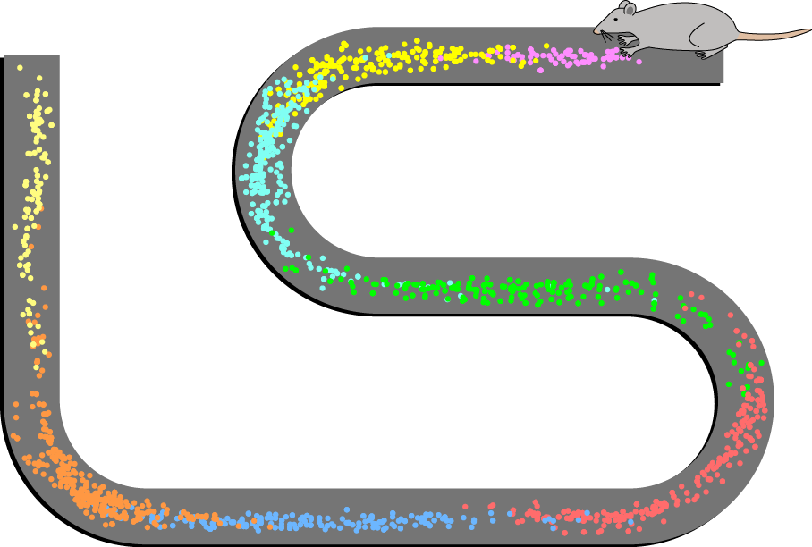
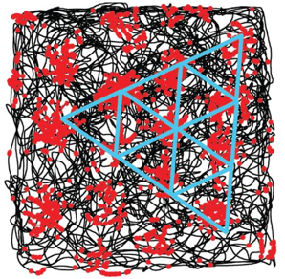
The Nobel Laureates’ Contributions
John O’Keefe discovered place cells in the hippocampus that signal position and provide the brain with spatial memory capacity.
May-Britt Moser and Edvard I. Moser discovered in the medial entorhinal cortex, a region of the brain next to hippocampus, grid cells that provide the brain with a coordinate system for navigation.
Place cells
firings
(image from
Wikipedia)
Grid cells
firings
(image from Moser/Rowland/Moser, 2015)
Notes:
Place cells fire whenever an animal occupies a specific location in its environment, with each place cell firing at a different spot.
Grid cells generate virtual maps of the surroundings that resemble grids of repeating triangles. Whenever an animal steps onto a corner of one of these virtual triangles, the grid cell that generated that map starts to fire.
Head direction cells increase their firing whenever an animal’s head is pointing in a specific direction.
These cell types thus provide animals with complementary information about their location.

Slide 10
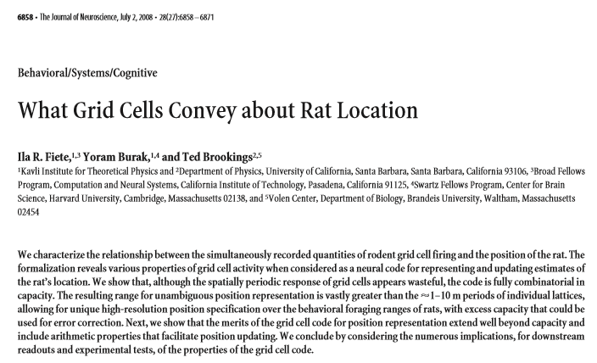
First Attempt at Understanding

Slide 11
Localization with Grid Cells
Rat’s navigation system
  Wavy travel path
  Straight return path
  Even in the dark
Nervous system has place cells & grid cells
  Grid cell firings
  Relative in-cell position
 End
 A
 Start
 (a) Travel and return paths
 (b) Rat’s hexagonal grid
  In-cell positions within several grids pinpoints rat’s absolute location
 (c) Firings and locations [3]
 (d) Two hexagonal grids [3]

Slide 12
The Questions to Be Addressed
A rat can go up to a certain distance and still be able to find its way back (range)
  Translating grid-cell firings to spatial information
  How the range is related to grid-cell parameters
  Representation range vs. the observed distance
Fiete, Burak, and Brookings had connected the grid cells to residue representation
  Couldn’t confirm the hypothesis theoretically
  Relied on extensive simulation for confirmation

Slide 13
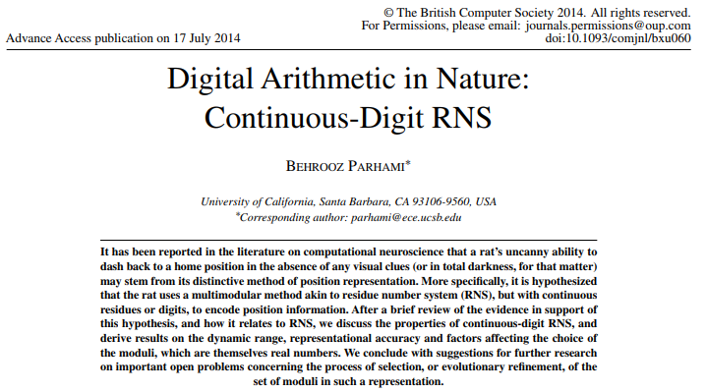
My First Contribution to the Problem

Slide 14
RNS with Analog Digits (Remainders)
I formulated the spatial representation problem with the grid cells to CD-RNS
  First time RNS is used with analog remainders
  Conventional RNS theory is inapplicable
  I developed a theory for CD-RNS and its range
Analog and mixed digital-analog technology has a long history in computer arithmetic
  Brief review presented in the next few slides
  More use of analog features expected to come

Slide 15
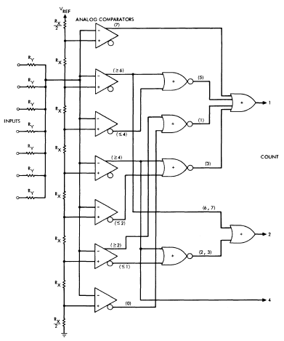
Quasi-Digital Parallel Counter
Analog current summing
  7 inputs, 3-bit output
  (*): Number of 1 inputs required to produce a 1
The scheme is even older
  Riordan and Morton, Use of Analog Techniques in Binary Arithmetic Units, IEEE TC, Feb. 1965
Figure from: Swartzlander
(IEEE TC, Nov. 1973)

Slide 16
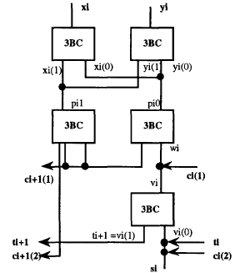
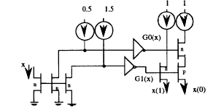
Current-Summing Multivalued Logic
Binary stored-carry addition
  Limited-carry algorithm
  3-valued to binary conv.: 3BC
CMOS
3BC
Figures from: Etiemble & Navi (SMVP, May 1993)

Slide 17
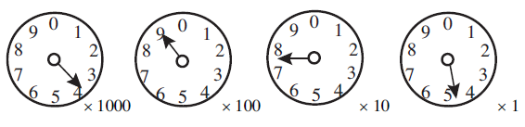
Mixed D/A Positional Representation
Continuous-valued number system (CVNS)
  The MSD has all the magnitude info
  Other digits provide successive refinements
Familiar example: utility meter
Figure from: Saed, Ahmadi, Jullien (IEEE TC, 2002)

Slide 18
An Ancient Chinese Puzzle
Puzzle, due to the Chinese scholar Sun Tzu,1500⁺ years ago:
What number has the remainders of 2, 3, and 2
when divided by 7, 5, and 3, respectively?
Residues (akin to digits in positional systems) uniquely identify the number, hence they constitute a representation: (2 | 3 | 2)_{RNS(7|5|3)}
In a weird way, RNS is a weighted representation
For RNS(7 | 5 | 3), the weights of the 3 positions are:
15 21 70
Example -- Chinese puzzle: (2 | 3 | 2)_{RNS(7|5|3)} represents the number
⟨15 × 2 + 21 × 3 + 70 × 2⟩₁₀₅ = ⟨233⟩₁₀₅ = 23

Slide 19
Residue Number System (RNS)
Pairwise prime moduli: m_{k–1} > . . . > m₁ > m₀
Representation of x: {r_{i} = x mod m_{i} | 0 ≤ i ≤ k – 1}
RNS dynamic range: M = Π_{0≤ i ≤k–1} m_{i}
  Unsigned in [0, M – 1]
  Signed in [–M/2, M/2 – 1]
RNS arithmetic algorithms
  Digitwise add, sub, mult
  Difficult div, sign test, compare

Slide 20
Integer Moduli and Residues
Two-modulus RNS {4, 3}
Dynamic range [0, 11]
Imagine residues with errors
  Errors < 0.5 correctable
  Errors < 1.0 detectable
Multiresidue systems
  3-modulus RNS {5, 4, 3}
  {5,4,3} ≡ {20,3} ≡ {15,4} ≡ {12,5}

Slide 21
Integer Moduli, Continuous Residues
Residue errors ε₁ and ε₀
Decoding error ≤ max(ε₁, ε₀)
Dynamic range?
Max allowable error < 0.25
[0, 12 – ε_{max}]
Line with slope of 1
(Incorrect value)
R′
ε₀
ε₁
R + ε_{max}
  ρ₁
R″ (decoded value)
R (correct value)
R – ε_{max}
ρ₀

Slide 22
Continuous Moduli and Residues
4.8
9.6
14.4
Case 1: The moduli are integer
multiples of their difference
4.8
With proper scaling, the CD-RNS
can be converted to an RNS
3.6
3.6
2.4
7.2
This example is equivalent to
RNS {4, 3} with scale factor 1.2
1.2
10.8
Question:
Are there CD-RNSs that cannot be replaced with ordinary RNSs?
0.0
0.0
1.2
2.4
3.6

Slide 23
Equivalence of CD-RNS and RNS
Case 2a: The moduli are integer
multiples of some number s
(that divides their difference)
With proper scaling, the CD-RNS
can be converted to an RNS,
provided max error target is ≤ s/4
For this example, s = 0.4 and
the system is equivalent to
RNS {11, 9} with scale factor 0.4

Slide 24
Representational Power of CD-RNS
Case 2b: The moduli are integer
multiples of some number s
(that divides their difference),
but max error target > s/4
The CD-RNS is not equivalent to
an RNS in terms of representational
capability and dynamic range
For this example, s = 0.1 but
the system is different from
RNS {65, 44} with scale factor 0.1

Slide 25
Conceptually Simpler 1D Example
Distance encoded by mod-a and mod-b residues
  Phases φ and ψ given
  Reverse conversion provides R
  R is a point whose mod-a and mod-b residues match φ and ψ to within the error bound
ai
φ
i – 2
i – 1
i
i +1
i +2
i + 3
x
j – 1
j
j +1
j +2
y
ψ
bj
R

Slide 26
Backward Conversion to Binary
CRT and its derivatives are inapplicable
  Conversion amplifies the errors
  Example 15 in my 2015 Computer Journal paper
View the conversion as nonlinear optimization
  Convergence occurs with circuit’s RC time constant
R
Forward conversion
C
ρ₁
x
mod μ₁
A
ρ₀
mod μ₀
Sun & Yao, IEEE Int’l Conf. Neural Networks, 1994

Slide 27
Hex Grid Coordinate System
Point identified by 3 coordinates, one of which is redundant
2 0 0
Redundancy allows error correction beyond the system’s accuracy range
x
1⁻2 2
z
1 1⁻1
y
⁻2 0 0

Slide 28
Open Problems in Neurobiology
Dynamic range of rat’s navigation system
Numerical simulation: Range ∼ (1/ε_{max})^{Exponent}
Exponent ≈ Number of moduli – θ
Example: 12 moduli ⇒ Exponent = 10.7
Our results yield an exponent of 11.0
How did the rat’s navigational grids evolve? (Evolutionary basis for moduli optimization)

Slide 29
Dynamic Range Lower Bound
CD-RNS with the moduli μ₁ and μ₀
σ_{–1} = μ₁; σ₀ = μ₀; σ_{i+1} = min(|σ_{i–1}|_{σi}, σ_{i} – |σ_{i–1}|_{σi})
Theorem 2: Dynamic range is at least
μ₀(1 + ⎣μ₁/μ₀⎦ ⎣μ₀/σ₁⎦)⎣σ₁/σ₂⎦ ⎣σ₂/σ₃⎦ . . . ⎣σ_{j–1}/σ_{j}⎦
where j is the largest index for which σ_{j} ≥ 2ε_{max}
Intuition: Remove floors to get μ₀μ₁/(2ε_{max})
Example 6: CD-RNS with μ₁ = 4.4, μ₀ = 3.6, ε_{max} = 0.2 ⇒ σ₁ = 0.8, σ₂ = 0.4 ⇒ Dynamic range ≥ 36.0

Slide 30
Dynamic Range Upper Bound
CD-RNS with the moduli μ₁ and μ₀
δ = Largest number that divides μ₁ and μ₀ if it exists, 0 otherwise
Theorem 3: Dynamic range is at most
max(μ₀ ⎣μ₁/γ⎦, μ₁ ⎣μ₀/γ⎦)
where γ = max(2ε_{max}, δ)
Intuition: Remove floors to get μ₀μ₁/γ
Example 6: CD-RNS with μ₁ = 4.4, μ₀ = 3.6, ε_{max} = 0.2 ⇒ δ = 0.4, γ = 0.4 ⇒ Dynamic range ≤ 39.6

Slide 31
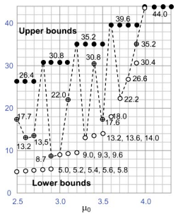
Lower and Upper Bounds Example
Example 10 in paper
Fix μ₁ at 4.4
Vary μ₀ in steps of 0.1
Range varies (dashed)
Tightness varies
Matching of upper bound = Optimality?
Achieving wider range

Slide 32
Choosing the CD-RNS Moduli
Theorem 2: μ ≥ 36.0
Theorem 3: μ ≤ 39.6
Intuitively, the moduli are optimal
when the two bounds coincide
To cover the dynamic range μ,
choose the moduli that are
on the order of (2με_{max})^{1/2}
and differ by 2ε_{max}

Slide 33
Conclusions
Introduced RNS with continuous residues
  Distinct from ordinary RNS
  Advantages (similar to other hybrid schemes)
Studied range, accuracy, and tradeoffs
  Tight bounds for dynamic range
  Optimal choice of moduli
Showed link to computational neuroscience
  Rat’s sense of location, navigation
  Moduli in nature: evolutionary implications

Slide 34
Ongoing and Future Work
Refine and extend the theoretical framework
  Arithmetic and algorithmic implications
  Exact dynamic range, or even tighter bounds
Study development and application aspects
  Circuit realization and building blocks
  Latency, area, and energy implications
Pursue links with other hybrid D/A methods
  Mixed implementations?

Slide 35
Thank You for Your Attention
parhami@ece.ucsb.edu
http://www.ece.ucsb.edu/~parhami/
?
?
?
?
?

Slide 36
Neurophysiological Discoveries of the 2014 Nobel Prize Winners in Medicine from a Computer Arithmetic Perspective
Behrooz Parhami
Dept. Electrical & Computer Engr.
Univ. of California, Santa Barbara, USA
parhami@ece.ucsb.edu
Back-up Slides

Slide 37
RNS Dynamic Range
Product M of the k pairwise relatively prime moduli is the dynamic range
M = m_{k–1} × . . . × m₁ × m₀
For RNS(8 | 7 | 5 | 3), M = 8 × 7 × 5 × 3 = 840
Negative numbers: Complement relative to M
⟨–x⟩_{mi} = ⟨M – x⟩_{mi}
21 = (5 | 0 | 1 | 0)_{RNS}
–21 = (8 – 5 | 0 | 5 – 1 | 0)_{RNS} = (3 | 0 | 4 | 0)_{RNS}
We can take the range of RNS(8|7|5|3) to be [−420, 419] or any other set of 840 consecutive integers
Here are some example numbers in our default RNS(8 | 7 | 5 | 3):
(0 | 0 | 0 | 0)_{RNS} Represents 0 or 840 or . . .
(1 | 1 | 1 | 1)_{RNS} Represents 1 or 841 or . . .
(2 | 2 | 2 | 2)_{RNS} Represents 2 or 842 or . . .
(0 | 1 | 3 | 2)_{RNS} Represents 8 or 848 or . . .
(5 | 0 | 1 | 0)_{RNS} Represents 21 or 861 or . . .
(0 | 1 | 4 | 1)_{RNS} Represents 64 or 904 or . . .
(2 | 0 | 0 | 2)_{RNS} Represents –70 or 770 or . . .
(7 | 6 | 4 | 2)_{RNS} Represents –1 or 839 or . . .
37

Slide 38
RNS Encoding and Arithmetic Operations
Fig. 4.1 Binary-coded format for RNS(8 | 7 | 5 | 3).
Fig. 4.2 The structure of an adder, subtractor, or multiplier for RNS(8|7|5|3).
Arithmetic in RNS(8 | 7 | 5 | 3)
(5 | 5 | 0 | 2)_{RNS} Represents x = +5
(7 | 6 | 4 | 2)_{RNS} Represents y = –1
(4 | 4 | 4 | 1)_{RNS} x + y : ⟨5 + 7⟩₈ = 4, ⟨5 + 6⟩₇ = 4, etc.
(6 | 6 | 1 | 0)_{RNS} x – y : ⟨5 – 7⟩₈ = 6, ⟨5 – 6⟩₇ = 6, etc.
(alternatively, find –y and add to x)
(3 | 2 | 0 | 1)_{RNS} x × y : ⟨5 × 7⟩₈ = 3, ⟨5 × 6⟩₇ = 2, etc.
38

Slide 39
Difficult RNS Arithmetic Operations
Sign test and magnitude comparison are difficult
Example: Of the following RNS(8 | 7 | 5 | 3) numbers:
Which, if any, are negative?
Which is the largest?
Which is the smallest?
Assume a range of [–420, 419]
a = (0 | 1 | 3 | 2)_{RNS}
b = (0 | 1 | 4 | 1)_{RNS}
c = (0 | 6 | 2 | 1)_{RNS}
d = (2 | 0 | 0 | 2)_{RNS}
e = (5 | 0 | 1 | 0)_{RNS}
f = (7 | 6 | 4 | 2)_{RNS}
Answers:
d < c < f < a < e < b
–70 < –8 < –1 < 8 < 21 < 64
39

Slide 40
Forward and Reverse Conversions
One or more
arithmetic
Operations
Binary
Output
Binary
Inputs
Binary-to-RNS converter
RNS-to-binary converter
Encoding or forward conversion
Example:
Digital filter
Decoding or reverse conversion
The more the amount of computation performed between the
initial forward conversion and final reverse conversion (reconversion), the greater the benefits of RNS representation.
40

Slide 41
Intuitive Justification for CRT
Puzzle: What number has the remainders of 2, 3, and 2
when divided by the numbers 7, 5, and 3, respectively?
x = (2 | 3 | 2)_{RNS(7|5|3)} = (?)_{ten}
(1 | 0 | 0)_{RNS(7|5|3)} = multiple of 15 that is 1 mod 7 = 15
(0 | 1 | 0)_{RNS(7|5|3)} = multiple of 21 that is 1 mod 5 = 21
(0 | 0 | 1)_{RNS(7|5|3)} = multiple of 35 that is 1 mod 3 = 70
(2 | 3 | 2)_{RNS(7|5|3)} = (2 | 0 | 0) + (0 | 3 | 0) + (0 | 0 | 2)
= 2 × (1 | 0 | 0) + 3 × (0 | 1 | 0) + 2 × (0 | 0 | 1)
= 2 × 15 + 3 × 21 + 2 × 70
= 30 + 63 + 140
= 233 = 23 mod 105
Therefore, x = (23)_{ten}
41

Slide 42
Example RNS with Special Moduli
For RNS(17 | 16 | 15), the weights of the 3 positions are:
2160 3825 2176
Example: (x₂, x₁, x₀) = (2 | 3 | 4)_{RNS} represents the number
⟨2160×2 + 3825×3 + 2176×4⟩₄₀₈₀ = ⟨24,499⟩₄₀₈₀ = 19
2160 = 2⁴ × (2⁴ – 1) × (2³ + 1) = 2¹¹ + 2⁷ – 2⁴
3825 = (2⁸ – 1) × (2⁴ – 1) = 2¹² – 2⁸ – 2⁴ + 1
2176 = 2⁷ × (2⁴ + 1) = 2¹¹ + 2⁷
4080 = 2¹² – 2⁴ ; thus, to subtract 4080, ignore bit 12 and add 2⁴
Reverse converter: Multioperand adder, with shifted x_{i}s as inputs
42

Slide 43
Limits of Fast Arithmetic in RNS
Known results from number theory
Theorem 4.2: The ith prime p_{i} is asymptotically i ln i
Theorem 4.3: The number of primes in [1, n] is asymptotically n / ln n
Theorem 4.4: The product of all primes in [1, n] is asymptotically e^{n}
Implications to speed of arithmetic in RNS
Theorem 4.5: It is possible to represent all k-bit binary numbers
in RNS with O(k / log k) moduli such that the largest modulus
has O(log k) bits
That is, with fast log-time adders, addition needs O(log log k) time
43

