Slide 1

Hybrid Digital-Analog
Number Representation in Computing and in Nature
Behrooz Parhami
Dept. Electrical & Computer Engr.
Univ. of California, Santa Barbara, USA
parhami@ece.ucsb.edu
Keynote Address at the 11th Annual IEEE Information Technology, Electronics,
and Mobile Communication Conference, November 4-6, 2020

Slide 2
About This Presentation
This slide show was first developed for a November 2020 keynote address at the 11th Annual IEEE Information Technology, Electronics and Mobile Communication Conference (virtual event). All rights reserved for the author. ©2020 Behrooz Parhami.
Edition | Released | Revised | Revised | Revised
First | Nov. 2020

Slide 3
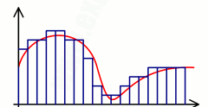
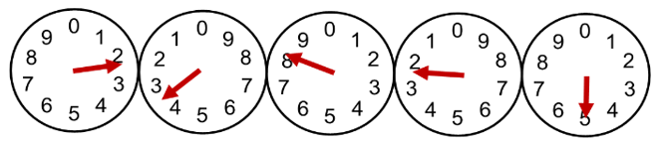
Outline
Introduction and Background
  Why analog is cool again
  Residue number system (RNS)
  The brain and numeracy
Hybrid Numbers and Arithmetic
  Historical perspective
  Some hybrid representations
  Nobel Prize in medicine, 2014
Continuous-Digits RNS
  CD-RNS models rat’s navigation
  Different from discrete RNS
  Dynamic range and precision
  Other properties and challenges
Conclusions and Future Work
Notes:
Four sections: 10 min, 10 min, 15 min, 5 min = 40 min

Slide 4
Abstract
The discovery that mammals use a multi-modular method akin to residue number system (RNS), but with continuous residues or digits, to encode position information led to the award of the 2014 Nobel Prize in Medicine. After a brief review of the evidence in support of this hypothesis, and how it relates to RNS, I discuss the properties of continuous-digit RNS, and discuss results on the dynamic range, representational accuracy, and factors affecting the choice of the moduli, which are themselves real numbers. I then take a step back and briefly explore hybrid digital-analog number representations and their robustness and noise-immunity advantages more generally. I conclude with suggestions for further research on important open problems in the domain of hybrid digital-analog number representation and processing.

Slide 5

Speaker’s Brief Technical Bio
Behrooz Parhami (PhD, UCLA 1973) is Professor of Electrical and Computer Engineering, and former Associate Dean for Academic Personnel, College of Engineering, at University of California, Santa Barbara, where he teaches and does research in the field of computer architecture: more specifically, in computer arithmetic, parallel processing, and dependable computing.
A Life Fellow of IEEE, a Fellow of IET and British Computer Society, and recipient of several other awards (including a most-cited paper award from J. Parallel & Distributed Computing), he has written six textbooks and more than 300 peer-reviewed technical papers. Professionally, he serves on journal editorial boards (including for 3 different IEEE Transactions) and conference program committees, and he is also active in technical consulting.

Slide 6
Outline
Introduction and Background
  Why analog is cool again
  Residue number system (RNS)
  The brain and numeracy
Hybrid Numbers and Arithmetic
  Historical perspective
  Some hybrid representations
  Nobel Prize in medicine, 2014
Continuous-Digits RNS
  CD-RNS models rat’s navigation
  Different from discrete RNS
  Dynamic range and precision
  Other properties and challenges
Conclusions and Future Work

Slide 7
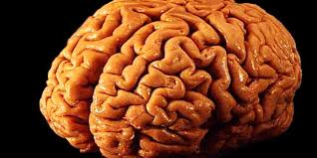

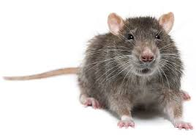
How Looking at Nature Helps my Research
Parallel processing
Parallelism used extensively in human brain
and other natural systems
Dependable (fault-tolerant) computing
The self-healing amphibian axolotl
can regenerate a near-perfect replica
of almost any body part it loses
Computer arithmetic
My subject area today: Use of residue
representation in rat’s navigational system

Slide 8
Analog Computation Is Back!
Digital data has been replacing analog data for years: From 1986 to 2007, share of digital stored data went from near-zero to 90%; a decade later, digital was fully dominant
We now struggle with complexity and energy limitations: The solution seems to be approximate and analog computing
Hybrid digital/analog can give us the best of both worlds: Digital’s higher latency and power used only when needed
Hence, multi-resolution representations are desirable: Combine fast, efficient low-precision computation with slower, energy-intensive high-precision computation

Slide 9
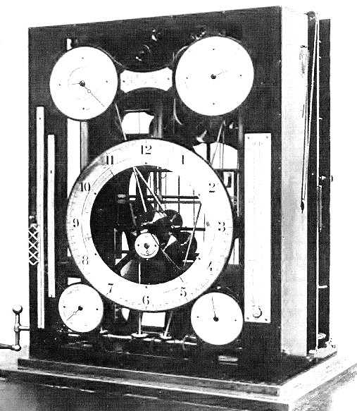
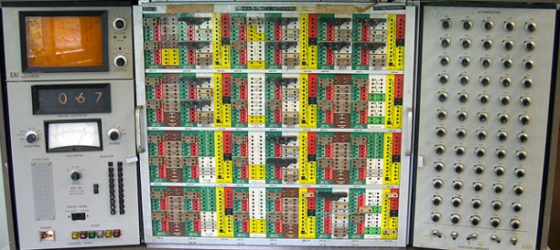
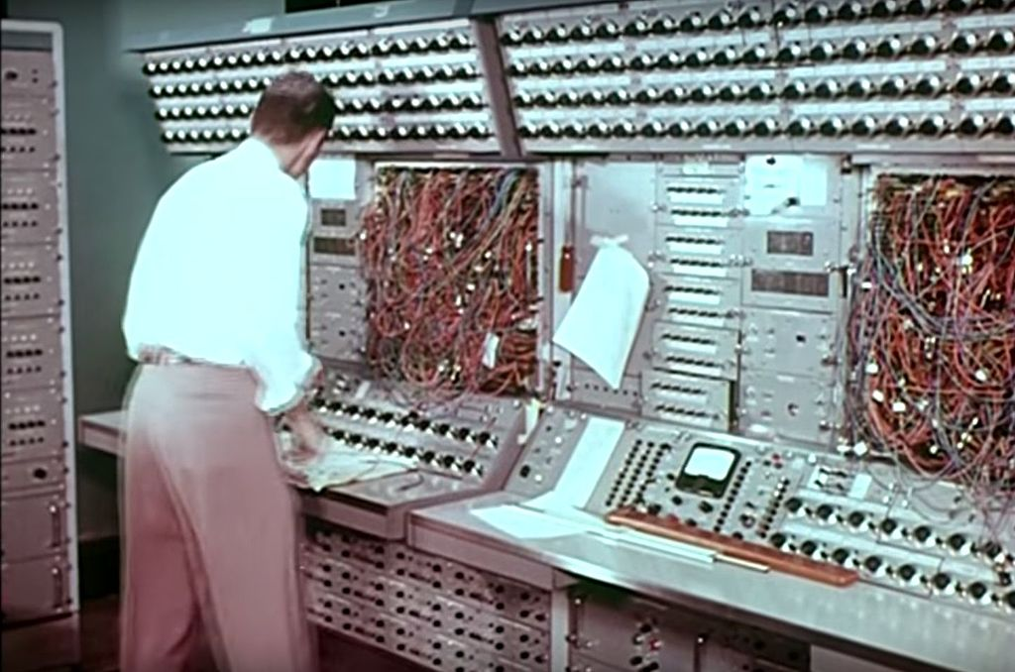
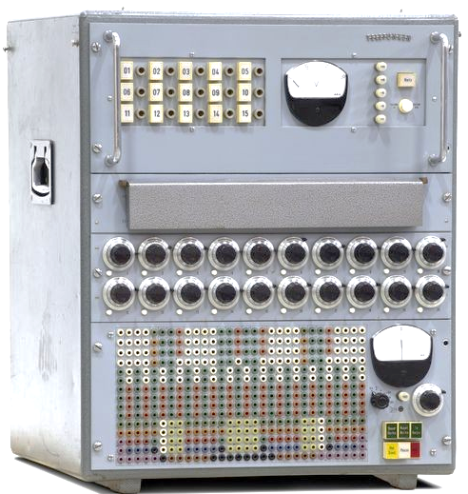
Analog Computers as Simulators
Tide-Predicting
Machine, 1880s
(Wikipedia)
Pace TR-48:
Programming
via Plugboard
X-15
Orbiter
Simulator
(Wikipedia)
Telefunken
RAT 700/2
(Computer
History Museum)
Notes:
Physical systems are governed by differential equations and analog computers can be set up to solve such equations.

Slide 10
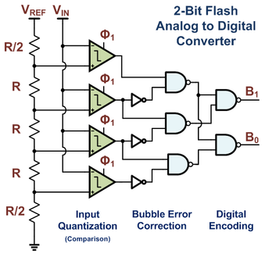
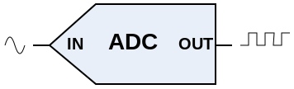

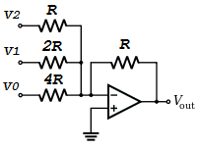
A/D and D/A Conversion
Analog-to-Digital
  Sound from microphone
  IoT instruments/sensors
  Resolution, linearity, speed
Digital-to-Analog
  Sound output to speakers
  Motor control (motion)
  Resolution, range, speed
3-Bit D/A Converter
with Summing Amp

Slide 11
Residue Number System (RNS)
Pairwise prime moduli: m_{k–1} > . . . > m₁ > m₀
Representation of x: {r_{i} = x mod m_{i} | 0 ≤ i ≤ k – 1}
RNS dynamic range: M = Π_{0≤ i ≤k–1} m_{i}
  Unsigned in [0, M – 1]
  Signed in [–M/2, M/2 – 1]
RNS arithmetic algorithms
  Digitwise add, sub, mult
  Difficult div, sign test, compare

Slide 12
RNS: An Ancient Chinese Puzzle
Puzzle, due to the Chinese scholar Sun Tzu,1500⁺ years ago:
What number has the remainders of 2, 3, and 2
when divided by 7, 5, and 3, respectively?
Residues (akin to digits in positional systems) uniquely identify the number, hence they constitute a representation: (2 | 3 | 2)_{RNS(7|5|3)}
In a weird way, RNS is a weighted representation
For RNS(7 | 5 | 3), the weights of the 3 positions are:
15 21 70
Example -- Chinese puzzle: (2 | 3 | 2)_{RNS(7|5|3)} represents the number
⟨15 × 2 + 21 × 3 + 70 × 2⟩₁₀₅ = ⟨233⟩₁₀₅ = 23

Slide 13
Forward and Reverse Conversions
One or more
arithmetic
Operations
Binary
Output
Binary
Inputs
Binary-to-RNS converter
RNS-to-binary converter
Encoding or forward conversion
Example:
Digital filter
Decoding or reverse conversion
The more the amount of computation performed between the
initial forward conversion and final reverse conversion (reconversion), the greater the benefits of RNS representation.
13

Slide 14
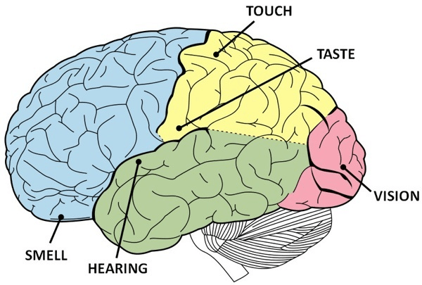
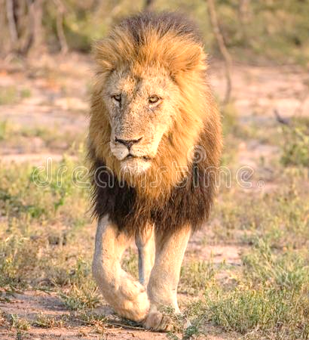
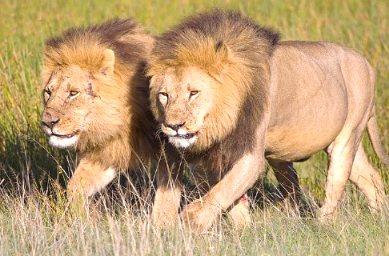
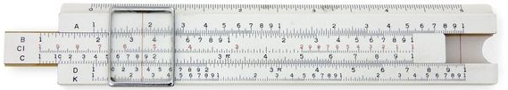
Three Related Abilities of the Brain
Sense of numbers
Basics wired-in by evolution
Advanced numeracy is learned
Sense of time
Your Brain Is a Time Machine
Mechanisms for different time scales
Sense of place
Location on different scales
“Maps” of our surroundings

Slide 15
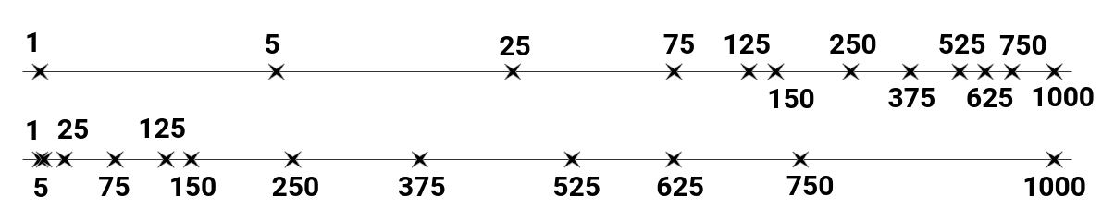

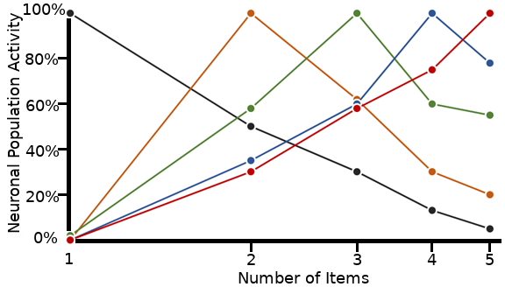
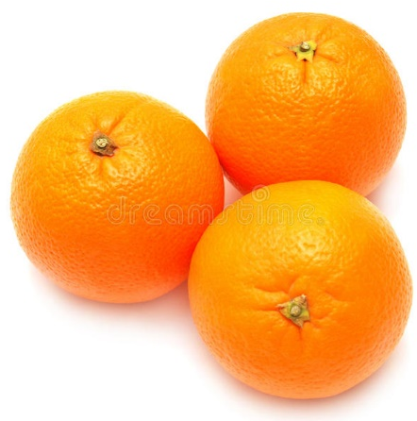
Sense of Numbers in Humans and Animals

Slide 16

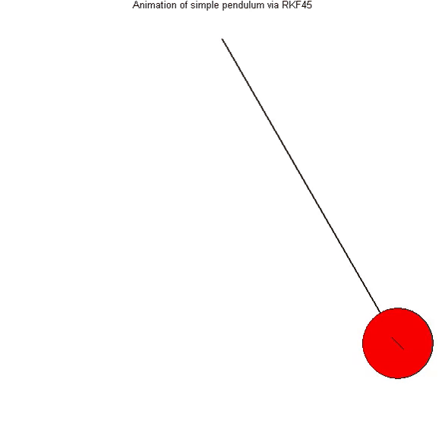

Sense of Time in Humans and Animals
Current time, time duration, finishing on time
Remind me in 15 minutes; I’ll have to leave! (Set timer)
When did Amy arrive here? (Time duration, but in the past)
Circadian clock (day/night)
Periodic events (music)
Following a schedule
Clock =
Oscillator +
Counter
Notes:
Waking up when you need to, without setting an alarm clock

Slide 17

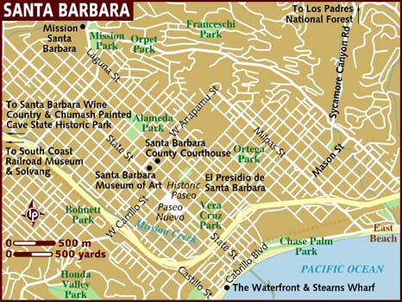
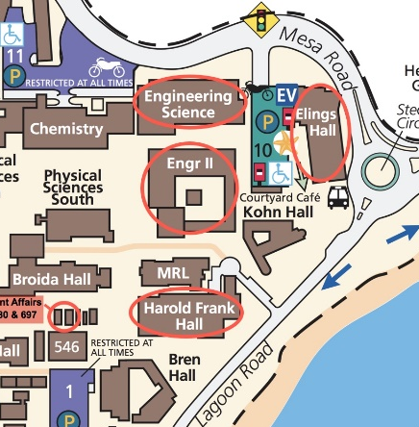
Sense of Place in Humans and Animals
The sense of place and the ability to navigate are some of the most fundamental brain functions.
German philosopher Immanuel Kant (1724-1804) argued that some mental abilities exist independent of experience.
He considered perception of place as one of these innate abilities through which the external world had to be organized/perceived.

Slide 18
Outline
Introduction and Background
  Why analog is cool again
  Residue number system (RNS)
  The brain and numeracy
Hybrid Numbers and Arithmetic
  Historical perspective
  Some hybrid representations
  Nobel Prize in medicine, 2014
Continuous-Digits RNS
  CD-RNS models rat’s navigation
  Different from discrete RNS
  Dynamic range and precision
  Other properties and challenges
Conclusions and Future Work

Slide 19
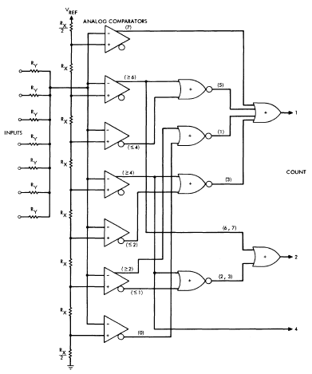
Quasi-Digital Parallel Counter
Analog current summing
  7 inputs, 3-bit output
  (*): Number of 1 inputs required to produce a 1
The scheme is even older
  Riordan and Morton, Use of Analog Techniques in Binary Arithmetic Units, IEEE TC, Feb. 1965
Figure from: Swartzlander
(IEEE TC, Nov. 1973)

Slide 20
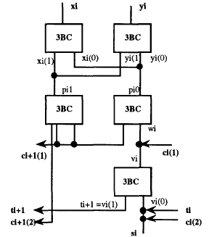
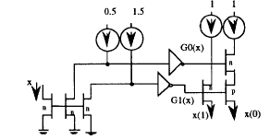
Current-Summing Multivalued Logic
Binary stored-carry addition
  Limited-carry algorithm
  3-valued to binary conv.: 3BC
CMOS
3BC
Figures from: Etiemble & Navi (SMVP, May 1993)

Slide 21
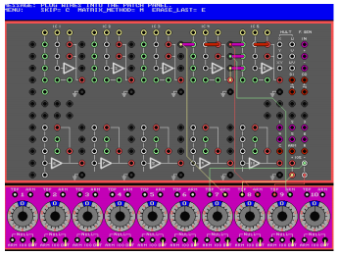
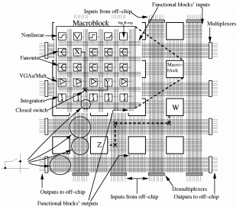
From Replacement to Resurgence
Analog co-processor
unit for a digital CPU
Patch panel of Systron-Donner Model 3400
Digital simulation of
an analog computer
Cowan/Melville/Tsividis, 2005

Slide 22
Hybrid Digital/Analog Representations
Continuous-digit residue number system (CD-RNS):
Inspired by how positional info encoding in rat’s brain
Continuous-valued number system (CVNS):
A positional number system with analog digits
Race logic represents information as timing delays:
Results based on relative signal propagation delays
Space-time logic mimics spike-based neural nets:
Signal timing and magnitude both carry information

Slide 23
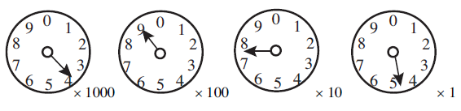
Mixed D/A Positional Representation
Continuous-valued number system (CVNS)
  Contains a form of natural redundancy
  The MSD has all the magnitude info
  Other digits provide successive refinements
Familiar example: utility meter
Figure from: Saed, Ahmadi, Jullien (IEEE TC, 2002)

Slide 24
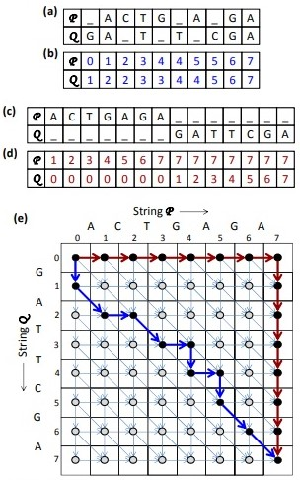
Time-Delay-Based Race Logic
Not useful for general use (yet)
Quite efficient in some domains
Example: String alignment
(as in DNA/protein matching)
Closeness judged by “edit distance”
2D array of simple hardware cells
O(m²) hardware complexity
Paths represent alignments
Horizontal, vertical, diagonal
moves have different latencies
Fastest path
Best alignment

Slide 25
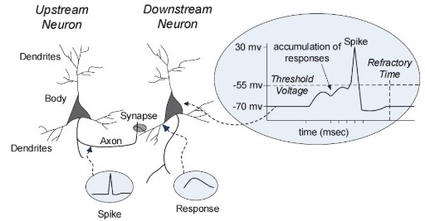
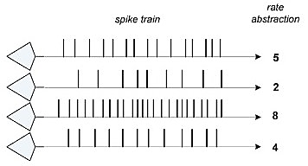
Brain-Like Space-Time Computing
Example: Transmitting one 8-bit byte representing n
Binary: Delay = 9 slots; Average energy = 5 spikes
Start/synch spike, followed by 8 spikes/no-spikes
Space-time: Average delay = 130 slots; Energy = 2 spikes
Start/synch spike, followed by n no-spikes, then end spike
Rate encoding

Slide 26

Nobel Prize in Physiology or Medicine: 2014
One half went to John O'Keefe (University College, London), the other half to May-Britt Moser (Center for Neural Computation, Norway) and Edvard I. Moser (Kavli Institute for Systems Neuroscience, Norway) "for their discoveries of cells that constitute a positioning system in the brain."

Slide 27
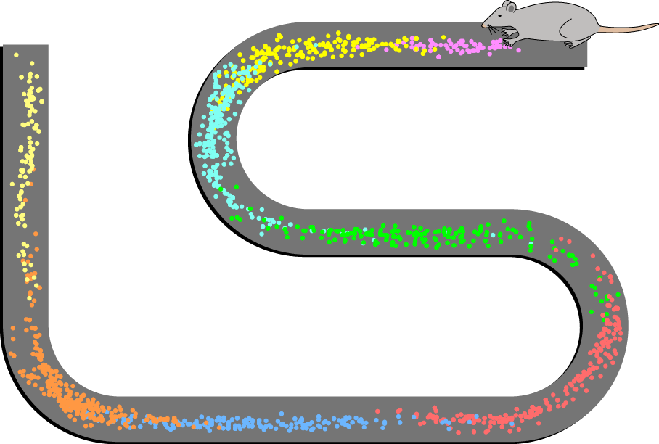
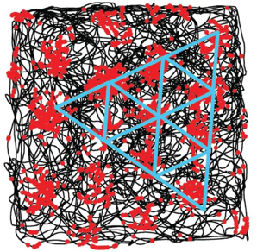
The Nobel Laureates’ Contributions
John O’Keefe discovered place cells in the hippocampus that signal position and provide the brain with spatial memory capacity.
May-Britt Moser and Edvard I. Moser discovered in the medial entorhinal cortex, a region of the brain next to hippocampus, grid cells that provide the brain with a coordinate system for navigation.
Place cells
firings
(image from
Wikipedia)
Grid cells
firings
(image from Moser/Rowland/Moser, 2015)
Notes:
Place cells fire whenever an animal occupies a specific location in its environment, with each place cell firing at a different spot.
Grid cells generate virtual maps of the surroundings that resemble grids of repeating triangles. Whenever an animal steps onto a corner of one of these virtual triangles, the grid cell that generated that map starts to fire.
Head direction cells increase their firing whenever an animal’s head is pointing in a specific direction.
These cell types thus provide animals with complementary information about their location.

Slide 28
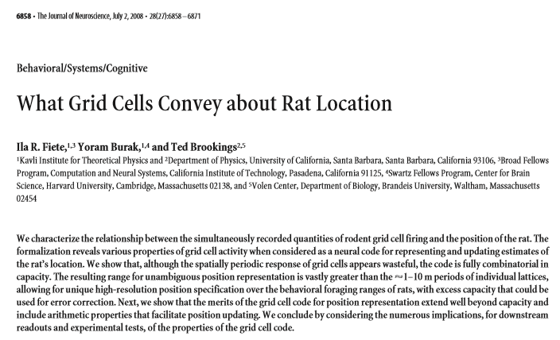
First Attempt at Understanding

Slide 29
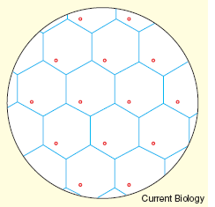
Localization with Grid Cells
Rat’s navigation system
  Wavy travel path
  Straight return path
  Even in the dark
Nervous system has place cells & grid cells
  Grid cell firings
  Relative in-cell position
 End
 A
 Start
 (a) Travel and return paths
 (b) Rat’s hexagonal grid
  In-cell positions within several grids pinpoints rat’s absolute location
 (c) Firings and locations [3]
 (d) Two hexagonal grids [3]

Slide 30
The Questions to Be Addressed
A rat can go up to a certain distance and still be able to find its way back (range)
  Translating grid-cell firings to spatial information
  How the range is related to grid-cell parameters
  Representation range vs. the observed distance
Fiete, Burak, and Brookings had connected the grid cells to residue representation
  Couldn’t confirm the hypothesis theoretically
  Relied on extensive simulation for confirmation

Slide 31
Outline
Introduction and Background
  Why analog is cool again
  Residue number system (RNS)
  The brain and numeracy
Hybrid Numbers and Arithmetic
  Historical perspective
  Some hybrid representations
  Nobel Prize in medicine, 2014
Continuous-Digits RNS
  CD-RNS models rat’s navigation
  Different from discrete RNS
  Dynamic range and precision
  Other properties and challenges
Conclusions and Future Work

Slide 32
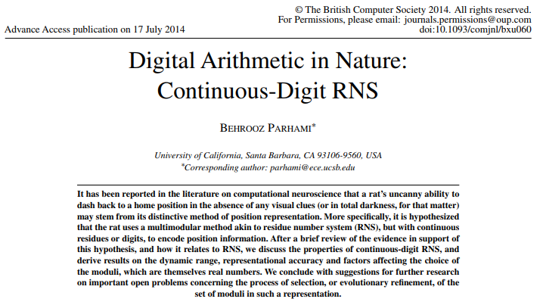
My First Contribution to the Problem

Slide 33
RNS with Analog Digits (Remainders)
I formulated the spatial representation problem with the grid cells as CD-RNS
  First time RNS is used with analog remainders
  Conventional RNS theory is inapplicable
  I developed a theory for CD-RNS and its range
Analog and mixed digital-analog technology has a long history in computer arithmetic
  Digital so good that these were not pursued
  More use of analog features expected to come

Slide 34
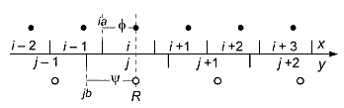

CD-RNS Representation
Modular arithmetic with continuous residues
Extension of RNS to non-integer moduli and residues
Offers precision-range-robustness trade-offs
More accurate residues widen the range and increase robustness
Of interest to neuroscientists: Rat’s navigation system
Rat uses “space cells” (absolute) and “grid cells” (relative)
Can return to home position in the dark, without any visual cues
Rat’s hex grid
Localization with 2 grids in 1D space

Slide 35
Integer Moduli and Residues
Two-modulus RNS {4, 3}
Dynamic range [0, 11]
Imagine residues with errors
  Errors < 0.5 correctable
  Errors < 1.0 detectable
Multiresidue systems
  3-modulus RNS {5, 4, 3}
  {5,4,3} ≡ {20,3} ≡ {15,4} ≡ {12,5}

Slide 36
Integer Moduli, Continuous Residues
Residue errors ε₁ and ε₀
Decoding error ≤ max(ε₁, ε₀)
Dynamic range?
Max allowable error < 0.25
[0, 12 – ε_{max}]
Line with slope of 1
(Incorrect value)
ε₀
R′
ε₁
R + ε_{max}
  ρ₁
R″ (decoded value)
R (correct value)
R – ε_{max}
ρ₀

Slide 37
Range-Precision Trade-off in CD-RNS
Dynamic range is proportional to the product of moduli, divided by maximum error
Left diagram: Range extension beyond Π m_{i}
Middle diagram: Decoding error
Right diagram: CD-RNS with m₁ = 6.5, m₀ = 4.4
136.5
6
5
4
13
17.6
39.6
4
8
4
12
ρ₁
3
3
Line with slope of 1
3
15.84
7
11
(Incorrect value)
ε₀
2
R′
ε₁
R + ε_{max}
2
2
15
6
R″ (decoded value)
ρ₁
ρ₁
R (correct value)
1
10
1
5
14
R – ε_{max}
1
R′
18
0
9
0
ρ₀
0
0
1
ρ₀
2
3
0
1
2
ρ₀
3
4

Slide 38
Continuous Moduli and Residues
4.8
9.6
14.4
Case 1: The moduli are integer
multiples of their difference
4.8
With proper scaling, the CD-RNS
can be converted to an RNS
3.6
3.6
2.4
7.2
This example is equivalent to
RNS {4, 3} with scale factor 1.2
1.2
10.8
Question:
Are there CD-RNSs that cannot be replaced with ordinary RNSs?
0.0
0.0
1.2
2.4
3.6

Slide 39
Equivalence of CD-RNS and RNS
Case 2a: The moduli are integer
multiples of some number s
(that divides their difference)
With proper scaling, the CD-RNS
can be converted to an RNS,
provided max error target is ≤ s/4
For this example, s = 0.4 and
the system is equivalent to
RNS {11, 9} with scale factor 0.4

Slide 40
Representational Power of CD-RNS
Case 2b: The moduli are integer
multiples of some number s
(that divides their difference),
but max error target > s/4
The CD-RNS is not equivalent to
an RNS in terms of representational
capability and dynamic range
For this example, s = 0.1 but
the system is different from
RNS {65, 44} with scale factor 0.1

Slide 41
Conceptually Simpler 1D Example
Distance encoded by mod-a and mod-b residues
  Phases φ and ψ given
  Reverse conversion provides R
  R is a point whose mod-a and mod-b residues match φ and ψ to within the error bound
ai
φ
i – 2
i – 1
i
i +1
i +2
i + 3
x
j – 1
j
j +1
j +2
y
ψ
bj
R

Slide 42
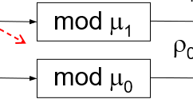
Forward Conversion to CD-RNS
Quite similar to ordinary RNS
  What multiple of the modulus should be subtracted?
  Multiple comparators (like those in A/D converters)
  Use binary search to reduce hardware complexity
Example: mod-4.4, with dynamic range 35.0
  Compare with 17.6; Subtract if greater
  Compare with 8.8; Subtract if greater
  Compare with 4.4; Subtract if greater
  Output the remainder

Slide 43
Backward Conversion to Binary
CRT and its derivatives are inapplicable
  Conversion amplifies the errors
  Example 15 in my 2015 Computer Journal paper
View the conversion as nonlinear optimization
  Convergence occurs with circuit’s RC time constant
R
Forward conversion
C
ρ₁
x
mod μ₁
A
ρ₀
mod μ₀
Sun & Yao, IEEE Int’l Conf. Neural Networks, 1994

Slide 44
Hex Grid Coordinate System
Point identified by 3 coordinates, one of which is redundant
2 0 0
Redundancy allows error correction beyond the system’s accuracy range
x
1⁻2 2
z
1 1⁻1
y
⁻2 0 0

Slide 45
Open Problems in Neurobiology
Dynamic range of rat’s navigation system
Numerical simulation: Range ∼ (1/ε_{max})^{Exponent}
Exponent ≈ Number of moduli – θ
Example: 12 moduli ⇒ Exponent = 10.7
Our results yield an exponent of 11.0
How did the rat’s navigational grids evolve? (Evolutionary basis for moduli optimization)

Slide 46
Choosing the CD-RNS Moduli
Theorem 2: μ ≥ 36.0
Theorem 3: μ ≤ 39.6
Intuitively, the moduli are optimal
when the two bounds coincide
To cover the dynamic range μ,
choose the moduli that are
on the order of (2με_{max})^{1/2}
and differ by 2ε_{max}

Slide 47
Outline
Introduction and Background
  Why analog is cool again
  Residue number system (RNS)
  The brain and numeracy
Hybrid Numbers and Arithmetic
  Historical perspective
  Some hybrid representations
  Nobel Prize in medicine, 2014
Continuous-Digits RNS
  CD-RNS models rat’s navigation
  Different from discrete RNS
  Dynamic range and precision
  Other properties and challenges
Conclusions and Future Work

Slide 48


Summary and Conclusions
Introduced RNS with continuous residues
  Distinct from ordinary RNS
  Advantages (similar to other hybrid schemes)
Studied range, accuracy, tradeoffs
  Tight bounds for dynamic range
  Optimal choice of moduli
Showed link to computational neuroscience
  Rat’s sense of location, navigation
  Moduli in nature: evolutionary implications
D - A

Slide 49

Ongoing and Future Work
Refine and extend the theoretical framework
  Arithmetic and algorithmic implications
  Exact dynamic range, or even tighter bounds
Study development and application aspects
  Circuit realization & building blocks
  Latency, area, energy implications
Pursue links with other D/A methods
  Mixed implementations?
⛏️

Slide 50
Wrapping Up: The Big Picture
Analog computing is making a comeback and hybrid digital/analog computing is becoming more attractive
D-A computing can be combined at various levels:
Representation level, as in CVNS and CD-RNS
Analog approximation, digital refinement Neuromorphic computing paradigm
Multi-level combination methods
Future work and more detailed comparisons
Assessment of relative speeds in application contexts
Quantifying cost and energy requirements
Effects of radix and moduli selection
Other D/A combination methods
D - A
⛏️

Slide 51
Thank You for Your Attention
parhami@ece.ucsb.edu
http://www.ece.ucsb.edu/~parhami/
?
?
?
?
?

Slide 52
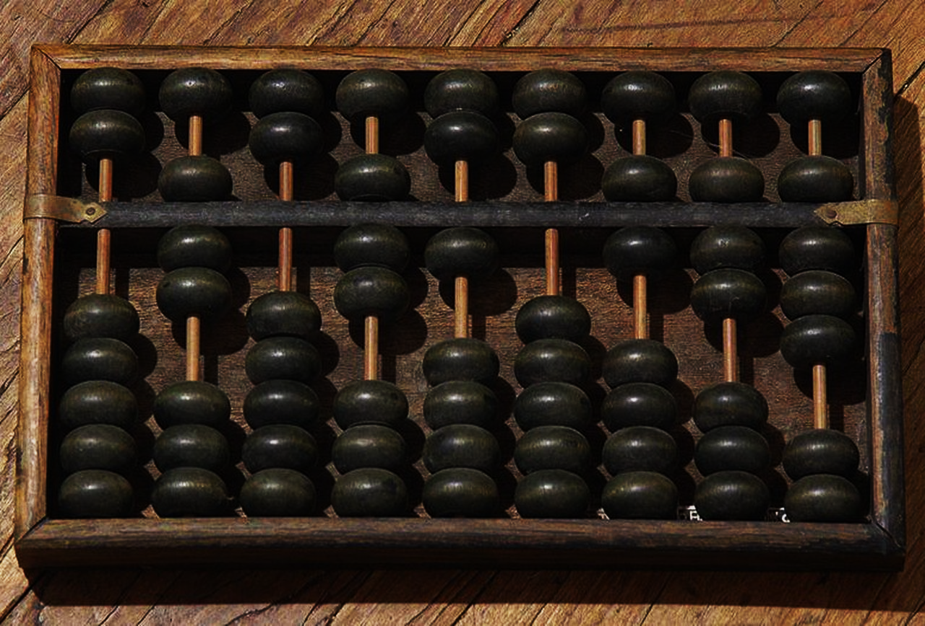

Hybrid Digital-Analog Number Representation
in Computing and in Nature
Back-Up Slides
Behrooz Parhami
University of California, Santa Barbara

Slide 53
RNS Dynamic Range
Product M of the k pairwise relatively prime moduli is the dynamic range
M = m_{k–1} × . . . × m₁ × m₀
For RNS(8 | 7 | 5 | 3), M = 8 × 7 × 5 × 3 = 840
Negative numbers: Complement relative to M
⟨–x⟩_{mi} = ⟨M – x⟩_{mi}
21 = (5 | 0 | 1 | 0)_{RNS}
–21 = (8 – 5 | 0 | 5 – 1 | 0)_{RNS} = (3 | 0 | 4 | 0)_{RNS}
We can take the range of RNS(8|7|5|3) to be [−420, 419] or any other set of 840 consecutive integers
Here are some example numbers in our default RNS(8 | 7 | 5 | 3):
(0 | 0 | 0 | 0)_{RNS} Represents 0 or 840 or . . .
(1 | 1 | 1 | 1)_{RNS} Represents 1 or 841 or . . .
(2 | 2 | 2 | 2)_{RNS} Represents 2 or 842 or . . .
(0 | 1 | 3 | 2)_{RNS} Represents 8 or 848 or . . .
(5 | 0 | 1 | 0)_{RNS} Represents 21 or 861 or . . .
(0 | 1 | 4 | 1)_{RNS} Represents 64 or 904 or . . .
(2 | 0 | 0 | 2)_{RNS} Represents –70 or 770 or . . .
(7 | 6 | 4 | 2)_{RNS} Represents –1 or 839 or . . .
53

Slide 54
RNS Encoding and Arithmetic Operations
Fig. 4.1 Binary-coded format for RNS(8 | 7 | 5 | 3).
Fig. 4.2 The structure of an adder, subtractor, or multiplier for RNS(8|7|5|3).
Arithmetic in RNS(8 | 7 | 5 | 3)
(5 | 5 | 0 | 2)_{RNS} Represents x = +5
(7 | 6 | 4 | 2)_{RNS} Represents y = –1
(4 | 4 | 4 | 1)_{RNS} x + y : ⟨5 + 7⟩₈ = 4, ⟨5 + 6⟩₇ = 4, etc.
(6 | 6 | 1 | 0)_{RNS} x – y : ⟨5 – 7⟩₈ = 6, ⟨5 – 6⟩₇ = 6, etc.
(alternatively, find –y and add to x)
(3 | 2 | 0 | 1)_{RNS} x × y : ⟨5 × 7⟩₈ = 3, ⟨5 × 6⟩₇ = 2, etc.
54

Slide 55
Difficult RNS Arithmetic Operations
Sign test and magnitude comparison are difficult
Example: Of the following RNS(8 | 7 | 5 | 3) numbers:
Which, if any, are negative?
Which is the largest?
Which is the smallest?
Assume a range of [–420, 419]
a = (0 | 1 | 3 | 2)_{RNS}
b = (0 | 1 | 4 | 1)_{RNS}
c = (0 | 6 | 2 | 1)_{RNS}
d = (2 | 0 | 0 | 2)_{RNS}
e = (5 | 0 | 1 | 0)_{RNS}
f = (7 | 6 | 4 | 2)_{RNS}
Answers:
d < c < f < a < e < b
–70 < –8 < –1 < 8 < 21 < 64
55

Slide 56
Intuitive Justification for CRT
Puzzle: What number has the remainders of 2, 3, and 2
when divided by the numbers 7, 5, and 3, respectively?
x = (2 | 3 | 2)_{RNS(7|5|3)} = (?)_{ten}
(1 | 0 | 0)_{RNS(7|5|3)} = multiple of 15 that is 1 mod 7 = 15
(0 | 1 | 0)_{RNS(7|5|3)} = multiple of 21 that is 1 mod 5 = 21
(0 | 0 | 1)_{RNS(7|5|3)} = multiple of 35 that is 1 mod 3 = 70
(2 | 3 | 2)_{RNS(7|5|3)} = (2 | 0 | 0) + (0 | 3 | 0) + (0 | 0 | 2)
= 2 × (1 | 0 | 0) + 3 × (0 | 1 | 0) + 2 × (0 | 0 | 1)
= 2 × 15 + 3 × 21 + 2 × 70
= 30 + 63 + 140
= 233 = 23 mod 105
Therefore, x = (23)_{ten}
56

Slide 57
Example RNS with Special Moduli
For RNS(17 | 16 | 15), the weights of the 3 positions are:
2160 3825 2176
Example: (x₂, x₁, x₀) = (2 | 3 | 4)_{RNS} represents the number
⟨2160×2 + 3825×3 + 2176×4⟩₄₀₈₀ = ⟨24,499⟩₄₀₈₀ = 19
2160 = 2⁴ × (2⁴ – 1) × (2³ + 1) = 2¹¹ + 2⁷ – 2⁴
3825 = (2⁸ – 1) × (2⁴ – 1) = 2¹² – 2⁸ – 2⁴ + 1
2176 = 2⁷ × (2⁴ + 1) = 2¹¹ + 2⁷
4080 = 2¹² – 2⁴ ; thus, to subtract 4080, ignore bit 12 and add 2⁴
Reverse converter: Multioperand adder, with shifted x_{i}s as inputs
57

Slide 58
Limits of Fast Arithmetic in RNS
Known results from number theory
Theorem 4.2: The ith prime p_{i} is asymptotically i ln i
Theorem 4.3: The number of primes in [1, n] is asymptotically n / ln n
Theorem 4.4: The product of all primes in [1, n] is asymptotically e^{n}
Implications to speed of arithmetic in RNS
Theorem 4.5: It is possible to represent all k-bit binary numbers
in RNS with O(k / log k) moduli such that the largest modulus
has O(log k) bits
That is, with fast log-time adders, addition needs O(log log k) time
58

Slide 59
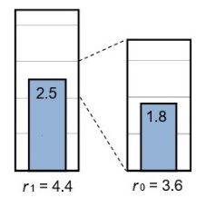
CVNS and CD-RNS Similarities
Two-level scheme: Analog representation at the low (digit) level and digital interpretation at the high (inter-digit) level
CVNS likely has performance edge in general applications
Mixed-radix format: CVNS is based on fixed integer radix, but extension to mixed and non-integer radices is possible
Approximate computing: Both CVNS and CD-RNS suited to low-precision, adaptive-precision, and lazy arithmetic
Example mixed-radix CVNS: Representation of
9.0 = 2.5 × 3.6 = 2 × 3.6 + 1.8

Slide 60
CVNS and CD-RNS Differences
Word-level parallelism: CD-RNS has greater affinity with parallel processing of digits in add/subtract/multiply
Input/output overheads: CVNS has simple/direct forward and reverse conversion processes (low-cost and low-energy)
CD-RNS conversions are even more complex than RNS
Noise immunity: Consider 2-digit CVNS and CD-RNS
CVNS range decreases quadratically with increased noise immunity
CD-RNS range decreases linearly with increased noise immunity
(cutting the radix r in half, versus using the equation με ≤ μ₀μ₁)
Fault tolerance: CVNS can be protected through coding
CD-RNS has precision-robustness trade-off built in

Slide 61
CD-RNS Dynamic Range Lower Bound
CD-RNS with the moduli μ₁ and μ₀
σ_{–1} = μ₁; σ₀ = μ₀; σ_{i+1} = min(|σ_{i–1}|_{σi}, σ_{i} – |σ_{i–1}|_{σi})
Theorem 2: Dynamic range is at least
μ₀(1 + ⎣μ₁/μ₀⎦ ⎣μ₀/σ₁⎦)⎣σ₁/σ₂⎦ ⎣σ₂/σ₃⎦ . . . ⎣σ_{j–1}/σ_{j}⎦
where j is the largest index for which σ_{j} ≥ 2ε_{max}
Intuition: Remove floors to get μ₀μ₁/(2ε_{max})
Example 6: CD-RNS with μ₁ = 4.4, μ₀ = 3.6, ε_{max} = 0.2 ⇒ σ₁ = 0.8, σ₂ = 0.4 ⇒ Dynamic range ≥ 36.0

Slide 62
CD-RNS Dynamic Range Upper Bound
CD-RNS with the moduli μ₁ and μ₀
δ = Largest number that divides μ₁ and μ₀ if it exists, 0 otherwise
Theorem 3: Dynamic range is at most
max(μ₀ ⎣μ₁/γ⎦, μ₁ ⎣μ₀/γ⎦)
where γ = max(2ε_{max}, δ)
Intuition: Remove floors to get μ₀μ₁/γ
Example 6: CD-RNS with μ₁ = 4.4, μ₀ = 3.6, ε_{max} = 0.2 ⇒ δ = 0.4, γ = 0.4 ⇒ Dynamic range ≤ 39.6

Slide 63
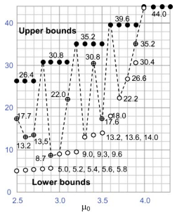
CD-RNS Lower/Upper Bounds Example
Example 10 in paper
Fix μ₁ at 4.4
Vary μ₀ in steps of 0.1
Range varies (dashed)
Tightness varies
Matching of upper bound = Optimality?
Achieving wider range

